Slide 1
More Counting
CSE 312 Winter 26
Lecture 2

Slide 2
Where Are We?
Last time:
Sum and Product Rules
Sequential Processes
Different ways of thinking lead to different formulas
Today:
Wrap up the book example
A few more rules: Combinations and Permutations.
Proof by double counting

Slide 3








Assigning Books
We have 5 books to split to 3 people (Alice, Bob, and Charlie)
Every book goes to exactly one person, but each person could end up with no books (or all of them, or something in between).
1
Alice
2
Bob
3
4
Charlie
5

Slide 4
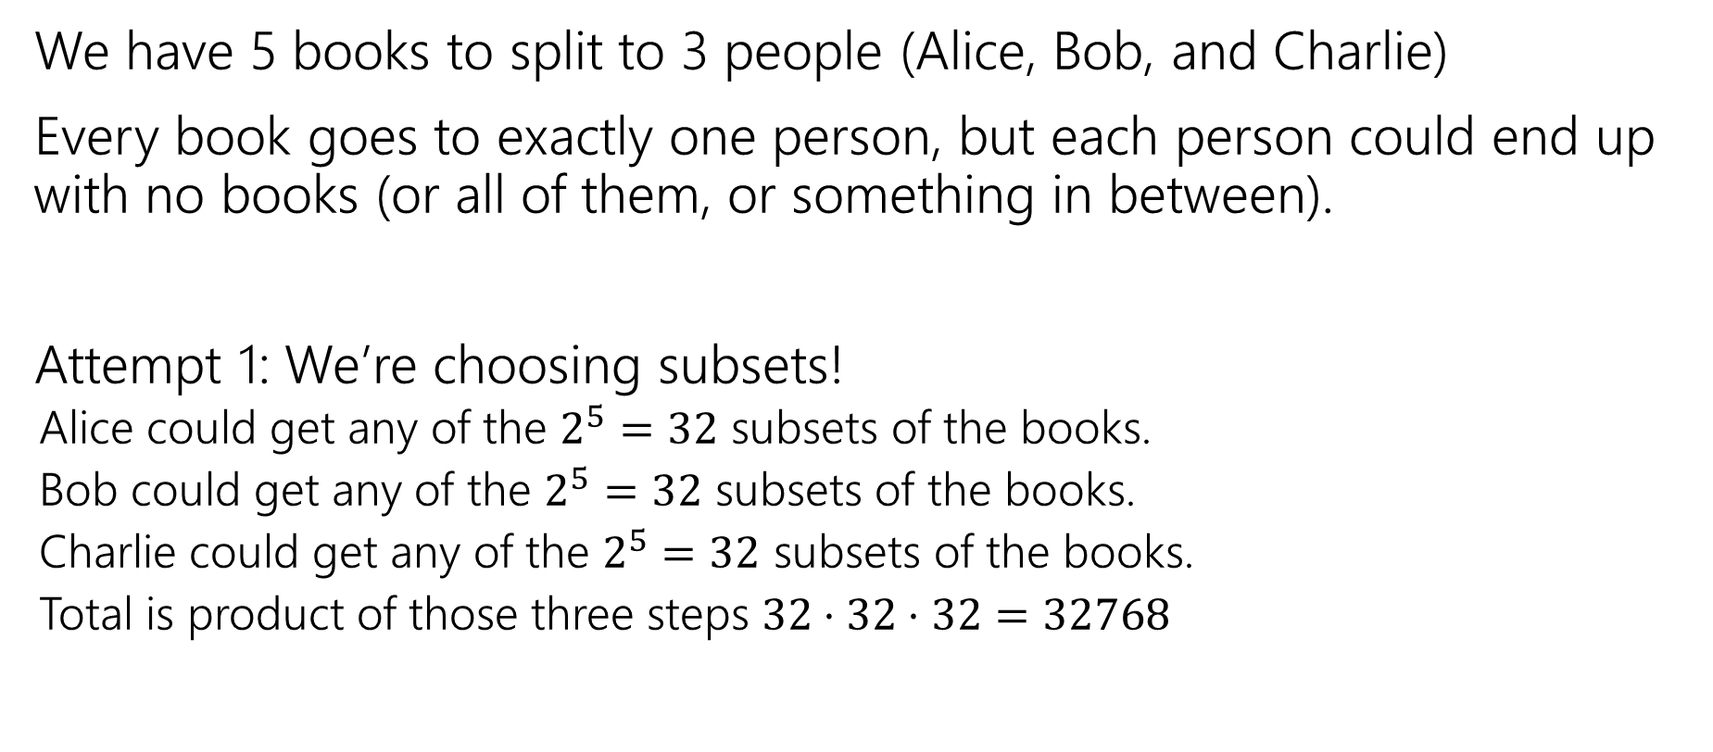
Assigning Books (attempt 1)
We have 5 books to split to 3 people (Alice, Bob, and Charlie)
Every book goes to exactly one person, but each person could end up with no books (or all of them, or something in between).
Attempt 1: We’re choosing subsets!
Alice could get any of the $2^{5}=32$ subsets of the books.
Bob could get any of the $2^{5}=32$ subsets of the books.
Charlie could get any of the $2^{5}=32$ subsets of the books.
Total is product of those three steps $32⋅32⋅32=32768$

Slide 5
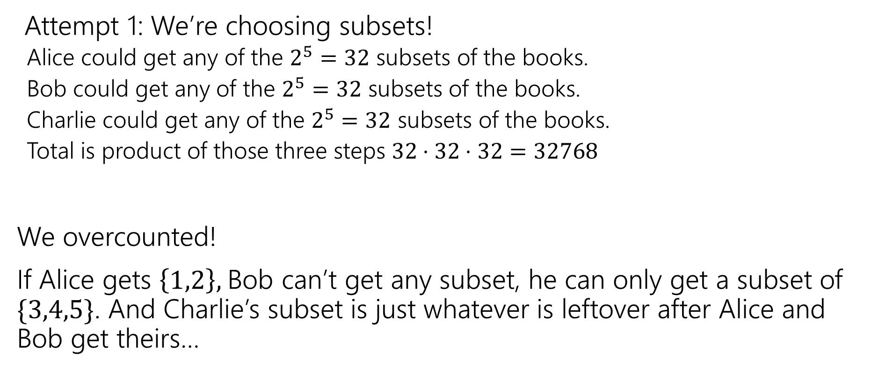
Analyzing Attempt 1
Attempt 1: We’re choosing subsets!
Alice could get any of the $2^{5}=32$ subsets of the books.
Bob could get any of the $2^{5}=32$ subsets of the books.
Charlie could get any of the $2^{5}=32$ subsets of the books.
Total is product of those three steps $32⋅32⋅32=32768$
We overcounted!
If Alice gets $\left\{1,2\right\},$Bob can’t get any subset, he can only get a subset of $\{3,4,5\}$. And Charlie’s subset is just whatever is leftover after Alice and Bob get theirs…

Slide 6
Fixing All The Books (attempt 1)
You could
List out all the options for Alice.
For each of those (separately), list all the possible options for Bob and Charlie.
Use the Summation rule to combine.
~OR~ you could come at the problem from a different angle.

Slide 7
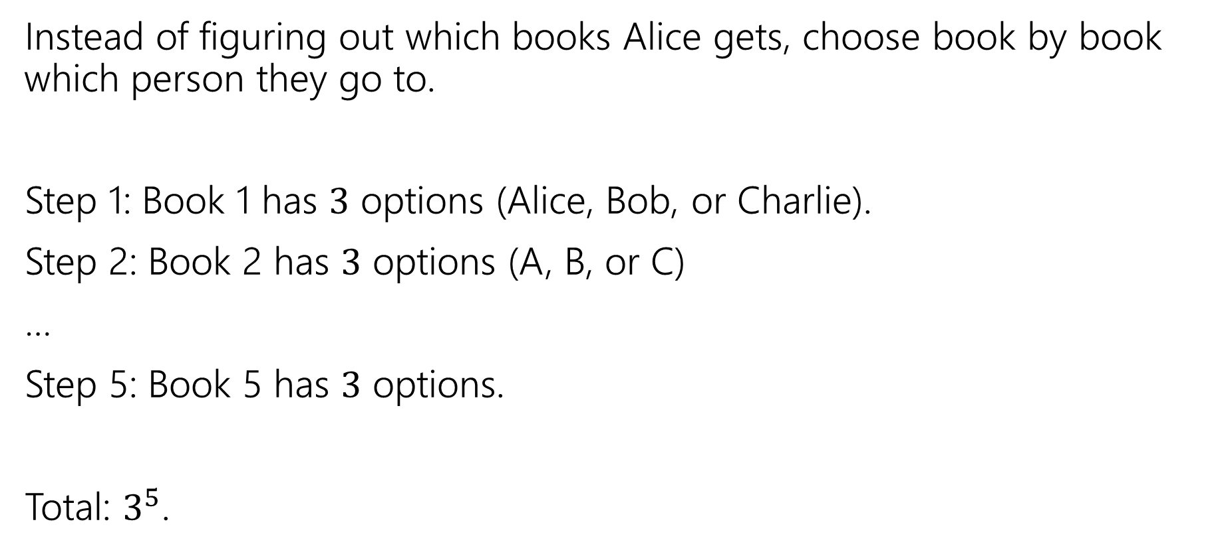
Fixing All the Books (attempt 2)
Instead of figuring out which books Alice gets, choose book by book which person they go to.
Step 1: Book 1 has $3$ options (Alice, Bob, or Charlie).
Step 2: Book 2 has $3$ options (A, B, or C)
…
Step 5: Book 5 has $3$ options.
Total: $3^{5}$.

Slide 8

More sequence practice
How many length 3 sequences are there consisting of distinct elements of $\{1,2,3\}$.

Slide 9
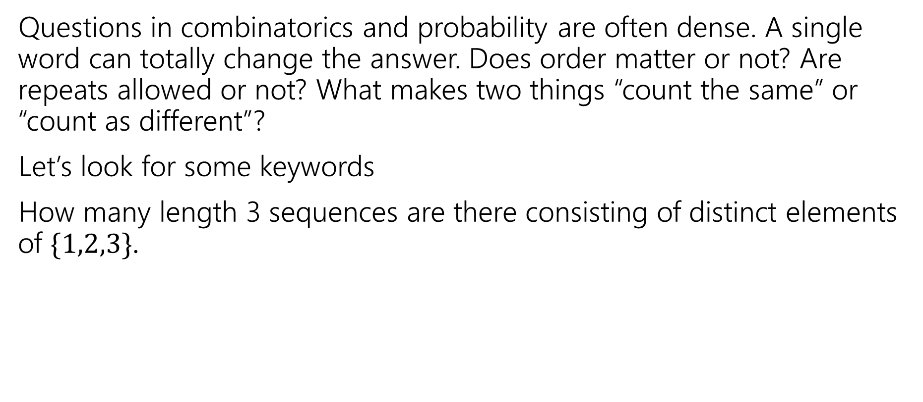

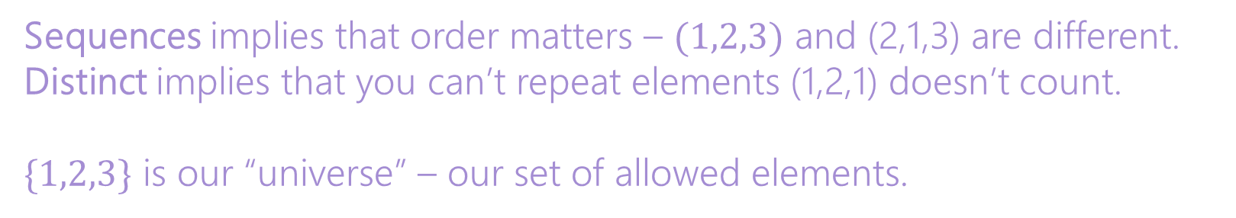
Pause
Questions in combinatorics and probability are often dense. A single word can totally change the answer. Does order matter or not? Are repeats allowed or not? What makes two things “count the same” or “count as different”?
Let’s look for some keywords
How many length 3 sequences are there consisting of distinct elements of $\{1,2,3\}$.
Sequences implies that order matters – $(1,2,3)$ and (2,1,3) are different.
Distinct implies that you can’t repeat elements (1,2,1) doesn’t count.
$\{1,2,3\}$ is our “universe” – our set of allowed elements.

Slide 10
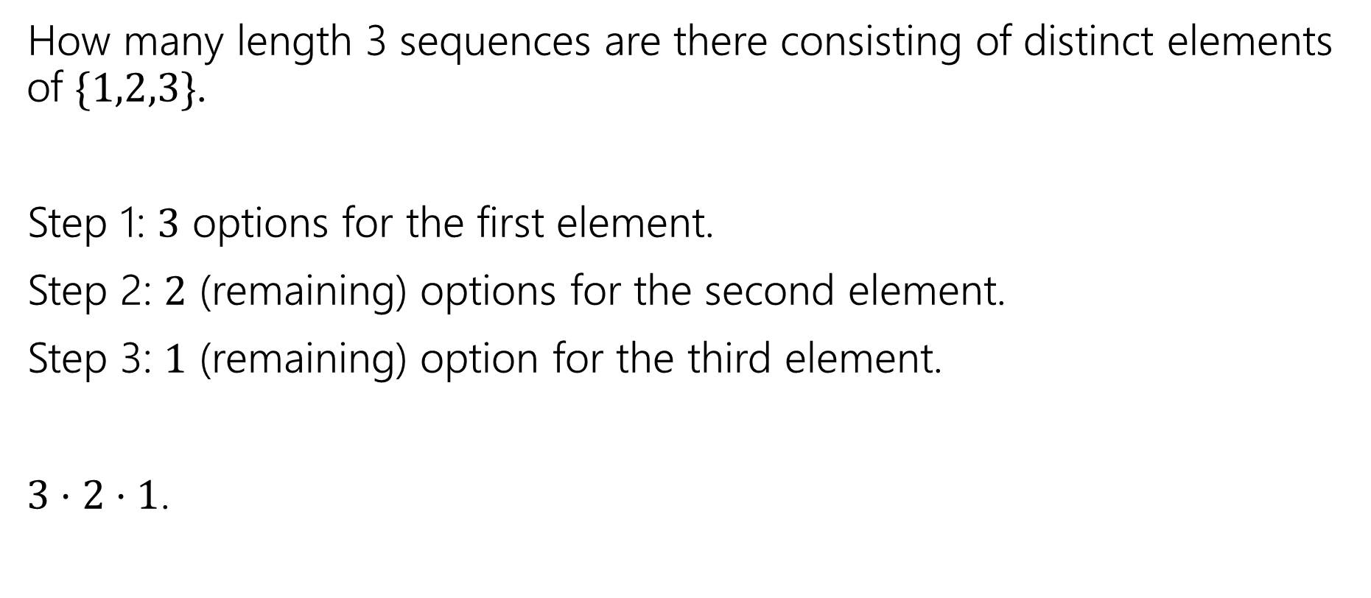
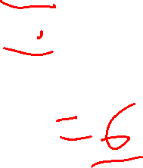
More sequence practice (answer)
How many length 3 sequences are there consisting of distinct elements of $\{1,2,3\}$.
Step 1: $3$ options for the first element.
Step 2: $2$ (remaining) options for the second element.
Step 3: $1$ (remaining) option for the third element.
$3⋅2⋅1$.

Slide 11

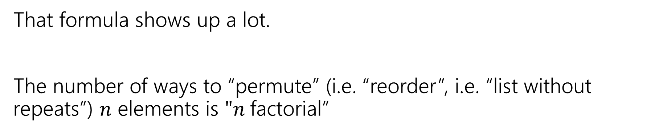


Factorial
That formula shows up a lot.
The number of ways to “permute” (i.e. “reorder”, i.e. “list without repeats”) $n$ elements is $"n$factorial”
$$n!=n⋅\left(n−1\right)⋅\left(n−2\right)⋯1$$
$n$ factorial
We only define 𝑛! for natural numbers 𝑛.
As a convention, we define: 0!=1.

Slide 12


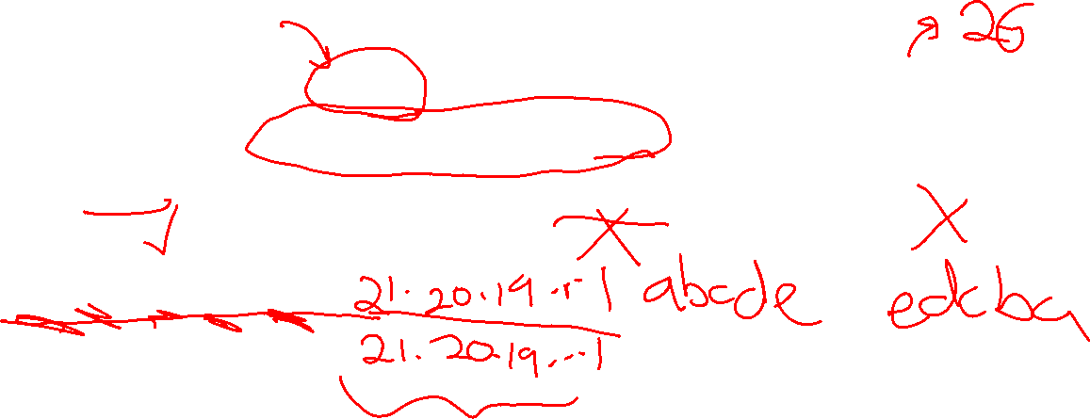
Distinct Letters
How many length $5$ strings are there over the alphabet $\{a,b,…,z\}$ where each string does not repeat a letter.
E.g. “azure” is an allowed string, but “steve” is not, nor is “abcdef”
$26⋅25⋅24⋅23⋅22$

Slide 13
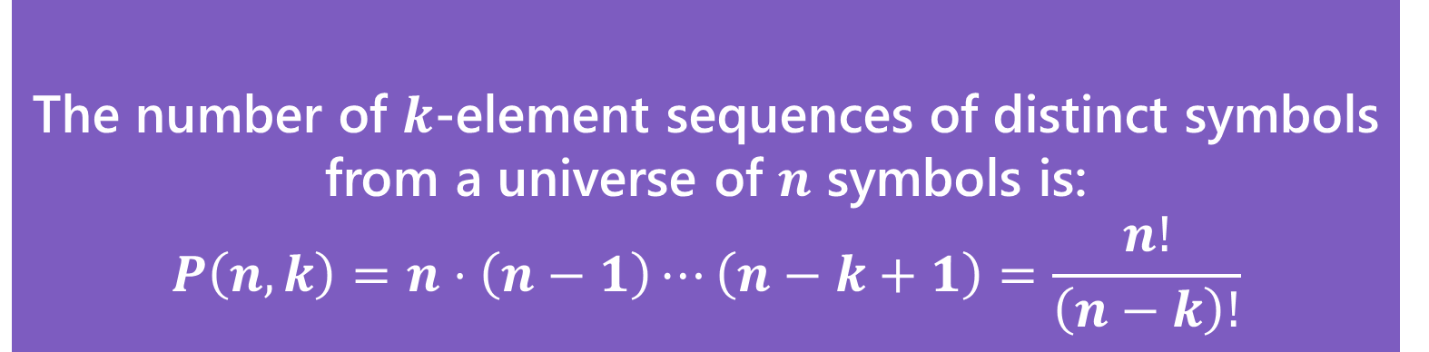
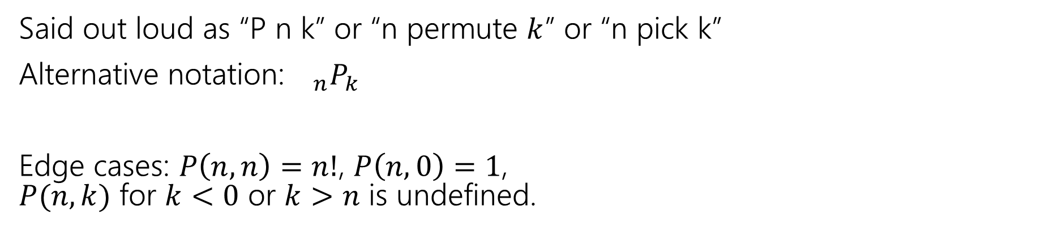
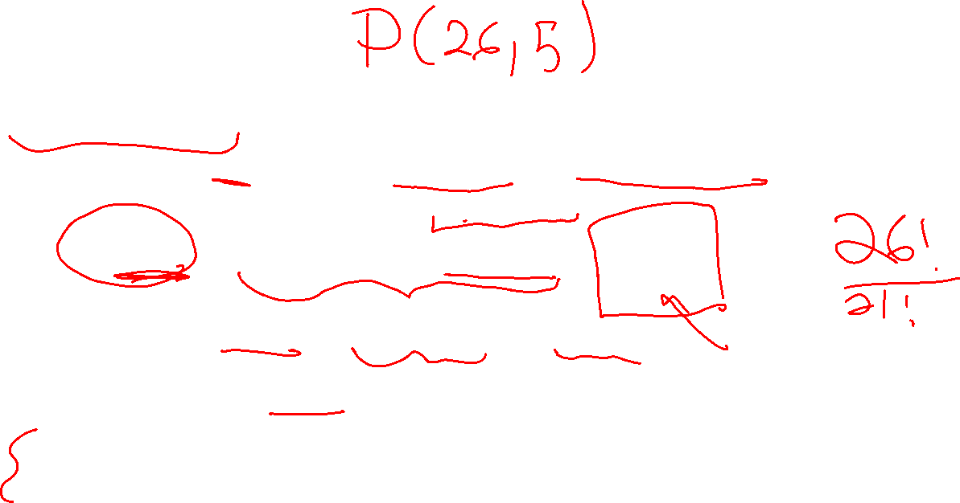
In General
The number of $k$-element sequences of distinct symbols from a universe of $n$ symbols is:
$$P\left(n,k\right)=n⋅\left(n−1\right)⋯\left(n−k+1\right)=\frac{n!}{\left(n−k\right)!}$$
$k$-permutation
Said out loud as “P n k” or “n permute $k$” or “n pick k”
Alternative notation:${}_{n}P_{k}$
Edge cases: $P\left(n,n\right)=n!$, $P\left(n,0\right)=1$, $P(n,k)$ for $k<0$ or $k>n$ is undefined.

Slide 14
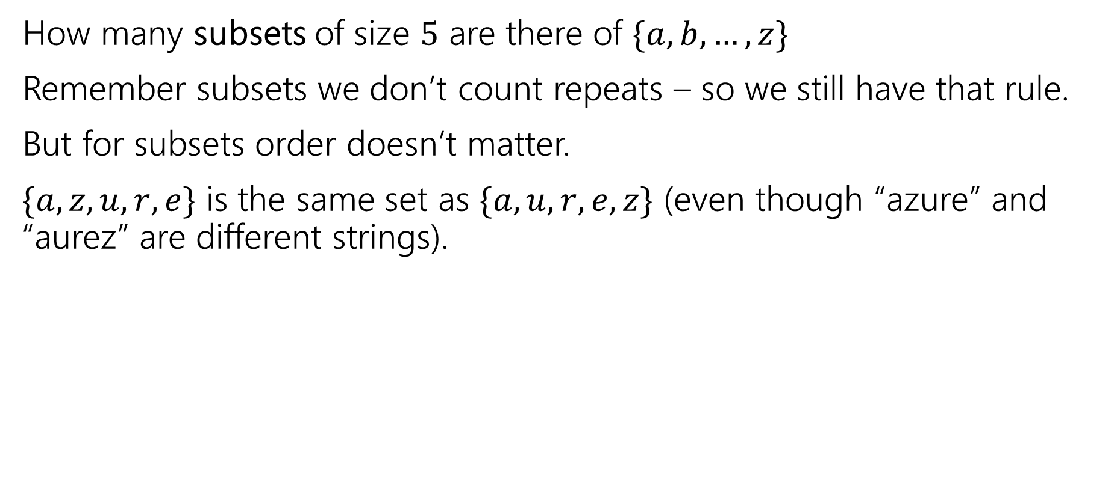

Change it slightly
How many subsets of size $5$ are there of $\{a,b,…,z\}$
Remember subsets we don’t count repeats – so we still have that rule.
But for subsets order doesn’t matter.
$\{a,z,u,r,e\}$ is the same set as $\{a,u,r,e,z\}$ (even though “azure” and “aurez” are different strings).

Slide 15
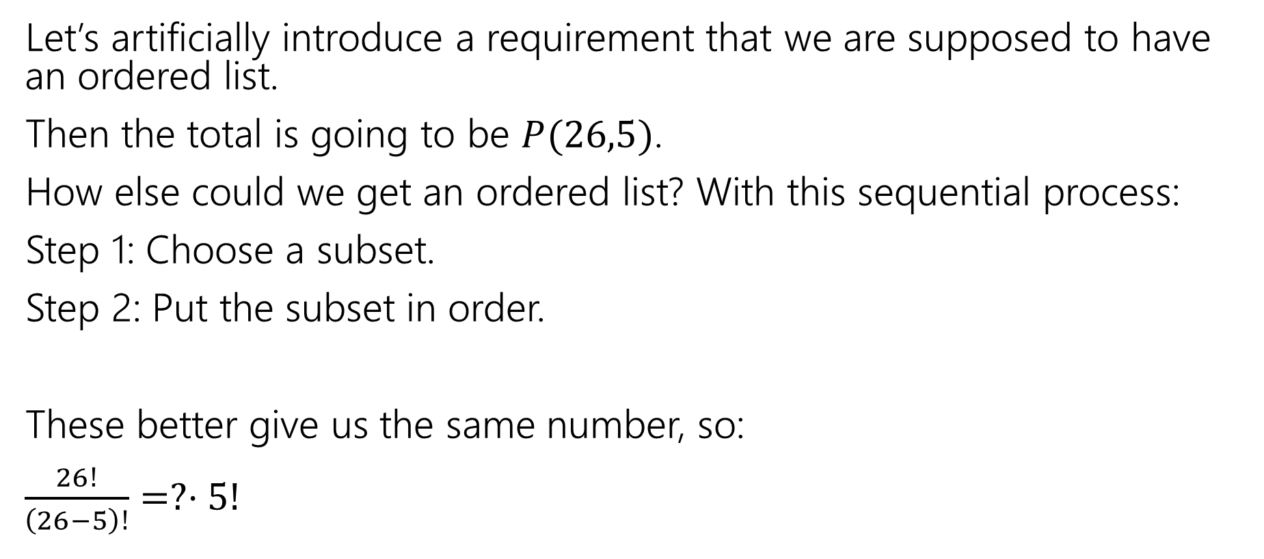

Clever approach – count two ways
Let’s artificially introduce a requirement that we are supposed to have an ordered list.
Then the total is going to be $P(26,5)$.
How else could we get an ordered list? With this sequential process:
Step 1: Choose a subset.
Step 2: Put the subset in order.
These better give us the same number, so:
$\frac{26!}{\left(26−5\right)!}=?⋅5!$

Slide 16
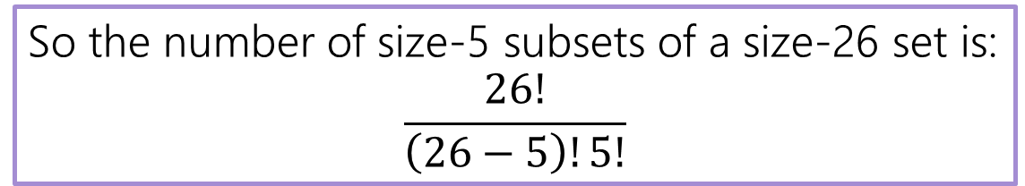
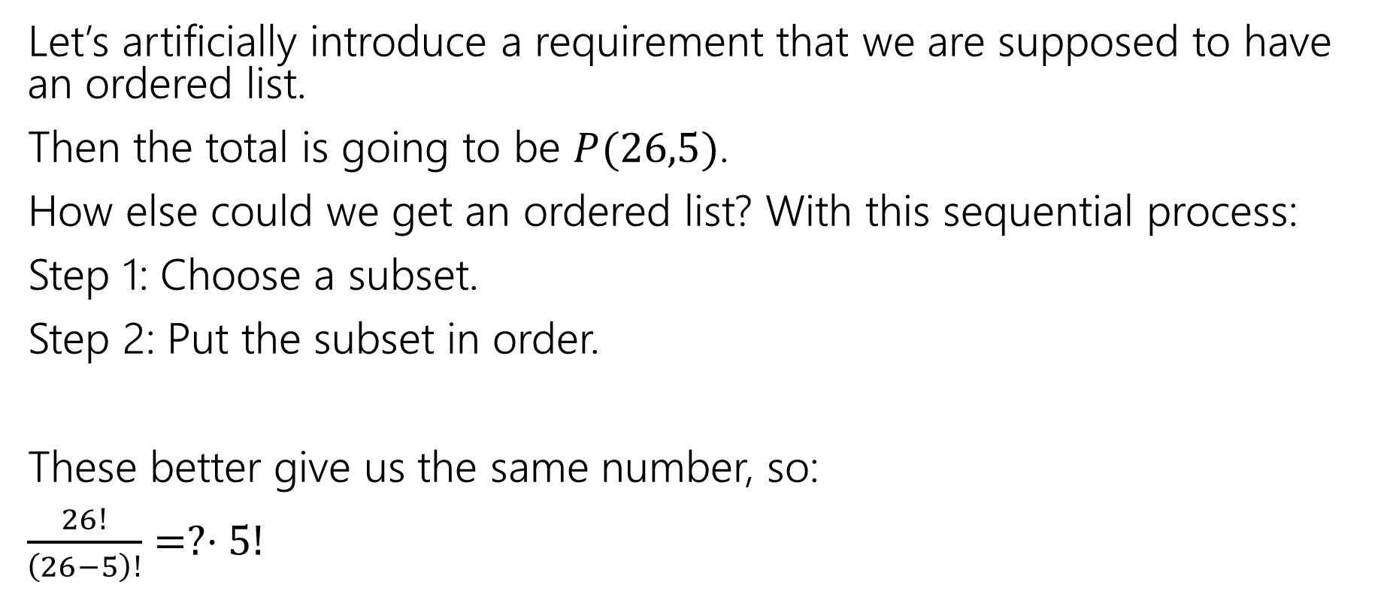

Clever approach – count two ways (answer)
Let’s artificially introduce a requirement that we are supposed to have an ordered list.
Then the total is going to be $P(26,5)$.
How else could we get an ordered list? With this sequential process:
Step 1: Choose a subset.
Step 2: Put the subset in order.
These better give us the same number, so:
$\frac{26!}{\left(26−5\right)!}=?⋅5!$
So the number of size-5 subsets of a size-26 set is:
$$\frac{26!}{\left(26−5\right)!5!}$$

Slide 17
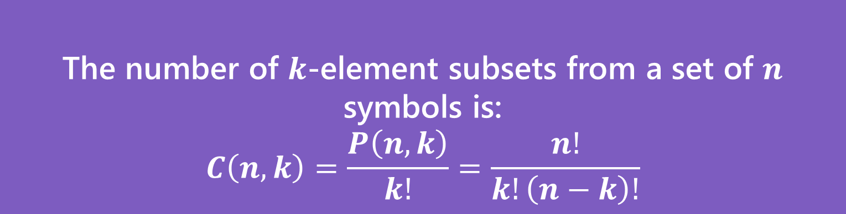
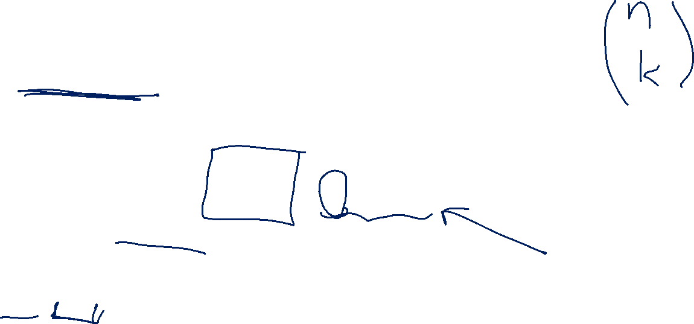
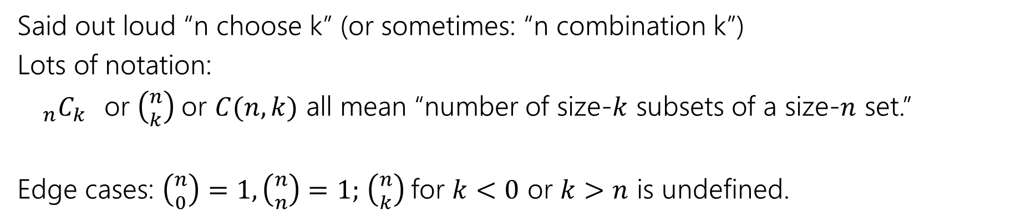
Number of Subsets
The number of $k$-element subsets from a set of $n$ symbols is:
$$C\left(n,k\right)=\frac{P\left(n,k\right)}{k!}=\frac{n!}{k!\left(n−k\right)!}$$
$k$-combination
Said out loud “n choose k” (or sometimes: “n combination k”)
Lots of notation:
${}_{n}C_{k}$or $\left({n \atop k}\right)$or $C(n,k)$ all mean “number of size-$k$ subsets of a size-$n$ set.”
Edge cases: $\left({n \atop 0}\right)=1,\left({n \atop n}\right)=1;$ $\left({n \atop k}\right)$for $k<0$ or $k>n$ is undefined.

Slide 18
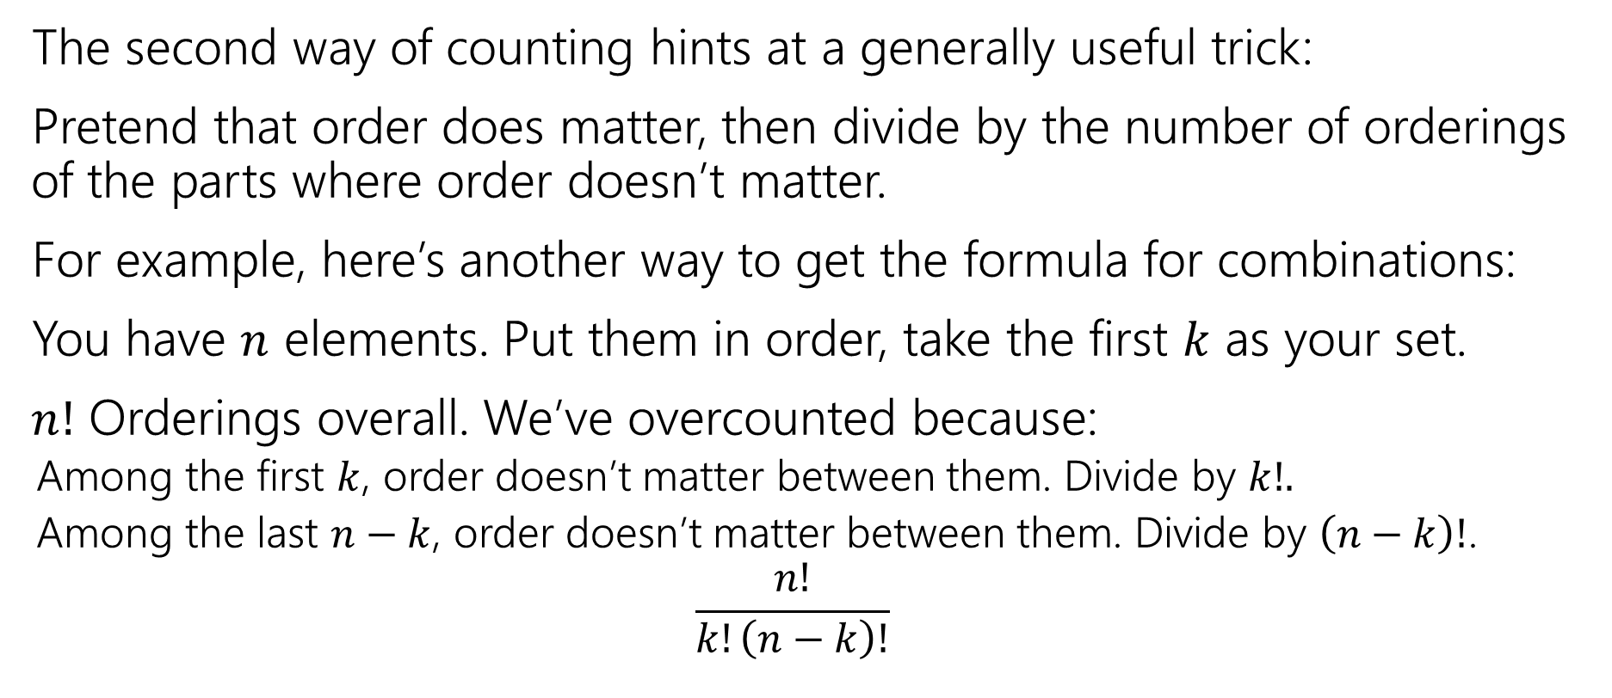
Second Takeaway
The second way of counting hints at a generally useful trick:
Pretend that order does matter, then divide by the number of orderings of the parts where order doesn’t matter.
For example, here’s another way to get the formula for combinations:
You have $n$ elements. Put them in order, take the first $k$ as your set.
$n!$ Orderings overall. We’ve overcounted because:
Among the first $k$, order doesn’t matter between them. Divide by $k!.$
Among the last $n−k$, order doesn’t matter between them. Divide by $\left(n−k\right)!$.
$$\frac{n!}{k!\left(n−k\right)!}$$

Slide 19
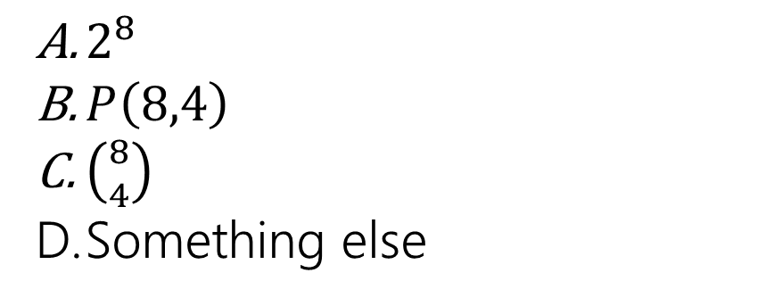
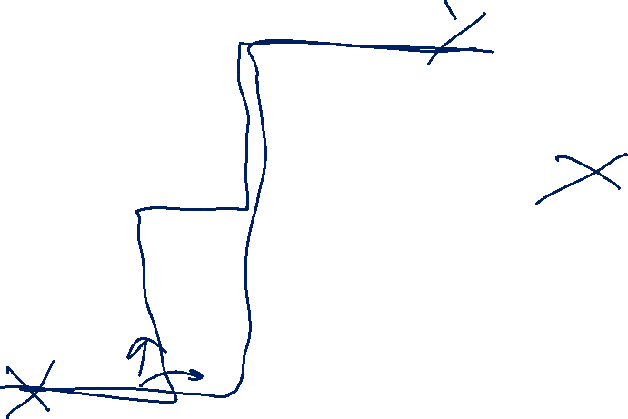
Path Counting (options)
We’re in the lower-left corner, and want to get to the upper-right corner.
We’re only going to go right and up.
How many different paths are there?
$2^{8}$
$P\left(8,4\right)$
$\left({8 \atop 4}\right)$
Something else

Slide 20
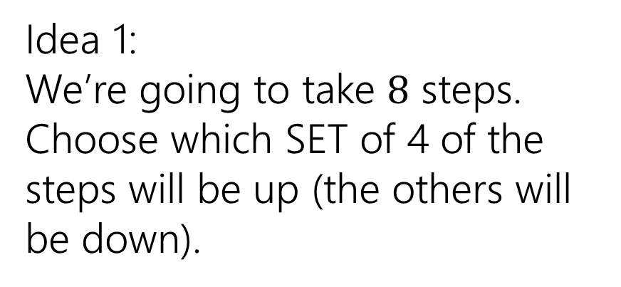
Path Counting
We’re in the lower-left corner, and want to get to the upper-right corner.
We’re only going to go right and up.
How many different paths are there?
Idea 1:
We’re going to take $8$ steps. Choose which SET of 4 of the steps will be up (the others will be down).

Slide 21
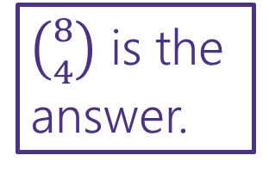
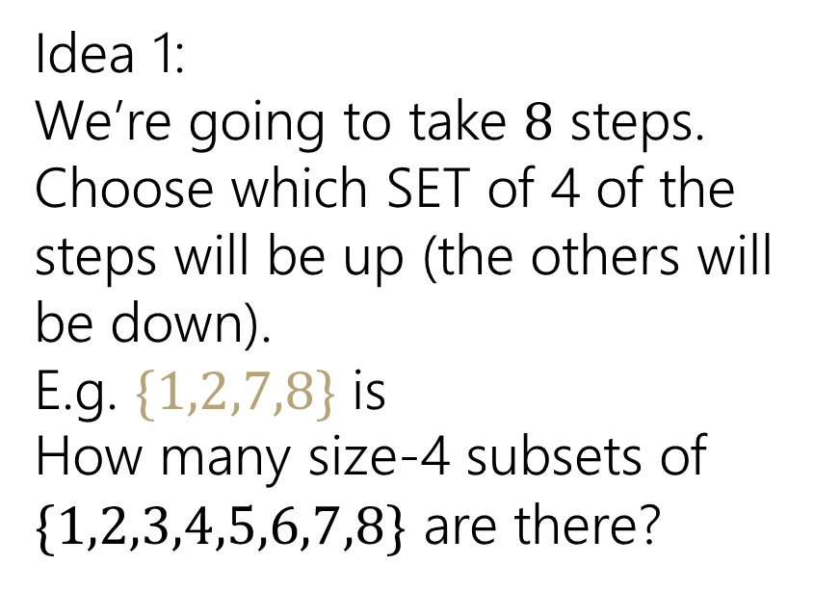
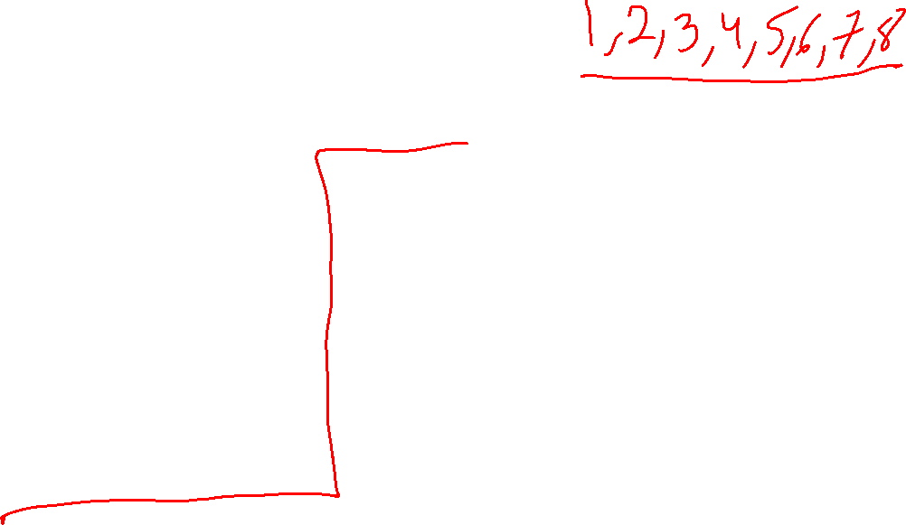
Path Counting (Idea 1)
We’re in the lower-left corner, and want to get to the upper-right corner.
We’re only going to go right and up.
How many different paths are there?
Idea 1:
We’re going to take $8$ steps. Choose which SET of 4 of the steps will be up (the others will be down).
E.g. $\{1,2,7,8\}$ is
How many size-4 subsets of $\{1,2,3,4,5,6,7,8\}$ are there?
$\left({8 \atop 4}\right)$ is the answer.

Slide 22



Path Counting (Idea 2)
We’re in the lower-left corner, and want to get to the upper-right corner.
We’re only going to go right and up.
How many different paths are there?
Idea 2: Introduce artificial ordering
Order $↑_{A}↑_{B}↑_{C}↑_{D}→_{A}→_{B}→_{C}→_{D}$ $8!$
Remove the overcounting
Those $4$ $↑$ are really the same,
divide by $4!$
The $4→$ are really the same,
divide by $4!$
Total: $\frac{8!}{4!⋅4!}$
$\left({8 \atop 4}\right)$ is the answer.

Slide 23
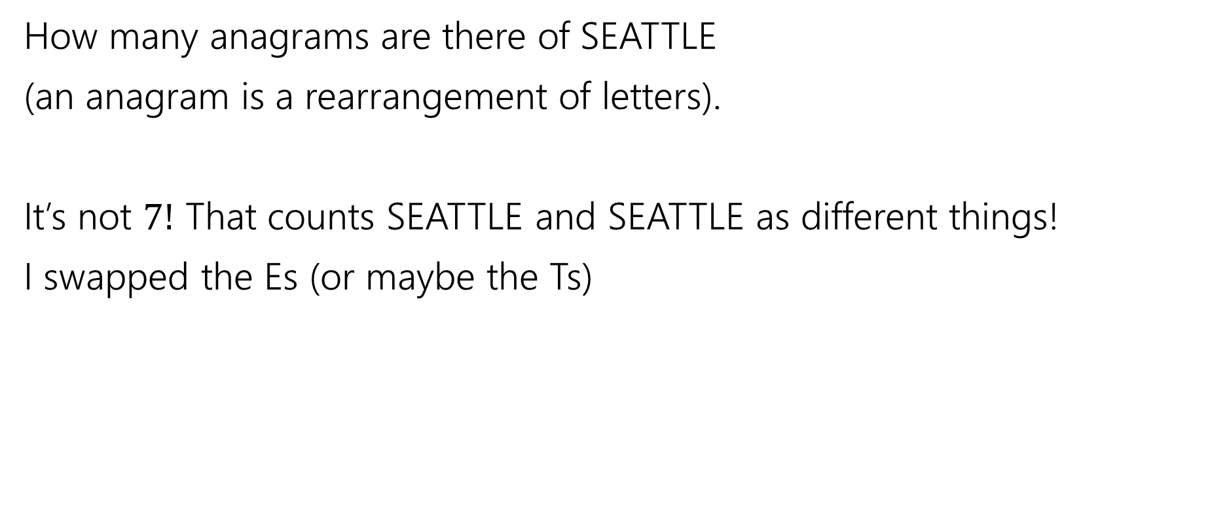
Overcounting
How many anagrams are there of SEATTLE
(an anagram is a rearrangement of letters).
It’s not $7!$ That counts SEATTLE and SEATTLE as different things!
I swapped the Es (or maybe the Ts)

Slide 24
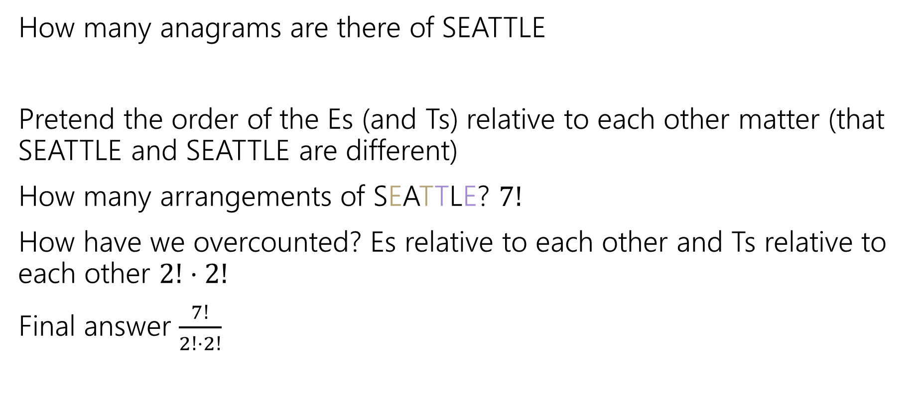
Overcounting (answer)
How many anagrams are there of SEATTLE
Pretend the order of the Es (and Ts) relative to each other matter (that SEATTLE and SEATTLE are different)
How many arrangements of SEATTLE? $7!$
How have we overcounted? Es relative to each other and Ts relative to each other $2!⋅2!$
Final answer $\frac{7!}{2!⋅2!}$

Slide 25
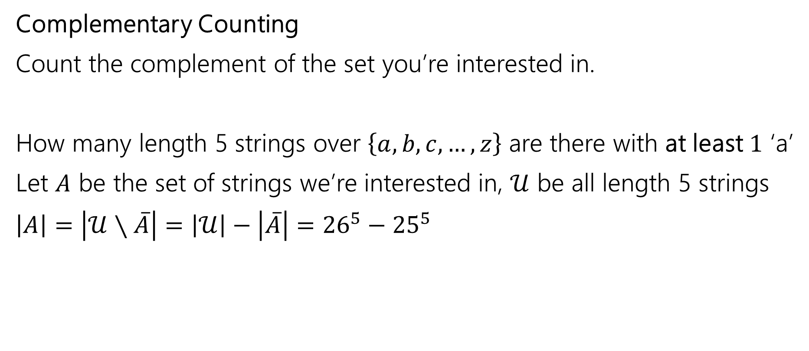
One More Counting Technique
Complementary Counting
Count the complement of the set you’re interested in.
How many length 5 strings over $\left\{a,b,c,…,z\right\}$ are there with at least $1$ ‘a’
Let $A$ be the set of strings we’re interested in, $𝒰$ be all length 5 strings
$\left|A\right|=\left|𝒰∖\overline{A}\right|=\left|𝒰\right|−\left|\overline{A}\right|={26}^{5}−{25}^{5}$

Slide 26
Combination Facts

Slide 27

Some Facts about combinations
Symmetry of combinations: $\left({n \atop k}\right)=\left({n \atop n−k}\right)$
Pascal’s Rule: $\left({n \atop k}\right)=\left({n−1 \atop k−1}\right)+\left({n−1 \atop k}\right)$

Slide 28

Two Proofs of Symmetry
Proof 1: By algebra
$\left({n \atop k}\right)=\frac{n!}{k!\left(n−k\right)!}$
$=\frac{n!}{\left(n−k\right)!k!}$
$=\left({n \atop n−k}\right)$
Definition of Combination
Algebra (commutativity of multiplication)
Definition of Combination

Slide 29
Two Proofs of Symmetry (analysis)
Wasn’t that a great proof.
Airtight. No disputing it.
Got to say “commutativity of multiplication.”
But…do you know why? Can you feel why it’s true?

Slide 30
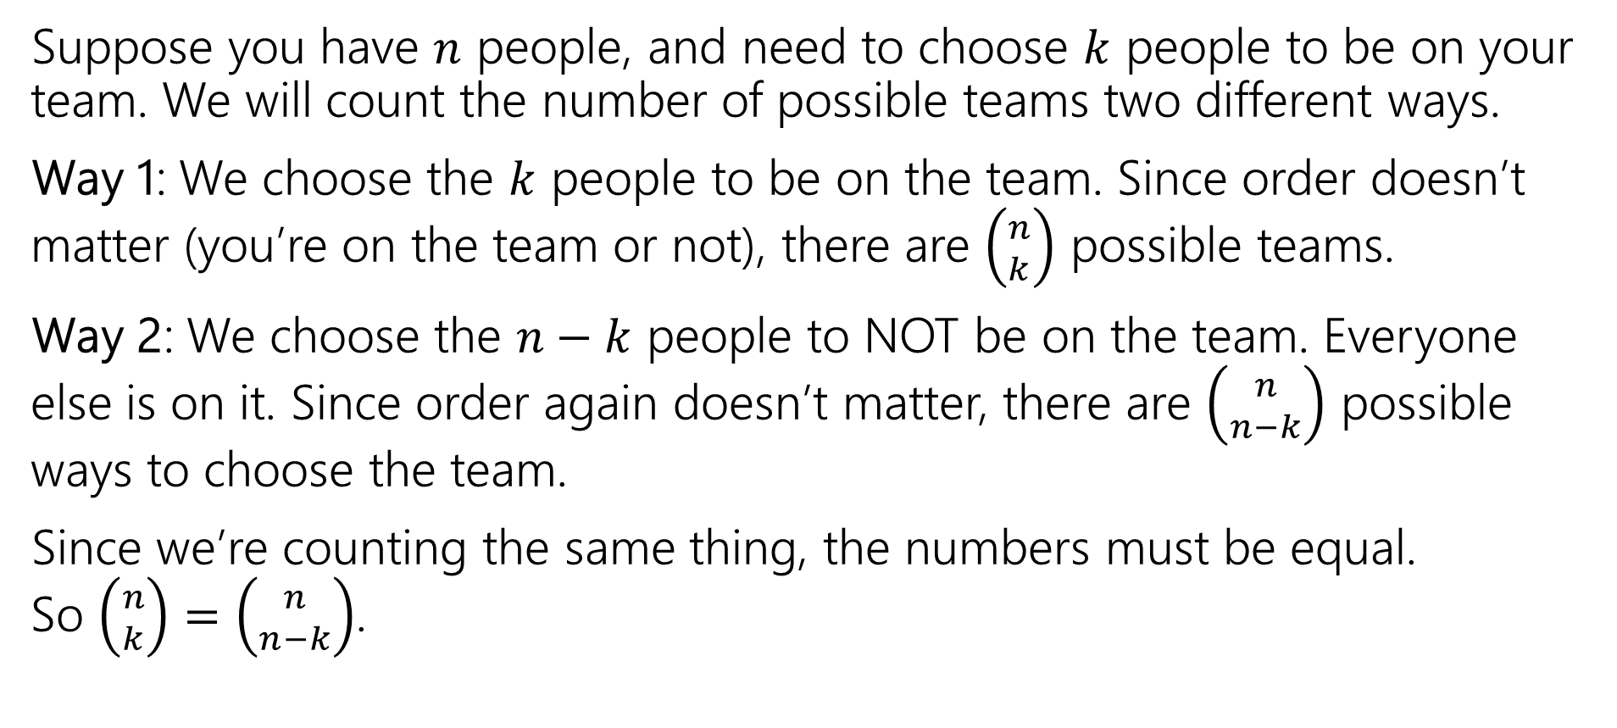
Combinatorial Proof of Symmetry
Suppose you have $n$ people, and need to choose $k$ people to be on your team. We will count the number of possible teams two different ways.
Way 1: We choose the $k$ people to be on the team. Since order doesn’t matter (you’re on the team or not), there are $\left({n \atop k}\right)$ possible teams.
Way 2: We choose the $n−k$ people to NOT be on the team. Everyone else is on it. Since order again doesn’t matter, there are $\left({n \atop n−k}\right)$ possible ways to choose the team.
Since we’re counting the same thing, the numbers must be equal. So $\left({n \atop k}\right)=\left({n \atop n−k}\right)$.

Slide 31
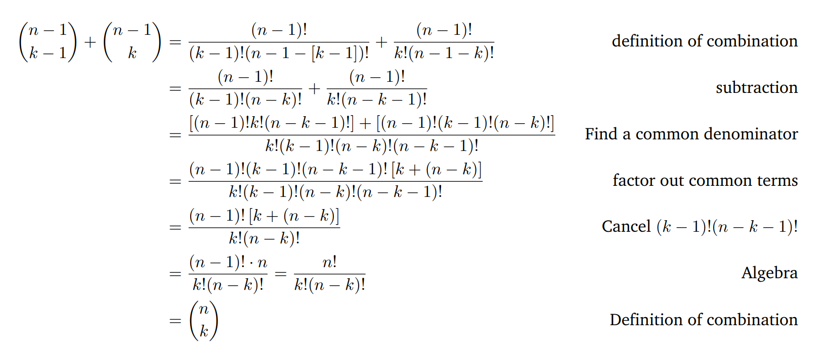
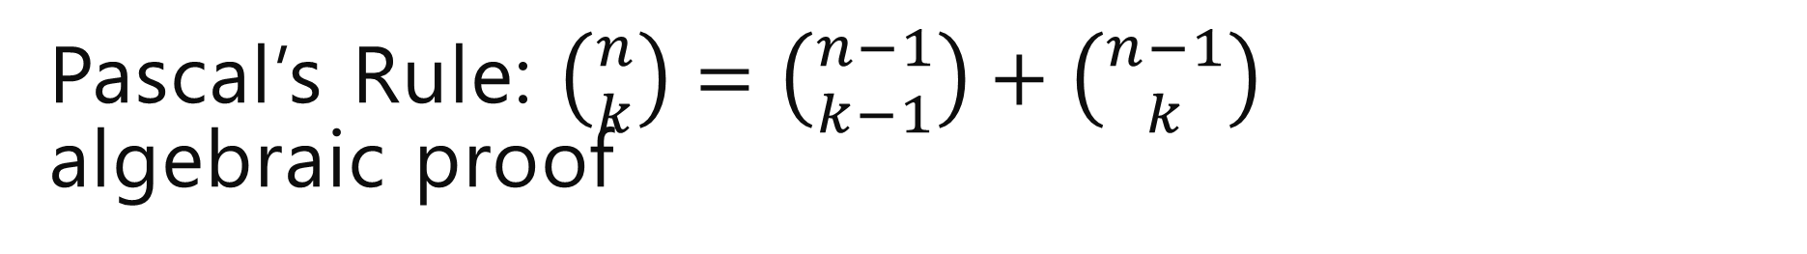
Pascal’s Rule: $\left({n \atop k}\right)=\left({n−1 \atop k−1}\right)+\left({n−1 \atop k}\right)$ algebraic proof

Slide 32
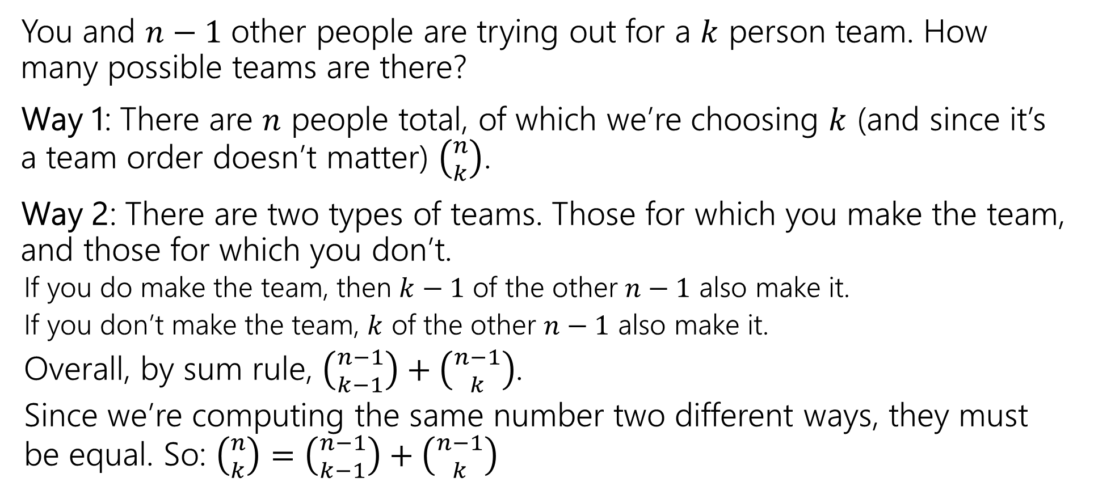

Pascal’s Rule: $\left({n \atop k}\right)=\left({n−1 \atop k−1}\right)+\left({n−1 \atop k}\right)$ combinatorial proof
You and $n−1$ other people are trying out for a $k$ person team. How many possible teams are there?
Way 1: There are $n$ people total, of which we’re choosing $k$ (and since it’s a team order doesn’t matter) $\left({n \atop k}\right)$.
Way 2: There are two types of teams. Those for which you make the team, and those for which you don’t.
If you do make the team, then $k−1$ of the other $n−1$ also make it.
If you don’t make the team, $k$ of the other $n−1$ also make it.
Overall, by sum rule, $\left({n−1 \atop k−1}\right)+\left({n−1 \atop k}\right)$.
Since we’re computing the same number two different ways, they must be equal. So: $\left({n \atop k}\right)=\left({n−1 \atop k−1}\right)+\left({n−1 \atop k}\right)$

Slide 33
Takeaways
Formulas for factorial, permutations, combinations.
A useful trick for counting is to pretend order matters, then account for the overcounting at the end (by dividing out repetitions)
When trying to prove facts about counting, try to have each side of the equation count the same thing.
Much more fun and much more informative than just churning through algebra.

Slide 34
Extra Practice

Slide 35
Books, revisited
Remember the books problem from lecture 1? Books 1,2,3,4,5 need to be assigned to Alice, Bob, and Charlie (each book to exactly one person).
Now that we know combinations, try a sequential process approach. It won’t be as nice as the change of perspective, but we can make it work.
Break into cases based on how many books Alice gets, use the sum rule to combine.

Slide 36
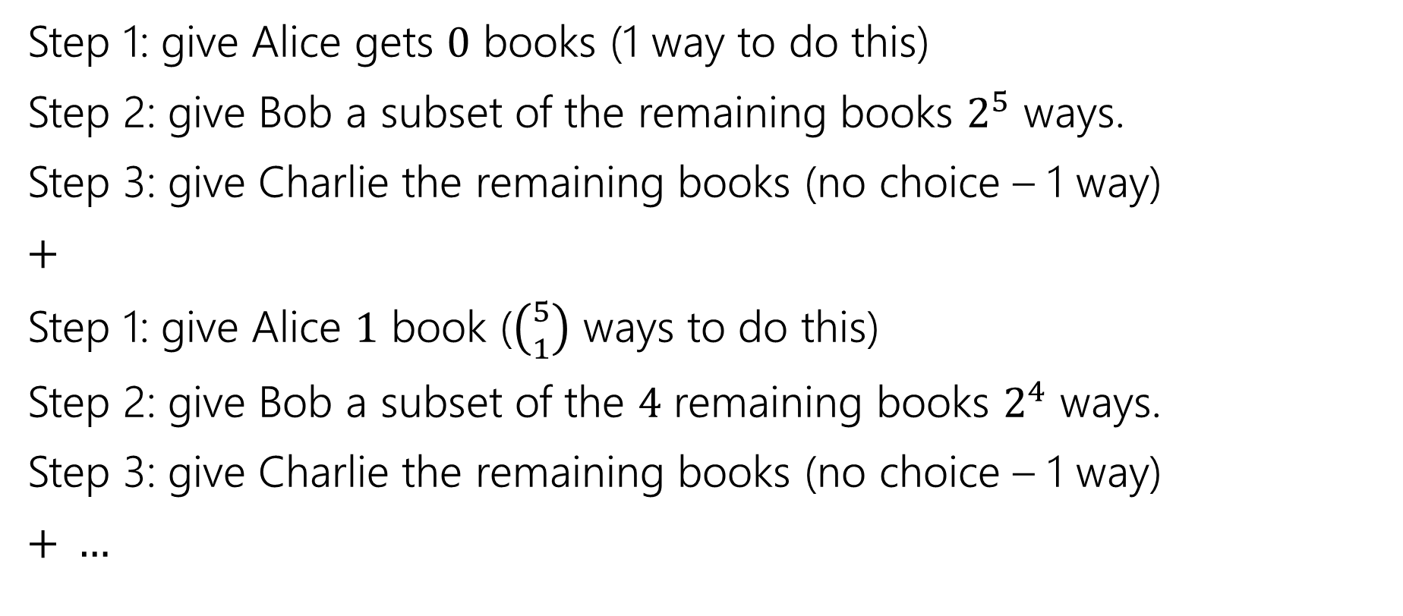
Books, revisited (2)
Step 1: give Alice gets $0$ books (1 way to do this)
Step 2: give Bob a subset of the remaining books $2^{5}$ ways.
Step 3: give Charlie the remaining books (no choice – 1 way)
$+$
Step 1: give Alice $1$ book ($\left({5 \atop 1}\right)$ ways to do this)
Step 2: give Bob a subset of the $4$ remaining books $2^{4}$ ways.
Step 3: give Charlie the remaining books (no choice – 1 way)
$+ …$

Slide 37

Books, revisited (3)
Add all the options together
$1⋅2^{5}⋅1+\left({5 \atop 1}\right)⋅2^{4}⋅1+\left({5 \atop 2}\right)⋅2^{3}⋅1+\left({5 \atop 3}\right)⋅2^{2}⋅1+\left({5 \atop 4}\right)⋅2^{1}⋅1+\left({5 \atop 5}\right)⋅2^{0}⋅1$
If you plug and chug, you’ll get the number we got last time. It took quite a bit of work, but we got there!

Slide 38
Why Divide?

Slide 39
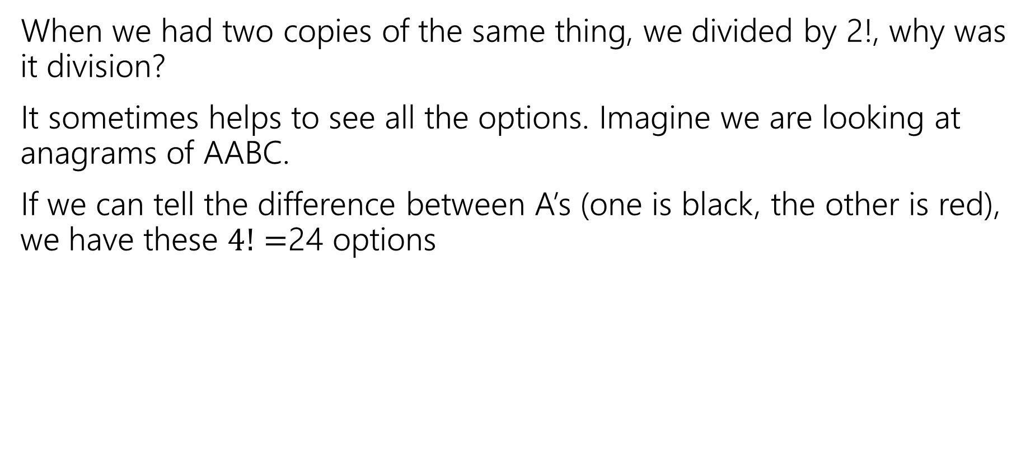
Why divide by 2! (not subtract)
When we had two copies of the same thing, we divided by 2!, why was it division?
It sometimes helps to see all the options. Imagine we are looking at anagrams of AABC.
If we can tell the difference between A’s (one is black, the other is red), we have these $4!=$24 options
Anagrams
AABC | AABC | AACB | AACB
ABCA | ABCA | ACBA | ACBA
BCAA | BCAA | CBAA | CBAA
ABAC | ABAC | ACAB | ACAB
BAAC | BAAC | CAAB | CAAB
BCAA | BCAA | BCAA | BCAA

Slide 40
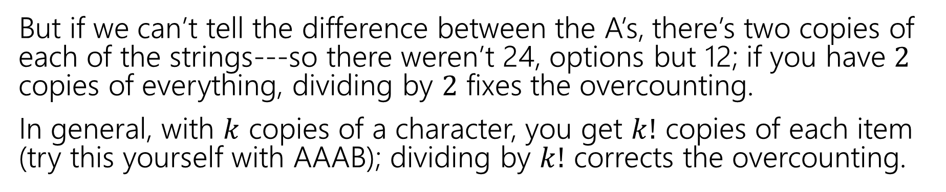
Why divide (in general)
If we can tell the difference between A’s (one is black, the other is red), we have these 24 options
Anagrams
AABC | AABC | AACB | AACB
ABCA | ABCA | ACBA | ACBA
BCAA | BCAA | CBAA | CBAA
ABAC | ABAC | ACAB | ACAB
BAAC | BAAC | CAAB | CAAB
BCAA | BCAA | BCAA | BCAA
But if we can’t tell the difference between the A’s, there’s two copies of each of the strings---so there weren’t 24, options but 12; if you have $2$ copies of everything, dividing by $2$ fixes the overcounting.
In general, with $k$ copies of a character, you get $k!$ copies of each item (try this yourself with AAAB); dividing by $k!$ corrects the overcounting.

Slide 41
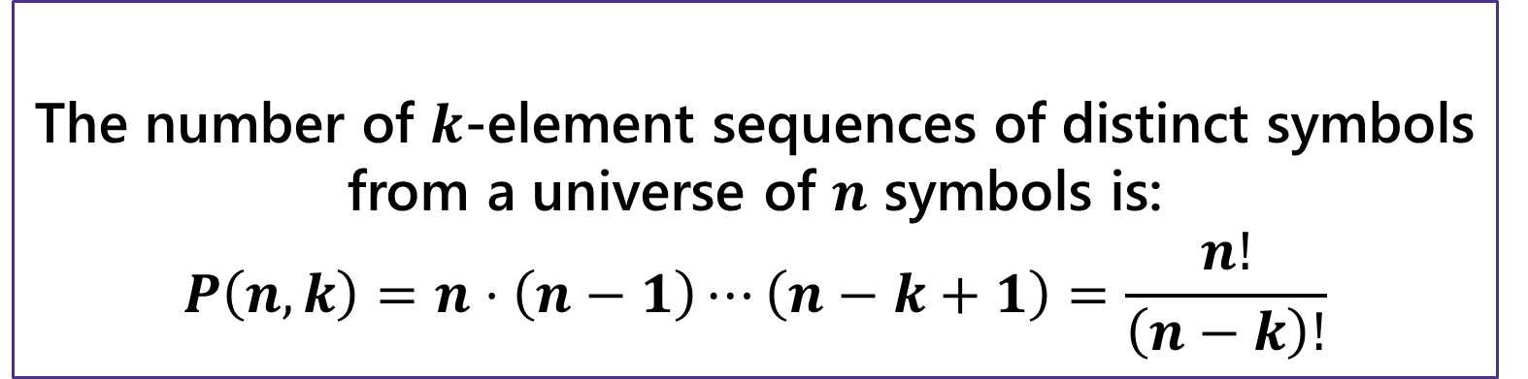
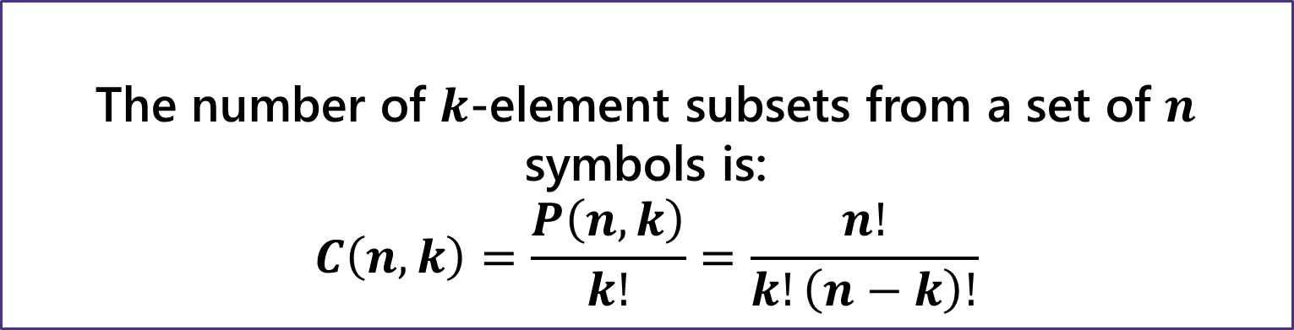
The number of $k$-element sequences of distinct symbols from a universe of $n$ symbols is:
$$P\left(n,k\right)=n⋅\left(n−1\right)⋯\left(n−k+1\right)=\frac{n!}{\left(n−k\right)!}$$
$k$-permutation
The number of $k$-element subsets from a set of $n$ symbols is:
$$C\left(n,k\right)=\frac{P\left(n,k\right)}{k!}=\frac{n!}{k!\left(n−k\right)!}$$
$k$-combination

