Slide 1

Here Early?
Here for CSE 312?
Welcome! You’re early!
Want a copy of these slides to take notes?
You can download them from the webpage cs.uw.edu/312

Slide 2
Introduction and Counting
CSE 312 26Wi
Lecture 1

Slide 3

Staff
TAs
Aadi Anand | Vlad Murad
Anika Arugunta | Lucas Ng
Advait Bhargav | Cindy Ni
Owen Boseley | Vinay Pritamani
Isaiah Greenlee | Sam Sullivan
Caleb Hsu | Cleah Winston
Emma Huang | Jai Wongcharoensangsiri
Heon Jwa | Alice Zhu
Krisha Khandelwal
Instructor: Robbie Weber
Ph.D. from UW CSE in theory
Sixth year as teaching faculty
Email: rtweber2@cs.washington.edu Office: CSE2 311

Slide 4

Logistics
Sections meet on Thursdays (starting this week)
Please go to your assigned section.
If you can’t make your assigned section occasionally, you can ask the TA(s) in charge of another for permission to join.
Section participation is required.
The course is designed to give you high-level ideas here and practice in section.
Get participation credit by doing problems; either in section or emailed to your TA.
Details on Syllabus and Ed (including what to do if you can’t attend section).
Sections will not be recorded – we want you to be able to ask questions and give feedback without worrying about being recorded.
Handouts and solutions will be posted.

Slide 5

Concept Checks
Each Lecture will have a “concept check” associated with it.
Idea: Make sure you’ve understood today’s topic before we build on it 2 days later.
Available on gradescope at 2:20 (after B lecture). Due the day of the next lecture at 9:30 (start of A lecture).
You can submit as many times as you want.
When you get an answer correct the explanation will appear.
Worth a small amount of your grade, and an 80% average for the quarter is all you need for full credit.
Details in the syllabus.
You can (and should!) submit until you get full credit!
CC1 out this afternoon; due on Friday (in case of late adds/logistics issues)

Slide 6

Exam Dates
We’re going to have 4 quizzes in sections(20 minutes each)
Thursdays: Jan 22, Feb 5, Feb 26, Mar 5
One evening midterm: Thursday February 19th (6 PM)
“Second chance quizzes”; optional chances to retake two of your quizzes to improve scores
Quiz second-chance: Evening Thursday Mar 12
Final Exam: Combined Mon March 16, 12:30

Slide 7
Syllabus
When in doubt, it’s on the webpage:
(or it will be soon ☺ )
https://courses.cs.washington.edu/courses/cse312/26wi/
Video coming later this week covering more syllabus information.

Slide 8

What is This Class?
We’re going to learn fundamentals of probability theory.
A beautiful and useful branch of mathematics.
Applications in:
Machine Learning
Natural Language Processing
Cryptography
Error-Correcting Codes
Data Structures
Data Compression
Complexity Theory
Algorithm Design
…

Slide 9

Content
Combinatorics (fancy counting)
Permutations, combinations, inclusion-exclusion, pigeonhole principle
Formal definitions for Probability
Probability space, events, conditional probability, independence, expectation, variance
Common patterns in probability
Equations and inequalities, “zoo” of common random variables, tail bounds
Continuous Probability
pdf, cdf, sample distributions, central limit theorem, estimating probabilities
Applications
Across CS, but with some focus on ML.

Slide 10

Themes
Precise mathematical communication
Both reading and writing dense statements.
Probability in the “real world”
A mix of CS applications
And some actual “real life” ones.
Refine your intuition
Most people have some base level feeling of what the chances of some event are.
We’re going to train you to have better gut feelings.

Slide 11
Counting

Slide 12
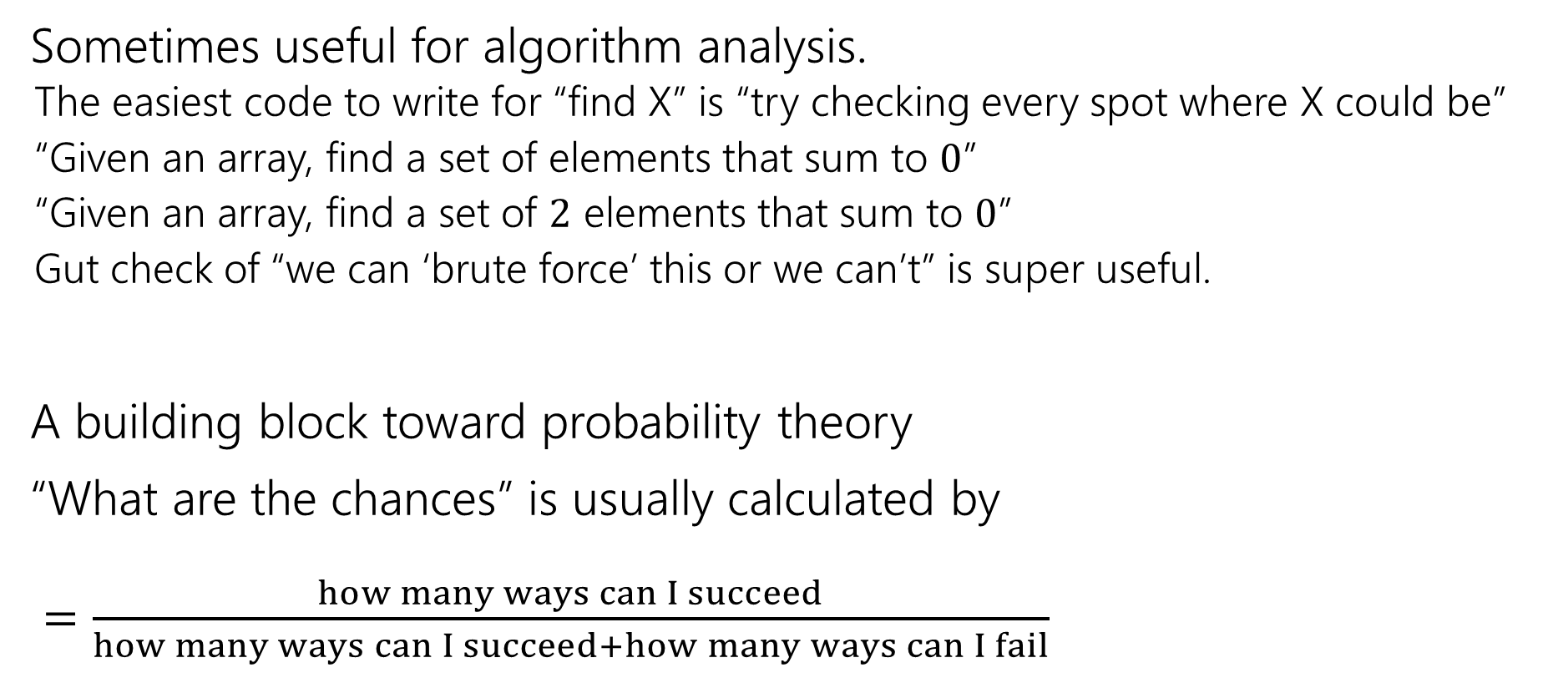

Why Counting?
Sometimes useful for algorithm analysis.
The easiest code to write for “find X” is “try checking every spot where X could be”
“Given an array, find a set of elements that sum to $0$”
“Given an array, find a set of $2$ elements that sum to $0$”
Gut check of “we can ‘brute force’ this or we can’t” is super useful.
A building block toward probability theory
“What are the chances” is usually calculated by $=\frac{how many ways can I succeed}{how many ways can I succeed+how many ways can I fail}$

Slide 13
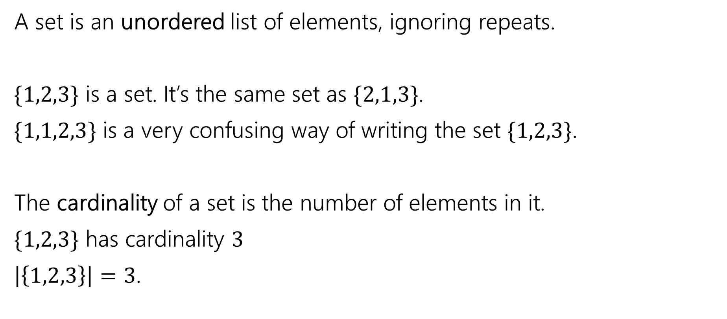

Remember sets?
A set is an unordered list of elements, ignoring repeats.
$\{1,2,3\}$ is a set. It’s the same set as $\{2,1,3\}$.
$\{1,1,2,3\}$ is a very confusing way of writing the set $\{1,2,3\}$.
The cardinality of a set is the number of elements in it.
$\{1,2,3\}$ has cardinality $3$
$\left|\left\{1,2,3\right\}\right|=3$.

Slide 14
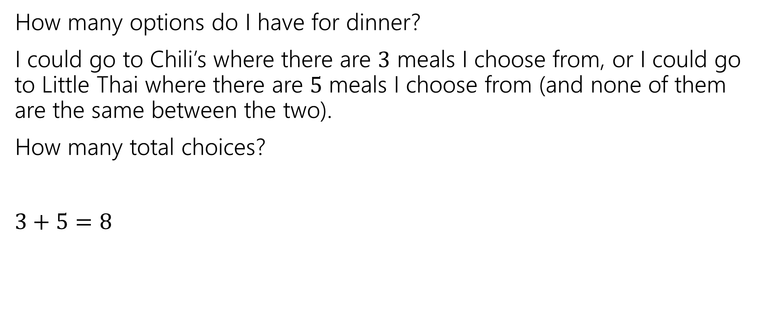
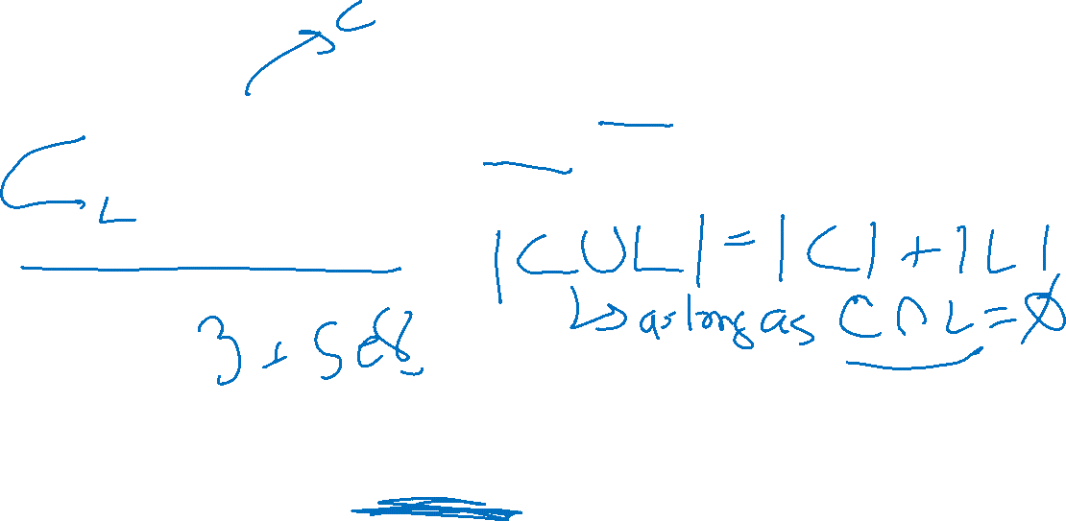
Counting Rules
How many options do I have for dinner?
I could go to Chili’s where there are $3$ meals I choose from, or I could go to Little Thai where there are $5$ meals I choose from (and none of them are the same between the two).
How many total choices?
$3+5=8$
Sum Rule: If you are choosing one thing between $n$ options in one group and $m$in another group with no overlap, the total number of options is: $n+m$.

Slide 15
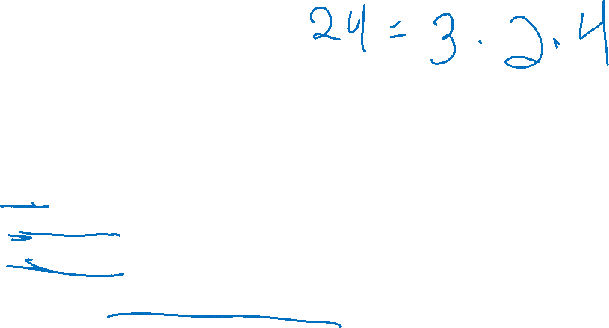
Counting Rules
I’m still hungry…
I decide to make a sandwich. My sandwiches are always:
One of three types of bread (white, wheat, or sourdough).
One of two spreads (mayo or mustard)
One of four cheeses (American, cheddar, swiss, or Havarti)
How many sandwiches can I make?

Slide 16
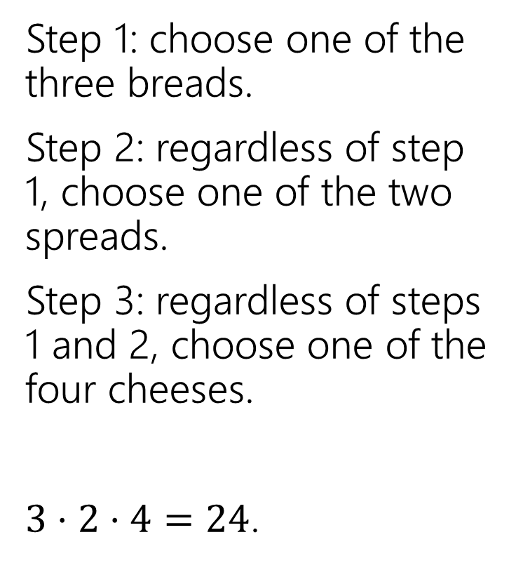

Sandwiches
Step 1: choose one of the three breads.
Step 2: regardless of step 1, choose one of the two spreads.
Step 3: regardless of steps 1 and 2, choose one of the four cheeses.
$3⋅2⋅4=24$.
White
Sourdough
Wheat
Mayo
Mustard
A
C
S
H

Slide 17
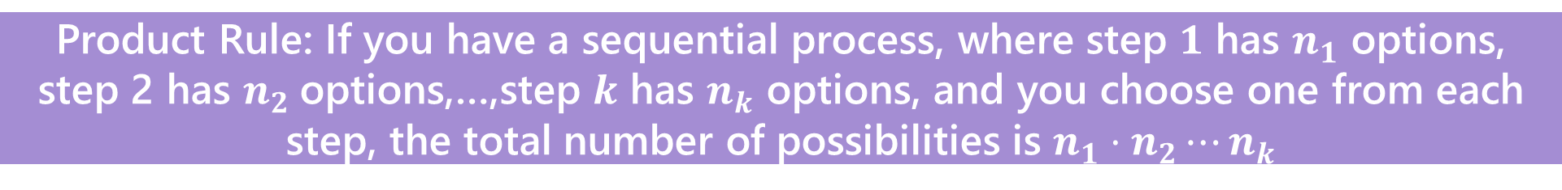

Counting Rules
Sum Rule: If you are choosing one thing between $n$ options in one group and $m$in another group with no overlap, the total number of options is: $n+m$.
Product Rule: If you have a sequential process, where step $1$ has $n_{1}$ options, step 2 has $n_{2}$options,…,step $k$ has $n_{k}$ options, and you choose one from each step, the total number of possibilities is $n_{1}⋅n_{2}⋯n_{k}$

Slide 18
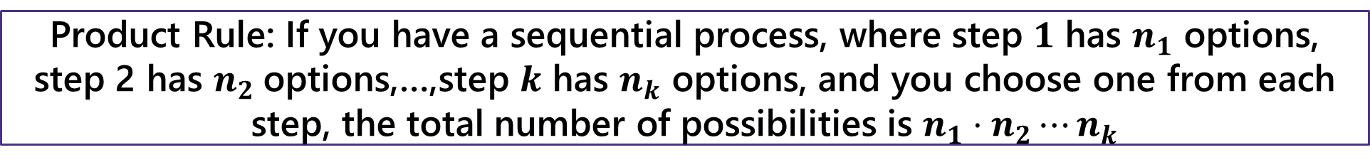
Counting Rules
Sum Rule: If you are choosing one thing between $n$ options in one group and $m$in another group with no overlap, the total number of options is: $n+m$.
Product Rule: If you have a sequential process, where step $1$ has $n_{1}$ options, step 2 has $n_{2}$options,…,step $k$ has $n_{k}$ options, and you choose one from each step, the total number of possibilities is $n_{1}⋅n_{2}⋯n_{k}$

Slide 19
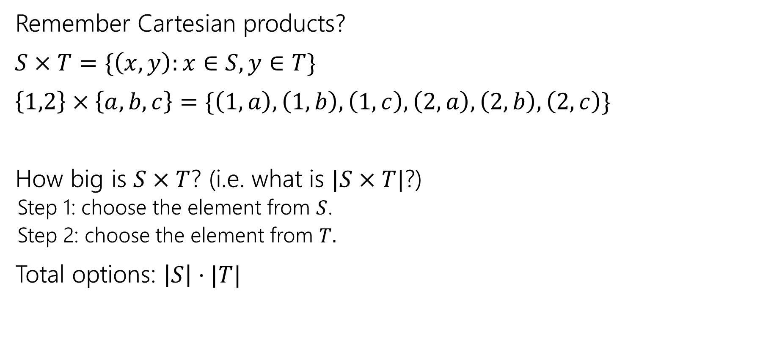
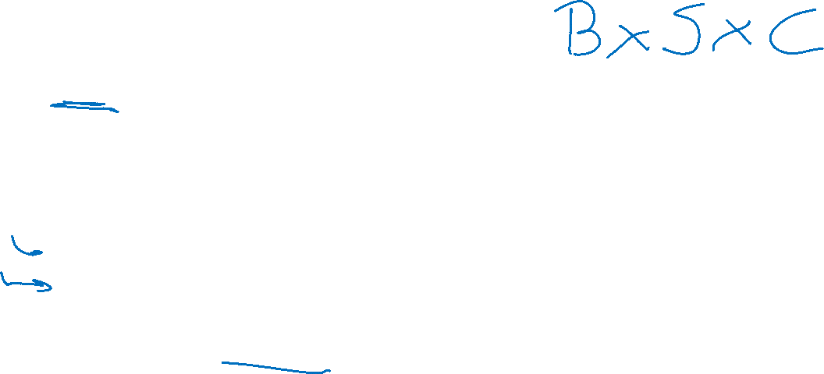
Applications of the product rule
Remember Cartesian products?
$S×T=\{\left(x,y\right):x∈S, y∈T\}$
$\left\{1,2\right\}×\left\{a,b,c\right\}=\{\left(1,a\right),\left(1,b\right),\left(1,c\right),\left(2,a\right),\left(2,b\right),\left(2,c\right)\}$
How big is $S×T$? (i.e. what is $|S×T|$?)
Step 1: choose the element from $S$.
Step 2: choose the element from $T.$
Total options: $\left|S\right|⋅|T|$

Slide 20

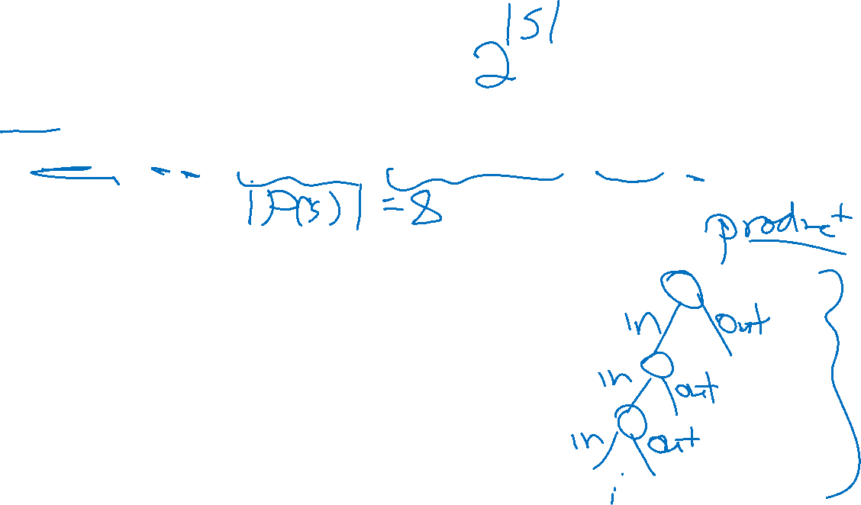
Power Sets
$𝒫\left(S\right)=\{X:X⊆S\}$
$𝒫\left(\left\{1,2,3\right\}\right)=\{ ∅, \left\{1\right\},\left\{2\right\},\left\{3\right\}, \left\{1,2\right\},\left\{1,3\right\},\left\{2,3\right\}, \left\{1,2,3\right\} \}$
How many subsets are there of $S$, i.e. what is $\left|𝒫\left(S\right)\right|$?

Slide 21
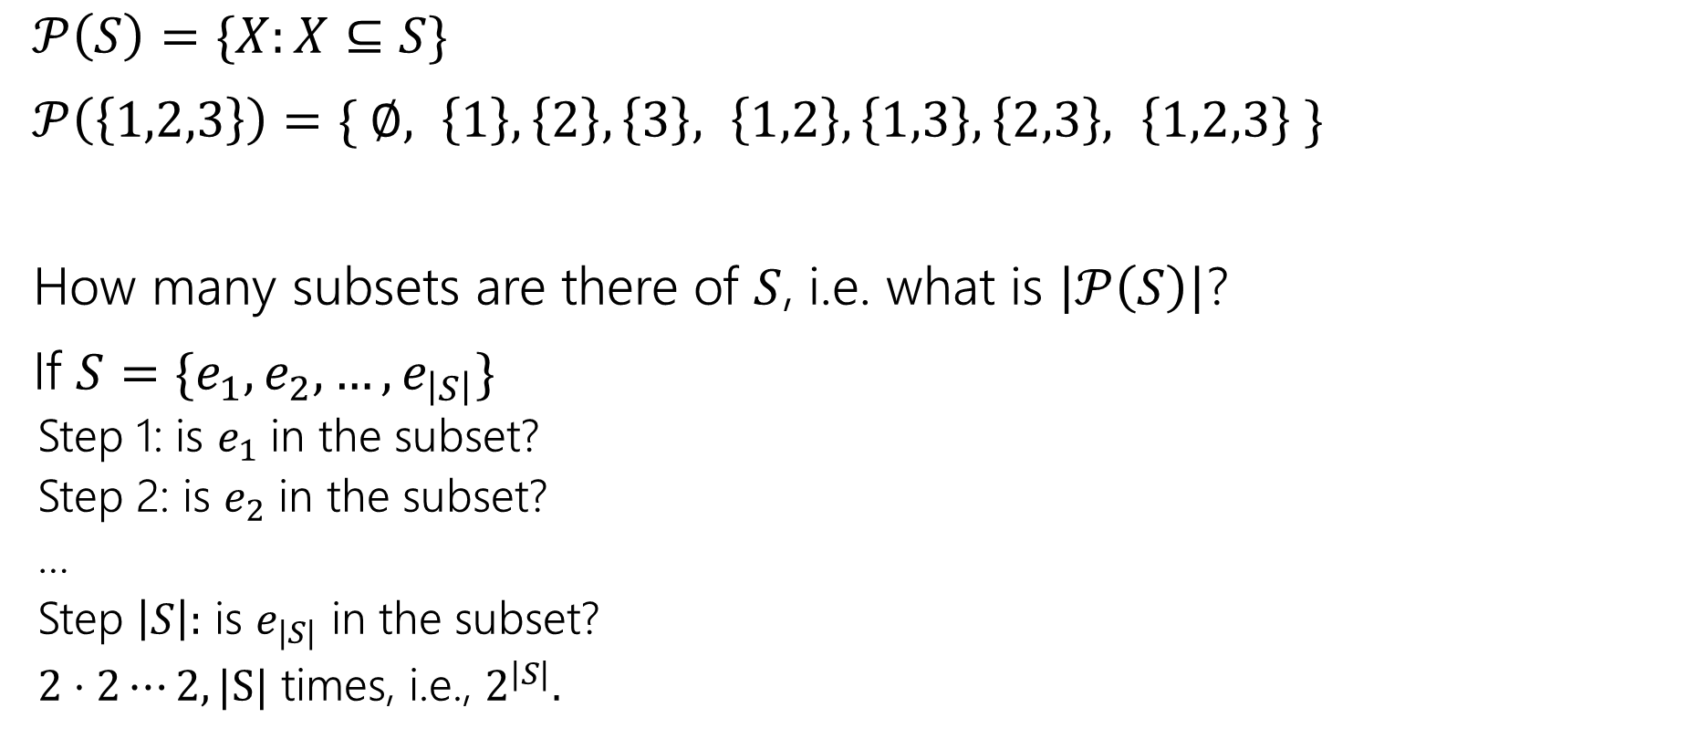
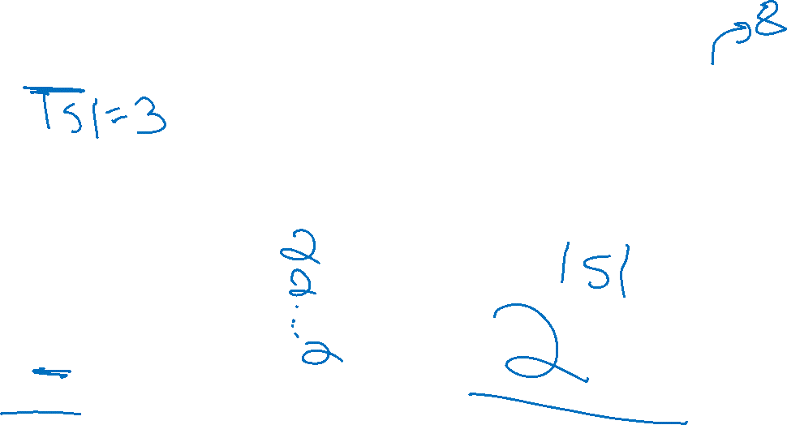
Power Sets
$𝒫\left(S\right)=\{X:X⊆S\}$
$𝒫\left(\left\{1,2,3\right\}\right)=\{ ∅, \left\{1\right\},\left\{2\right\},\left\{3\right\}, \left\{1,2\right\},\left\{1,3\right\},\left\{2,3\right\}, \left\{1,2,3\right\} \}$
How many subsets are there of $S$, i.e. what is $\left|𝒫\left(S\right)\right|$?
If $S=\{e_{1},e_{2},…,e_{\left|S\right|}\}$
Step 1: is $e_{1}$ in the subset?
Step 2: is $e_{2}$ in the subset?
…
Step $\left|S\right|:$ is $e_{|S|}$ in the subset?
$2⋅2⋯2, |S|$ times, i.e., $2^{|S|}.$

Slide 22
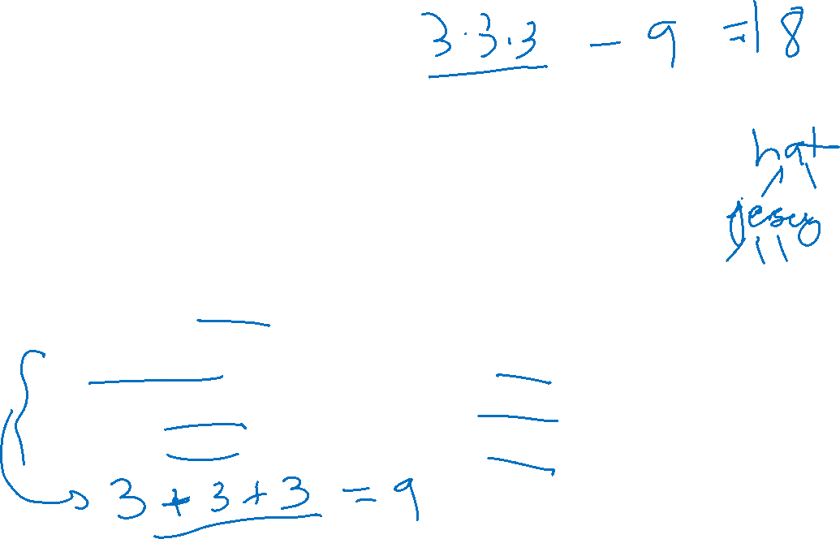
Baseball Outfits
The Husky baseball team has three hats (purple, black, gray)
Three jerseys (pinstripe, purple, gold)
And three pairs of pants (gray, white, black)
How many outfits are there (consisting of one hat, jersey, and pair of pants) if
the pinstripe jersey cannot be worn with gray pants,
the purple jersey cannot be worn with white pants,
and the gold jersey cannot be worn with black pants.

Slide 23
Baseball Outfits
Step 1: 3 choices for hats.
Step 2: 3 choices for jerseys
Step 3:…

Slide 24
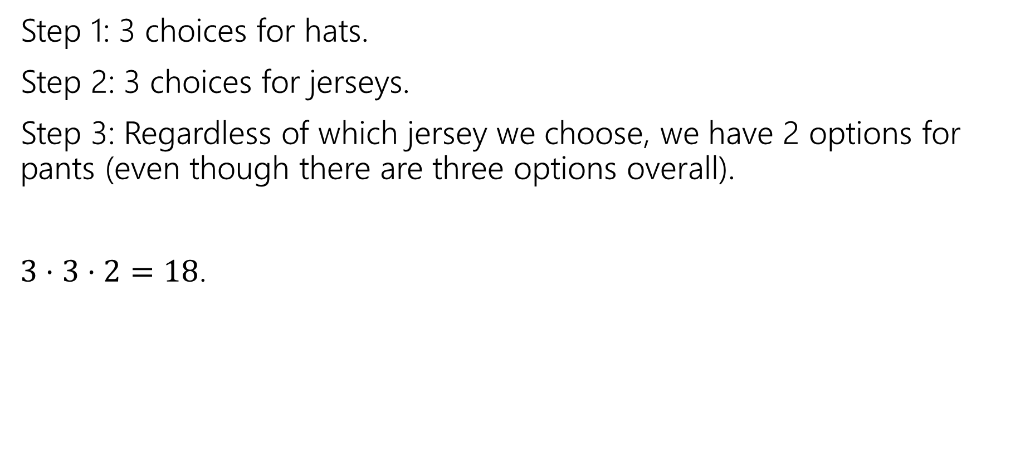
Baseball Outfits
Step 1: 3 choices for hats.
Step 2: 3 choices for jerseys.
Step 3: Regardless of which jersey we choose, we have 2 options for pants (even though there are three options overall).
$3⋅3⋅2=18$.

Slide 25









Assigning Books
We have 5 books to split to 3 people (Alice, Bob, and Charlie)
Every book goes to exactly one person, but each person could end up with no books (or all of them, or something in between).
1
Alice
2
Bob
3
4
Charlie
5

Slide 26
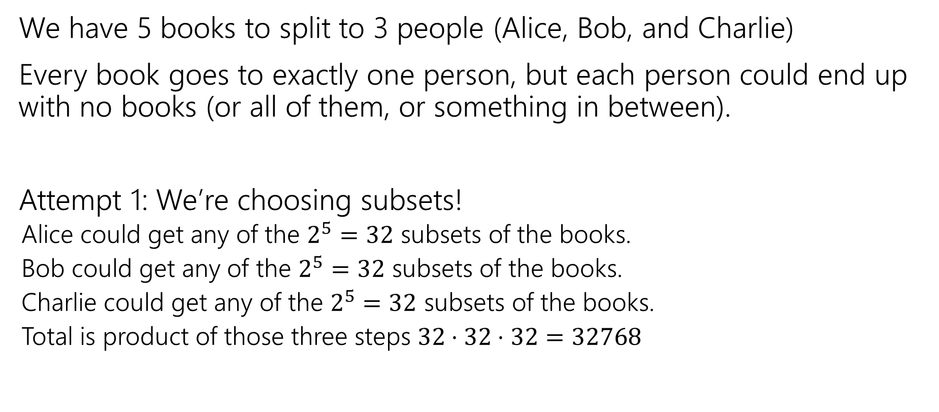
Assigning Books
We have 5 books to split to 3 people (Alice, Bob, and Charlie)
Every book goes to exactly one person, but each person could end up with no books (or all of them, or something in between).
Attempt 1: We’re choosing subsets!
Alice could get any of the $2^{5}=32$ subsets of the books.
Bob could get any of the $2^{5}=32$ subsets of the books.
Charlie could get any of the $2^{5}=32$ subsets of the books.
Total is product of those three steps $32⋅32⋅32=32768$

Slide 27

Activity
Attempt 1: We’re choosing subsets!
Alice could get any of the $2^{5}=32$ subsets of the books.
Bob could get any of the $2^{5}=32$ subsets of the books.
Charlie could get any of the $2^{5}=32$ subsets of the books.
Total is product of those three steps $32⋅32⋅32=32768$

Slide 28
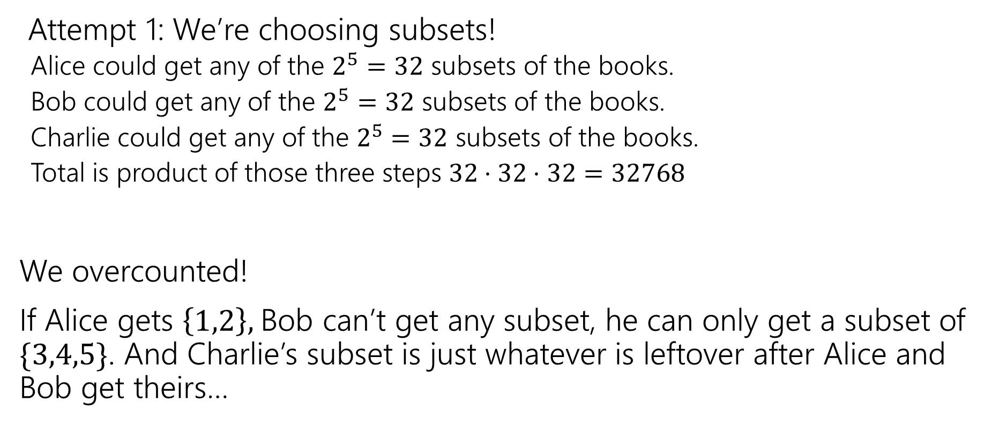
Activity
Attempt 1: We’re choosing subsets!
Alice could get any of the $2^{5}=32$ subsets of the books.
Bob could get any of the $2^{5}=32$ subsets of the books.
Charlie could get any of the $2^{5}=32$ subsets of the books.
Total is product of those three steps $32⋅32⋅32=32768$
We overcounted!
If Alice gets $\left\{1,2\right\},$Bob can’t get any subset, he can only get a subset of $\{3,4,5\}$. And Charlie’s subset is just whatever is leftover after Alice and Bob get theirs…

Slide 29
Fixing All The Books
You could
List out all the options for Alice.
For each of those (separately), list all the possible options for Bob and Charlie.
Use the Summation rule to combine.
~OR~ you could come at the problem from a different angle.

Slide 30
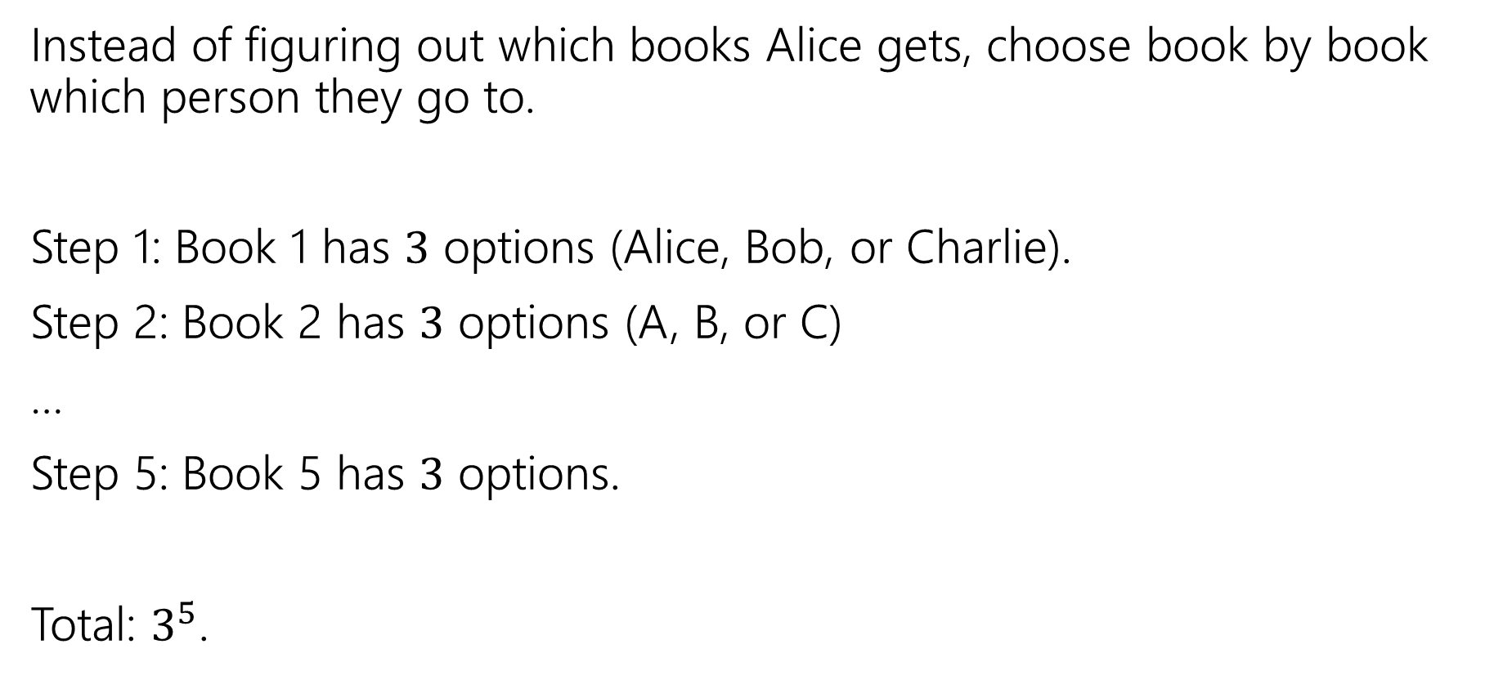
Fixing All the Books
Instead of figuring out which books Alice gets, choose book by book which person they go to.
Step 1: Book 1 has $3$ options (Alice, Bob, or Charlie).
Step 2: Book 2 has $3$ options (A, B, or C)
…
Step 5: Book 5 has $3$ options.
Total: $3^{5}$.

Slide 31

More sequence practice
How many length 3 sequences are there consisting of distinct elements of $\{1,2,3\}$.

Slide 32
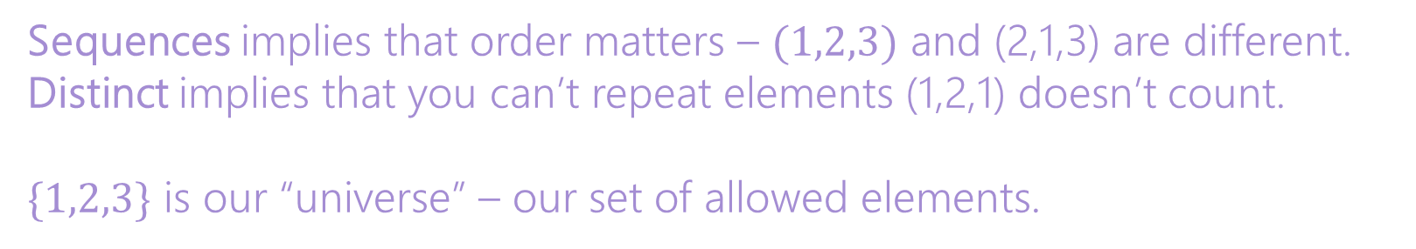
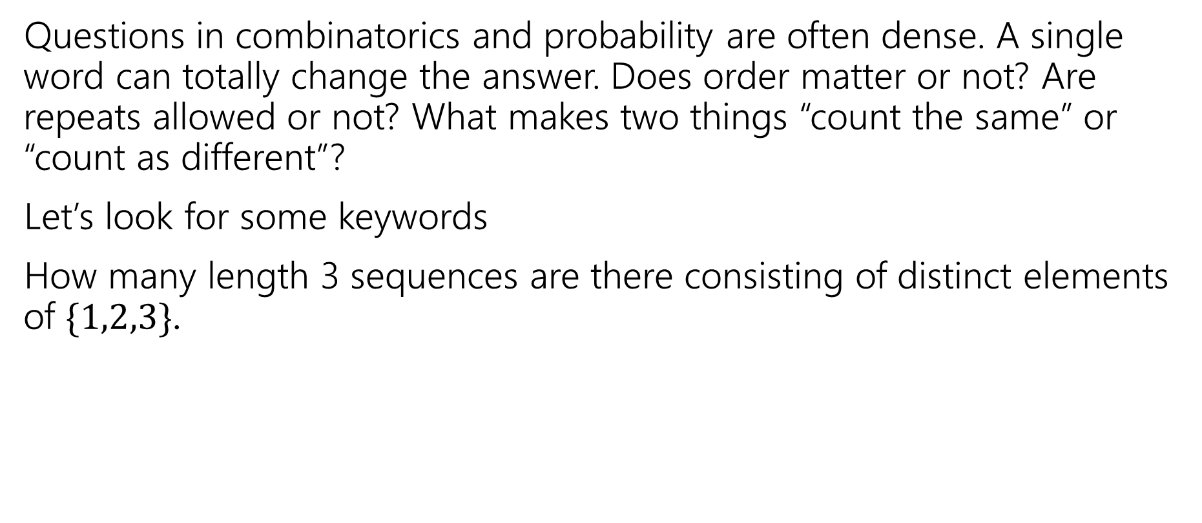
Pause
Questions in combinatorics and probability are often dense. A single word can totally change the answer. Does order matter or not? Are repeats allowed or not? What makes two things “count the same” or “count as different”?
Let’s look for some keywords
How many length 3 sequences are there consisting of distinct elements of $\{1,2,3\}$.
Sequences implies that order matters – $(1,2,3)$ and (2,1,3) are different.
Distinct implies that you can’t repeat elements (1,2,1) doesn’t count.
$\{1,2,3\}$ is our “universe” – our set of allowed elements.

Slide 33
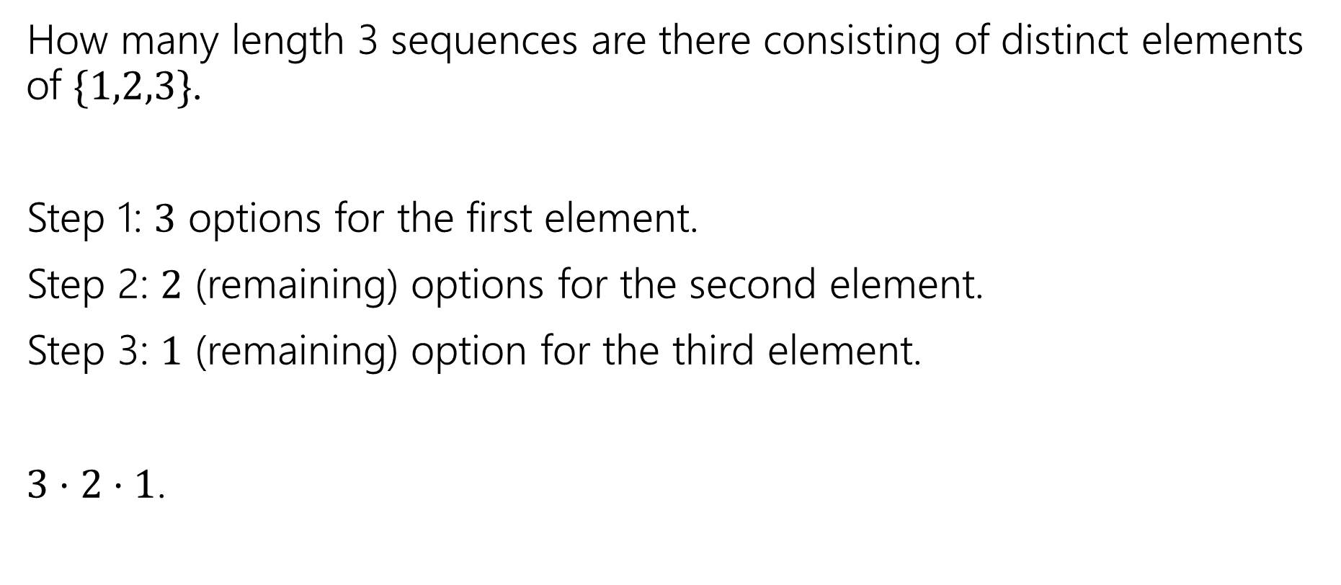
More sequence practice
How many length 3 sequences are there consisting of distinct elements of $\{1,2,3\}$.
Step 1: $3$ options for the first element.
Step 2: $2$ (remaining) options for the second element.
Step 3: $1$ (remaining) option for the third element.
$3⋅2⋅1$.

Slide 34

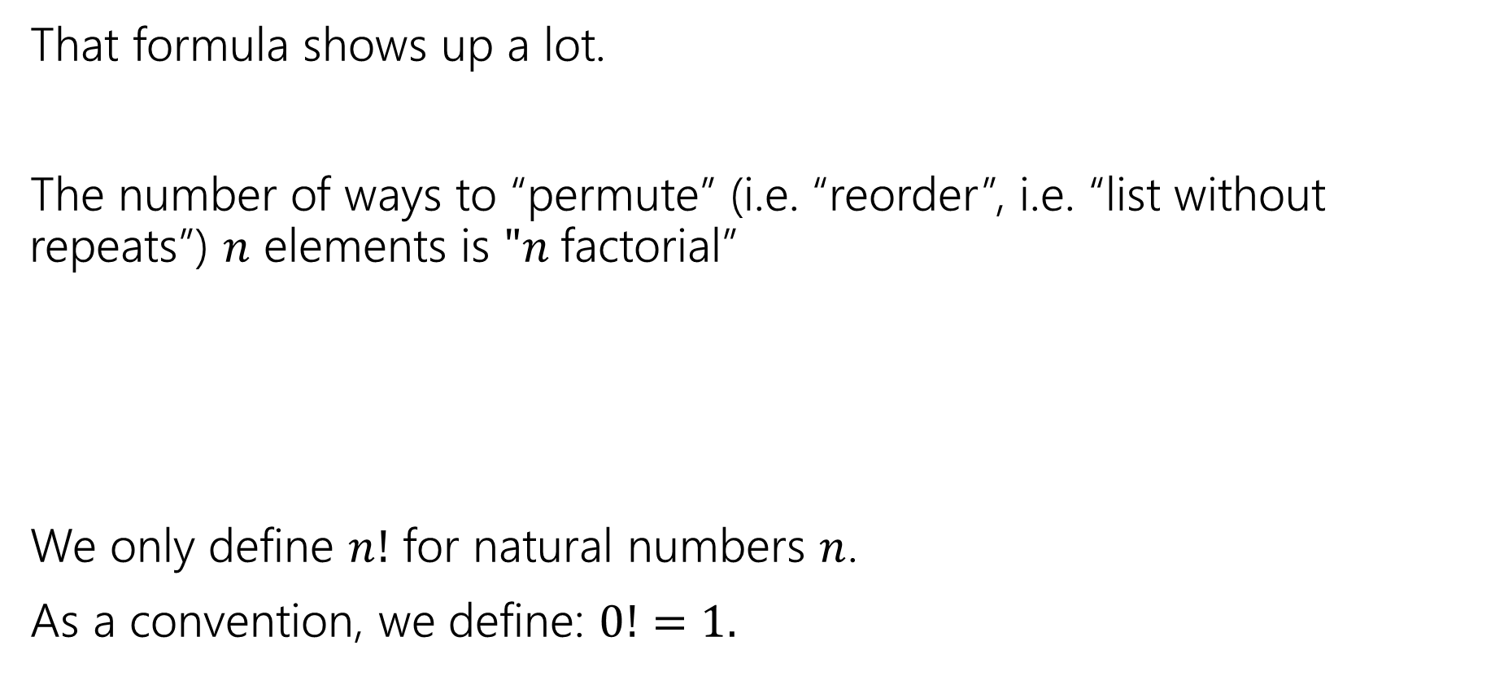

Factorial
That formula shows up a lot.
The number of ways to “permute” (i.e. “reorder”, i.e. “list without repeats”) $n$ elements is $"n$factorial”
We only define $n!$ for natural numbers $n$.
As a convention, we define: $0!=1.$
$$n!=n⋅\left(n−1\right)⋅\left(n−2\right)⋯1$$
$n$ factorial

Slide 35
More Practice

Slide 36

Strings
How many strings of length $5$ are there over the alphabet $\{A,B,C,…,Z\}$? (repeated characters allowed)
How many binary strings of length $n$ are there?

Slide 37

Strings
How many strings of length $5$ are there over the alphabet $\{A,B,C,…,Z\}$? (repeated characters allowed)
${26}^{5}$
How many binary strings of length $n$ are there?
$2^{n}$

