Slide 1
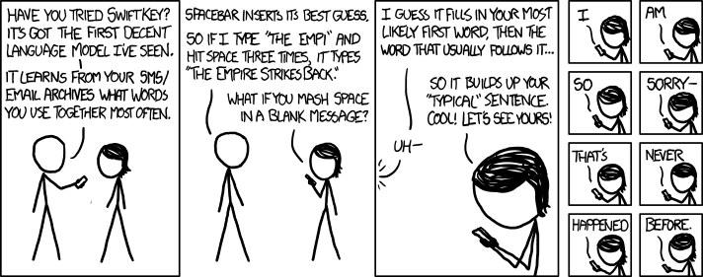
Markov Chains
CSE 312 26Su
Lecture 23
https://xkcd.com/1068/
Slides adapted from Shreya Jayaraman
Notes:
Adapted from Robbie’s 25wi adaptation of Tessaro / Rao
And Shreya
Announcements:
Pset 7 due tonight
Late deadline is Wednesday
Final is Thursday + Friday

Slide 2

So far: “one-shot” processes
Outcome
Distribution $D$
Random
Process →
Notes:
We have spent a lot of time looking at probabilities for “single-shot” experiments

Slide 3

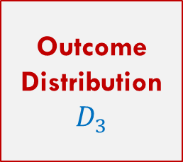

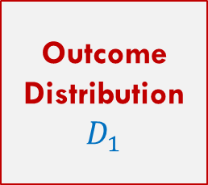
So far: “one-shot” processes
Outcome
Distribution $D$
Random
Process →
More generally: randomness can enter over many steps and depend on previous outcomes
Outcome
Distribution $D_{1}$
Outcome
Distribution $D_{2}$
Outcome
Distribution $D_{3}$
Random
Process 1 →
Random
Process 2→
Random
Process 3 →
$$⋯$$

Slide 4
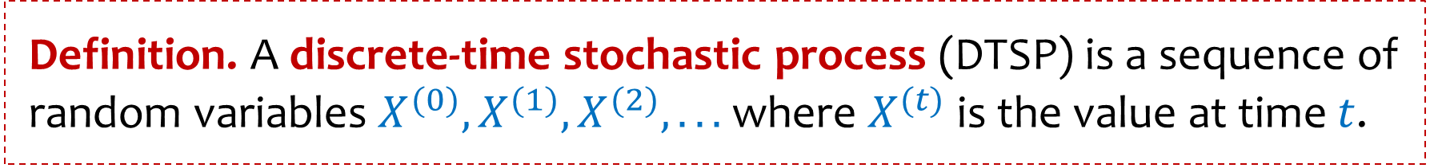
Stochastic processes
Definition. A discrete-time stochastic process (DTSP) is a sequence of random variables $X^{(0)}, {X^{(1)},X}^{(2)}, . . .$where $X^{(t)}$ is the value at time $t$.
Today:
A very special type of DTSP called Markov Chains

Slide 5

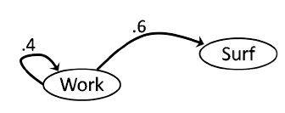
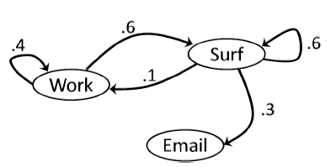
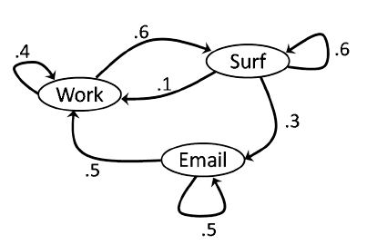
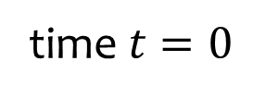
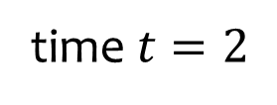
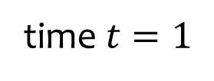
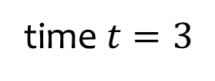
A typical day in my life
time $t=0$
time $t=1$
time $t=2$
time $t=3$

Slide 6
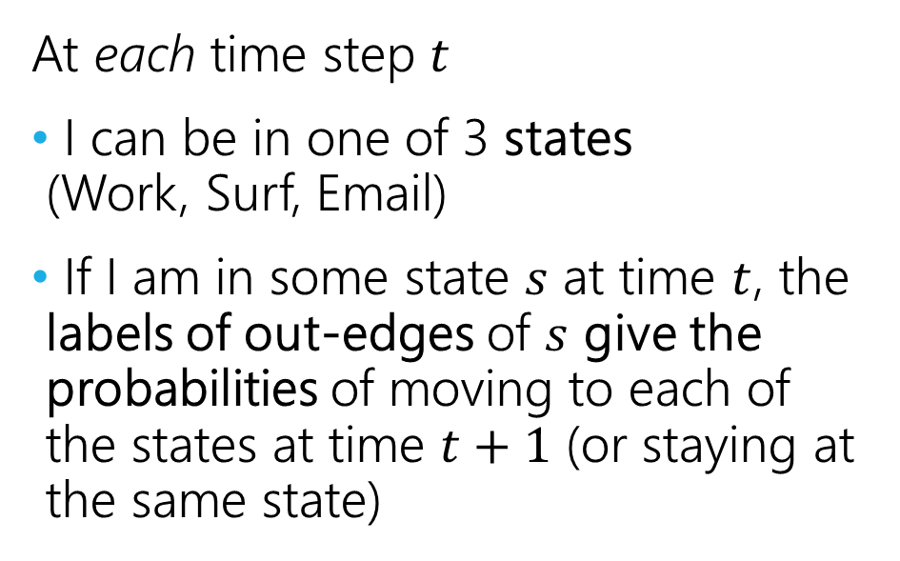
Our first Markov Chain
At each time step $t$
I can be in one of 3 states
(Work, Surf, Email)
If I am in some state $s$ at time $t$, the labels of out-edges of $s$ give the probabilities of moving to each of the states at time $t+1$ (or staying at the same state)

Slide 7
Hey! That looks familiar to me!
Yes, Markov chains are a special kind of probabilistic (finite) automation.
They look like Deterministic Finite Automata (DFAs) from 311, except…
No input symbols on the edges (input is “tick of the clock”)
Out edges are labeled with probabilities.
No start state or accept states.
But like DFAs, the only thing they remember about the past is the state they are currently in.

Slide 8
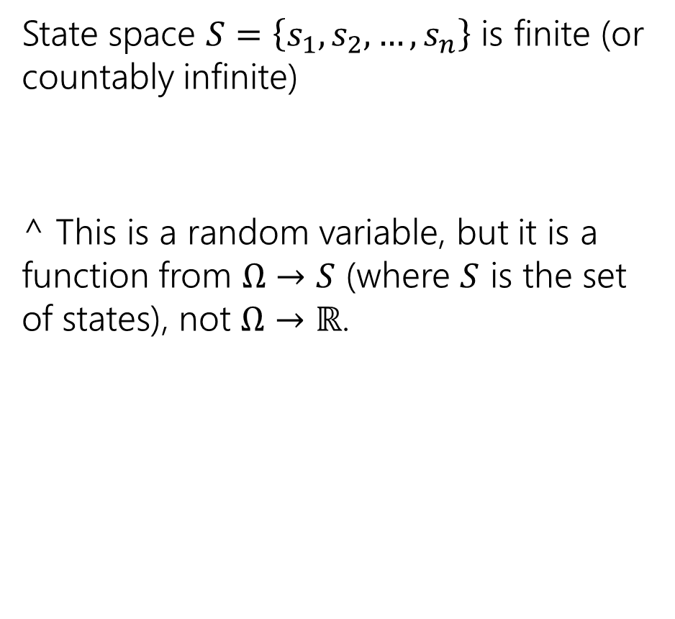
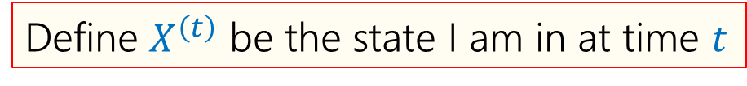
State Space
State space $S=\left\{s_{1},s_{2},…, s_{n}\right\}$ is finite (or countably infinite)
^ This is a random variable, but it is a function from $Ω→S$ (where $S$ is the set of states), not $Ω→ℝ$.
Define $X^{\left(t\right)}$ be the state I am in at time $t$

Slide 9

Markov Property
The future is conditionally independent of the past, given the present.
$$ℙ\left(X_{t+1}=x_{t+1}\right|X_{0}=x_{0}, …, X_{t}=x_{t})=ℙ(X_{t+1}=x_{t+1}\left|X_{t}=x_{t}\right)$$

Slide 10

Stationary Transition Probabilities
We always transition from state $s_{i}$ to $s_{j}$ with probability independent of the current time.
The number of transition probabilities is the number of ways to move from one state to another: $n^{2}$.

Slide 11
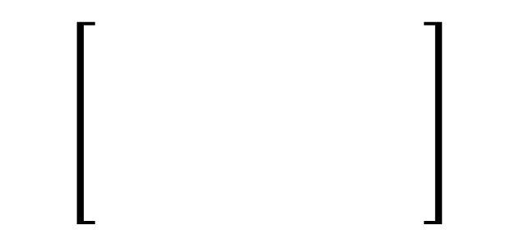

Transition Probability Matrix (TPM)
A TPM is a matrix that contains information about the probability of transitioning between states.
$M_{i,j}=ℙ(X_{t+1}=s_{j}|X_{t}=s_{i})$(i.e., row $i$ column $j$) is probability of transitioning from $i$ to $j$ (assuming you are currently at $i$)
Note that each row sums to 1 (it’s a distribution!)
Col = next state
Row = current state

Slide 12


Transition Probability Matrix (TPM)
$M_{i,j}=ℙ(X_{t+1}=s_{j}|X_{t}=s_{i})$(i.e., row $i$ column $j$) is probability of transitioning from $i$ to $j$ (assuming you are currently at $i$)
Note that each row sums to 1 (it’s a distribution!)

Slide 13

Transition Probability Matrix (TPM)
A TPM is a matrix that contains information about the probability of transitioning between states.
$M_{i,j}=ℙ(X_{t+1}=s_{j}|X_{t}=s_{i})$(i.e., row $i$ column $j$) is probability of transitioning from $i$ to $j$ (assuming you are currently at $i$)
Note that each row sums to 1 (it’s a distribution!)
Col = next state
$$\left[\begin{matrix}0.4 & 0.6 & 0 \\ 0.1 & 0.6 & 0.3 \\ 0.5 & 0 & 0.5\end{matrix}\right]$$
Row = current state

Slide 14
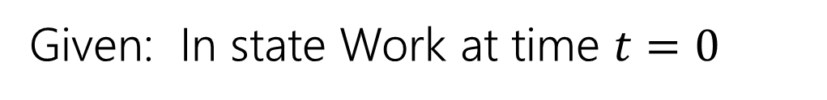
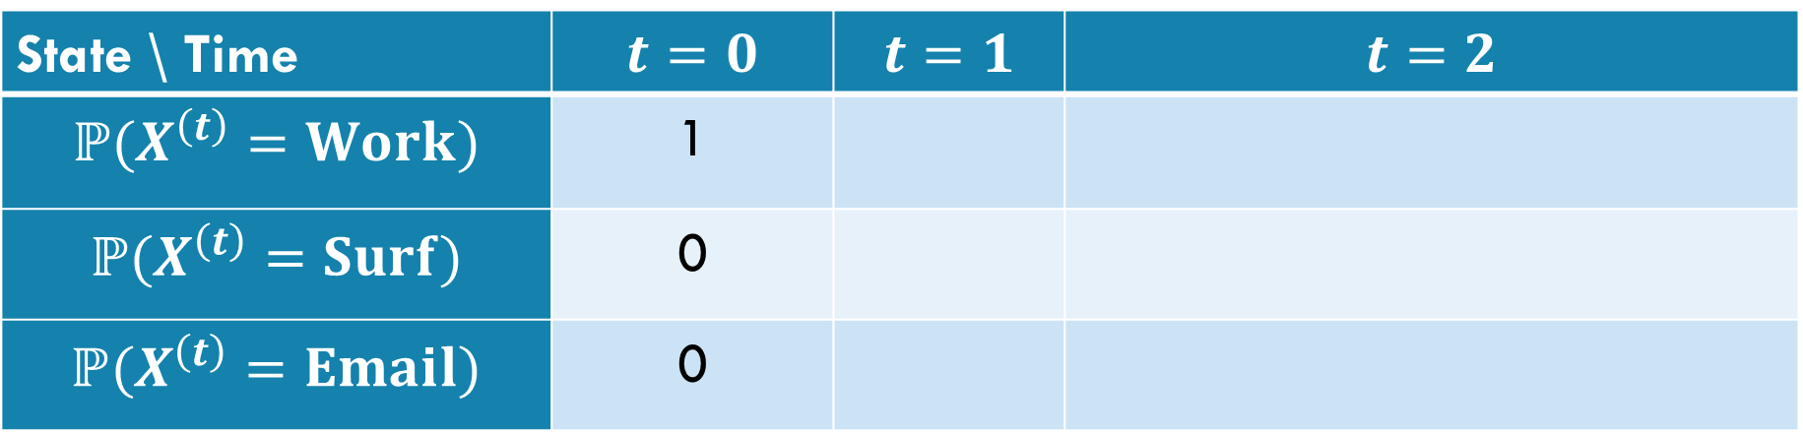
Extending the time…
What is the probability that I am in state $s$ at time $1$?
Given: In state Work at time $t=0$
State \ Time | $$t=0$$ | $$t=1$$ | $$t=2$$
$$ℙ(X^{\left(t\right)}=Work)$$ | 1
$$ℙ(X^{\left(t\right)}=Surf)$$ | 0
$$ℙ(X^{\left(t\right)}=Email)$$ | 0

Slide 15
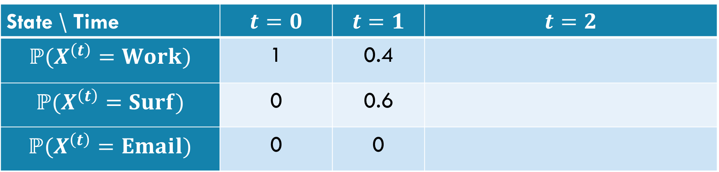
Extending the time…
What is the probability that I am in state $s$ at time $1$?
Given: In state Work at time $t=0$
State \ Time | $$t=0$$ | $$t=1$$ | $$t=2$$
$$ℙ(X^{\left(t\right)}=Work)$$ | 1 | 0.4
$$ℙ(X^{\left(t\right)}=Surf)$$ | 0 | 0.6
$$ℙ(X^{\left(t\right)}=Email)$$ | 0 | 0
Notes:
LTP with X2 given X1

Slide 16
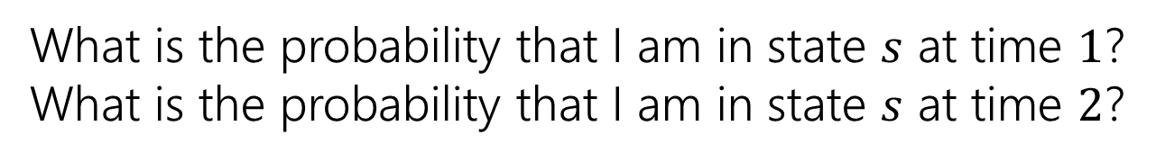
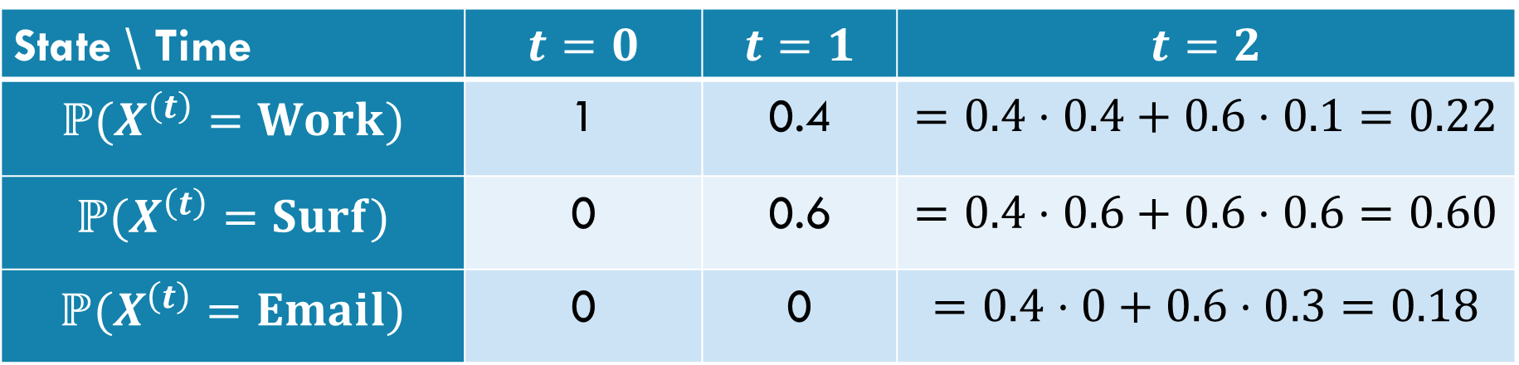
Extending the time…
What is the probability that I am in state $s$ at time $1$?
What is the probability that I am in state $s$ at time $2$?
Given: In state Work at time $t=0$
State \ Time | $$t=0$$ | $$t=1$$ | $$t=2$$
$$ℙ(X^{\left(t\right)}=Work)$$ | 1 | 0.4 | $$=0.4⋅0.4+0.6⋅0.1=0.22$$
$$ℙ(X^{\left(t\right)}=Surf)$$ | 0 | 0.6 | $$=0.4⋅0.6+0.6⋅0.6=0.60$$
$$ℙ(X^{\left(t\right)}=Email)$$ | 0 | 0 | $$=0.4⋅0+0.6⋅0.3=0.18$$

Slide 17

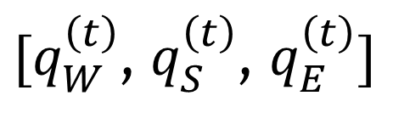
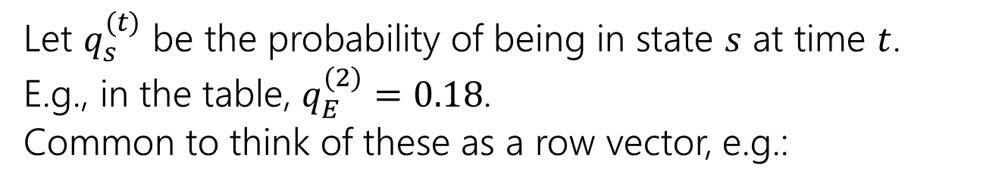
A Linear Algebra Perspective
Let $q_{s}^{(t)}$ be the probability of being in state $s$ at time $t$.
E.g., in the table, $q_{E}^{(2)}=0.18$.
Common to think of these as a row vector, e.g.:
$[q_{W}^{\left(t\right)}$, $q_{S}^{\left(t\right)}$, $q_{E}^{\left(t\right)}]$
State \ Time | $$t=0$$ | $$t=1$$ | $$t=2$$
$$ℙ(X^{\left(t\right)}=Work)$$ | 1 | 0.4 | $$=0.4⋅0.4+0.6⋅0.1=0.22$$
$$ℙ(X^{\left(t\right)}=Surf)$$ | 0 | 0.6 | $$=0.4⋅0.6+0.6⋅0.6=0.60$$
$$ℙ(X^{\left(t\right)}=Email)$$ | 0 | 0 | $$=0.4⋅0+0.6⋅0.3=0.18$$
Notes:
Row vector is [ 1 0 0 ] at t=0
Row vector is [0.4 0.6 0] at t=1

Slide 18
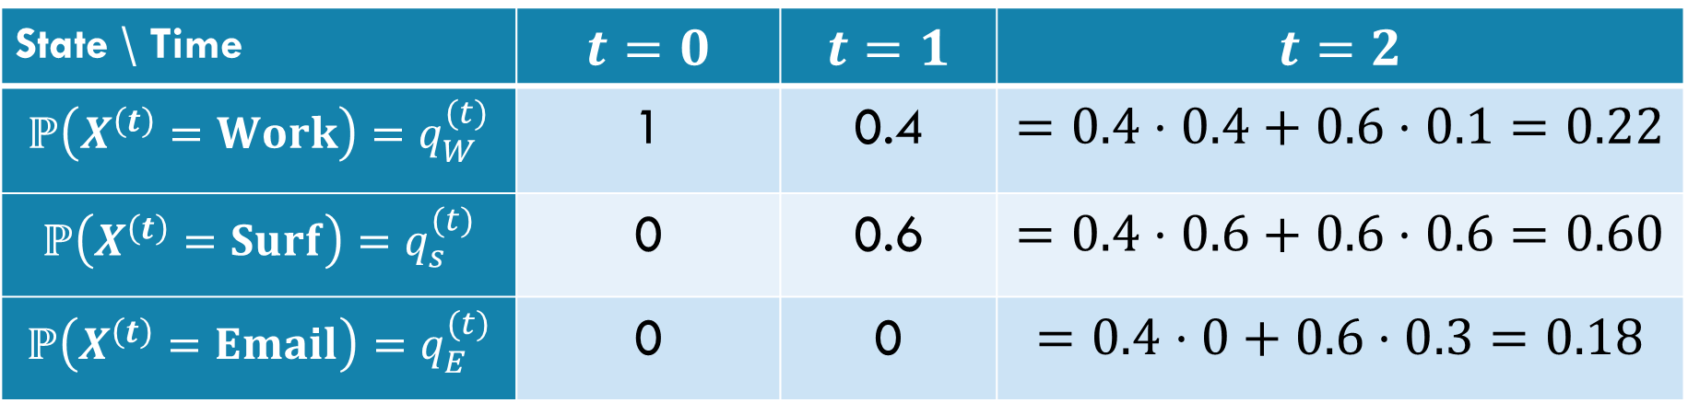
A Linear Algebra Perspective
Let $q_{s}^{(t)}$ be the probability of being in state $s$ at time $t$.
E.g., in the table, $q_{E}^{(2)}=0.18$.
Common to think of these as a row vector, e.g.:
$[q_{W}^{\left(t\right)}$, $q_{S}^{\left(t\right)}$, $q_{E}^{\left(t\right)}]$
State \ Time | $$t=0$$ | $$t=1$$ | $$t=2$$
$$ℙ\left(X^{\left(t\right)}=Work\right)=q_{W}^{(t)}$$ | 1 | 0.4 | $$=0.4⋅0.4+0.6⋅0.1=0.22$$
$$ℙ\left(X^{\left(t\right)}=Surf\right)=q_{s}^{(t)}$$ | 0 | 0.6 | $$=0.4⋅0.6+0.6⋅0.6=0.60$$
$$ℙ\left(X^{\left(t\right)}=Email\right)=q_{E}^{(t)}$$ | 0 | 0 | $$=0.4⋅0+0.6⋅0.3=0.18$$
Notes:
Row vector is [ 1 0 0 ] at t=0
Row vector is [0.4 0.6 0] at t=1

Slide 19
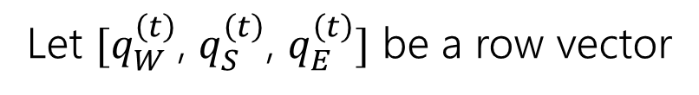
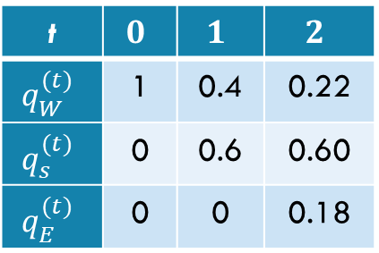
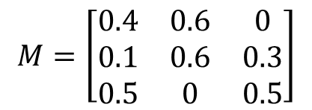
A Linear Algebra Perspective
$$M=\left[\begin{matrix}0.4 & 0.6 & 0 \\ 0.1 & 0.6 & 0.3 \\ 0.5 & 0 & 0.5\end{matrix}\right]$$
Let $[q_{W}^{\left(t\right)}$, $q_{S}^{\left(t\right)}$, $q_{E}^{\left(t\right)}]$ be a row vector
t | $$0$$ | $$1$$ | $$2$$
$$q_{W}^{(t)}$$ | 1 | 0.4 | 0.22
$$q_{s}^{(t)}$$ | 0 | 0.6 | 0.60
$$q_{E}^{(t)}$$ | 0 | 0 | 0.18
Notes:
Row vector is [ 1 0 0 ] at t=0
Row vector is [0.4 0.6 0] at t=1

Slide 20
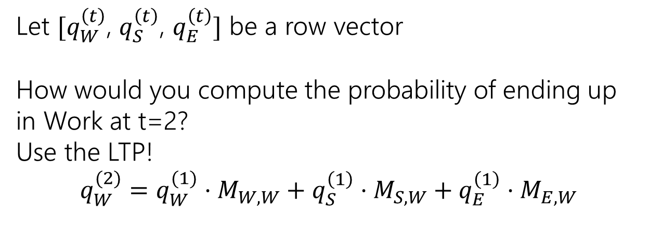
A Linear Algebra Perspective
$$M=\left[\begin{matrix}0.4 & 0.6 & 0 \\ 0.1 & 0.6 & 0.3 \\ 0.5 & 0 & 0.5\end{matrix}\right]$$
Let $[q_{W}^{\left(t\right)}$, $q_{S}^{\left(t\right)}$, $q_{E}^{\left(t\right)}]$ be a row vector
How would you compute the probability of ending up in Work at t=2?
Use the LTP!
$$q_{W}^{(2)}=q_{W}^{(1)}⋅M_{W,W}+q_{S}^{\left(1\right)}⋅M_{S,W}+q_{E}^{\left(1\right)}⋅M_{E,W}$$
t | $$0$$ | $$1$$ | $$2$$
$$q_{W}^{(t)}$$ | 1 | 0.4 | 0.22
$$q_{s}^{(t)}$$ | 0 | 0.6 | 0.60
$$q_{E}^{(t)}$$ | 0 | 0 | 0.18
Notes:
Row vector is [ 1 0 0 ] at t=0
Row vector is [0.4 0.6 0] at t=1

Slide 21
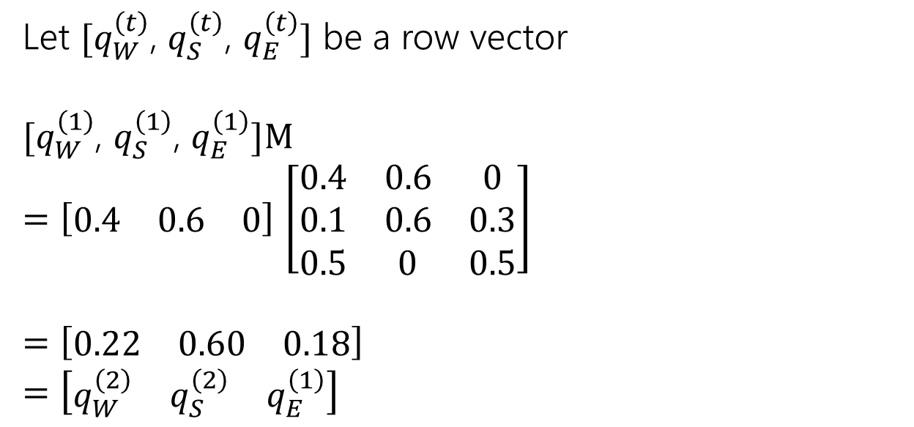
A Linear Algebra Perspective
$$M=\left[\begin{matrix}0.4 & 0.6 & 0 \\ 0.1 & 0.6 & 0.3 \\ 0.5 & 0 & 0.5\end{matrix}\right]$$
Let $[q_{W}^{\left(t\right)}$, $q_{S}^{\left(t\right)}$, $q_{E}^{\left(t\right)}]$ be a row vector
$[q_{W}^{\left(1\right)}$, $q_{S}^{\left(1\right)}$, $q_{E}^{\left(1\right)}]M$
$=\left[\begin{matrix}0.4 & 0.6 & 0\end{matrix}\right]$ $\left[\begin{matrix}0.4 & 0.6 & 0 \\ 0.1 & 0.6 & 0.3 \\ 0.5 & 0 & 0.5\end{matrix}\right]$
$=\left[\begin{matrix}0.22 & 0.60 & 0.18\end{matrix}\right]$
$=\left[\begin{matrix}q_{W}^{\left(2\right)} & q_{S}^{\left(2\right)} & q_{E}^{\left(1\right)}\end{matrix}\right]$
t | $$0$$ | $$1$$ | $$2$$
$$q_{W}^{(t)}$$ | 1 | 0.4 | 0.22
$$q_{s}^{(t)}$$ | 0 | 0.6 | 0.60
$$q_{E}^{(t)}$$ | 0 | 0 | 0.18
Notes:
Row vector is [ 1 0 0 ] at t=0
Row vector is [0.4 0.6 0] at t=1

Slide 22
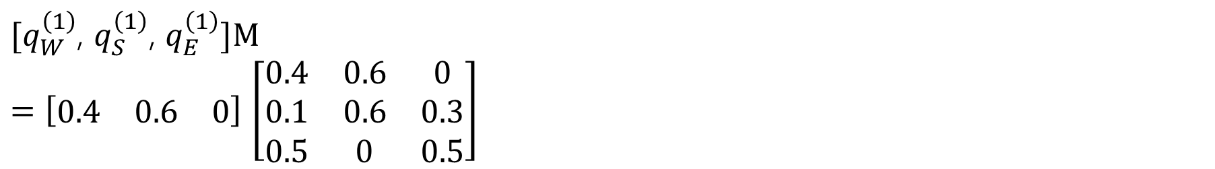
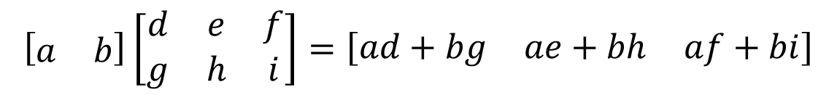
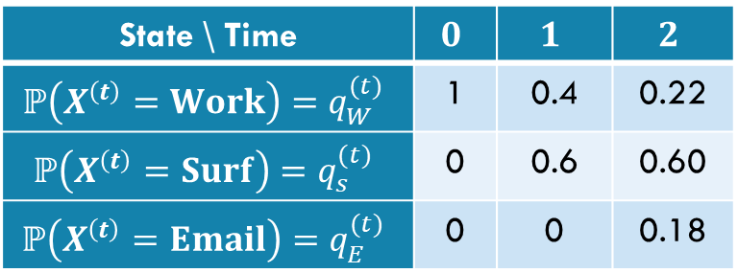
A Linear Algebra Perspective
$$M=\left[\begin{matrix}0.4 & 0.6 & 0 \\ 0.1 & 0.6 & 0.3 \\ 0.5 & 0 & 0.5\end{matrix}\right]$$
Let $[q_{W}^{\left(t\right)}$, $q_{S}^{\left(t\right)}$, $q_{E}^{\left(t\right)}]$ be a row vector
$[q_{W}^{\left(1\right)}$, $q_{S}^{\left(1\right)}$, $q_{E}^{\left(1\right)}]M$
$=\left[\begin{matrix}0.4 & 0.6 & 0\end{matrix}\right]$ $\left[\begin{matrix}0.4 & 0.6 & 0 \\ 0.1 & 0.6 & 0.3 \\ 0.5 & 0 & 0.5\end{matrix}\right]$
State \ Time | $$0$$ | $$1$$ | $$2$$
$$ℙ\left(X^{\left(t\right)}=Work\right)=q_{W}^{(t)}$$ | 1 | 0.4 | 0.22
$$ℙ\left(X^{\left(t\right)}=Surf\right)=q_{s}^{(t)}$$ | 0 | 0.6 | 0.60
$$ℙ\left(X^{\left(t\right)}=Email\right)=q_{E}^{(t)}$$ | 0 | 0 | 0.18
$$\left[\begin{matrix}a & b\end{matrix}\right]\left[\begin{matrix}d & e & f \\ g & h & i\end{matrix}\right]=\left[\begin{matrix}ad+bg & ae+bh & af+bi\end{matrix}\right]$$
Notes:
Row vector is [ 1 0 0 ] at t=0
Row vector is [0.4 0.6 0] at t=1

Slide 23
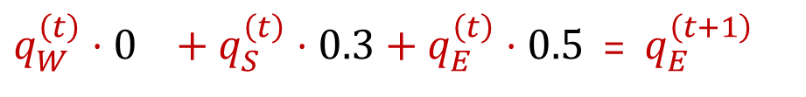
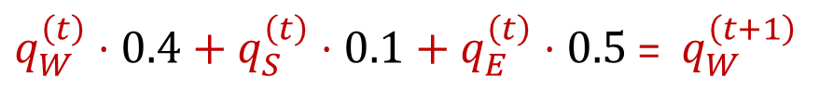
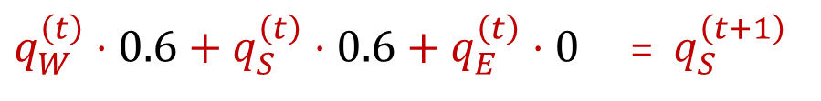
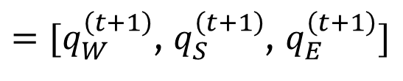
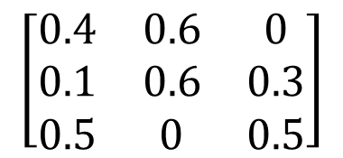
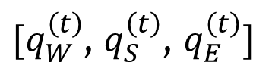

General Vector-Matrix Multiplication
That Vector-Matrix multiplication representation works for any step.
$$M$$
$[q_{W}^{\left(t\right)}$, $q_{S}^{\left(t\right)}$, $q_{E}^{\left(t\right)}]$
$$\left[\begin{matrix}0.4 & 0.6 & 0 \\ 0.1 & 0.6 & 0.3 \\ 0.5 & 0 & 0.5\end{matrix}\right]$$
$=[q_{W}^{\left(t+1\right)}$, $q_{S}^{\left(t+1\right)}$, $q_{E}^{\left(t+1\right)}]$
$q_{W}^{\left(t\right)}⋅0.4+q_{S}^{\left(t\right)}⋅0.1+q_{E}^{\left(t\right)}⋅0.5$ =${ q}_{W}^{\left(t+1\right)}$
Vector-matrix multiplication
$q_{W}^{\left(t\right)}⋅0.6+q_{S}^{\left(t\right)}⋅0.6+q_{E}^{\left(t\right)}⋅0$ =${ q}_{S}^{\left(t+1\right)}$
$q_{W}^{\left(t\right)}⋅0 +q_{S}^{\left(t\right)}⋅0.3+q_{E}^{\left(t\right)}⋅0.5$ =${ q}_{E}^{\left(t+1\right)}$

Slide 24
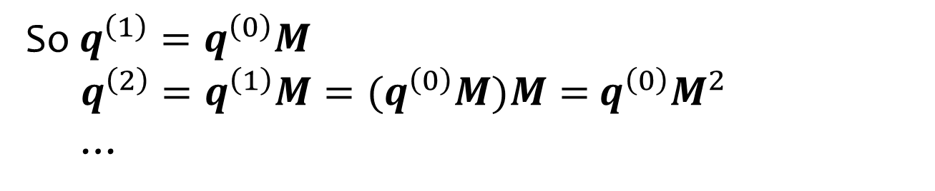
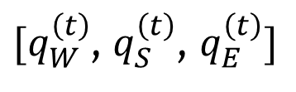
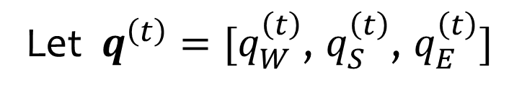
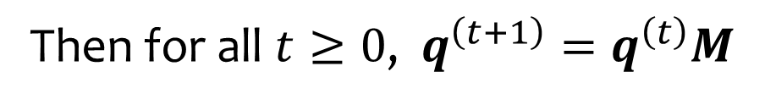

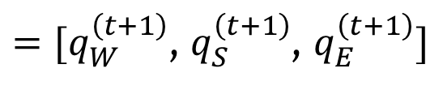
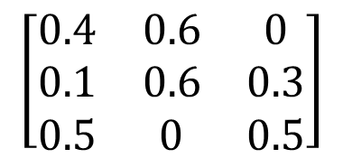
A little bit of induction
$$M$$
$[q_{W}^{\left(t\right)}$, $q_{S}^{\left(t\right)}$, $q_{E}^{\left(t\right)}]$
$$\left[\begin{matrix}0.4 & 0.6 & 0 \\ 0.1 & 0.6 & 0.3 \\ 0.5 & 0 & 0.5\end{matrix}\right]$$
$=[q_{W}^{\left(t+1\right)}$, $q_{S}^{\left(t+1\right)}$, $q_{E}^{\left(t+1\right)}]$
Let $q^{\left(t\right)}=[q_{W}^{\left(t\right)}\text{,} q_{S}^{\left(t\right)}\text{,} q_{E}^{\left(t\right)}]$
Then for all $t≥0$, $q^{\left(t+1\right)}=q^{\left(t\right)}M$
So $q^{\left(1\right)}=q^{\left(0\right)}M$
$q^{\left(2\right)}=q^{\left(1\right)}M={(q}^{\left(0\right)}M)M=$ $q^{\left(0\right)}M^{2}$
…

Slide 25
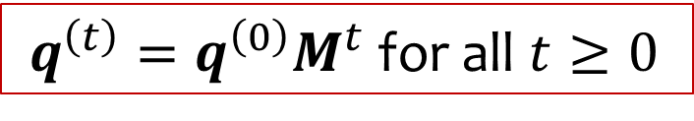
A little bit of induction
$$M$$
$[q_{W}^{\left(t\right)}$, $q_{S}^{\left(t\right)}$, $q_{E}^{\left(t\right)}]$
$$\left[\begin{matrix}0.4 & 0.6 & 0 \\ 0.1 & 0.6 & 0.3 \\ 0.5 & 0 & 0.5\end{matrix}\right]$$
$=[q_{W}^{\left(t+1\right)}$, $q_{S}^{\left(t+1\right)}$, $q_{E}^{\left(t+1\right)}]$
Let $q^{\left(t\right)}=[q_{W}^{\left(t\right)}\text{,} q_{S}^{\left(t\right)}\text{,} q_{E}^{\left(t\right)}]$
Then for all $t≥0$, $q^{\left(t+1\right)}=q^{\left(t\right)}M$
So $q^{\left(1\right)}=q^{\left(0\right)}M$
$q^{\left(2\right)}=q^{\left(1\right)}M={(q}^{\left(0\right)}M)M=$ $q^{\left(0\right)}M^{2}$
…
$q^{\left(t\right)}=q^{\left(0\right)}M^{t}$ for all $t≥0$

Slide 26
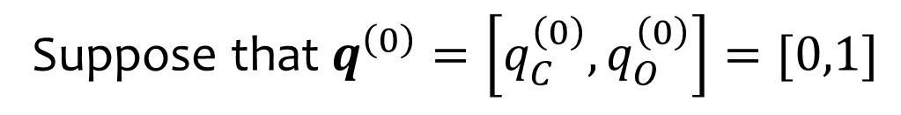


Another example:
0.7
0.5
Suppose that $q^{\left(0\right)}=\left[q_{C}^{\left(0\right)},q_{O}^{\left(0\right)}\right]=[0,1]$
0.3
Clear
Overcast
We have $M=\left[\begin{matrix}0.7 & 0.3 \\ 0.5 & 0.5\end{matrix}\right]$
0.5
What is $q^{\left(2\right)}$ ?
$\left[0.3, 0.7\right]$
$\left[0.6, 0.4\right]$
$\left[0.7, 0.3\right]$
$\left[0.5, 0.5\right]$
$\left[0.4, 0.6\right]$
Notes:
Option d

Slide 27



Markov Chain Questions
What is the probability that I am in state $s$ at time $1$?
What is the probability that I am in state $s$ at time $2$?
What is the probability that I am in state $s$ at some time $t$ far in the future?
$q^{\left(t\right)}=q^{\left(0\right)}M^{t}$ for all $t≥0$
What does $M^{t}$ look like for really big $t$ ?

Slide 28















$M^{t}$ as $t$ grows
$q^{\left(t\right)}=q^{\left(0\right)}M^{t}$ for all $t≥0$
$$M$$
$$M^{2}$$
$$M^{3}$$
$$\left[\begin{matrix}0.4 & 0.6 & 0 \\ 0.1 & 0.6 & 0.3 \\ 0.5 & 0 & 0.5\end{matrix}\right]$$
$$M^{10}$$
$$M^{30}$$
$$M^{60}$$
What does this say about $q^{\left(t\right)}$?

Slide 29


What does this say about $q^{\left(t\right)}=q^{\left(0\right)}M^{t}$ ?
Note that no matter what probability distribution $q^{\left(0\right)}$ is … ${q^{\left(0\right)}M}^{t}$ is just a weighted average of the rows of $M^{t}$
If every row of $M^{t}$ were exactly the same …that would mean that ${q^{\left(0\right)}M}^{t}$ would be equal to the common row
  So $q^{\left(t\right)}$ wouldn’t depend on $q^{\left(0\right)}$
The rows aren’t exactly the same, but they are very close
  So $q^{\left(t\right)}$ barely depends on $q^{\left(0\right)}$ after very few steps

Slide 30

Observation
If $q^{(t+1)}$ = $q^{(t)}$ then it will never change again!
Called a stationary distribution and has a special symbol
$π$ = ($π_{W}, π_{S},π_{E}$)
Solution to $π = π M$
Typically happens after a “long time” (mixing time)

Slide 31



Solving for Stationary Distribution
$M=\left(\begin{matrix}.4 & .6 & 0 \\ .1 & .6 & .3 \\ .5 & 0 & .5\end{matrix}\right)$
Stationary Distribution satisfies
$π = πM$, where $π$ = ($π_{W}, π_{S},π_{E})$
$π_{W}+π_{S}+π_{E}=1$
$π_{W}=\frac{10}{34},{ π}_{S}=\frac{15}{34},{ π}_{E}=\frac{9}{34}$
As $t→∞, q^{(t)}→π$ no matter what distribution $q^{\left(0\right)}$is !!

Slide 32

Markov Chains in general
A set of $n$ states $S=\left\{s_{1},s_{2},…, s_{n}\right\}$
The state at time $t$ is denoted by $X^{(t)}$
A $n×n$ transition matrix $M$, with $Mij=P⁡\left(X^{\left(t+1\right)}=j \right| X^{(t) }=i)$
$q^{(t)}=(q_{1}^{\left(t\right)}\text{,}{ q}_{2}^{\left(t\right)}\text{,}…,q_{n}^{\left(t\right)}\text{)}$ where ${ q}_{i}^{\left(t\right)}$= ${P(X}^{(t) }=i)$
Transition: LTP ⇒ $q^{(t+1)}=q^{(t)} M$ so $q^{(t)}=q^{(0)} M^{t}$
A stationary distribution $π$ is the solution to:
$π = π M$, normalized so that $Σ_{i∈[n]}πi$ $=1$

Slide 33

The Fundamental Theorem of Markov Chains
Every Markov chain that is irreducible and aperiodic has a unique stationary distribution $π$.
Moreover, as $t→∞:$ for all $i,j:{\left(M_{ij}\right)}^{t}=π_{j}$
The Fundamental Theorem of Markov Chains
Details of “irreducible” and “aperiodic” are beyond our scope; but suffice it to say that practically relevant Markov chains usually meet both these conditions (or can be rearranged to meet them).
Notes:
If you’re curious:
Aperiodic intuitively means you’re not forced into some sort of cycling behavior (e.g., it’s not just a simple cycle or bipartite or something like that)
Irreducible means you’ll never say “you can’t get there from here” (graph is strongly connected).
But those are rough intuition, not the formal definitions. Get a textbook for the formal statement.
Stationary distribution (π): A distribution that does not change when multiplied by the transition matrix (π = π P
Limiting distribution: The actual limit of the n-step transition probabilities as n → ∞ (\(\lim_{n \to \infty} P^{(n)}\
Ergodic chain: If a chain is irreducible (all states connect) and aperiodic (no stuck cycles), a unique limiting distribution always exists and equals the stationary distribution
Periodic chains: If a chain has fixed repeating cycles (like alternating back and forth), the limit of \(P^{(n)}\) may not exist in the traditional sense, but the stationary distribution still tells you the long-run average time spent in each state
The main difference is that a stationary distribution is an equilibrium state that stays constant once reached, while a limiting distribution is the long-run destination the system approaches regardless of its starting state.
Every limiting distribution is stationary, but not every stationary distribution is a limiting distribution.
Limiting requires convergence, from any state
Stationary could exist for only some starting states

Slide 34
Example: Random Walks
2
Suppose we start at node 1, and at each step
transition to a neighboring node with equal
probability.
This is called a “random walk” on this graph.
1
4
3
5

Slide 35



Example: Random Walks on an Undirected Graph
Start by defining transition probs.
To 1
To 2
To 3
To 4
To 5
1
2
From 1
$$\left[\begin{matrix}\begin{matrix}0 \\ 1/2 \\ \begin{matrix}1/2 \\ 0 \\ 0\end{matrix}\end{matrix} & \begin{matrix}1/2 \\ 0 \\ \begin{matrix}0 \\ 1/3 \\ 0\end{matrix}\end{matrix} & \begin{matrix}\begin{matrix}1/2 \\ 0 \\ \begin{matrix}0 \\ 1/3 \\ 0\end{matrix}\end{matrix} & \begin{matrix}0 \\ 1/2 \\ \begin{matrix}1/2 \\ 0 \\ 1\end{matrix}\end{matrix} & \begin{matrix}0 \\ 0 \\ \begin{matrix}0 \\ 1/3 \\ 0\end{matrix}\end{matrix}\end{matrix}\end{matrix}\right]$$
From 2
From 3
4
From 4
From 5
3
5
$$M_{ij}=P\left(X^{\left(t+1\right)}=j | X^{\left(t\right)}=i\right)$$
$$q_{i}^{(t)}=P\left(X^{\left(t\right)}=i\right)={\left(q^{\left(0\right)}M^{t}\right)}_{i}$$

Slide 36
Example: Random Walks on an Undirected Graph
Start by defining transition probs.
To 1
To 2
To 3
To 4
To 5
1
2
From 1
$$\left[\begin{matrix}\begin{matrix}0 \\ 1/2 \\ \begin{matrix}1/2 \\ 0 \\ 0\end{matrix}\end{matrix} & \begin{matrix}1/2 \\ 0 \\ \begin{matrix}0 \\ 1/3 \\ 0\end{matrix}\end{matrix} & \begin{matrix}\begin{matrix}1/2 \\ 0 \\ \begin{matrix}0 \\ 1/3 \\ 0\end{matrix}\end{matrix} & \begin{matrix}0 \\ 1/2 \\ \begin{matrix}1/2 \\ 0 \\ 1\end{matrix}\end{matrix} & \begin{matrix}0 \\ 0 \\ \begin{matrix}0 \\ 1/3 \\ 0\end{matrix}\end{matrix}\end{matrix}\end{matrix}\right]$$
From 2
From 3
4
From 4
From 5
3
5
$$M_{ij}=P\left(X^{\left(t+1\right)}=j | X^{\left(t\right)}=i\right)$$
$$q_{i}^{(t)}=P\left(X^{\left(t\right)}=i\right)={\left(q^{\left(0\right)}M^{t}\right)}_{i}$$

Slide 37
Markov Chain Monte Carlo (MCMC)

Slide 38
Markov Chain Monte Carlo
A modelling technique.
Two common uses:
> Sampling from a (hard) distribution (Bayesian analysis!)
> Approximate solutions to complex optimization problems

Slide 39
Markov Chain Monte Carlo
A modelling technique.
Two common uses:
> Sampling from a (hard) distribution (Bayesian analysis!)
> Approximate solutions to complex optimization problems
Simulate a random walk that moves among possible configurations of a system and will converge to a useful distribution over these configurations

Slide 40

The 0-1 knapsack problem
Given $n$ items with weights $w_{1}, …, w_{n}>0$ and values $v_{1},…, v_{n}>0$
Knapsack with weight limit $W$
Find the most valuable subset of items which satisfy the weight constraint of the knapsack.

Slide 41

The 0-1 knapsack problem
Given $n$ items with weights $w_{1}, …, w_{n}>0$ and values $v_{1},…, v_{n}>0$
Knapsack with weight limit $W$
Find the most valuable subset of items which satisfy the weight constraint of the knapsack.
Item 1: 2lb, $5
Item 2: 4lb, $9
Item 3: 2lb, $10
Limit $W$= 4lb Then best is choosing items 1 and 3

Slide 42

MCMC formalization
Let $x=\left(x_{1},…, x_{n}\right)∈{\left\{0, 1\right\}}^{n}$ represent whether we took item $i$ or not
We want to maximize total value: $\sum_{i=1}^{n}{v_{i}x_{i}}$
With weight constraint: $\sum_{i=1}^{n}{w_{i}x_{i}}≤W$

Slide 43

MCMC formalization
Let $x=\left(x_{1},…, x_{n}\right)∈{\left\{0, 1\right\}}^{n}$ represent whether we took item $i$ or not
We want to maximize total value: $\sum_{i=1}^{n}{v_{i}x_{i}}$
With weight constraint: $\sum_{i=1}^{n}{w_{i}x_{i}}≤W$
Define a Markov chain.
The states are the possible solutions.
How many?
Notes:
2^n

Slide 44

MCMC formalization
Let $x=\left(x_{1},…, x_{n}\right)∈{\left\{0, 1\right\}}^{n}$ represent whether we took item $i$ or not
We want to maximize total value: $\sum_{i=1}^{n}{v_{i}x_{i}}$
With weight constraint: $\sum_{i=1}^{n}{w_{i}x_{i}}≤W$
Define a Markov chain.
The states are the possible solutions.
How many? $2^{n}$
Notes:
2^n

Slide 45

MCMC formalization
Let $x=\left(x_{1},…, x_{n}\right)∈{\left\{0, 1\right\}}^{n}$ represent whether we took item $i$ or not
We want to maximize total value: $\sum_{i=1}^{n}{v_{i}x_{i}}$
With weight constraint: $\sum_{i=1}^{n}{w_{i}x_{i}}≤W$
Define a Markov chain.
The states are the possible solutions.
How many? $2^{n}$
Implicit TPM. Higher probability of a “good” solution
One “good” definition: solutions that satisfy the weight constraint.
Notes:
2^n

Slide 46

Knapsack: Starter Algorithm
Notes:
2^n

Slide 47
MCMC Strategy (for optimization)
Define a Markov chain:
> States = possible solutions
> Implicitly defined TPM (higher probabilities on “good” solutions)
Run MCMC: Simulate Markov Chain for many iterations until we reach a “good” state (transitioning according to the TPM until stationary distribution).
Notes:
2^n

Slide 48

A Better Algorithm
Notes:
2^n

Slide 49
A Better Algorithm
Check multiple “better” features:
Does it satisfy the weight constraint?
Is it a solution of higher value?
Notes:
2^n

Slide 50
A Better Algorithm
Exploitation: Transition to higher total values
Exploration: random transitions occasionally, to avoid local optima
Notes:
2^n

Slide 51
PageRank

Slide 52
PageRank: Some History
The year was 1997
  Bill Clinton in the White House
  Deep Blue beat world chess champion (Kasparov)
The Internet was not like it was today. Finding stuff was hard!
  In Nov 1997, only one of the top 4 search engines found itself when you searched for it.

Slide 53
The Problem
Search engines worked by matching words in your queries to documents.
Not bad in theory, but in practice there are lots of documents that match a query.
  Search for ‘Bill Clinton’, top result is ‘Bill Clinton Joke of the Day’
  Susceptible to spammers and advertisers

Slide 54
The Fix: Ranking Results
Start by doing filtering to relevant documents (with decent textual match).
Then rank the results based on some measure of ‘quality’ or ‘authority’.
Key question: How to define ‘quality’ or ‘authority’?
Enter two groups:
  Jon Kleinberg (professor at Cornell)
  Larry Page and Sergey Brin (Ph.D. students at Stanford)

Slide 55
Both groups had the same brilliant idea
Larry Page and Sergey Brin (Ph.D. students at Stanford)
  Took the idea and founded Google, making billions
Jon Kleinberg (professor at Cornell)
  MacArthur genius prize, Nevanlinna Prize and many other academic honors

Slide 56

PageRank - Idea
Take into account the directed graph structure of the web.
Use hyperlink analysis to compute what pages are high quality or have high authority.
Trust the Internet itself define what is useful via its links.

Slide 57
PageRank – Idea (try 1)
Idea 1 : Think of each link as a citation “vote of quality”
Rank pages by in-degree?

Slide 58
PageRank – Idea 1 doesn’t work
Idea 1 : Think of each link as a citation “vote of quality”
Rank pages by in-degree?
Problems:
Spamming
Some linkers are not discriminating
Not all links created equal

Slide 59
PageRank – Idea (try 2)
Idea 2 : Perhaps we should weight the links somehow and then use the weights of the in-links to rank pages

Slide 60

Inching towards PageRank
Web page has high quality if it’s linked to by lots of high quality pages
That’s a recursive definition!

Slide 61

Inching towards PageRank
(importance)
If web page $x$ has $d$ outgoing links, one of which goes to $y$, this contributes $1/d$ to the importance of $y$
But $1/d$ of what?
  We want to take into account the importance of $x$ too…
…so it actually contributes $1/d$ of the importance of $x$

Slide 62

This gives the following equations
Idea: Use the transition matrix $M$defined by a random walk on the web to compute quality of webpages.
Namely: Find $q$ such that $qM=q$
This is the stationary distribution for the Markov chain defined by a random web surfer
  Starts at some node (webpage) and randomly follows a link to another.
  Use stationary distribution of her surfing patterns after a long time as notion of quality

Slide 63
Issues with PageRank
How to handle dangling nodes (dead ends that don’t link to anything) ?
How to handle Rank sinks – group of pages that only link to each other ?
Both solutions can be solved by “teleportation”

Slide 64

Final PageRank Algorithm
Make a Markov Chain with one state for each webpage on the Internet with the transition probabilities $M_{ij}=\frac{1}{outdeg(i)}$.
Use a modified random walk. At each point in time if the surfer is at some webpage $i$:
  If $i$ has outlinks:
    With probability $p$, take a step to one of the neighbors of $i$ (equally likely)
    With probability $1−p$, “teleport” to a uniformly random page in the whole Internet.
  Otherwise, always “teleport”
Compute stationary distribution $π$ of this perturbed Markov chain.
Define the PageRank of a webpage $i$ as the stationary probability $π_{i}$.
Find all pages with decent textual match to search and then order those pages by PageRank!

Slide 65

PageRank - Example

Slide 66
It Gets More Complicated
While this basic algorithm was the defining idea that launched Google on their path to success, this is far from the end to optimizing search
Nowadays, Google and other web search engines have a LOT more secret sauce to rank pages, most of which they don’t reveal 1) for competitive advantage and 2) to avoid gaming of their algorithms.

Slide 67
A Sample Application of Markov Chains

Slide 68






Computing the Stationary Distribution
$[π_{W}$, $π_{S}$, $π_{E}]$
$$\left[\begin{matrix}0.4 & 0.6 & 0 \\ 0.1 & 0.6 & 0.3 \\ 0.5 & 0 & 0.5\end{matrix}\right]$$
$=[π_{W}$, $π_{S}$, $π_{E}]$
Solve system of equations:
$$0.4⋅π_{W}+0.1⋅π_{S}+0.5⋅π_{E}=π_{W}$$
Stationary Distribution satisfies
$π = πM$, where $π$ = ($π_{W}, π_{S},π_{E})$
$π_{W}+π_{S}+π_{E}=1$
$π_{W}=\frac{10}{34},{ π}_{S}=\frac{15}{34},{ π}_{E}=\frac{9}{34}$
$$0.6⋅π_{W}+0.6⋅π_{S} =π_{S}$$
$$0.3⋅π_{S}+0.5⋅π_{E}={ π}_{E}$$
$$π_{W}+ π_{S}+ π_{E}=1$$
How did we get this?

Slide 69









Computing the Stationary Distribution (math)
$[π_{W}$, $π_{S}$, $π_{E}]$
$$\left[\begin{matrix}0.4 & 0.6 & 0 \\ 0.1 & 0.6 & 0.3 \\ 0.5 & 0 & 0.5\end{matrix}\right]$$
$=[π_{W}$, $π_{S}$, $π_{E}]$
Solve system of equations:
There is an infinite set of solutions ($2π, 3π,\sqrt{2}π,−3π,…$) also satisfy the system you get just from the matrix.
❶
$$0.4⋅π_{W}+0.1⋅π_{S}+0.5⋅π_{E}=π_{W}$$
$$0.6⋅π_{W}+0.6⋅π_{S} =π_{S}$$
$$0.6⋅π_{W}=0.4⋅π_{S}$$
❷
$$0.3⋅π_{S}+0.5⋅π_{E}={ π}_{E}$$
$$0.3⋅π_{S }=0.5⋅π_{E}$$
❸
$$π_{W}+ π_{S}+ π_{E}=1$$
From ❸ we get
$0.1⋅π_{S}+0.5⋅π_{E}=0.4⋅π_{S }$
so ❶ becomes equivalent to ❷

Slide 70





A little more algebra
$[π_{W}$, $π_{S}$, $π_{E}]$
$$\left[\begin{matrix}0.4 & 0.6 & 0 \\ 0.1 & 0.6 & 0.3 \\ 0.5 & 0 & 0.5\end{matrix}\right]$$
$=[π_{W}$, $π_{S}$, $π_{E}]$
Solve system of equations:
Choose the simplest ones to work with
$$0.4⋅π_{W}+0.1⋅π_{S}+0.5⋅π_{E}=π_{W}$$
$$0.6⋅π_{W}+0.6⋅π_{S} =π_{S}$$
$$0.6⋅π_{W}=0.4⋅π_{S}$$
$$π_{W}=(2/3){ π}_{S}$$
$$0.3⋅π_{S}+0.5⋅π_{E}={ π}_{E}$$
$$0.3⋅π_{S }=0.5⋅π_{E}$$
$$(3/5)⋅π_{S }=π_{E}$$
$$π_{W}+ π_{S}+ π_{E}=1$$
$$(2/3){ π}_{S}+ π_{S}+(3/5)⋅π_{S }=1$$
But more equations than unknowns ???
$$((10+15+9)/15)⋅{ π}_{S} =1$$
$${ π}_{S} =15/34$$

Slide 71

Another stationary distribution example
1
2
1
$$M=\left[\begin{matrix}0 & 1 & 0 \\ 0 & 0 & 1 \\ 1 & 0 & 0\end{matrix}\right]$$
1
1
3
The stationary distribution for this Markov Chain …
is [1/3,1/6,1/2]
is [1/2,1/2,1/2]
is [1/2,1/4,1/4]
is [1/3,1/3,1/3]
doesn’t exist

Slide 72


Another stationary distribution example (answer)
1
2
1
$$M=\left[\begin{matrix}0 & 1 & 0 \\ 0 & 0 & 1 \\ 1 & 0 & 0\end{matrix}\right]$$
1
1
3
$$q_{1}=0q_{1}+0q_{2}+q_{3}$$
$$q_{2}=q_{1}+0q_{2}+0q_{3}$$
$$q_{3}=0q_{1}+q_{2}+0q_{3}$$
$$q_{1}+q_{2}+q_{3}=1$$
All equal and sum to 1?
$$π=\left[\frac{1}{3},\frac{1}{3},\frac{1}{3}\right]$$

Slide 73


Why doesn’t it converge?
1
Every Markov chain that is irreducible and aperiodic has a unique stationary distribution $π$.
Moreover, as $t→∞:$ for all $i,j:{\left(M_{ij}\right)}^{t}=π_{j}$
2
The Fundamental Theorem of Markov Chains
1
1
1
3
Having a stationary distribution does not mean we converge to it
For convergence, all conditions in the Fundamental Theorem need to be satisfied
This Markov Chain that is periodic and does not converge
If $X^{\left(0\right)}=1$ then the sequence of states $X^{\left(0\right)},X^{\left(1\right)},X^{\left(2\right)},…$ is always
$$1,2,3,1,2,3,1,2,3,1,2,3,1,2,3,1,2,3,…$$

Slide 74
Another Example: Random Walks
2
Suppose we start at node 1, and at each step
transition to a neighboring node with equal
probability.
This is called a “random walk” on this graph.
1
4
3
5

Slide 75
Example: Random Walks on an Undirected Graph
Start by defining transition probs.
To 1
To 2
To 3
To 4
To 5
1
2
From 1
$$\left[\begin{matrix}\begin{matrix}0 \\ 1/2 \\ \begin{matrix}1/2 \\ 0 \\ 0\end{matrix}\end{matrix} & \begin{matrix}1/2 \\ 0 \\ \begin{matrix}0 \\ 1/3 \\ 0\end{matrix}\end{matrix} & \begin{matrix}\begin{matrix}1/2 \\ 0 \\ \begin{matrix}0 \\ 1/3 \\ 0\end{matrix}\end{matrix} & \begin{matrix}0 \\ 1/2 \\ \begin{matrix}1/2 \\ 0 \\ 1\end{matrix}\end{matrix} & \begin{matrix}0 \\ 0 \\ \begin{matrix}0 \\ 1/3 \\ 0\end{matrix}\end{matrix}\end{matrix}\end{matrix}\right]$$
From 2
From 3
4
From 4
From 5
3
5
$$M_{ij}=P\left(X^{\left(t+1\right)}=j | X^{\left(t\right)}=i\right)$$
$$q_{i}^{(t)}=P\left(X^{\left(t\right)}=i\right)={\left(q^{\left(0\right)}M^{t}\right)}_{i}$$

Slide 76
Example: Random Walks on an Undirected Graph (answer)
Start by defining transition probs.
To 1
To 2
To 3
To 4
To 5
1
2
From 1
$$\left[\begin{matrix}\begin{matrix}0 \\ 1/2 \\ \begin{matrix}1/2 \\ 0 \\ 0\end{matrix}\end{matrix} & \begin{matrix}1/2 \\ 0 \\ \begin{matrix}0 \\ 1/3 \\ 0\end{matrix}\end{matrix} & \begin{matrix}\begin{matrix}1/2 \\ 0 \\ \begin{matrix}0 \\ 1/3 \\ 0\end{matrix}\end{matrix} & \begin{matrix}0 \\ 1/2 \\ \begin{matrix}1/2 \\ 0 \\ 1\end{matrix}\end{matrix} & \begin{matrix}0 \\ 0 \\ \begin{matrix}0 \\ 1/3 \\ 0\end{matrix}\end{matrix}\end{matrix}\end{matrix}\right]$$
From 2
From 3
4
From 4
From 5
3
5
$$M_{ij}=P\left(X^{\left(t+1\right)}=j | X^{\left(t\right)}=i\right)$$
$$q_{i}^{(t)}=P\left(X^{\left(t\right)}=i\right)={\left(q^{\left(0\right)}M^{t}\right)}_{i}$$

Slide 77

Activity (Random Walk)
Suppose we know that $X^{\left(0\right)}=2.$What is $P\left(X^{\left(2\right)}=3\right)$ ?
1
2
4
3
5
$$\left[\begin{matrix}\begin{matrix}0 \\ 1/2 \\ \begin{matrix}1/2 \\ 0 \\ 0\end{matrix}\end{matrix} & \begin{matrix}1/2 \\ 0 \\ \begin{matrix}0 \\ 1/3 \\ 0\end{matrix}\end{matrix} & \begin{matrix}\begin{matrix}1/2 \\ 0 \\ \begin{matrix}0 \\ 1/3 \\ 0\end{matrix}\end{matrix} & \begin{matrix}0 \\ 1/2 \\ \begin{matrix}1/2 \\ 0 \\ 1\end{matrix}\end{matrix} & \begin{matrix}0 \\ 0 \\ \begin{matrix}0 \\ 1/3 \\ 0\end{matrix}\end{matrix}\end{matrix}\end{matrix}\right]$$
Notes:
LTP approach w/ Markov assumption
t=0 [0,1,0,0,0]
T=1: [1/2,0,0,1/2,0]
T=2: [0,1/4+1/6,1/4+1/6,0,1/6]=[0,5/12,5/12,0,1/6]
X^{(2)}=3 is third entry so 5/12.

Slide 78
Differential Privacy

Slide 79
Privacy Preservation
A real-world example (adapted from The Ethical Algorithm by Kearns and Roth; based on protocol by Warner [1965]).
And gives a sense of how randomness is actually used to protect privacy.

Slide 80

Privacy Preservation with Randomness
You’re working with a social scientist. They want to get accurate data on the rate at which people cheat on their romantic partners.
We know about polling accuracy!
Do a poll, call up a random sample of adults and ask them “have you ever cheated on your romantic partner?”
Use a tail-bound to estimate the needed number $n$ get a guaranteed good estimate, right?
You do that, and somehow, no one says they cheated.

Slide 81
What’s the problem?
People lie.
Or they might be concerned about you keeping this data.
Databases can be leaked (or infiltrated. Or subpoenaed).
You don’t want to hold this data, and the people you’re calling don’t want you to hold this data.

Slide 82
Doing Better With Randomness
You don’t really need to know who was cheating. Just how many people were.
Here’s a protocol:
Please flip a coin.
  If the coin is heads, or you have ever cheated, please tell me “heads”
  If the coin is tails and you have not ever cheated, please tell me “tails”

Slide 83
Will it be private?
If you are someone who has cheated, and you report heads can that be used against you? Not substantially – just say “no the coin came up heads!”
You discover your partner said heads, what’s the probability that they cheated?

Slide 84

Will it be private?
If you are someone who has cheated on your spouse, and you report heads can that be used against you? Not substantially – just say “no the coin came up heads!”
$ℙ\left(C | H\right)=\frac{ℙ(H|C)⋅ℙ(C)}{ℙ(H)}$ $=\frac{1⋅ℙ(C)}{\frac{1}{2}ℙ(\overline{C}) +1⋅ℙ(C)}$
Is this a substantial change?
No. For real world values (~15%) of $ℙ(C)$, the probability estimate would increase (to ~26%). But that isn’t too damaging.
Notes:
Largest absolute increase is between .15 and .2, happens at P(C)approx. .4. Plot x-x/(.5(1-x)+.5)

Slide 85

But will it be accurate?
But we’ve lost our data haven’t we? People answered a different question. Can we still estimate how many people cheated?
Suppose you asked 100 people the “heads/tails” question, and 60 people said “heads.” What do you predict would be the number of people who cheated on a partner?
Can you generalize your idea for $n$ people polled, and $X$ the number of people that said “heads”?
Notes:
This is actually dubious logic. We’ve found *an* unbiased estimator, but we should really use a more justified method. Tune in next week for MLEs, this is actually also the MLE.

Slide 86

But will it be accurate?
But we’ve lost our data haven’t we? People answered a different question. Can we still estimate how many people cheated?
Suppose you poll $n$people, and let $X$ be the number of people who said “heads” We’ll find an estimate $Y$ of the number of people who cheated in the sample, and let $p$ be the true probability of cheating in the population.
What should $Y$ be? Can we draw a margin of error around $Y$?
$ℙ\left(X_{i}=1\right)=\frac{1}{2}+\frac{1}{2}⋅p$
$𝔼\left[X\right]=\frac{n}{2}+\frac{1}{2}𝔼\left[Y\right]$
We’ll define $Y$ to be: $Y=2\left(X−\frac{n}{2}\right)$.
This is a definition, based on how the $𝔼[Y]$ should relate to the $𝔼[X]$.
Notes:
This is actually dubious logic. We’ve found *an* unbiased estimator, but we should really use a more justified method. Tune in next week for MLEs, this is actually also the MLE.

Slide 87

But will it be accurate?
$Y=2\left(X−\frac{n}{2}\right)$
$Var\left(X\right)=Var\left(∑X_{i}\right)=∑Var\left(X_{i}\right)$
$Var\left(X_{i}\right)$? It’s an indicator with parameter $p+\left(1−p\right)⋅\frac{1}{2}=\frac{1}{2}+\frac{p}{2}$
So $Var\left(X_{i}\right)=\left(\frac{1}{2}+\frac{p}{2}\right)\left(\frac{1}{2}−\frac{p}{2}\right)$
$Var\left(Y\right)=4Var\left(X\right)=4nVar\left(X_{i}\right)=4n\left(\frac{1}{2}+\frac{p}{2}\right)\left(\frac{1}{2}−\frac{p}{2}\right)≤\frac{4n}{4}=n$
The variance is 4 times as much as it would have been for a non-anonymous poll.

Slide 88


Can we use Chernoff?
Let $X_{1},X_{2},…,X_{n}$ be independent Bernoulli random variables.
Let $X=∑X_{i}$, and $μ=𝔼\left[X\right]$. For any $0≤δ≤1$
$ℙ\left(X≥\left(1+δ\right)μ\right)≤\exp\left(−\frac{δ^{2}μ}{3}\right)$ and $ℙ\left(X≤\left(1−δ\right)μ\right)≤\exp\left(−\frac{δ^{2}μ}{2}\right)$
(Multiplicative) Chernoff Bound
What happens with $n=1000$ people?
What range will we be within at least $95\%$ of the time?

Slide 89

A different inequality
If we try to use Chernoff, we’ll hit a frustrating block.
Since $μ$ depends on $p$, $p$ appears in the formula for $δ$. And we wouldn’t get an absolute guarantee unless we could plug in a $p$.
And it’ll turn out that as $p→0$ that $δ→∞$ so we don’t say anything then.
Luckily, there’s always another bound…

Slide 90


☹ Can’t bound $δ$ without bounding $p$
The right tail is the looser bound, so ensuring the right tail is less than $2.5$% gives us the needed guarantee.
$ℙ\left(X≥\left(1+δ\right)μ\right)≤\exp\left(−\frac{δ^{2}μ}{3}\right)=\exp\left(−\frac{δ^{2}1000p}{3}\right)≤.025$
$−\frac{δ^{2}1000p}{3}≤ln⁡(.025)$
${−δ}^{2}≤\frac{3⋅\ln\left(.025\right)}{1000p}$
$δ≥\sqrt{\frac{−3ln⁡(.025)}{1000p}}$
As $p→0$, $δ→∞$ – we’re not actually making a claim anymore.

Slide 91


Hoeffding’s Inequality
Let $X_{1},X_{2},…,X_{n}$ be independent RVs, each with range$[0,1]$.
Let $\overline{X}=∑X_{i}/n$, and $μ=𝔼\left[\overline{X}\right]$. For any $t≥0$
$$ℙ\left(\left|\overline{X}−𝔼\left[\overline{X}\right]\right|≥t\right)≤2\exp\left(−2nt^{2}\right)$$
Hoeffding’s Inequality
$\left|X−𝔼\left[X\right]\right|≥t$ if and only if $|Y−𝔼\left[Y\right]|≥2t$. Why?

Slide 92


$Y=2\left(X−\frac{n}{2}\right)$ or $X=\frac{Y+n}{2}$
$\left|X−𝔼\left[X\right]\right|$
$=\left|\frac{Y+n}{2}−𝔼\left[\frac{Y+n}{2}\right]\right|$
$=\left|\frac{Y+n}{2}−𝔼\left[\frac{Y}{2}\right]−\frac{n}{2}\right|$
$=\left|\frac{Y}{2}−𝔼\left[\frac{Y}{2}\right]\right|$
$=\frac{1}{2}\left|Y−𝔼\left[Y\right]\right|$
So $\left|X−𝔼\left[X\right]\right|≥t$ if and only if $\frac{1}{2}\left|Y−𝔼\left[Y\right]\right|≥t$ iff $\left|Y−𝔼\left[Y\right]\right|≥2t$.

Slide 93

Hoeffding’s Inequality
Let $X_{1},X_{2},…,X_{n}$ be independent RVs, each with range$[0,1]$.
Let $\overline{X}=∑X_{i}/n$, and $μ=𝔼\left[\overline{X}\right]$. For any $t≥0$
$$ℙ\left(\left|\overline{X}−𝔼\left[\overline{X}\right]\right|≥t\right)≤2\exp\left(−2nt^{2}\right)$$
Hoeffding’s Inequality
How close will we be with n=1000 with probability at least $.95$?
$\left|X−𝔼\left[X\right]\right|≥t$ if and only if $|Y−𝔼\left[Y\right]|≥2t$.

Slide 94

Margin of Error
$ℙ\left(\left|Y−𝔼\left[Y\right]\right|≥t\right)=ℙ\left(\left|X−𝔼\left[X\right]\right|≥t/2\right)≤2\exp\left(−2nt^{2}\right)≤.05$
For $n=1000$, we get:
$2\exp\left(−2n{\left(\frac{t}{2}\right)}^{2}\right)≤.05$ $⇒−\frac{2000t^{2}}{4}≤\ln\left(.025\right)⇒t≤.086$.
$ℙ\left(\left|Y−𝔼\left[Y\right]\right|≥.086\right)≤.05$
So our margin of error is about 8.6%.
To get a margin-of-error of $5\%$ need $2\exp\left(−2n{\left(\frac{.05}{2}\right)}^{2}\right)≤.05$
$n≥2952$

Slide 95

How much do we lose?
We lose a factor of two in the length of the margin (equivalently, we’d need to talk to $4$ times as many people to have the same confidence.
You can also control this tradeoff.
Want more accuracy? Make it roll a die: report 1 if cheated (truth o/w)
Want more security? Make it Bernoulli with probability $p≫\frac{1}{2}$ or cheated have the same report (e.g. report “die roll 1 [and didn’t cheat]” or “die roll 2-6 [or did cheat]”

Slide 96
In The Real World
Injecting randomness to preserve privacy is a real thing.
Instead of having everyone flip a coin, “random noise” can be inserted after all the data has been collected.
Differential privacy is being used to protect the 2020 Census data.
The overall count of people in each state is exact (well, exactly the data they collected). But the data per block or per city will be randomized to protect against revealing who lives where.
This video nicely explains what’s involved. Notice that the accuracy guarantees come in the same “inside-margin-of-error-with-probability” guarantees we’ve been giving for our randomness (just much stronger).

