Slide 1
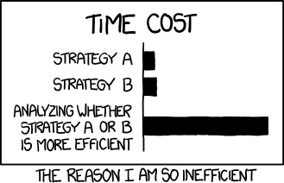
Multi-Armed
Bandits
CSE 312 26Su
Lecture 22
https://xkcd.com/1445/

Slide 2

The Problem
There are 𝐾 slot machines (“bandits” with “arms”).
“Bandits” because they steal your money
You pull arms 𝑇 times, where the arm you pull at time 𝑡 (arm pulled at time t is 𝑎_{𝑡} ∈ {1, … , 𝐾}) will return a random reward to you

Slide 3

The Problem
Your goal? Win as much money as possible! That is, maximize your total expected reward after T pulls of an arm of the K slot machines.
Question: How do you know which arm to pull (based on information you have – the past) to achieve your goal?
Assumptions:
Rewards from each arm are independent.
The reward distribution of an arm does not change over time.

Slide 4
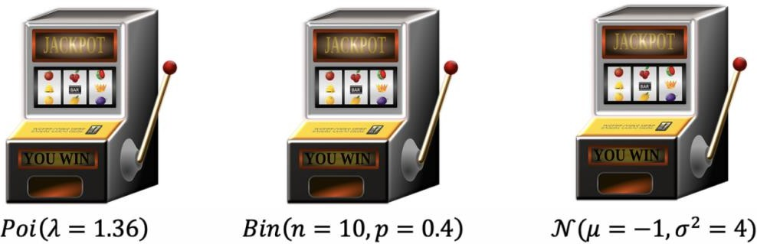
If you knew the reward distribution…
You have the below 𝐾 = 3 slot machines, whose distribution of rewards you know. What strategy are you going to use to maximize your total (expected) reward?

Slide 5
If you knew the reward distribution…
You have the below 𝐾 = 3 slot machines, whose distribution of rewards you know. What strategy are you going to use to maximize your total
(expected) reward?
We compute expected reward per pull: 1.36, 4, −1. So, pull arm 2 all times!

Slide 6

Neat! Problem solved! Or not…
Aren’t you glad you learnt calculate expectations so early in this course?
Oh wait…why would we know the reward distributions of slot machines?
We don’t ☹
We need to… estimate all K expectations. WHILE maximizing the total (expected) reward.
???
???
???

Slide 7
Our Problem (summarized)
There are 𝑘 “arms”. We get some reward when we pull the arm, but we don’t know the distribution with which the rewards are given.
Each time we pull an arm, we can observe the reward we get.
Our goal: Derive a strategy for picking which arm to pull to maximize the total reward based on observations from your previous pulls.

Slide 8
Before we go on…why is this important?
Lot’s of problems (reinforcement learning) can be phrased as a bandit problem!
A/B Testing: Experiment with releasing a new feature, or test ads to maximize click rate.
Arms: feature(s)/ad(s) to test Maximize: total ratings/click rate
Networks: Adaptive routings for picking best route for each pieces of data.
Arms: available routes Maximize: transmission speed
Recommendations: 𝐾 movies options. Recommend each person a movie and observe.
Arms: available movies Maximize: clicks/rating recommendations
Clinical Trials: 𝐾 treatment options. For each patient, give treatment and observe results.
Arms: different possible treatments Maximize: number of patients healed
Very real life: For each meal, you choose food, and track your happiness after eating.
Arms: possible food options Maximize: total/average happiness

Slide 9
Why is this a challenging problem?
There’s a tradeoff between…
Exploitation (act accordingly to what you know is going to work) Pulling arms that we know are “good” based on reward history.
Exploration (explore other options that might increase reward) Pulling other arms in case they could be “good” or “better”.
Regret: The difference between the optimal, best possible total (expected) reward and the actual reward from our choices of T pulls

Slide 10
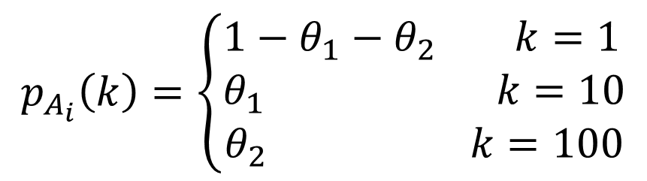
Simplification for the problem
In this case, let’s say that each “arm” rewards either $1, $10, or $100.
We don’t know what the probabilities are though…so the PMF for the reward of arm 𝑖 is:
$$p_{A_{i}}\left(k\right)=\left\{\begin{aligned}&1−θ_{1}−θ_{2} k=1 \\ &θ_{1} k=10 \\ θ_{2} k=100\end{aligned}\right.$$
Again, our goal is to find a strategy for picking an arm to pull that will maximize the total reward over the T pulls.

Slide 11
Strategy 1: Naïve, Greedy Approach

Slide 12
Strategy 1: Naïve, Greedy Approach
1. Explore. Pull each arm 𝑀 times and record the reward from each Based on data for each, estimate the parameters 𝜃₁ and 𝜃₂ for each arm
2. Exploit. Pick arm with highest estimated expected value and only use that arm for the remaining pulls.
1. Explore (here, there are 3 arms, and 𝑀 = 2)
2. Exploit
1
1
2
2
3
3
2
2
2
2
2

Slide 13
Strategy 1: Naïve, Greedy Approach
1. Explore. Pull each arm 𝑀 times and record the reward from each Based on data for each, estimate the parameters 𝜃₁ and 𝜃₂ for each arm
How do we do this…..Maximum Likelihood Estimation!
2. Exploit. Pick arm with highest estimated expected value and only use that arm for the remaining pulls.
1. Explore (here, there are 3 arms, and 𝑀 = 2)
2. Exploit
1
1
2
2
3
3
2
2
2
2
2

Slide 14
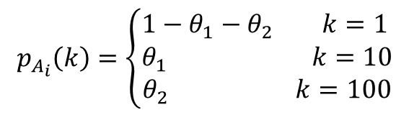
Strategy 1: Naïve, Greedy Approach
Pull arm 1 35 times and record the reward from each.
We see rewards 𝑥₁, 𝑥₂, … , 𝑥₃₅. Out of these, we get $1 5 times, $10 10 times and $100 20 times. What is the MLE for 𝜃₁ and 𝜃₂ for arm 1?
1. Likelihood Function
$$p_{A_{i}}\left(k\right)=\left\{\begin{aligned}&1−θ_{1}−θ_{2} k=1 \\ &θ_{1} k=10 \\ θ_{2} k=100\end{aligned}\right.$$
2. Log-likelihood Function
3. Derivative(s) of Log-likelihood Function
Notes:
$L\left(x_{1},...,x_{n};θ_{1},θ_{2}\right)={\left(θ_{1}\right)}^{10}{\left(θ_{2} \right)}^{20}{\left(1−θ_{1}−θ_{2}\right)}^{5}$
$\ln\left(L\left(x_{1},...,x_{n};θ_{1},θ_{2}\right))=10⋅\ln\left(θ_{1}\right)+20⋅\ln\left(θ_{2}\right)+5⋅\ln\left(1−θ_{1}−θ_{2}\right)\right)$
$\frac{10}{\hat{θ_{1}}}−\frac{5}{1−\hat{θ_{1}}−\hat{θ_{2}}}=0$ and $\frac{20}{\hat{θ_{2}}}−\frac{5}{1−\hat{θ_{1}}−\hat{θ_{2}}}$

Slide 15
4. Set the derivative(s) to 0 and solve for MLE(s)
….
Second derivative Test
  Next step would be to repeat this process and get estimates all arms
  Use the estimates to compute the expected reward from each
  Pick the arm with highest expected reward for the remaining pulls
Notes:
Rearrange to get system
2=3θ^1​+2θ^2
4=4θ^1​+5θ^2
10=15θ^1​+10θ^2
8=8θ^1​+10θ^2
Theta1 = 2/7
2 = 3 * 2/7 + 2 theta2
2 = 6/7 + 2 theta2
8/7 = 2 theta2
Theta2 = 4/7

Slide 16
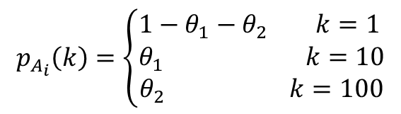
Strategy 1: Naïve, Greedy Approach
Pull arm 1 35 times and record the reward from each.
We see rewards 𝑥₁, 𝑥₂, … , 𝑥₃₅. Out of these, we get $1 5 times, $10 10 times and $100 20
times. What is the MLE for 𝜃₁ and 𝜃₂ for arm 1?
1. Likelihood Function
$$p_{A_{i}}\left(k\right)=\left\{\begin{aligned}&1−θ_{1}−θ_{2} k=1 \\ &θ_{1} k=10 \\ θ_{2} k=100\end{aligned}\right.$$
10 20 5
ℒ 𝑥₁, … , 𝑥_{𝑛}; 𝜃₁, 𝜃₂ = 𝜃₁ 𝜃₂ 1 − 𝜃₁ − 𝜃₂
2. Log-likelihood Function
ln ℒ 𝑥₁, … , 𝑥_{𝑛}; 𝜃₁, 𝜃₂ = 10 ⋅ ln 𝜃₁ + 20 ⋅ ln 𝜃₂
+ 5 ⋅ ln 1 − 𝜃₁ − 𝜃₂
3. Derivative(s) of Log-likelihood Function
𝛛
₌ 10 ₋ 5
Partial derivative w.r.t. 𝜃 :
𝛛𝜃₁
𝛛
ln ℒ 𝑥₁, … , 𝑥_{𝑛}; 𝜃₁, 𝜃₂
𝜃₁ 1−𝜃₁−𝜃₂
5
1
₌ 20 ₋
Partial derivative w.r.t. 𝜃 :
ln ℒ 𝑥₁, … , 𝑥_{𝑛}; 𝜃₁, 𝜃₂
2
𝛛𝜃₁
𝜃₂ 1−𝜃₁−𝜃₂
4. Set the derivative(s) to 0 and solve for MLE(s)
$\frac{10}{\hat{θ_{1}}}−\frac{5}{1−\hat{θ_{1}}−\hat{θ_{2}}}=0$ and $\frac{20}{\hat{θ_{2}}}−\frac{5}{1−\hat{θ_{1}}−\hat{θ_{2}}}=0$. Solving system of equations… $\hat{θ_{1}}=\frac{10}{35}, \hat{θ_{2}}=\frac{20}{35}$
5. Second derivative Test

Slide 17
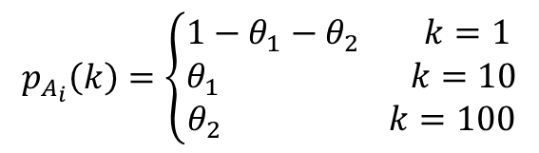
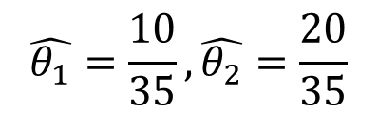
Strategy 1: Naïve, Greedy Approach
Pull arm 1 35 times and record the reward from each.
We see rewards 𝑥₁, 𝑥₂, … , 𝑥₃₅. Out of these, we get $1 5 times, $10 10 times and $100 20 times. What is the MLE for 𝜃₁ and 𝜃₂ for arm 1?
$$\hat{θ_{1}}=\frac{10}{35}, \hat{θ_{2}}=\frac{20}{35}$$
$$p_{A_{i}}\left(k\right)=\left\{\begin{aligned}&1−θ_{1}−θ_{2} k=1 \\ &θ_{1} k=10 \\ θ_{2} k=100\end{aligned}\right.$$
How good is this estimator? Is it biased?
1. Write a generalized form of the estimator
2. Check if it’s unbiased

Slide 18

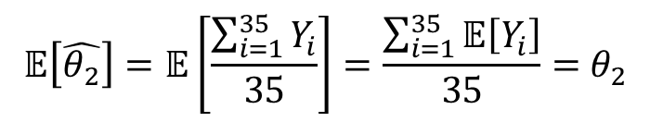
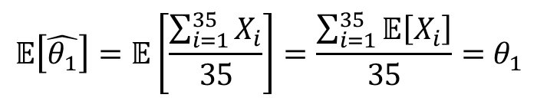
Strategy 1: Naïve, Greedy Approach
Pull arm 1 35 times and record the reward from each.
We see rewards 𝑥₁, 𝑥₂, … , 𝑥₃₅. Out of these, we get $1 5 times, $10 10 times and $100 20 times. What is the MLE for 𝜃₁ and 𝜃₂ for arm 1?
$$\hat{θ_{1}}=\frac{10}{35}, \hat{θ_{2}}=\frac{20}{35}$$
$$p_{A_{i}}\left(k\right)=\left\{\begin{aligned}&1−θ_{1}−θ_{2} k=1 \\ &θ_{1} k=10 \\ θ_{2} k=100\end{aligned}\right.$$
How good is this estimator? Is it biased?
1. Write a generalized form of the estimator
Let 𝑋_{𝑖}~Ber(𝜃₁) and 𝑌_{𝑖}~Ber(𝜃₂) --> $\hat{θ_{1}}=\frac{\sum_{i=1}^{35}{X_{i}}}{35}, \hat{θ_{2}}=\frac{\sum_{i=1}^{35}{Y_{i}}}{35}$
2. Check if it’s unbiased
$$𝔼\left[\hat{θ_{1}}\right]=𝔼\left[\frac{\sum_{i=1}^{35}{X_{i}}}{35}\right]=\frac{\sum_{i=1}^{35}{𝔼\left[X_{i}\right]}}{35}=θ_{1}$$
$$𝔼\left[\hat{θ_{2}}\right]=𝔼\left[\frac{\sum_{i=1}^{35}{Y_{i}}}{35}\right]=\frac{\sum_{i=1}^{35}{𝔼\left[Y_{i}\right]}}{35}=θ_{2}$$

Slide 19
Problems with this approach
We may not get an accurate idea from our first 𝑀 pulls of each arm
If we choose the wrong best arm, we’d regret it for the rest of time!
If we increase M, we are spending more time on sub-optimal arms
Problem: We did all exploration, and then all exploitation. Why don’t we blend the two a bit more?

Slide 20
Strategy 2: Epsilon-Greedy

Slide 21
Strategy 2: Epsilon Greedy
Explore. Pull each arm 𝑀 times and record the reward from each (same as before)
Exploit (with a mix of exploration!). With a small probability of 𝜀, try a random other arm. Otherwise calculate “best arm” Based on data for each, estimate the parameters 𝜃₁ and 𝜃₂ for each arm and pick best arm with highest estimated expected value.
Better!
  > continuously updates estimated expected reward when it is pulled
  > explores with some probability 𝜀 which allows you to choose how to balance exploration and exploitation.

Slide 22
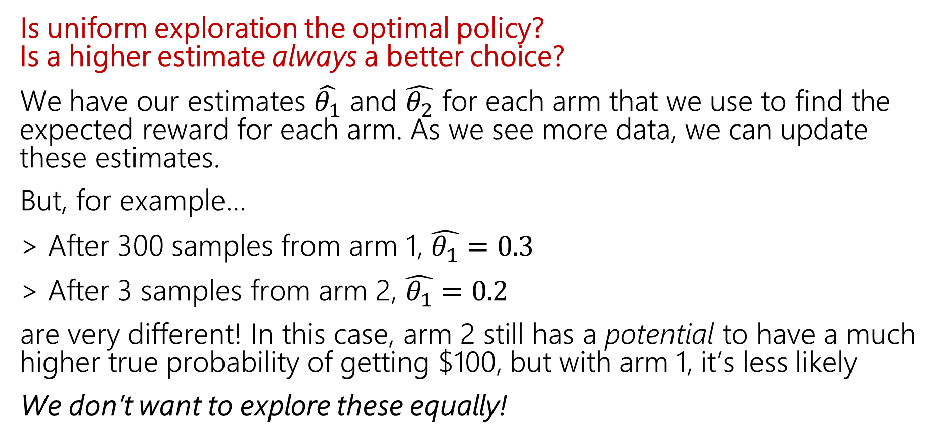
Still some problems!
Is uniform exploration the optimal policy? Is a higher estimate always a better choice?
We have our estimates $\hat{θ_{1}}$ and $\hat{θ_{2}}$ for each arm that we use to find the expected reward for each arm. As we see more data, we can update these estimates.
But, for example…
After 300 samples from arm 1, $\hat{θ_{1}}$ = 0.3
After 3 samples from arm 2, $\hat{θ_{1}}$ = 0.2
are very different! In this case, arm 2 still has a potential to have a much higher true probability of getting $100, but with arm 1, it’s less likely
We don’t want to explore these equally!

Slide 23
Strategy 3: Upper Confidence Bound
Explore arms that have a higher potential of a better expectation

Slide 24
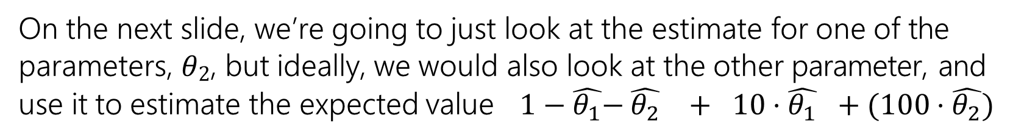
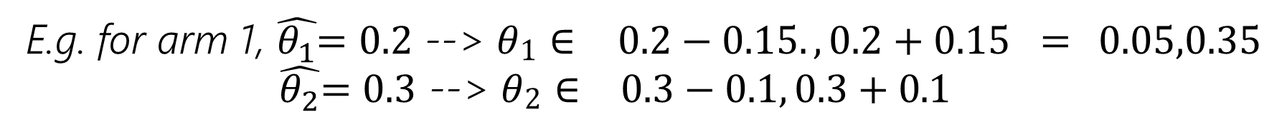
Confidence Interval for Our Estimates
Instead of picking the arm with the highest expected value, pick the arm with the highest potential for expected value?
How to calculate “potential”? Use a confidence interval!
For each of the estimated parameters, what range can we be 95% sure the true parameter lies in?
E.g. for arm 1, $\hat{θ_{1}}$= 0.2 --> 𝜃₁ ∈ 0.2 − 0.15. , 0.2 + 0.15 = 0.05,0.35
$\hat{θ_{2}}$= 0.3 --> 𝜃₂ ∈ 0.3 − 0.1, 0.3 + 0.1
= [0.2,0.4]
On the next slide, we’re going to just look at the estimate for one of the parameters, 𝜃₂, but ideally, we would also look at the other parameter, and use it to estimate the expected value 1 − $\hat{θ_{1}}$− $\hat{θ_{2}}$ + 10 ⋅ $\hat{θ_{1}}$ + (100 ⋅ $\hat{θ_{2}}$)

Slide 25
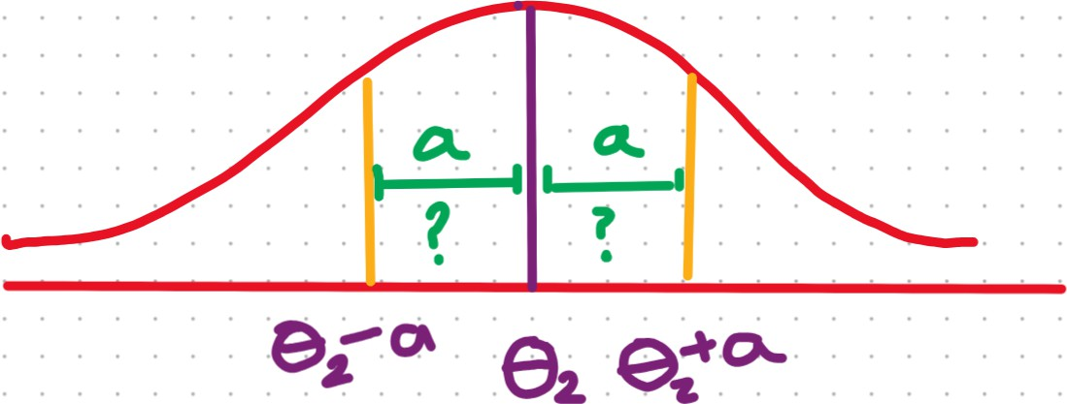
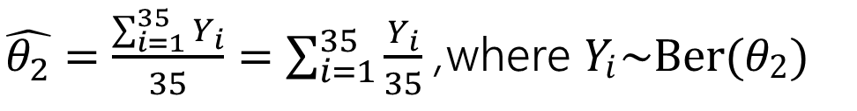
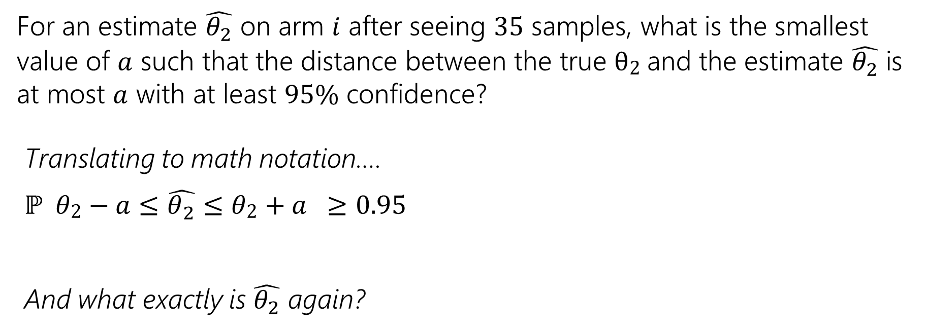
Confidence Interval for Our Estimates
For an estimate $\hat{θ_{2}}$ on arm 𝑖 after seeing 35 samples, what is the smallest
value of 𝑎 such that the distance between the true θ₂ and the estimate $\hat{θ_{2}}$ is at most 𝑎 with at least 95% confidence?
Translating to math notation….
ℙ 𝜃₂ − 𝑎 ≤ $\hat{θ_{2}}$ ≤ 𝜃₂ + 𝑎 ≥ 0.95
And what exactly is $\hat{θ_{2}}$ again?
$\hat{θ_{2}}=\frac{\sum_{i=1}^{35}{Y_{i}}}{35}=\sum_{i=1}^{35}{\frac{Y_{i}}{35}}$, where 𝑌_{𝑖}~Ber(𝜃₂)
^ is a sum of i.i.d RVs! So, what can we use to solve for 𝑎?

Slide 26

Outline of CLT steps
1. Setup the problem (e.g., $X=\sum_{i=1}^{n}{X_{i}}$, 𝑋_{𝑖} are i.i.d., and we want ℙ(𝑋 ≤ 𝑘))
Write event you are interested in, in terms of sum of random variables.
Apply continuity correction here if RVs are discrete.
Apply CLT (e.g., approx 𝑋 as 𝑌~𝑁(𝑛𝜇, 𝑛𝜎²) -> ℙ 𝑋 ≤ 𝑘 ≈ ℙ 𝑌 ≤ 𝑘
Approximate sum of RVs as normal with appropriate mean and variance
from here, we’re working with a normal distribution, which we’ve worked with before!
Compute probability approximation using Phi table
𝑌−𝜇 ≤ 𝑘−𝜇 _{𝑍 ≤} 𝑘−𝜇
> Standardize (𝑍 = ^{𝑁−𝜇}) -> ℙ 𝑌 ≤ 𝑘 = ℙ
= ℙ
𝜎
Write in terms of 𝛷 𝑧
Look up in table
𝜎 𝜎 𝜎
= ℙ(Z ≤ 𝑧)

Slide 27
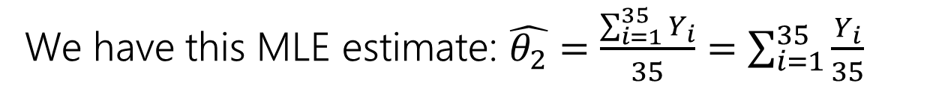
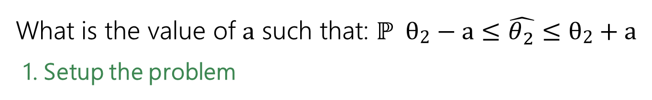
Confidence Interval for Our Estimates
We have this MLE estimate: $\hat{θ_{2}}=\frac{\sum_{i=1}^{35}{Y_{i}}}{35}=\sum_{i=1}^{35}{\frac{Y_{i}}{35}}$
, where 𝑌_{𝑖}~Ber(𝜃₂)
≥ 0.95
What is the value of a such that: ℙ θ₂ − a ≤ $\hat{θ_{2}}$ ≤ θ₂ + a
1. Setup the problem
2. Apply CLT
Notes:
$\hat{θ_{2}}=\sum_{i=1}^{35}{\frac{Y_{i}}{35}}$,
where $E\left[Y_{i}\right]=θ_{2}$, $Var\left(Y_{i}\right)=θ_{2}\left(1−θ_{2}\right)$
so $E\left[\frac{Y_{i}}{35}\right]=\frac{θ_{2}}{35}$, $Var\left(\frac{Y_{i}}{35}\right)=\frac{θ_{2}\left(1−θ_{2}\right)}{{35}^{2}}$
Let $W\sim N\left(θ_{2},\frac{θ_{2}\left(1−θ_{2}\right)}{35}\right)$
By CLT, $\hat{θ_{2}}≈W$

Slide 28
3. Compute probability approximation using Phi table
Notes:
Let $σ=\frac{θ_{2}\left(1−θ_{2}\right)}{35}$
$P\left(θ_{2}−a≤W≤θ_{2}+a\right)=P\left(\frac{θ_{2}−a−θ_{2}}{σ}≤Z≤\frac{θ_{2}+a−θ_{2}}{σ}\right)$
$$=Φ\left(\frac{a}{σ}\right)−Φ\left(−\frac{a}{σ}\right)$$
$$=Φ\left(\frac{a}{σ}\right)−\left(1−Φ\left(\frac{a}{σ}\right)\right)$$
$$=2Φ\left(\frac{a}{σ}\right)−1$$
$$2Φ\left(\frac{a}{σ}\right)−1≥0.95$$
$$Φ\left(\frac{a}{σ}\right)≥0.975$$
$$\frac{a}{σ}≥1.96$$
$$a≥1.96⋅\sqrt{\frac{θ_{2}\left(1−θ_{2}\right)}{35}}$$

Slide 29
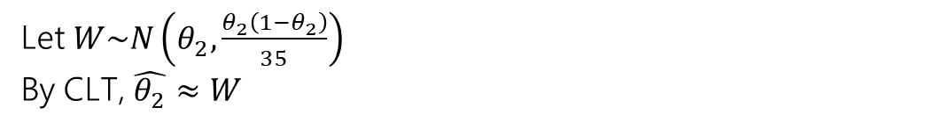
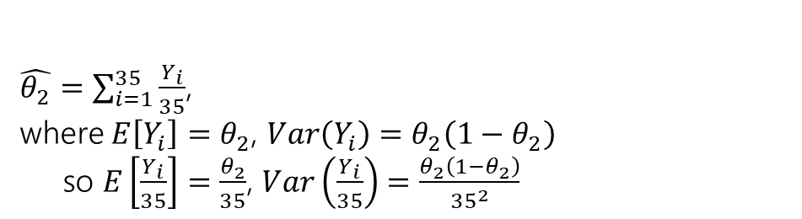
Confidence Interval for Our Estimates
We have this MLE estimate: $\hat{θ_{2}}=\frac{\sum_{i=1}^{35}{Y_{i}}}{35}=\sum_{i=1}^{35}{\frac{Y_{i}}{35}}$
, where 𝑌_{𝑖}~Ber(𝜃₂)
≥ 0.95
What is the value of a such that: ℙ θ₂ − a ≤ $\hat{θ_{2}}$ ≤ θ₂ + a
1. Setup the problem
$\hat{θ_{2}}=\sum_{i=1}^{35}{\frac{Y_{i}}{35}}$,
where $E\left[Y_{i}\right]=θ_{2}$, $Var\left(Y_{i}\right)=θ_{2}\left(1−θ_{2}\right)$
so $E\left[\frac{Y_{i}}{35}\right]=\frac{θ_{2}}{35}$, $Var\left(\frac{Y_{i}}{35}\right)=\frac{θ_{2}\left(1−θ_{2}\right)}{{35}^{2}}$
2. Apply CLT
Let $W\sim N\left(θ_{2},\frac{θ_{2}\left(1−θ_{2}\right)}{35}\right)$
By CLT, $\hat{θ_{2}}≈W$

Slide 30
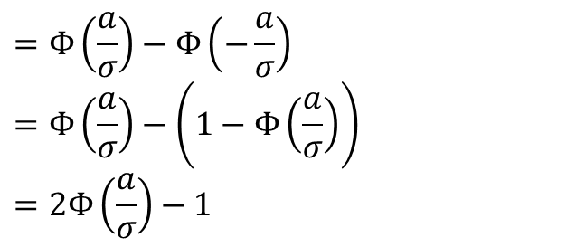
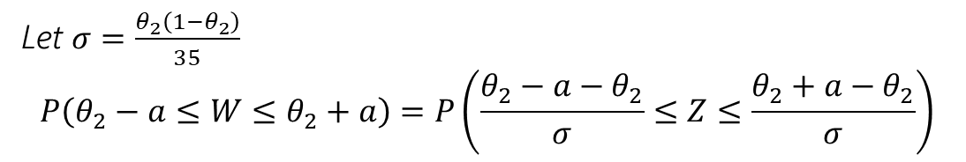
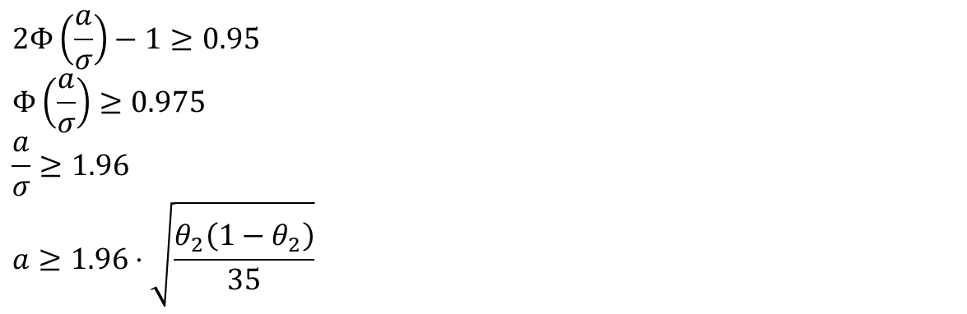
3. Compute probability approximation using Phi table
Let $σ=\frac{θ_{2}\left(1−θ_{2}\right)}{35}$
$$P\left(θ_{2}−a≤W≤θ_{2}+a\right)=P\left(\frac{θ_{2}−a−θ_{2}}{σ}≤Z≤\frac{θ_{2}+a−θ_{2}}{σ}\right)$$
$$=Φ\left(\frac{a}{σ}\right)−Φ\left(−\frac{a}{σ}\right)$$
$$=Φ\left(\frac{a}{σ}\right)−\left(1−Φ\left(\frac{a}{σ}\right)\right)$$
$$=2Φ\left(\frac{a}{σ}\right)−1$$
$$2Φ\left(\frac{a}{σ}\right)−1≥0.95$$
$$Φ\left(\frac{a}{σ}\right)≥0.975$$
$$\frac{a}{σ}≥1.96$$
$$a≥1.96⋅\sqrt{\frac{θ_{2}\left(1−θ_{2}\right)}{35}}$$

Slide 31
Handling 𝜃₂ 1 − 𝜃₂
Justification 1: If we make a mistake, we want it to be making 𝑛 bigger.
(since we’re trying to say “take 𝑛 at least this big, and you’ll be safe”).
The bigger the standard deviation, the bigger 𝑛 will need to be to control it. So assume the biggest possible standard deviation.
Justification 2:
As 𝜃₂ 1 − 𝜃₂ gets bigger, the interval gets smaller (it’s in the
denominator), so assuming the biggest value of 𝜃₂ 1 − 𝜃₂ gives us the most restricted interval. So no matter what the true interval is we
have a subset of it. And if our probability is at least .95 then the true
probability is at least .95.
What’s the maximum of 𝜃₂ 1 − 𝜃₂ ?

Slide 32
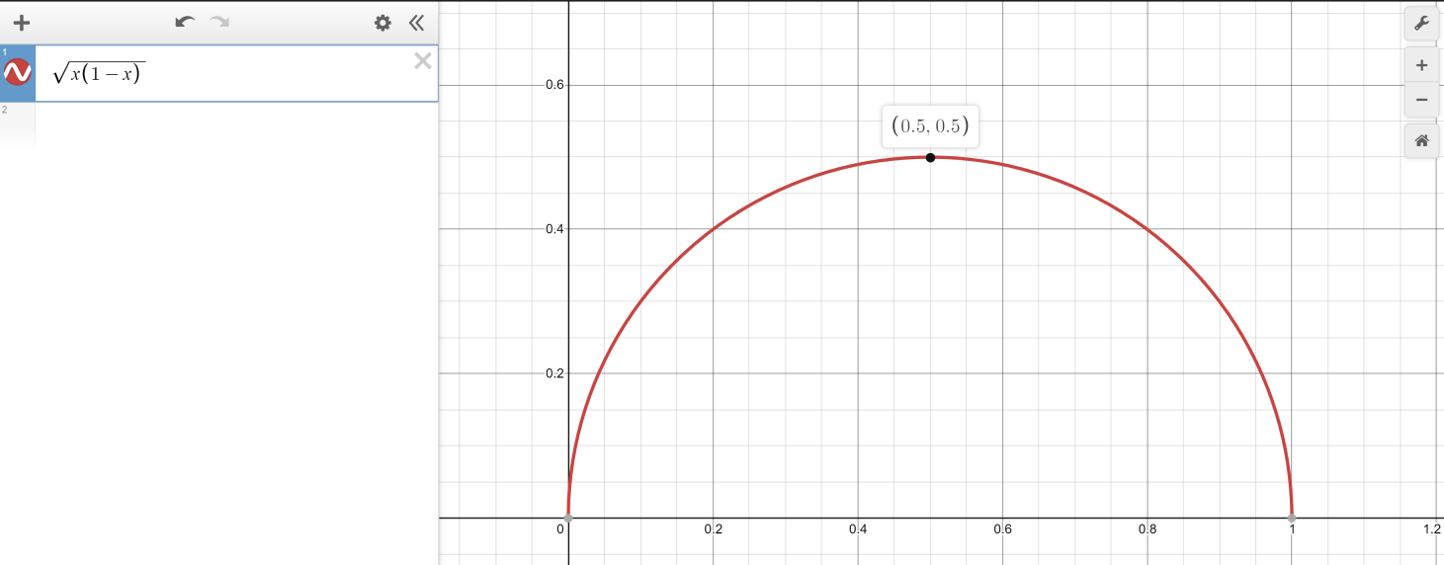
Worst value of 𝑝
Calculus time!
𝑑
Set 𝑝 − 𝑝² = 0
¹ 1 − 2𝑝 = 0
𝑑𝑝
𝑝−𝑝²
1 − 2𝑝 = 0 → 𝑝 = 1/2
Second derivative test will
confirm 𝑝 = ¹ is a maximizer
2
Or just plot it.
1
1 − ¹ =
1/4.
2 2

Slide 33
Side note: A similar process can be used when we’re trying to figure out things like how many people do we need to poll to be confident in our result when we know NOTHING about the true mean or variance of the population’s votes!

Slide 34
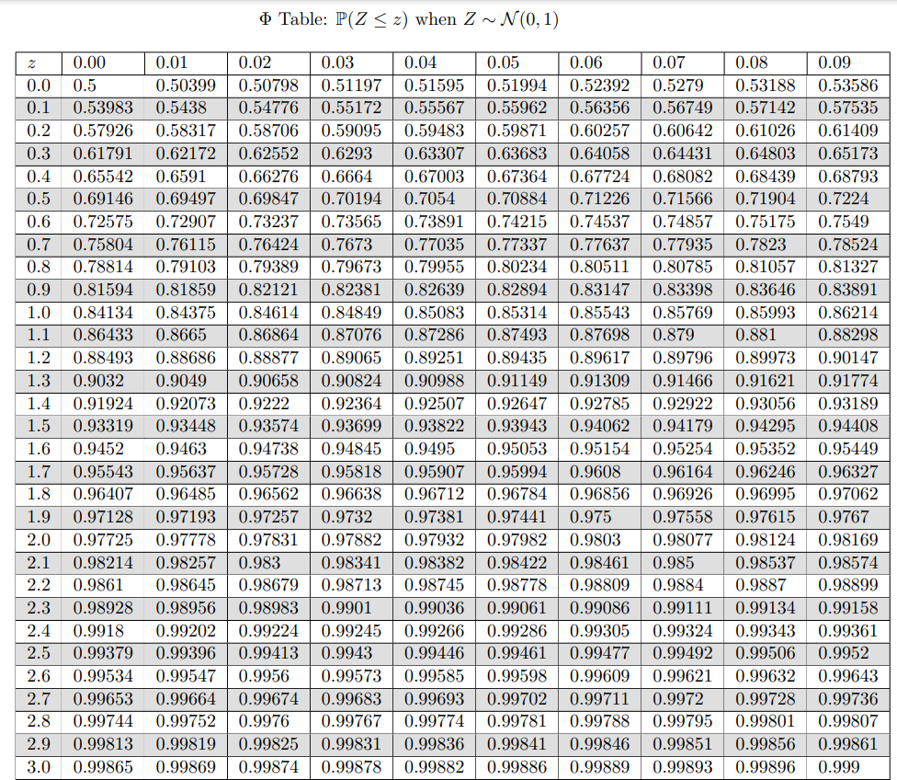

Slide 35
Upper Confidence Bound
Our strategy now is:
> First sample K of each arm to get some initial data
> Now, for every choice, we will use the previous data to figure out confidence intervals for each arm, use this to get ranges for the potential expectations of each arm, and pick the arm with the highest upper bound

Slide 36
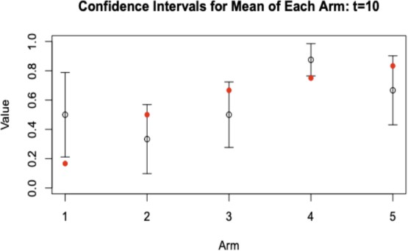
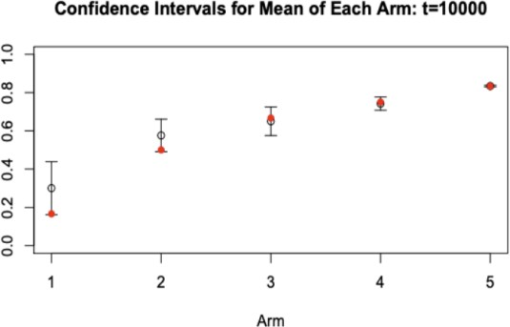
Upper Confidence Bound
More frequent pulls from an arm --> smaller upper confidence bound
After seeing more observations, the variance of distribution decreases
Less frequent pulls from an arm --> larger upper confidence bound
After not seeingmany observations, more variation is still possible

Slide 37
Strategy 4: Thompson Sampling
See Alex Tsun’s textbook for details about this ☺

Slide 38
Muti-Armed Bandits aren’t perfect
They don’t personalize!
they only find overall “winners”, but sometimes, different customers need different things. There are other external factors that affect what the best choice is
When there are too many arms, MABs don’t work as fast and as well e.g., if the arms are the time of day to send an email, if you find that if you send an email at 3pm, the customer buys the product, that tells you that 2pm and 4pm are also more likely to be better times
Contextual Bandits are the next step! If you’re curious, here are some great resources for learning about this.
article, another article, another another article
If you like these topics, this is also the basis for reinforcement learning
Notes:
Contextual bandits, not all users are the same
Traffic allocation depends on user characteristics

