Slide 1
Maximum Likelihood Estimation
CSE 312 26Su
Lecture 21

Slide 2
Announcements
Final information on website
Homework 6 is due today
Homework 7 (last homework!) will be released today
Quiz 7 on Friday (Tail Bounds + MLE)

Slide 3
Where Are We?
Today:
  Tail Bounds
    Chernoff Bound
    not a tail bound, but Union Bound
  Maximum Likelihood Estimation
Today:
  Maximum Likelihood Estimation
  Biased / Unbiased Estimators

Slide 4
Up till now…
So far, the probability questions we’ve asked have followed a pattern:
You’re given a model with the probabilities you need to make predictions.
𝑋~Bin(𝑛, 𝑝), compute some probabilities about 𝑋, compute 𝐸[𝑋]
We have a distribution that takes on these outcomes with these probabilities. Compute the probability of some event or set of outcomes.
Before we run the entire experiment, let’s make some predictions
In real world, we usually don’t know all the rules of a random experiment
hence tail bounds, CLT, etc. to estimate probabilities in these situations
But, can we estimate those missing rules/parameters to a distribution?

Slide 5

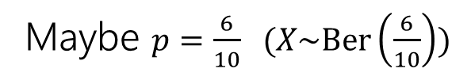
Maximum Likelihood Estimation
We derive an estimate $\hat{θ}$ for the parameter $θ$ based on observed data
We’re going to run the random experiment a bunch of times (i.e., collect a bunch of samples from the distribution) -> this gives data
e.g., we flip a coin that follows Ber(𝑝) 10 times and write down the results – HTTTH…
Estimate the missing rules (unknown parameter(s)) based on the data
Suppose you flip a coin independently 10 times, and you see
HTTTHHTHHH
(6 heads, 4 tails)
What is your estimate of 𝑝, the probability the coin comes up heads?
Maybe $p=\frac{6}{10}$ ($X\sim \text{Ber}\left(\frac{6}{10}\right))$
But how to argue “objectively” this is the best estimate?

Slide 6

Likelihood function
Remember, our goal:
Collect some data/samples from the distribution
Find an estimate for 𝜃
𝓛(𝑬; 𝜽) is ℙ(𝐸) when the experiment is run with 𝜃
“what is probability of seeing the event 𝐸 (in our case, the set of data), if the experiment is run with the parameter 𝜃?”
We can’t use probability notation because likelihood doesn’t follow the same rules
Coin example
We ran the experiment 10 times independently. The result was HTTTHHTHHH
$ℒ\left(\text{HTTTHHTHHH};θ\right)=θ^{6}{\left(1−θ\right)}^{4}$ (multiply because independent)
“Probability of observing HTTTHHTHHH if 𝜽 is probability of heads on a single flip”
We want to pick the value of 𝜽 that make this likelihood function the largest. So…

Slide 7
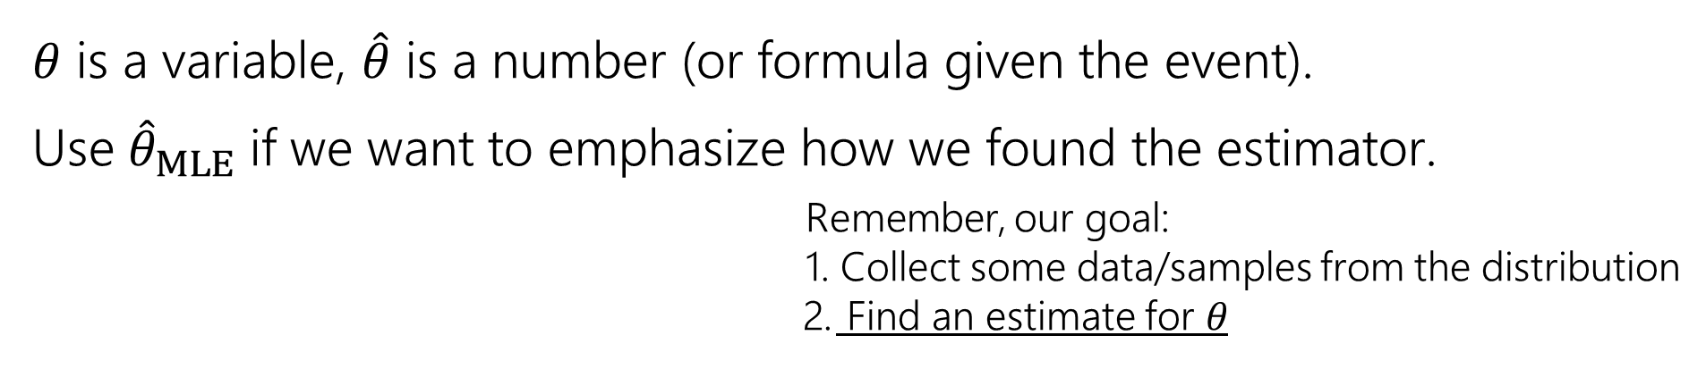
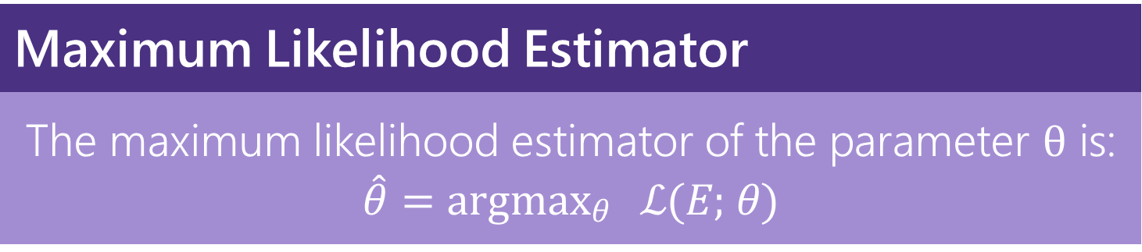
Maximum Likelihood Estimation
We will choose the estimator $\hat{θ}=$ argmax_{𝜃} ℒ(𝐸; 𝜃)
“the value of 𝜃 that makes the likelihood of seeing the observed data the highest”
Maximum Likelihood Estimator
The maximum likelihood estimator of the parameter θ is: $\hat{θ}=$ argmax_{𝜃} ℒ(𝐸; 𝜃)
𝜃 is a variable, $\hat{θ}$ is a number (or formula given the event).
Use ${\hat{θ}}_{MLE}$ if we want to emphasize how we found the estimator.
Remember, our goal:
Collect some data/samples from the distribution
Find an estimate for 𝜃

Slide 8
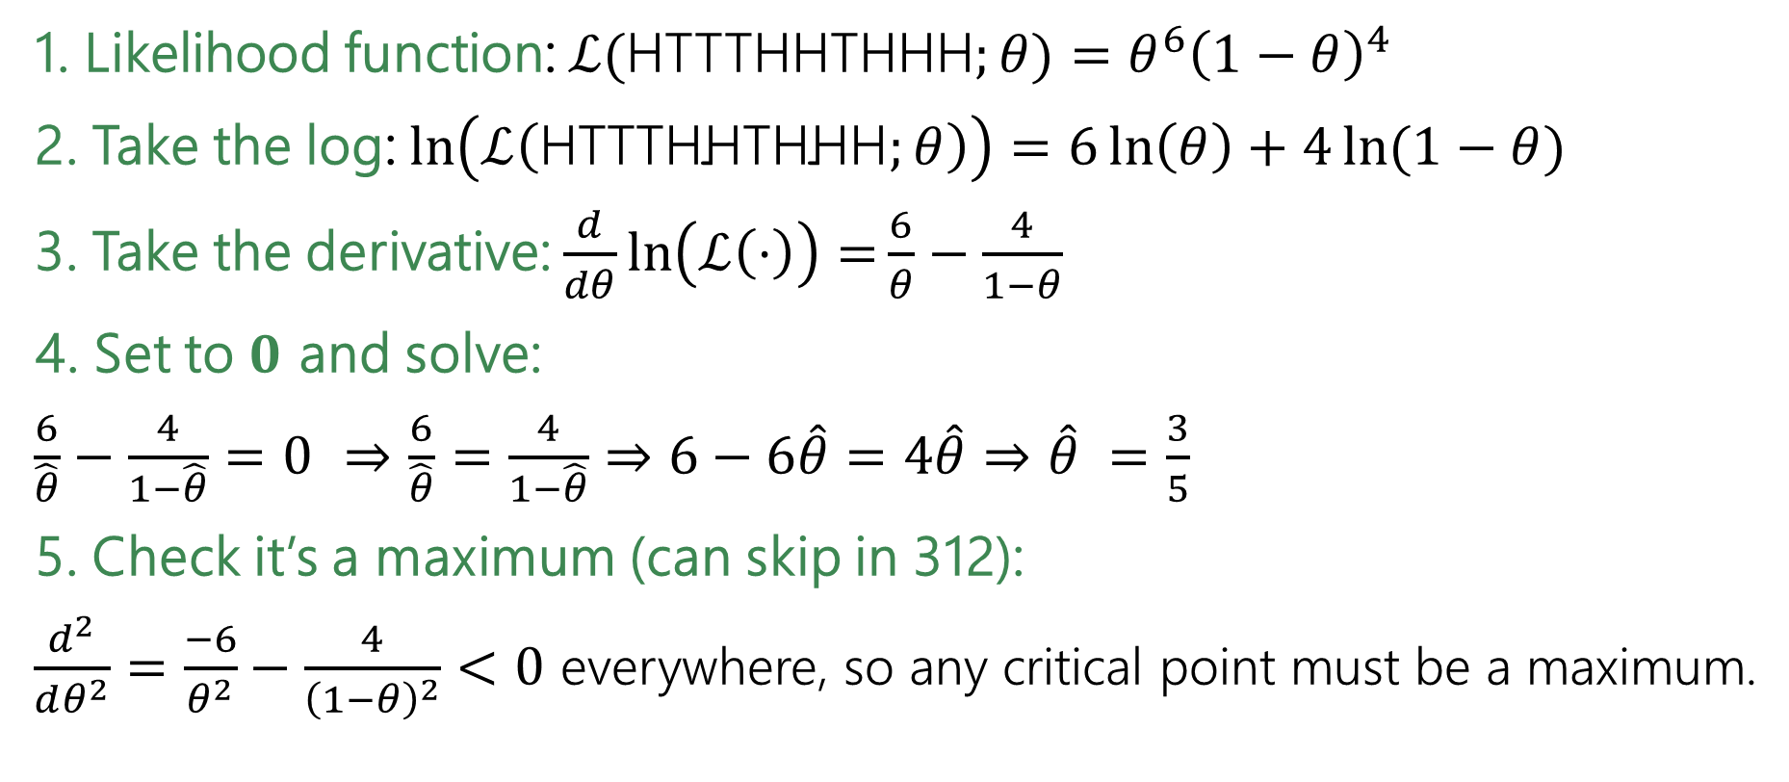
Coin flips is easier
1. Likelihood function: $ℒ($HTTTHHTHHH$;θ)=θ^{6}{\left(1−θ\right)}^{4}$
2. Take the log: $\ln\left(ℒ\left(\text{HTTTHHTHHH};θ\right)\right)=6\ln\left(θ\right)+4\ln{(1−θ)}$
3. Take the derivative: $\frac{d}{dθ}\ln\left(ℒ\left(⋅\right)\right)=\frac{6}{θ}−\frac{4}{1−θ}$
4. Set to $0$ and solve:
$\frac{6}{\hat{θ}}−\frac{4}{1−\hat{θ}}=0$ $⇒$ $\frac{6}{\hat{θ}}=\frac{4}{1−\hat{θ}}$ $⇒$ $6−6\hat{θ}=4\hat{θ}⇒$ $\hat{θ} =\frac{3}{5}$
5. Check it’s a maximum (can skip in 312):
$\frac{d^{2}}{dθ^{2}}=\frac{−6}{θ^{2}}−\frac{4}{{\left(1−θ\right)}^{2}}<0$ everywhere, so any critical point must be a maximum.

Slide 9
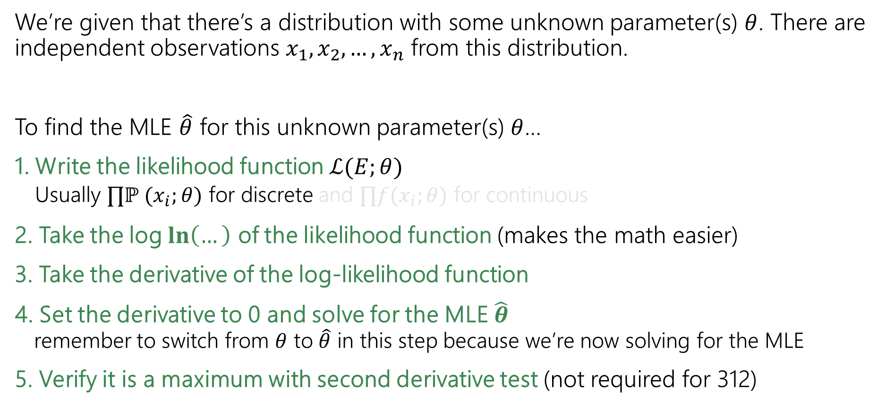
Solving MLE (the process)
We’re given that there’s a distribution with some unknown parameter(s) $θ$. There are independent observations $x_{1}, x_{2}, …, x_{n}$ from this distribution.
To find the MLE $\hat{θ}$ for this unknown parameter(s) $θ$…
1. Write the likelihood function $ℒ(E;θ)$
  Usually $∏ℙ (x_{i};θ)$ for discrete and $∏f(x_{i};θ)$ for continuous
2. Take the log $\ln\left(…\right)$ of the likelihood function (makes the math easier)
3. Take the derivative of the log-likelihood function
4. Set the derivative to 0 and solve for the MLE $\hat{θ}$
remember to switch from $θ$ to $\hat{θ}$ in this step because we’re now solving for the MLE
5. Verify it is a maximum with second derivative test (not required for 312)

Slide 10

Important log rules
$\ln\left(a⋅b\right)=\ln\left(a\right)+\ln\left(b\right)$
$\ln\left(a^{b}\right)=b⋅\ln\left(a\right)$
$\ln\left(a−b\right)=\frac{\ln\left(a\right)}{\ln\left(b\right)}$
$\ln\left(e^{a}\right)=a$
$\frac{d}{dθ}\ln\left(m\right)=\frac{1}{m}⋅\frac{d}{dθ}\left(m\right)$

Slide 11
MLEs with Continuous RVs

Slide 12

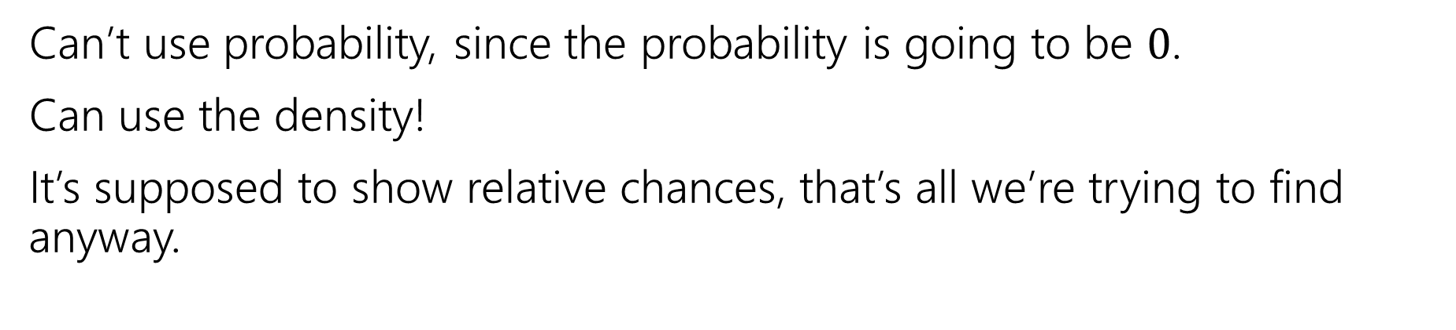
What about continuous random variables?
Can’t use probability, since the probability is going to be $0$.
Can use the density!
It’s supposed to show relative chances, that’s all we’re trying to find anyway.
Likelihood Function: Likelihood of 𝑛 observations (from continuous distribution)
$ℒ\left(x_{1},x_{2},…,x_{n};θ\right)=\prod_{i=1}^{n}{f_{X}\left(x_{i};θ\right)}$

Slide 13
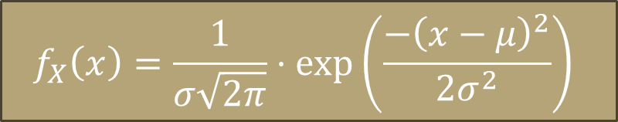
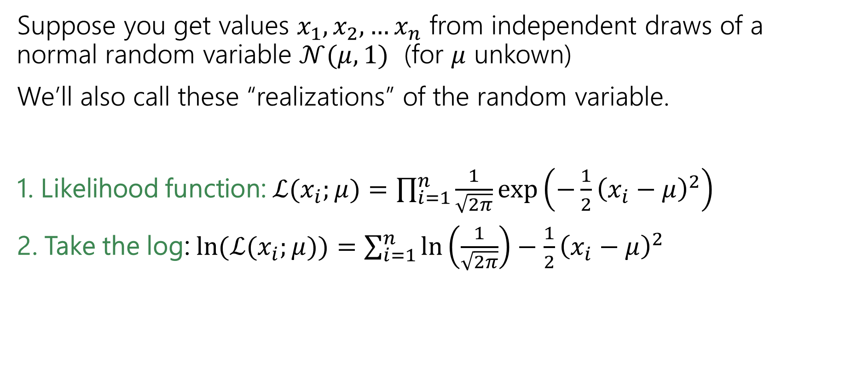
Continuous Example
$$f_{X}\left(x\right)=\frac{1}{σ\sqrt{2π}}⋅\exp\left(\frac{−{\left(x−μ\right)}^{2}}{2σ^{2}}\right)$$
Suppose you get values $x_{1},x_{2},…x_{n}$ from independent draws of a normal random variable $𝒩(μ,1)$ (for $μ$ unkown)
We’ll also call these “realizations” of the random variable.
1. Likelihood function: $ℒ(x_{i};μ)=\prod_{i=1}^{n}{\frac{1}{\sqrt{2π}}\exp\left(−\frac{1}{2}{\left(x_{i}−μ\right)}^{2}\right)}$
2. Take the log: $\ln{(ℒ(x_{i};μ))=\sum_{i=1}^{n}{\ln\left(\frac{1}{\sqrt{2π}}\right)−\frac{1}{2}{\left(x_{i}−μ\right)}^{2}}}$

Slide 14
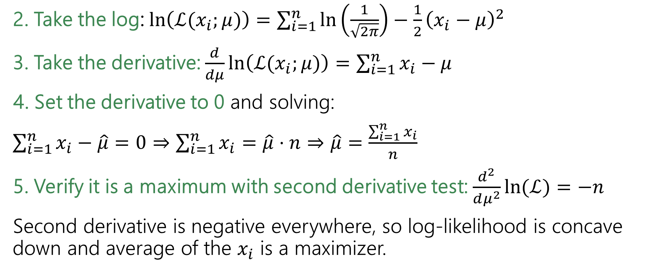

Finding $\hat{μ}$
2. Take the log: $\ln\left(ℒ(x_{i};μ)\right)=\sum_{i=1}^{n}{\ln\left(\frac{1}{\sqrt{2π}}\right)−\frac{1}{2}{\left(x_{i}−μ\right)}^{2}}$
3. Take the derivative: $\frac{d}{dμ}\ln\left(ℒ(x_{i};μ)\right)=\sum_{i=1}^{n}{x_{i}−μ}$
4. Set the derivative to 0 and solving:
$\sum_{i=1}^{n}{x_{i}−\hat{μ}}=0⇒\sum_{i=1}^{n}{x_{i}}=\hat{μ}⋅n⇒\hat{μ}=\frac{\sum_{i=1}^{n}{x_{i}}}{n}$
5. Verify it is a maximum with second derivative test: $\frac{d^{2}}{dμ^{2}}\ln{(ℒ)}=−n$
Second derivative is negative everywhere, so log-likelihood is concave down and average of the $x_{i}$ is a maximizer.

Slide 15
MLEs with Multiple Parameters

Slide 16

Generalizing Normals
We just saw to estimate $μ$ for $𝒩(μ,1)$ we get:
$\hat{μ}=∑x_{i}/n$
Now what happens if we know our data is normally distributed but both the mean and the variance are unknown?

Slide 17
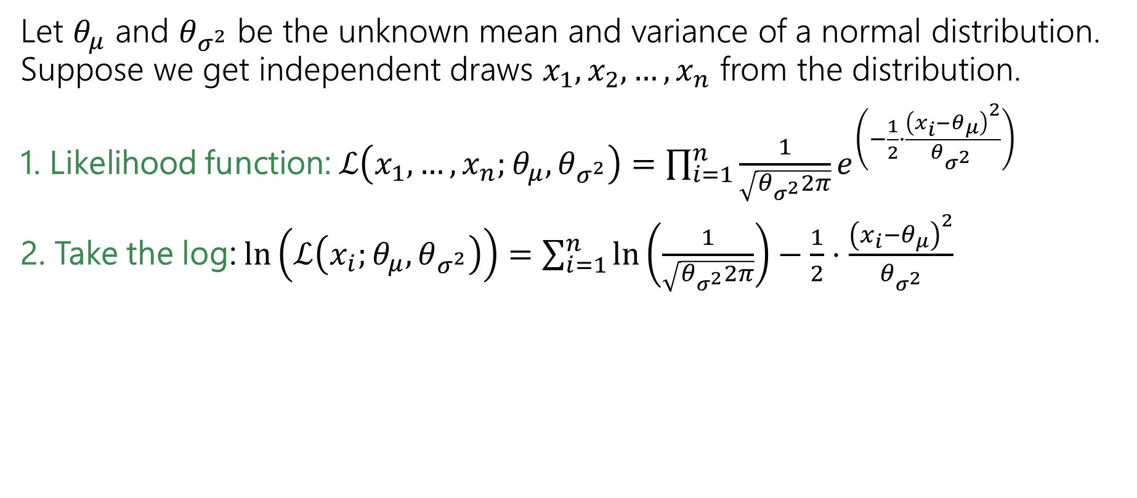
Generalizing Normals
Let $θ_{μ}$ and $θ_{σ^{2}}$ be the unknown mean and variance of a normal distribution. Suppose we get independent draws $x_{1},x_{2},…, x_{n}$ from the distribution.
1. Likelihood function: $ℒ\left(x_{1},…,x_{n};θ_{μ},θ_{σ^{2}}\right)=\prod_{i=1}^{n}{\frac{1}{\sqrt{θ_{σ^{2}}2π}}e^{\left(−\frac{1}{2}⋅\frac{{\left(x_{i}−θ_{μ}\right)}^{2}}{θ_{σ^{2} }}\right)}}$
2. Take the log:$\ln\left(ℒ\left(x_{i};θ_{μ},θ_{σ^{2}}\right)\right)=\sum_{i=1}^{n}{\ln\left(\frac{1}{\sqrt{θ_{σ^{2}}2π}}\right)−\frac{1}{2}⋅\frac{{\left(x_{i}−θ_{μ}\right)}^{2}}{θ_{σ^{2}}} }$
With multiple parameters, take partial derivatives to find maxima.

Slide 18
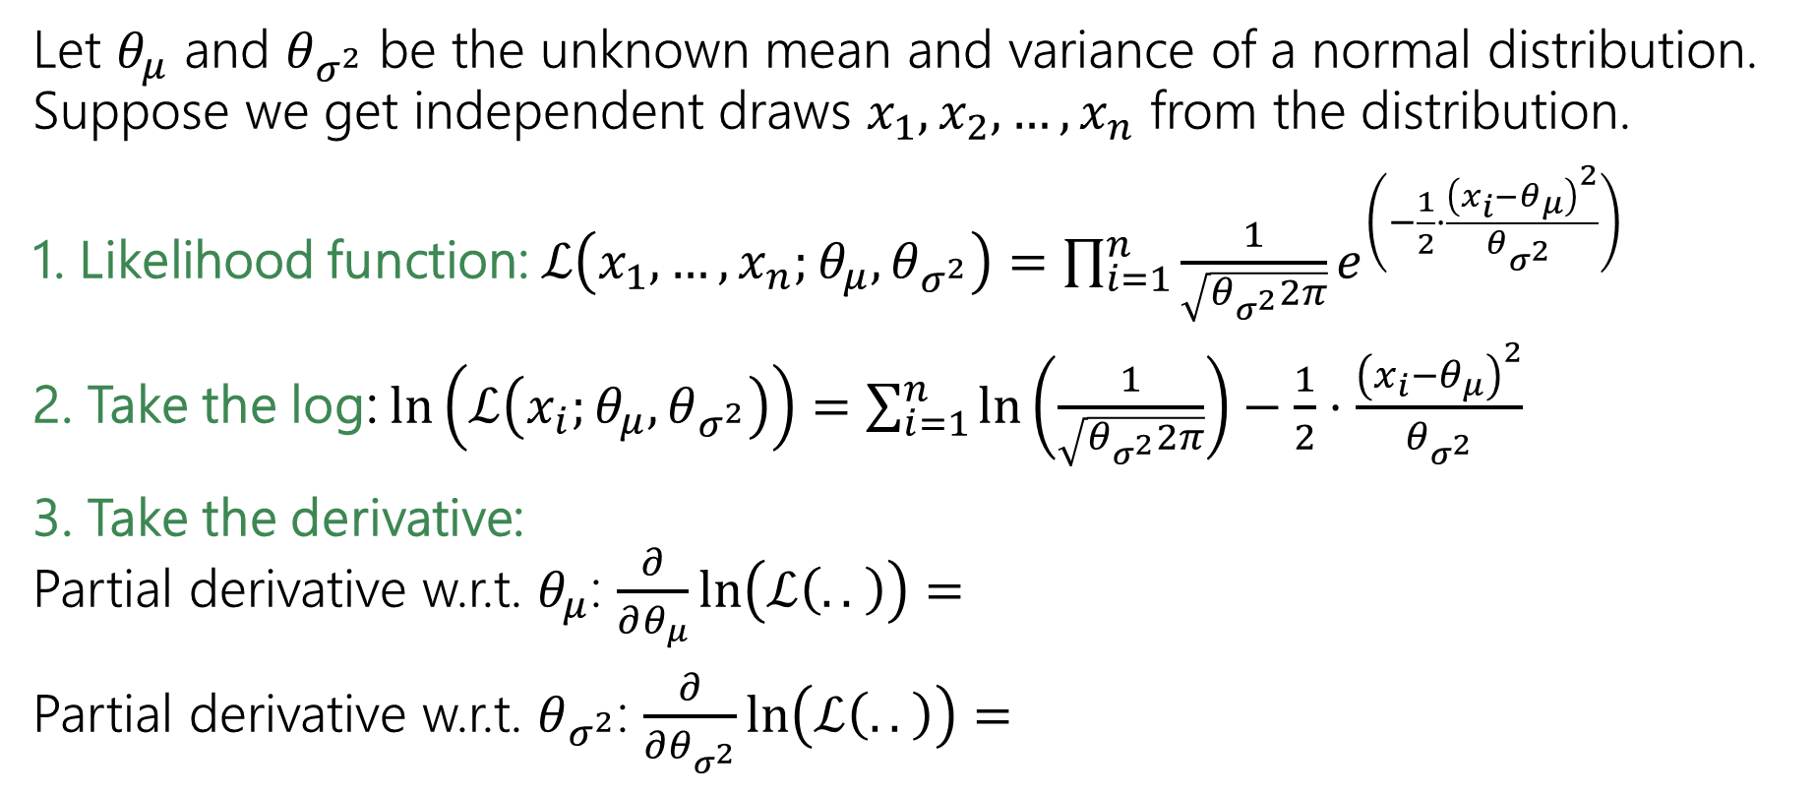
Generalizing Normals
Let $θ_{μ}$ and $θ_{σ^{2}}$ be the unknown mean and variance of a normal distribution. Suppose we get independent draws $x_{1},x_{2},…, x_{n}$ from the distribution.
1. Likelihood function: $ℒ\left(x_{1},…,x_{n};θ_{μ},θ_{σ^{2}}\right)=\prod_{i=1}^{n}{\frac{1}{\sqrt{θ_{σ^{2}}2π}}e^{\left(−\frac{1}{2}⋅\frac{{\left(x_{i}−θ_{μ}\right)}^{2}}{θ_{σ^{2} }}\right)}}$
2. Take the log:$\ln\left(ℒ\left(x_{i};θ_{μ},θ_{σ^{2}}\right)\right)=\sum_{i=1}^{n}{\ln\left(\frac{1}{\sqrt{θ_{σ^{2}}2π}}\right)−\frac{1}{2}⋅\frac{{\left(x_{i}−θ_{μ}\right)}^{2}}{θ_{σ^{2}}} }$
3. Take the derivative:
Partial derivative w.r.t. $θ_{μ}$: $\frac{∂}{∂θ_{μ}}\ln\left(ℒ\left(.. \right)\right)=$
Partial derivative w.r.t. $θ_{σ^{2}}$: $\frac{∂}{∂θ_{σ^{2}}}\ln\left(ℒ\left(.. \right)\right)=$

Slide 19
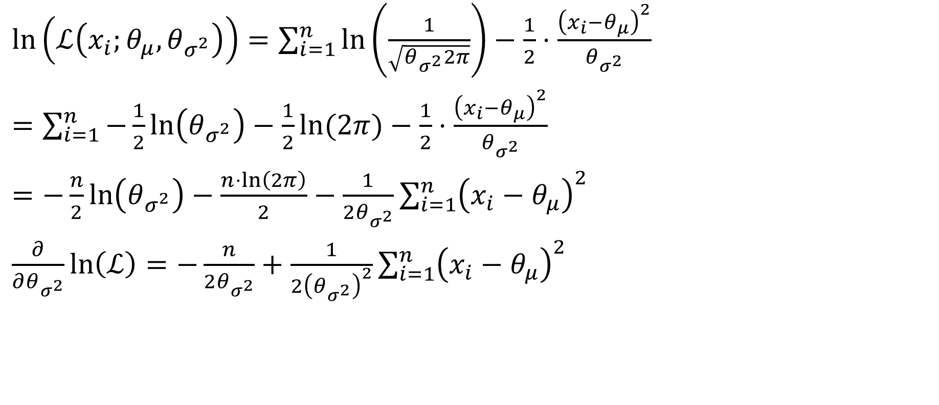

Partial derivative w.r.t. $θ_{σ^{2}}$
$\ln\left(ℒ\left(x_{i};θ_{μ},θ_{σ^{2}}\right)\right)=\sum_{i=1}^{n}{\ln\left(\frac{1}{\sqrt{θ_{σ^{2}}2π}}\right)−\frac{1}{2}⋅\frac{{\left(x_{i}−θ_{μ}\right)}^{2}}{θ_{σ^{2}}} }$
$=\sum_{i=1}^{n}{−\frac{1}{2}\ln\left(θ_{σ^{2}}\right)−\frac{1}{2}\ln{(2π)}}−\frac{1}{2}⋅\frac{{\left(x_{i}−θ_{μ}\right)}^{2}}{θ_{σ^{2}}}$
$=−\frac{n}{2}\ln\left(θ_{σ^{2}}\right)−\frac{n⋅\ln\left(2π\right)}{2}−\frac{1}{2θ_{σ^{2}}}\sum_{i=1}^{n}{{\left(x_{i}−θ_{μ}\right)}^{2}}$
$\frac{∂}{∂θ_{σ^{2}}}\ln\left(ℒ\right)=−\frac{n}{2θ_{σ^{2}}}+\frac{1}{2{\left(θ_{σ^{2}}\right)}^{2}}\sum_{i=1}^{n}{{\left(x_{i}−θ_{μ}\right)}^{2}}$

Slide 20
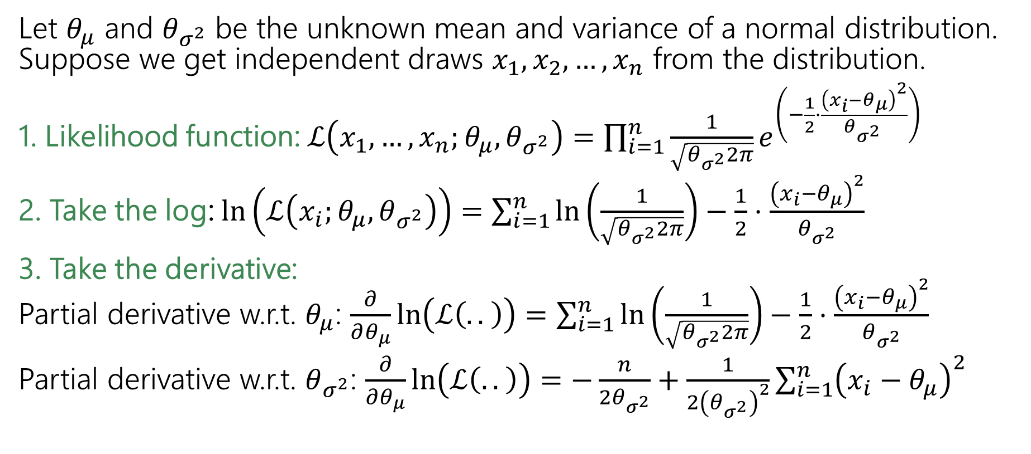
Generalizing Normals
Let $θ_{μ}$ and $θ_{σ^{2}}$ be the unknown mean and variance of a normal distribution. Suppose we get independent draws $x_{1},x_{2},…, x_{n}$ from the distribution.
1. Likelihood function: $ℒ\left(x_{1},…,x_{n};θ_{μ},θ_{σ^{2}}\right)=\prod_{i=1}^{n}{\frac{1}{\sqrt{θ_{σ^{2}}2π}}e^{\left(−\frac{1}{2}⋅\frac{{\left(x_{i}−θ_{μ}\right)}^{2}}{θ_{σ^{2} }}\right)}}$
2. Take the log:$\ln\left(ℒ\left(x_{i};θ_{μ},θ_{σ^{2}}\right)\right)=\sum_{i=1}^{n}{\ln\left(\frac{1}{\sqrt{θ_{σ^{2}}2π}}\right)−\frac{1}{2}⋅\frac{{\left(x_{i}−θ_{μ}\right)}^{2}}{θ_{σ^{2}}} }$
3. Take the derivative:
Partial derivative w.r.t. $θ_{μ}$: $\frac{∂}{∂θ_{μ}}\ln\left(ℒ\left(.. \right)\right)=\sum_{i=1}^{n}{\ln\left(\frac{1}{\sqrt{θ_{σ^{2}}2π}}\right)−\frac{1}{2}⋅\frac{{\left(x_{i}−θ_{μ}\right)}^{2}}{θ_{σ^{2}}} }$
Partial derivative w.r.t. $θ_{σ^{2}}$: $\frac{∂}{∂θ_{μ}}\ln\left(ℒ\left(.. \right)\right)=−\frac{n}{2θ_{σ^{2}}}+\frac{1}{2{\left(θ_{σ^{2}}\right)}^{2}}\sum_{i=1}^{n}{{\left(x_{i}−θ_{μ}\right)}^{2}}$

Slide 21
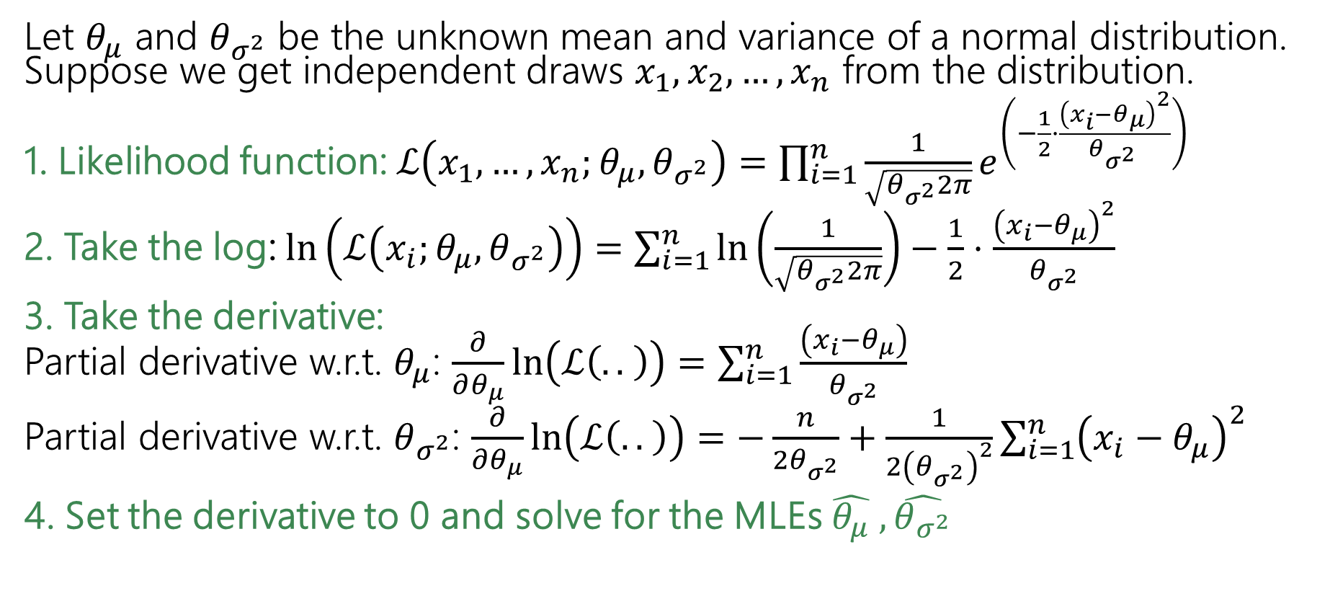
Generalizing Normals
Let $θ_{μ}$ and $θ_{σ^{2}}$ be the unknown mean and variance of a normal distribution. Suppose we get independent draws $x_{1},x_{2},…, x_{n}$ from the distribution.
1. Likelihood function: $ℒ\left(x_{1},…,x_{n};θ_{μ},θ_{σ^{2}}\right)=\prod_{i=1}^{n}{\frac{1}{\sqrt{θ_{σ^{2}}2π}}e^{\left(−\frac{1}{2}⋅\frac{{\left(x_{i}−θ_{μ}\right)}^{2}}{θ_{σ^{2} }}\right)}}$
2. Take the log:$\ln\left(ℒ\left(x_{i};θ_{μ},θ_{σ^{2}}\right)\right)=\sum_{i=1}^{n}{\ln\left(\frac{1}{\sqrt{θ_{σ^{2}}2π}}\right)−\frac{1}{2}⋅\frac{{\left(x_{i}−θ_{μ}\right)}^{2}}{θ_{σ^{2}}} }$
3. Take the derivative:
Partial derivative w.r.t. $θ_{μ}$: $\frac{∂}{∂θ_{μ}}\ln\left(ℒ\left(.. \right)\right)=\sum_{i=1}^{n}{\frac{\left(x_{i}−θ_{μ}\right)}{θ_{σ^{2}}}}$
Partial derivative w.r.t. $θ_{σ^{2}}$: $\frac{∂}{∂θ_{μ}}\ln\left(ℒ\left(.. \right)\right)=−\frac{n}{2θ_{σ^{2}}}+\frac{1}{2{\left(θ_{σ^{2}}\right)}^{2}}\sum_{i=1}^{n}{{\left(x_{i}−θ_{μ}\right)}^{2}}$
4. Set the derivative to 0 and solve for the MLEs $\hat{θ_{μ}} , \hat{θ_{σ^{2}}}$

Slide 22
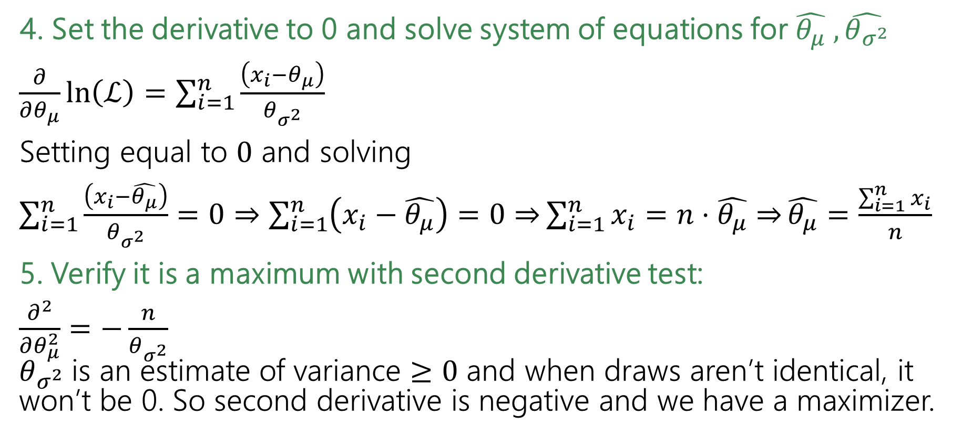
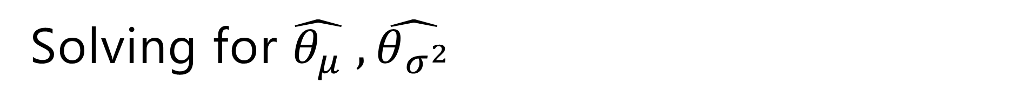
Solving for $\hat{θ_{μ}} , \hat{θ_{σ^{2}}}$
4. Set the derivative to 0 and solve system of equations for $\hat{θ_{μ}} , \hat{θ_{σ^{2}}}$
$\frac{∂}{∂θ_{μ}}\ln\left(ℒ\right)=\sum_{i=1}^{n}{\frac{\left(x_{i}−θ_{μ}\right)}{θ_{σ^{2}}}}$
Setting equal to $0$ and solving
$\sum_{i=1}^{n}{\frac{\left(x_{i}−\hat{θ_{μ}}\right)}{θ_{σ^{2}}}}=0⇒\sum_{i=1}^{n}{\left(x_{i}−\hat{θ_{μ}}\right)=0⇒}\sum_{i=1}^{n}{x_{i}=n⋅\hat{θ_{μ}}⇒}\hat{θ_{μ}}=\frac{\sum_{i=1}^{n}{x_{i}}}{n}$
5. Verify it is a maximum with second derivative test:
$\frac{∂^{2}}{∂θ_{μ}^{2}}=−\frac{n}{θ_{σ^{2}}}$
$θ_{σ^{2}}$is an estimate of variance $≥0$ and when draws aren’t identical, it won’t be 0. So second derivative is negative and we have a maximizer.

Slide 23
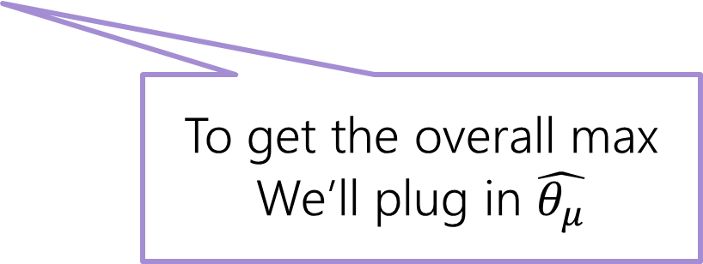
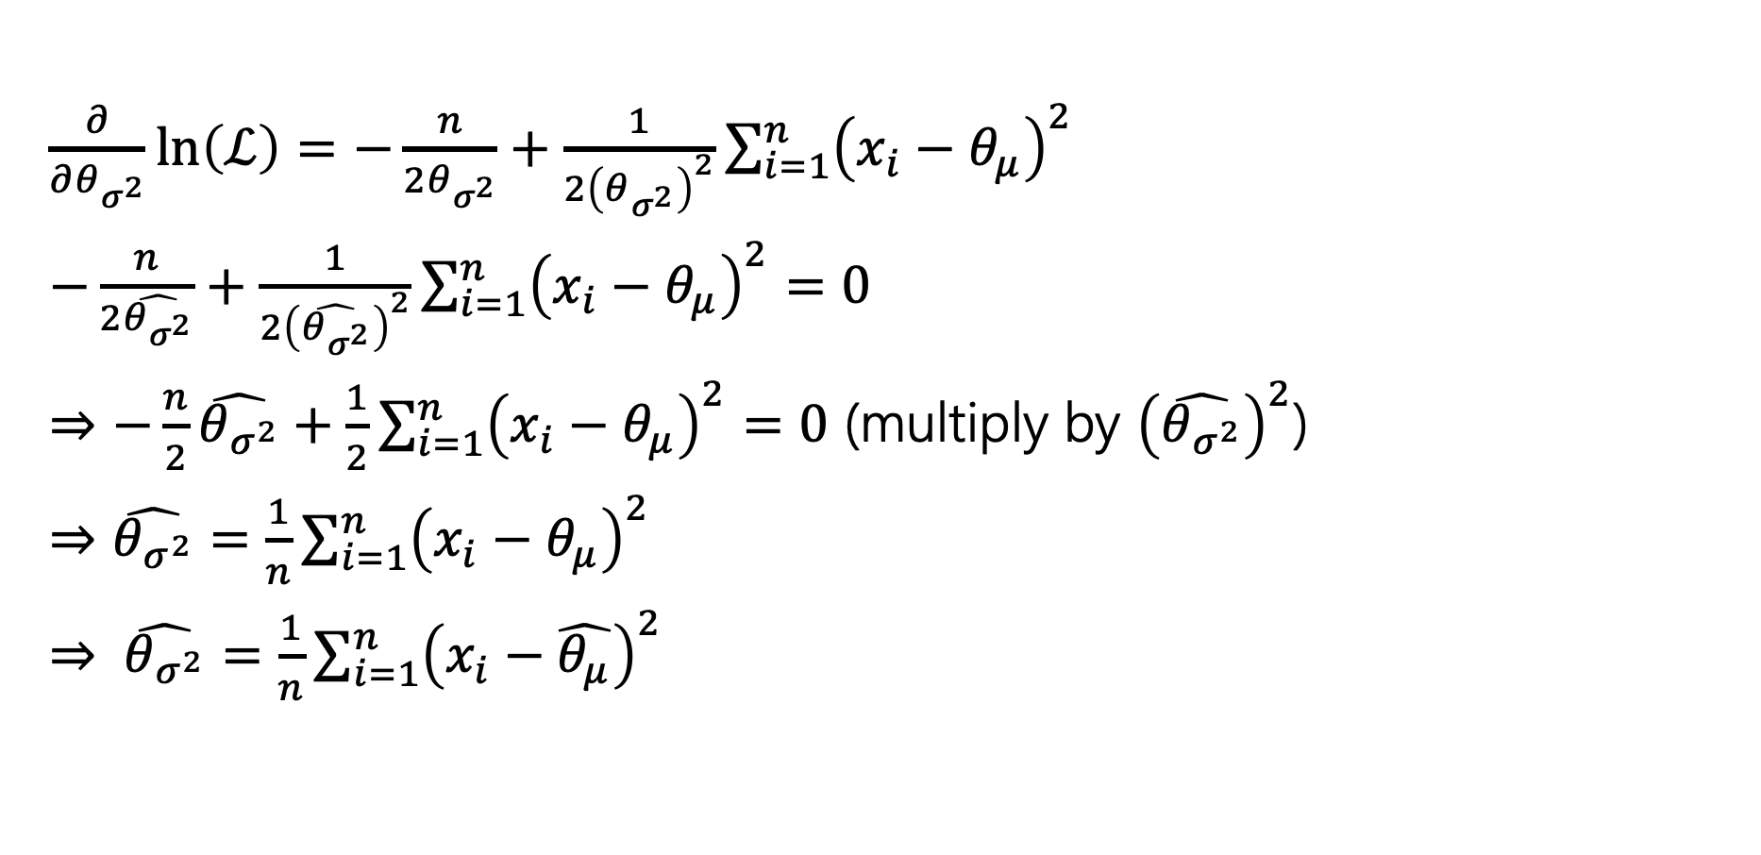
Solving for $\hat{θ_{μ}} , \hat{θ_{σ^{2}}}$
$\frac{∂}{∂θ_{σ^{2}}}\ln\left(ℒ\right)=−\frac{n}{2θ_{σ^{2}}}+\frac{1}{2{\left(θ_{σ^{2}}\right)}^{2}}\sum_{i=1}^{n}{{\left(x_{i}−θ_{μ}\right)}^{2}}$
$−\frac{n}{2\hat{θ_{σ^{2}}}}+\frac{1}{2{\left(\hat{θ_{σ^{2}}}\right)}^{2}}\sum_{i=1}^{n}{{\left(x_{i}−θ_{μ}\right)}^{2}}=0$
$⇒−\frac{n}{2}\hat{θ_{σ^{2}}}+\frac{1}{2}\sum_{i=1}^{n}{{\left(x_{i}−θ_{μ}\right)}^{2}}=0$ (multiply by ${\left(\hat{θ_{σ^{2}}}\right)}^{2}$)
$⇒\hat{θ_{σ^{2}}}=\frac{1}{n}\sum_{i=1}^{n}{{\left(x_{i}−θ_{μ}\right)}^{2}}$
$⇒ \hat{θ_{σ^{2}}}=\frac{1}{n}\sum_{i=1}^{n}{{\left(x_{i}−\hat{θ_{μ}}\right)}^{2}}$
To get the overall max
We’ll plug in $\hat{θ_{μ}}$
Notes:
Regardless of the value of $θ_{σ^{2}}$ that’s selected, the likelihood is maximized by setting $θ_{μ}$ to the value of $\hat{θ_{μ}}$ . So we should pick $θ_{μ}$ first (it’s without loss of generality to do so), then we can plug in the value and realize that the likelihood is overall maximized when $\hat{θ_{σ^{2}}}$ is selected as in the slide.

Slide 24
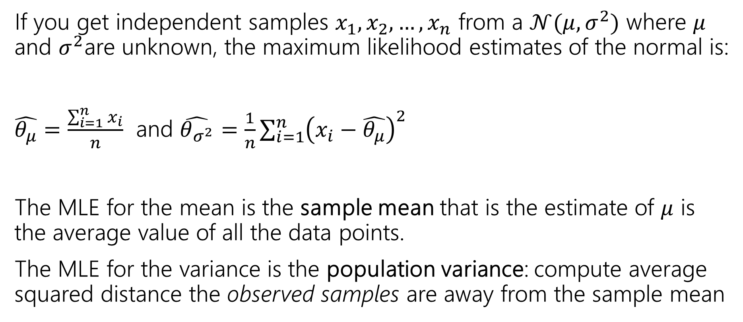
Generalizing Normals Summary
If you get independent samples $x_{1},x_{2},…,x_{n}$ from a $𝒩(μ,σ^{2})$ where $μ$ and $σ^{2}$are unknown, the maximum likelihood estimates of the normal is:
$\hat{θ_{μ}}=\frac{\sum_{i=1}^{n}{x_{i}}}{n}$ and $\hat{θ_{σ^{2}}}=\frac{1}{n}\sum_{i=1}^{n}{{\left(x_{i}−\hat{θ_{μ}}\right)}^{2}}$
The MLE for the mean is the sample mean that is the estimate of $μ$ is the average value of all the data points.
The MLE for the variance is the population variance: compute average squared distance the observed samples are away from the sample mean

Slide 25
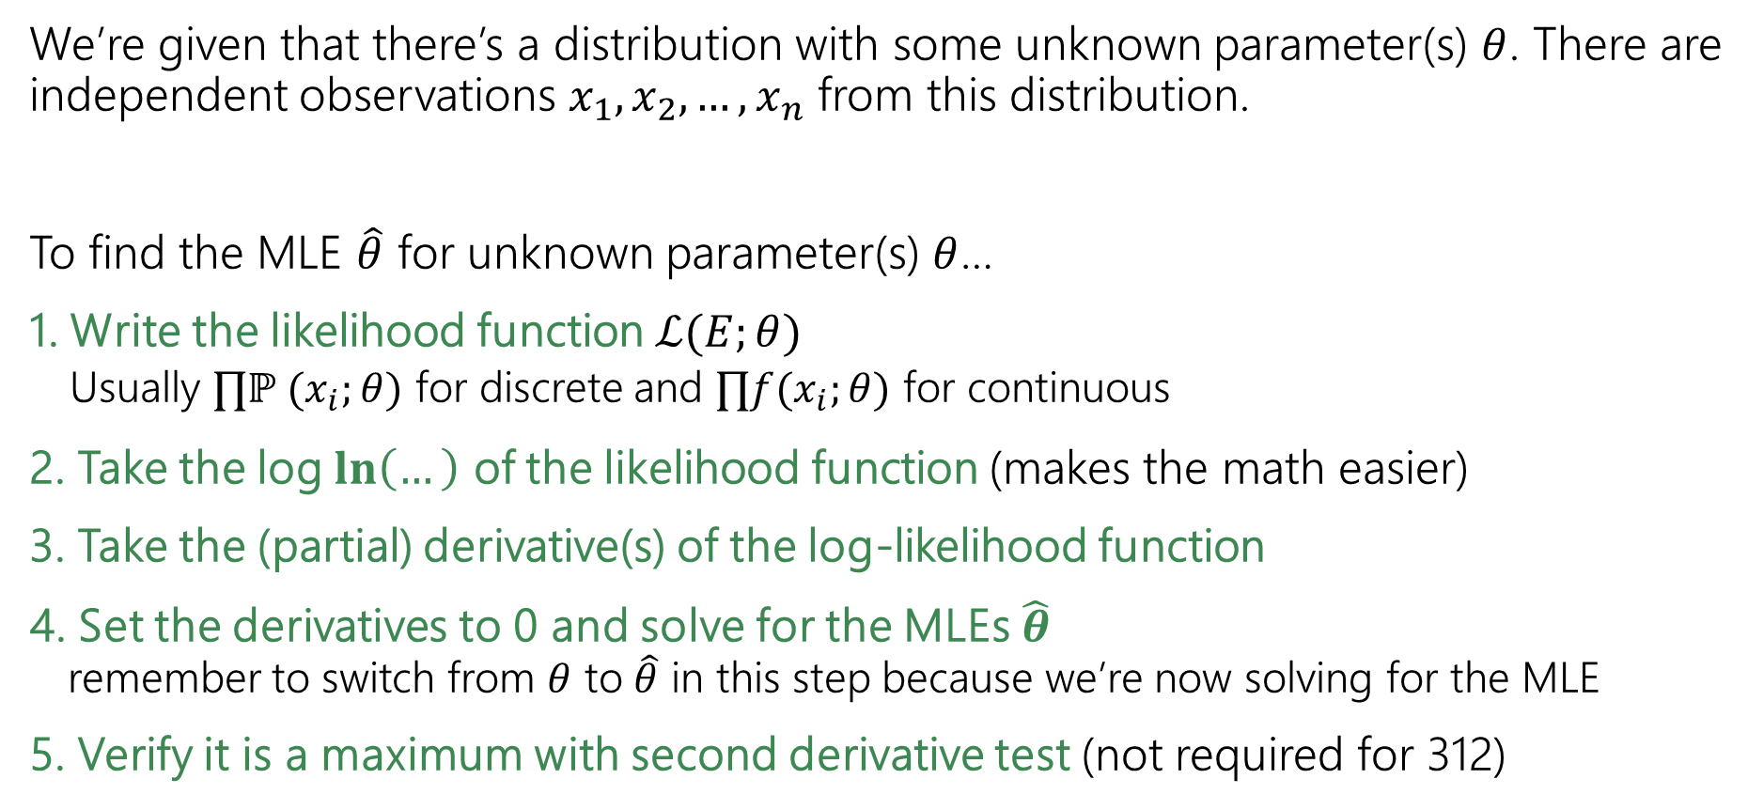
Solving MLE (the process)
We’re given that there’s a distribution with some unknown parameter(s) $θ$. There are independent observations $x_{1}, x_{2}, …, x_{n}$ from this distribution.
To find the MLE $\hat{θ}$ for unknown parameter(s) $θ$…
1. Write the likelihood function $ℒ(E;θ)$
  Usually $∏ℙ (x_{i};θ)$ for discrete and $∏f(x_{i};θ)$ for continuous
2. Take the log $\ln\left(…\right)$ of the likelihood function (makes the math easier)
3. Take the (partial) derivative(s) of the log-likelihood function
4. Set the derivatives to 0 and solve for the MLEs $\hat{θ}$
remember to switch from $θ$ to $\hat{θ}$ in this step because we’re now solving for the MLE
5. Verify it is a maximum with second derivative test (not required for 312)

Slide 26
Properties of Estimators
How do we tell whether an estimator is “good”?

Slide 27

Biased
One property we might want from an estimator is for it to be unbiased.
The expectation is taken over the randomness in the samples we drew.
The formula is fixed, the data we draw to evaluate the formula becomes the source of the randomness. We redefine each observed sample as random variables.
“On average over many samples, is our estimator correct?”
An estimator $\hat{θ}$is “unbiased” if
$$𝔼\left[\hat{θ}\right]=θ$$

Slide 28


Biased
If the bias isn’t unbiased then it is biased.
$\text{Bias}\left(θ, \hat{θ}\right)=0$ → unbiased
$\text{Bias}\left(θ, \hat{θ}\right)>0$ → overestimate
$\text{Bias}\left(θ, \hat{θ}\right)<0$ → underestimate
The “bias” of an estimator $\hat{θ}$ is
$$\text{Bias}\left(θ, \hat{θ}\right)=𝔼\left[\hat{θ}\right]−θ$$

Slide 29
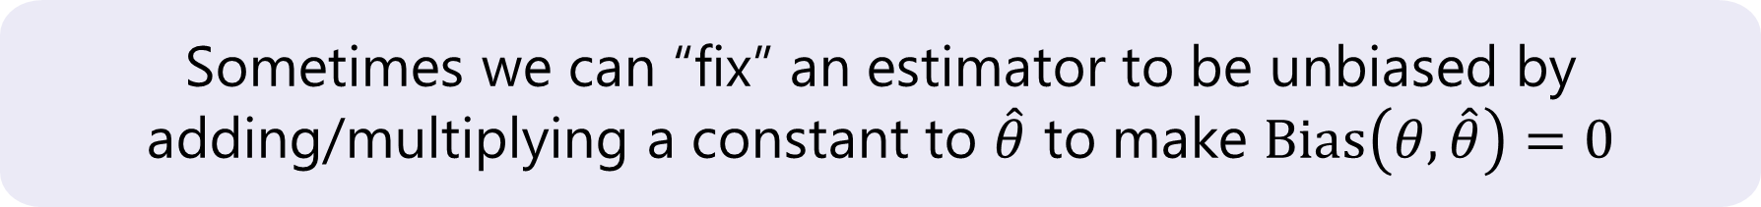
Biased
If the bias isn’t unbiased then it is biased.
$\text{Bias}\left(θ, \hat{θ}\right)=0$ → unbiased
$\text{Bias}\left(θ, \hat{θ}\right)>0$ → overestimate
$\text{Bias}\left(θ, \hat{θ}\right)<0$ → underestimate
The “bias” of an estimator $\hat{θ}$ is
$$\text{Bias}\left(θ, \hat{θ}\right)=𝔼\left[\hat{θ}\right]−θ$$
Sometimes we can “fix” an estimator to be unbiased by
adding/multiplying a constant to $\hat{θ}$ to make $\text{Bias}\left(θ, \hat{θ}\right)=0$

Slide 30

Are our MLEs unbiased?
We aim to evaluate the performance of our estimator on average. Instead of focusing on specific data, we define random variables representing the distribution from which each sample is drawn.
Example: MLE for mean of normal distribution
Each observed $x_{i}$ is a sample from $𝒩\left(μ,σ^{2}\right)$. Let $X_{i}\sim 𝒩\left(μ,σ^{2}\right)$
$\hat{θ_{μ}}=\frac{\sum_{i=1}^{n}{X_{i}}}{n}$
$𝔼\left[\hat{θ_{μ}}\right]=𝔼\left[\frac{\sum_{i=1}^{n}{X_{i}}}{n}\right]=$
Notes:
Want to

Slide 31
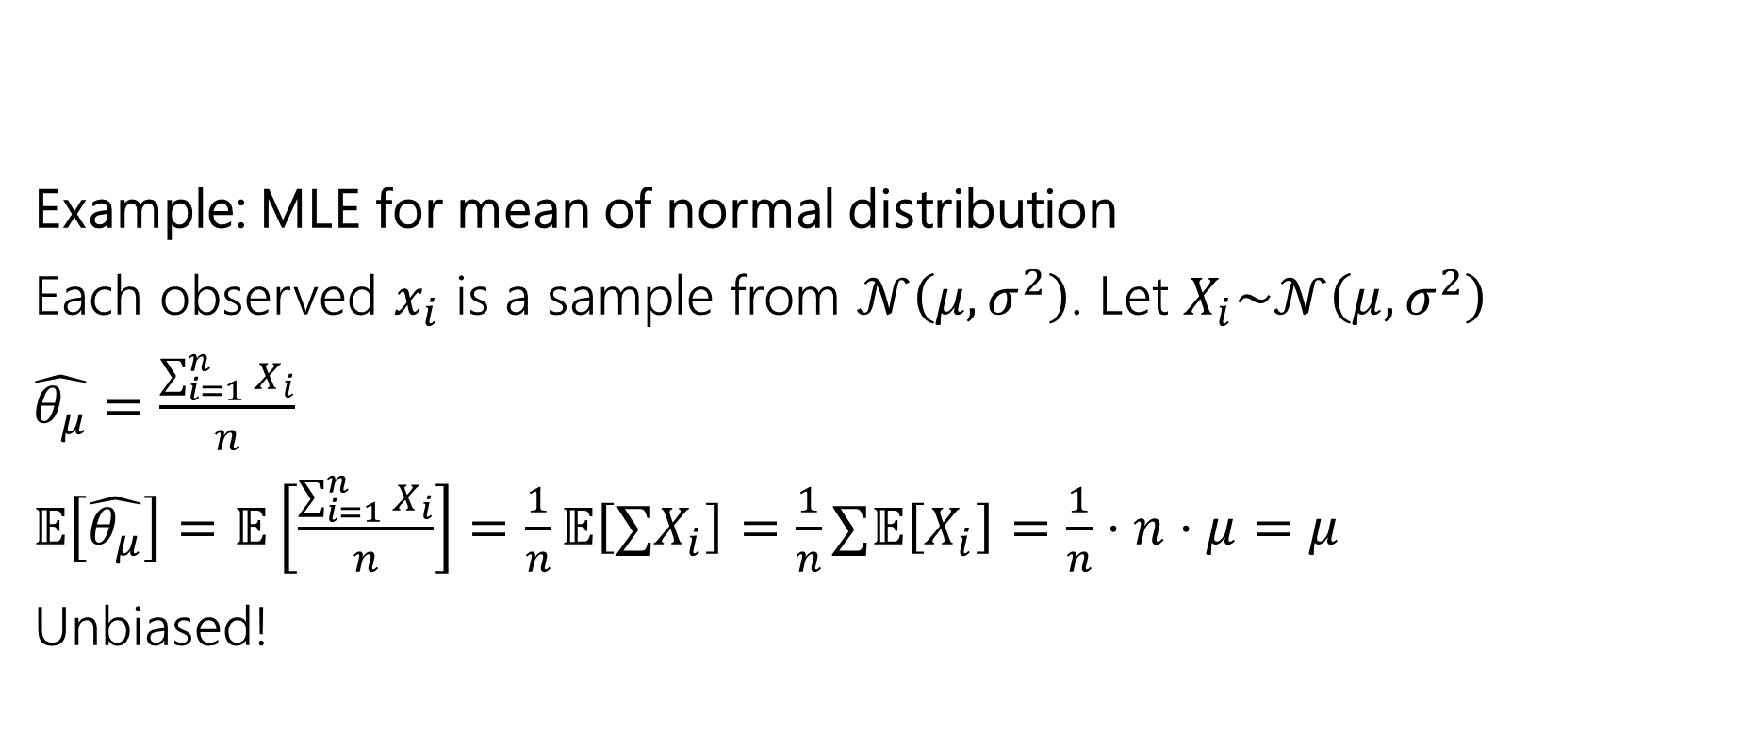
Are our MLEs unbiased?
We aim to evaluate the performance of our estimator on average. Instead of focusing on specific data, we define random variables representing the distribution from which each sample is drawn.
Example: MLE for mean of normal distribution
Each observed $x_{i}$ is a sample from $𝒩\left(μ,σ^{2}\right)$. Let $X_{i}\sim 𝒩\left(μ,σ^{2}\right)$
$\hat{θ_{μ}}=\frac{\sum_{i=1}^{n}{X_{i}}}{n}$
$𝔼\left[\hat{θ_{μ}}\right]=𝔼\left[\frac{\sum_{i=1}^{n}{X_{i}}}{n}\right]=\frac{1}{n}𝔼\left[∑X_{i}\right]=\frac{1}{n}∑𝔼\left[X_{i}\right]=\frac{1}{n}⋅n⋅μ=μ$
Unbiased!
Notes:
Want to

Slide 32
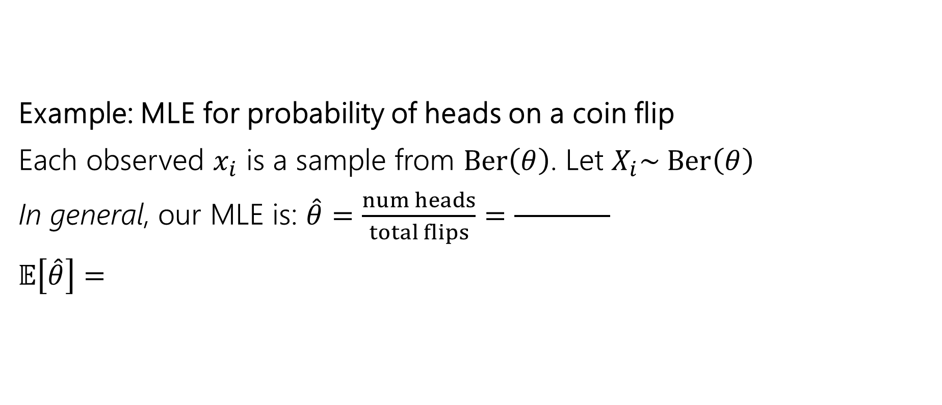
Are our MLEs unbiased?
We aim to evaluate the performance of our estimator on average. Instead of focusing on specific data, we define random variables representing the distribution from which each sample is drawn.
Example: MLE for probability of heads on a coin flip
Each observed $x_{i}$ is a sample from $Ber\left(θ\right)$. Let $X_{i}\sim Ber\left(θ\right)$
In general, our MLE is: $\hat{θ}=\frac{num heads}{total flips}=\frac{ }{ }$
$𝔼\left[\hat{θ}\right]=$
Notes:
Want to

Slide 33
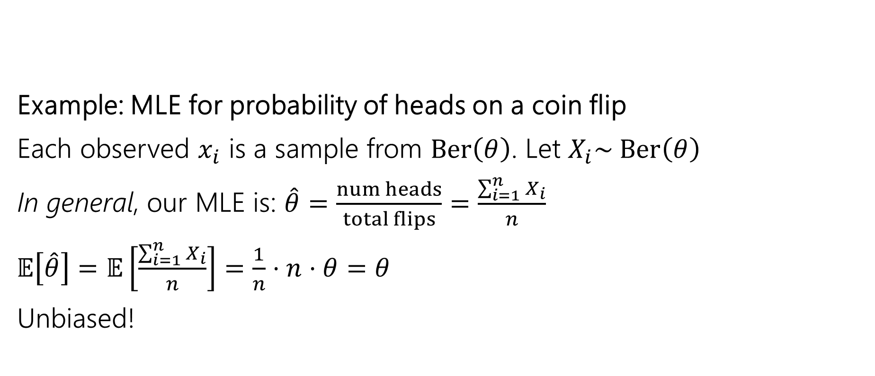
Are our MLEs unbiased?
We aim to evaluate the performance of our estimator on average. Instead of focusing on specific data, we define random variables representing the distribution from which each sample is drawn.
Example: MLE for probability of heads on a coin flip
Each observed $x_{i}$ is a sample from $Ber\left(θ\right)$. Let $X_{i}\sim Ber\left(θ\right)$
In general, our MLE is: $\hat{θ}=\frac{num heads}{total flips}=\frac{\sum_{i=1}^{n}{X_{i}}}{n}$
$𝔼\left[\hat{θ}\right]=𝔼\left[\frac{\sum_{i=1}^{n}{X_{i}}}{n}\right]=\frac{1}{n}⋅n⋅θ=θ$
Unbiased!
Notes:
Want to

Slide 34
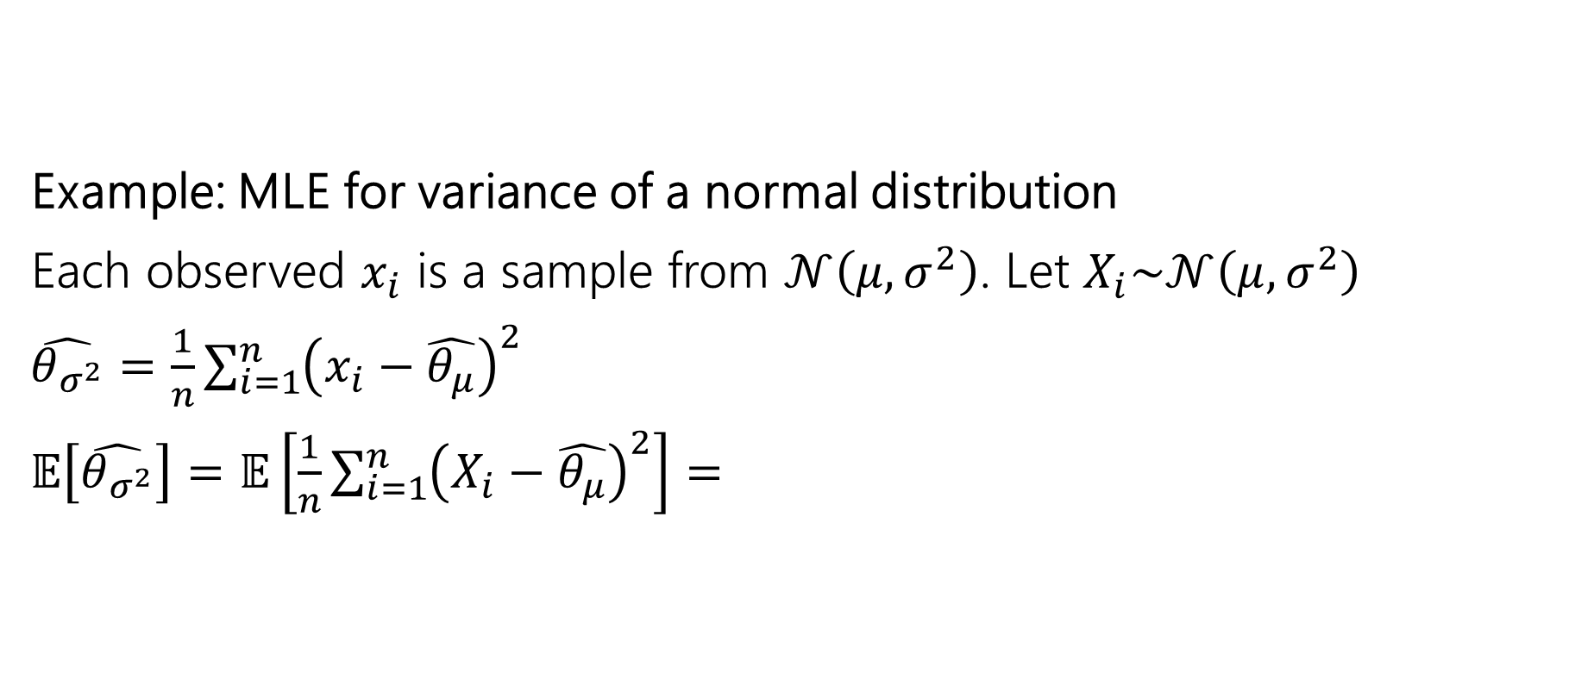
Are our MLEs unbiased?
We aim to evaluate the performance of our estimator on average. Instead of focusing on specific data, we define random variables representing the distribution from which each sample is drawn.
Example: MLE for variance of a normal distribution
Each observed $x_{i}$ is a sample from $𝒩\left(μ,σ^{2}\right)$. Let $X_{i}\sim 𝒩\left(μ,σ^{2}\right)$
$\hat{θ_{σ^{2}}}=\frac{1}{n}\sum_{i=1}^{n}{{\left(x_{i}−\hat{θ_{μ}}\right)}^{2}}$
$𝔼\left[\hat{θ_{σ^{2}}}\right]=𝔼\left[\frac{1}{n}\sum_{i=1}^{n}{{\left(X_{i}−\hat{θ_{μ}}\right)}^{2}}\right]=$
Notes:
Want to

Slide 35
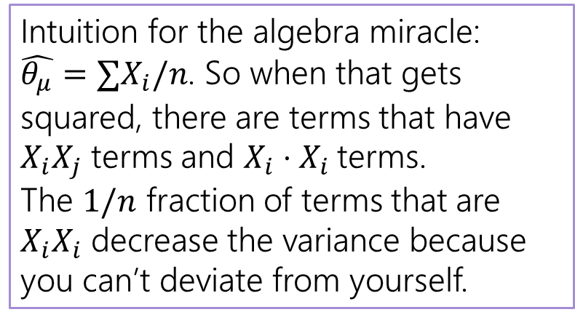

Are our MLEs unbiased? (variance)
$𝔼\left[\hat{θ_{σ^{2}}}\right]=𝔼[\frac{1}{n}\sum_{i=1}^{n}{{\left(X_{i}−\hat{θ_{μ}}\right)}^{2}]}$
$=\frac{1}{n}𝔼\left[{∑\left(X_{i}−\hat{θ_{μ}}\right)}^{2}\right]$
$=\frac{1}{n}𝔼\left[∑X_{i}^{2}−2X_{i}\hat{θ_{μ}}+{\hat{θ_{μ}}}^{2}\right]$
$…$
Then an algebraic miracle occurs…
$=\frac{n−1}{n}⋅σ^{2}$ where $σ^{2}=𝔼\left[{(X}_{i}−𝔼\left[X_{i}\right])^2\right]$
Intuition for the algebra miracle:
$\hat{θ_{μ}}=∑X_{i}/n$. So when that gets squared, there are terms that have $X_{i}X_{j}$ terms and $X_{i}⋅X_{i}$terms.
The $1/n$ fraction of terms that are $X_{i}X_{i}$ decrease the variance because you can’t deviate from yourself.

Slide 36
Optional: Algebra
Showing MLE of Variance is biased

Slide 37


That Algebraic Miracle
$=\frac{1}{n}𝔼\left[∑X_{i}^{2}−2X_{i}\hat{θ_{μ}}+{\hat{θ_{μ}}}^{2}\right]$
$=\frac{1}{n}𝔼\left[∑X_{i}^{2}\right]−\frac{1}{n}𝔼\left[∑2X_{i}\hat{θ_{μ}}−{∑\hat{θ_{μ}}}^{2}\right]$
$=\frac{1}{n}n𝔼\left[X_{1}^{2}\right]−\frac{1}{n}𝔼\left[2\hat{θ_{μ}}∑X_{i}−{∑\hat{θ_{μ}}}^{2}\right]$
$=𝔼\left[X_{1}^{2}\right]−\frac{1}{n}𝔼\left[2n{\hat{θ_{μ}}}^{2}−n{\hat{θ_{μ}}}^{2}\right]$
$=𝔼\left[X_{1}^{2}\right]−\frac{1}{n}𝔼\left[n{\hat{θ_{μ}}}^{2}\right]$
$=𝔼\left[X_{1}^{2}\right]−𝔼\left[{\hat{θ_{μ}}}^{2}\right]$
$$\hat{θ_{μ}}=∑X_{i}/n$$

Slide 38
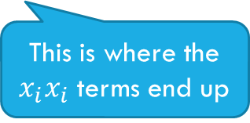
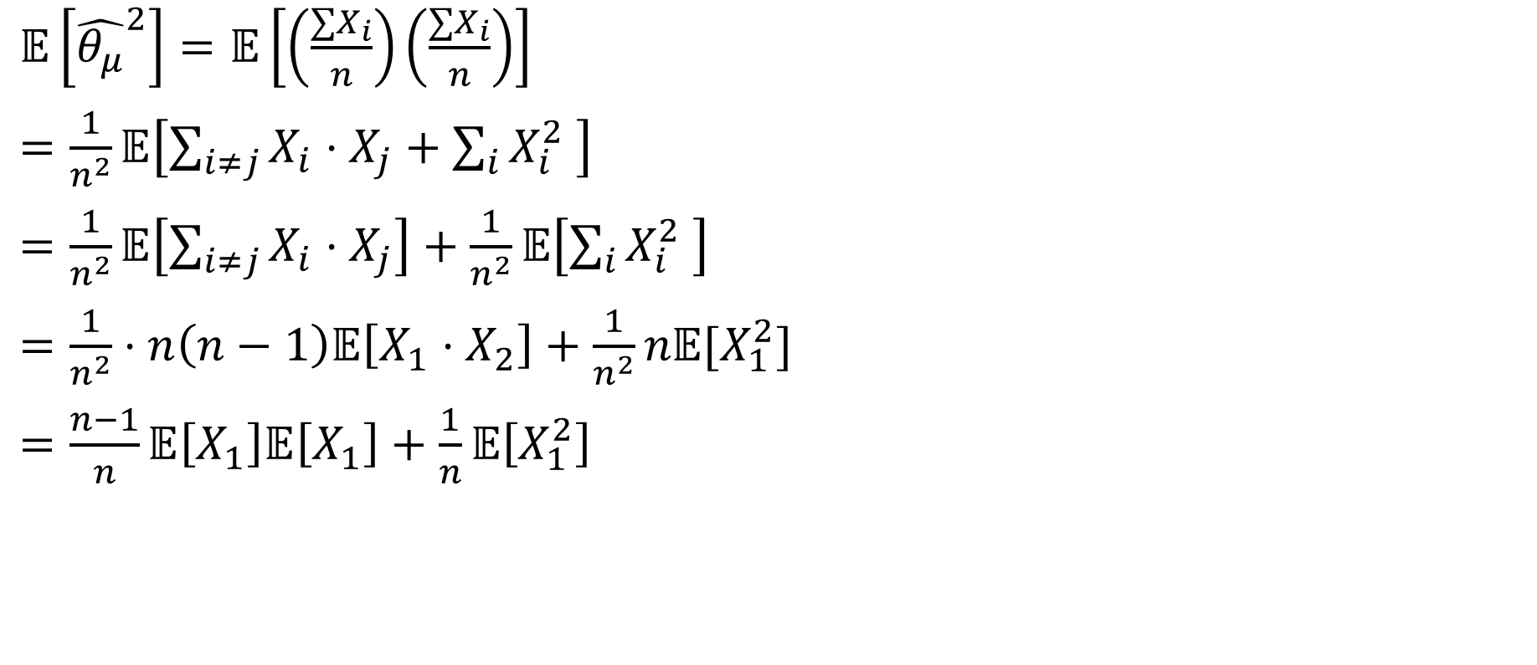

More of That Algebraic Miracle
$𝔼\left[{\hat{θ_{μ}}}^{2}\right]=𝔼\left[\left(\frac{∑X_{i}}{n}\right)\left(\frac{∑X_{i}}{n}\right)\right]$
$=\frac{1}{n^{2}}𝔼\left[\sum_{i≠j}{X_{i}⋅X_{j}}+\sum_{i}{X_{i}^{2} }\right]$
$=\frac{1}{n^{2}}𝔼\left[\sum_{i≠j}{X_{i}⋅X_{j}}\right]+\frac{1}{n^{2}}𝔼\left[\sum_{i}{X_{i}^{2} }\right]$
$=\frac{1}{n^{2}}⋅n\left(n−1\right)𝔼\left[X_{1}⋅X_{2}\right]+\frac{1}{n^{2}}n𝔼[X_{1}^{2}]$
$=\frac{n−1}{n}𝔼\left[X_{1}\right]𝔼\left[X_{1}\right]+\frac{1}{n}𝔼\left[X_{1}^{2}\right]$
These are the $x_{i}x_{i}$ terms.
This is where the $x_{i}x_{i}$ terms end up

Slide 39
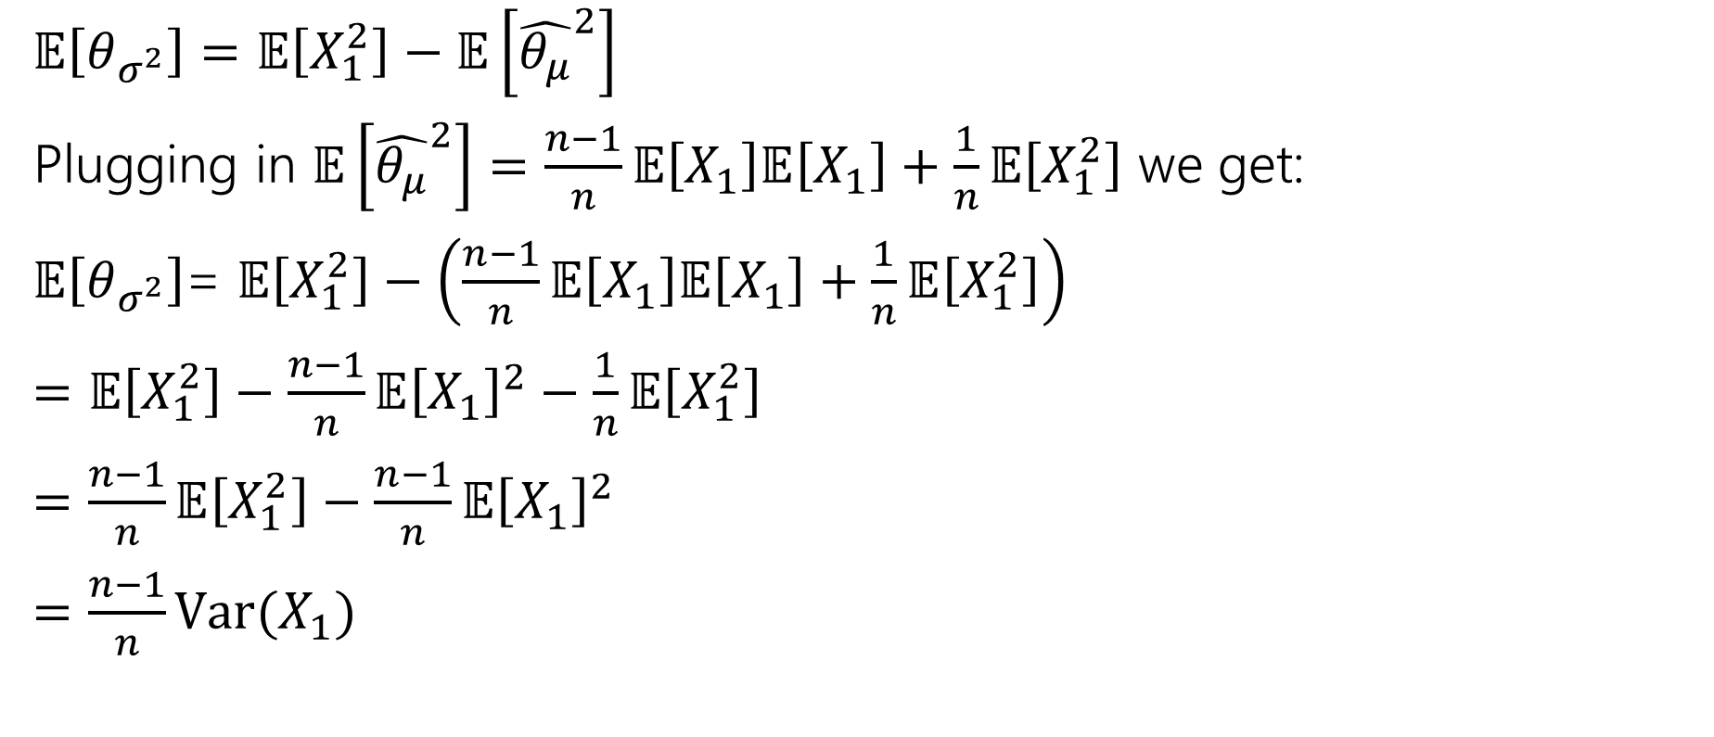
Wrapping Up the Algebraic Miracle
$𝔼\left[θ_{σ^{2}}\right]=𝔼\left[X_{1}^{2}\right]−𝔼\left[{\hat{θ_{μ}}}^{2}\right]$
Plugging in $𝔼\left[{\hat{θ_{μ}}}^{2}\right]=\frac{n−1}{n}𝔼\left[X_{1}\right]𝔼\left[X_{1}\right]+\frac{1}{n}𝔼\left[X_{1}^{2}\right]$ we get:
$𝔼\left[θ_{σ^{2}}\right]$= $𝔼\left[X_{1}^{2}\right]−\left(\frac{n−1}{n}𝔼\left[X_{1}\right]𝔼\left[X_{1}\right]+\frac{1}{n}𝔼\left[X_{1}^{2}\right]\right)$
$=𝔼\left[X_{1}^{2}\right]−\frac{n−1}{n}𝔼{\left[X_{1}\right]}^{2}−\frac{1}{n}𝔼\left[X_{1}^{2}\right]$
$=\frac{n−1}{n}𝔼\left[X_{1}^{2}\right]−\frac{n−1}{n}𝔼{\left[X_{1}\right]}^{2}$
$=\frac{n−1}{n}Var(X_{1})$

Slide 40
Non-Optional Takeaways

Slide 41
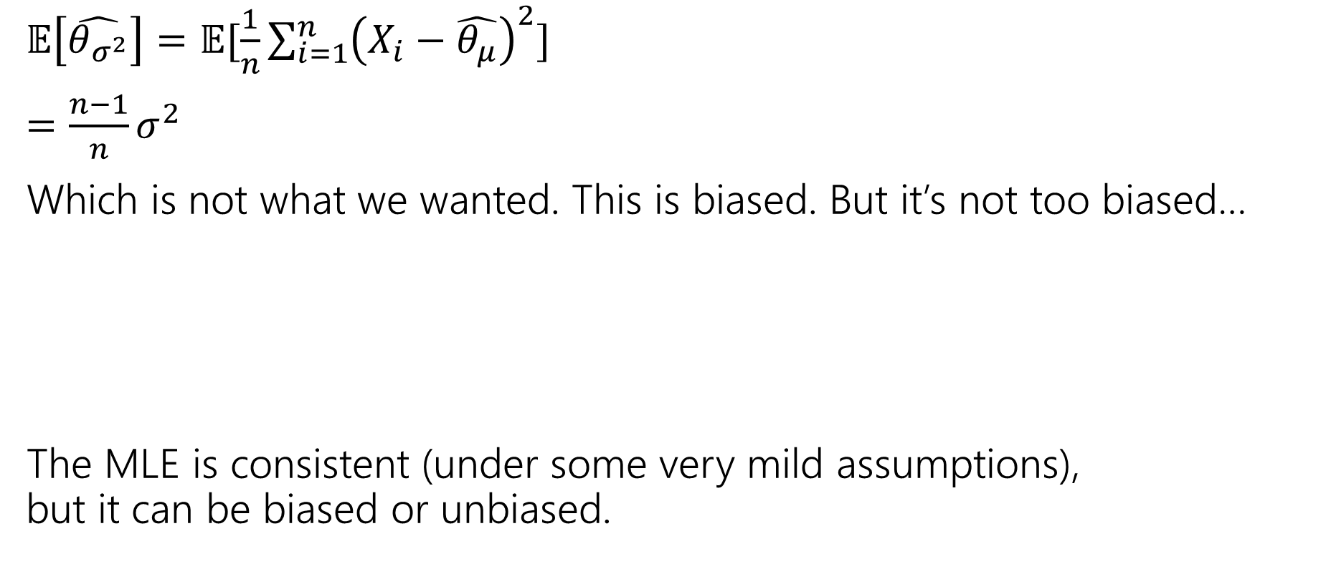

Not Unbiased
$𝔼\left[\hat{θ_{σ^{2}}}\right]=𝔼[\frac{1}{n}\sum_{i=1}^{n}{{\left(X_{i}−\hat{θ_{μ}}\right)}^{2}]}$
$=\frac{n−1}{n}σ^{2}$
Which is not what we wanted. This is biased. But it’s not too biased…
The MLE is consistent (under some very mild assumptions),
but it can be biased or unbiased.
An estimator $\hat{θ}$is “consistent” if
$$\lim_{n→∞}{𝔼\left[\hat{θ}\right]}=θ$$
Notes:
See, e.g., https://stats.stackexchange.com/questions/323873/assumptions-of-mle
In Boos & Stefanski "Essential Statistical Inference" (pp. 278-281), four conditions on the sampling density $f\left(⋅ ; θ\right)$are given as sufficient for consistency:
Identifiability of the parameter $θ$, i.e., when $θ_{1}≠θ_{2}$, the set
$$\{x;f\left(x ; θ_{2}\right)=f\left(x ; θ_{1}\right)\}$$
is not of measure one;
Boundedness of the expected likelihood, i.e.,
$$\int{log}{\{}f\left(x ; θ\right)\}dF\left(x ; θ_{0}\right)<∞$$
in a neighbourhood of the true parameter value $θ_{0}$;
Differentiability of the log-likelihood, i.e., $\log{\{}f\left(x ; θ\right)\}$is continuously differentiable in a neighbourhood of the true parameter value $θ_{0}$for almost every $x$in the support of $F\left(x ; θ_{0}\right)$;
Uniform integrability, i.e., $\log{\{}f\left(x ; θ\right)\}$is bounded uniformly in $θ$by an integrable function $h\left(x\right)$[integrable against $F\left(x ; θ_{0}\right)$]

Slide 42
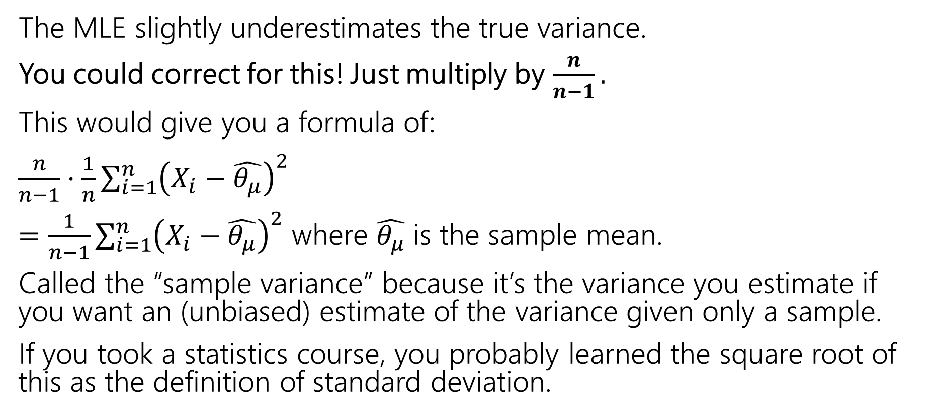
Correction
The MLE slightly underestimates the true variance.
You could correct for this! Just multiply by $\frac{n}{n−1}.$
This would give you a formula of:
$\frac{n}{n−1}⋅\frac{1}{n}\sum_{i=1}^{n}{{\left(X_{i}−\hat{θ_{μ}}\right)}^{2}}$
$=\frac{1}{n−1}\sum_{i=1}^{n}{{\left(X_{i}−\hat{θ_{μ}}\right)}^{2}}$ where $\hat{θ_{μ}}$ is the sample mean.
Called the “sample variance” because it’s the variance you estimate if you want an (unbiased) estimate of the variance given only a sample.
If you took a statistics course, you probably learned the square root of this as the definition of standard deviation.
Notes:
This would no longer be an MLE estimator, it is a different estimator.
Do other estimator exist? Yes! Maximum a posteriori probability estimation (MAP)

Slide 43
Fun Facts

Slide 44
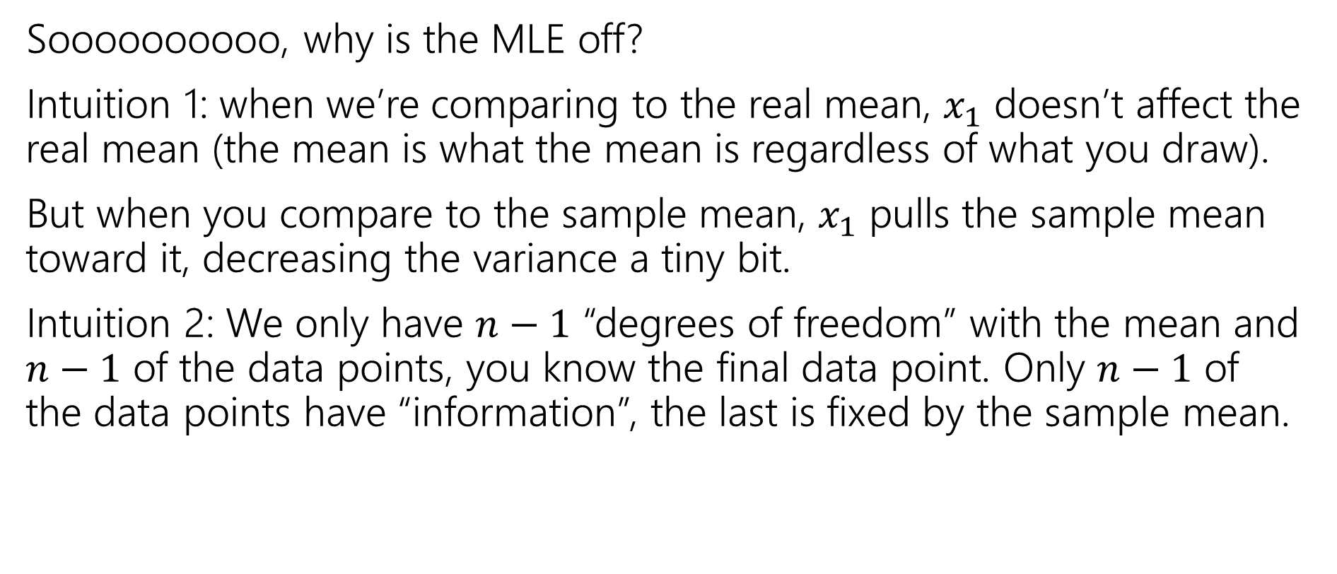

What’s with the $n−1$?
Soooooooooo, why is the MLE off?
Intuition 1: when we’re comparing to the real mean, $x_{1}$ doesn’t affect the real mean (the mean is what the mean is regardless of what you draw).
But when you compare to the sample mean, $x_{1}$ pulls the sample mean toward it, decreasing the variance a tiny bit.
Intuition 2: We only have $n−1$ “degrees of freedom” with the mean and $n−1$ of the data points, you know the final data point. Only $n−1$ of the data points have “information”, the last is fixed by the sample mean.

Slide 45
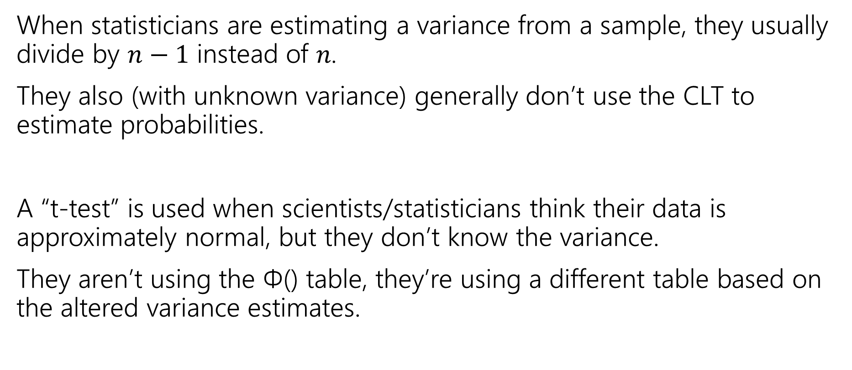
Why does it matter?
When statisticians are estimating a variance from a sample, they usually divide by $n−1$ instead of 𝑛.
They also (with unknown variance) generally don’t use the CLT to estimate probabilities.
A “t-test” is used when scientists/statisticians think their data is approximately normal, but they don’t know the variance.
They aren’t using the Φ() table, they’re using a different table based on the altered variance estimates.

Slide 46
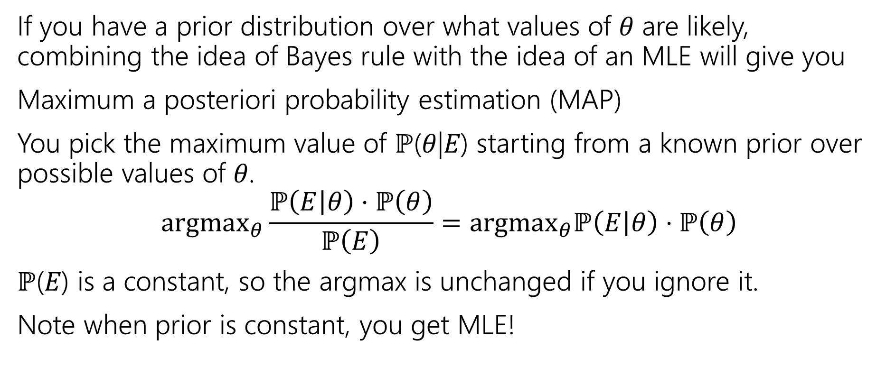
Why use MLEs? Are there other estimators?
If you have a prior distribution over what values of 𝜃 are likely, combining the idea of Bayes rule with the idea of an MLE will give you
Maximum a posteriori probability estimation (MAP)
You pick the maximum value of ℙ(𝜃|𝐸) starting from a known prior over possible values of 𝜃.
$$\text{argma}{\text{x}}_{θ}\frac{ℙ\left(E | θ\right)⋅ℙ\left(θ\right)}{ℙ\left(E\right)}=\text{argma}{\text{x}}_{θ}ℙ\left(E | θ\right)⋅ℙ\left(θ\right)$$
ℙ(𝐸) is a constant, so the argmax is unchanged if you ignore it.
Note when prior is constant, you get MLE!

