Slide 1
Maximum Likelihood Estimation
CSE 312 26Su
Lecture 20

Slide 2
Announcements
Final information on website
Homework 6 is due on Wednesday
Quiz 7 on Friday (Tail Bounds + MLE)

Slide 3
Where Are We?
Today:
  Tail Bounds
    Chebyshev’s Inequality
    Chernoff Bound
Today:
  Tail Bounds
    Finish up Chernoff Bound
    not a tail bound, but Union Bound
  Maximum Likelihood Estimation

Slide 4
Chernoff Bound
(Multiplicative) Chernoff Bound
Let 𝑋₁, 𝑋₂, … , 𝑋_{𝑛} be independent Bernoulli random variables.
Let 𝑋 = ∑𝑋_{𝑖}, and 𝜇 = 𝔼 𝑋 . For any 0 ≤ 𝛿 ≤ 1
−
𝛿²𝜇 𝛿²𝜇
ℙ 𝑋 ≤ 1 − 𝛿 𝜇 ≤ 𝑒
LEFT TAIL
and ℙ 𝑋 ≥ 1 + 𝛿 𝜇 ≤ 𝑒
RIGHT TAIL
−
2
3
Requirements:
X is a sum of independent Bernoulli random variables.
We know 𝔼 𝑋

Slide 5

Example: Polling (again, but better!)
Suppose you run a poll of 1000 people where in the true population 60% of the population supports you. What is the probability that the poll is not within 10-percentage-points of the true value?
Goal: bound ℙ$\left(|\overline{X}−0.6\right|≥0.1)=\text{ℙ}\text{(}\overline{X}≤0.5)+\text{ℙ}\text{(}\overline{X}≥0.7)$
(Multiplicative) Chernoff Bound
Let 𝑋₁, 𝑋₂, … , 𝑋_{𝑛} be independent Bernoulli random variables.
Let 𝑋 = ∑𝑋_{𝑖}, and 𝜇 = 𝔼 𝑋 . For any 0 ≤ 𝛿 ≤ 1
−
𝛿²𝜇 𝛿²𝜇
ℙ 𝑋 ≤ 1 − 𝛿 𝜇 ≤ 𝑒
LEFT TAIL
and ℙ 𝑋 ≥ 1 + 𝛿 𝜇 ≤ 𝑒
RIGHT TAIL
−
2
3

Slide 6
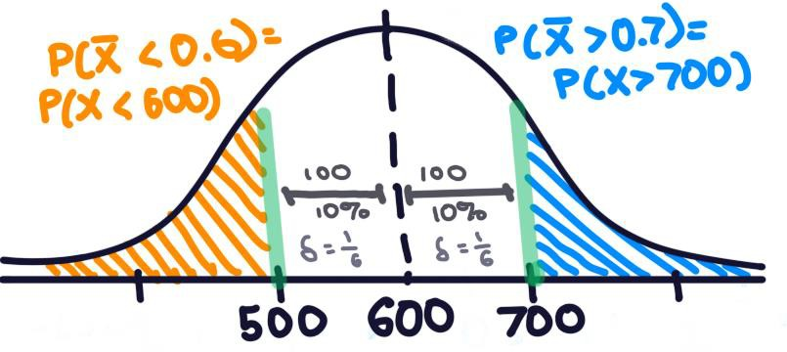
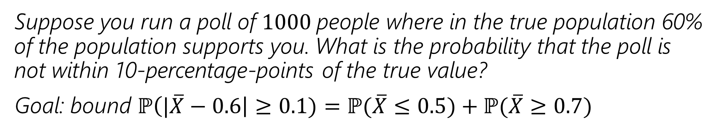
Suppose you run a poll of 1000 people where in the true population 60% of the population supports you. What is the probability that the poll is not within 10-percentage-points of the true value?
Goal: bound ℙ$\left(|\overline{X}−0.6\right|≥0.1)=\text{ℙ}\text{(}\overline{X}≤0.5)+\text{ℙ}\text{(}\overline{X}≥0.7)$

Slide 7
Example: Polling (1. bound the left tail)
Goal: bound ℙ$\left(|\overline{X}−0.6\right|≥0.1)=\text{ℙ}\text{(}\overline{X}≤0.5)+\text{ℙ}\text{(}\overline{X}≥0.7)$
Suppose you run a poll of 1000 people where in the true population 60% of the population supports you. What is the probability that the poll is not within 10-percentage-points of the true value?
𝑋 = ∑𝑋_{𝑖}, where 𝑋_{𝑖}~Ber(0.6), 𝜇 = 𝔼 𝑋
= 1000 ⋅ 0.6 = 600
ℙ
𝑋
≤ 0.5 =
1000
Chernoff Bound (left tail)
Let 𝑋₁, 𝑋₂, … , 𝑋_{𝑛} be independent
Bernoulli random variables.
Let 𝑋 = ∑𝑋_{𝑖}, and 𝜇 = 𝔼 𝑋 . For any 0 ≤ 𝛿 ≤ 1
₋ 𝛿²𝜇
ℙ 𝑋 ≤ 1 − 𝛿 𝜇 ≤ exp
2

Slide 8
Example: Polling (1. bound the left tail)
Goal: bound ℙ$\left(|\overline{X}−0.6\right|≥0.1)=\text{ℙ}\text{(}\overline{X}≤0.5)+\text{ℙ}\text{(}\overline{X}≥0.7)$
Suppose you run a poll of 1000 people where in the true population 60% of the population supports you. What is the probability that the poll is not within 10-percentage-points of the true value?
𝑋 = ∑𝑋_{𝑖}, where 𝑋_{𝑖}~Ber(0.6), 𝜇 = 𝔼 𝑋
= 1000 ⋅ 0.6 = 600
𝑋
Chernoff Bound (left tail)
ℙ
≤ 0.5 = ℙ(𝑋 ≤ 500)
1000
1
6
Let 𝑋₁, 𝑋₂, … , 𝑋_{𝑛} be independent
Bernoulli random variables.
Let 𝑋 = ∑𝑋_{𝑖}, and 𝜇 = 𝔼 𝑋 . For any 0 ≤ 𝛿 ≤ 1
500 =
1 − 𝛿 600 -> 𝛿 =
¹ ⋅600
1
₋₆2
… = ℙ 𝑋 ≤ 1 −
6
≈ 0.0003
𝜇 ≤ 𝑒
2
₋ 𝛿²𝜇
ℙ 𝑋 ≤ 1 − 𝛿 𝜇 ≤ exp
2

Slide 9
Example: Polling (2. bound the right tail)
Goal: bound ℙ$\left(|\overline{X}−0.6\right|≥0.1)=\text{ℙ}\text{(}\overline{X}≤0.5)+\text{ℙ}\text{(}\overline{X}≥0.7)$
Suppose you run a poll of 1000 people where in the true population 60% of the population supports you. What is the probability that the poll is not within 10-percentage-points of the true value?
𝑋 = ∑𝑋_{𝑖}, where 𝑋_{𝑖}~Ber(0.6), 𝜇 = 𝔼 𝑋
= 1000 ⋅ 0.6 = 600
ℙ
𝑋
≥ 0.7 =
Chernoff Bound (right tail)
1000
Let 𝑋₁, 𝑋₂, … , 𝑋_{𝑛} be independent
Bernoulli random variables.
Let 𝑋 = ∑𝑋_{𝑖}, and 𝜇 = 𝔼 𝑋 . For any 0 ≤ 𝛿 ≤ 1
𝛿²𝜇
ℙ 𝑋 ≥ 1 + 𝛿 𝜇 ≤ exp −
3

Slide 10
Example: Polling (2. bound the right tail)
Goal: bound ℙ$\left(|\overline{X}−0.6\right|≥0.1)=\text{ℙ}\text{(}\overline{X}≤0.5)+\text{ℙ}\text{(}\overline{X}≥0.7)$
Suppose you run a poll of 1000 people where in the true population 60% of the population supports you. What is the probability that the poll is not within 10-percentage-points of the true value?
𝑋 = ∑𝑋_{𝑖}, where 𝑋_{𝑖}~Ber(0.6), 𝜇 = 𝔼 𝑋
= 1000 ⋅ 0.6 = 600
𝑋
Chernoff Bound (right tail)
ℙ
≥ 0.7 = ℙ(𝑋 ≥ 700)
1000
Let 𝑋₁, 𝑋₂, … , 𝑋_{𝑛} be independent
Bernoulli random variables.
Let 𝑋 = ∑𝑋_{𝑖}, and 𝜇 = 𝔼 𝑋 . For any 0 ≤ 𝛿 ≤ 1
𝛿²𝜇
700 =
1 + 𝛿 600 -> 𝛿 = ¹
6
¹ ⋅600
1
6
₋₆2
… = ℙ 𝑋 ≥ 1 +
≈ 0.0039
𝜇 ≤ 𝑒
3
ℙ 𝑋 ≥ 1 + 𝛿 𝜇 ≤ exp −
3

Slide 11
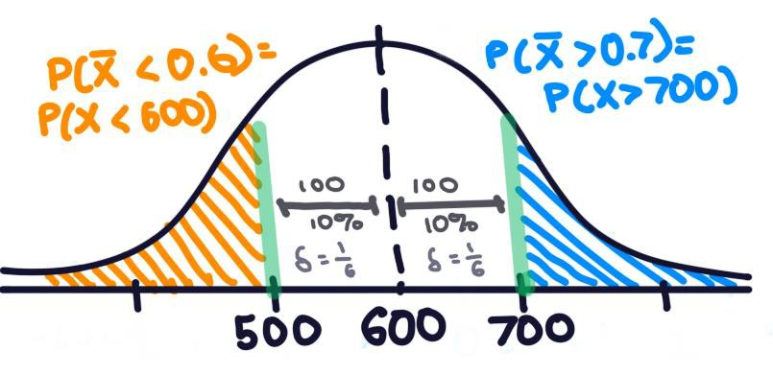
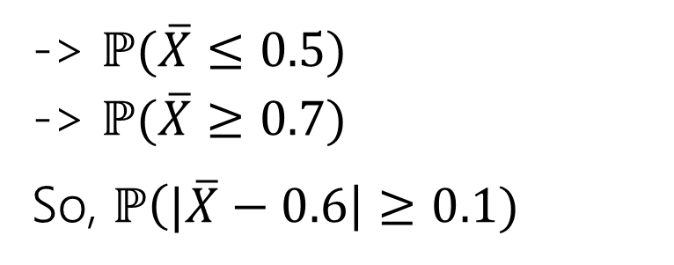
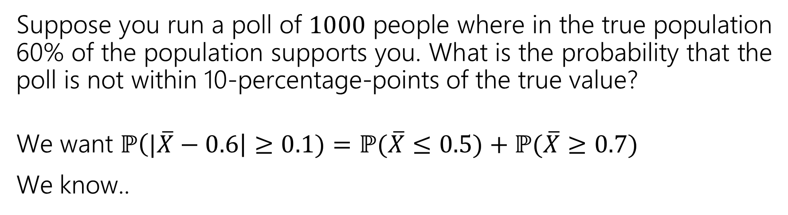
Example: Polling (3. Putting it all together)
Suppose you run a poll of 1000 people where in the true population 60% of the population supports you. What is the probability that the poll is not within 10-percentage-points of the true value?
We want ℙ$\left(|\overline{X}−0.6\right|≥0.1)=\text{ℙ}\text{(}\overline{X}≤0.5)+\text{ℙ}\text{(}\overline{X}≥0.7)$
We know..
-> $\text{ℙ}\text{(}\overline{X}≤0.5)$
-> $\text{ℙ}\text{(}\overline{X}≥0.7)$
So, ℙ$\left(|\overline{X}−0.6\right|≥0.1)$
= ℙ 𝑋 ≤ 500 ≤ 0.0003 (from Chernoff bound, left tail)
= ℙ 𝑋 ≥ 700 ≤ 0.0039 (from Chernoff bound, right tail)
≤ 0.0003 + 0.0039 = 0.0042
Less than 1%. That’s a better bound than Chebyshev gave!

Slide 12
Wait a Minute
This is just a binomial!
Well if all the 𝑋_{𝑖} have the same probability. It does work if they’re independent but have different distributions. But there’s bigger reasons to care…
The concentration inequality will let you control 𝑛 easily, even as a
variable. That’s not easy with the binomial.
What happens when 𝑛 gets big?
Evaluating
20000
. 51¹⁰⁰⁰⁰ ⋅.49¹⁰⁰⁰⁰ is fraught with chances for floating
10000
point error and other issues. Chernoff is much better.

Slide 13
Wait a Minute
I asked Wikipedia about the “Chernoff Bound” and I saw something
different?
This is the “easiest to use” version of the bound. If you need something
more precise, there are other versions.
Why are the tails different??
The strongest/original versions of “Chernoff bounds” are symmetric (1 +
𝛿 and 1 − 𝛿 correspond), but those bounds are ugly and hard to use.
When computer scientists made the “easy to use versions”, they needed to use some inequalities. The numerators now have plain old 𝛿’s, instead of 1 + or 1 −. As part of the simplification to this version, there were different inequalities used so you don’t get exactly the same expression.

Slide 14
But Wait! There’s More
For this class, please limit yourself to:
Markov, Chebyshev, and Chernoff, as stated in these slides…
But for your information. There’s more.
Trying to apply Chebyshev, but only want a “one-sided” bound (and tired of
losing that almost-factor-of-two)Try Cantelli’s Inequality
In a position to use Chernoff, but want additive distance to the mean instead of multiplicative? They got one of those.
Have a sum of independent random variables that aren’t indicators, but are
bounded, you better believe Wikipedia’s got one
Have a sum of random matrices instead of a sum of random numbers. Not only is that a thing you can do, but the eigenvalue of the matrix concentrates
There’s a whole book of these!

Slide 15
Tail Bounds – Takeaways
Useful when an experiment is complicated and you just need the
probability to be small (you don’t need the exact value).
Choosing a minimum 𝑛 for a poll – don’t need exact probability of failure, just to make sure it’s small.
Designing probabilistic algorithms – just need a guarantee that they’ll
be extremely accurate
Learning more about the situation (e.g. learning variance instead of just mean, knowing bounds on the support of the starting variables) usually lets you get more accurate bounds.

Slide 16
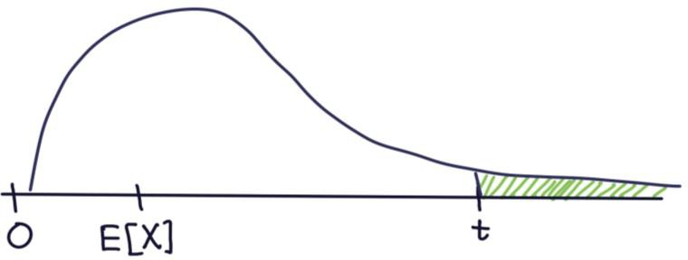
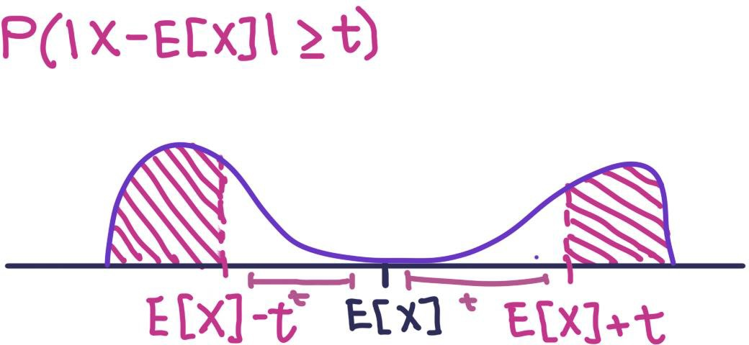
Tail Bounds – Summary
≤ 𝔼[𝑋]
Markov’s inequality - ℙ 𝑋 ≥ 𝑡
𝑡
Use if 𝑋 is non-negative and we know the expectation
Useful when we don’t know much about 𝑋
≤ Var t
Chebyshev’s inequality - ℙ |𝑋 − 𝔼 𝑋 | ≥ 𝑡
_{𝑡}2
Use if we know the expectation and variance of 𝑋
Gives better bounds with small variances
Chernoff Bound
−
𝛿²𝜇
𝛿²𝜇
ℙ 𝑋 ≤ 1 − 𝛿 𝜇 ≤ 𝑒 and ℙ 𝑋 ≥ 1 + 𝛿 𝜇 ≤ 𝑒 ⁻
2
3
Use if 𝑋 is a sum of independent Bernoulli random variables
Gives a very good bound usually, and is especially helpful when 𝑋 is binomial and we can’t easily computationally compute some summations/probability

Slide 17
One More Bound – Union Bound

Slide 18
Union Bound (not a tail bound, but still a bound)
Union Bound
Sometimes we don’t’ have enough information to compute this probability exactly, so we use the union bound to bound that probability
For any events 𝐸, 𝐹
ℙ 𝑬 ∪ 𝑭 ≤ ℙ 𝑬 + ℙ(𝑭)
Proof?
By inclusion-exclusion, ℙ 𝐸 ∪ 𝐹
And ℙ 𝐸 ∩ 𝐹 ≥ 0.
= ℙ 𝐸
+ ℙ 𝐹
− ℙ(𝐸 ∩ 𝐹)

Slide 19
Concentration Applications
A common pattern:
“What’s the probability something goes wrong?”
Figure out “what could possibly go wrong” – often these are dependent.
Use a concentration inequality for each of the things that could go wrong.
Union bound over everything that could go wrong.

Slide 20
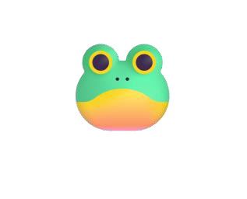
Example: Frogs
There are 20 frogs on each location in a 5x5 grid. Each frog will independently jump to the left, right, up, down, or stay where it is with equal probability. A frog at an edge of the grid magically warps to the corresponding edge (pac-man-style).
Bound the probability at least one square ends up with at least 36 frogs.

Slide 21
Example: Frogs
There are 20 frogs on each location in a 5x5 grid. Each frog will independently jump to the left, right, up, down, or stay where it is with equal probability. A frog at an edge of the grid magically warps to the corresponding edge (pac-man-style).
Bound the probability at least one square ends up with at least 36 frogs.
𝐴_{𝑖} is the event the 𝑖’th square has at least 36 frogs
ℙ 𝐴₁ ∪ 𝐴₂ ∪ 𝐴₃ ∪ ⋯ ∪ 𝐴₂₅
≤ ℙ 𝐴₁ + ℙ 𝐴₂ + ℙ 𝐴₃ + ⋯ + ℙ 𝐴₂₅ by the union bound
How do we find ℙ(𝑨_{𝒊})? Use another bound!
These events are dependent – adjacent squares affect each other!

Slide 22
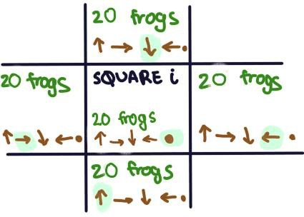
Example: Frogs
There are 20 frogs on each location in a 5x5 grid. Each frog will independently jump to the left, right, up, down, or stay where it is with equal probability. A frog at an edge of the grid magically warps to the corresponding edge (pac-man-style).
Bound the probability at least one square ends up with at least 36 frogs.
𝐴_{𝑖} is the event the 𝑖’th square has at least 36 frogs How do we find ℙ(𝑨_{𝒊})? Use another bound!
Let 𝑌 be the number frogs in i’th square
𝑌 = ∑¹⁰⁰ 𝑋 , X ~Ber(1/5), 𝐸 𝑌 = ¹⁰⁰ = 20
𝑗=1
𝑗 j
5
ℙ 𝐴 = ℙ(𝑌 ≥ 36) =ℙ 𝑌 ≥ 1 + ⁴ 20
₄ 2
𝑖
5
₋ 5
⋅20
≤ 𝑒
3
≤ 0.015 by the Chernoff bound

Slide 23
Example: Frogs
There are 20 frogs on each location in a 5x5 grid. Each frog will independently jump to the left, right, up, down, or stay where it is with equal probability. A frog at an edge of the grid magically warps to the corresponding edge (pac-man-style).
Bound the probability at least one square ends up with at least 36 frogs.
𝐴_{𝑖} is the event the 𝑖’th square has at least 36 frogs
ℙ 𝐴₁ ∪ 𝐴₂ ∪ 𝐴₃ ∪ ⋯ ∪ 𝐴₂₅
≤ ℙ 𝐴₁ + ℙ 𝐴₂ + ℙ 𝐴₃ + ⋯ + ℙ 𝐴₂₅ by the union bound
≤ 0.015 + 0.015 + 0.015 + ⋯ + 0.015 = 25 ⋅ 0.015 by the Chernoff bound
= 0.375

Slide 24
Example: Frogs
For an arbitrary location:
There are 100 frogs who could end up there (those above, below, left, right, and at that location). Each with probability .2. Let 𝑋 be the number that land at the location we’re interested in.
4
5
2
⋅20
ℙ 𝑋 ≥ 36 = ℙ 𝑋 ≥ 1 + 𝛿 20 ≤ exp −
≤ 0.015
3
There are 25 locations. Since all locations are symmetric, by the union bound the probability of at least one location having 36 or more frogs is at most 25 ⋅ 0.015 ≤ 0.375.

Slide 25

Tail Bounds – Summary
≤ 𝔼[𝑋]
Markov’s inequality - ℙ 𝑋 ≥ 𝑡
𝑡
Use if 𝑋 is non-negative and we know the expectation
Useful when we don’t know much about 𝑋
≤ Var t
Chebyshev’s inequality - ℙ |𝑋 − 𝔼 𝑋 | ≥ 𝑡
_{𝑡}2
Use if we know the expectation and variance of 𝑋
Gives better bounds with small variances
Chernoff Bound
−
𝛿²𝜇
𝛿²𝜇
ℙ 𝑋 ≤ 1 − 𝛿 𝜇 ≤ 𝑒
2
and ℙ 𝑋 ≥ 1 + 𝛿 𝜇 ≤ 𝑒 ⁻
3
Use if 𝑋 is a sum of independent Bernoulli random variables
Gives a very good bound usually, and is especially helpful when 𝑋 is binomial
and we can’t easily computationally compute some summations/probability
Union Bound - ℙ 𝐴 ∪ 𝐵 ≤ ℙ 𝐴 + ℙ(𝐵)
  Use if we don’t have enough information to find the union (e.g,. ways for at least
of to occur, for A, or B, or C, or … to occur)

Slide 26
Applications

Slide 27
Privacy Preservation
A real-world example (adapted from The Ethical Algorithm by Kearns and Roth; based on protocol by Warner [1965]).
And gives a sense of how randomness is actually used to protect privacy.

Slide 28
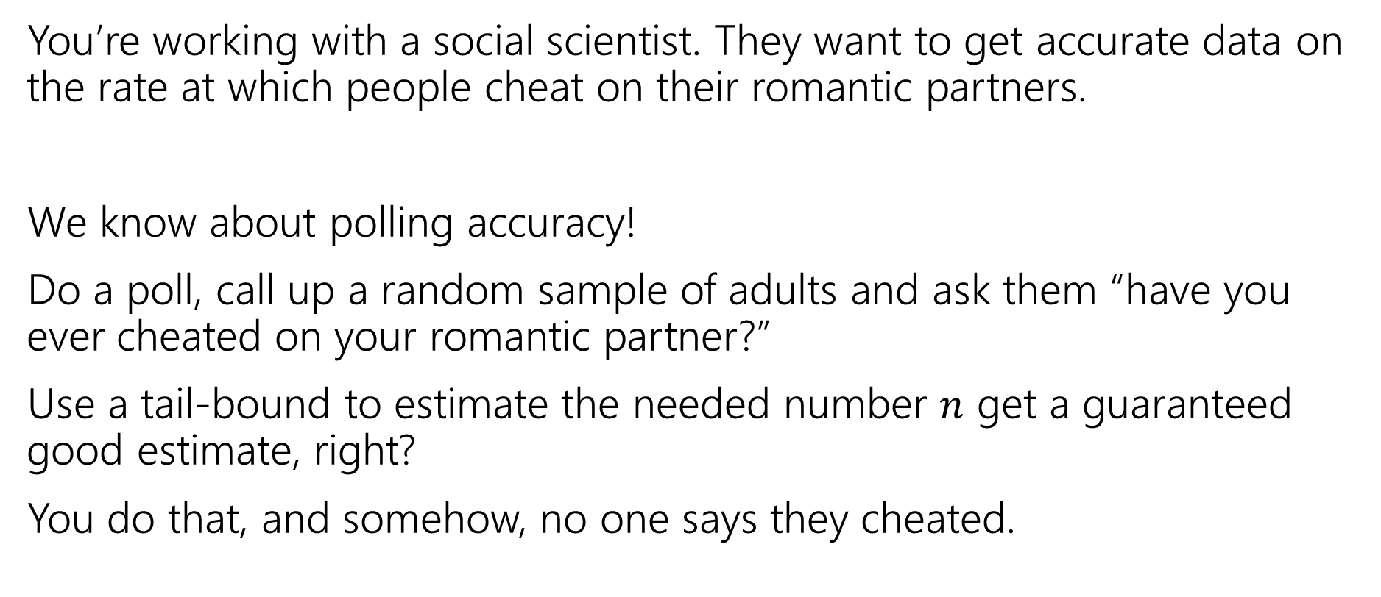
Privacy Preservation with Randomness
You’re working with a social scientist. They want to get accurate data on the rate at which people cheat on their romantic partners.
We know about polling accuracy!
Do a poll, call up a random sample of adults and ask them “have you ever cheated on your romantic partner?”
Use a tail-bound to estimate the needed number $n$ get a guaranteed good estimate, right?
You do that, and somehow, no one says they cheated.

Slide 29
What’s the problem?
People lie.
Or they might be concerned about you keeping this data.
Databases can be leaked (or infiltrated. Or subpoenaed).
You don’t want to hold this data, and the people you’re calling don’t want you to hold this data.

Slide 30
Doing Better With Randomness
You don’t really need to know who was cheating. Just how many people were.
Here’s a protocol:
Please flip a coin.
  If the coin is heads, or you have ever cheated, please tell me “heads”
  If the coin is tails and you have not ever cheated, please tell me “tails”

Slide 31
Will it be private?
If you are someone who has cheated, and you report heads can that be used against you? Not substantially – just say “no the coin came up heads!”
You discover your partner said heads, what’s the probability that they cheated?

Slide 32
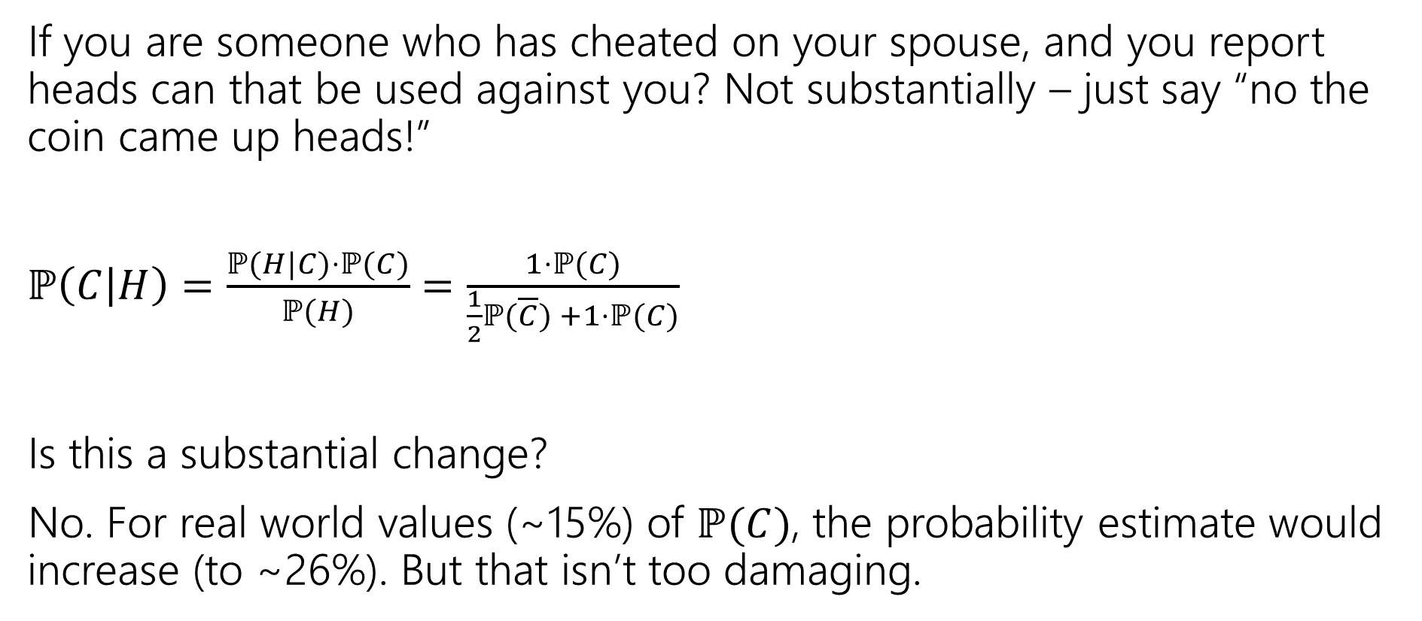
Will it be private?
If you are someone who has cheated on your spouse, and you report heads can that be used against you? Not substantially – just say “no the coin came up heads!”
$ℙ\left(C | H\right)=\frac{ℙ(H|C)⋅ℙ(C)}{ℙ(H)}$ $=\frac{1⋅ℙ(C)}{\frac{1}{2}ℙ(\overline{C}) +1⋅ℙ(C)}$
Is this a substantial change?
No. For real world values (~15%) of $ℙ(C)$, the probability estimate would increase (to ~26%). But that isn’t too damaging.
Notes:
Largest absolute increase is between .15 and .2, happens at P(C)approx. .4. Plot x-x/(.5(1-x)+.5)

Slide 33
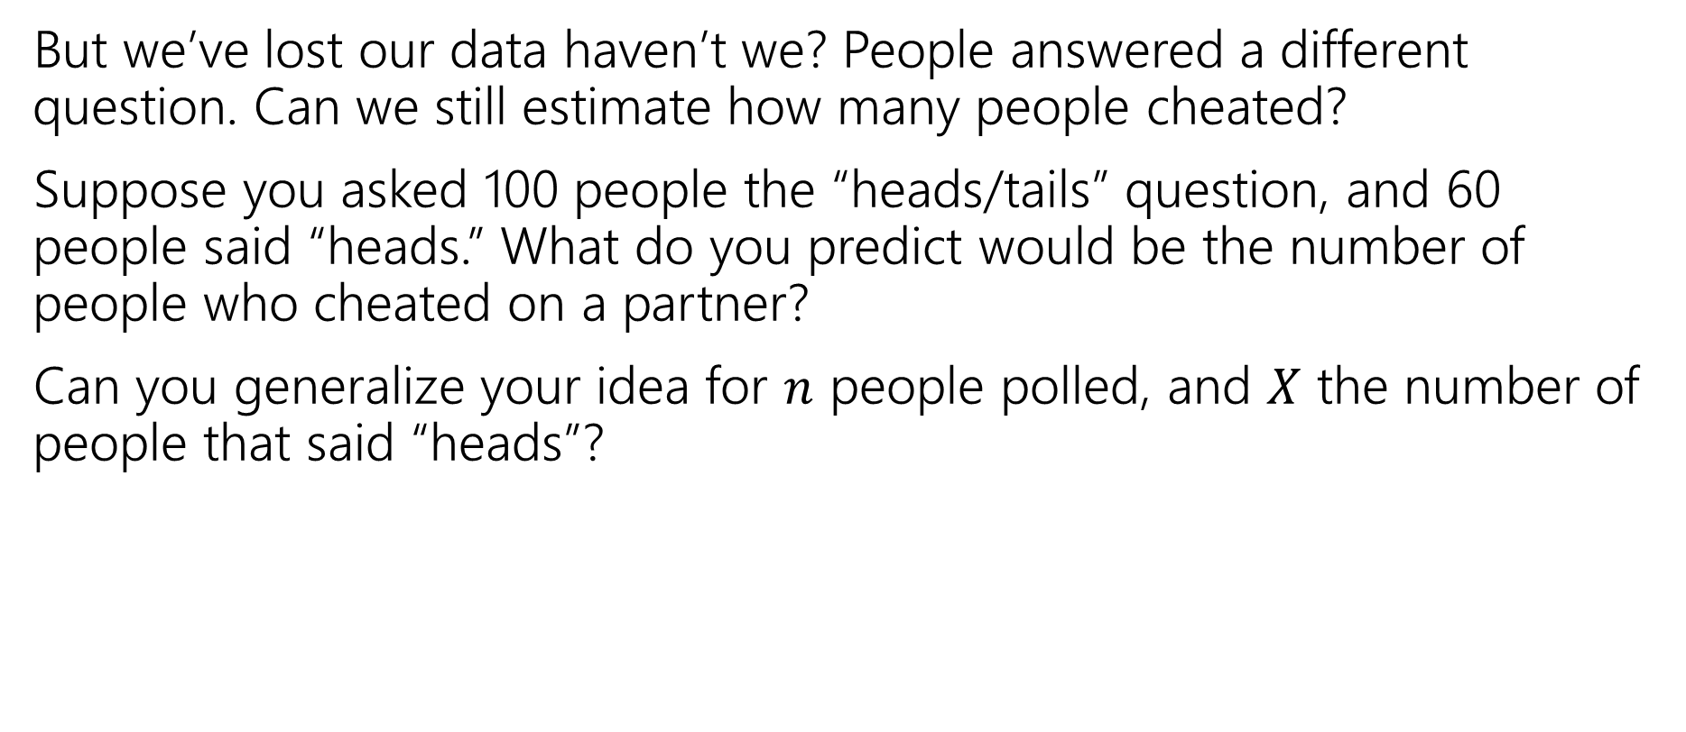
But will it be accurate?
But we’ve lost our data haven’t we? People answered a different question. Can we still estimate how many people cheated?
Suppose you asked 100 people the “heads/tails” question, and 60 people said “heads.” What do you predict would be the number of people who cheated on a partner?
Can you generalize your idea for $n$ people polled, and $X$ the number of people that said “heads”?
Notes:
This is actually dubious logic. We’ve found *an* unbiased estimator, but we should really use a more justified method. Tune in next week for MLEs, this is actually also the MLE.

Slide 34
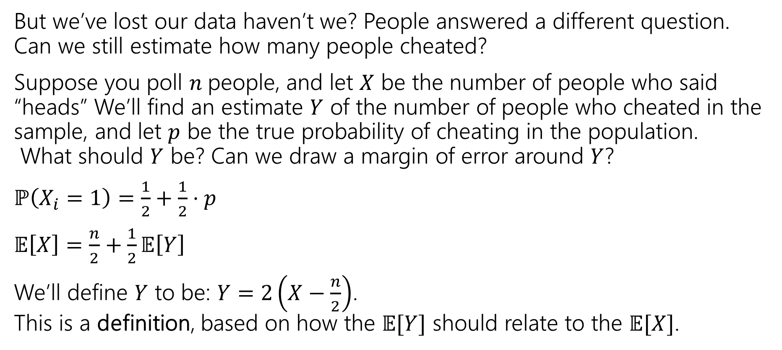
But will it be accurate?
But we’ve lost our data haven’t we? People answered a different question. Can we still estimate how many people cheated?
Suppose you poll $n$people, and let $X$ be the number of people who said “heads” We’ll find an estimate $Y$ of the number of people who cheated in the sample, and let $p$ be the true probability of cheating in the population.
What should $Y$ be? Can we draw a margin of error around $Y$?
$ℙ\left(X_{i}=1\right)=\frac{1}{2}+\frac{1}{2}⋅p$
$𝔼\left[X\right]=\frac{n}{2}+\frac{1}{2}𝔼\left[Y\right]$
We’ll define $Y$ to be: $Y=2\left(X−\frac{n}{2}\right)$.
This is a definition, based on how the $𝔼[Y]$ should relate to the $𝔼[X]$.
Notes:
This is actually dubious logic. We’ve found *an* unbiased estimator, but we should really use a more justified method. Tune in next week for MLEs, this is actually also the MLE.

Slide 35
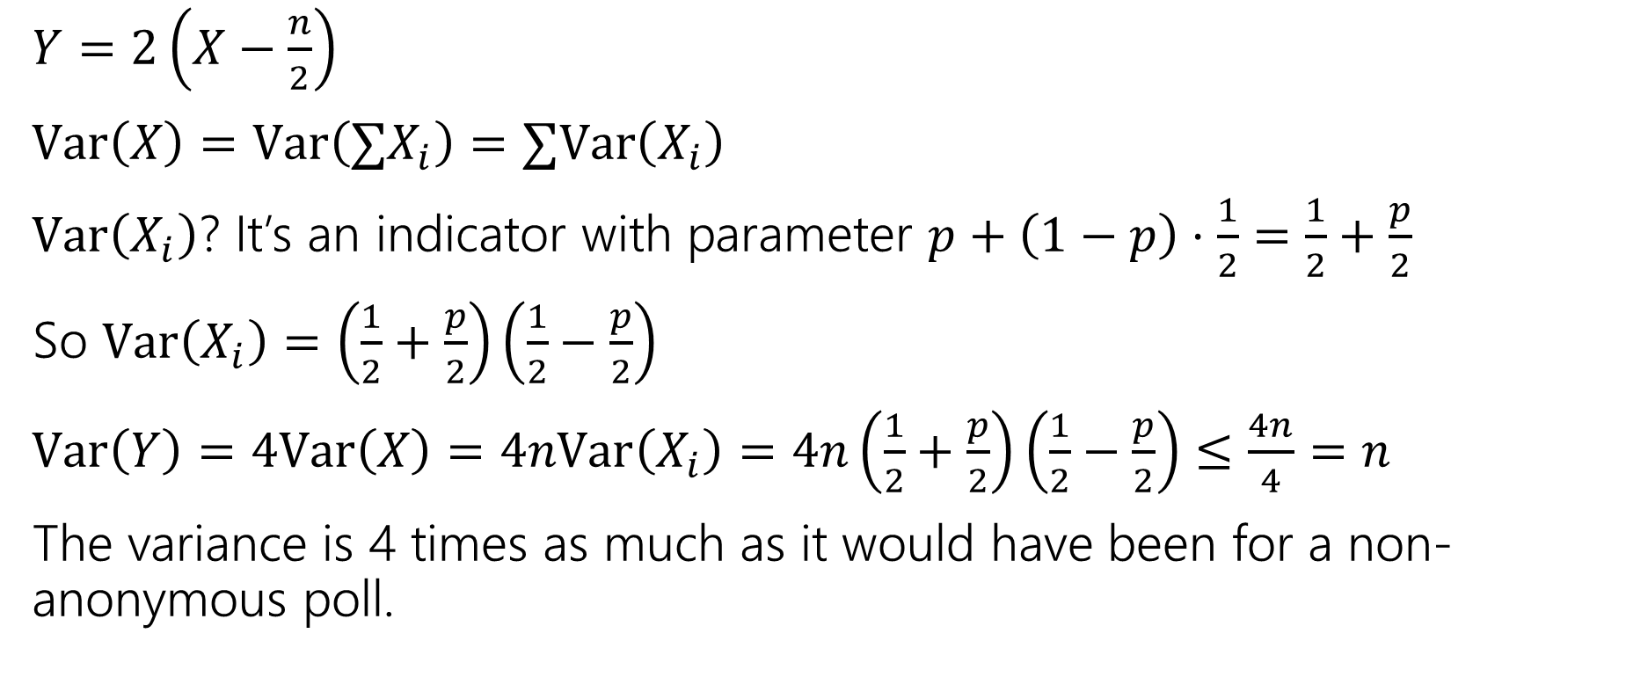
But will it be accurate?
$Y=2\left(X−\frac{n}{2}\right)$
$Var\left(X\right)=Var\left(∑X_{i}\right)=∑Var\left(X_{i}\right)$
$Var\left(X_{i}\right)$? It’s an indicator with parameter $p+\left(1−p\right)⋅\frac{1}{2}=\frac{1}{2}+\frac{p}{2}$
So $Var\left(X_{i}\right)=\left(\frac{1}{2}+\frac{p}{2}\right)\left(\frac{1}{2}−\frac{p}{2}\right)$
$Var\left(Y\right)=4Var\left(X\right)=4nVar\left(X_{i}\right)=4n\left(\frac{1}{2}+\frac{p}{2}\right)\left(\frac{1}{2}−\frac{p}{2}\right)≤\frac{4n}{4}=n$
The variance is 4 times as much as it would have been for a non-anonymous poll.

Slide 36
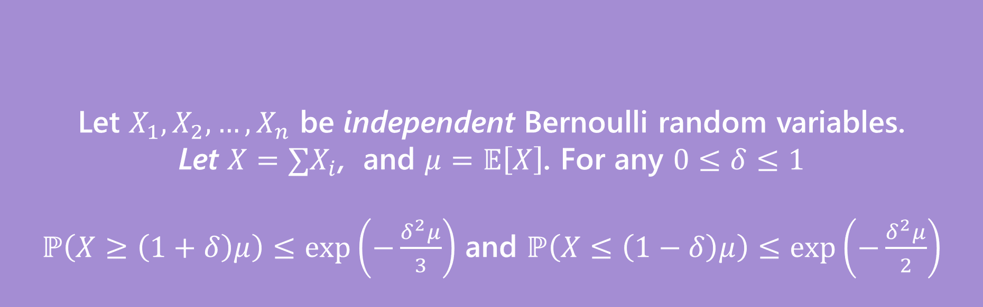
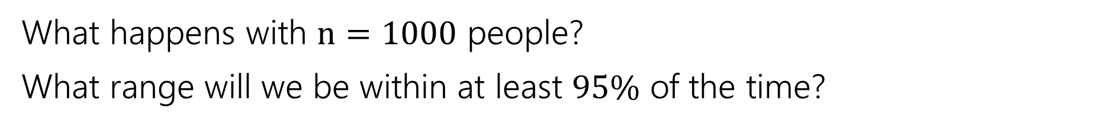
Can we use Chernoff?
Let $X_{1},X_{2},…,X_{n}$ be independent Bernoulli random variables.
Let $X=∑X_{i}$, and $μ=𝔼\left[X\right]$. For any $0≤δ≤1$
$ℙ\left(X≥\left(1+δ\right)μ\right)≤\exp\left(−\frac{δ^{2}μ}{3}\right)$ and $ℙ\left(X≤\left(1−δ\right)μ\right)≤\exp\left(−\frac{δ^{2}μ}{2}\right)$
(Multiplicative) Chernoff Bound
What happens with $n=1000$ people?
What range will we be within at least $95\%$ of the time?

Slide 37
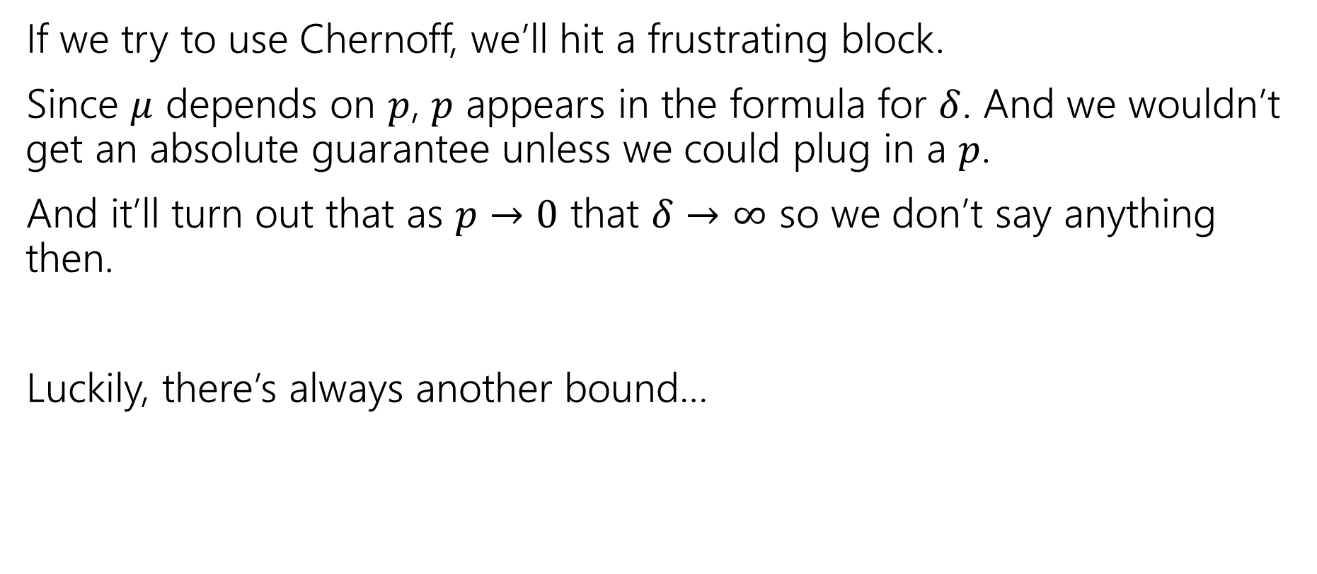
A different inequality
If we try to use Chernoff, we’ll hit a frustrating block.
Since $μ$ depends on $p$, $p$ appears in the formula for $δ$. And we wouldn’t get an absolute guarantee unless we could plug in a $p$.
And it’ll turn out that as $p→0$ that $δ→∞$ so we don’t say anything then.
Luckily, there’s always another bound…

Slide 38
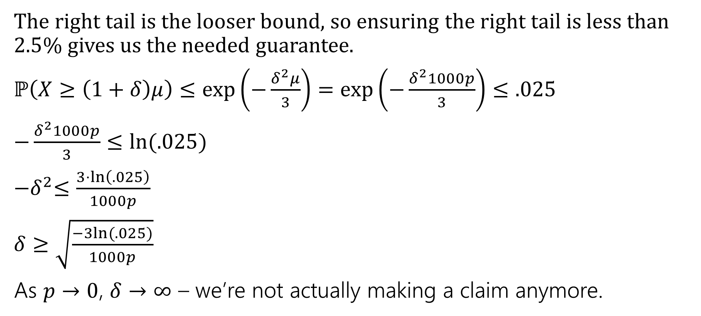
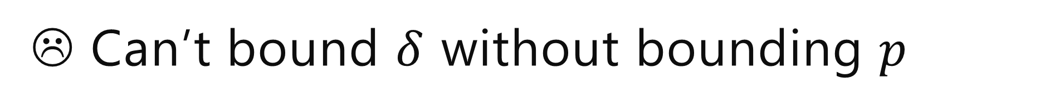
☹ Can’t bound $δ$ without bounding $p$
The right tail is the looser bound, so ensuring the right tail is less than $2.5$% gives us the needed guarantee.
$ℙ\left(X≥\left(1+δ\right)μ\right)≤\exp\left(−\frac{δ^{2}μ}{3}\right)=\exp\left(−\frac{δ^{2}1000p}{3}\right)≤.025$
$−\frac{δ^{2}1000p}{3}≤ln⁡(.025)$
${−δ}^{2}≤\frac{3⋅\ln\left(.025\right)}{1000p}$
$δ≥\sqrt{\frac{−3ln⁡(.025)}{1000p}}$
As $p→0$, $δ→∞$ – we’re not actually making a claim anymore.

Slide 39
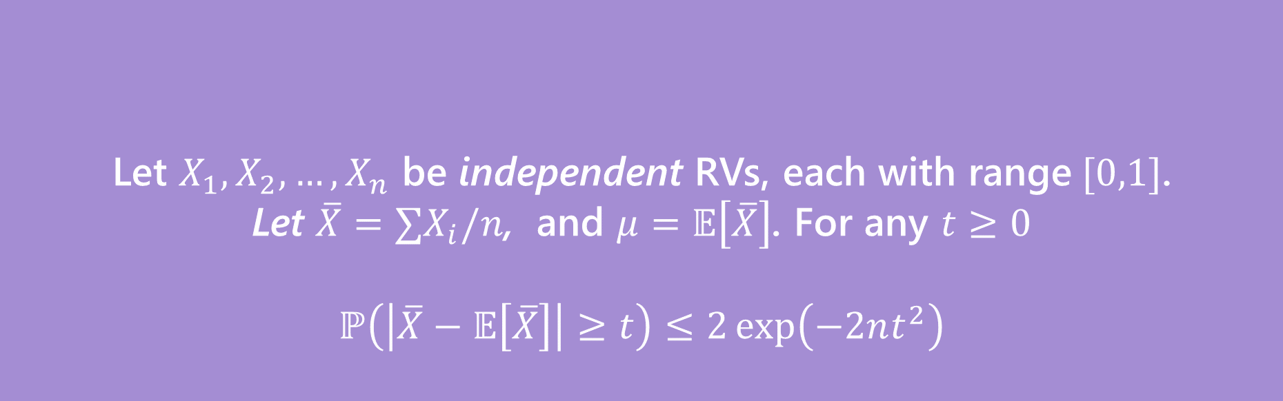
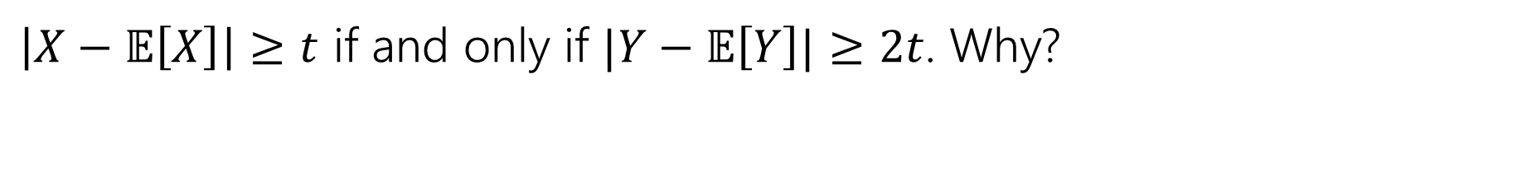
Hoeffding’s Inequality
Let $X_{1},X_{2},…,X_{n}$ be independent RVs, each with range$[0,1]$.
Let $\overline{X}=∑X_{i}/n$, and $μ=𝔼\left[\overline{X}\right]$. For any $t≥0$
$$ℙ\left(\left|\overline{X}−𝔼\left[\overline{X}\right]\right|≥t\right)≤2\exp\left(−2nt^{2}\right)$$
Hoeffding’s Inequality
$\left|X−𝔼\left[X\right]\right|≥t$ if and only if $|Y−𝔼\left[Y\right]|≥2t$. Why?

Slide 40

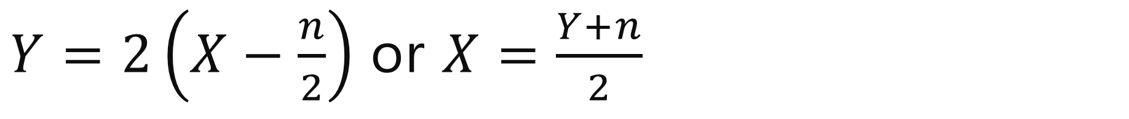
$Y=2\left(X−\frac{n}{2}\right)$ or $X=\frac{Y+n}{2}$
$\left|X−𝔼\left[X\right]\right|$
$=\left|\frac{Y+n}{2}−𝔼\left[\frac{Y+n}{2}\right]\right|$
$=\left|\frac{Y+n}{2}−𝔼\left[\frac{Y}{2}\right]−\frac{n}{2}\right|$
$=\left|\frac{Y}{2}−𝔼\left[\frac{Y}{2}\right]\right|$
$=\frac{1}{2}\left|Y−𝔼\left[Y\right]\right|$
So $\left|X−𝔼\left[X\right]\right|≥t$ if and only if $\frac{1}{2}\left|Y−𝔼\left[Y\right]\right|≥t$ iff $\left|Y−𝔼\left[Y\right]\right|≥2t$.

Slide 41
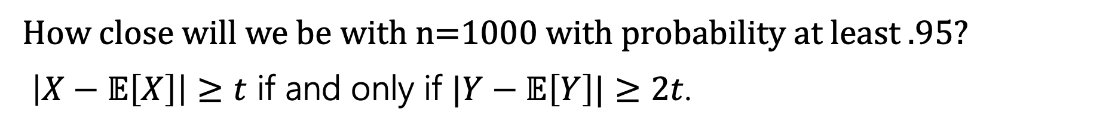
Hoeffding’s Inequality
Let $X_{1},X_{2},…,X_{n}$ be independent RVs, each with range$[0,1]$.
Let $\overline{X}=∑X_{i}/n$, and $μ=𝔼\left[\overline{X}\right]$. For any $t≥0$
$$ℙ\left(\left|\overline{X}−𝔼\left[\overline{X}\right]\right|≥t\right)≤2\exp\left(−2nt^{2}\right)$$
Hoeffding’s Inequality
How close will we be with n=1000 with probability at least $.95$?
$\left|X−𝔼\left[X\right]\right|≥t$ if and only if $|Y−𝔼\left[Y\right]|≥2t$.

Slide 42
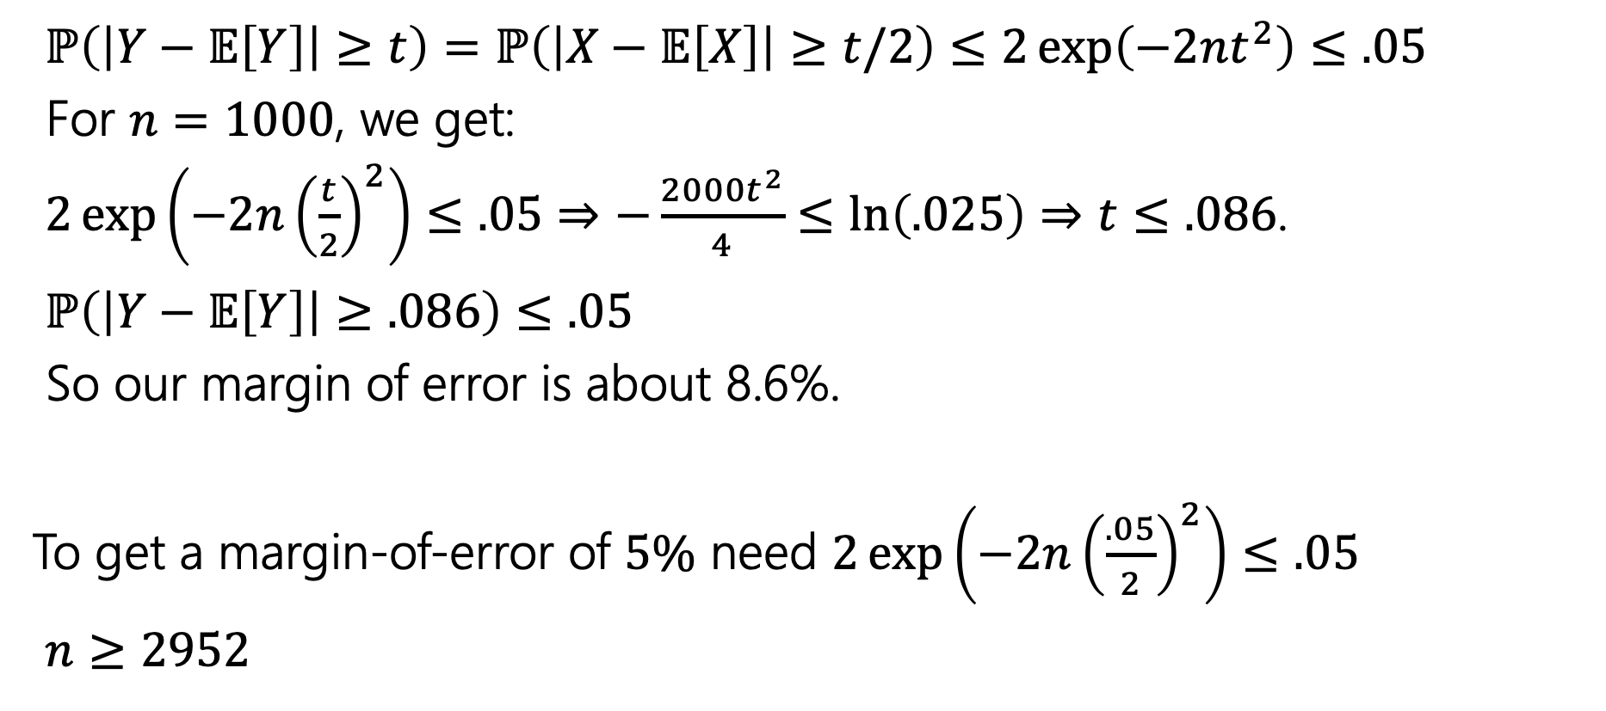
Margin of Error
$ℙ\left(\left|Y−𝔼\left[Y\right]\right|≥t\right)=ℙ\left(\left|X−𝔼\left[X\right]\right|≥t/2\right)≤2\exp\left(−2nt^{2}\right)≤.05$
For $n=1000$, we get:
$2\exp\left(−2n{\left(\frac{t}{2}\right)}^{2}\right)≤.05$ $⇒−\frac{2000t^{2}}{4}≤\ln\left(.025\right)⇒t≤.086$.
$ℙ\left(\left|Y−𝔼\left[Y\right]\right|≥.086\right)≤.05$
So our margin of error is about 8.6%.
To get a margin-of-error of $5\%$ need $2\exp\left(−2n{\left(\frac{.05}{2}\right)}^{2}\right)≤.05$
$n≥2952$

Slide 43
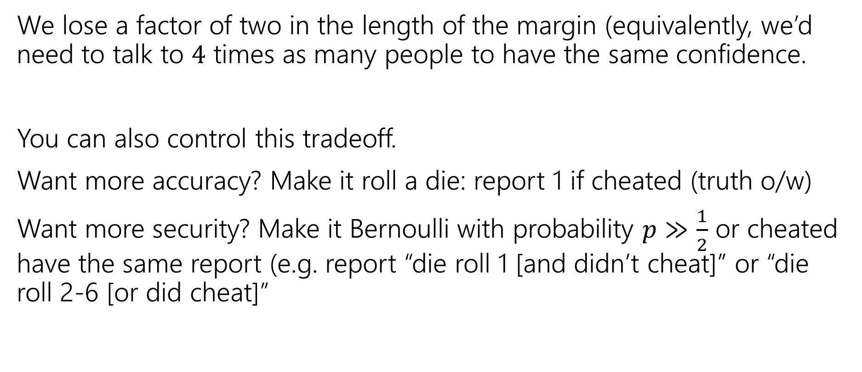
How much do we lose?
We lose a factor of two in the length of the margin (equivalently, we’d need to talk to $4$ times as many people to have the same confidence.
You can also control this tradeoff.
Want more accuracy? Make it roll a die: report 1 if cheated (truth o/w)
Want more security? Make it Bernoulli with probability $p≫\frac{1}{2}$ or cheated have the same report (e.g. report “die roll 1 [and didn’t cheat]” or “die roll 2-6 [or did cheat]”

Slide 44
In The Real World
Injecting randomness to preserve privacy is a real thing.
Instead of having everyone flip a coin, “random noise” can be inserted after all the data has been collected.
Differential privacy is being used to protect the 2020 Census data.
The overall count of people in each state is exact (well, exactly the data they collected). But the data per block or per city will be randomized to protect against revealing who lives where.
This video nicely explains what’s involved. Notice that the accuracy guarantees come in the same “inside-margin-of-error-with-probability” guarantees we’ve been giving for our randomness (just much stronger).

Slide 45
Maximum Likelihood Estimation

Slide 46
Up till now…
So far, the probability questions we’ve asked have followed a pattern:
You’re given a model with the probabilities you need to make predictions.
𝑋~Bin(𝑛, 𝑝), compute some probabilities about 𝑋, compute 𝐸[𝑋]
We have a distribution that takes on these outcomes with these probabilities. Compute the probability of some event or set of outcomes.
Before we run the entire experiment, let’s make some predictions

Slide 47
Up till now…
So far, the probability questions we’ve asked have followed a pattern:
You’re given a model with the probabilities you need to make predictions.
𝑋~Bin(𝑛, 𝑝), compute some probabilities about 𝑋, compute 𝐸[𝑋]
We have a distribution that takes on these outcomes with these probabilities. Compute the probability of some event or set of outcomes.
Before we run the entire experiment, let’s make some predictions
In real world, we usually don’t know all the rules of a random experiment
hence tail bounds, CLT, etc. to estimate probabilities in these situations
But, can we estimate those missing rules/parameters to a distribution?

Slide 48
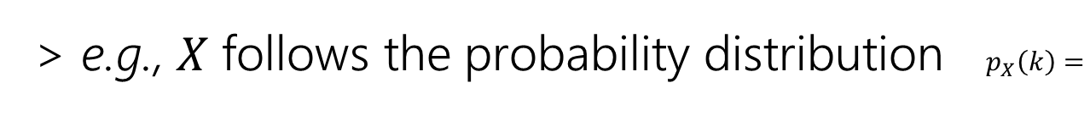
What could those “missing rules/parameters” be?
We’re going to call the unknown parameter(s) to a distribution 𝜽
All distributions from the zoo we’ve are a distribution + parameter(s) 𝜽:
> Ber(𝑝) --> 𝜃 = 𝑝
> Poi(𝜆) --> 𝜃 = 𝜆
> Unif(𝑎, 𝑏) --> 𝜃 = (𝑎, 𝑏)
Some probability distributions are in terms of some unknown parameter(s) 𝜽
𝜃 2𝜃
1 − 3𝜃
0
𝑘 = 1
𝑘 = 2
𝑘 = 3 otherwise
e.g., 𝑋 follows the probability distribution $p_{X}\left(k\right)=$
Our goal is to estimate the value of 𝜃

Slide 49
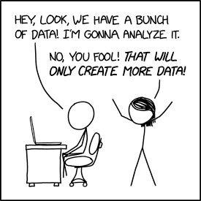
The Remix – going backwards
Let’s say you have a coin. You don’t know if it’s fair or not.
It’s reasonable to think that a coin flip
follows a Bernoulli distribution.
But what’s the parameter?
In the real world, you’re not given
parameters :(
https://xkcd.com/2582/

Slide 50
The Remix – going backwards
Let’s say you have a coin. You don’t know if it’s fair or not.
It’s reasonable to think that a coin flip
follows a Bernoulli distribution.
But what’s the parameter?
In the real world, you’re not given
parameters :(
But we do have… data!
https://xkcd.com/2582/

Slide 51
Maximum Likelihood Estimation
We derive an estimate $\hat{θ}$ for the parameter $θ$ based on observed data

Slide 52
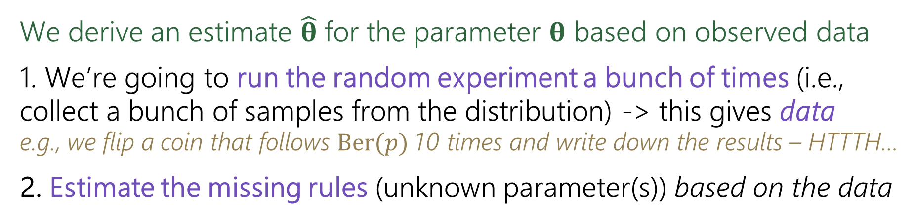
Maximum Likelihood Estimation
We derive an estimate $\hat{θ}$ for the parameter $θ$ based on observed data
We’re going to run the random experiment a bunch of times (i.e., collect a bunch of samples from the distribution) -> this gives data
e.g., we flip a coin that follows Ber(𝑝) 10 times and write down the results – HTTTH…
Estimate the missing rules (unknown parameter(s)) based on the data

Slide 53

Maximum Likelihood Estimation
We derive an estimate $\hat{θ}$ for the parameter $θ$ based on observed data
We’re going to run the random experiment a bunch of times (i.e., collect a bunch of samples from the distribution) -> this gives data
e.g., we flip a coin that follows Ber(𝑝) 10 times and write down the results – HTTTH…
Estimate the missing rules (unknown parameter(s)) based on the data
Suppose you flip a coin independently 10 times, and you see
HTTTHHTHHH
(6 heads, 4 tails)
What is your estimate of 𝑝, the probability the coin comes up heads?

Slide 54

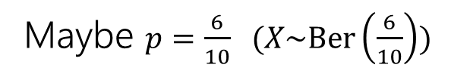
Maximum Likelihood Estimation
We derive an estimate $\hat{θ}$ for the parameter $θ$ based on observed data
We’re going to run the random experiment a bunch of times (i.e., collect a bunch of samples from the distribution) -> this gives data
e.g., we flip a coin that follows Ber(𝑝) 10 times and write down the results – HTTTH…
Estimate the missing rules (unknown parameter(s)) based on the data
Suppose you flip a coin independently 10 times, and you see
HTTTHHTHHH
(6 heads, 4 tails)
What is your estimate of 𝑝, the probability the coin comes up heads?
Maybe $p=\frac{6}{10}$ ($X\sim \text{Ber}\left(\frac{6}{10}\right))$
But how to argue “objectively” this is the best estimate?

Slide 55
Maximum Likelihood Estimation
We derive an estimate $\hat{θ}$ for the parameter $θ$ based on observed data
We’re going to run the random experiment a bunch of times (i.e., collect a bunch of samples from the distribution) -> this gives data
e.g., we flip a coin that follows Ber(𝑝) 10 times and write down the results – HTTTH…
Estimate the missing rules (unknown parameter(s)) based on the data

Slide 56
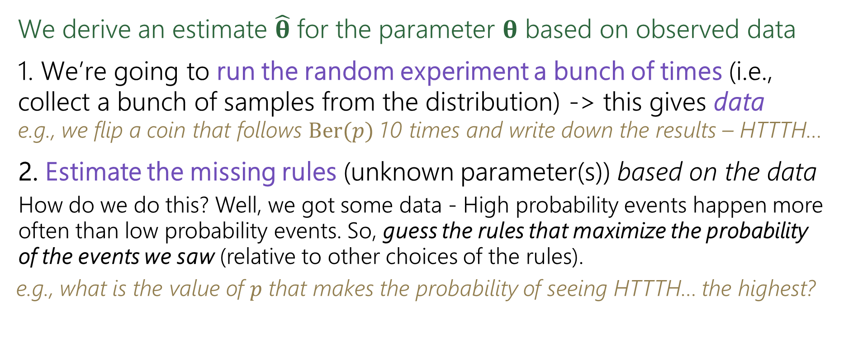
Maximum Likelihood Estimation
We derive an estimate $\hat{θ}$ for the parameter $θ$ based on observed data
We’re going to run the random experiment a bunch of times (i.e., collect a bunch of samples from the distribution) -> this gives data
e.g., we flip a coin that follows Ber(𝑝) 10 times and write down the results – HTTTH…
Estimate the missing rules (unknown parameter(s)) based on the data
How do we do this? Well, we got some data - High probability events happen more often than low probability events. So, guess the rules that maximize the probability
of the events we saw (relative to other choices of the rules).
e.g., what is the value of 𝑝 that makes the probability of seeing HTTTH… the highest?

Slide 57
Maximum Likelihood Estimation
We derive an estimate $\hat{θ}$ for the parameter $θ$ based on observed data
We’re going to run the random experiment a bunch of times (i.e., collect a bunch of samples from the distribution) -> this gives data
e.g., we flip a coin that follows Ber(𝑝) 10 times and write down the results – HTTTH…
Estimate the missing rules (unknown parameter(s)) based on the data
How do we do this? Well, we got some data - High probability events happen more often than low probability events. So, guess the rules that maximize the probability
of the events we saw (relative to other choices of the rules).
e.g., what is the value of 𝑝 that makes the probability of seeing HTTTH… the highest?
To do this, we will define a function that will tell us the probability of seeing particular data (a particular set of samples from the distribution) based on a particular value of the unknown parameter(s) 𝜃

Slide 58
Likelihood function
Remember, our goal:
Collect some data/samples from the distribution
Find an estimate for 𝜃
𝓛(𝑬; 𝜽) is ℙ(𝐸) when the experiment is run with 𝜃
“what is probability of seeing the event 𝐸 (in our case, the set of data), if the experiment is run with the parameter 𝜃?”
We can’t use probability notation because likelihood doesn’t follow the same rules

Slide 59
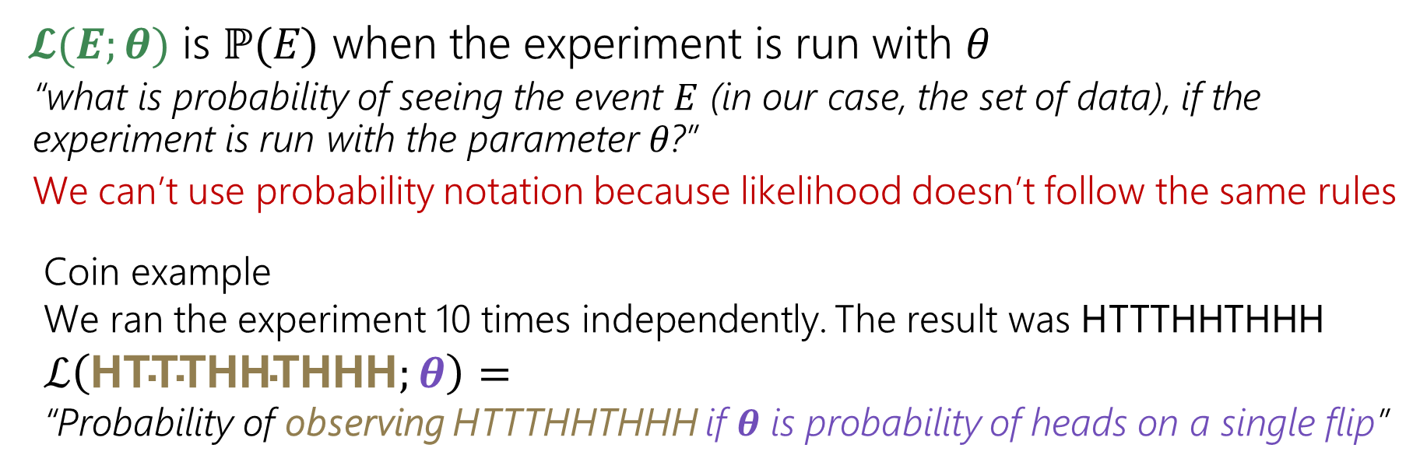
Likelihood function
Remember, our goal:
Collect some data/samples from the distribution
Find an estimate for 𝜃
𝓛(𝑬; 𝜽) is ℙ(𝐸) when the experiment is run with 𝜃
“what is probability of seeing the event 𝐸 (in our case, the set of data), if the experiment is run with the parameter 𝜃?”
We can’t use probability notation because likelihood doesn’t follow the same rules
Coin example
We ran the experiment 10 times independently. The result was HTTTHHTHHH
$$ℒ\left(\text{HTTTHHTHHH};θ\right)=$$
“Probability of observing HTTTHHTHHH if 𝜽 is probability of heads on a single flip”

Slide 60
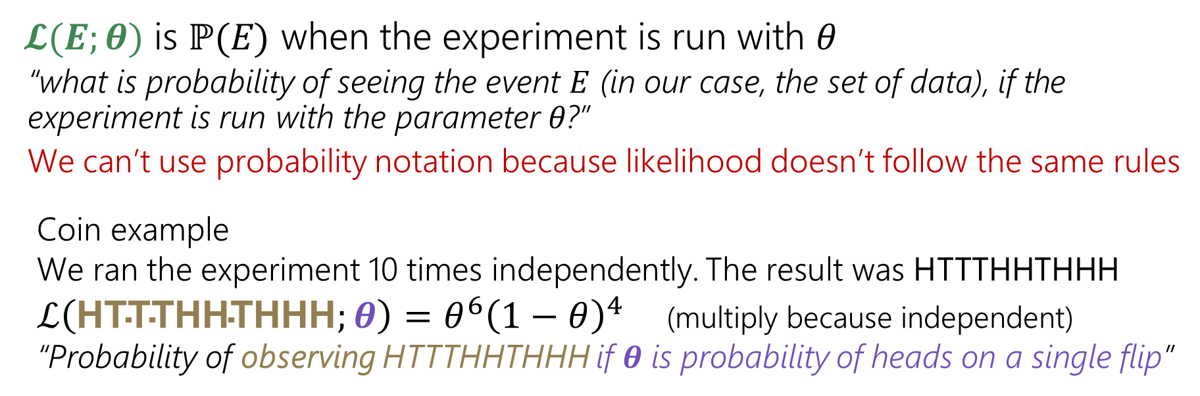
Likelihood function
Remember, our goal:
Collect some data/samples from the distribution
Find an estimate for 𝜃
𝓛(𝑬; 𝜽) is ℙ(𝐸) when the experiment is run with 𝜃
“what is probability of seeing the event 𝐸 (in our case, the set of data), if the experiment is run with the parameter 𝜃?”
We can’t use probability notation because likelihood doesn’t follow the same rules
Coin example
We ran the experiment 10 times independently. The result was HTTTHHTHHH
$ℒ\left(\text{HTTTHHTHHH};θ\right)=θ^{6}{\left(1−θ\right)}^{4}$ (multiply because independent)
“Probability of observing HTTTHHTHHH if 𝜽 is probability of heads on a single flip”

Slide 61
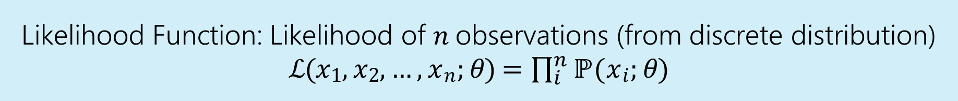

Likelihood function
Remember, our goal:
Collect some data/samples from the distribution
Find an estimate for 𝜃
𝓛(𝑬; 𝜽) is ℙ(𝐸) when the experiment is run with 𝜃
“what is probability of seeing the event 𝐸 (in our case, the set of data), if the experiment is run with the parameter 𝜃?”
We can’t use probability notation because likelihood doesn’t follow the same rules
Coin example
We ran the experiment 10 times independently. The result was HTTTHHTHHH
$ℒ\left(\text{HTTTHHTHHH};θ\right)=θ^{6}{\left(1−θ\right)}^{4}$ (multiply because independent)
“Probability of observing HTTTHHTHHH if 𝜽 is probability of heads on a single flip”
Likelihood Function: Likelihood of 𝑛 observations (from discrete distribution)
ℒ(𝑥₁, 𝑥₂, … , 𝑥_{𝑛}; 𝜃) = $\prod_{i}^{n}{\text{ℙ(x}\text{i}\text{;} \text{θ)}}$

Slide 62
Notation comparison
ℙ(𝑋|𝑌) probability of 𝑋, conditioned on the event 𝑌 having happened (𝑌 is a subset of the sample space).
ℙ(𝑋; 𝜃) probability of 𝑋, where to properly define our probability space we need to know the extra piece of information 𝜃. Since 𝜃 isn’t an event (it’s not a subset of the sample space), this is not conditioning.
We have a fixed model, want to find the probability of seeing some data
ℒ(𝑋; 𝜃) the likelihood of event 𝑋, given that an experiment was run with parameter 𝜃. Likelihoods don’t have all the properties we associate with probabilities (e.g. they don’t all sum up to 1) and this isn’t conditioning on an event (𝜃 is a parameter/rule of how the event could be generated).
We have some fixed data, we want to look at the probability of a particular model

Slide 63
Likelihood function
Remember, our goal:
Collect some data/samples from the distribution
Find an estimate for 𝜃
𝓛(𝑬; 𝜽) is ℙ(𝐸) when the experiment is run with 𝜃
“what is probability of seeing the event 𝐸 (in our case, the set of data), if the experiment is run with the parameter 𝜃?”
We can’t use probability notation because likelihood doesn’t follow the same rules
Coin example
We ran the experiment 10 times independently. The result was HTTTHHTHHH
$ℒ\left(\text{HTTTHHTHHH};θ\right)=θ^{6}{\left(1−θ\right)}^{4}$ (multiply because independent)
“Probability of observing HTTTHHTHHH if 𝜽 is probability of heads on a single flip”

Slide 64

Likelihood function
Remember, our goal:
Collect some data/samples from the distribution
Find an estimate for 𝜃
𝓛(𝑬; 𝜽) is ℙ(𝐸) when the experiment is run with 𝜃
“what is probability of seeing the event 𝐸 (in our case, the set of data), if the experiment is run with the parameter 𝜃?”
We can’t use probability notation because likelihood doesn’t follow the same rules
Coin example
We ran the experiment 10 times independently. The result was HTTTHHTHHH
$ℒ\left(\text{HTTTHHTHHH};θ\right)=θ^{6}{\left(1−θ\right)}^{4}$ (multiply because independent)
“Probability of observing HTTTHHTHHH if 𝜽 is probability of heads on a single flip”
We want to pick the value of 𝜽 that make this likelihood function the largest. So…

Slide 65
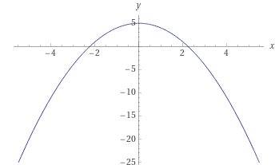
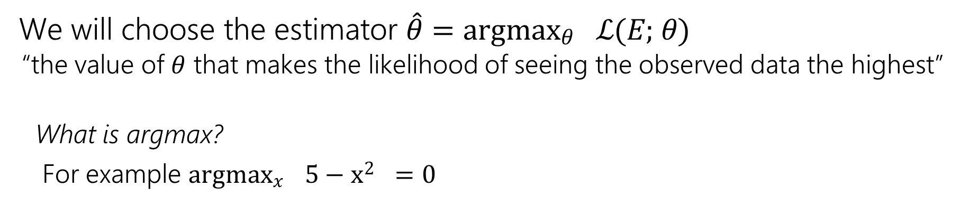
Maximum Likelihood Estimation
We will choose the estimator $\hat{θ}=$ argmax_{𝜃} ℒ(𝐸; 𝜃)
“the value of 𝜃 that makes the likelihood of seeing the observed data the highest”
What is argmax?
For example argmax_{𝑥} 5 − x² = 0
max 5 − 𝑥² = 5, the input (argument) which produces 5 is 0, so the argmax is 0
𝑥
Remember, our goal:
Collect some data/samples from the distribution
Find an estimate for 𝜃

Slide 66
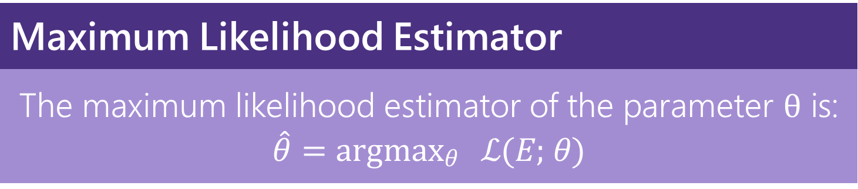
Maximum Likelihood Estimation
We will choose the estimator $\hat{θ}=$ argmax_{𝜃} ℒ(𝐸; 𝜃)
“the value of 𝜃 that makes the likelihood of seeing the observed data the highest”
Maximum Likelihood Estimator
The maximum likelihood estimator of the parameter θ is: $\hat{θ}=$ argmax_{𝜃} ℒ(𝐸; 𝜃)
Remember, our goal:
Collect some data/samples from the distribution
Find an estimate for 𝜃

Slide 67
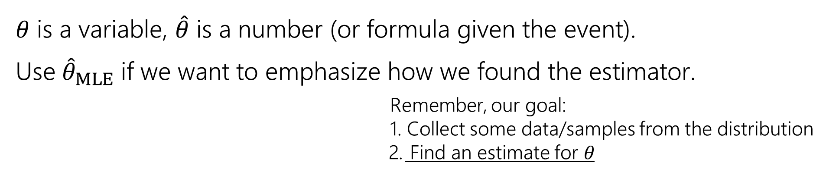
Maximum Likelihood Estimation
We will choose the estimator $\hat{θ}=$ argmax_{𝜃} ℒ(𝐸; 𝜃)
“the value of 𝜃 that makes the likelihood of seeing the observed data the highest”
Maximum Likelihood Estimator
The maximum likelihood estimator of the parameter θ is: $\hat{θ}=$ argmax_{𝜃} ℒ(𝐸; 𝜃)
𝜃 is a variable, $\hat{θ}$ is a number (or formula given the event).
Use ${\hat{θ}}_{MLE}$ if we want to emphasize how we found the estimator.
Remember, our goal:
Collect some data/samples from the distribution
Find an estimate for 𝜃

Slide 68
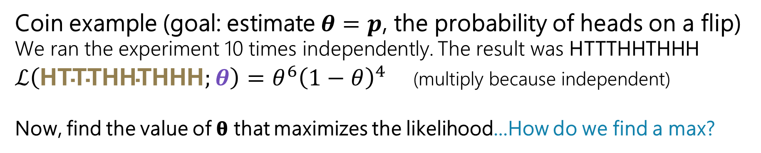
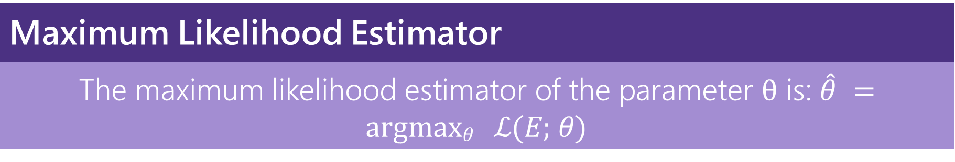
Maximum Likelihood Estimator
The maximum likelihood estimator of the parameter θ is: $\hat{θ}$ = argmax_{𝜃} ℒ(𝐸; 𝜃)
Coin example (goal: estimate $θ=p$, the probability of heads on a flip)
We ran the experiment 10 times independently. The result was HTTTHHTHHH
$ℒ\left(\text{HTTTHHTHHH};θ\right)=θ^{6}{\left(1−θ\right)}^{4}$ (multiply because independent)
Now, find the value of 𝛉 that maximizes the likelihood…How do we find a max?

Slide 69
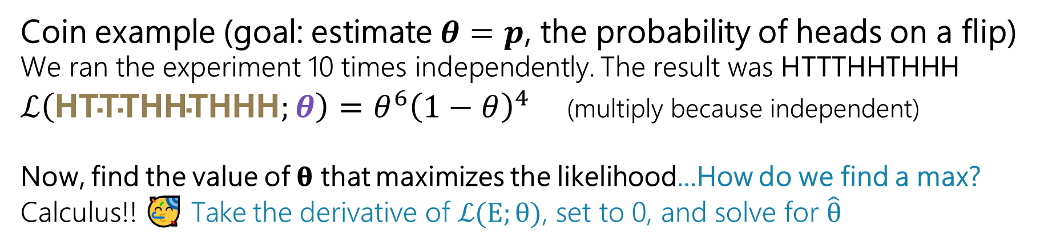
Maximum Likelihood Estimator
The maximum likelihood estimator of the parameter θ is: $\hat{θ}$ = argmax_{𝜃} ℒ(𝐸; 𝜃)
Coin example (goal: estimate $θ=p$, the probability of heads on a flip)
We ran the experiment 10 times independently. The result was HTTTHHTHHH
$ℒ\left(\text{HTTTHHTHHH};θ\right)=θ^{6}{\left(1−θ\right)}^{4}$ (multiply because independent)
Now, find the value of 𝛉 that maximizes the likelihood…How do we find a max?
Calculus!! 🥳 Take the derivative of ℒ(E; θ), set to 0, and solve for $\hat{θ}$

Slide 70
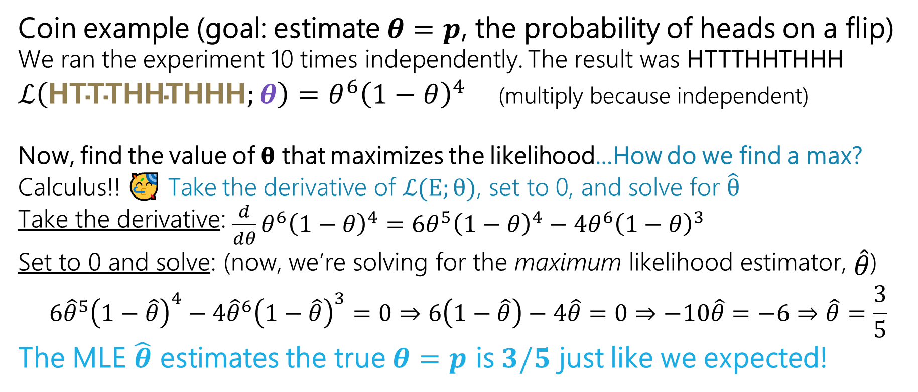
Maximum Likelihood Estimator
The maximum likelihood estimator of the parameter θ is: $\hat{θ}$ = argmax_{𝜃} ℒ(𝐸; 𝜃)
Coin example (goal: estimate $θ=p$, the probability of heads on a flip)
We ran the experiment 10 times independently. The result was HTTTHHTHHH
$ℒ\left(\text{HTTTHHTHHH};θ\right)=θ^{6}{\left(1−θ\right)}^{4}$ (multiply because independent)
Now, find the value of 𝛉 that maximizes the likelihood…How do we find a max?
Calculus!! 🥳 Take the derivative of ℒ(E; θ), set to 0, and solve for $\hat{θ}$
^{Take the derivative:} $\frac{d}{dθ}θ^{6}{\left(1−θ\right)}^{4}=6θ^{5}{\left(1−θ\right)}^{4}−{4θ}^{6}{\left(1−θ\right)}^{3}$
Set to 0 and solve: (now, we’re solving for the maximum likelihood estimator, $\hat{θ}$⁾
$$6{\hat{θ}}^{5}{\left(1−\hat{θ}\right)}^{4}−{4\hat{θ}}^{6}{\left(1−\hat{θ}\right)}^{3}=0⇒6\left(1−\hat{θ}\right)−4\hat{θ}=0⇒−10\hat{θ}=−6⇒\hat{θ}=\frac{3}{5}$$
The MLE $\hat{θ}$ estimates the true $θ=p$ is $3/5$ just like we expected!

Slide 71
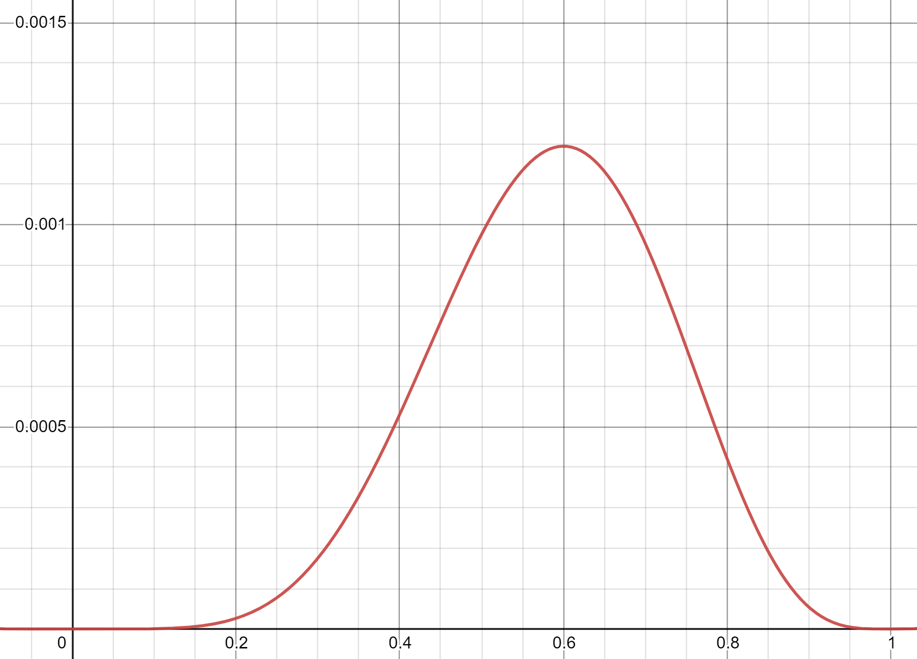
Maximum Likelihood Estimator
The maximum likelihood estimator of the parameter θ is: $\hat{θ}$ = argmax_{𝜃} ℒ(𝐸; 𝜃)
Coin example (goal: estimate $θ=p$, the probability of heads on a flip)
We ran the experiment 10 times independently. The result was HTTTHHTHHH
$ℒ\left(\text{HTTTHHTHHH};θ\right)=θ^{6}{\left(1−θ\right)}^{4}$ (multiply because independent)
Now, find the value of 𝛉 that maximizes the likelihood…How do we find a max?
Calculus!! 🥳 Take the derivative of ℒ(E; θ), set to 0, and solve for $\hat{θ}$
^{Take the derivative:} $\frac{d}{dθ}θ^{6}{\left(1−θ\right)}^{4}=6θ^{5}{\left(1−θ\right)}^{4}−{4θ}^{6}{\left(1−θ\right)}^{3}$
Set to 0 and solve: (now, we’re solving for the maximum likelihood estimator, $\hat{θ}$⁾
$$6{\hat{θ}}^{5}{\left(1−\hat{θ}\right)}^{4}−{4\hat{θ}}^{6}{\left(1−\hat{θ}\right)}^{3}=0⇒6\left(1−\hat{θ}\right)−4\hat{θ}=0⇒−10\hat{θ}=−6⇒\hat{θ}=\frac{3}{5}$$
The MLE $\hat{θ}$ estimates the true $θ=p$ is $3/5$ just like we expected!

Slide 72
Is that really the maximum?
What we really did was find the critical point (which could either be the maximum or the minimum), so ideally do second derivative test to check
Take the second derivative (the derivative of the derivative)
If negative everywhere around the critical point, it is the maximum
In this class, we won’t ask you to do the second derivative test, you can assume the solution you find is a maximum ☺
  to sanity check your answer, at least make sure that the estimator you find is valid for what you are trying to estimate

Slide 73
Half a step backwards…
Since the likelihood function is a product of probabilities of seeing each
of the samples, we’re going to be taking the derivative of products a lot
The product rule is not fun!! There has to be a better way!

Slide 74
Half a step backwards…
Since the likelihood function is a product of probabilities of seeing each
of the samples, we’re going to be taking the derivative of products a lot
The product rule is not fun!! There has to be a better way!
Take the log of the likelihood function before taking the derivative! Recall: ln 𝑎 ⋅ 𝑏 = ln 𝑎 + ln product(𝑏)
And, we don’t need the product rule if our expression is a sum!
Can we still take the max? Yes! ln() is an increasing function, so
argmax_{θ} ln ℒ(𝐸; 𝜃) = argmax_{θ} ℒ 𝐸; 𝜃
“the log of the likelihood will increase as the likelihood increases and vice verse, so, the value of 𝜃 that maximizes the log likelihood also maximized the likelihood”

Slide 75

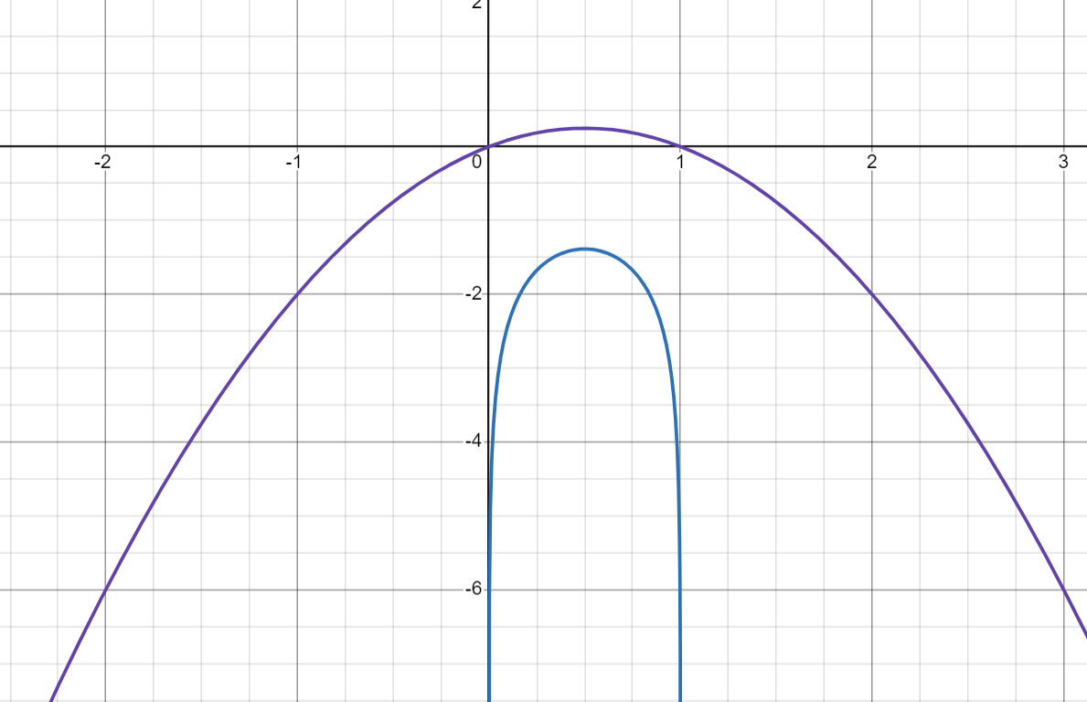
Half a step backwards…
Since the likelihood function is a product of probabilities of seeing each
of the samples, we’re going to be taking the derivative of products a lot
The product rule is not fun!! There has to be a better way!
Take the log of the likelihood function before taking the derivative! Recall: ln 𝑎 ⋅ 𝑏 = ln 𝑎 + ln product(𝑏)
And, we don’t need the product rule if our expression is a sum!
Can we still take the max? Yes! ln() is an increasing function, so
argmax_{θ} ln ℒ(𝐸; 𝜃) = argmax_{θ} ℒ 𝐸; 𝜃
“the log of the likelihood will increase as the likelihood increases and vice verse, so, the value of 𝜃 that maximizes the log likelihood also maximized the likelihood”
𝜃(1 − 𝜃)
ln(𝜃(1 − 𝜃)

Slide 76
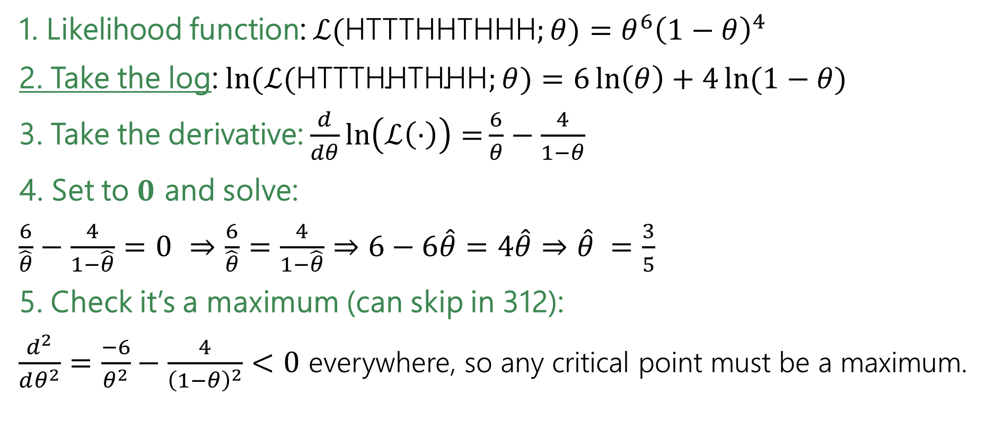
Coin flips is easier
1. Likelihood function: $ℒ($HTTTHHTHHH$;θ)=θ^{6}{\left(1−θ\right)}^{4}$
2. Take the log: $\ln{(ℒ(\text{HTTTHHTHHH};θ)}=6\ln\left(θ\right)+4\ln{(1−θ)}$
3. Take the derivative: $\frac{d}{dθ}\ln\left(ℒ\left(⋅\right)\right)=\frac{6}{θ}−\frac{4}{1−θ}$
4. Set to $0$ and solve:
$\frac{6}{\hat{θ}}−\frac{4}{1−\hat{θ}}=0$ $⇒$ $\frac{6}{\hat{θ}}=\frac{4}{1−\hat{θ}}$ $⇒$ $6−6\hat{θ}=4\hat{θ}⇒$ $\hat{θ} =\frac{3}{5}$
5. Check it’s a maximum (can skip in 312):
$\frac{d^{2}}{dθ^{2}}=\frac{−6}{θ^{2}}−\frac{4}{{\left(1−θ\right)}^{2}}<0$ everywhere, so any critical point must be a maximum.

Slide 77
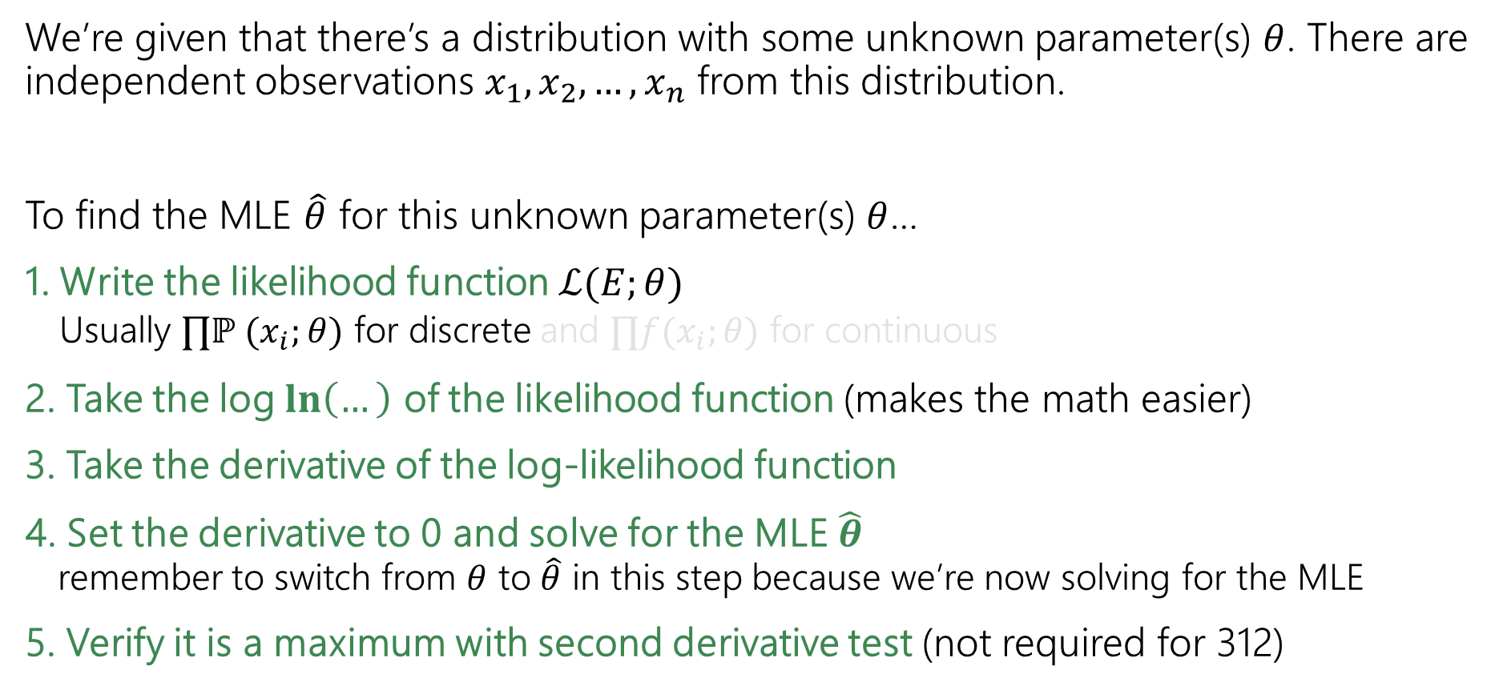
Solving MLE (the process)
We’re given that there’s a distribution with some unknown parameter(s) $θ$. There are independent observations $x_{1}, x_{2}, …, x_{n}$ from this distribution.
To find the MLE $\hat{θ}$ for this unknown parameter(s) $θ$…
1. Write the likelihood function $ℒ(E;θ)$
  Usually $∏ℙ (x_{i};θ)$ for discrete and $∏f(x_{i};θ)$ for continuous
2. Take the log $\ln\left(…\right)$ of the likelihood function (makes the math easier)
3. Take the derivative of the log-likelihood function
4. Set the derivative to 0 and solve for the MLE $\hat{θ}$
remember to switch from $θ$ to $\hat{θ}$ in this step because we’re now solving for the MLE
5. Verify it is a maximum with second derivative test (not required for 312)

