Slide 1
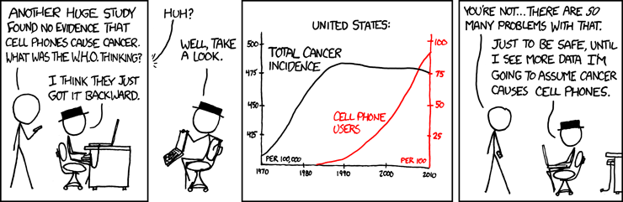
More Joint Distributions, Tail Bounds
CSE 312 26Su
Lecture 17
https://xkcd.com/925/

Slide 2
Announcements
Quiz 5 on Friday
^{Reference sheet on Ed}
Homework 5 due tonight
Homework 6 released this evening
After that, we’ll be going over some applications which will also allow us to have some more review and practice with the main course content

Slide 3
Where Are We?
Today:
  Joint Distributions
    Joint Support
    Joint PMF / PDF
    Joint CDF
    Joint Expectation
  Conditional Distributions
    Conditional Expectation
  Law of Total Expectation
  Covariance
Today:
  Recap
    One more joint distribution example
    One more LTE example
  Tail Bounds
    Markov’s Inequality
    Chebyshev’s Inequality
    (next: Chernoff Bound)
    (next: not a tail bound, but Union Bound)

Slide 4
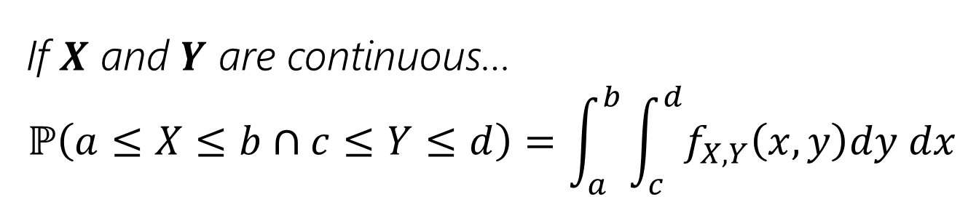
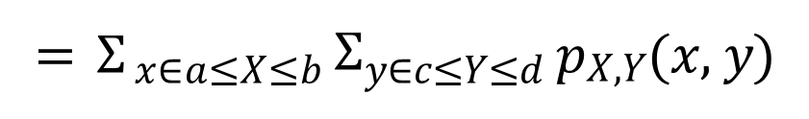
Joint Probabilities
To find probability of 𝑋 and 𝑌 being in ranges, we use the joint distribution:
If 𝑿 and 𝒀 are discrete….
ℙ 𝑎 ≤ 𝑋 ≤ 𝑏 ∩ 𝑐 ≤ 𝑌 ≤ 𝑑
⁼ $Σ$𝑥∈𝑎≤𝑋≤𝑏 $Σ$𝑦∈𝑐≤𝑌≤𝑑 ^{𝑝}𝑋,𝑌^{(𝑥, 𝑦)}
sum over the joint PMF for all pairs of x and y that fall in this range
If 𝑿 and 𝒀 are continuous…
$$ℙ\left(a≤X≤b∩c≤Y≤d\right)=\int_{a}^{b}{\int_{c}^{d}{f_{X,Y}\left(x,y\right)dy dx}}$$
integrate over the joint PDF for all pairs of x and y that fall in this range

Slide 5
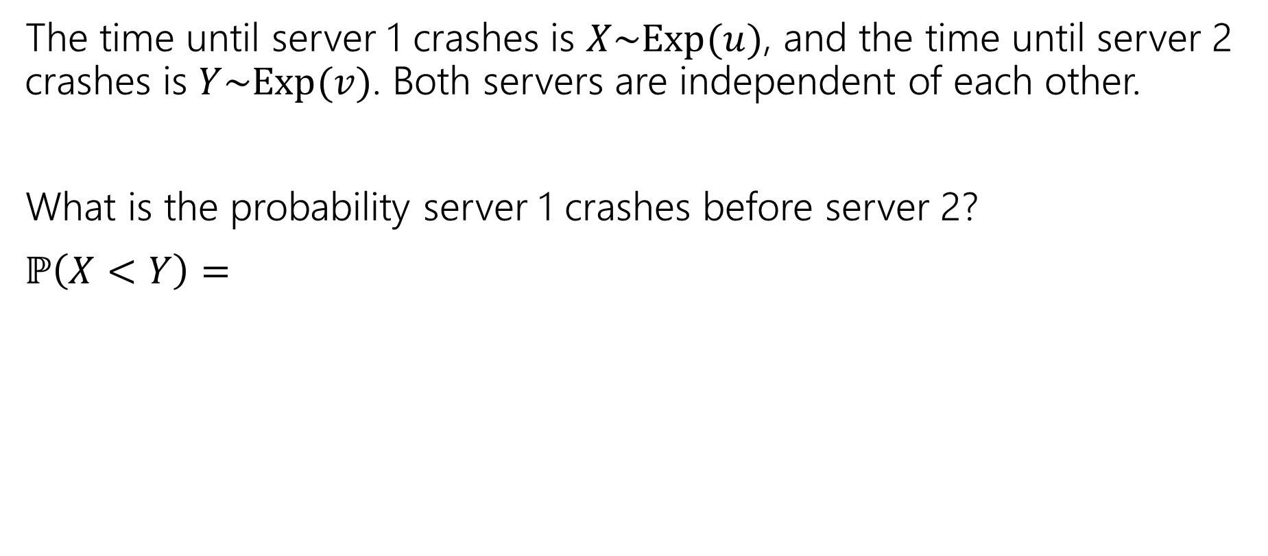


Example: Continuous Servers
The time until server 1 crashes is $X\sim Exp(u)$, and the time until server 2 crashes is $Y\sim Exp(v)$. Both servers are independent of each other.
What is the probability server 1 crashes before server 2?
$$ℙ\left(X<Y\right)=$$
$$y$$
pollev.com/jolie312
$$x$$

Slide 6
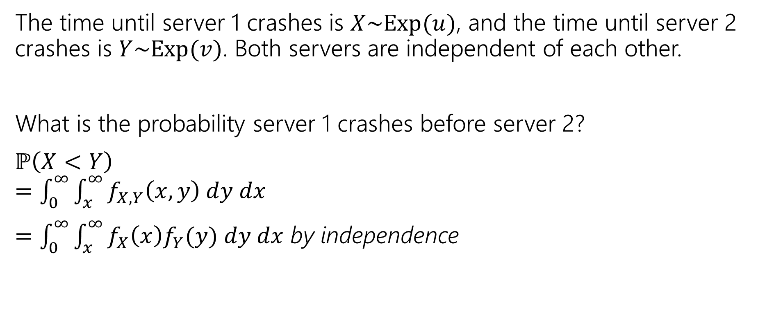
Example: Continuous Servers
The time until server 1 crashes is $X\sim Exp(u)$, and the time until server 2 crashes is $Y\sim Exp(v)$. Both servers are independent of each other.
What is the probability server 1 crashes before server 2?
$$ℙ\left(X<Y\right)$$
$=\int_{0}^{∞}{\int_{x}^{∞}{f_{X,Y}\left(x,y\right) dy dx}}$
$=\int_{0}^{∞}{\int_{x}^{∞}{f_{X}\left(x\right)f_{Y}(y) dy dx}}$ by independence
$$y$$
𝑥 = 𝑦
$$x$$

Slide 7
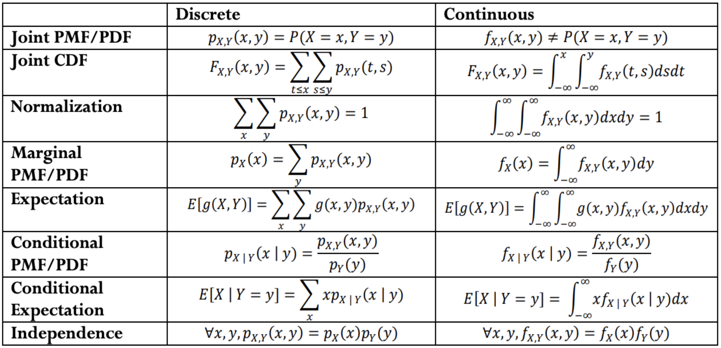
Discrete vs. Continuous Joint Distributions

Slide 8
Law of Total Expectation
Let $A_{1},A_{2},…,A_{k}$ be a partition of the sample space, then
$$𝔼[X]=\sum_{i=1}^{n}{𝔼\left[X | A_{i}\right]ℙ(A_{i})}$$
Let $X,Y$be discrete random variables, then
$$𝔼[X]=\sum_{y∈Ω_{Y}}{𝔼\left[X | Y=y\right]ℙ(Y=y)}$$
Similar in form to law of total probability, and the proof goes that way as well.

Slide 9

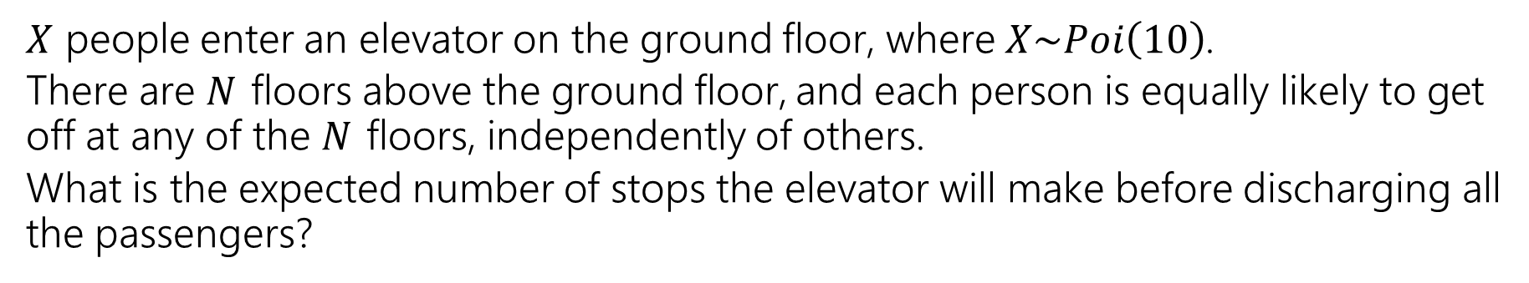
LTE Example: Elevator Rides
$X$ people enter an elevator on the ground floor, where $X\sim Poi\left(10\right)$.
There are 𝑁 floors above the ground floor, and each person is equally likely to get off at any of the 𝑁 floors, independently of others.
What is the expected number of stops the elevator will make before discharging all the passengers?

Slide 10
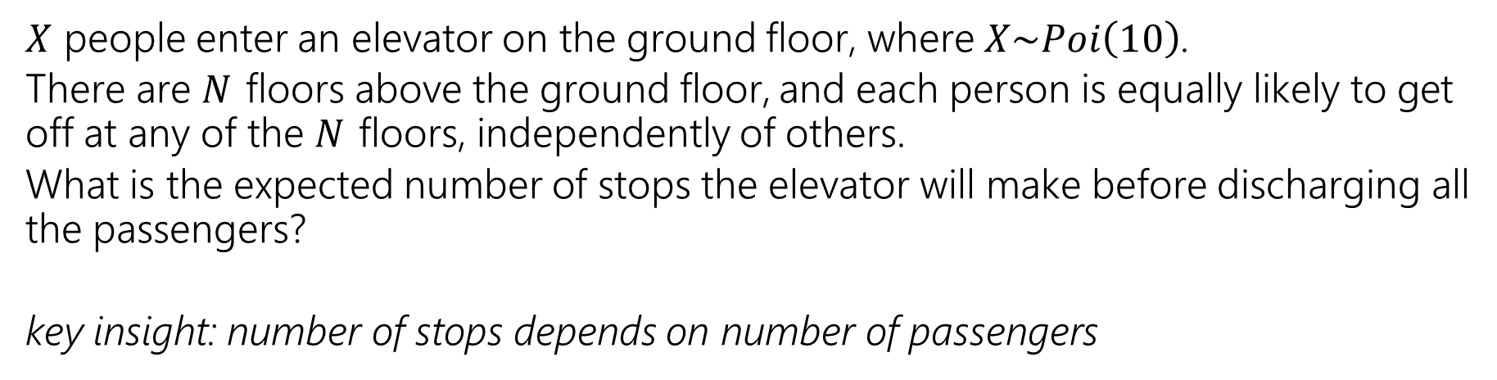
LTE Example: Elevator Rides
$X$ people enter an elevator on the ground floor, where $X\sim Poi\left(10\right)$.
There are 𝑁 floors above the ground floor, and each person is equally likely to get off at any of the 𝑁 floors, independently of others.
What is the expected number of stops the elevator will make before discharging all the passengers?
key insight: number of stops depends on number of passengers

Slide 11
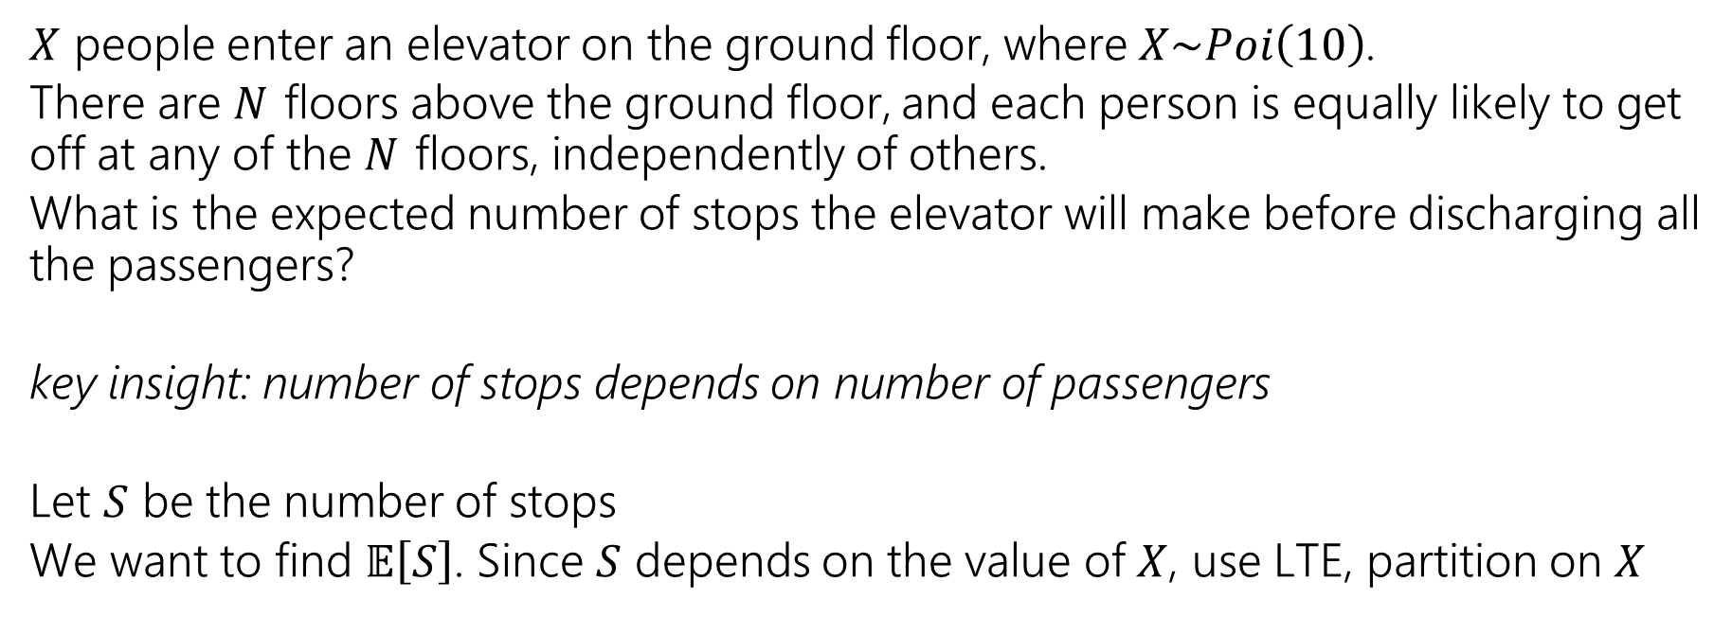
LTE Example: Elevator Rides
$X$ people enter an elevator on the ground floor, where $X\sim Poi\left(10\right)$.
There are 𝑁 floors above the ground floor, and each person is equally likely to get off at any of the 𝑁 floors, independently of others.
What is the expected number of stops the elevator will make before discharging all the passengers?
key insight: number of stops depends on number of passengers
Let $S$ be the number of stops
We want to find $𝔼\left[S\right]$. Since $S$ depends on the value of $X$, use LTE, partition on $X$

Slide 12
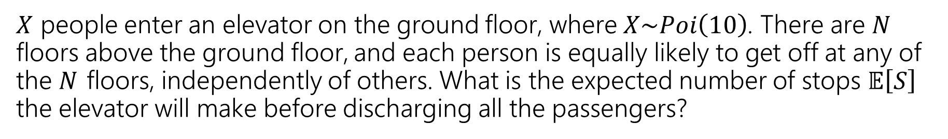
LTE Example: Elevator Rides
$X$ people enter an elevator on the ground floor, where $X\sim Poi\left(10\right)$. There are 𝑁 floors above the ground floor, and each person is equally likely to get off at any of the 𝑁 floors, independently of others. What is the expected number of stops $𝔼\left[S\right]$ the elevator will make before discharging all the passengers?

Slide 13
LTE Example: Elevator Rides

Slide 14
Covariance

Slide 15
Covariance
We sometimes want to measure how “intertwined” 𝑋 and 𝑌 are – how much knowing about one of them will affect the other.
Cov(𝑋, 𝑌) measure the dependence between 𝑋 and 𝑌
Covariance is positive -> they are positively correlated
If X increases, 𝑌 tends to also increase
Covariance is negative -> they are negatively correlated
If 𝑋 increases, 𝑌 tends to decrease
Covariance
𝐂𝐨𝐯 𝐗, 𝐘 = 𝔼 𝑿 − 𝔼 𝑿 (𝒀 − 𝔼 𝒀 ) = 𝔼 𝑿𝒀 − 𝔼[𝑿]𝔼[𝒀]

Slide 16
Covariance
Cov(𝑋, 𝑌) measures how much one random variable varies with a second.
Can be:
Positive (↑ in one var, ↑ in other)
Zero
Negative (↑ in one var, ↓ in other)

Slide 17
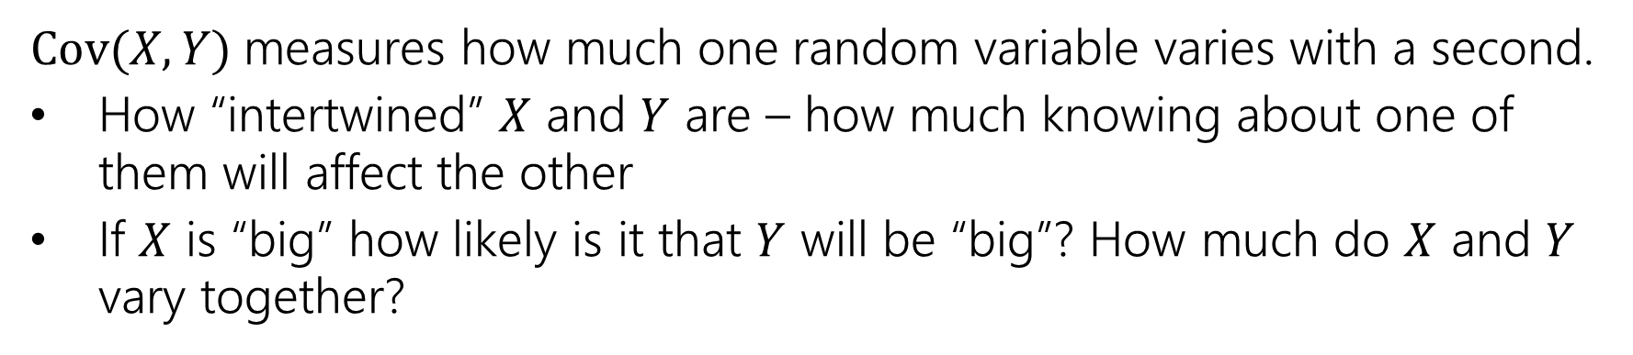
Covariance
Cov(𝑋, 𝑌) measures how much one random variable varies with a second.
How “intertwined” $X$ and $Y$ are – how much knowing about one of them will affect the other
If $X$ is “big” how likely is it that $Y$ will be “big”? How much do $X$ and $Y$ vary together?
Covariance
𝐂𝐨𝐯 𝐗, 𝐘 = 𝔼 𝑿 − 𝔼 𝑿 (𝒀 − 𝔼 𝒀 ) = 𝔼 𝑿𝒀 − 𝔼[𝑿]𝔼[𝒀]

Slide 18
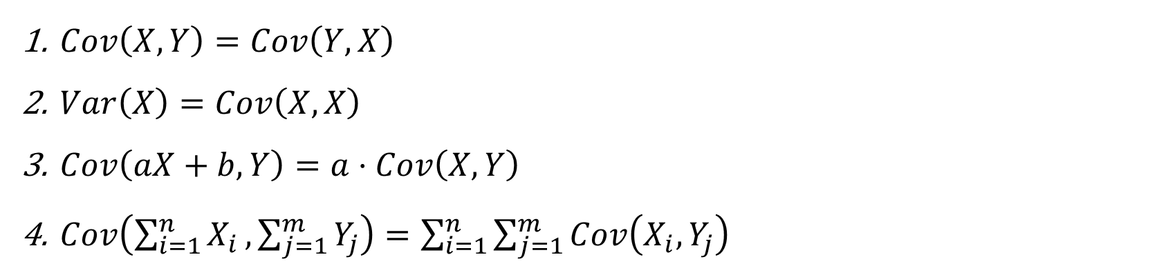
Properties of Covariance
Covariance
𝐂𝐨𝐯 𝐗, 𝐘 = 𝔼 𝑿 − 𝔼 𝑿 (𝒀 − 𝔼 𝒀 ) = 𝔼 𝑿𝒀 − 𝔼[𝑿]𝔼[𝒀]
$Cov\left(X,Y\right)=Cov\left(Y, X\right)$
$Var\left(X\right)=Cov\left(X,X\right)$
$Cov\left(aX+b,Y\right)=a⋅Cov\left(X,Y\right)$
$Cov\left(\sum_{i=1}^{n}{X_{i}},\sum_{j=1}^{m}{Y_{j}}\right)=\sum_{i=1}^{n}{\sum_{j=1}^{m}{Cov\left(X_{i},Y_{j}\right)}}$

Slide 19
Properties of Covariance
Covariance
𝐂𝐨𝐯 𝐗, 𝐘 = 𝔼 𝑿 − 𝔼 𝑿 (𝒀 − 𝔼 𝒀 ) = 𝔼 𝑿𝒀 − 𝔼[𝑿]𝔼[𝒀]
If $X⊥Y$, what do you expect $Cov\left(X,Y\right)$ to be?

Slide 20
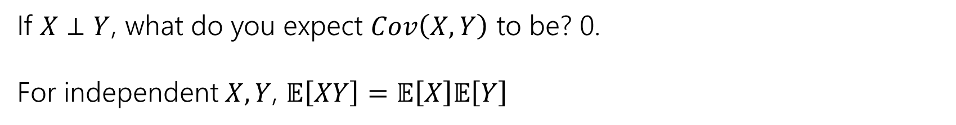
Properties of Covariance
Covariance
𝐂𝐨𝐯 𝐗, 𝐘 = 𝔼 𝑿 − 𝔼 𝑿 (𝒀 − 𝔼 𝒀 ) = 𝔼 𝑿𝒀 − 𝔼[𝑿]𝔼[𝒀]
If $X⊥Y$, what do you expect $Cov\left(X,Y\right)$ to be? 0.
For independent $X, Y$, $𝔼\left[XY\right]=𝔼\left[X\right]𝔼\left[Y\right]$

Slide 21
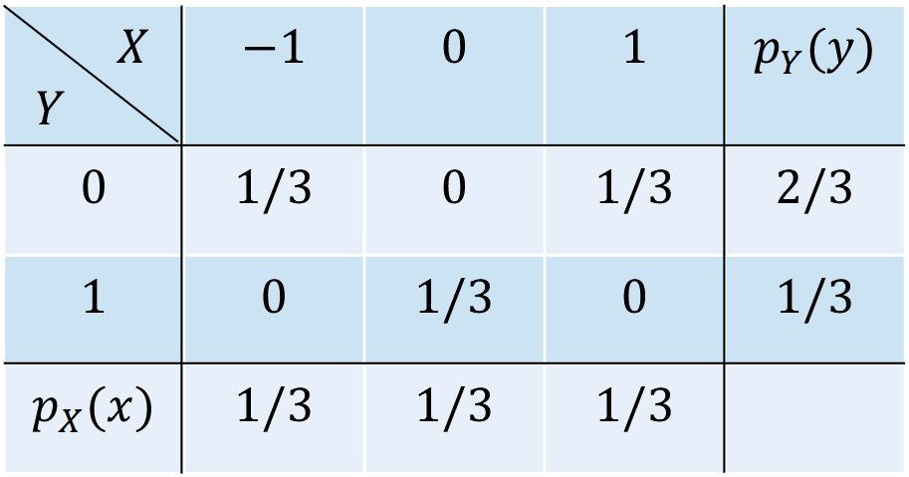
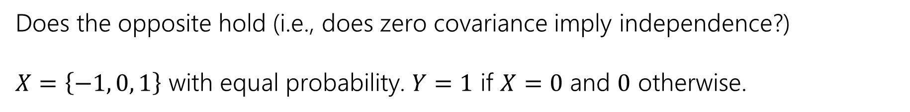
Properties of Covariance
Does the opposite hold (i.e., does zero covariance imply independence?)
$X=\left\{−1, 0, 1\right\}$ with equal probability. $Y=1$ if $X=0$ and $0$ otherwise.

Slide 22
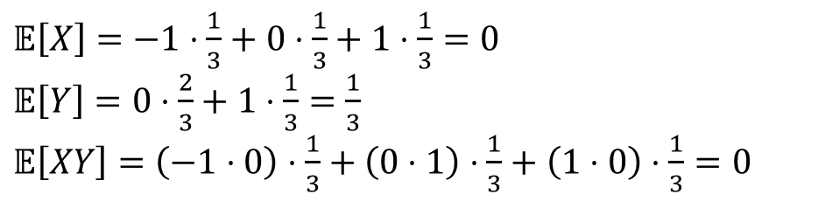
Properties of Covariance
Does the opposite hold (i.e., does zero covariance imply independence?)
$X=\left\{−1, 0, 1\right\}$ with equal probability. $Y=1$ if $X=0$ and $0$ otherwise.
$𝔼\left[X\right]=−1⋅\frac{1}{3}+0⋅\frac{1}{3}+1⋅\frac{1}{3}=0$
$𝔼\left[Y\right]=0⋅\frac{2}{3}+1⋅\frac{1}{3}=\frac{1}{3}$
$𝔼\left[XY\right]=\left(−1⋅0\right)⋅\frac{1}{3}+\left(0⋅1\right)⋅\frac{1}{3}+\left(1⋅0\right)⋅\frac{1}{3}=0$

Slide 23
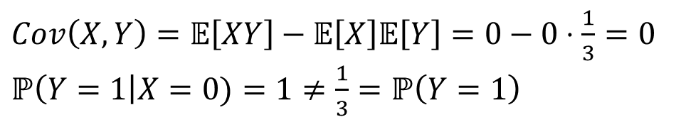
Properties of Covariance
Does the opposite hold (i.e., does zero covariance imply independence?)
$X=\left\{−1, 0, 1\right\}$ with equal probability. $Y=1$ if $X=0$ and $0$ otherwise.
$𝔼\left[X\right]=−1⋅\frac{1}{3}+0⋅\frac{1}{3}+1⋅\frac{1}{3}=0$
$𝔼\left[Y\right]=0⋅\frac{2}{3}+1⋅\frac{1}{3}=\frac{1}{3}$
$𝔼\left[XY\right]=\left(−1⋅0\right)⋅\frac{1}{3}+\left(0⋅1\right)⋅\frac{1}{3}+\left(1⋅0\right)⋅\frac{1}{3}=0$
$Cov\left(X,Y\right)=𝔼\left[XY\right]−𝔼\left[X\right]𝔼\left[Y\right]=0−0⋅\frac{1}{3}=0$
$ℙ\left(Y=1\right|X=0)=1≠\frac{1}{3}=ℙ\left(Y=1\right)$

Slide 24
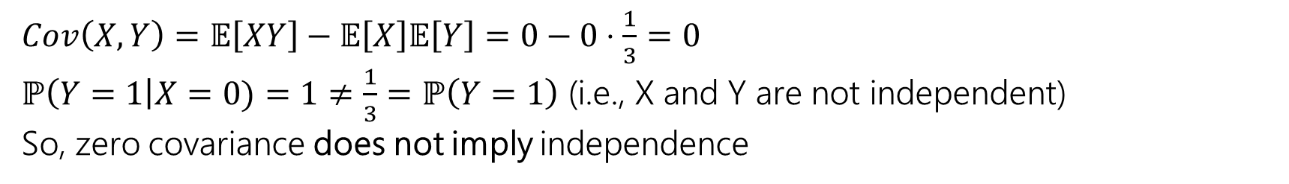
Properties of Covariance
Does the opposite hold (i.e., does zero covariance imply independence?)
$X=\left\{−1, 0, 1\right\}$ with equal probability. $Y=1$ if $X=0$ and $0$ otherwise.
$𝔼\left[X\right]=−1⋅\frac{1}{3}+0⋅\frac{1}{3}+1⋅\frac{1}{3}=0$
$𝔼\left[Y\right]=0⋅\frac{2}{3}+1⋅\frac{1}{3}=\frac{1}{3}$
$𝔼\left[XY\right]=\left(−1⋅0\right)⋅\frac{1}{3}+\left(0⋅1\right)⋅\frac{1}{3}+\left(1⋅0\right)⋅\frac{1}{3}=0$
$Cov\left(X,Y\right)=𝔼\left[XY\right]−𝔼\left[X\right]𝔼\left[Y\right]=0−0⋅\frac{1}{3}=0$
$ℙ\left(Y=1\right|X=0)=1≠\frac{1}{3}=ℙ\left(Y=1\right)$ (i.e., X and Y are not independent)
So, zero covariance does not imply independence

Slide 25
Covariance used for variance of a sum
Var 𝑋 + 𝑌 = Var 𝑋 + Var 𝑌 + 2Cov(𝑋, 𝑌)
^ we do not need 𝑋 and 𝑌 to be independent to use this formula!
Proof:
Var 𝑋 + 𝑌
= Cov(𝑋 + 𝑌, 𝑋 + 𝑌)
= Cov 𝑋, 𝑋 + Cov 𝑋, 𝑌 + Cov 𝑌, 𝑋 + Cov 𝑌, 𝑌
= Var 𝑋 + Var 𝑌 + 2Cov(𝑋, 𝑌)

Slide 26
Covariance used for variance of a sum
Cov X, Y = 𝔼 𝑋 − 𝔼 𝑋 (𝑌 − 𝔼 𝑌 ) = 𝔼 𝑋𝑌 − 𝔼[𝑋]𝔼[𝑌]
Var 𝑋 + 𝑌 = Var 𝑋 + Var 𝑌 + 2Cov(𝑋, 𝑌)
You and your friend are playing a game, you flip a coin: if heads you pay your friend a dollar, if tails they pay you a dollar. Let 𝑋 be your profit and 𝑌 be your friend’s profit.
What is Var(𝑋 + 𝑌)?
Fill out the poll everywhere: pollev.com/cse312
pollev.com/jolie312
Before you calculate, make a prediction. What should it be?

Slide 27
Covariance used for variance of a sum
You and your friend are playing a game, you flip a coin: if heads you pay your friend a dollar, if tails they pay you a dollar. Let 𝑋 be your profit and 𝑌 be your friend’s profit.
What is Var(𝑋 + 𝑌)?
Var 𝑋 = Var 𝑌 = 𝔼 𝑋² − 𝔼 𝑋 ² = 1 − 0² = 1
Cov 𝑋, 𝑌 = 𝔼 𝑋𝑌
− 𝔼[𝑋]𝔼[𝑌]
1
1
2 2
𝔼 𝑋𝑌 =
⋅ −1 ⋅ 1 + 1 ⋅ −1 = −1
Cov 𝑋, 𝑌 = −1 − 0 ⋅ 0 = −1.
Var 𝑋 + 𝑌 = 1 + 1 + 2 ⋅ −1 = 0

Slide 28
Covariance
The magnitude of covariance is affected by the units of the random
variables involved because Cov 2𝑋, 𝑌 = 2Cov 𝑋, 𝑌 , so we can’t really compare and it’s not very helpful
is covariance big because of the units or because of a very strong relationship?
The sign of the covariance (positive or negative) is helpful but it only tells us the direction.
We want to understand the strength of the relationship!

Slide 29
Pearson Correlation (normalized covariance!)
To understand the strength, we normalize the covariance!
Cov 𝑋,𝑌
Var 𝑋 Var 𝑌
Pearson correlation: 𝜌(𝑋, 𝑌) = ^{Cov 𝑋,𝑌} =
𝜎_{𝑋}⋅𝜎_{𝑌}
divide the covariance by the product of the standard deviation of 𝑋
and the standard deviation of 𝑌
a value in the range −1 ≤ 𝜌(𝑋, 𝑌) ≤ 1
−1 means STRONG negative correlation, +1 means STRONG positive correlation

Slide 30
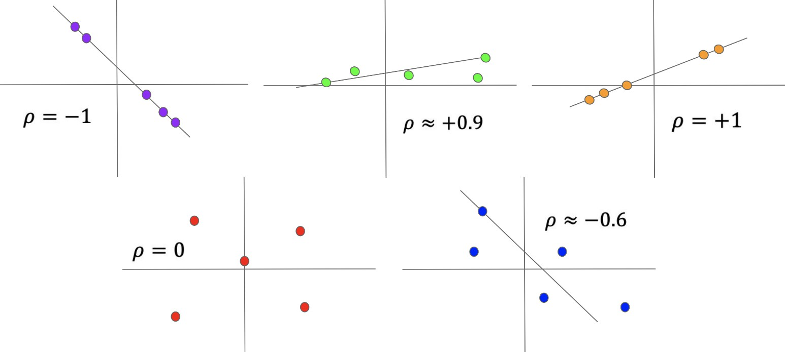
Pearson Correlation (normalized covariance!)

Slide 31
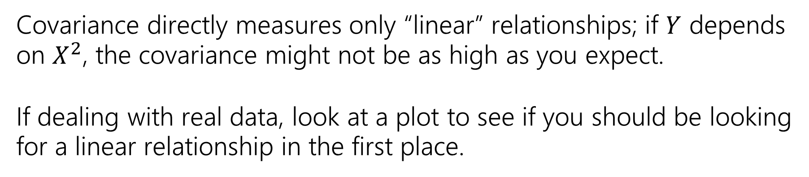
Additional Notes
Covariance directly measures only “linear” relationships; if $Y$ depends on $X^{2}$, the covariance might not be as high as you expect.
If dealing with real data, look at a plot to see if you should be looking for a linear relationship in the first place.

Slide 32
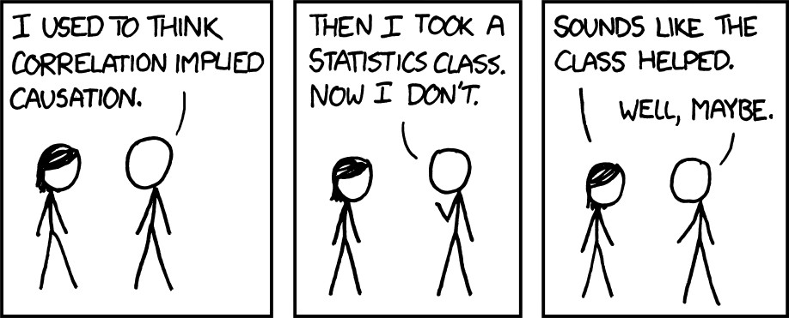
https://xkcd.com/552/

Slide 33
Tail Bounds

Slide 34
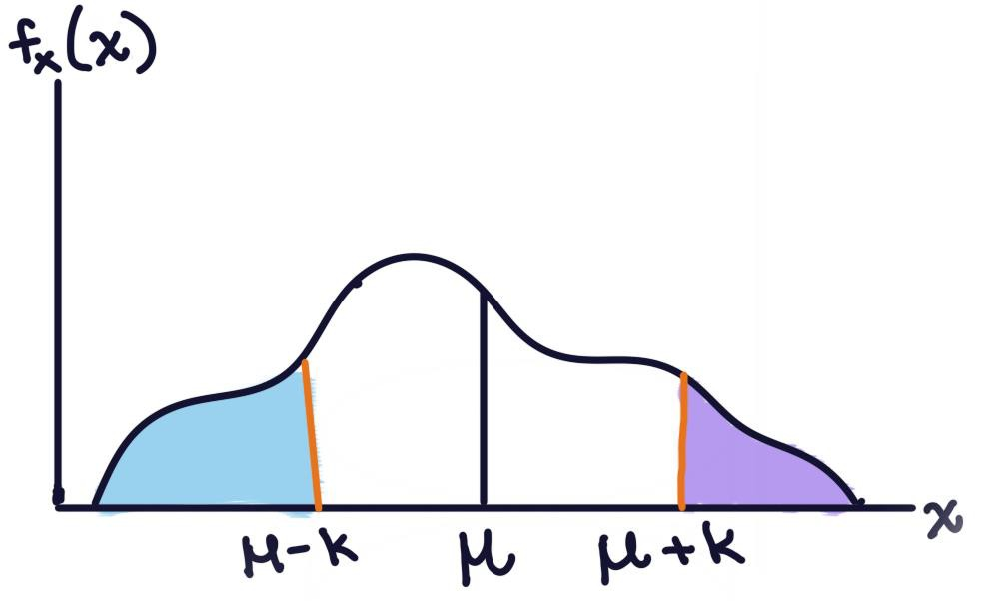
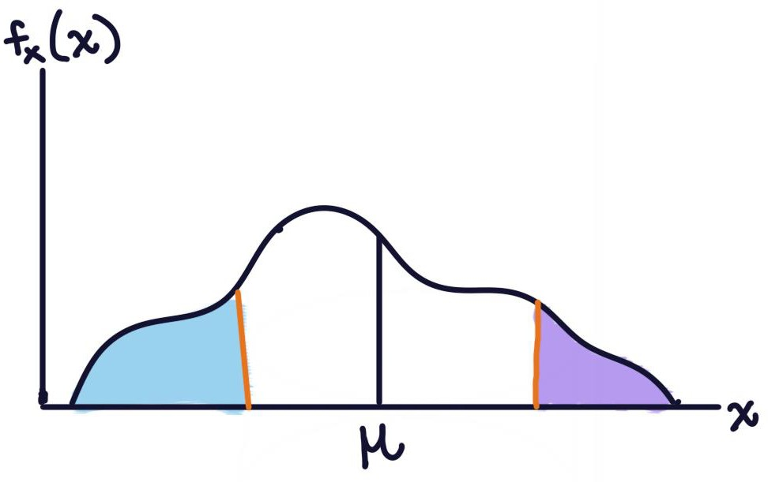
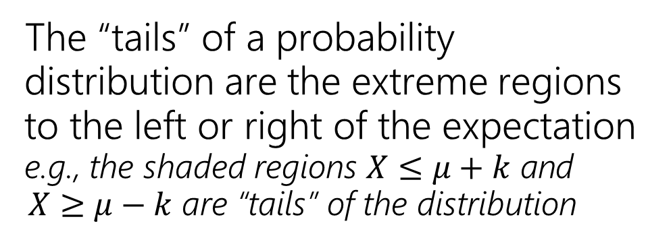
What’s a Tail Bound?
The “tails” of a probability distribution are the extreme regions to the left or right of the expectation e.g., the shaded regions 𝑋 ≤ 𝜇 + 𝑘 and
𝑋 ≥ 𝜇 $−$ 𝑘 are “tails” of the distribution

Slide 35
What’s a Tail Bound?
The “tails” of a probability distribution are the extreme regions to the left or right of the expectation e.g., the shaded regions 𝑋 ≤ 𝜇 + 𝑘 and
𝑋 ≥ 𝜇 − 𝑘 are “tails” of the distribution
Often, we want to make some guarantees about the probability of being in a tail is (e.g., ℙ 𝑋 ≥ 𝑘 ≤ ? ?)
guarantees about the running time (the chance of being > 5sec is no more than )

Slide 36
What’s a Tail Bound?
The “tails” of a probability distribution are the extreme regions to the left or right of the expectation e.g., the shaded regions 𝑋 ≤ 𝜇 + 𝑘 and
𝑋 ≥ 𝜇 − 𝑘 are “tails” of the distribution
Often, we want to make some guarantees about the probability of being in a tail is (e.g., ℙ 𝑋 ≥ 𝑘 ≤ ? ?)
guarantees about the running time (the chance of being > 5sec is no more than )
A tail bound (or concentration inequality) is a statement that bounds the
probability in the “tails” of the distribution (e.g., there’s little probability far from
the center) or (equivalently) the probability is concentrated near the expectation.

Slide 37
What’s a Tail Bound?
A tail bound (or concentration inequality) bounds the probability in the “tails” of the distribution. e.g., statements like ℙ 𝑋 ≥ 4 ≤ 0.8, ℙ 𝑋 ≥ 4 ≤ 0.8

Slide 38
What’s a Tail Bound?
A tail bound (or concentration inequality) bounds the probability in the “tails” of
the distribution. e.g., statements like ℙ 𝑋 ≥ 4 ≤ 0.8, ℙ 𝑋 ≥ 4 ≤ 0.8
We’ve seen this before! We can:
Compute these probabilities exactly in some cases
Approximate 𝑋 as normal using CLT if 𝑋 is the sum of a bunch of i.i.d random variables

Slide 39
What’s a Tail Bound?
A tail bound (or concentration inequality) bounds the probability in the “tails” of
the distribution. e.g., statements like ℙ 𝑋 ≥ 4 ≤ 0.8, ℙ 𝑋 ≥ 4 ≤ 0.8
We’ve seen this before! We can:
Compute these probabilities exactly in some cases
Approximate 𝑋 as normal using CLT if 𝑋 is the sum of a bunch of i.i.d random variables
But what if we barely know anything about 𝑋 and it doesn’t fit into the
frameworks we’ve learned about? Can we still make some tail bound guarantees?

Slide 40
Tail Bounds
We’re going to learn about 3 tail bounds that we can use when all we know about 𝑋 is it’s expected value and/or variance:
Markov’s Inequality
Chebysev’s Inequality
Chernoff Bound

Slide 41
Upper vs. Lower Bound
If we find something like ℙ 𝐴 ≤ 𝑏, we found an upper bound
This highest/”uppermost” value the probability of 𝐴 could be is 𝑏
If we find something like ℙ 𝐴 ≥ 𝑏, we found a lower bound
This lowest/smallest value the probability of 𝐴 could be is 𝑏

Slide 42
Markov’s Inequality
Two statements are equivalent. Left form is often easier to use. Right form is more intuitive.
Markov’s Inequality
Markov’s Inequality
Let 𝑋 be a random variable supported (only) on non-negative numbers. For any 𝒕 > 𝟎
𝔼[𝑿]
Let 𝑋 be a random variable supported (only) on non-negative numbers. For any 𝐤 > 𝟎
𝟏
ℙ 𝑿 ≥ 𝒕 ≤
ℙ 𝑿 ≥ 𝒌𝔼[𝑿] ≤
𝒕
𝒌
Requirements:
1. 𝑋 must be non-negative
2. We know the expectation of 𝑋

Slide 43
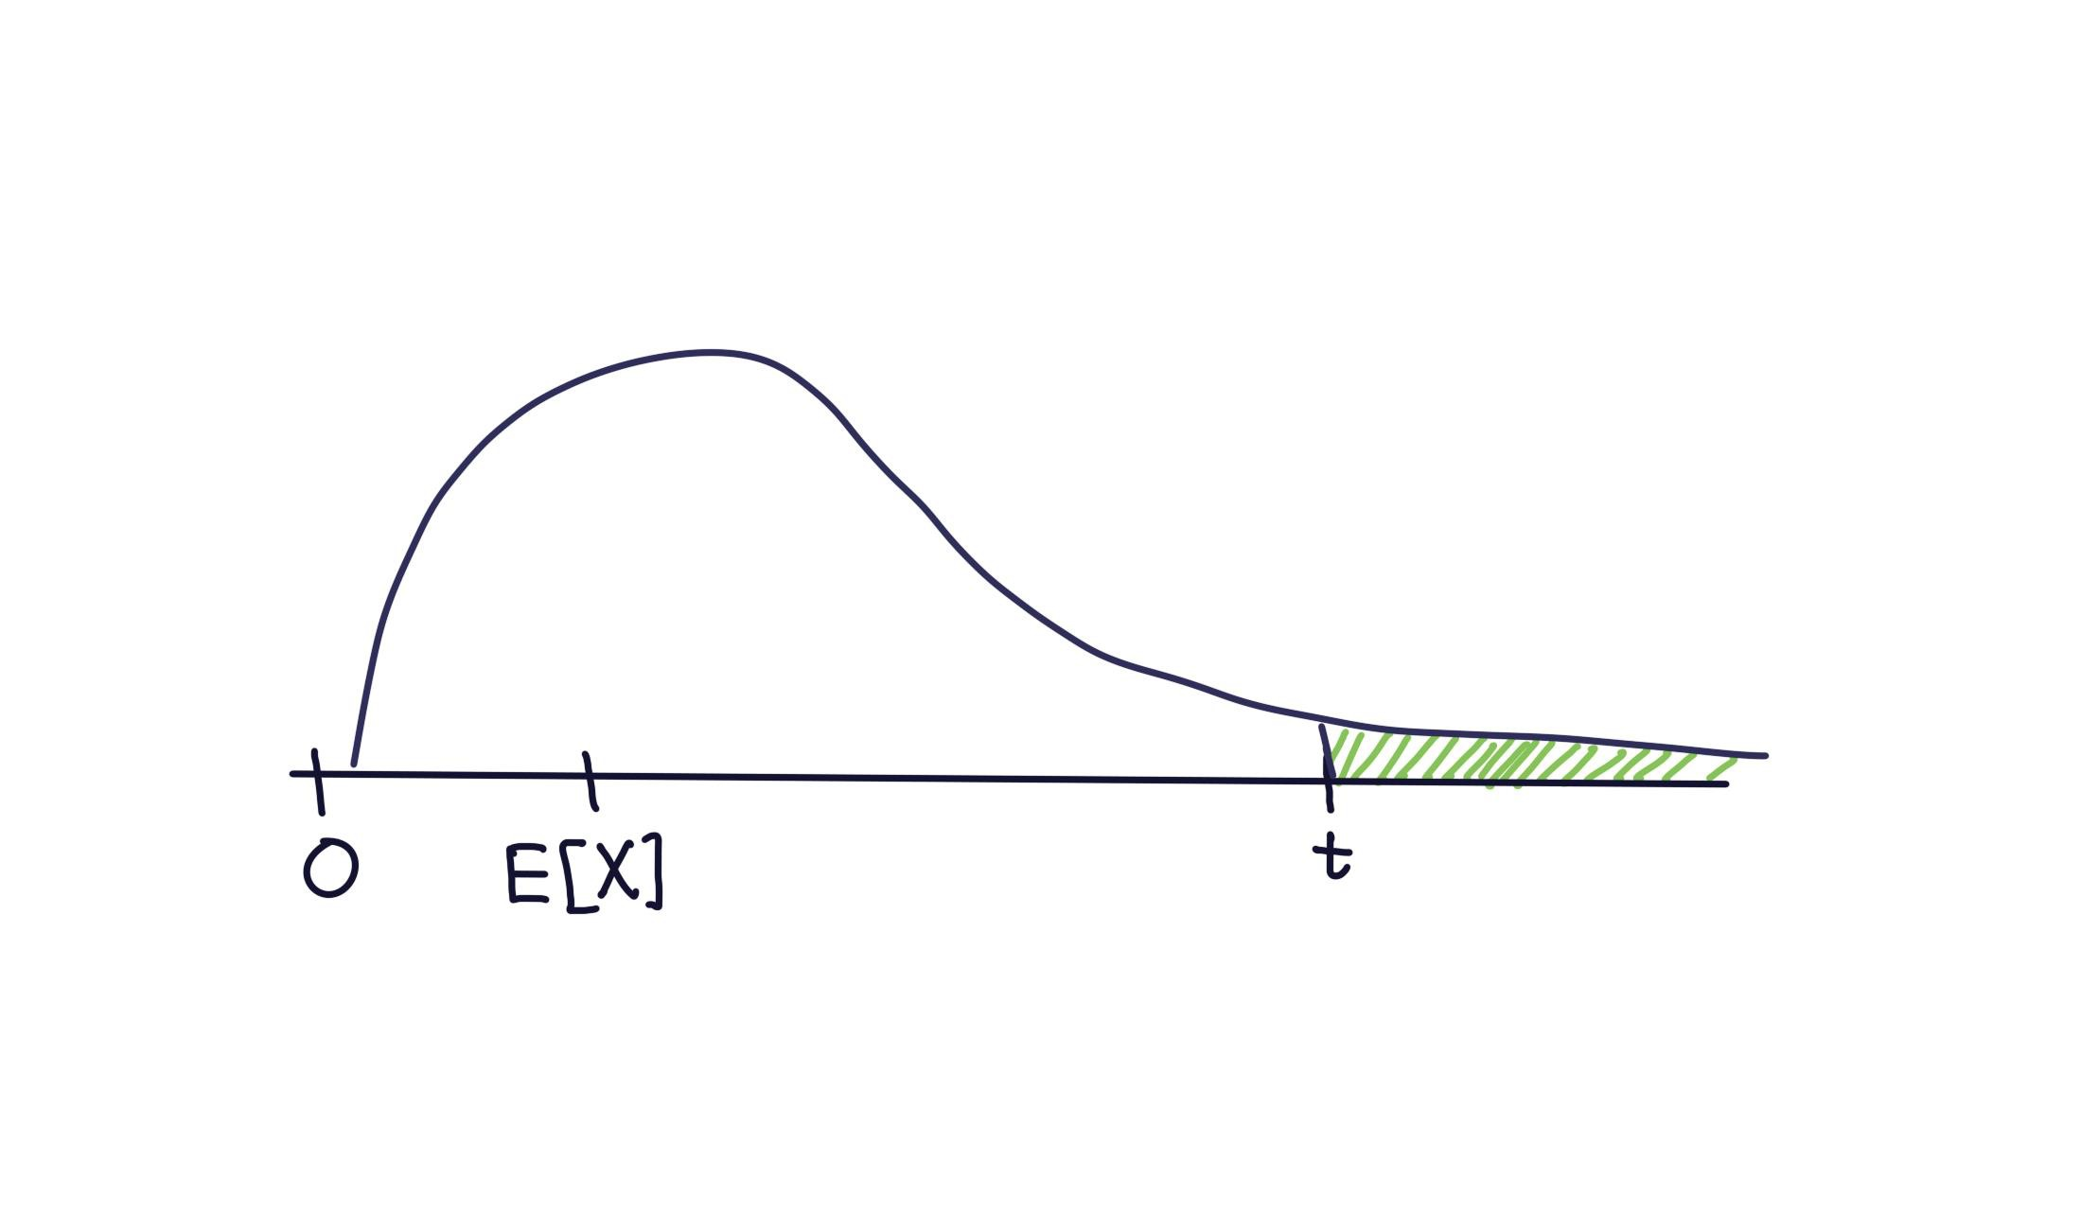

Slide 44
Proof
𝔼 𝑋 = 𝔼 𝑋 𝑋 < 𝑡 ℙ 𝑋 < 𝑡 + 𝔼 𝑋 𝑋 ≥ 𝑡 ℙ 𝑋 ≥ 𝑡
≥ 𝔼 𝑋 𝑋 ≥ 𝑡 ℙ 𝑋 ≥ 𝑡
𝔼 X X ≥ t ℙ X ≥ t ≥ 0 if X is non-negative
≥ 𝑡 ⋅ ℙ 𝑋 ≥ 𝑡
𝔼 𝑋 ≥ 𝑡 ⋅ ℙ(𝑋 ≥ 𝑡)
Doing some algebra…we get exactly
what’s in Markov’s inequality! ➔
Markov’s Inequality
Let 𝑋 be a random variable supported (only) on non-negative numbers. For any 𝒕 > 𝟎
𝔼[𝑿]
ℙ 𝑿 ≥ 𝒕 ≤
𝒕

Slide 45
Example: Let’s see how good this bound is…
Suppose you roll a fair (6-sided) die until you see a 6. Let 𝑋 be the number of rolls. Bound the probability that 𝑋 ≥ 12.
1 1
6 6
𝑋~Geo
, so 𝔼 𝑋 = 1/( ) = 6
Applying Markov’s Inequality…
Markov’s Inequality
1
12 12 2
ℙ 𝑋 ≥ 12 ≤
𝔼 𝑋 6
= =
Let 𝑋 be a random variable
supported (only) on non-negative numbers. For any 𝒕 > 𝟎
𝔼[𝑿]
ℙ 𝑿 ≥ 𝒕 ≤
𝒕

Slide 46
Example: Let’s see how good this bound is…
Suppose you roll a fair (6-sided) die until you see a 6. Let 𝑋 be the number of rolls. Bound the probability that 𝑋 ≥ 12.
𝑋~Geo
1 1
, so 𝔼 𝑋 = 1/( ) = 6
6 6
Applying Markov’s Inequality…
≤ 𝔼 𝑋
6 ₌ 1
12 2
Markov’s Inequality
ℙ 𝑋 ≥ 12
=
12
Let 𝑋 be a random variable supported (only) on non-negative numbers. For any 𝒕 > 𝟎
Exact probability?
1 − ℙ 𝑋 < 12 ≈ 1 − 0.865 = 0.135
𝔼[𝑿]
ℙ 𝑿 ≥ 𝒕 ≤
𝒕

Slide 47
Example: Ads
Suppose the average number of ads you see on a website is 25. Give an upper bound on the probability of seeing a website with 75 or more ads.
Markov’s Inequality
Let 𝑋 be a random variable
supported (only) on non-negative numbers. For any 𝒕 > 𝟎
𝔼[𝑿]
ℙ 𝑿 ≥ 𝒕 ≤
𝒕

Slide 48
Example: Ads
Suppose the average number of ads you see on a website is 25. Give an upper bound on the probability of seeing a website with 75 or more ads.
≤ 𝔼 𝑋 ₌ 25 ₌ 1
75 75 3
ℙ 𝑋 ≥ 75
Markov’s Inequality
Let 𝑋 be a random variable supported (only) on non-negative numbers. For any 𝒕 > 𝟎
𝔼[𝑿]
ℙ 𝑿 ≥ 𝒕 ≤
𝒕

Slide 49
Example: More Ads
Suppose the average number of ads you see on a website is 25. Give an upper bound on the probability of seeing a website with 20 or more ads.
Markov’s Inequality
Let 𝑋 be a random variable
supported (only) on non-negative numbers. For any 𝒕 > 𝟎
Fill out the poll everywhere: pollev.com/jolie312
𝔼[𝑿]
ℙ 𝑿 ≥ 𝒕 ≤
𝒕

Slide 50
Example: More Ads
Suppose the average number of ads you see on a website is 25. Give an upper bound on the probability of seeing a website with 20 or more ads.
≤ 𝔼 𝑋
ℙ 𝑋 ≥ 20
= ²⁵ = 1.25
20
20
Well, that’s…true. Technically.
But without more information we couldn’t hope to do much better. What
if every page gives exactly 25 ads? Then the probability really is 1.

Slide 51
So…what do we do?
A better inequality!
We’re trying to bound the tails of the distribution.
What parameter of a random variable describes the tails? The variance!

Slide 52
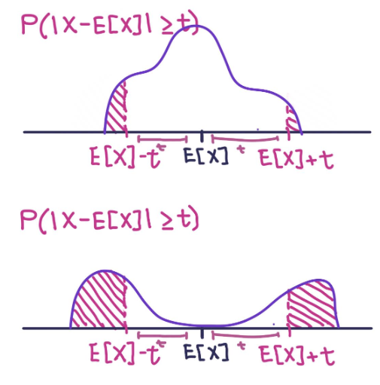
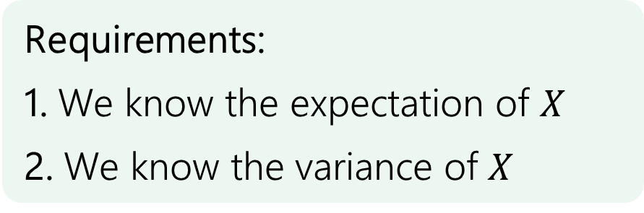
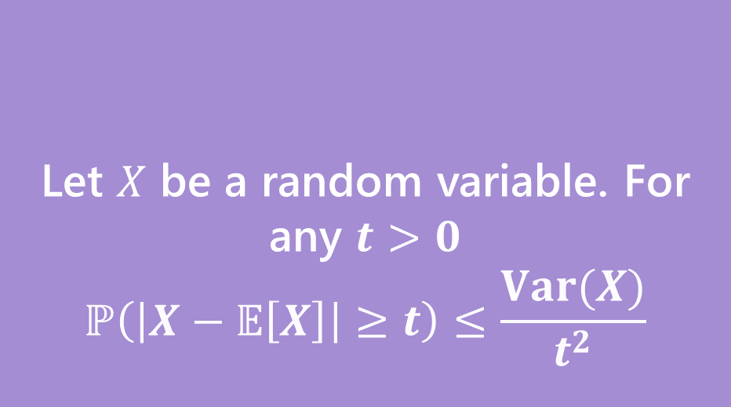
Chebyshev’s Inequality
Let $X$ be a random variable. For any $t>0$
$$ℙ\left(\left|X−𝔼\left[X\right]\right|≥t\right)≤\frac{Var(X)}{t^{2}}$$
Chebyshev’s Inequality
Requirements:
1. We know the expectation of $X$
2. We know the variance of 𝑋

Slide 53
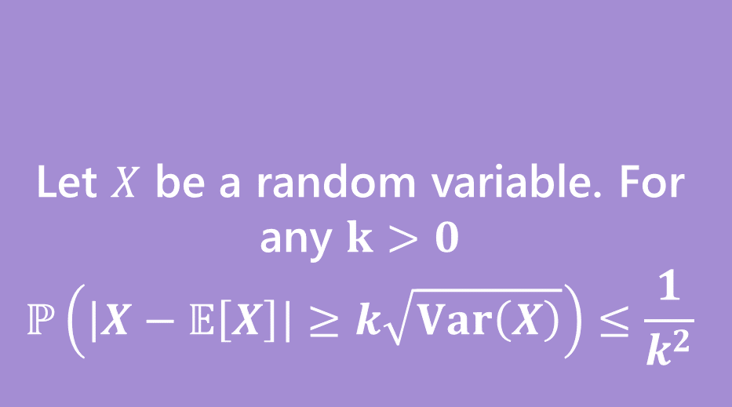
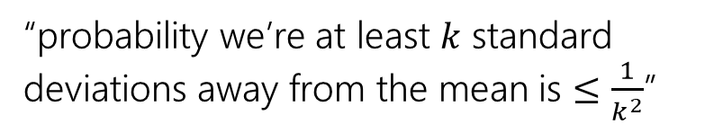
Chebyshev’s Inequality
Two statements are equivalent. Left form is often easier to use. Right form is more intuitive.
Let $X$ be a random variable. For any $t>0$
$$ℙ\left(\left|X−𝔼\left[X\right]\right|≥t\right)≤\frac{Var(X)}{t^{2}}$$
Let $X$ be a random variable. For any $k>0$
$$ℙ\left(\left|X−𝔼\left[X\right]\right|≥k\sqrt{Var\left(X\right)}\right)≤\frac{1}{k^{2}}$$
Chebyshev’s Inequality
Chebyshev’s Inequality
Requirements:
1. We know the expectation of $X$
2. We know the variance of 𝑋
“probability we’re at least 𝑘 standard deviations away from the mean is $≤\frac{1}{k^{2}}$”

Slide 54
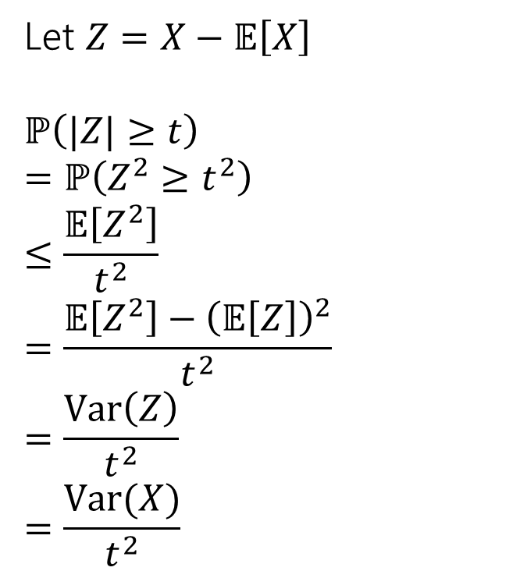
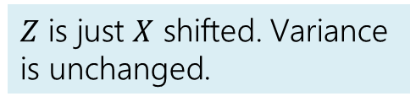

Proof of Chebyshev
Let $X$ be a random variable. For any $t>0$
$$ℙ\left(\left|X−𝔼\left[X\right]\right|≥t\right)≤\frac{Var(X)}{t^{2}}$$
Let $Z=X−𝔼\left[X\right]$
$$ℙ\left(|Z|≥t\right)$$
$$=ℙ\left(Z^{2}≥t^{2}\right)$$
$$≤\frac{𝔼\left[Z^{2}\right]}{t^{2}}$$
$$=\frac{𝔼\left[Z^{2}\right]−{\left(𝔼\left[Z\right]\right)}^{2}}{t^{2}}$$
$$=\frac{Var\left(Z\right)}{t^{2}}$$
$$=\frac{Var(X)}{t^{2}}$$
Chebyshev’s Inequality
Inequalities are equivalent (square each side)
Markov’s Inequality
$$𝔼\left[Z\right]=0$$
$Z$ is just $X$ shifted. Variance is unchanged.

Slide 55
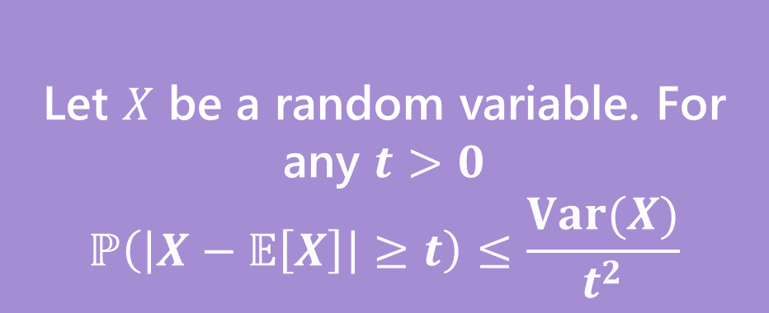
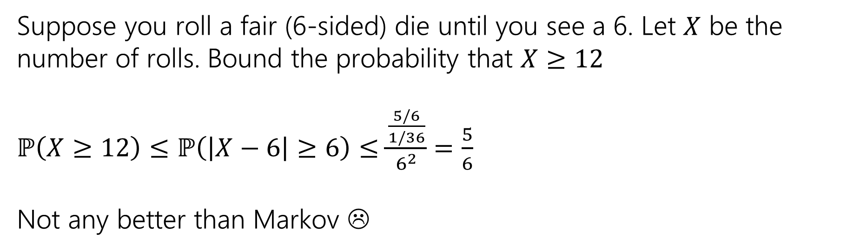

Example with geometric RV
Markov’s inequality gave $ℙ\left(X≥12\right)≤1/2$
Suppose you roll a fair (6-sided) die until you see a 6. Let $X$ be the number of rolls. Bound the probability that $X≥12$
$ℙ\left(X≥12\right)≤ℙ\left(\left|X−6\right|≥6\right)≤\frac{\frac{5/6}{1/36}}{6^{2}}$ $=\frac{5}{6}$
Not any better than Markov ☹
Let $X$ be a random variable. For any $t>0$
$$ℙ\left(\left|X−𝔼\left[X\right]\right|≥t\right)≤\frac{Var(X)}{t^{2}}$$
Chebyshev’s Inequality

Slide 56
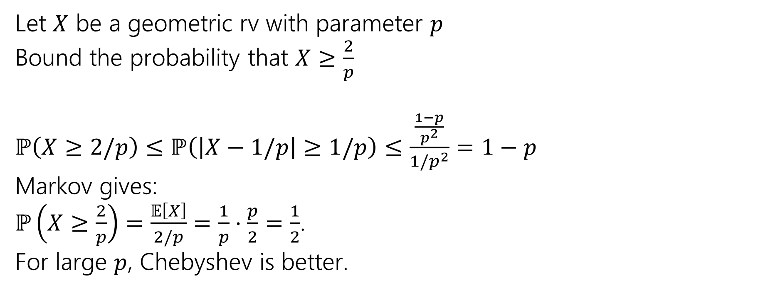
Example with geometric RV
Let $X$ be a geometric rv with parameter $p$
Bound the probability that $X≥\frac{2}{p}$
$ℙ\left(X≥2/p\right)≤ℙ\left(\left|X−1/p\right|≥1/p\right)≤\frac{\frac{1−p}{p^{2}}}{{1/p}^{2}}$ $=1−p$
Markov gives:
$ℙ\left(X≥\frac{2}{p}\right)=\frac{𝔼\left[X\right]}{2/p}=\frac{1}{p}⋅\frac{p}{2}=\frac{1}{2}$.
For large $p$, Chebyshev is better.
Let $X$ be a random variable. For any $t>0$
$$ℙ\left(\left|X−𝔼\left[X\right]\right|≥t\right)≤\frac{Var(X)}{t^{2}}$$
Chebyshev’s Inequality

Slide 57

Example: Ads (but better!)
Markov’s inequality gave $ℙ\left(X≥75\right)≤1/3$
Suppose the average number of ads you see on a website is 25. And the variance of the number of ads is 16. Give an upper bound on the probability of seeing a website with 75 or more ads.
Let $X$ be a random variable. For any $t>0$
$$ℙ\left(\left|X−𝔼\left[X\right]\right|≥t\right)≤\frac{Var(X)}{t^{2}}$$
Chebyshev’s Inequality

Slide 58
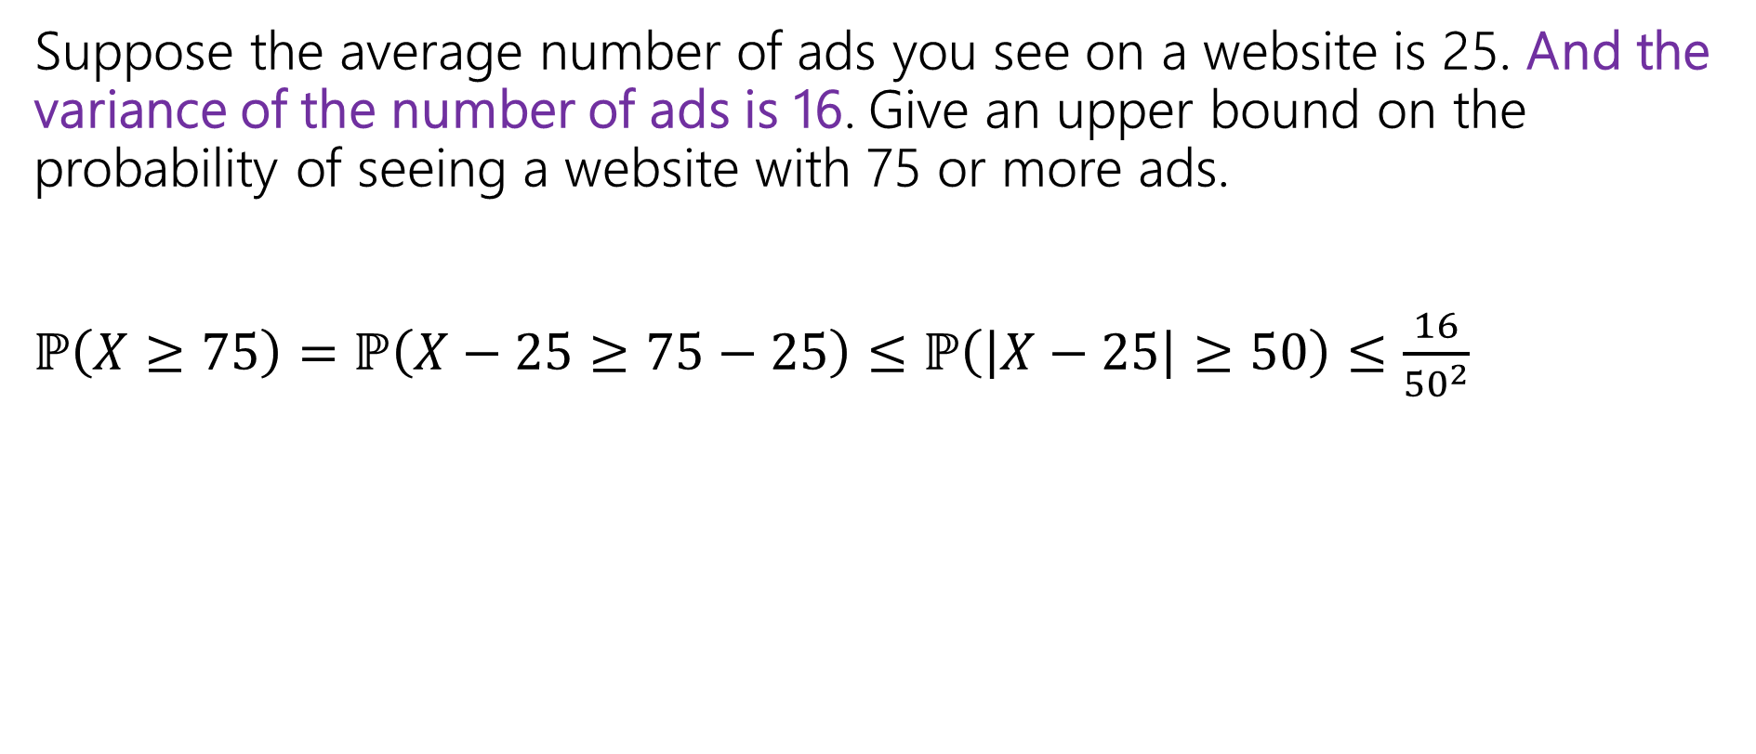
Example: Ads (but better!)
Markov’s inequality gave $ℙ\left(X≥75\right)≤1/3$
Suppose the average number of ads you see on a website is 25. And the variance of the number of ads is 16. Give an upper bound on the probability of seeing a website with 75 or more ads.
$ℙ\left(X≥75\right)=ℙ\left(X−25≥75−25\right)≤ℙ\left(\left|X−25\right|≥50\right)≤\frac{16}{{50}^{2}}$
Let $X$ be a random variable. For any $t>0$
$$ℙ\left(\left|X−𝔼\left[X\right]\right|≥t\right)≤\frac{Var(X)}{t^{2}}$$
Chebyshev’s Inequality

Slide 59
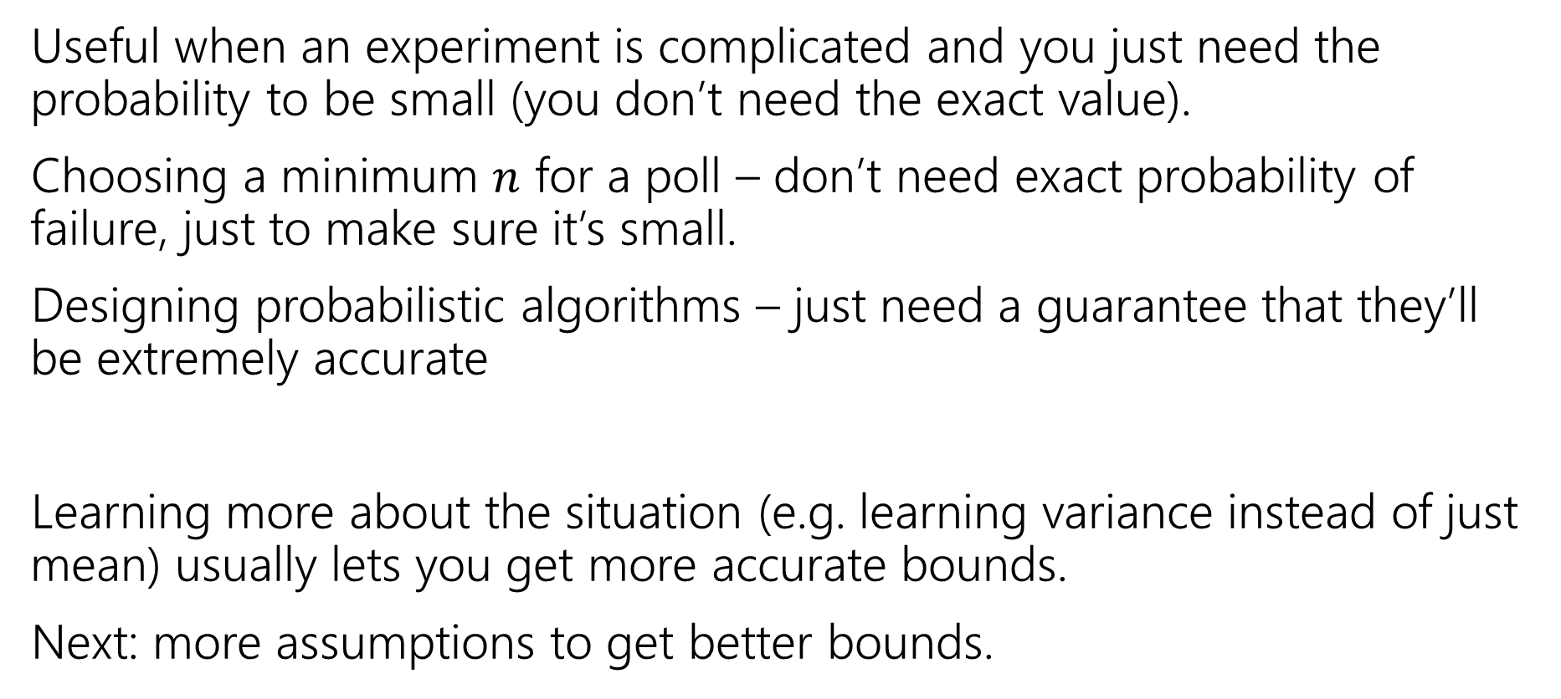
Tail Bounds – Takeaways
Useful when an experiment is complicated and you just need the probability to be small (you don’t need the exact value).
Choosing a minimum $n$ for a poll – don’t need exact probability of failure, just to make sure it’s small.
Designing probabilistic algorithms – just need a guarantee that they’ll be extremely accurate
Learning more about the situation (e.g. learning variance instead of just mean) usually lets you get more accurate bounds.
Next: more assumptions to get better bounds.

