Slide 1
Joint Distributions
CSE 312 26Su
Lecture 17

Slide 2
Announcements
Homework 5 due Wednesday
Quiz 5 on Friday

Slide 3
Where Are We?
Last time:
  Polling
Today:
  Joint Distributions
    Joint Support
    Joint PMF / PDF
    Joint CDF
    Joint Expectation
  Conditional Distributions
    Conditional Expectation
  Law of Total Expectation
  Covariance

Slide 4
Multiple Random Variables

Slide 5
Analyzing Multiple Random Variables
So far, we’ve pretty much only analyzed one random variable at a time
  We’ve worked with multiple random variables (e.g., the sum of them) but haven’t really analyzed their relationships except for independence
Today, we will talk about analyzing the relations between multiple RVs

Slide 6
Analyzing Multiple Random Variables
Examples:
Economics: Analyzing the relationship between stock returns and volume helps in understanding market behavior and making investment decisions
Healthcare: Understanding how different factors (like blood pressure and cholesterol levels) affects the probability of medical conditionals
Machine learning: understanding how different features contribute to predicting a label and improving model accuracy (what features are most important)
Recommendation systems: Understanding relationship between user preferences and item features to improve recommendation systems, or other factors like age and choices of products

Slide 7
Joint Distributions
We’ll start with the discrete case

Slide 8

We have two discrete random variables $X$ and $Y$
  (that may or may not be independent)

Slide 9
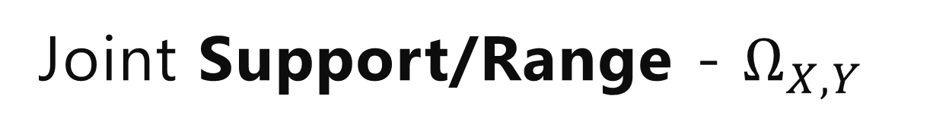
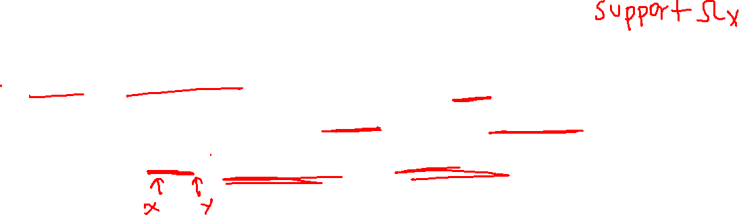
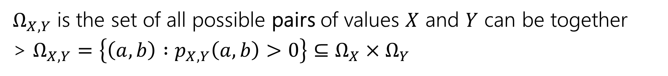
Joint Support/Range - $Ω_{X,Y}$
We have two discrete random variables $X$ and $Y$
  (that may or may not be independent)
$Ω_{X,Y}$ is the set of all possible pairs of values $X$ and $Y$ can be together
> $Ω_{X,Y}=\left\{\left(a,b\right) :p_{X,Y}\left(a,b\right)>0\right\}⊆Ω_{X}×Ω_{Y}$

Slide 10
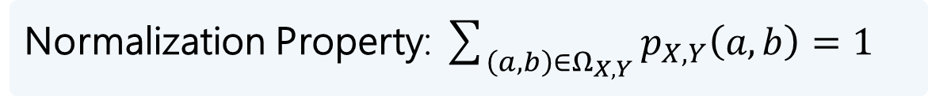
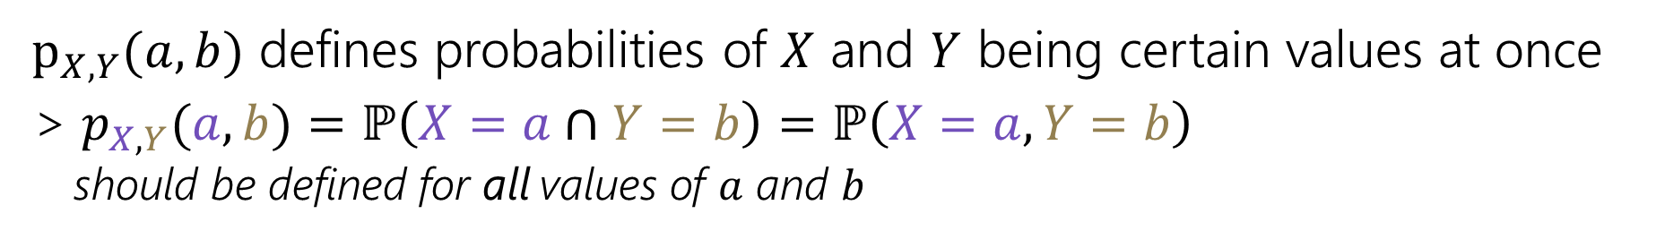
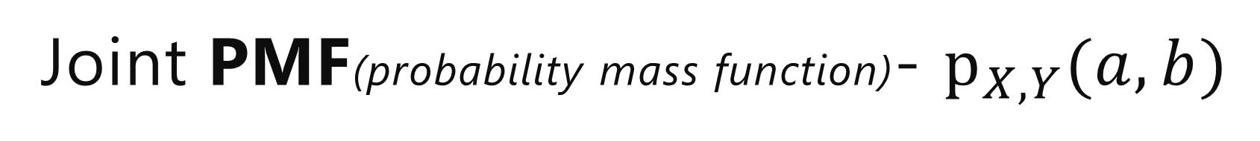
Joint Support/Range - $Ω_{X,Y}$
We have two discrete random variables $X$ and $Y$
  (that may or may not be independent)
$Ω_{X,Y}$ is the set of all possible pairs of values $X$ and $Y$ can be together
> $Ω_{X,Y}=\left\{\left(a,b\right) :p_{X,Y}\left(a,b\right)>0\right\}⊆Ω_{X}×Ω_{Y}$
Joint PMF(probability mass function)- $p_{X,Y}(a,b)$
$p_{X,Y}(a,b)$ defines probabilities of $X$ and $Y$ being certain values at once
> $p_{X,Y}(a,b)=ℙ\left(X=a∩Y=b\right)=ℙ\left(X=a,Y=b\right)$
  should be defined for all values of $a$ and $b$
Normalization Property: $\sum_{\left(a,b\right)∈Ω_{X,Y}}{p_{X,Y}\left(a,b\right)=1}$

Slide 11
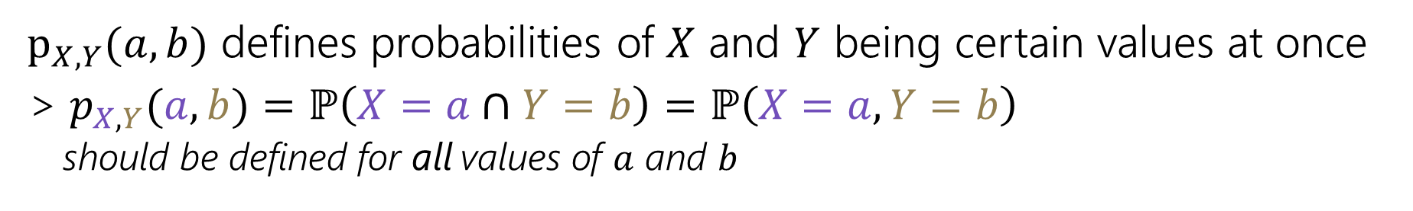
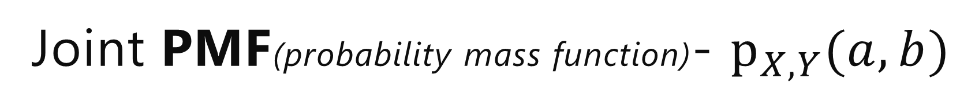
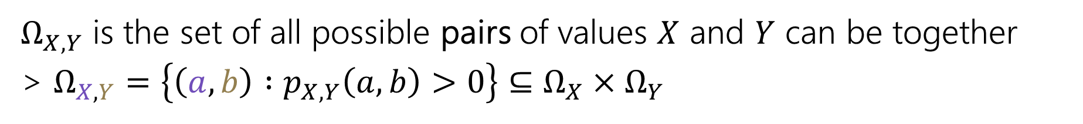
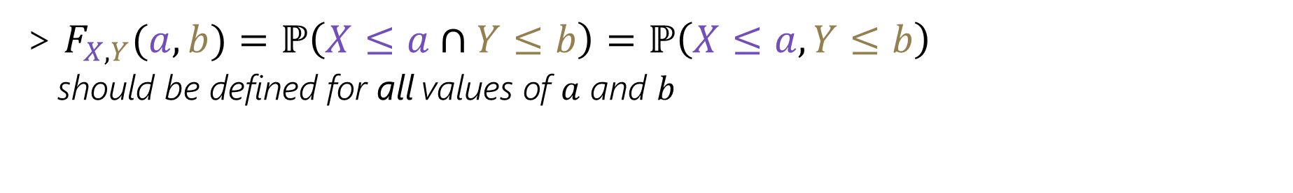
Joint Support/Range - $Ω_{X,Y}$
We have two discrete random variables $X$ and $Y$
  (that may or may not be independent)
$Ω_{X,Y}$ is the set of all possible pairs of values $X$ and $Y$ can be together
> $Ω_{X,Y}=\left\{\left(a,b\right) :p_{X,Y}\left(a,b\right)>0\right\}⊆Ω_{X}×Ω_{Y}$
Joint PMF(probability mass function)- $p_{X,Y}(a,b)$
$p_{X,Y}(a,b)$ defines probabilities of $X$ and $Y$ being certain values at once
> $p_{X,Y}(a,b)=ℙ\left(X=a∩Y=b\right)=ℙ\left(X=a,Y=b\right)$
  should be defined for all values of $a$ and $b$
Joint CDF(cumulative distribution function)- $F_{X,Y}(a,b)$
> $F_{X,Y}(a,b)=ℙ\left(X≤a∩Y≤b\right)=ℙ\left(X≤a,Y≤b\right)$
  should be defined for all values of $a$ and $b$

Slide 12
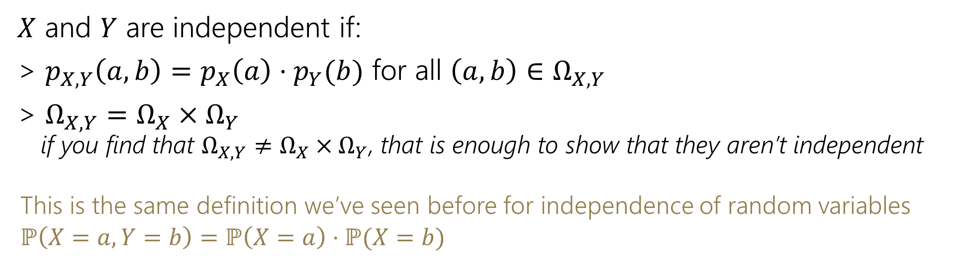
(Joint) Independence
We have two discrete random variables $X$ and $Y$
  (that may or may not be independent)
$X$ and $Y$ are independent if:
> $p_{X,Y}\left(a,b\right)=p_{X}\left(a\right)⋅p_{Y}(b)$ for all $\left(a, b\right)∈Ω_{X,Y}$
> $Ω_{X,Y}=Ω_{X}×Ω_{Y}$
  if you find that $Ω_{X,Y}≠Ω_{X}×Ω_{Y}$, that is enough to show that they aren’t independent
  This is the same definition we’ve seen before for independence of random variables
  $$ℙ\left(X=a, Y=b\right)=ℙ\left(X=a\right)⋅ℙ(X=b)$$
08/03: missing symbol corrected

Slide 13
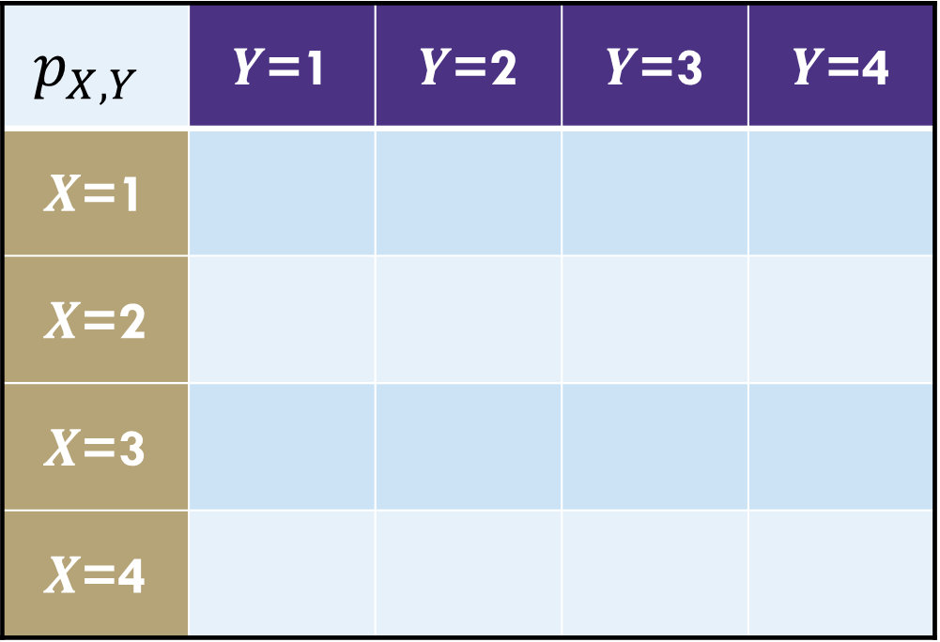
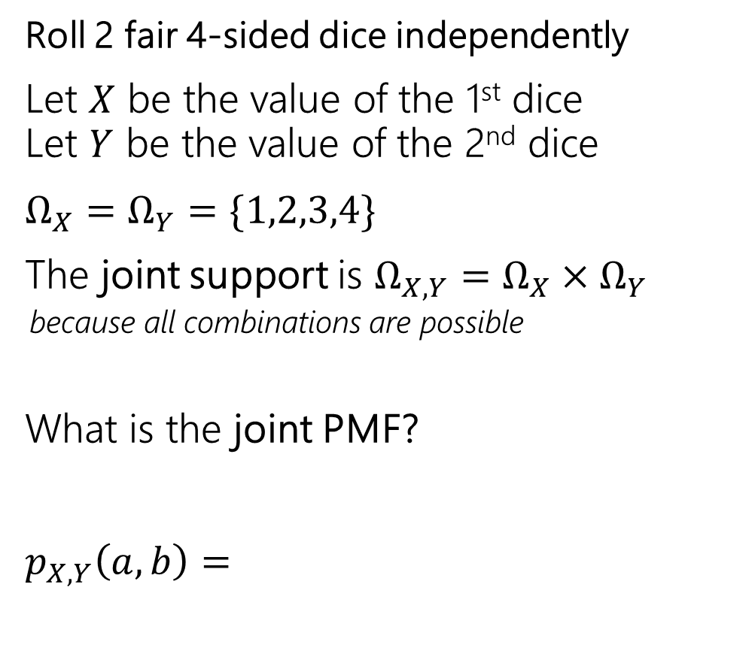
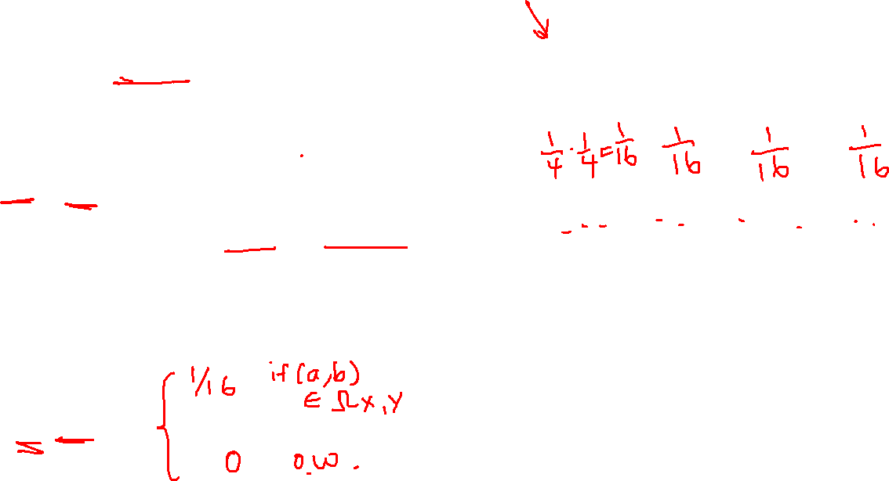
Example: Weird Dice
Roll 2 fair 4-sided dice independently
Let $X$ be the value of the 1st dice
Let $Y$ be the value of the 2nd dice
$Ω_{X}=Ω_{Y}=\{1,2,3,4\}$
The joint support is $Ω_{X,Y}=Ω_{X}×Ω_{Y}$
  because all combinations are possible
What is the joint PMF?
$p_{X,Y}\left(a,b\right)=$
$$p_{X,Y}$$ | $Y$=1 | $Y$=2 | $Y$=3 | $Y$=4
$X$=1
$X$=2
$X$=3
$X$=4

Slide 14
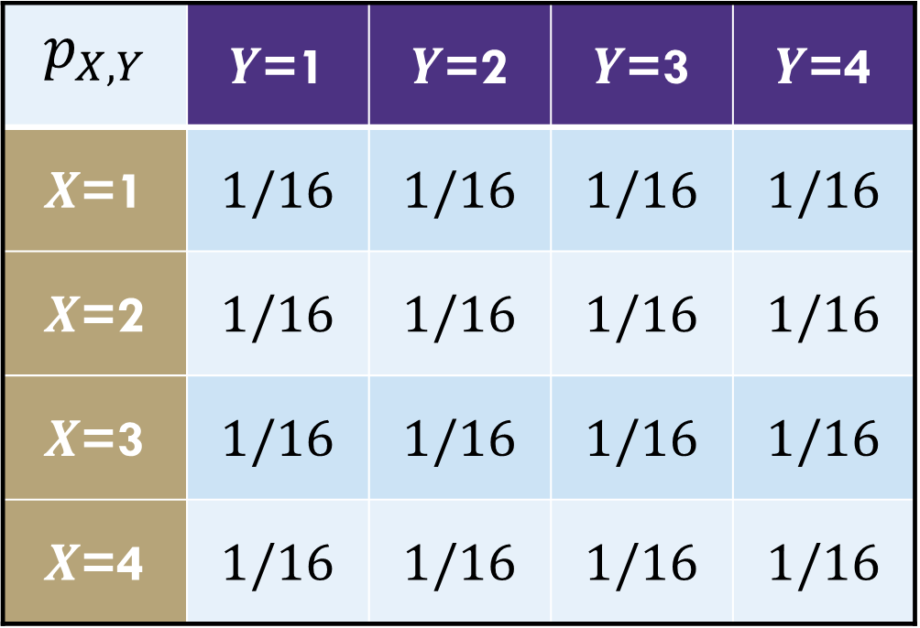
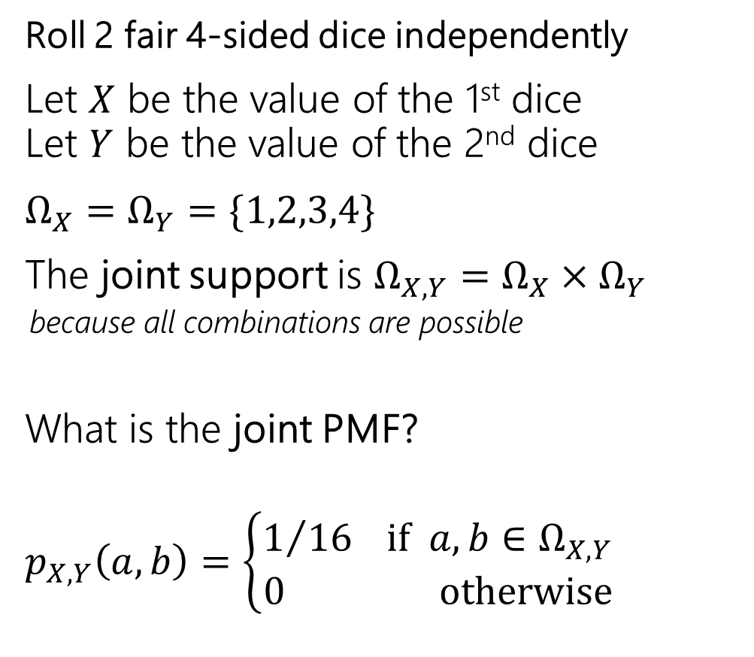
Example: Weird Dice
Roll 2 fair 4-sided dice independently
Let $X$ be the value of the 1st dice
Let $Y$ be the value of the 2nd dice
$Ω_{X}=Ω_{Y}=\{1,2,3,4\}$
The joint support is $Ω_{X,Y}=Ω_{X}×Ω_{Y}$
  because all combinations are possible
What is the joint PMF?
$p_{X,Y}\left(a,b\right)=\left\{\begin{matrix}1/{16} if a,b∈Ω_{X,Y} \\ 0 otherwise\end{matrix}\right.$
$$p_{X,Y}$$ | $Y$=1 | $Y$=2 | $Y$=3 | $Y$=4
$X$=1 | $$1/16$$ | $$1/16$$ | $$1/16$$ | $$1/16$$
$X$=2 | $$1/16$$ | $$1/16$$ | $$1/16$$ | $$1/16$$
$X$=3 | $$1/16$$ | $$1/16$$ | $$1/16$$ | $$1/16$$
$X$=4 | $$1/16$$ | $$1/16$$ | $$1/16$$ | $$1/16$$

Slide 15
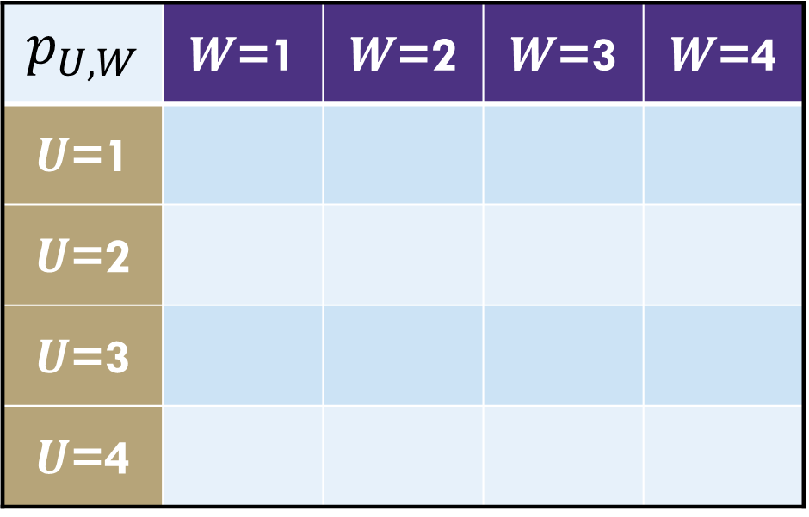

Example: Weird Dice
Roll 2 fair 4-sided dice independently
Let $U$ be the min value $U=\min\left(X,Y\right)$
Let $W$ be the max value $W=max⁡(X,Y)$
$Ω_{U}=Ω_{W}=\{1,2,3,4\}$
The joint support is:
$$p_{U,W}$$ | $W$=1 | $W$=2 | $W$=3 | $W$=4
$U$=1
$U$=2
$U$=3
$U$=4

Slide 16
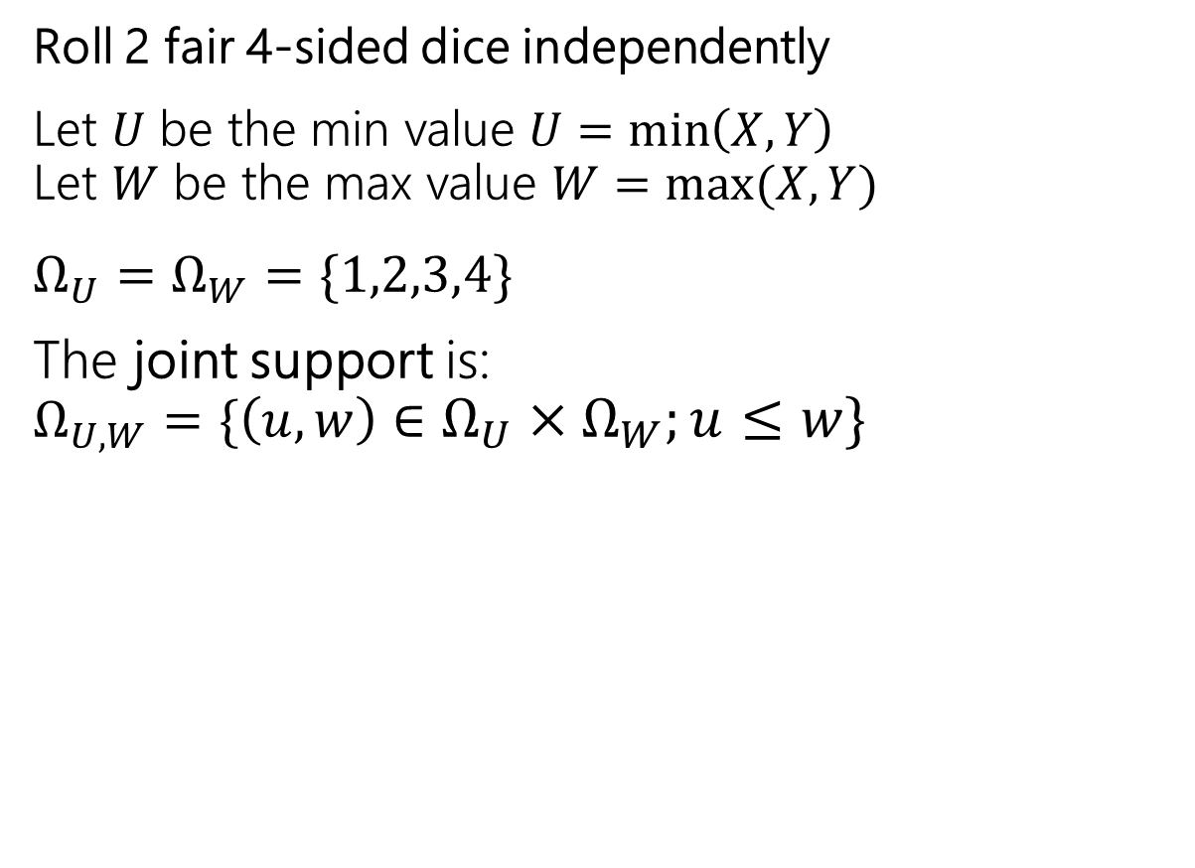
Example: Weird Dice
Roll 2 fair 4-sided dice independently
Let $U$ be the min value $U=\min\left(X,Y\right)$
Let $W$ be the max value $W=max⁡(X,Y)$
$Ω_{U}=Ω_{W}=\{1,2,3,4\}$
The joint support is:
$Ω_{U,W}=\{\left(u,w\right)∈Ω_{U}×Ω_{W};u≤w\}$
$$p_{U,W}$$ | $W$=1 | $W$=2 | $W$=3 | $W$=4
$U$=1
$U$=2
$U$=3
$U$=4

Slide 17
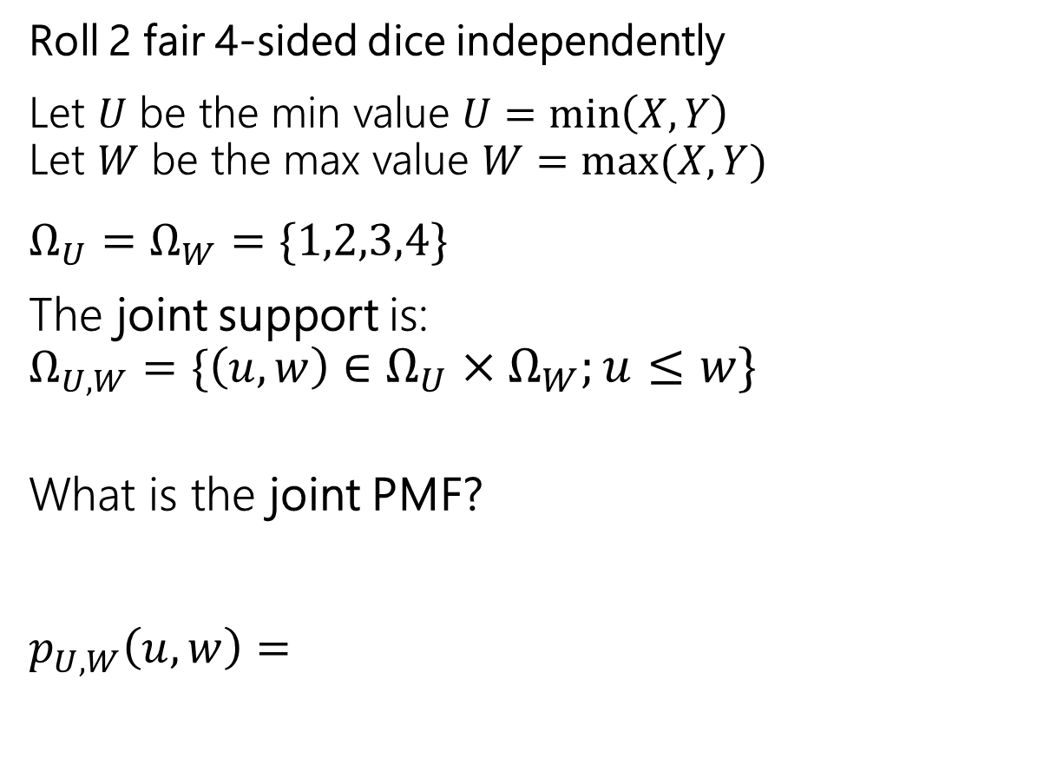
Example: Weird Dice
Roll 2 fair 4-sided dice independently
Let $U$ be the min value $U=\min\left(X,Y\right)$
Let $W$ be the max value $W=max⁡(X,Y)$
$Ω_{U}=Ω_{W}=\{1,2,3,4\}$
The joint support is:
$Ω_{U,W}=\{\left(u,w\right)∈Ω_{U}×Ω_{W};u≤w\}$
What is the joint PMF?
$p_{U,W}\left(u,w\right)=$
$$p_{U,W}$$ | $W$=1 | $W$=2 | $W$=3 | $W$=4
$U$=1
$U$=2
$U$=3
$U$=4
Notes:
Impossible for W > U
1 outcome possible along diagonal
2 outcomes possible for others

Slide 18
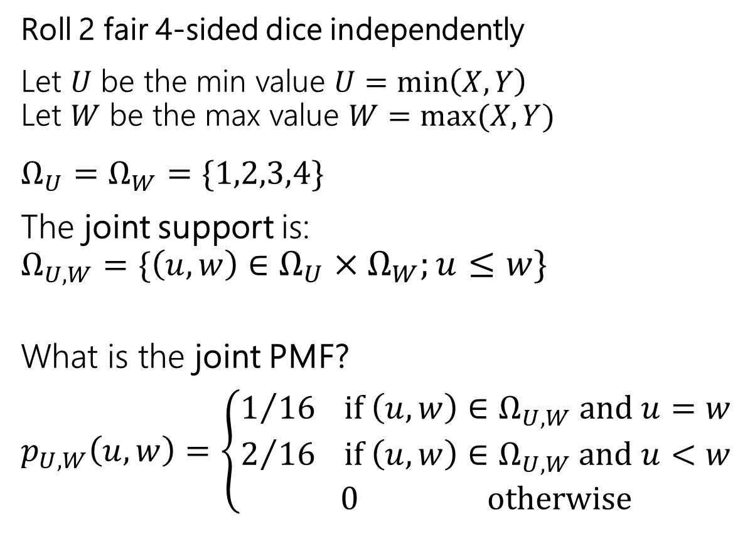
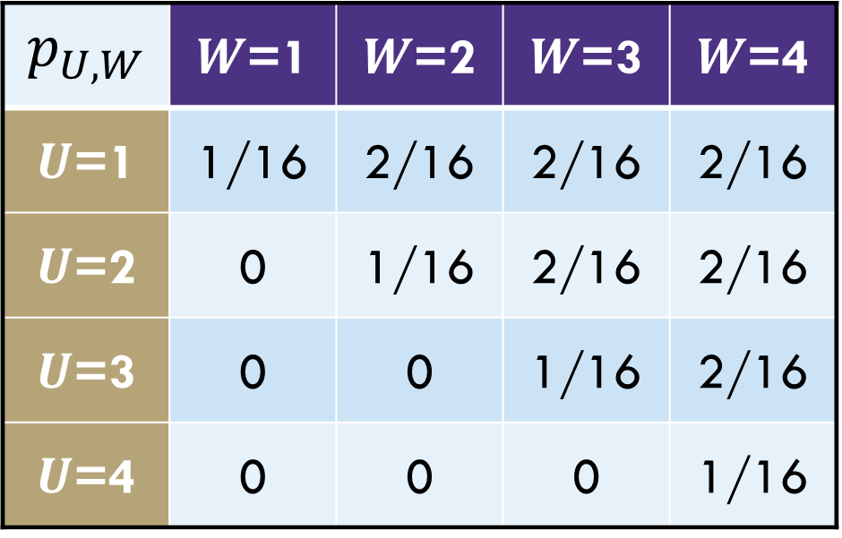
Example: Weird Dice
Roll 2 fair 4-sided dice independently
Let $U$ be the min value $U=\min\left(X,Y\right)$
Let $W$ be the max value $W=max⁡(X,Y)$
$Ω_{U}=Ω_{W}=\{1,2,3,4\}$
The joint support is:
$Ω_{U,W}=\{\left(u,w\right)∈Ω_{U}×Ω_{W};u≤w\}$
What is the joint PMF?
$p_{U,W}\left(u,w\right)=$ $\left\{\begin{matrix}\begin{aligned}1/{16} if \left(u,w\right)∈Ω_{U,W} and u=w \\ 2/{16} if \left(u,w\right)∈Ω_{U,W} and u<w\end{aligned} \\ 0 otherwise\end{matrix}\right.$
$$p_{U,W}$$ | $W$=1 | $W$=2 | $W$=3 | $W$=4
$U$=1 | 1/16 | 2/16 | 2/16 | 2/16
$U$=2 | 0 | 1/16 | 2/16 | 2/16
$U$=3 | 0 | 0 | 1/16 | 2/16
$U$=4 | 0 | 0 | 0 | 1/16
Notes:
Next q: are they independent?

Slide 19
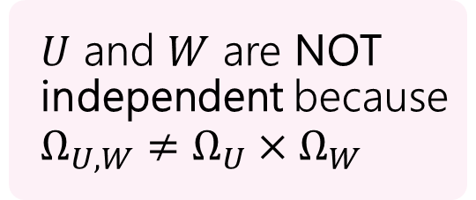
Example: Weird Dice
Roll 2 fair 4-sided dice independently
Let $U$ be the min value $U=\min\left(X,Y\right)$
Let $W$ be the max value $W=max⁡(X,Y)$
$Ω_{U}=Ω_{W}=\{1,2,3,4\}$
The joint support is:
$Ω_{U,W}=\{\left(u,w\right)∈Ω_{U}×Ω_{W};u≤w\}$
What is the joint PMF?
$p_{U,W}\left(u,w\right)=$ $\left\{\begin{matrix}\begin{aligned}1/{16} if \left(u,w\right)∈Ω_{U,W} and u=w \\ 2/{16} if \left(u,w\right)∈Ω_{U,W} and u<w\end{aligned} \\ 0 otherwise\end{matrix}\right.$
$$p_{U,W}$$ | $W$=1 | $W$=2 | $W$=3 | $W$=4
$U$=1 | 1/16 | 2/16 | 2/16 | 2/16
$U$=2 | 0 | 1/16 | 2/16 | 2/16
$U$=3 | 0 | 0 | 1/16 | 2/16
$U$=4 | 0 | 0 | 0 | 1/16
$U$ and $W$ are NOT independent because $Ω_{U,W}≠Ω_{U}×Ω_{W}$

Slide 20
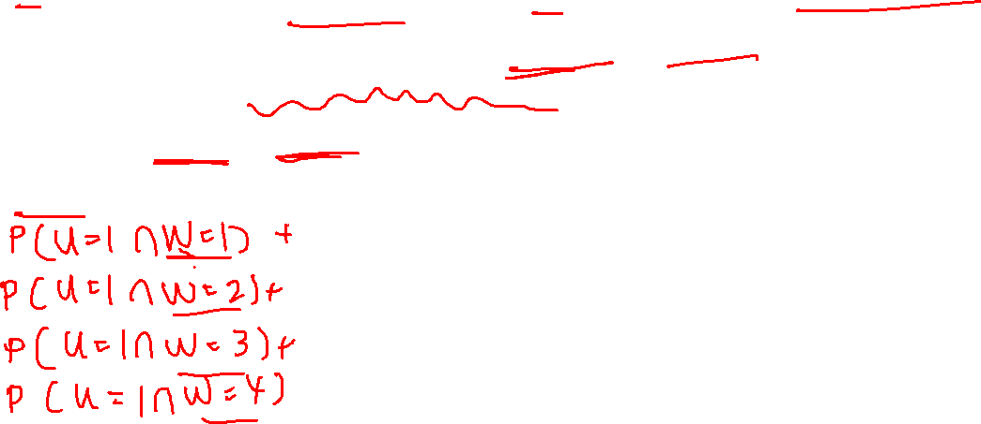
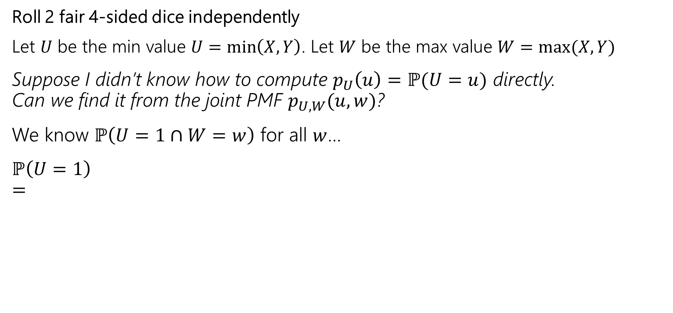
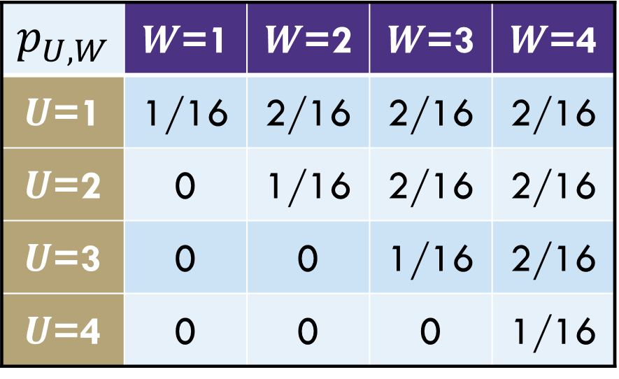
Example: Weird Dice
Roll 2 fair 4-sided dice independently
Let $U$ be the min value $U=\min\left(X,Y\right)$. Let $W$ be the max value $W=max⁡(X,Y)$
Suppose I didn’t know how to compute $p_{U}\left(u\right)=ℙ(U=u)$ directly.
Can we find it from the joint PMF $p_{U,W}(u,w)$?
We know $ℙ\left(U=1∩W=w\right)$ for all $w$…
$ℙ\left(U=1\right)$
$=$
$$p_{U,W}$$ | $W$=1 | $W$=2 | $W$=3 | $W$=4
$U$=1 | 1/16 | 2/16 | 2/16 | 2/16
$U$=2 | 0 | 1/16 | 2/16 | 2/16
$U$=3 | 0 | 0 | 1/16 | 2/16
$U$=4 | 0 | 0 | 0 | 1/16

Slide 21
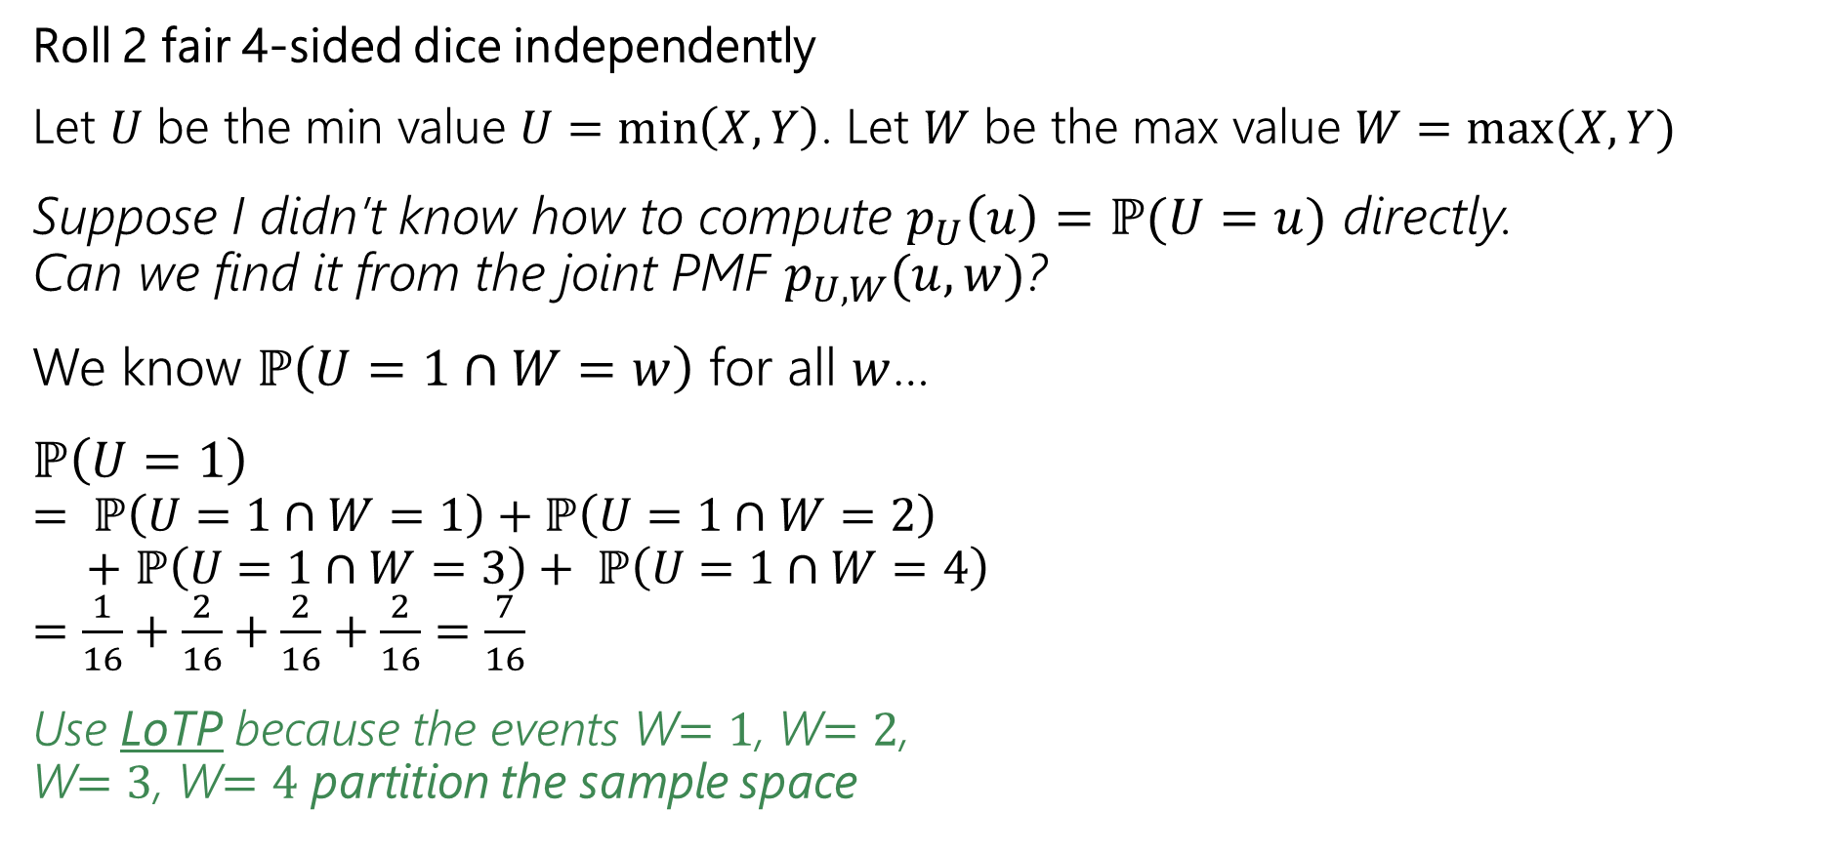
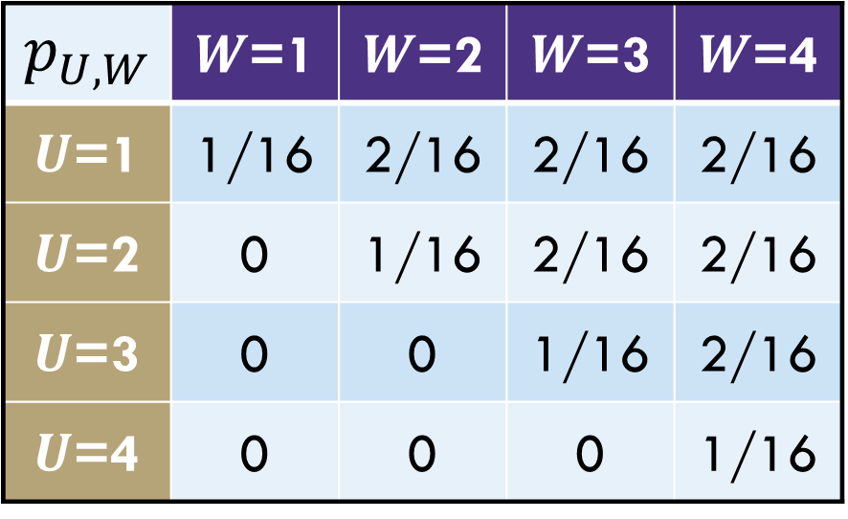
Example: Weird Dice
Roll 2 fair 4-sided dice independently
Let $U$ be the min value $U=\min\left(X,Y\right)$. Let $W$ be the max value $W=max⁡(X,Y)$
Suppose I didn’t know how to compute $p_{U}\left(u\right)=ℙ(U=u)$ directly.
Can we find it from the joint PMF $p_{U,W}(u,w)$?
We know $ℙ\left(U=1∩W=w\right)$ for all $w$…
$ℙ\left(U=1\right)$
$= ℙ\left(U=1∩W=1\right)+ℙ\left(U=1∩W=2\right)$
$+$ $ℙ\left(U=1∩W=3\right)+ ℙ\left(U=1∩W=4\right)$
$=\frac{1}{16}+\frac{2}{16}+\frac{2}{16}+\frac{2}{16}=\frac{7}{16}$
Use LoTP because the events W$=1$, W$=2$,
W$=3$, W$=4$ partition the sample space
$$p_{U,W}$$ | $W$=1 | $W$=2 | $W$=3 | $W$=4
$U$=1 | 1/16 | 2/16 | 2/16 | 2/16
$U$=2 | 0 | 1/16 | 2/16 | 2/16
$U$=3 | 0 | 0 | 1/16 | 2/16
$U$=4 | 0 | 0 | 0 | 1/16

Slide 22
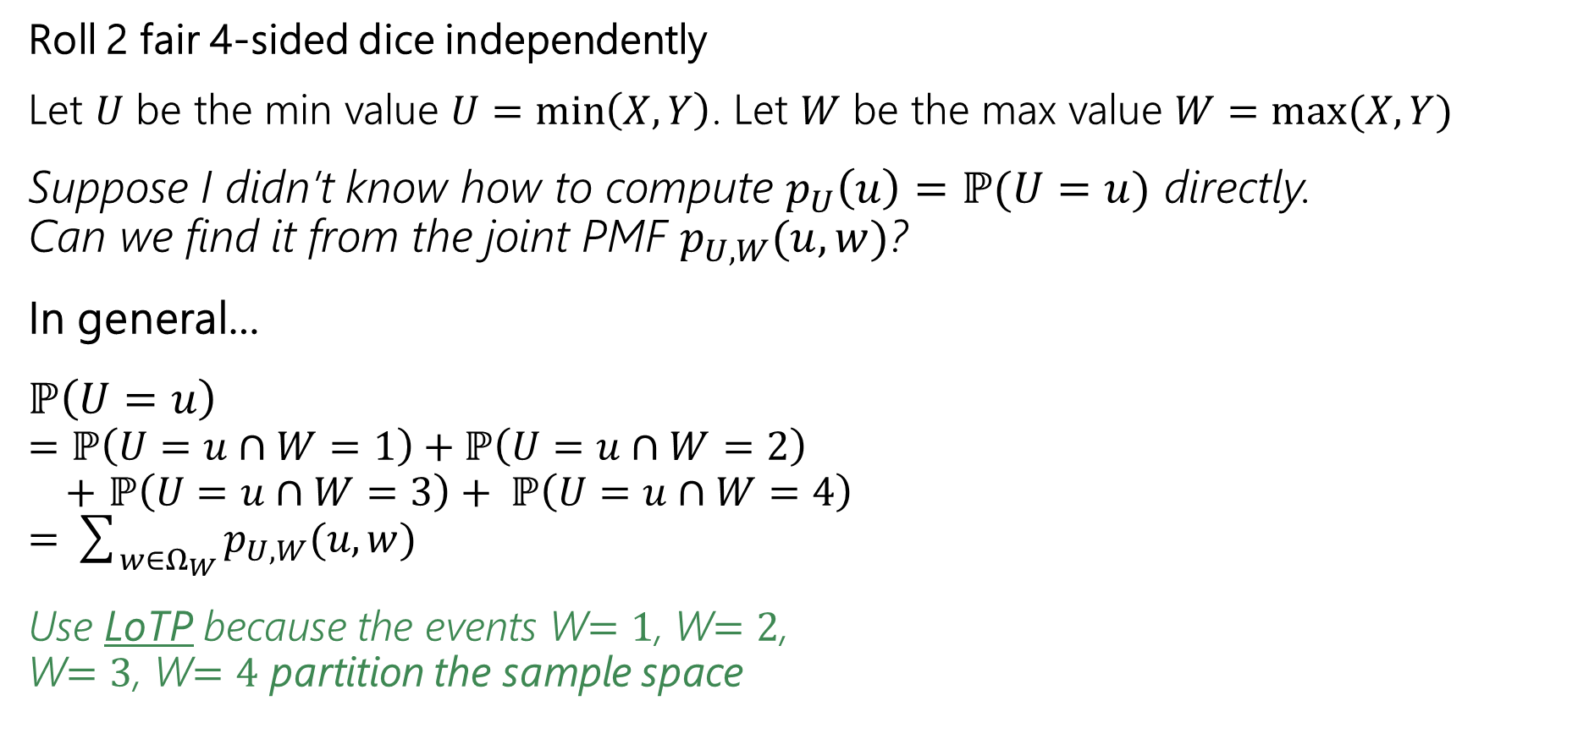
Example: Weird Dice
Roll 2 fair 4-sided dice independently
Let $U$ be the min value $U=\min\left(X,Y\right)$. Let $W$ be the max value $W=max⁡(X,Y)$
Suppose I didn’t know how to compute $p_{U}\left(u\right)=ℙ(U=u)$ directly.
Can we find it from the joint PMF $p_{U,W}(u,w)$?
In general…
$ℙ\left(U=u\right)$
$=ℙ\left(U=u∩W=1\right)+ℙ\left(U=u∩W=2\right)$
$+$ $ℙ\left(U=u∩W=3\right)+ ℙ\left(U=u∩W=4\right)$
$=\sum_{w∈Ω_{W}}{p_{U,W}(u, w)}$
Use LoTP because the events W$=1$, W$=2$,
W$=3$, W$=4$ partition the sample space
$$p_{U,W}$$ | $W$=1 | $W$=2 | $W$=3 | $W$=4
$U$=1 | 1/16 | 2/16 | 2/16 | 2/16
$U$=2 | 0 | 1/16 | 2/16 | 2/16
$U$=3 | 0 | 0 | 1/16 | 2/16
$U$=4 | 0 | 0 | 0 | 1/16

Slide 23

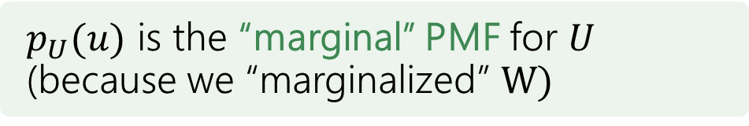
Example: Weird Dice
Roll 2 fair 4-sided dice independently
Let $U$ be the min value $U=\min\left(X,Y\right)$. Let $W$ be the max value $W=max⁡(X,Y)$
Suppose I didn’t know how to compute $p_{U}\left(u\right)=ℙ(U=u)$ directly.
Can we find it from the joint PMF $p_{U,W}(u,w)$?
In general…
$ℙ\left(U=u\right)=\sum_{w∈Ω_{W}}{p_{U,W}(u, w)}$
Use LoTP because the events W$=1$, W$=2$,
W$=3$, W$=4$ partition the sample space
$$p_{U,W}$$ | $W$=1 | $W$=2 | $W$=3 | $W$=4
$U$=1 | 1/16 | 2/16 | 2/16 | 2/16
$U$=2 | 0 | 1/16 | 2/16 | 2/16
$U$=3 | 0 | 0 | 1/16 | 2/16
$U$=4 | 0 | 0 | 0 | 1/16
$p_{U}(u)$ is the “marginal” PMF for $U$ (because we “marginalized” $W)$
08/03: V typo corrected to W

Slide 24
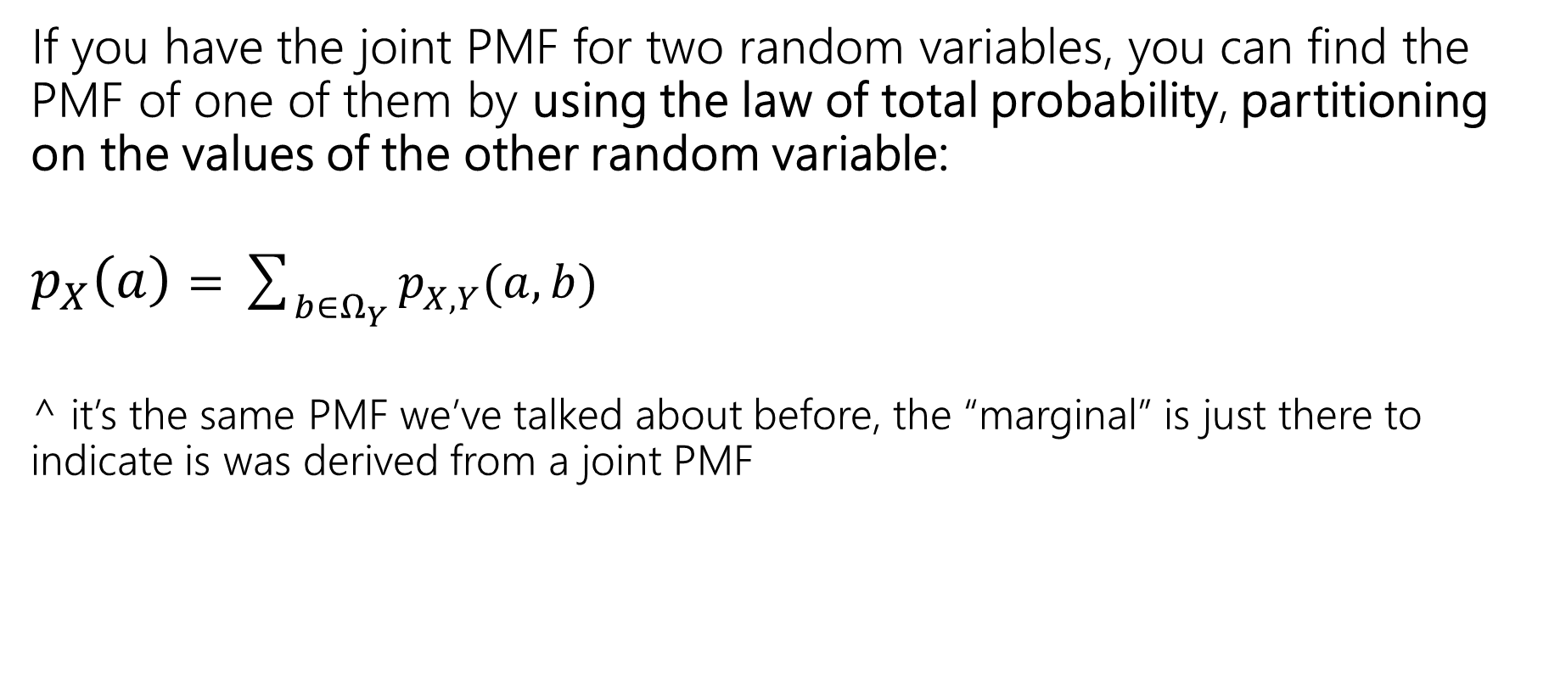
Marginal Distribution
If you have the joint PMF for two random variables, you can find the PMF of one of them by using the law of total probability, partitioning on the values of the other random variable:
$p_{X}\left(a\right)=\sum_{b∈Ω_{Y}}{p_{X,Y}(a, b)}$
^ it’s the same PMF we’ve talked about before, the “marginal” is just there to indicate is was derived from a joint PMF

Slide 25
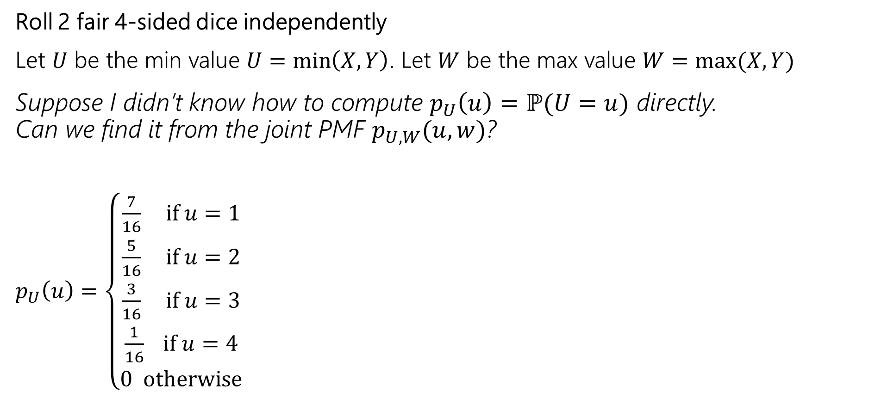
Example: Weird Dice
Roll 2 fair 4-sided dice independently
Let $U$ be the min value $U=\min\left(X,Y\right)$. Let $W$ be the max value $W=max⁡(X,Y)$
Suppose I didn’t know how to compute $p_{U}\left(u\right)=ℙ(U=u)$ directly.
Can we find it from the joint PMF $p_{U,W}(u,w)$?
$p_{U}\left(u\right)=\left\{\begin{aligned}\frac{7}{16} if u=1 \\ \frac{5}{16} if u=2 \\ \frac{3}{16} if u=3 \\ \frac{1}{16} if u=4 \\ 0 otherwise\end{aligned}\right.$
$$p_{U,W}$$ | $W$=1 | $W$=2 | $W$=3 | $W$=4
$U$=1 | 1/16 | 2/16 | 2/16 | 2/16
$U$=2 | 0 | 1/16 | 2/16 | 2/16
$U$=3 | 0 | 0 | 1/16 | 2/16
$U$=4 | 0 | 0 | 0 | 1/16

Slide 26
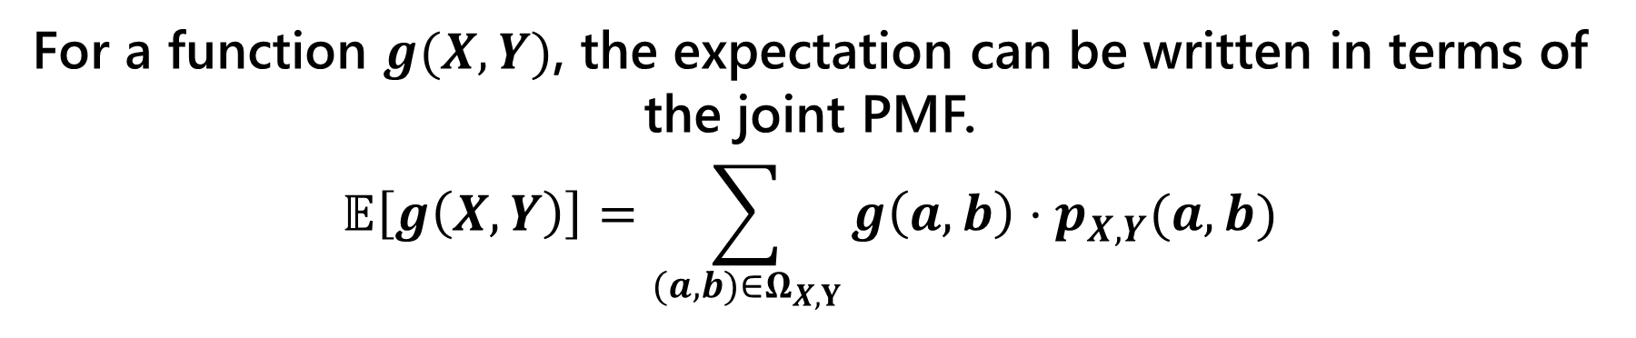
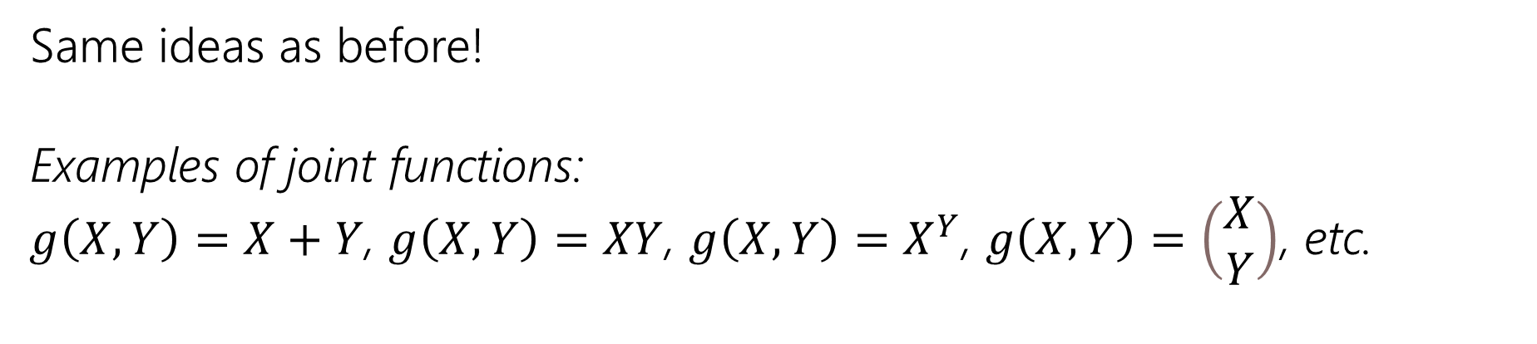
Joint Expectation
Joint Expectations
For a function $g(X,Y)$, the expectation can be written in terms of the joint PMF.
$$𝔼\left[g\left(X,Y\right)\right]=\sum_{(a,b)∈Ω_{X,Y}}{g\left(a,b\right)⋅p_{X, Y}(a,b)}$$
Same ideas as before!
Examples of joint functions:
$g\left(X,Y\right)=X+Y$, $g\left(X,Y\right)=XY$, $g\left(X,Y\right)=X^{Y}$, $g\left(X,Y\right)=\left(\begin{matrix}X \\ Y\end{matrix}\right)$, etc.

Slide 27

Expectation of a function of two RVs
What’s $𝔼[UW]$ for $U,W$ from the last slide?
08/03: typo corrected

Slide 28
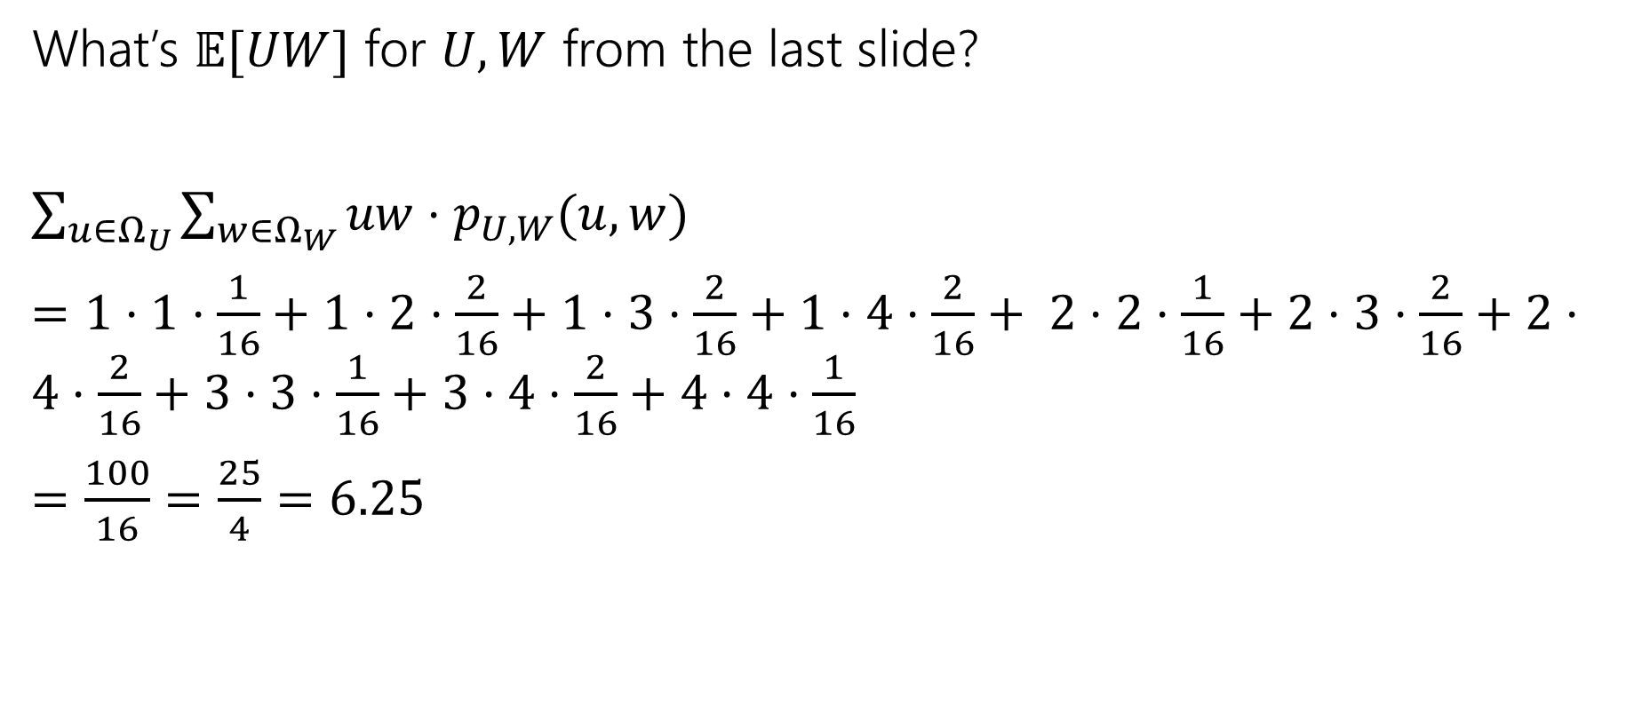
Expectation of a function of two RVs
What’s $𝔼[UW]$ for $U,W$ from the last slide?
$\sum_{u∈Ω_{U}}{\sum_{w∈Ω_{W}}{uw⋅p_{U,W}(u,w)}}$
$=1⋅1⋅\frac{1}{16}+1⋅2⋅\frac{2}{16}+1⋅3⋅\frac{2}{16}+1⋅4⋅\frac{2}{16}+ 2⋅2⋅\frac{1}{16}+2⋅3⋅\frac{2}{16}+2⋅4⋅\frac{2}{16}+3⋅3⋅\frac{1}{16}+3⋅4⋅\frac{2}{16}+4⋅4⋅\frac{1}{16}$
$=\frac{100}{16}=\frac{25}{4}=6.25$
08/03: typo corrected, missing term added, calculation corrected

Slide 29


Conditional Expectation
Waaaaaay back when, we said conditioning on an event creates a new probability space, with all the laws holding.
So we can define things like “conditional expectations” which is the expectation of a random variable in that new probability space.
$$𝔼\left[X | E\right]=\sum_{x∈Ω_{X}}{x⋅ℙ(X=x|E)}$$
$$𝔼\left[X | Y=y\right]=\sum_{x∈Ω_{X}}{x⋅ℙ\left(X=x | Y=y\right)}$$
Notes:
Give example with die

Slide 30

Conditional Expectations
All your favorite theorems are still true.
For example, linearity of expectation still holds
$$𝔼\left[(aX+bY+c) \right|E]=a𝔼\left[X | E\right]+b𝔼\left[Y | E\right]+c$$

Slide 31


Law of Total Expectation
Let $A_{1},A_{2},…,A_{k}$ be a partition of the sample space, then
$$𝔼[X]=\sum_{i=1}^{n}{𝔼\left[X | A_{i}\right]ℙ(A_{i})}$$
Let $X,Y$be discrete random variables, then
$$𝔼[X]=\sum_{y∈Ω_{Y}}{𝔼\left[X | Y=y\right]ℙ(Y=y)}$$
Similar in form to law of total probability, and the proof goes that way as well.

Slide 32

LTE
You will flip $2$ (independent, fair coins). Call the number of heads $X$. Then (independently of the coin flips) draw an exponential random variable $Y$from the distribution $Exp(X+1)$.
What is $𝔼[Y]$?
Notes:
Y has a very strange distribution! We can find it in principle, but if we just want the expectation, we can avoid that work.
We can partition on the values that X takes on.

Slide 33
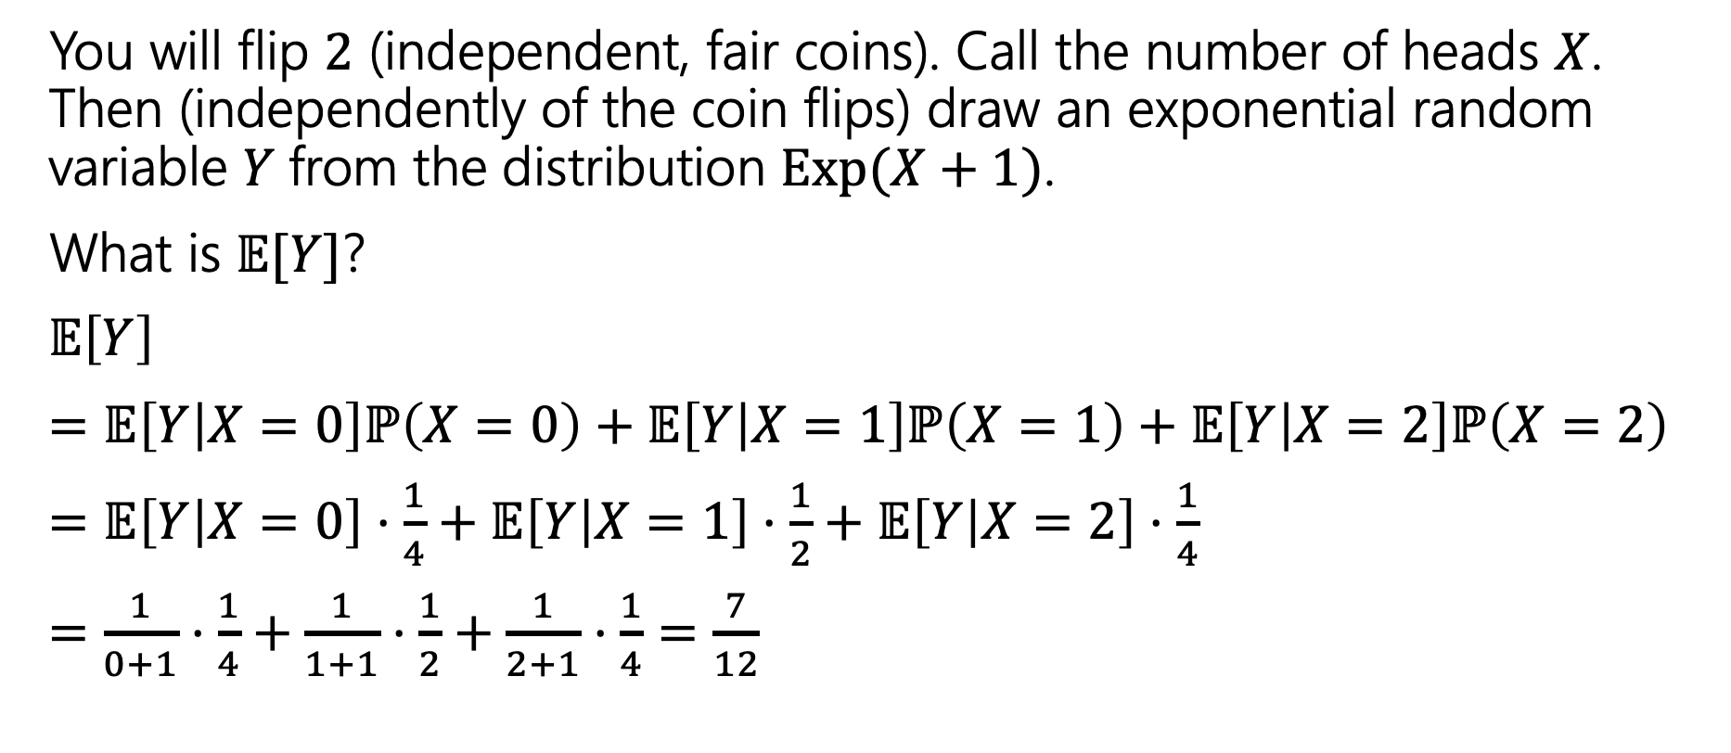
LTE
You will flip $2$ (independent, fair coins). Call the number of heads $X$. Then (independently of the coin flips) draw an exponential random variable $Y$from the distribution $Exp(X+1)$.
What is $𝔼[Y]$?
$𝔼\left[Y\right]$
$=𝔼\left[Y | X=0\right]ℙ\left(X=0\right)+𝔼\left[Y | X=1\right]ℙ\left(X=1\right)+𝔼\left[Y | X=2\right]ℙ\left(X=2\right)$
$=𝔼\left[Y | X=0\right]⋅\frac{1}{4}+𝔼\left[Y | X=1\right]⋅\frac{1}{2}+𝔼\left[Y | X=2\right]⋅\frac{1}{4}$
$=\frac{1}{0+1}⋅\frac{1}{4}+\frac{1}{1+1}⋅\frac{1}{2}+\frac{1}{2+1}⋅\frac{1}{4}=\frac{7}{12}$

Slide 34
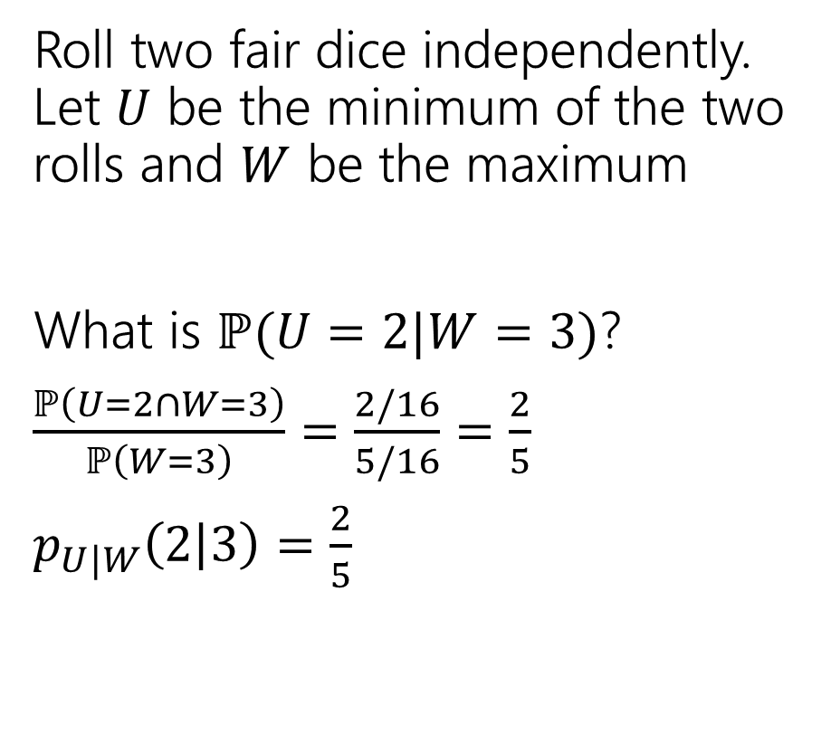
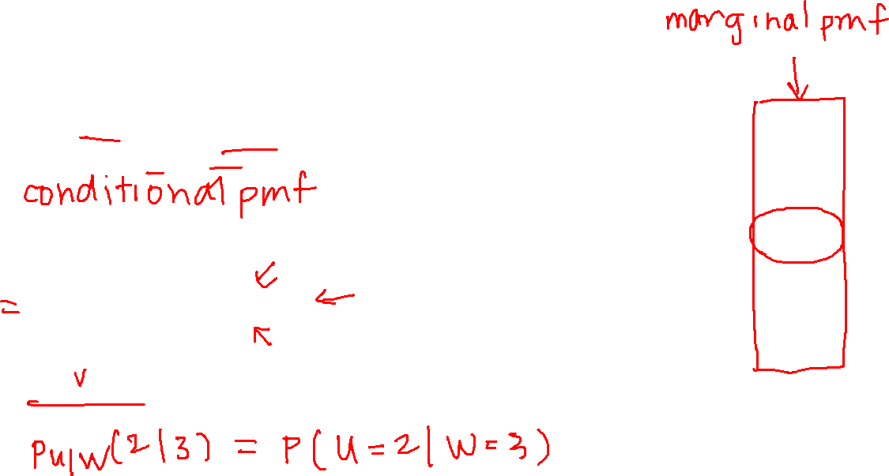

Different dice
Roll two fair dice independently. Let $U$ be the minimum of the two rolls and $W$ be the maximum
What is $ℙ(U=2|W=3)$?
$\frac{ℙ\left(U=2∩W=3\right)}{ℙ\left(W=3\right)}=\frac{2/16}{5/16}=\frac{2}{5}$
$p_{U|W}\left(2 | 3\right)=\frac{2}{5}$
$$p_{U,W}$$ | $W$=1 | $W$=2 | $W$=3 | $W$=4
$U$=1 | 1/16 | 2/16 | 2/16 | 2/16
$U$=2 | 0 | 1/16 | 2/16 | 2/16
$U$=3 | 0 | 0 | 1/16 | 2/16
$U$=4 | 0 | 0 | 0 | 1/16
08/03: typo corrected
Notes:
Sometimes you’ll want to look at a lot of these values, so we will define a conditional PMF. This is the notation that we will use, so we don’t forget that we are conditioning.

Slide 35

Different dice
Find these values
$p_{W|U}\left(2|1\right)=$
$p_{U|W}\left(1 | 2\right)=$
$p_{U|W}\left(4 | 1\right)=$
$$p_{U,W}$$ | $W$=1 | $W$=2 | $W$=3 | $W$=4
$U$=1 | 1/16 | 2/16 | 2/16 | 2/16
$U$=2 | 0 | 1/16 | 2/16 | 2/16
$U$=3 | 0 | 0 | 1/16 | 2/16
$U$=4 | 0 | 0 | 0 | 1/16

Slide 36
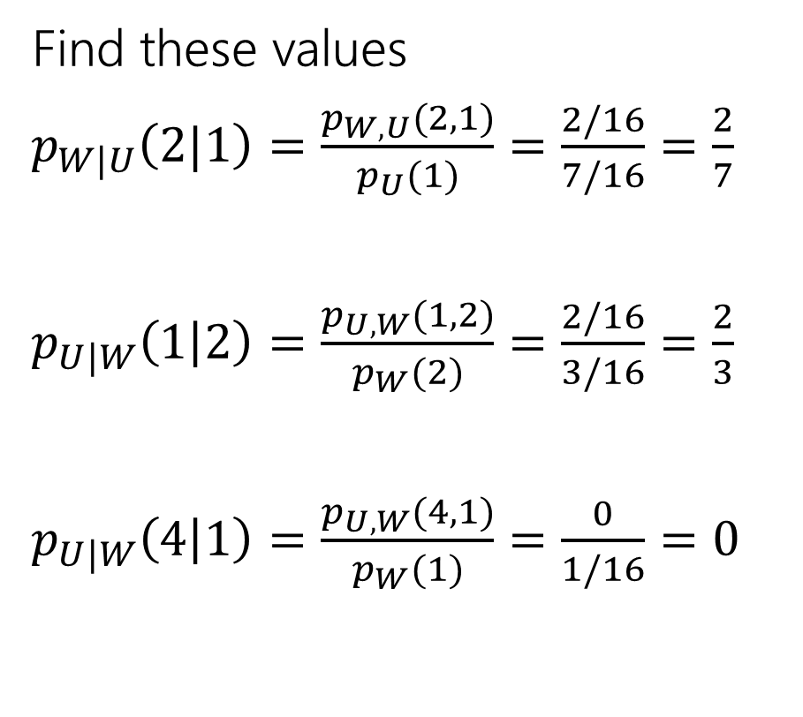
Different dice
Find these values
$p_{W|U}\left(2|1\right)=\frac{p_{W,U}(2,1)}{p_{U}(1)}=\frac{2/16}{7/16}=\frac{2}{7}$
$p_{U|W}\left(1 | 2\right)=\frac{p_{U,W}(1,2)}{p_{W}(2)}=\frac{2/16}{3/16}=\frac{2}{3}$
$p_{U|W}\left(4 | 1\right)=\frac{p_{U,W}(4,1)}{p_{W}(1)}=\frac{0}{1/16}=0$
$$p_{U,W}$$ | $W$=1 | $W$=2 | $W$=3 | $W$=4
$U$=1 | 1/16 | 2/16 | 2/16 | 2/16
$U$=2 | 0 | 1/16 | 2/16 | 2/16
$U$=3 | 0 | 0 | 1/16 | 2/16
$U$=4 | 0 | 0 | 0 | 1/16
Notes:
With conditioning order really matters.

Slide 37
Joint Distributions
For continuous joint distributions, everything will look very similar but we replace summations with integrals, and use a density function instead of the PMF

Slide 38

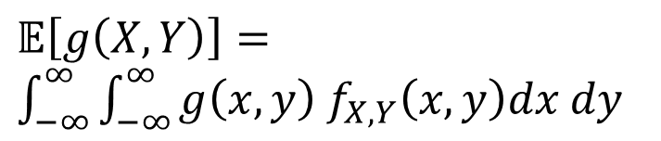

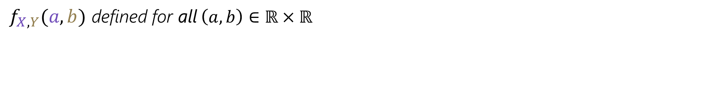
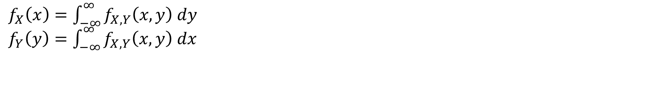
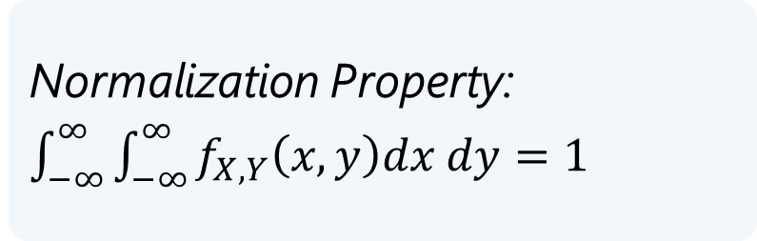
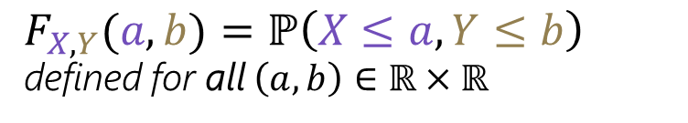
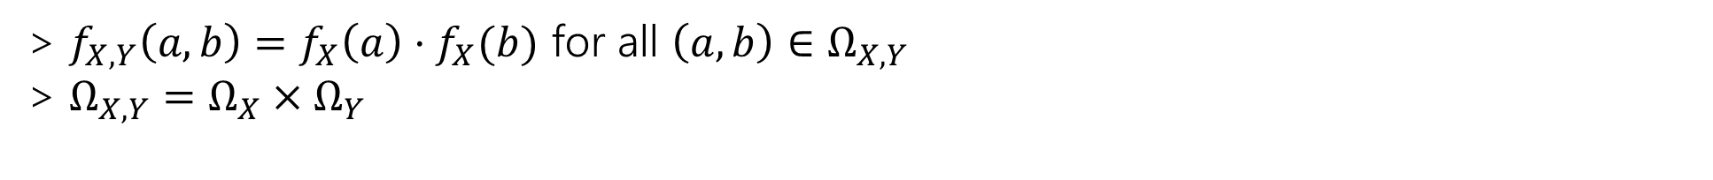
Joint Support/Range - $Ω_{X,Y}$
We have two continuous random variables $X$ and $Y$
  (that may or may not be independent)
$Ω_{X,Y}=\left\{\left(a,b\right) :f_{X,Y}\left(a,b\right)>0\right\}⊆Ω_{X}×Ω_{Y}$
Joint CDF - $F_{X,Y}(a,b)$
Joint PDF - $f_{X,Y}(a,b)$
$F_{X,Y}(a,b)=ℙ\left(X≤a,Y≤b\right)$
defined for all $\left(a,b\right)∈ℝ×ℝ$
$f_{X,Y}(a,b)$ defined for all $\left(a,b\right)∈ℝ×ℝ$
Normalization Property:
$\int_{−∞}^{∞}{\int_{−∞}^{∞}{f_{X,Y}\left(x,y\right)dx dy}=1}$
Joint Independence
> $f_{X,Y}\left(a,b\right)=f_{X}\left(a\right)⋅f_{X}(b)$ for all $\left(a, b\right)∈Ω_{X,Y}$
> $Ω_{X,Y}=Ω_{X}×Ω_{Y}$
Joint Expectation
Marginal PDF - $f_{X}(x)$, $f_{Y}(y)$
$$𝔼\left[g\left(X,Y\right)\right]=$$
$\int_{−∞}^{∞}{\int_{−∞}^{∞}{g\left(x,y\right) f_{X,Y}\left(x,y\right)dx dy}}$
$f_{X}\left(x\right)=\int_{−∞}^{∞}{f_{X,Y}\left(x,y\right) dy}$
$f_{Y}\left(y\right)=\int_{−∞}^{∞}{f_{X,Y}\left(x,y\right) dx}$
Notice we’re integrating (summing) over what the other RV can be

Slide 39

Example: Darts
We throw a dart uniformly at random onto a circle of radius $r$ centered around the origin. $X$ and $Y$ are the x and y coordinates of the point the dart lands at.
Let’s find and sketch the joint range $Ω_{X,Y}$
08/03: ‘version’ typo corrected to ‘origin’

Slide 40




Example: Darts
We throw a dart uniformly at random onto a circle of radius $r$ centered around the version. $X$ and $Y$ are the x and y coordinates of the point the dart lands at.
Let’s find and sketch the joint range $Ω_{X,Y}$
$$y$$
$$x$$
$$Ω_{X,Y}=\{\left(x,y\right)∈ℝ×ℝ;x^{2}+y^{2}≤r^{2}\}$$
08/03: circle equation typo corrected to $r^{2}$

Slide 41






Example: Darts
We throw a dart uniformly at random onto a circle of radius $r$ centered around the version. $X$ and $Y$ are the x and y coordinates of the point the dart lands at.
Let’s find and sketch the joint PDF $f_{X,Y}(x,y)$
$$f_{X,Y}(x,y)$$
$$f_{X,Y}\left(x,y\right)=\left\{\begin{matrix} \\ \begin{aligned} \\ \\ \\ \\ \end{aligned}\end{matrix}\right.$$
$$y$$
$$x$$
Notes:
Volume needs to integrate to 1
It’s a cylinder
On the circle
1 / pi r ^2

Slide 42

Example: Darts
We throw a dart uniformly at random onto a circle of radius $r$ centered around the version. $X$ and $Y$ are the x and y coordinates of the point the dart lands at.
Let’s find and sketch the joint PDF $f_{X,Y}(x,y)$
$$f_{X,Y}(x,y)$$
$$f_{X,Y}\left(x,y\right)=\left\{\begin{aligned}\frac{1}{πr^{2}} x^{2}+y^{2}≤r^{2} \\ 0 otherwise\end{aligned}\right.$$
$$y$$
$$x$$
08/03: circle equation typo corrected to $r^{2}$

Slide 43



Example: Darts
We throw a dart uniformly at random onto a circle of radius $r$ centered around the version. $X$ and $Y$ are the x and y coordinates of the point the dart lands at.
What is the marginal PDF for $X$ and $Y$?
$$f_{X,Y}\left(x,y\right)=\left\{\begin{aligned}\frac{1}{πr^{2}} x^{2}+y^{2}≤r^{2} \\ 0 otherwise\end{aligned}\right.$$
$$f_{X,Y}(x,y)$$
$$f_{X}\left(a\right)=$$
$$f_{Y}\left(b\right)=$$
$$y$$
$$x$$
08/03: circle equation typo corrected to $r^{2}$
Notes:
Same as getting a slice, integrating with respect to direction

Slide 44

Example: Darts
We throw a dart uniformly at random onto a circle of radius $r$ centered around the version. $X$ and $Y$ are the x and y coordinates of the point the dart lands at.
What is the marginal PDF for $X$ and $Y$?
$$f_{X,Y}\left(x,y\right)=\left\{\begin{aligned}\frac{1}{πr^{2}} x^{2}+y^{2}≤r^{2} \\ 0 otherwise\end{aligned}\right.$$
$$f_{X,Y}(x,y)$$
$$f_{X}\left(a\right)=\int_{−∞}^{∞}{f_{X,Y}\left(a, y\right)dy}$$
$$f_{Y}\left(b\right)=\int_{−∞}^{∞}{f_{X,Y}\left(x, b\right)dx}$$
$$y$$
$$x$$
08/03: circle equation typo corrected to $r^{2}$

Slide 45
Example: Darts
We throw a dart uniformly at random onto a circle of radius $r$ centered around the version. $X$ and $Y$ are the x and y coordinates of the point the dart lands at.
What is the marginal PDF for $X$ and $Y$?
$$f_{X,Y}\left(x,y\right)=\left\{\begin{aligned}\frac{1}{πr^{2}} x^{2}+y^{2}≤r^{2} \\ 0 otherwise\end{aligned}\right.$$
$$y$$
$$f_{X}\left(a\right)=\int_{−∞}^{∞}{f_{X,Y}\left(a, y\right)dy}$$
$$f_{Y}\left(b\right)=\int_{−∞}^{∞}{f_{X,Y}\left(x, b\right)dx}$$
$$x$$
08/03: circle equation typo corrected to $r^{2}$

Slide 46

Example: Darts
We throw a dart uniformly at random onto a circle of radius $r$ centered around the version. $X$ and $Y$ are the x and y coordinates of the point the dart lands at.
What is the marginal PDF for $X$ and $Y$?
$$f_{X,Y}\left(x,y\right)=\left\{\begin{aligned}\frac{1}{πr^{2}} x^{2}+y^{2}≤r^{2} \\ 0 otherwise\end{aligned}\right.$$
$$y$$
$$f_{X}\left(a\right)=\int_{−∞}^{∞}{f_{X,Y}\left(a, y\right)dy}=\int_{−\sqrt{r^{2}−a^{2}}}^{\sqrt{r^{2}−a^{2}}}{\frac{1}{πr^{2}}dy}=\frac{2\sqrt{r^{2}−a^{2}}}{πr^{2}}$$
$$f_{Y}\left(b\right)=\int_{−∞}^{∞}{f_{X,Y}\left(x, b\right)dx}=\int_{−\sqrt{r^{2}−b^{2}}}^{\sqrt{r^{2}−b^{2}}}{\frac{1}{πr^{2}}dx}=\frac{2\sqrt{r^{2}−b^{2}}}{πr^{2}}$$
$$x$$
08/03: circle equation typo corrected to $r^{2}$

Slide 47

Joint Continuous Probabilities
Just like we’ve done with PDFs for single random variables…
$ℙ\left(a≤X≤b∩c≤Y≤d\right)=\int_{a}^{b}{\int_{c}^{d}{f_{X,Y}\left(x,y\right)dy dx}}$

Slide 48

Analogues for continuous
Everything we saw today has a continuous version.
There are “no surprises”– replace pmf with pdf and sums with integrals.

Slide 49

A note on independence
The definition of independence says $X,Y$ independent if and only if
$p_{X,Y}\left(x,y\right)=p_{X}\left(x\right)p_{Y}(y)$ or $f_{X,Y}\left(x,y\right)=f_{X}\left(x\right)f_{Y}(y)$ (as appropriate)
There’s often a nice shortcut. If $X,Y$ are independent then joint support of $X,Y$ (denoted $Ω_{X,Y}$) must be $Ω_{X}×Ω_{Y}$.
Joint support is $\{\left(x,y\right):p_{X,Y}\left(x,y\right)>0\}$.
Often easier to verify dependence when those are different (especially in the continuous case).
But note this is a single implication not an if-and-only-if.
Notes:
$U,V$ from last example can have their dependence verified this way.
Step 1: check the support
Step 2: go through the math to check for independence

Slide 50



Example: Continuous Servers
The time until server 1 crashes is $X\sim Exp(u)$, and the time until server 2 crashes is $Y\sim Exp(v)$. Both servers are independent of each other.
What is the probability server 1 crashes before server 2?
$ℙ\left(X<Y\right)=$
$$y$$
pollev.con/jolie312
$$x$$

Slide 51

Example: Continuous Servers
The time until server 1 crashes is $X\sim Exp(u)$, and the time until server 2 crashes is $Y\sim Exp(v)$. Both servers are independent of each other.
What is the probability server 1 crashes before server 2?
$ℙ\left(X<Y\right)$
$=\int_{0}^{∞}{\int_{x}^{∞}{f_{X,Y}\left(x,y\right) dy dx}}$
$=\int_{0}^{∞}{\int_{x}^{∞}{f_{X}\left(x\right)f_{Y}(y) dy dx}}$ by independence
$$y$$
$$x$$

Slide 52
Covariance
Notes:
When we have two random variables that are dependent, we want to answer when how dependent are they. Does knowing the value Y took on tell up a lot about what value X would take on or not that much. Covariance is out way of measuring this exact thing.

Slide 53


Covariance
We sometimes want to measure how “intertwined” $X$ and $Y$ are – how much knowing about one of them will affect the other.
If $X$ turns out “big” how likely is it that $Y$ will be “big”,
how much do they “vary together”
$$Cov\left(X,Y\right)=𝔼\left[\left(X−𝔼\left[X\right]\right)(Y−𝔼\left[Y\right])\right]=𝔼\left[XY\right]−𝔼[X]𝔼[Y]$$
Covariance

Slide 54


$$Cov\left(X,Y\right)=𝔼\left[\left(X−𝔼\left[X\right]\right)(Y−𝔼\left[Y\right])\right]=𝔼\left[XY\right]−𝔼[X]𝔼[Y]$$
Covariance
If $X,Y$ go in the same direction
If $X,Y$ go in the opposite directions
Notes:
Cov(X,Y) < 0, negative trend
Cov(X,Y) = 0, no trend, center circle
Cov(X,Y) > 0, positive trend
X, Y in same direction
If X > E[X], positive
If Y > E[Y], positive
Product is positive
If X < E[X], negative
If Y < E[Y], negative
Product is positive
Differing signs, product is negative

Slide 55

Covariance
$Var\left(X+Y\right)=Var\left(X\right)+Var\left(Y\right)+2Cov(X,Y)$
That’s consistent with our previous knowledge for independent variables. (for $X,Y$independent, $𝔼\left[XY\right]=𝔼\left[X\right]𝔼[Y]$).

Slide 56

Covariance
$Var\left(X+Y\right)=Var\left(X\right)+Var\left(Y\right)+2Cov(X,Y)$
You and your friend are playing a game, you flip a coin: if heads you pay your friend a dollar, if tails they pay you a dollar. Let $X$ be your profit and $Y$ be your friend’s profit.
What is $Var(X+Y)$?
Before you calculate, make a prediction. What should it be?

Slide 57

Covariance
You and your friend are playing a game, you flip a coin: if heads you pay your friend a dollar, if tails they pay you a dollar. Let $X$ be your profit and $Y$ be your friend’s profit.
What is $Var(X+Y)$?
$Var\left(X\right)=Var\left(Y\right)=𝔼\left[X^{2}\right]−{\left(𝔼\left[X\right]\right)}^{2}=1−0^{2}=1$
$Cov\left(X,Y\right)=𝔼\left[XY\right]−𝔼[X]𝔼[Y]$
$𝔼\left[XY\right]=\frac{1}{2}⋅\left(−1⋅1\right)+\frac{1}{2}\left(1⋅−1\right)=−1$
$Cov\left(X,Y\right)=−1−0⋅0=−1$.
$Var\left(X+Y\right)=1+1+2⋅−1=0$

Slide 58

Covariance, Another example
Let $X$ be a Bernoulli RV with probability $p$ of success.
Let $Y=X$ ($Y$ is $X$, not an iid copy, literally the same experiment)
Let $Z=−X$
Let $W$ be an independent Bernoulli, indentically distributed to$X$
Find
$Cov\left(X,Y\right)$, $Cov\left(X,Z\right), Cov(X,W)$

Slide 59

Covariance, Another example
Let $X$ be a Bernoulli RV with probability $p$ of success.
Let $Y=X$ ($Y$ is $X$, not an iid copy, literally the same experiment)
Let $Z=−X$
Let $W$ be an independent Bernoulli, indentically distributed to$X$
$Cov\left(X,Y\right)=𝔼\left[XY\right]−𝔼\left[X\right]𝔼[Y]$
$=\left(1⋅1⋅p+0⋅0⋅\left[1−p\right]\right)−p⋅p$
$=p−p^{2}=p(1−p)$
Hey, that’s the variance of $X$. This is a pattern: $Cov(X,X)=Var(X)$

Slide 60

Covariance, Another example
Let $X$ be a Bernoulli RV with probability $p$ of success.
Let $Y=X$ ($Y$ is $X$, not an iid copy, literally the same experiment)
Let $Z=−X$
Let $W$ be an independent Bernoulli, indentically distributed to$X$
$Cov\left(X,Z\right)=𝔼\left[XY\right]−𝔼\left[X\right]𝔼[Y]$
$=\left(1⋅−1⋅p+0⋅−0⋅\left[1−p\right]\right)−\left(p⋅\left[−p\right]\right)$
$=−p−\left[−p^{2}\right]=−p(1−p)$
General pattern: $Cov\left(X,−Y\right)=−Cov(X,Y)$
Notes:
Cov(aX,Y)=aCov(X,Y) in general

Slide 61

Covariance, Another example
Let $X$ be a Bernoulli RV with probability $p$ of success.
Let $Y=X$ ($Y$ is $X$, not an iid copy, literally the same experiment)
Let $Z=−X$
Let $W$ be an independent Bernoulli, indentically distributed to$X$
$Cov\left(X,W\right)=𝔼\left[XW\right]−𝔼\left[X\right]𝔼[W]$
$=\left(1⋅1⋅p^{2}+1⋅0⋅p\left[1−p\right]+0⋅1⋅\left[1−p\right]p+0⋅0⋅{\left[1−p\right]}^{2}\right)−\left(p⋅\left[p\right]\right)$
$={(p}^{2})−p^{2}=0$
General pattern: if $X,Y$ independent $Cov(X,Y)=0$
Notes:
Converse is not a general pattern; there are “uncorrelated” random variables which are dependent but have covariance 0.
Covariance only measures “linear” relationship; sometimes higher dimensional relationships are hidden. Taking $X\sim N\left(0,1\right), Y=X^2$ is a standard example, but not worth the effort to compute here.

Slide 62

A Few Notes
Covariance is an un-normalized number.
It measures both how intertwined $X,Y$ are and in some sense how much $X,Y$ vary in the first place (if you multiply both $X,Y$ by $2$, the strength of the relationship intuitively is the same, but covariance increases).
If you want just the strength of the relationship, you probably want the “correlation coefficient”: $\frac{Cov(X,Y)}{\sqrt{Var\left(X\right)Var\left(Y\right)}}$ always between $−1$ and $1$.
Covariance directly measures only “linear” relationships; if $Y$ depends on $X^{2}$, the covariance might not be as high as you expect.
If dealing with real data, look at a plot to see if you should be looking for a linear relationship in the first place.

