Slide 1
Confidence Intervals +
Joint Distributions I
CSE 312 26Su
Lecture 16

Slide 2
Where Are We?
Last time:
  Central Limit Theorem
Today:
  Polling
  Joint Distributions
    Joint Support
    Joint PMF

Slide 3
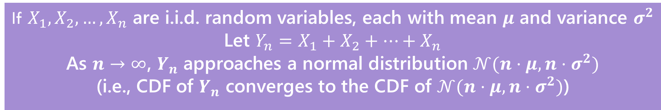
Central Limit Theorem (Review)
“The sum of any independent random variables approaches a normal distribution. It becomes closer to normal/the approximation gets better as we sum more RVs together.”
Central Limit Theorem
If $X_{1},X_{2},…,X_{n}$ are i.i.d. random variables, each with mean $μ$ and variance $σ^{2}$
Let $Y_{n}=X_{1}+X_{2}+…+X_{n}$
As $n→∞$, $Y_{n}$ approaches a normal distribution $𝒩(n⋅μ,n⋅σ^{2})$
(i.e., CDF of $Y_{n}$ converges to the CDF of $𝒩(n⋅μ,n⋅σ^{2})$)

Slide 4
When to use CLT
Use the CLT when:
The random variable you’re interested in is the sum of independent random variables.
The random variable you’re interested in does not have an easily accessible or easy to use pmf/pdf (or the question you’re asking doesn’t lend it self to easily using the pmf/pdf)
You only need an approximate answer, and the sum is of at least a moderate number of random variables.

Slide 5
Polling

Slide 6
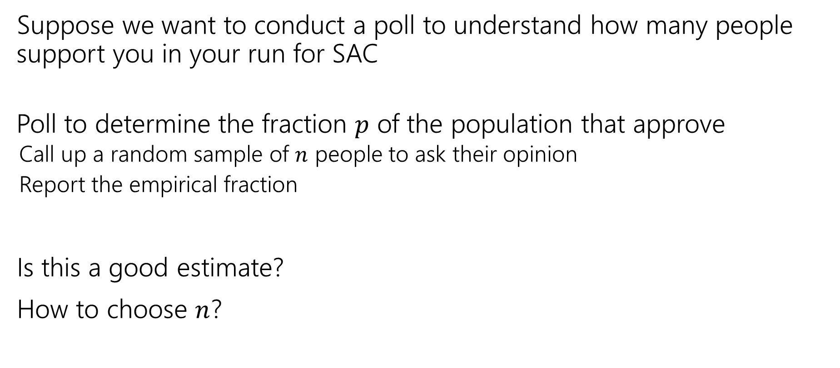
(Idealized) Polling
Suppose we want to conduct a poll to understand how many people support you in your run for SAC
Poll to determine the fraction $p$ of the population that approve
  Call up a random sample of $n$ people to ask their opinion
  Report the empirical fraction
Is this a good estimate?
How to choose $n$?

Slide 7
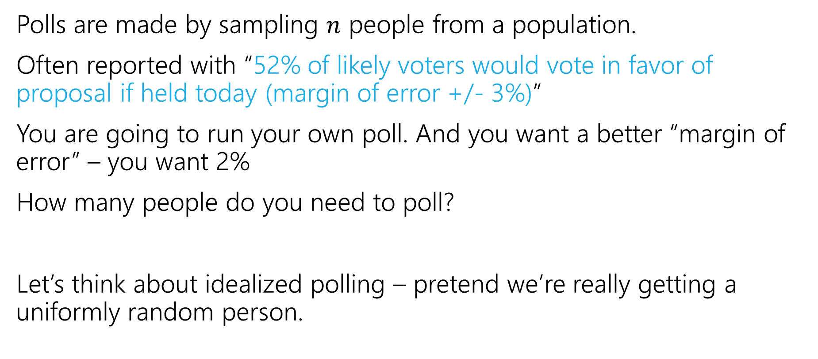
The Reverse Question
Polls are made by sampling $n$ people from a population.
Often reported with “52% of likely voters would vote in favor of proposal if held today (margin of error +/- 3%)”
You are going to run your own poll. And you want a better “margin of error” – you want 2%
How many people do you need to poll?
Let’s think about idealized polling – pretend we’re really getting a uniformly random person.

Slide 8
Margin of Error
Wait…what’s a “margin of error”
The result of the poll is a random variable – it has a distribution.
You’d like to know something about its variance (Did you poll everyone in the entire country? Just 3 people? How much variance is there in the poll?)
A “margin of error” is an intuitive measurement of the variance of the poll. “If I performed this poll repeatedly, 95% of the time, we’re within true +/- the margin of error.”

Slide 9

Our Goal
Set a target – I want my margin of error to be $2\%$. That is, at least $95\%$ of the time, your poll’s estimate of the fraction of people in favor will be within $2$ percentage points of the true value.
So…how many people are you going to need to interview?

Slide 10
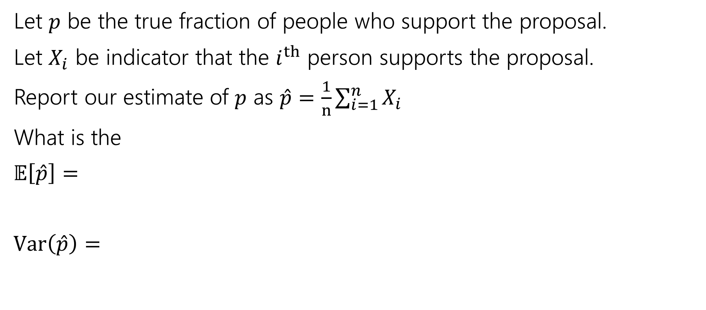
Poll Setup
Let $p$ be the true fraction of people who support the proposal.
Let $X_{i}$ be indicator that the $i^{th}$ person supports the proposal.
Report our estimate of $p$ as $\hat{p}=$ $\frac{1}{n}\sum_{i=1}^{n}{X_{i}}$
What is the
$𝔼\left[\hat{p}\right]=$
$Var\left(\hat{p}\right)=$

Slide 11
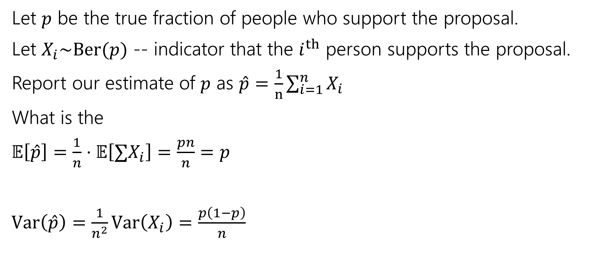
Poll Setup
Let $p$ be the true fraction of people who support the proposal.
Let $X_{i}\sim \text{Ber}(p)$ -- indicator that the $i^{th}$ person supports the proposal.
Report our estimate of $p$ as $\hat{p}=$ $\frac{1}{n}\sum_{i=1}^{n}{X_{i}}$
What is the
$𝔼\left[\hat{p}\right]=\frac{1}{n}⋅𝔼\left[∑X_{i}\right]=\frac{pn}{n}=p$
$Var\left(\hat{p}\right)=\frac{1}{n^{2}}Var\left(X_{i}\right)=\frac{p\left(1−p\right)}{n}$

Slide 12

Poll Setup
Let $p$ be the true fraction of people who support the proposal.
Let $X_{i}\sim \text{Ber}(p)$ -- indicator that the $i^{th}$ person supports the proposal.
Report our estimate of $p$ as $\hat{p}=$ $\frac{1}{n}\sum_{i=1}^{n}{X_{i}}$
What is the
$𝔼\left[\hat{p}\right]=\frac{1}{n}⋅𝔼\left[∑X_{i}\right]=\frac{pn}{n}=p$
$Var\left(\hat{p}\right)=\frac{1}{n^{2}}Var\left(X_{i}\right)=\frac{p\left(1−p\right)}{n}$
By CLT, as $n→∞$,
$\hat{p}→N\left(p,\frac{p\left(1−p\right)}{n}\right)$

Slide 13
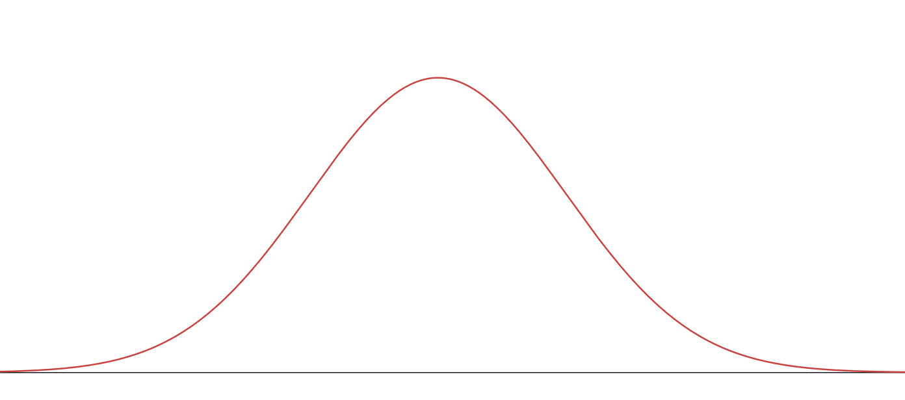





Using the CLT
Same question as: for what $n$ is $P\left(\left|\hat{p}−p\right|>0.02\right)≤0.05$?
What are we looking for? Well we have a margin of error:
$ℙ\left(p−.02≤\hat{p}≤p+.02\right)≥.95$
That says we’re within the $2\%$ margin of error at least $95\%$of the time.
Good estimate if $\hat{p}$ in this region
$$p−.02$$
$$p$$
$$p+.02$$

Slide 14
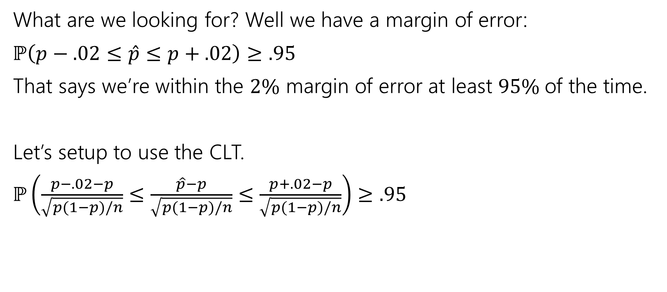
Using the CLT
Same question as: for what $n$ is $P\left(\left|\hat{p}−p\right|>0.02\right)≤0.05$?
What are we looking for? Well we have a margin of error:
$ℙ\left(p−.02≤\hat{p}≤p+.02\right)≥.95$
That says we’re within the $2\%$ margin of error at least $95\%$of the time.
Let’s setup to use the CLT.
$ℙ\left(\frac{p−.02−p}{\sqrt{p(1−p)/n}}≤\frac{\hat{p}−p}{\sqrt{p(1−p)/n}}≤\frac{p+.02−p}{\sqrt{p(1−p)/n}}\right)≥.95$

Slide 15
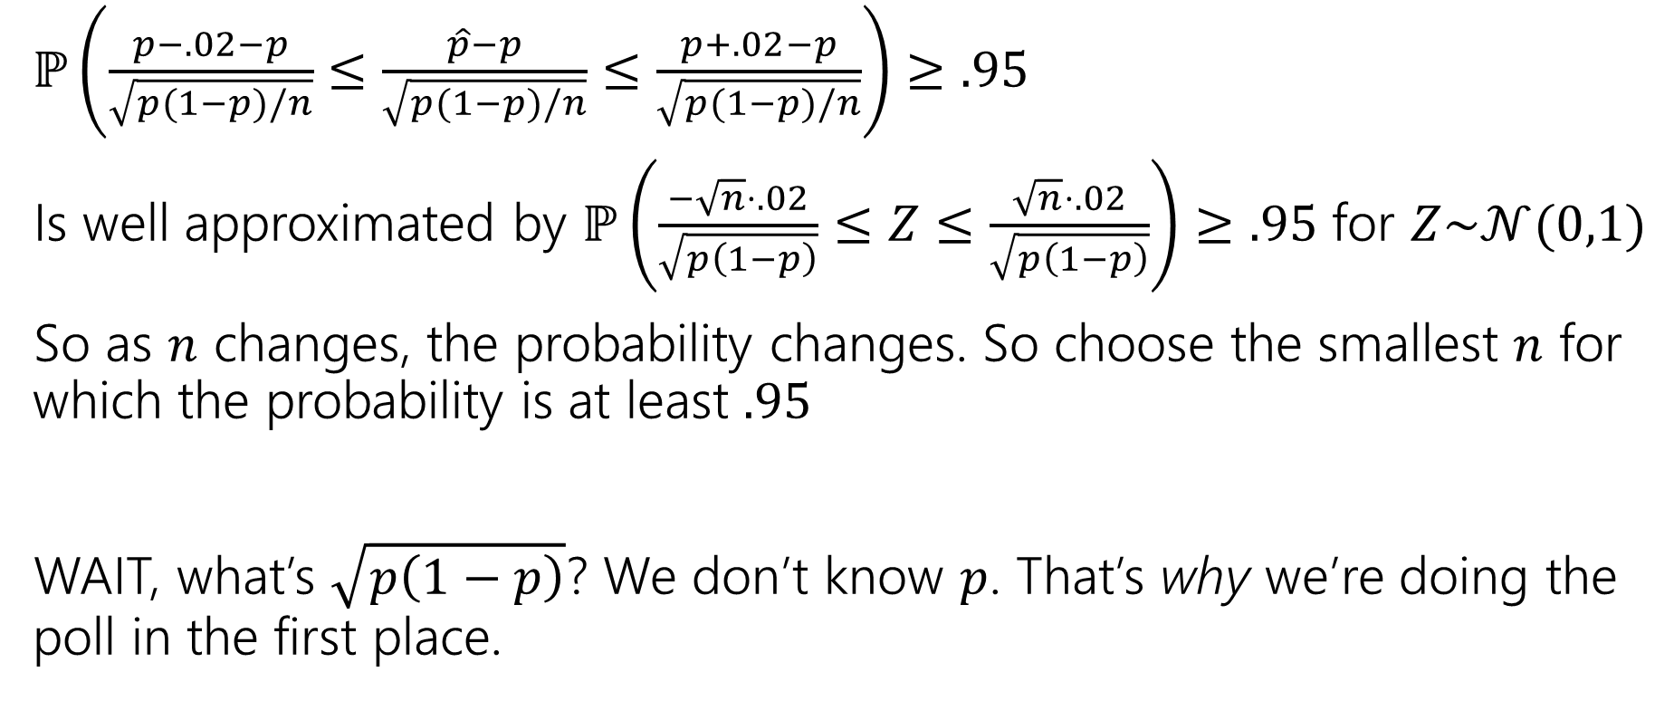
Apply the CLT
$ℙ\left(\frac{p−.02−p}{\sqrt{p(1−p)/n}}≤\frac{\hat{p}−p}{\sqrt{p(1−p)/n}}≤\frac{p+.02−p}{\sqrt{p(1−p)/n}}\right)≥.95$
Is well approximated by $ℙ\left(\frac{−\sqrt{n}⋅.02}{\sqrt{p\left(1−p\right)}}≤Z≤\frac{\sqrt{n}⋅.02}{\sqrt{p\left(1−p\right)}}\right)≥.95$ for $Z\sim 𝒩(0,1)$
So as $n$ changes, the probability changes. So choose the smallest $n$ for which the probability is at least $.95$
WAIT, what’s $\sqrt{p\left(1−p\right)}$? We don’t know $p$. That’s why we’re doing the poll in the first place.

Slide 16
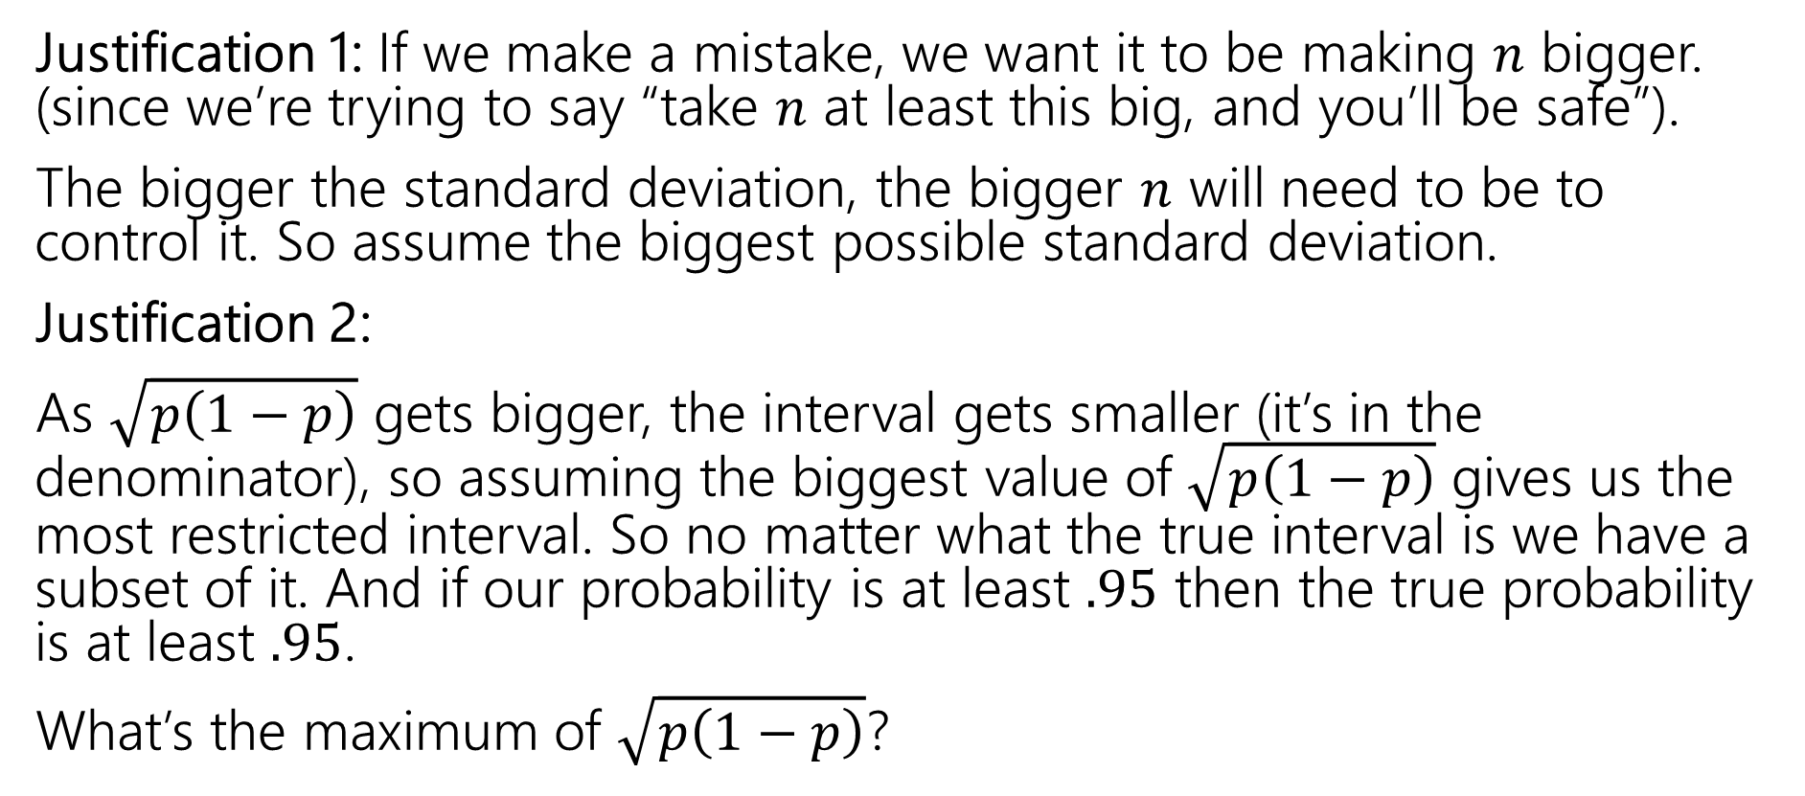

Handling $\sqrt{p\left(1−p\right)}$
Justification 1: If we make a mistake, we want it to be making $n$ bigger. (since we’re trying to say “take $n$ at least this big, and you’ll be safe”).
The bigger the standard deviation, the bigger $n$ will need to be to control it. So assume the biggest possible standard deviation.
Justification 2:
As $\sqrt{p\left(1−p\right)}$ gets bigger, the interval gets smaller (it’s in the denominator), so assuming the biggest value of $\sqrt{p\left(1−p\right)}$ gives us the most restricted interval. So no matter what the true interval is we have a subset of it. And if our probability is at least $.95$ then the true probability is at least $.95$.
What’s the maximum of $\sqrt{p\left(1−p\right)}$?

Slide 17
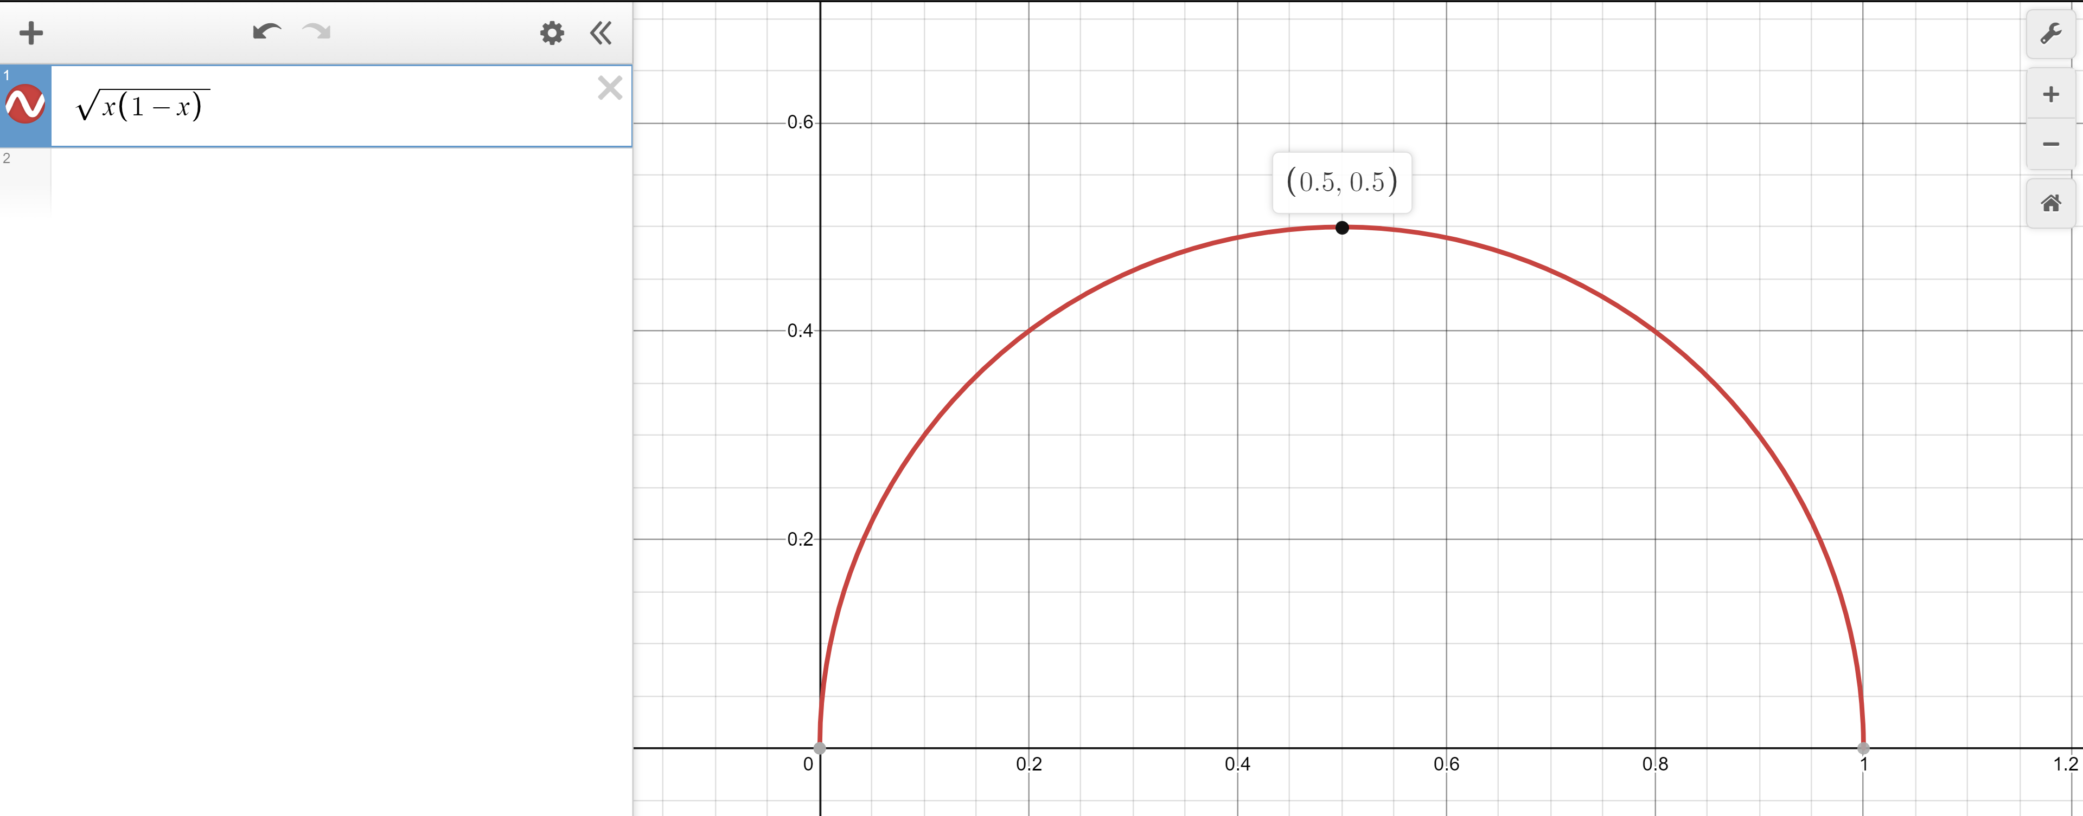
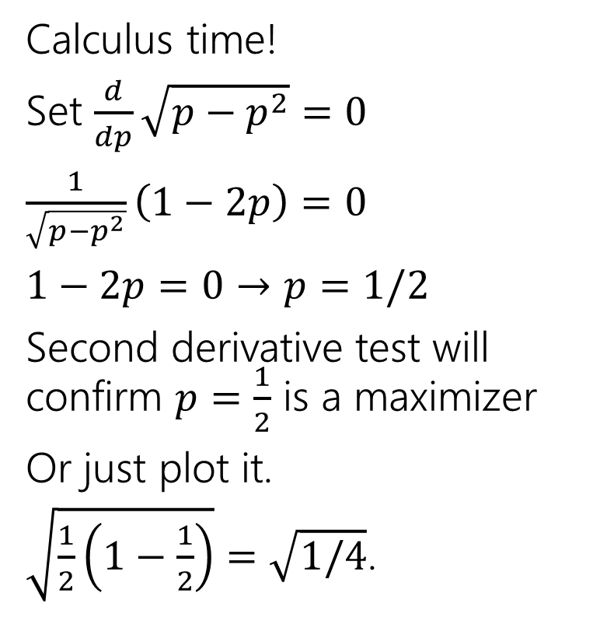

Worst value of $p$
Calculus time!
Set $\frac{d}{dp}\sqrt{p−p^{2}}=0$
$\frac{1}{\sqrt{p−p^{2}}}\left(1−2p\right)=0$
$1−2p=0$ $→p=1/2$
Second derivative test will confirm $p=\frac{1}{2}$ is a maximizer
Or just plot it.
$\sqrt{\frac{1}{2}\left(1−\frac{1}{2}\right)}=\sqrt{1/4}$.

Slide 18
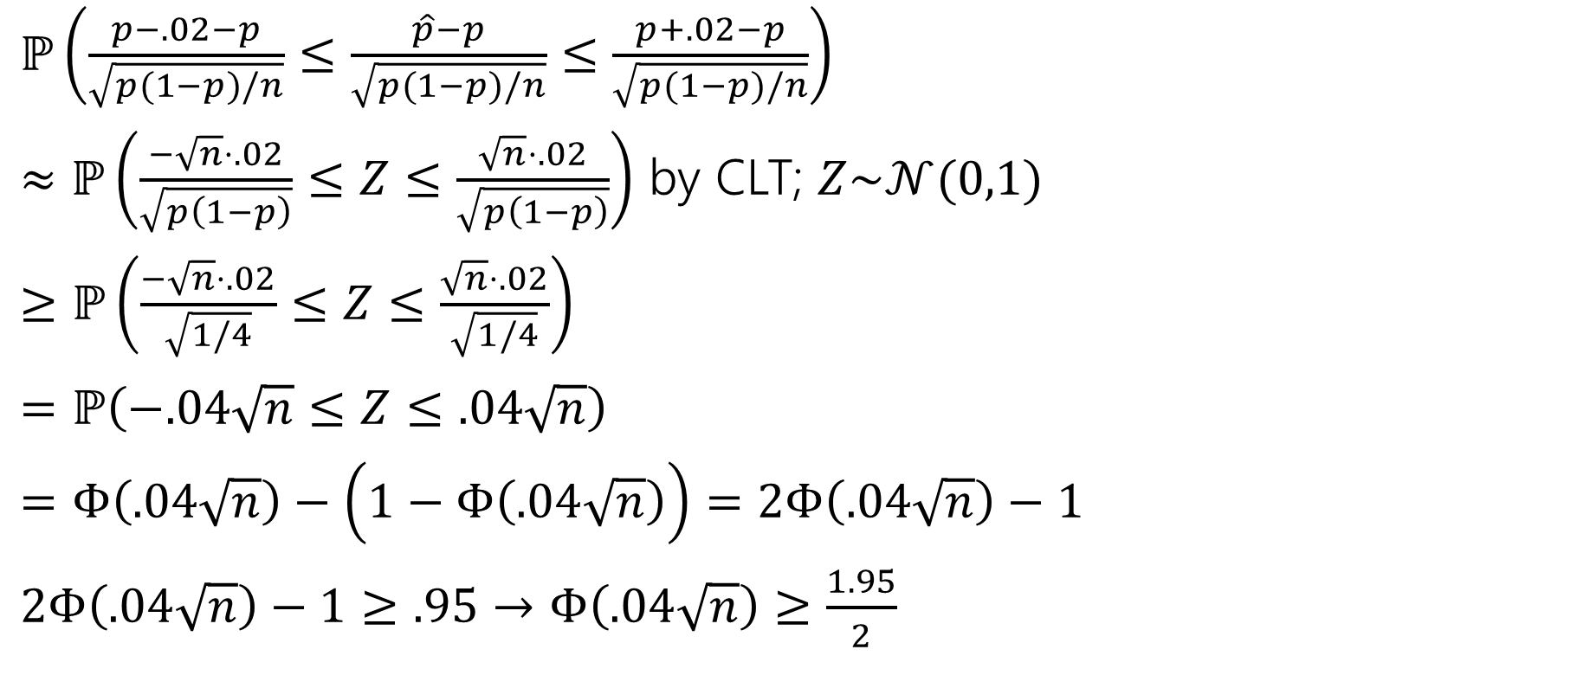
Doing the algebra
$ℙ\left(\frac{p−.02−p}{\sqrt{p(1−p)/n}}≤\frac{\hat{p}−p}{\sqrt{p(1−p)/n}}≤\frac{p+.02−p}{\sqrt{p(1−p)/n}}\right)$
$≈ℙ\left(\frac{−\sqrt{n}⋅.02}{\sqrt{p\left(1−p\right)}}≤Z≤\frac{\sqrt{n}⋅.02}{\sqrt{p\left(1−p\right)}}\right)$ by CLT; $Z\sim 𝒩(0,1)$
$≥ℙ\left(\frac{−\sqrt{n}⋅.02}{\sqrt{1/4}}≤Z≤\frac{\sqrt{n}⋅.02}{\sqrt{1/4}}\right)$
$=ℙ\left(−.04\sqrt{n}≤Z≤.04\sqrt{n}\right)$
$=Φ\left(.04\sqrt{n}\right)−\left(1−Φ\left(.04\sqrt{n}\right)\right)=2Φ\left(.04\sqrt{n}\right)−1$
$2Φ\left(.04\sqrt{n}\right)−1≥.95$ $→$ $Φ\left(.04\sqrt{n}\right)≥\frac{1.95}{2}$

Slide 19
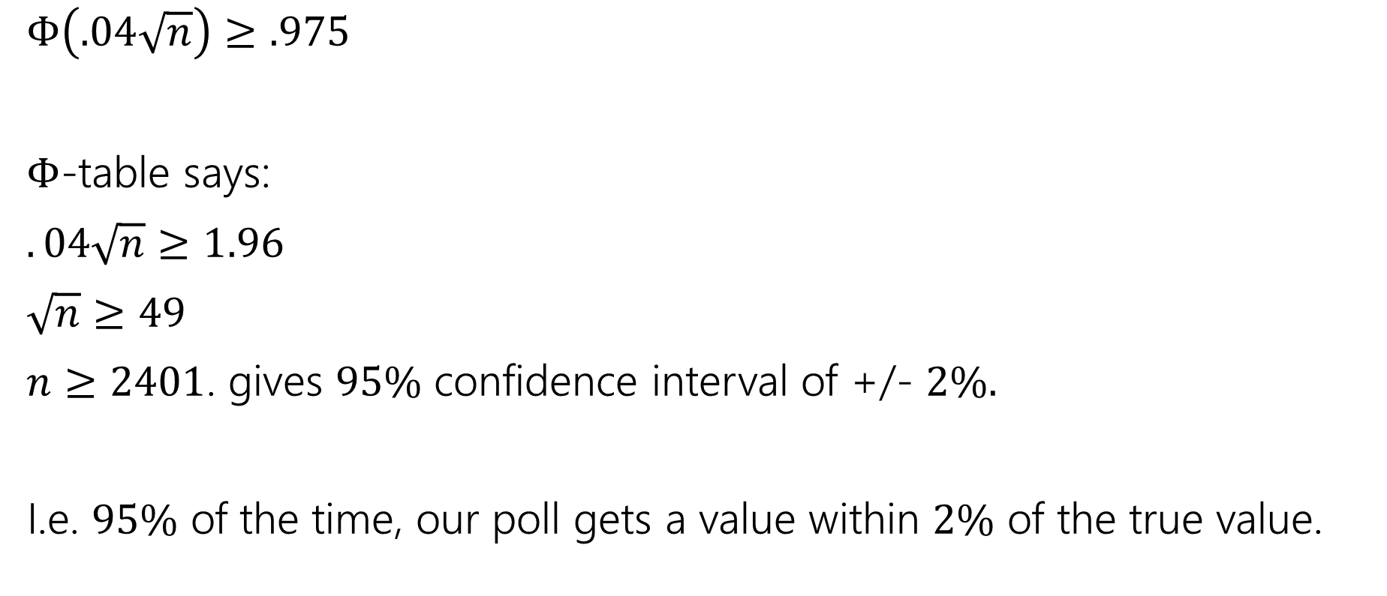

Using the $Φ$-table
$Φ\left(.04\sqrt{n}\right)≥.975$
$Φ$-table says:
$.04\sqrt{n}≥1.96$
$\sqrt{n}≥49$
$n≥2401$. gives $95\%$ confidence interval of +/- $2\%.$
I.e. $95\%$ of the time, our poll gets a value within $2\%$ of the true value.

Slide 20
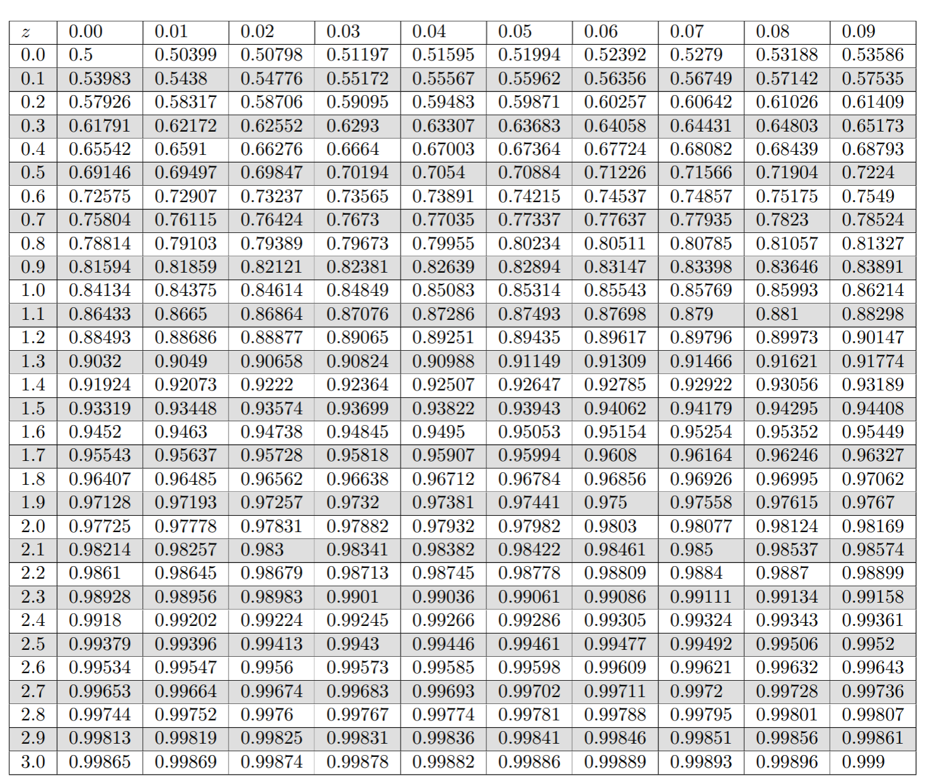

Slide 21
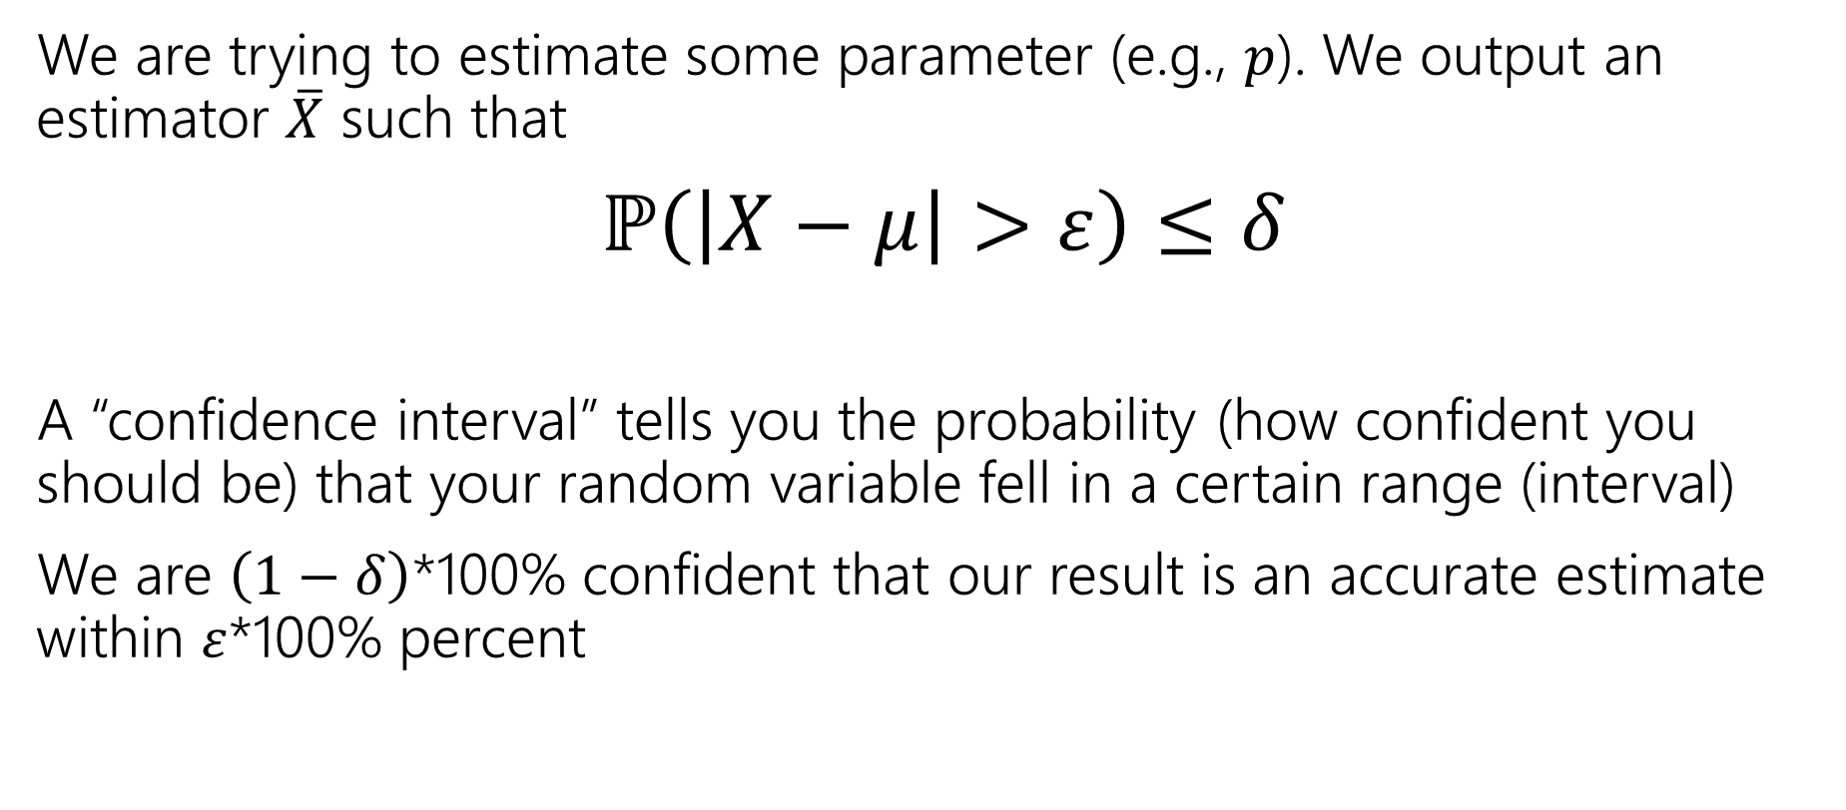
Confidence Intervals
We are trying to estimate some parameter (e.g., $p$). We output an estimator $\overline{X}$ such that
$ℙ\left(\left|X−μ\right|>ε\right)≤δ$
A “confidence interval” tells you the probability (how confident you should be) that your random variable fell in a certain range (interval)
We are $\left(1−δ\right)$*100% confident that our result is an accurate estimate within $ε$*100% percent

Slide 22
Idealized Polling
We have just discussed “idealized polling”. Real life is normally not so nice ☹
Assumed we can sample people uniformly at random, not really possible in practice
  Not everyone responds
  Response rates might differ in different groups
  Will people respond truthfully?
Makes polling in real life much more complex than this idealized model!

Slide 23
Multiple Random Variables

Slide 24
Analyzing Multiple Random Variables
So far, we’ve pretty much only analyzed one random variable at a time
  We’ve worked with multiple random variables (e.g., the sum of them) but haven’t really analyzed their relationships except for independence
Today, we will talk about analyzing the relations between multiple RVs
> Joint Distributions
  Joint PMF/PDF, Joint CDF, Joint Expectation

Slide 25
Analyzing Multiple Random Variables
Examples:
Economics: Analyzing the relationship between stock returns and volume helps in understanding market behavior and making investment decisions
Healthcare: Understanding how different factors (like blood pressure and cholesterol levels) affects the probability of medical conditionals
Machine learning: understanding how different features contribute to predicting a label and improving model accuracy (what features are most important)
Recommendation systems: Understanding relationship between user preferences and item features to improve recommendation systems, or other factors like age and choices of products

Slide 26
Joint Distributions
We’ll start with the discrete case

Slide 27
We have two discrete random variables $X$ and $Y$
  (that may or may not be independent)

Slide 28
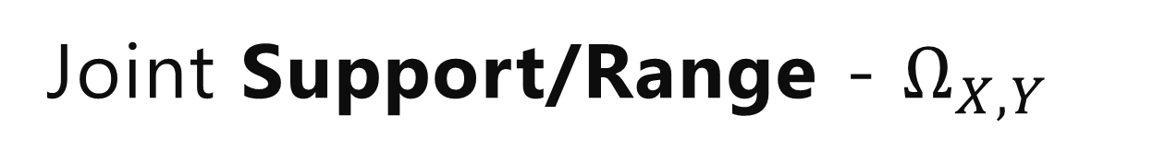
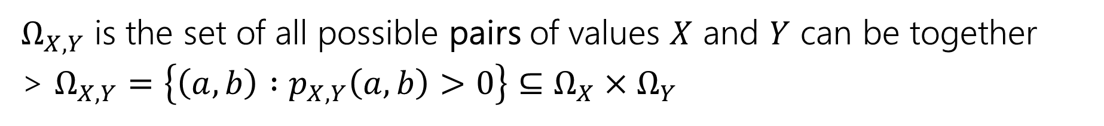
Joint Support/Range - $Ω_{X,Y}$
We have two discrete random variables $X$ and $Y$
  (that may or may not be independent)
$Ω_{X,Y}$ is the set of all possible pairs of values $X$ and $Y$ can be together
> $Ω_{X,Y}=\left\{\left(a,b\right) :p_{X,Y}\left(a,b\right)>0\right\}⊆Ω_{X}×Ω_{Y}$

Slide 29
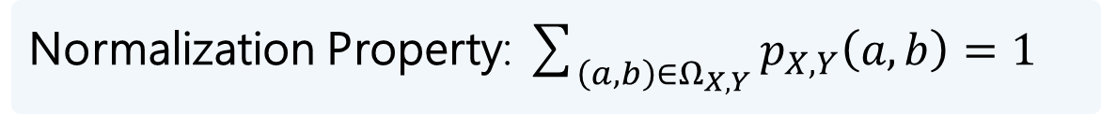
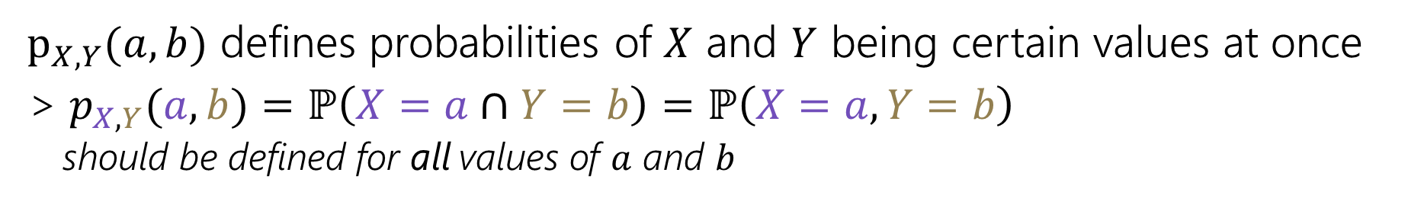
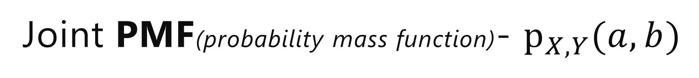
Joint Support/Range - $Ω_{X,Y}$
We have two discrete random variables $X$ and $Y$
  (that may or may not be independent)
$Ω_{X,Y}$ is the set of all possible pairs of values $X$ and $Y$ can be together
> $Ω_{X,Y}=\left\{\left(a,b\right) :p_{X,Y}\left(a,b\right)>0\right\}⊆Ω_{X}×Ω_{Y}$
Joint PMF(probability mass function)- $p_{X,Y}(a,b)$
$p_{X,Y}(a,b)$ defines probabilities of $X$ and $Y$ being certain values at once
> $p_{X,Y}(a,b)=ℙ\left(X=a∩Y=b\right)=ℙ\left(X=a,Y=b\right)$
  should be defined for all values of $a$ and $b$
Normalization Property: $\sum_{\left(a,b\right)∈Ω_{X,Y}}{p_{X,Y}\left(a,b\right)=1}$

Slide 30
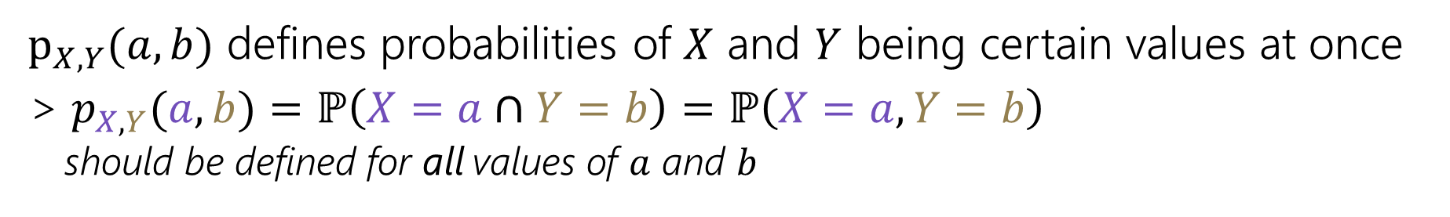
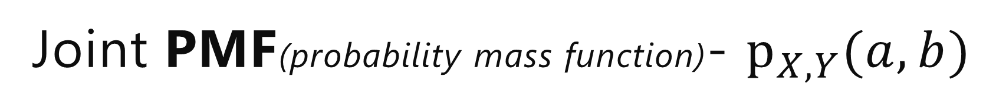
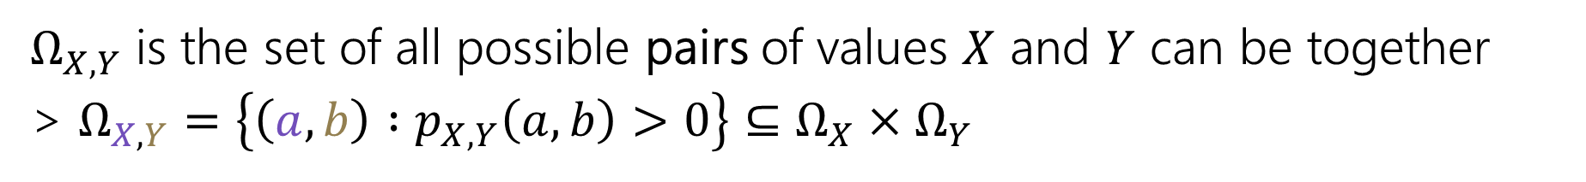
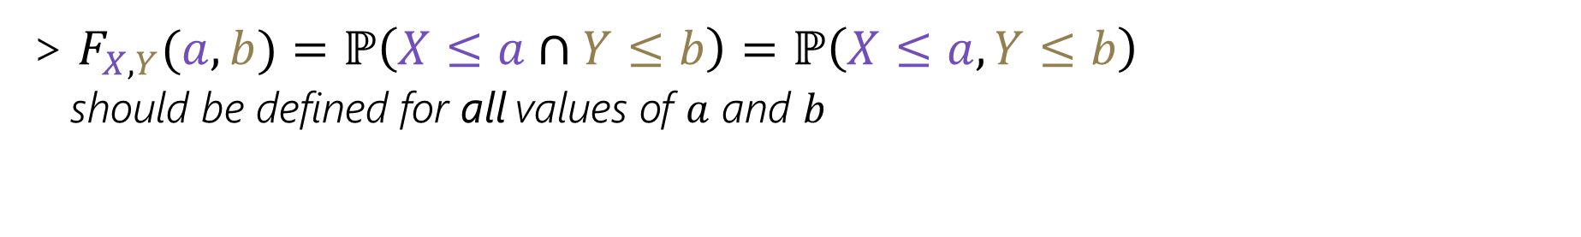
Joint Support/Range - $Ω_{X,Y}$
We have two discrete random variables $X$ and $Y$
  (that may or may not be independent)
$Ω_{X,Y}$ is the set of all possible pairs of values $X$ and $Y$ can be together
> $Ω_{X,Y}=\left\{\left(a,b\right) :p_{X,Y}\left(a,b\right)>0\right\}⊆Ω_{X}×Ω_{Y}$
Joint PMF(probability mass function)- $p_{X,Y}(a,b)$
$p_{X,Y}(a,b)$ defines probabilities of $X$ and $Y$ being certain values at once
> $p_{X,Y}(a,b)=ℙ\left(X=a∩Y=b\right)=ℙ\left(X=a,Y=b\right)$
  should be defined for all values of $a$ and $b$
Joint CDF(cumulative distribution function)- $F_{X,Y}(a,b)$
> $F_{X,Y}(a,b)=ℙ\left(X≤a∩Y≤b\right)=ℙ\left(X≤a,Y≤b\right)$
  should be defined for all values of $a$ and $b$

Slide 31
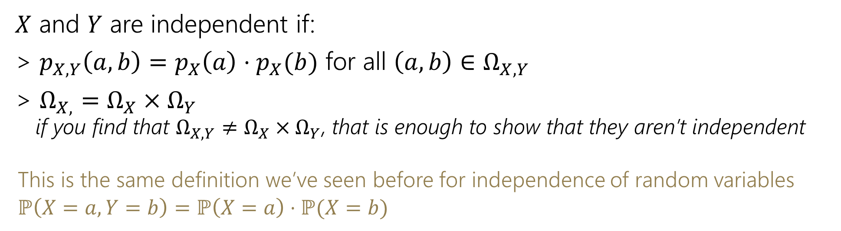
(Joint) Independence
We have two discrete random variables $X$ and $Y$
  (that may or may not be independent)
$X$ and $Y$ are independent if:
> $p_{X,Y}\left(a,b\right)=p_{X}\left(a\right)⋅p_{X}(b)$ for all $\left(a, b\right)∈Ω_{X,Y}$
> $Ω_{X,}=Ω_{X}×Ω_{Y}$
  if you find that $Ω_{X,Y}≠Ω_{X}×Ω_{Y}$, that is enough to show that they aren’t independent
  This is the same definition we’ve seen before for independence of random variables
  $$ℙ\left(X=a, Y=b\right)=ℙ\left(X=a\right)⋅ℙ(X=b)$$

Slide 32
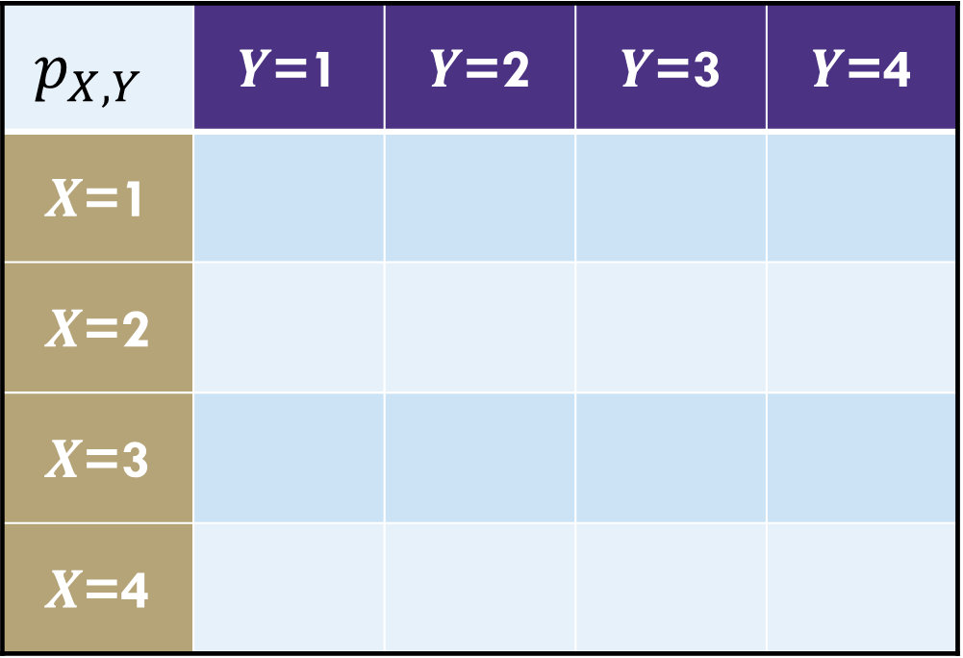
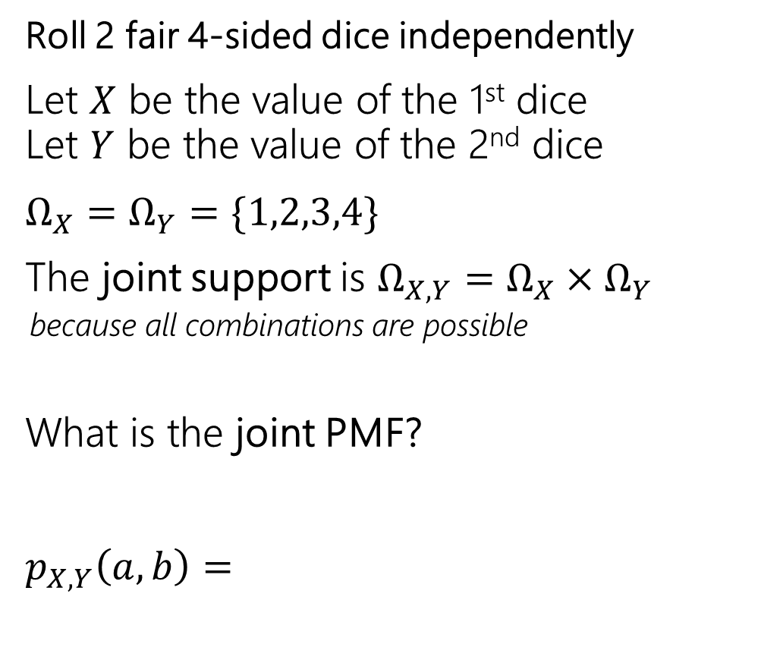
Example: Weird Dice
Roll 2 fair 4-sided dice independently
Let $X$ be the value of the 1st dice
Let $Y$ be the value of the 2nd dice
$Ω_{X}=Ω_{Y}=\{1,2,3,4\}$
The joint support is $Ω_{X,Y}=Ω_{X}×Ω_{Y}$
  because all combinations are possible
What is the joint PMF?
$p_{X,Y}\left(a,b\right)=$
$$p_{X,Y}$$ | $Y$=1 | $Y$=2 | $Y$=3 | $Y$=4
$X$=1
$X$=2
$X$=3
$X$=4

Slide 33
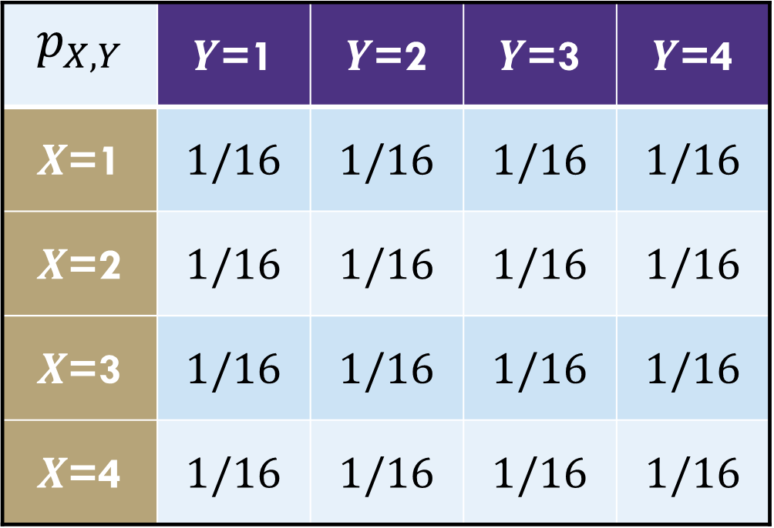
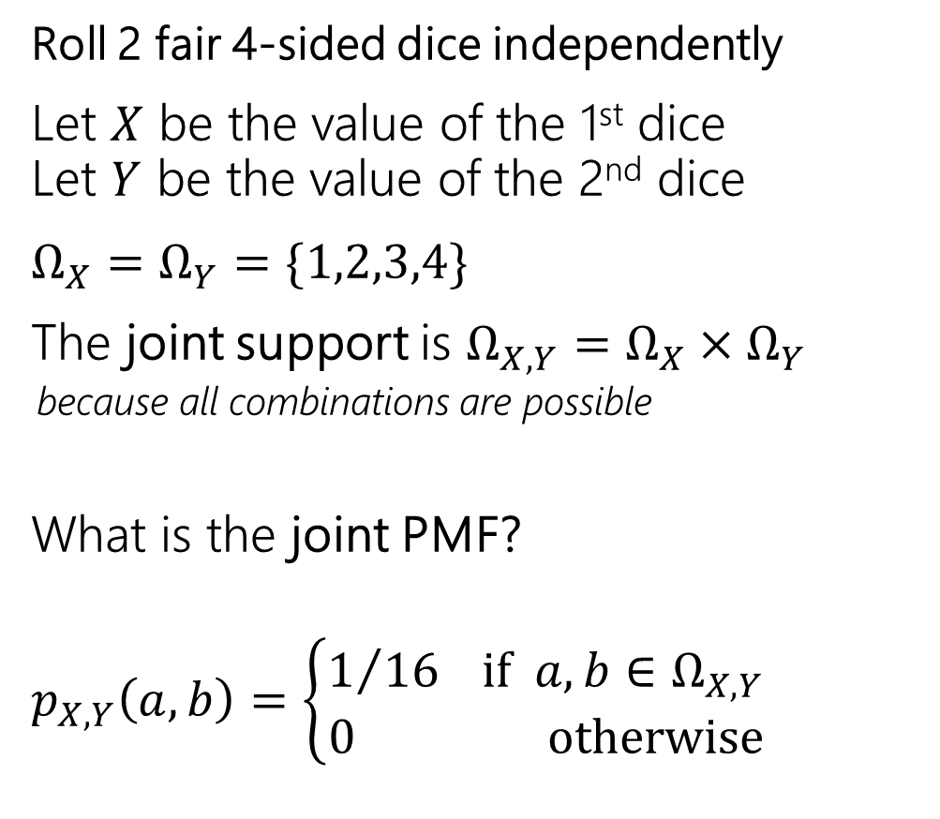
Example: Weird Dice
Roll 2 fair 4-sided dice independently
Let $X$ be the value of the 1st dice
Let $Y$ be the value of the 2nd dice
$Ω_{X}=Ω_{Y}=\{1,2,3,4\}$
The joint support is $Ω_{X,Y}=Ω_{X}×Ω_{Y}$
  because all combinations are possible
What is the joint PMF?
$p_{X,Y}\left(a,b\right)=\left\{\begin{matrix}1/{16} if a,b∈Ω_{X,Y} \\ 0 otherwise\end{matrix}\right.$
$$p_{X,Y}$$ | $Y$=1 | $Y$=2 | $Y$=3 | $Y$=4
$X$=1 | $$1/16$$ | $$1/16$$ | $$1/16$$ | $$1/16$$
$X$=2 | $$1/16$$ | $$1/16$$ | $$1/16$$ | $$1/16$$
$X$=3 | $$1/16$$ | $$1/16$$ | $$1/16$$ | $$1/16$$
$X$=4 | $$1/16$$ | $$1/16$$ | $$1/16$$ | $$1/16$$

Slide 34
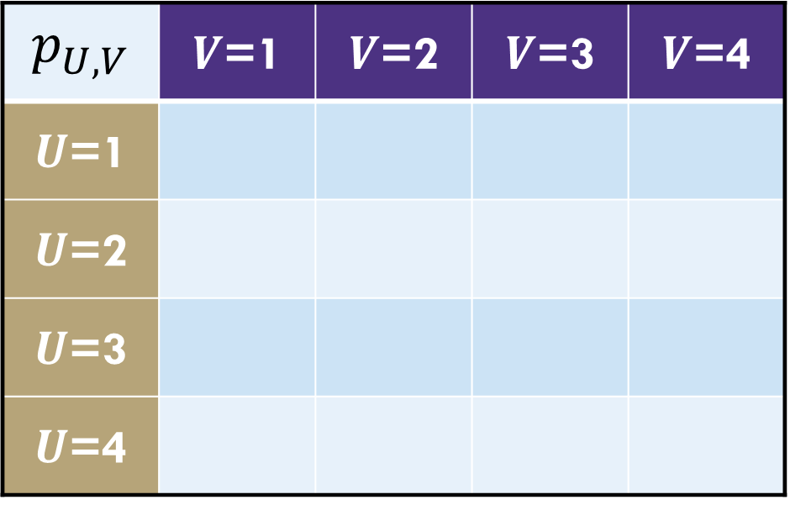

Example: Weird Dice
Roll 2 fair 4-sided dice independently
Let $U$ be the min value $U=\min\left(X,Y\right)$
Let $W$ be the max value $W=max⁡(X,Y)$
$Ω_{U}=Ω_{W}=\{1,2,3,4\}$
The joint support is:
$$p_{U,V}$$ | $V$=1 | $V$=2 | $V$=3 | $V$=4
$U$=1
$U$=2
$U$=3
$U$=4

Slide 35
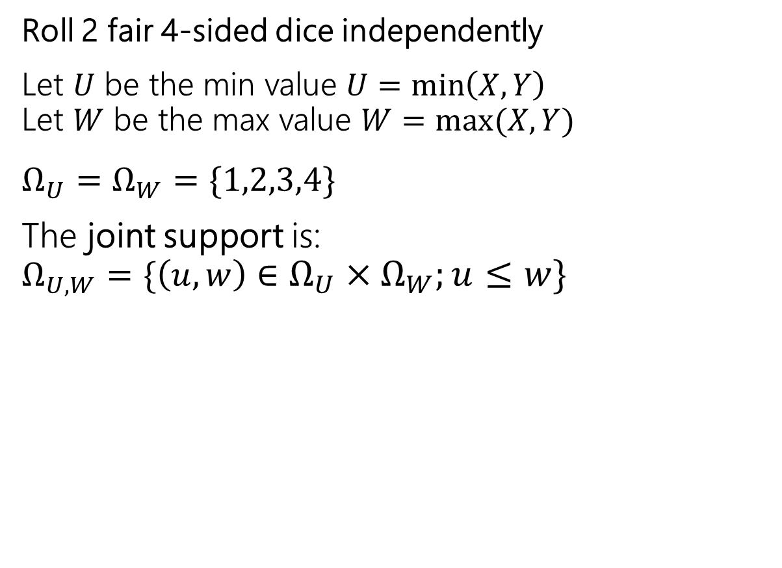
Example: Weird Dice
Roll 2 fair 4-sided dice independently
Let $U$ be the min value $U=\min\left(X,Y\right)$
Let $W$ be the max value $W=max⁡(X,Y)$
$Ω_{U}=Ω_{W}=\{1,2,3,4\}$
The joint support is:
$Ω_{U,W}=\{\left(u,w\right)∈Ω_{U}×Ω_{W};u≤w\}$
$$p_{U,V}$$ | $V$=1 | $V$=2 | $V$=3 | $V$=4
$U$=1
$U$=2
$U$=3
$U$=4

Slide 36
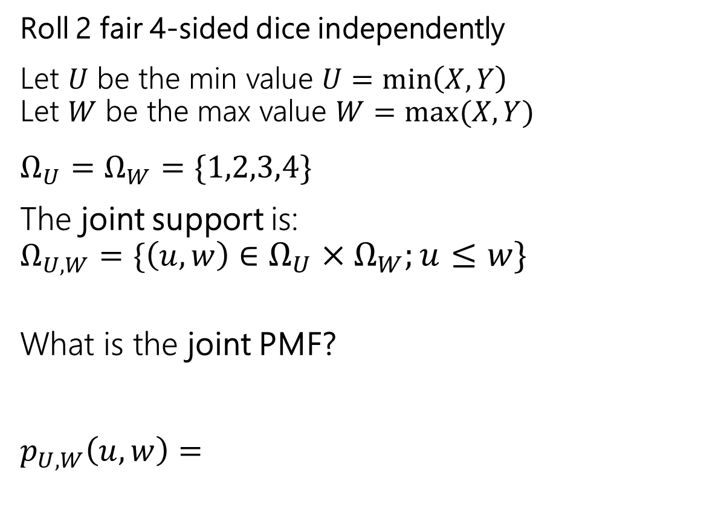
Example: Weird Dice
Roll 2 fair 4-sided dice independently
Let $U$ be the min value $U=\min\left(X,Y\right)$
Let $W$ be the max value $W=max⁡(X,Y)$
$Ω_{U}=Ω_{W}=\{1,2,3,4\}$
The joint support is:
$Ω_{U,W}=\{\left(u,w\right)∈Ω_{U}×Ω_{W};u≤w\}$
What is the joint PMF?
$p_{U,W}\left(u,w\right)=$
$$p_{U,V}$$ | $V$=1 | $V$=2 | $V$=3 | $V$=4
$U$=1
$U$=2
$U$=3
$U$=4

Slide 37
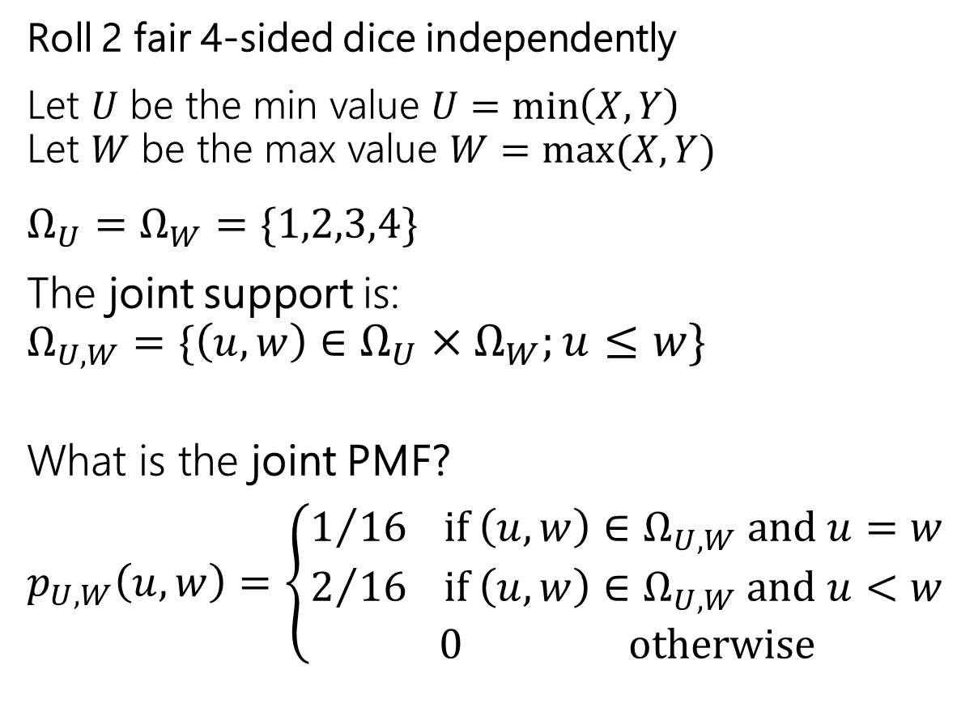
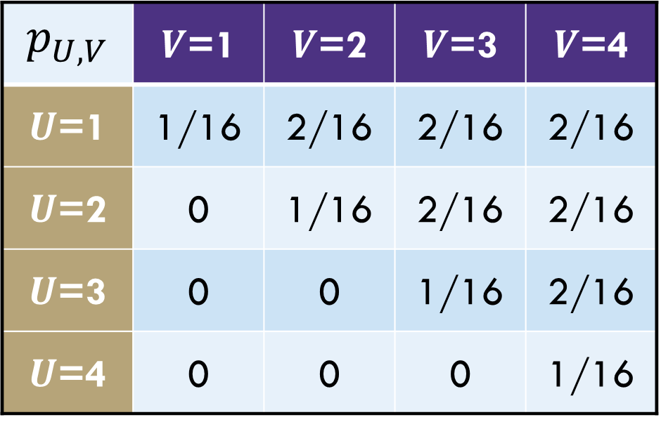
Example: Weird Dice
Roll 2 fair 4-sided dice independently
Let $U$ be the min value $U=\min\left(X,Y\right)$
Let $W$ be the max value $W=max⁡(X,Y)$
$Ω_{U}=Ω_{W}=\{1,2,3,4\}$
The joint support is:
$Ω_{U,W}=\{\left(u,w\right)∈Ω_{U}×Ω_{W};u≤w\}$
What is the joint PMF?
$p_{U,W}\left(u,w\right)=$ $\left\{\begin{matrix}\begin{aligned}1/{16} if \left(u,w\right)∈Ω_{U,W} and u=w \\ 2/{16} if \left(u,w\right)∈Ω_{U,W} and u<w\end{aligned} \\ 0 otherwise\end{matrix}\right.$
$$p_{U,V}$$ | $V$=1 | $V$=2 | $V$=3 | $V$=4
$U$=1 | 1/16 | 2/16 | 2/16 | 2/16
$U$=2 | 0 | 1/16 | 2/16 | 2/16
$U$=3 | 0 | 0 | 1/16 | 2/16
$U$=4 | 0 | 0 | 0 | 1/16
Notes:
Next q: are they independent?

Slide 38
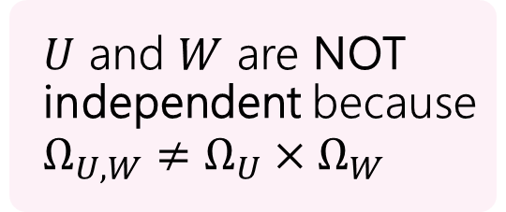
Example: Weird Dice
Roll 2 fair 4-sided dice independently
Let $U$ be the min value $U=\min\left(X,Y\right)$
Let $W$ be the max value $W=max⁡(X,Y)$
$Ω_{U}=Ω_{W}=\{1,2,3,4\}$
The joint support is:
$Ω_{U,W}=\{\left(u,w\right)∈Ω_{U}×Ω_{W};u≤w\}$
What is the joint PMF?
$p_{U,W}\left(u,w\right)=$ $\left\{\begin{matrix}\begin{aligned}1/{16} if \left(u,w\right)∈Ω_{U,W} and u=w \\ 2/{16} if \left(u,w\right)∈Ω_{U,W} and u<w\end{aligned} \\ 0 otherwise\end{matrix}\right.$
$$p_{U,V}$$ | $V$=1 | $V$=2 | $V$=3 | $V$=4
$U$=1 | 1/16 | 2/16 | 2/16 | 2/16
$U$=2 | 0 | 1/16 | 2/16 | 2/16
$U$=3 | 0 | 0 | 1/16 | 2/16
$U$=4 | 0 | 0 | 0 | 1/16
$U$ and $W$ are NOT independent because $Ω_{U,W}≠Ω_{U}×Ω_{W}$

Slide 39
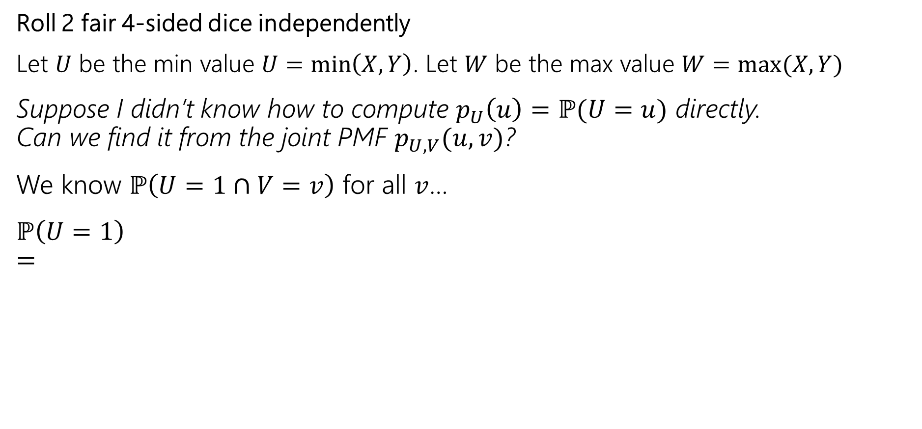
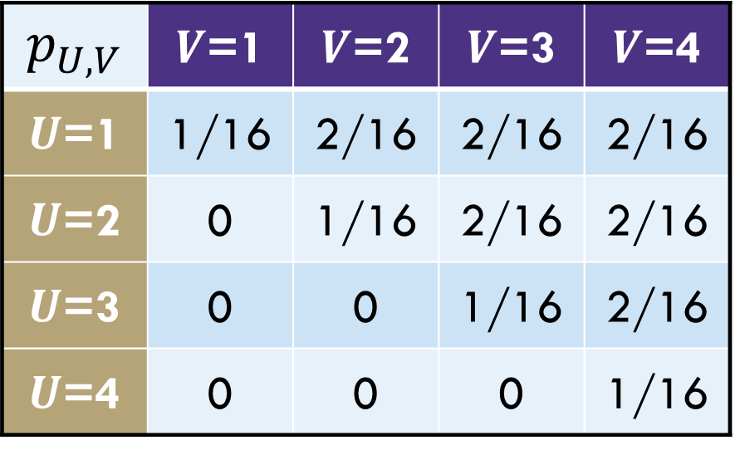
Example: Weird Dice
Roll 2 fair 4-sided dice independently
Let $U$ be the min value $U=\min\left(X,Y\right)$. Let $W$ be the max value $W=max⁡(X,Y)$
Suppose I didn’t know how to compute $p_{U}\left(u\right)=ℙ(U=u)$ directly.
Can we find it from the joint PMF $p_{U,V}(u,v)$?
We know $ℙ\left(U=1∩V=v\right)$ for all $v$…
$ℙ\left(U=1\right)$
$=$
$$p_{U,V}$$ | $V$=1 | $V$=2 | $V$=3 | $V$=4
$U$=1 | 1/16 | 2/16 | 2/16 | 2/16
$U$=2 | 0 | 1/16 | 2/16 | 2/16
$U$=3 | 0 | 0 | 1/16 | 2/16
$U$=4 | 0 | 0 | 0 | 1/16

Slide 40
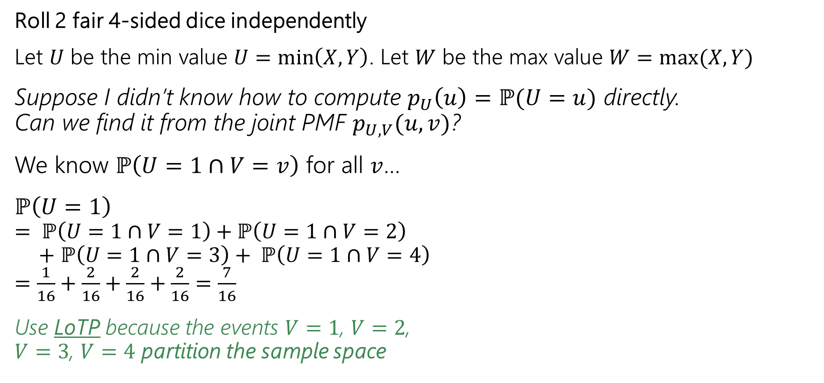
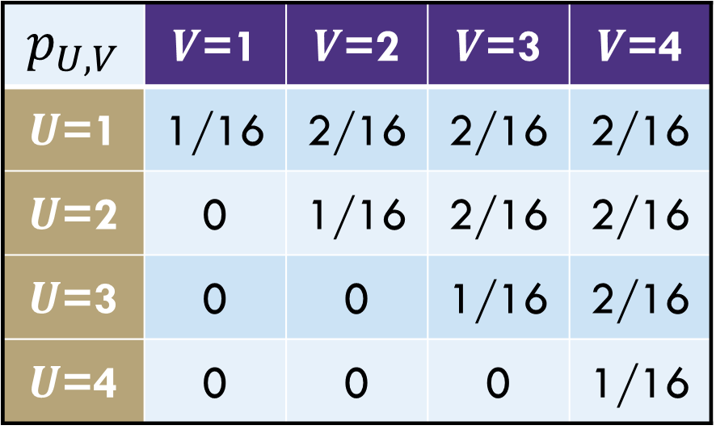
Example: Weird Dice
Roll 2 fair 4-sided dice independently
Let $U$ be the min value $U=\min\left(X,Y\right)$. Let $W$ be the max value $W=max⁡(X,Y)$
Suppose I didn’t know how to compute $p_{U}\left(u\right)=ℙ(U=u)$ directly.
Can we find it from the joint PMF $p_{U,V}(u,v)$?
We know $ℙ\left(U=1∩V=v\right)$ for all $v$…
$ℙ\left(U=1\right)$
$= ℙ\left(U=1∩V=1\right)+ℙ\left(U=1∩V=2\right)$
$+$ $ℙ\left(U=1∩V=3\right)+ ℙ\left(U=1∩V=4\right)$
$=\frac{1}{16}+\frac{2}{16}+\frac{2}{16}+\frac{2}{16}=\frac{7}{16}$
Use LoTP because the events $V=1$, $V=2$,
$V=3$, $V=4$ partition the sample space
$$p_{U,V}$$ | $V$=1 | $V$=2 | $V$=3 | $V$=4
$U$=1 | 1/16 | 2/16 | 2/16 | 2/16
$U$=2 | 0 | 1/16 | 2/16 | 2/16
$U$=3 | 0 | 0 | 1/16 | 2/16
$U$=4 | 0 | 0 | 0 | 1/16

Slide 41
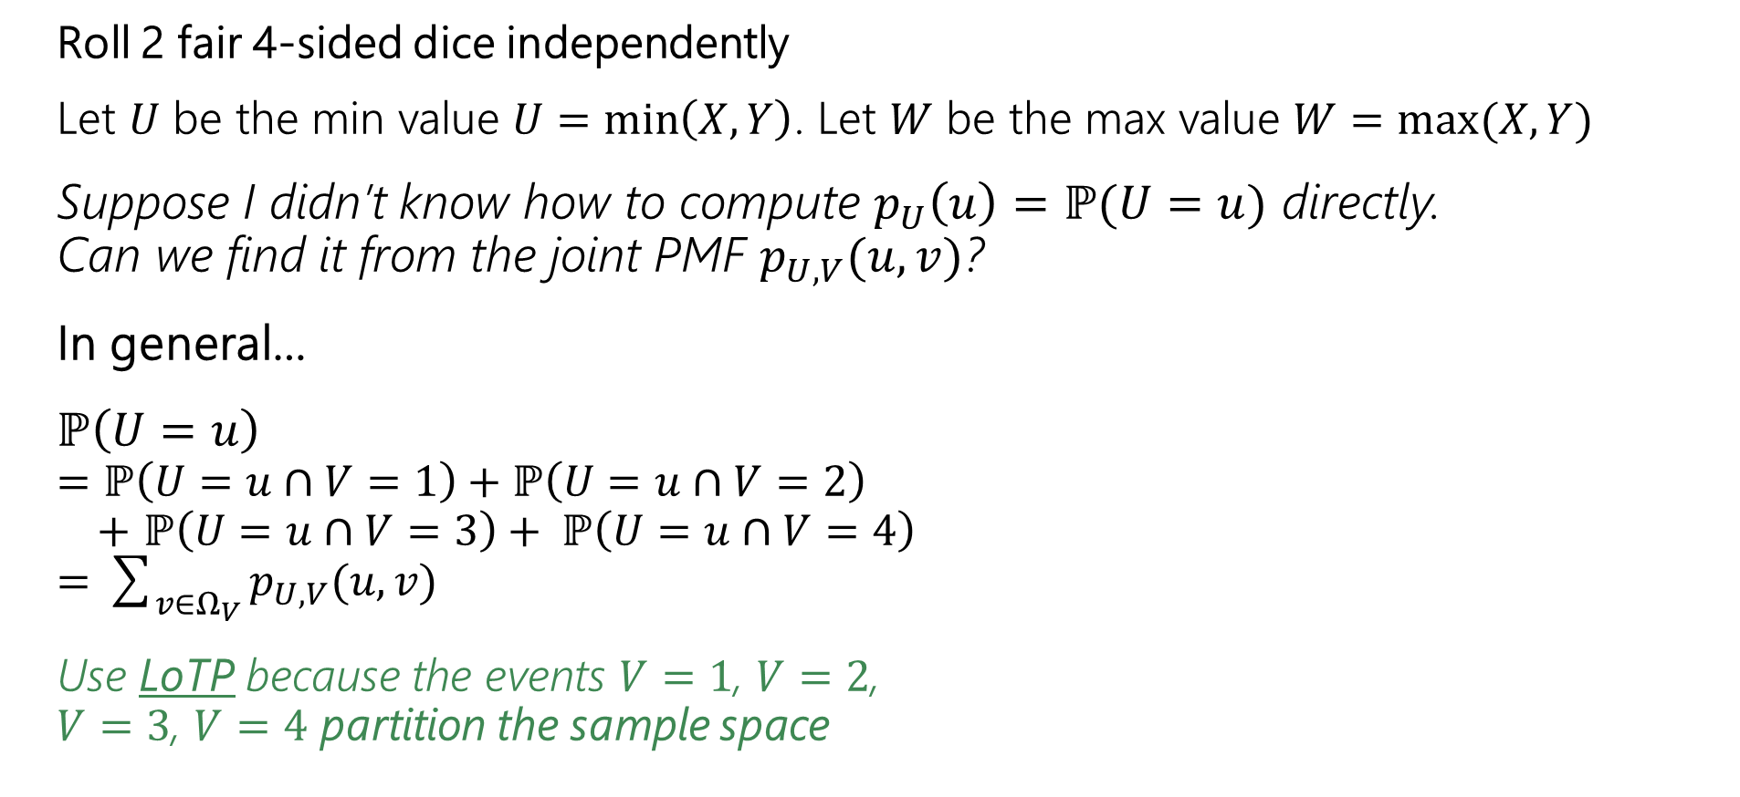
Example: Weird Dice
Roll 2 fair 4-sided dice independently
Let $U$ be the min value $U=\min\left(X,Y\right)$. Let $W$ be the max value $W=max⁡(X,Y)$
Suppose I didn’t know how to compute $p_{U}\left(u\right)=ℙ(U=u)$ directly.
Can we find it from the joint PMF $p_{U,V}(u,v)$?
In general…
$ℙ\left(U=u\right)$
$=ℙ\left(U=u∩V=1\right)+ℙ\left(U=u∩V=2\right)$
$+$ $ℙ\left(U=u∩V=3\right)+ ℙ\left(U=u∩V=4\right)$
$=\sum_{v∈Ω_{V}}{p_{U,V}(u, v)}$
Use LoTP because the events $V=1$, $V=2$,
$V=3$, $V=4$ partition the sample space
$$p_{U,V}$$ | $V$=1 | $V$=2 | $V$=3 | $V$=4
$U$=1 | 1/16 | 2/16 | 2/16 | 2/16
$U$=2 | 0 | 1/16 | 2/16 | 2/16
$U$=3 | 0 | 0 | 1/16 | 2/16
$U$=4 | 0 | 0 | 0 | 1/16

Slide 42

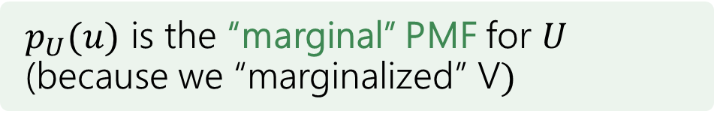
Example: Weird Dice
Roll 2 fair 4-sided dice independently
Let $U$ be the min value $U=\min\left(X,Y\right)$. Let $W$ be the max value $W=max⁡(X,Y)$
Suppose I didn’t know how to compute $p_{U}\left(u\right)=ℙ(U=u)$ directly.
Can we find it from the joint PMF $p_{U,V}(u,v)$?
In general…
$ℙ\left(U=u\right)=\sum_{v∈Ω_{V}}{p_{U,V}(u, v)}$
Use LoTP because the events $V=1$, $V=2$,
$V=3$, $V=4$ partition the sample space
$$p_{U,V}$$ | $V$=1 | $V$=2 | $V$=3 | $V$=4
$U$=1 | 1/16 | 2/16 | 2/16 | 2/16
$U$=2 | 0 | 1/16 | 2/16 | 2/16
$U$=3 | 0 | 0 | 1/16 | 2/16
$U$=4 | 0 | 0 | 0 | 1/16
$p_{U}(u)$ is the “marginal” PMF for $U$ (because we “marginalized” V$)$

Slide 43
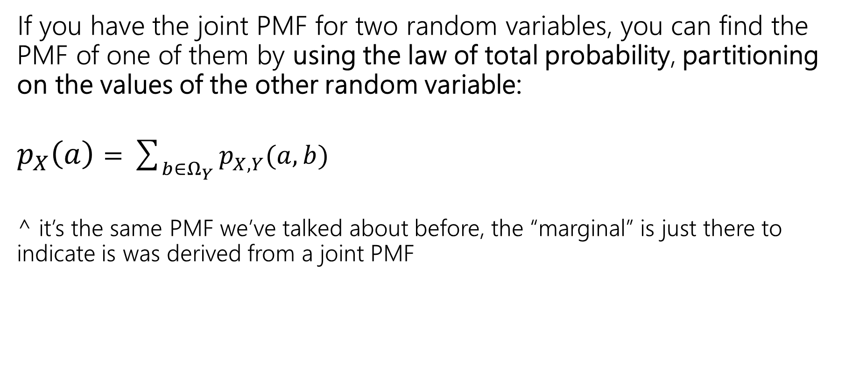
Marginal Distribution
If you have the joint PMF for two random variables, you can find the PMF of one of them by using the law of total probability, partitioning on the values of the other random variable:
$p_{X}\left(a\right)=\sum_{b∈Ω_{Y}}{p_{X,Y}(a, b)}$
^ it’s the same PMF we’ve talked about before, the “marginal” is just there to indicate is was derived from a joint PMF

Slide 44
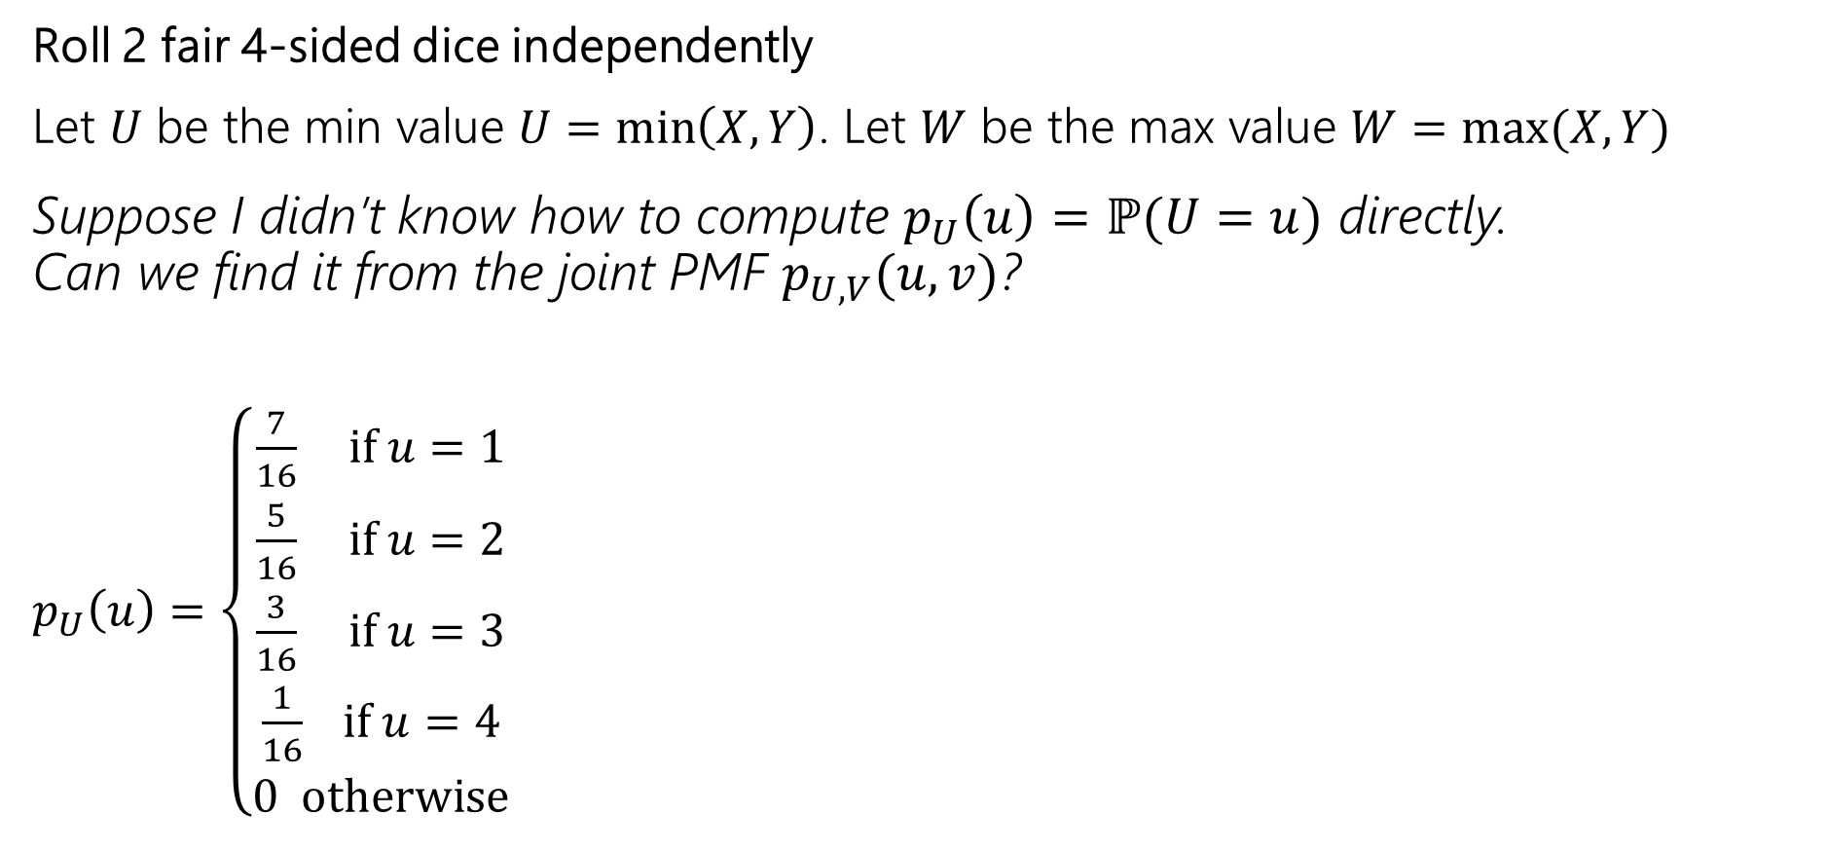
Example: Weird Dice
Roll 2 fair 4-sided dice independently
Let $U$ be the min value $U=\min\left(X,Y\right)$. Let $W$ be the max value $W=max⁡(X,Y)$
Suppose I didn’t know how to compute $p_{U}\left(u\right)=ℙ(U=u)$ directly.
Can we find it from the joint PMF $p_{U,V}(u,v)$?
$p_{U}\left(u\right)=\left\{\begin{aligned}\frac{7}{16} if u=1 \\ \frac{5}{16} if u=2 \\ \frac{3}{16} if u=3 \\ \frac{1}{16} if u=4 \\ 0 otherwise\end{aligned}\right.$
$$p_{U,V}$$ | $V$=1 | $V$=2 | $V$=3 | $V$=4
$U$=1 | 1/16 | 2/16 | 2/16 | 2/16
$U$=2 | 0 | 1/16 | 2/16 | 2/16
$U$=3 | 0 | 0 | 1/16 | 2/16
$U$=4 | 0 | 0 | 0 | 1/16

Slide 45
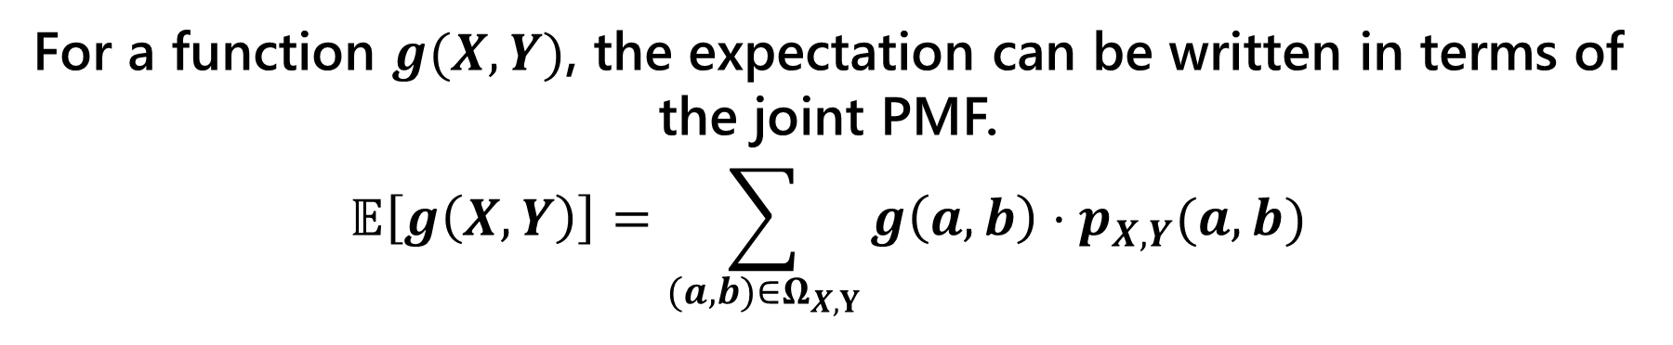
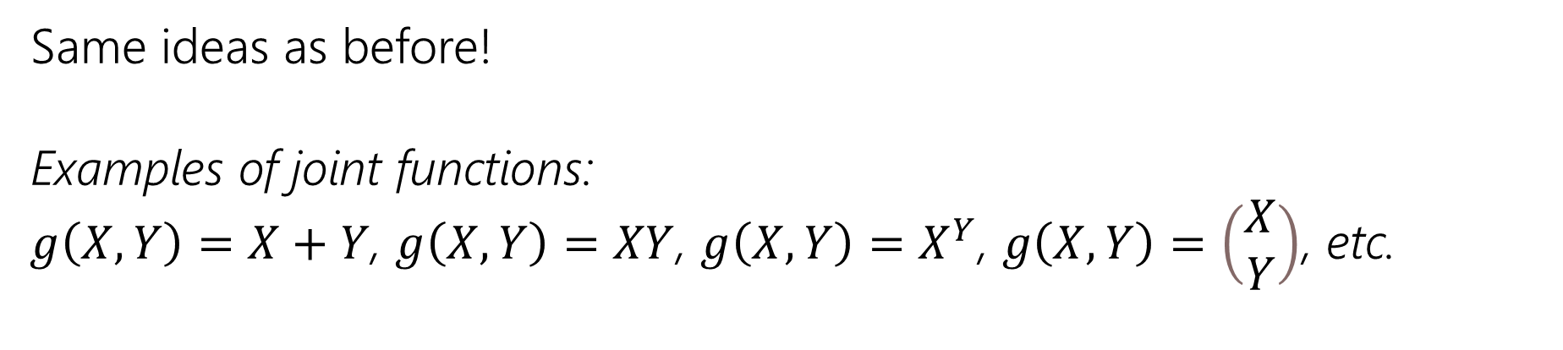
Joint Expectation
Joint Expectations
For a function $g(X,Y)$, the expectation can be written in terms of the joint PMF.
$$𝔼\left[g\left(X,Y\right)\right]=\sum_{(a,b)∈Ω_{X,Y}}{g\left(a,b\right)⋅p_{X, Y}(a,b)}$$
Same ideas as before!
Examples of joint functions:
$g\left(X,Y\right)=X+Y$, $g\left(X,Y\right)=XY$, $g\left(X,Y\right)=X^{Y}$, $g\left(X,Y\right)=\left(\begin{matrix}X \\ Y\end{matrix}\right)$, etc.

Slide 46
Joint Distributions
For continuous joint distributions, everything will look very similar but we replace summations with integrals, and use a density function instead of the PMF

Slide 47








Joint Support/Range - $Ω_{X,Y}$
We have two continuous random variables $X$ and $Y$
  (that may or may not be independent)
$Ω_{X,Y}=\left\{\left(a,b\right) :f_{X,Y}\left(a,b\right)>0\right\}⊆Ω_{X}×Ω_{Y}$
Joint CDF - $F_{X,Y}(a,b)$
Joint PDF - $f_{X,Y}(a,b)$
$F_{X,Y}(a,b)=ℙ\left(X≤a,Y≤b\right)$
defined for all $\left(a,b\right)∈ℝ×ℝ$
$f_{X,Y}(a,b)$ defined for all $\left(a,b\right)∈ℝ×ℝ$
Normalization Property:
$\int_{−∞}^{∞}{\int_{−∞}^{∞}{f_{X,Y}\left(x,y\right)dx dy}=1}$
Joint Independence
> $f_{X,Y}\left(a,b\right)=f_{X}\left(a\right)⋅f_{X}(b)$ for all $\left(a, b\right)∈Ω_{X,Y}$
> $Ω_{X,}=Ω_{X}×Ω_{Y}$
Joint Expectation
Marginal PDF - $f_{X}(x)$, $f_{Y}(y)$
$$𝔼\left[g\left(X,Y\right)\right]=$$
$\int_{−∞}^{∞}{\int_{−∞}^{∞}{g\left(x,y\right) f_{X,Y}\left(x,y\right)dx dy}}$
$f_{X}\left(x\right)=\int_{−∞}^{∞}{f_{X,Y}\left(x,y\right) dy}$
$f_{Y}\left(y\right)=\int_{−∞}^{∞}{f_{X,Y}\left(x,y\right) dx}$
Notice we’re integrating (summing) over what the other RV can be

Slide 48

Example: Darts
We throw a dart uniformly at random onto a circle of radius $r$ centered around the version. $X$ and $Y$ are the x and y coordinates of the point the dart lands at.
Let’s find and sketch the joint range $Ω_{X,Y}$

Slide 49



Example: Darts
We throw a dart uniformly at random onto a circle of radius $r$ centered around the version. $X$ and $Y$ are the x and y coordinates of the point the dart lands at.
Let’s find and sketch the joint range $Ω_{X,Y}$
$$y$$
$$x$$
$$Ω_{X,Y}=\{\left(x,y\right)∈ℝ×ℝ;x^{2}+y^{2}≤r\}$$

Slide 50






Example: Darts
We throw a dart uniformly at random onto a circle of radius $r$ centered around the version. $X$ and $Y$ are the x and y coordinates of the point the dart lands at.
Let’s find and sketch the joint PDF $f_{X,Y}(x,y)$
$$f_{X,Y}(x,y)$$
$$f_{X,Y}\left(x,y\right)=\left\{\begin{matrix} \\ \begin{aligned} \\ \\ \\ \\ \end{aligned}\end{matrix}\right.$$
$$y$$
$$x$$

Slide 51

Example: Darts
We throw a dart uniformly at random onto a circle of radius $r$ centered around the version. $X$ and $Y$ are the x and y coordinates of the point the dart lands at.
Let’s find and sketch the joint PDF $f_{X,Y}(x,y)$
$$f_{X,Y}(x,y)$$
$$f_{X,Y}\left(x,y\right)=\left\{\begin{aligned}\frac{1}{πr^{2}} x^{2}+y^{2}≤1 \\ 0 otherwise\end{aligned}\right.$$
$$y$$
$$x$$

Slide 52



Example: Darts
We throw a dart uniformly at random onto a circle of radius $r$ centered around the version. $X$ and $Y$ are the x and y coordinates of the point the dart lands at.
What is the marginal PDF for $X$ and $Y$?
$$f_{X,Y}\left(x,y\right)=\left\{\begin{aligned}\frac{1}{πr^{2}} x^{2}+y^{2}≤1 \\ 0 otherwise\end{aligned}\right.$$
$$f_{X,Y}(x,y)$$
$$f_{X}\left(a\right)=$$
$$f_{Y}\left(b\right)=$$
$$y$$
$$x$$

Slide 53

Example: Darts
We throw a dart uniformly at random onto a circle of radius $r$ centered around the version. $X$ and $Y$ are the x and y coordinates of the point the dart lands at.
What is the marginal PDF for $X$ and $Y$?
$$f_{X,Y}\left(x,y\right)=\left\{\begin{aligned}\frac{1}{πr^{2}} x^{2}+y^{2}≤1 \\ 0 otherwise\end{aligned}\right.$$
$$f_{X,Y}(x,y)$$
$$f_{X}\left(a\right)=\int_{−∞}^{∞}{f_{X,Y}\left(a, y\right)dy}$$
$$f_{Y}\left(b\right)=\int_{−∞}^{∞}{f_{X,Y}\left(x, b\right)dx}$$
$$y$$
$$x$$

Slide 54
Example: Darts
We throw a dart uniformly at random onto a circle of radius $r$ centered around the version. $X$ and $Y$ are the x and y coordinates of the point the dart lands at.
What is the marginal PDF for $X$ and $Y$?
$$f_{X,Y}\left(x,y\right)=\left\{\begin{aligned}\frac{1}{πr^{2}} x^{2}+y^{2}≤1 \\ 0 otherwise\end{aligned}\right.$$
$$y$$
$$f_{X}\left(a\right)=\int_{−∞}^{∞}{f_{X,Y}\left(a, y\right)dy}$$
$$f_{Y}\left(b\right)=\int_{−∞}^{∞}{f_{X,Y}\left(x, b\right)dx}$$
$$x$$

Slide 55


Example: Darts
We throw a dart uniformly at random onto a circle of radius $r$ centered around the version. $X$ and $Y$ are the x and y coordinates of the point the dart lands at.
What is the marginal PDF for $X$ and $Y$?
$$f_{X,Y}\left(x,y\right)=\left\{\begin{aligned}\frac{1}{πr^{2}} x^{2}+y^{2}≤r \\ 0 otherwise\end{aligned}\right.$$
$$y$$
$$f_{X}\left(a\right)=\int_{−∞}^{∞}{f_{X,Y}\left(a, y\right)dy}=\int_{−\sqrt{r−a^{2}}}^{\sqrt{r−a^{2}}}{\frac{1}{πr^{2}}dy}=\frac{2\sqrt{r−a^{2}}}{πr^{2}}$$
$$f_{Y}\left(b\right)=\int_{−∞}^{∞}{f_{X,Y}\left(x, b\right)dx}=\int_{−\sqrt{r−b^{2}}}^{\sqrt{r−b^{2}}}{\frac{1}{πr^{2}}dx}=\frac{2\sqrt{r−b^{2}}}{πr^{2}}$$
$$x$$

Slide 56

Joint Continuous Probabilities
Just like we’ve done with PDFs for single random variables…
$ℙ\left(a≤X≤b∩c≤Y≤d\right)=\int_{a}^{b}{\int_{c}^{d}{f_{X,Y}\left(x,y\right)dy dx}}$

Slide 57



Example: Continuous Servers
The time until server 1 crashes is $X\sim Exp(u)$, and the time until server 2 crashes is $Y\sim Exp(v)$. Both servers are independent of each other.
What is the probability server 1 crashes before server 2?
$ℙ\left(X<Y\right)=$
$$y$$
$$x$$

Slide 58

Example: Continuous Servers
The time until server 1 crashes is $X\sim Exp(u)$, and the time until server 2 crashes is $Y\sim Exp(v)$. Both servers are independent of each other.
What is the probability server 1 crashes before server 2?
$ℙ\left(X<Y\right)$
$=\int_{0}^{∞}{\int_{x}^{∞}{f_{X,Y}\left(x,y\right) dy dx}}$
$=\int_{0}^{∞}{\int_{x}^{∞}{f_{X}\left(x\right)f_{Y}(y) dy dx}}$ by independence
$$y$$
$$x$$

Slide 59

Analogues for continuous
Everything we saw today has a continuous version.
There are “no surprises”– replace pmf with pdf and sums with integrals.

Slide 60


Covariance
We sometimes want to measure how “intertwined” $X$ and $Y$ are – how much knowing about one of them will affect the other.
If $X$ turns out “big” how likely is it that $Y$ will be “big” how much do they “vary together”
$$Cov\left(X,Y\right)=𝔼\left[\left(X−𝔼\left[X\right]\right)(Y−𝔼\left[Y\right])\right]=𝔼\left[XY\right]−𝔼[X]𝔼[Y]$$
Covariance

Slide 61

Covariance
$Var\left(X+Y\right)=Var\left(X\right)+Var\left(Y\right)+2Cov(X,Y)$
That’s consistent with our previous knowledge for independent variables. (for $X,Y$independent, $𝔼\left[XY\right]=𝔼\left[X\right]𝔼[Y]$).
You and your friend are playing a game, you flip a coin: if heads you pay your friend a dollar, if tails they pay you a dollar. Let $X$ be your profit and $Y$ be your friend’s profit.
What is $Var(X+Y)$?
Before you calculate, make a prediction. What should it be?

Slide 62

Covariance
You and your friend are playing a game, you flip a coin: if heads you pay your friend a dollar, if tails they pay you a dollar. Let $X$ be your profit and $Y$ be your friend’s profit.
What is $Var(X+Y)$?
$Var\left(X\right)=Var\left(Y\right)=𝔼\left[X^{2}\right]−{\left(𝔼\left[X\right]\right)}^{2}=1−0^{2}=1$
$Cov\left(X,Y\right)=𝔼\left[XY\right]−𝔼[X]𝔼[Y]$
$𝔼\left[XY\right]=\frac{1}{2}⋅\left(−1⋅1\right)+\frac{1}{2}\left(1⋅−1\right)=−1$
$Cov\left(X,Y\right)=−1−0⋅0=−1$.
$Var\left(X+Y\right)=1+1+2⋅−1=0$

