Slide 1
Central Limit Theorem
CSE 312 26Su
Lecture 15

Slide 2
Logistics
Midterm grades released
See Ed post for more info!
Quiz on Friday
    Discrete + Continuous RVs (lectures 10-14)
    Midterm cheat sheet + distribution sheet + z-table

Slide 3
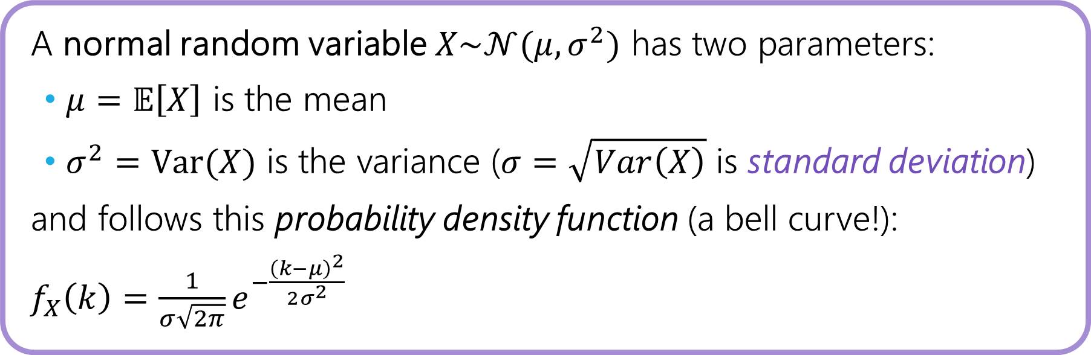
Normal Distributions
A normal random variable $X\sim 𝒩(μ,σ^{2})$ has two parameters:
$μ=𝔼\left[X\right]$ is the mean
$σ^{2}=Var(X)$ is the variance ($σ=\sqrt{Var\left(X\right)}$ is standard deviation)
and follows this probability density function (a bell curve!):
$f_{X}\left(k\right)=\frac{1}{σ\sqrt{2π}}e^{−\frac{{\left(k−μ\right)}^{2}}{2σ^{2}}}$

Slide 4
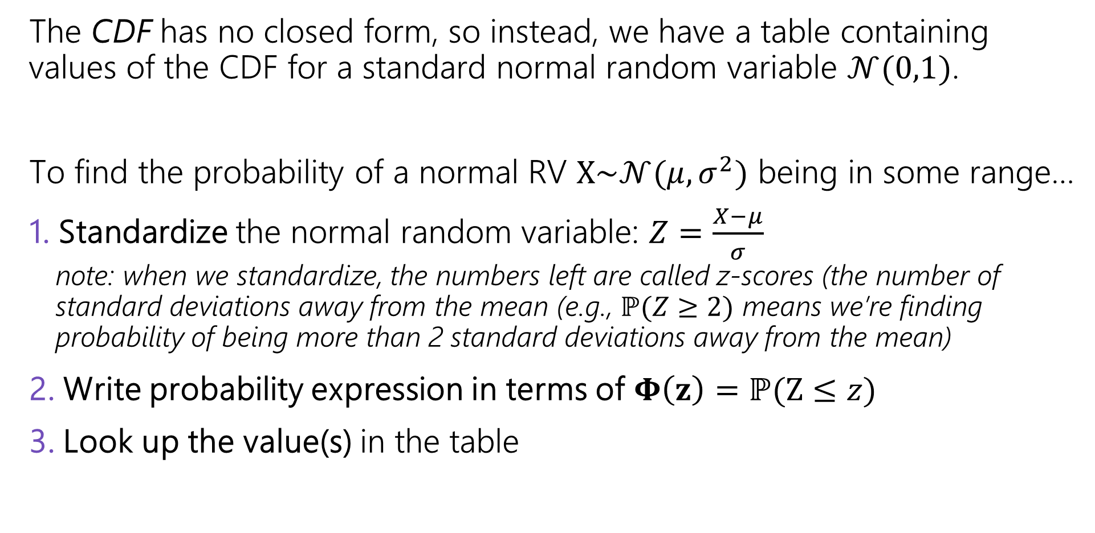
Normal Distributions
The CDF has no closed form, so instead, we have a table containing values of the CDF for a standard normal random variable $𝒩(0,1)$.
To find the probability of a normal RV $X\sim 𝒩(μ, σ^{2})$ being in some range…
1. Standardize the normal random variable: $Z=\frac{X−μ}{σ}$
  note: when we standardize, the numbers left are called z-scores (the number of
  standard deviations away from the mean (e.g., $ℙ(Z≥2)$ means we’re finding
  probability of being more than 2 standard deviations away from the mean)
2. Write probability expression in terms of $Φ\left(z\right)=ℙ(Z≤z)$
3. Look up the value(s) in the table

Slide 5
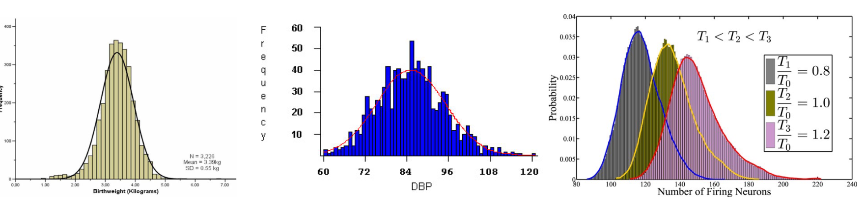
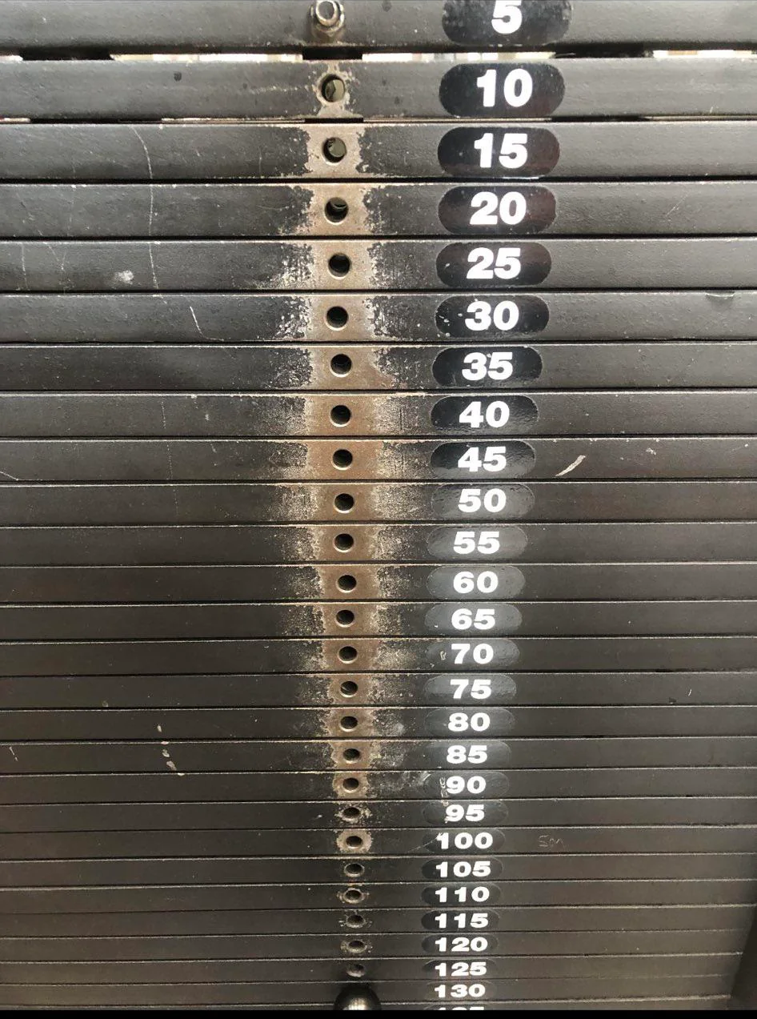
Normal distributions show up everywhere!

Slide 6
But…why?
This is because of what we call, the central limit theorem!
“The sum of any independent random variables approaches a normal distribution. It becomes closer to normal as we sum more RVs together.”

Slide 7
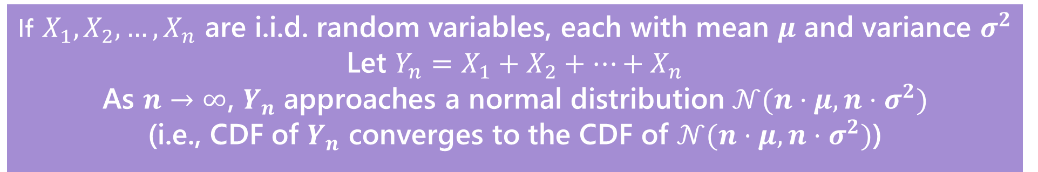
More formally, the Central Limit Theorem!
This is because of what we call, the central limit theorem!
“The sum of any independent random variables approaches a normal distribution. It becomes closer to normal as we sum more RVs together.”
Central Limit Theorem
If $X_{1},X_{2},…,X_{n}$ are i.i.d. random variables, each with mean $μ$ and variance $σ^{2}$
Let $Y_{n}=X_{1}+X_{2}+…+X_{n}$
As $n→∞$, $Y_{n}$ approaches a normal distribution $𝒩(n⋅μ,n⋅σ^{2})$
(i.e., CDF of $Y_{n}$ converges to the CDF of $𝒩(n⋅μ,n⋅σ^{2})$)

Slide 8
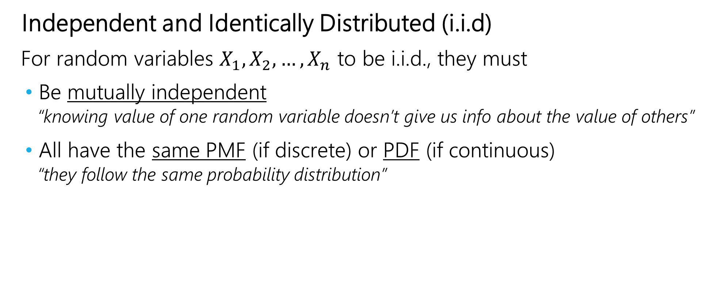
What does i.i.d mean?
Independent and Identically Distributed (i.i.d)
For random variables $X_{1}, X_{2},…, X_{n}$ to be i.i.d., they must
Be mutually independent
  “knowing value of one random variable doesn’t give us info about the value of others”
All have the same PMF (if discrete) or PDF (if continuous)
  “they follow the same probability distribution”

Slide 9
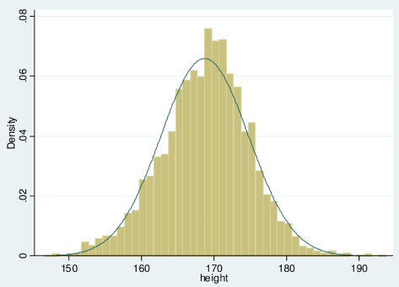
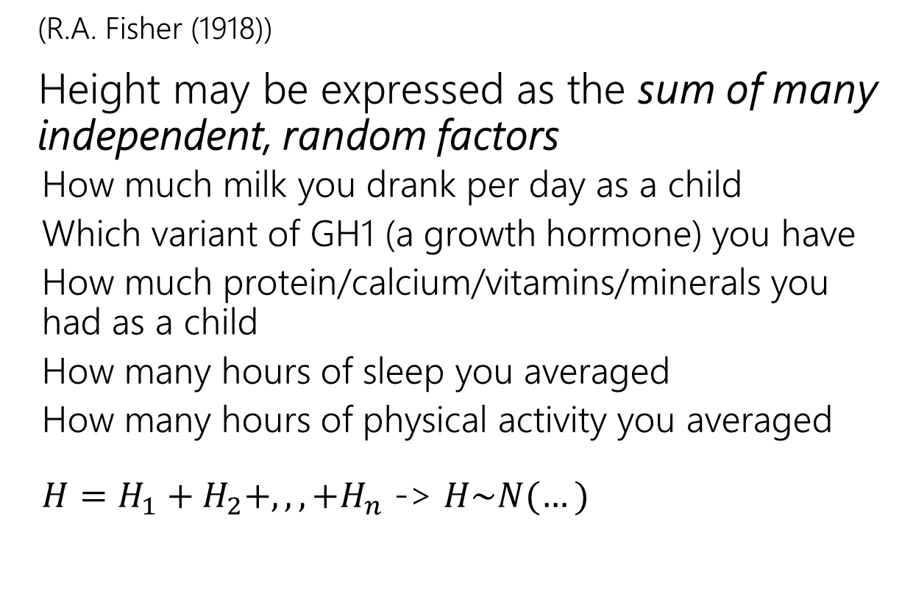
CLT with RVs that are NOT i.i.d
(R.A. Fisher (1918))
Height may be expressed as the sum of many independent, random factors
  How much milk you drank per day as a child
  Which variant of GH1 (a growth hormone) you have
  How much protein/calcium/vitamins/minerals you had as a child
  How many hours of sleep you averaged
  How many hours of physical activity you averaged
  $H=H_{1}+H_{2}+,,,+H_{n}$ -> $H\sim N(…)$
A version of CLT does work here! But it’s outside the scope of this class.

Slide 10
CLT with RVs that are i.i.d
“number of firing neurons” – sum of indicator random variables for whether each neuron fired
  Assume: each neuron is independent, and has the same probability
“number of people who voted for someone” – sum of indicator random variables for (assume people are independent)
  Assume: each person makes independent, and has the same probability
“total amount invested in a year” – sum of random variables four amount invested each day (assume each investment is independent)
  Assume: each day’s investment is independent and follows the same distribution
We will use CLT in this class on problems like this.

Slide 11
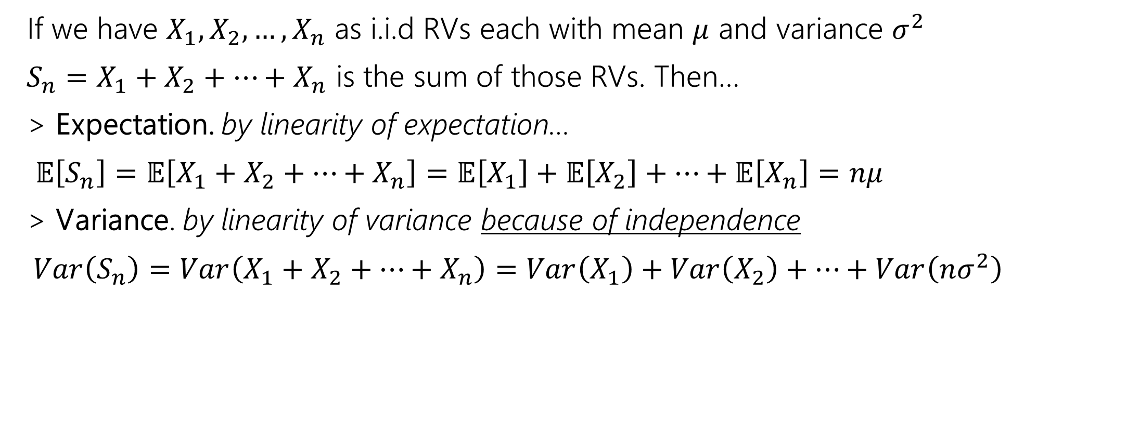
A Sum of i.i.d Random Variables
If we have $X_{1}, X_{2}, …, X_{n}$ as i.i.d RVs each with mean $μ$ and variance $σ^{2}$
$S_{n}=X_{1}+X_{2}+…+X_{n}$ is the sum of those RVs. Then…
> Expectation. by linearity of expectation…
$𝔼\left[S_{n}\right]=𝔼\left[X_{1}+X_{2}+…+X_{n}\right]=𝔼\left[X_{1}\right]+𝔼\left[X_{2}\right]+…+𝔼\left[X_{n}\right]=nμ$
> Variance. by linearity of variance because of independence
$Var\left(S_{n}\right)=Var\left(X_{1}+X_{2}+…+X_{n}\right)=Var\left(X_{1}\right)+Var\left(X_{2}\right)+…+Var\left(nσ^{2}\right)$

Slide 12

Proof of the CLT?
We’re not going to cover the proof here.
How is the proof done?
Step 1: Prove that for all positive integers $k,𝔼\left[{\left(Y_{n}\right)}^{k}\right]→𝔼[Z^{k}]$
Step 2: Prove that if $𝔼\left[{\left(Y_{n}\right)}^{k}\right]=𝔼\left[Z^{k}\right]$ for all $k$ then $F_{Y_{n}}\left(z\right)=F_{Z}(z)$

Slide 13
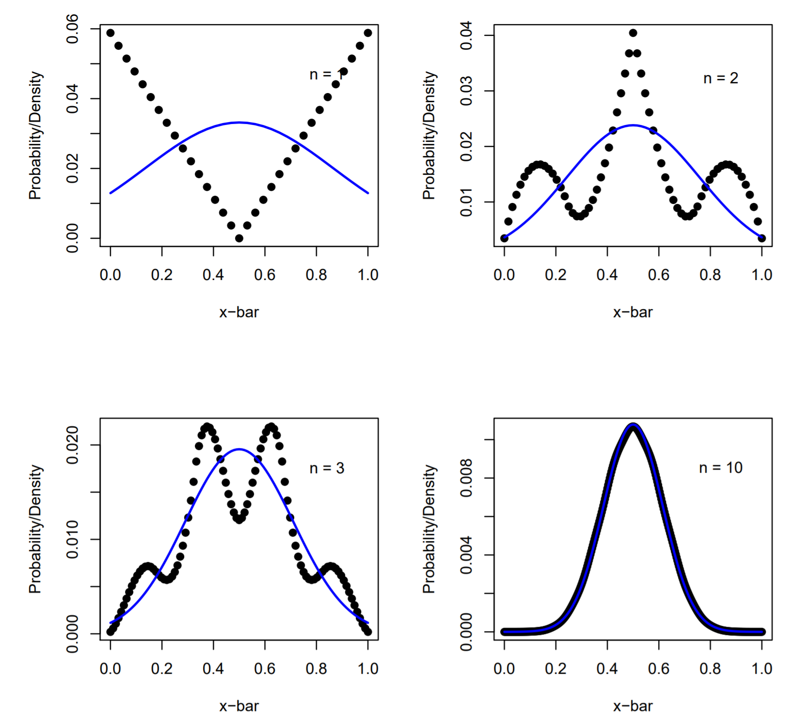




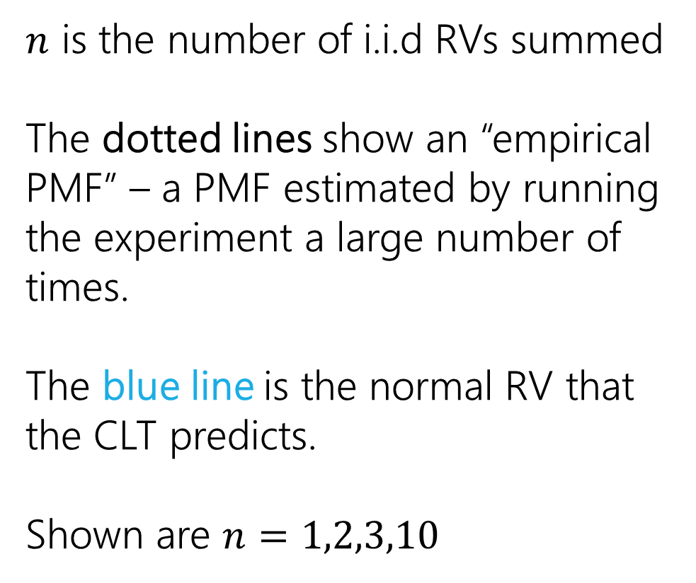

“Proof by example”
CLT says a sum of $n$ i.i.d RVs approaches a normal distribution as $n$ gets larger
$$n=1$$
$$n=2$$
$n$ is the number of i.i.d RVs summed
The dotted lines show an “empirical PMF” – a PMF estimated by running the experiment a large number of times.
The blue line is the normal RV that the CLT predicts.
Shown are $n=1,2,3,10$
$$n=3$$
$$n=10$$

Slide 14
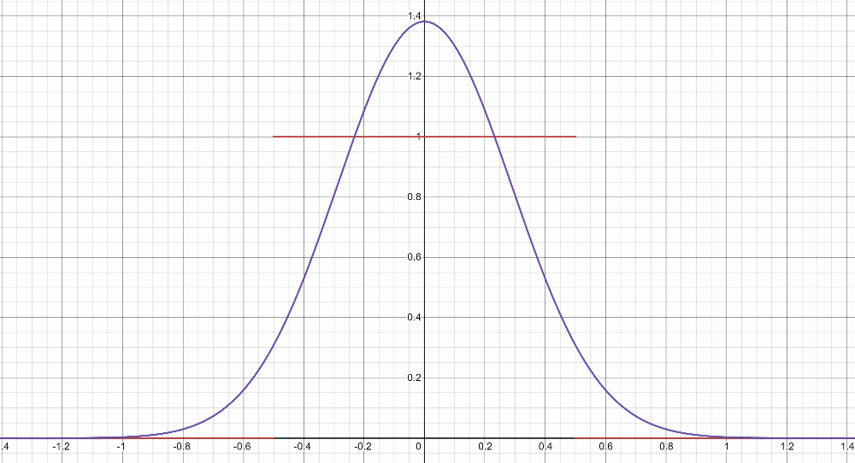
“Proof by example” -- uniform
https://www.desmos.com/calculator/2n2m05a9km

Slide 15
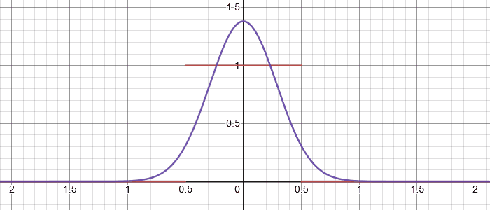
“Proof by example” -- uniform
$$X=X_{1}$$
where each $X_{i}\sim Unif(0,1)$ and is independent

Slide 16
“Proof by example” -- uniform
$$X=X_{1}$$
where each $X_{i}\sim Unif(0,1)$ and is independent

Slide 17
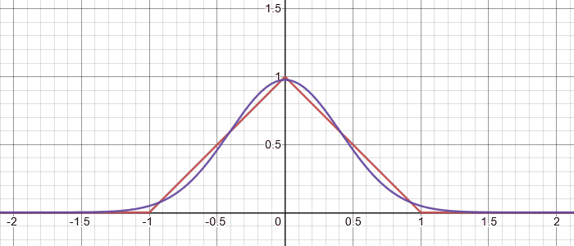
“Proof by example” -- uniform
$$X=X_{1}+X_{2}$$
where each $X_{i}\sim Unif(0,1)$ and is independent

Slide 18
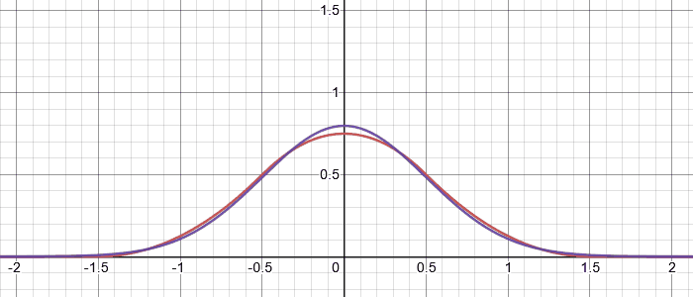
“Proof by example” -- uniform
$$X=X_{1}+X_{2}+X_{3}$$
where each $X_{i}\sim Unif(0,1)$ and is independent

Slide 19
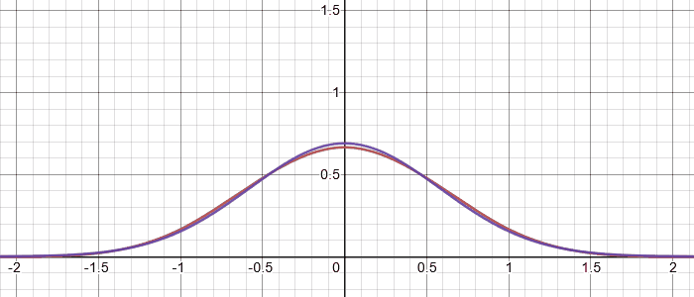
“Proof by example” -- uniform
$$X=X_{1}+X_{2}+X_{3}+X_{4}$$
where each $X_{i}\sim Unif(0,1)$ and is independent

Slide 20
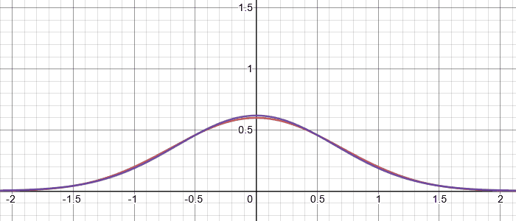
“Proof by example” -- uniform
$$X=X_{1}+X_{2}+X_{3}+X_{4}+X_{5}$$
where each $X_{i}\sim Unif(0,1)$ and is independent

Slide 21
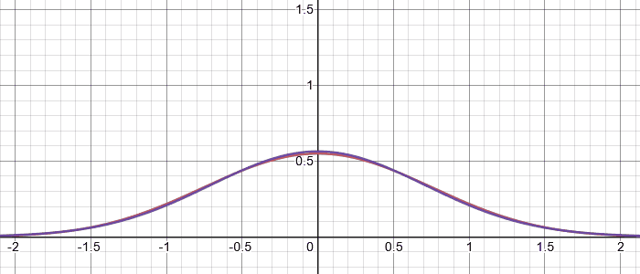
“Proof by example” -- uniform
$$X=X_{1}+X_{2}+X_{3}+X_{4}+X_{5}+X_{6}$$
where each $X_{i}\sim Unif(0,1)$ and is independent

Slide 22
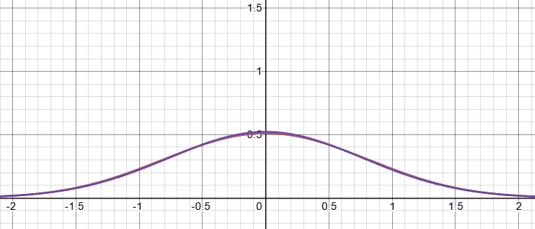
“Proof by example” -- uniform
$$X=X_{1}+X_{2}+X_{3}+X_{4}+X_{5}+X_{6}+X_{7}$$
where each $X_{i}\sim Unif(0,1)$ and is independent

Slide 23
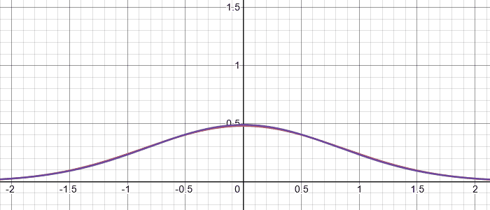
“Proof by example” -- uniform
$$X=X_{1}+X_{2}+X_{3}+X_{4}+X_{5}+X_{6}+X_{7}+X_{8}$$
where each $X_{i}\sim Unif(0,1)$ and is independent

Slide 24
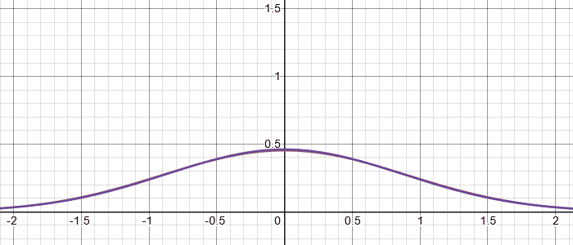
“Proof by example” -- uniform
$$X=X_{1}+X_{2}+X_{3}+X_{4}+X_{5}+X_{6}+X_{7}+X_{8}+X_{9}$$
where each $X_{i}\sim Unif(0,1)$ and is independent

Slide 25
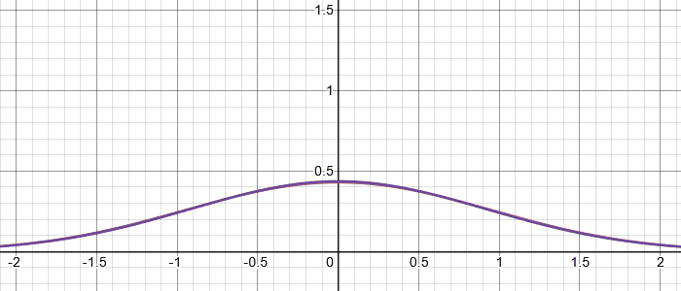
“Proof by example” -- uniform
$$X=X_{1}+X_{2}+X_{3}+X_{4}+X_{5}+X_{6}+X_{7}+X_{8}+X_{9}+X_{10}$$
where each $X_{i}\sim Unif(0,1)$ and is independent

Slide 26
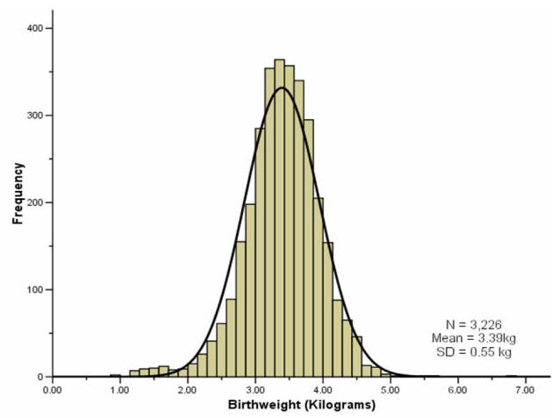
“Proof by real-world”
A lot of real-world bell-curves can be explained as:
1. The random variable comes from a combination of independent factors.
2. The CLT says the distribution will become like a bell curve.
birthweight

Slide 27
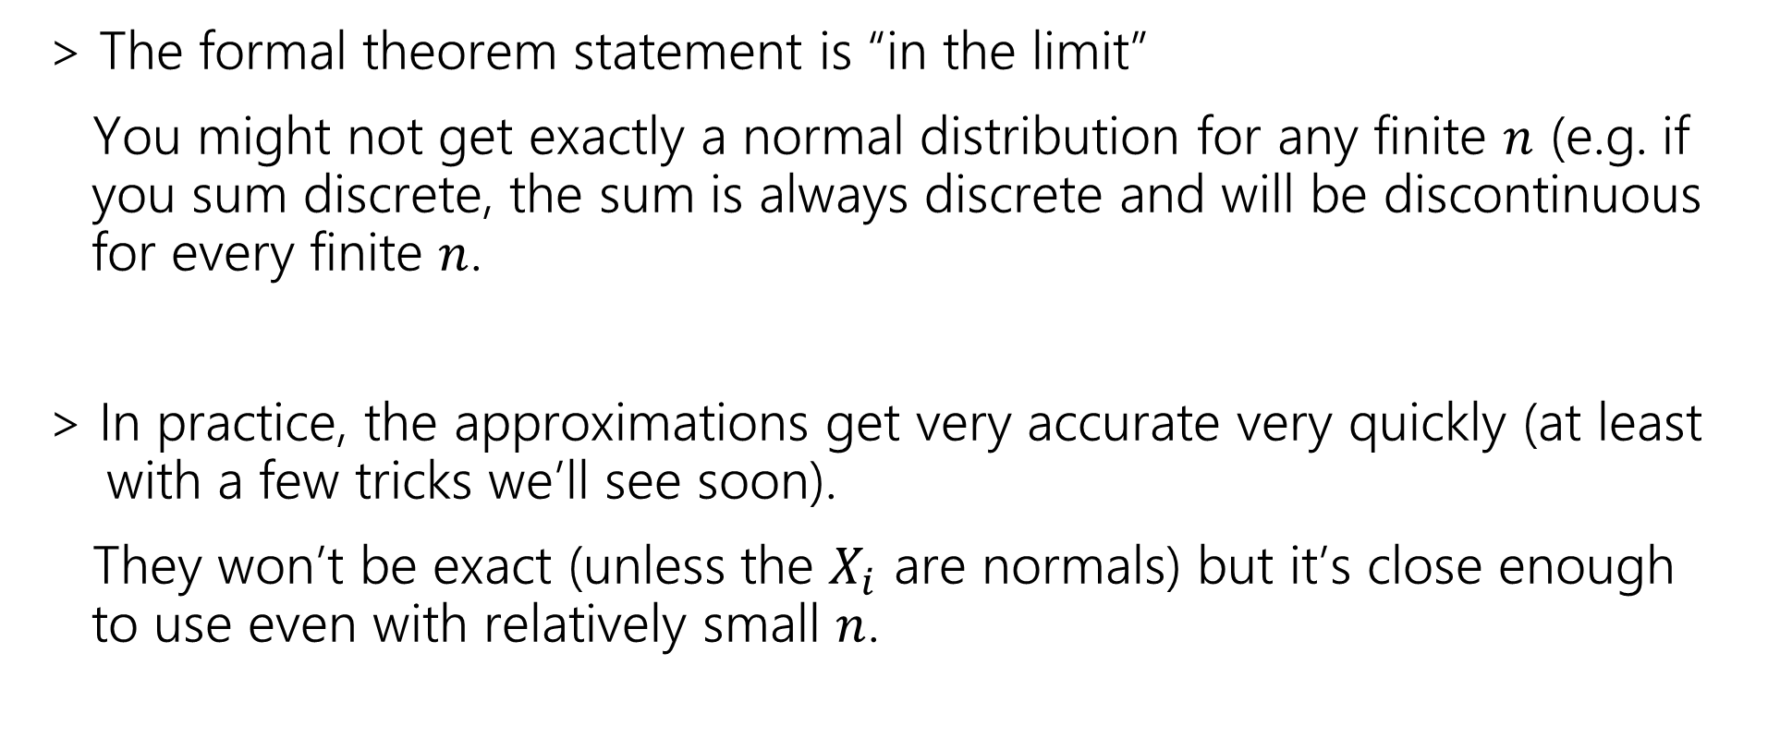
Theory vs. Practice
> The formal theorem statement is “in the limit”
You might not get exactly a normal distribution for any finite $n$ (e.g. if
you sum discrete, the sum is always discrete and will be discontinuous
for every finite $n$.
> In practice, the approximations get very accurate very quickly (at least
with a few tricks we’ll see soon).
They won’t be exact (unless the $X_{i}$ are normals) but it’s close enough
to use even with relatively small $n$.

Slide 28
Using the Central Limit Theorem
Let’s start with the case when we are using CLT to approximate a sum of continuous i.i.d random variables as normal

Slide 29
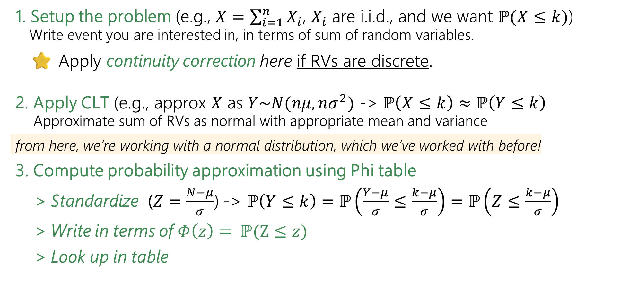
Outline of CLT steps
1. Setup the problem (e.g., $X=\sum_{i=1}^{n}{X_{i}}$, $X_{i}$ are i.i.d., and we want $ℙ(X≤k)$)
  Write event you are interested in, in terms of sum of random variables.
⭐ Apply continuity correction here if RVs are discrete.
2. Apply CLT (e.g., approx $X$ as $Y\sim N(nμ,nσ^{2})$ -> $ℙ\left(X≤k\right)≈ℙ\left(Y≤k\right)$
  Approximate sum of RVs as normal with appropriate mean and variance
from here, we’re working with a normal distribution, which we’ve worked with before!
3. Compute probability approximation using Phi table
> Standardize ($Z=\frac{N−μ}{σ}$) -> $ℙ\left(Y≤k\right)=ℙ\left(\frac{Y−μ}{σ}≤\frac{k−μ}{σ}\right)=ℙ\left(Z≤\frac{k−μ}{σ}\right)$
> Write in terms of $Φ\left(z\right)= ℙ(Z≤z)$
> Look up in table
⚠️we’re going to be adding one more step here when we talk about discrete RVs!⚠️

Slide 30
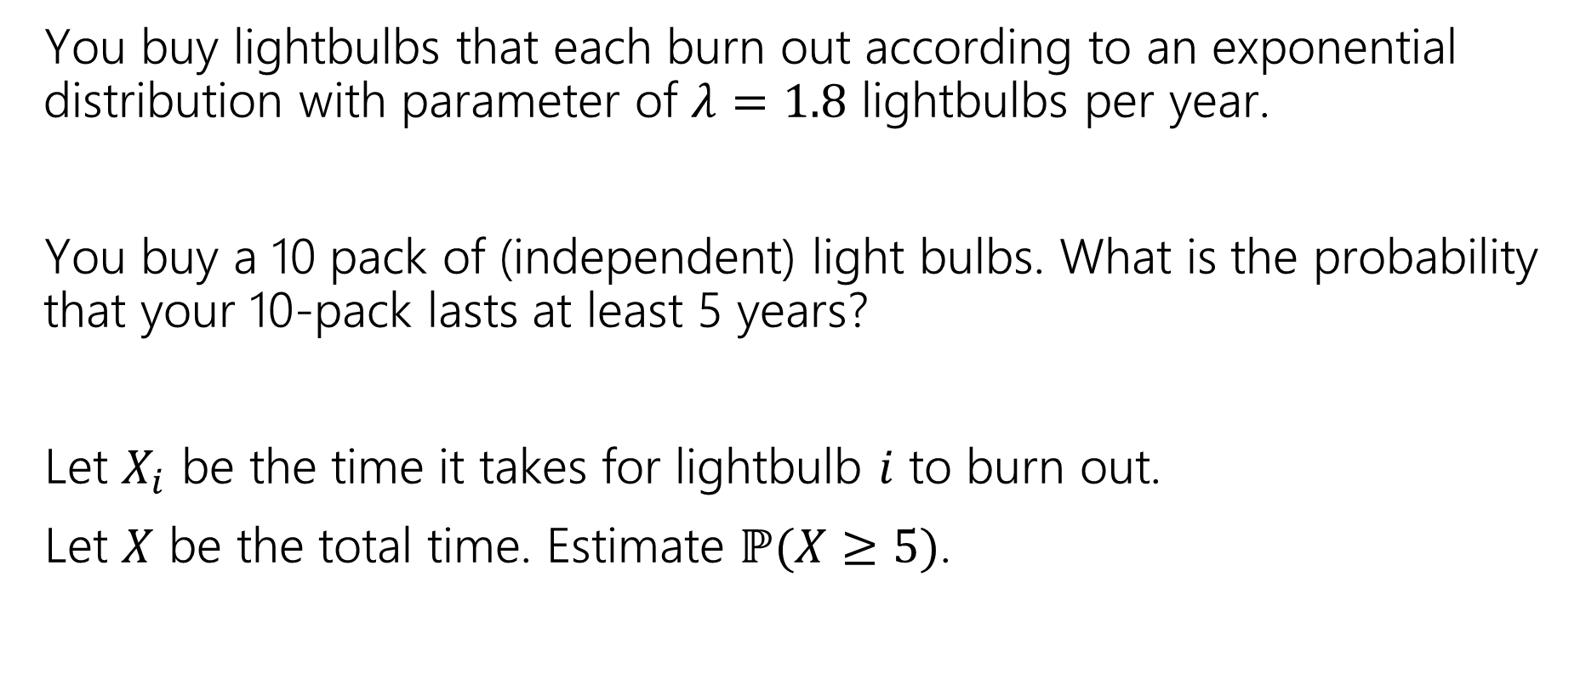
Lightbulbs💡
You buy lightbulbs that each burn out according to an exponential distribution with parameter of $λ=1.8$ lightbulbs per year.
You buy a 10 pack of (independent) light bulbs. What is the probability that your 10-pack lasts at least 5 years?
Let $X_{i}$ be the time it takes for lightbulb $i$ to burn out.
Let $X$ be the total time. Estimate $ℙ(X≥5)$.

Slide 31

Lightbulbs💡
You buy lightbulbs that each burn out according to distribution $Exp(1.8)$ lightbulbs per year. Estimate the probability your 10-pack (independent) lasts at least 5 years?
1. Setup the Problem:
2. Apply CLT.
3. Compute Probability.
Notes:
Let $X_{i}$ be the time it takes for lightbulb $i$ to burn out.
$X_{i}\sim Exp(1.8)$
$μ=𝔼\left[X_{i}\right]=\frac{1}{1.8}$
$σ^{2}=Var\left(X_{i}\right)=\frac{1}{{1.8}^{2}}$.
Let $X$ be the total time and $X=\sum_{i=1}^{10}{X_{i}}$.
We are interested in $ℙ(X≥5)$.
2. Apply CLT.
Because the $X_{i}$’s are i.d.d, we can apply CLT and $X$ can be approximated by $Y∼𝒩(10⋅\frac{1}{1.8}, 10⋅\frac{1}{{1.8}^{2}})$. $ℙ\left(X≥5\right)≈ℙ\left(Y≥5\right)$
3. Compute Probability.
$ℙ\left(Y≥5\right)=ℙ\left(Z≥\frac{5−10/1.8}{\sqrt{10}/1.8}\right)$ standardize
$≈ℙ\left(Z≥−0.32\right)=ℙ\left(Z≤0.32\right)$(symmetry)
$=Φ(0.32)$ $≈.62552$ plug into z-table

Slide 32
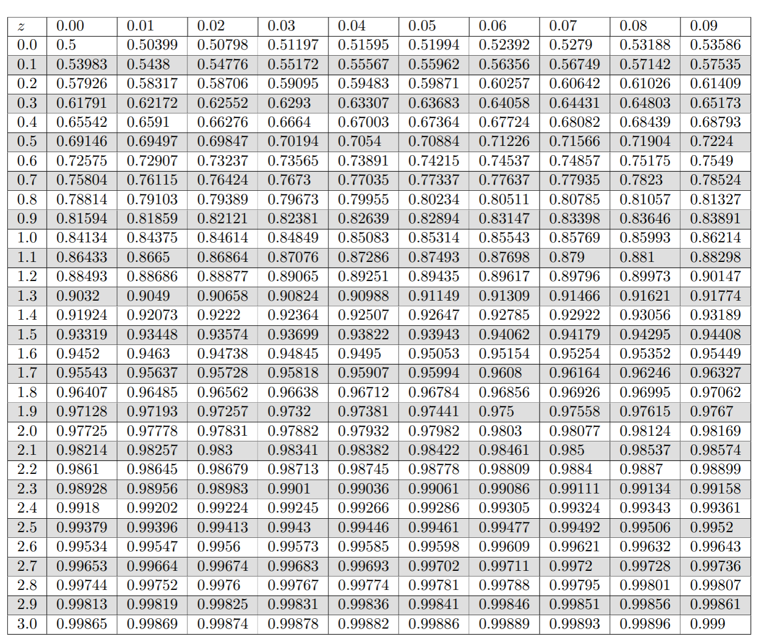

Slide 33
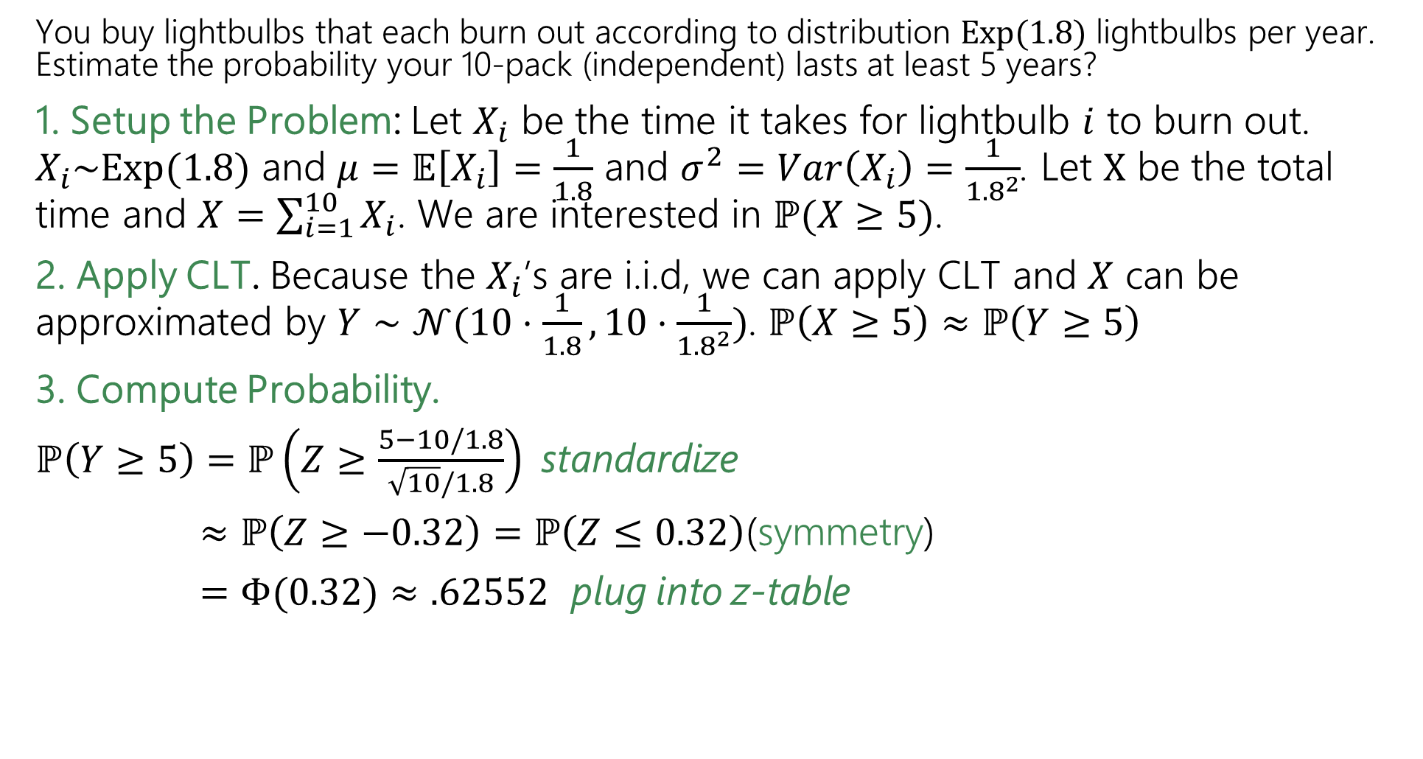
Lightbulbs💡
True value (uses a distribution not in our zoo) is $≈0.58741$
You buy lightbulbs that each burn out according to distribution $Exp(1.8)$ lightbulbs per year. Estimate the probability your 10-pack (independent) lasts at least 5 years?
1. Setup the Problem: Let $X_{i}$ be the time it takes for lightbulb $i$ to burn out. $X_{i}\sim Exp(1.8)$ and $μ=𝔼\left[X_{i}\right]=\frac{1}{1.8}$ and $σ^{2}=Var\left(X_{i}\right)=\frac{1}{{1.8}^{2}}$. Let $X$ be the total time and $X=\sum_{i=1}^{10}{X_{i}}$. We are interested in $ℙ(X≥5)$.
2. Apply CLT. Because the $X_{i}$’s are i.i.d, we can apply CLT and $X$ can be approximated by $Y∼𝒩(10⋅\frac{1}{1.8}, 10⋅\frac{1}{{1.8}^{2}})$. $ℙ\left(X≥5\right)≈ℙ\left(Y≥5\right)$
3. Compute Probability.
$ℙ\left(Y≥5\right)=ℙ\left(Z≥\frac{5−10/1.8}{\sqrt{10}/1.8}\right)$ standardize
$≈ℙ\left(Z≥−0.32\right)=ℙ\left(Z≤0.32\right)$(symmetry)
$=Φ(0.32)$ $≈.62552$ plug into z-table

Slide 34
Using the Central Limit Theorem
Now, let’s try the case when we are using CLT to approximate a sum of discrete i.i.d random variables as normal

Slide 35

Factory Widgets 🕰️
Suppose you are managing a factory, that produces widgets. Each widget produced is defective (independently) with probability $5\%$.
Your factory will produce 1000 (possibly defective) widgets. What is the probability of producing at most 940 non-defective widgets?
Notes:
Let $X\sim Bin(1000,.95)$
Our goal: $ℙ(X≤940)$

Slide 36

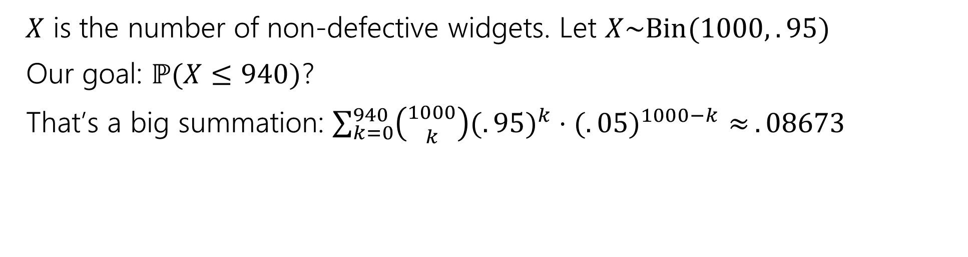
Factory Widgets 🕰️- Exact Answer
Suppose you are managing a factory, that produces widgets. Each widget produced is defective (independently) with probability $5\%$.
Your factory will produce 1000 (possibly defective) widgets. What is the probability of producing at most 940 non-defective widgets?
$X$ is the number of non-defective widgets. Let $X\sim Bin(1000,.95)$
Our goal: $ℙ(X≤940)$?
That’s a big summation: $\sum_{k=0}^{940}{\left({1000 \atop k}\right)(.{95)}^{k}⋅(.{05)}^{1000−k}≈}.08673$

Slide 37
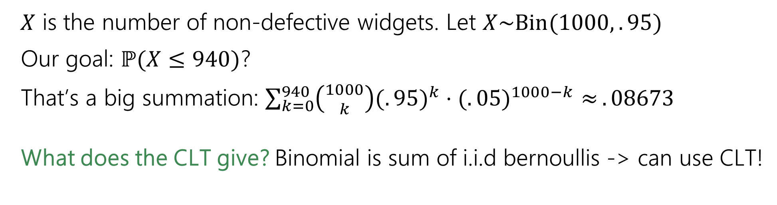
Factory Widgets 🕰️- Exact Answer
Suppose you are managing a factory, that produces widgets. Each widget produced is defective (independently) with probability $5\%$.
Your factory will produce 1000 (possibly defective) widgets. What is the probability of producing at most 940 non-defective widgets?
$X$ is the number of non-defective widgets. Let $X\sim Bin(1000,.95)$
Our goal: $ℙ(X≤940)$?
That’s a big summation: $\sum_{k=0}^{940}{\left({1000 \atop k}\right)(.{95)}^{k}⋅(.{05)}^{1000−k}≈}.08673$
What does the CLT give? Binomial is sum of i.i.d bernoullis -> can use CLT!

Slide 38


Factory Widgets 🕰️- CLT
Suppose you are managing a factory, that produces widgets. Each widget produced is defective (independently) with probability $5\%$.
Your factory will produce 1000 (possibly defective) widgets. What is the probability of producing at most 940 non-defective widgets?
1. Setup the Problem:
2. Apply CLT.
3. Compute Probability.
Notes:
$X$ is the number of non-defective widgets.
$X=\sum_{i=1}^{1000}{X_{i}}$ where $X_{i}$ is 1 if the i’th widget is non-defective.
Goal: $ℙ(X≤940)$
2. Apply CLT. $X$ is sum of i.i.d RVs each with $μ=𝔼\left[X_{i}\right]=p=.95$ and $Var\left(X_{i}\right)=p\left(1−p\right)=.0475$
We can approximate $X$ with $Y\sim 𝒩(1000⋅0.95, 1000⋅0.0475)$.
So, $ℙ\left(X≤940\right)≈ℙ(Y≤940)$
3. Compute Probability.
$ℙ\left(Y≤940\right)=ℙ\left(Z≤\frac{940−1000⋅0.95}{\sqrt{1000⋅0.0475}}\right)$ standardize
$≈Φ\left(−1.45\right)=1−Φ(1.45)$ write in terms of $Φ$
$≈1−.92647=.07353$. plug into z-table

Slide 39

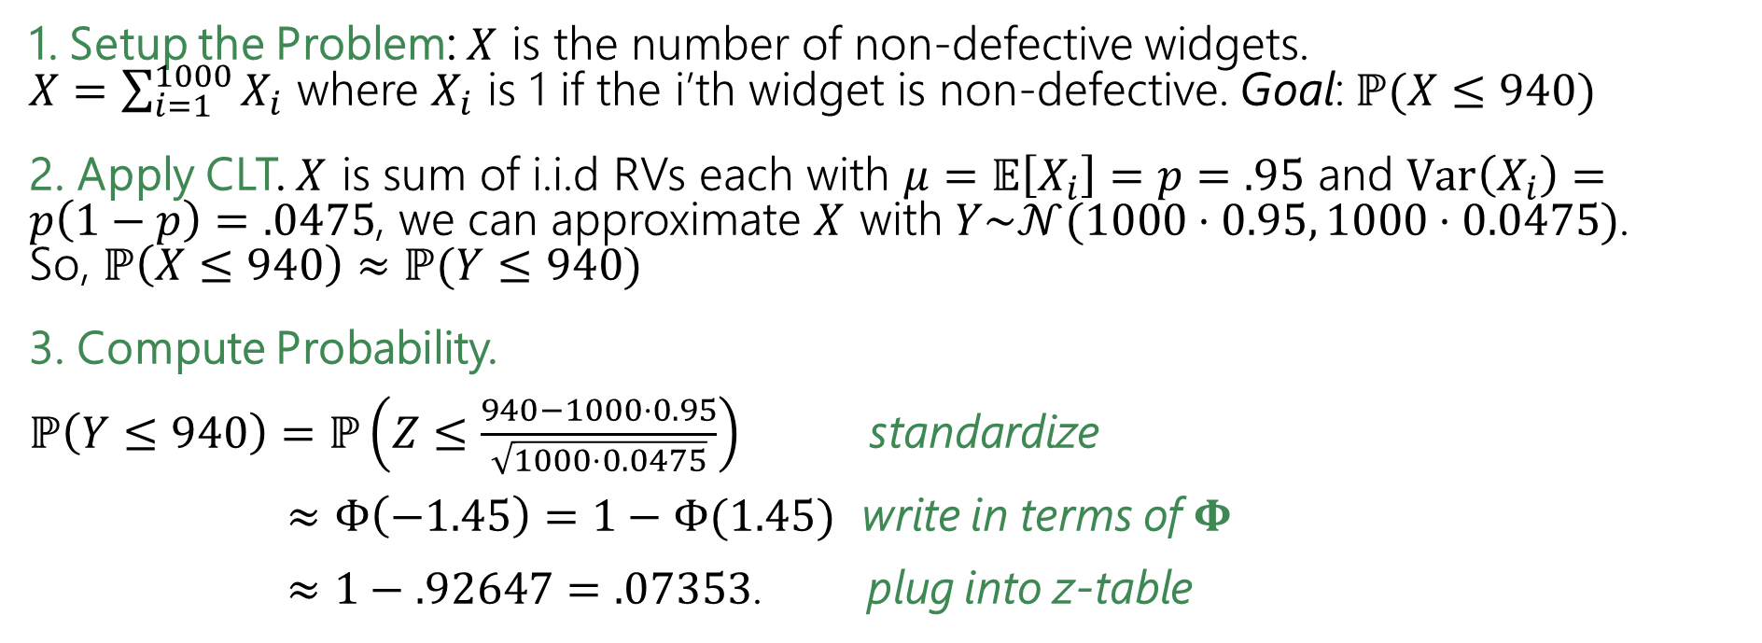
Factory Widgets 🕰️- CLT
Suppose you are managing a factory, that produces widgets. Each widget produced is defective (independently) with probability $5\%$.
Your factory will produce 1000 (possibly defective) widgets. What is the probability of producing at most 940 non-defective widgets?
1. Setup the Problem: $X$ is the number of non-defective widgets.
$X=\sum_{i=1}^{1000}{X_{i}}$ where $X_{i}$ is 1 if the i’th widget is non-defective. Goal: $ℙ(X≤940)$
2. Apply CLT. $X$ is sum of i.i.d RVs each with $μ=𝔼\left[X_{i}\right]=p=.95$ and $Var\left(X_{i}\right)=p\left(1−p\right)=.0475$, we can approximate $X$ with $Y\sim 𝒩(1000⋅0.95, 1000⋅0.0475)$.
So, $ℙ\left(X≤940\right)≈ℙ(Y≤940)$
3. Compute Probability.
$ℙ\left(Y≤940\right)=ℙ\left(Z≤\frac{940−1000⋅0.95}{\sqrt{1000⋅0.0475}}\right)$ standardize
$≈Φ\left(−1.45\right)=1−Φ(1.45)$ write in terms of $Φ$
$≈1−.92647=.07353$. plug into z-table

Slide 40

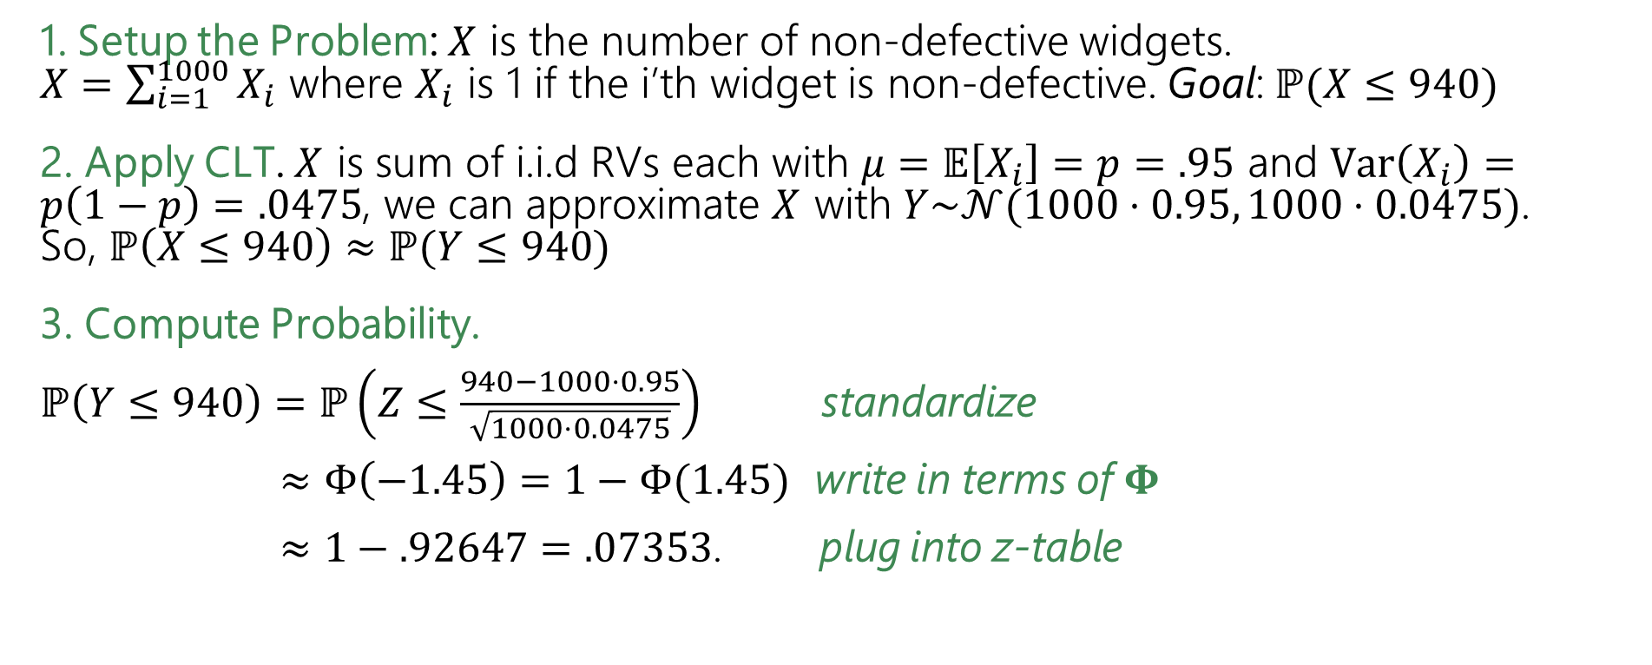
Factory Widgets 🕰️- CLT
Suppose you are managing a factory, that produces widgets. Each widget produced is defective (independently) with probability $5\%$.
Your factory will produce 1000 (possibly defective) widgets. What is the probability of producing at most 940 non-defective widgets?
1. Setup the Problem: $X$ is the number of non-defective widgets.
$X=\sum_{i=1}^{1000}{X_{i}}$ where $X_{i}$ is 1 if the i’th widget is non-defective. Goal: $ℙ(X≤940)$
2. Apply CLT. $X$ is sum of i.i.d RVs each with $μ=𝔼\left[X_{i}\right]=p=.95$ and $Var\left(X_{i}\right)=p\left(1−p\right)=.0475$, we can approximate $X$ with $Y\sim 𝒩(1000⋅0.95, 1000⋅0.0475)$.
So, $ℙ\left(X≤940\right)≈ℙ(Y≤940)$
3. Compute Probability.
$ℙ\left(Y≤940\right)=ℙ\left(Z≤\frac{940−1000⋅0.95}{\sqrt{1000⋅0.0475}}\right)$ standardize
$≈Φ\left(−1.45\right)=1−Φ(1.45)$ write in terms of $Φ$
$≈1−.92647=.07353$. plug into z-table
The exact probability is $.08673$. We’re off by ~$1.3\%$!

Slide 41
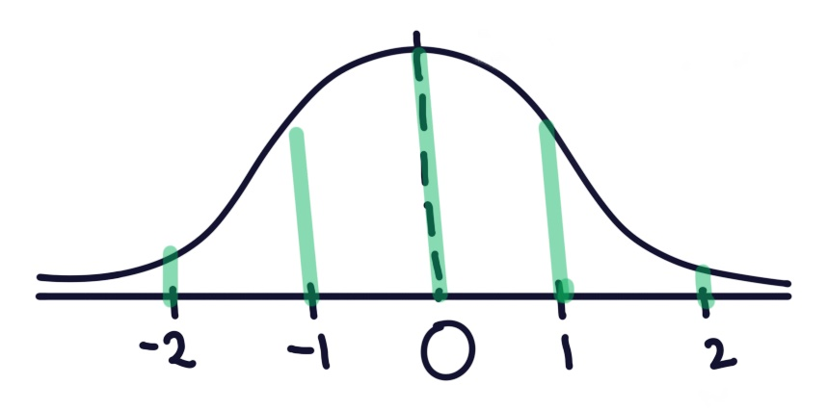
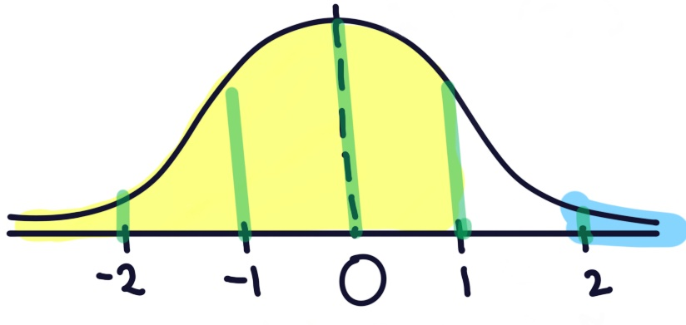
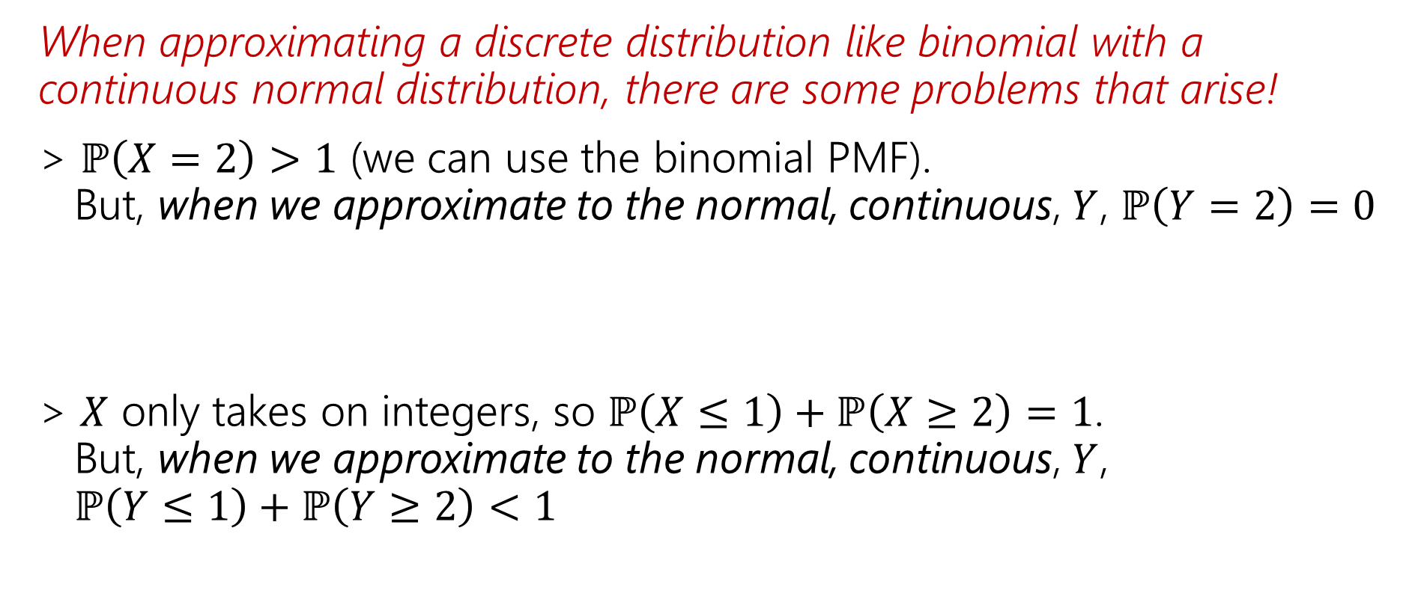
There’s are some problems ☹
When approximating a discrete distribution like binomial with a continuous normal distribution, there are some problems that arise!
> $ℙ\left(X=2\right)>1$ (we can use the binomial PMF).
But, when we approximate to the normal, continuous, $Y$, $ℙ\left(Y=2\right)=0$
> $X$ only takes on integers, so $ℙ\left(X≤1\right)+ℙ\left(X≥2\right)=1$.
But, when we approximate to the normal, continuous, $Y$,
$ℙ\left(Y≤1\right)+ℙ\left(Y≥2\right)<1$

Slide 42
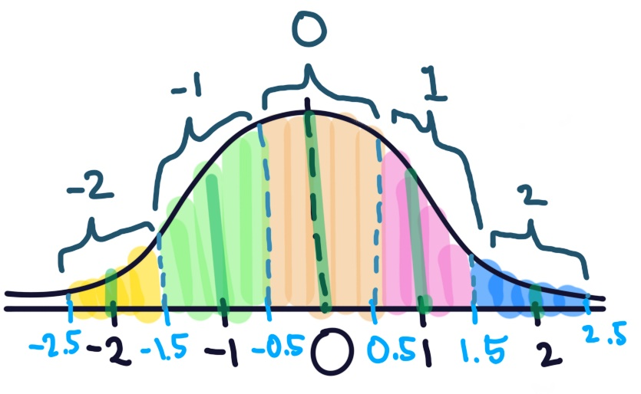

Continuity Correction
The binomial distribution is discrete, but the normal is continuous.
Let’s correct for that (called a “continuity correction”)
⭐ Assign each value in the discrete range to a continuous interval
Here the support of $X$ is $\{…,−2, −1, 0, 1, 2,…\}$

Slide 43
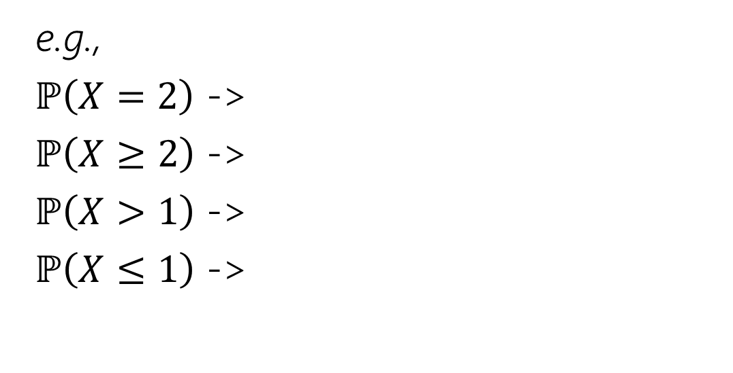
Continuity Correction
The binomial distribution is discrete, but the normal is continuous.
Let’s correct for that (called a “continuity correction”)
⭐ Assign each value in the discrete range to a continuous interval
Here the support of $X$ is $\{…,−2, −1, 0, 1, 2,…\}$
e.g.,
$ℙ\left(X=2\right)$ ->
$ℙ\left(X≥2\right)$ ->
$ℙ\left(X>1\right)$ ->
$ℙ\left(X≤1\right)$ ->

Slide 44

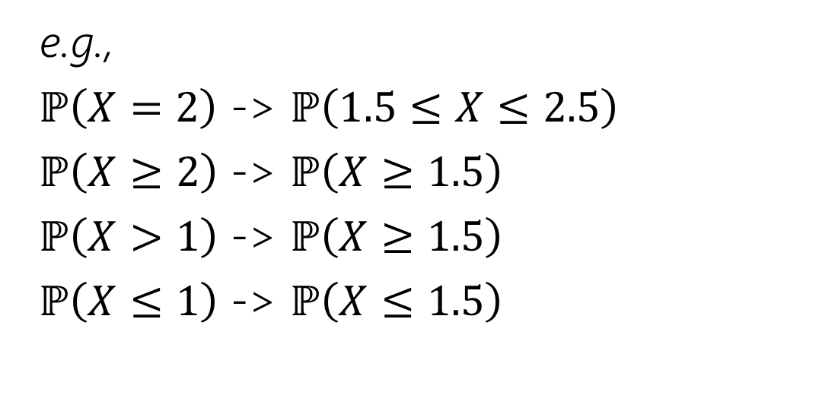
Continuity Correction
The binomial distribution is discrete, but the normal is continuous.
Let’s correct for that (called a “continuity correction”)
⭐ Assign each value in the discrete range to a continuous interval
Here the support of $X$ is $\{…,−2, −1, 0, 1, 2,…\}$
e.g.,
$ℙ\left(X=2\right)$ -> $ℙ\left(1.5≤X≤2.5\right)$
$ℙ\left(X≥2\right)$ -> $ℙ\left(X≥1.5\right)$
$ℙ\left(X>1\right)$ -> $ℙ\left(X≥1.5\right)$
$ℙ\left(X≤1\right)$ -> $ℙ\left(X≤1.5\right)$

Slide 45
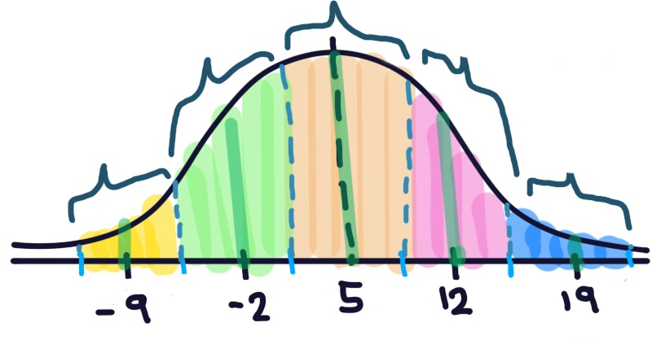

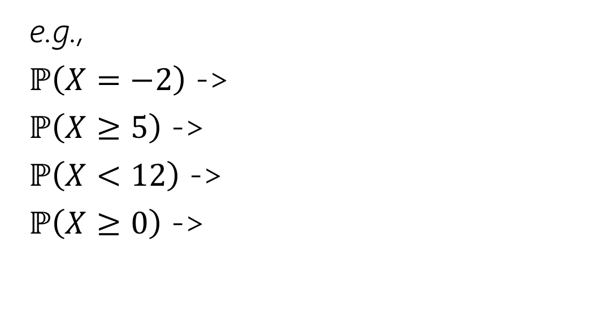
Continuity Correction
The binomial distribution is discrete, but the normal is continuous.
Let’s correct for that (called a “continuity correction”)
⭐ Assign each value in the discrete range to a continuous interval
Here the support of $X$ is $\{…,−2, 5, 12, 19…\}$
e.g.,
$ℙ\left(X=−2\right)$ ->
$ℙ\left(X≥5\right)$ ->
$ℙ\left(X<12\right)$ ->
$ℙ\left(X≥0\right)$ ->
Fill out the poll everywhere: pollev.com/jolie312

Slide 46
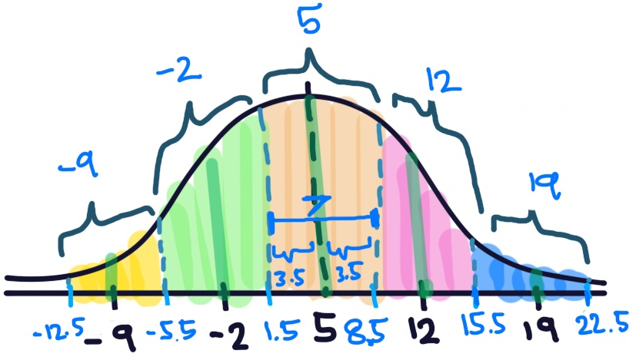
Continuity Correction
The binomial distribution is discrete, but the normal is continuous.
Let’s correct for that (called a “continuity correction”)
⭐ Assign each value in the discrete range to a continuous interval
Here the support of $X$ is $\{…,−2, 5, 12, 19…\}$
e.g.,
$ℙ\left(X=−2\right)$ ->
$ℙ\left(X≥5\right)$ ->
$ℙ\left(X<12\right)$ ->
$ℙ\left(X≥0\right)$ ->

Slide 47
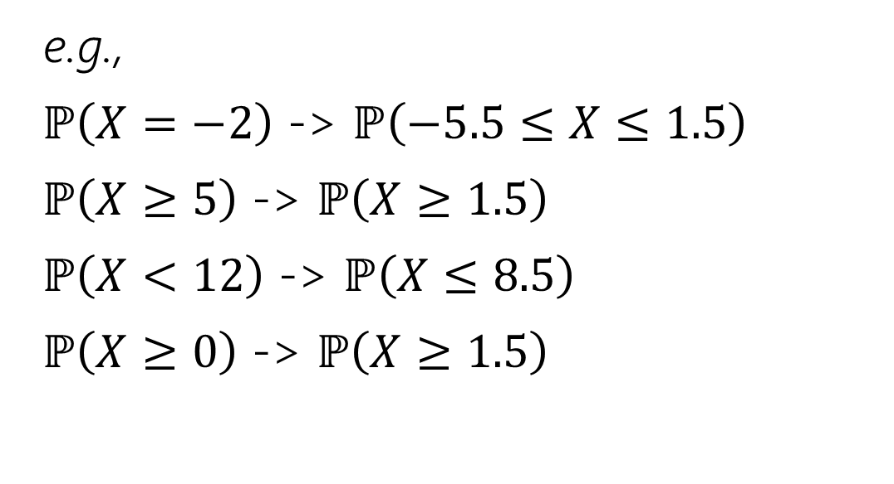
Continuity Correction
The binomial distribution is discrete, but the normal is continuous.
Let’s correct for that (called a “continuity correction”)
⭐ Assign each value in the discrete range to a continuous interval
Here the support of $X$ is $\{…,−2, 5, 12, 19…\}$
e.g.,
$ℙ\left(X=−2\right)$ -> $ℙ\left(−5.5≤X≤1.5\right)$
$ℙ\left(X≥5\right)$ -> $ℙ\left(X≥1.5\right)$
$ℙ\left(X<12\right)$ -> $ℙ\left(X≤8.5\right)$
$ℙ\left(X≥0\right)$ -> $ℙ\left(X≥1.5\right)$

Slide 48

Outline of CLT steps
1. Setup the problem (e.g., $X=\sum_{i=1}^{n}{X_{i}}$, $X_{i}$ are i.i.d., and we want $ℙ(X≤k)$)
  Write event you are interested in, in terms of sum of random variables.
⭐ Apply continuity correction here if RVs are discrete.
2. Apply CLT (e.g., approx $X$ as $Y\sim N(nμ,nσ^{2})$ -> $ℙ\left(X≤k\right)≈ℙ\left(Y≤k\right)$
  Approximate sum of RVs as normal with appropriate mean and variance
from here, we’re working with a normal distribution, which we’ve worked with before!
3. Compute probability approximation using Phi table
> Standardize ($Z=\frac{N−μ}{σ}$) -> $ℙ\left(Y≤k\right)=ℙ\left(\frac{Y−μ}{σ}≤\frac{k−μ}{σ}\right)=ℙ\left(Z≤\frac{k−μ}{σ}\right)$
> Write in terms of $Φ\left(z\right)= ℙ(Z≤z)$
> Look up in table

Slide 49
Factory Widgets 🕰️- CLT
Where to apply continuity correction?
Suppose you are managing a factory, that produces widgets. Each widget produced is defective (independently) with probability $5\%$.
Your factory will produce 1000 (possibly defective) widgets. What is the probability of producing at most 940 non-defective widgets?
1. Setup the Problem: $X$ is the number of non-defective widgets.
$X=\sum_{i=1}^{1000}{X_{i}}$ where $X_{i}$ is 1 if the i’th widget is non-defective. Goal: $ℙ(X≤940)$
2. Apply CLT. $X$ is sum of i.i.d RVs each with $μ=𝔼\left[X_{i}\right]=p=.95$ and $Var\left(X_{i}\right)=p\left(1−p\right)=.0475$, we can approximate $X$ with $Y\sim 𝒩(1000⋅0.95, 1000⋅0.0475)$.
So, $ℙ\left(X≤940\right)≈ℙ(Y≤940)$
3. Compute Probability.
$ℙ\left(Y≤940\right)=ℙ\left(Z≤\frac{940−1000⋅0.95}{\sqrt{1000⋅0.0475}}\right)$ standardize
$≈Φ\left(−1.45\right)=1−Φ(1.45)$ write in terms of $Φ$
$≈1−.92647=.07353$. plug into z-table

Slide 50



Factory Widgets 🕰️- CLT with continuity correction
Suppose you are managing a factory, that produces widgets. Each widget produced is defective (independently) with probability $5\%$. Your factory will produce 1000 (possibly defective) widgets. What is the probability of producing at most 940 non-defective widgets?
1. Setup the Problem: $X$ is the number of non-defective widgets.
$X=\sum_{i=1}^{1000}{X_{i}}$ where $X_{i}$ is 1 if the i’th widget is non-defective. We want to find $ℙ(X≤940)$.
Because $X$ is discrete, we use continuity correction: $ℙ\left(X≤940\right)=ℙ(X≤940.5)$
2. Apply CLT. $X$ is sum of i.i.d RVs each with $μ=𝔼\left[X_{i}\right]=p=.95$ and $Var\left(X_{i}\right)=p\left(1−p\right)=.0475$, we can approximate $X$ with $Y\sim 𝒩(1000⋅0.95, 1000⋅0.0475)$.
So, $ℙ\left(X≤940.5\right)≈ℙ(Y≤940.5)$
3. Compute Probability.
$ℙ\left(Y≤940.5\right)=ℙ\left(Z≤\frac{940.5−1000⋅0.95}{\sqrt{1000⋅0.0475}}\right)$ standardize
$≈Φ\left(−1.38\right)=1−Φ(1.38)$ write in terms of $Φ$
$≈1−.91621=.08379$. plug into z-table
The exact probability is $.08673$. Still an approximation, but very close now! :D

Slide 51

What if we are asked something like…
> How people need to be surveyed to draw __ conclusion about [something to do with a sum of i.i.d RVs’ with __ probability?
> How many trials should we do till the average amount from the trails [sum of i.i.d RVs] is __ away from the mean with __ probability?
> What should the standard deviation be in order for the probability of [something to do with a sum of i.id. RVs] to be ___?
We will follow the exact same process as before for using CLT! Except now, we’ll end up with something like $ℙ\left(Y≤c\right)=0.96$ where we need to solve for $c$

Slide 52

Cereal
A cereal company claims that their boxes contain an average of 500 grams of cereal with a variance of 100 grams. To test this claim, you take a random sample of $n$ boxes. You want to determine the sample size $n$ such that the probability of the sample mean being within 2 grams of the true mean (i.e., between 498 grams and 502 grams) is at least 95%.
1. Setup the Problem.
2. Apply CLT
3. Compute Probability
Notes:
Let $X_{i}$ be the weight of the $i$th box weighed. The sample mean is $\overline{X}=\frac{1}{n}\sum_{i=1}^{n}{X_{i}}=$ $\sum_{j=1}^{n}{ }$
Goal: $ℙ\left(498≤\overline{X}≤502\right)≥0.95$

Slide 53


Cereal
A cereal company claims that their boxes contain an average of 500 grams of cereal with a variance of 100 grams. To test this claim, you take a random sample of $n$ boxes. You want to determine the sample size $n$ such that the probability of the sample mean being within 2 grams of the true mean (i.e., between 498 grams and 502 grams) is at least 95%.
1. Setup the Problem.
Let $X_{i}$ be the weight of the $i$th box weighed. The sample mean is $\overline{X}=\frac{1}{n}\sum_{i=1}^{n}{X_{i}}=$ $\sum_{i=1}^{n}{ }$
Goal: $ℙ\left(498≤\overline{X}≤502\right)≥0.95$
2. Apply CLT
3. Compute Probability
($\frac{X_{i}}{n})$

Slide 54

Cereal
A cereal company claims that their boxes contain an average of 500 grams of cereal with a variance of 100 grams. To test this claim, you take a random sample of $n$ boxes. You want to determine the sample size $n$ such that the probability of the sample mean being within 2 grams of the true mean (i.e., between 498 grams and 502 grams) is at least 95%.
1. Setup the Problem.
Let $X_{i}$ be the weight of the $i$th box weighed. The sample mean is $\overline{X}=\frac{1}{n}\sum_{i=1}^{n}{X_{i}}=$ $\sum_{i=1}^{n}{ }$
Goal: $ℙ\left(498≤\overline{X}≤502\right)≥0.95$
2. Apply CLT
$\overline{X}$ is a sum of i.i.d random variables each with $μ=E\left[\frac{X_{i}}{n}\right]=\frac{500}{n}$ and $σ^{2}=Var\left(\frac{X_{i}}{n}\right)=\frac{100}{n^{2}}$
Let $Y\sim 𝒩\left(n⋅\frac{500}{n}, n⋅\frac{100}{n^{2}}\right)=𝒩\left(500,\frac{100}{n}\right)$→ By CLT, $ℙ\left(498≤\overline{X}≤502\right)≈ℙ(498≤Y≤502)$
3. Compute Probability
($\frac{X_{i}}{n})$

Slide 55

Cereal
A cereal company claims that their boxes contain an average of 500 grams of cereal with a variance of 100 grams. To test this claim, you take a random sample of $n$ boxes. You want to determine the sample size $n$ such that the probability of the sample mean being within 2 grams of the true mean (i.e., between 498 grams and 502 grams) is at least 95%.
1. Setup the Problem.
Let $X_{i}$ be the weight of the $i$th box weighed. The sample mean is $\overline{X}=\frac{1}{n}\sum_{i=1}^{n}{X_{i}}=$ $\sum_{j=1}^{n}{ }$
Goal: $ℙ\left(498≤\overline{X}≤502\right)≥0.95$
2. Apply CLT
$\overline{X}$ is a sum of i.i.d random variables each with $μ=E\left[\frac{X_{i}}{n}\right]=\frac{500}{n}$ and $σ^{2}=Var\left(\frac{X_{i}}{n}\right)=\frac{100}{n^{2}}$
Let $Y\sim 𝒩\left(n⋅\frac{500}{n}, n⋅\frac{100}{n^{2}}\right)=𝒩\left(500,\frac{100}{n}\right)$→ By CLT, $ℙ\left(498≤\overline{X}≤502\right)≈ℙ(498≤Y≤502)$
3. Compute Probability
$ℙ\left(498≤Y≤502\right)=ℙ\left(\frac{498−500}{\sqrt{100/n}}≤Z≤\frac{502−500}{\sqrt{100/n}}\right)=ℙ\left(\frac{−2}{10/\sqrt{n}}≤Z≤\frac{2}{10/\sqrt{n}}\right)$ standardize
($\frac{X_{i}}{n})$

Slide 56

Cereal
A cereal company claims that their boxes contain an average of 500 grams of cereal with a variance of 100 grams. To test this claim, you take a random sample of $n$ boxes. You want to determine the sample size $n$ such that the probability of the sample mean being within 2 grams of the true mean (i.e., between 498 grams and 502 grams) is at least 95%.
…
Let $Y\sim 𝒩\left(n⋅\frac{500}{n}, n⋅\frac{100}{n^{2}}\right)=𝒩\left(500,\frac{100}{n}\right)$→ By CLT, $ℙ\left(498≤\overline{X}≤502\right)≈ℙ(498≤Y≤502)$
3. Compute Probability
$ℙ\left(498≤Y≤502\right)=ℙ\left(\frac{498−500}{\sqrt{100/n}}≤Z≤\frac{502−500}{\sqrt{100/n}}\right)=ℙ\left(\frac{−2}{10/\sqrt{n}}≤Z≤\frac{2}{10/\sqrt{n}}\right)$ standardize

Slide 57

Cereal
A cereal company claims that their boxes contain an average of 500 grams of cereal with a variance of 100 grams. To test this claim, you take a random sample of $n$ boxes. You want to determine the sample size $n$ such that the probability of the sample mean being within 2 grams of the true mean (i.e., between 498 grams and 502 grams) is at least 95%.
…
Let $Y\sim 𝒩\left(n⋅\frac{500}{n}, n⋅\frac{100}{n^{2}}\right)=𝒩\left(500,\frac{100}{n}\right)$→ By CLT, $ℙ\left(498≤\overline{X}≤502\right)≈ℙ(498≤Y≤502)$
3. Compute Probability
$ℙ\left(498≤Y≤502\right)=ℙ\left(\frac{498−500}{\sqrt{100/n}}≤Z≤\frac{502−500}{\sqrt{100/n}}\right)=ℙ\left(\frac{−2}{10/\sqrt{n}}≤Z≤\frac{2}{10/\sqrt{n}}\right)$ standardize
$=Φ(\frac{2}{10/\sqrt{n}})−(1−Φ(\frac{2}{10/\sqrt{n}}))=2Φ(\frac{2}{10/\sqrt{n}})−1$ write in terms of $Φ$
$≥0.95$

Slide 58

Cereal
A cereal company claims that their boxes contain an average of 500 grams of cereal with a variance of 100 grams. To test this claim, you take a random sample of $n$ boxes. You want to determine the sample size $n$ such that the probability of the sample mean being within 2 grams of the true mean (i.e., between 498 grams and 502 grams) is at least 95%.
…
Let $Y\sim 𝒩\left(n⋅\frac{500}{n}, n⋅\frac{100}{n^{2}}\right)=𝒩\left(500,\frac{100}{n}\right)$→ By CLT, $ℙ\left(498≤\overline{X}≤502\right)≈ℙ(498≤Y≤502)$
3. Compute Probability
$ℙ\left(498≤Y≤502\right)=ℙ\left(\frac{498−500}{\sqrt{100/n}}≤Z≤\frac{502−500}{\sqrt{100/n}}\right)=ℙ\left(\frac{−2}{10/\sqrt{n}}≤Z≤\frac{2}{10/\sqrt{n}}\right)$ standardize
$=Φ(\frac{2}{10/\sqrt{n}})−(1−Φ(\frac{2}{10/\sqrt{n}}))=2Φ(\frac{2}{10/\sqrt{n}})−1$ write in terms of $Φ$
$≥0.95$
Doing some algebra…
$2Φ(\frac{2}{10/\sqrt{n}})−1$ $≥0.95$ with some algebra, we get $Φ(\frac{2}{10/\sqrt{n}})$ $≥0.975$
reverse table lookup: what can we plug into the z-table to get $Φ(z)≥0.975$?

Slide 60

Cereal
A cereal company claims that their boxes contain an average of 500 grams of cereal with a variance of 100 grams. To test this claim, you take a random sample of $n$ boxes. You want to determine the sample size $n$ such that the probability of the sample mean being within 2 grams of the true mean (i.e., between 498 grams and 502 grams) is at least 95%.
…
Let $Y\sim 𝒩\left(n⋅\frac{500}{n}, n⋅\frac{100}{n^{2}}\right)=𝒩\left(500,\frac{100}{n}\right)$→ By CLT, $ℙ\left(498≤\overline{X}≤502\right)≈ℙ(498≤Y≤502)$
3. Compute Probability
$ℙ\left(498≤Y≤502\right)=ℙ\left(\frac{498−500}{\sqrt{100/n}}≤Z≤\frac{502−500}{\sqrt{100/n}}\right)=ℙ\left(\frac{−2}{10/\sqrt{n}}≤Z≤\frac{2}{10/\sqrt{n}}\right)$ standardize
$=Φ(\frac{2}{10/\sqrt{n}})−(1−Φ(\frac{2}{10/\sqrt{n}}))=2Φ(\frac{2}{10/\sqrt{n}})−1$ write in terms of $Φ$
$≥0.95$
Doing some algebra…
$2Φ(\frac{2}{10/\sqrt{n}})−1$ $≥0.95$ with some algebra, we get $Φ(\frac{2}{10/\sqrt{n}})$ $≥0.975$
reverse table lookup: what can we plug into the z-table to get $Φ(z)≥0.975$?
$\frac{2}{10/\sqrt{n}}$ $≥1.96$ -> solve the inequality -> $n≥97$

Slide 61

Some more practice with that reverse z-table lookup step!
> What value of $c$ such that $Φ\left(c\right)=0.76$?
> What condition on $c$ so that $Φ\left(c\right)≥0.94$?
> What condition on $c$ so that $Φ\left(c\right)≤ick 0.94$?
once we have that expression, we solve for whatever we’re interested in $c$!
Notes:
$c≈0.53$ (it’s an estimate, it gives us a value that’s pretty close to $0.76$)
some write this as $Φ^{−1}\left(0.76\right)≈0.53$
> What condition on $c$ so that $Φ\left(c\right)≥0.94$?
$Φ\left(1.56\right)=0.94062$. 1.56 is the first value that gives us a value $≥0.94$
So, if $c≥1.56$, $Φ\left(c\right)≥0.94$
> What condition on $c$ so that $Φ\left(c\right)≤0.94$?
Now, if we want the probability $≤0.94$, $c≤1.55$ because $Φ\left(1.55\right)=0.93943$
if we said $c≤1.56$ that would include $Φ\left(1.56\right)=0.94062>0.94$ and values that give
probability between $0.94$ and $0.94062$

Slide 63

Some more practice with that reverse z-table lookup step!
> What value of $c$ such that $Φ\left(c\right)=0.76$?
$c≈0.53$ (it’s an estimate, it gives us a value that’s pretty close to $0.76$)
some write this as $Φ^{−1}\left(0.76\right)≈0.53$
> What condition on $c$ so that $Φ\left(c\right)≥0.94$?
$Φ\left(1.56\right)=0.94062$. 1.56 is the first value that gives us a value $≥0.94$
So, if $c≥1.56$, $Φ\left(c\right)≥0.94$
> What condition on $c$ so that $Φ\left(c\right)≤0.94$?
Now, if we want the probability $≤0.94$, $c≤1.55$ because $Φ\left(1.55\right)=0.93943$
if we said $c≤1.56$ that would include $Φ\left(1.56\right)=0.94062>0.94$ and values that give
probability between $0.94$ and $0.94062$
once we have that expression, we solve for whatever we’re interested in $c$!

Slide 64
When to use CLT
Use the CLT when:
The random variable you’re interested in is the sum of independent random variables.
The random variable you’re interested in does not have an easily accessible or easy to use pmf/pdf (or the question you’re asking doesn’t lend it self to easily using the pmf/pdf)
You only need an approximate answer, and the sum is of at least a moderate number of random variables.

