Slide 1
Zoo of Continuous Random Variables
CSE 312 26Su
Lecture 14

Slide 2
Where Are We?
Last time:
  Continuous Random Variables
    Probability Density Function
    Cumulative Distribution Function
    Expectation and Variance
  Comparing Discrete vs. Continuous
  Continuous Uniform Distribution
Today:
  Zoo of continuous random variables 🐻
    Exponential distribution
    Normal distribution

Slide 3
Discrete Random Variables
The support has finite or countably infinite values
  e.g., number of successes, number of trials till success, attendance at a class are all discrete because they take on a set of finite or countably infinite values
Continuous Random Variables
  Random variables with a support of uncountably-infinite values
  > e.g., RVs that take on any real number in some interval(s) like distance, height, time, etc.
  Some random experiments have uncountably-infinite sample spaces
> How long until the next bus shows up?
> Throwing a dart on a board (what location does the dart land?)
Notes:
Random variables describe quantitative properties of outcomes in a random experiment.
Up till now, we’ve been working with discrete random variables. Thse are random variables that have a support with finite or countably finite values. That could include things like integers… if I asked you what are the values the random variable can take on between 0 and 10. we can list out those specific values.. Examples of this are numbers of successes, attendance in a class, trials till success… discrete random variables…
sometimes, we’re dealing with random experiments, where there is an uncountably infinite sample space. the quantitative properties we’re interested in are continuous. The possible values of these quantitative
Sometimes we’re dealing with random experiments that have uncountably infinite sample spaces. We can’t list out the specific possible outcomes that could occur. For example, if we’re waiting for the next bus, we really can’t ilst out all the possible options for when that bus shows up. It could sho up at 12pm, 12pm and 1 section.. 1.5 seconds. Etc.similarly, if we throw a dart on a board. It could land here or here… anywhere! There are infinite possible and listing them out in some order is impossible.
Because these random experiments have uncountably infinite sample spaces, the quantitative properties or the random variables that we use to describe outcomes in this sample space are usually going to have a support of uncountably infinite values. We call these random variables that have a support of unc… continuous random variables. Uncountabl… standard example is real numbers. For example, …
So in discrete random variables if we’re asked ot list out the values X could take on between 0 and 5, we could list those out, maybe it’s 0,1,2,3,4,5. but in conntinous, we can’t list it out. There’s infinite values in that range – 0, 0.1, 0.001, 0.000001. 0.012.. Infintie. Vlaues.
Small note, random experiments could have both discrete and continuous random variables that we could defin. For example, we could define a discrete rv that saying whether or not the dart hits the target….or we could …both are looking at the same random experiment looking at different quantitiave properties..
Any question about what the difference between these two is.
Ok! So to work with these continuos random variables, work with these continuous probability spaces. I want to first convince you that we’re going to need to use some new techniques.

Slide 4
Discrete RVs
Continuous RVs

Slide 5
Discrete RVs
Continuous RVs
Support is finite/countably infinite (e.g. integers)
Support is uncountably infinite (e.g., real numbers)

Slide 6

Discrete RVs
Continuous RVs
Support is finite/countably infinite (e.g. integers)
Support is uncountably infinite (e.g., real numbers)
$ℙ\left(X=k\right)=\frac{1}{∞}=0$ so we don’t use PMF. instead...

Slide 7
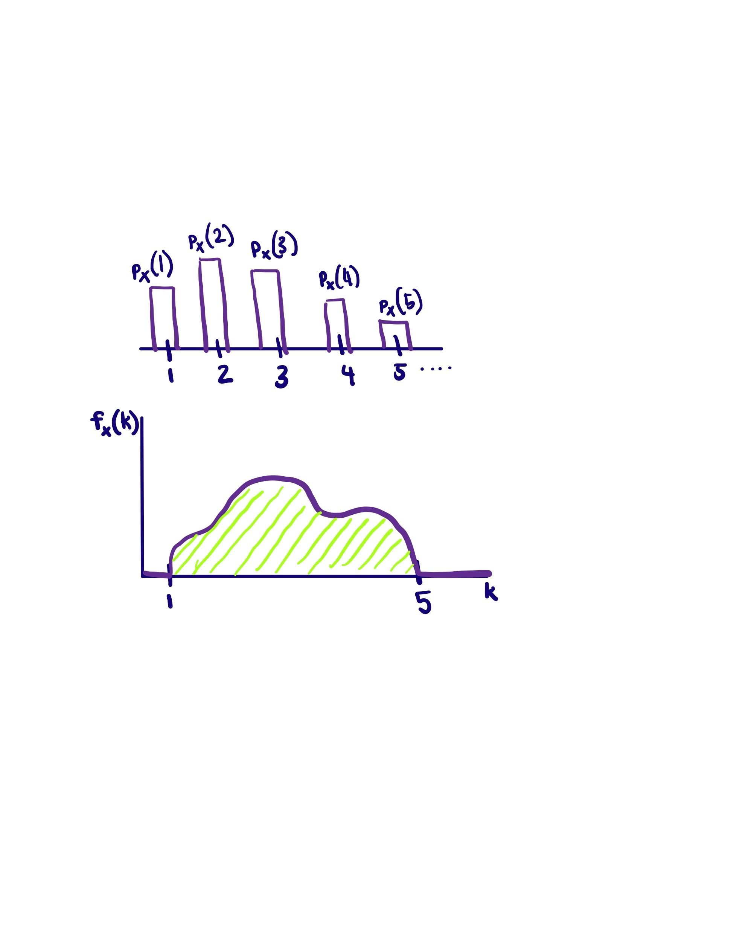




Discrete RVs
Continuous RVs
Support is finite/countably infinite (e.g. integers)
Probability mass function $p_{X}\left(k\right)$ gives probability of each value in support
Support is uncountably infinite (e.g., real numbers)
$ℙ\left(X=k\right)=\frac{1}{∞}=0$ so we don’t use PMF. instead...
Probability density function $f_{X}(k)$ describes relative chances of taking values around $k$
$$\sum_{k∈Ω_{X}}{p_{X}(k)}=1$$
$$0≤p_{X}\left(k\right)≤1$$
$$\int_{−∞}^{∞}{f_{X}(k)} dk=1$$
$$f_{X}\left(k\right)≥0$$

Slide 8
Discrete RVs
Continuous RVs
Support is finite/countably infinite (e.g. integers)
Probability mass function $p_{X}\left(k\right)$ gives probability of each value in support
Support is uncountably infinite (e.g., real numbers)
$ℙ\left(X=k\right)=\frac{1}{∞}=0$ so we don’t use PMF. instead...
Probability density function $f_{X}(k)$ describes relative chances of taking values around $k$
$$\sum_{k∈Ω_{X}}{p_{X}(k)}=1$$
$$0≤p_{X}\left(k\right)≤1$$
$$\int_{−∞}^{∞}{f_{X}(k)} dk=1$$
$$f_{X}\left(k\right)≥0$$
Cumulative Distribution Function (CDF) is the function $F_{X}\left(k\right)=ℙ(X≤k)$

Slide 9
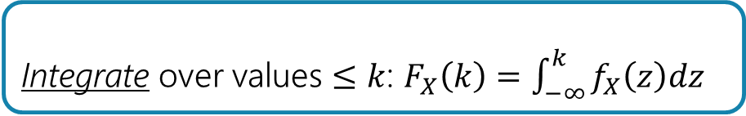
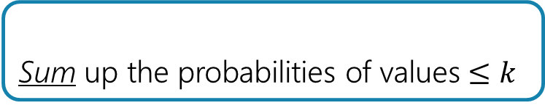
Discrete RVs
Continuous RVs
Support is finite/countably infinite (e.g. integers)
Probability mass function $p_{X}\left(k\right)$ gives probability of each value in support
Support is uncountably infinite (e.g., real numbers)
$ℙ\left(X=k\right)=\frac{1}{∞}=0$ so we don’t use PMF. instead...
Probability density function $f_{X}(k)$ describes relative chances of taking values around $k$
$$\sum_{k∈Ω_{X}}{p_{X}(k)}=1$$
$$0≤p_{X}\left(k\right)≤1$$
$$\int_{−∞}^{∞}{f_{X}(k)} dk=1$$
$$f_{X}\left(k\right)≥0$$
Cumulative Distribution Function (CDF) is the function $F_{X}\left(k\right)=ℙ(X≤k)$
Sum up the probabilities of values $≤k$
Integrate over values $≤k$: $F_{X}\left(k\right)=\int_{−∞}^{k}{f_{X}\left(z\right)dz}$

Slide 10


Discrete RVs
Continuous RVs
Support is finite/countably infinite (e.g. integers)
Probability mass function $p_{X}\left(k\right)$ gives probability of each value in support
Expectation: $𝔼\left[X\right]=\sum_{k∈Ω_{X}}{(k⋅p_{X}\left(k\right))}$
$𝔼\left[g(X)\right]=\sum_{k∈Ω_{X}}{(g(k)⋅p_{X}\left(k\right))}$
Support is uncountably infinite (e.g., real numbers)
$ℙ\left(X=k\right)=\frac{1}{∞}=0$ so we don’t use PMF. instead...
Probability density function $f_{X}(k)$ describes relative chances of taking values around $k$
Expectation: $𝔼\left[X\right]=\int_{−∞}^{∞}{z⋅f_{X}\left(z\right) dz}$
$𝔼\left[g(X)\right]=\int_{−∞}^{∞}{g(z)⋅f_{X}\left(z\right) dz}$
$$\sum_{k∈Ω_{X}}{p_{X}(k)}=1$$
$$0≤p_{X}\left(k\right)≤1$$
$$\int_{−∞}^{∞}{f_{X}(k)} dk=1$$
$$f_{X}\left(k\right)≥0$$
Cumulative Distribution Function (CDF) is the function $F_{X}\left(k\right)=ℙ(X≤k)$
Sum up the probabilities of values $≤k$
Integrate over values $≤k$: $F_{X}\left(k\right)=\int_{−∞}^{k}{f_{X}\left(z\right)dz}$

Slide 11
Discrete RVs
Continuous RVs
Support is finite/countably infinite (e.g. integers)
Probability mass function $p_{X}\left(k\right)$ gives probability of each value in support
Expectation: $𝔼\left[X\right]=\sum_{k∈Ω_{X}}{(k⋅p_{X}\left(k\right))}$
$𝔼\left[g(X)\right]=\sum_{k∈Ω_{X}}{(g(k)⋅p_{X}\left(k\right))}$
Support is uncountably infinite (e.g., real numbers)
$ℙ\left(X=k\right)=\frac{1}{∞}=0$ so we don’t use PMF. instead...
Probability density function $f_{X}(k)$ describes relative chances of taking values around $k$
Expectation: $𝔼\left[X\right]=\int_{−∞}^{∞}{z⋅f_{X}\left(z\right) dz}$
$𝔼\left[g(X)\right]=\int_{−∞}^{∞}{g(z)⋅f_{X}\left(z\right) dz}$
$$\sum_{k∈Ω_{X}}{p_{X}(k)}=1$$
$$0≤p_{X}\left(k\right)≤1$$
$$\int_{−∞}^{∞}{f_{X}(k)} dk=1$$
$$f_{X}\left(k\right)≥0$$
Cumulative Distribution Function (CDF) is the function $F_{X}\left(k\right)=ℙ(X≤k)$
Sum up the probabilities of values $≤k$
Integrate over values $≤k$: $F_{X}\left(k\right)=\int_{−∞}^{k}{f_{X}\left(z\right)dz}$
Variance is $Var\left(X\right)=𝔼\left[X^{2}\right]−{\left(𝔼\left[X\right]\right)}^{2}$

Slide 12
Discrete RVs
Continuous RVs
Support is finite/countably infinite (e.g. integers)
Probability mass function $p_{X}\left(k\right)$ gives probability of each value in support
Expectation: $𝔼\left[X\right]=\sum_{k∈Ω_{X}}{(k⋅p_{X}\left(k\right))}$
$𝔼\left[g(X)\right]=\sum_{k∈Ω_{X}}{(g(k)⋅p_{X}\left(k\right))}$
Support is uncountably infinite (e.g., real numbers)
$ℙ\left(X=k\right)=\frac{1}{∞}=0$ so we don’t use PMF. instead...
Probability density function $f_{X}(k)$ describes relative chances of taking values around $k$
Expectation: $𝔼\left[X\right]=\int_{−∞}^{∞}{z⋅f_{X}\left(z\right) dz}$
$𝔼\left[g(X)\right]=\int_{−∞}^{∞}{g(z)⋅f_{X}\left(z\right) dz}$
$$\sum_{k∈Ω_{X}}{p_{X}(k)}=1$$
$$0≤p_{X}\left(k\right)≤1$$
$$\int_{−∞}^{∞}{f_{X}(k)} dk=1$$
$$f_{X}\left(k\right)≥0$$
Cumulative Distribution Function (CDF) is the function $F_{X}\left(k\right)=ℙ(X≤k)$
Sum up the probabilities of values $≤k$
Integrate over values $≤k$: $F_{X}\left(k\right)=\int_{−∞}^{k}{f_{X}\left(z\right)dz}$
Variance is $Var\left(X\right)=𝔼\left[X^{2}\right]−{\left(𝔼\left[X\right]\right)}^{2}$
Linearity of expectation and properties of expectation and variance applies in both!

Slide 13
Zoo of Continuous Random variables
and get practice with working with continuous random variables!
Notes:
So for continuous random variables, we’re going to try to do things as similarly to the discrete random variables. The first thing we’re going to talk about is probability density function. Abbreviated as the pdf.. We’re going to s

Slide 14
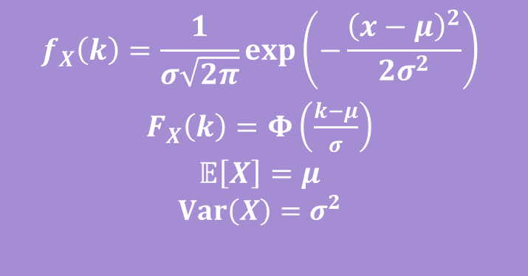
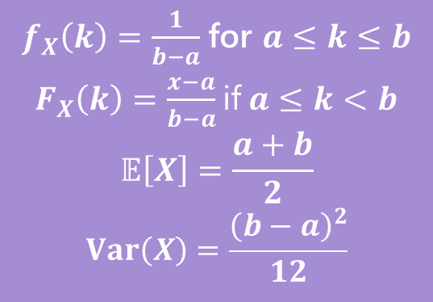
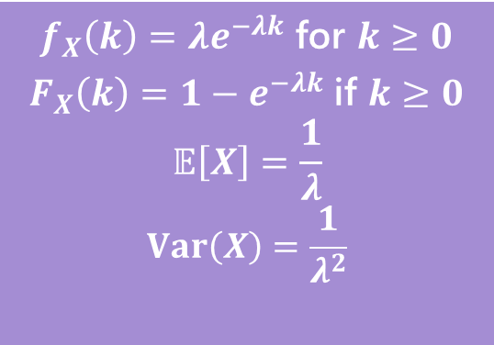
Continuous Zoo
This zoo defines common patterns for continuous random variables and gives us the PDF, CDF, expectation, and variance, so we don’t have to compute it every time!
$$X\sim Unif(a,b)$$
$$X\sim Exp(λ)$$
$$X\sim 𝒩(μ,σ^{2})$$
$f_{X}\left(k\right)=\frac{1}{b−a}$ for $a≤k≤b$
$F_{X}\left(k\right)=\frac{x−a}{b−a}$ if $a≤k<b$
$$𝔼\left[X\right]=\frac{a+b}{2}$$
$$Var\left(X\right)=\frac{{\left(b−a\right)}^{2}}{12}$$
$f_{X}\left(k\right)=λe^{−λk}$ for $k≥0$
$F_{X}\left(k\right)=1−e^{−λk}$ if $k≥0$
$$𝔼\left[X\right]=\frac{1}{λ}$$
$$Var\left(X\right)=\frac{1}{λ^{2}}$$
$$f_{X}\left(k\right)=\frac{1}{σ\sqrt{2π}}exp\left(−\frac{{\left(x−μ\right)}^{2}}{2σ^{2}}\right)$$
$F_{X}\left(k\right)=Φ\left(\frac{k−μ}{σ}\right)$
$$𝔼\left[X\right]=μ$$
$$Var\left(X\right)=σ^{2}$$
It’s a smaller zoo, but it’s just as much fun! :D

Slide 15
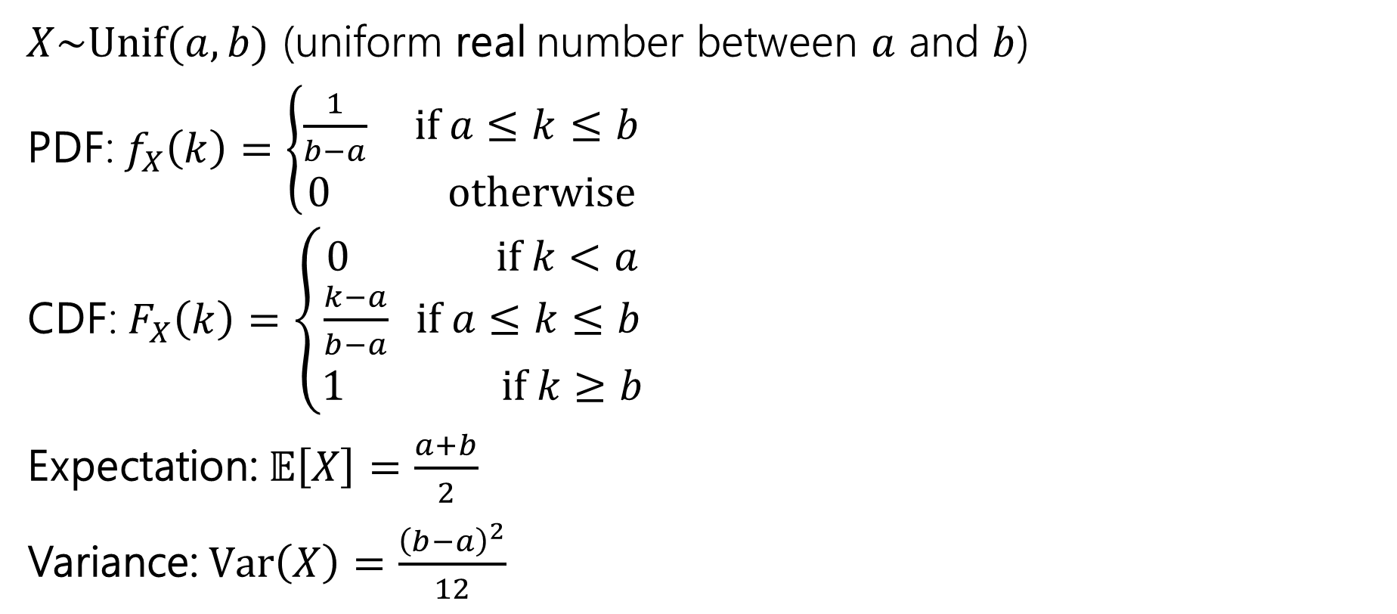
Continuous Uniform Distribution
$X\sim Unif(a,b)$ (uniform real number between $a$ and $b$)
PDF: $f_{X}\left(k\right)=\left\{\begin{aligned}\frac{1}{b−a} if a≤k≤b \\ 0 otherwise\end{aligned}\right.$
CDF: $F_{X}\left(k\right)=\left\{\begin{aligned}0 if k<a \\ \frac{k−a}{b−a} if a≤k≤b \\ 1 if k≥b\end{aligned}\right.$
Expectation: $𝔼\left[X\right]=\frac{a+b}{2}$
Variance: $Var\left(X\right)=\frac{{\left(b−a\right)}^{2}}{12}$

Slide 16
Exponential Distribution
How much time till an event occurs?
  e.g., seconds till thunder, time till the first customer
With the geometric distribution, we said trials must be independent ->
  “If the flip 1 is tails, the coin doesn’t remember it was tails, you’ve made no progress”
  Here, waiting must not make the event happen any sooner ->
  “If we don’t get success in the first 3.87sec, chances of seeing success doesn’t change”
This sounds very similar to a geometric distribution!
> Geometric random variable is the number of trials till success (discrete).
> Exponential random variable is time (a real number, continuous) till success
This means memorylessness! $ℙ\left(X≥k+1 \right|X≥1)=ℙ(Y≥k)$

Slide 17

Exponential Distribution- CDF
$X\sim Exp(λ)$ is time till the first event. Average of $λ$ events per time unit.
It would be hard to come up with the PDF directly here, so start with CDF.
We want $F_{X}\left(t\right)=$ $ℙ\left(X≤t\right)=1−ℙ(X>t)$

Slide 18
Exponential Distribution- CDF
$X\sim Exp(λ)$ is time till the first event. Average of $λ$ events per time unit.
It would be hard to come up with the PDF directly here, so start with CDF.
We want $F_{X}\left(t\right)=$ $ℙ\left(X≤t\right)=1−ℙ(X>t)$
What distribution do we know about the also deals with time?

Slide 19
Exponential Distribution- CDF
$X\sim Exp(λ)$ is time till the first event. Average of $λ$ events per time unit.
It would be hard to come up with the PDF directly here, so start with CDF.
We want $F_{X}\left(t\right)=$ $ℙ\left(X≤t\right)=1−ℙ(X>t)$
What distribution do we know about the also deals with time…Poisson!
  Poisson random variable gives us the number of events in a unit of time

Slide 20
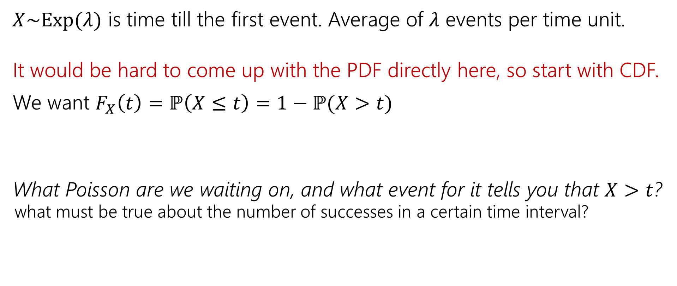
Exponential Distribution- CDF
$X\sim Exp(λ)$ is time till the first event. Average of $λ$ events per time unit.
It would be hard to come up with the PDF directly here, so start with CDF.
We want $F_{X}\left(t\right)=$ $ℙ\left(X≤t\right)=1−ℙ(X>t)$
What Poisson are we waiting on, and what event for it tells you that $X>t$?
  what must be true about the number of successes in a certain time interval?
What distribution do we know about the also deals with time…Poisson!
  Poisson random variable gives us the number of events in a unit of time
Notes:
Draw picture

Slide 21
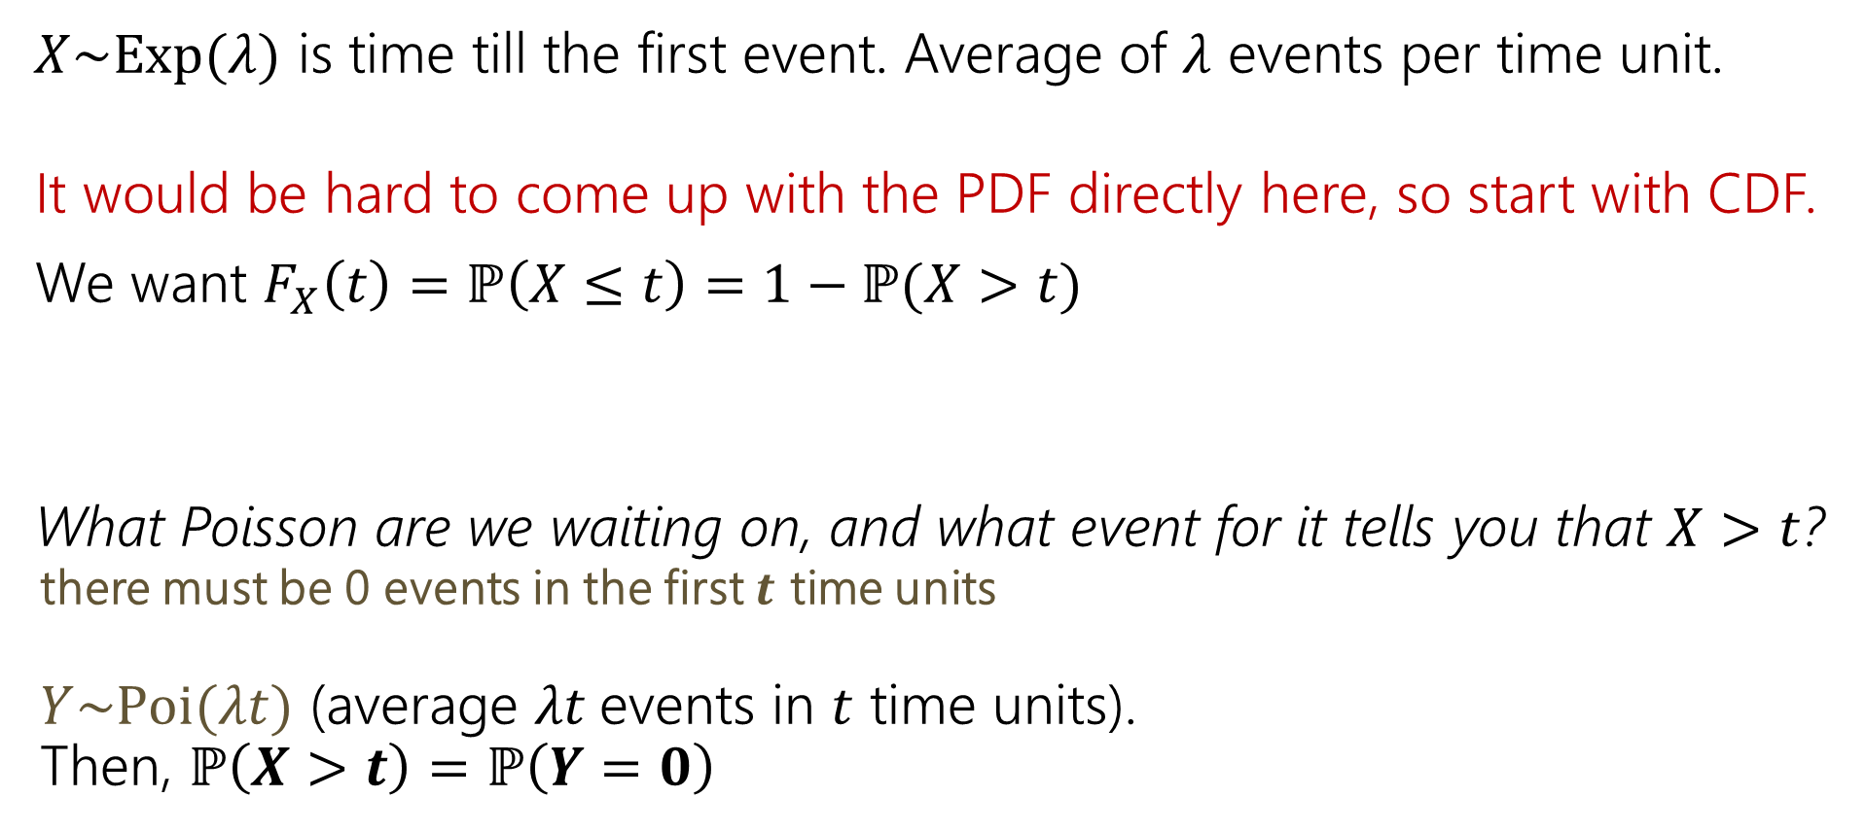
Exponential Distribution- CDF
$X\sim Exp(λ)$ is time till the first event. Average of $λ$ events per time unit.
It would be hard to come up with the PDF directly here, so start with CDF.
We want $F_{X}\left(t\right)=$ $ℙ\left(X≤t\right)=1−ℙ(X>t)$
What Poisson are we waiting on, and what event for it tells you that $X>t$?
  there must be 0 events in the first $t$ time units
  $Y\sim Poi(λt)$ (average $λt$events in $t$ time units).
  Then, $ℙ\left(X>t\right)=ℙ\left(Y=0\right)$
What distribution do we know about the also deals with time…Poisson!
  Poisson random variable gives us the number of events in a unit of time

Slide 22
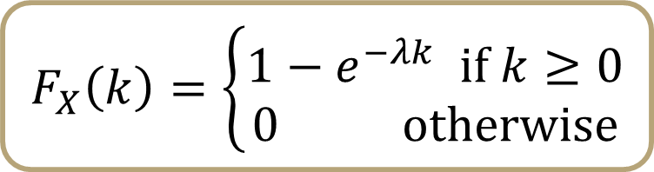
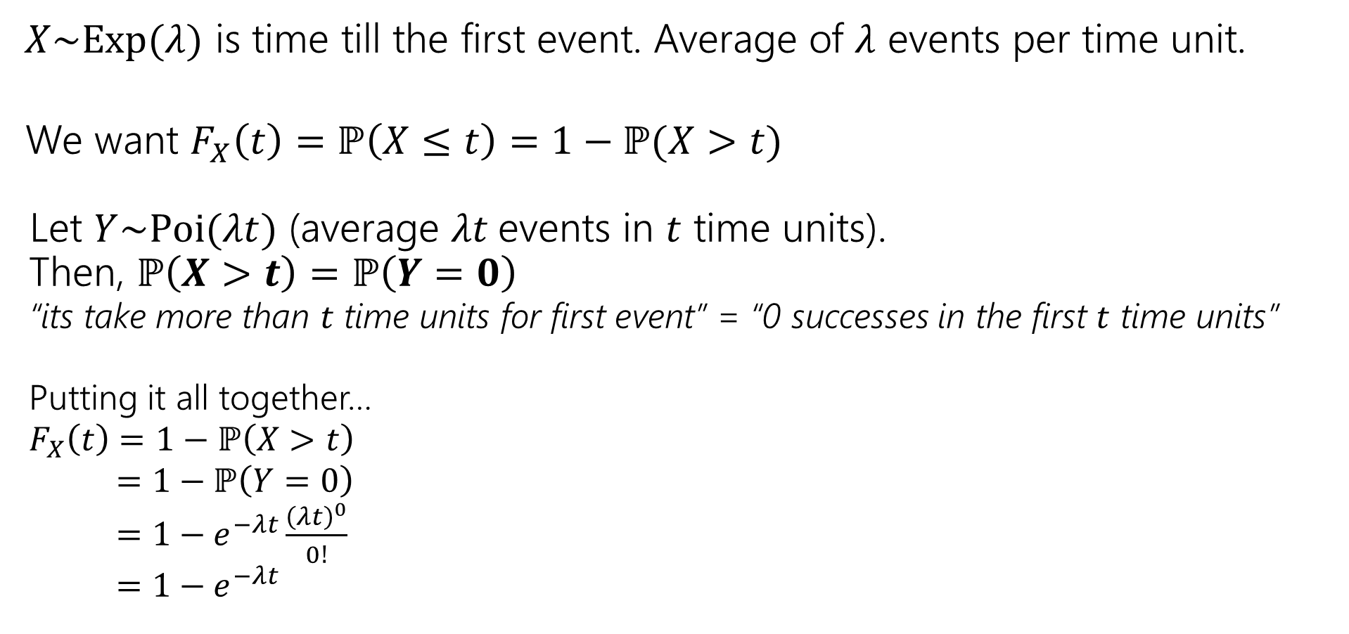
Exponential Distribution- CDF
$X\sim Exp(λ)$ is time till the first event. Average of $λ$ events per time unit.
We want $F_{X}\left(t\right)=$ $ℙ\left(X≤t\right)=1−ℙ(X>t)$
  Let $Y\sim Poi(λt)$ (average $λt$events in $t$ time units).
  Then, $ℙ\left(X>t\right)=ℙ\left(Y=0\right)$
  “its take more than $t$ time units for first event” = “0 successes in the first $t$ time units”
  Putting it all together…
  $F_{X}\left(t\right)=$ $1−ℙ\left(X>t\right)$
  $=1−ℙ\left(Y=0\right)$
  $=1−e^{−λt}\frac{{\left(λt\right)}^{0}}{0!}$
  $=$ $1−e^{−λt}$
$$F_{X}\left(k\right)=\left\{\begin{aligned}1−e^{−λk} if k≥0 \\ 0 otherwise\end{aligned}\right.$$

Slide 23

Exponential Distribution- PDF
Now we know the CDF: $F_{X}\left(k\right)=\left\{\begin{aligned}1−e^{−λk} if k≥0 \\ 0 otherwise\end{aligned}\right.$
What’s the PDF (probability density function)?
$f_{Y}\left(t\right)=$

Slide 24
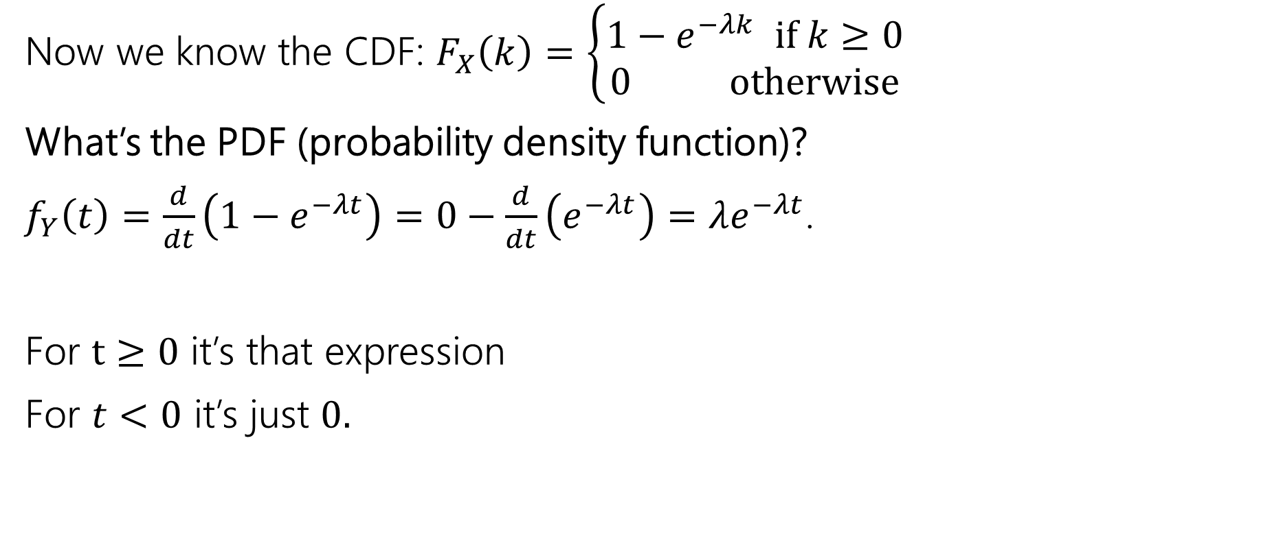
Exponential Distribution- PDF
Now we know the CDF: $F_{X}\left(k\right)=\left\{\begin{aligned}1−e^{−λk} if k≥0 \\ 0 otherwise\end{aligned}\right.$
What’s the PDF (probability density function)?
$f_{Y}\left(t\right)=\frac{d}{dt}\left(1−e^{−λt}\right)=0−\frac{d}{dt}\left(e^{−λt}\right)=λe^{−λt}$.
For $t≥0$ it’s that expression
For $t<0$ it’s just $0.$

Slide 25
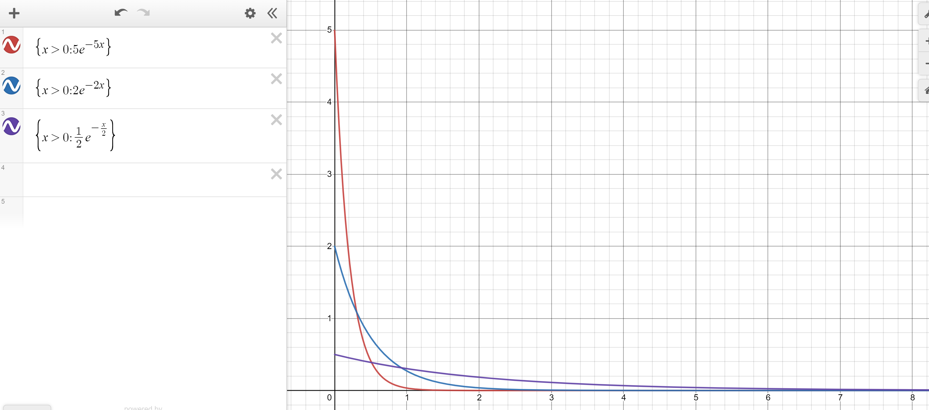
Exponential Distribution- PDF
Red: $λ=5$
Blue: $λ=2$
Purple: $λ=0.5$
Notes:
Lambda is the rate, expected number of successes in a time unit.. If we have a higher rathe of success, density decreases a lot faster.. Highest density at the start

Slide 26
Memorylessness
$ℙ\left(X≥k+1 | X≥1\right)=\frac{ℙ(X≥k+1∩X≥1)}{ℙ(X≥1)}=\frac{ℙ(X≥k+1)}{1−(1−e^{−λ⋅1})}$
$=\frac{e^{−λ(k+1)}}{e^{−λ}}=e^{−λk}$
What about $ℙ(X≥k)$ (without conditioning on the first step)?
${1−(1−e}^{−λk})=e^{−λk}$
It’s the same!!!
More generally, for an exponential rv $X,$ $ℙ\left(X≥s+t | X≥s\right)=ℙ(X≥t)$

Slide 27
Side note
I hid a trick in that algebra,
$ℙ\left(X≥1\right)=1−ℙ\left(X<1\right)=1−ℙ(X≤1)$
The first step is the complementary law.
The second step is using that $\int_{1}^{1}{f_{X}\left(z\right)dz}=0$
In general, for continuous random variables we can switch out $≤$ and $<$without anything changing.
  We can’t make those switches for discrete random variables.

Slide 28
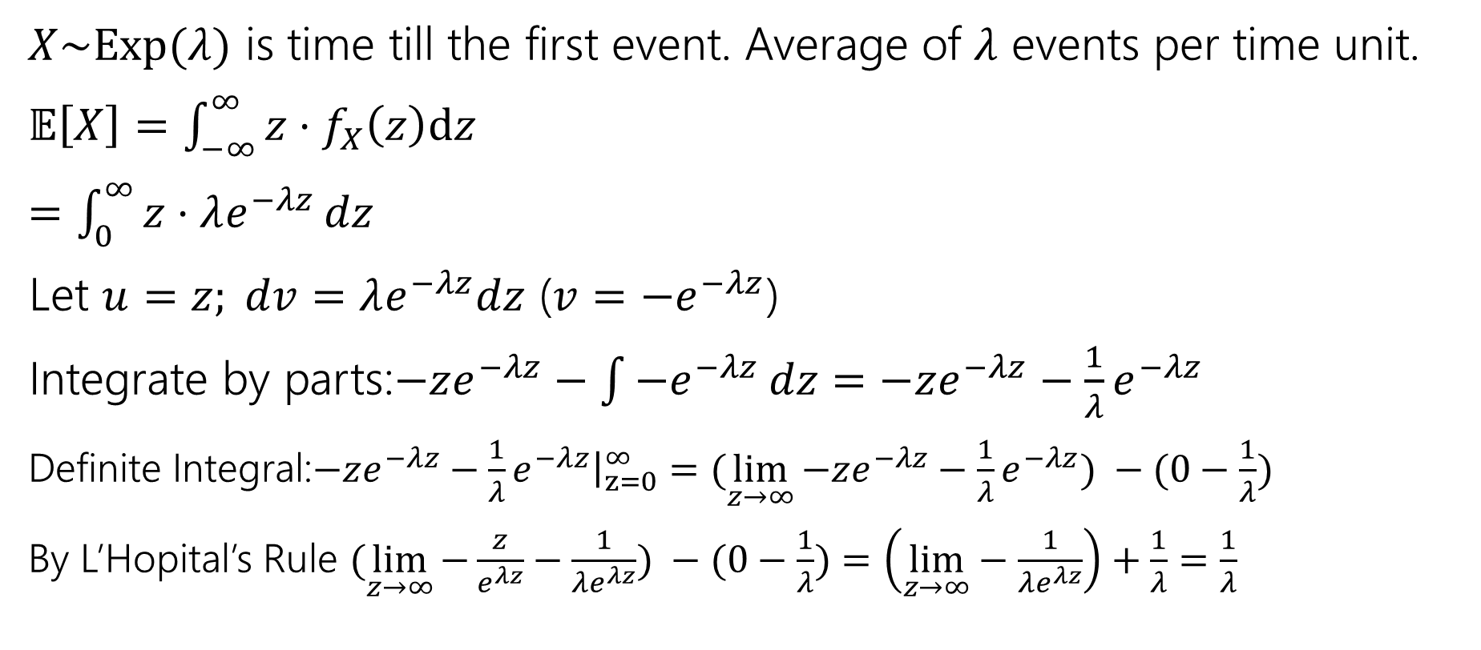
Exponential Distribution- Expectation
$X\sim Exp(λ)$ is time till the first event. Average of $λ$ events per time unit.
$𝔼\left[X\right]=\int_{−∞}^{∞}{{z⋅f}_{X}\left(z\right)dz}$
$=\int_{0}^{∞}{z⋅λe^{−λz}}dz$
Let $u=z; dv=λe^{−λz}dz$ ($v=−e^{−λz}$)
Integrate by parts:$−ze^{−λz}−\int{−e^{−λz}}dz=−ze^{−λz}−\frac{1}{λ}e^{−λz}$
Definite Integral:$−ze^{−λz}−\frac{1}{λ}e^{−λz}{\left.​\right|}_{z=0}^{∞}=(\lim_{z→∞}{−ze^{−λz}−\frac{1}{λ}e^{−λz}) −(0−\frac{1}{λ})}$
By L’Hopital’s Rule $(\lim_{z→∞}{−\frac{z}{e^{λz}}−\frac{1}{λe^{λz}}) −(0−\frac{1}{λ})}=\left(\lim_{z→∞}−\frac{1}{λe^{λz}}\right)+\frac{1}{λ}=\frac{1}{λ}$
Don’t worry about the derivation (it’s here if you’re interested; you’re not responsible for the derivation. Just the value.
Notes:
This Is more complicated calculus than you need to know for this calss.

Slide 29

Exponential Distribution- Variance
$X\sim Exp(λ)$ is time till the first event. Average of $λ$ events per time unit.
$Var\left(X\right)=E\left[X^{2}\right]−{\left(E\left[X\right]\right)}^{2}$
$=$ $\int_{−∞}^{∞}{{z^{2}⋅f}_{X}\left(z\right)dz} −{\left(\frac{1}{λ}\right)}^{2}$
$= …$after a bunch of calculus
$=\frac{1}{λ^{2}}$
Don’t worry about the actual calculus here as well ☺
Notes:
For the variance,

Slide 30
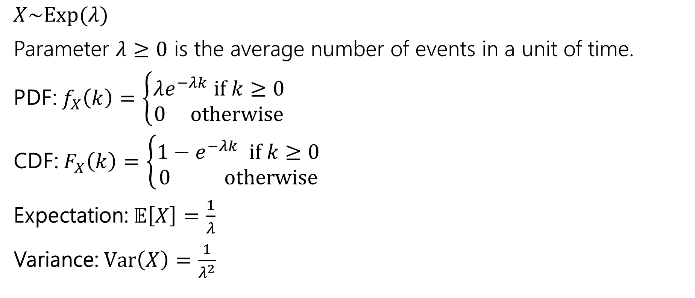
Exponential Distribution
$X\sim Exp(λ)$
Parameter $λ≥0$ is the average number of events in a unit of time.
PDF: $f_{X}\left(k\right)=\left\{\begin{aligned}λe^{−λk} if k≥0 \\ 0 otherwise\end{aligned}\right.$
CDF: $F_{X}\left(k\right)=\left\{\begin{aligned}1−e^{−λk} if k≥0 \\ 0 otherwise\end{aligned}\right.$
Expectation: $𝔼\left[X\right]=\frac{1}{λ}$
Variance: $Var\left(X\right)=\frac{1}{λ^{2}}$

Slide 31
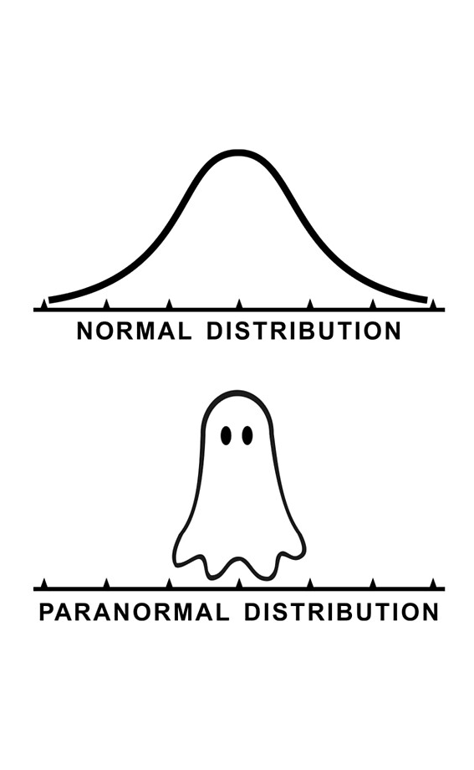
Normal Distribution

Slide 32
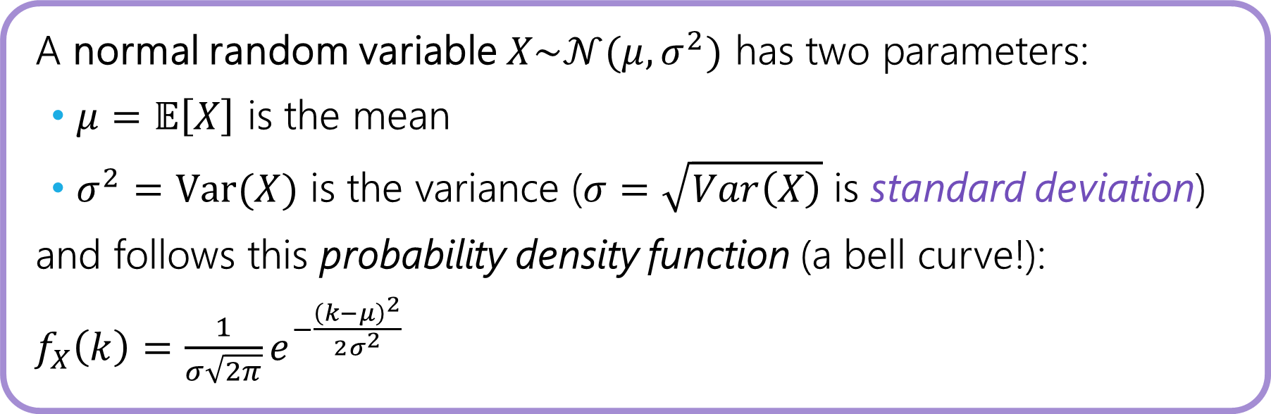
Normal Random Variable (AKA Gaussian)
There’s not a single scenario that follows a normal distribution…
But we’re going to see that it shows up in a lot of real world situations!
A normal random variable $X\sim 𝒩(μ,σ^{2})$ has two parameters:
$μ=𝔼\left[X\right]$ is the mean
$σ^{2}=Var(X)$ is the variance ($σ=\sqrt{Var\left(X\right)}$ is standard deviation)
and follows this probability density function (a bell curve!):
$f_{X}\left(k\right)=\frac{1}{σ\sqrt{2π}}e^{−\frac{{\left(k−μ\right)}^{2}}{2σ^{2}}}$
Notes:
Today, we’re going to focus on talingabout this distribution.. And then on Monday, we’re going to see how this distribution shows up in a lot of real world scenarios.

Slide 33
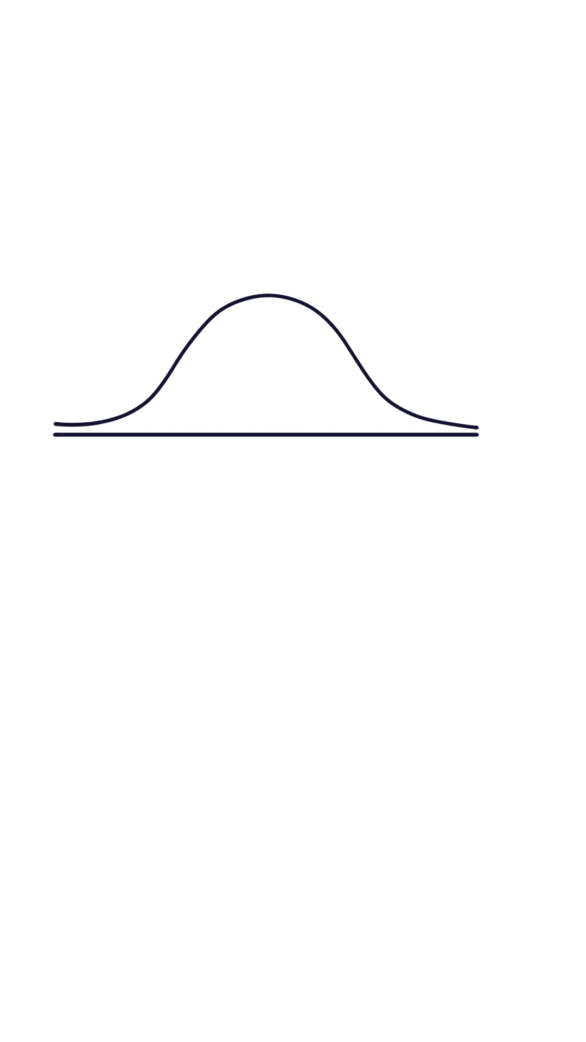
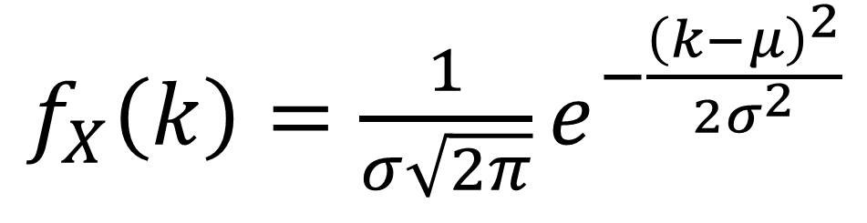
Let’s take a closer look at that PDF…
$X\sim 𝒩(μ,σ^{2})$ iff $X$ follows the following PDF:
symmetric around the mean
constant for normalization
$f_{X}\left(k\right)=\frac{1}{σ\sqrt{2π}}e^{−\frac{{\left(k−μ\right)}^{2}}{2σ^{2}}}$
variance to control spread
exponential term for tails
Notes:
Today, we’re going to focus on talking about this distribution.. And then on Monday, we’re going to see how this distribution shows up in a lot of real world scenarios.
Normalization constant.. So that when we integrate over all values, that will be 1. this part here is the more interesting part, it’s where the k is. We have e raised to some negative power. This is some kind of exponential decay… it’s going to get exponentially smaller with really big or really small values of k.. X minus mu is how far you are away from the mean. We’re looking at that squared deviation, keep everything positive.. This might look a little similar to the formula for variance. We don’t want to just look at that in absolute terms, we want to compare it to the variance, which is why we’re dividieing… if the variance Is high, having a large distance is not that impressive it’s more likely to occur. But if the variance is low, having a large distance is more impressive, we’re less likely to see that.

Slide 34
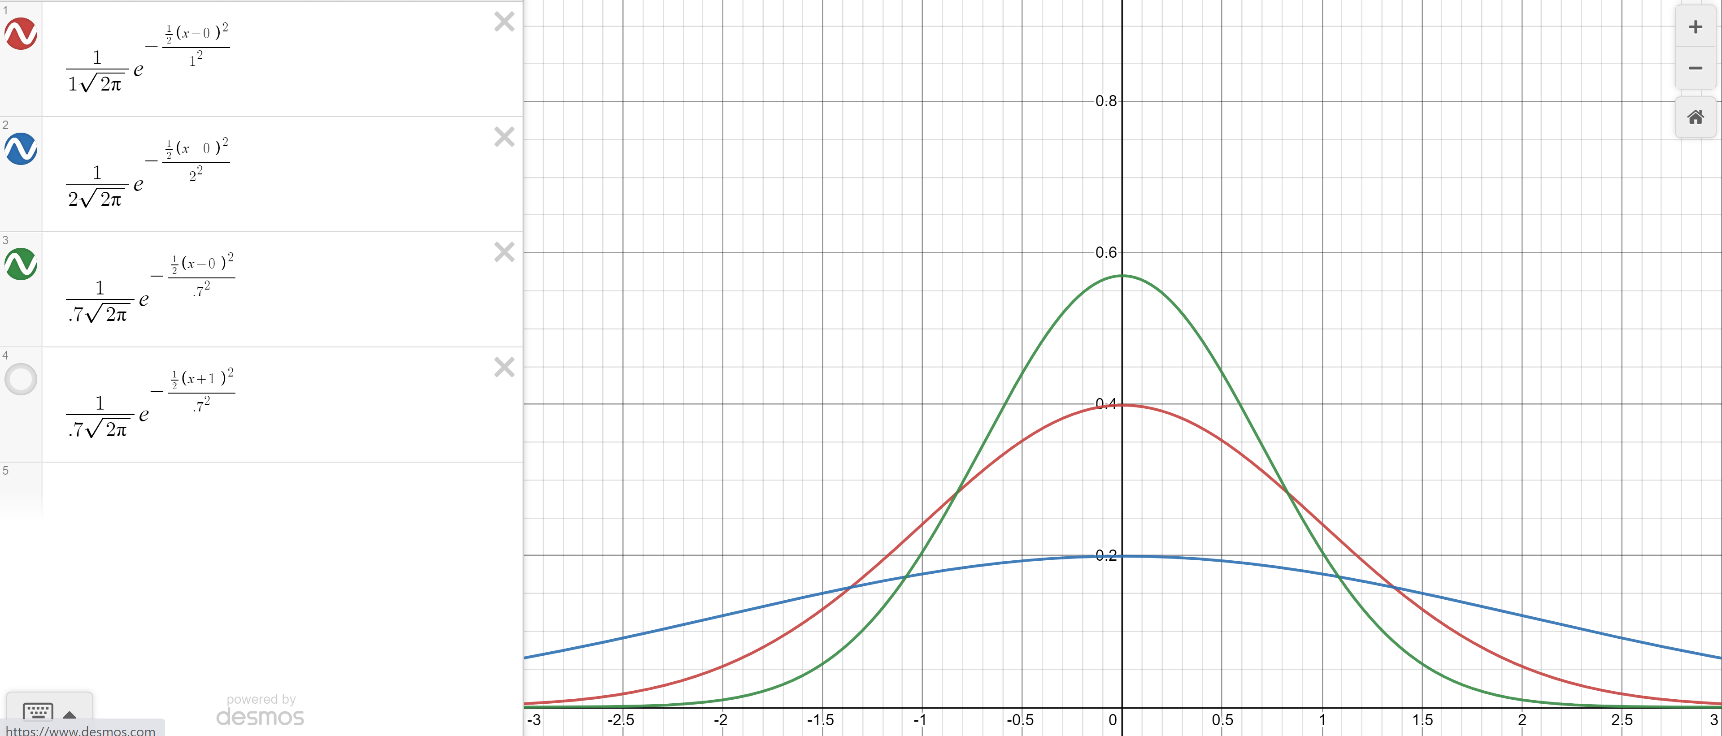

Changing the variance
Green: $σ^{2}=.7$
Red $σ^{2}=1$
Blue: $σ^{2}=2$
Notes:
Angint eh

Slide 35
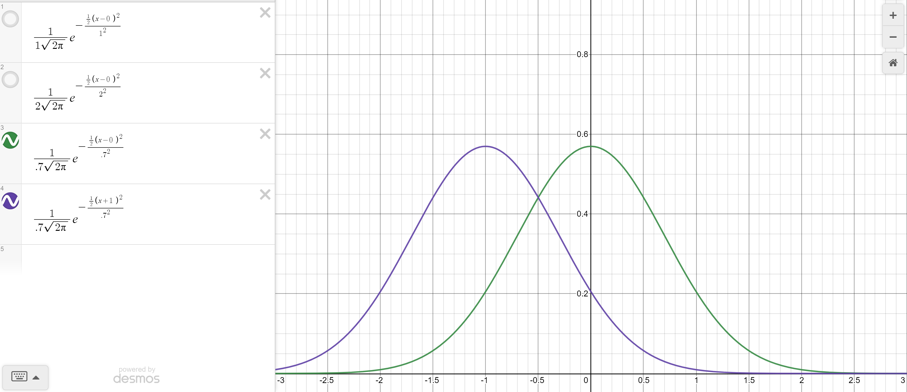

Changing the mean
Green: $σ^{2}=.7, μ=0$
Purple $σ^{2}=.7, μ=−1$

Slide 36
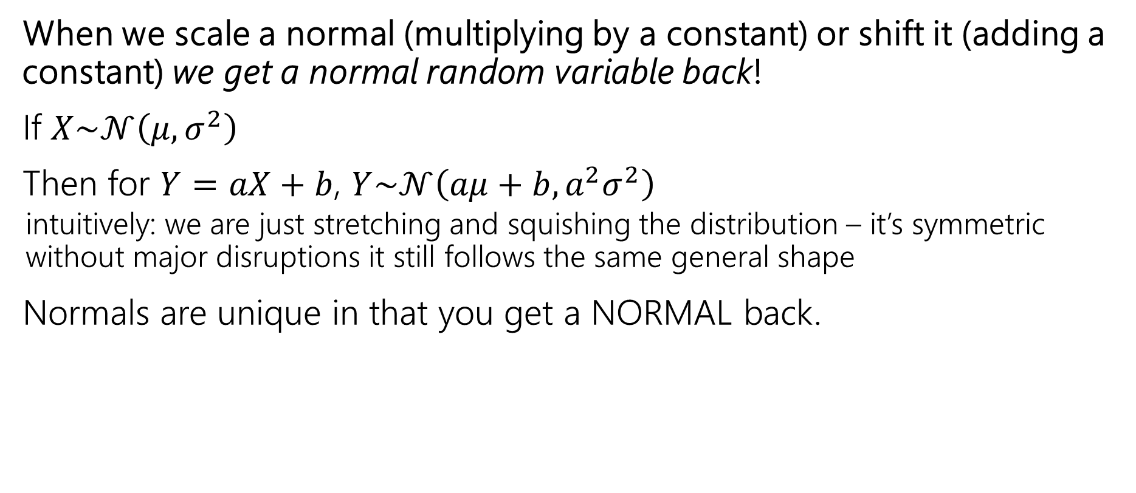

Closure of Normals Under Scale and Shift
When we scale a normal (multiplying by a constant) or shift it (adding a constant) we get a normal random variable back!
If $X\sim 𝒩\left(μ,σ^{2}\right)$
Then for $Y=aX+b$, $Y\sim 𝒩\left(aμ+b, a^{2}σ^{2}\right)$
  intuitively: we are just stretching and squishing the distribution – it’s symmetric without major disruptions it still follows the same general shape
Normals are unique in that you get a NORMAL back.
If you multiply a binomial by $3/2$ you don’t get a binomial
(it’s support isn’t even integers!)
Notes:
A property of normal random variables. Epxected value and variance are not surprising. Using linearity of expectation, and properties of variance … key thing to realize is that this random variable is still normal it still has the same pdf that we talked about, jstu with different parameters.
This is not something that is always true. Fore xample if we have a binaiomal random variables… range (0, 1, …n),

Slide 37
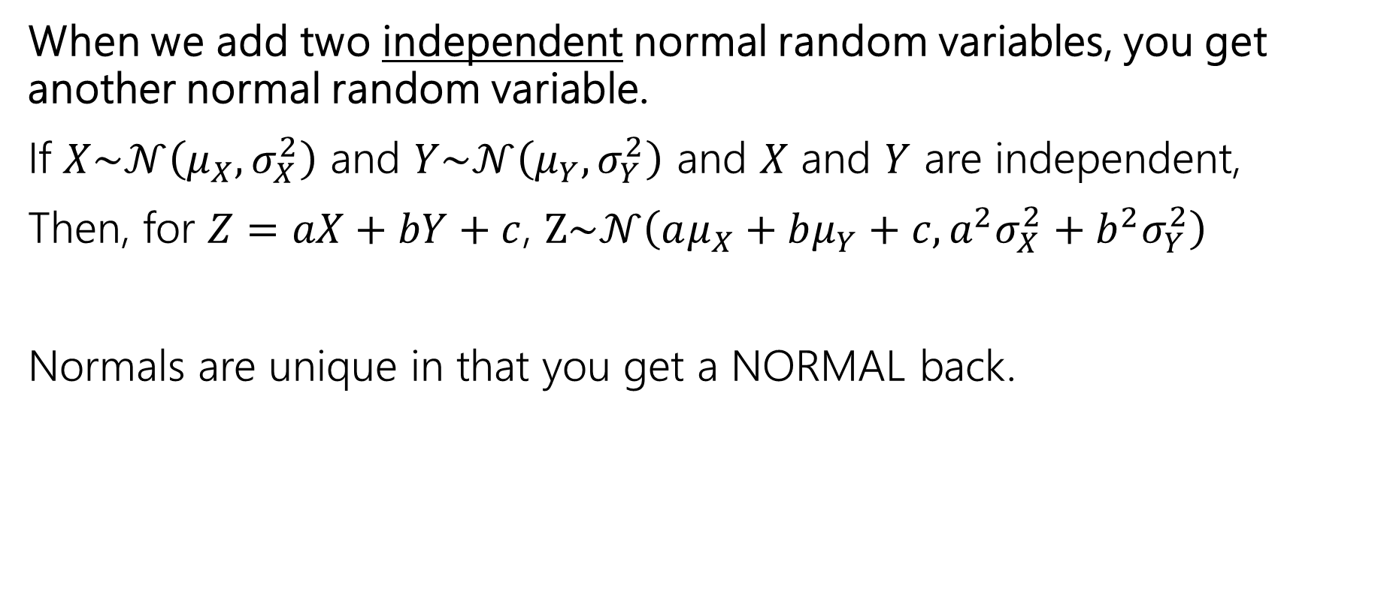
Closure of Normals Under Addition
When we add two independent normal random variables, you get another normal random variable.
If $X\sim 𝒩\left(μ_{X},σ_{X}^{2}\right)$ and $Y\sim 𝒩\left(μ_{Y},σ_{Y}^{2}\right)$ and $X$ and $Y$ are independent,
Then, for $Z=aX+bY+c$, $Z\sim 𝒩\left(aμ_{X}+bμ_{Y}+c,{a^{2}σ}_{X}^{2}+{b^{2}σ}_{Y}^{2}\right)$
Normals are unique in that you get a NORMAL back.
The sum of two dice rolls (sum of two uniform distributions) does not follow a uniform distribution
Notes:
A property of normal random variables. Epxected value and variance are not surprising. Using linearity of expectation, and properties of variance … key thing to realize is that this random variable is still normal it still has the same pdf that we talked about, jstu with different parameters.
This is not something that is always true. Fore xample if we have a binaiomal random variables… range (0, 1, …n),

Slide 38

Ok…what about the CDF?
There is no closed form for the CDF ☹
So how can we find the values $F_{X}\left(k\right)=ℙ(X≤k)$?
And for finding the probability of $X$ being in other ranges, we certainly don’t want to bother integrating over that PDF…

Slide 39
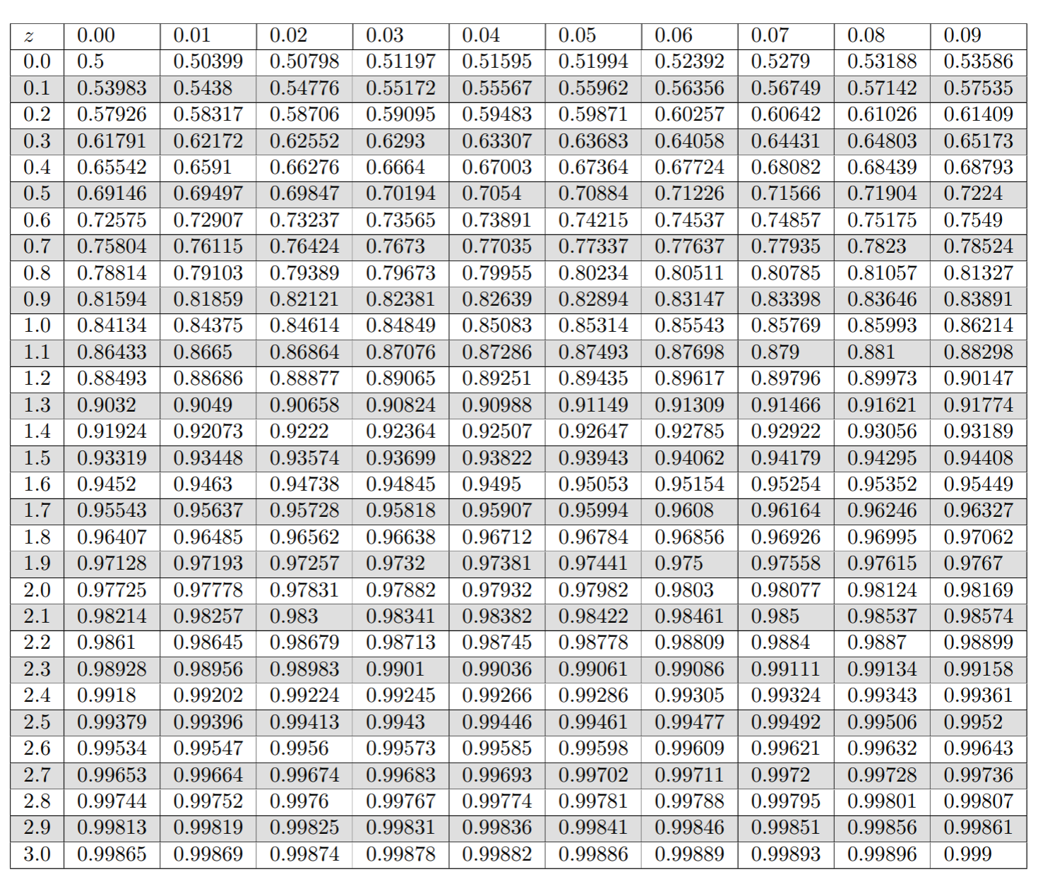
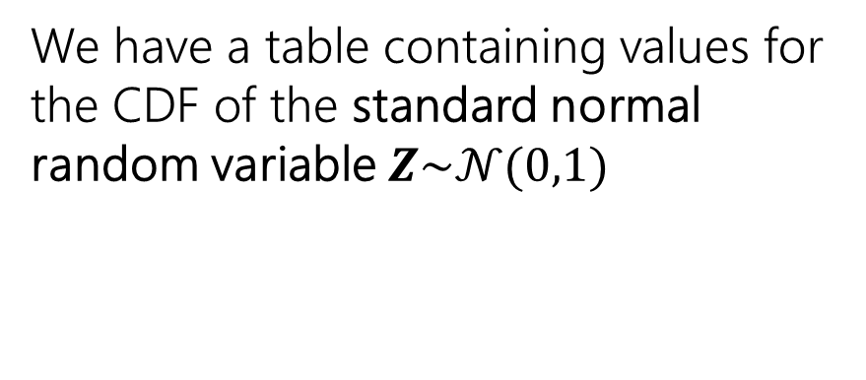
We have a table with precomputed values!
AKA the “z-table”, “phi-table”
We have a table containing values for the CDF of the standard normal random variable $Z\sim 𝒩(0,1)$
Yes, we’re going to use a table in 2026 🤩 Mainly for consistency in this class.
(In the real world, we have programming libraries like Python’s scipy: stats.norm.cdf)
Notes:
Many years ago, someone decided to compute the values in the CDF for a bunch of r values for a normal random variable with mean 0 and variance 1. we have this talbe to look up those values.. Instead of having a formula we have this beautifyl thing. Somsone when through each of these values and computed the cdf for it\\maybeyou’re thinking… it’s 1014 .. Why are we just ..

Slide 40
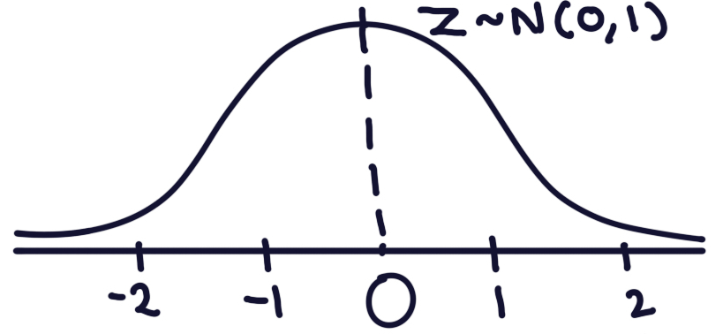
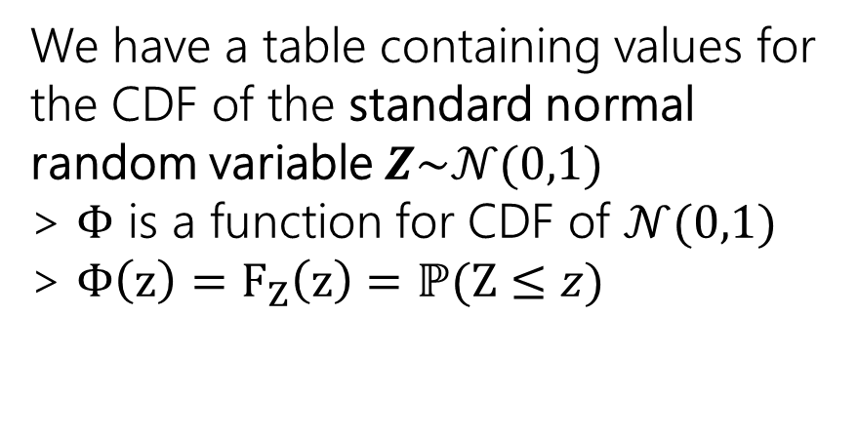
We have a table with precomputed values!
AKA the “z-table”, “phi-table”
We have a table containing values for the CDF of the standard normal random variable $Z\sim 𝒩(0,1)$
> $Φ$ is a function for CDF of $𝒩(0,1)$
> $Φ\left(z\right)=F_{Z}\left(z\right)=ℙ(Z≤z)$
Notes:
As a short hand we’re going to use this function, called Phi, Greek leteter for the CDF of a nomal distribution with mean 0 and variance 1. If we write something like this… We’re looking at …

Slide 41
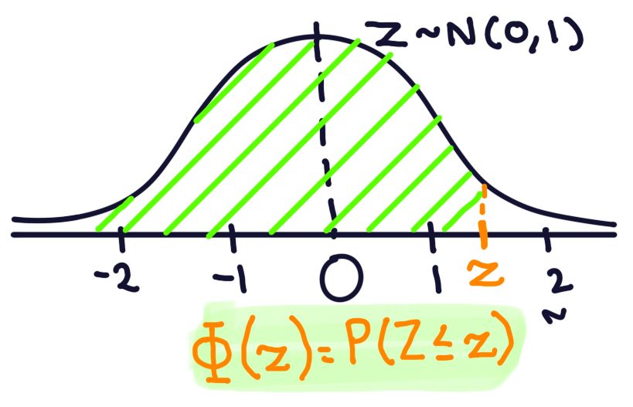
We have a table with precomputed values!
AKA the “z-table”, “phi-table”
We have a table containing values for the CDF of the standard normal random variable $Z\sim 𝒩(0,1)$
> $Φ$ is a function for CDF of $𝒩(0,1)$
> $Φ\left(z\right)=F_{Z}\left(z\right)=ℙ(Z≤z)$
Notes:
Example here P(Z <= 0.34)=

Slide 42

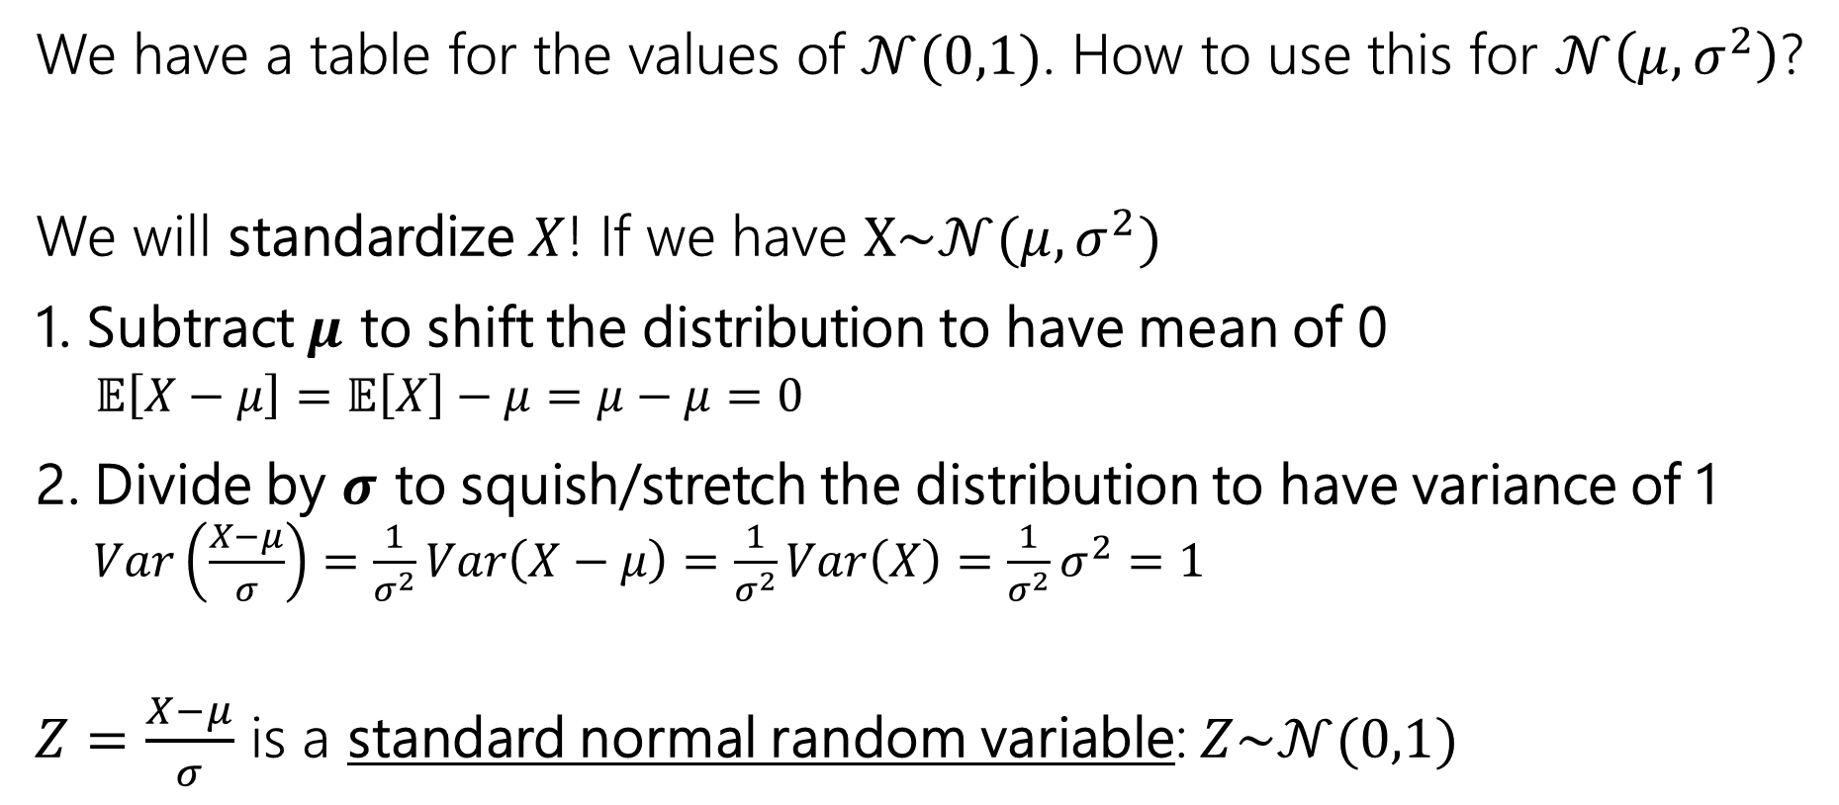
But how to go from $𝒩\left(μ,σ^{2}\right)$ to $𝒩(0,1)$?
We have a table for the values of $𝒩(0,1)$. How to use this for $𝒩\left(μ,σ^{2}\right)$?
We will standardize $X$! If we have $X\sim 𝒩(μ,σ^{2})$
1. Subtract $μ$ to shift the distribution to have mean of 0
  $𝔼\left[X−μ\right]=𝔼\left[X\right]−μ=μ−μ=0$
2. Divide by $σ$ to squish/stretch the distribution to have variance of 1
    $Var\left(\frac{X−μ}{σ}\right)=\frac{1}{σ^{2}}Var\left(X−μ\right)=\frac{1}{σ^{2}}Var\left(X\right)=\frac{1}{σ^{2}}σ^{2}=1$
$Z=\frac{X−μ}{σ}$ is a standard normal random variable: $Z\sim 𝒩(0,1)$
Notes:
The table gives us values for a normal raviarable with mean 0 and std 1. butwhat about other random variables that have a different mean and variance? We are going to standardize it, to get a normal random variable that has mean and variable 1. …
We have a random variable with mean …. The first thing we’re going to want to do, if shift it, and get it centered around 0. subtract mean to have mean of. 0
Now, we are
Remember divided by s

Slide 43
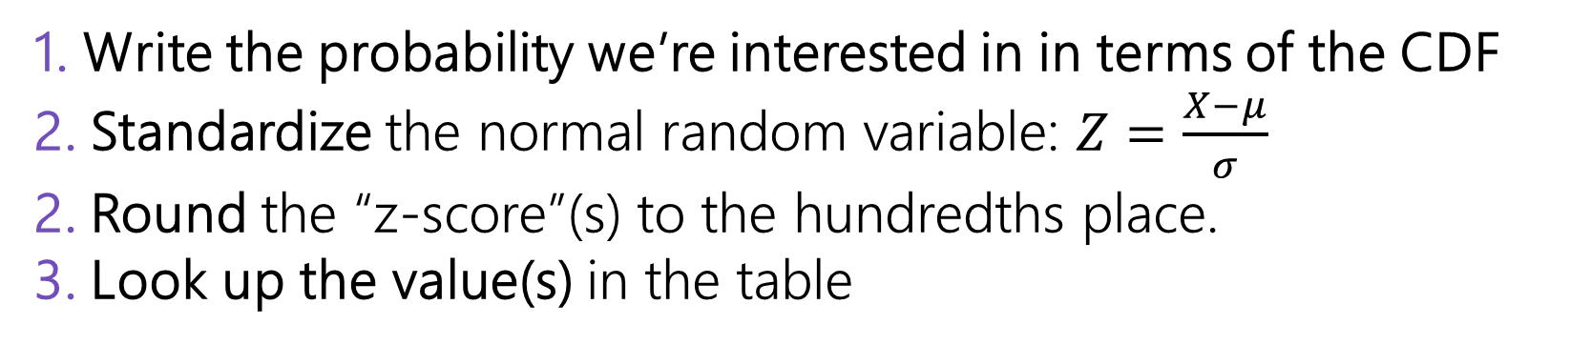
Computing Probabilities of Normal RVs
1. Write the probability we’re interested in in terms of the CDF
2. Standardize the normal random variable: $Z=\frac{X−μ}{σ}$
2. Round the “z-score”(s) to the hundredths place.
3. Look up the value(s) in the table

Slide 44
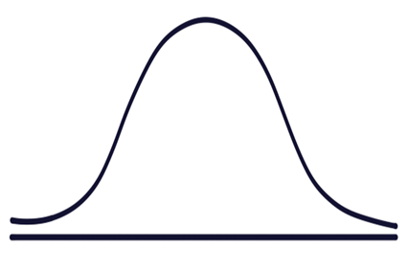
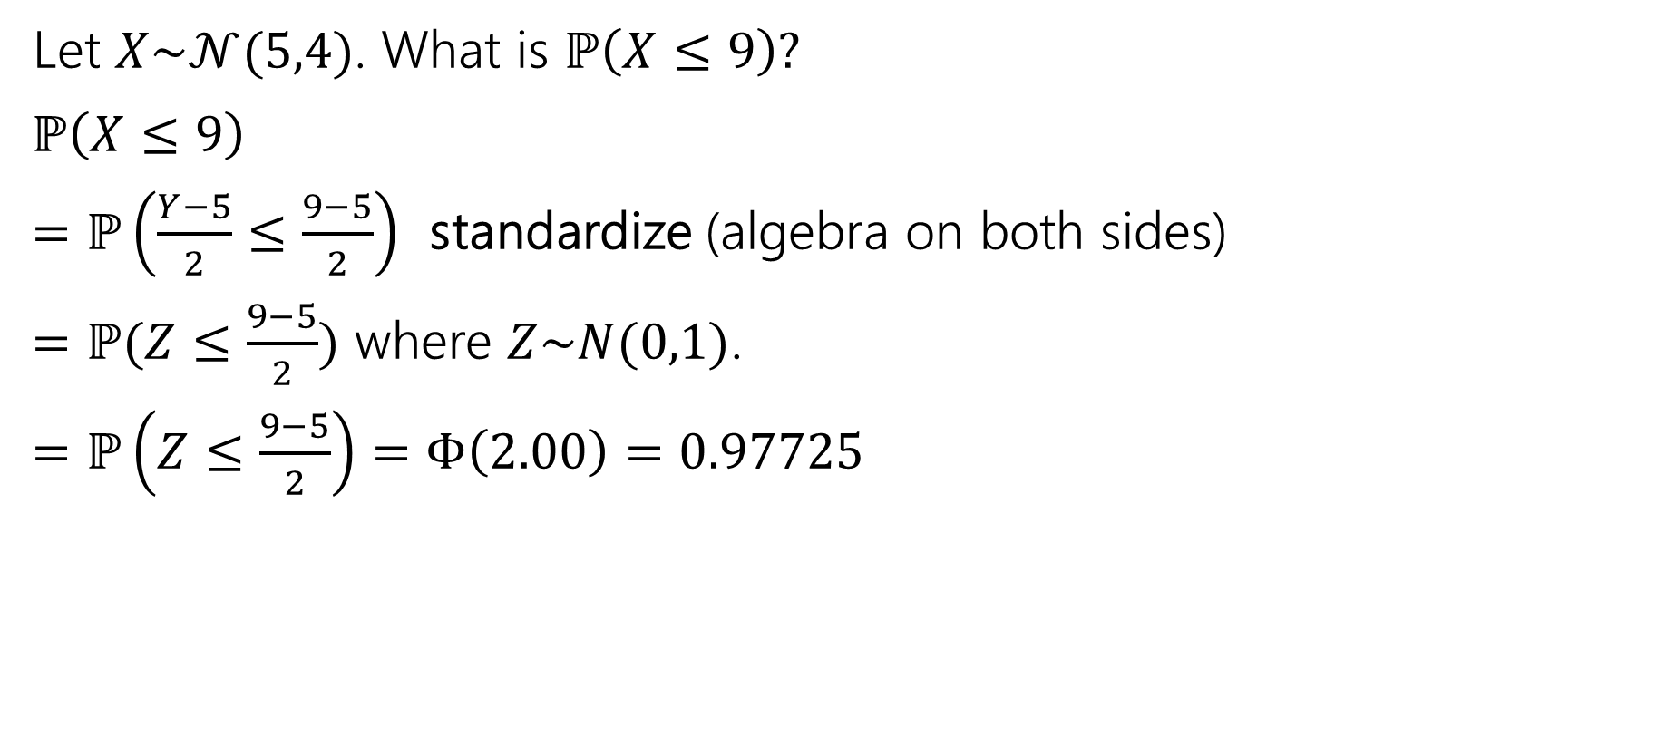


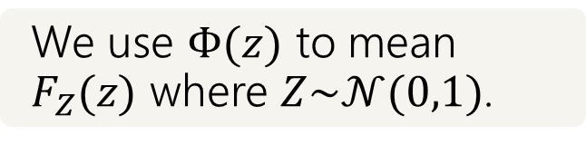
Practice!
We use $Φ(z)$ to mean $F_{Z}(z)$ where $Z\sim 𝒩(0,1)$.
Let $X\sim 𝒩(5,4)$. What is $ℙ\left(X≤9\right)?$
$ℙ\left(X≤9\right)$
$=ℙ\left(\frac{Y−5}{2}≤\frac{9−5}{2}\right)$ standardize (algebra on both sides)
$=ℙ(Z≤\frac{9−5}{2})$ where $Z\sim N(0,1)$.
$=ℙ\left(Z≤\frac{9−5}{2}\right)=Φ\left(2.00\right)=0.97725$
$$5$$
$$9$$

Slide 45
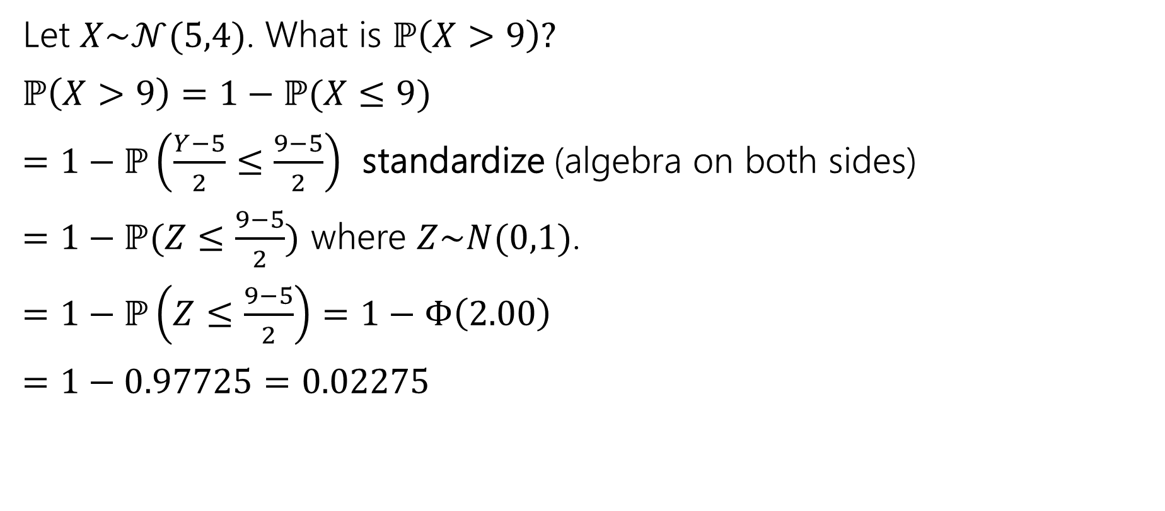
Practice!
We use $Φ(z)$ to mean $F_{Z}(z)$ where $Z\sim 𝒩(0,1)$.
Let $X\sim 𝒩(5,4)$. What is $ℙ\left(X>9\right)?$
$ℙ\left(X>9\right)=1−ℙ(X≤9)$
$=1−ℙ\left(\frac{Y−5}{2}≤\frac{9−5}{2}\right)$ standardize (algebra on both sides)
$=1−ℙ(Z≤\frac{9−5}{2})$ where $Z\sim N(0,1)$.
$=1−ℙ\left(Z≤\frac{9−5}{2}\right)=1−Φ\left(2.00\right)$
$=1−0.97725=0.02275$
$$5$$
$$9$$

Slide 47




More practice
Let $X\sim 𝒩(3, 2)$.
What is the probability that $1≤X≤4$?
$ℙ\left(1≤X≤4\right)$
$$1$$
$$3$$
$$4$$

Slide 48
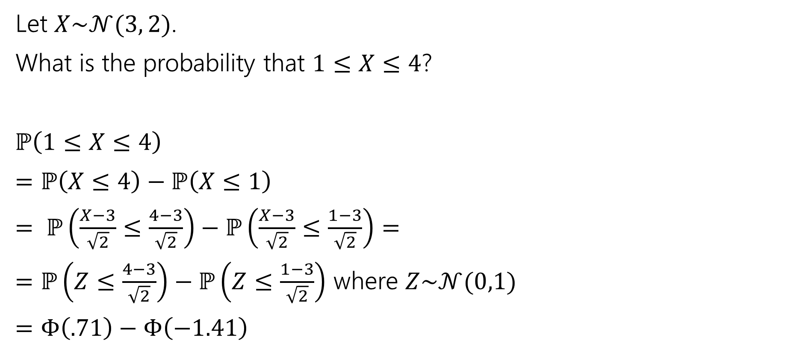
More practice
Let $X\sim 𝒩(3, 2)$.
What is the probability that $1≤X≤4$?
$ℙ\left(1≤X≤4\right)$
$=ℙ\left(X≤4\right)−ℙ\left(X≤1\right)$
$= ℙ\left(\frac{X−3}{\sqrt{2}}≤\frac{4−3}{\sqrt{2}}\right)−ℙ\left(\frac{X−3}{\sqrt{2}}≤\frac{1−3}{\sqrt{2}}\right)=$
$=ℙ\left(Z≤\frac{4−3}{\sqrt{2}}\right)−ℙ\left(Z≤\frac{1−3}{\sqrt{2}}\right)$ where $Z\sim 𝒩(0,1)$
$=Φ\left(.71\right)−Φ\left(−1.41\right)$
$$1$$
$$3$$
$$4$$

Slide 49
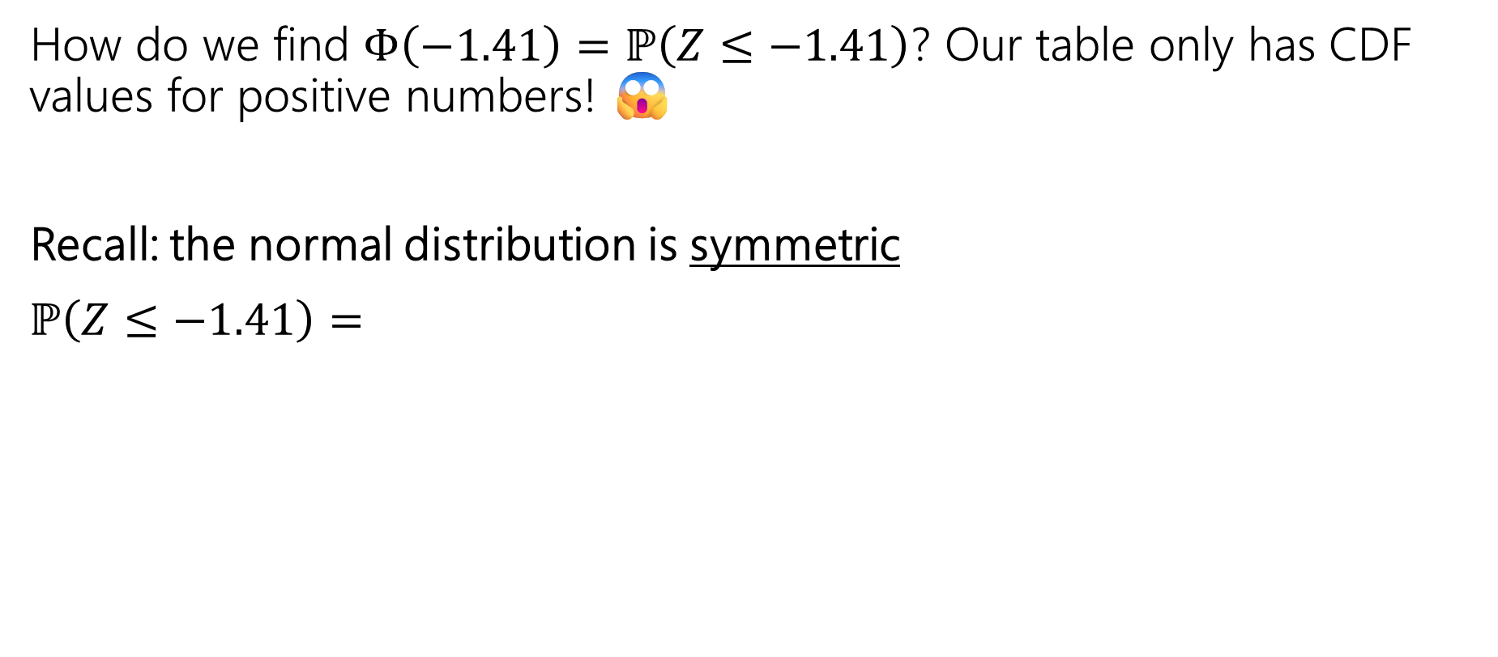



More practice
How do we find $Φ\left(−1.41\right)=ℙ\left(Z≤−1.41\right)$? Our table only has CDF values for positive numbers! 😱
Recall: the normal distribution is symmetric
$ℙ\left(Z≤−1.41\right)=$
$$−1.41$$
$$1$$
$$1.41$$

Slide 50


More practice
How do we find $Φ\left(−1.41\right)=ℙ\left(Z≤−1.41\right)$? Our table only has CDF values for positive numbers! 😱
Recall: the normal distribution is symmetric
$ℙ\left(Z≤−1.41\right)=ℙ\left(Z≥1.41\right)$
$=1−ℙ\left(Z≤1.41\right)$
$=1−Φ(1.41)$ this is something we can do…
$$−1.41$$
$$1$$
$$0.71$$

Slide 51

More practice
Let $X\sim 𝒩(3, 2)$.
What is the probability that $1≤X≤4$?
$ℙ\left(1≤X≤4\right)$
$=ℙ\left(X≤4\right)−ℙ\left(X≤1\right)$
$= ℙ\left(\frac{X−3}{\sqrt{2}}≤\frac{4−3}{\sqrt{2}}\right)−ℙ\left(\frac{X−3}{\sqrt{2}}≤\frac{1−3}{\sqrt{2}}\right)=$
$=ℙ\left(Z≤\frac{4−3}{\sqrt{2}}\right)−ℙ\left(Z≤\frac{1−3}{\sqrt{2}}\right)$ where $Z\sim 𝒩(0,1)$
$=Φ\left(.71\right)−Φ\left(−1.41\right)=Φ\left(.71\right)−(1−Φ\left(1.41))\right)$
$=0.76115 −\left(1−0.92073\right)=0.68188$
$$1$$
$$3$$
$$4$$

Slide 52

“within __ standard deviations from the mean”
What’s the probability of being within two standard deviations from the mean?
$ℙ\left(μ−2σ≤X≤μ+2σ\right)$
$=ℙ\left(X≤μ+2σ\right)−ℙ\left(X≤μ−2σ\right)=ℙ\left(Z≤\frac{μ+2σ−μ}{σ}\right)−ℙ\left(Z≤\frac{μ−2σ−μ}{σ}\right)$
$=Φ\left(2\right)−Φ\left(−2\right)$
$=Φ\left(2\right)−\left(1−Φ\left(2\right)\right)$
$=.97725−\left(1−.97725\right)=.9545$
You’ll sometimes hear statisticians refer to the “68-95-99.7 rule” which is the probability of being within 1,2, or 3 standard deviations of the mean.

Slide 53

Normal (aka Guassian)
When finding the probability of a normal random variable, draw a picture!! It can help reasoning about how we can use the CDF and the z-table to compute the desired region.
1. Write the probability we’re interested in in terms of the CDF
2. Standardize the normal random variable: $Z=\frac{X−μ}{σ}$
2. Round the “z-score”(s) to the hundredths place.
3. Look up the value(s) in the table

Slide 54

Can you spot the normal distribution?
It turns out the normal distribution appear a LOT in the real world. Like…in the gym!
Picture from reddit

Slide 55


Normal distributions show up everywhere!

Slide 56
But…why?
This is because of what we call, the central limit theorem!
“The sum of any independent random variables approaches a normal distribution. It becomes closer to normal as we sum more RVs together.”

Slide 57

More formally, the Central Limit Theorem!
This is because of what we call, the central limit theorem!
“The sum of any independent random variables approaches a normal distribution. It becomes closer to normal as we sum more RVs together.”
Central Limit Theorem
If $X_{1},X_{2},…,X_{n}$ are i.i.d. random variables, each with mean $μ$ and variance $σ^{2}$
Let $Y_{n}=X_{1}+X_{2}+…+X_{n}$
As $n→∞$, $Y_{n}$ approaches a normal distribution $𝒩(n⋅μ,n⋅σ^{2})$
(i.e., CDF of $Y_{n}$ converges to the CDF of $𝒩(n⋅μ,n⋅σ^{2})$)

Slide 58

What does i.i.d mean?
Independent and Identically Distributed (i.i.d)
For random variables $X_{1}, X_{2},…, X_{n}$ to be i.i.d., they must
Be mutually independent
  “knowing value of one random variable doesn’t give us info about the value of others”
All have the same PMF (if discrete) or PDF (if continuous)
  “they follow the same probability distribution”

Slide 59


CLT with RVs that are NOT i.i.d
(R.A. Fisher (1918))
Height may be expressed as the sum of many independent, random factors
  How much milk you drank per day as a child
  Which variant of GH1 (a growth hormone) you have
  How much protein/calcium/vitamins/minerals you had as a child
  How many hours of sleep you averaged
  How many hours of physical activity you averaged
  $H=H_{1}+H_{2}+,,,+H_{n}$ -> $H\sim N(…)$
A version of CLT does work here! But it’s outside the scope of this class.

Slide 60
CLT with RVs that are i.i.d
“number of firing neurons” – sum of indicator random variables for whether each neuron fired
  Assume: each neuron is independent, and has the same probability
“number of people who voted for someone” – sum of indicator random variables for (assume people are independent)
  Assume: each person makes independent, and has the same probability
“total amount invested in a year” – sum of random variables four amount invested each day (assume each investment is independent)
  Assume: each day’s investment is independent and follows the same distribution
We will use CLT in this class on problems like this.

Slide 61

A Sum of i.i.d Random Variables
If we have $X_{1}, X_{2}, …, X_{n}$ as i.i.d RVs each with mean $μ$ and variance $σ^{2}$
$S_{n}=X_{1}+X_{2}+…+X_{n}$ is the sum of those RVs. Then…
> Expectation. by linearity of expectation…
$𝔼\left[S_{n}\right]=𝔼\left[X_{1}+X_{2}+…+X_{n}\right]=𝔼\left[X_{1}\right]+𝔼\left[X_{2}\right]+…+𝔼\left[X_{n}\right]=nμ$
> Variance. by linearity of variance because of independence
$Var\left(S_{n}\right)=Var\left(X_{1}+X_{2}+…+X_{n}\right)=Var\left(X_{1}\right)+Var\left(X_{2}\right)+…+Var\left(nσ^{2}\right)$

Slide 62

Proof of the CLT?
We’re not going to cover the proof here.
How is the proof done?
Step 1: Prove that for all positive integers $k, \left[{\left(Y_{n}\right)}^{k}\right]→𝔼[Z^{k}]$
Step 2: Prove that if $𝔼\left[{\left(Y_{n}\right)}^{k}\right]=𝔼\left[Z^{k}\right]$ for all $k$ then $F_{Y_{n}}\left(z\right)=F_{Z}(z)$

Slide 63







“Proof by example”
CLT says a sum of $n$ i.i.d RVs approaches a normal distribution as $n$ gets larger
$$n=1$$
$$n=2$$
$n$ is the number of i.i.d RVs summed
The dotted lines show an “empirical PMF” – a PMF estimated by running the experiment a large number of times.
The blue line is the normal RV that the CLT predicts.
Shown are $n=1,2,3,10$
$$n=3$$
$$n=10$$

Slide 64

“Proof by example” -- uniform
https://www.desmos.com/calculator/2n2m05a9km

Slide 65

“Proof by example” -- uniform
$$X=X_{1}$$
where each $X_{i}\sim Unif(0,1)$ and is independent

Slide 66
“Proof by example” -- uniform
$$X=X_{1}$$
where each $X_{i}\sim Unif(0,1)$ and is independent

Slide 67

“Proof by example” -- uniform
$$X=X_{1}+X_{2}$$
where each $X_{i}\sim Unif(0,1)$ and is independent

Slide 68

“Proof by example” -- uniform
$$X=X_{1}+X_{2}+X_{3}$$
where each $X_{i}\sim Unif(0,1)$ and is independent

Slide 69

“Proof by example” -- uniform
$$X=X_{1}+X_{2}+X_{3}+X_{4}$$
where each $X_{i}\sim Unif(0,1)$ and is independent

Slide 70

“Proof by example” -- uniform
$$X=X_{1}+X_{2}+X_{3}+X_{4}+X_{5}$$
where each $X_{i}\sim Unif(0,1)$ and is independent

Slide 71

“Proof by example” -- uniform
$$X=X_{1}+X_{2}+X_{3}+X_{4}+X_{5}+X_{6}$$
where each $X_{i}\sim Unif(0,1)$ and is independent

Slide 72

“Proof by example” -- uniform
$$X=X_{1}+X_{2}+X_{3}+X_{4}+X_{5}+X_{6}+X_{7}$$
where each $X_{i}\sim Unif(0,1)$ and is independent

Slide 73

“Proof by example” -- uniform
$$X=X_{1}+X_{2}+X_{3}+X_{4}+X_{5}+X_{6}+X_{7}+X_{8}$$
where each $X_{i}\sim Unif(0,1)$ and is independent

Slide 74

“Proof by example” -- uniform
$$X=X_{1}+X_{2}+X_{3}+X_{4}+X_{5}+X_{6}+X_{7}+X_{8}+X_{9}$$
where each $X_{i}\sim Unif(0,1)$ and is independent

Slide 75

“Proof by example” -- uniform
$$X=X_{1}+X_{2}+X_{3}+X_{4}+X_{5}+X_{6}+X_{7}+X_{8}+X_{9}+X_{10}$$
where each $X_{i}\sim Unif(0,1)$ and is independent

Slide 76

“Proof by real-world”
A lot of real-world bell-curves can be explained as:
1. The random variable comes from a combination of independent factors.
2. The CLT says the distribution will become like a bell curve.
birthweight

Slide 77

Theory vs. Practice
> The formal theorem statement is “in the limit”
You might not get exactly a normal distribution for any finite $n$ (e.g. if
you sum discrete, the sum is always discrete and will be discontinuous
for every finite $n$.
> In practice, the approximations get very accurate very quickly (at least
with a few tricks we’ll see soon).
They won’t be exact (unless the $X_{i}$ are normals) but it’s close enough
to use even with relatively small $n$.

