Slide 1

Continuous Random Variables
CSE 312 26Su
Lecture 13
Fun fact!
You play a game where a fair coin is tossed until it comes up heads. The payoff is $2^{n}$ dollars, where $n$ is the number of tosses. The expected value of this game is infinite, which is surprising because no one would realistically pay an extremely high entry fee to play. (convince yourself of this using the geometric distribution PMF and LOTUS!)

Slide 2
Announcements
HW4 released and due next Wednesday

Slide 3
What have we done over the past 4 weeks?
Counting
  Combinations, permutations, indistinguishable elements, starts and bars, inclusion-exclusion…
  Probability foundations
  Events, sample space, axioms of probability, expectation, variance
  Conditional probability
  Conditioning, independence, Bayes’ Rule
  Refined our intuition
  Especially around Bayes’ Rule

Slide 4
What’s next?
Continuous random variables.
  So far our sample spaces have been countable. What happens if we want to choose a random real number?
  How do expectation, variance, conditioning, etc. change in this new context?
  Mostly analogous to discrete cases, but with integrals instead of sums.
  Analysis when it’s inconvenient (or impossible) to exactly calculate probabilities.
  Central Limit Theorem (approximating discrete distributions with continuous ones)
  Tail Bounds/Concentration (arguing it’s unlikely that a random variable is far from its expectation)
  A first taste of making predictions from data (i.e., a bit of ML)

Slide 5
Where Are We?
Last time:
  Zoo of Discrete RVs
Today:
  Continuous Random Variables
    Probability Density Function
    Cumulative Distribution Function
    Expectation and Variance
  Comparing Discrete vs. Continuous
  Continuous Uniform Distribution

Slide 6
Continuous Random Variables
Goal for today is to get intuition on what’s different in the continuous case
ASK QUESTIONS (always! but today especially ☺)

Slide 7
Discrete Random Variables
The kind that we’ve been working with up till now!
The support has finite or countably infinite values
  e.g., number of successes, number of trials till success, attendance at a class are all discrete because they take on a set of finite or countably infinite values
  Some random experiments have uncountably-infinite sample spaces
> How long until the next bus shows up?
> Throwing a dart on a board (what location does the dart land?)
Continuous Random Variables
  Random variables with a support of uncountably-infinite values
  > e.g., RVs that take on any real number in some interval(s) like distance, height, time, etc.

Slide 8
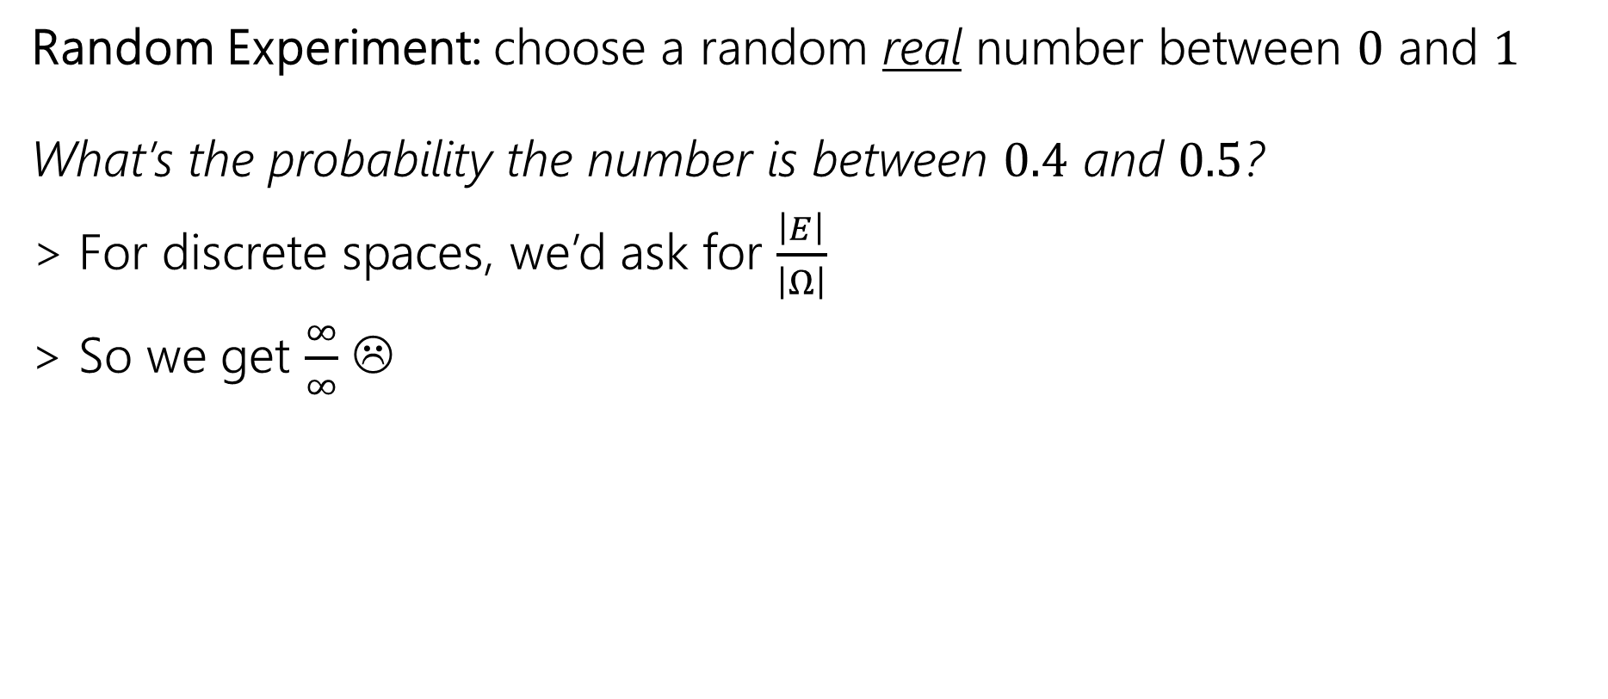
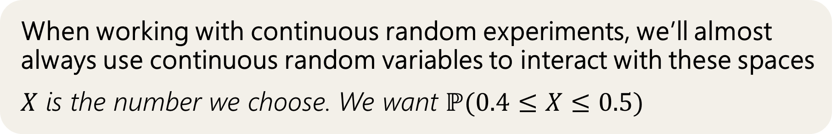
Why Need New Rules?
Random Experiment: choose a random real number between $0$ and $1$
What’s the probability the number is between $0.4$ and $0.5$?
> For discrete spaces, we’d ask for $\frac{\left|E\right|}{\left|Ω\right|}$
> So we get $\frac{∞}{∞}$ ☹
When working with continuous random experiments, we’ll almost always use continuous random variables to interact with these spaces
$X$ is the number we choose. We want $ℙ(0.4≤X≤0.5)$

Slide 9
Probability Density Function (PDF)
Analogous to PMF in a discrete random variable

Slide 10

How to describe probability of a single value?
For discrete random variables, we defined the PMF: $p_{Y}\left(k\right)=ℙ(Y=k)$.

Slide 11
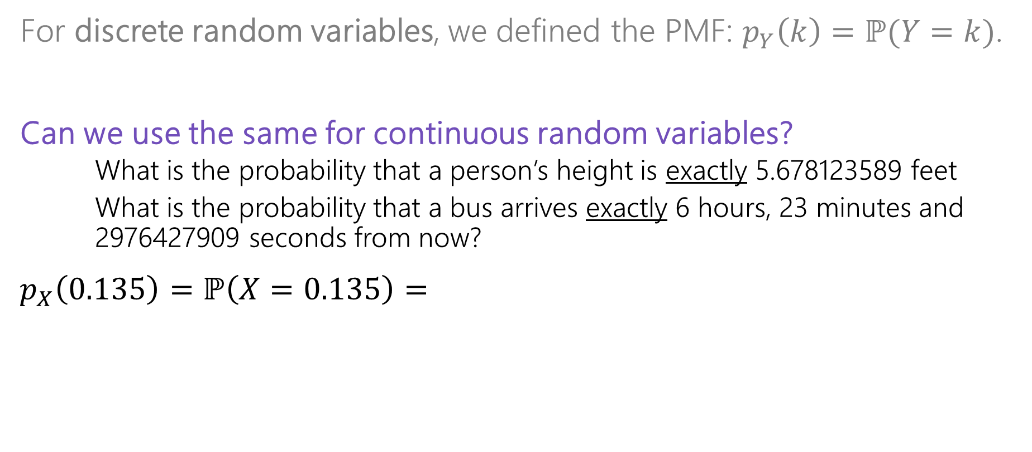
How to describe probability of a single value?
For discrete random variables, we defined the PMF: $p_{Y}\left(k\right)=ℙ(Y=k)$.
Can we use the same for continuous random variables?
  What is the probability that a person’s height is exactly 5.678123589 feet
  What is the probability that a bus arrives exactly 6 hours, 23 minutes and
  2976427909 seconds from now?
$p_{X}\left(0.135\right)=ℙ\left(X=0.135\right)=$

Slide 12

How to describe probability of a single value?
For discrete random variables, we defined the PMF: $p_{Y}\left(k\right)=ℙ(Y=k)$.
Can we use the same for continuous random variables?
  What is the probability that a person’s height is exactly 5.678123589 feet
  What is the probability that a bus arrives exactly 6 hours, 23 minutes and
  2976427909 seconds from now?
$p_{X}\left(0.135\right)=ℙ\left(X=0.135\right)=\frac{1}{∞}$ = 0 No!

Slide 13
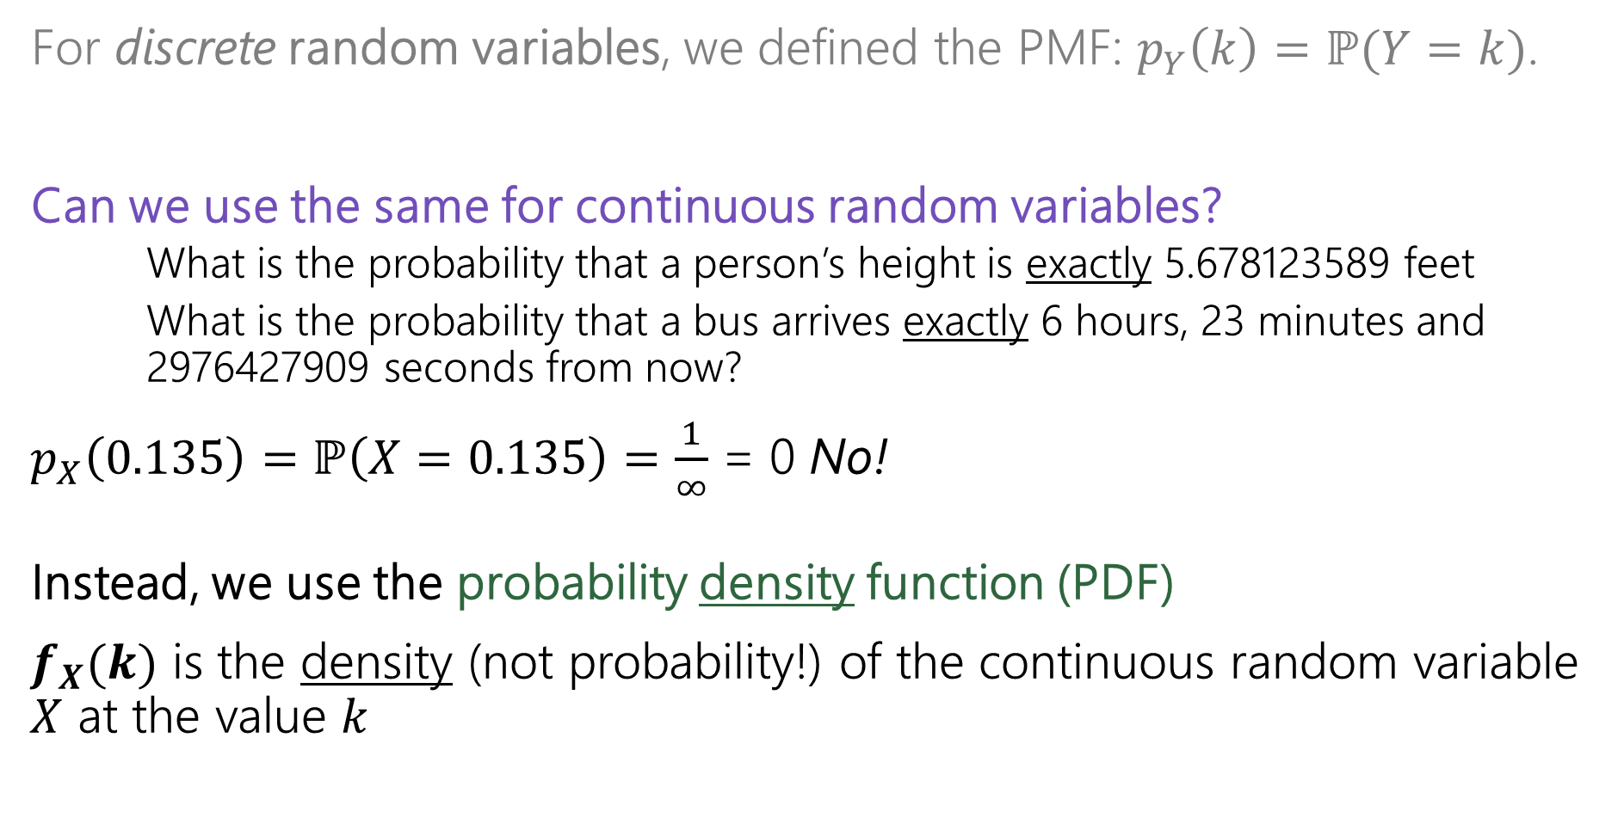
How to describe probability of a single value?
For discrete random variables, we defined the PMF: $p_{Y}\left(k\right)=ℙ(Y=k)$.
Can we use the same for continuous random variables?
  What is the probability that a person’s height is exactly 5.678123589 feet
  What is the probability that a bus arrives exactly 6 hours, 23 minutes and
  2976427909 seconds from now?
$p_{X}\left(0.135\right)=ℙ\left(X=0.135\right)=\frac{1}{∞}$ = 0 No!
Instead, we use the probability density function (PDF)
$f_{X}(k)$ is the density (not probability!) of the continuous random variable $X$ at the value $k$

Slide 14

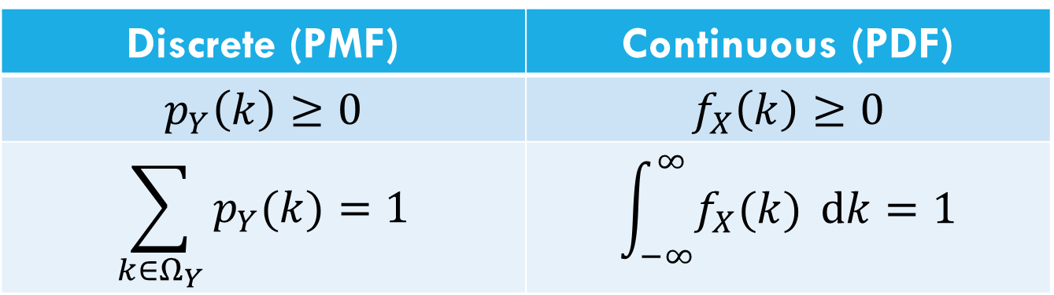
Probability Density Function
For discrete random variables, we defined the PMF: $p_{Y}\left(k\right)=ℙ(Y=k)$.
For continuous random variables, we use the probability density function
$f_{X}(k)$ is the density (not probability!) of the continuous random variable $X$ at the value $k$
Discrete (PMF) | Continuous (PDF)
$$p_{Y}\left(k\right)≥0$$ | $$f_{X}\left(k\right)≥0$$
$$\sum_{k∈Ω_{Y}}{p_{Y}(k)}=1$$ | $$\int_{−∞}^{∞}{f_{X}(k)} dk=1$$

Slide 15
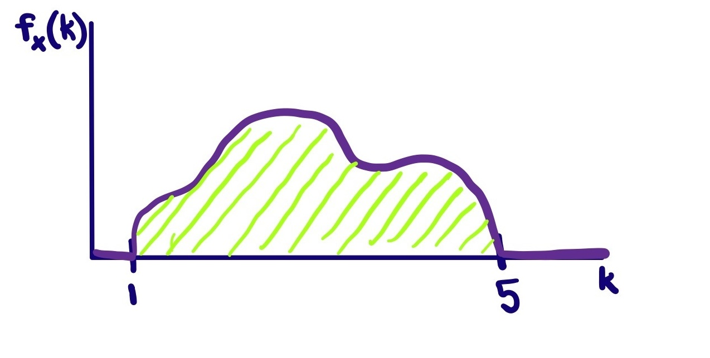
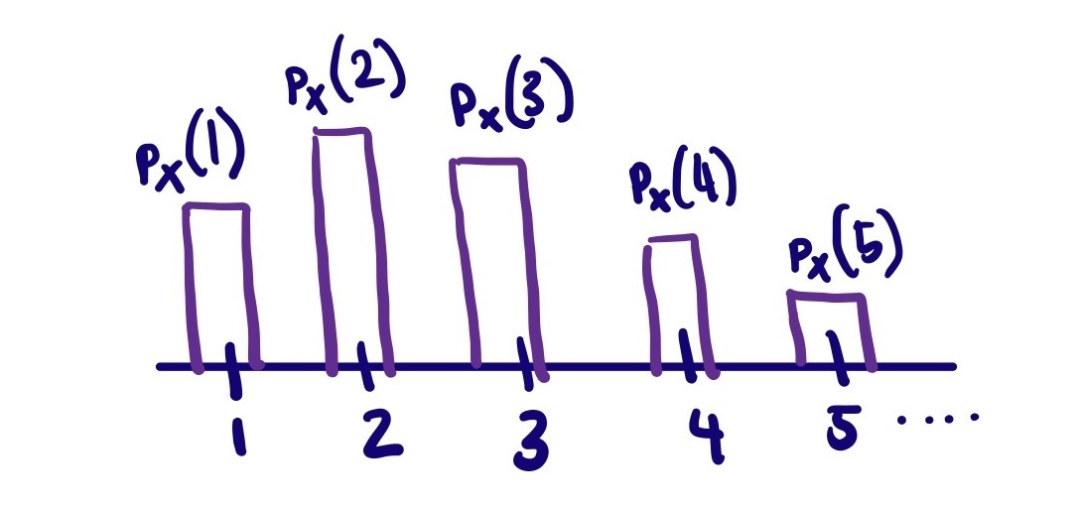


Probability Density Function
For discrete random variables, we defined the PMF: $p_{Y}\left(k\right)=ℙ(Y=k)$.
For continuous random variables, we use the probability density function
$f_{X}(k)$ is the density (not probability!) of the continuous random variable $X$ at the value $k$
e.g., PMF for a discrete RV, $X$
e.g., PDF for a continuous RV, $X$

Slide 16
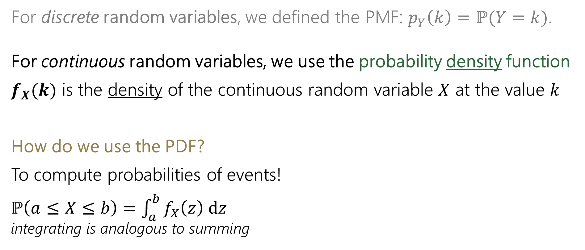
Probability Density Function
For discrete random variables, we defined the PMF: $p_{Y}\left(k\right)=ℙ(Y=k)$.
For continuous random variables, we use the probability density function
$f_{X}(k)$ is the density of the continuous random variable $X$ at the value $k$
How do we use the PDF?
To compute probabilities of events!
$ℙ\left(a≤X≤b\right)=$ $\int_{a}^{b}{f_{X}\left(z\right) dz}$
integrating is analogous to summing
e.g., PDF for a continuous RV, $X$

Slide 17
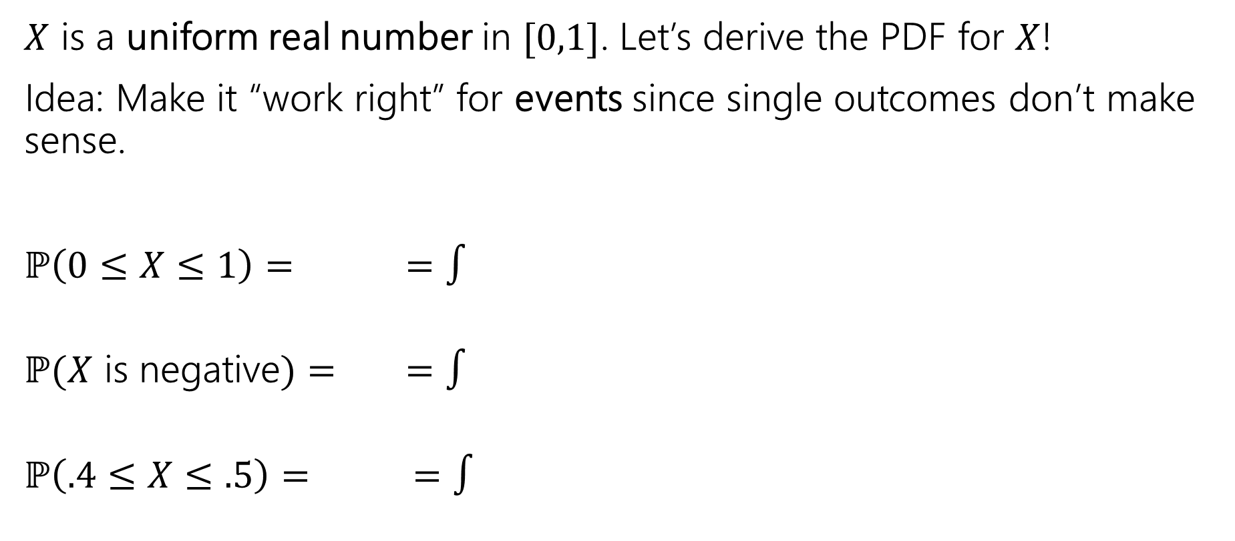
Probability Density Function (example)
$X$ is a uniform real number in $[0,1]$. Let’s derive the PDF for $X$!
Idea: Make it “work right” for events since single outcomes don’t make sense.
$ℙ\left(0≤X≤1\right)= =∫$
$ℙ(X$ is negative$)= =∫$
$ℙ\left(.4≤X≤.5\right)= =∫$

Slide 18
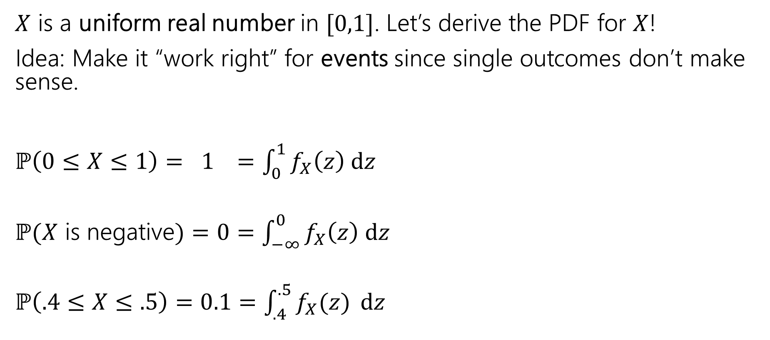
Probability Density Function (example)
$X$ is a uniform real number in $[0,1]$. Let’s derive the PDF for $X$!
Idea: Make it “work right” for events since single outcomes don’t make sense.
$ℙ\left(0≤X≤1\right)= 1 =\int_{0}^{1}{f_{X}\left(z\right) dz}$
$ℙ(X$ is negative$)=0=\int_{−∞}^{0}{f_{X}\left(z\right) dz}$
$ℙ\left(.4≤X≤.5\right)=0.1=\int_{.4}^{.5}{f_{X}(z)} dz$

Slide 19
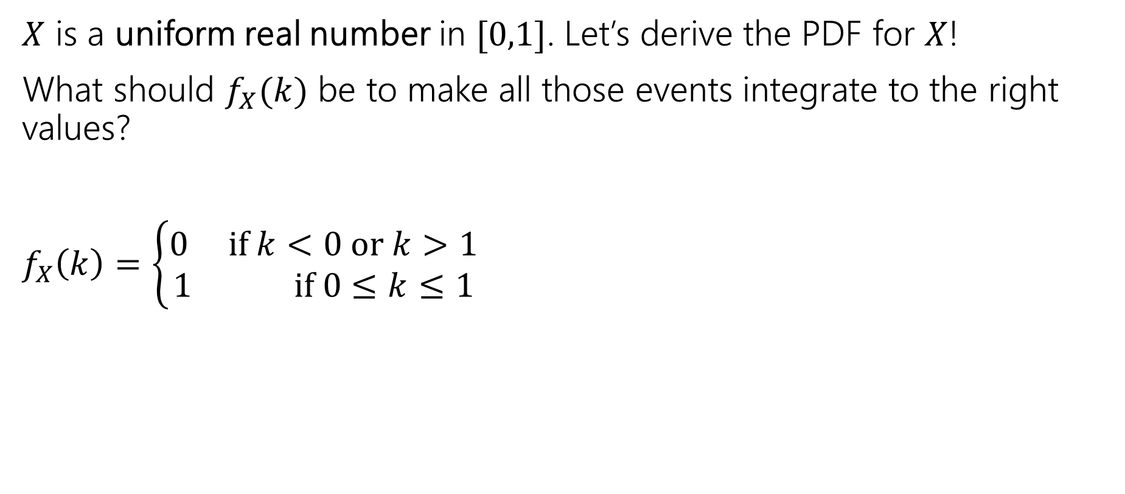
Probability Density Function (example)
$X$ is a uniform real number in $[0,1]$. Let’s derive the PDF for $X$!
What should $f_{X}(k)$ be to make all those events integrate to the right values?
$f_{X}\left(k\right)=\left\{\begin{aligned}0 if k<0 or k>1 \\ 1 if 0≤k≤1\end{aligned}\right.$
0
1

Slide 20
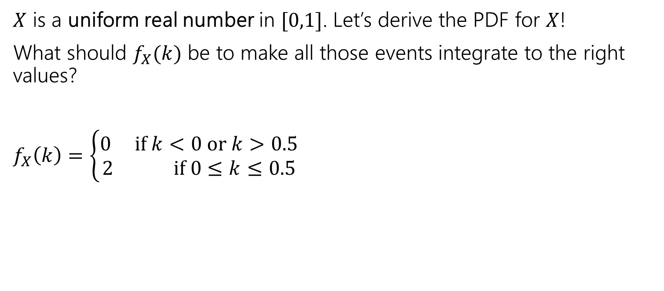
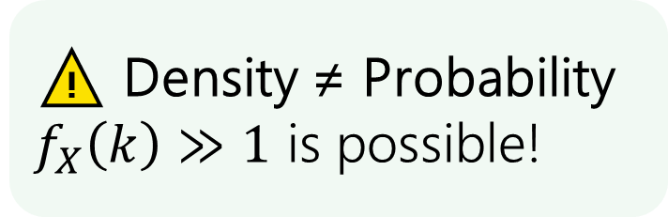
Probability Density Function (example 2)
$X$ is a uniform real number in $[0,1]$. Let’s derive the PDF for $X$!
What should $f_{X}(k)$ be to make all those events integrate to the right values?
$f_{X}\left(k\right)=\left\{\begin{aligned}0 if k<0 or k>0.5 \\ 2 if 0≤k≤0.5\end{aligned}\right.$
⚠️ Density ≠ Probability
$f_{X}\left(k\right)≫1$ is possible!
0
0.5
1

Slide 21
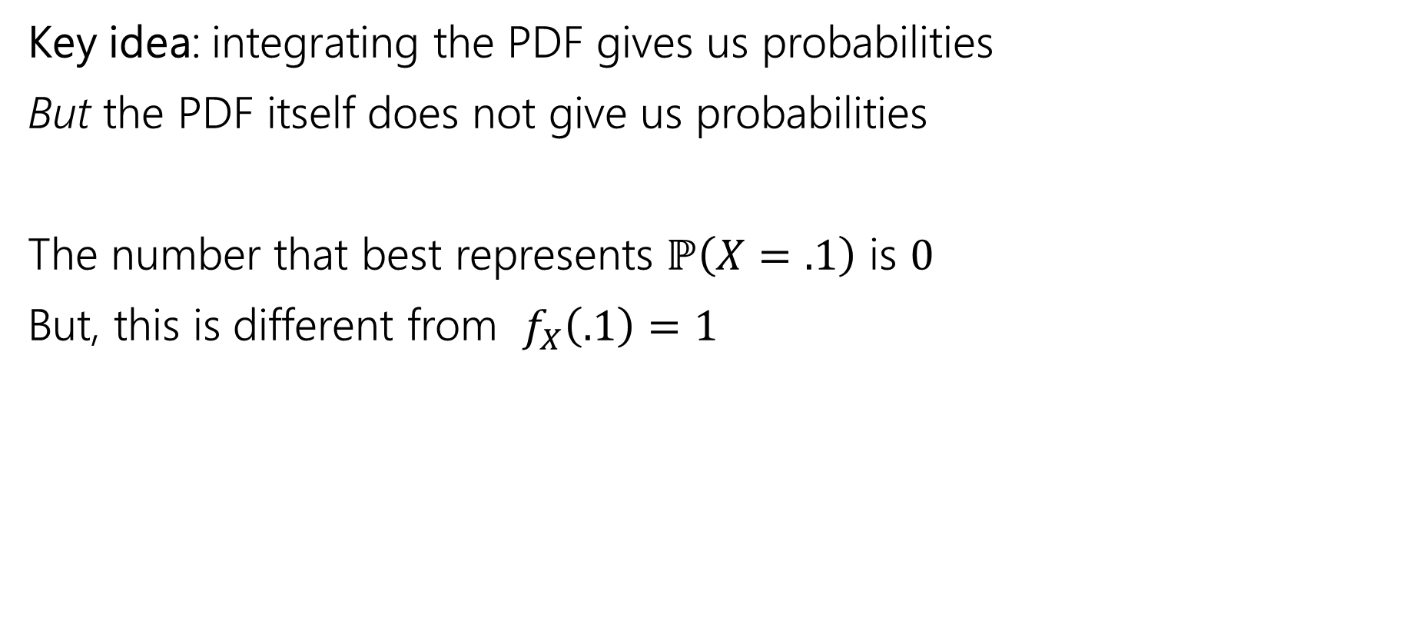
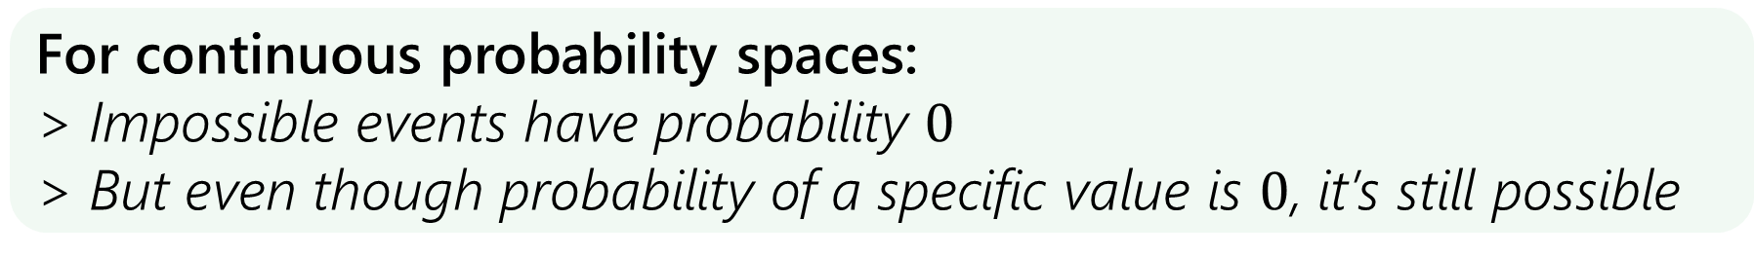
Probability vs. Density
Key idea: integrating the PDF gives us probabilities
But the PDF itself does not give us probabilities
The number that best represents $ℙ\left(X=.1\right)$ is $0$
But, this is different from $f_{X}\left(.1\right)=1$
For continuous probability spaces:
> Impossible events have probability $0$
> But even though probability of a specific value is $0$, it’s still possible

Slide 22
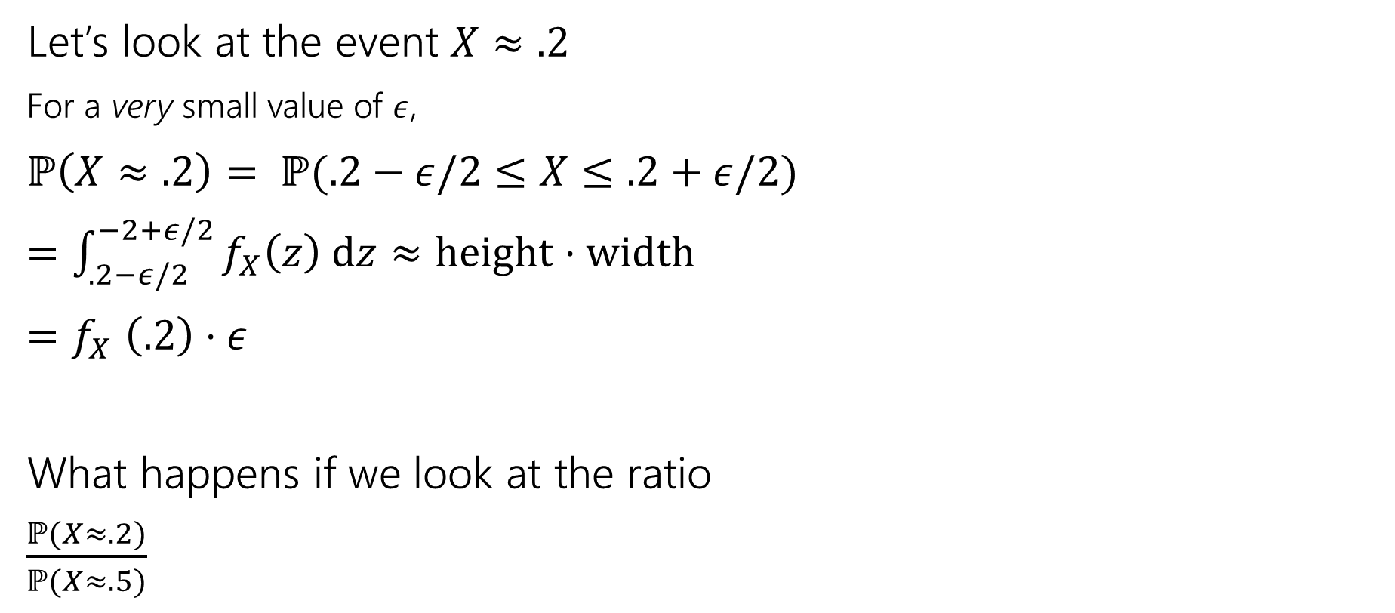
What exactly do the values in the PDF mean?
Let’s look at the event $X≈.2$
For a very small value of $ε$,
$ℙ\left(X≈.2\right)= ℙ(.2−ε/2≤X≤.2+ε/2)$
$=\int_{.2−ε/2}^{−2+ε/2}{f_{X}\left(z\right) dz}≈height⋅width$
${=f}_{X}\left(.2\right)⋅ε$
What happens if we look at the ratio
$\frac{ℙ(X≈.2)}{ℙ(X≈.5)}$
.2

Slide 23
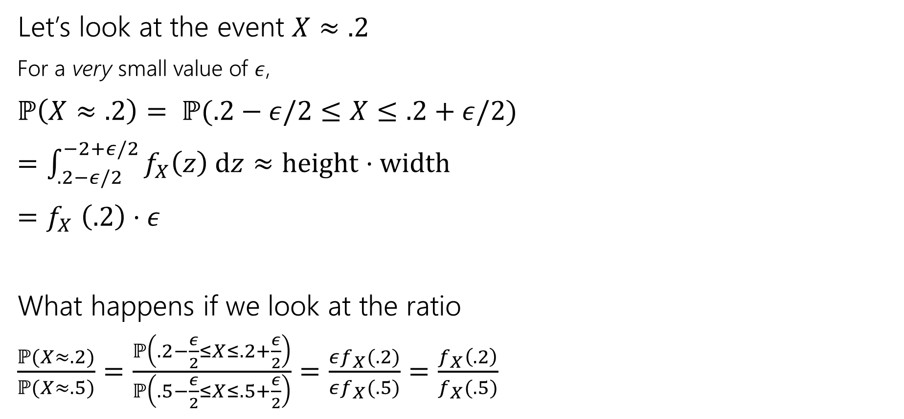
What exactly do the values in the PDF mean?
Let’s look at the event $X≈.2$
For a very small value of $ε$,
$ℙ\left(X≈.2\right)= ℙ(.2−ε/2≤X≤.2+ε/2)$
$=\int_{.2−ε/2}^{−2+ε/2}{f_{X}\left(z\right) dz}≈height⋅width$
${=f}_{X}\left(.2\right)⋅ε$
What happens if we look at the ratio
$\frac{ℙ(X≈.2)}{ℙ(X≈.5)}=\frac{ℙ\left(.2−\frac{ε}{2}≤X≤.2+\frac{ε}{2}\right)}{ℙ\left(.5−\frac{ε}{2}≤X≤.5+\frac{ε}{2}\right)}=\frac{εf_{X}(.2)}{εf_{X}(.5)}=\frac{f_{X}\left(.2\right)}{f_{X}(.5)}$
.2
.5

Slide 24
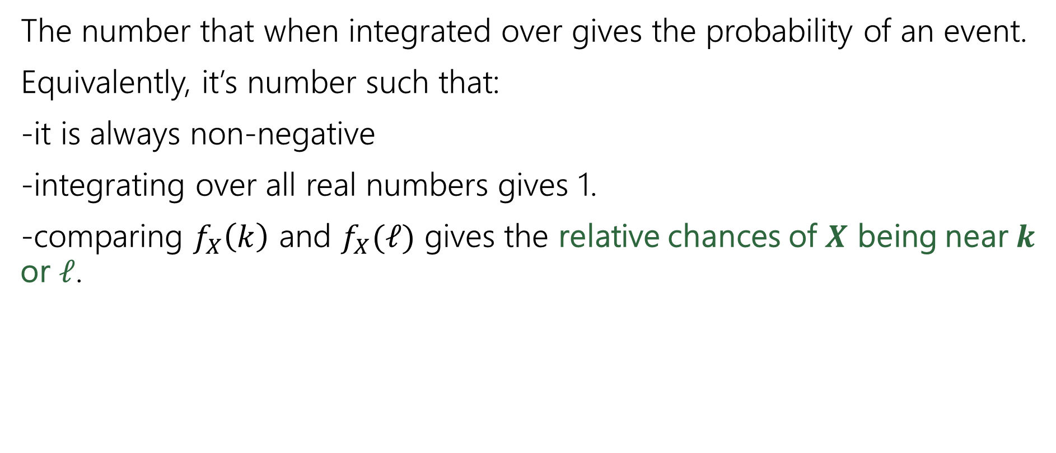
What exactly do the values in the PDF mean?
The number that when integrated over gives the probability of an event.
Equivalently, it’s number such that:
-it is always non-negative
-integrating over all real numbers gives 1.
-comparing $f_{X}\left(k\right)$ and $f_{X}(ℓ)$ gives the relative chances of $X$ being near $k$ or $ℓ$.

Slide 25
Cumulative Distribution Function (CDF)

Slide 26
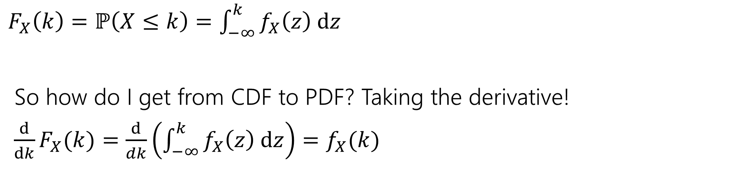

What’s a CDF?
The Cumulative Distribution Function $F_{X}\left(k\right)=ℙ(X≤k)$
analogous to the CDF for discrete variables.
$F_{X}\left(k\right)=ℙ\left(X≤k\right)=\int_{−∞}^{k}{f_{X}\left(z\right) dz}$
So how do I get from CDF to PDF? Taking the derivative!
$\frac{d}{dk}F_{X}(k)=\frac{d}{dk}\left(\int_{−∞}^{k}{f_{X}\left(z\right) dz}\right)=f_{X}(k)$

Slide 27
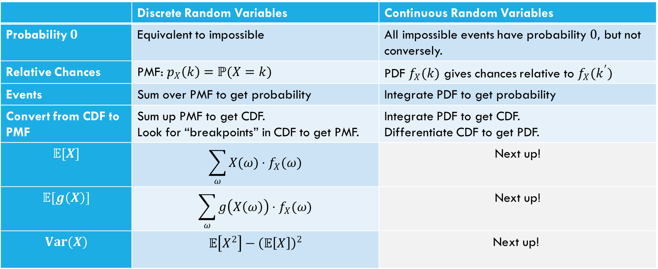
Comparing Discrete and Continuous
 | Discrete Random Variables | Continuous Random Variables
Probability $0$ | Equivalent to impossible | All impossible events have probability $0,$ but not conversely.
Relative Chances | PMF: $p_{X}\left(k\right)=ℙ(X=k)$ | PDF $f_{X}(k)$ gives chances relative to $f_{X}(k^{′})$
Events | Sum over PMF to get probability | Integrate PDF to get probability
Convert from CDF to PMF | Sum up PMF to get CDF. Look for “breakpoints” in CDF to get PMF. | Integrate PDF to get CDF. Differentiate CDF to get PDF.
$$𝔼[X]$$ | $$\sum_{ω}{X(ω)⋅f_{X}(ω)}$$ | Next up!
$$𝔼[g\left(X\right)]$$ | $$\sum_{ω}{g\left(X\left(ω\right)\right)⋅f_{X}(ω)}$$ | Next up!
$$Var(X)$$ | $$𝔼\left[X^{2}\right]−{\left(𝔼\left[X\right]\right)}^{2}$$ | $$\text{Next} \text{up}\text{!}$$

Slide 28
Expectation and Variance

Slide 29
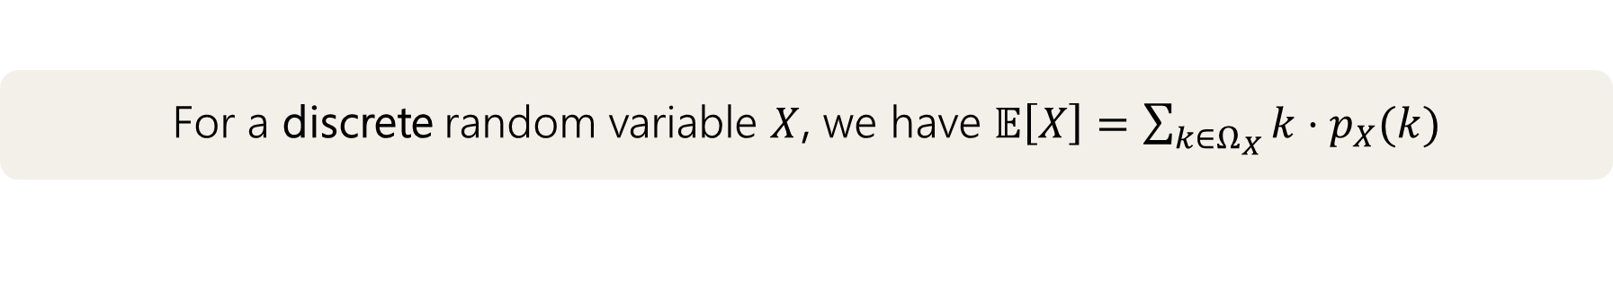
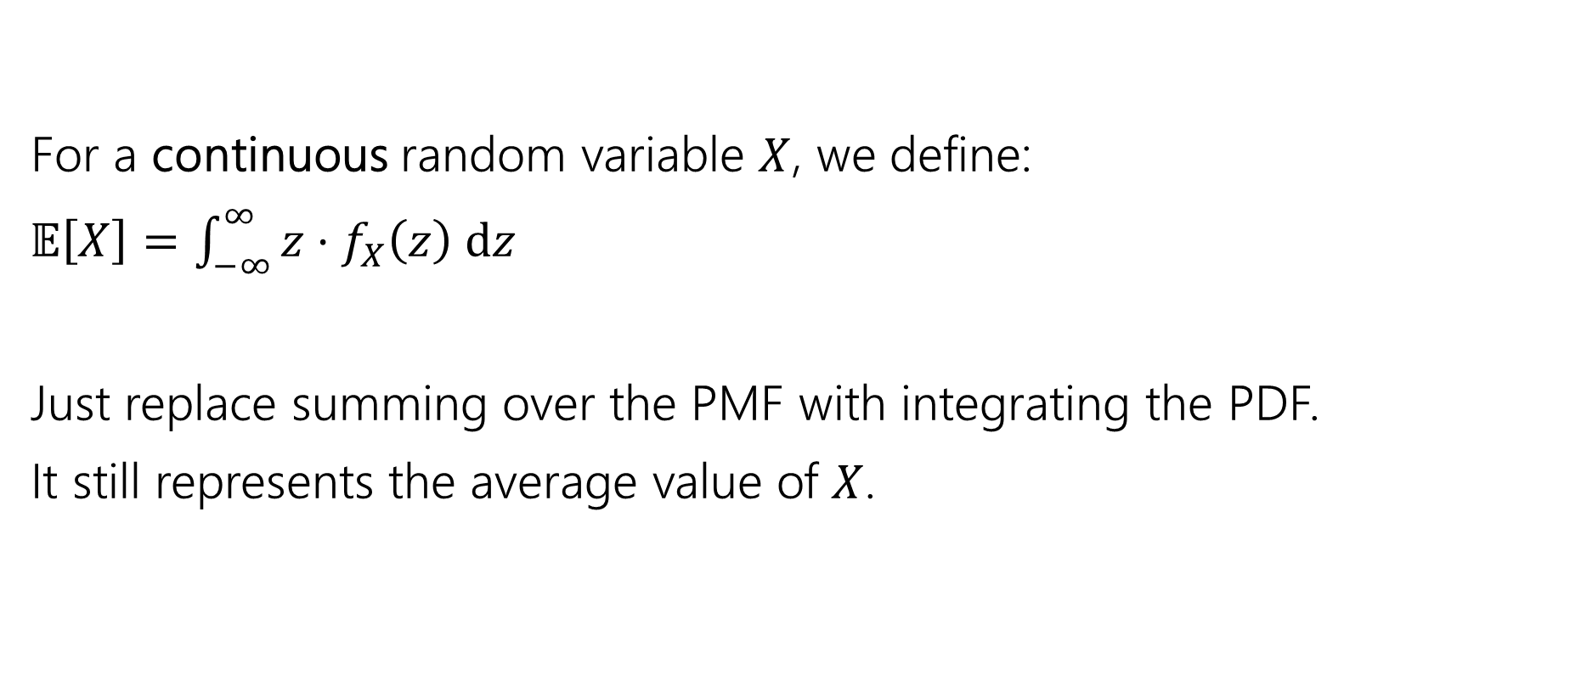
What about expectation?
For a discrete random variable $X$, we have $𝔼\left[X\right]=\sum_{k∈Ω_{X}}{k⋅p_{X}(k)}$
For a continuous random variable $X$, we define:
$𝔼\left[X\right]=\int_{−∞}^{∞}{{z⋅f}_{X}\left(z\right) dz}$
Just replace summing over the PMF with integrating the PDF.
It still represents the average value of $X$.

Slide 30
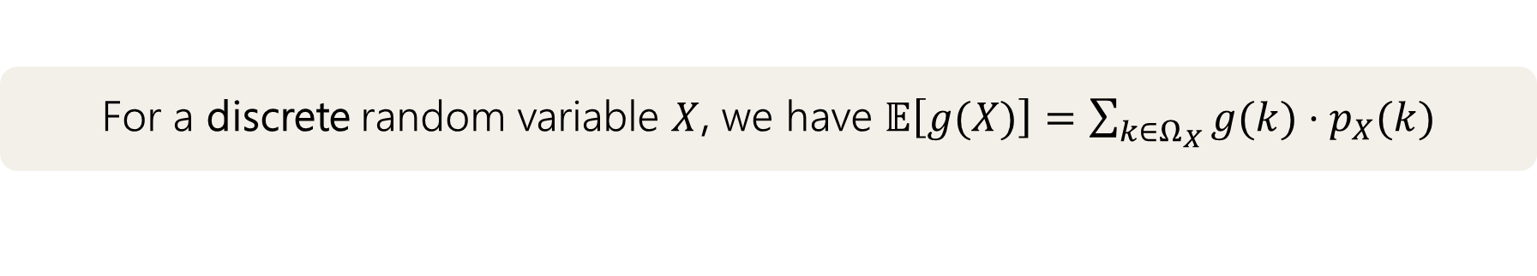
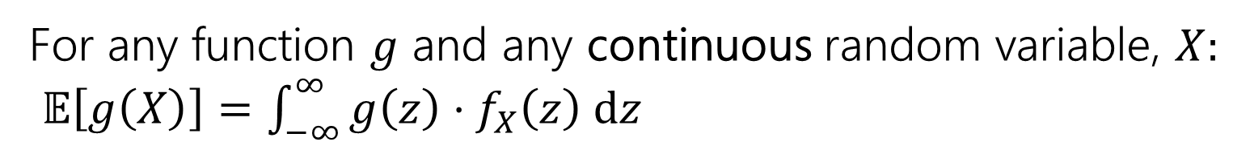
Expectation of a function
For a discrete random variable $X$, we have $𝔼\left[g(X)\right]=\sum_{k∈Ω_{X}}{g(k)⋅p_{X}(k)}$
For any function $g$ and any continuous random variable, $X:$
$𝔼\left[g\left(X\right)\right]=\int_{−∞}^{∞}{g\left(z\right)⋅f_{X}\left(z\right) dz}$
Again, analogous to the discrete case; just replace summation with integration and pmf with the pdf.

Slide 31

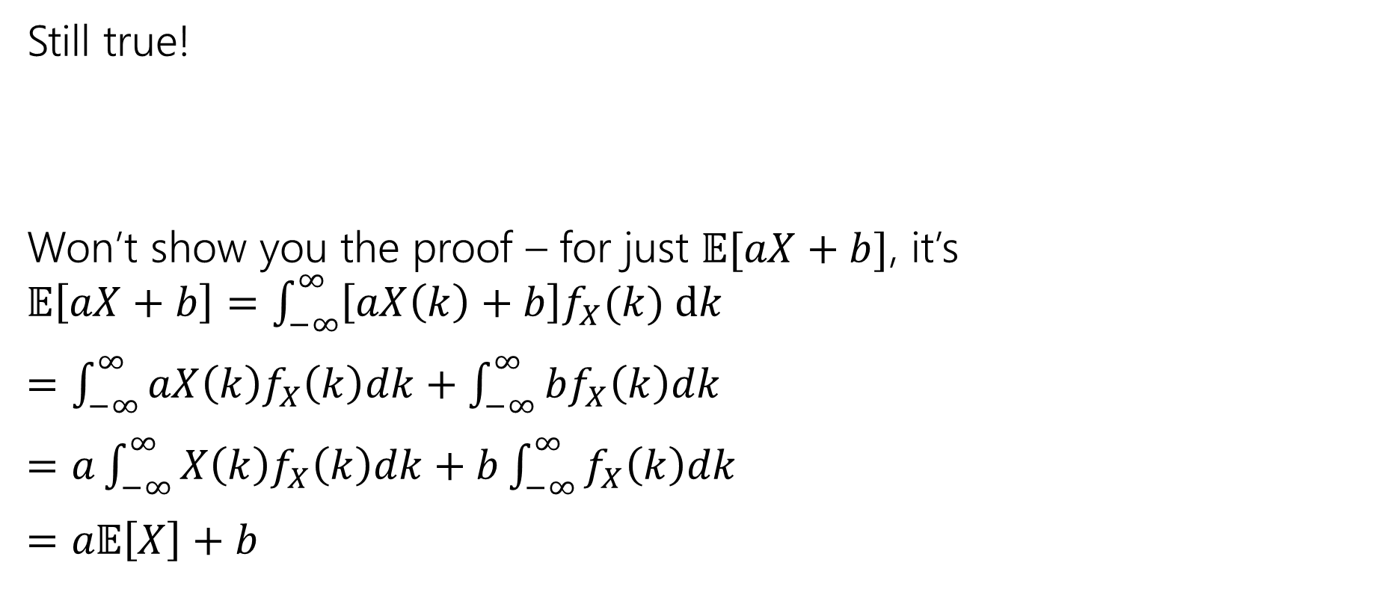
Linearity of Expectation
Still true!
Won’t show you the proof – for just $𝔼[aX+b]$, it’s
$𝔼\left[aX+b\right]=\int_{−∞}^{∞}{\left[aX\left(k\right)+b\right]f_{X}(k) dk}$
$=\int_{−∞}^{∞}{aX\left(k\right)f_{X}\left(k\right)dk}+\int_{−∞}^{∞}{bf_{X}\left(k\right)dk}$
$=a\int_{−∞}^{∞}{X\left(k\right)f_{X}\left(k\right)dk}+b\int_{−∞}^{∞}{f_{X}\left(k\right)dk}$
$=a𝔼\left[X\right]+b$
$$𝔼\left[aX+bY+c\right]=a𝔼\left[X\right]+b𝔼\left[Y\right\}+c$$
For all $X,Y$; even if they’re continuous.

Slide 32

Variance
No surprises here
$$Var\left(X\right)=𝔼\left[X^{2}\right]−{\left(𝔼\left[X\right]\right)}^{2}=\int_{−∞}^{∞}{{f_{X}(k)\left(k−𝔼\left[X\right]\right)}^{2} dk}$$

Slide 33
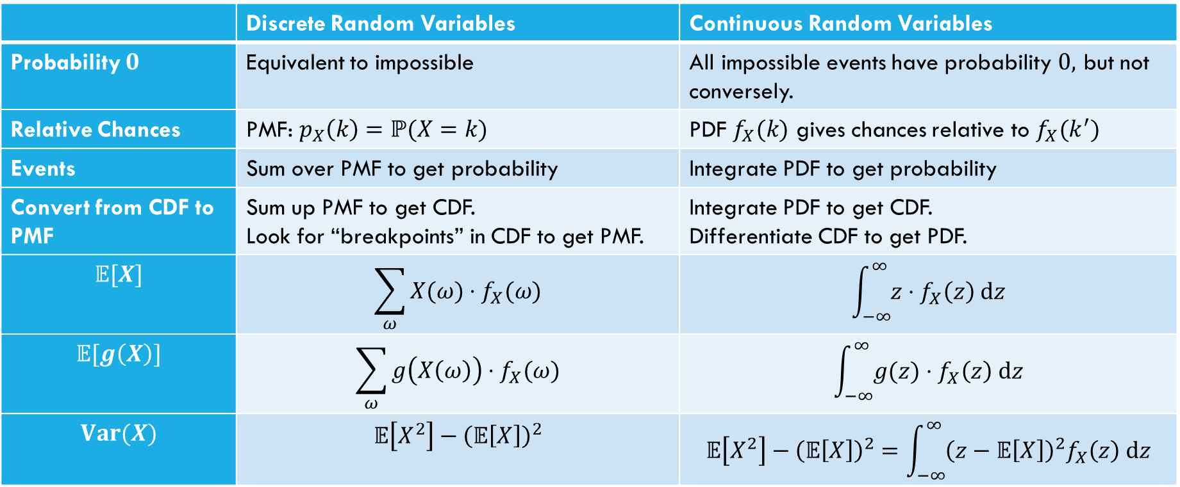
Comparing Discrete and Continuous
 | Discrete Random Variables | Continuous Random Variables
Probability $0$ | Equivalent to impossible | All impossible events have probability $0,$ but not conversely.
Relative Chances | PMF: $p_{X}\left(k\right)=ℙ(X=k)$ | PDF $f_{X}(k)$ gives chances relative to $f_{X}(k^{′})$
Events | Sum over PMF to get probability | Integrate PDF to get probability
Convert from CDF to PMF | Sum up PMF to get CDF. Look for “breakpoints” in CDF to get PMF. | Integrate PDF to get CDF. Differentiate CDF to get PDF.
$$𝔼[X]$$ | $$\sum_{ω}{X(ω)⋅f_{X}(ω)}$$ | $$\int_{−∞}^{∞}{z⋅f_{X}\left(z\right) dz}$$
$$𝔼[g\left(X\right)]$$ | $$\sum_{ω}{g\left(X\left(ω\right)\right)⋅f_{X}(ω)}$$ | $$\int_{−∞}^{∞}{g(z)⋅f_{X}\left(z\right) dz}$$
$$Var(X)$$ | $$𝔼\left[X^{2}\right]−{\left(𝔼\left[X\right]\right)}^{2}$$ | $$𝔼\left[X^{2}\right]−{\left(𝔼\left[X\right]\right)}^{2}=\int_{−∞}^{∞}{{\left(z−𝔼\left[X\right]\right)}^{2}f_{X}\left(z\right) dz}$$

Slide 34
Zoo of Continuous Random variables
and get practice with working with continuous random variables!
Notes:
So for continuous random variables, we’re going to try to do things as similarly to the discrete random variables. The first thing we’re going to talk about is probability density function. Abbreviated as the pdf.. We’re going to s

Slide 35
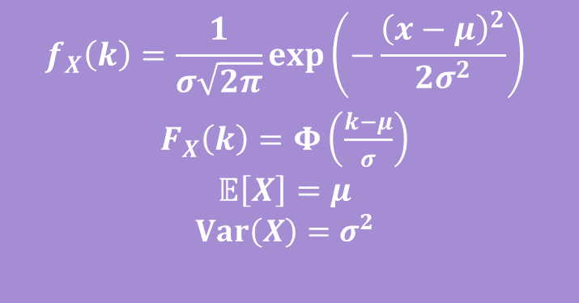
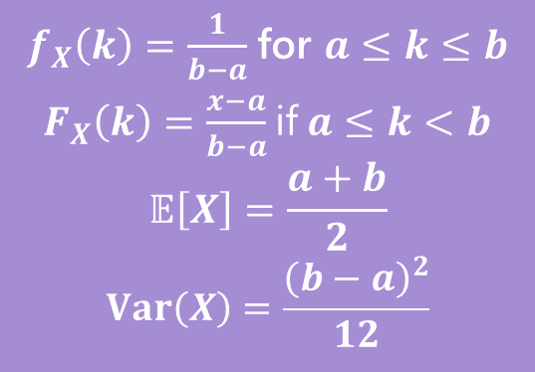
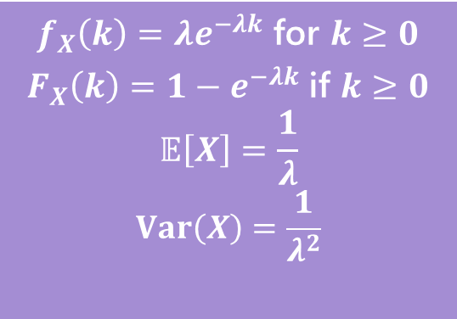
Continuous Zoo
This zoo defines common patterns for continuous random variables and gives us the PDF, CDF, expectation, and variance, so we don’t have to compute it every time!
$$X\sim Unif(a,b)$$
$$X\sim Exp(λ)$$
$$X\sim 𝒩(μ,σ^{2})$$
$f_{X}\left(k\right)=\frac{1}{b−a}$ for $a≤k≤b$
$F_{X}\left(k\right)=\frac{x−a}{b−a}$ if $a≤k<b$
$$𝔼\left[X\right]=\frac{a+b}{2}$$
$$Var\left(X\right)=\frac{{\left(b−a\right)}^{2}}{12}$$
$f_{X}\left(k\right)=λe^{−λk}$ for $k≥0$
$F_{X}\left(k\right)=1−e^{−λk}$ if $k≥0$
$$𝔼\left[X\right]=\frac{1}{λ}$$
$$Var\left(X\right)=\frac{1}{λ^{2}}$$
$$f_{X}\left(k\right)=\frac{1}{σ\sqrt{2π}}exp\left(−\frac{{\left(x−μ\right)}^{2}}{2σ^{2}}\right)$$
$F_{X}\left(k\right)=Φ\left(\frac{k−μ}{σ}\right)$
$$𝔼\left[X\right]=μ$$
$$Var\left(X\right)=σ^{2}$$
It’s a smaller zoo, but it’s just as much fun! :D

Slide 36

Continuous Uniform Distribution
Scenario: Pick a random real number between $a$ and $b$. $X$ is our choice.
> $X$ is a uniform random real number between $a$ and $b$ -> $X∼Unif(a,b)$
We saw the discrete uniform distribution before – it took on an integer between $a$ and $b$
This is the continuous uniform distribution – it takes on a real number between $a$ and $b$

Slide 37





Continuous Uniform Distribution - PDF
> $X$ is a uniform random real number between $a$ and $b$ -> $X∼Unif\left(a,b\right)$
What is the PDF, $f_{X}\left(k\right)$?
  Draw a picture and think about the properties the PDF must have!
$$f_{X}(k)$$
Fill out the poll everywhere: pollev.com/jolie312
$$a$$
$$b$$
$$k$$

Slide 38
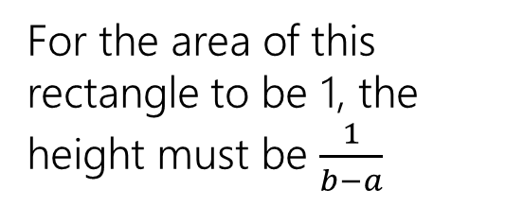

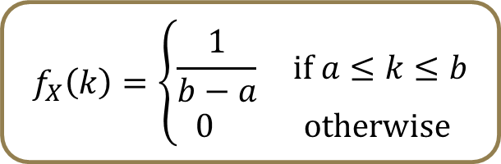


Continuous Uniform Distribution - PDF
> $X$ is a uniform random real number between $a$ and $b$ -> $X∼Unif\left(a,b\right)$
What is the PDF, $f_{X}\left(k\right)$?
  Draw a picture and think about the properties the PDF must have!
$$b−a$$
$$f_{X}(k)$$
$$1/(b−a)$$
For the area of this rectangle to be 1, the height must be $\frac{1}{b−a}$
$$f_{X}\left(k\right)=\left\{\begin{aligned}\frac{1}{b−a} if a≤k≤b \\ 0 otherwise\end{aligned}\right.$$
$$a$$
$$b$$
$$k$$
The area under a PDF must be 1. $\int_{−∞}^{∞}{f_{X}\left(z\right)ⅆz}=1$

Slide 39










Continuous Uniform Distribution – CDF(Visual)
> $X$ is a uniform random real number between $a$ and $b$ -> $X∼Unif\left(a,b\right)$
What is the CDF, $F_{X}\left(k\right)$? Let’s compute this “visually”….
$$b−a$$
$$f_{X}(z)$$
$$F_{X}\left(k\right)=\left\{ \begin{aligned} \\ \\ \\ \\ \end{aligned}\right.$$
$$1/(b−a)$$
$\frac{1}{b−a}$
$$a$$
$$k$$
$$b$$
$$z$$

Slide 40


Continuous Uniform Distribution – CDF(Visual)
> $X$ is a uniform random real number between $a$ and $b$ -> $X∼Unif\left(a,b\right)$
What is the CDF, $F_{X}\left(k\right)$? Let’s compute this “visually”….
  $F_{X}\left(k\right)=P(X≤k)$ is the area of the green region below: $\frac{k−a}{b−a}$ if $a≤k<b$
$$b−a$$
$$f_{X}(z)$$
$$F_{X}\left(k\right)=\left\{\begin{aligned} \\ \\ \frac{k−a}{b−a} if a≤k≤b \\ \\ \end{aligned}\right.$$
$$1/(b−a)$$
$\frac{1}{b−a}$
$$a$$
$$k$$
$$b$$
$$z$$

Slide 41


Continuous Uniform Distribution – CDF(Visual)
> $X$ is a uniform random real number between $a$ and $b$ -> $X∼Unif\left(a,b\right)$
What is the CDF, $F_{X}\left(k\right)$? Let’s compute this “visually”….
  $F_{X}\left(k\right)=P(X≤k)$ is the area of the green region below: $\frac{k−a}{b−a}$ if $a≤k<b$
$$b−a$$
$$f_{X}(z)$$
$$F_{X}\left(k\right)=\left\{\begin{aligned} \\ 0 if k<a \\ \frac{k−a}{b−a} if a≤k≤b \\ \\ \end{aligned}\right.$$
$$1/(b−a)$$
$\frac{1}{b−a}$
$$k$$
$$a$$
$$b$$
$$z$$

Slide 42


Continuous Uniform Distribution – CDF(Visual)
> $X$ is a uniform random real number between $a$ and $b$ -> $X∼Unif\left(a,b\right)$
What is the CDF, $F_{X}\left(k\right)$? Let’s compute this “visually”….
  $F_{X}\left(k\right)=P(X≤k)$ is the area of the green region below: $\frac{k−a}{b−a}$ if $a≤k<b$
$$b−a$$
$$f_{X}(z)$$
$$F_{X}\left(k\right)=\left\{\begin{aligned} \\ 0 if k<a \\ \frac{k−a}{b−a} if a≤k≤b \\ \\ 1 if k≥b\end{aligned}\right.$$
$$1/(b−a)$$
$\frac{1}{b−a}$
$$a$$
$$b$$
$$k$$
$$z$$

Slide 43
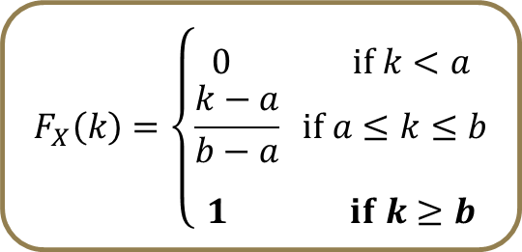
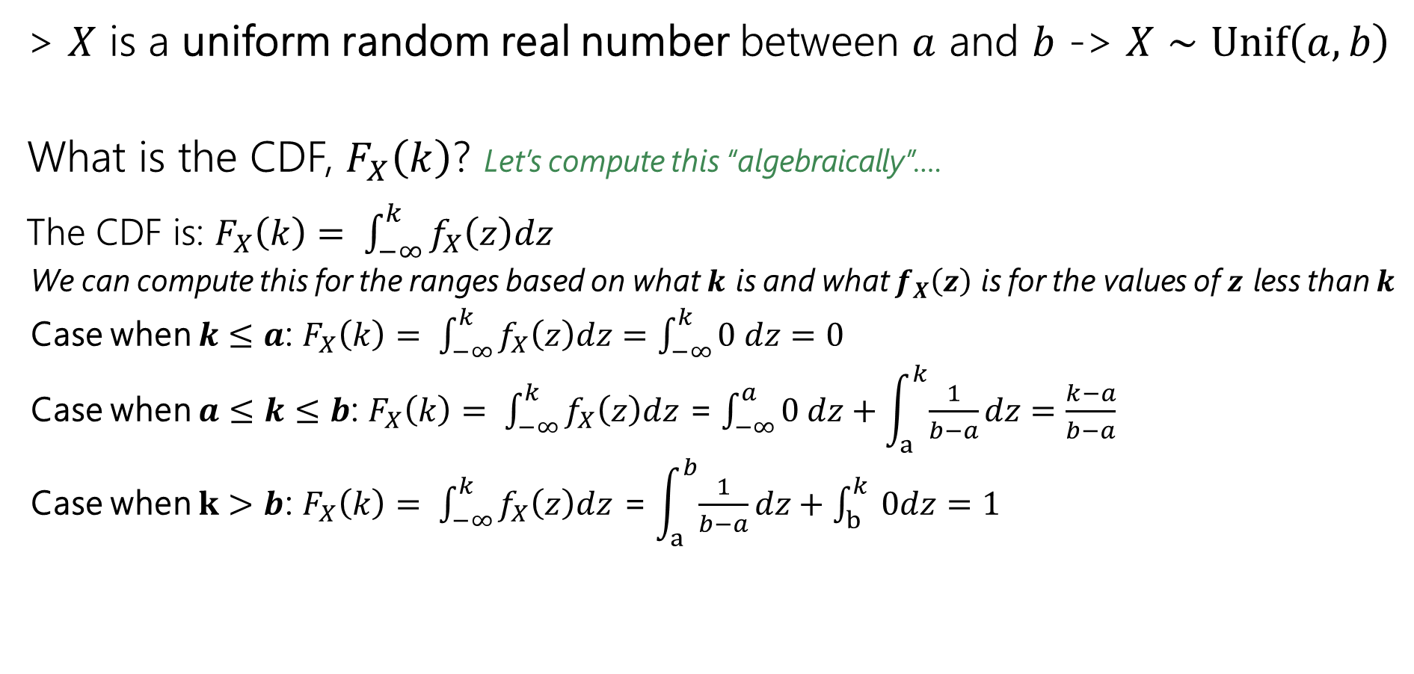
Continuous Uniform Distribution – CDF(Integral)
> $X$ is a uniform random real number between $a$ and $b$ -> $X∼Unif\left(a,b\right)$
What is the CDF, $F_{X}\left(k\right)$? Let’s compute this “algebraically”….
The CDF is: $F_{X}\left(k\right)= \int_{−∞}^{k}{f_{X}\left(z\right)dz}$
  We can compute this for the ranges based on what $k$ is and what $f_{X}\left(z\right)$ is for the values of $z$ less than $k$
  Case when $k≤a$: $F_{X}\left(k\right)= \int_{−∞}^{k}{f_{X}\left(z\right)dz}=\int_{−∞}^{k}{0 dz=0}$
  Case when $a≤k≤b$: $F_{X}\left(k\right)= \int_{−∞}^{k}{f_{X}\left(z\right)dz}$ = $\int_{−∞}^{a}{0 dz}+\int_{a}^{k}{\frac{1}{b−a}dz}=\frac{k−a}{b−a}$
  Case when $k>b$: $F_{X}\left(k\right)= \int_{−∞}^{k}{f_{X}\left(z\right)dz}$ = $\int_{a}^{b}{\frac{1}{b−a}dz}+\int_{b}^{k}{ 0dz}=1$
$$F_{X}\left(k\right)=\left\{\begin{aligned} \\ 0 if k<a \\ \frac{k−a}{b−a} if a≤k≤b \\ \\ 1 if k≥b\end{aligned}\right.$$

Slide 44
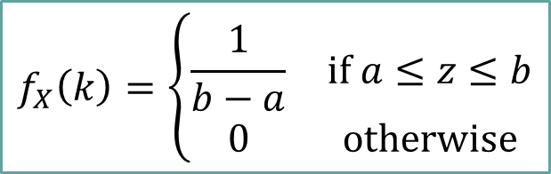
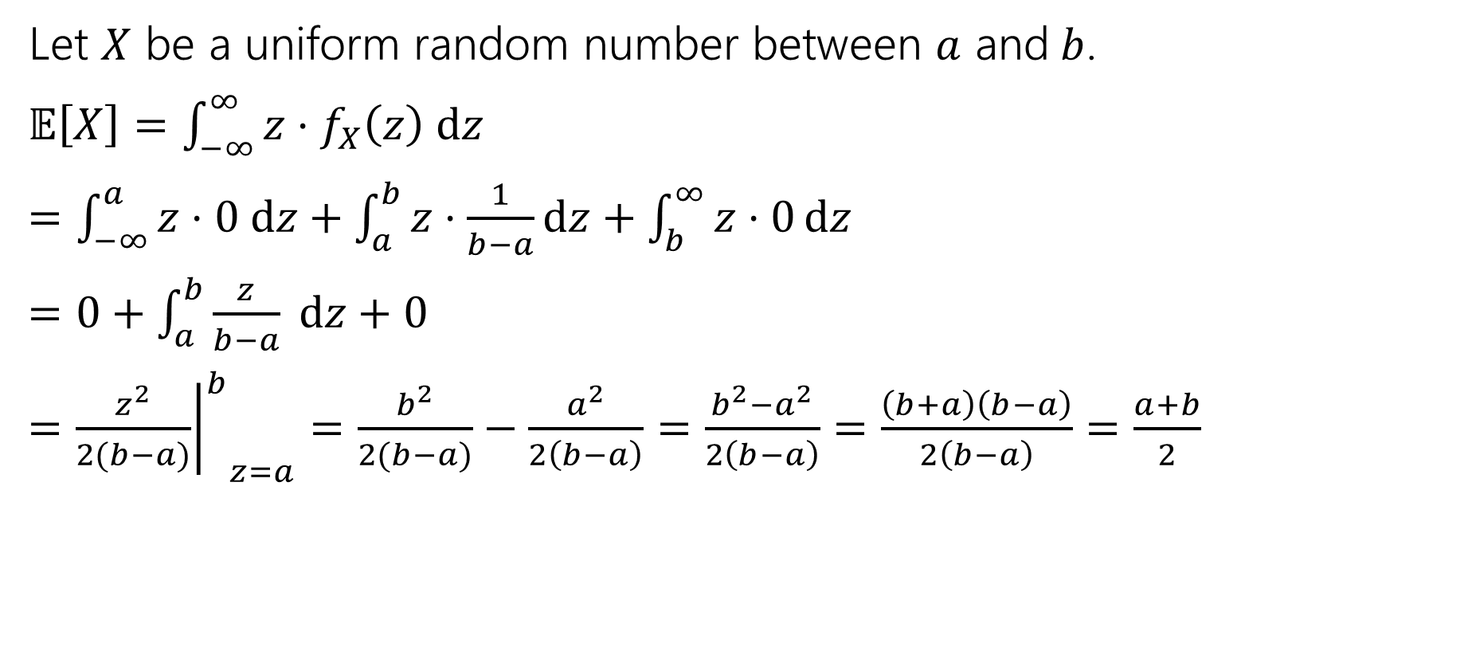
Let’s calculate an expectation
$$f_{X}\left(k\right)=\left\{\begin{matrix}\frac{1}{b−a} & \text{if} a≤z≤b \\ 0 & \text{otherwise}\end{matrix}\right.$$
Let $X$ be a uniform random number between $a$ and$b$.
$𝔼\left[X\right]=\int_{−∞}^{∞}{z⋅f_{X}\left(z\right) dz}$
$=\int_{−∞}^{a}{z⋅0 dz}+\int_{a}^{b}{z⋅\frac{1}{b−a}dz}+\int_{b}^{∞}{z⋅0}dz$
$=0+\int_{a}^{b}{\frac{z}{b−a} dz+0}$
$={{\left.\frac{z^{2}}{2(b−a)}\right|}^{b}}_{z=a}=\frac{b^{2}}{2(b−a)}−\frac{a^{2}}{2\left(b−a\right)}=\frac{b^{2}−a^{2}}{2\left(b−a\right)}=\frac{\left(b+a\right)\left(b−a\right)}{2\left(b−a\right)}=\frac{a+b}{2}$

Slide 45
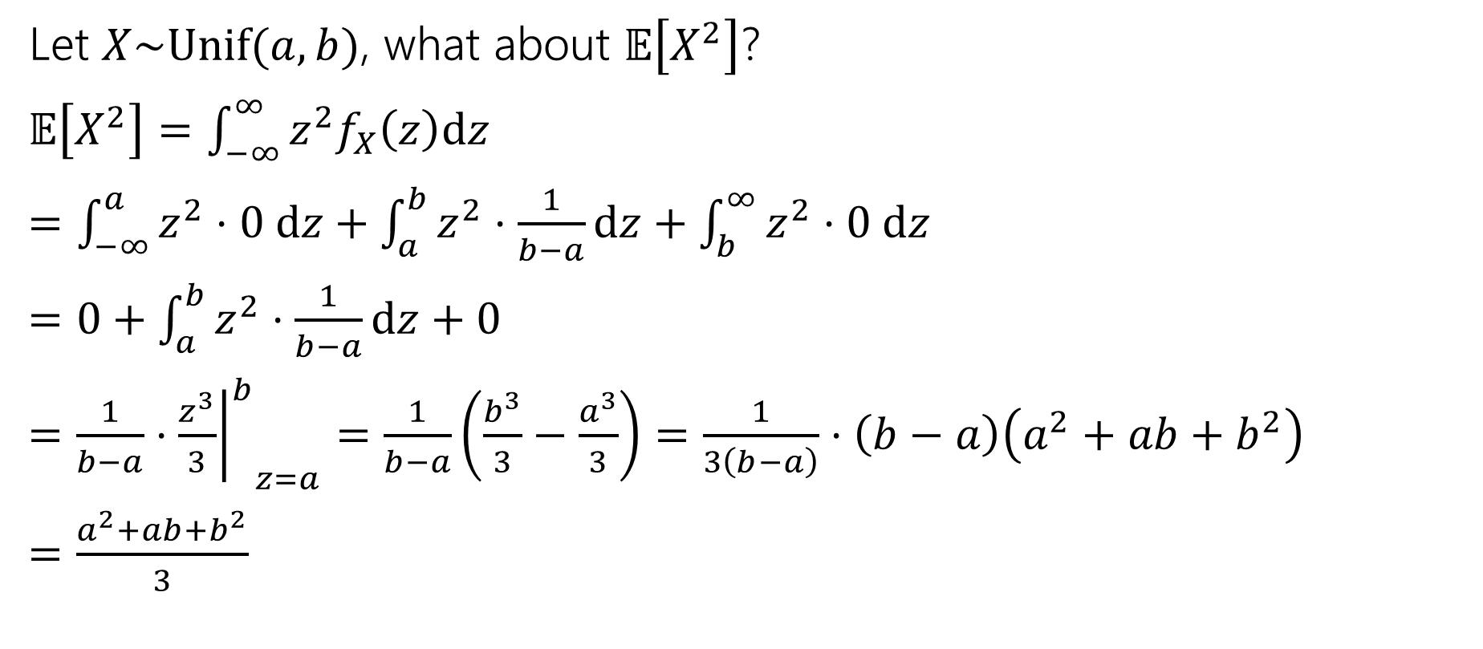

What about $𝔼\left[g\left(X\right)\right]$
Let $X\sim Unif(a,b)$, what about $𝔼\left[X^{2}\right]$?
$𝔼\left[X^{2}\right]=\int_{−∞}^{∞}{z^{2}f_{X}\left(z\right)dz}$
$=\int_{−∞}^{a}{z^{2}⋅0 dz+\int_{a}^{b}{z^{2}⋅\frac{1}{b−a}dz}+\int_{b}^{∞}{z^{2}⋅0 dz}}$
$=0+\int_{a}^{b}{z^{2}⋅\frac{1}{b−a}dz}+0$
$=\frac{1}{b−a}⋅{{\left.\frac{z^{3}}{3}\right|}^{b}}_{z=a}=\frac{1}{b−a}\left(\frac{b^{3}}{3}−\frac{a^{3}}{3}\right)=\frac{1}{3\left(b−a\right)}⋅\left(b−a\right)\left(a^{2}+ab+b^{2}\right)$
$=\frac{a^{2}+ab+b^{2}}{3}$

Slide 46

Let’s assemble the variance
$Var\left(X\right)=𝔼\left[X^{2}\right]−{\left(𝔼\left[X\right]\right)}^{2}$
$=\frac{a^{2}+ab+b^{2}}{3}−{\left(\frac{a+b}{2}\right)}^{2}$
$=\frac{4(a^{2}+ab+b^{2})}{12}−\frac{{3(a}^{2}+2ab+b^{2})}{12}$
$=\frac{a^{2}−2ab+b^{2}}{12}$
$=\frac{{\left(a−b\right)}^{2}}{12}$

Slide 47
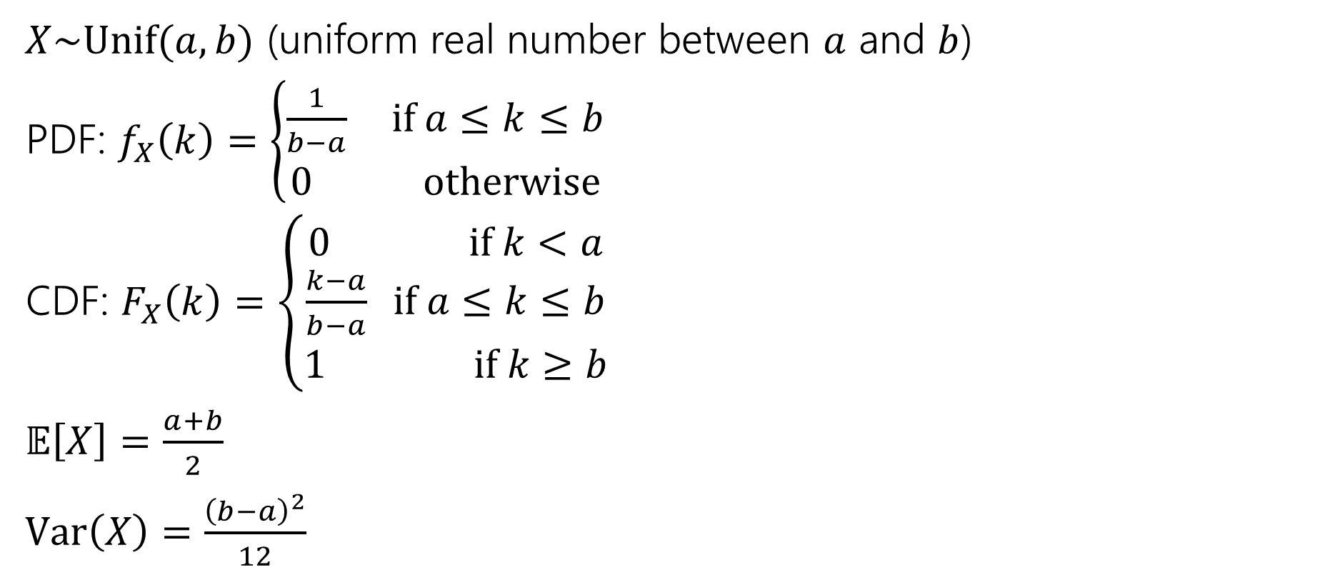
Continuous Uniform Distribution
$X\sim Unif(a,b)$ (uniform real number between $a$ and $b$)
PDF: $f_{X}\left(k\right)=\left\{\begin{aligned}\frac{1}{b−a} if a≤k≤b \\ 0 otherwise\end{aligned}\right.$
CDF: $F_{X}\left(k\right)=\left\{\begin{aligned}0 if k<a \\ \frac{k−a}{b−a} if a≤k≤b \\ 1 if k≥b\end{aligned}\right.$
$𝔼\left[X\right]=\frac{a+b}{2}$
$Var\left(X\right)=\frac{{\left(b−a\right)}^{2}}{12}$

