Slide 1
Discrete Random Variable Zoo II
CSE 312 26Su
Lecture 11

Slide 2
Discrete Zoo of Random Variables
There are common patterns of random experiments
We’re going to identify some common patterns, and compute the support, PMF, CDF, expectation, and variance for them, so when we see a random variable that matches that pattern, we don’t have to re-compute everything!

Slide 3
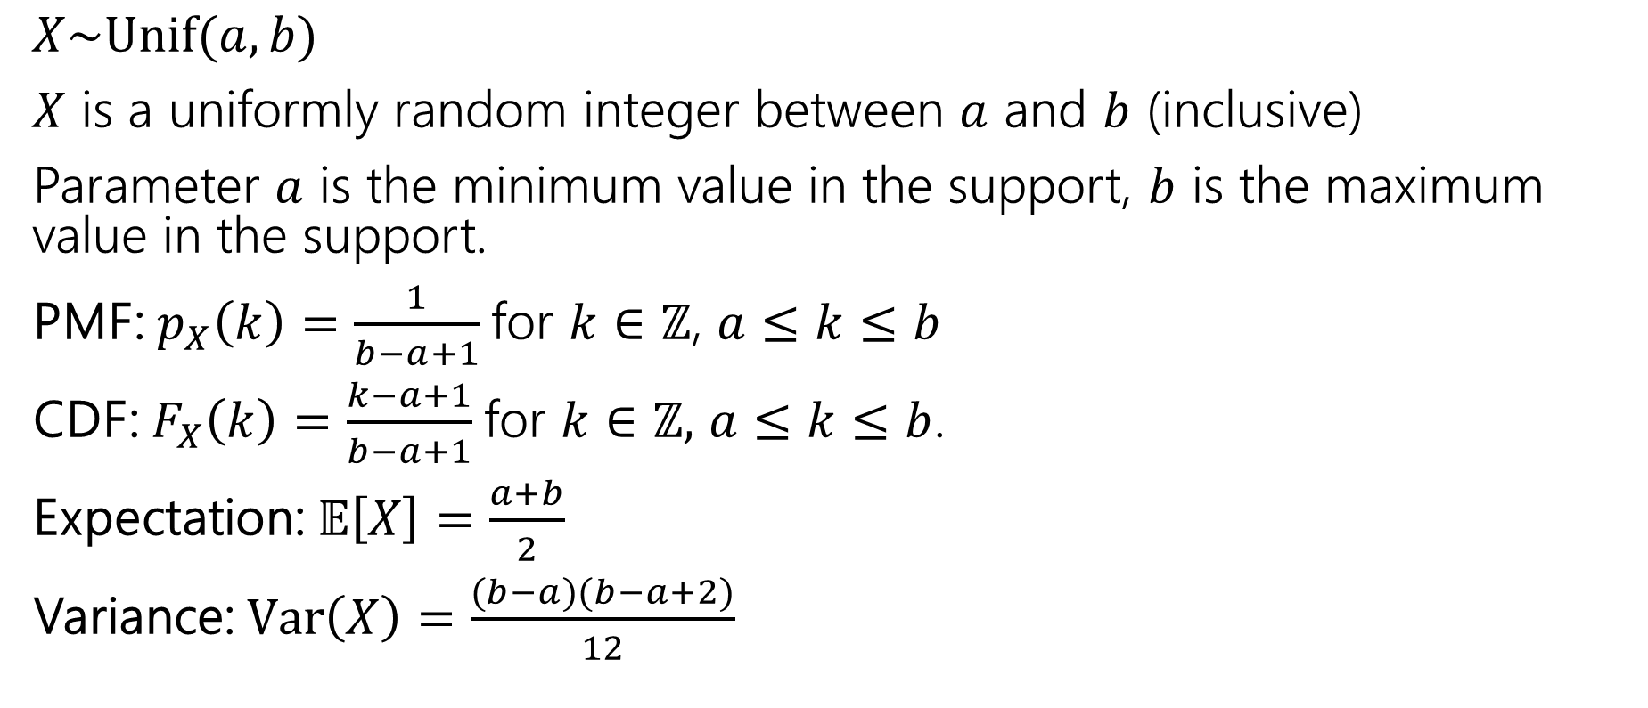
Discrete Uniform Distribution
$X\sim Unif(a,b)$
$X$ is a uniformly random integer between $a$ and $b$ (inclusive)
Parameter $a$ is the minimum value in the support, $b$ is the maximum value in the support.
PMF: $p_{X}\left(k\right)=\frac{1}{b−a+1}$for $k∈ℤ$, $a≤k≤b$
CDF: $F_{X}\left(k\right)=\frac{k−a+1}{b−a+1}$for $k∈ℤ,$ $a≤k≤b$.
Expectation: $𝔼\left[X\right]=\frac{a+b}{2}$
Variance: $Var\left(X\right)=\frac{(b−a)(b−a+2)}{12}$

Slide 4
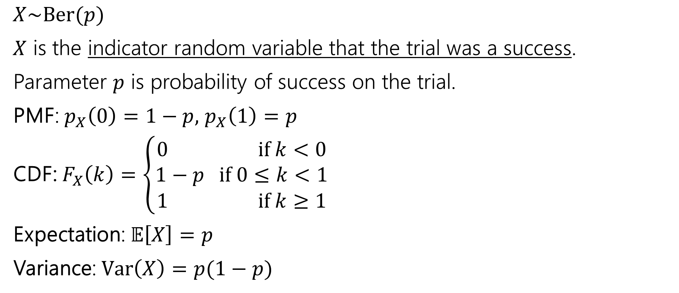
Bernoulli Distribution
$X\sim Ber(p)$
$X$ is the indicator random variable that the trial was a success.
Parameter $p$ is probability of success on the trial.
PMF: $p_{X}\left(0\right)=1−p,$ $p_{X}\left(1\right)=p$
CDF: $F_{X}\left(k\right)=\left\{\begin{aligned}0 if k<0 \\ 1−p if 0≤k<1 \\ 1 if k≥1\end{aligned}\right.$
Expectation: $𝔼\left[X\right]=p$
Variance: $Var\left(X\right)=p(1−p)$

Slide 5
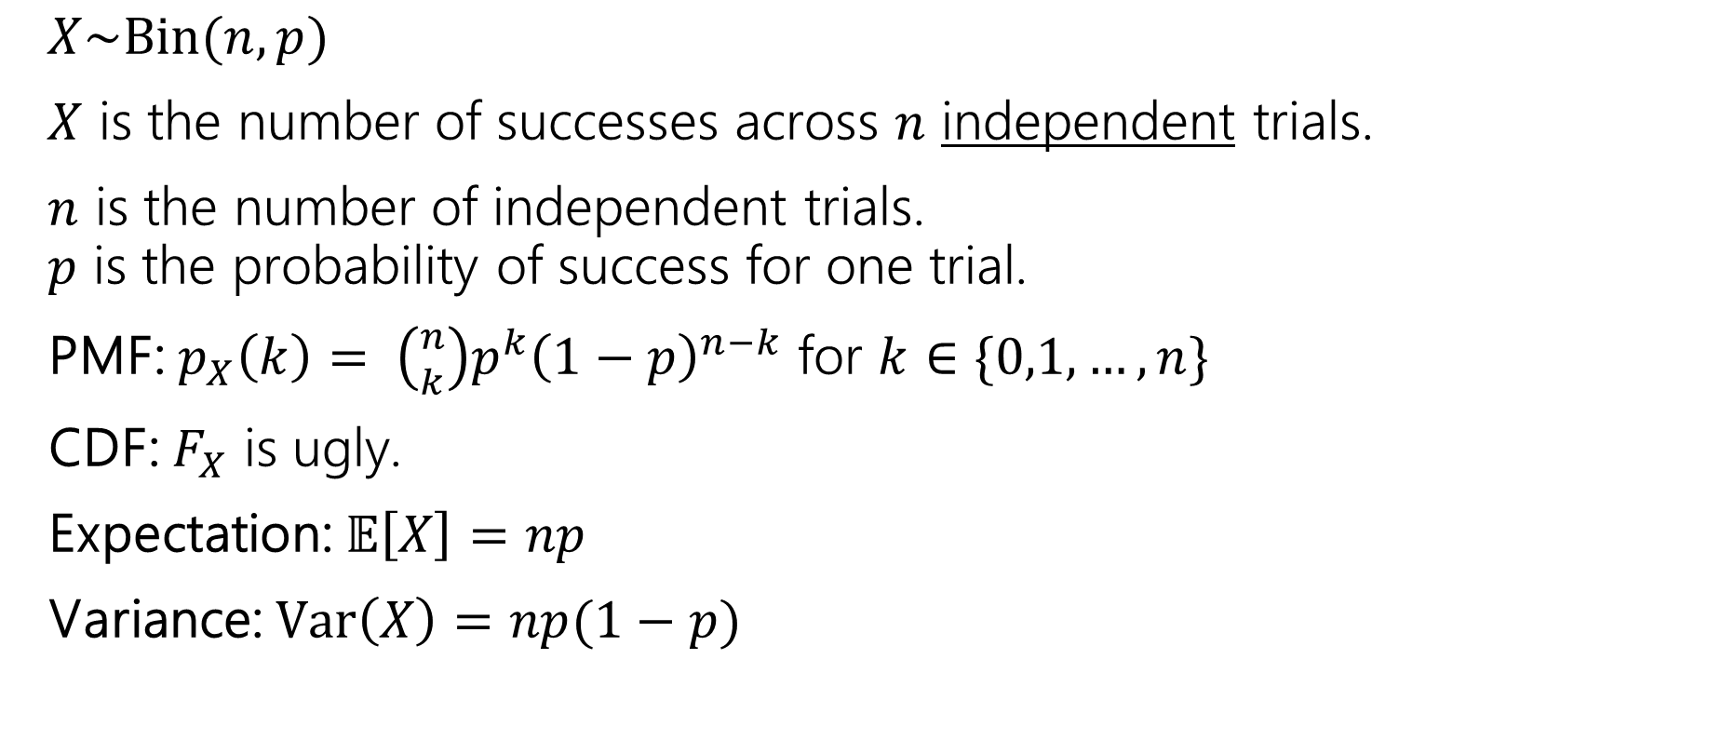
Binomial Distribution
$X\sim Bin(n,p)$
$X$ is the number of successes across $n$ independent trials.
$n$ is the number of independent trials.
$p$ is the probability of success for one trial.
PMF: $p_{X}\left(k\right)= \left({n \atop k}\right)p^{k}{\left(1−p\right)}^{n−k}$ for $k∈\{0,1,…,n\}$
CDF: $F_{X}$ is ugly.
Expectation: $𝔼\left[X\right]=np$
Variance: $Var\left(X\right)=np(1−p)$

Slide 6
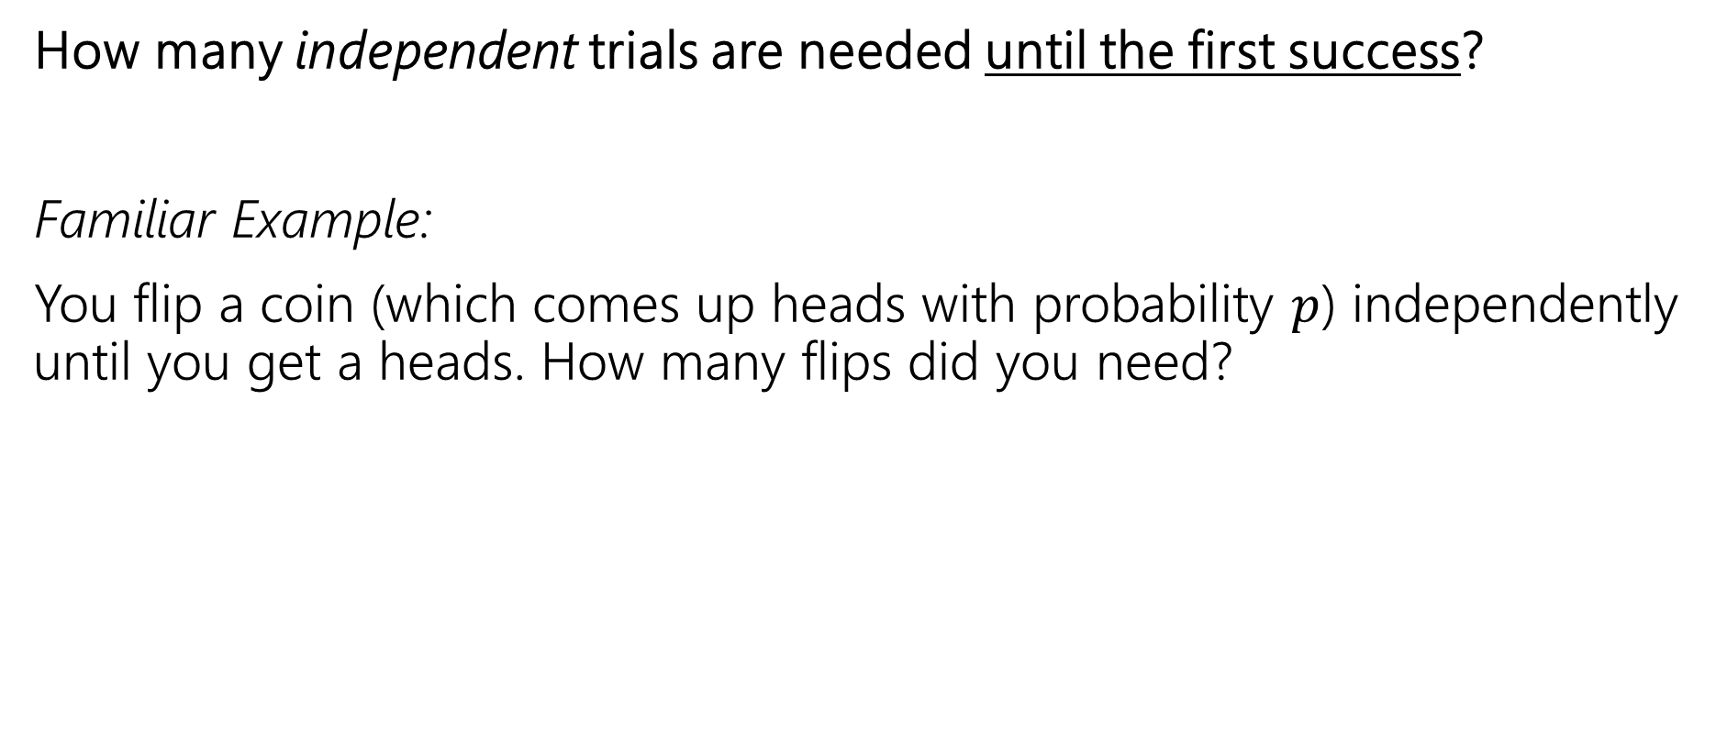
Situation: Geometric
How many independent trials are needed until the first success?
Familiar Example:
You flip a coin (which comes up heads with probability $p$) independently until you get a heads. How many flips did you need?

Slide 7

Geometric Distribution
$X\sim Geo(p)$
$X$ is the number of trials needed to see the first success.
$p$ is the probability of success for one trial.

Slide 8
Geometric Distribution Examples
How many bits can we write before one is incorrect?
How many questions do you have to answer until you get one right?
How many times can you run an experiment until it fails for the first time?

Slide 9
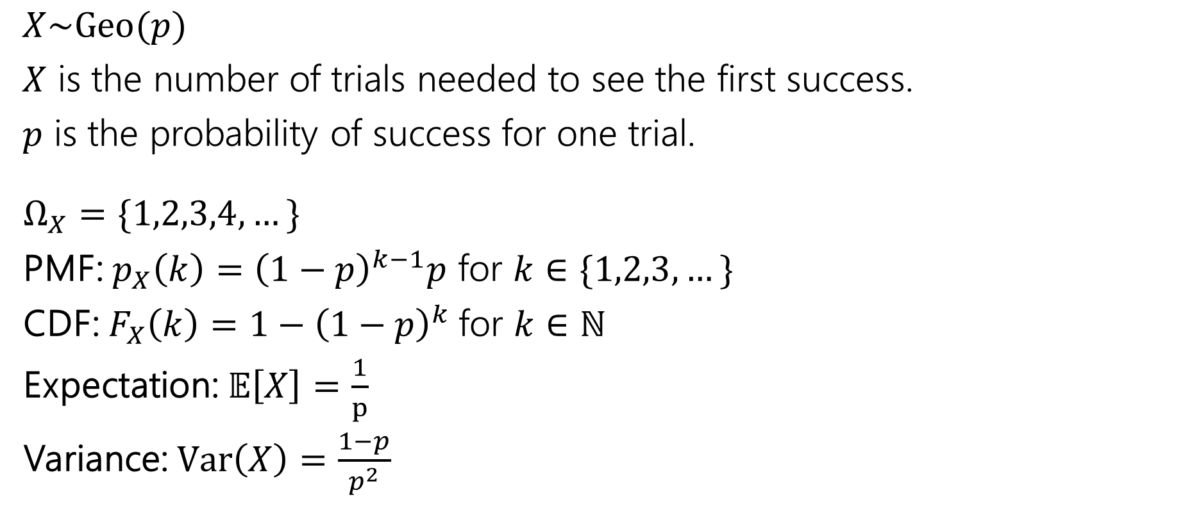
Geometric Distribution
$X\sim Geo(p)$
$X$ is the number of trials needed to see the first success.
$p$ is the probability of success for one trial.
$Ω_{X}=\{1,2,3,4,…\}$
PMF: $p_{X}\left(k\right)={\left(1−p\right)}^{k−1}p$ for $k∈\{1,2,3,…\}$
CDF: $F_{X}\left(k\right)=1−{\left(1−p\right)}^{k}$for $k∈ℕ$
Expectation: $𝔼\left[X\right]=\frac{1}{p}$
Variance: $Var\left(X\right)=\frac{1−p}{p^{2}}$

Slide 10



Geometric: Expectation
$𝔼\left[X\right]=\sum_{k=1}^{∞}{k{\left(1−p\right)}^{k−1}p}$
$=p\sum_{k=1}^{∞}{k{\left(1−p\right)}^{k−1}}=p⋅\frac{1}{p^{2}}=\frac{1}{p}$.
$Var\left(X\right)=𝔼\left[X^{2}\right]−{\left(𝔼\left[X\right]\right)}^{2}$
$=\frac{2−p}{p^{2}}−\frac{1}{p^{2}}=\frac{1−p}{p^{2}}$
Intuition: Smaller $p$ means longer wait
Intuition: for small $p$ lots of variance (might have to wait a long time, and it’s variable)
For large $p$ very little variance (for $p=1$ there’s no variation at all!)

Slide 11
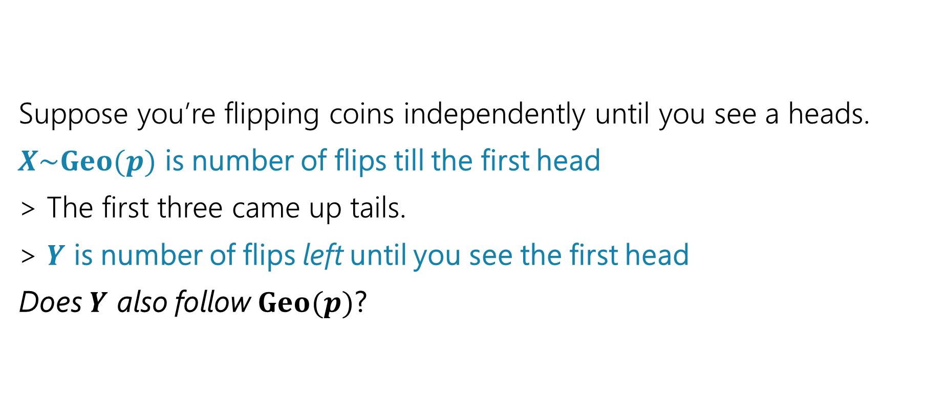
Geometric Property
Suppose you’re flipping coins independently until you see a heads.
$X\sim Geo(p)$ is number of flips till the first head
> The first three came up tails.
> $Y$ is number of flips left until you see the first head
Does $Y$ also follow $Geo(p)$?
Fill out the poll everywhere: pollev.com/jolie312
T
T
T
?
?
?
…
?

Slide 12
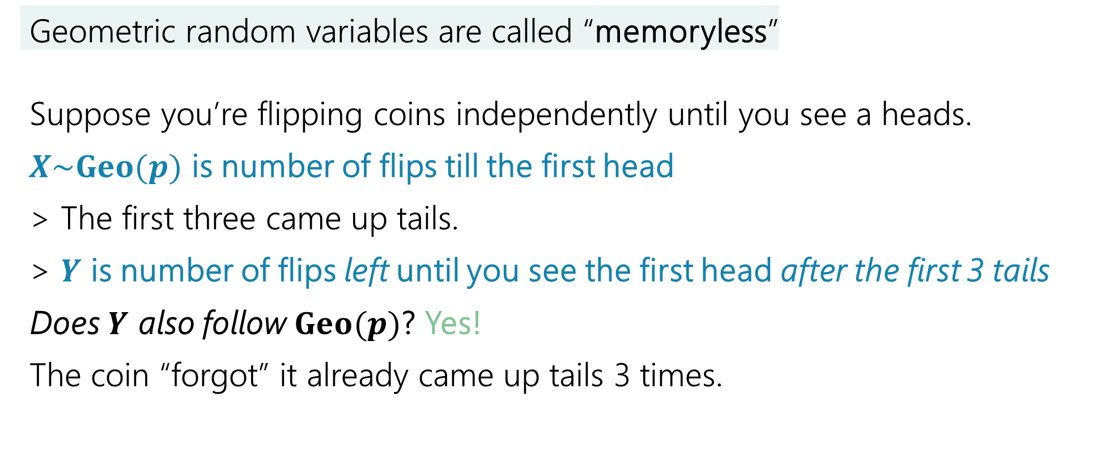
Geometric Property - Memoryless
Geometric random variables are called “memoryless”
Suppose you’re flipping coins independently until you see a heads.
$X\sim Geo(p)$ is number of flips till the first head
> The first three came up tails.
> $Y$ is number of flips left until you see the first head after the first 3 tails
Does $Y$ also follow $Geo(p)$? Yes!
The coin “forgot” it already came up tails 3 times.
T
T
T
?
?
?
…
?

Slide 13

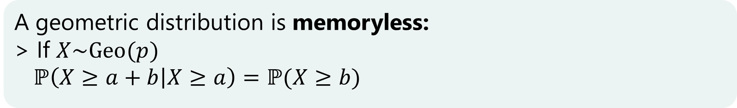
Formally…
Let $X$ be the number of flips needed, $Y$ be the flips after the third.
$ℙ\left(Y=k\right|X≥3)=ℙ(Y=k∩X≥3)/ℙ(X≥3)$
$\frac{{\left(1−p\right)}^{k+3−1}p}{{\left(1−p\right)}^{3}}$
$={\left(1−p\right)}^{k−1}p$
Which is $p_{X}(k)$.
A geometric distribution is memoryless:
> If $X\sim Geo(p)$
$ℙ\left(X≥a+b | X≥a\right)=ℙ(X≥b)$

Slide 14
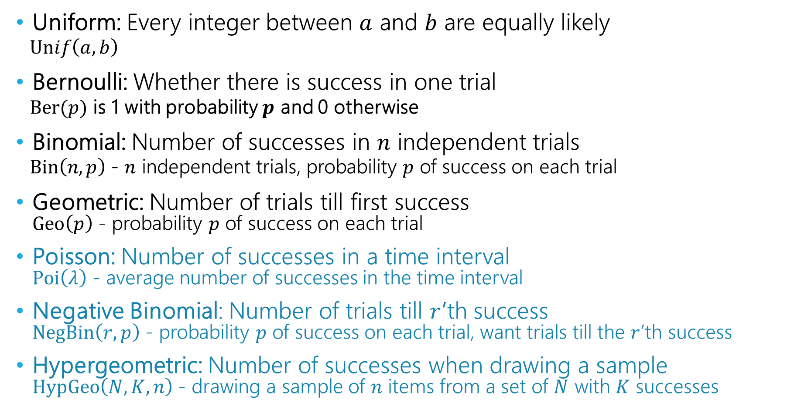
Discrete Zoo of Random Variables (today!)
Uniform: Every integer between $a$ and $b$ are equally likely
  $Unif\left(a,b\right)$
Bernoulli: Whether there is success in one trial
  $Ber(p)$ is 1 with probability $p$ and 0 otherwise
Binomial: Number of successes in $n$ independent trials
  $Bin\left(n,p\right)$ - $n$ independent trials, probability $p$ of success on each trial
Geometric: Number of trials till first success
$Geo\left(p\right)$ - probability $p$ of success on each trial
Poisson: Number of successes in a time interval
$Poi\left(λ\right)$ - average number of successes in the time interval
Negative Binomial: Number of trials till $r$’th success
$NegBin\left(r,p\right)$ - probability $p$ of success on each trial, want trials till the $r$’th success
Hypergeometric: Number of successes when drawing a sample
$HypGeo\left(N,K,n\right)$ - drawing a sample of $n$ items from a set of $N$ with $K$ successes

Slide 15
Scenario: The Poisson Distribution
We’re trying to count the number of times something happens in some interval of time.
Examples:
  How many traffic accidents occur in Seattle in a day
  How many major earthquakes occur in a year (not including aftershocks)
  How many customers visit a bakery in an hour
Why not just use counting coin flips / binomial distribution?
  What are the flips…the number of cars? Every person who might visit the bakery? There are too many of these to count exactly or think about dependency between.
  Let’s try modeling with a Poisson distribution.

Slide 16
Scenario: The Poisson Distribution
  We’re trying to count the number of times something happens in some interval of time.
  > Events occur at a fixed rate per time interval, but at random times
  > We know the expected number of events in the time interval
  > Event occurrences on disjoint time intervals are independent of the others
  Example: model # of people who buy a mango chili lime donut in a day

Slide 17
Scenario: The Poisson Distribution
  X - # of people who buy a mango chili lime donut in a day, E[X] = λ > 0
  Assume events on disjoint time intervals occur independently
1 day
0
1
0
1
0
1
0
0
0
1
1
0

Slide 18
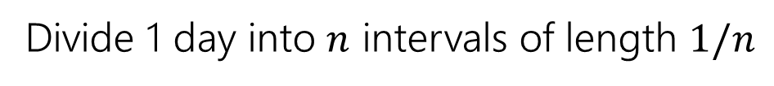
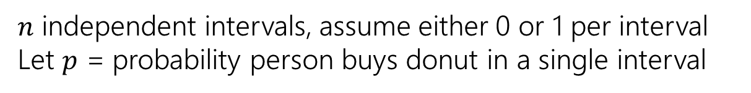

Scenario: The Poisson Distribution
  X - # of people who buy a mango chili lime donut in a day, E[X] = λ > 0
  Assume events on disjoint time intervals occur independently
Divide 1 day into $n$ intervals of length $1/n$
$$1/n$$
$n$ independent intervals, assume either 0 or 1 per interval
Let $p$ = probability person buys donut in a single interval

Slide 19
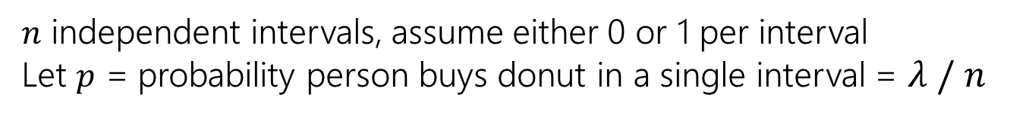
Scenario: The Poisson Distribution
  X - # of people who buy a mango chili lime donut in a day, E[X] = λ > 0
  Assume events on disjoint time intervals occur independently
Divide 1 day into $n$ intervals of length $1/n$
$$1/n$$
0
1
0
1
0
1
0
0
0
1
1
0
$n$ independent intervals, assume either 0 or 1 per interval
Let $p$ = probability person buys donut in a single interval = $λ / n$

Slide 20
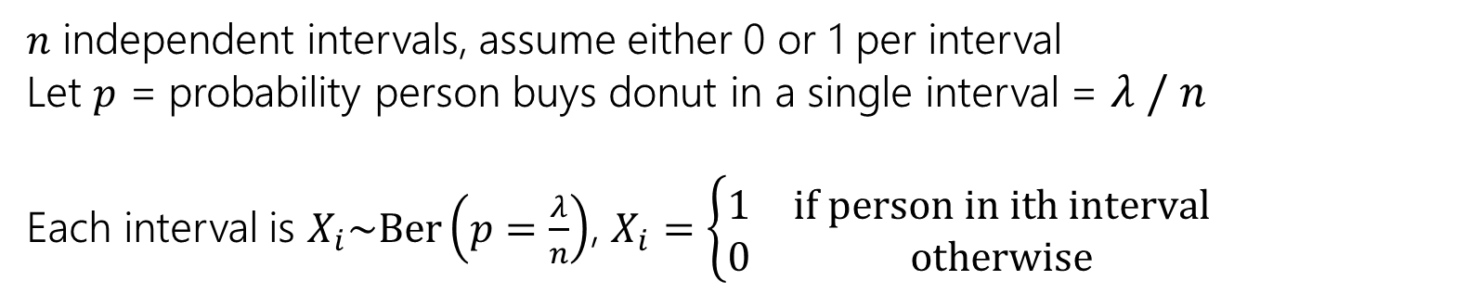
Scenario: The Poisson Distribution
  X - # of people who buy a mango chili lime donut in a day, E[X] = λ > 0
  Assume events on disjoint time intervals occur independently
Divide 1 day into $n$ intervals of length $1/n$
$$1/n$$
0
1
0
1
0
1
0
0
0
1
1
0
$n$ independent intervals, assume either 0 or 1 per interval
Let $p$ = probability person buys donut in a single interval = $λ / n$
Each interval is $X_{i}\sim \text{Ber}\left(p=\frac{λ}{n}\right)$, $X_{i}=\left\{\begin{matrix}1 & \text{if} \text{person} \text{in} \text{ith} \text{interval} \\ 0 & \text{otherwise}\end{matrix}\right.$

Slide 21

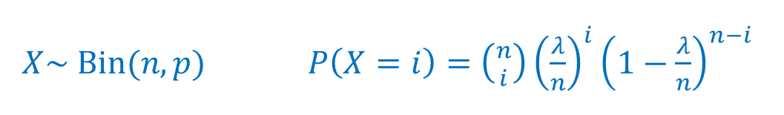
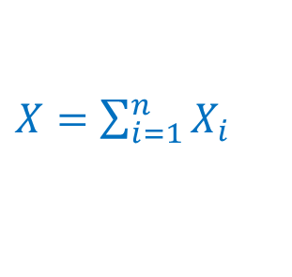
Scenario: The Poisson Distribution
  X - # of people who buy a mango chili lime donut in a day, E[X] = λ > 0
  Assume events on disjoint time intervals occur independently
Divide 1 day into $n$ intervals of length $1/n$
$$1/n$$
0
1
0
1
0
1
0
0
0
1
1
0
Each interval is $X_{i}\sim \text{Ber}\left(p=\frac{λ}{n}\right)$, $X_{i}=\left\{\begin{matrix}1 & \text{if} \text{person} \text{in} \text{ith} \text{interval} \\ 0 & \text{otherwise}\end{matrix}\right.$
$X=\sum_{i=1}^{n}{X_{i}}$
$X\sim Bin(n,p)$ $P\left(X=i\right)=\left({n \atop i}\right){\left(\frac{λ}{n}\right)}^{i}{\left(1−\frac{λ}{n}\right)}^{n−i}$
indeed! $𝔼\left[X\right]=pn=λ$

Slide 22


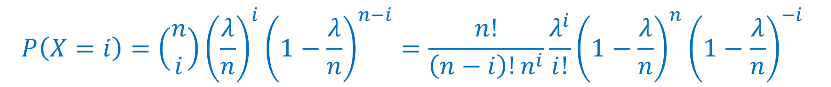
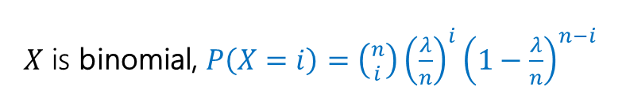
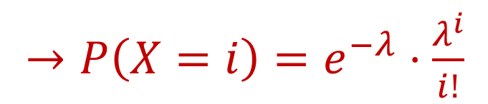


Take the limit
$X$ is binomial, $P\left(X=i\right)=\left({n \atop i}\right){\left(\frac{λ}{n}\right)}^{i}{\left(1−\frac{λ}{n}\right)}^{n−i}$
Divide 1 day into $n$ intervals of length $1/n$, as $n→∞$
$$1/n$$
0
1
0
1
0
1
0
0
0
1
1
0
$$P\left(X=i\right)=\left({n \atop i}\right){\left(\frac{λ}{n}\right)}^{i}{\left(1−\frac{λ}{n}\right)}^{n−i}=\frac{n!}{\left(n−i\right)!n^{i}}\frac{λ^{i}}{i!}{\left(1−\frac{λ}{n}\right)}^{n}{\left(1−\frac{λ}{n}\right)}^{−i}$$
$→P\left(X=i\right)=e^{−λ}⋅\frac{λ^{i}}{i!}$
$$→1$$
$$→e^{−λ}$$
$$→1$$

Slide 23
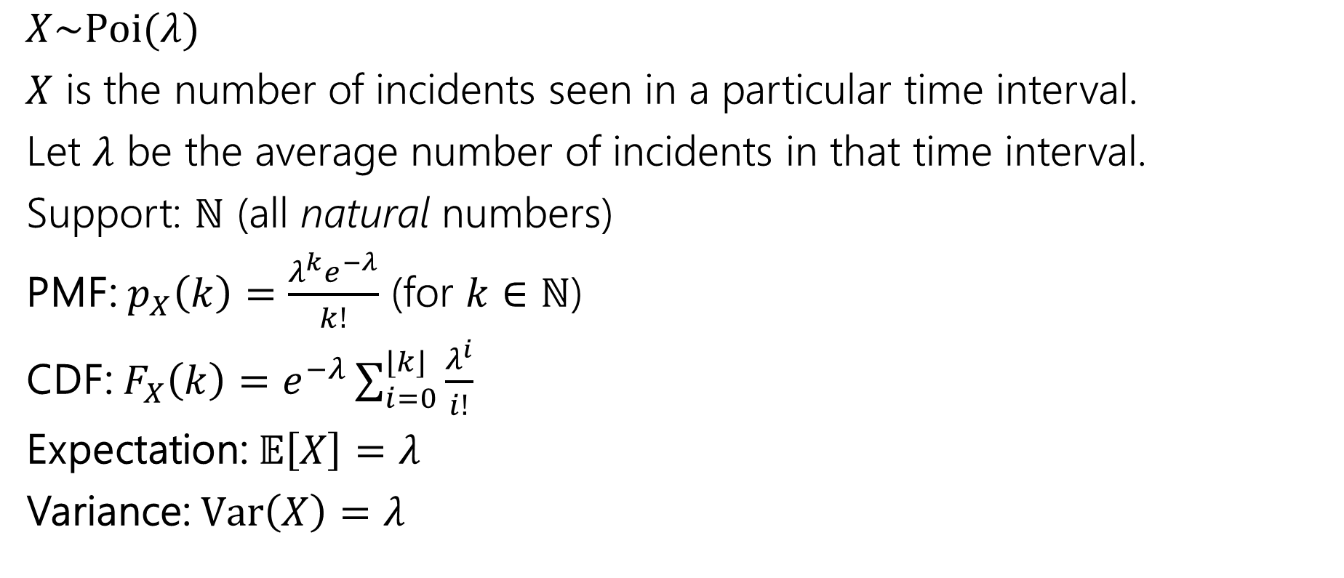
Poisson Distribution
$X\sim Poi(λ)$
$X$ is the number of incidents seen in a particular time interval.
Let $λ$ be the average number of incidents in that time interval.
Support: $ℕ$ (all natural numbers)
PMF: $p_{X}\left(k\right)=\frac{λ^{k}e^{−λ}}{k!}$ (for $k∈ℕ$)
CDF: $F_{X}\left(k\right)=e^{−λ}\sum_{i=0}^{⌊k⌋}{\frac{λ^{i}}{i!}}$
Expectation: $𝔼\left[X\right]=λ$
Variance: $Var\left(X\right)=λ$

Slide 24
Poisson Distribution (sample PMFs)
…
…
0
5
10
0
5
10

Slide 25


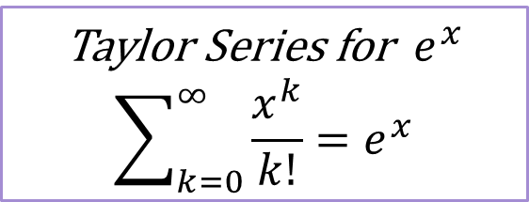
Let’s take a closer look at that PMF
$p_{X}\left(k\right)=\frac{λ^{k}e^{−λ}}{k!}$ (for $k∈ℕ$)
If this is a real PMF, it should sum to $1$.
$\sum_{k=0}^{∞}{\frac{λ^{k}e^{−λ}}{k!}}$
$=e^{−λ}\sum_{k=0}^{∞}{\frac{λ^{k}}{k!}}$
Taylor Series for $e^{x}$
$$\sum_{k=0}^{∞}{\frac{x^{k}}{k!}}=e^{x}$$
$$=e^{−λ}e^{λ}=e^{0}=1$$

Slide 26
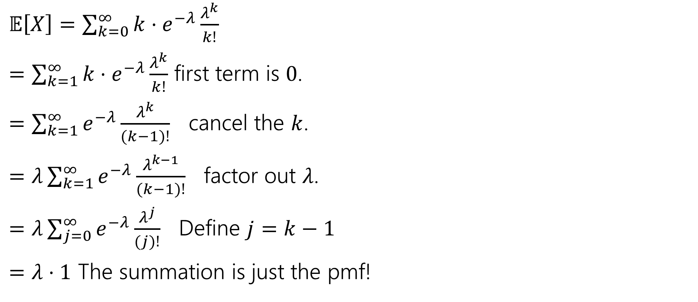
Let’s check something…the expectation
$𝔼\left[X\right]=\sum_{k=0}^{∞}{k⋅e^{−λ}\frac{λ^{k}}{k!}}$
$=\sum_{k=1}^{∞}{k⋅e^{−λ}\frac{λ^{k}}{k!}}$ first term is $0$.
$=\sum_{k=1}^{∞}{e^{−λ}\frac{λ^{k}}{(k−1)!}}$ cancel the $k$.
$=λ\sum_{k=1}^{∞}{e^{−λ}\frac{λ^{k−1}}{(k−1)!}}$ factor out $λ$.
$=λ\sum_{j=0}^{∞}{e^{−λ}\frac{λ^{j}}{(j)!}}$ Define $j=k−1$
$=λ⋅1$ The summation is just the pmf!

Slide 27
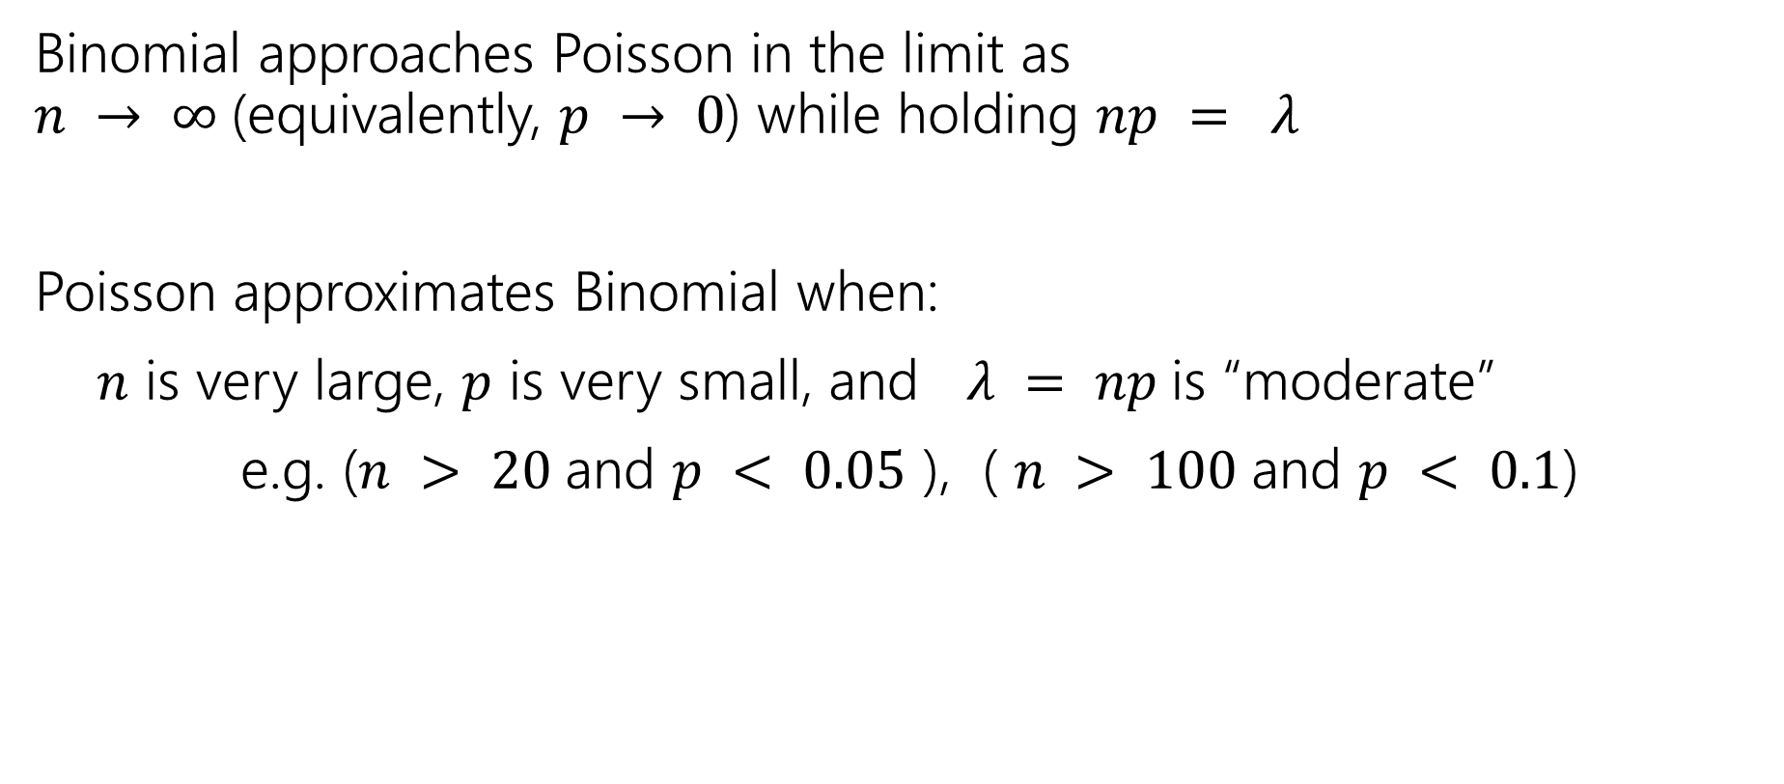
From Binomial to Poisson
Binomial approaches Poisson in the limit as
$n → ∞$(equivalently, $p → 0$) while holding $np = λ$
Poisson approximates Binomial when:
$n$ is very large, $p$ is very small, and $λ = np$is “moderate”
e.g. ($n > 20$and $p < 0.05$ ), ( $n > 100$and $p < 0.1$)

Slide 28
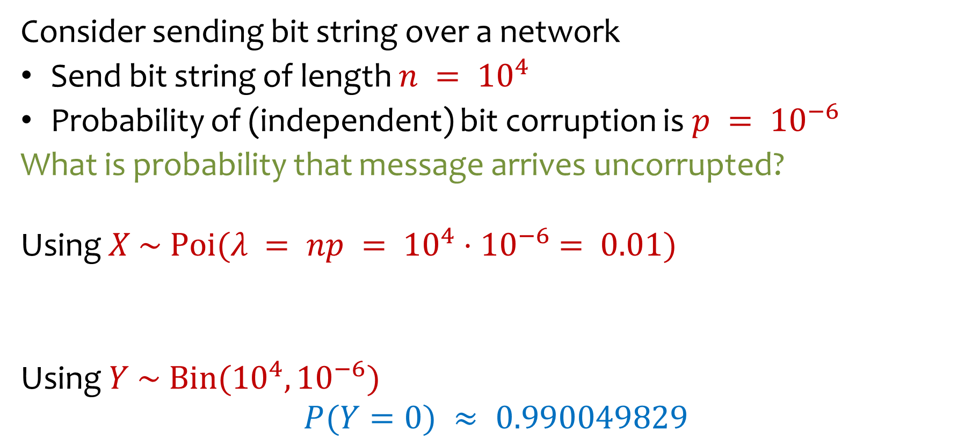
Example: From Binomial to Poisson
Consider sending bit string over a network
Send bit string of length $n = {10}^{4}$
Probability of (independent) bit corruption is $p = {10}^{−6}$
What is probability that message arrives uncorrupted?
Using $X \sim Poi(λ = np = {10}^{4}{⋅10}^{−6} = 0.01)$
Using $Y \sim Bin({10}^{4}, {10}^{−6})$
$$P(Y=0) ≈ 0.990049829$$
$$P\left(X=0\right)=e^{−λ}⋅\frac{λ^{0}}{0!}=e^{−0.01}⋅\frac{{0.01}^{0}}{0!}≈0.990049834$$

Slide 29

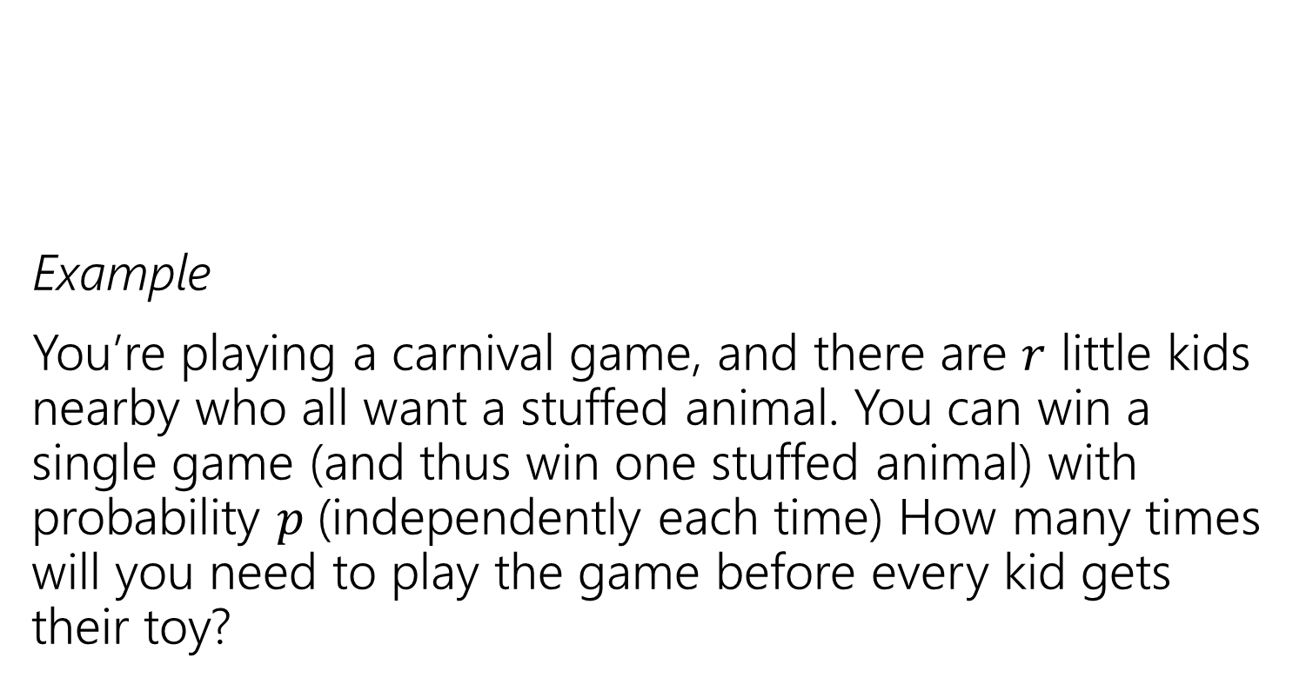

Scenario: Negative Binomial
Example
You’re playing a carnival game, and there are $r$ little kids nearby who all want a stuffed animal. You can win a single game (and thus win one stuffed animal) with probability $p$(independently each time) How many times will you need to play the game before every kid gets their toy?
Run independent trials with probability $p$. How many trials do you need until $r$ successes?

Slide 30
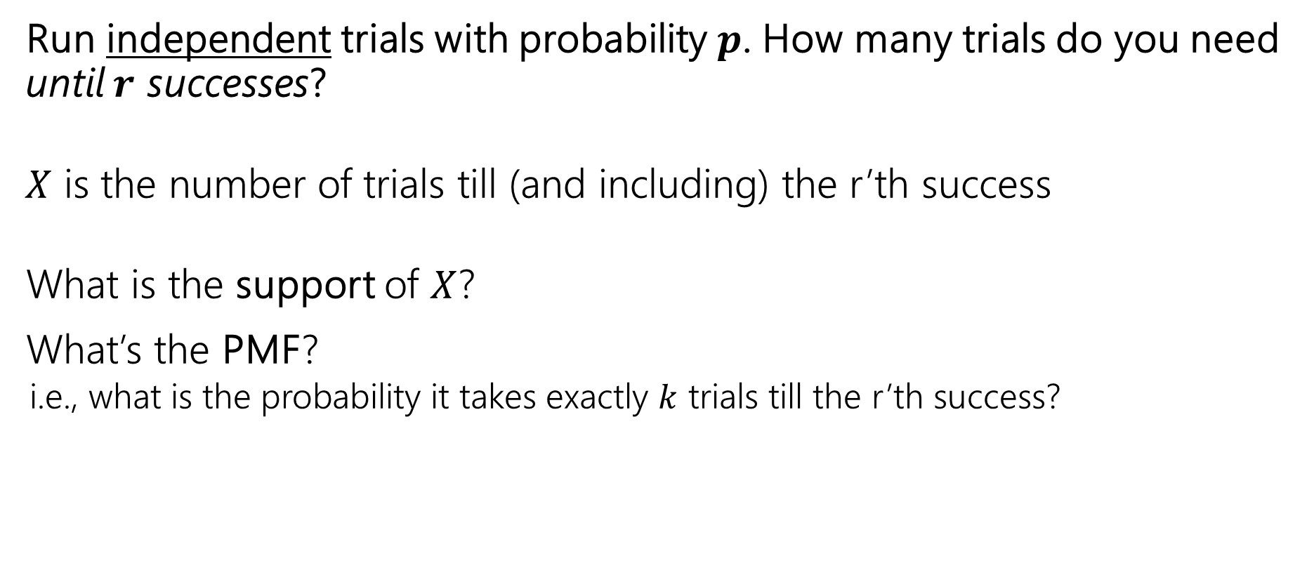
Try it
Run independent trials with probability $p$. How many trials do you need until $r$ successes?
$X$ is the number of trials till (and including) the r’th success
What is the support of $X$?
What’s the PMF?
  i.e., what is the probability it takes exactly $k$ trials till the r’th success?
Fill out the poll everywhere: pollev.com/jolie312

Slide 31
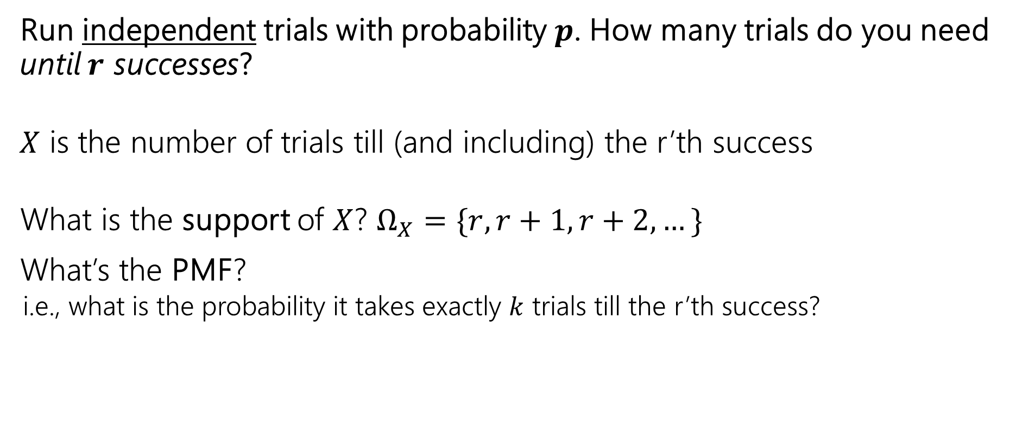
Try it
Run independent trials with probability $p$. How many trials do you need until $r$ successes?
$X$ is the number of trials till (and including) the r’th success
What is the support of $X$? $Ω_{X}=\{r, r+1, r+2, …\}$
What’s the PMF?
  i.e., what is the probability it takes exactly $k$ trials till the r’th success?

Slide 32

Negative Binomial Analysis
Run independent trials with probability $p$
$X$ is the number of trials till (and including) the r’th success
What’s the PMF? Well how would we know $X=k$?

Slide 33
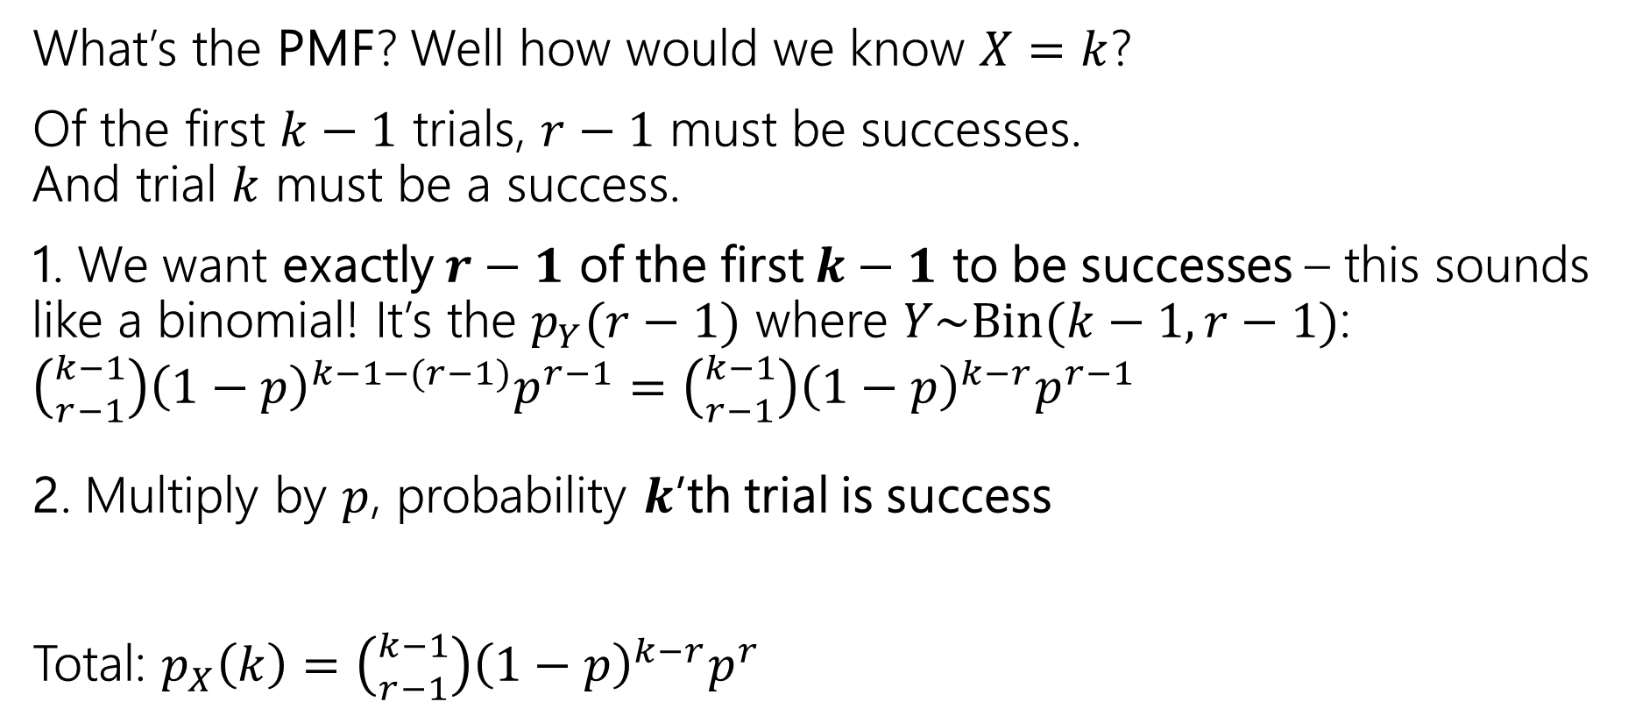
Negative Binomial Analysis
What’s the PMF? Well how would we know $X=k$?
Of the first $k−1$ trials, $r−1$ must be successes.
And trial $k$ must be a success.
1. We want exactly $r−1$ of the first $k−1$ to be successes – this sounds like a binomial! It’s the $p_{Y}(r−1)$ where $Y\sim Bin(k−1, r−1)$:
$\left({k−1 \atop r−1}\right){\left(1−p\right)}^{k−1−(r−1)}p^{r−1}=\left({k−1 \atop r−1}\right){\left(1−p\right)}^{k−r}p^{r−1}$
2. Multiply by $p$, probability $k$’th trial is success
Total: $p_{X}\left(k\right)=\left({k−1 \atop r−1}\right){\left(1−p\right)}^{k−r}p^{r}$

Slide 34
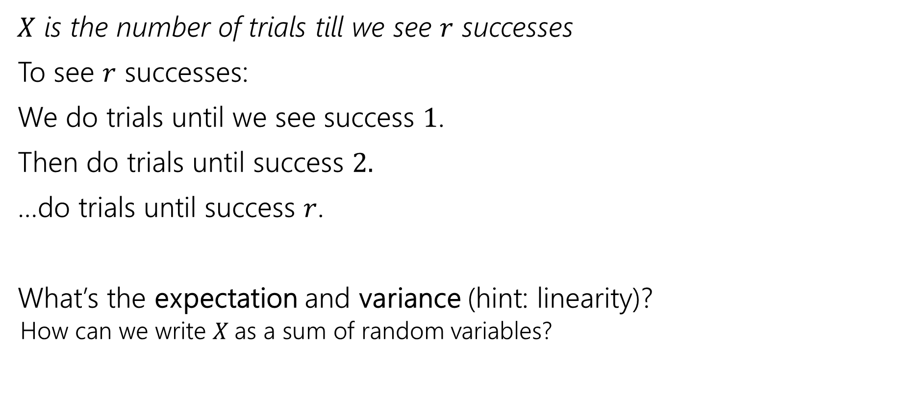
Negative Binomial Analysis
$X$ is the number of trials till we see $r$ successes
To see $r$ successes:
We do trials until we see success $1$.
Then do trials until success $2.$
…do trials until success $r$.
What’s the expectation and variance (hint: linearity)?
  How can we write $X$as a sum of random variables?
Fill out the poll everywhere: pollev.com/jolie312

Slide 35
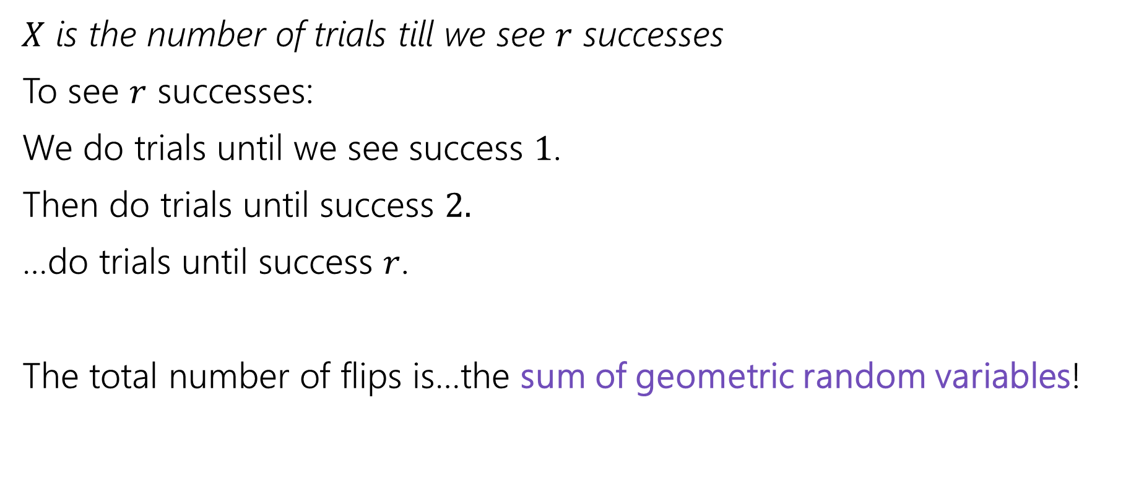
Negative Binomial Analysis
$X$ is the number of trials till we see $r$ successes
To see $r$ successes:
We do trials until we see success $1$.
Then do trials until success $2.$
…do trials until success $r$.
The total number of flips is…the sum of geometric random variables!

Slide 36

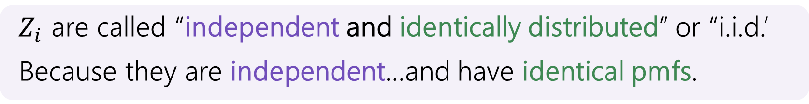
Negative Binomial Analysis
Let $Z_{1},Z_{2},…,Z_{r}$ be independent copies of $Geo(p)$
$X\sim NegBin(r,p)$ $X=Z_{1}+Z_{2}+…+Z_{r}$.
$𝔼\left[X\right]=𝔼\left[Z_{1}+Z_{2}+…Z_{r}\right]=𝔼\left[Z_{1}\right]+𝔼\left[Z_{2}\right]+…+𝔼\left[Z_{r}\right]=r⋅\frac{1}{p}$
$Z_{i}$ are called “independent and identically distributed” or “i.i.d.’
Because they are independent…and have identical pmfs.

Slide 37
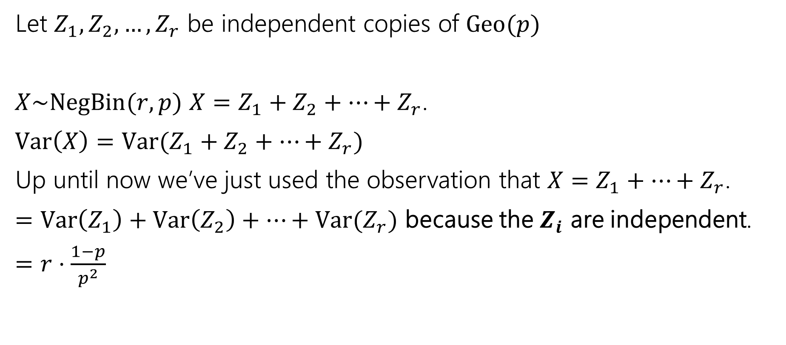
Negative Binomial Analysis
Let $Z_{1},Z_{2},…,Z_{r}$ be independent copies of $Geo(p)$
$X\sim NegBin(r,p)$ $X=Z_{1}+Z_{2}+…+Z_{r}$.
$Var\left(X\right)=Var(Z_{1}+Z_{2}+…+Z_{r})$
Up until now we’ve just used the observation that $X=Z_{1}+…+Z_{r}$.
$=Var\left(Z_{1}\right)+Var\left(Z_{2}\right)+…+Var(Z_{r})$ because the $Z_{i}$ are independent.
$=r⋅\frac{1−p}{p^{2}}$

Slide 38
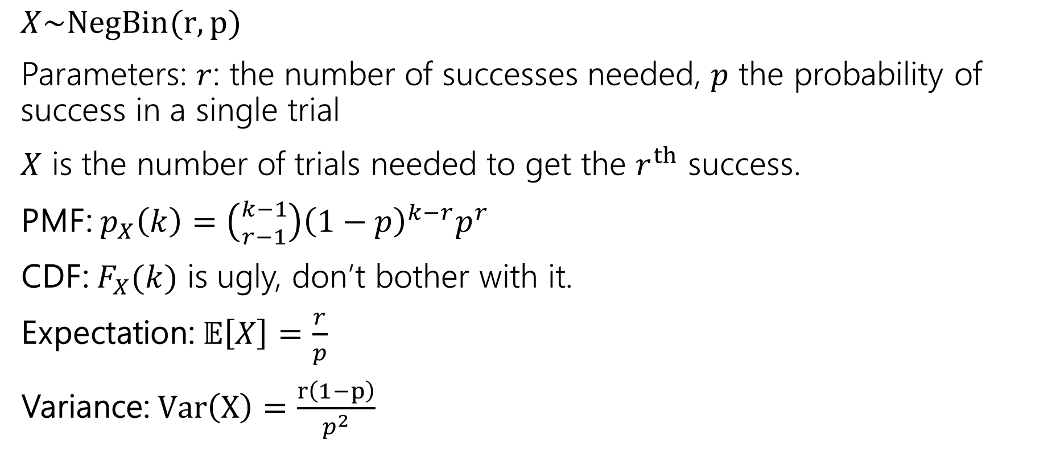
Negative Binomial
$X\sim NegBin(r,p)$
Parameters: $r$: the number of successes needed, $p$ the probability of success in a single trial
$X$ is the number of trials needed to get the $r^{th}$ success.
PMF: $p_{X}\left(k\right)=\left({k−1 \atop r−1}\right){\left(1−p\right)}^{k−r}p^{r}$
CDF: $F_{X}(k)$ is ugly, don’t bother with it.
Expectation: $𝔼\left[X\right]=\frac{r}{p}$
Variance: $Var\left(X\right)=\frac{r\left(1−p\right)}{p^{2}}$

Slide 39

Scenario: Hypergeometric
You have an urn with $N$ balls, of which $K$ are purple. You are going to draw $n$ balls out of the urn without replacement. How many purple balls do we get in this sample?
  $X$ is the number of purple balls in this sample

Slide 40

Hypergeometric: Analysis (PMF)
You have an urn with $N$ balls, of which $K$ are purple. You are going to draw $n$ balls out of the urn without replacement. How many purple balls do we get in this sample?
  $X$ is the number of purple balls in this sample
If you draw out $n$ balls, what is the probability you see $k$ purple ones?
N
n
K
k
n-k

Slide 41
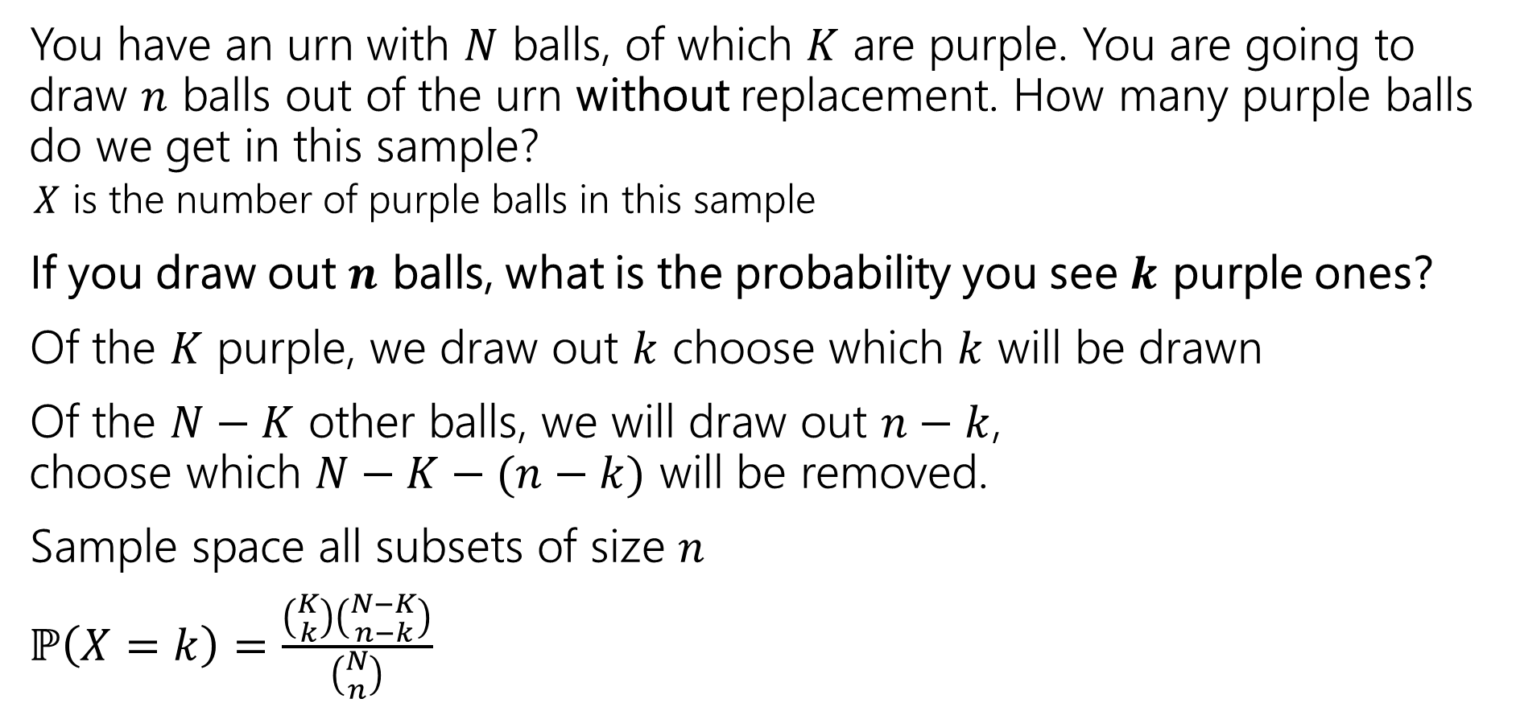
Hypergeometric: Analysis (PMF)
You have an urn with $N$ balls, of which $K$ are purple. You are going to draw $n$ balls out of the urn without replacement. How many purple balls do we get in this sample?
  $X$ is the number of purple balls in this sample
If you draw out $n$ balls, what is the probability you see $k$ purple ones?
Of the $K$ purple, we draw out $k$ choose which $k$ will be drawn
Of the $N−K$ other balls, we will draw out $n−k$,
choose which $N−K−(n−k)$ will be removed.
Sample space all subsets of size $n$
$ℙ\left(X=k\right)=\frac{\left({K \atop k}\right)\left({N−K \atop n−k}\right)}{\left({N \atop n}\right)}$
N
n
K
k
n-k

Slide 42
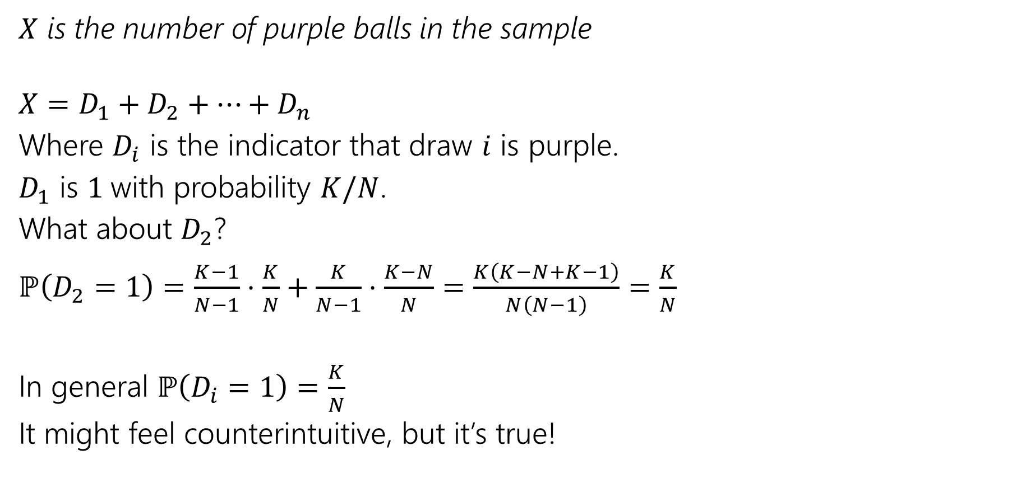
Hypergeometric: Analysis (Expectation)
$X$ is the number of purple balls in the sample
$X=D_{1}+D_{2}+…+D_{n}$
Where $D_{i}$ is the indicator that draw $i$ is purple.
$D_{1}$ is $1$with probability $K/N$.
What about $D_{2}$?
$ℙ\left(D_{2}=1\right)=\frac{K−1}{N−1}⋅\frac{K}{N}+\frac{K}{N−1}⋅\frac{K−N}{N}=\frac{K\left(K−N+K−1\right)}{N\left(N−1\right)}=\frac{K}{N}$
In general $ℙ\left(D_{i}=1\right)=\frac{K}{N}$
It might feel counterintuitive, but it’s true!

Slide 43

Hypergeometric: Analysis
$𝔼[X]$
$=𝔼\left[D_{1}+…D_{n}\right]=𝔼\left[D_{1}\right]+…+𝔼\left[D_{n}\right]=n⋅\frac{K}{N}$
Can we do the same for variance?
No! The $D_{i}$ are dependent. Even if they have the same probability.

Slide 44
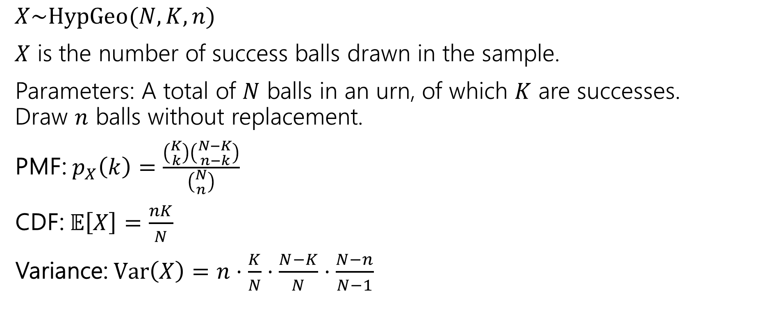
Hypergeometric Random Variable
$X\sim HypGeo(N,K,n)$
$X$ is the number of success balls drawn in the sample.
Parameters: A total of $N$ balls in an urn, of which $K$ are successes.
Draw $n$ balls without replacement.
PMF: $p_{X}\left(k\right)=\frac{\left({K \atop k}\right)\left({N−K \atop n−k}\right)}{\left({N \atop n}\right)}$
CDF: $𝔼\left[X\right]=\frac{nK}{N}$
Variance: $Var\left(X\right)=n⋅\frac{K}{N}⋅\frac{N−K}{N}⋅\frac{N−n}{N−1}$

Slide 45
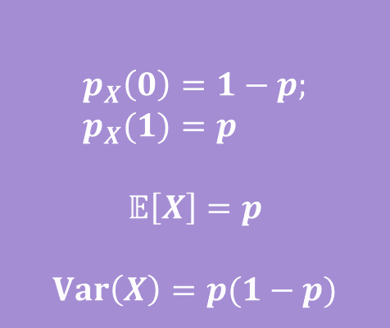
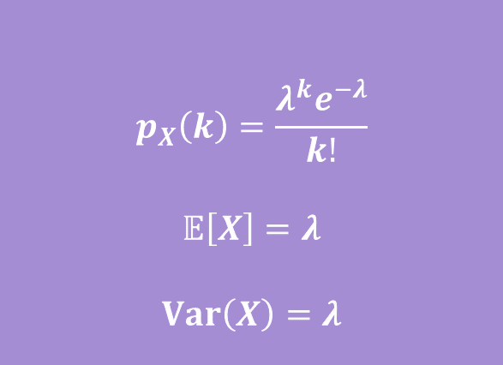



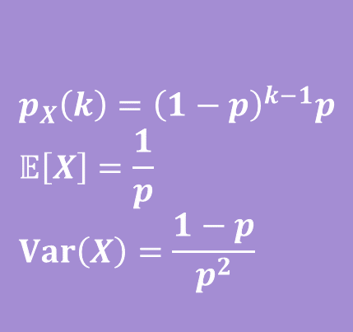
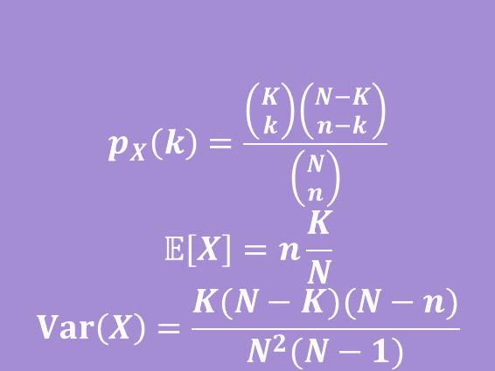

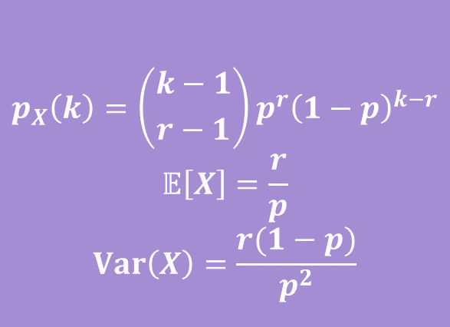





Zoo!
$$X\sim Geo(p)$$
$$X\sim Unif(a,b)$$
$$p_{X}\left(k\right)={\left(1−p\right)}^{k−1}p \\ 𝔼\left[X\right]=\frac{1}{p} \\ Var\left(X\right)=\frac{1−p}{p^{2}}$$
$$p_{X}\left(k\right)=\frac{1}{b−a+1}$$
$$𝔼\left[X\right]=\frac{a+b}{2}$$
$$Var\left(X\right)=\frac{\left(b−a\right)\left(b−a+2\right)}{12}$$
$$X\sim Ber(p)$$
$$X\sim Bin(n,p)$$
$$p_{X}\left(0\right)=1−p; \\ p_{X}(1)=p$$
$$𝔼\left[X\right]=p$$
$$Var\left(X\right)=p(1−p)$$
$$p_{X}\left(k\right)=\left({n \atop k}\right)p^{k}{\left(1−p\right)}^{n−k}$$
$$𝔼\left[X\right]=np$$
$$Var\left(X\right)=np(1−p)$$
$$X\sim Poi(λ)$$
$$X\sim NegBin(r,p)$$
$$p_{X}\left(k\right)=\frac{λ^{k}e^{−λ}}{k!}$$
$$𝔼\left[X\right]=λ$$
$$Var\left(X\right)=λ$$
$$p_{X}\left(k\right)=\left({k−1 \atop r−1}\right)p^{r}{\left(1−p\right)}^{k−r}$$
$$𝔼\left[X\right]=\frac{r}{p}$$
$$Var\left(X\right)=\frac{r(1−p)}{p^{2}}$$
$$X\sim HypGeo(N,K,n)$$
$$p_{X}\left(k\right)=\frac{\left({K \atop k}\right)\left({N−K \atop n−k}\right)}{\left({N \atop n}\right)}$$
$$𝔼\left[X\right]=n\frac{K}{N}$$
$$Var\left(X\right)=\frac{K(N−K)(N−n)}{N^{2}(N−1)}$$

Slide 46
Zoo Takeaways
You can do relatively complicated counting/probability calculations much more quickly than you could week 1!
You can now explain why your problem is a zoo variable and save explanation on homework (and save yourself calculations in the future).
Don’t spend extra effort memorizing…but be careful when looking up Wikipedia articles.
  The exact definitions of the parameters can differ (is a geometric random variable the number of failures before the first success, or the total number of trials including the success?)

Slide 47

Discrete Zoo of Random Variables
Uniform: Every integer between $a$ and $b$ are equally likely
  $Unif\left(a,b\right)$
Bernoulli: Whether there is success in one trial
  $Ber(p)$ is 1 with probability $p$ and 0 otherwise
Binomial: Number of successes in $n$ independent trials
  $Bin\left(n,p\right)$ - $n$ independent trials, probability $p$ of success on each trial
Geometric: Number of trials till first success
$Geo\left(p\right)$ - probability $p$ of success on each trial
Poisson: Number of successes in a time interval
$Poi\left(λ\right)$ - average number of successes in the time interval
Negative Binomial: Number of trials till $r$’th success
$NegBin\left(r,p\right)$ - probability $p$ of success on each trial, want trials till the $r$’th success
Hypergeometric: Number of successes when drawing a sample
$HypGeo\left(N,K,n\right)$ - drawing a sample of $n$ items from a set of $N$ with $K$ successes

Slide 48
Halfway Point!

Slide 49
What have we done over the past 4 weeks?
Counting
  Combinations, permutations, indistinguishable elements, starts and bars, inclusion-exclusion…
  Probability foundations
  Events, sample space, axioms of probability, expectation, variance
  Conditional probability
  Conditioning, independence, Bayes’ Rule
  Refined our intuition
  Especially around Bayes’ Rule

Slide 50
What’s next?
Continuous random variables.
  So far our sample spaces have been countable. What happens if we want to choose a random real number?
  How do expectation, variance, conditioning, etc. change in this new context?
  Mostly analogous to discrete cases, but with integrals instead of sums.
  Analysis when it’s inconvenient (or impossible) to exactly calculate probabilities.
  Central Limit Theorem (approximating discrete distributions with continuous ones)
  Tail Bounds/Concentration (arguing it’s unlikely that a random variable is far from its expectation)
  A first taste of making predictions from data (i.e., a bit of ML)

