Slide 1
Variance + Discrete Zoo I
CSE 312 26Su
Lecture 10
Fun fact!
Over a large number of trials, the average result will get closer to the expected value.
This principle is why casinos make consistent profits. Even though individual results can vary widely, the “law of large numbers” ensures that the casino’s profit prevails over time.

Slide 2
Announcements
HW2 grades are out (regrade request closes Saturday night)
HW3 due tonight
No HW released tonight! (HW4 released next Wednesday)

Slide 3
Announcements
Quiz 3 Random Variables on Friday
Lectures 7-9 content
Midterm next week on Wednesday 7/22
See information on website
~ 5 questions
T/F/short answer, counting, probability, conditional probability, random variables

Slide 4
Where Are We?
Last time:
  Expectation
  Linearity of Expectation
Today:
  Recap LOE
  Independence of RVs
  Expectation of a function
  Variance
  Zoo of Discrete Random Variables

Slide 5
Recap LOE

Slide 6

Rotating the table
$n$ people are sitting around a circular table. There is a name tag in each place. Nobody is sitting in front of their own name tag.
Rotate the table by a random number $k$ of positions between 1 and n-1 (equally likely)
$X$ is the number of people that end up in front of their own name tag. Find $𝔼\left[X\right]$.

Slide 7
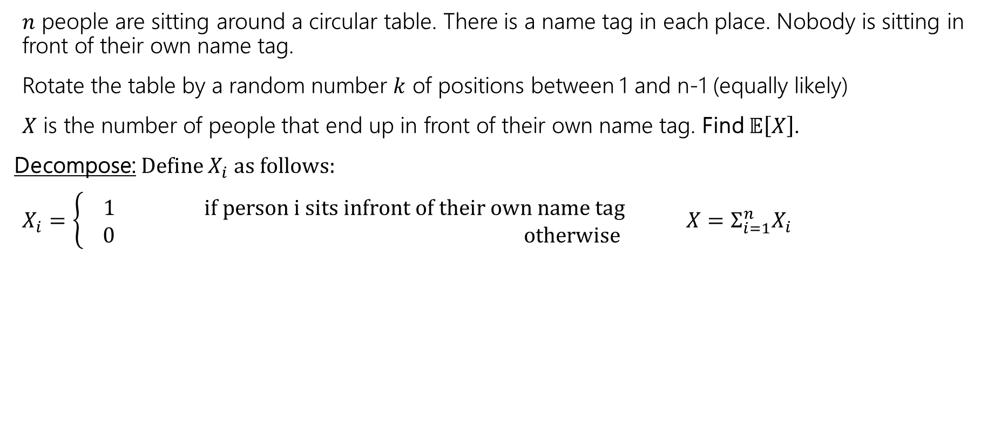
Rotating the table
$n$ people are sitting around a circular table. There is a name tag in each place. Nobody is sitting in front of their own name tag.
Rotate the table by a random number $k$ of positions between 1 and n-1 (equally likely)
$X$ is the number of people that end up in front of their own name tag. Find $𝔼\left[X\right]$.
Decompose: Define $X_{i}$as follows:
$X_{i}=\left\{\begin{aligned} 1 if person i sits infront of their own name tag \\ 0 otherwise\end{aligned}\right.$ ${X=Σ_{i=1}^{n}X}_{i}$

Slide 8
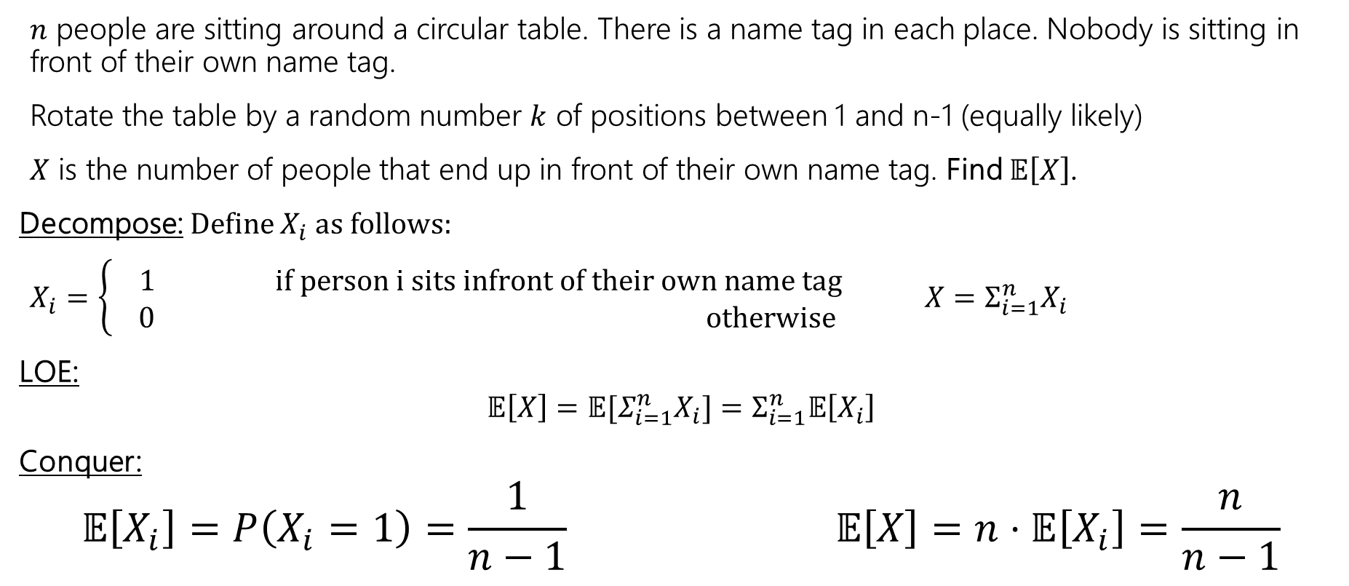
Rotating the table
$n$ people are sitting around a circular table. There is a name tag in each place. Nobody is sitting in front of their own name tag.
Rotate the table by a random number $k$ of positions between 1 and n-1 (equally likely)
$X$ is the number of people that end up in front of their own name tag. Find $𝔼\left[X\right]$.
Decompose: Define $X_{i}$as follows:
$X_{i}=\left\{\begin{aligned} 1 if person i sits infront of their own name tag \\ 0 otherwise\end{aligned}\right.$ ${X=Σ_{i=1}^{n}X}_{i}$
LOE:
$$𝔼\left[X\right]=𝔼[Σ_{i=1}^{n}X_{i}]=Σ_{i=1}^{n}𝔼\left[X_{i}\right]$$
Conquer:
$$𝔼\left[X_{i}\right]=P\left(X_{i}=1\right)=\frac{1}{n−1} 𝔼\left[X\right]=n⋅𝔼\left[X_{i}\right]=\frac{n}{n−1}$$

Slide 9
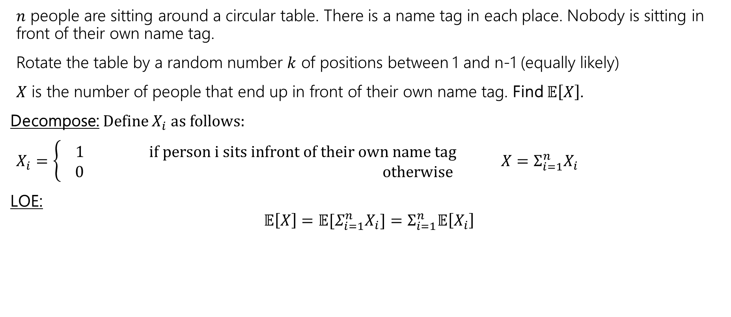
Rotating the table
$n$ people are sitting around a circular table. There is a name tag in each place. Nobody is sitting in front of their own name tag.
Rotate the table by a random number $k$ of positions between 1 and n-1 (equally likely)
$X$ is the number of people that end up in front of their own name tag. Find $𝔼\left[X\right]$.
Decompose: Define $X_{i}$as follows:
$X_{i}=\left\{\begin{aligned} 1 if person i sits infront of their own name tag \\ 0 otherwise\end{aligned}\right.$ ${X=Σ_{i=1}^{n}X}_{i}$
LOE:
$$𝔼\left[X\right]=𝔼[Σ_{i=1}^{n}X_{i}]=Σ_{i=1}^{n}𝔼\left[X_{i}\right]$$

Slide 10
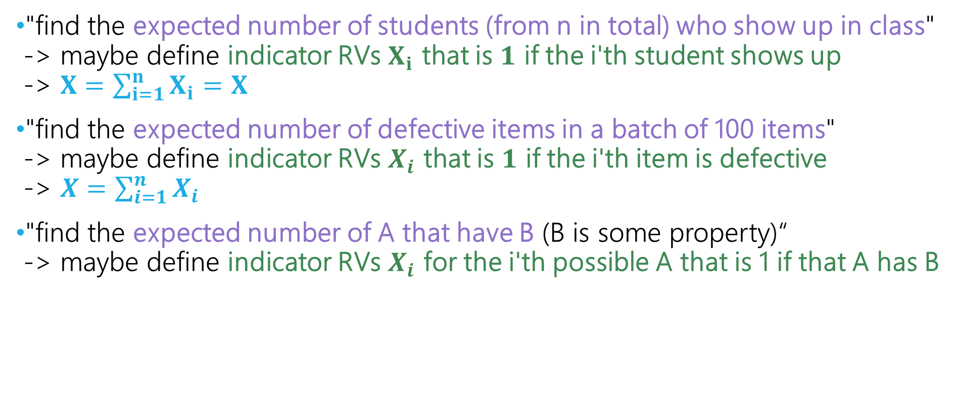
How to know what indicators to define?
"find the expected number of students (from n in total) who show up in class" -> maybe define indicator RVs $X_{i}$​ that is $1$ if the i'th student shows up
-> $X=\sum_{i=1}^{n}{X_{i}}=X$
"find the expected number of defective items in a batch of 100 items"
-> maybe define indicator RVs $X_{i}$​ that is $1$ if the i'th item is defective
-> $X=\sum_{i=1}^{n}{X_{i}}$
"find the expected number of A that have B (B is some property)“
-> maybe define indicator RVs $X_{i}$​​ for the i'th possible A that is 1 if that A has B

Slide 11
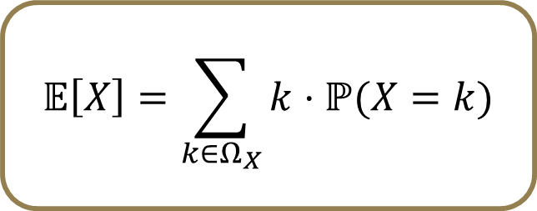
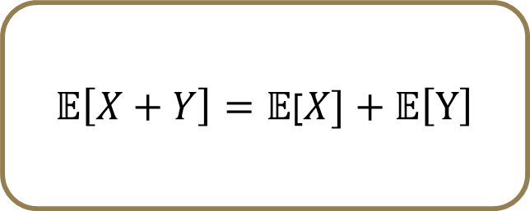
Techniques For Finding Expectation
1. Definition of Expectation
When the support is small enough and we can find the PMF of X
2. Linearity of Expectation
When we can break X into a sum
  Break into indicator RVs if it’s some kind of count
3. LOTUS (Law of the unconscious statistician)
When it’s a function of X (e.g, X2)
$$𝔼\left[X\right]=\sum_{k∈Ω_{X}}{k⋅ℙ(X=k)}$$
$𝔼\left[X+Y\right]=𝔼$[$X]+𝔼\left[Y\right]$
We’ll see this in a couple slides!

Slide 12
Independence of Random Variables

Slide 13
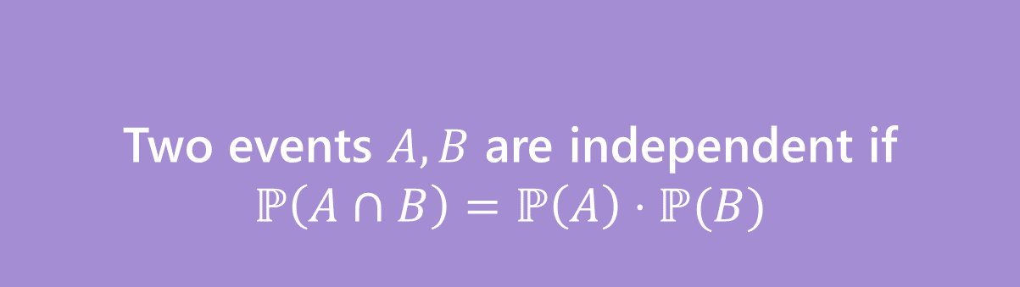
Independence of events
Recall the definition of independence of events:
“knowing whether one event occurred doesn’t tell us anything about whether the other event occurred”
Two events $A,B$ are independent if
$$ℙ\left(A∩B\right)=ℙ\left(A\right)⋅ℙ(B)$$
Independence
Notes:
We’ve talked about independence for events, that formula looked like this, one of the definitions. We say that two events are independent if … in other the way that we think about… to get the probability of both occurring we don’t have to conditioning on each toerh w the chain rule, we can just multiply their probabilities.

Slide 14


Independence of Random Variables
That’s for events…what about random variables?
$X$ and $Y$ are independent if for all $k∈Ω_{X},ℓ∈Ω_{Y}$
$$ℙ\left(X=k, Y=ℓ\right)=ℙ\left(X=k\right)ℙ(Y=ℓ)$$
Independence (of random variables)
We’ll often use commas instead of $∩$ symbol to save space.
“knowing the value of one random variable doesn’t tell us anything about what the value of the other might be”
Notes:
What about for random variables? So if I rolled a pair of dice and I care about the sum of the dice, well then is that independent of just one of the dice rolls? And we know how to do that for events for the event. I got a four on the red die or a seven on the blue die, or seven as the sum of the two dice, I want to talk about how we do that for random variables as well when we look at that number output, not just the event.
We define independence in a very similar way. Two random variables variables .. Are .. Notee that X=k and Y=l are both events, we’re checking that these events are independent of each other. We need to check that these are indepnedne for all k and l we could plug in over here. If we find that two rvs are indpenent.. That means that knowing the value of one… we need to check this indpenednce for all the possible values.
Small notational note – we’re commas instead id of intersection because we love ti save space, commas are a bit easier to type.. Feel free to use whatever.

Slide 15

Independence of Random Variables
The “for all values” is important.
We say that the event “the sum is 7” is independent of “the red die is 5”
What about $S=$“the sum of two dice” and $R=$“the value of the red die”
Notes:
Let’s look at an example.. We’ve looked at these 2 events b4. sum … what about the corresponding random variables? So we have S … and R…
We know that S=7 and R=5 Re indpeendnent, based on this, we’vefound this earlier. But to know that these wto RVs are indpenent, we need to check this for all values of S and R. when we look through some examples, we’re going to find that this doesn’t work when S=2 and R=5.. So they are not independent.

Slide 16
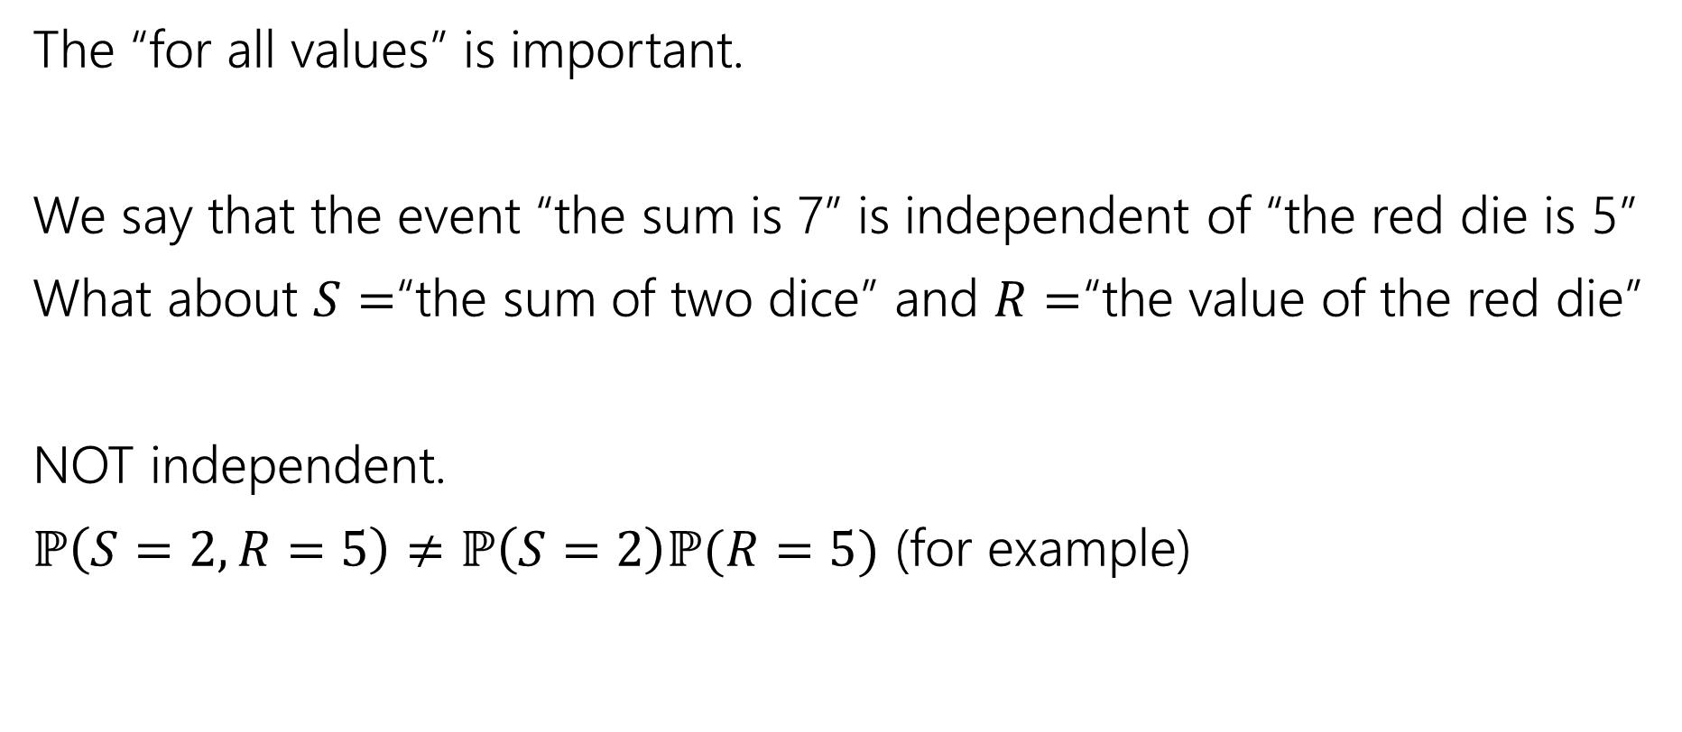
Independence of Random Variables
The “for all values” is important.
We say that the event “the sum is 7” is independent of “the red die is 5”
What about $S=$“the sum of two dice” and $R=$“the value of the red die”
NOT independent.
$ℙ\left(S=2, R=5\right)≠ℙ\left(S=2\right)ℙ(R=5)$ (for example)

Slide 17

Independence of Random Variables
Flip a coin independently $2n$ times.
Let $X$ be “the number of heads in the first $n$ flips.”
Let $Y$ be “the number of heads in the last $n$ flips.”
$X$ and $Y$ are independent.
Notes:
Very often, we’re not going to need to go through the effort of checking all those values to check indpenendence of RVs.. So for example here… if we wanted to check independence formally, we would need to check all the possible n values of X and the values of h… that would take awhile
Usually independence of random variables is going to follow pretty quickly just from the definitions given in a problem.

Slide 18

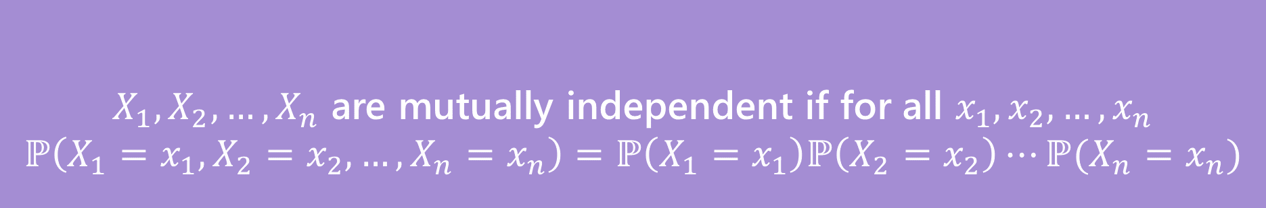
Mutual Independence for RVs
A little simpler to write down than for events
DON’T need to check all subsets for random variables…
But you do need to check all values (all possible $x_{i}$) still.
$X_{1},X_{2},…,X_{n}$ are mutually independent if for all $x_{1},x_{2},…,x_{n}$
$$ℙ\left(X_{1}=x_{1}, X_{2}=x_{2},…,X_{n}=x_{n}\right)=ℙ\left(X_{1}=x_{1}\right)ℙ\left(X_{2}=x_{2}\right)⋯ℙ(X_{n}=x_{n})$$
Mutual Independence (of random variables)
Notes:
If we’re looking at the independence for 3 or more random variables, then we’ll uses this formula to chekck for mutual independnce.. Again there are cases where this is going to following pretty quickly from the problem statmentws.

Slide 19
Techniques For Finding Expectation
1. Definition of Expectation
When the support is small enough and we can find the PMF of X
2. Linearity of Expectation
When we can break X into a sum
  Break into indicator RVs if it’s some kind of count
3. LOTUS (Law of the unconscious statistician)
When it’s a function of X (e.g, X2)
$$𝔼\left[X\right]=\sum_{k∈Ω_{X}}{k⋅ℙ(X=k)}$$
$𝔼\left[X+Y\right]=𝔼$[$X]+𝔼\left[Y\right]$
We’ll see this now!

Slide 20
Expectation of a Function of a Random Variable
Notes:
What we’re going to do for the rest of today’s lecture is talk a bunch more about expectation, so let’s first review what expectation is

Slide 21
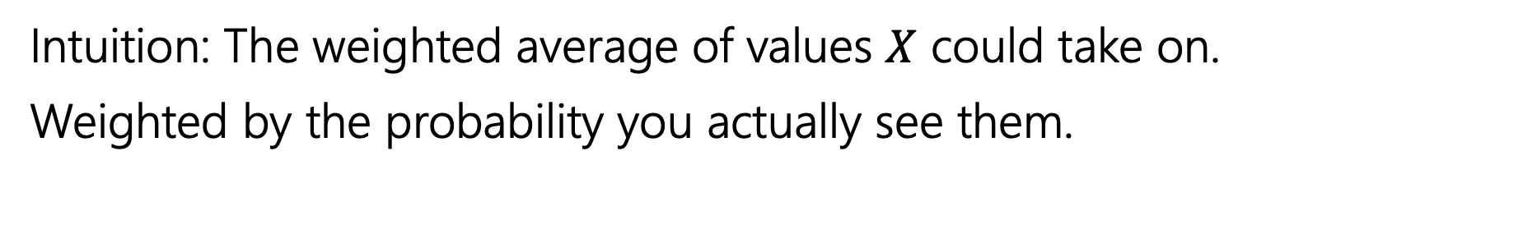
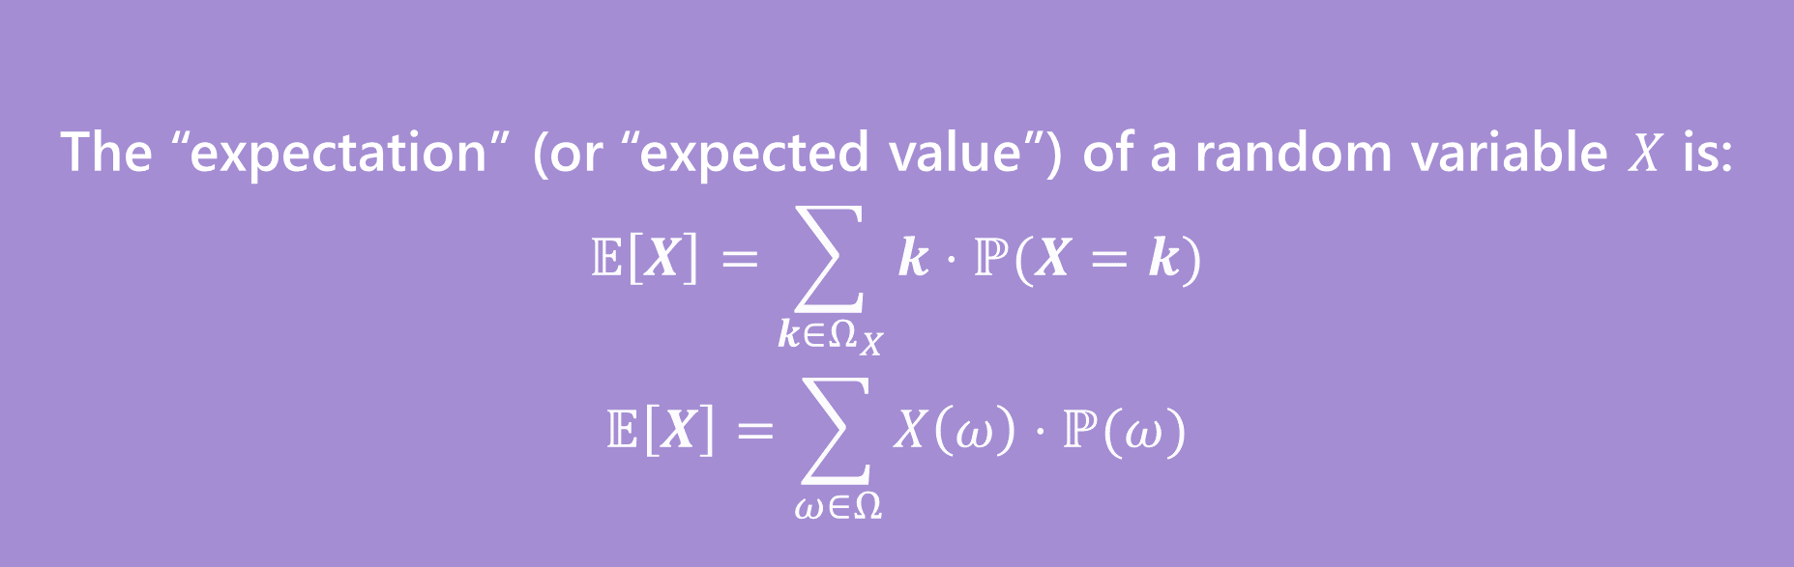
Expectation
The “expectation” (or “expected value”) of a random variable $X$ is:
$$𝔼\left[X\right]=\sum_{k∈Ω_{X}}{k⋅ℙ(X=k)}$$
$$𝔼\left[X\right]=\sum_{ω∈Ω}{X\left(ω\right)⋅ℙ(ω)}$$
Expectation
Intuition: The weighted average of values $X$ could take on.
Weighted by the probability you actually see them.
Notes:
We’re talked about eepctated value as the weighted average.. This first formula is what we’ve seem before,. says look at the random variable, look at the support of the random variable, for every k in the support what is the probability that X takes on the value k, use that probability as the weight when you find the weighted average of all those values in the support of the random variable, that is your expected outcome, your average outcome for the random variable X, we call that the expectation. The other formula calculates the same value, but instead of thinking k by k, value by value in the support, this looks at the sample space of the experiment. Look at the sample space and go outcome by outcome in the sample space, on that outcome what value does X take on, now multiply that by the probability of seeing that outcome, you add up all of those and get the expectation. Depending on the context one formula may be more useful than the other.
If asked, think of R.V. sum of two dice roll and {2, ... ,12} v.s. {(1,1), ... , (6,6)}.

Slide 22
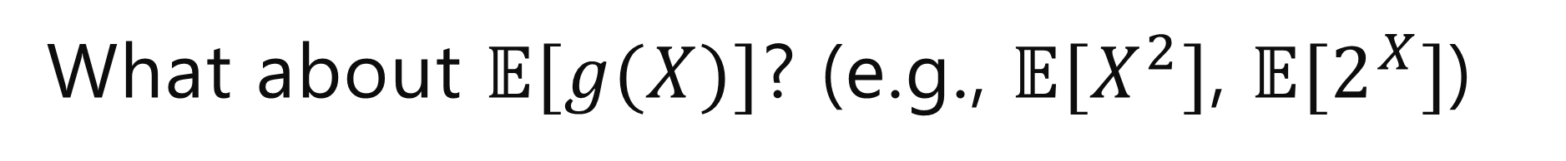
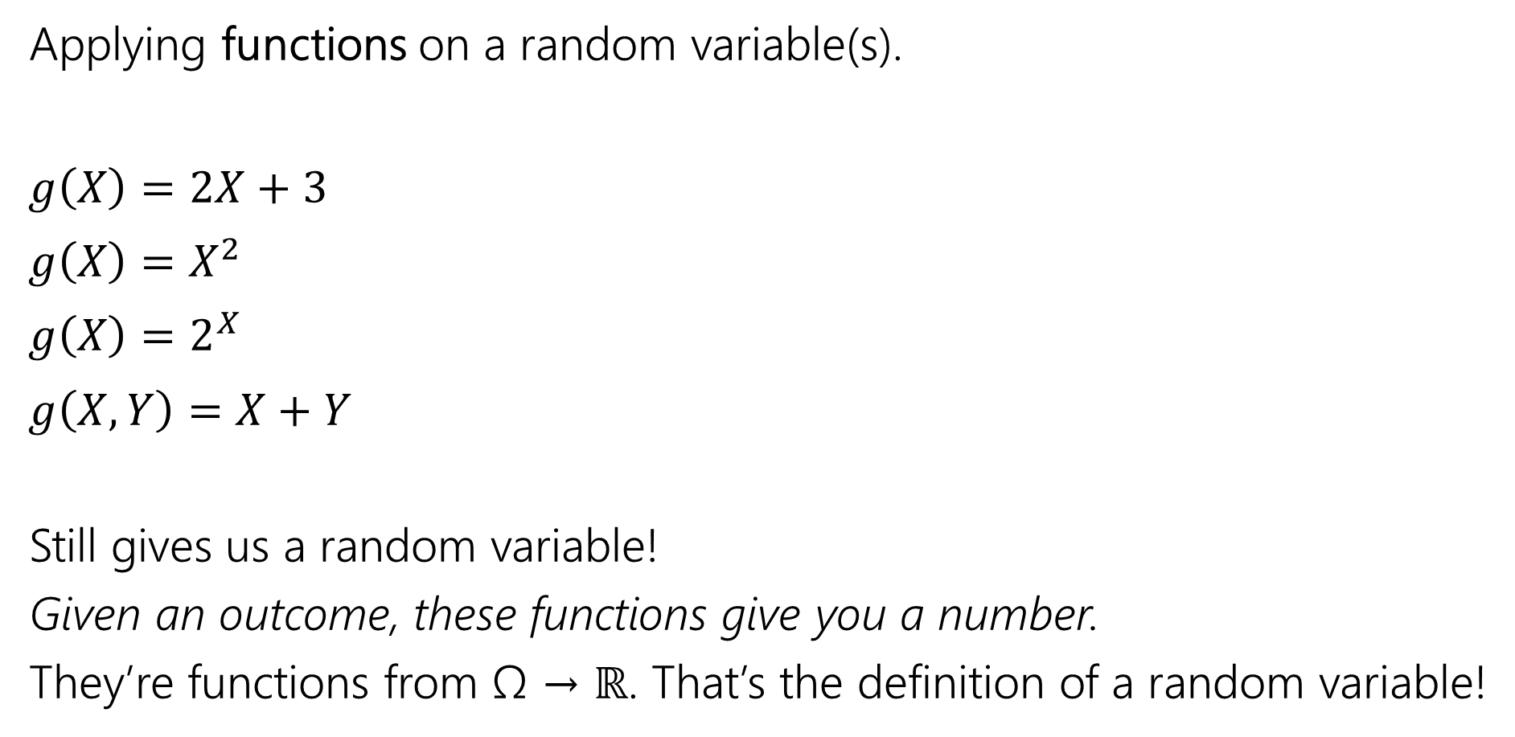
What about $𝔼[g(X)]$? (e.g., $𝔼[X^{2}]$, $𝔼[2^{X}]$)
Applying functions on a random variable(s).
$g\left(X\right)=2X+3$
${g\left(X\right)=X}^{2}$
${g\left(X\right)=2}^{X}$
$g\left(X,Y\right)=X+Y$
Still gives us a random variable!
Given an outcome, these functions give you a number.
They’re functions from Ω → ℝ. That’s the definition of a random variable!
Notes:
Sometimes we might want to find the expectation of some function of X. here are some example of functions. G(X) that we might apply on this random variable. So for exmapl,e we have X is a random variable it assigns anumber ot each outome. We’re going to take that number it assigns whatever that might be, multiply by 2 and add 3 to it. Here are a couple more examples. We might also have a function of two randomv ariables. For example that adds up the values that both those random variables assign to… note that each of these they’re still a random variable. They can sitill take in an outcome, and it give us a number.

Slide 23

What about $𝔼[g(X)]$? (e.g., $𝔼[X^{2}]$, $𝔼[2^{X}]$)
What if we want to find the expected value of some function of $X$?
Let’s say we want to find $𝔼[X^{2}]$. Is $𝔼\left[X^{2}\right]=(𝔼{\left[X\right])}^{2}$ ?
Notes:
Now let’s say we want to find the expected value of one of these functions. Let’s say we want to find e[x^2. our first guess might be. Wel…
This isn’t actually ture in general. For example… let’s say we have some random variable that follows this pmf. It take on 1 or -1 with equal probability..
However, e[x^2] is 1 because when we square each of these we’re going to get a 1, when means that X6@ is always being 1.
Why is this? Let’s look at the PMF for X^2

Slide 24
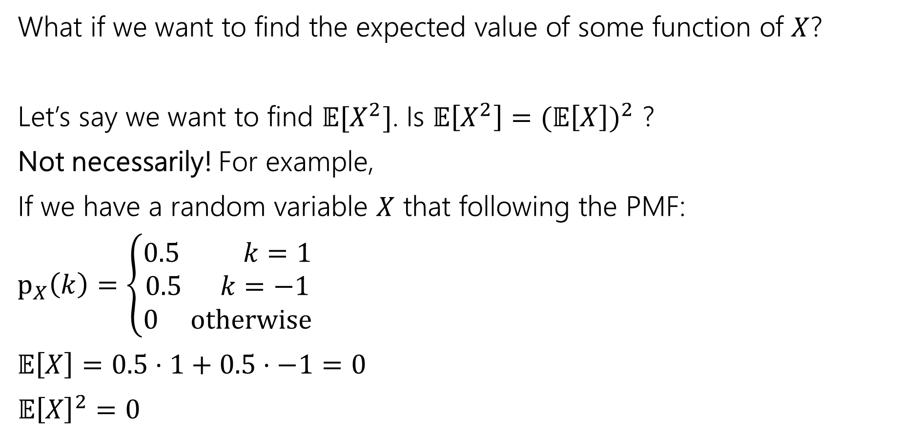
What about $𝔼[g(X)]$? (e.g., $𝔼[X^{2}]$, $𝔼[2^{X}]$)
What if we want to find the expected value of some function of $X$?
Let’s say we want to find $𝔼[X^{2}]$. Is $𝔼\left[X^{2}\right]=(𝔼{\left[X\right])}^{2}$ ?
Not necessarily! For example,
If we have a random variable $X$ that following the PMF:
$p_{X}\left(k\right)=\left\{\begin{aligned}0.5 k=1 \\ 0.5 k=−1 \\ 0 otherwise\end{aligned}\right.$
$𝔼\left[X\right]=0.5⋅1+0.5⋅−1=0$
$𝔼{\left[X\right]}^{2}=0$
Notes:
Now let’s say we want to find the expected value of one of these functions. Let’s say we want to find e[x^2. our first guess might be. Wel…
This isn’t actually ture in general. For example… let’s say we have some random variable that follows this pmf. It take on 1 or -1 with equal probability..
However, e[x^2] is 1 because when we square each of these we’re going to get a 1, when means that X6@ is always being 1.
Why is this? Let’s look at the PMF for X^2

Slide 25

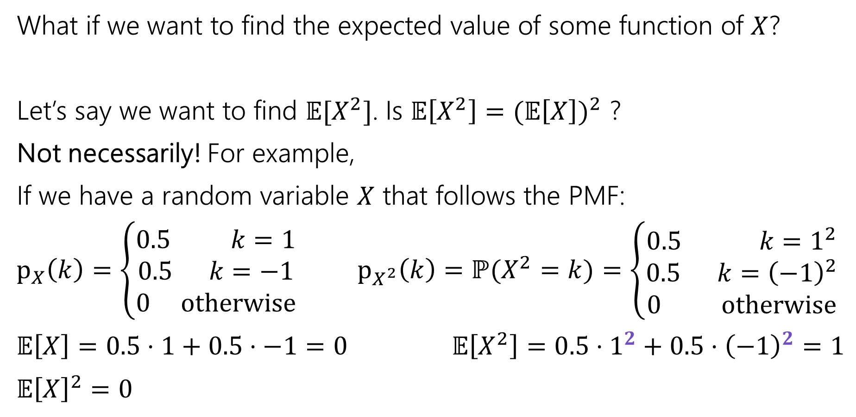
What about $𝔼[g(X)]$? (e.g., $𝔼[X^{2}]$)
What if we want to find the expected value of some function of $X$?
Let’s say we want to find $𝔼[X^{2}]$. Is $𝔼\left[X^{2}\right]=(𝔼{\left[X\right])}^{2}$ ?
Not necessarily! For example,
If we have a random variable $X$ that follows the PMF:
$p_{X}\left(k\right)=\left\{\begin{aligned}0.5 k=1 \\ 0.5 k=−1 \\ 0 otherwise\end{aligned}\right.$ $p_{X^{2}}\left(k\right)=ℙ(X^{2}=k)=\left\{\begin{aligned}0.5 k=1^{2} \\ 0.5 k={\left(−1\right)}^{2} \\ 0 otherwise\end{aligned}\right.$
$𝔼\left[X\right]=0.5⋅1+0.5⋅−1=0$ $𝔼\left[X^{2}\right]=0.5⋅1^{2}+0.5⋅{\left(−1\right)}^{2}=1$
$𝔼{\left[X\right]}^{2}=0$
Notes:
When we square X, what we’re really doing is squaring the values in the sUPPORT of X. this is the PMF for X, the PMF for X^2 Is this the probabilities remain the same but we’re going to square each of the values in the range.. The outcomes that correspond the X=1 are the same, they have the same probability, we’re just saying that X^2 is not going assign 1 to that outcome it’s going to assign 1^2.. When we do this we can thn..

Slide 26

What about $𝔼[g(X)]$? (e.g., $𝔼[X^{2}]$)
What if we want to find the expected value of some function of $X$?
Let’s say we want to find $𝔼[X^{2}]$. Is $𝔼\left[X^{2}\right]=(𝔼{\left[X\right])}^{2}$ ?
Not necessarily! For example,
If we have a random variable $X$ that follows the PMF:
$p_{X}\left(k\right)=\left\{\begin{aligned}0.5 k=1 \\ 0.5 k=−1 \\ 0 otherwise\end{aligned}\right.$ $p_{X^{2}}\left(k\right)=ℙ(X^{2}=k)=\left\{\begin{aligned}1 k=1 \\ 0 otherwise\end{aligned}\right.$
$𝔼\left[X\right]=0.5⋅1+0.5⋅−1=0$ $𝔼\left[X^{2}\right]=0.5⋅1^{2}+0.5⋅{\left(−1\right)}^{2}=1$
$𝔼{\left[X\right]}^{2}=0$

Slide 27
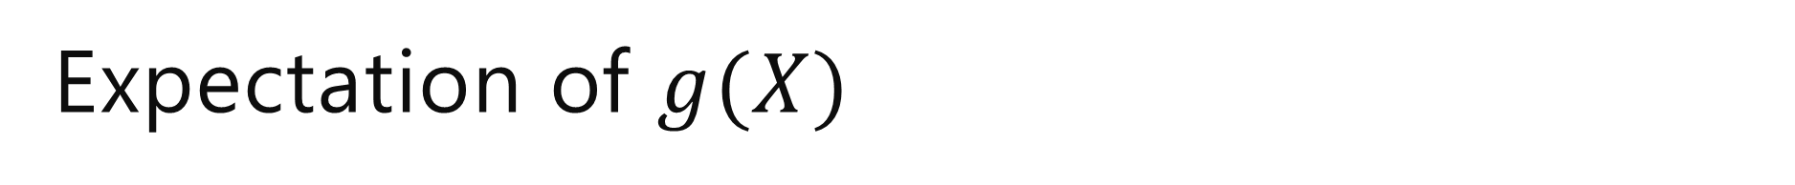
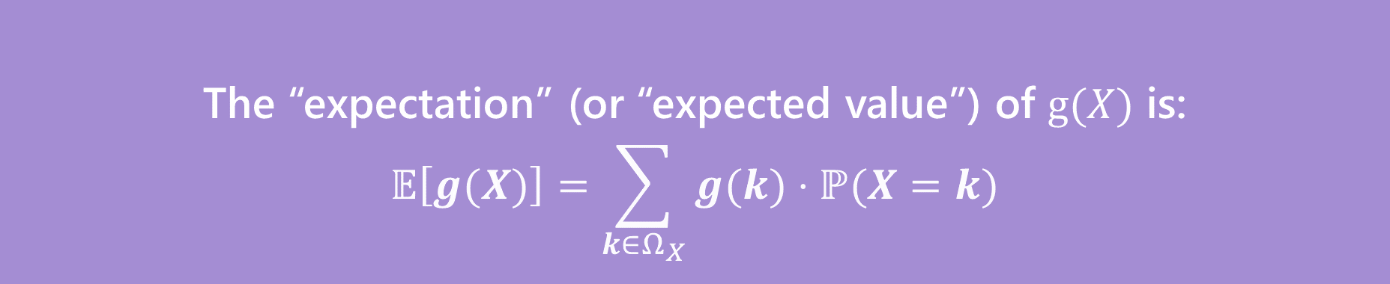
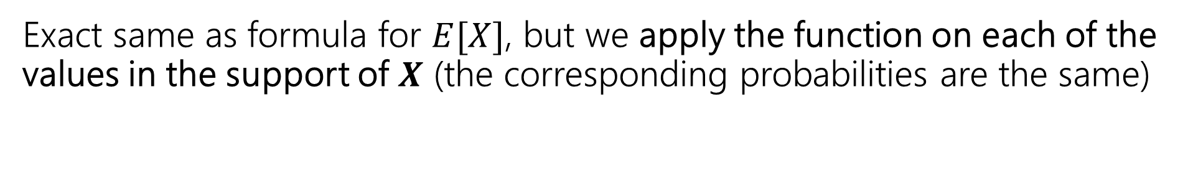
Expectation of $g(X)$
The “expectation” (or “expected value”) of $g(X)$ is:
$$𝔼\left[g(X)\right]=\sum_{k∈Ω_{X}}{g(k)⋅ℙ(X=k)}$$
“Law of the unconscious statistician” (LOTUS)
Exact same as formula for $E[X]$, but we apply the function on each of the values in the support of $X$ (the corresponding probabilities are the same)
Notes:
In general, to find the expected value of some function ofX. We do the exact same thing, we’re taking thes ame weighted average, but now, we’re going to apply whatever function we have on each of the valuesin the support of X. we’re doing g(k) instead of just k. that’s the only difference. If X^2, we’ll to k^2 here. If it’s 2^X i

Slide 28
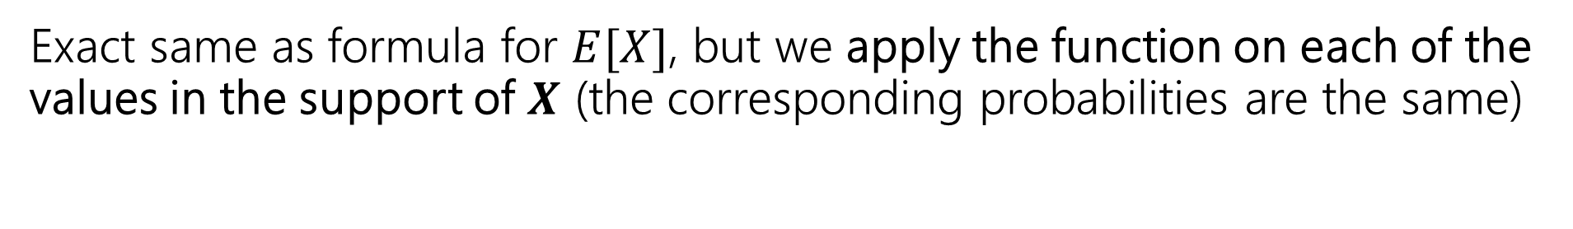
Expectation of $g(X)$
The “expectation” (or “expected value”) of $g(X)$ is:
$$𝔼\left[g(X)\right]=\sum_{k∈Ω_{X}}{g(k)⋅ℙ(X=k)}$$
“Law of the unconscious statistician” (LOTUS)
Exact same as formula for $E[X]$, but we apply the function on each of the values in the support of $X$ (the corresponding probabilities are the same)
What if $g(X)$ is a linear function? E.g., $g\left(X,Y\right)=X+Y$
Notes:
What if X is the linear function, it’s just adding together somethings?

Slide 29
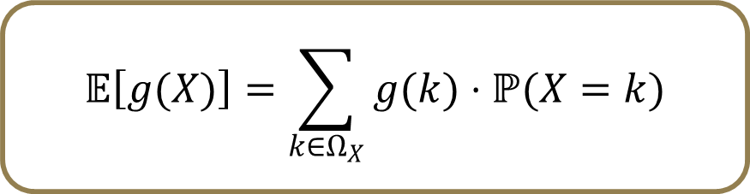
Techniques For Finding Expectation
1. Definition of Expectation
When the support is small enough and we can find the PMF of X
2. Linearity of Expectation
When we can break X into a sum
  Break into indicator RVs if it’s some kind of count
3. LOTUS (Law of the unconscious statistician)
When it’s a function of X (e.g, X2)
$$𝔼\left[X\right]=\sum_{k∈Ω_{X}}{k⋅ℙ(X=k)}$$
$𝔼\left[X+Y\right]=𝔼$[$X]+𝔼\left[Y\right]$
$$𝔼\left[g(X)\right]=\sum_{k∈Ω_{X}}{g(k)⋅ℙ(X=k)}$$

Slide 30
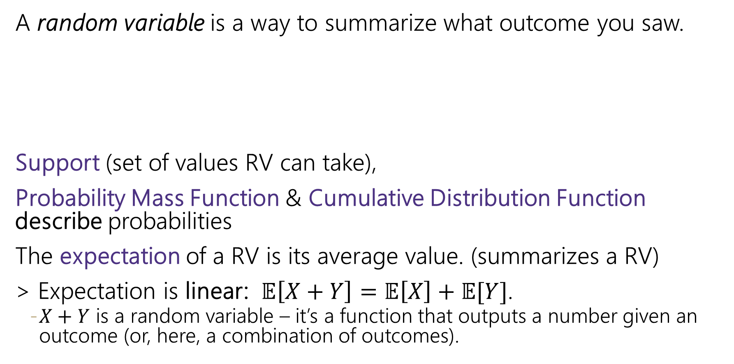
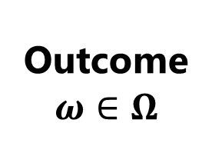


Where are we?
A random variable is a way to summarize what outcome you saw.
Support (set of values RV can take),
Probability Mass Function & Cumulative Distribution Function describe probabilities
The expectation of a RV is its average value. (summarizes a RV)
> Expectation is linear: $𝔼\left[X+Y\right]=𝔼\left[X\right]+𝔼[Y]$.
    $X+Y$ is a random variable – it’s a function that outputs a number given an outcome (or, here, a combination of outcomes).
$Ω$ is set of possible outcomes
Outcome
$$ω∈Ω$$
Quantitative value
$$X$$

Slide 31
Variance

Slide 32
Variance
Another one number summary of a random variable.
But wait, we already have expectation, what’s this for?

Slide 33
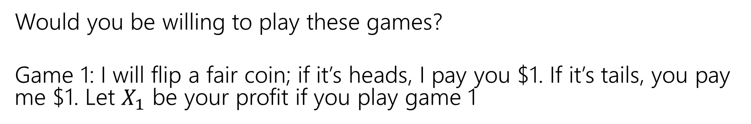


Consider these two games
Would you be willing to play these games?
Game 1: I will flip a fair coin; if it’s heads, I pay you $1. If it’s tails, you pay me $1. Let $X_{1}$ be your profit if you play game 1
$$\frac{1}{2}$$
$$\frac{1}{2}$$
-1
0
1

Slide 34
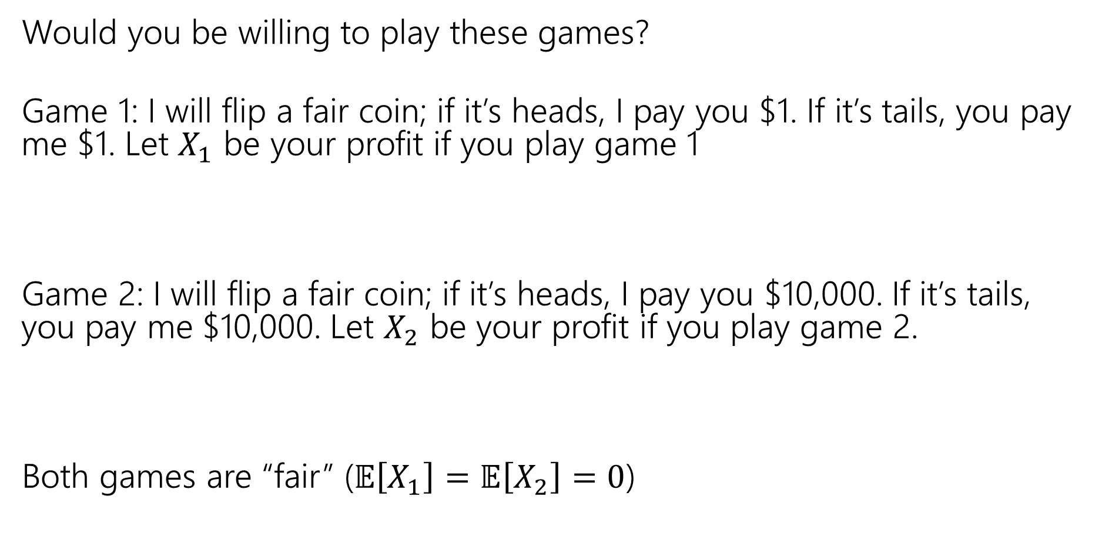


Consider these two games
Would you be willing to play these games?
Game 1: I will flip a fair coin; if it’s heads, I pay you $1. If it’s tails, you pay me $1. Let $X_{1}$ be your profit if you play game 1
Game 2: I will flip a fair coin; if it’s heads, I pay you $10,000. If it’s tails, you pay me $10,000. Let $X_{2}$ be your profit if you play game 2.
Both games are “fair” ($𝔼\left[X_{1}\right]=𝔼\left[X_{2}\right]=0$)
$$\frac{1}{2}$$
$$\frac{1}{2}$$
-1
0
1
$$\frac{1}{2}$$
$$\frac{1}{2}$$
-10,000
0
10,000

Slide 35
What’s the difference
Expectation tells you what the average will be…
But it doesn’t tell you how “extreme” your results could be.
Nor how likely those extreme results are.
Game 2 has many (well, only) very extreme results.
In expectation they “cancel out” but if you can only play once…
…it would be nice to measure that.

Slide 36
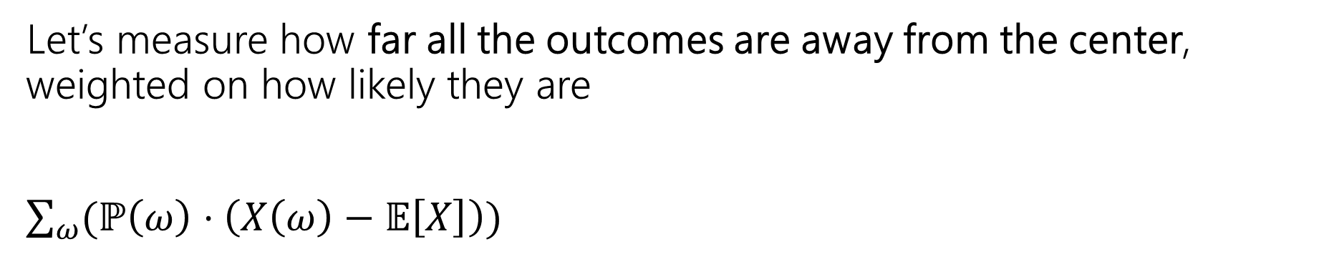
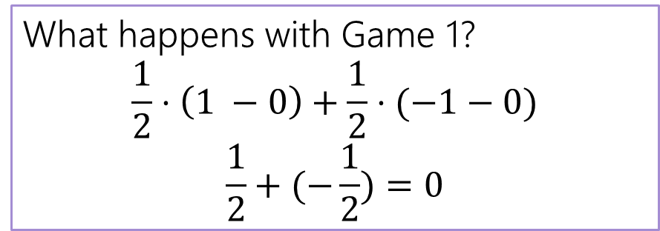
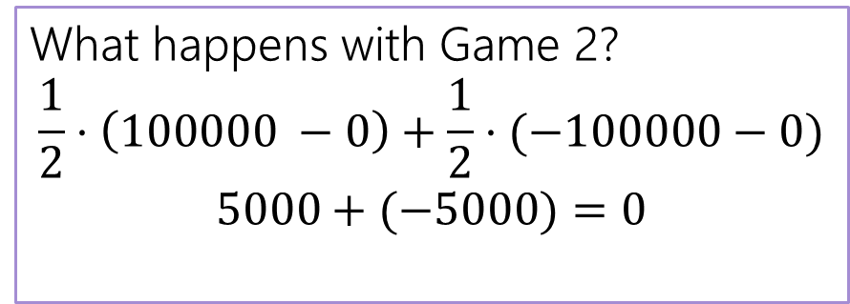
Designing a Measure – Try 1
Let’s measure how far all the outcomes are away from the center, weighted on how likely they are
$\sum_{ω}{(ℙ\left(ω\right)⋅\left(X\left(ω\right)−𝔼\left[X\right]\right)) }$
What happens with Game 1?
$$\frac{1}{2}⋅\left(1 −0\right)+\frac{1}{2}⋅(−1−0)$$
$$\frac{1}{2}+(−\frac{1}{2})=0$$
What happens with Game 2?
$$\frac{1}{2}⋅\left(100000 −0\right)+\frac{1}{2}⋅(−100000−0)$$
$$5000+(−5000)=0$$

Slide 37
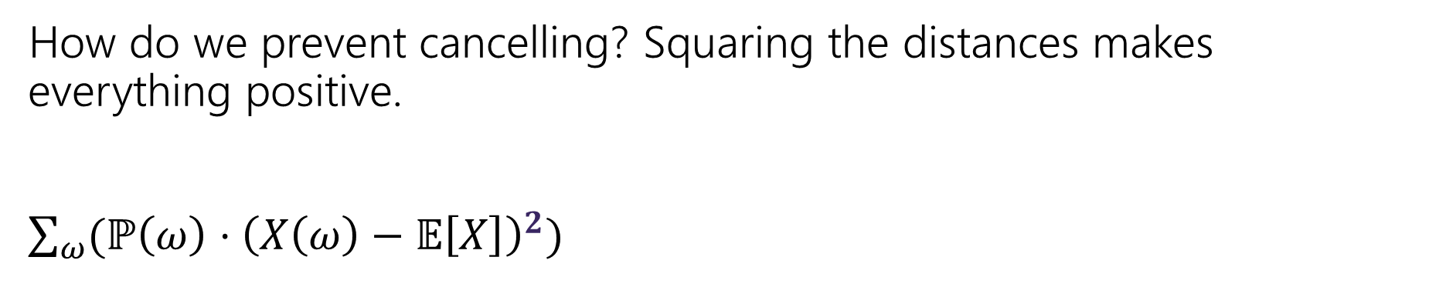
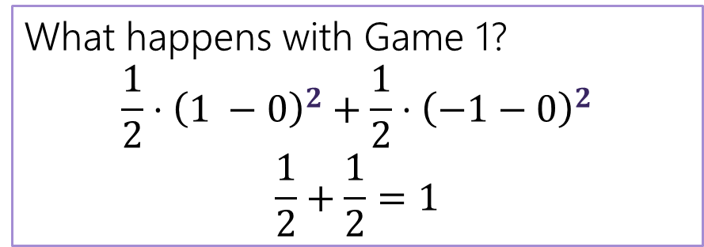
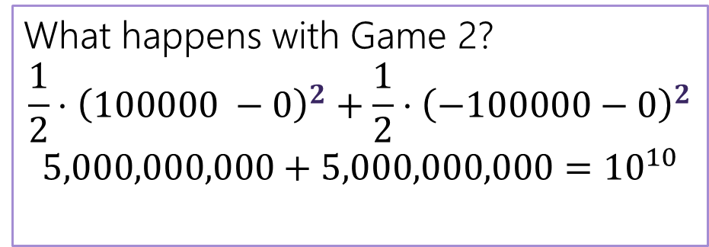
Designing a Measure – Try 2
How do we prevent cancelling? Squaring the distances makes everything positive.
$\sum_{ω}{(ℙ\left(ω\right)⋅{\left(X\left(ω\right)−𝔼\left[X\right]\right)}^{2}) }$
This is the variance!
What happens with Game 1?
$$\frac{1}{2}⋅{\left(1 −0\right)}^{2}+\frac{1}{2}⋅{\left(−1−0\right)}^{2}$$
$$\frac{1}{2}+\frac{1}{2}=1$$
What happens with Game 2?
$$\frac{1}{2}⋅{\left(100000 −0\right)}^{2}+\frac{1}{2}⋅{\left(−100000−0\right)}^{2}$$
$$5,000,000,000+5,000,000,000={10}^{10}$$

Slide 38
Why Squaring
Why not absolute value? Or fourth power?
> Squaring is nicer algebraically.
> Our goal with variance was to talk about the spread of results.
Squaring makes extreme results even more extreme.
> Fourth power over-emphasizes the extreme results (for our purposes).

Slide 39
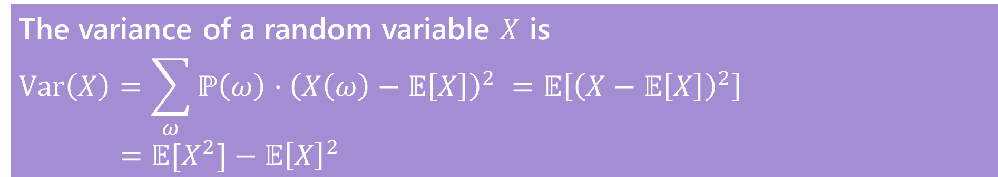
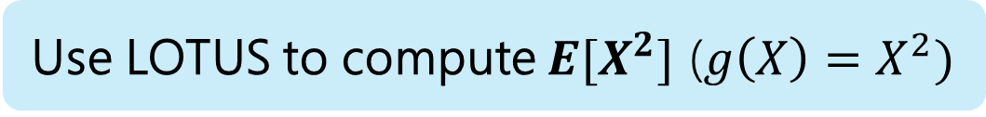
Variance
Use LOTUS to compute $E[X^{2}]$ ($g\left(X\right)=X^{2})$
Variance
The first form forms are the definition. The last one is an algebra trick.
Intuition: Variance is a quantity that measures on average how “far”
the random variable is from its expectation
> higher values means values are very spread out
> smaller values means values are closer and tend to be closer to expectation
The variance of a random variable $X$ is
$$Var\left(X\right)=\sum_{ω}{ℙ\left(ω\right)⋅{\left(X\left(ω\right)−𝔼\left[X\right]\right)}^{2} }=𝔼\left[{\left(X−𝔼\left[X\right]\right)}^{2}\right]$$
$$=𝔼[X^{2}]−𝔼{\left[X\right]}^{2}$$

Slide 40

Proof of Calculation Trick
$𝔼\left[{\left(X−𝔼\left[X\right]\right)}^{2}\right]=𝔼\left[X^{2}−2X𝔼\left[X\right]+{\left(𝔼\left[X\right]\right)}^{2}\right]$ expanding the square
$=$

Slide 41
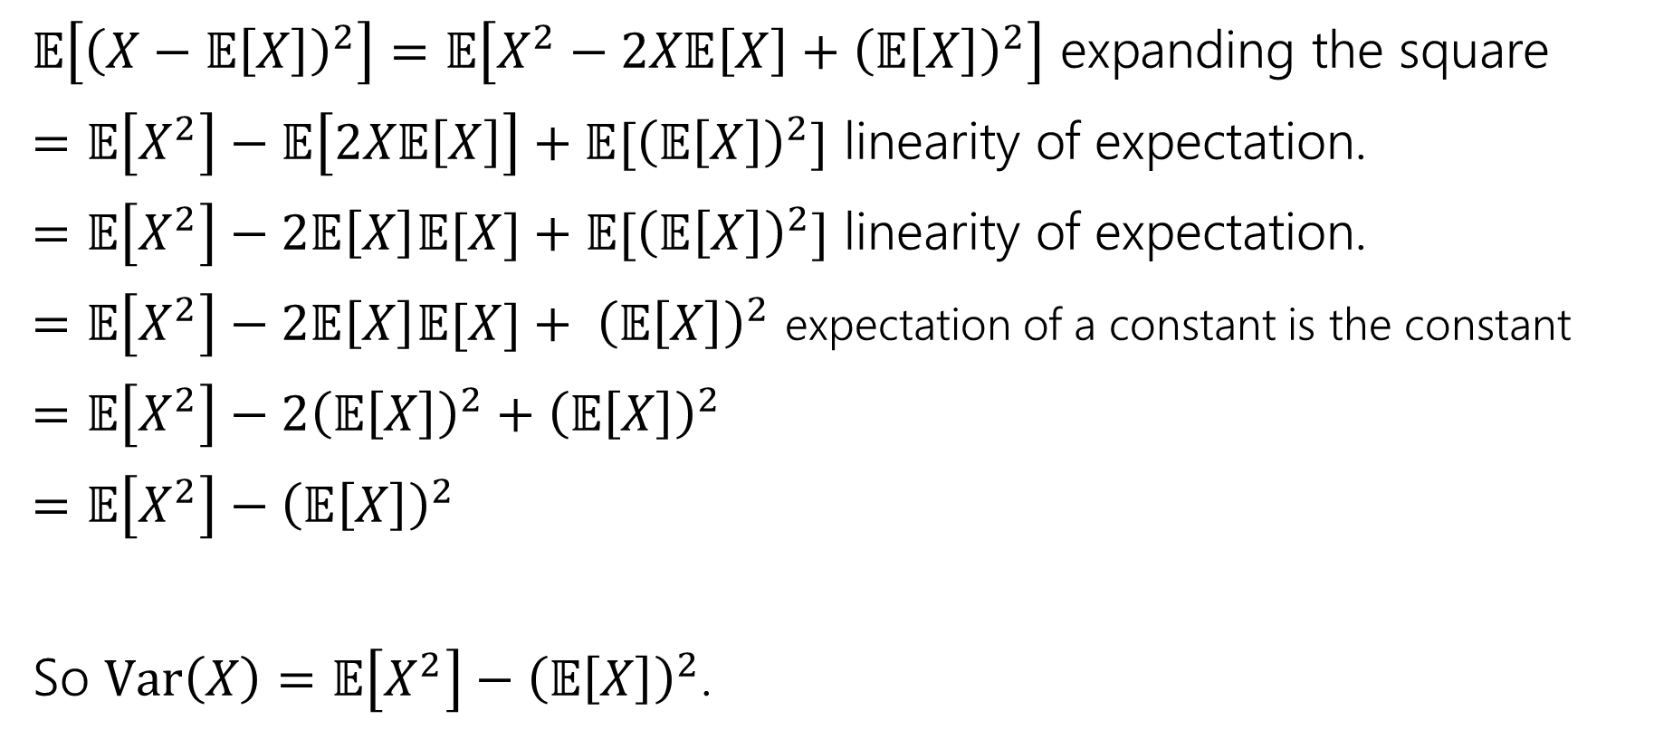
Proof of Calculation Trick
$𝔼\left[{\left(X−𝔼\left[X\right]\right)}^{2}\right]=𝔼\left[X^{2}−2X𝔼\left[X\right]+{\left(𝔼\left[X\right]\right)}^{2}\right]$ expanding the square
$=𝔼\left[X^{2}\right]−𝔼\left[2X𝔼\left[X\right]\right]+𝔼[{\left(𝔼\left[X\right]\right)}^{2}]$ linearity of expectation.
$=𝔼\left[X^{2}\right]−2𝔼\left[X\right]𝔼[X]+𝔼[{\left(𝔼\left[X\right]\right)}^{2}]$ linearity of expectation.
$=𝔼\left[X^{2}\right]−2𝔼\left[X\right]𝔼[X]+ {\left(𝔼\left[X\right]\right)}^{2}$ expectation of a constant is the constant
$=𝔼\left[X^{2}\right]−2{\left(𝔼\left[X\right]\right)}^{2}+{\left(𝔼\left[X\right]\right)}^{2}$
$=𝔼\left[X^{2}\right]−{\left(𝔼\left[X\right]\right)}^{2}$
So $Var\left(X\right)=𝔼\left[X^{2}\right]−{\left(𝔼\left[X\right]\right)}^{2}$.

Slide 42
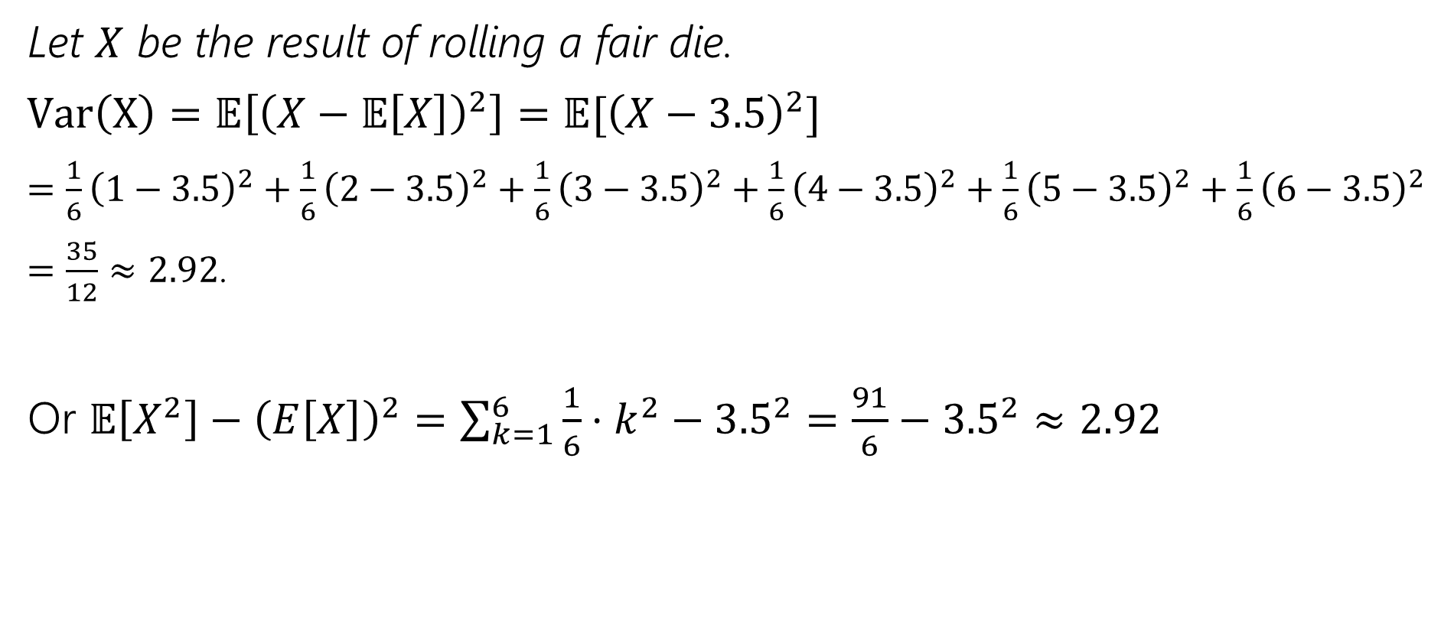
Variance of a die
Let $X$ be the result of rolling a fair die.
$Var\left(X\right)=𝔼\left[{\left(X−𝔼\left[X\right]\right)}^{2}\right]=𝔼[{\left(X−3.5\right)}^{2}]$
$=\frac{1}{6}{\left(1−3.5\right)}^{2}+\frac{1}{6}{\left(2−3.5\right)}^{2}+\frac{1}{6}{\left(3−3.5\right)}^{2}+\frac{1}{6}{\left(4−3.5\right)}^{2}+\frac{1}{6}{\left(5−3.5\right)}^{2}+\frac{1}{6}{\left(6−3.5\right)}^{2}$
$=\frac{35}{12}≈2.92$.
Or $𝔼\left[X^{2}\right]−{\left(E\left[X\right]\right)}^{2}=\sum_{k=1}^{6}{\frac{1}{6}⋅k^{2}−{3.5}^{2}}=\frac{91}{6}−{3.5}^{2}≈2.92$

Slide 43
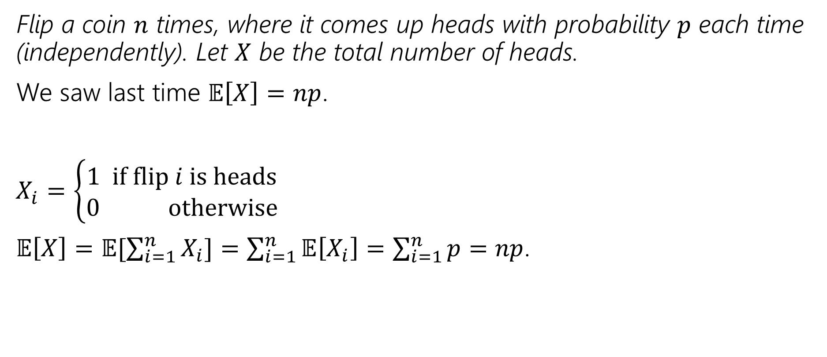

Variance of $n$ Coin Flips
Flip a coin $n$ times, where it comes up heads with probability $p$ each time (independently). Let $X$ be the total number of heads.
We saw last time $𝔼\left[X\right]=np$.
$X_{i}=\left\{\begin{aligned}1 if flip i is heads \\ 0 otherwise\end{aligned}\right.$
$𝔼\left[X\right]=𝔼[\sum_{i=1}^{n}{X_{i}]=\sum_{i=1}^{n}{𝔼\left[X_{i}\right]=\sum_{i=1}^{n}{p=np}}}$.

Slide 44
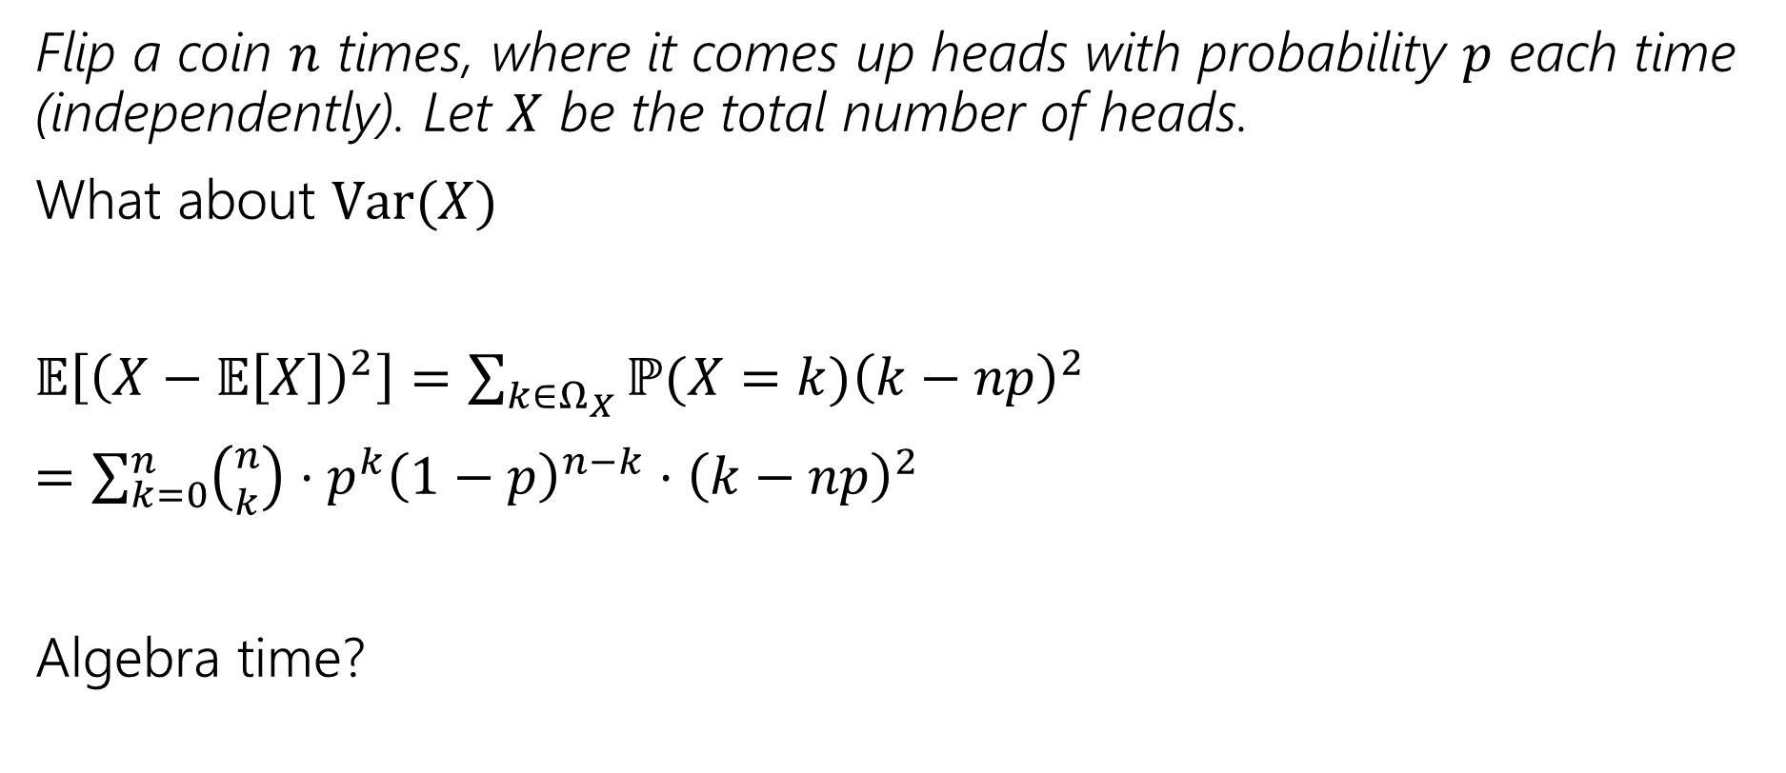
Variance of $n$ Coin Flips
Flip a coin $n$ times, where it comes up heads with probability $p$ each time (independently). Let $X$ be the total number of heads.
What about $Var(X)$
$𝔼\left[{\left(X−𝔼\left[X\right]\right)}^{2}\right]=\sum_{k∈Ω_{X}}{ℙ(X=k){\left(k−np\right)}^{2}}$
$=\sum_{k=0}^{n}{\left({n \atop k}\right)⋅p^{k}{\left(1−p\right)}^{n−k}⋅{\left(k−np\right)}^{2}}$
Algebra time?

Slide 45
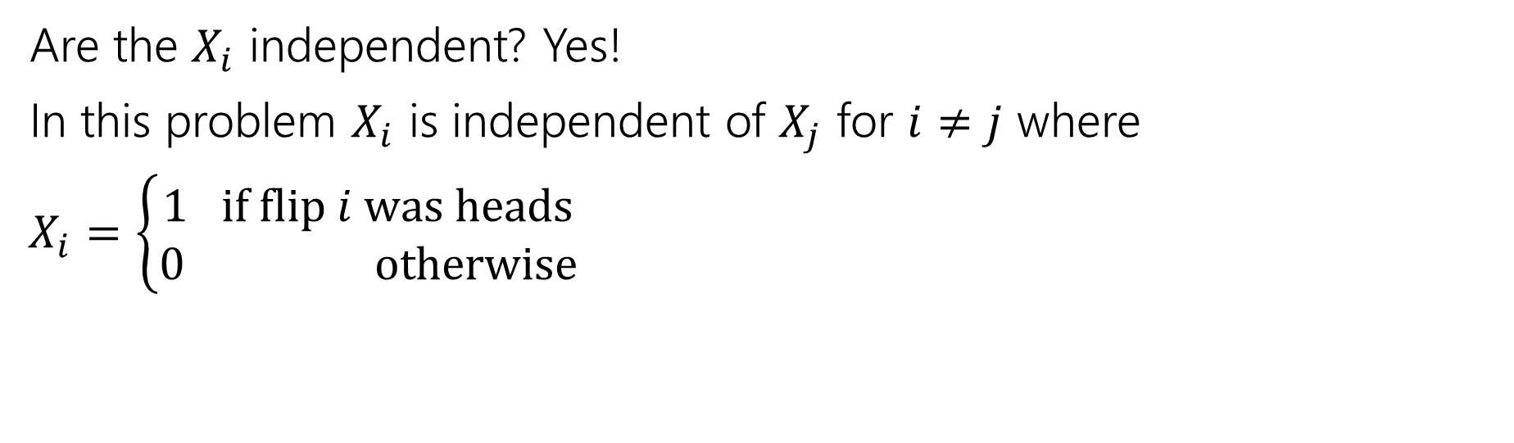

Variance Adds If Independent
If $X$ and $Y$ are independent then
$$Var\left(X+Y\right)=Var\left(X\right)+Var(Y)$$
Are the $X_{i}$ independent? Yes!
In this problem $X_{i}$ is independent of $X_{j}$ for $i≠j$ where
$X_{i}=\left\{\begin{aligned}1 if flip i was heads \\ 0 otherwise\end{aligned}\right.$

Slide 46

Variance Adds If Independent
$Var\left(X\right)=Var(\sum_{i=1}^{n}{X_{i})=\sum_{i=1}^{n}{Var(X_{i})}}$
What’s the $Var(X_{i})$?
$Var\left(X_{i}\right)=𝔼\left[X_{i}^{2}\right]−𝔼{\left[X_{i}\right]}^{2}$
$=𝔼\left[X_{i}\right]−p^{2}$
$=p−p^{2}$
$=p(1−p)$

Slide 47

Variance Adds If Independent
$Var\left(X\right)=Var(\sum_{i=1}^{n}{X_{i})=\sum_{i=1}^{n}{Var(X_{i})}}$
What’s the $Var(X_{i})$?
$p(1−p)$.
$Var\left(X\right)=\sum_{i=1}^{n}{p\left(1−p\right)=}np(1−p)$.

Slide 48
Expectation and Variance aren’t everything
Alright, so expectation and variance is everything right?
No!
A PMF or CDF *does* fully describe a random variable.
Flip a fair coin 3 times indep. Count heads.
Flip a biased coin (prob heads=2/3) until heads. Count flips.
…

Slide 49
Useful Facts

Slide 50

Make a prediction
How should $Var\left(X+c\right)$ relate to $Var(X)$ if $c$ is a constant?
How should $Var(aX)$ relate to $Var(X)$ is $a$ is a constant?

Slide 51

Facts About Variance
$Var\left(X+c\right)=Var(X)$
Proof:
$Var\left(X+c\right)=𝔼\left[{\left(X+c\right)}^{2}\right]−𝔼{\left[X+c\right]}^{2}$
$=𝔼\left[X^{2}\right]+𝔼\left[2Xc\right]+𝔼\left[c^{2}\right]−{\left(𝔼\left[X\right]+c\right)}^{2}$
$=𝔼\left[X^{2}\right]+2c𝔼\left[X\right]+c^{2}−𝔼{\left[X\right]}^{2}−2c𝔼\left[X\right]−c^{2}$
$=𝔼\left[X^{2}\right]−𝔼{\left[X\right]}^{2}$
$=Var(X)$
Intuition: Adding a constant just shifts the distribution – the spread says the same

Slide 52

Facts about Variance
$Var\left(aX\right)=$

Slide 53

Facts about Variance
$Var\left(aX\right)=a^{2}Var(X)$
$=𝔼\left[{\left(aX\right)}^{2}\right]−(𝔼{\left[aX\right])}^{2}$
$=a^{2}𝔼\left[X^{2}\right]−{\left(a𝔼\left[X\right]\right)}^{2}$
$=a^{2}𝔼\left[X^{2}\right]−a^{2}𝔼{\left[X\right]}^{2}$
$=a^{2}\left(𝔼\left[X^{2}\right]−𝔼{\left[X\right]}^{2}\right)$
Intuition: Multiplying by a positive constant makes it more spread out

Slide 54


Summary of Expectation and Variance
Expectation (“on average”)
$$𝔼\left[X\right]=\sum_{k∈Ω_{X}}{k⋅ℙ(X=k)}$$
> $𝔼\left[g(X)\right]=\sum_{k∈Ω_{X}}{g(k)⋅ℙ(X=k)}$
Linearity of Expectation (LoE)
$𝔼\left[X+Y\right]=𝔼\left[X\right]+𝔼[Y]$ (always true)
Shifting and Scaling:
$$𝔼\left[aX+b\right]=a𝔼\left[X\right]+b$$
If $X$ and $Y$ are independent:
$𝔼\left[X⋅Y\right]=𝔼\left[X\right]𝔼\left[Y\right]$
Variance (“how spread out”)
$$Var\left(X\right)=𝔼[X^{2}]−𝔼{\left[X\right]}^{2}$$
Linearity of Variance
only if $X$ and $Y$ are independent
Shifting and Scaling:
$$Var\left(aX+b\right)=a^{2}Var(X)$$
If $X$ and $Y$ are independent:
$$Var\left(X+Y\right)=Var\left(X\right)+Var(Y)$$

Slide 55
Discrete Random Variable Zoo

Slide 56
Discrete Random Variable Zoo
There are common patterns of experiments:
> Flip a [fair/unfair] coin [blah] times and count the number of heads.
> Flip a [fair/unfair] coin until the first time that you see a heads
> Draw a uniformly random element from [set]
> Define an indicator random variable for [event]
…
Instead of calculating the support, PMF, CDF, expectation, variance every time, why not calculate it once and look it up every time?

Slide 57
for example…
E.g.
the number of coin tosses till we get the first heads
the number of games we need to play till we first win
the number of dice rolls till the first 6
all follow the same format as,
the number of trials till we get the first success
The discrete zoo defines some common patterns and gives us the PMF, expectation, and variance, so we don’t have to compute it every time!

Slide 58

What’s our goal?
Your goal is NOT to memorize these facts (it’ll be convenient to memorize some of them, but don’t waste time making flash cards).
  Everything is on Wikipedia anyway. Everyone checks Wikipedia when they forget these.

Slide 59
What’s our goal?
Your goal is NOT to memorize these facts (it’ll be convenient to memorize some of them, but don’t waste time making flash cards).
  Everything is on Wikipedia anyway. Everyone checks Wikipedia when they forget these.
While learning about this zoo, we will also get the chance too:
0. Introduce one new distribution we haven’t seen at all (next time).
1. Practice expectation, variance, etc. for ones we have gotten hints of.
2. Review the first half of the course with some probability calculations.

Slide 60














Zoo!
$$X\sim Geo(p)$$
$$X\sim Unif(a,b)$$
$$p_{X}\left(k\right)={\left(1−p\right)}^{k−1}p \\ 𝔼\left[X\right]=\frac{1}{p} \\ Var\left(X\right)=\frac{1−p}{p^{2}}$$
$$p_{X}\left(k\right)=\frac{1}{b−a+1}$$
$$𝔼\left[X\right]=\frac{a+b}{2}$$
$$Var\left(X\right)=\frac{\left(b−a\right)\left(b−a+2\right)}{12}$$
$$X\sim Ber(p)$$
$$X\sim Bin(n,p)$$
$$p_{X}\left(0\right)=1−p; \\ p_{X}(1)=p$$
$$𝔼\left[X\right]=p$$
$$Var\left(X\right)=p(1−p)$$
$$p_{X}\left(k\right)=\left({n \atop k}\right)p^{k}{\left(1−p\right)}^{n−k}$$
$$𝔼\left[X\right]=np$$
$$Var\left(X\right)=np(1−p)$$
$$X\sim Poi(λ)$$
$$X\sim NegBin(r,p)$$
$$p_{X}\left(k\right)=\frac{λ^{k}e^{−λ}}{k!}$$
$$𝔼\left[X\right]=λ$$
$$Var\left(X\right)=λ$$
$$p_{X}\left(k\right)=\left({k−1 \atop r−1}\right)p^{r}{\left(1−p\right)}^{k−r}$$
$$𝔼\left[X\right]=\frac{r}{p}$$
$$Var\left(X\right)=\frac{r(1−p)}{p^{2}}$$
$$X\sim HypGeo(N,K,n)$$
$$p_{X}\left(k\right)=\frac{\left({K \atop k}\right)\left({N−K \atop n−k}\right)}{\left({N \atop n}\right)}$$
$$𝔼\left[X\right]=n\frac{K}{N}$$
$$Var\left(X\right)=\frac{K(N−K)(N−n)}{N^{2}(N−1)}$$

Slide 61
Scenario: Uniform
You want an integer in some range, with each integer equally likely.
Familiar example:
Outcome of rolling a fair die (or draw a random integer from 1,…,n)
  equally likely to be an integer between 1 and 6

Slide 62

Discrete Uniform Distribution
$X\sim Unif(a,b)$
$X$ is a uniformly random integer between $a$ and $b$ (inclusive)
Parameter $a$ is the minimum value in the support, $b$ is the maximum value in the support.
PMF: $p_{X}\left(k\right)=\frac{1}{b−a+1}$for $k∈ℤ$, $a≤k≤b$
CDF: $F_{X}\left(k\right)=\frac{k−a+1}{b−a+1}$for $k∈ℤ,$ $a≤k≤b$.
Expectation: $𝔼\left[X\right]=\frac{a+b}{2}$
Variance: $Var\left(X\right)=\frac{(b−a)(b−a+2)}{12}$

Slide 63

Situation: Bernoulli
Do I get a success in one trial with probability $p$ of “success”?
Familiar examples:
You flip a biased coin (once) and want to record whether its heads.
An indicator random variable that is either 1 or 0

Slide 64

Bernoulli Distribution
$X\sim Ber(p)$
$X$ is the indicator random variable that the trial was a success.
Parameter $p$ is probability of success on the trial.
PMF: $p_{X}\left(0\right)=1−p,$ $p_{X}\left(1\right)=p$
CDF: $F_{X}\left(k\right)=\left\{\begin{aligned}0 if k<0 \\ 1−p if 0≤k<1 \\ 1 if k≥1\end{aligned}\right.$
Expectation: $𝔼\left[X\right]=p$
Variance: $Var\left(X\right)=p(1−p)$

Slide 65
Bernoulli Distribution Examples
Did a particular bit get written correctly on the device?
Did you guess right on a multiple-choice test?
Did a server in a cluster fail?
Did a disk drive crash?
Did buying a particular share of a stock pay off?
Did a user like or dislike a YouTube video? (Back in ye olden days, at least)
Does a user click an ad?
In each of these, we find the probability of success on a trial, define a RV as an indicator for whether the event occurred, say the RV follows a bernoulli distribution with relevant and we have the PMF, E[X] and Var(X)!

Slide 66

Situation: Binomial
How many success did you see in $n$ independent trials, where each trial has probability $p$ of success?
Familiar example:
You flip a coin $n$ times independently, each with a probability $p$ of coming up heads. How many heads are there?

Slide 67

Binomial Distribution
$X\sim Bin(n,p)$
$X$ is the number of successes across $n$ independent trials.
$n$ is the number of independent trials.
$p$ is the probability of success for one trial.
PMF: $p_{X}\left(k\right)= \left({n \atop k}\right)p^{k}{\left(1−p\right)}^{n−k}$ for $k∈\{0,1,…,n\}$
CDF: $F_{X}$ is ugly.
Expectation: $𝔼\left[X\right]=np$
Variance: $Var\left(X\right)=np(1−p)$

Slide 68
Binomial Distribution Examples
How many bits were written correctly on the device?
How many questions did you guess right on a multiple-choice test?
How many servers in a cluster failed?
How many keys went to one bucket in a hash table?

Slide 69

Example: Unpopular Donuts
A donut shop serves 50 people a day and serves a mango chili lime donut. The probability that a customer chooses this donut is 0.2. All customers’ choices are independent of each other.
What is the probability that exactly $10$ people choose this flavor?
What is the probability that at least $3$ people choose this flavor?

Slide 70
Example: Unpopular Donuts
A donut shop serves 50 people a day and serves a mango chili lime donut. The probability that a customer chooses this donut is 0.2. All customers’ choices are independent of each other.
What is the probability that exactly $10$ people choose this flavor?
What is the probability that at least $3$ people choose this flavor?
PMF: $p_{X}\left(k\right)= \left({n \atop k}\right)p^{k}{\left(1−p\right)}^{n−k}$ for $k∈\{0,1,…,n\}$

Slide 71

Example: Unpopular Donuts
A donut shop serves 50 people a day and serves a mango chili lime donut. The probability that a customer chooses this donut is 0.2. All customers’ choices are independent of each other.
What is the probability that exactly $10$ people choose this flavor?
$X\sim$number of people who choose this flavor. $X\sim Bin(50, 0.2)$
$ℙ\left(X=10\right)=\left({50 \atop 10}\right){0.2}^{10}{\left(1−0.2\right)}^{50−10}$
What is the probability that at least $3$ people choose this flavor?
$ℙ\left(X≥3\right)=1−ℙ\left(X<3\right)=1−(ℙ\left(X=0\right)+ℙ\left(X=1\right)+ℙ\left(X=2\right))$
  $=1−(\left({50 \atop 0}\right){0.2}^{0}{(0.8)}^{50−0}+\left({50 \atop 1}\right){0.2}^{1}{\left(0.8\right)}^{50−1}+\left({50 \atop 2}\right){0.2}^{2}{\left(0.8\right)}^{50−2})$

Slide 72

Situation: Geometric
How many independent trials are needed until the first success?
Familiar Example:
You flip a coin (which comes up heads with probability $p$) until you get a heads. How many flips did you need?

Slide 73

Geometric Distribution
$X\sim Geo(p)$
$X$ is the number of trials needed to see the first success.
$p$ is the probability of success for one trial.
PMF: $p_{X}\left(k\right)={\left(1−p\right)}^{k−1}p$ for $k∈\{1,2,3,…\}$
$F_{X}\left(k\right)=1−{\left(1−p\right)}^{k}$for $k∈ℕ$
$𝔼\left[X\right]=\frac{1}{p}$
$Var\left(X\right)=\frac{1−p}{p^{2}}$

Slide 74
Geometric Distribution Examples
How many bits can we write before one is incorrect?
How many questions do you have to answer until you get one right?
How many times can you run an experiment until it fails for the first time?

Slide 75
Geometric: Analysis
Both the expectation and variance are new to us.
The derivations of both are uninformative
  Every derivation I’ve ever seen has wild algebra tricks.

Slide 76



Geometric: Expectation
$𝔼\left[X\right]=\sum_{k=1}^{∞}{k{\left(1−p\right)}^{k−1}p}$
$=p\sum_{k=1}^{∞}{k{\left(1−p\right)}^{k−1}}=p⋅\frac{1}{p^{2}}=\frac{1}{p}$.
$Var\left(X\right)=𝔼\left[X^{2}\right]−{\left(𝔼\left[X\right]\right)}^{2}$
$=\frac{2−p}{p^{2}}−\frac{1}{p^{2}}=\frac{1−p}{p^{2}}$
Intuition: Smaller $p$ means longer wait
Intuition: for small $p$ lots of variance (might have to wait a long time, and it’s variable)
For large $p$ very little variance (for $p=1$ there’s no variation at all!)

Slide 77
Geometric Property
Geometric random variables are called “memoryless”
Suppose you’re flipping coins (independently) until you see a heads.
The first three came up tails.
How many flips are left until you see the first heads?
It’s another independent copy of the original!
The coin “forgot” it already came up tails 3 times.

Slide 78

Formally…
Let $X$ be the number of flips needed, $Y$ be the flips after the third.
$ℙ\left(Y=k\right|X≥3)=?$
…
Which is $p_{X}(k)$.

Slide 79

Formally…
Let $X$ be the number of flips needed, $Y$ be the flips after the third.
$ℙ\left(Y=k\right|X≥3)=ℙ(Y=k∩X≥3)/ℙ(X≥3)$
$\frac{{\left(1−p\right)}^{k+3−1}p}{{\left(1−p\right)}^{3}}$
$={\left(1−p\right)}^{k−1}p$
Which is $p_{X}(k)$.

Slide 80

Summary
Today we covered the following random variables from the zoo:
Bernoulli: Whether there is success in one trial
  $Ber(p)$ is 1 with probability $p$ and 0 otherwise
Binomial: Number of successes in $n$ independent trials
  $Bin\left(n,p\right)$ - $n$ independent trials, probability $p$ of success on each trial
Geometric: Number of trials until the first success
  $Geo(p)$ – probability $p$ of success on a single trial
Uniform: Every integer between $a$ and $b$ are equally likely
  $Unif\left(a,b\right)$
More on Friday ☺

