Slide 1
Linearity of Expectation
CSE 312 26Su
Lecture 9

Slide 2
Announcements
- Midterm information has been posted on the course website
- Quiz 2 grades are released
- HW 3 is due this week on Wednesday

Slide 3
Where Are We?
Last time:
  Random Variables
  Probability Mass Function (PMF)
  Cumulative Distribution Function (CDF)
  Expectation
Today:
  Review Expectation
  Linearity of Expectation

Slide 4
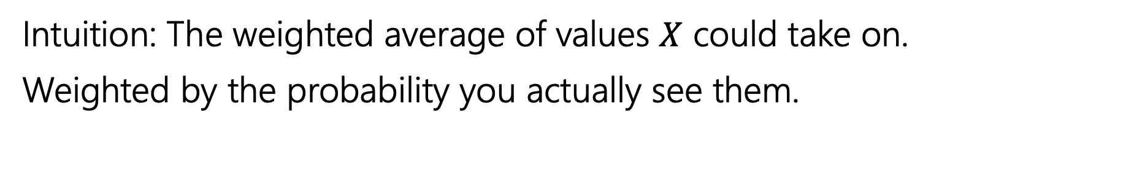
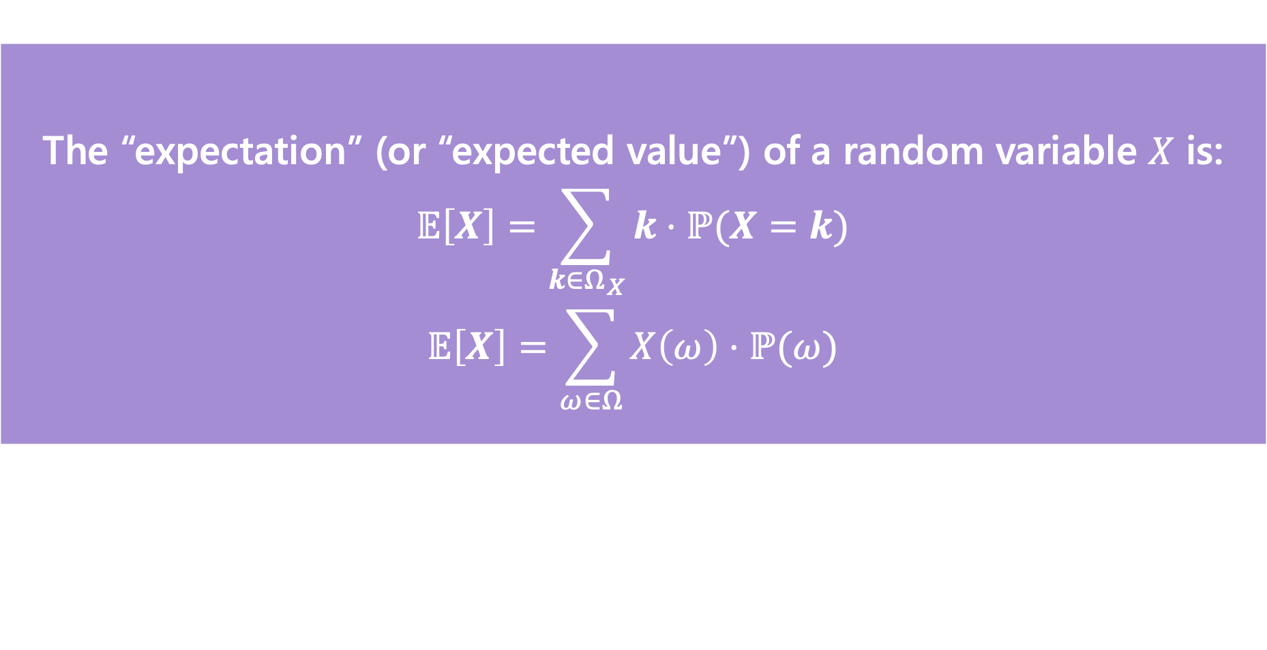
Expectation
The “expectation” (or “expected value”) of a random variable $X$ is:
$$𝔼\left[X\right]=\sum_{k∈Ω_{X}}{k⋅ℙ(X=k)}$$
$$𝔼\left[X\right]=\sum_{ω∈Ω}{X\left(ω\right)⋅ℙ(ω)}$$
Expectation
Intuition: The weighted average of values $X$ could take on.
Weighted by the probability you actually see them.

Slide 5
Example 2
You roll a biased die.
It shows a 6 with probability $\frac{1}{3}$, and 1,…,5 with probability $2/15$ each.
Let $X$ be the value of the die. What is $𝔼[X]$?

Slide 6
Example 2
You roll a biased die.
It shows a 6 with probability $\frac{1}{3}$, and 1,…,5 with probability $2/15$ each.
Let $X$ be the value of the die. What is $𝔼[X]$?
1. Write the PMF for $X$: $p_{X}\left(k\right)=\left\{\begin{aligned}2/15 k∈\{1,2,3,4,5\} \\ 1/3 k=6 \\ 0 otherwise\end{aligned}\right.$
2. Plug in formula: $𝔼\left[X\right]=\frac{2}{15}⋅1+\frac{2}{15}⋅2+\frac{2}{15}⋅3+\frac{2}{15}⋅4+\frac{2}{15}⋅5+\frac{1}{3}⋅6=4$
$𝔼[X]$ is not just the most likely outcome!

Slide 7
Linearity of Expectation

Slide 8

Linearity of Expectation
For any two random variables $X$ and $Y$:
$$𝔼\left[X+Y\right]=𝔼\left[X\right]+𝔼[Y]$$
Note: $X$ and $Y$ do not have to be independent
Linearity of Expectation

Slide 9
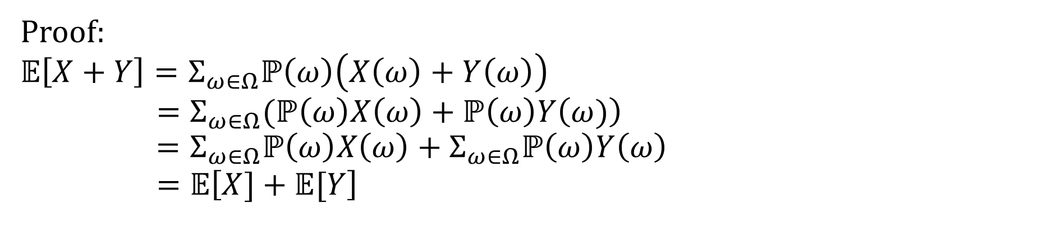


Linearity of Expectation - Proof
For any two random variables $X$ and $Y$:
$$𝔼\left[X+Y\right]=𝔼\left[X\right]+𝔼[Y]$$
Note: $X$ and $Y$ do not have to be independent
Linearity of Expectation
Proof:
$$𝔼\left[X+Y\right]=Σ_{ω∈Ω}ℙ\left(ω\right)\left(X\left(ω\right)+Y\left(ω\right)\right)$$
$$=Σ_{ω∈Ω}(ℙ\left(ω\right)X\left(ω\right)+ℙ\left(ω\right)Y\left(ω)\right) \\ =Σ_{ω∈Ω}ℙ\left(ω\right)X\left(ω\right)+Σ_{ω∈Ω}ℙ\left(ω\right)Y\left(ω\right)$$
$$=𝔼\left[X]+𝔼[Y\right]$$
Definition of expectation:
$$𝔼\left[X\right]=\sum_{ω∈Ω}{X\left(ω\right)⋅ℙ(ω)}$$

Slide 10
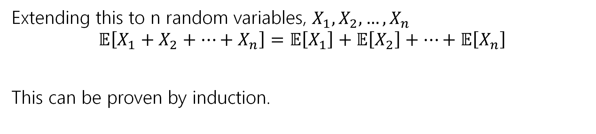
Linearity of Expectation
For any two random variables $X$ and $Y$:
$$𝔼\left[X+Y\right]=𝔼\left[X\right]+𝔼[Y]$$
Note: $X$ and $Y$ do not have to be independent
Linearity of Expectation
Extending this to n random variables, $X_{1},X_{2},…,X_{n}$
$$𝔼\left[X_{1}+X_{2}+…+X_{n}\right]=𝔼\left[X_{1}\right]+𝔼\left[X_{2}\right]+…+𝔼\left[X_{n}\right]$$
This can be proven by induction.

Slide 11
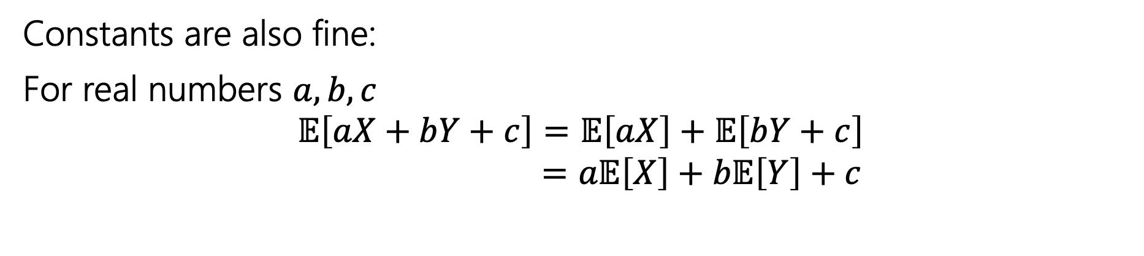
Linearity of Expectation
For any two random variables $X$ and $Y$:
$$𝔼\left[X+Y\right]=𝔼\left[X\right]+𝔼[Y]$$
Note: $X$ and $Y$ do not have to be independent
Linearity of Expectation
Constants are also fine:
For real numbers $a,b,c$
$$𝔼\left[aX+bY+c\right]=𝔼\left[aX\right]+𝔼\left[bY+c\right]$$
$$=a𝔼\left[X\right]+b𝔼\left[Y\right]+c$$
Notes:
We will also see time when we are multiplying or adding constants to R.Vs, linearity of expectation also let us handle this.
Walk thorough steps
The proof for this is really similar to the one on the last slide.
In the last lecture we emphasized that E[g(X)] might not always equal g(E[X]), but in this case they are equal.
Now that we have this LoE formula we're going to see that is makes it easier to find expectations in spots that might have been difficult or impossible before. Let's see an example.

Slide 12
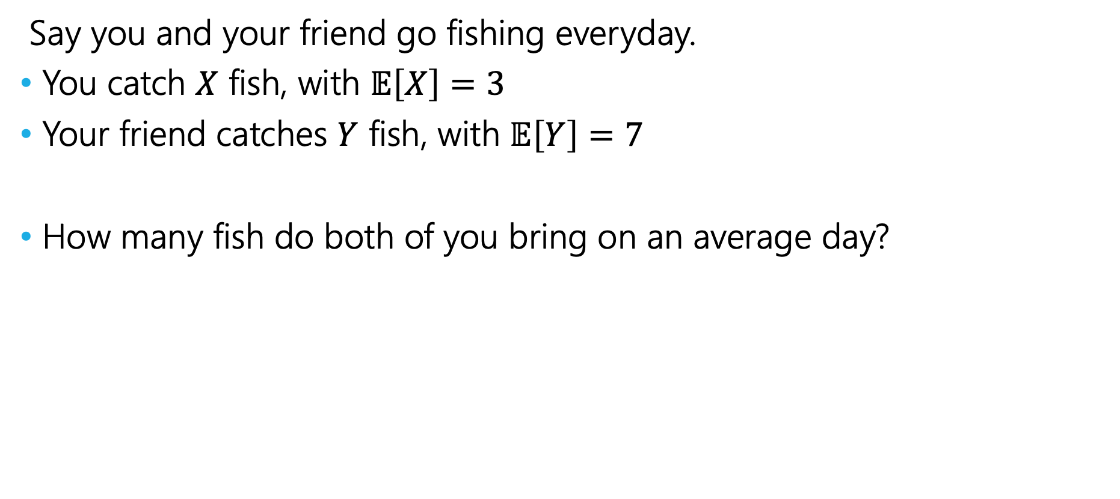
Fishy Business
Say you and your friend go fishing everyday.
You catch $X$ fish, with $𝔼\left[X\right]=3$
Your friend catches $Y$ fish, with $𝔼\left[Y\right]=7$
How many fish do both of you bring on an average day?
Notes:
Lets say you and your friend go fishing everyday. You now want to start thinking about how many fish you bring home together.
Lets define X to be the number of fish that you catch today.
Let Y be the number of fish that your friend catches today.
Based on past finishing trips you know that on average you catch 3 fish and your friend catches 7 fish. This means that the expectation of X is 3 and the expectation of Y is 7.
We want to figure out how many fish you are your friend will bring on average.
Notice that we only have the expectation of X and Y, so we cannot solve this question using our definition of expectation.
Does anyone have any idea on how to go about solving this with LoE?

Slide 13
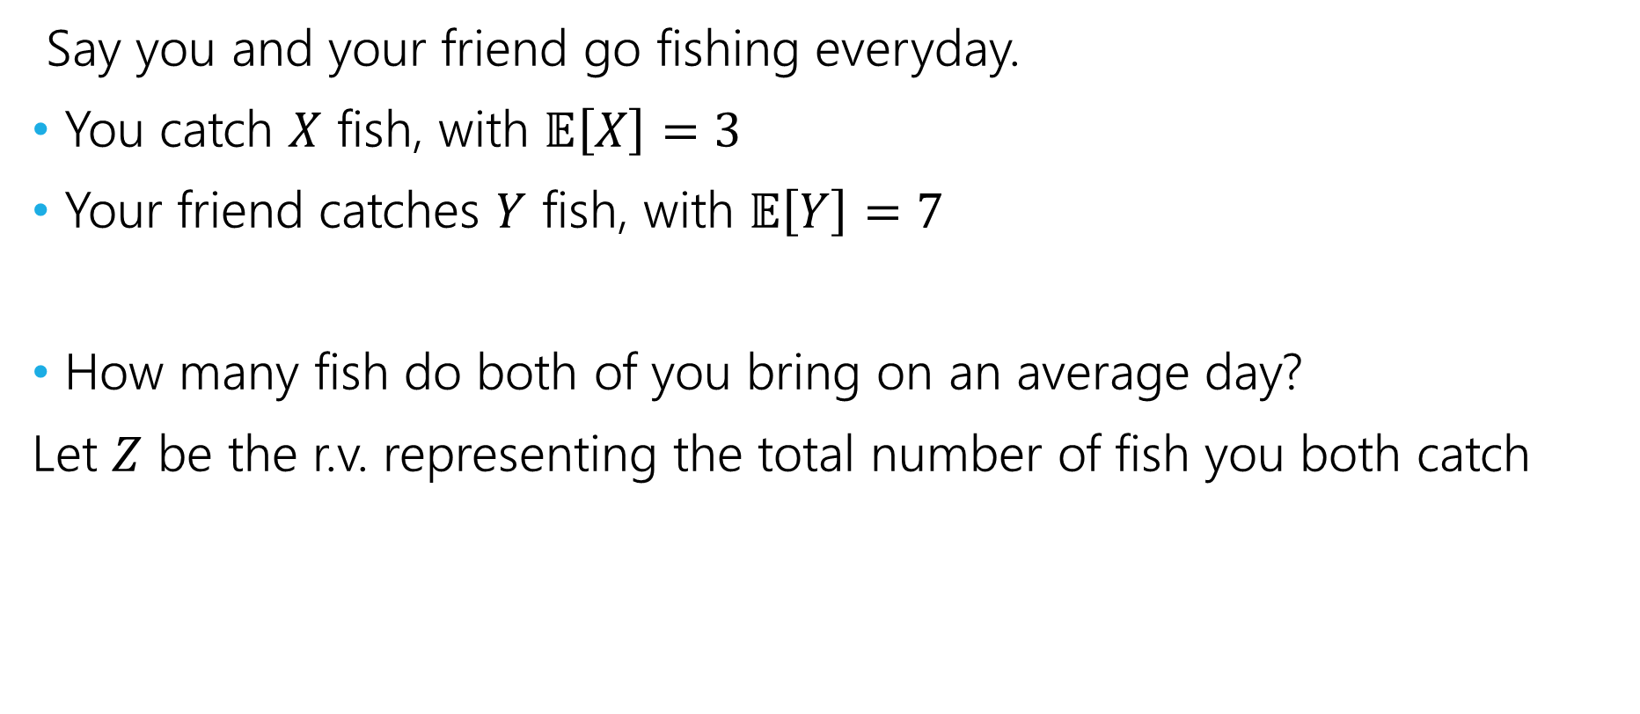
Fishy Business
Say you and your friend go fishing everyday.
You catch $X$ fish, with $𝔼\left[X\right]=3$
Your friend catches $Y$ fish, with $𝔼\left[Y\right]=7$
How many fish do both of you bring on an average day?
Let $Z$ be the r.v. representing the total number of fish you both catch

Slide 14
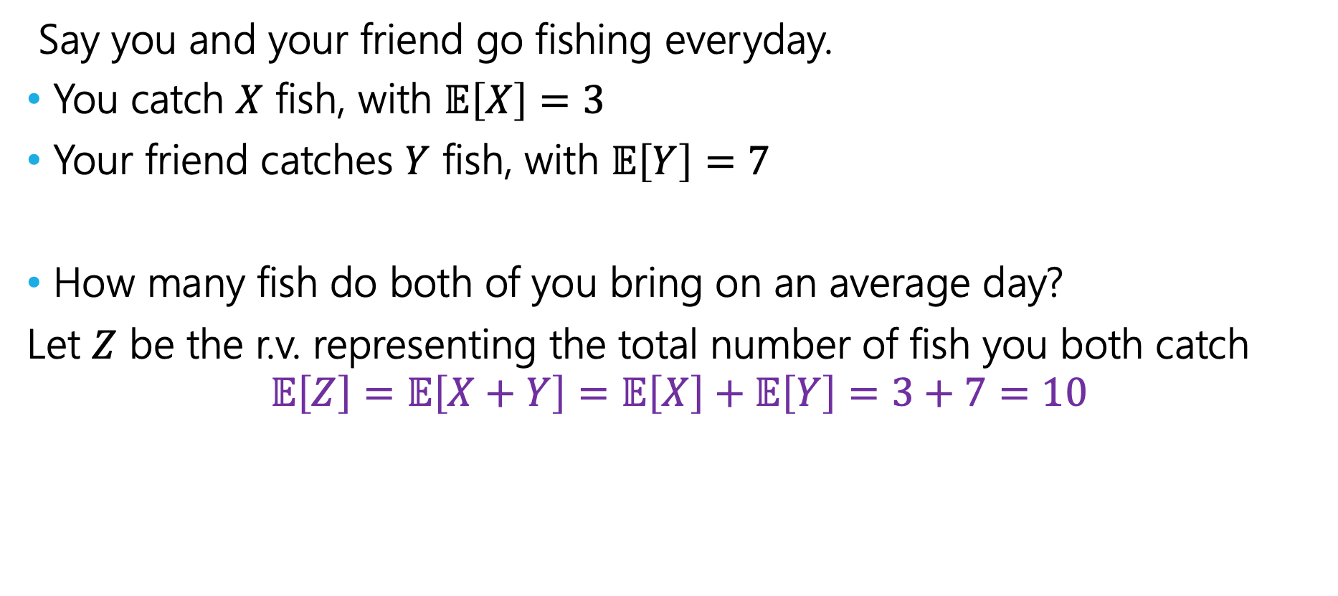
Fishy Business
Say you and your friend go fishing everyday.
You catch $X$ fish, with $𝔼\left[X\right]=3$
Your friend catches $Y$ fish, with $𝔼\left[Y\right]=7$
How many fish do both of you bring on an average day?
Let $Z$ be the r.v. representing the total number of fish you both catch
$$𝔼\left[Z\right]=𝔼\left[X+Y\right]=𝔼\left[X\right]+𝔼\left[Y\right]=3+7=10$$
Notes:
Notes that if we didn’t’ have loe, this would have been impossible! Since the def of expectation req us to know the pmf of the random variable

Slide 15
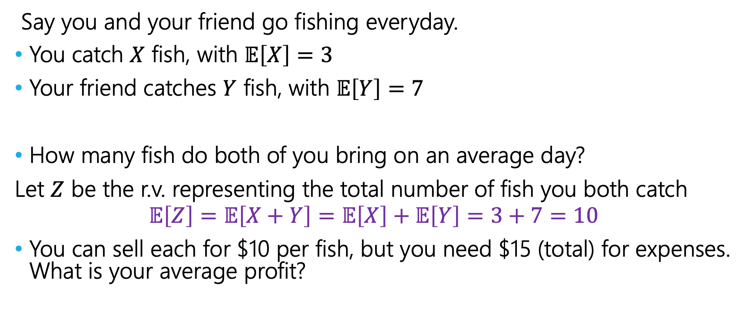
Fishy Business
Say you and your friend go fishing everyday.
You catch $X$ fish, with $𝔼\left[X\right]=3$
Your friend catches $Y$ fish, with $𝔼\left[Y\right]=7$
How many fish do both of you bring on an average day?
Let $Z$ be the r.v. representing the total number of fish you both catch
$$𝔼\left[Z\right]=𝔼\left[X+Y\right]=𝔼\left[X\right]+𝔼\left[Y\right]=3+7=10$$
You can sell each for $10 per fish, but you need $15 (total) for expenses. What is your average profit?

Slide 16
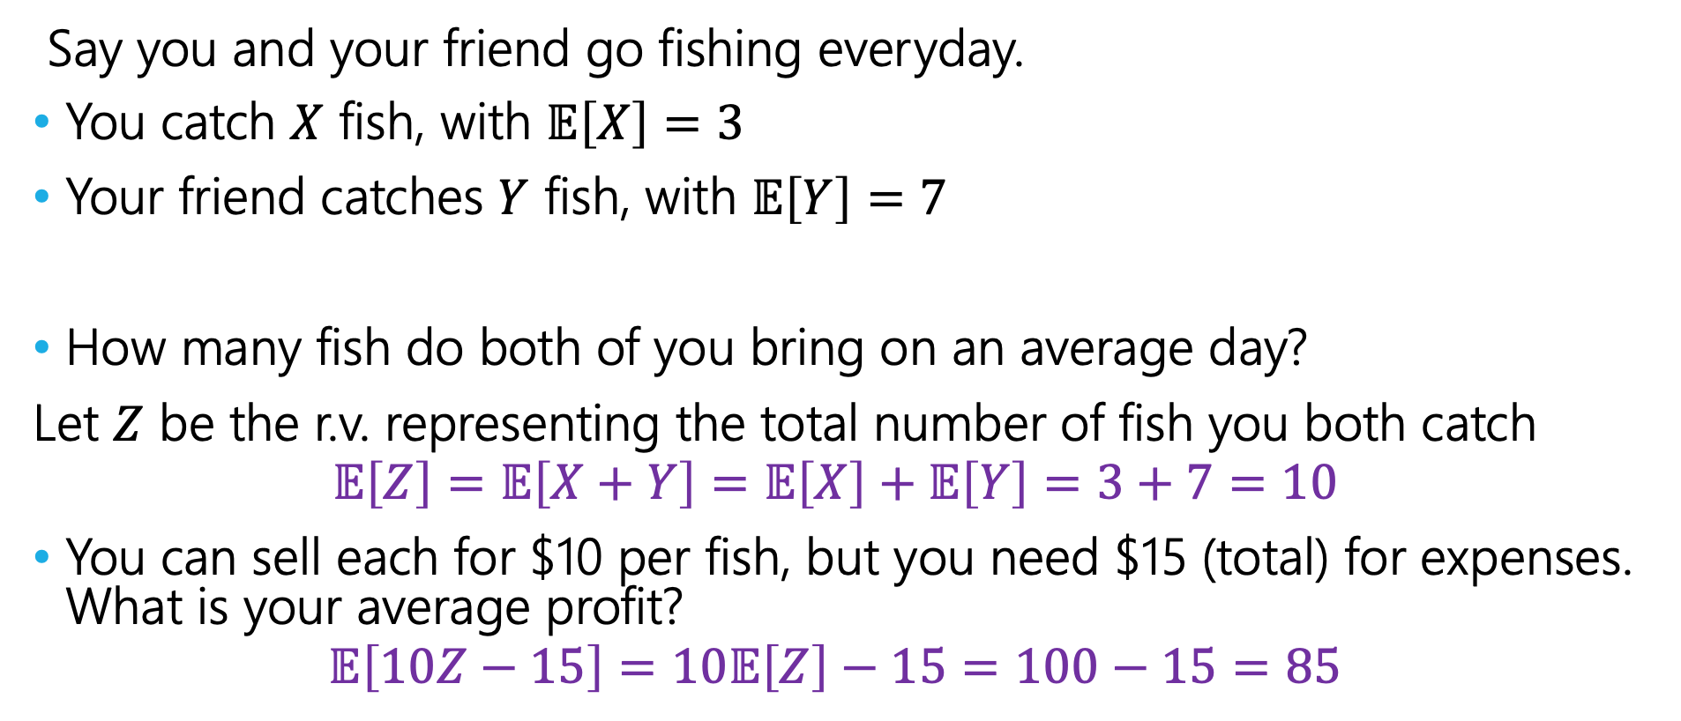
Fishy Business
Say you and your friend go fishing everyday.
You catch $X$ fish, with $𝔼\left[X\right]=3$
Your friend catches $Y$ fish, with $𝔼\left[Y\right]=7$
How many fish do both of you bring on an average day?
Let $Z$ be the r.v. representing the total number of fish you both catch
$$𝔼\left[Z\right]=𝔼\left[X+Y\right]=𝔼\left[X\right]+𝔼\left[Y\right]=3+7=10$$
You can sell each for $10 per fish, but you need $15 (total) for expenses. What is your average profit?
$$𝔼\left[10Z−15\right]=10𝔼\left[Z\right]−15=100−15=85$$
Notes:
We are now done with this example, are there any questions at this point? [Huge pause]
Lets see another example

Slide 17
Coin Tosses
If we flip a coin twice, what is the expected number of heads that come up?
Notes:
On Monday we talked about this example

Slide 18
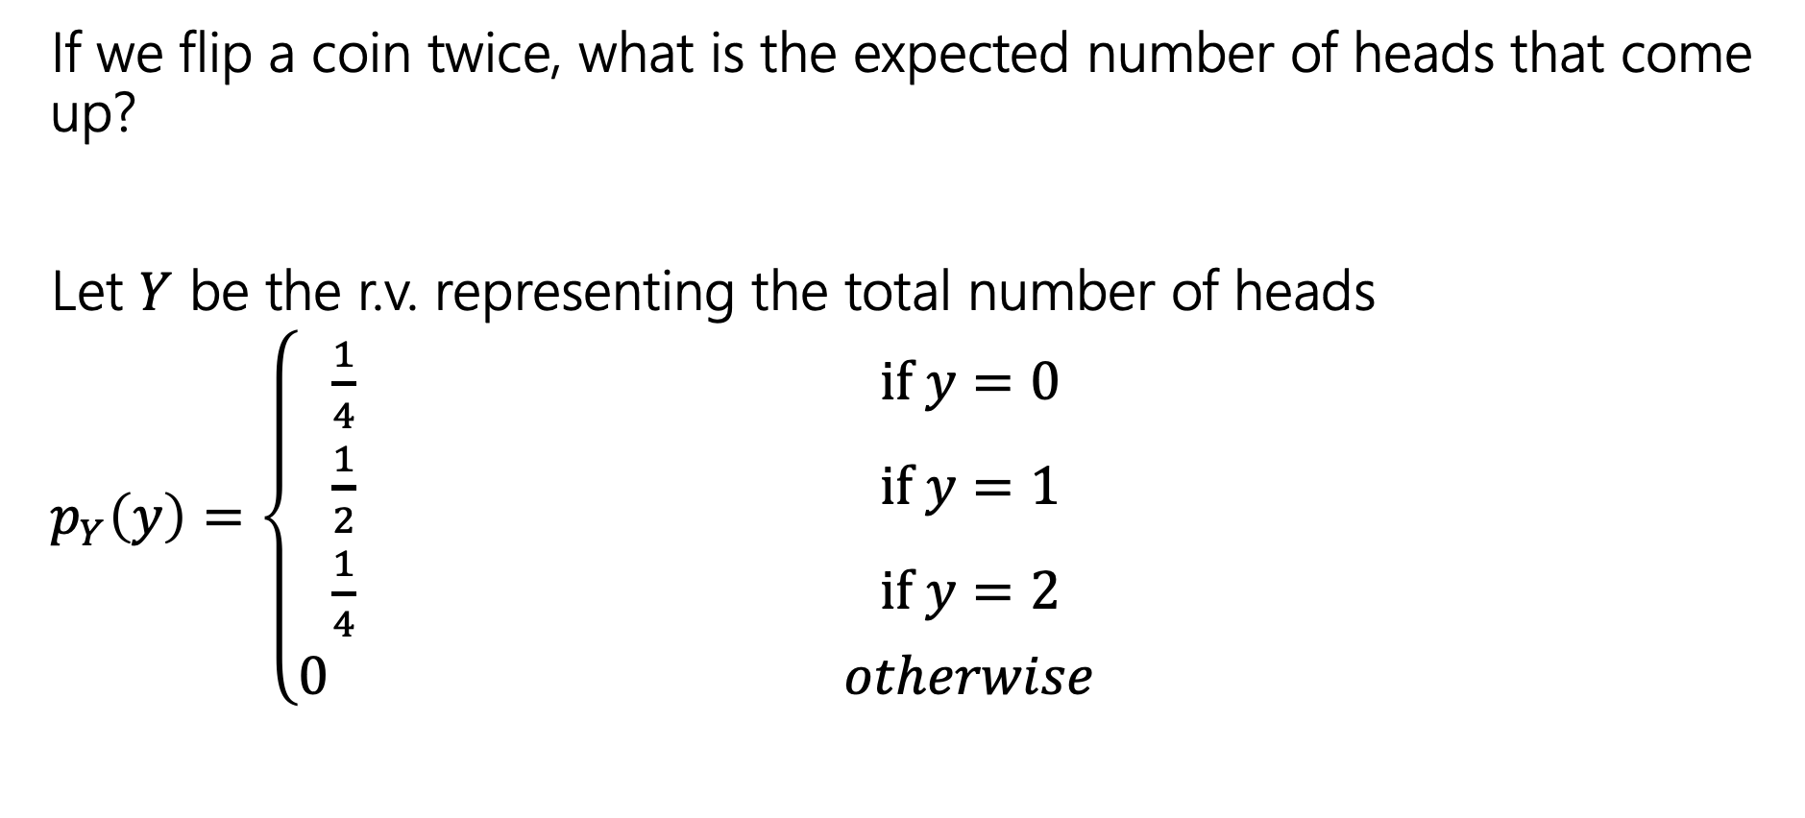
Coin Tosses
If we flip a coin twice, what is the expected number of heads that come up?
Let $Y$ be the r.v. representing the total number of heads
$p_{Y}\left(y\right)=\left\{\begin{aligned}\frac{1}{4} if y=0 \\ \frac{1}{2} if y=1 \\ \frac{1}{4} if y=2 \\ 0 otherwise\end{aligned}\right.$
Notes:
We were able to figure out the probabilities of all these values to create this PMF.

Slide 19
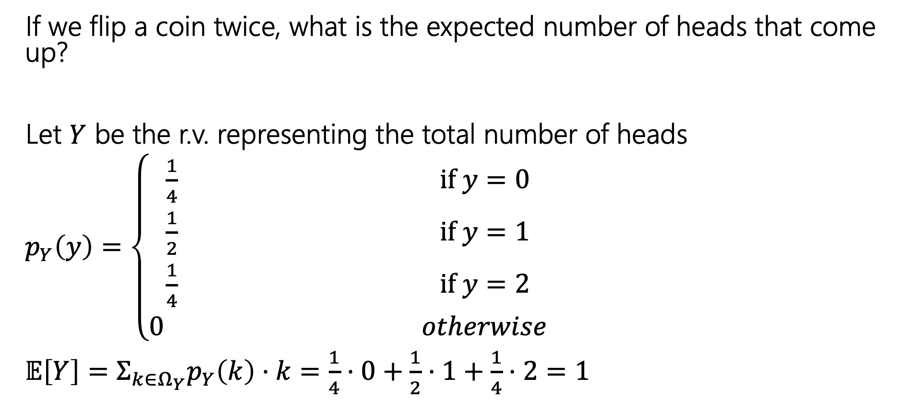
Coin Tosses
If we flip a coin twice, what is the expected number of heads that come up?
Let $Y$ be the r.v. representing the total number of heads
$p_{Y}\left(y\right)=\left\{\begin{aligned}\frac{1}{4} if y=0 \\ \frac{1}{2} if y=1 \\ \frac{1}{4} if y=2 \\ 0 otherwise\end{aligned}\right.$
$𝔼\left[Y\right]=Σ_{k∈Ω_{Y}}p_{Y}\left(k\right)⋅k=\frac{1}{4}⋅0+\frac{1}{2}⋅1+\frac{1}{4}⋅2=1$
Notes:
We plugged this into our formula of expectation summing over every k in the support and got one as the expected number of heads after two coin flips.
Now this wasn’t too bad, but what if we were interested in 3 coin flips? 4 coin flips? 5 coin flips?
Let's try to generalize this.

Slide 20

Repeated Coin Tosses
Now what if the probability of flipping a head was $p$ and that we wanted to find the total number of heads flipped when we flip the coin $n$ times?
Let $X$ be the r.v. representing the total number of heads.
Notes:
Instead of having two flips now we will have n flips and instead of flipping a fair coin we will have a coin that has the probability of p of landing on heads
Take some time and this about what you intuitively think this should be.

Slide 21
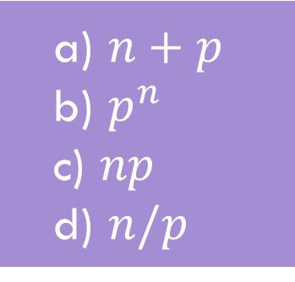

Repeated Coin Tosses
Now what if the probability of flipping a head was $p$ and that we wanted to find the total number of heads flipped when we flip the coin $n$ times?
Let $X$ be the r.v. representing the total number of heads.
a) $n+p$
b) $p^{n}$
c) $np$
d) $n/p$
Make a prediction --- what should $𝔼[X]$ be?
Notes:
Instead of having two flips now we will have n flips and instead of flipping a fair coin we will have a coin that has the probability of p of landing on heads
Take some time and this about what you intuitively think this should be.
10 minutes

Slide 22
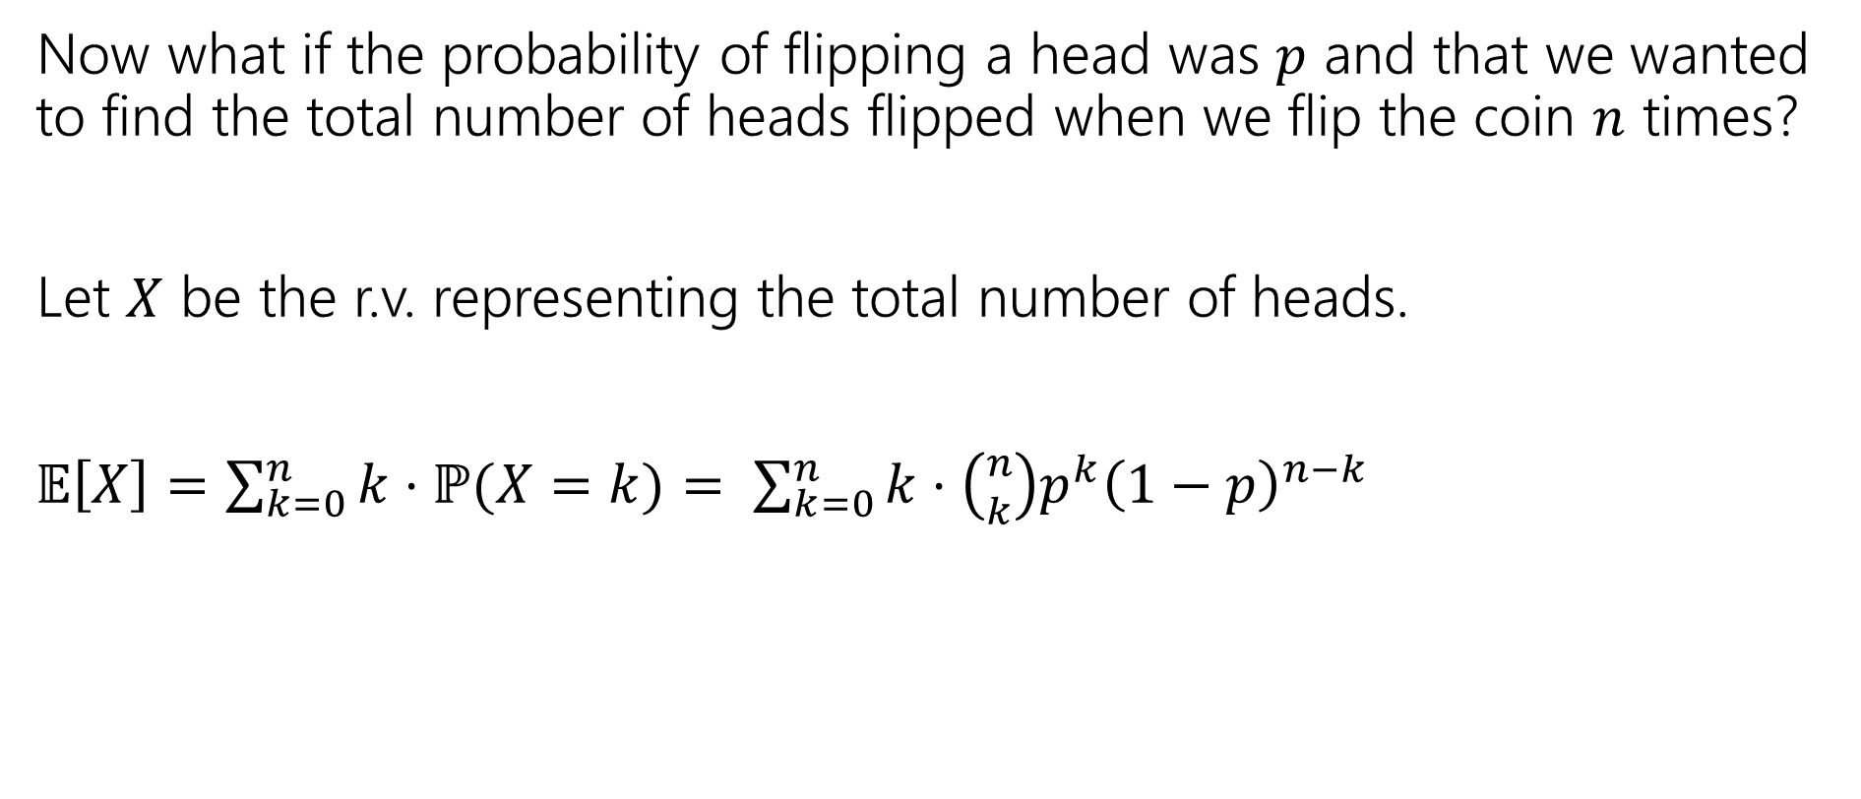
Repeated Coin Tosses
Now what if the probability of flipping a head was $p$ and that we wanted to find the total number of heads flipped when we flip the coin $n$ times?
Let $X$ be the r.v. representing the total number of heads.
$𝔼\left[X\right]=\sum_{k=0}^{n}{k⋅ℙ(X=k)}= \sum_{k=0}^{n}{k⋅\left({n \atop k}\right)p^{k}{\left(1−p\right)}^{n−k}}$
Notes:
Using our definition of expectation where we are summing over the values in the support of X we get, k * the probability of having exactly k heads in n flips. Where did this probability come from? Well this is picking the k flips that will be head, and we will have heads with probability p, k times, so p^k and we will have n-k tails with probability 1-p. The flips are independent, so we can just multiply these probabilities.
We intuitively think that this should be n*p, but this summation does not really look n*p, at least not to me.. It also doesn’t really tell us muck. For example, if p increased odes this expectation go up or down? I would think it should go up but this sint’ really giving us much.

Slide 23
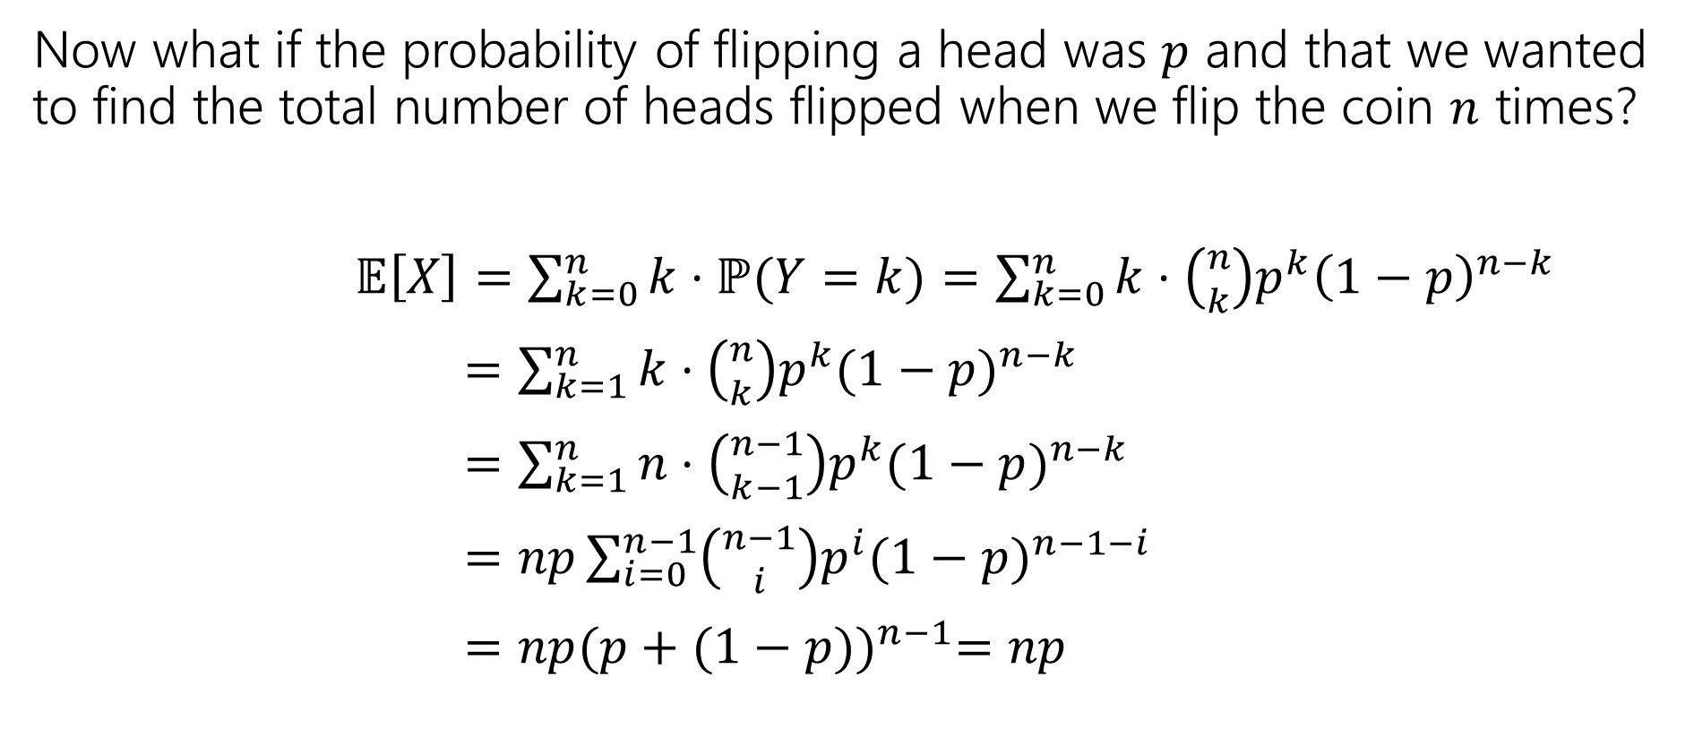
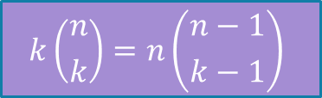
Repeated Coin Tosses
Now what if the probability of flipping a head was $p$ and that we wanted to find the total number of heads flipped when we flip the coin $n$ times?
$𝔼\left[X\right]=\sum_{k=0}^{n}{k⋅ℙ(Y=k)}=\sum_{k=0}^{n}{k⋅\left({n \atop k}\right)p^{k}{\left(1−p\right)}^{n−k}}$
$=\sum_{k=1}^{n}{k⋅\left({n \atop k}\right)p^{k}{(1−p)}^{n−k}}$
$=\sum_{k=1}^{n}{n⋅\left({n−1 \atop k−1}\right)p^{k}{(1−p)}^{n−k}}$
$=np\sum_{i=0}^{n−1}{\left({n−1 \atop i}\right)p^{i}{(1−p)}^{n−1−i}}$
$=np{(p+(1−p))}^{n−1}=np$
$$k\left({n \atop k}\right)=n\left({n−1 \atop k−1}\right)$$
Binomial Theorem!
We did it! And all it took was a clever application of the binomial theorem,
setup by a very non-obvious application of an obscure combinatorial identity.
Notes:
Here is the proof. Doesn't it look pretty gnarly? Don't worry, we won't ask you to do a proof like this. It requires the use of an obscure identity and a clever application of the binomial theorem.

Slide 24
Repeated Coin Tosses
Now what if the probability of flipping a head was $p$ and that we wanted to find the total number of heads flipped when we flip the coin $n$ times?
$𝔼\left[X\right]=\sum_{k=0}^{n}{k⋅ℙ(Y=k)}=\sum_{k=0}^{n}{k⋅\left({n \atop k}\right)p^{k}{\left(1−p\right)}^{n−k}}$
$=\sum_{k=1}^{n}{k⋅\left({n \atop k}\right)p^{k}{(1−p)}^{n−k}}$
$=\sum_{k=1}^{n}{n⋅\left({n−1 \atop k−1}\right)p^{k}{(1−p)}^{n−k}}$
$=np\sum_{i=0}^{n−1}{\left({n−1 \atop i}\right)p^{i}{(1−p)}^{n−1−i}}$
$=np{(p+(1−p))}^{n−1}=np$
No one wants to do proofs like this every time!
$$k\left({n \atop k}\right)=n\left({n−1 \atop k−1}\right)$$
Binomial Theorem!
We did it! And all it took was a clever application of the binomial theorem,
setup by a very non-obvious application of an obscure combinatorial identity. Ezpz.
Notes:
I don’t know about you, but I wouldn’t want to do 3+ homework problems like this per week for the next few weeks.
If only there was a better way. Lets go back to a previous slide and see how LoE can simplify problems like this.

Slide 25
Linearity of Expectation
For any two random variables $X$ and $Y$:
$$𝔼\left[X+Y\right]=𝔼\left[X\right]+𝔼[Y]$$
Note: $X$ and $Y$ do not have to be independent
Linearity of Expectation
Extending this to n random variables, $X_{1},X_{2},…,X_{n}$
$$𝔼\left[X_{1}+X_{2}+…+X_{n}\right]=𝔼\left[X_{1}\right]+𝔼\left[X_{2}\right]+…+𝔼\left[X_{n}\right]$$
This can be proven by induction.
Notes:
LoE says if I can define some R.V. that would add up to our random variable X and I can find the expectation of those smaller variables, then I can just add those expectations together to get the expectation of X.
We want these R.V. to be simple enough that we can calculate their expectation easily. The simples R.V that we have is an indicator variable.

Slide 26









Indicator Random Variables
For any event $A$, we can define the indicator random variable $1[A]$ for $A$
$1\left[A\right]=X=\left\{\begin{aligned} 1 if event A occurs \\ 0 otherwise\end{aligned}\right.$
You’ll also see notation like:
$$ℙ\left(X=1\right)=ℙ\left(A\right)$$
$$ℙ\left(X=0\right)=1−ℙ(A)$$
$$p_{X}\left(k\right)=\left\{\begin{aligned}ℙ\left(A\right) if k=1 \\ 1−ℙ\left(A\right) if k=0 \\ 0 otherwise\end{aligned}\right.$$
$$𝔼 \left[X\right]=1⋅p_{X}\left(1\right)+0⋅p_{X}(0)=p_{X}\left(1\right)=ℙ(A)$$
Notes:
Its support is {0,1} and if it is 1, then it indicates that the even happened. Its like a Boolean that we cast to an int, so we can add it up.
Probability, gives us simple PMF, now here is the expectation. Notice that for an indicator R.V. the expectation of is it just the probability of the event occurring. We are interested in this because of LoE. These are going to be the simple R.V. that make up our big R.V. and once we apply the LoE we will need the expectations of our indicators. Again, the expectation of an indicator random variable is just the probability of the event occurring.
Now lets return back to our generalized coin flip example
Questions?

Slide 27

Repeated Coin Tosses (Again)
The probability of flipping a head is $p$ and we want to find the total number of heads flipped when we flip the coin $n$ times?
Let $X$ be the total number of heads
What indicators can we define? What ‘Booleans’ have enough information to combine (add) and solve the problem?
Notes:
Now that we know about indicator variables, lets try this again using LoE. When we were solving this with def of expectation, we had to look at the total number of heads and found that was hard ot find.. With loe, we’re going to be able to look at each of these individual coin tosses, and sum their expectations together, which will give us a more striaghtforwad computation! First step is to define …
Take a few minutes to think about what indicators you can define for this problem.

Slide 28
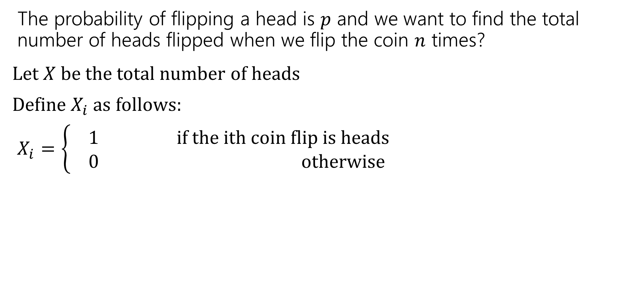
Repeated Coin Tosses (Again)
The probability of flipping a head is $p$ and we want to find the total number of heads flipped when we flip the coin $n$ times?
Let $X$ be the total number of heads
Define $X_{i}$as follows:
$X_{i}=\left\{\begin{aligned} 1 if the ith coin flip is heads \\ 0 otherwise\end{aligned}\right.$

Slide 29
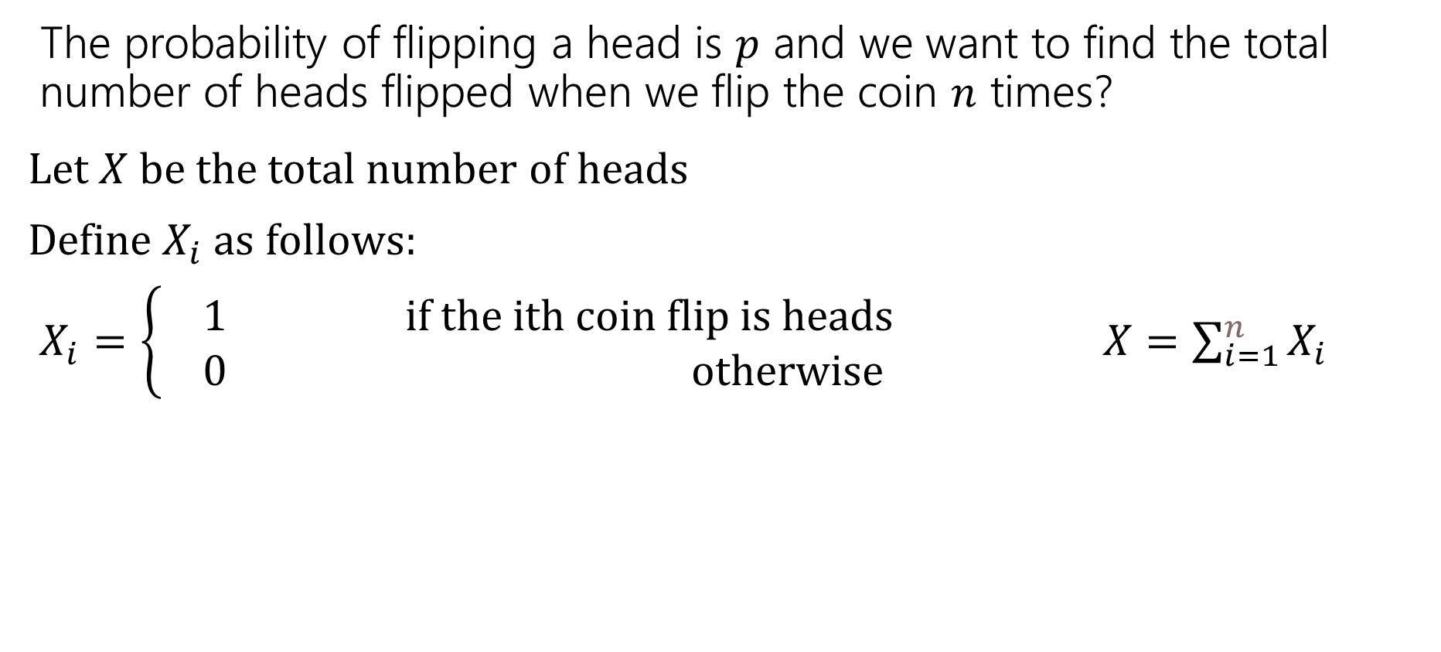
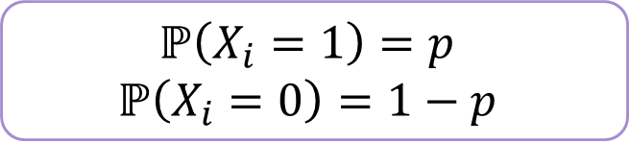
Repeated Coin Tosses (Again)
The probability of flipping a head is $p$ and we want to find the total number of heads flipped when we flip the coin $n$ times?
Let $X$ be the total number of heads
Define $X_{i}$as follows:
$X_{i}=\left\{\begin{aligned} 1 if the ith coin flip is heads \\ 0 otherwise\end{aligned}\right.$ $X=\sum_{i=1}^{n}{X_{i}}$
$$ℙ\left(X_{i}=1\right)=p$$
$$ℙ\left(X_{i}=0\right)=1−p$$
Notes:
So much cleaner than what we did when finding E[X] directly! Loe allows us to break into these smaller subproblems

Slide 30
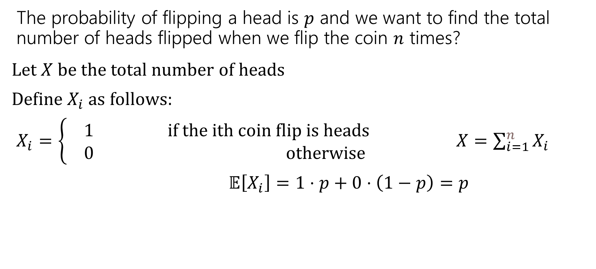
Repeated Coin Tosses (Again)
The probability of flipping a head is $p$ and we want to find the total number of heads flipped when we flip the coin $n$ times?
Let $X$ be the total number of heads
Define $X_{i}$as follows:
$X_{i}=\left\{\begin{aligned} 1 if the ith coin flip is heads \\ 0 otherwise\end{aligned}\right.$ $X=\sum_{i=1}^{n}{X_{i}}$
$𝔼\left[X_{i}\right]=1⋅p+0⋅\left(1−p\right)=p$
$$ℙ\left(X_{i}=1\right)=p$$
$$ℙ\left(X_{i}=0\right)=1−p$$
Notes:
So much cleaner than what we did when finding E[X] directly! Loe allows us to break into these smaller subproblems

Slide 31
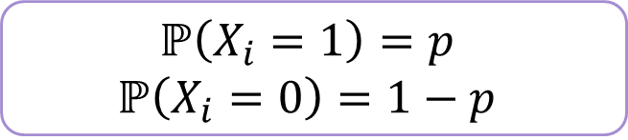
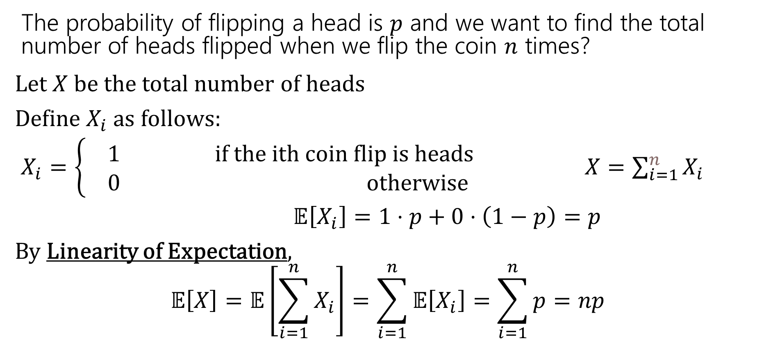
Repeated Coin Tosses (Again)
The probability of flipping a head is $p$ and we want to find the total number of heads flipped when we flip the coin $n$ times?
Let $X$ be the total number of heads
Define $X_{i}$as follows:
$X_{i}=\left\{\begin{aligned} 1 if the ith coin flip is heads \\ 0 otherwise\end{aligned}\right.$ $X=\sum_{i=1}^{n}{X_{i}}$
$𝔼\left[X_{i}\right]=1⋅p+0⋅\left(1−p\right)=p$
By Linearity of Expectation,
$$𝔼\left[X\right]=𝔼\left[\sum_{i=1}^{n}{X_{i}}\right]=\sum_{i=1}^{n}{𝔼\left[X_{i}\right]=\sum_{i=1}^{n}{p}=np}$$
$$ℙ\left(X_{i}=1\right)=p$$
$$ℙ\left(X_{i}=0\right)=1−p$$

Slide 32
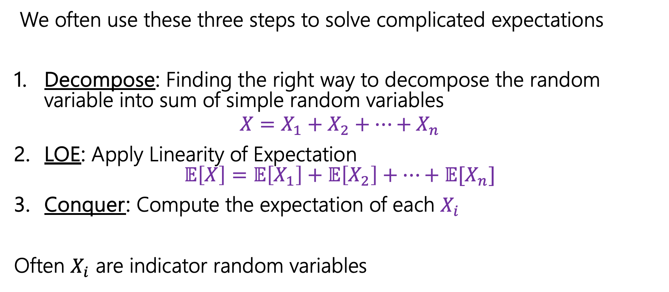
Computing complicated expectations
We often use these three steps to solve complicated expectations
Decompose: Finding the right way to decompose the random variable into sum of simple random variables
$$X=X_{1}+X_{2}+…+X_{n}$$
LOE: Apply Linearity of Expectation
$𝔼\left[X\right]=𝔼\left[X_{1}\right]+𝔼\left[X_{2}\right]+…+𝔼[X_{n}]$
Conquer: Compute the expectation of each $X_{i}$
Often $X_{i}$ are indicator random variables
Notes:
you now have 2 approaches for computing expected values: 1 using the def of expectation - useful for when we ahve a smllaer range, or we have the pmf availabe to use. 2. using loe useufl when we're dealing with something that's clearly the sum of some random variables (like summing dice rolls togheter) or when we're dealing with some sort of count or something more complicated where we may be able to break into some indicator random variables and then use loe.

Slide 33
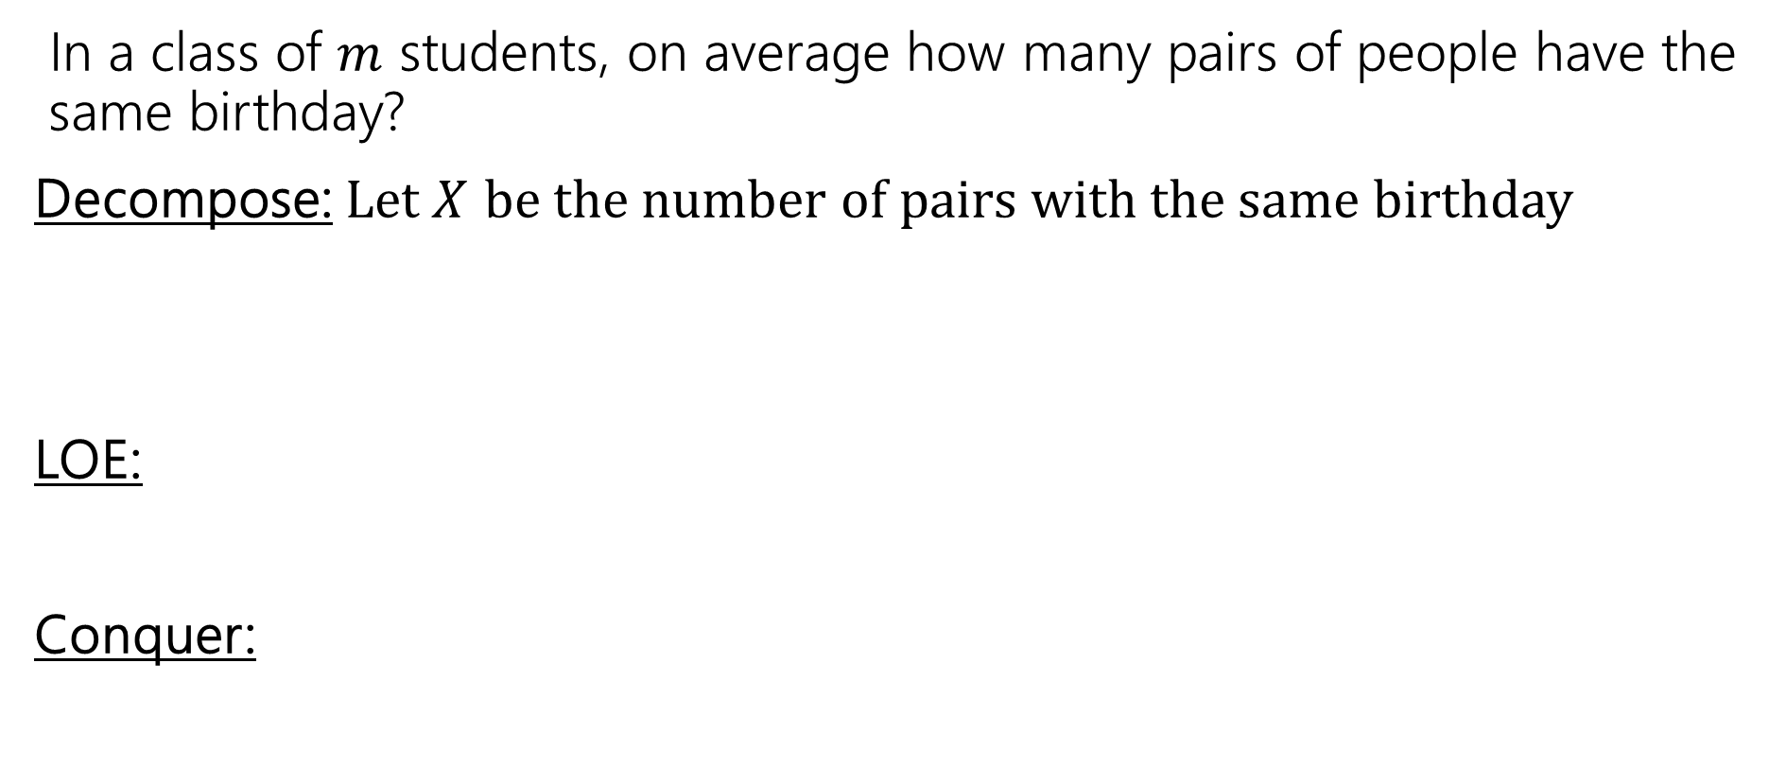
Pairs with the same birthday
In a class of $m$ students, on average how many pairs of people have the same birthday?
Decompose: Let $X$ be the number of pairs with the same birthday
LOE:
Conquer:
Notes:
Time
Write how many pairs?
Probability of a pair having the same birthday?
35 minutes

Slide 34
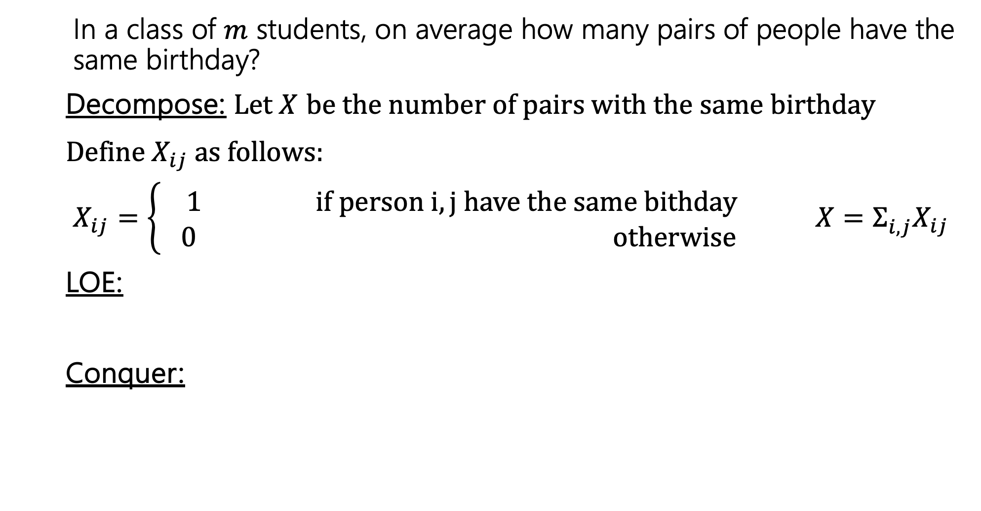
Pairs with the same birthday
In a class of $m$ students, on average how many pairs of people have the same birthday?
Decompose: Let $X$ be the number of pairs with the same birthday
Define $X_{ij}$as follows:
$X_{ij}=\left\{\begin{aligned} 1 if person i,j have the same bithday \\ 0 otherwise\end{aligned}\right.$ ${X=Σ_{i,j}^{}X}_{ij}$
LOE:
Conquer:
Notes:
a pair for every district pair of students. For example, for Robbie and Anna, if we have X_R,A we dont also have X_A,R

Slide 35
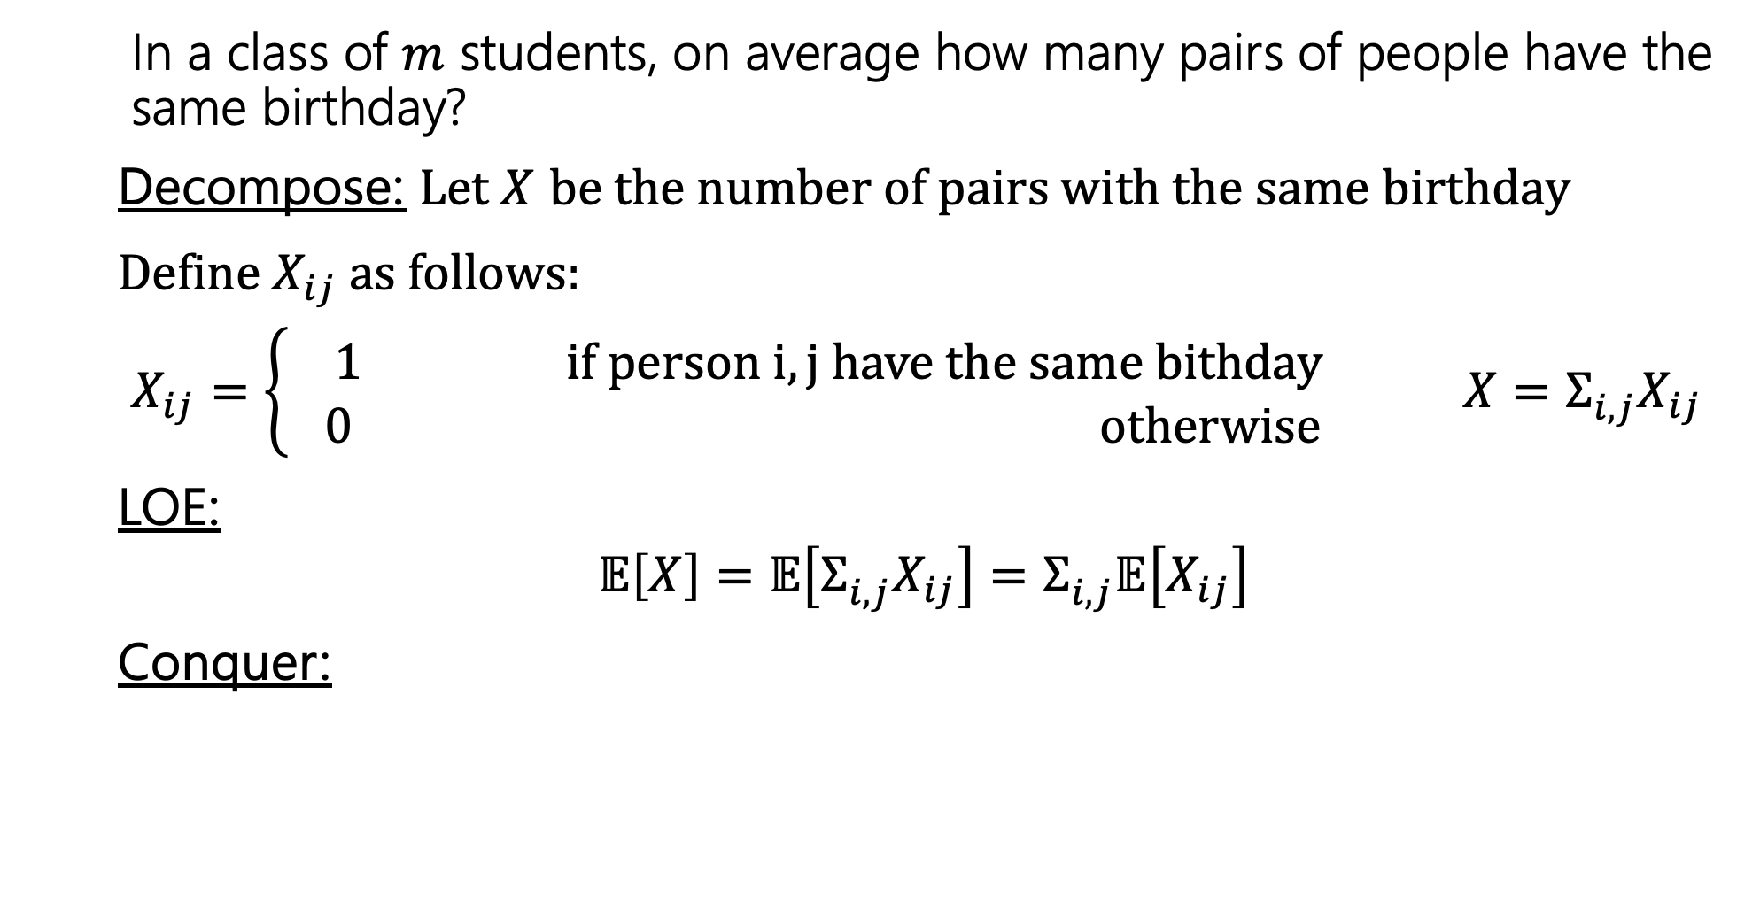
Pairs with the same birthday
In a class of $m$ students, on average how many pairs of people have the same birthday?
Decompose: Let $X$ be the number of pairs with the same birthday
Define $X_{ij}$as follows:
$X_{ij}=\left\{\begin{aligned} 1 if person i,j have the same bithday \\ 0 otherwise\end{aligned}\right.$ ${X=Σ_{i,j}^{}X}_{ij}$
LOE:
$$𝔼\left[X\right]=𝔼\left[Σ_{i,j}^{}X_{ij}\right]=Σ_{i,j}^{}𝔼\left[X_{ij}\right]$$
Conquer:

Slide 36
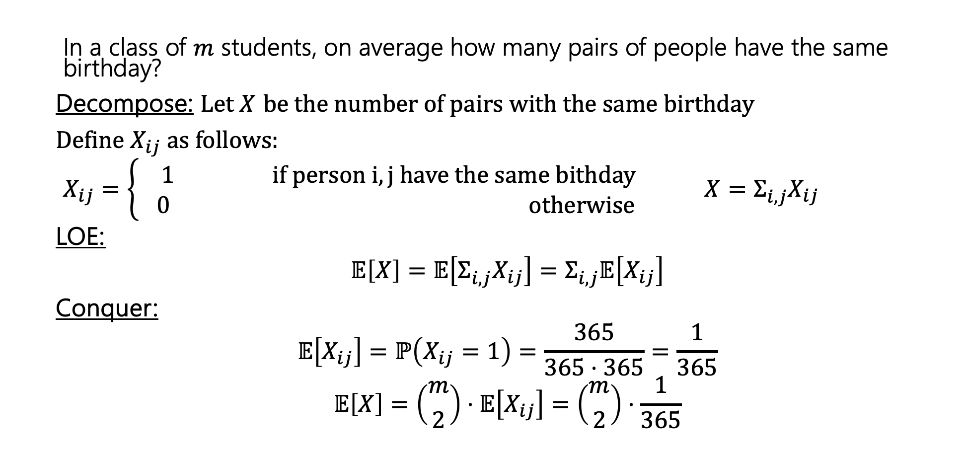
Pairs with the same birthday
In a class of $m$ students, on average how many pairs of people have the same birthday?
Decompose: Let $X$ be the number of pairs with the same birthday
Define $X_{ij}$as follows:
$X_{ij}=\left\{\begin{aligned} 1 if person i,j have the same bithday \\ 0 otherwise\end{aligned}\right.$ ${X=Σ_{i,j}^{}X}_{ij}$
LOE:
$$𝔼\left[X\right]=𝔼\left[Σ_{i,j}^{}X_{ij}\right]=Σ_{i,j}^{}𝔼\left[X_{ij}\right]$$
Conquer:
$$𝔼\left[X_{ij}\right]=ℙ\left(X_{ij}=1\right)=\frac{365}{365⋅365}=\frac{1}{365}$$
$$𝔼\left[X\right]=\left({m \atop 2}\right)⋅𝔼\left[X_{ij}\right]=\left({m \atop 2}\right)⋅\frac{1}{365}$$
Notes:
Okay, before we more onto our last example, does anyone have any questions?

Slide 37
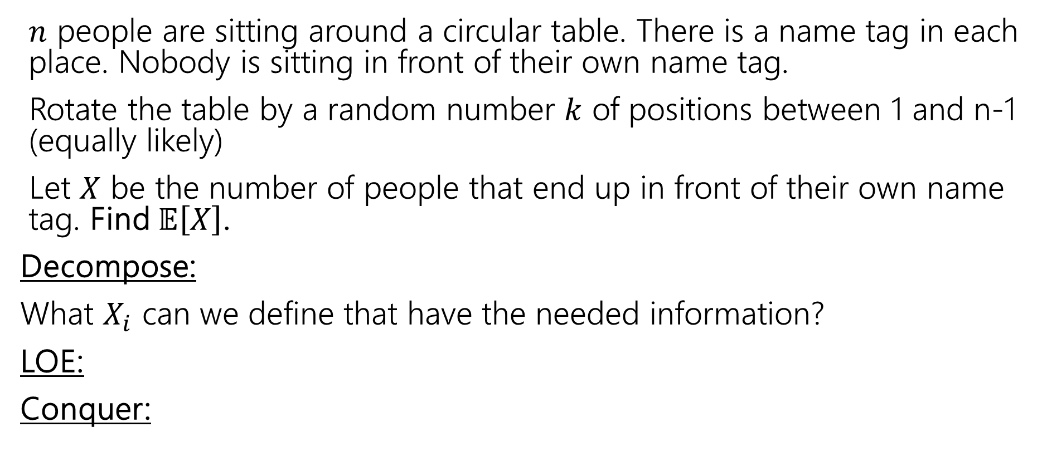
Rotating the table
$n$ people are sitting around a circular table. There is a name tag in each place. Nobody is sitting in front of their own name tag.
Rotate the table by a random number $k$ of positions between 1 and n-1 (equally likely)
Let $X$ be the number of people that end up in front of their own name tag. Find $𝔼\left[X\right]$.
Decompose:
What $X_{i}$ can we define that have the needed information?
LOE:
Conquer:
Notes:
Imagine this scenario. We have a round table where there are n seats and n name tags placed in front of every seat. Your group of n friends come in and all sit down. Everyone sits in the wrong seat, which means no one has their nametag in front of them. Now instead of all standing up and moving around you decide to just spin the table some k positions so that the table doesn't come back to where it started. This means that there are 1 to n-1 positions that are all equally likely.
You want to know after this rotation, how many people will have their nametag in front of them?

Slide 38

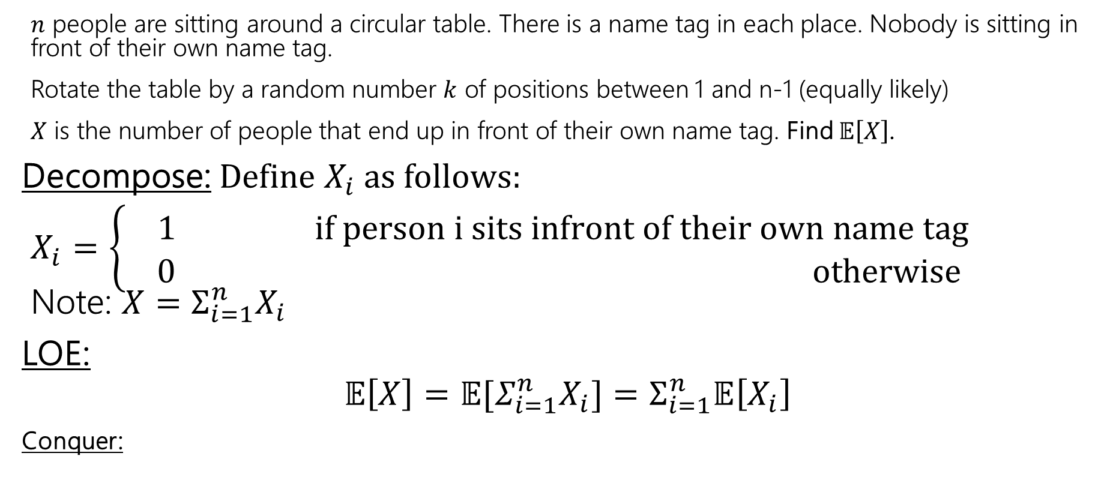
Rotating the table
$n$ people are sitting around a circular table. There is a name tag in each place. Nobody is sitting in front of their own name tag.
Rotate the table by a random number $k$ of positions between 1 and n-1 (equally likely)
$X$ is the number of people that end up in front of their own name tag. Find $𝔼\left[X\right]$.
Decompose: Define $X_{i}$as follows:
$X_{i}=\left\{\begin{aligned} 1 if person i sits infront of their own name tag \\ 0 otherwise\end{aligned}\right.$ Note: ${X=Σ_{i=1}^{n}X}_{i}$
LOE:
$$𝔼\left[X\right]=𝔼[Σ_{i=1}^{n}X_{i}]=Σ_{i=1}^{n}𝔼\left[X_{i}\right]$$
Conquer:
These $X_{i}$ are not independent!
That’s ok!!

Slide 39
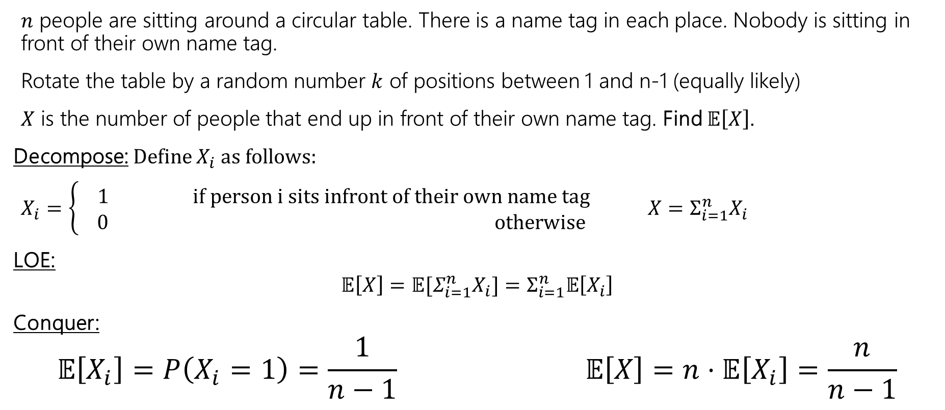
Rotating the table
$n$ people are sitting around a circular table. There is a name tag in each place. Nobody is sitting in front of their own name tag.
Rotate the table by a random number $k$ of positions between 1 and n-1 (equally likely)
$X$ is the number of people that end up in front of their own name tag. Find $𝔼\left[X\right]$.
Decompose: Define $X_{i}$as follows:
$X_{i}=\left\{\begin{aligned} 1 if person i sits infront of their own name tag \\ 0 otherwise\end{aligned}\right.$ ${X=Σ_{i=1}^{n}X}_{i}$
LOE:
$$𝔼\left[X\right]=𝔼[Σ_{i=1}^{n}X_{i}]=Σ_{i=1}^{n}𝔼\left[X_{i}\right]$$
Conquer:
$$𝔼\left[X_{i}\right]=P\left(X_{i}=1\right)=\frac{1}{n−1} 𝔼\left[X\right]=n⋅𝔼\left[X_{i}\right]=\frac{n}{n−1}$$
Notes:
This is approximately 1, so spinning the table is probably not the best option if you are trying to have everyone sit in front of their name tag since on average, after a spin we can expect approximately one person to be in front of their nametag.
Now we have one more some example at the end of this slide dec for you to take a look.
Thank you for coming to lecture and I hope you have a wonderful weekend.

Slide 40
How to know what indicators to define?
"find the expected number of students (from n in total) who show up in class" -> maybe define indicator RVs $X_{i}$​ that is $1$ if the i'th student shows up
-> $X=\sum_{i=1}^{n}{X_{i}}=X$
"find the expected number of defective items in a batch of 100 items"
-> maybe define indicator RVs $X_{i}$​ that is $1$ if the i'th item is defective
-> $X=\sum_{i=1}^{n}{X_{i}}$
"find the expected number of A that have B (B is some property)“
-> maybe define indicator RVs $X_{i}$​​ for the i'th possible A that is 1 if that A has B

Slide 41
Techniques For Finding Expectation
1. Definition of Expectation
When the support is small enough and we can find the PMF of X
2. Linearity of Expectation
When we can break X into a sum
  Break into indicator RVs if it’s some kind of count
3. LOTUS (Law of the unconscious statistician)
When it’s a function of X (e.g, X2)
$$𝔼\left[X\right]=\sum_{k∈Ω_{X}}{k⋅ℙ(X=k)}$$
$𝔼\left[X+Y\right]=𝔼$[$X]+𝔼\left[Y\right]$
$$𝔼\left[g(X)\right]=\sum_{k∈Ω_{X}}{g(k)⋅ℙ(X=k)}$$

Slide 42
Where are we?
A random variable is a way to summarize what outcome you saw.
Support (set of values RV can take),
Probability Mass Function & Cumulative Distribution Function describe probabilities
The expectation of a RV is its average value. (summarizes a RV)
> Expectation is linear: $𝔼\left[X+Y\right]=𝔼\left[X\right]+𝔼[Y]$.
    $X+Y$ is a random variable – it’s a function that outputs a number given an outcome (or, here, a combination of outcomes).
$Ω$ is set of possible outcomes
Outcome
$$ω∈Ω$$
Quantitative value
$$X$$

Slide 43
Extra Practice

Slide 44

Frogger
A frog starts on a 1-dimensional number line at 0.
Each second, independently, the frog takes a unit step right with probability $p_{1}$, to the left with probability $p_{2}$, and doesn't move with probability $p_{3}$, where ${p_{1}+p}_{2}+p_{3}=1$.
After 2 seconds, let $X$ be the location of the frog. Find $𝔼\left[X\right]$.

Slide 45
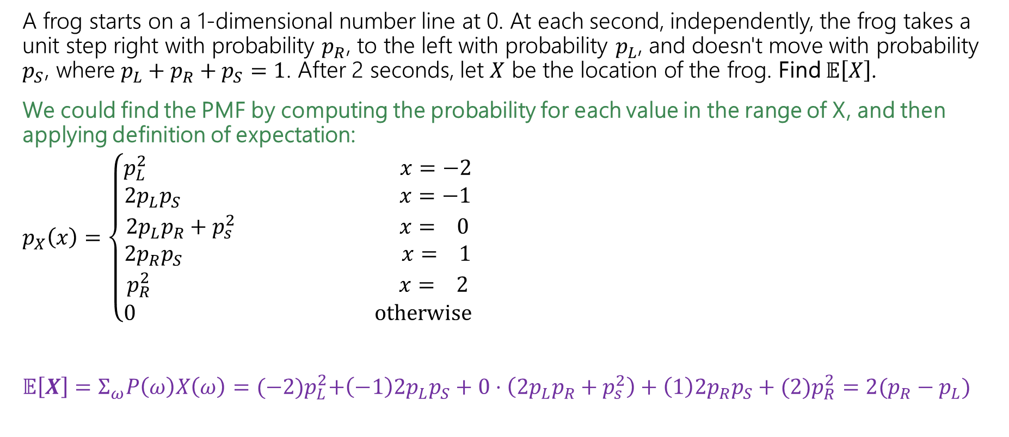
Frogger – Brute Force
A frog starts on a 1-dimensional number line at 0. At each second, independently, the frog takes a unit step right with probability $p_{R}$, to the left with probability $p_{L}$, and doesn't move with probability $p_{S}$, where ${p_{L}+p}_{R}+p_{S}=1$. After 2 seconds, let $X$ be the location of the frog. Find $𝔼\left[X\right]$.
We could find the PMF by computing the probability for each value in the range of X, and then applying definition of expectation:
$p_{X}\left(x\right)=\left\{\begin{aligned}p_{L}^{2} x=−2 \\ {2p}_{L}p_{S} x=−1 \\ {2p}_{L}p_{R}+p_{s}^{2} x= 0 \\ {2p}_{R}p_{S} x= 1 \\ p_{R}^{2} x= 2 \\ 0 otherwise\end{aligned}\right.$
$𝔼\left[X\right]=Σ_{ω}P\left(ω\right)X\left(ω\right)={(−2)p}_{L}^{2}+\left(−1\right){2p}_{L}p_{S}+0⋅\left({2p}_{L}p_{R}+p_{s}^{2}\right)+\left(1\right){2p}_{R}p_{S}+(2)p_{R}^{2}=2(p_{R}−p_{L})$
We think about the outcomes that correspond to each value of X and compute the probability of that. For example, X=0 happens when the frog is at the same position after 2 sec – this means it either moved left and then right, or right and then left, or did not move both seconds.

Slide 46
Frogger – LOE
Or we can apply LoE!
A frog starts on a 1-dimensional number line at 0. At each second, independently, the frog takes a unit step right with probability $p_{R}$, to the left with probability $p_{L}$, and doesn't move with probability $p_{S}$, where ${p_{L}+p}_{R}+p_{S}=1$. After 2 seconds, let $X$ be the location of the frog. Find $𝔼\left[X\right]$.
Define $X_{i}$as follows:
$X_{i}=\left\{\begin{aligned} −1 if the frog moved left on the ith step \\ 0 otherwise \\ 1 if the frog moved right on the ith step\end{aligned}\right.$
$$𝔼\left[X_{i}\right]={−1⋅p_{L}+1⋅p}_{R}+0⋅p_{S}=(p_{R}−p_{L})$$
By Linearity of Expectation,
$𝔼\left[X\right]=𝔼\left[\sum_{i=1}^{2}{X_{i}}\right]=\sum_{i=1}^{2}{𝔼[X_{i}]}$ =$2(p_{R}−p_{L})$

Slide 47
Frogger – LOE
If we interested in a whole minute (60 sec), the first approach would be awful because we would need to compute many probabilities or deal with a gnarly summation! Instead, we can use LoE!
A frog starts on a 1-dimensional number line at 0. At each second, independently, the frog takes a unit step right with probability $p_{R}$, to the left with probability $p_{L}$, and doesn't move with probability $p_{S}$, where ${p_{L}+p}_{R}+p_{S}=1$. After 60 seconds, let $X$ be the location of the frog. Find $𝔼\left[X\right]$.
Define $X_{i}$as follows:
$X_{i}=\left\{\begin{aligned} −1 if the frog moved left on the ith step \\ 0 otherwise \\ 1 if the frog moved right on the ith step\end{aligned}\right.$
$$𝔼\left[X_{i}\right]={−1⋅p_{L}+1⋅p}_{R}+0⋅p_{S}=(p_{R}−p_{L})$$
By Linearity of Expectation,
$𝔼\left[X\right]=𝔼\left[\sum_{i=1}^{60}{X_{i}}\right]=\sum_{i=1}^{60}{𝔼[X_{i}]}$ =$60(p_{R}−p_{L})$

