Slide 1

Independence + Chain Rule
CSE 312 26Su
Lecture 6
Fun application of conditional probability! (Monty Hall Problem)
There are 3 doors (1 door is a prize and the other 2 are goats) and you must pick which door to open. You pick a door randomly. The host opens one of the other two doors to reveal a goat. If you now switch which door you open, your chances of winning increases from $1/3$ to $2/3$!

Slide 2
Announcements
> HW2 is out is due on Wednesday (July 8th)
> Please email me as soon as you can if you are expecting a hard conflict for the midterm by Wednesday (July 15th)
  -- more information / resources for the midterm will be posted end of week

Slide 3
Where Are We?
Last time:
  Conditional Probability
  Bayes Theorem
  Law of Total Probability
Today:
  Independence
  Chain Rule
  Conditional Independence

Slide 4
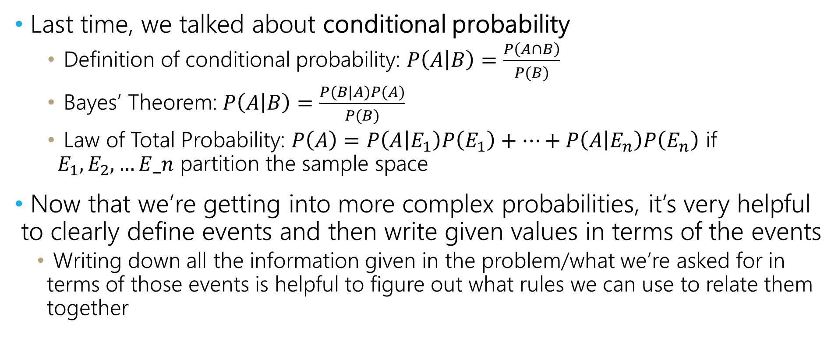
Summary + Tips
Last time, we talked about conditional probability
      Definition of conditional probability: $P\left(A | B\right)=\frac{P\left(A∩B\right)}{P(B)}$
      Bayes’ Theorem: $P\left(A | B\right)=\frac{P(B|A)P(A)}{P(B)}$
      Law of Total Probability: $P\left(A\right)=P\left(A | E_{1}\right)P\left(E_{1}\right)+…+P\left(A | E_{n}\right)P\left(E_{n}\right)$ if $E_{1},E_{2},…E_n$ partition the sample space
Now that we’re getting into more complex probabilities, it’s very helpful to clearly define events and then write given values in terms of the events
    Writing down all the information given in the problem/what we’re asked for in terms of those events is helpful to figure out what rules we can use to relate them together

Slide 5

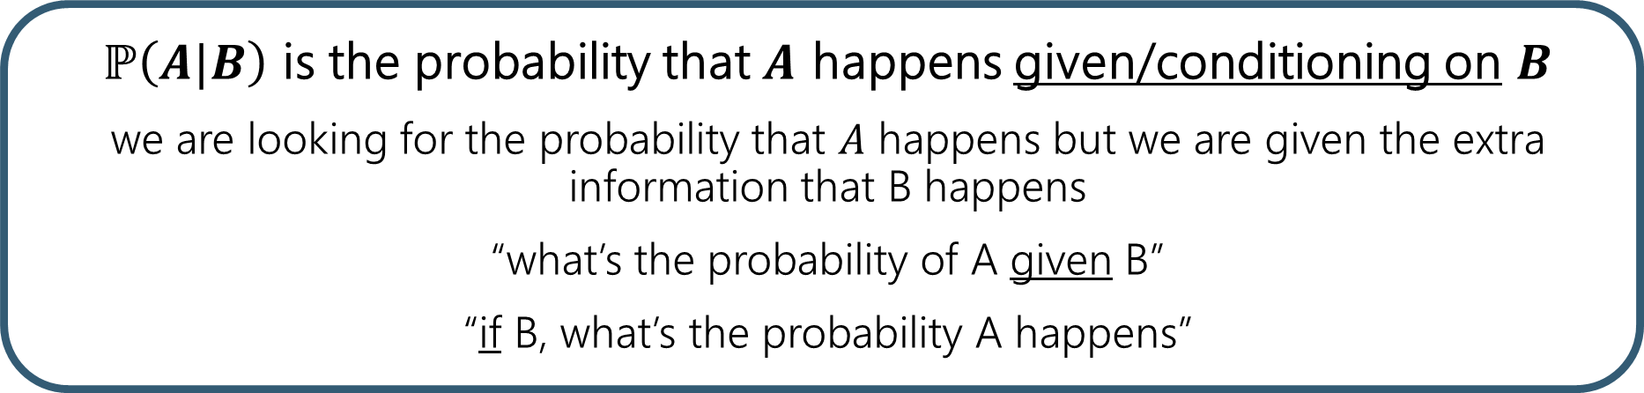
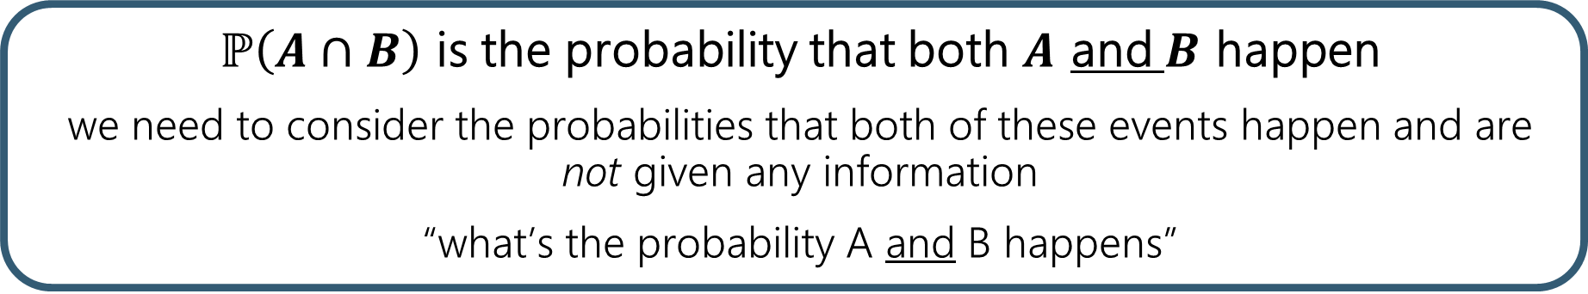
$ℙ(A|B)$ versus $ℙ(A∩B)$
$ℙ\left(A∩B\right)$ is the probability that both $A$ and $B$ happen
we need to consider the probabilities that both of these events happen and are not given any information
“what’s the probability A and B happens”
$ℙ\left(A|B\right)$ is the probability that $A$ happens given/conditioning on $B$
we are looking for the probability that $A$ happens but we are given the extra information that B happens
“what’s the probability of A given B”
“if B, what’s the probability A happens”

Slide 6



A Technical Note
After you condition on an event, what remains is a probability space.
$(Ω,ℙ)$ is a valid probability space $(A,ℙ(⋅|A))$ is valid probability space
  and, $A⊆Ω$
Sum of probabilities of outcomes in a sample space is 1: $\sum_{ω∈Ω}{ℙ(ω)=1}$
$ℙ\left(\overline{E}\right)=1−ℙ(E)$
Sum of probabilities in this conditioned probability space is 1: $\sum_{ω∈A}{ℙ\left(ω | A\right)=1}$
$ℙ\left(\overline{E}|A\right)=1−ℙ(E|A)$
⚠️Careful! $ℙ\left(E|\overline{A}\right)≠1−ℙ(E|A)$ because this changes the sample space!

Slide 7
Independence

Slide 8
Definition of Independence
We’ve calculated conditional probabilities.
Sometimes conditioning – getting some partial information about the outcome – doesn’t actually change the probability.
  i.e., knowing B happened doesn’t change the probability A happened
We already saw an example like this…

Slide 9
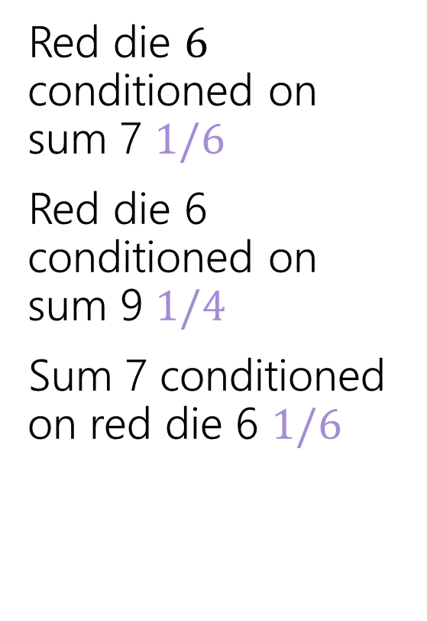
Conditioning Practice
from last week’s lecture
Red die $6$ conditioned on sum 7 $1/6$
Red die 6 conditioned on sum 9 $1/4$
Sum 7 conditioned on red die 6 $1/6$
 | D2=1 | D2=2 | D2=3 | D2=4 | D2=5 | D2=6
D1=1 | (1,1) | (1,2) | (1,3) | (1,4) | (1,5) | (1.6)
D1=2 | (2,1) | (2,2) | (2,3) | (2,4) | (2,5) | (2,6)
D1=3 | (3,1) | (3,2) | (3,3) | (3,4) | (3,5) | (3,6)
D1=4 | (4,1) | (4,2) | (4,3) | (4,4) | (4,5) | (4,6)
D1=5 | (5,1) | (5,2) | (5,3) | (5,4) | (5,5) | (5,6)
D1=6 | (6,1) | (6,2) | (6,3) | (6,4) | (6,5) | (6,6)
Red die 6 has probability 1/6 before or after conditioning on sum 7.

Slide 10
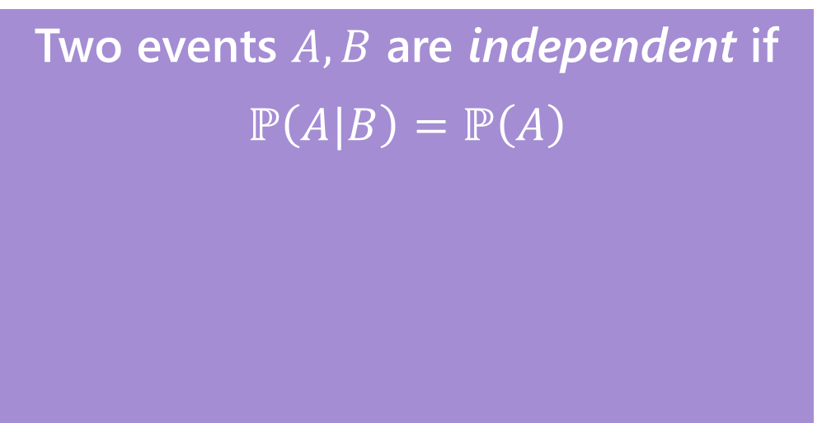

Independence
Independence (if $ℙ\left(A\right)$ and $ℙ\left(B\right)$ are $>0$)
Two events $A,B$ are independent if
$$ℙ\left(A|B\right)=ℙ\left(A\right)$$

Slide 11

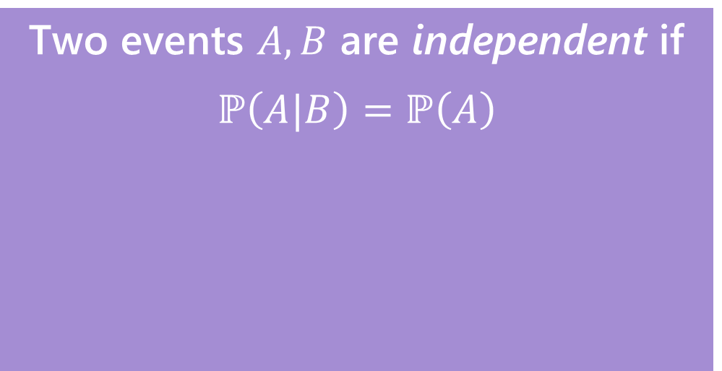
Independence
Independence (if $ℙ\left(A\right)$ and $ℙ\left(B\right)$ are $>0$)
Two events $A,B$ are independent if
$$ℙ\left(A|B\right)=ℙ\left(A\right)$$
“Knowing $B$ doesn’t tell us anything about whether $A$ happened”

Slide 12

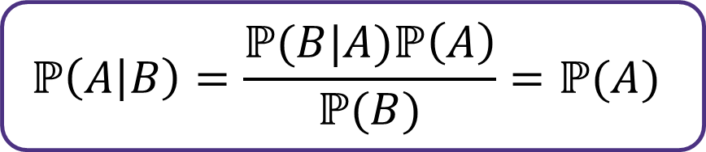
Independence
$$ℙ\left(A | B\right)=\frac{ℙ(B|A)ℙ\left(A\right)}{ℙ(B)}=ℙ(A)$$
Independence (if $ℙ\left(A\right)$ and $ℙ\left(B\right)$ are $>0$)
Two events $A,B$ are independent if
$$ℙ\left(A|B\right)=ℙ\left(A\right)$$
“Knowing $B$ doesn’t tell us anything about whether $A$ happened”

Slide 13

Independence
$$ℙ\left(A | B\right)=\frac{ℙ(B|A)ℙ\left(A\right)}{ℙ(B)}=ℙ(A)$$
Independence (if $ℙ\left(A\right)$ and $ℙ\left(B\right)$ are $>0$)
$$ℙ(B|A)ℙ\left(A\right) =ℙ(A)ℙ(B)$$
Two events $A,B$ are independent if
$$ℙ\left(A|B\right)=ℙ\left(A\right)$$
“Knowing $B$ doesn’t tell us anything about whether $A$ happened”

Slide 14

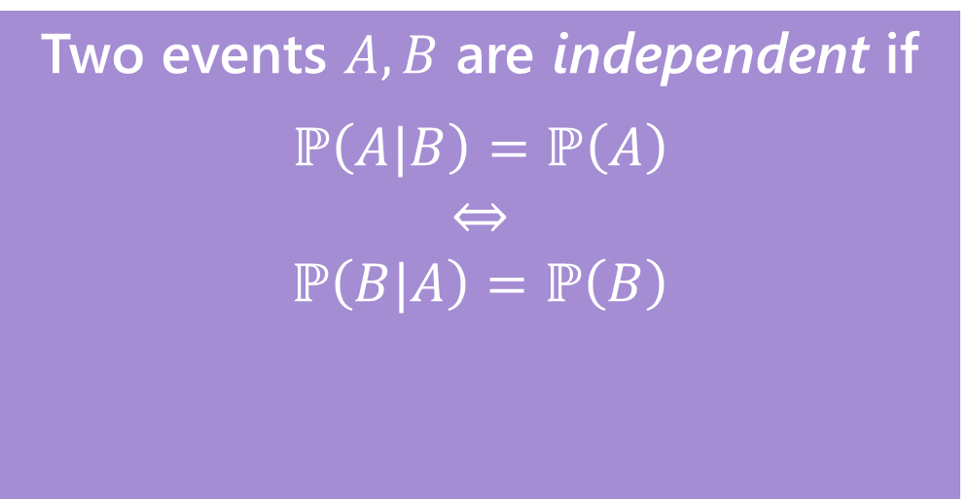
Independence
$$ℙ\left(A | B\right)=\frac{ℙ(B|A)ℙ\left(A\right)}{ℙ(B)}=ℙ(A)$$
Independence (if $ℙ\left(A\right)$ and $ℙ\left(B\right)$ are $>0$)
$$ℙ(B|A)ℙ\left(A\right) =ℙ(A)ℙ(B)$$
Two events $A,B$ are independent if
$$ℙ\left(A|B\right)=ℙ\left(A\right)$$
$$⇔$$
$$ℙ\left(B|A\right)=ℙ\left(B\right)$$
$$ℙ(B|A)=ℙ(B)$$
“Knowing $B$ doesn’t tell us anything about whether $A$ happened”

Slide 15

Independence
$$ℙ\left(A | B\right)=\frac{ℙ(B|A)ℙ\left(A\right)}{ℙ(B)}=ℙ(A)$$
Independence (if $ℙ\left(A\right)$ and $ℙ\left(B\right)$ are $>0$)
$$ℙ(B|A)ℙ\left(A\right) =ℙ(A)ℙ(B)$$
Two events $A,B$ are independent if
$$ℙ\left(A|B\right)=ℙ\left(A\right)$$
$$⇔$$
$$ℙ\left(B|A\right)=ℙ\left(B\right)$$
$$ℙ(B|A)=ℙ(B)$$
“Knowing $B$ doesn’t tell us anything about whether $A$ happened”
“Knowing $A$ doesn’t tell us anything about whether $B$ happened”

Slide 16
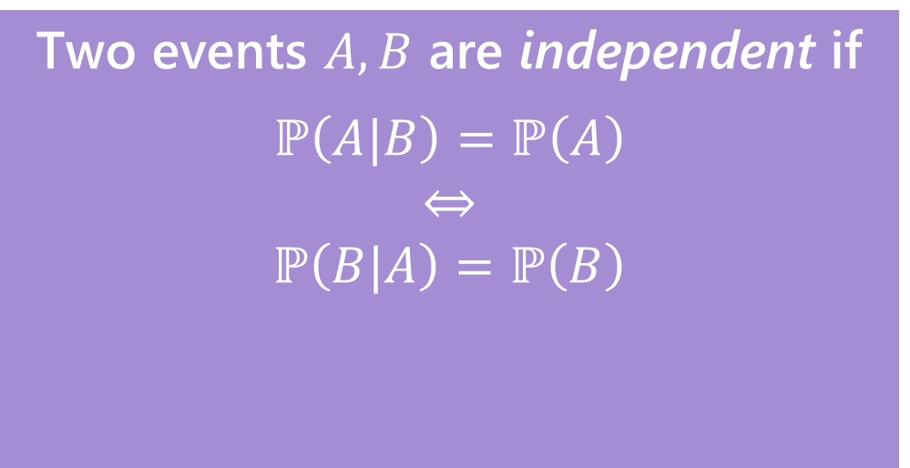
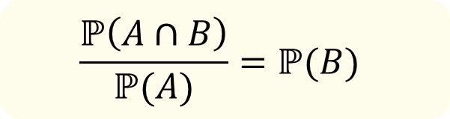
Independence
$$ℙ\left(A | B\right)=\frac{ℙ(B|A)ℙ\left(A\right)}{ℙ(B)}=ℙ(A)$$
Independence (if $ℙ\left(A\right)$ and $ℙ\left(B\right)$ are $>0$)
$$ℙ(B|A)ℙ\left(A\right) =ℙ(A)ℙ(B)$$
Two events $A,B$ are independent if
$$ℙ\left(A|B\right)=ℙ\left(A\right)$$
$$⇔$$
$$ℙ\left(B|A\right)=ℙ\left(B\right)$$
$$ℙ(B|A)=ℙ(B)$$
$$\frac{ℙ\left(A∩B\right)}{ℙ(A)}=ℙ(B)$$
“Knowing $B$ doesn’t tell us anything about whether $A$ happened”
“Knowing $A$ doesn’t tell us anything about whether $B$ happened”

Slide 17

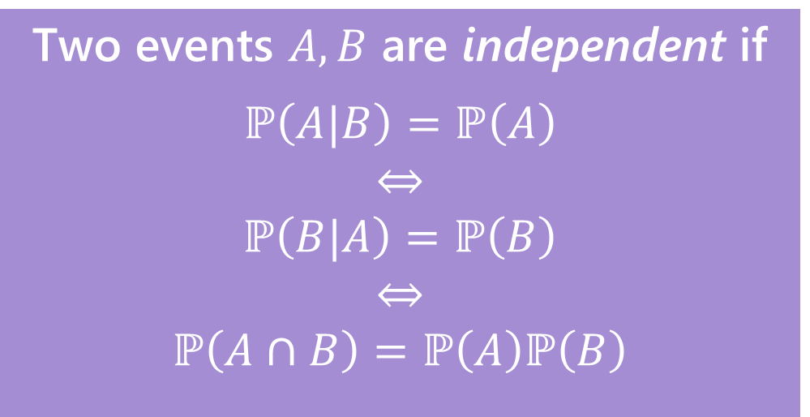
Independence
$$ℙ\left(A | B\right)=\frac{ℙ(B|A)ℙ\left(A\right)}{ℙ(B)}=ℙ(A)$$
Independence (if $ℙ\left(A\right)$ and $ℙ\left(B\right)$ are $>0$)
$$ℙ(B|A)ℙ\left(A\right) =ℙ(A)ℙ(B)$$
Two events $A,B$ are independent if
$$ℙ\left(A|B\right)=ℙ\left(A\right)$$
$$⇔$$
$$ℙ\left(B|A\right)=ℙ\left(B\right)$$
$$⇔$$
$$ℙ\left(A∩B\right)=ℙ\left(A\right)ℙ\left(B\right)$$
$$ℙ(B|A)=ℙ(B)$$
$$\frac{ℙ\left(A∩B\right)}{ℙ(A)}=ℙ(B)$$
$$ℙ\left(A∩B\right) =ℙ\left(A\right)⋅ℙ(B)$$
“Knowing $B$ doesn’t tell us anything about whether $A$ happened”
“Knowing $A$ doesn’t tell us anything about whether $B$ happened”

Slide 18
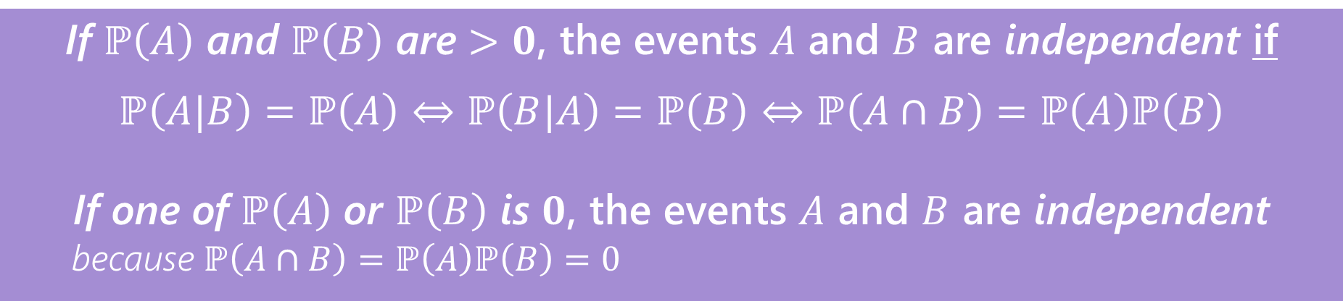
Independence
Independence
If $ℙ\left(A\right)$ and $ℙ\left(B\right)$ are $>0$, the events $A$ and $B$ are independent if
$$ℙ\left(A|B\right)=ℙ\left(A\right)⇔ℙ\left(B|A\right)=ℙ\left(B\right)⇔ℙ\left(A∩B\right)=ℙ\left(A\right)ℙ\left(B\right)$$
If one of $ℙ\left(A\right)$ or $ℙ\left(B\right)$ is $0$, the events $A$ and $B$ are independent
because $ℙ\left(A∩B\right)=ℙ\left(A\right)ℙ\left(B\right)=0$
You’ll sometimes see this called “statistical independence” to emphasize that we’re talking about probabilities (not, say, physical interactions).

Slide 19
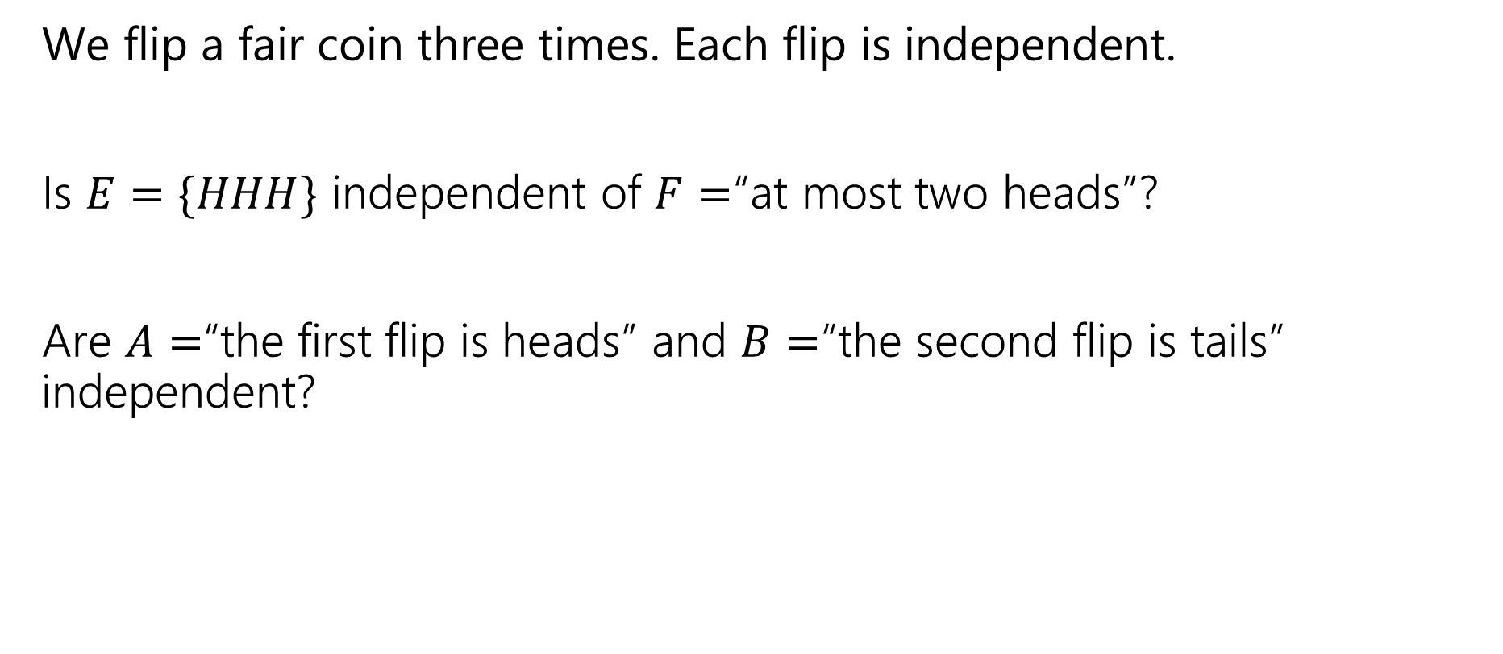
Examples
We flip a fair coin three times. Each flip is independent.
Is $E=\{HHH\}$ independent of $F=$“at most two heads”?
Are $A=$“the first flip is heads” and $B=$“the second flip is tails” independent?

Slide 20
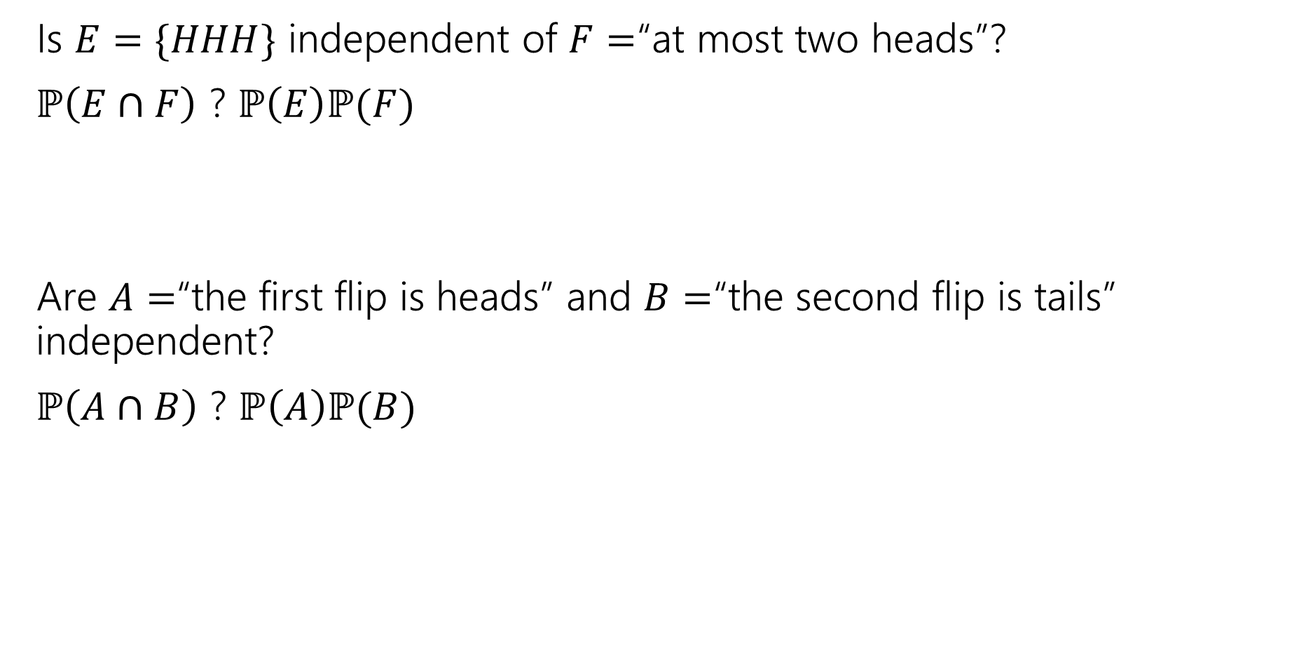
Examples
We flip a fair coin three times. Each flip is independent.
Is $E=\{HHH\}$ independent of $F=$“at most two heads”?
$ℙ\left(E∩F\right)$ ? $ℙ\left(E\right)ℙ(F)$
Are $A=$“the first flip is heads” and $B=$“the second flip is tails” independent?
$ℙ\left(A∩B\right)$ ? $ℙ\left(A\right)ℙ(B)$

Slide 21
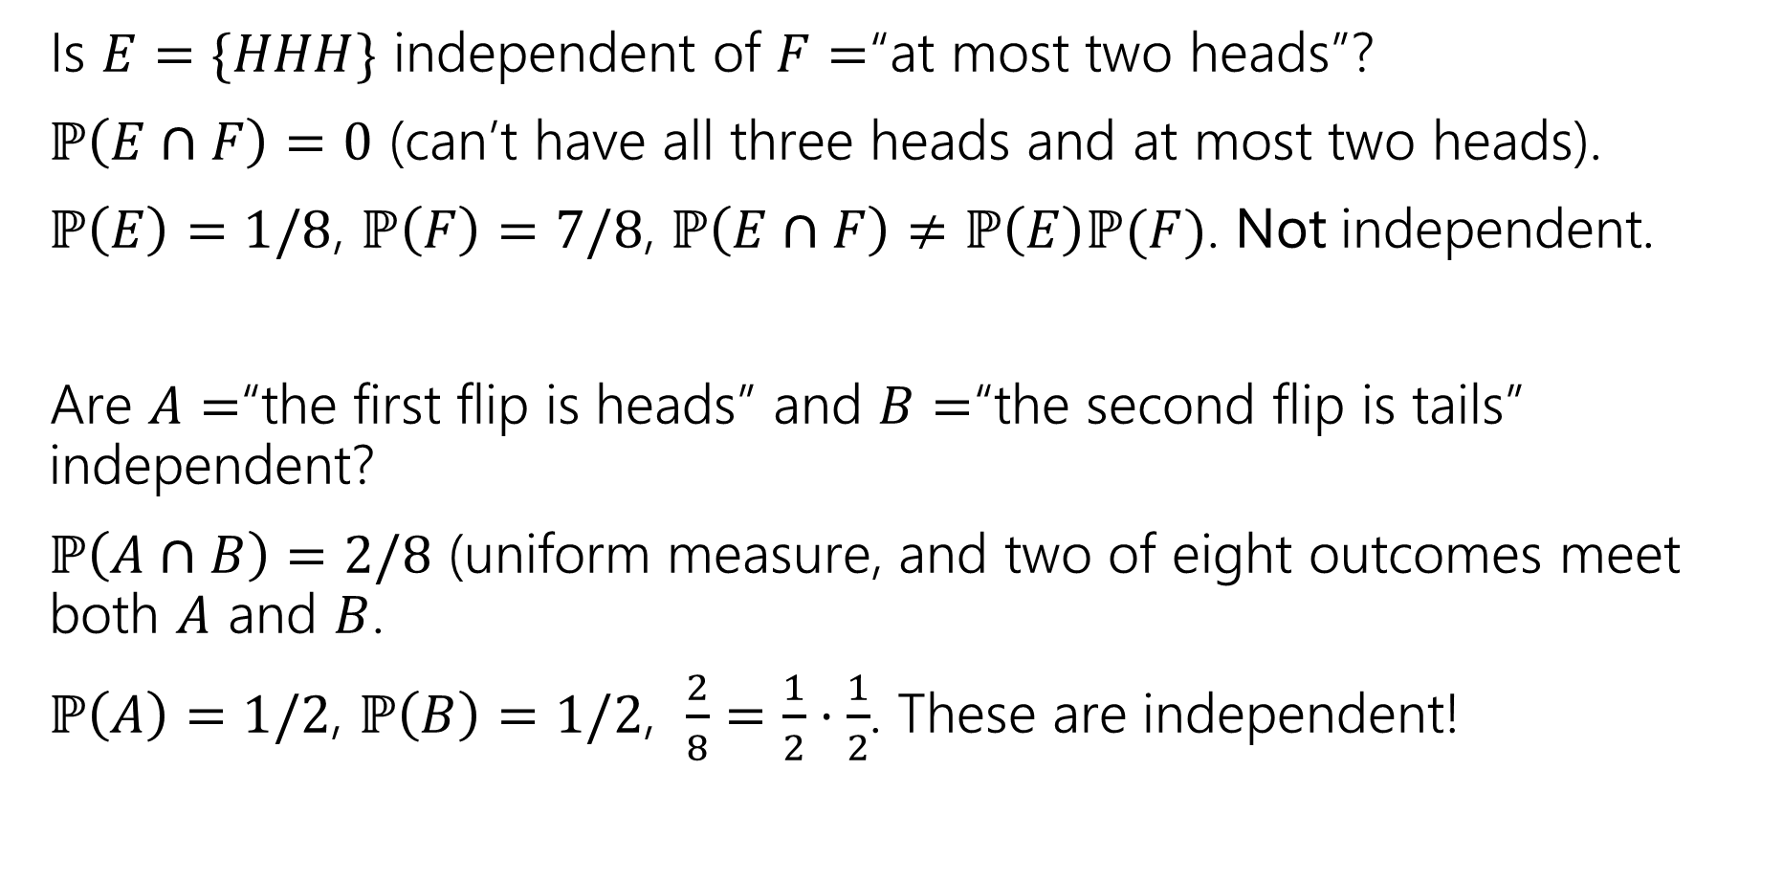
Examples
Is $E=\{HHH\}$ independent of $F=$“at most two heads”?
$ℙ\left(E∩F\right)=0$ (can’t have all three heads and at most two heads).
$ℙ\left(E\right)=1/8$, $ℙ\left(F\right)=7/8$, $ℙ\left(E∩F\right)≠ℙ\left(E\right)ℙ(F)$. Not independent.
Are $A=$“the first flip is heads” and $B=$“the second flip is tails” independent?
$ℙ\left(A∩B\right)=2/8$ (uniform measure, and two of eight outcomes meet both $A$ and $B$.
$ℙ\left(A\right)=1/2$, $ℙ\left(B\right)=1/2$, $\frac{2}{8}=\frac{1}{2}⋅\frac{1}{2}$. These are independent!

Slide 22
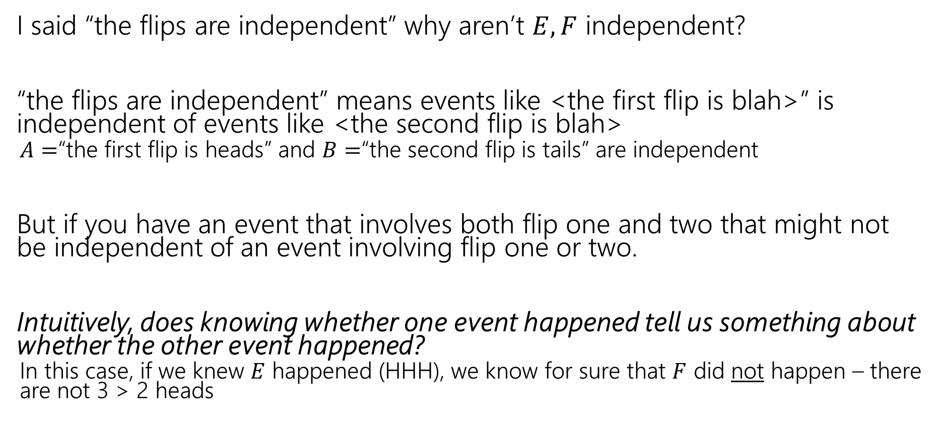
Hey Wait
I said “the flips are independent” why aren’t $E,F$ independent?
“the flips are independent” means events like <the first flip is blah>” is independent of events like <the second flip is blah>
  $A=$“the first flip is heads” and $B=$“the second flip is tails” are independent
But if you have an event that involves both flip one and two that might not be independent of an event involving flip one or two.
Intuitively, does knowing whether one event happened tell us something about whether the other event happened?
  In this case, if we knew $E$ happened (HHH), we know for sure that $F$ did not happen – there are not 3 > 2 heads

Slide 23
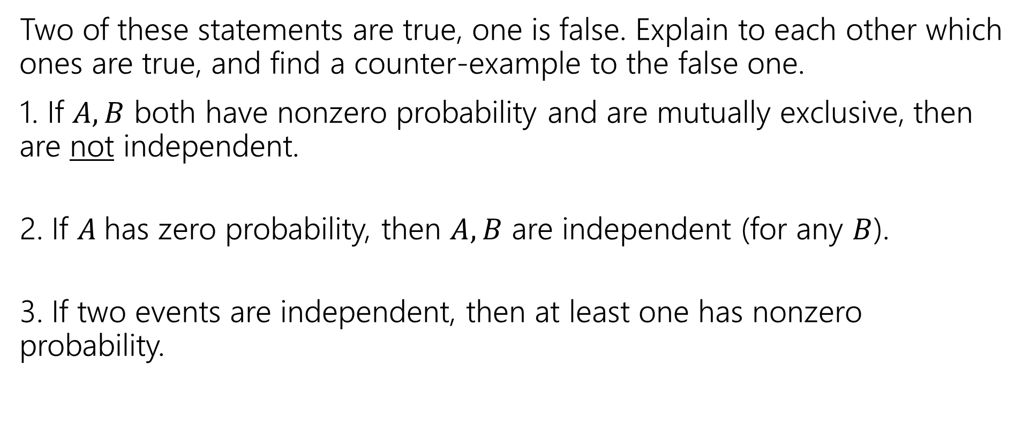
Two Truths and a Lie!
Two of these statements are true, one is false. Explain to each other which ones are true, and find a counter-example to the false one.
1. If $A,B$ both have nonzero probability and are mutually exclusive, then are not independent.
2. If $A$has zero probability, then $A,B$ are independent (for any $B$).
3. If two events are independent, then at least one has nonzero probability.
pollev.com/jolie312

Slide 24
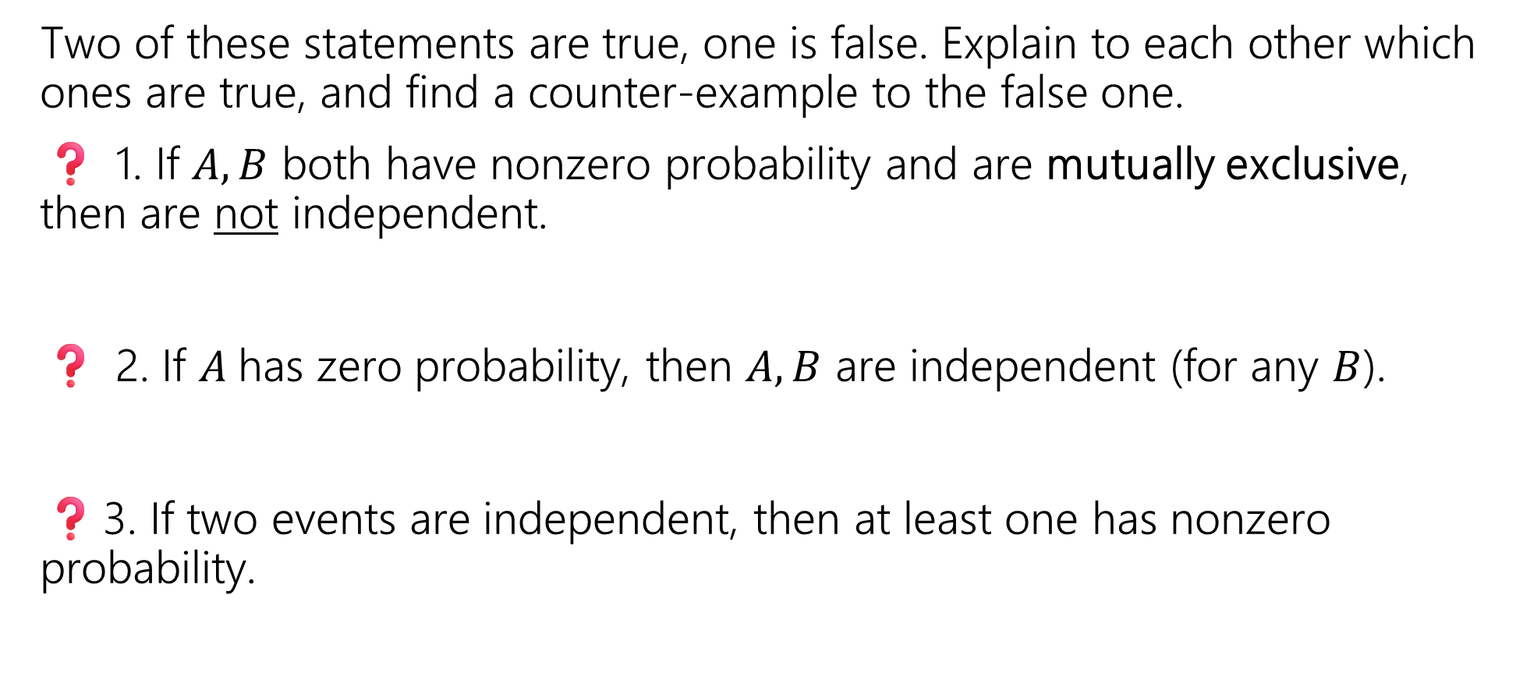
Two Truths and a Lie!
Two of these statements are true, one is false. Explain to each other which ones are true, and find a counter-example to the false one.
❓ 1. If $A,B$ both have nonzero probability and are mutually exclusive, then are not independent.
❓ 2. If $A$has zero probability, then $A,B$ are independent (for any $B$).
❓3. If two events are independent, then at least one has nonzero probability.

Slide 25
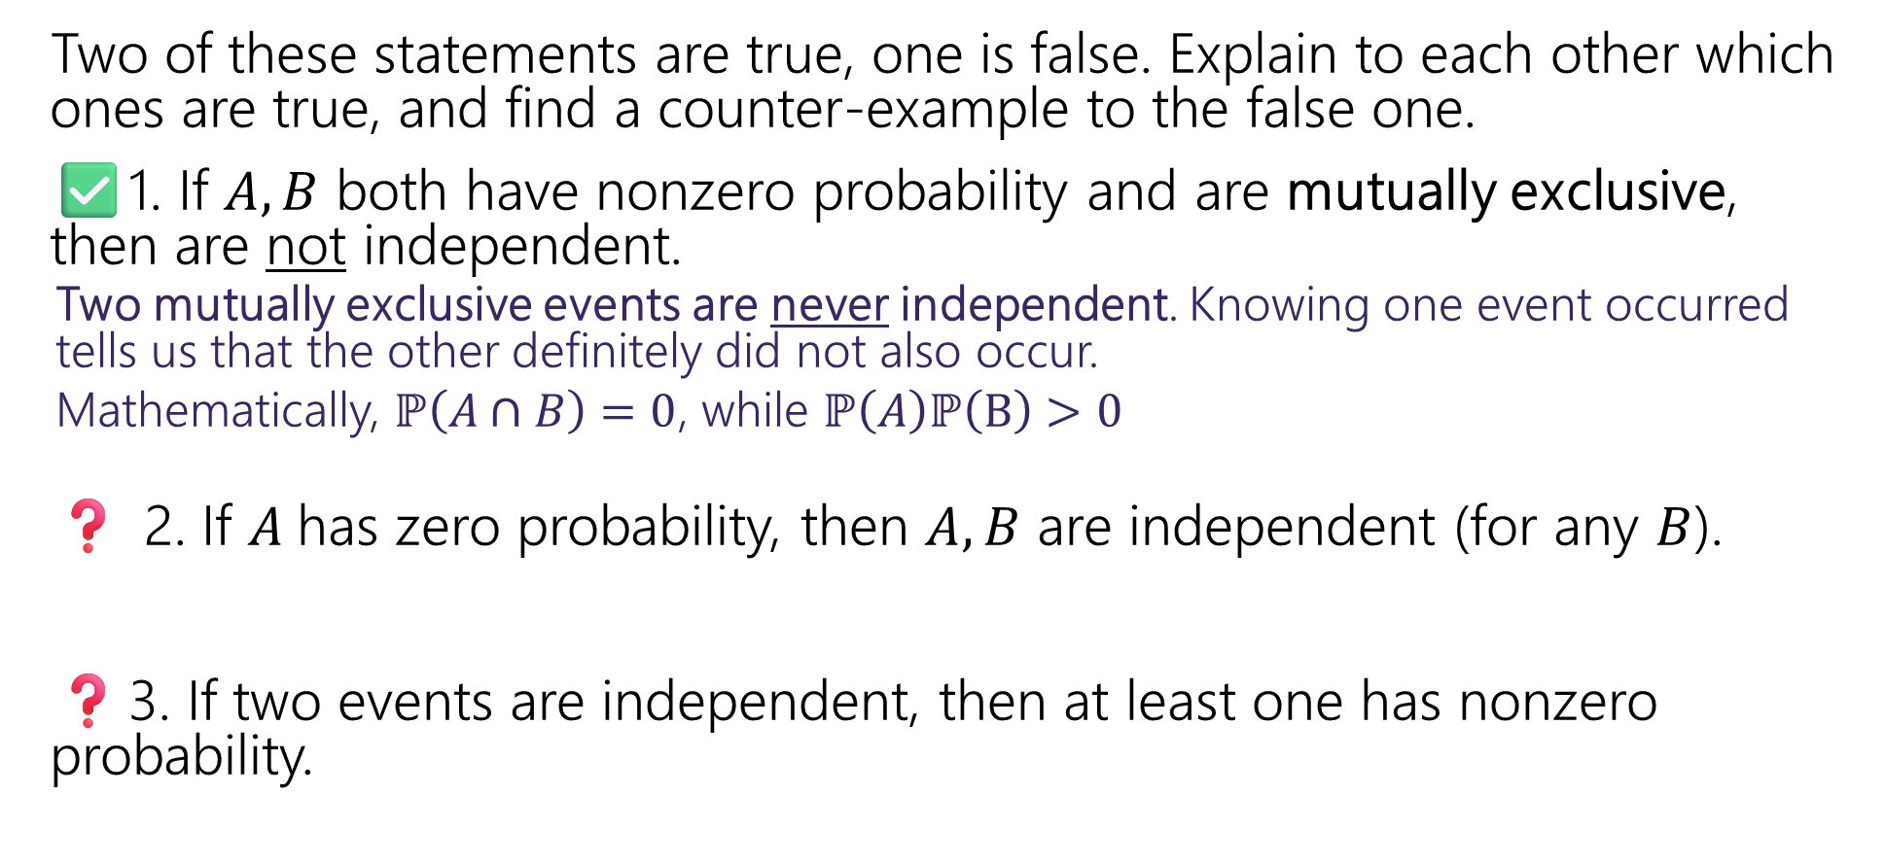
Two Truths and a Lie!
Two of these statements are true, one is false. Explain to each other which ones are true, and find a counter-example to the false one.
✅1. If $A,B$ both have nonzero probability and are mutually exclusive, then are not independent.
  Two mutually exclusive events are never independent. Knowing one event occurred tells us that the other definitely did not also occur.
  Mathematically, $ℙ\left(A∩B\right)=0$, while $ℙ\left(A\right)ℙ\left(B\right)>0$
❓ 2. If $A$has zero probability, then $A,B$ are independent (for any $B$).
❓3. If two events are independent, then at least one has nonzero probability.

Slide 26
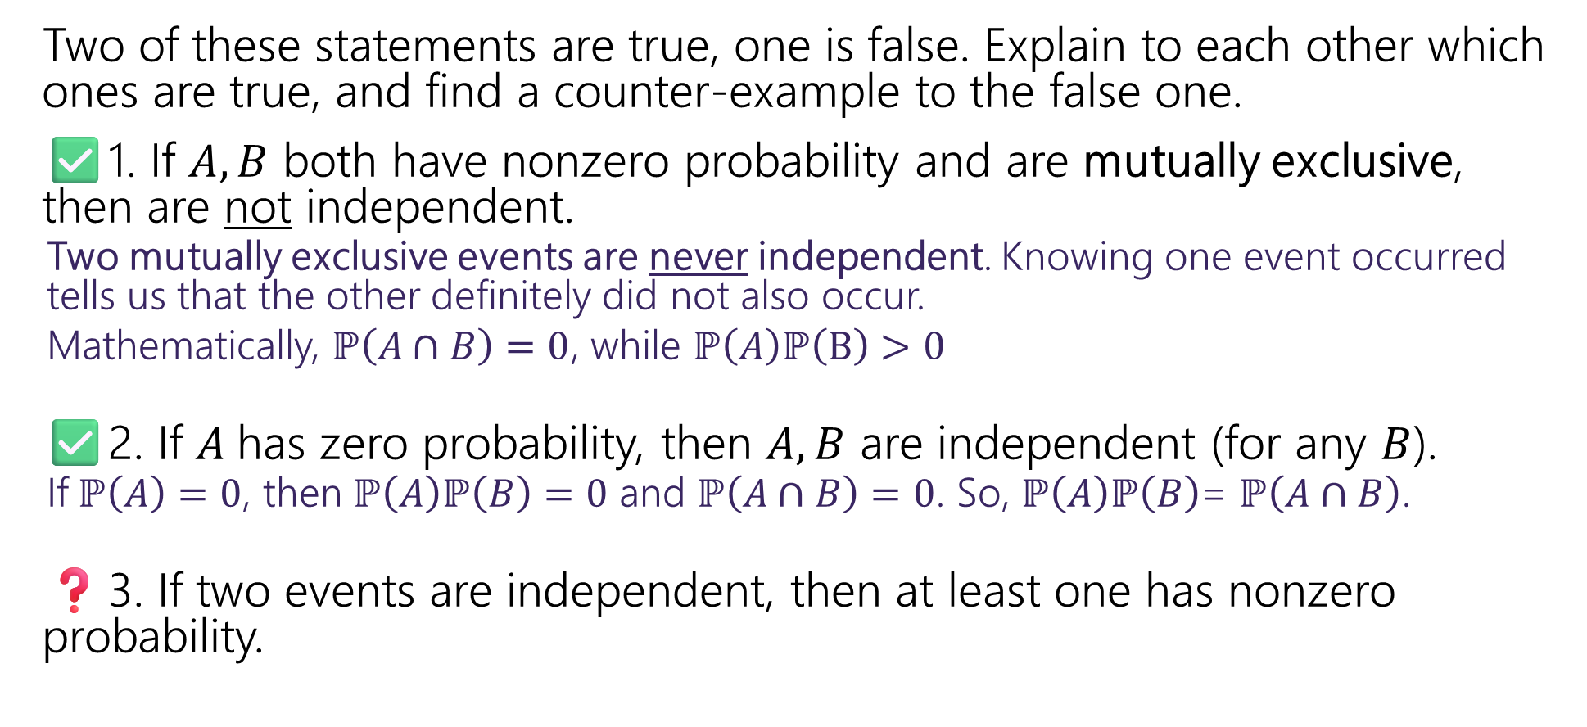
Two Truths and a Lie!
Two of these statements are true, one is false. Explain to each other which ones are true, and find a counter-example to the false one.
✅1. If $A,B$ both have nonzero probability and are mutually exclusive, then are not independent.
  Two mutually exclusive events are never independent. Knowing one event occurred tells us that the other definitely did not also occur.
  Mathematically, $ℙ\left(A∩B\right)=0$, while $ℙ\left(A\right)ℙ\left(B\right)>0$
✅2. If $A$has zero probability, then $A,B$ are independent (for any $B$).
  If$ℙ\left(A\right)=0$, then $ℙ\left(A\right)ℙ\left(B\right)=0$ and $ℙ\left(A∩B\right)=0$. So, $ℙ\left(A\right)ℙ\left(B\right)$= $ℙ\left(A∩B\right)$.
❓3. If two events are independent, then at least one has nonzero probability.

Slide 27
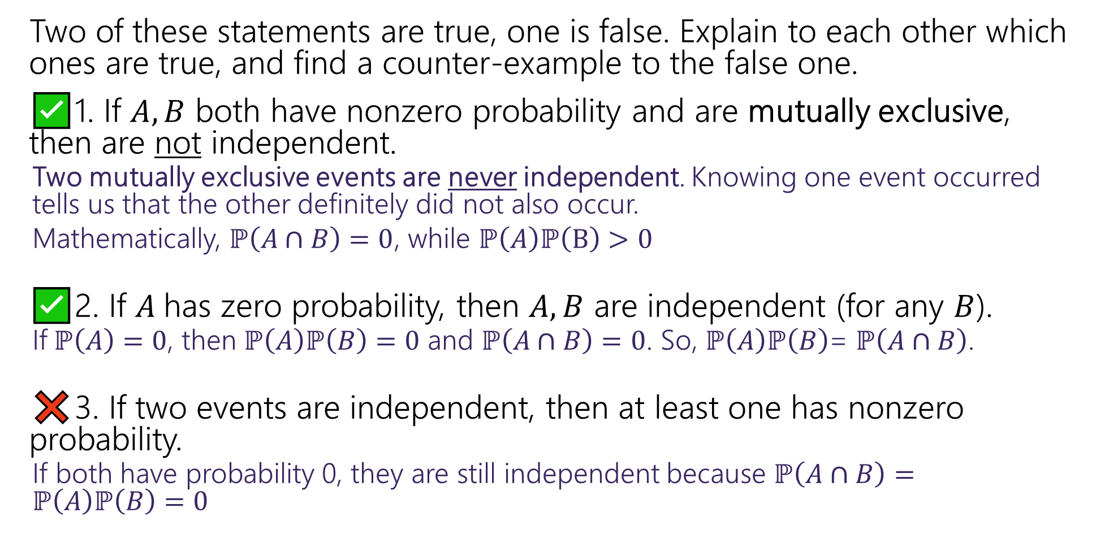
Two Truths and a Lie!
Two of these statements are true, one is false. Explain to each other which ones are true, and find a counter-example to the false one.
✅1. If $A,B$ both have nonzero probability and are mutually exclusive, then are not independent.
  Two mutually exclusive events are never independent. Knowing one event occurred tells us that the other definitely did not also occur.
  Mathematically, $ℙ\left(A∩B\right)=0$, while $ℙ\left(A\right)ℙ\left(B\right)>0$
✅2. If $A$has zero probability, then $A,B$ are independent (for any $B$).
  If$ℙ\left(A\right)=0$, then $ℙ\left(A\right)ℙ\left(B\right)=0$ and $ℙ\left(A∩B\right)=0$. So, $ℙ\left(A\right)ℙ\left(B\right)$= $ℙ\left(A∩B\right)$.
❌3. If two events are independent, then at least one has nonzero probability.
  If both have probability 0, they are still independent because $ℙ\left(A∩B\right)=ℙ\left(A\right)ℙ\left(B\right)=0$

Slide 28
Independence of 3 or more events
Pairwise independence and mutual independence

Slide 29

Independence for 3 or more events
For three or more events, we need two kinds of independence
Events $A_{1},A_{2},…,A_{n}$ are pairwise independent if
$ℙ\left(A_{i}∩A_{j}\right)=ℙ\left(A_{i}\right)⋅ℙ\left(A_{j}\right)$ for all $i,j$
Pairwise Independence

Slide 30
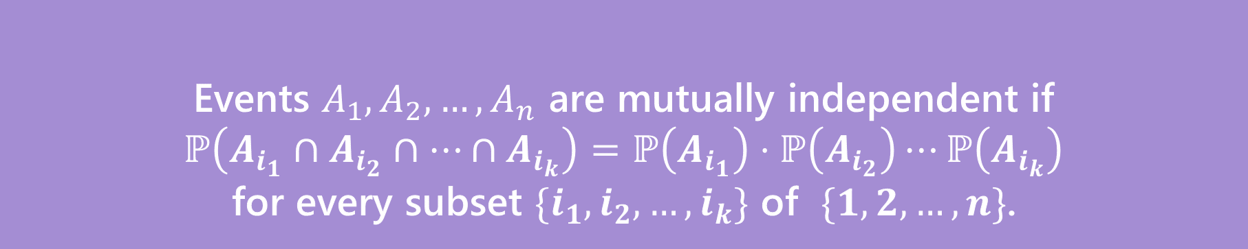

Independence for 3 or more events
For three or more events, we need two kinds of independence
Events $A_{1},A_{2},…,A_{n}$ are pairwise independent if
$ℙ\left(A_{i}∩A_{j}\right)=ℙ\left(A_{i}\right)⋅ℙ\left(A_{j}\right)$ for all $i,j$
Pairwise Independence
Events $A_{1},A_{2},…,A_{n}$ are mutually independent if
$ℙ\left(A_{i_{1}}∩A_{i_{2}}∩…∩A_{i_{k}}\right)=ℙ\left(A_{i_{1}}\right)⋅ℙ\left(A_{i_{2}}\right)⋯ℙ\left(A_{i_{k}}\right)$
for every subset $\{i_{1},i_{2},…,i_{k}\}$ of $\{1,2,…,n\}$.
Mutual Independence

Slide 31

Pairwise Independence vs. Mutual Independence
Roll two fair dice (one red one blue) independently
$R=$“red die is $3$”
$B=$“blue die is 5”
$S=$“sum is $7$”
How should we describe these events?

Slide 32

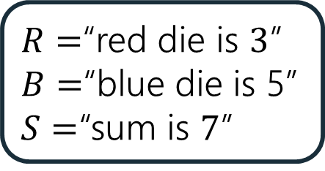
Pairwise Independence
$R=$“red die is $3$”
$B=$“blue die is 5”
$S=$“sum is $7$”
$R,B,S$are pairwise independent

Slide 33

Pairwise Independence
$R=$“red die is $3$”
$B=$“blue die is 5”
$S=$“sum is $7$”
$R,B,S$are pairwise independent
$ℙ\left(R∩B\right) ?=ℙ\left(R\right)ℙ(B)$
$ℙ\left(R∩S\right) ?=ℙ\left(R\right)ℙ(S)$
$ℙ\left(B∩S\right) ?=ℙ\left(B\right)ℙ\left(S\right)$

Slide 34
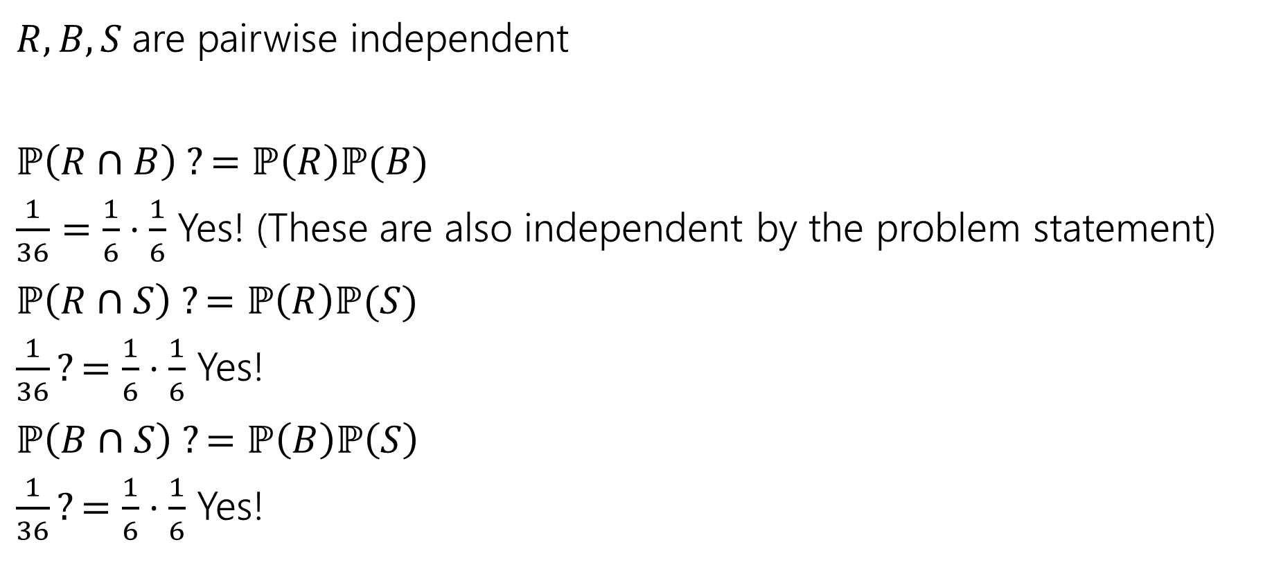
Pairwise Independence
$R=$“red die is $3$”
$B=$“blue die is 5”
$S=$“sum is $7$”
$R,B,S$are pairwise independent
$ℙ\left(R∩B\right) ?=ℙ\left(R\right)ℙ(B)$
$\frac{1}{36}=\frac{1}{6}⋅\frac{1}{6}$ Yes! (These are also independent by the problem statement)
$ℙ\left(R∩S\right) ?=ℙ\left(R\right)ℙ(S)$
$\frac{1}{36}?=\frac{1}{6}⋅\frac{1}{6}$ Yes!
$ℙ\left(B∩S\right) ?=ℙ\left(B\right)ℙ\left(S\right)$
$\frac{1}{36}?=\frac{1}{6}⋅\frac{1}{6}$ Yes!
Since all three pairs are independent, we say the random variables are pairwise independent.

Slide 35

Mutual Independence
$R=$“red die is $3$”
$B=$“blue die is 5”
$S=$“sum is $7$”
$R,B,S$ are mutually independent?
$ℙ\left(R∩B∩S\right)=$
$ℙ\left(R\right)ℙ\left(B\right)ℙ\left(S\right)=$

Slide 36

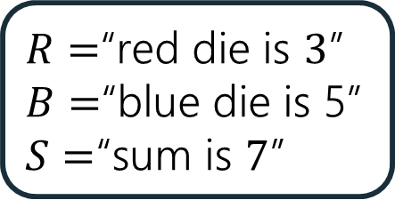
Mutual Independence
$R=$“red die is $3$”
$B=$“blue die is 5”
$S=$“sum is $7$”
$R,B,S$ are not mutually independent.
$ℙ\left(R∩B∩S\right)=0;$if the red die is 3, and blue die is 5 then the sum is 8 (so it can’t be 7)
$ℙ\left(R\right)ℙ\left(B\right)ℙ\left(S\right)={\left(\frac{1}{6}\right)}^{3}=\frac{1}{216}≠0$

Slide 37
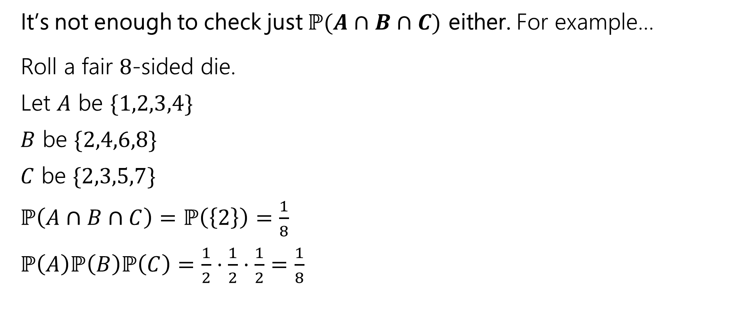
Checking Mutual Independence
It’s not enough to check just $ℙ(A∩B∩C)$ either. For example…
Roll a fair $8$-sided die.
Let $A$ be $\{1,2,3,4\}$
$B$ be $\{2,4,6,8\}$
$C$ be $\{2,3,5,7\}$
$ℙ\left(A∩B∩C\right)=ℙ\left(\left\{2\right\}\right)=\frac{1}{8}$
$ℙ\left(A\right)ℙ\left(B\right)ℙ\left(C\right)=\frac{1}{2}⋅\frac{1}{2}⋅\frac{1}{2}=\frac{1}{8}$

Slide 38
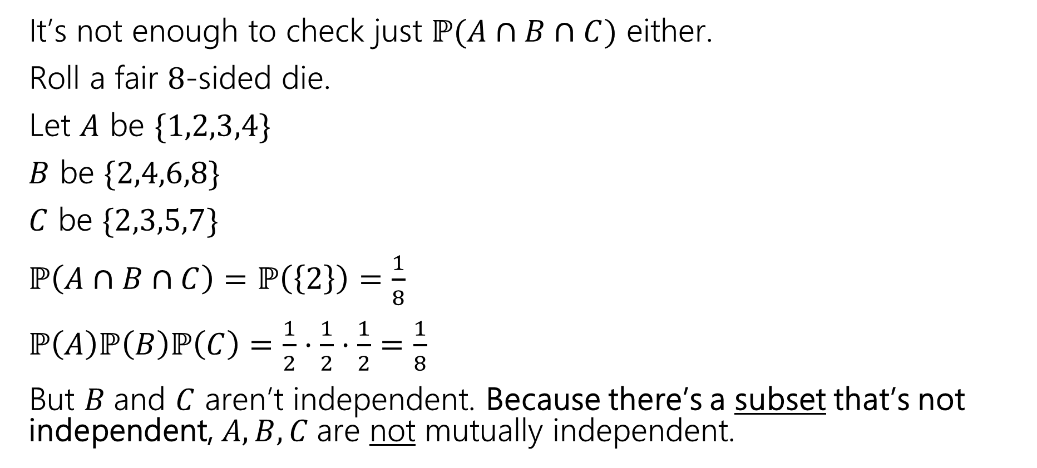
Checking Mutual Independence
It’s not enough to check just $ℙ(A∩B∩C)$ either.
Roll a fair $8$-sided die.
Let $A$ be $\{1,2,3,4\}$
$B$ be $\{2,4,6,8\}$
$C$ be $\{2,3,5,7\}$
$ℙ\left(A∩B∩C\right)=ℙ\left(\left\{2\right\}\right)=\frac{1}{8}$
$ℙ\left(A\right)ℙ\left(B\right)ℙ\left(C\right)=\frac{1}{2}⋅\frac{1}{2}⋅\frac{1}{2}=\frac{1}{8}$
But $B$and $C$ aren’t independent. Because there’s a subset that’s not independent, $A,B,C$are not mutually independent.

Slide 39
Checking Pairwise / Mutual Independence
To check pairwise independence of events:
Check every subset of size two.
To check mutual independence of events:
Check every subset.
If a set of events are mutually independent, it is also pairwise independent.
but not necessarily the other way around!

Slide 40
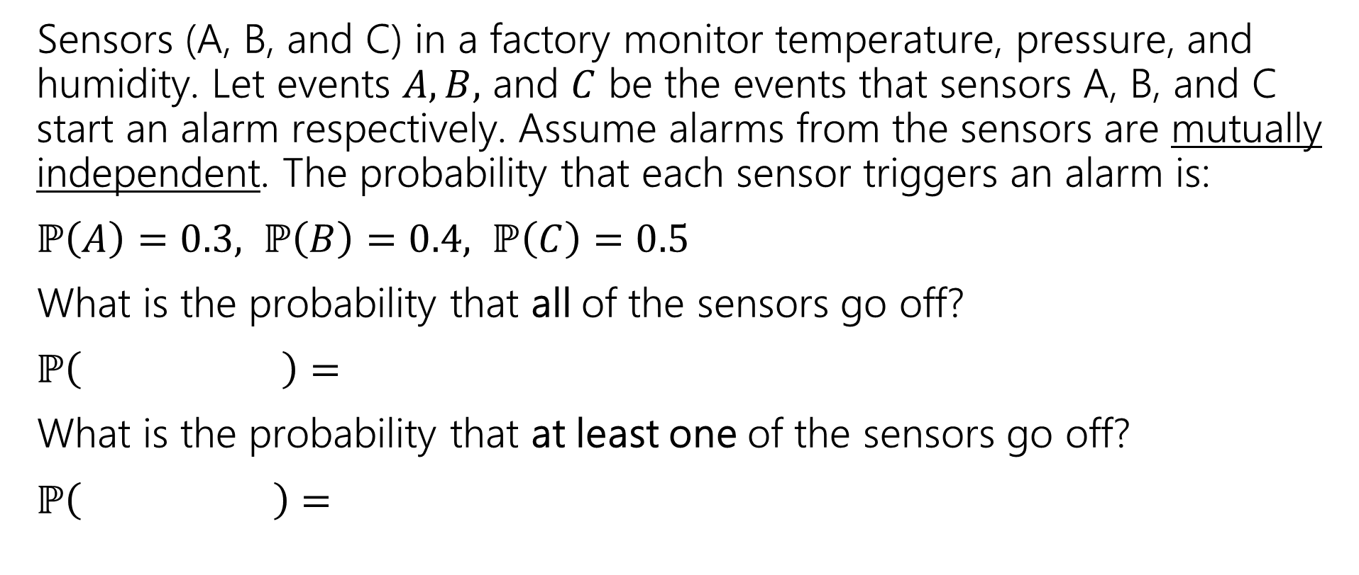
How do these properties help us?
Sensors (A, B, and C) in a factory monitor temperature, pressure, and humidity. Let events $A,B,$ and $C$ be the events that sensors A, B, and C start an alarm respectively. Assume alarms from the sensors are mutually independent. The probability that each sensor triggers an alarm is:
$ℙ\left(A\right)=0.3, ℙ\left(B\right)=0.4, ℙ\left(C\right)=0.5$
What is the probability that all of the sensors go off?
$ℙ\left( \right)=$
What is the probability that at least one of the sensors go off?
$ℙ\left( \right)=$

Slide 41
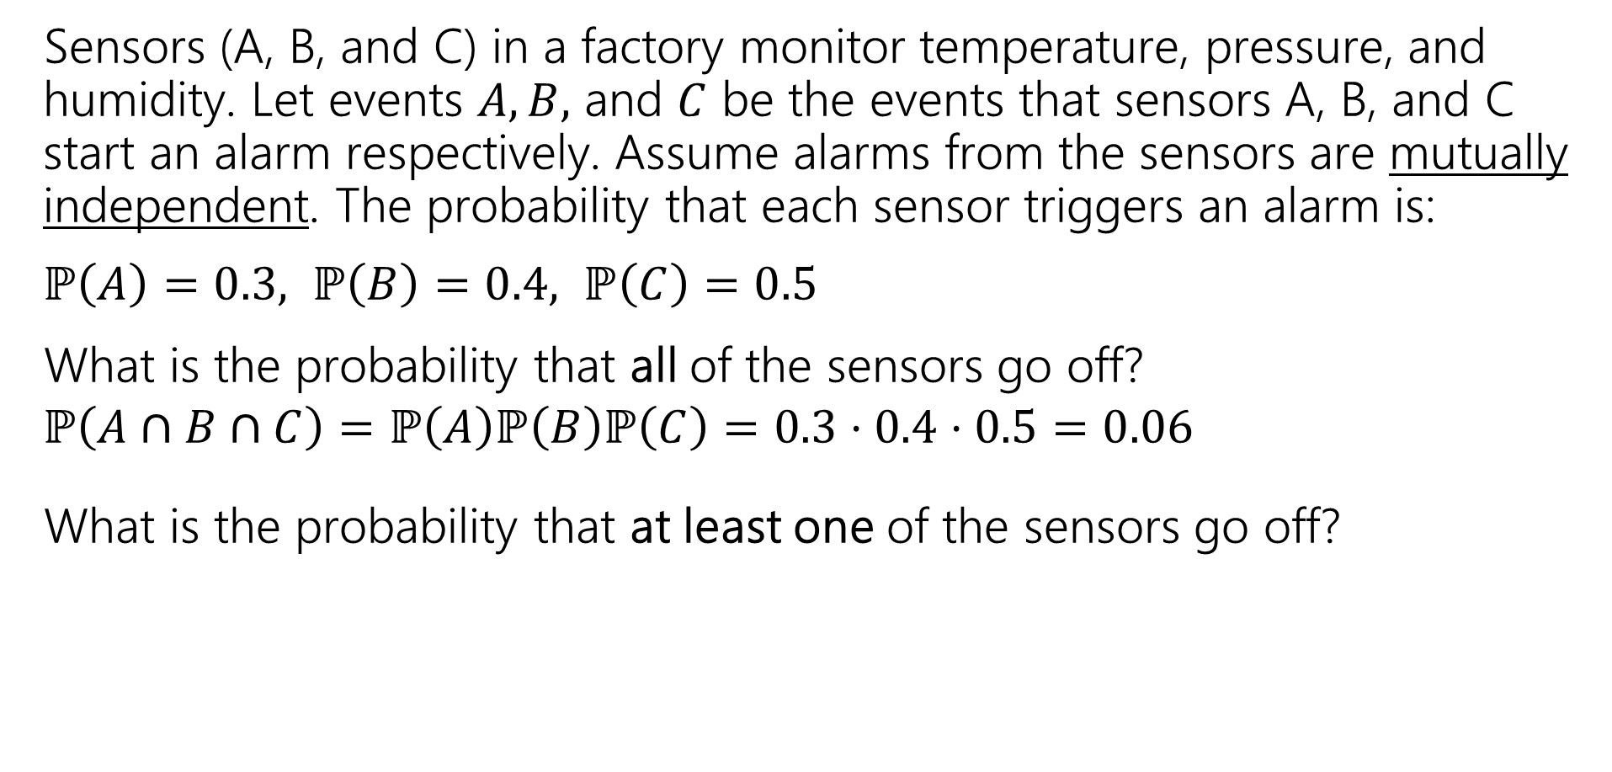
How do these properties help us?
Sensors (A, B, and C) in a factory monitor temperature, pressure, and humidity. Let events $A,B,$ and $C$ be the events that sensors A, B, and C start an alarm respectively. Assume alarms from the sensors are mutually independent. The probability that each sensor triggers an alarm is:
$ℙ\left(A\right)=0.3, ℙ\left(B\right)=0.4, ℙ\left(C\right)=0.5$
What is the probability that all of the sensors go off?
$ℙ\left(A∩B∩C\right)=ℙ\left(A\right)ℙ\left(B\right)ℙ\left(C\right)=0.3⋅0.4⋅0.5=0.06$
What is the probability that at least one of the sensors go off?
mutual independence

Slide 42
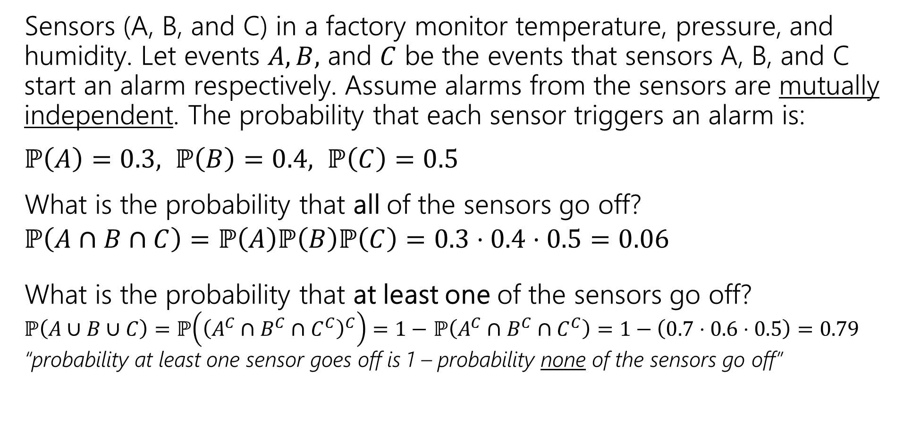
How do these properties help us?
Sensors (A, B, and C) in a factory monitor temperature, pressure, and humidity. Let events $A,B,$ and $C$ be the events that sensors A, B, and C start an alarm respectively. Assume alarms from the sensors are mutually independent. The probability that each sensor triggers an alarm is:
$ℙ\left(A\right)=0.3, ℙ\left(B\right)=0.4, ℙ\left(C\right)=0.5$
What is the probability that all of the sensors go off?
$ℙ\left(A∩B∩C\right)=ℙ\left(A\right)ℙ\left(B\right)ℙ\left(C\right)=0.3⋅0.4⋅0.5=0.06$
What is the probability that at least one of the sensors go off?
$ℙ\left(A∪B∪C\right)=ℙ\left({\left(A^{C}∩B^{C}∩C^{C}\right)}^{C}\right)=1−$ $ℙ\left(A^{C}∩B^{C}∩C^{C}\right)=1−\left(0.7⋅0.6⋅0.5\right)=0.79$
“probability at least one sensor goes off is 1 – probability none of the sensors go off”
mutual independence

Slide 43
Conditional Independence

Slide 44
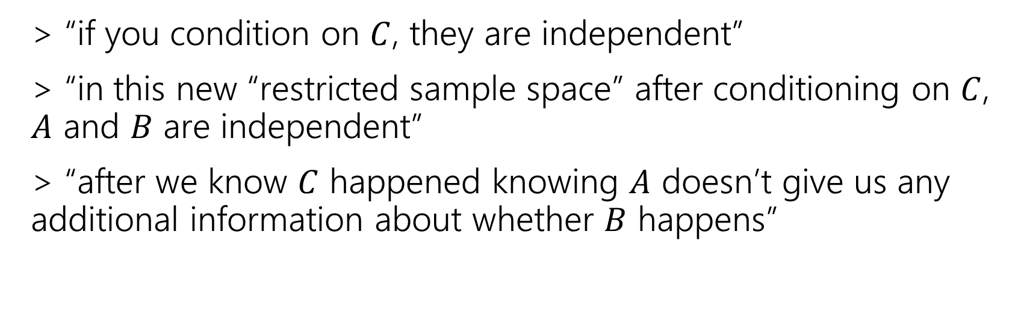

Conditional Independence
Conditional Independence
Two events $A,B$ are conditionally independent on $C$ if
$$ℙ\left(A∩B|C\right)=ℙ\left(A|C\right)⋅ℙ(B|C)$$
> “if you condition on $C$, they are independent”
> “in this new “restricted sample space” after conditioning on $C$, $A$ and $B$ are independent”
> “after we know $C$ happened knowing $A$ doesn’t give us any additional information about whether $B$ happens”

Slide 45
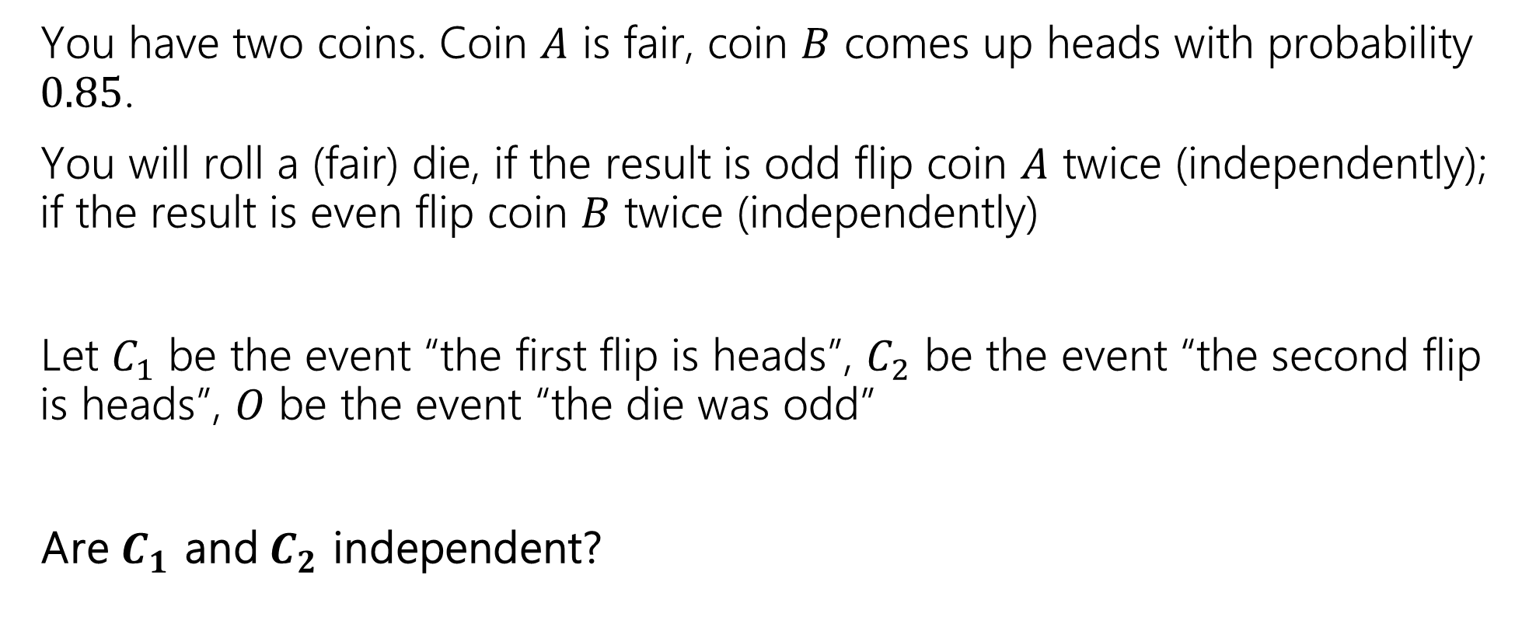
Example
You have two coins. Coin $A$ is fair, coin $B$ comes up heads with probability $0.85$.
You will roll a (fair) die, if the result is odd flip coin $A$ twice (independently); if the result is even flip coin $B$ twice (independently)
Let $C_{1}$ be the event “the first flip is heads”, $C_{2}$ be the event “the second flip is heads”, $O$ be the event “the die was odd”
Are $C_{1}$ and $C_{2}$ independent?
pollev.com/jolie312

Slide 46



(Unconditioned) Independence check whether $ℙ\left(C_{1}∩C_{2}\right)=ℙ\left(C_{1}\right)ℙ\left(C_{2}\right)$
$ℙ\left(C_{1}\right)=$
Coin $A$ is fair, coin $B$ is heads with probability $0.85$.
If the die is odd flip coin $A$ twice (independently); otherwise flip coin $B$ twice (independently)
$C_{1}$ ~“the first flip is heads”
$C_{2}$ ~ “the second flip is heads”
$O$ ~ “the die was odd”

Slide 47

(Unconditioned) Independence check whether $ℙ\left(C_{1}∩C_{2}\right)=ℙ\left(C_{1}\right)ℙ\left(C_{2}\right)$
$ℙ\left(C_{1}\right)=ℙ\left(C_{1} | O\right)ℙ\left(O\right)+ℙ(C_{1}|\overline{O})ℙ\left(\overline{O}\right)=\frac{1}{2}⋅\frac{1}{2}+\frac{1}{2}⋅0.85=.675$
Coin $A$ is fair, coin $B$ is heads with probability $0.85$.
If the die is odd flip coin $A$ twice (independently); otherwise flip coin $B$ twice (independently)
$C_{1}$ ~“the first flip is heads”
$C_{2}$ ~ “the second flip is heads”
$O$ ~ “the die was odd”

Slide 48

(Unconditioned) Independence check whether $ℙ\left(C_{1}∩C_{2}\right)=ℙ\left(C_{1}\right)ℙ\left(C_{2}\right)$
$ℙ\left(C_{1}\right)=ℙ\left(C_{1} | O\right)ℙ\left(O\right)+ℙ(C_{1}|\overline{O})ℙ\left(\overline{O}\right)=\frac{1}{2}⋅\frac{1}{2}+\frac{1}{2}⋅0.85=.675$
$ℙ\left(C_{2}\right)=.675$ (the same formula works)
Coin $A$ is fair, coin $B$ is heads with probability $0.85$.
If the die is odd flip coin $A$ twice (independently); otherwise flip coin $B$ twice (independently)
$C_{1}$ ~“the first flip is heads”
$C_{2}$ ~ “the second flip is heads”
$O$ ~ “the die was odd”

Slide 49

(Unconditioned) Independence check whether $ℙ\left(C_{1}∩C_{2}\right)=ℙ\left(C_{1}\right)ℙ\left(C_{2}\right)$
$ℙ\left(C_{1}\right)=ℙ\left(C_{1} | O\right)ℙ\left(O\right)+ℙ(C_{1}|\overline{O})ℙ\left(\overline{O}\right)=\frac{1}{2}⋅\frac{1}{2}+\frac{1}{2}⋅0.85=.675$
$ℙ\left(C_{2}\right)=.675$ (the same formula works)
$ℙ\left(C_{1}\right)ℙ\left(C_{2}\right)={.675}^{2}=.455625$
Coin $A$ is fair, coin $B$ is heads with probability $0.85$.
If the die is odd flip coin $A$ twice (independently); otherwise flip coin $B$ twice (independently)
$C_{1}$ ~“the first flip is heads”
$C_{2}$ ~ “the second flip is heads”
$O$ ~ “the die was odd”

Slide 50

(Unconditioned) Independence check whether $ℙ\left(C_{1}∩C_{2}\right)=ℙ\left(C_{1}\right)ℙ\left(C_{2}\right)$
$ℙ\left(C_{1}\right)=ℙ\left(C_{1} | O\right)ℙ\left(O\right)+ℙ(C_{1}|\overline{O})ℙ\left(\overline{O}\right)=\frac{1}{2}⋅\frac{1}{2}+\frac{1}{2}⋅0.85=.675$
$ℙ\left(C_{2}\right)=.675$ (the same formula works)
$ℙ\left(C_{1}\right)ℙ\left(C_{2}\right)={.675}^{2}=.455625$
$ℙ\left(C_{1}∩C_{2}\right)=$
Coin $A$ is fair, coin $B$ is heads with probability $0.85$.
If the die is odd flip coin $A$ twice (independently); otherwise flip coin $B$ twice (independently)
$C_{1}$ ~“the first flip is heads”
$C_{2}$ ~ “the second flip is heads”
$O$ ~ “the die was odd”

Slide 51
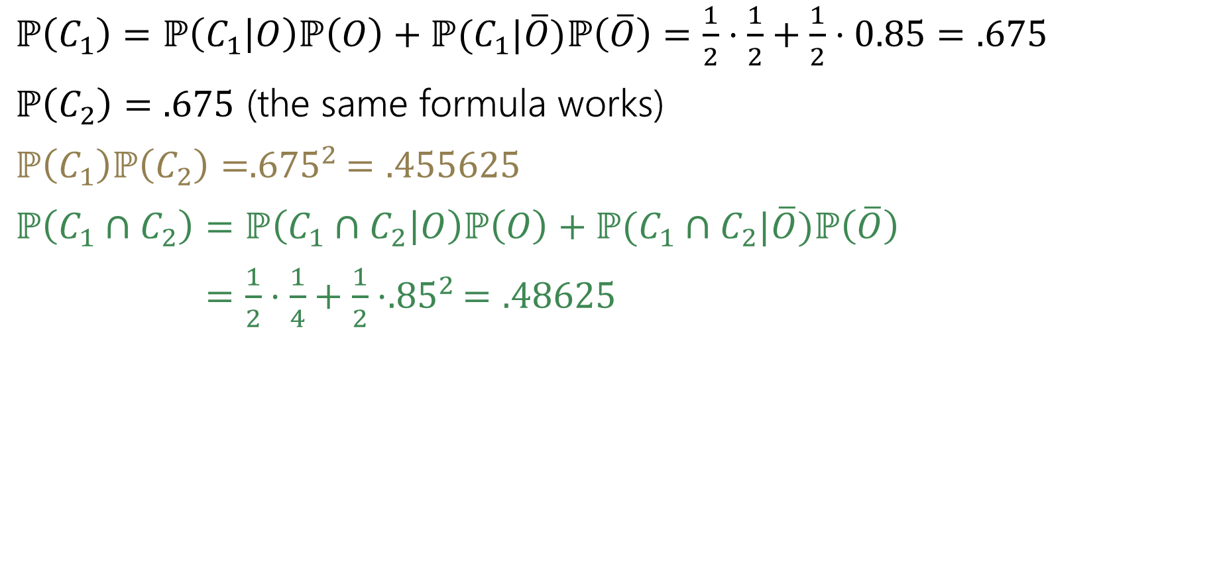
(Unconditioned) Independence check whether $ℙ\left(C_{1}∩C_{2}\right)=ℙ\left(C_{1}\right)ℙ\left(C_{2}\right)$
$ℙ\left(C_{1}\right)=ℙ\left(C_{1} | O\right)ℙ\left(O\right)+ℙ(C_{1}|\overline{O})ℙ\left(\overline{O}\right)=\frac{1}{2}⋅\frac{1}{2}+\frac{1}{2}⋅0.85=.675$
$ℙ\left(C_{2}\right)=.675$ (the same formula works)
$ℙ\left(C_{1}\right)ℙ\left(C_{2}\right)={.675}^{2}=.455625$
$ℙ\left(C_{1}∩C_{2}\right)=ℙ\left(C_{1}∩C_{2} | O\right)ℙ\left(O\right)+ℙ(C_{1}∩C_{2}|\overline{O})ℙ\left(\overline{O}\right)$
$=\frac{1}{2}⋅\frac{1}{4}+\frac{1}{2}⋅{.85}^{2}=.48625$
Coin $A$ is fair, coin $B$ is heads with probability $0.85$.
If the die is odd flip coin $A$ twice (independently); otherwise flip coin $B$ twice (independently)
$C_{1}$ ~“the first flip is heads”
$C_{2}$ ~ “the second flip is heads”
$O$ ~ “the die was odd”

Slide 52
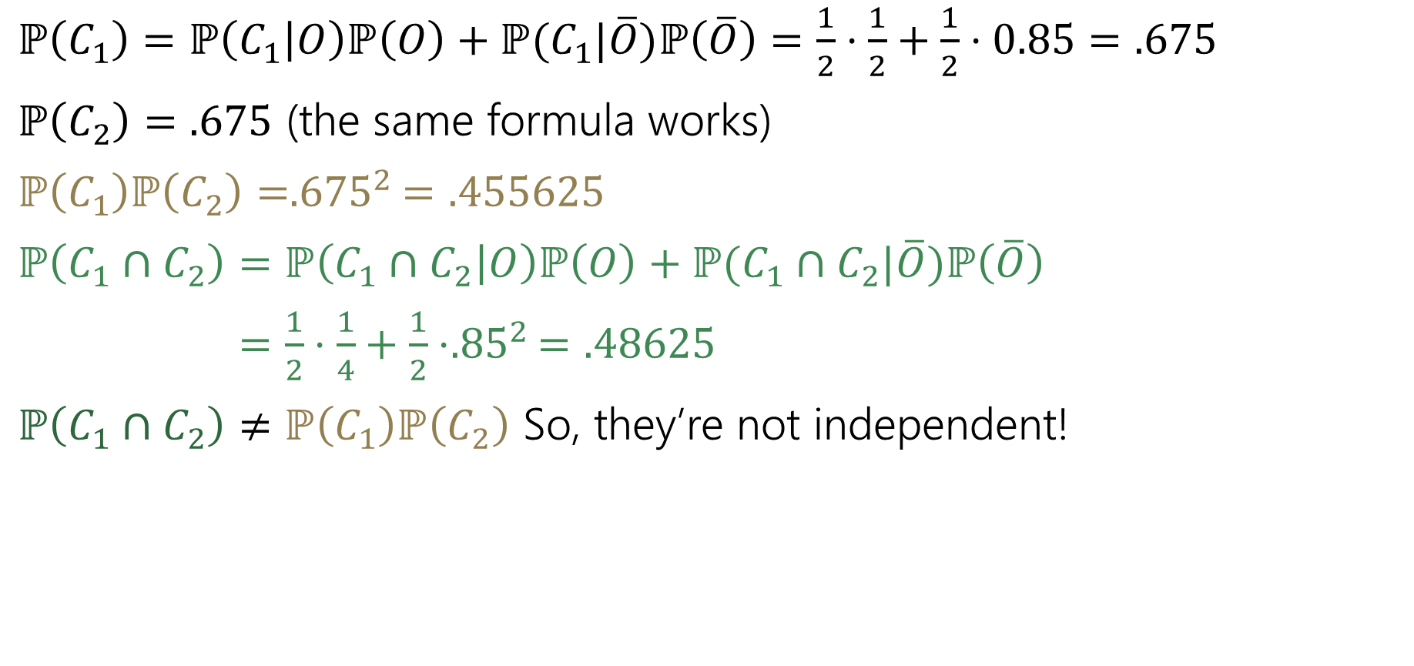
(Unconditioned) Independence check whether $ℙ\left(C_{1}∩C_{2}\right)=ℙ\left(C_{1}\right)ℙ\left(C_{2}\right)$
$ℙ\left(C_{1}\right)=ℙ\left(C_{1} | O\right)ℙ\left(O\right)+ℙ(C_{1}|\overline{O})ℙ\left(\overline{O}\right)=\frac{1}{2}⋅\frac{1}{2}+\frac{1}{2}⋅0.85=.675$
$ℙ\left(C_{2}\right)=.675$ (the same formula works)
$ℙ\left(C_{1}\right)ℙ\left(C_{2}\right)={.675}^{2}=.455625$
$ℙ\left(C_{1}∩C_{2}\right)=ℙ\left(C_{1}∩C_{2} | O\right)ℙ\left(O\right)+ℙ(C_{1}∩C_{2}|\overline{O})ℙ\left(\overline{O}\right)$
$=\frac{1}{2}⋅\frac{1}{4}+\frac{1}{2}⋅{.85}^{2}=.48625$
$ℙ\left(C_{1}∩C_{2}\right)≠ℙ\left(C_{1}\right)ℙ\left(C_{2}\right)$ So, they’re not independent!
Coin $A$ is fair, coin $B$ is heads with probability $0.85$.
If the die is odd flip coin $A$ twice (independently); otherwise flip coin $B$ twice (independently)
$C_{1}$ ~“the first flip is heads”
$C_{2}$ ~ “the second flip is heads”
$O$ ~ “the die was odd”

Slide 53
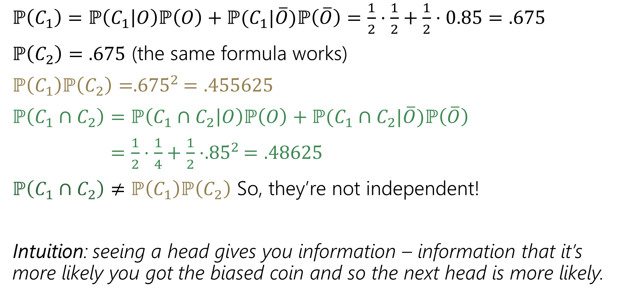
(Unconditioned) Independence check whether $ℙ\left(C_{1}∩C_{2}\right)=ℙ\left(C_{1}\right)ℙ\left(C_{2}\right)$
$ℙ\left(C_{1}\right)=ℙ\left(C_{1} | O\right)ℙ\left(O\right)+ℙ(C_{1}|\overline{O})ℙ\left(\overline{O}\right)=\frac{1}{2}⋅\frac{1}{2}+\frac{1}{2}⋅0.85=.675$
$ℙ\left(C_{2}\right)=.675$ (the same formula works)
$ℙ\left(C_{1}\right)ℙ\left(C_{2}\right)={.675}^{2}=.455625$
$ℙ\left(C_{1}∩C_{2}\right)=ℙ\left(C_{1}∩C_{2} | O\right)ℙ\left(O\right)+ℙ(C_{1}∩C_{2}|\overline{O})ℙ\left(\overline{O}\right)$
$=\frac{1}{2}⋅\frac{1}{4}+\frac{1}{2}⋅{.85}^{2}=.48625$
$ℙ\left(C_{1}∩C_{2}\right)≠ℙ\left(C_{1}\right)ℙ\left(C_{2}\right)$ So, they’re not independent!
Intuition: seeing a head gives you information – information that it’s more likely you got the biased coin and so the next head is more likely.
Coin $A$ is fair, coin $B$ is heads with probability $0.85$.
If the die is odd flip coin $A$ twice (independently); otherwise flip coin $B$ twice (independently)
$C_{1}$ ~“the first flip is heads”
$C_{2}$ ~ “the second flip is heads”
$O$ ~ “the die was odd”

Slide 54


Conditional Independence on $O$ check whether $ℙ\left(C_{1}∩C_{2}|O\right)=ℙ\left(C_{1}|O\right)ℙ\left(C_{2}|O\right)$
$ℙ\left(C_{1} | O\right)=1/2$
$ℙ\left(C_{2} | O\right)=1/2$
$ℙ\left(C_{1}|O\right)ℙ\left(C_{2}|O\right)$= $\frac{1}{2}⋅\frac{1}{2}=1/4$
Coin $A$ is fair, coin $B$ is heads with probability $0.85$.
If the die is odd flip coin $A$ twice (independently); otherwise flip coin $B$ twice (independently)
$C_{1}$ ~“the first flip is heads”
$C_{2}$ ~ “the second flip is heads”
$O$ ~ “the die was odd”

Slide 55

Conditional Independence on $O$ check whether $ℙ\left(C_{1}∩C_{2}|O\right)=ℙ\left(C_{1}|O\right)ℙ\left(C_{2}|O\right)$
$ℙ\left(C_{1} | O\right)=1/2$
$ℙ\left(C_{2} | O\right)=1/2$
$ℙ\left(C_{1}|O\right)ℙ\left(C_{2}|O\right)$= $\frac{1}{2}⋅\frac{1}{2}=1/4$
$ℙ\left(C_{1}∩C_{2} | O\right)=\frac{1}{4}$
  if the die is odd, there are 2 independent flips from A
Coin $A$ is fair, coin $B$ is heads with probability $0.85$.
If the die is odd flip coin $A$ twice (independently); otherwise flip coin $B$ twice (independently)
$C_{1}$ ~“the first flip is heads”
$C_{2}$ ~ “the second flip is heads”
$O$ ~ “the die was odd”

Slide 56

Conditional Independence on $O$ check whether $ℙ\left(C_{1}∩C_{2}|O\right)=ℙ\left(C_{1}|O\right)ℙ\left(C_{2}|O\right)$
$ℙ\left(C_{1} | O\right)=1/2$
$ℙ\left(C_{2} | O\right)=1/2$
$ℙ\left(C_{1}|O\right)ℙ\left(C_{2}|O\right)$= $\frac{1}{2}⋅\frac{1}{2}=1/4$
$ℙ\left(C_{1}∩C_{2} | O\right)=\frac{1}{4}$
  if the die is odd, there are 2 independent flips from A
$ℙ\left(C_{1} | O\right)ℙ\left(C_{2} | O\right)=ℙ(C_{1}∩C_{2}|O)$
Yes! $C_{1}$ and $C_{2}$ are conditionally independent, conditioned on $O$.
  once we know which coin is being flipped, there are 2 independent flips
Coin $A$ is fair, coin $B$ is heads with probability $0.85$.
If the die is odd flip coin $A$ twice (independently); otherwise flip coin $B$ twice (independently)
$C_{1}$ ~“the first flip is heads”
$C_{2}$ ~ “the second flip is heads”
$O$ ~ “the die was odd”

Slide 57










Takeaway
from the example we just did
Read the problem carefully!
> When we say “these steps are independent of each other” in a sequential process, we usually mean “conditioned on all prior steps, these steps are conditionally independent of each other.”
> Without this conditioning, the steps are often dependent because they can provide information about the chosen path.
$$0.5$$
$$0.5$$
Odd
Even
Coin A
Coin B
$$0.5$$
$$0.5$$
$$0.85$$
$$0.15$$
H
T
H
T
$$0.5$$
$$0.5$$
$$0.85$$
$$0.15$$
H
T
H
T

Slide 58
Chain Rule
How to compute $ℙ\left(A_{1}∩A_{2}∩…∩A_{n}\right)$ if there aren’t mutually independent?

Slide 59

Chain Rule
We defined conditional probability as: $ℙ\left(A_{1} | A_{2}\right)=\frac{ℙ\left(A_{1}∩A_{2}\right)}{ℙ\left(A_{2}\right)}$
Which means $ℙ\left(A_{1}∩A_{2}\right)=ℙ\left(A_{1} | A_{2}\right)ℙ\left(A_{2}\right)$
So, $ℙ\left(A_{1}∩A_{2}∩A_{3}\right)=ℙ\left(A_{1}∩A_{2}\right)ℙ\left(A_{3} | A_{1}∩A_{2}\right)$
$=ℙ(A_{1})ℙ(A_{2}|A_{1})ℙ\left(A_{3} | A_{1}∩A_{2}\right)$
extending this for $n$ events….

Slide 60



Chain Rule
We defined conditional probability as: $ℙ\left(A | B\right)=\frac{ℙ\left(A∩B\right)}{ℙ\left(B\right)}$
Which means $ℙ\left(A∩B\right)=ℙ(A|B)ℙ(B)$
Chain Rule
$$ℙ\left(A_{1}∩A_{2}∩…∩A_{n}\right)=ℙ\left(A_{1}\right)⋅ℙ\dot{\left(A_{2} | A_{1}\right)}…ℙ\left(A_{n−1} | A_{1}∩…∩A_{n−2}\right)⋅ℙ\left(A_{n} | A_{1}∩…∩A_{n−1}\right)$$
We have $n$ steps/tasks, and want the probability they all occur
> multiply the probability of each step, conditioning on all previous steps

Slide 61

Chain Rule Example
Shuffle a standard deck of 52 cards (so every ordering is equally likely).
  Let $A$ be the event “The top card is a K♦”
  Let $B$ be the event “the second card is a J ♠️
  Let $C$ be the event “the third card is a 5 ♠️
  What is $ℙ(A∩B∩C)$?
  Use the chain rule!
  $ℙ\left(A\right)⋅ℙ\left(B | A\right)⋅ℙ(C|A∩B)$
  $\frac{1}{52}⋅\frac{1}{51}⋅\frac{1}{50}$

Slide 62



















A Visual for the Chain Rule (and LoTP!)
$$Ω$$
$$ℙ\left(A\right)$$
$$ℙ(B)$$
$$A$$
$$B$$
$$…$$
$$ℙ(H|A)$$
$$ℙ(H|B)$$
$$ℙ(J|A)$$
$$ℙ(J|B)$$
$$A∩H$$
$$A∩J$$
…
$$B∩H$$
$$B∩J$$
$$…$$
$$ℙ(X|A∩H)$$
$$ℙ(Y|A∩H)$$
$$A∩H∩X$$
$$A∩H∩Y$$
…

Slide 63




A Visual for the Chain Rule (and LoTP!)
$$Ω$$
$$ℙ\left(A\right)$$
$$ℙ(B)$$
$$A$$
$$B$$
$$…$$
$$ℙ(H|A)$$
$$ℙ(H|B)$$
$$ℙ(J|A)$$
$$ℙ(J|B)$$
$$A∩H$$
$$A∩J$$
…
$$B∩H$$
$$B∩J$$
$$…$$
$$ℙ(X|A∩H)$$
$$ℙ(Y|A∩H)$$
$$A∩H∩X$$
$$A∩H∩Y$$
…
Chain Rule: The probability of one of the “nodes” (e.g.,$ℙ(A∩H)$) is the product of the probabilities of each of the steps that led to it:
$$ℙ\left(A∩H\right)= ℙ\left(A\right)ℙ\left(H | A\right)$$

Slide 64



A Visual for the Chain Rule (and LoTP!)
$$Ω$$
$$ℙ\left(A\right)$$
$$ℙ(B)$$
$$A$$
$$B$$
$$…$$
$$ℙ(H|A)$$
$$ℙ(H|B)$$
$$ℙ(J|A)$$
$$ℙ(J|B)$$
$$A∩H$$
$$A∩J$$
…
$$B∩H$$
$$B∩J$$
$$…$$
$$ℙ(X|A∩H)$$
$$ℙ(Y|A∩H)$$
$$A∩H∩X$$
$$A∩H∩Y$$
…
Chain Rule: The probability of one of the “nodes” (e.g.,$ℙ(A∩H∩X)$) is the product of the probabilities of each of the steps that led to it:
$$ℙ\left(A∩H∩X\right)=ℙ\left(A∩H\right)ℙ\left(X | A∩H\right)= ℙ\left(A\right)ℙ\left(H | A\right)ℙ(X|A∩H)$$

Slide 65













A Visual for the Chain Rule (and LoTP!)
$$Ω$$
$$ℙ\left(A\right)$$
$$ℙ(B)$$
$$…$$
$$A$$
$$B$$
$$ℙ(H|A)$$
$$ℙ(H|B)$$
$$ℙ(J|A)$$
$$ℙ(J|B)$$
$$A∩H$$
$$A∩J$$
…
$$B∩H$$
$$B∩J$$
$$…$$
$$ℙ(X|A∩H)$$
$$ℙ(X|B∩J)$$
$$ℙ(Y|A∩H)$$
$$ℙ(Y|B∩J)$$
$$A∩H∩X$$
$$A∩H∩Y$$
…
$$B∩J∩X$$
$$B∩J∩Y$$
…
Law of Total Probability: Sum up probabilities of intersection with other events
$$ℙ\left(H\right)=ℙ\left(A∩H\right)+ℙ\left(B∩H\right)+…=ℙ\left(A\right)ℙ\left(H | A\right)+ℙ(B)ℙ(H|B)$$

Slide 66

A Visual for the Chain Rule (and LoTP!)
$$Ω$$
$$ℙ\left(A\right)$$
$$ℙ(B)$$
$$…$$
$$A$$
$$B$$
$$ℙ(H|A)$$
$$ℙ(H|B)$$
$$ℙ(J|A)$$
$$ℙ(J|B)$$
$$A∩H$$
$$A∩J$$
…
$$B∩H$$
$$B∩J$$
$$…$$
$$ℙ(X|A∩H)$$
$$ℙ(X|B∩J)$$
$$ℙ(Y|A∩H)$$
$$ℙ(Y|B∩J)$$
$$A∩H∩X$$
$$A∩H∩Y$$
…
$$B∩J∩X$$
$$B∩J∩Y$$
…
⚠️on homeworks, you can use these kinds of visuals to help with reasoning, but make sure to still explicitly show applications of chain rule, LoTP, etc.) ⚠️

Slide 67
Summary
Today, we talked about
> Independence
  independence between 2 events, pairwise and mutual independence for >2 events, events being conditionally independent on a third event
> Chain Rule
  probability of an intersection of events/set of tasks or steps that aren’t mutually independent
On Wednesday, we are doing a breather/catch-up lecture! We will:
> Review what has been covered so far
> Talk about how to parse long problems, mentally process all the pieces
> Answer questions/talk about what you all want to!
So, bring questions! Questions don’t have to be specific, even just asking to go over a piece of content again is perfectly valid.

Slide 68
More Practice

