Slide 1
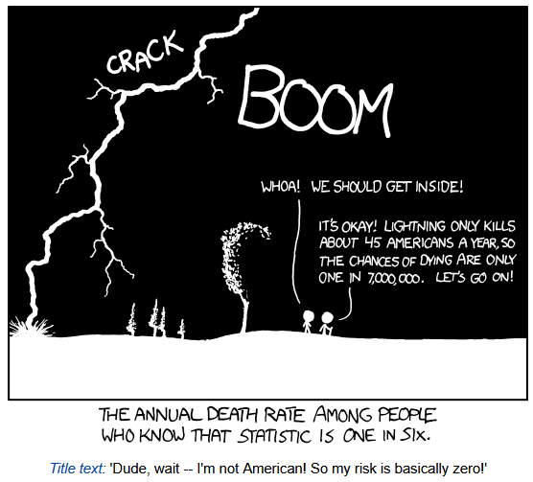
Conditional Probability
CSE 312 23Su
Lecture 5
https://xkcd.com/795/

Slide 2
Announcements
HW1 is due tonight (11:59pm)
HW2 will be released later today

Slide 3
Where Are We?
Last time:
  Probability
  Sample Space and Events
  Probability Axioms
  Uniform Probability Space
  More Examples
  Birthday Paradox
Today:
  Conditional Probability
  Bayes Theorem
  Law of Total Probability

Slide 4
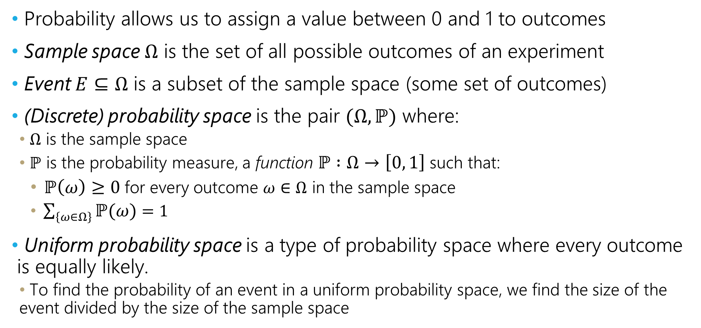
Recap
Probability allows us to assign a value between 0 and 1 to outcomes
Sample space $Ω$ is the set of all possible outcomes of an experiment
Event $E⊆Ω$ is a subset of the sample space (some set of outcomes)
(Discrete) probability space is the pair $(Ω,ℙ)$ where:
  $Ω$ is the sample space
  $ℙ$ is the probability measure, a function $ℙ :Ω→\left[0, 1\right]$ such that:
    $ℙ\left(ω\right)≥0$ for every outcome $ω∈Ω$ in the sample space
    $\sum_{\left\{ω∈Ω\right\}}{ℙ(ω)}=1$
Uniform probability space is a type of probability space where every outcome is equally likely.
  To find the probability of an event in a uniform probability space, we find the size of the event divided by the size of the sample space

Slide 5
Conditional Probabilities

Slide 6
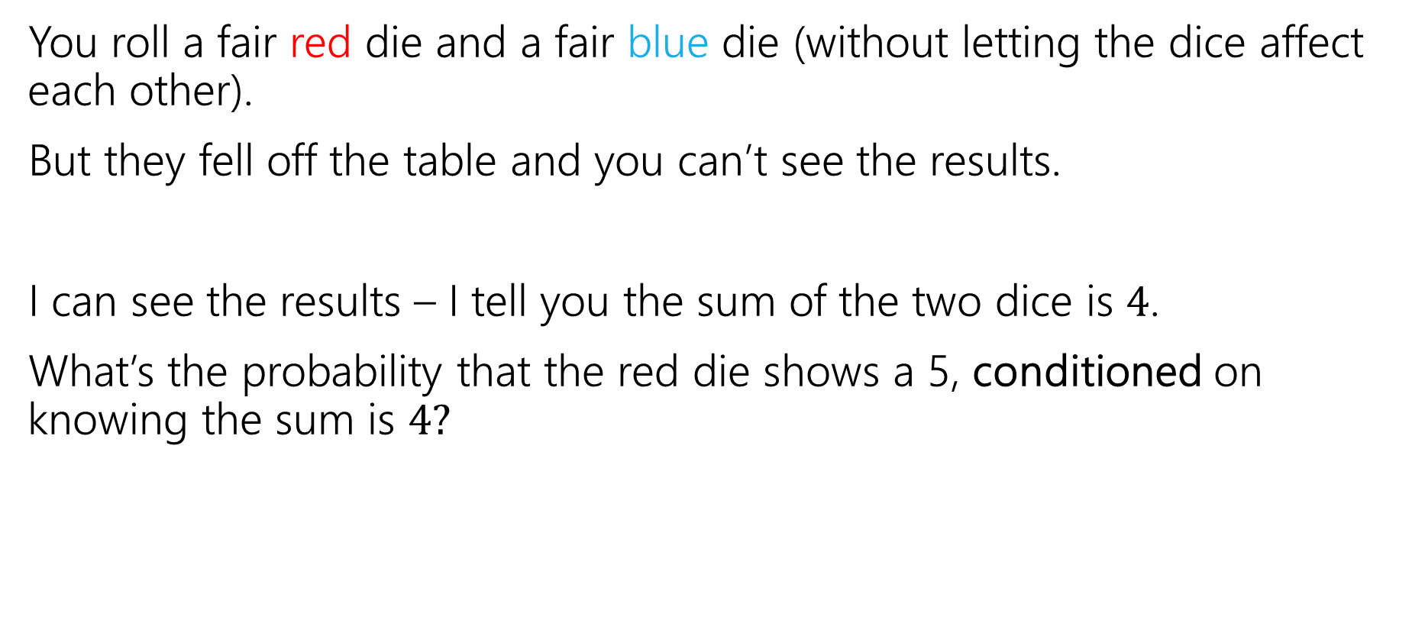
Conditioning
You roll a fair red die and a fair blue die (without letting the dice affect each other).
But they fell off the table and you can’t see the results.
I can see the results – I tell you the sum of the two dice is $4$.
What’s the probability that the red die shows a 5, conditioned on knowing the sum is $4?$

Slide 7
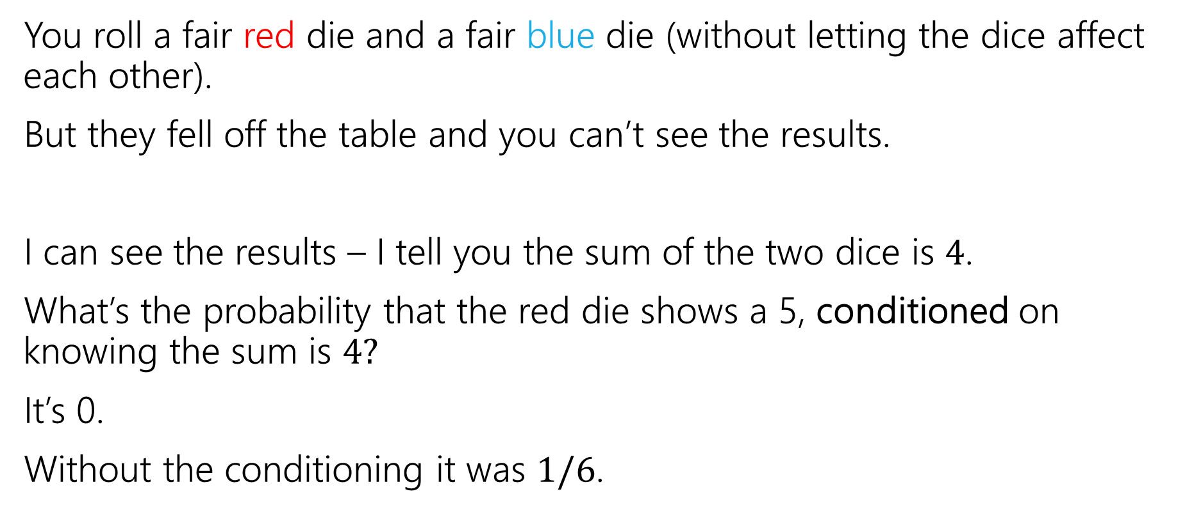
Conditioning
You roll a fair red die and a fair blue die (without letting the dice affect each other).
But they fell off the table and you can’t see the results.
I can see the results – I tell you the sum of the two dice is $4$.
What’s the probability that the red die shows a 5, conditioned on knowing the sum is $4?$
It’s 0.
Without the conditioning it was $1/6$.

Slide 8
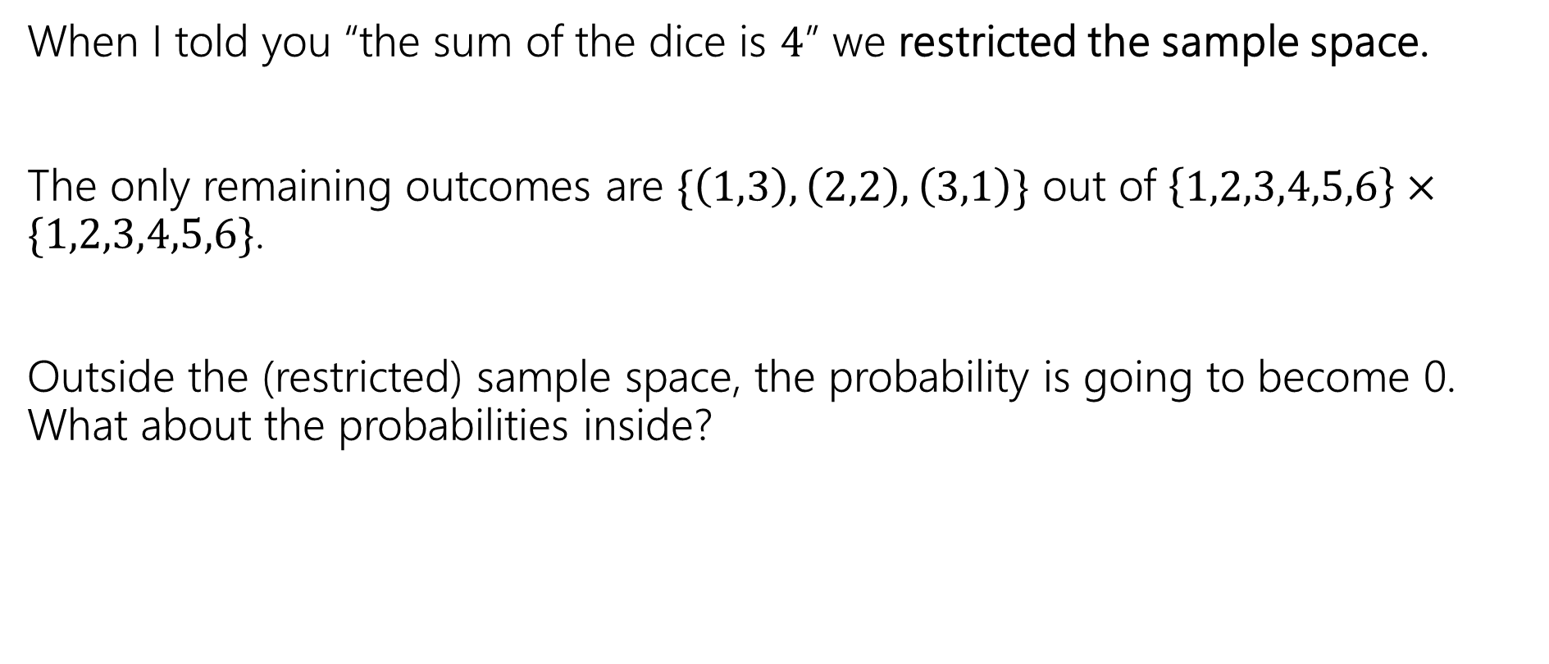
Conditioning
When I told you “the sum of the dice is $4$” we restricted the sample space.
The only remaining outcomes are $\{\left(1,3\right), \left(2,2\right), \left(3,1\right)\}$ out of $\left\{1,2,3,4,5,6\right\}×\{1,2,3,4,5,6\}$.
Outside the (restricted) sample space, the probability is going to become 0. What about the probabilities inside?

Slide 9
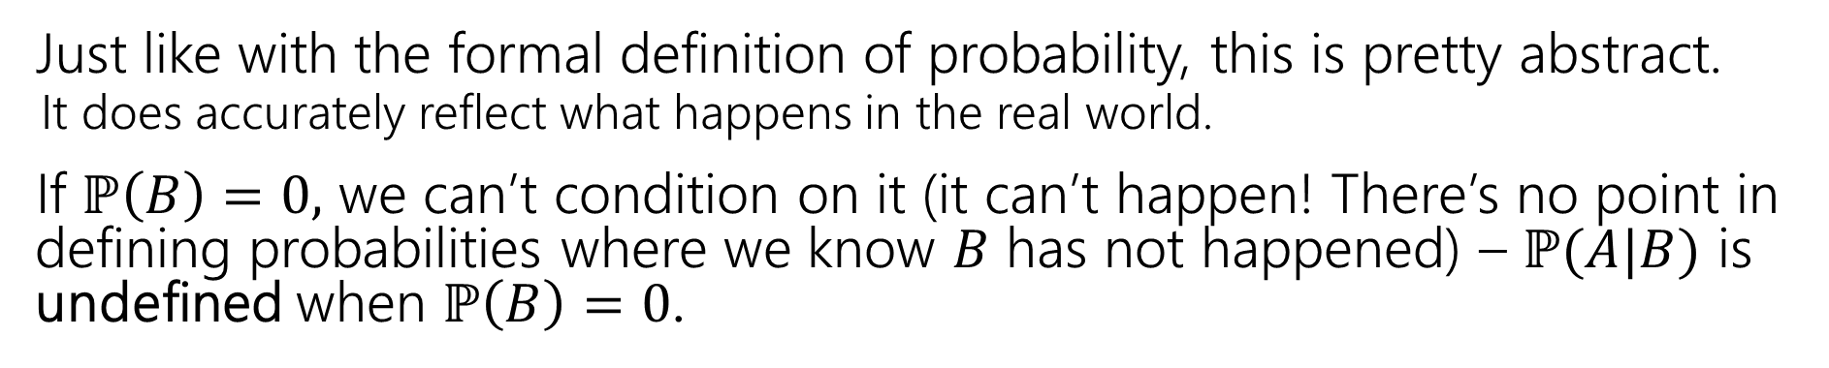

Conditional Probability
For an event $B$, with $ℙ\left(B\right)>0,$
$t$he “probability of $A$ conditioned on $B$” is
$$ℙ\left(A | B\right)=\frac{ℙ\left(A∩B\right)}{ℙ\left(B\right)}$$
Conditional Probability
Just like with the formal definition of probability, this is pretty abstract.
  It does accurately reflect what happens in the real world.
If $ℙ\left(B\right)=0,$ we can’t condition on it (it can’t happen! There’s no point in defining probabilities where we know $B$ has not happened) – $ℙ(A|B)$ is undefined when $ℙ\left(B\right)=0$.

Slide 10
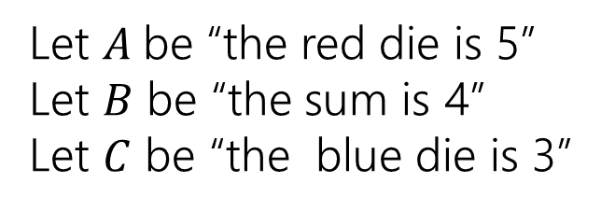
Conditioning…
 | D2=1 | D2=2 | D2=3 | D2=4 | D2=5 | D2=6
D1=1 | (1,1) | (1,2) | (1,3) | (1,4) | (1,5) | (1.6)
D1=2 | (2,1) | (2,2) | (2,3) | (2,4) | (2,5) | (2,6)
D1=3 | (3,1) | (3,2) | (3,3) | (3,4) | (3,5) | (3,6)
D1=4 | (4,1) | (4,2) | (4,3) | (4,4) | (4,5) | (4,6)
D1=5 | (5,1) | (5,2) | (5,3) | (5,4) | (5,5) | (5,6)
D1=6 | (6,1) | (6,2) | (6,3) | (6,4) | (6,5) | (6,6)
Let $A$be “the red die is 5”
Let $B$ be “the sum is 4”
Let $C$ be “the blue die is 3”

Slide 11
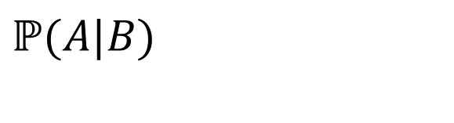
Conditioning…
 | D2=1 | D2=2 | D2=3 | D2=4 | D2=5 | D2=6
D1=1 | (1,1) | (1,2) | (1,3) | (1,4) | (1,5) | (1.6)
D1=2 | (2,1) | (2,2) | (2,3) | (2,4) | (2,5) | (2,6)
D1=3 | (3,1) | (3,2) | (3,3) | (3,4) | (3,5) | (3,6)
D1=4 | (4,1) | (4,2) | (4,3) | (4,4) | (4,5) | (4,6)
D1=5 | (5,1) | (5,2) | (5,3) | (5,4) | (5,5) | (5,6)
D1=6 | (6,1) | (6,2) | (6,3) | (6,4) | (6,5) | (6,6)
Let $A$be “the red die is 5”
Let $B$ be “the sum is 4”
Let $C$ be “the blue die is 3”
$$ℙ(A|B)$$

Slide 12
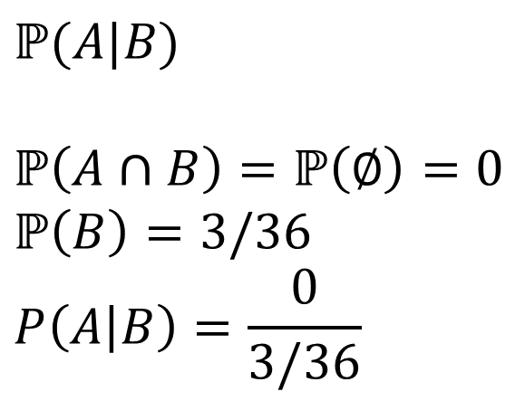
Conditioning…
 | D2=1 | D2=2 | D2=3 | D2=4 | D2=5 | D2=6
D1=1 | (1,1) | (1,2) | (1,3) | (1,4) | (1,5) | (1.6)
D1=2 | (2,1) | (2,2) | (2,3) | (2,4) | (2,5) | (2,6)
D1=3 | (3,1) | (3,2) | (3,3) | (3,4) | (3,5) | (3,6)
D1=4 | (4,1) | (4,2) | (4,3) | (4,4) | (4,5) | (4,6)
D1=5 | (5,1) | (5,2) | (5,3) | (5,4) | (5,5) | (5,6)
D1=6 | (6,1) | (6,2) | (6,3) | (6,4) | (6,5) | (6,6)
Let $A$be “the red die is 5”
Let $B$ be “the sum is 4”
Let $C$ be “the blue die is 3”
$$ℙ(A|B)$$
$$ℙ\left(A∩B\right)=ℙ\left(∅\right)=0$$
$$ℙ\left(B\right)=3/36$$
$$P\left(A | B\right)=\frac{0}{3/36}$$

Slide 13
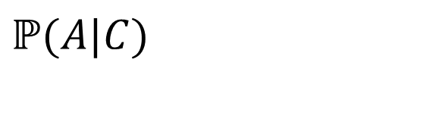
Conditioning…
 | D2=1 | D2=2 | D2=3 | D2=4 | D2=5 | D2=6
D1=1 | (1,1) | (1,2) | (1,3) | (1,4) | (1,5) | (1.6)
D1=2 | (2,1) | (2,2) | (2,3) | (2,4) | (2,5) | (2,6)
D1=3 | (3,1) | (3,2) | (3,3) | (3,4) | (3,5) | (3,6)
D1=4 | (4,1) | (4,2) | (4,3) | (4,4) | (4,5) | (4,6)
D1=5 | (5,1) | (5,2) | (5,3) | (5,4) | (5,5) | (5,6)
D1=6 | (6,1) | (6,2) | (6,3) | (6,4) | (6,5) | (6,6)
Let $A$be “the red die is 5”
Let $B$ be “the sum is 4”
Let $C$ be “the blue die is 3”
$$ℙ(A|C)$$

Slide 14
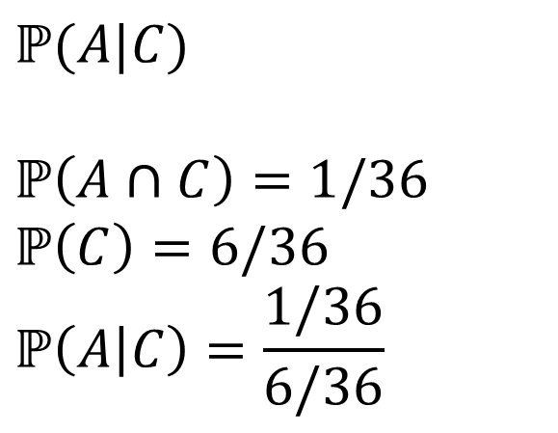
Conditioning…
 | D2=1 | D2=2 | D2=3 | D2=4 | D2=5 | D2=6
D1=1 | (1,1) | (1,2) | (1,3) | (1,4) | (1,5) | (1.6)
D1=2 | (2,1) | (2,2) | (2,3) | (2,4) | (2,5) | (2,6)
D1=3 | (3,1) | (3,2) | (3,3) | (3,4) | (3,5) | (3,6)
D1=4 | (4,1) | (4,2) | (4,3) | (4,4) | (4,5) | (4,6)
D1=5 | (5,1) | (5,2) | (5,3) | (5,4) | (5,5) | (5,6)
D1=6 | (6,1) | (6,2) | (6,3) | (6,4) | (6,5) | (6,6)
Let $A$be “the red die is 5”
Let $B$ be “the sum is 4”
Let $C$ be “the blue die is 3”
$$ℙ(A|C)$$
$$ℙ\left(A∩C\right)=1/36$$
$$ℙ\left(C\right)=6/36$$
$$ℙ\left(A | C\right)=\frac{1/36}{6/36}$$

Slide 15
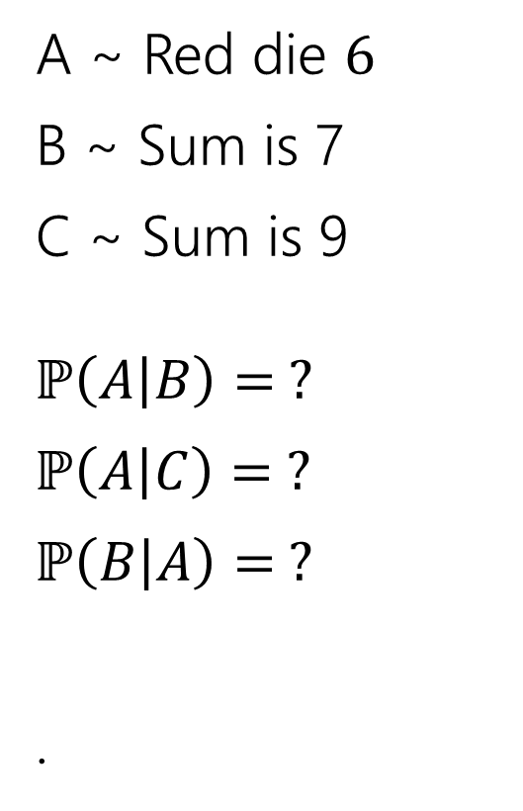
Conditioning Practice
A ~ Red die $6$
B ~ Sum is 7
C ~ Sum is 9
$ℙ\left(A | B\right)= ?$
$ℙ\left(A | C\right)= ?$
$ℙ\left(B | A\right)= ?$
.
 | D2=1 | D2=2 | D2=3 | D2=4 | D2=5 | D2=6
D1=1 | (1,1) | (1,2) | (1,3) | (1,4) | (1,5) | (1.6)
D1=2 | (2,1) | (2,2) | (2,3) | (2,4) | (2,5) | (2,6)
D1=3 | (3,1) | (3,2) | (3,3) | (3,4) | (3,5) | (3,6)
D1=4 | (4,1) | (4,2) | (4,3) | (4,4) | (4,5) | (4,6)
D1=5 | (5,1) | (5,2) | (5,3) | (5,4) | (5,5) | (5,6)
D1=6 | (6,1) | (6,2) | (6,3) | (6,4) | (6,5) | (6,6)
Work on this with the people around you! PollEv.com/jolie312

Slide 16
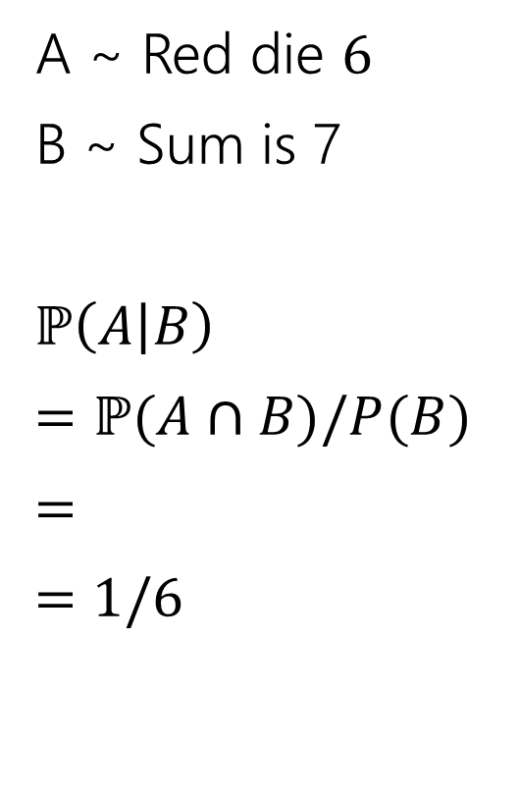
Conditioning Practice
A ~ Red die $6$
B ~ Sum is 7
$ℙ\left(A | B\right)$
$=ℙ(A∩B)/P(B)$
$=$
$=$ $1/6$
 | D2=1 | D2=2 | D2=3 | D2=4 | D2=5 | D2=6
D1=1 | (1,1) | (1,2) | (1,3) | (1,4) | (1,5) | (1.6)
D1=2 | (2,1) | (2,2) | (2,3) | (2,4) | (2,5) | (2,6)
D1=3 | (3,1) | (3,2) | (3,3) | (3,4) | (3,5) | (3,6)
D1=4 | (4,1) | (4,2) | (4,3) | (4,4) | (4,5) | (4,6)
D1=5 | (5,1) | (5,2) | (5,3) | (5,4) | (5,5) | (5,6)
D1=6 | (6,1) | (6,2) | (6,3) | (6,4) | (6,5) | (6,6)

Slide 17
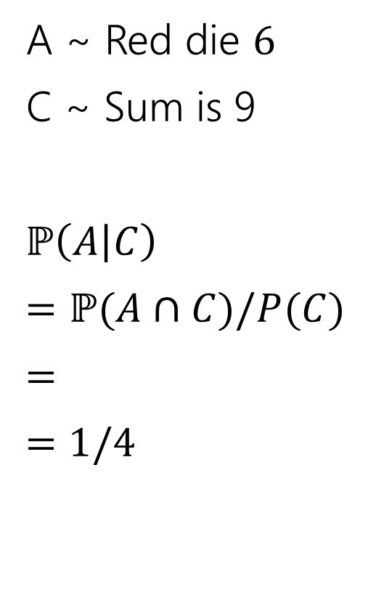
Conditioning Practice
A ~ Red die $6$
C ~ Sum is 9
$ℙ\left(A | C\right)$
$=ℙ(A∩C)/P(C)$
$=$
$=$ $1/4$
 | D2=1 | D2=2 | D2=3 | D2=4 | D2=5 | D2=6
D1=1 | (1,1) | (1,2) | (1,3) | (1,4) | (1,5) | (1.6)
D1=2 | (2,1) | (2,2) | (2,3) | (2,4) | (2,5) | (2,6)
D1=3 | (3,1) | (3,2) | (3,3) | (3,4) | (3,5) | (3,6)
D1=4 | (4,1) | (4,2) | (4,3) | (4,4) | (4,5) | (4,6)
D1=5 | (5,1) | (5,2) | (5,3) | (5,4) | (5,5) | (5,6)
D1=6 | (6,1) | (6,2) | (6,3) | (6,4) | (6,5) | (6,6)

Slide 18
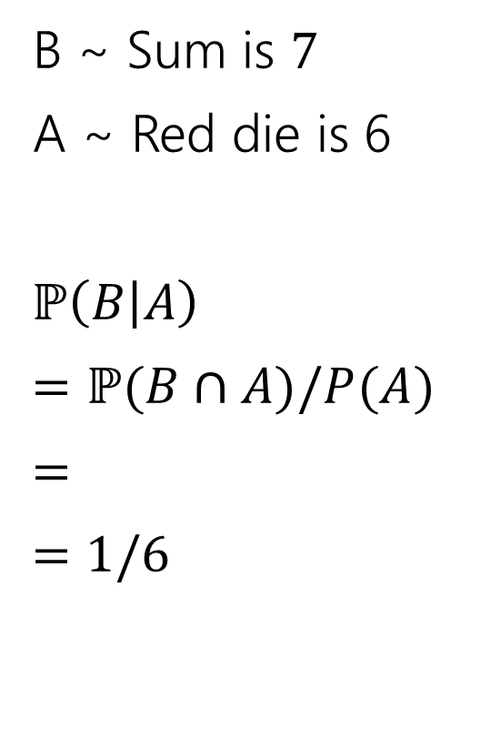
Conditioning Practice
B ~ Sum is $7$
A ~ Red die is 6
$ℙ\left(B | A\right)$
$=ℙ(B∩A)/P(A)$
$=$
$=$ $1/6$
 | D2=1 | D2=2 | D2=3 | D2=4 | D2=5 | D2=6
D1=1 | (1,1) | (1,2) | (1,3) | (1,4) | (1,5) | (1.6)
D1=2 | (2,1) | (2,2) | (2,3) | (2,4) | (2,5) | (2,6)
D1=3 | (3,1) | (3,2) | (3,3) | (3,4) | (3,5) | (3,6)
D1=4 | (4,1) | (4,2) | (4,3) | (4,4) | (4,5) | (4,6)
D1=5 | (5,1) | (5,2) | (5,3) | (5,4) | (5,5) | (5,6)
D1=6 | (6,1) | (6,2) | (6,3) | (6,4) | (6,5) | (6,6)

Slide 19
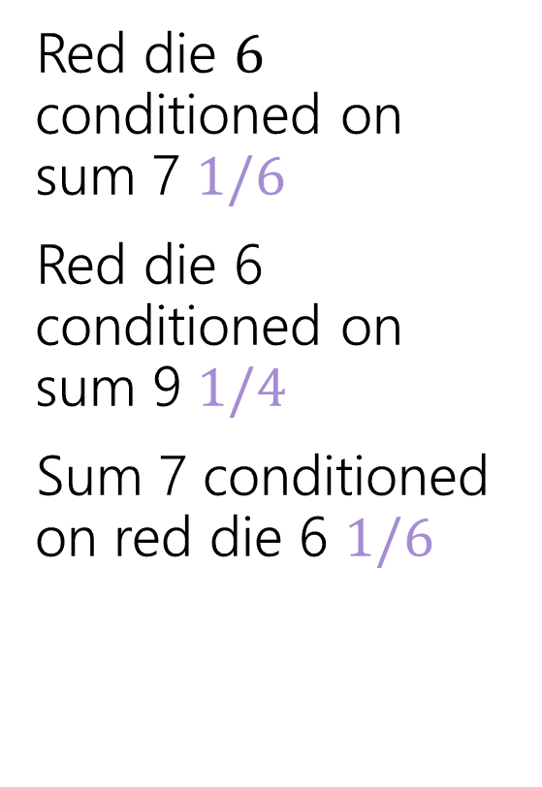
Conditioning Practice
Red die $6$ conditioned on sum 7 $1/6$
Red die 6 conditioned on sum 9 $1/4$
Sum 7 conditioned on red die 6 $1/6$
 | D2=1 | D2=2 | D2=3 | D2=4 | D2=5 | D2=6
D1=1 | (1,1) | (1,2) | (1,3) | (1,4) | (1,5) | (1.6)
D1=2 | (2,1) | (2,2) | (2,3) | (2,4) | (2,5) | (2,6)
D1=3 | (3,1) | (3,2) | (3,3) | (3,4) | (3,5) | (3,6)
D1=4 | (4,1) | (4,2) | (4,3) | (4,4) | (4,5) | (4,6)
D1=5 | (5,1) | (5,2) | (5,3) | (5,4) | (5,5) | (5,6)
D1=6 | (6,1) | (6,2) | (6,3) | (6,4) | (6,5) | (6,6)

Slide 20

Direction Matters?
Are $ℙ(A|B)$ and $ℙ(B|A)$ the same?

Slide 21
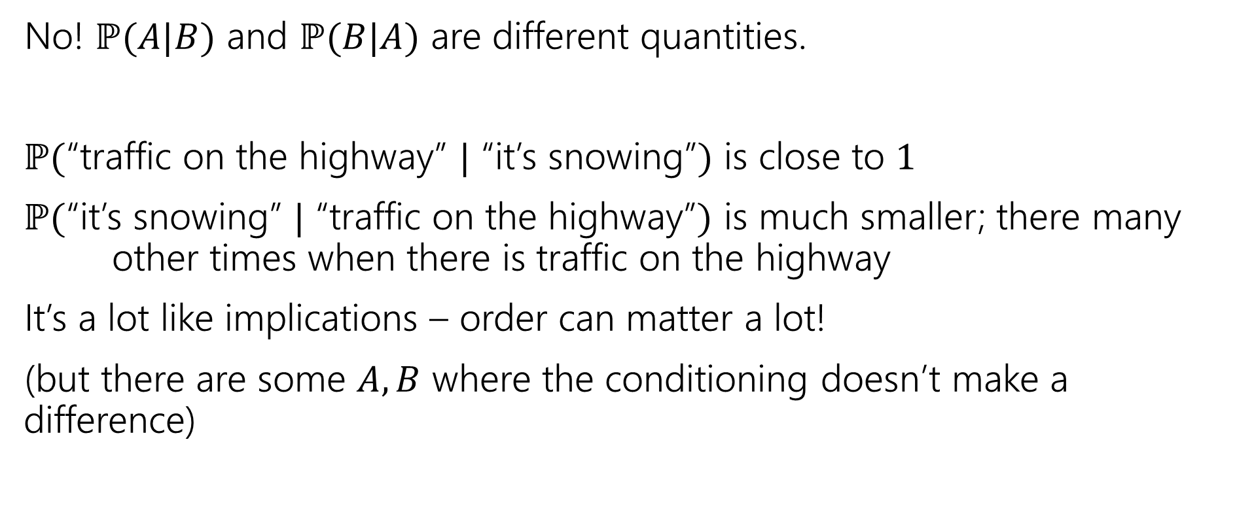
Direction Matters
No! $ℙ(A|B)$ and $ℙ(B|A)$ are different quantities.
$ℙ($“traffic on the highway” $|$ “it’s snowing”$)$ is close to $1$
$ℙ($“it’s snowing” $|$ “traffic on the highway”$)$ is much smaller; there many other times when there is traffic on the highway
It’s a lot like implications – order can matter a lot!
(but there are some $A,B$ where the conditioning doesn’t make a difference)

Slide 22
Wonka Bars🍫
Example working with conditional probabilities

Slide 23
Wonka Bars
Willy Wonka has placed golden tickets on 0.1% of his Wonka Bars.
You want to get a golden ticket. You could buy a 1000-or-so of the bars until you find one, but that’s expensive…you’ve got a better idea!
You have a test – a very precise scale you’ve bought.
  If the bar you weigh does have a golden ticket, the scale will alert you 99.9% of the time.
  If the bar you weigh does not have a golden ticket, the scale will (falsely) alert you only 1% of the time.
If you pick up a bar and it alerts, what is the probability you have a golden ticket?

Slide 24
Willy Wonka
  Willy Wonka has placed golden tickets on 0.1% of his Wonka Bars.
  If the bar you weigh does have a golden ticket, the scale will alert you 99.9% of the time.
  If the bar you weigh does not have a golden ticket, the scale will (falsely) alert you only 1% of the time.
If you pick up a bar and it alerts, what is the probability you have a golden ticket?
Which do you think is closest to the right answer?
0.1%
10%
50%
99%
99.9%
PollEv.com/jolie312

Slide 25
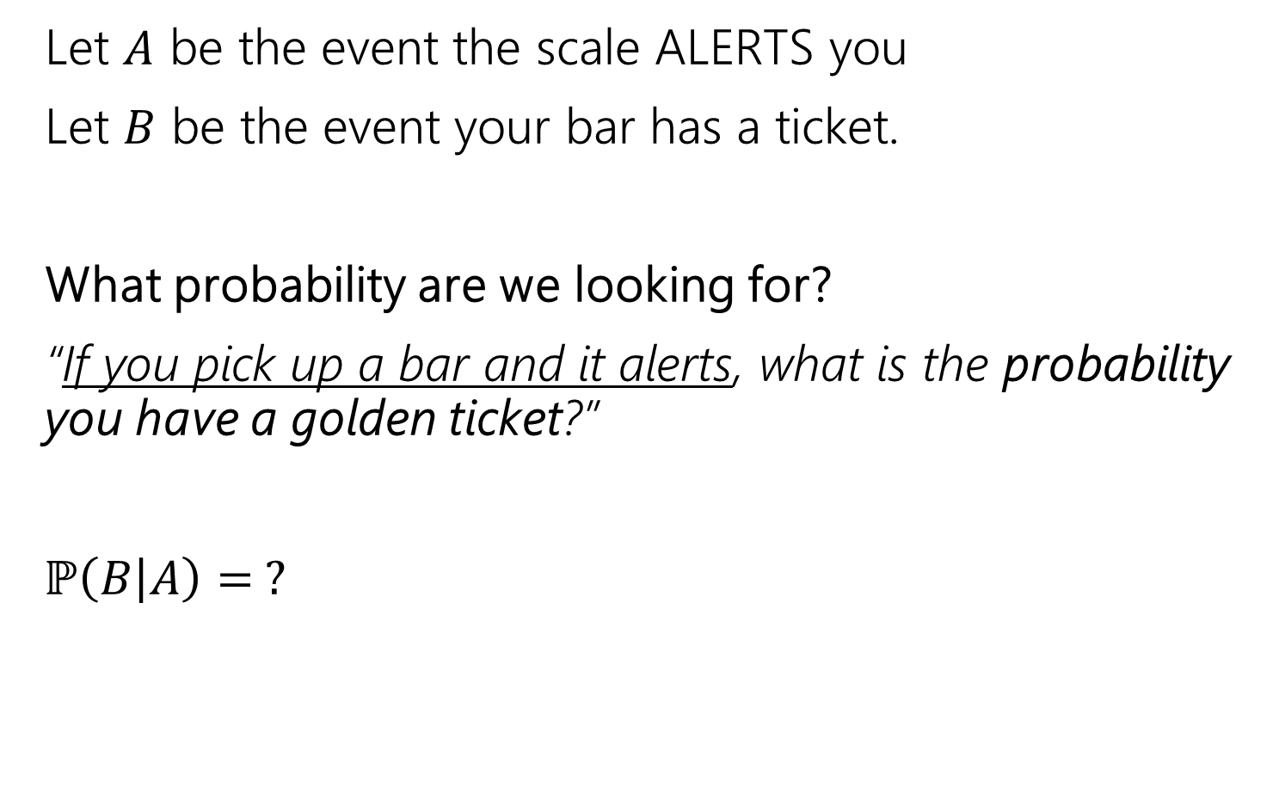
Conditioning
Let $A$ be the event the scale ALERTS you
Let $B$ be the event your bar has a ticket.
What probability are we looking for?
“If you pick up a bar and it alerts, what is the probability you have a golden ticket?”
$ℙ\left(B | A\right)= ?$

Slide 26
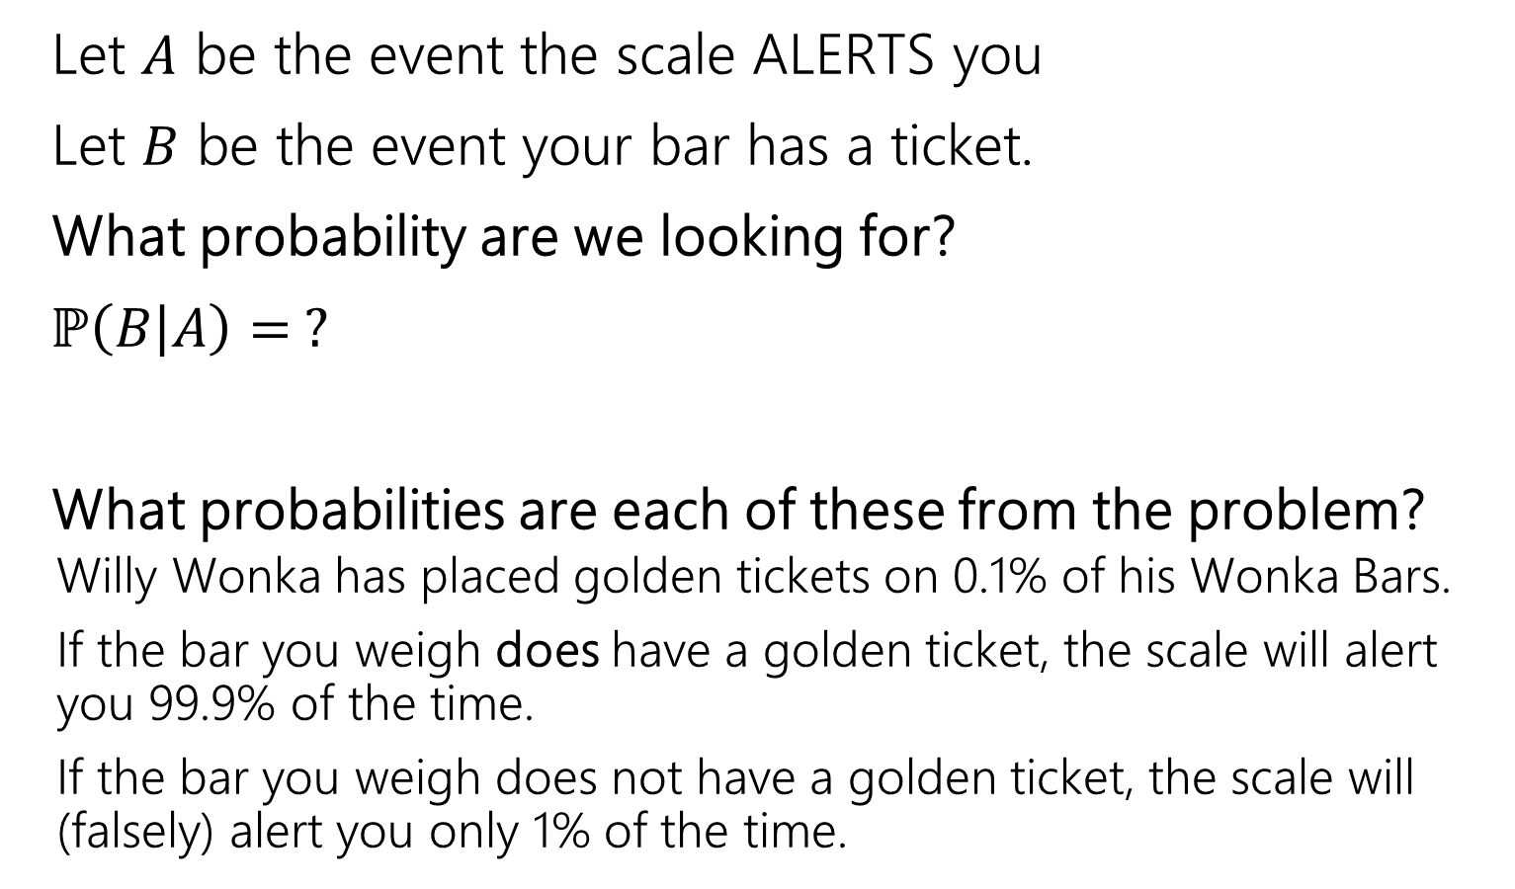
Conditioning
Let $A$ be the event the scale ALERTS you
Let $B$ be the event your bar has a ticket.
What probability are we looking for?
$ℙ\left(B | A\right)= ?$
What probabilities are each of these from the problem?
  Willy Wonka has placed golden tickets on 0.1% of his Wonka Bars.
  If the bar you weigh does have a golden ticket, the scale will alert you 99.9% of the time.
  If the bar you weigh does not have a golden ticket, the scale will (falsely) alert you only 1% of the time.

Slide 27
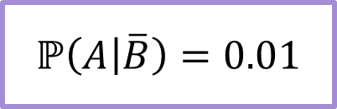
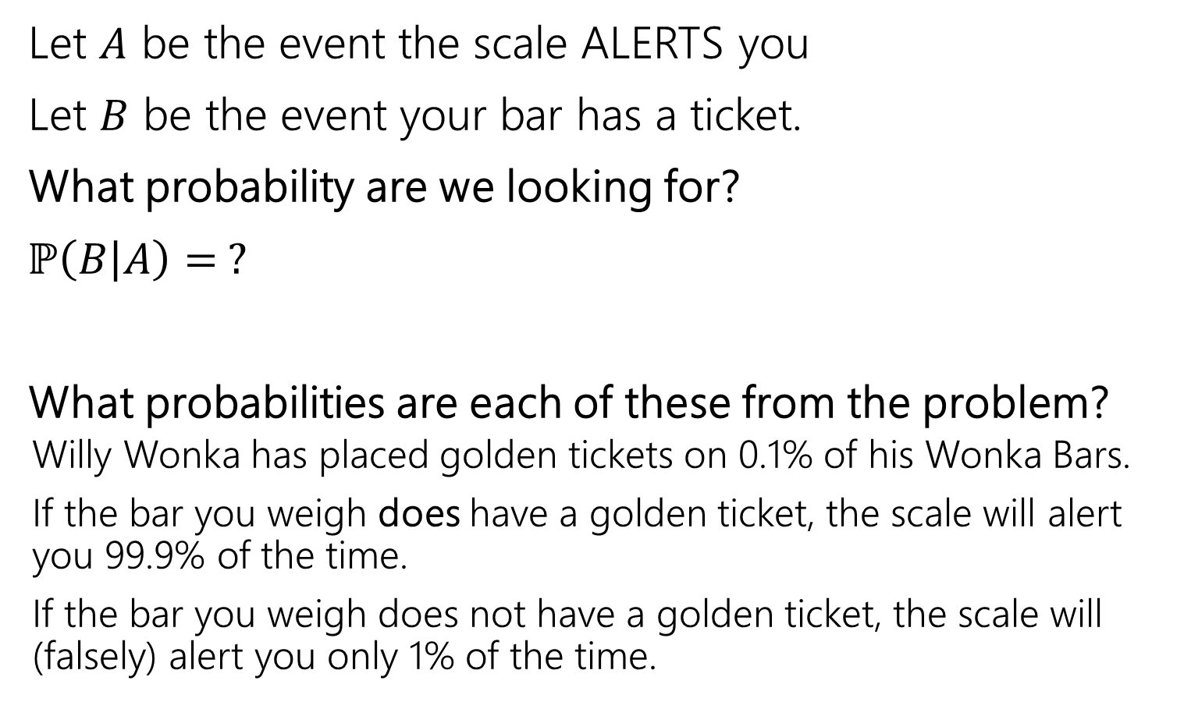

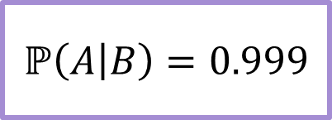
Conditioning
Let $A$ be the event the scale ALERTS you
Let $B$ be the event your bar has a ticket.
What probability are we looking for?
$ℙ\left(B | A\right)= ?$
What probabilities are each of these from the problem?
  Willy Wonka has placed golden tickets on 0.1% of his Wonka Bars.
  If the bar you weigh does have a golden ticket, the scale will alert you 99.9% of the time.
  If the bar you weigh does not have a golden ticket, the scale will (falsely) alert you only 1% of the time.
$$ℙ(B)=0.001$$
$$ℙ\left(A | B\right)=0.999$$
$$ℙ\left(A | \overline{B}\right)=0.01$$

Slide 28
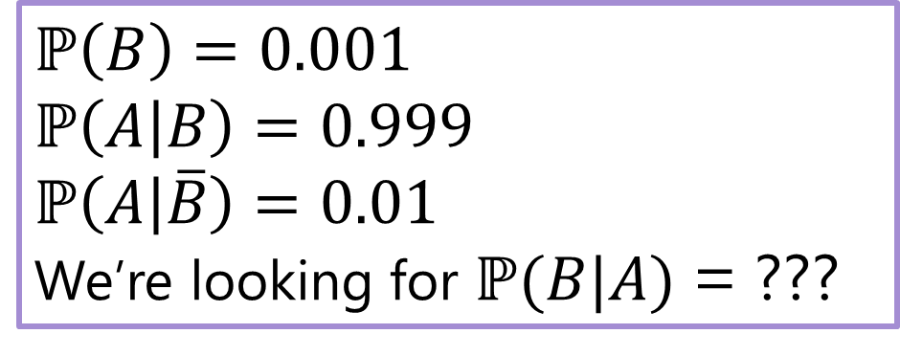
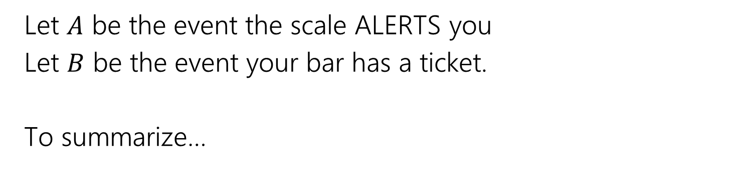
Conditioning
Let $A$ be the event the scale ALERTS you
Let $B$ be the event your bar has a ticket.
To summarize…
$ℙ\left(B\right)=0.001$
$$ℙ\left(A | B\right)=0.999$$
$ℙ\left(A | \overline{B}\right)=0.01$
We’re looking for $ℙ(B|A)$ = ???

Slide 29
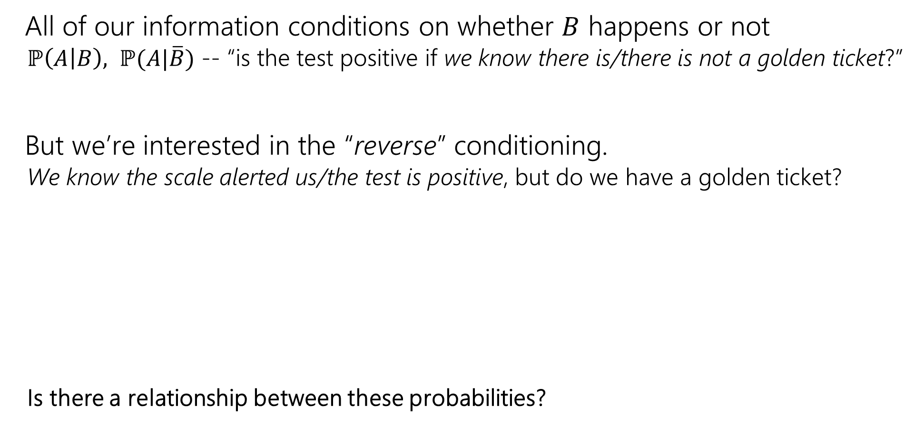
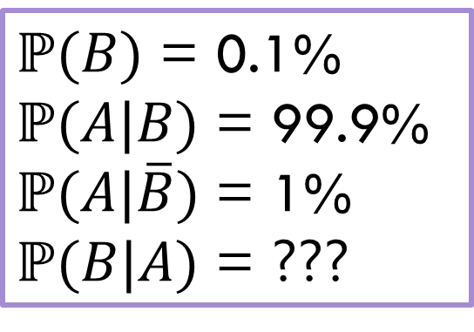
Reversing the Conditioning
All of our information conditions on whether $B$ happens or not
  $ℙ\left(A | B\right), ℙ(A|\overline{B})$ -- “is the test positive if we know there is/there is not a golden ticket?”
But we’re interested in the “reverse” conditioning.
  We know the scale alerted us/the test is positive, but do we have a golden ticket?
  Is there a relationship between these probabilities?
$ℙ(B)$ = 0.1%
$ℙ(A|B)$ = 99.9%
$ℙ(A|\overline{B})$ = 1%
$ℙ(B|A)$ = ???

Slide 30
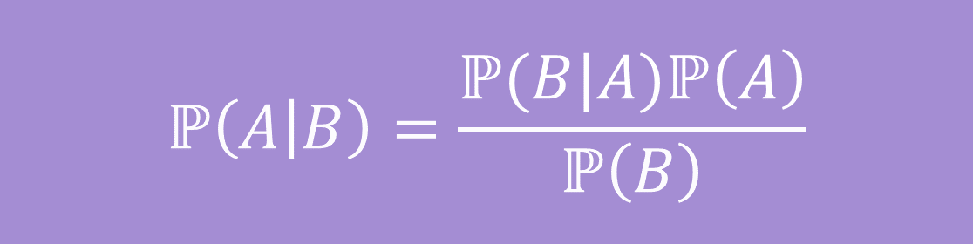

Bayes’ Rule: relates $ℙ(A|B)$ and $ℙ\left(B | A\right)$
Bayes’ Rule
$$ℙ\left(A | B\right)=\frac{ℙ(B|A)ℙ\left(A\right)}{ℙ\left(B\right)}$$

Slide 31
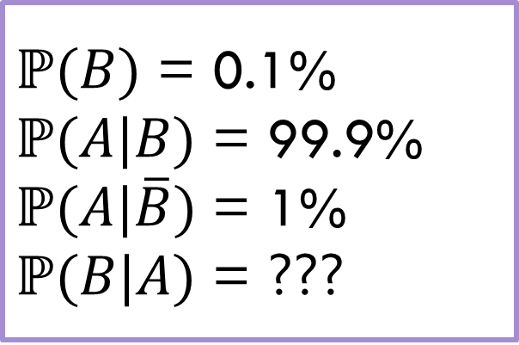

Bayes’ Rule: relates $ℙ(A|B)$ and $ℙ\left(B | A\right)$
Bayes’ Rule
$ℙ(B)$ = 0.1%
$ℙ(A|B)$ = 99.9%
$ℙ(A|\overline{B})$ = 1%
$ℙ(B|A)$ = ???
$$ℙ\left(A | B\right)=\frac{ℙ(B|A)ℙ\left(A\right)}{ℙ\left(B\right)}$$
What do we know about Wonka Bars?
$$0.999=\frac{ℙ\left(B | A\right)⋅ℙ(A)}{.001}$$

Slide 32

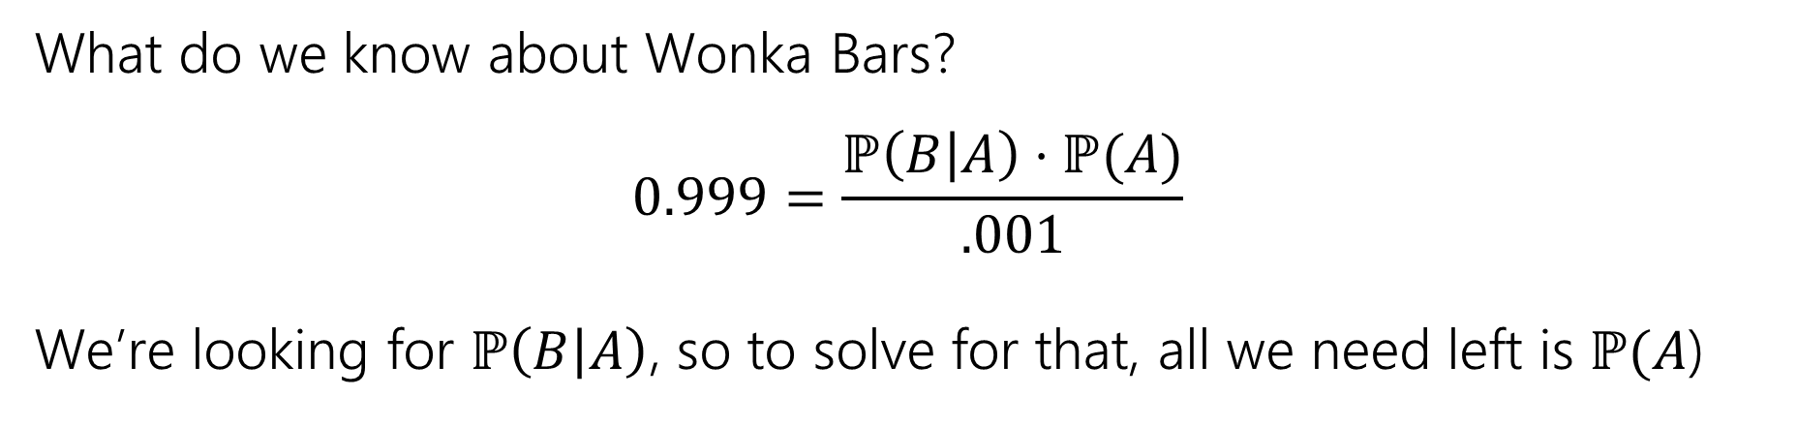
Bayes’ Rule: relates $ℙ(A|B)$ and $ℙ\left(B | A\right)$
Bayes’ Rule
$ℙ(B)$ = 0.1%
$ℙ(A|B)$ = 99.9%
$ℙ(A|\overline{B})$ = 1%
$ℙ(B|A)$ = ???
$$ℙ\left(A | B\right)=\frac{ℙ(B|A)ℙ\left(A\right)}{ℙ\left(B\right)}$$
What do we know about Wonka Bars?
$$0.999=\frac{ℙ\left(B | A\right)⋅ℙ(A)}{.001}$$
We’re looking for $ℙ\left(B | A\right)$, so to solve for that, all we need left is $ℙ(A$)

Slide 33


What’s $ℙ(A)$?
We know the probability of $A$ conditioned on whether the bar has the ticket ($B$ and $\overline{B}$)
How can we use those conditional probabilities to find the probability of $A$ when we’re not conditioning on anything?
We’ll use a trick called “the law of total probability”

Slide 34

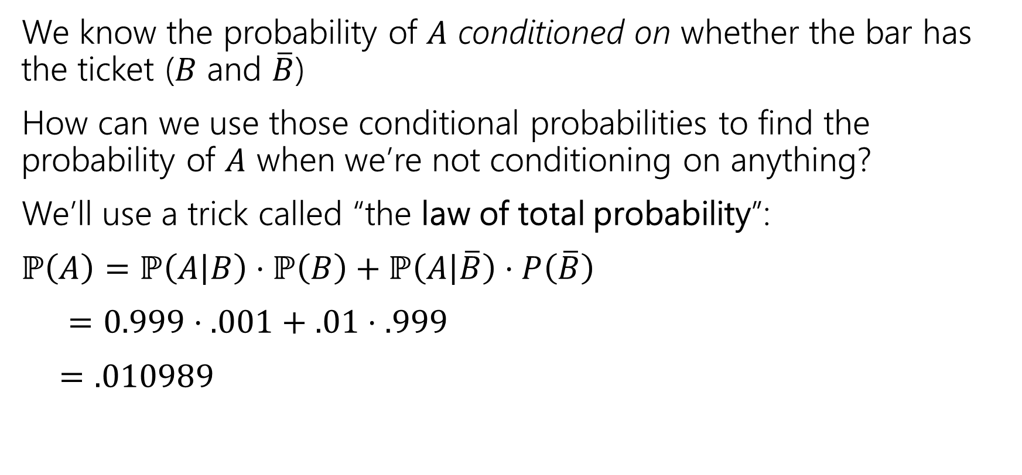
What’s $ℙ(A)$?
We know the probability of $A$ conditioned on whether the bar has the ticket ($B$ and $\overline{B}$)
How can we use those conditional probabilities to find the probability of $A$ when we’re not conditioning on anything?
We’ll use a trick called “the law of total probability”:
$ℙ\left(A\right)=ℙ\left(A | B\right)⋅ℙ\left(B\right)+ℙ\left(A | \overline{B}\right)⋅P\left(\overline{B}\right)$
$=0.999⋅.001+.01⋅.999$
$=.010989$

Slide 35
(detour) Law of Total Probability

Slide 36

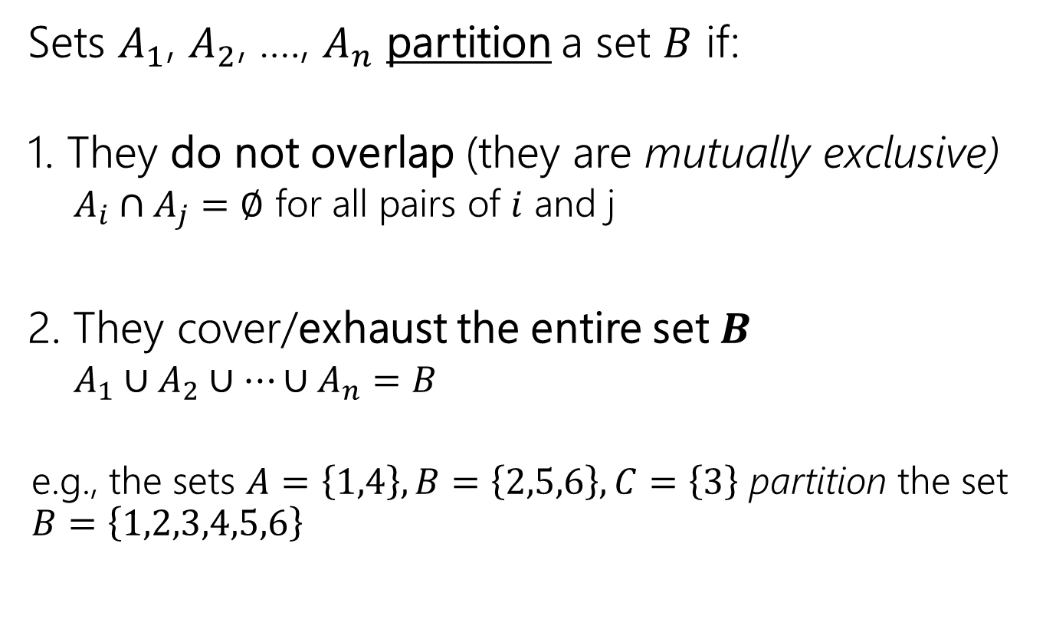




Partitions
$$B$$
Sets $A_{1}$, $A_{2}$, …., $A_{n}$ partition a set $B$ if:
1. They do not overlap (they are mutually exclusive)
  $A_{i}∩A_{j}=∅$ for all pairs of $i$ and j
2. They cover/exhaust the entire set $B$
  $A_{1}∪A_{2}∪…∪A_{n}=B$
  e.g., the sets $A=\left\{1,4\right\}, B=\left\{2,5,6\right\}, C=\left\{3\right\}$ partition the set $B=\left\{1,2,3,4,5,6\right\}$
$$A_{2}$$
$$A_{1}$$
$$A_{4}$$
$$A_{3}$$

Slide 37






Partitions of a sample space
$$Ω$$
Events $E_{1}$, $E_{2}$, $E_{3}$, $E_{4}$ partition the sample space $Ω$ if:
1. They do not overlap (they are mutually exclusive)
  $E_{i}∩E_{j}=∅$ for all pairs of $i$ and j
2. They cover/exhaust the entire sample space $Ω$
  $E_{1}∪E_{2}∪…∪E_{n}=Ω$
  An event and it’s complement ($A$ and $\overline{A}$) partition $Ω$
  Because (1) they are mutually exclusive
  (2) $A∪\overline{A}=Ω$, every outcome is either in the $A$ or not
$$E_{2}$$
$$E_{1}$$
$$E_{4}$$
$$E_{3}$$

Slide 38






Law of Total Probability
$$Ω$$
$E_{1}$, $E_{2}$, $E_{3}$, $E_{4}$partition the sample space $Ω$
$$E_{2}$$
$$E_{1}$$
$$E_{4}$$
$$E_{3}$$

Slide 39


Law of Total Probability
$$Ω$$
$E_{1}$, $E_{2}$, $E_{3}$, $E_{4}$partition the sample space $Ω$
Now, we want to find the probability of some event $A$ in this sample space - $ℙ(A)$
$$E_{2}$$
$$E_{1}$$
$$A$$
$$E_{4}$$
$$E_{3}$$

Slide 40
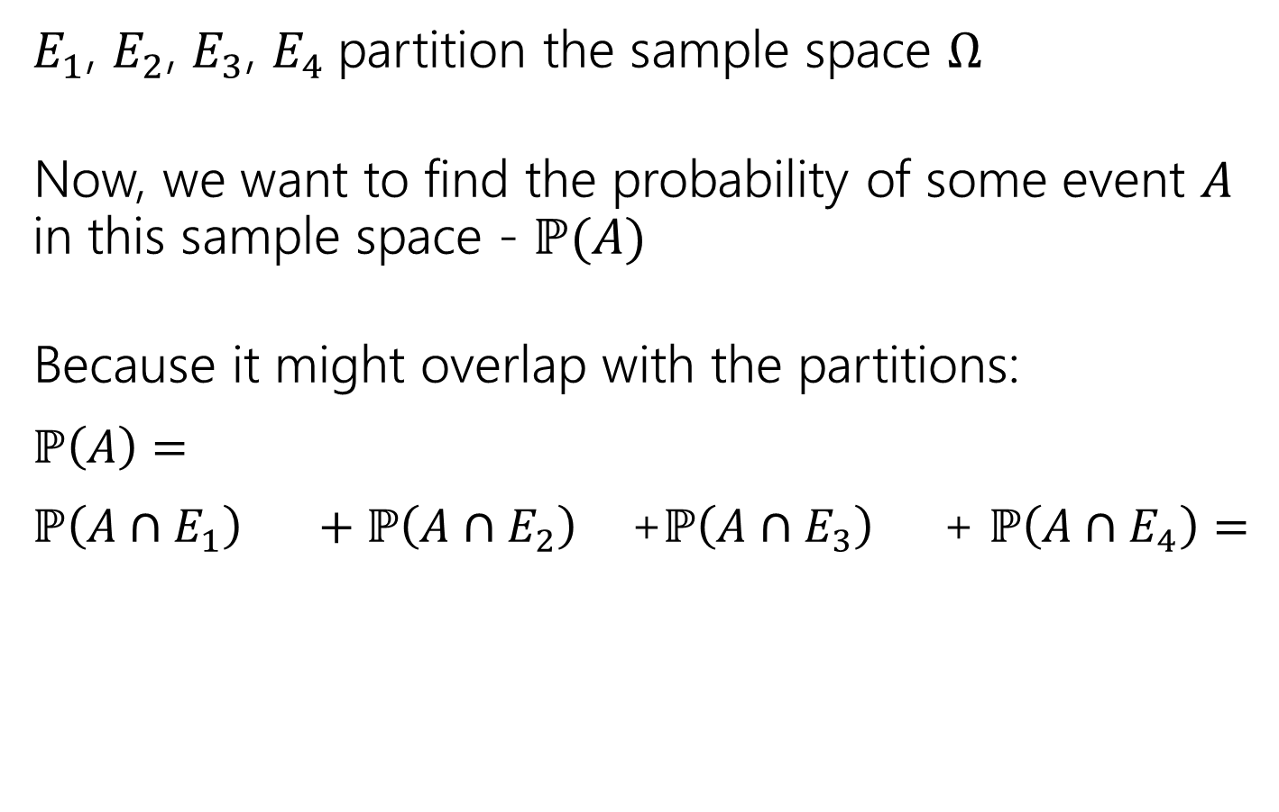
Law of Total Probability
$$Ω$$
$E_{1}$, $E_{2}$, $E_{3}$, $E_{4}$partition the sample space $Ω$
Now, we want to find the probability of some event $A$ in this sample space - $ℙ(A)$
Because it might overlap with the partitions:
$ℙ\left(A\right)=$
$ℙ\left(A∩E_{1}\right) +ℙ\left(A∩E_{2}\right)$ +$ℙ\left(A∩E_{3}\right)$ + $ℙ\left(A∩E_{4}\right)=$
$$E_{2}$$
$$E_{1}$$
$$A$$
$$E_{4}$$
$$E_{3}$$

Slide 41
Law of Total Probability
$$Ω$$
$E_{1}$, $E_{2}$, $E_{3}$, $E_{4}$partition the sample space $Ω$
Now, we want to find the probability of some event $A$ in this sample space - $ℙ(A)$
Because it might overlap with the partitions:
$ℙ\left(A\right)=$
$ℙ\left(A∩E_{1}\right) +ℙ\left(A∩E_{2}\right)$ +$ℙ\left(A∩E_{3}\right)$ + $ℙ\left(A∩E_{4}\right)=$
$$E_{2}$$
$$E_{1}$$
$$A$$
$$E_{4}$$
$$E_{3}$$
$ℙ\left(A|B\right)=\frac{ℙ\left(A∩B\right)}{ℙ\left(B\right)}$ → $ℙ\left(A∩B\right)$ = $ℙ\left(A|B\right)$ $ℙ\left(B\right)$

Slide 42
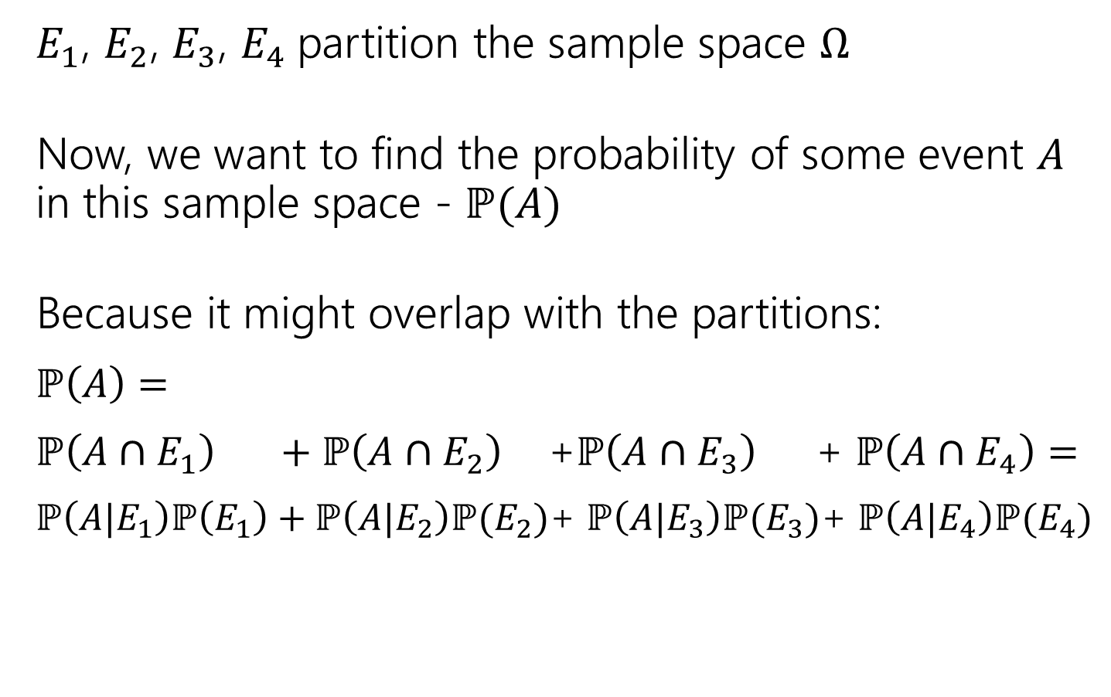
Law of Total Probability
$$Ω$$
$E_{1}$, $E_{2}$, $E_{3}$, $E_{4}$partition the sample space $Ω$
Now, we want to find the probability of some event $A$ in this sample space - $ℙ(A)$
Because it might overlap with the partitions:
$ℙ\left(A\right)=$
$ℙ\left(A∩E_{1}\right) +ℙ\left(A∩E_{2}\right)$ +$ℙ\left(A∩E_{3}\right)$ + $ℙ\left(A∩E_{4}\right)=$
$ℙ\left(A|E_{1}\right)ℙ\left(E_{1}\right)+ℙ\left(A|E_{2}\right)ℙ(E_{2})$+ $ℙ\left(A|E_{3}\right)ℙ(E_{3})$+ $ℙ\left(A|E_{4}\right)ℙ(E_{4})$
$$E_{2}$$
$$E_{1}$$
$$A$$
$$E_{4}$$
$$E_{3}$$
$ℙ\left(A|B\right)=\frac{ℙ\left(A∩B\right)}{ℙ\left(B\right)}$ → $ℙ\left(A∩B\right)$ = $ℙ\left(A|B\right)$ $ℙ\left(B\right)$

Slide 43
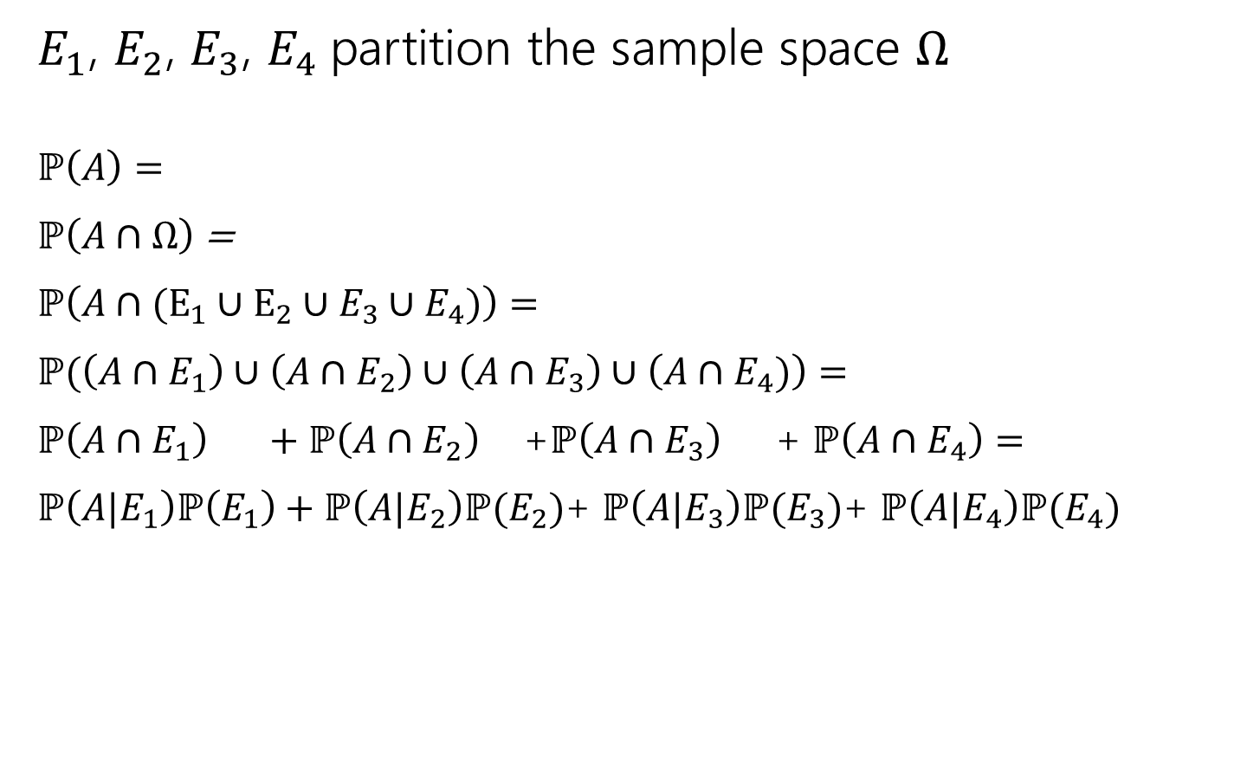
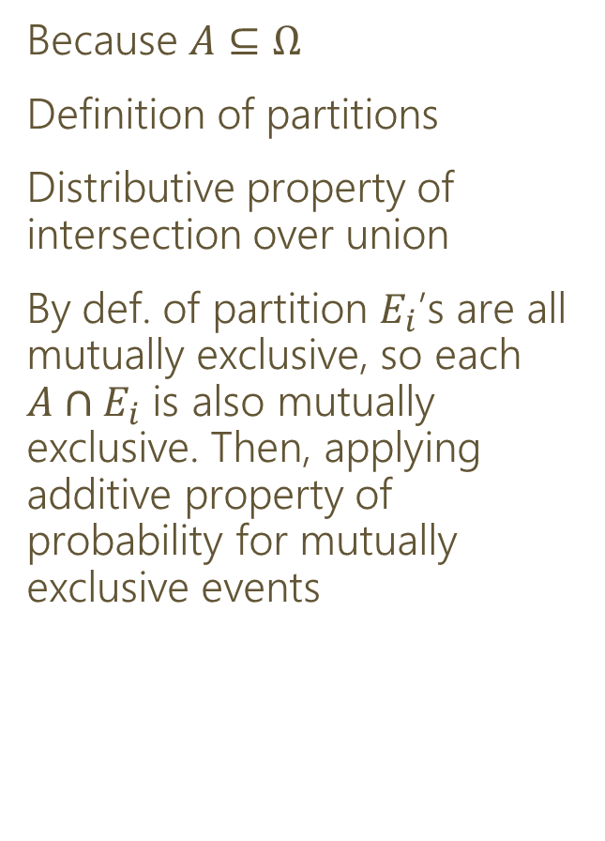
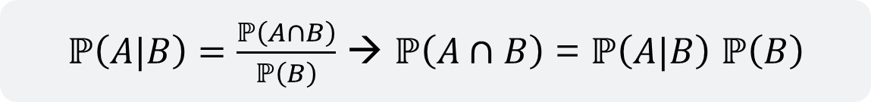
Law of Total Probability (more formally)
$E_{1}$, $E_{2}$, $E_{3}$, $E_{4}$partition the sample space $Ω$
$ℙ\left(A\right)=$
$ℙ\left(A∩Ω\right)$ =
$ℙ\left(A∩(E_{1}∪E_{2}∪E_{3}∪E_{4})\right)=$
$ℙ(\left(A∩E_{1}\right)∪\left(A∩E_{2}\right)∪\left(A∩E_{3}\right)∪\left(A∩E_{4})\right)=$
$ℙ\left(A∩E_{1}\right) +ℙ\left(A∩E_{2}\right)$ +$ℙ\left(A∩E_{3}\right)$ + $ℙ\left(A∩E_{4}\right)=$
$ℙ\left(A|E_{1}\right)ℙ\left(E_{1}\right)+ℙ\left(A|E_{2}\right)ℙ(E_{2})$+ $ℙ\left(A|E_{3}\right)ℙ(E_{3})$+ $ℙ\left(A|E_{4}\right)ℙ(E_{4})$
Because $A⊆Ω$
Definition of partitions
Distributive property of intersection over union
By def. of partition $E_{i}$’s are all mutually exclusive, so each $A∩E_{i}$ is also mutually exclusive. Then, applying additive property of probability for mutually exclusive events
$ℙ\left(A|B\right)=\frac{ℙ\left(A∩B\right)}{ℙ\left(B\right)}$ → $ℙ\left(A∩B\right)$ = $ℙ\left(A|B\right)$ $ℙ\left(B\right)$

Slide 44
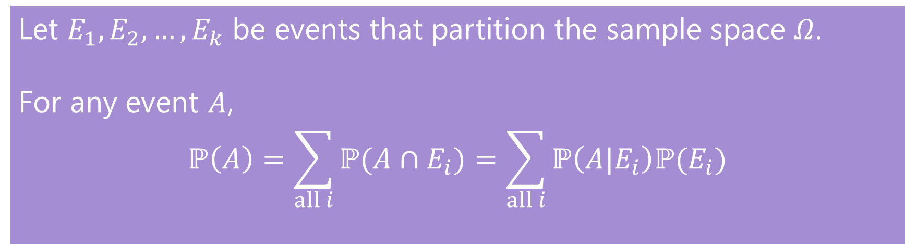
Law of Total Probability
To generalize…
Law of Total Probability
Let $E_{1},E_{2},…,E_{k}$ be events that partition the sample space $Ω$.
For any event $A$,
$$ℙ\left(A\right)=\sum_{all i}{ℙ(A∩E_{i})}=\sum_{all i}{ℙ\left(A|E_{i}\right)ℙ(E_{i})}$$

Slide 45
Back to the Wonka Bars!🍫
Now that we’ve totally forgotten why we needed this rule…

Slide 46
Wonka Bars
Willy Wonka has placed golden tickets on 0.1% of his Wonka Bars.
You want to get a golden ticket. You could buy a 1000-or-so of the bars until you find one, but that’s expensive…you’ve got a better idea!
You have a test – a very precise scale you’ve bought.
  If the bar you weigh does have a golden ticket, the scale will alert you 99.9% of the time.
  If the bar you weigh does not have a golden ticket, the scale will (falsely) alert you only 1% of the time.
If you pick up a bar and it alerts, what is the probability you have a golden ticket?

Slide 47
Conditioning
Let $A$ be the event the scale ALERTS you
Let $B$ be the event your bar has a ticket.
What probability are we looking for?
$ℙ\left(B | A\right)= ?$
What probabilities are each of these from the problem?
  Willy Wonka has placed golden tickets on 0.1% of his Wonka Bars.
  If the bar you weigh does have a golden ticket, the scale will alert you 99.9% of the time.
  If the bar you weigh does not have a golden ticket, the scale will (falsely) alert you only 1% of the time.
$$ℙ(B)=0.001$$
$$ℙ\left(A | B\right)=0.999$$
$$ℙ\left(A | \overline{B}\right)=0.01$$

Slide 48

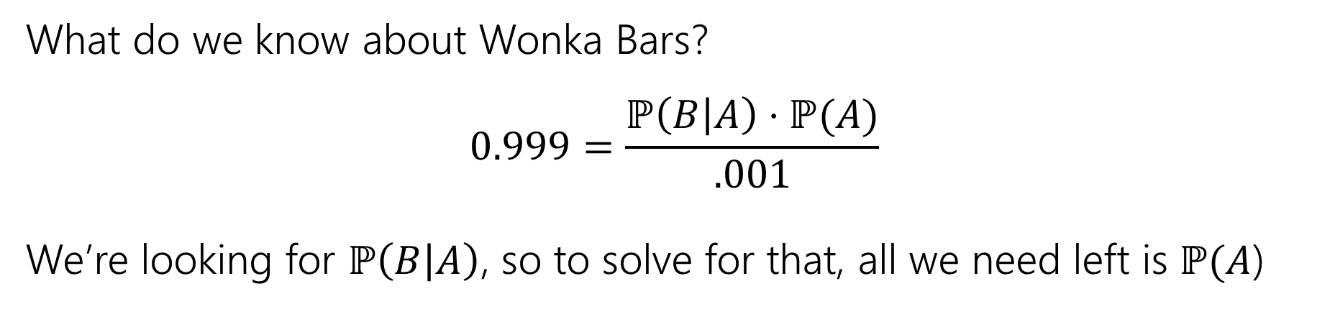
Bayes Rule: relates $ℙ(A|B)$ and $ℙ\left(B | A\right)$
Bayes’ Rule
$ℙ(B)$ = 0.1%
$ℙ(A|B)$ = 99.9%
$ℙ(A|\overline{B})$ = 1%
$ℙ(B|A)$ = ???
$$ℙ\left(A | B\right)=\frac{ℙ(B|A)ℙ\left(A\right)}{ℙ\left(B\right)}$$
What do we know about Wonka Bars?
$$0.999=\frac{ℙ\left(B | A\right)⋅ℙ(A)}{.001}$$
We’re looking for $ℙ\left(B | A\right)$, so to solve for that, all we need left is $ℙ(A$)

Slide 49
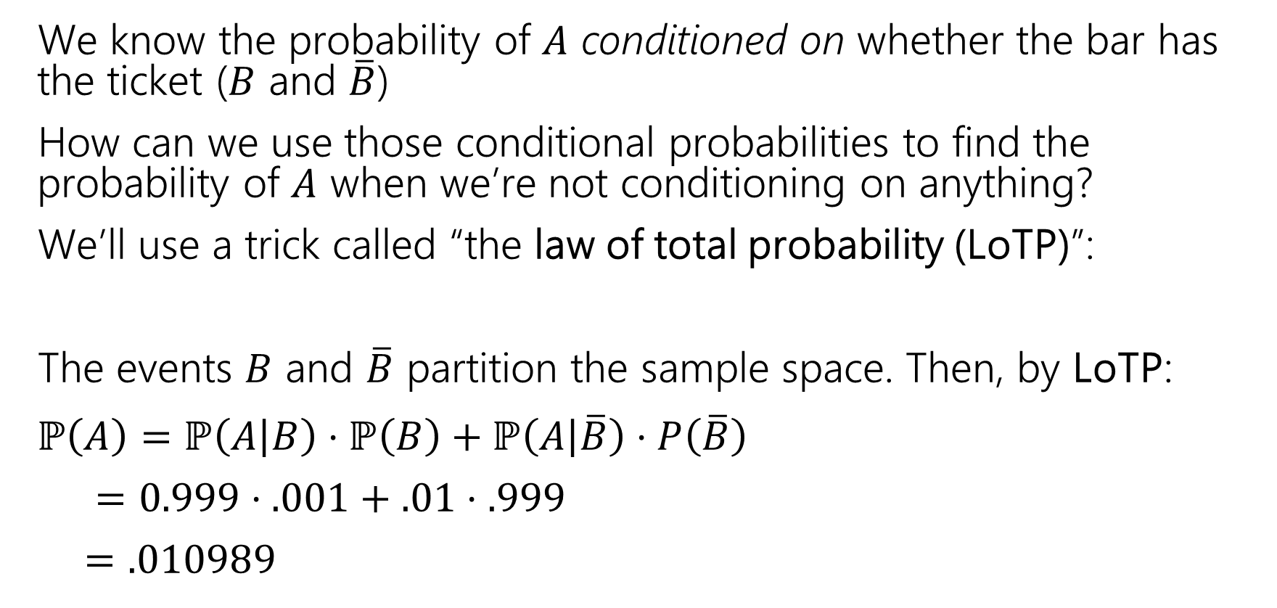
What’s $ℙ(A)$?
We know the probability of $A$ conditioned on whether the bar has the ticket ($B$ and $\overline{B}$)
How can we use those conditional probabilities to find the probability of $A$ when we’re not conditioning on anything?
We’ll use a trick called “the law of total probability (LoTP)”:
The events $B$ and $\overline{B}$ partition the sample space. Then, by LoTP:
$ℙ\left(A\right)=ℙ\left(A | B\right)⋅ℙ\left(B\right)+ℙ\left(A | \overline{B}\right)⋅P\left(\overline{B}\right)$
$=0.999⋅.001+.01⋅.999$
$=.010989$

Slide 50
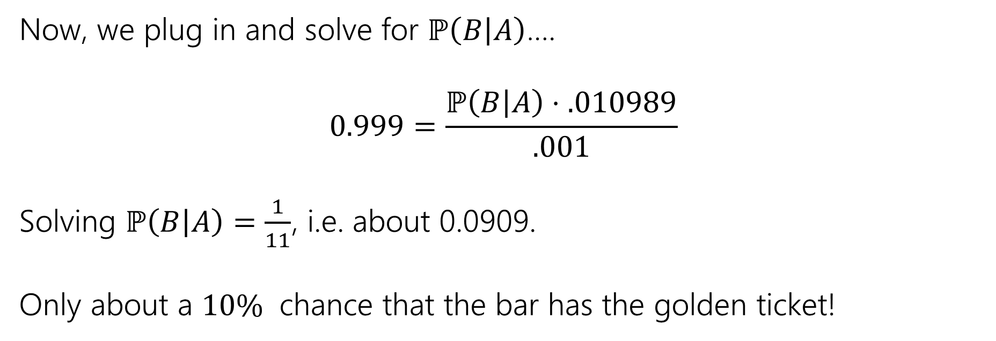
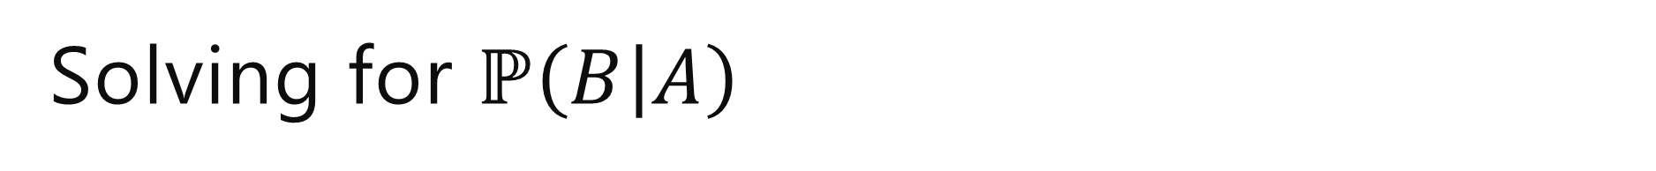
Solving for $ℙ\left(B | A\right)$
Now, we plug in and solve for $ℙ\left(B | A\right)$….
$$0.999=\frac{ℙ\left(B | A\right)⋅.010989}{.001}$$
Solving $ℙ\left(B | A\right)=\frac{1}{11}$, i.e. about 0.0909.
Only about a $10\%$ chance that the bar has the golden ticket!

Slide 51
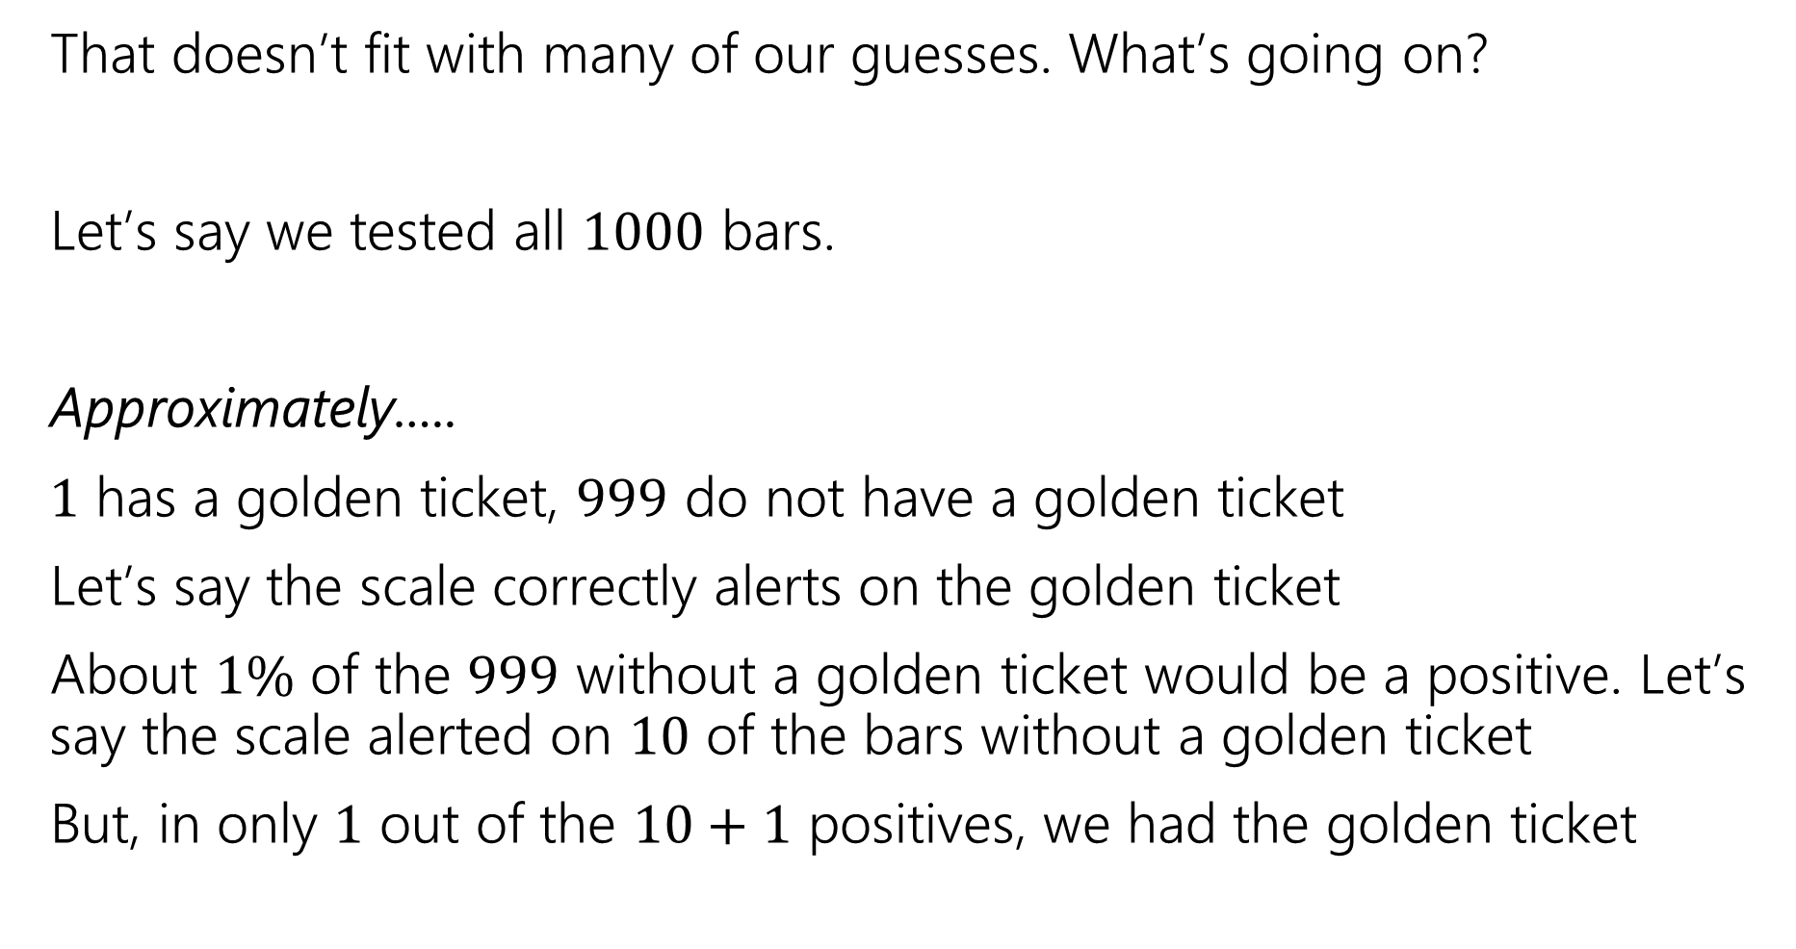
Wait a minute…
That doesn’t fit with many of our guesses. What’s going on?
Let’s say we tested all $1000$ bars.
Approximately…..
$1$ has a golden ticket, $999$ do not have a golden ticket
Let’s say the scale correctly alerts on the golden ticket
About $1\%$ of the $999$ without a golden ticket would be a positive. Let’s say the scale alerted on $10$ of the bars without a golden ticket
But, in only $1$ out of the $10+1$ positives, we had the golden ticket
  > Golden tickets on 0.1% of his Wonka Bars.
  > If the bar you weigh does have a golden ticket, the scale will alert you 99.9% of the time.
  > If the bar you weigh does not have a golden ticket, the scale will (falsely) alert you only 1% of the time.
  If you pick up a bar and it alerts, what is the probability you have a golden ticket?

Slide 52
Visually
Gold bar is the one (true) golden ticket bar.
True positive
Purple bars don’t have a ticket, tested negative.
True negative
Red bars don’t have a ticket, tested positive.
False positive
The test is, in a sense, doing really well.
It’s almost always right (only red is incorrect)
The problem is it’s also the case that the correct answer is almost always “no.”

Slide 53

Updating Your Intuition
  > Golden tickets on 0.1% of his Wonka Bars.
  > If the bar you weigh does have a golden ticket, the scale will alert you 99.9% of the time.
  > If the bar you weigh does not have a golden ticket, the scale will (falsely) alert you only 1% of the time.
  If you pick up a bar and it alerts, what is the probability you have a golden ticket?
Take 1: The test is actually good and has VASTLY increased our belief that there IS a golden ticket when you get a positive result.
If we told you “your job is to find a Wonka Bar with a golden ticket” without the test, you have 1/1000 chance, with the test, you have (about) a 1/11 chance. That’s (almost) 100 times better!
This is actually a huge improvement!

Slide 54
Updating Your Intuition
  > Golden tickets on 0.1% of his Wonka Bars.
  > If the bar you weigh does have a golden ticket, the scale will alert you 99.9% of the time.
  > If the bar you weigh does not have a golden ticket, the scale will (falsely) alert you only 1% of the time.
  If you pick up a bar and it alerts, what is the probability you have a golden ticket?
Take 2: Humans are really bad at intuitively understanding very large or very small numbers.
When I hear “99% chance”, “99.9% chance”, “99.99% chance” they all go into my brain as “well that’s basically guaranteed” And then I forget how many 9’s there actually were.
But the number of 9s matters because they end up “cancelling” with the “number of 9’s” in the population that’s truly negative.

Slide 55

Updating Your Intuition
  > Golden tickets on 0.1% of his Wonka Bars.
  > If the bar you weigh does have a golden ticket, the scale will alert you 99.9% of the time.
  > If the bar you weigh does not have a golden ticket, the scale will (falsely) alert you only 1% of the time.
  If you pick up a bar and it alerts, what is the probability you have a golden ticket?
Take 3: View tests as updating your beliefs, not as revealing the truth.
Bayes’ Rule says that $ℙ(B|A)$ has a factor of $ℙ(B)$ in it. You have to translate “The test says there’s a golden ticket” to “the test says you should increase your estimate of the chances that you have a golden ticket.”
A test takes you from your “prior” beliefs of the probability to your “posterior” beliefs.

Slide 56
The Technical Stuff

Slide 57


Proof of Bayes’ Rule
Bayes’ Rule
$$ℙ\left(A | B\right)=\frac{ℙ(B|A)ℙ\left(A\right)}{ℙ\left(B\right)}$$
$ℙ\left(A | B\right)=\frac{ℙ\left(A∩B\right)}{ℙ\left(B\right)}$ by definition of conditional probability.
We also know $ℙ\left(B | A\right)=\frac{ℙ\left(B∩A\right)}{ℙ\left(A\right)}$ → $ℙ\left(B∩A\right)=ℙ\left(B | A\right)⋅ℙ(A)$
Intersections are commutative, so $ℙ\left(A∩B\right)=ℙ\left(B∩A\right)$
$ℙ\left(A | B\right)=\frac{ℙ\left(A∩B\right)}{ℙ\left(B\right)}=\frac{ℙ\left(B∩A\right)}{ℙ\left(B\right)}=\frac{ℙ(B|A)⋅ℙ\left(A\right)}{ℙ\left(B\right)}$

Slide 58


A Technical Note
After you condition on an event, what remains is a probability space.
$(Ω,ℙ)$ is a valid probability space $(A,ℙ(⋅|A))$ is valid probability space
  and, $A⊆Ω$
Sum of probabilities of outcomes in a sample space is 1: $\sum_{ω∈Ω}{ℙ\left(ω\right)=1}$
$ℙ\left(\overline{E}\right)=1−ℙ(E)$
⚠️Careful! $ℙ\left(E|\overline{A}\right)≠1−ℙ(E|A)$ because this changes the sample space!

Slide 59

A Technical Note
After you condition on an event, what remains is a probability space.
$(Ω,ℙ)$ is a valid probability space $(A,ℙ(⋅|A))$ is valid probability space
  and, $A⊆Ω$
Sum of probabilities of outcomes in a sample space is 1: $\sum_{ω∈Ω}{ℙ\left(ω\right)=1}$
$ℙ\left(\overline{E}\right)=1−ℙ(E)$
Sum of probabilities in this conditioned probability space is 1: $\sum_{ω∈A}{ℙ\left(ω | A\right)=1}$
$ℙ\left(\overline{E}|A\right)=1−ℙ(E|A)$
⚠️Careful! $ℙ\left(E|\overline{A}\right)≠1−ℙ(E|A)$ because this changes the sample space!

Slide 60

An Example
Bayes Theorem still works in a probability space where we’ve already conditioned on $S.$
$ℙ\left(A | [B∩S]\right)=\frac{ℙ\left(B | [A∩S]\right)⋅ℙ\left(A | S\right)}{ℙ(B|S)}$

Slide 61

A Quick Technical Remark
I often see students write things like
$ℙ([A\left|B]\right|C)$
  Thinking something like “probability of $A$ given $B$ given we also know $C$
This is not a thing.
You probably want $ℙ\left(A | \left[B∩C\right]\right)$
  “probability of $A$ given both $B$ and $C$
$A|B$ isn’t an event – it’s describing an event and telling you to restrict the sample space. So you can’t ask for the probability of that conditioned on something else.

Slide 62

Summary + Tips
Today, we talked about conditional probability
      Definition of conditional probability: $P\left(A | B\right)=\frac{P\left(A∩B\right)}{P(B)}$
      Bayes’ Theorem: $P\left(A | B\right)=\frac{P(A|B)P(B)}{P(B)}$
      Law of Total Probability: $P\left(A\right)=P\left(A | E_{1}\right)P\left(E_{1}\right)+…+P\left(A | E_{n}\right)P\left(E_{n}\right)$ if $E_{1},E_{2},…E_n$ partition the sample space
Now that we’re getting into more complex probabilities, it’s very helpful to clearly define events and then write
    Writing down all the information given in the problem/what we’re asked for in terms of those events is helpful to figure out what rules we can use to relate them together

