Slide 1
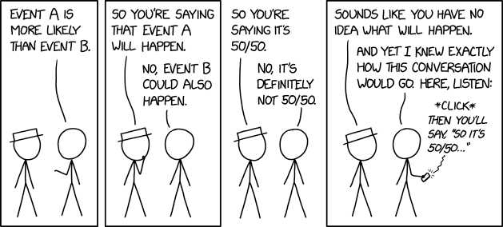
Probability
CSE 312 26Su
Lecture 4
Am I going too fast in lecture?
pollev.com/jolie312
(responses are anonymous)
https://xkcd.com/2370/

Slide 2
Announcements
HW1 is due Wednesday (11:59pm)
Office hours schedule is on the calendar on the webpage

Slide 3
Where Are We?
Last time:
  Stars and Bars
  Combinatorial Proofs
  Pigeonhole Principle
Today:
  Probability
  Sample Space and Events
  Probability Axioms
  Uniform Probability Space
  More Examples

Slide 4
Today
So far…we’ve done a lot of counting.
Starting today, we get to calculate probabilities!
  And the counting techniques we’ve learned are going to come in handy when computing probabilities ☺

Slide 5
Probability

Slide 6
What is Probability?
There are lots of things we aren’t certain about!
  Is it going to rain this weekend?
  Am I going to get a 6 when rolling this dice?

Slide 7
What is Probability?
There are lots of things we aren’t certain about!
  Is it going to rain this weekend?
  Am I going to get a 6 when rolling this dice?
Probability is a way of quantifying our uncertainty when more than one outcome is possible
  What is the probability that is rains tomorrow?
  What is the probability that I get a 6 when rolling a dice?

Slide 8
What is Probability?
There are lots of things we aren’t certain about!
  Is it going to rain this weekend?
  Am I going to get a 6 when rolling this dice?
Probability is a way of quantifying our uncertainty when more than one outcome is possible
  What is the probability that is rains tomorrow?
  What is the probability that I get a 6 when rolling a dice?
To have “real-world” examples, we’re going to make some assumptions:
  We can flip a coin, and each face is equally likely to come up
  We can roll a die, and every number is equally likely to come up
  We can shuffle a deck of cards so that every ordering is equally likely.

Slide 9
Experiment
An action or process that leads to one or more outcomes.
A random experiment is an experiment where the outcome can’t be predicted with certainty beforehand
Experiment
Examples:
Tossing a fair coin
Rolling a dice
Drawing a name from a hat

Slide 10
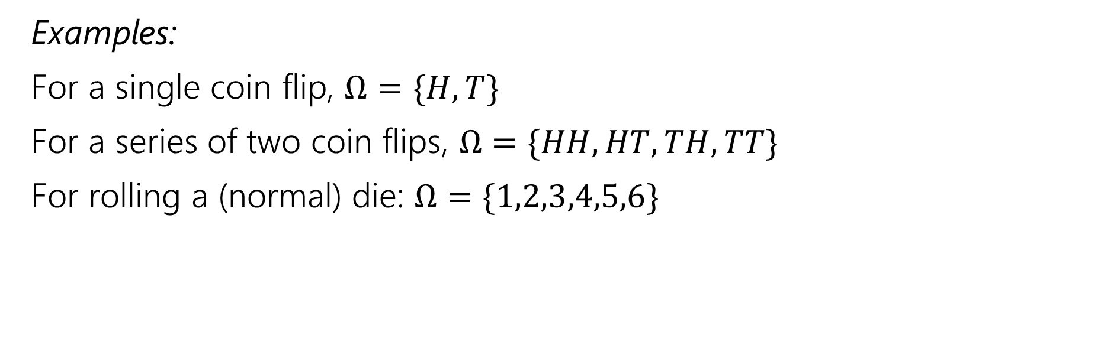

Sample Space
A sample space $Ω$ is the set of all possible outcomes of an experiment.
Sample Space
Examples:
For a single coin flip, $Ω=\{H,T\}$
For a series of two coin flips, $Ω=\{HH,HT,TH,TT\}$
For rolling a (normal) die: $Ω=\{1,2,3,4,5,6\}$

Slide 11
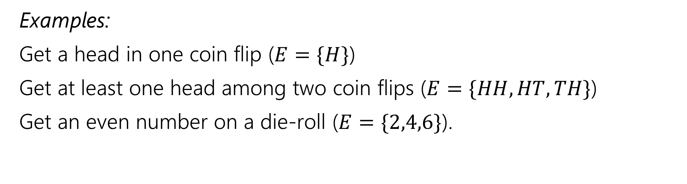
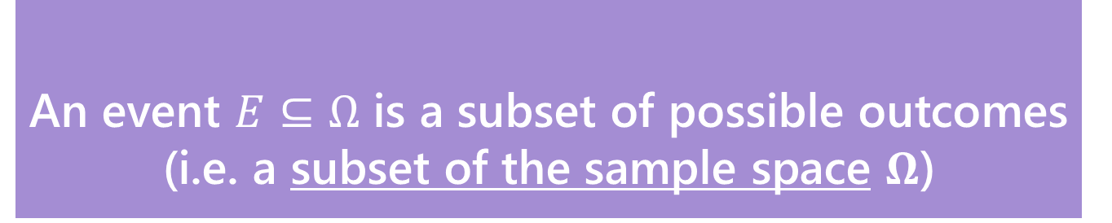
Event
An event $E⊆Ω$ is a subset of possible outcomes (i.e. a subset of the sample space $Ω$)
Event
Examples:
Get a head in one coin flip ($E=\{H\}$)
Get at least one head among two coin flips ($E=\{HH,HT,TH\}$)
Get an even number on a die-roll ($E=\{2,4,6\}$).

Slide 12
Event
An event $E⊆Ω$ is a subset of possible outcomes (i.e. a subset of the sample space $Ω$)
Event
Examples:
Get a head in one coin flip ($E=\{H\}$)
Get at least one head among two coin flips ($E=\{HH,HT,TH\}$)
Get an even number on a die-roll ($E=\{2,4,6\}$).
Notation note: Since sets are usually represented with a single capital letter, we also denote events with a single capital letter (it doesn’t have to be $E$, it can be anything!)

Slide 13
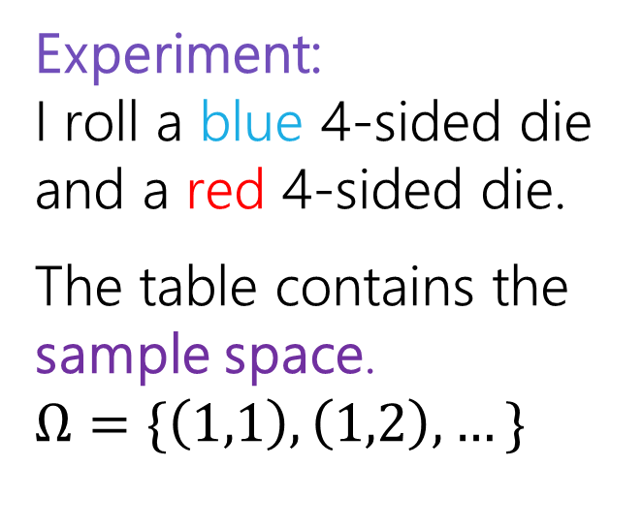
Examples
 | D2=1 | D2=2 | D2=3 | D2=4
D1=1 | (1,1) | (1,2) | (1,3) | (1,4)
D1=2 | (2,1) | (2,2) | (2,3) | (2,4)
D1=3 | (3,1) | (3,2) | (3,3) | (3,4)
D1=4 | (4,1) | (4,2) | (4,3) | (4,4)
Experiment:
I roll a blue 4-sided die and a red 4-sided die.
The table contains the sample space.
$$Ω=\{\left(1,1\right),\left(1,2\right),…\}$$

Slide 14
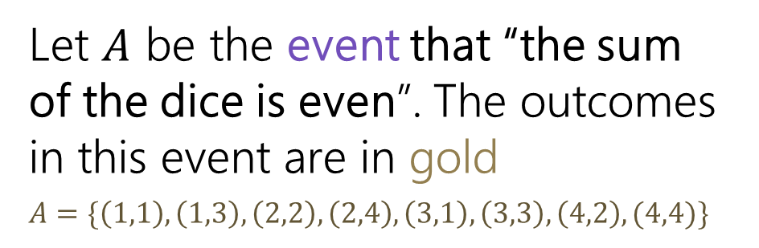
Examples
 | D2=1 | D2=2 | D2=3 | D2=4
D1=1 | (1,1) | (1,2) | (1,3) | (1,4)
D1=2 | (2,1) | (2,2) | (2,3) | (2,4)
D1=3 | (3,1) | (3,2) | (3,3) | (3,4)
D1=4 | (4,1) | (4,2) | (4,3) | (4,4)
Experiment:
I roll a blue 4-sided die and a red 4-sided die.
The table contains the sample space.
$$Ω=\{\left(1,1\right),\left(1,2\right),…\}$$
Let $A$ be the event that “the sum of the dice is even”. The outcomes in this event are in gold
$$A=\{\left(1,1\right),\left(1,3\right),\left(2,2\right),\left(2,4\right), \left(3,1\right),\left(3,3\right),\left(4,2\right),(4,4)\}$$

Slide 15

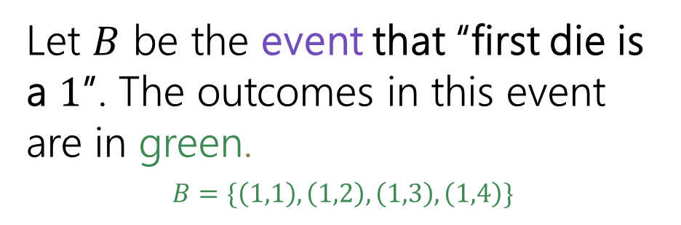
Examples
 | D2=1 | D2=2 | D2=3 | D2=4
D1=1 | (1,1) | (1,2) | (1,3) | (1,4)
D1=2 | (2,1) | (2,2) | (2,3) | (2,4)
D1=3 | (3,1) | (3,2) | (3,3) | (3,4)
D1=4 | (4,1) | (4,2) | (4,3) | (4,4)
Experiment:
I roll a blue 4-sided die and a red 4-sided die.
The table contains the sample space.
$$Ω=\{\left(1,1\right),\left(1,2\right),…\}$$
Let $A$ be the event that “the sum of the dice is even”. The outcomes in this event are in gold
$$A=\{\left(1,1\right),\left(1,3\right),\left(2,2\right),\left(2,4\right), \left(3,1\right),\left(3,3\right),\left(4,2\right),(4,4)\}$$
Let $B$ be the event that “first die is a $1$”. The outcomes in this event are in green.
$$B=\{\left(1,1\right),\left(1,2\right),\left(1,3\right),\left(1,4\right)\}$$

Slide 16




Mutually Exclusive Events
Two events $E,F$ are mutually exclusive if they can’t happen simultaneously.
In notation, $E∩F=∅$ (i.e. they’re disjoint subsets of the sample space).
$$Ω$$
$$E$$
$$F$$

Slide 17
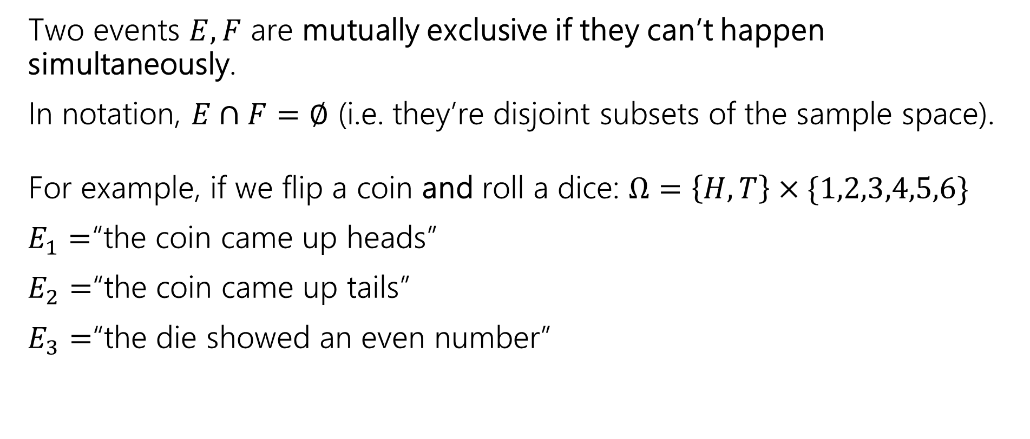
Mutually Exclusive Events
Two events $E,F$ are mutually exclusive if they can’t happen simultaneously.
In notation, $E∩F=∅$ (i.e. they’re disjoint subsets of the sample space).
For example, if we flip a coin and roll a dice: $Ω=\left\{H,T\right\}×\{1,2,3,4,5,6\}$
$E_{1}=$“the coin came up heads”
$E_{2}=$“the coin came up tails”
$E_{3}=$“the die showed an even number”
$$Ω$$
$$E$$
$$F$$

Slide 18
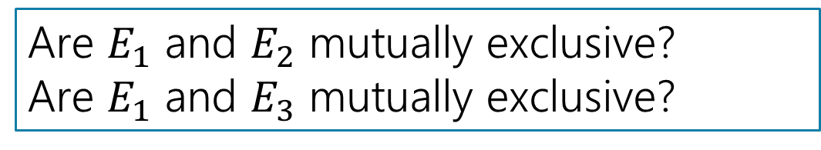
Mutually Exclusive Events
Two events $E,F$ are mutually exclusive if they can’t happen simultaneously.
In notation, $E∩F=∅$ (i.e. they’re disjoint subsets of the sample space).
For example, if we flip a coin and roll a dice: $Ω=\left\{H,T\right\}×\{1,2,3,4,5,6\}$
$E_{1}=$“the coin came up heads”
$E_{2}=$“the coin came up tails”
$E_{3}=$“the die showed an even number”
$$Ω$$
$$E$$
$$F$$
Are $E_{1}$ and $E_{2}$ mutually exclusive?
Are $E_{1}$ and $E_{3}$ mutually exclusive?

Slide 19
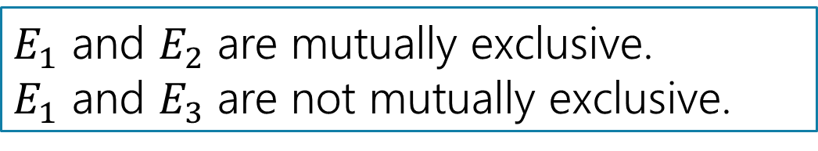
Mutually Exclusive Events
Two events $E,F$ are mutually exclusive if they can’t happen simultaneously.
In notation, $E∩F=∅$ (i.e. they’re disjoint subsets of the sample space).
For example, if we flip a coin and roll a dice: $Ω=\left\{H,T\right\}×\{1,2,3,4,5,6\}$
$E_{1}=$“the coin came up heads”
$E_{2}=$“the coin came up tails”
$E_{3}=$“the die showed an even number”
$$Ω$$
$$E$$
$$F$$
$E_{1}$ and $E_{2}$ are mutually exclusive.
$E_{1}$ and $E_{3}$ are not mutually exclusive.

Slide 20
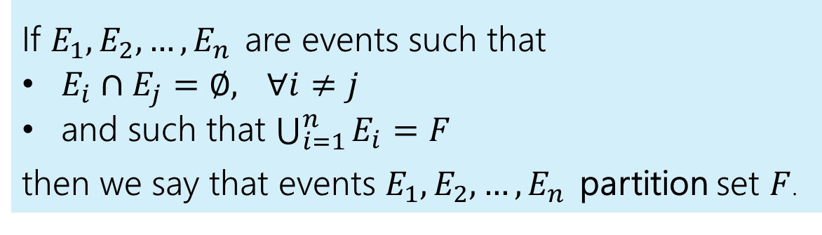
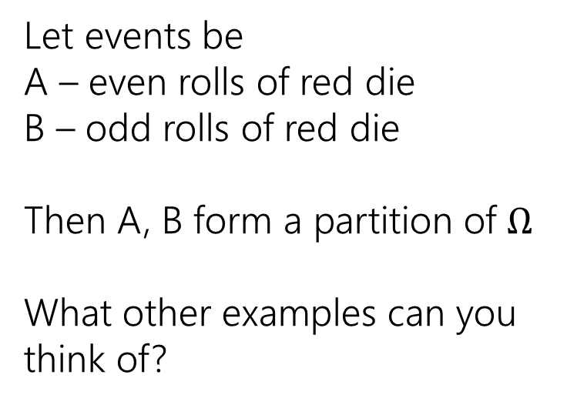
Mutually Exclusive Events & Partitions
If $E_{1},E_{2},…,E_{n}$ are events such that
$E_{i}∩E_{j}=∅,$ $∀i≠j$
and such that $\bigcup_{i=1}^{n}{E_{i}=F}$
then we say that events $E_{1},E_{2},…,E_{n}$ partition set $F$.
Let events be
A – even rolls of red die
B – odd rolls of red die
Then A, B form a partition of $Ω$
What other examples can you think of?
 | D2=1 | D2=2 | D2=3 | D2=4
D1=1 | (1,1) | (1,2) | (1,3) | (1,4)
D1=2 | (2,1) | (2,2) | (2,3) | (2,4)
D1=3 | (3,1) | (3,2) | (3,3) | (3,4)
D1=4 | (4,1) | (4,2) | (4,3) | (4,4)
Notes:
E1: die 1 = 1
E2: die 1 > 1
E1: die 1 = die 2
E2: die 1 > die 2
E3: die 1 < die 2

Slide 21

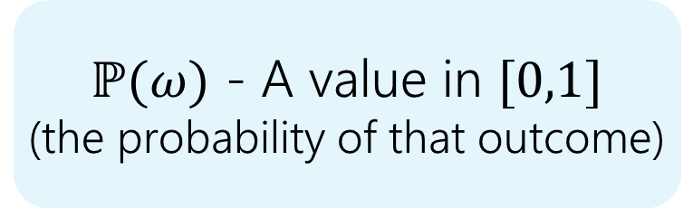


Probability
A probability is a number between 0 and 1 describing how likely a particular outcome or event is.
Probability
We define a function $ℙ$ that assigns a probability to every outcome $ω$ in the sample space.
$$ω$$
(a particular outcome
- an element of $Ω$)
$ℙ(ω)$ - A value in $[0,1]$
(the probability of that outcome)
$$ℙ$$
Notation: $ℙ\left(ω\right)$, $P(ω)$, $Pr⁡(ω)$ are all equivalent!

Slide 22

Example
Imagine we toss one coin.
Our sample space $Ω=\{H,T\}$
What do you want $ℙ$ to be?
  Recall: $ℙ$ assigns a probability to each outcome in the sample space

Slide 23
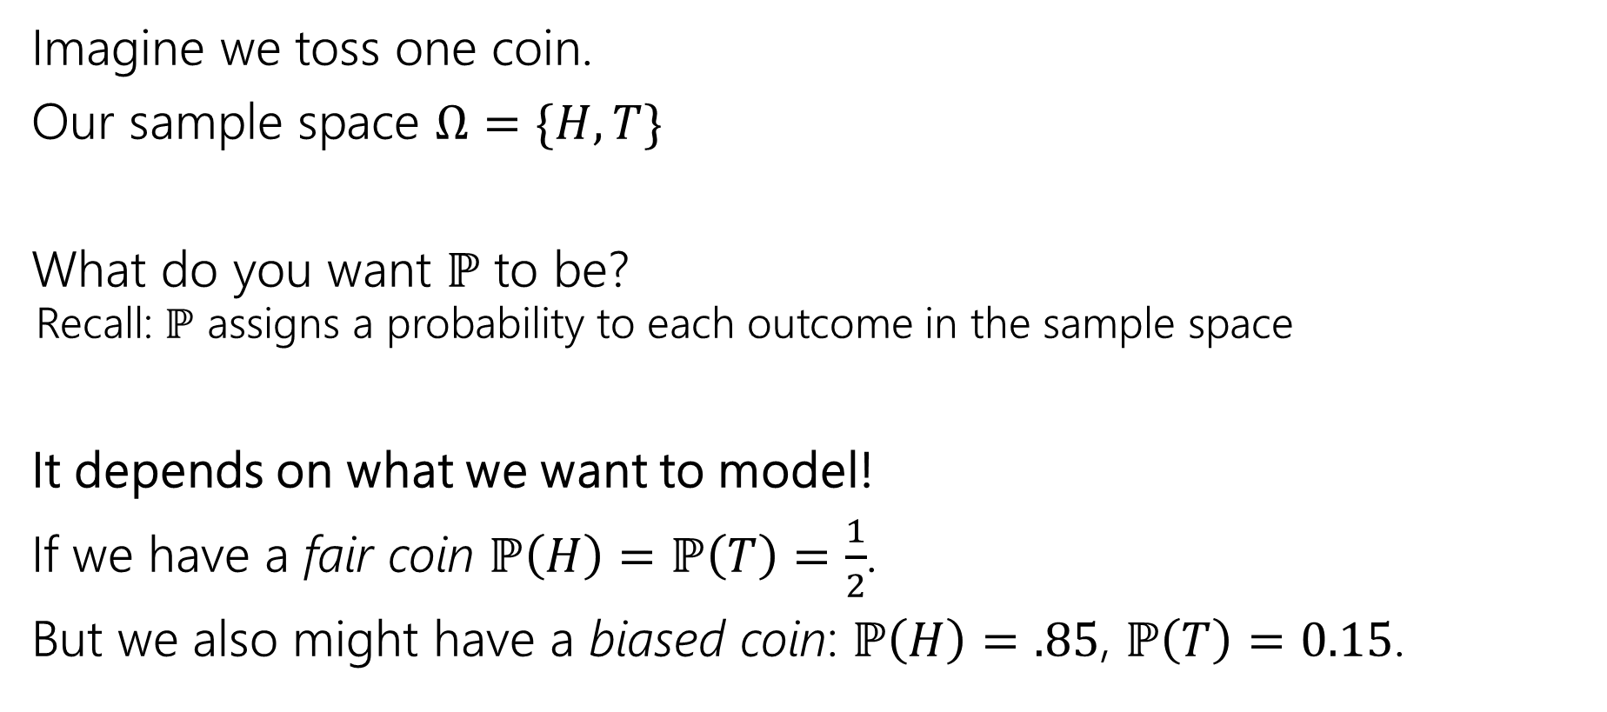
Example
Imagine we toss one coin.
Our sample space $Ω=\{H,T\}$
What do you want $ℙ$ to be?
  Recall: $ℙ$ assigns a probability to each outcome in the sample space
It depends on what we want to model!
If we have a fair coin $ℙ\left(H\right)=ℙ\left(T\right)=\frac{1}{2}$.
But we also might have a biased coin: $ℙ\left(H\right)=.85$, $ℙ\left(T\right)=0.15$.

Slide 24
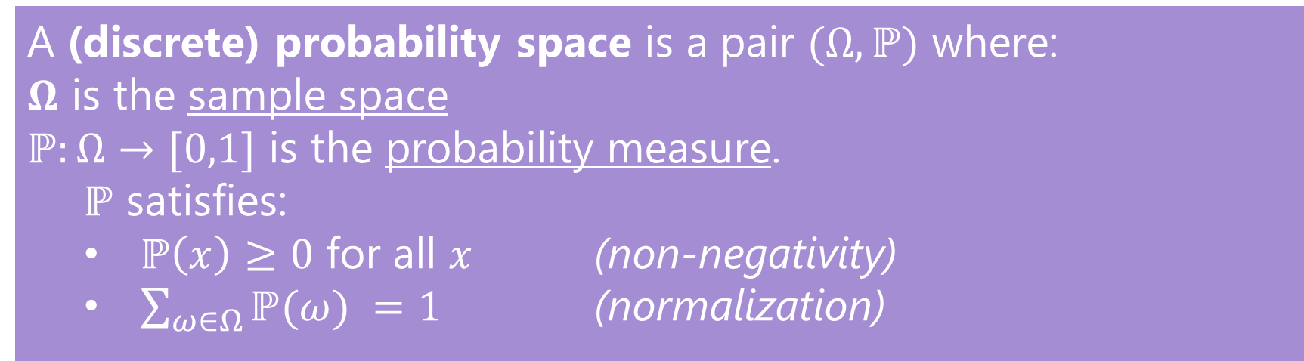
Probability Space
Probability Space
A (discrete) probability space is a pair $(Ω,ℙ)$ where:
$Ω$ is the sample space
$ℙ:Ω→[0,1]$ is the probability measure.
  $ℙ$ satisfies:
  $ℙ\left(x\right)≥0$ for all $x$ (non-negativity)
  $\sum_{ω∈Ω}{ℙ(ω)} =1$ (normalization)

Slide 25

Probability Space
Experiment: Flip a fair coin and roll a fair (6-sided) die.
$Ω=\left\{H,T\right\}×\left\{1,2,3,4,5,6\right\}=\{\left(H,1\right),\left(H,2\right)….,\left(T,1\right),\left(T,2\right),…\}$
$ℙ\left(ω\right)=\frac{1}{12}$ for every $ω∈Ω$
Is $(Ω,ℙ)$ a valid probability space?

Slide 26
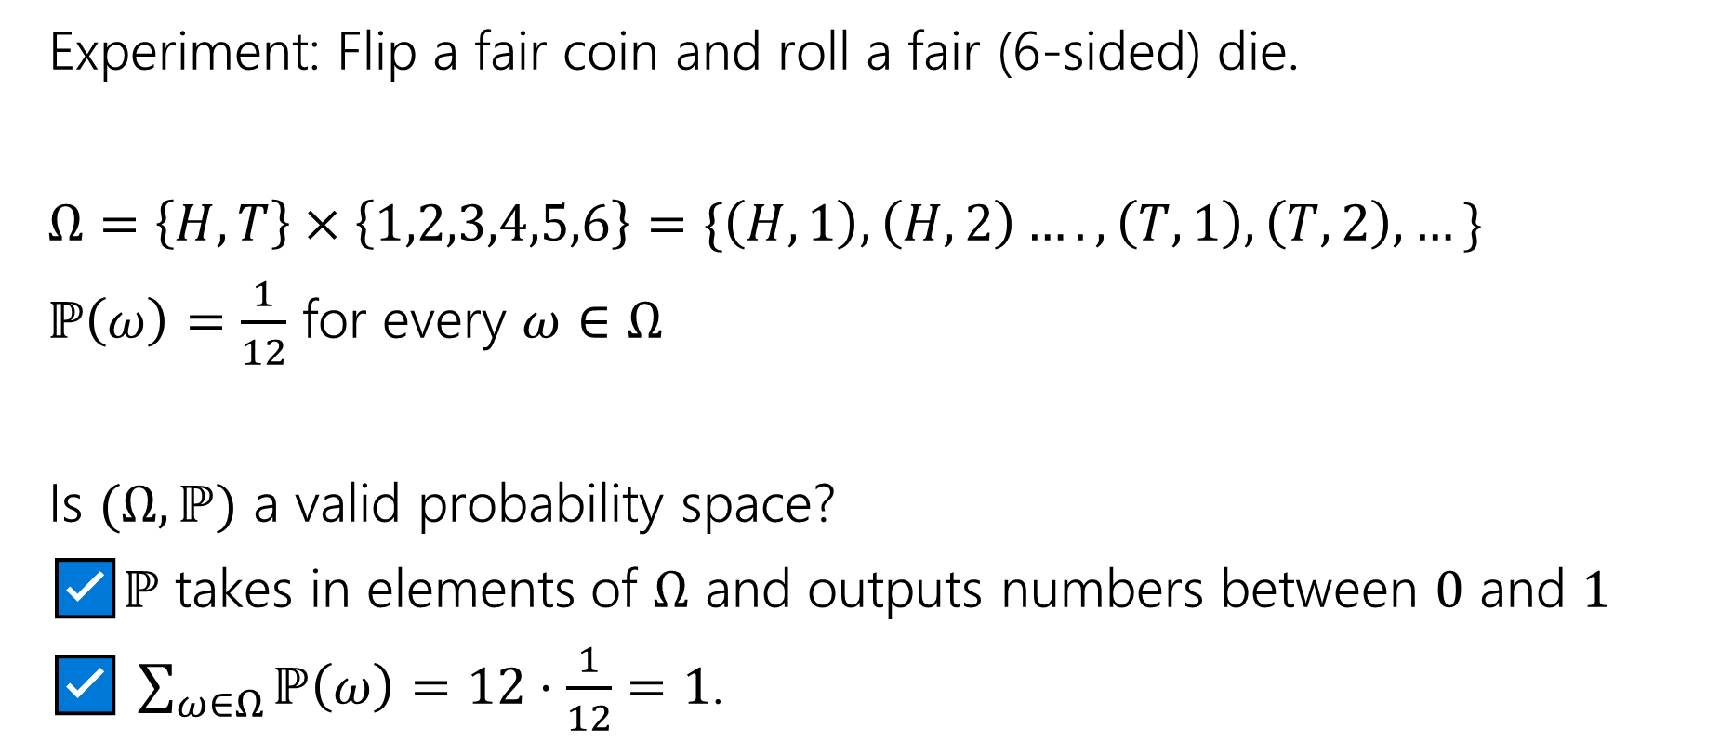
Probability Space
Experiment: Flip a fair coin and roll a fair (6-sided) die.
$Ω=\left\{H,T\right\}×\left\{1,2,3,4,5,6\right\}=\{\left(H,1\right),\left(H,2\right)….,\left(T,1\right),\left(T,2\right),…\}$
$ℙ\left(ω\right)=\frac{1}{12}$ for every $ω∈Ω$
Is $(Ω,ℙ)$ a valid probability space?
☑️$ℙ$ takes in elements of $Ω$ and outputs numbers between $0$ and $1$
☑️ $\sum_{ω∈Ω}{ℙ\left(ω\right)}=12⋅\frac{1}{12}=1$.

Slide 27
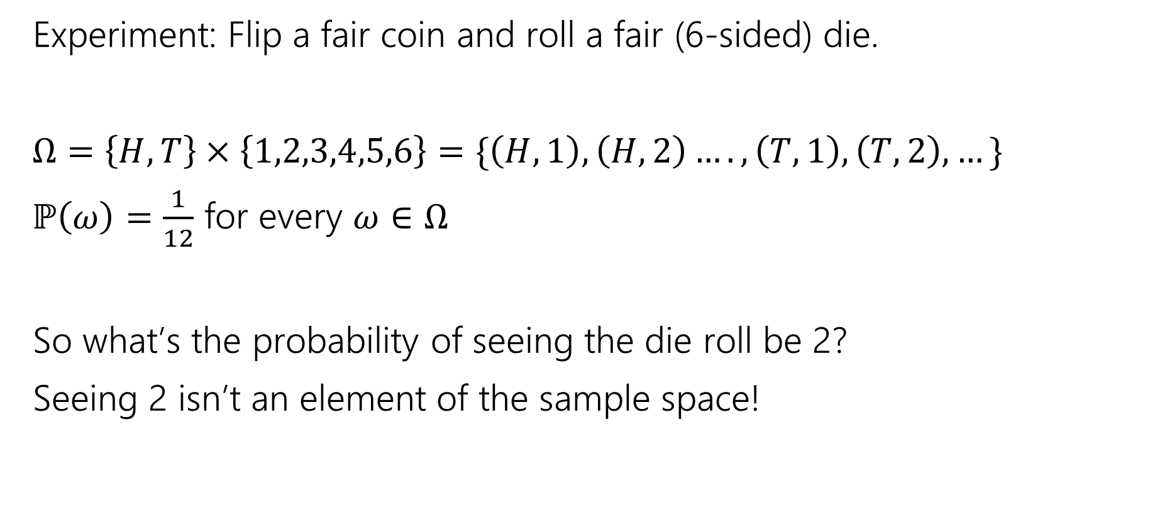
Probability Space
Experiment: Flip a fair coin and roll a fair (6-sided) die.
$Ω=\left\{H,T\right\}×\left\{1,2,3,4,5,6\right\}=\{\left(H,1\right),\left(H,2\right)….,\left(T,1\right),\left(T,2\right),…\}$
$ℙ\left(ω\right)=\frac{1}{12}$ for every $ω∈Ω$
So what’s the probability of seeing the die roll be 2?
Seeing 2 isn’t an element of the sample space!

Slide 28
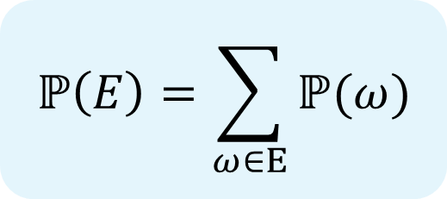

Probability of An Event
Formally, $ℙ$ takes in only single outcomes. But…we will use the same notation to define the probability of an event (set of outcomes)!
$$ℙ\left(E\right)=\sum_{ω∈E}{ℙ(ω)}$$

Slide 29

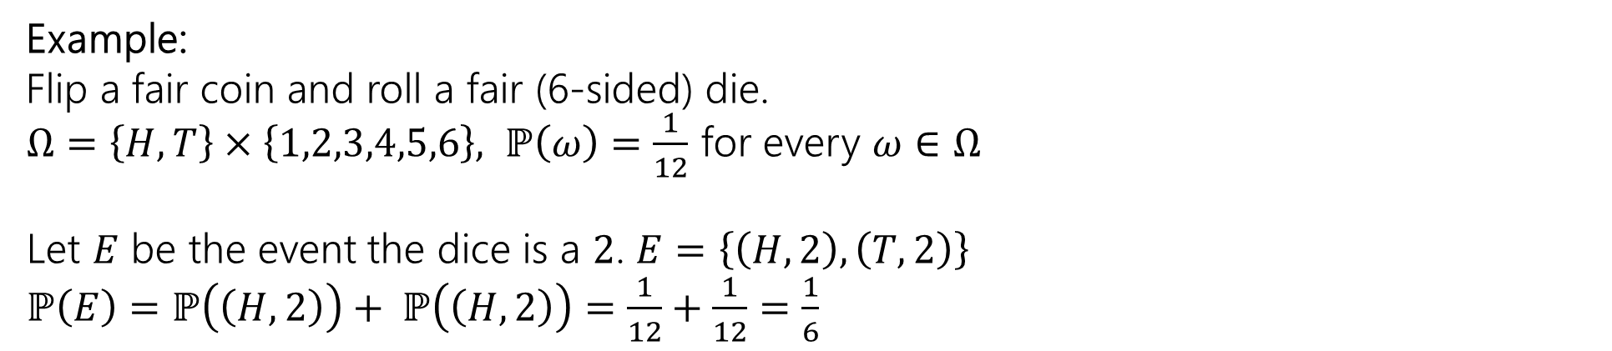
Probability of An Event
Formally, $ℙ$ takes in only single outcomes. But…we will use the same notation to define the probability of an event (set of outcomes)!
$$ℙ\left(E\right)=\sum_{ω∈E}{ℙ(ω)}$$
Example:
Flip a fair coin and roll a fair (6-sided) die.
$Ω=\left\{H,T\right\}×\left\{1,2,3,4,5,6\right\}, ℙ\left(ω\right)=\frac{1}{12}$ for every $ω∈Ω$
Let $E$ be the event the dice is a $2$. $E=\left\{\left(H,2\right), \left(T,2\right)\right\}$
$ℙ\left(E\right)=ℙ\left(\left(H,2\right)\right)+ ℙ\left(\left(H,2\right)\right)=\frac{1}{12}+\frac{1}{12}=\frac{1}{6}$

Slide 30
Probability Facts

Slide 31
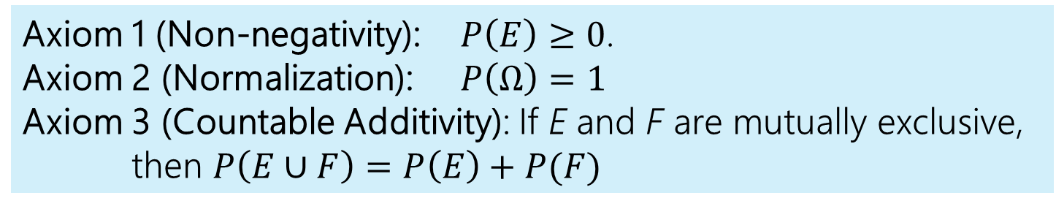

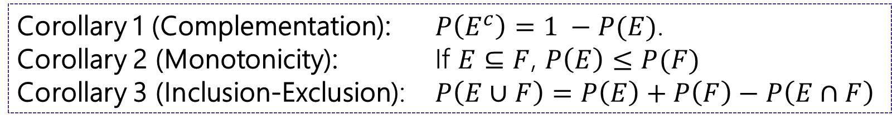
Axioms of Probability
Let $Ω$ denote the sample space and $E, F⊆Ω$ be events.
Axiom 1 (Non-negativity): $P\left(E\right)≥0$.
Axiom 2 (Normalization): $P\left(Ω\right)=1$
Axiom 3 (Countable Additivity): If E and F are mutually exclusive,
then $P\left(E∪F\right)=P\left(E\right)+P(F)$
Corollary 1 (Complementation): $P\left(E^{c}\right)=1 −P(E)$.
Corollary 2 (Monotonicity): If $E⊆F$, $P\left(E\right)≤P(F)$
Corollary 3 (Inclusion-Exclusion): $P\left(E∪F\right)=P\left(E\right)+P\left(F\right)−P\left(E∩F\right)$

Slide 32
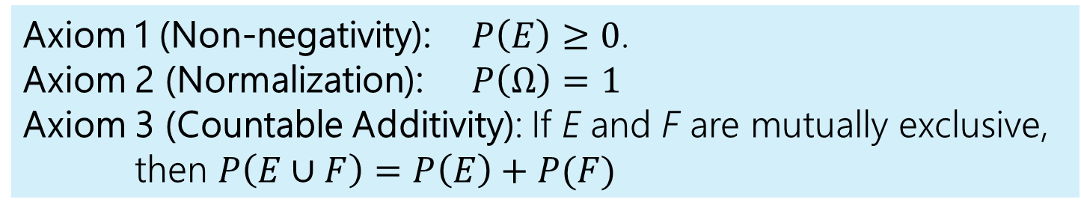
Axioms of Probability & Corollaries
Let $Ω$ denote the sample space and $E, F⊆Ω$ be events.
Axiom 1 (Non-negativity): $P\left(E\right)≥0$.
Axiom 2 (Normalization): $P\left(Ω\right)=1$
Axiom 3 (Countable Additivity): If E and F are mutually exclusive,
then $P\left(E∪F\right)=P\left(E\right)+P(F)$

Slide 33
Uniform Probability Spaces
A common type of probability space!

Slide 34

Uniform Probability Space
In a uniform probability space $\left(Ω,ℙ\right)$, every outcome in the sample space is equally likely to occur. For every outcome $ω∈Ω$,
$ℙ\left(ω\right)= ?$

Slide 35
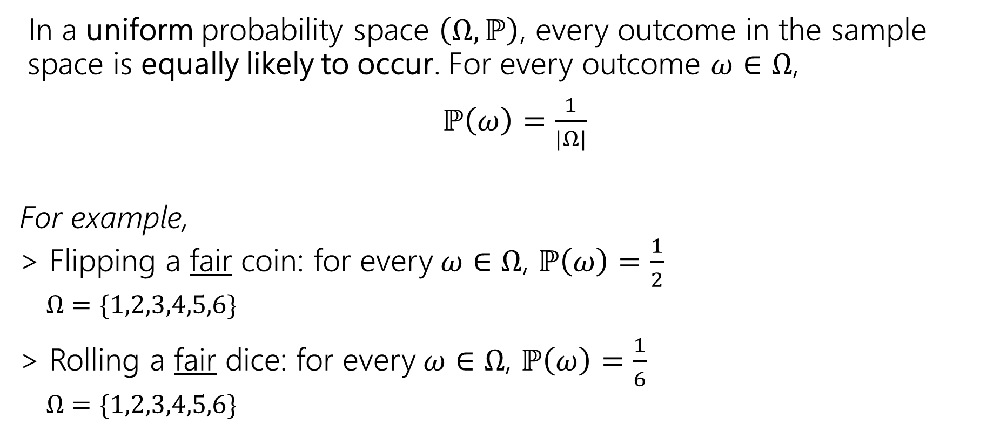
Uniform Probability Space
In a uniform probability space $\left(Ω,ℙ\right)$, every outcome in the sample space is equally likely to occur. For every outcome $ω∈Ω$,
$ℙ\left(ω\right)=\frac{1}{|Ω|}$
For example,
> Flipping a fair coin: for every$ω∈Ω$, $ℙ\left(ω\right)=\frac{1}{2}$
  $Ω=\{1,2,3,4,5,6\}$
> Rolling a fair dice: for every$ω∈Ω$, $ℙ\left(ω\right)=\frac{1}{6}$
  $Ω=\{1,2,3,4,5,6\}$

Slide 36
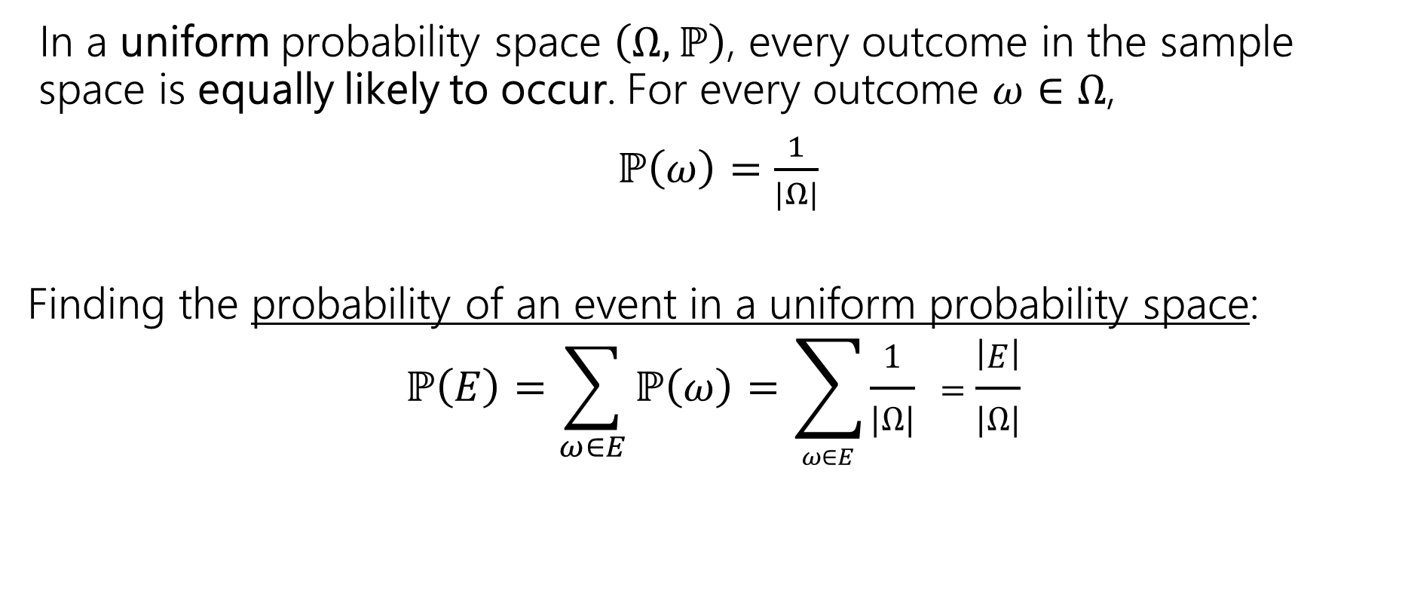
Uniform Probability Space
In a uniform probability space $\left(Ω,ℙ\right)$, every outcome in the sample space is equally likely to occur. For every outcome $ω∈Ω$,
$ℙ\left(ω\right)=\frac{1}{|Ω|}$
Finding the probability of an event in a uniform probability space:
$$ℙ\left(E\right)=\sum_{ω∈E}{ℙ\left(ω\right)}=\sum_{ω∈E}{\frac{1}{|Ω|} =\frac{\left|E\right|}{|Ω|}}$$

Slide 37
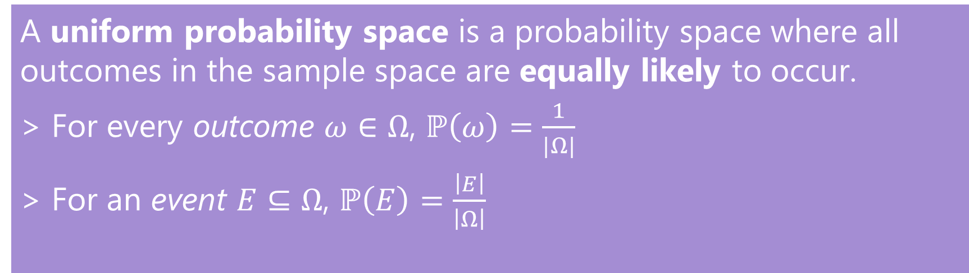
Uniform Probability Space (summarized ☺)
Uniform Probability Space
In a uniform probability space $\left(Ω,ℙ\right)$, every outcome in the sample space is equally likely to occur. For every outcome $ω∈Ω$,
$ℙ\left(ω\right)=\frac{1}{|Ω|}$
Finding the probability of an event in a uniform probability space:
$$ℙ\left(E\right)=\sum_{ω∈E}{ℙ\left(ω\right)}=\sum_{ω∈E}{\frac{1}{|Ω|} =\frac{\left|E\right|}{|Ω|}}$$
A uniform probability space is a probability space where all outcomes in the sample space are equally likely to occur.
> For every outcome $ω∈Ω$, $ℙ\left(ω\right)=\frac{1}{|Ω|}$
> For an event $E⊆Ω$, $ℙ\left(E\right)=\frac{\left|E\right|}{\left|Ω\right|}$

Slide 38
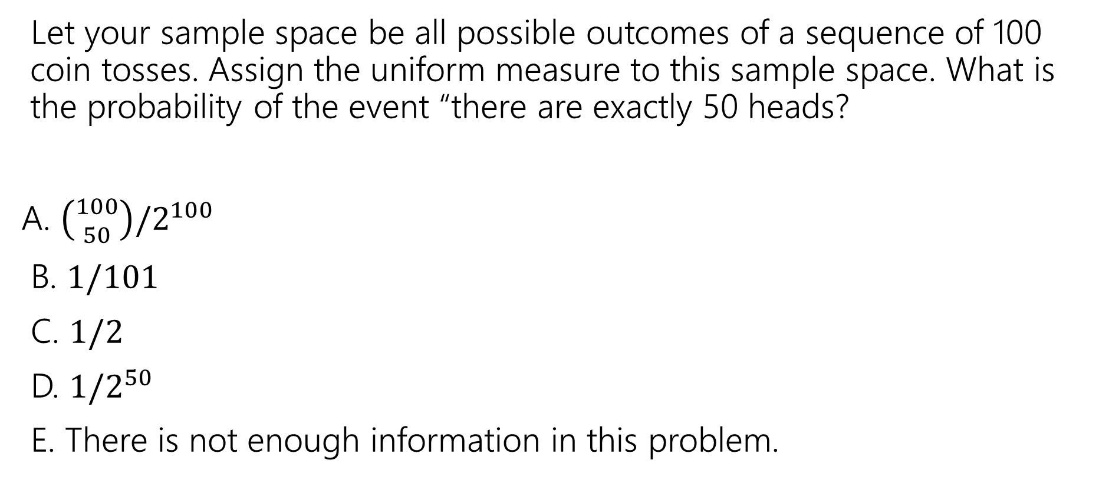
Uniform Probability Space
Let your sample space be all possible outcomes of a sequence of 100 coin tosses. Assign the uniform measure to this sample space. What is the probability of the event “there are exactly 50 heads?
A. $\left({100 \atop 50}\right)/2^{100}$
B. $1/101$
C. $1/2$
D. $1/2^{50}$
E. There is not enough information in this problem.
pollev.com/jolie312 and login with your UW net ID

Slide 39
Uniform Probability Space
Let your sample space be all possible outcomes of a sequence of 100 coin tosses. Assign the uniform measure to this sample space. What is the probability of the event “there are exactly 50 heads?

Slide 40

Uniform Probability Space
Let your sample space be all possible outcomes of a sequence of 100 coin tosses. Assign the uniform measure to this sample space. What is the probability of the event “there are exactly 50 heads?
$Ω$ is the set of all possible sequences of 100 coin tosses
  $\left|Ω\right|=2^{100}$ because each of the 100 coin tosses have $2$ options if it is head or tails

Slide 41
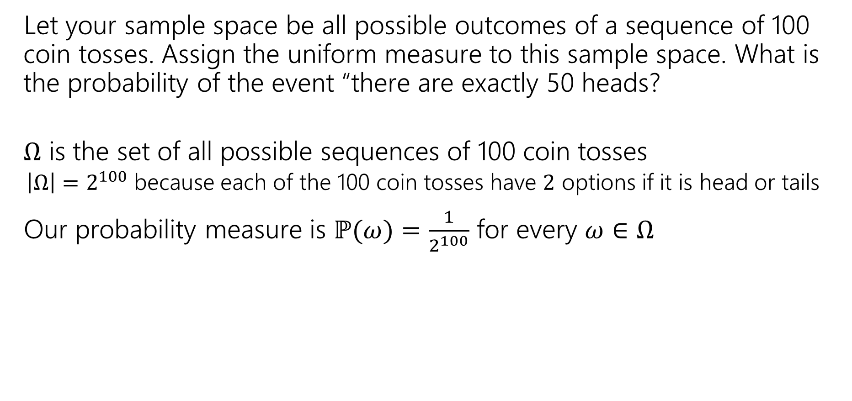
Uniform Probability Space
Let your sample space be all possible outcomes of a sequence of 100 coin tosses. Assign the uniform measure to this sample space. What is the probability of the event “there are exactly 50 heads?
$Ω$ is the set of all possible sequences of 100 coin tosses
  $\left|Ω\right|=2^{100}$ because each of the 100 coin tosses have $2$ options if it is head or tails
Our probability measure is $ℙ(ω)=\frac{1}{2^{100}}$ for every $ω∈Ω$

Slide 42
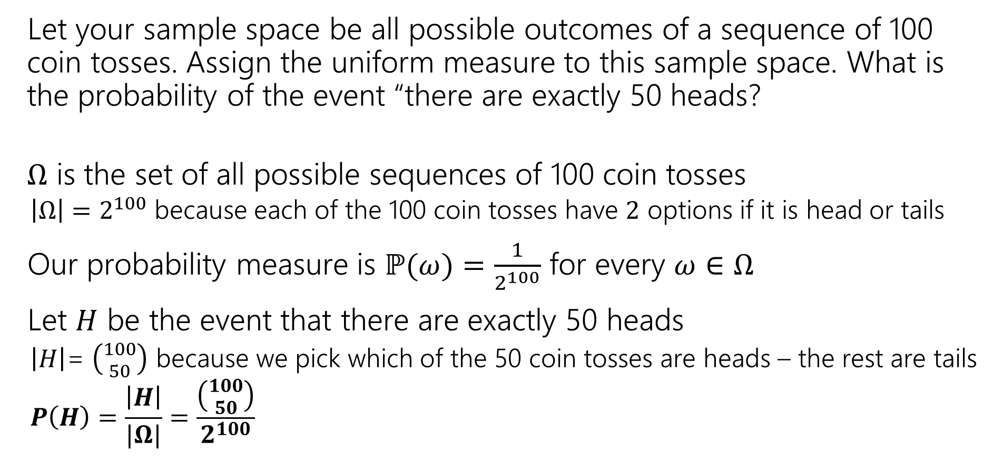
Uniform Probability Space
Let your sample space be all possible outcomes of a sequence of 100 coin tosses. Assign the uniform measure to this sample space. What is the probability of the event “there are exactly 50 heads?
$Ω$ is the set of all possible sequences of 100 coin tosses
  $\left|Ω\right|=2^{100}$ because each of the 100 coin tosses have $2$ options if it is head or tails
Our probability measure is $ℙ(ω)=\frac{1}{2^{100}}$ for every $ω∈Ω$
Let $H$ be the event that there are exactly 50 heads
  $\left|H\right|$= $\left({100 \atop 50}\right)$ because we pick which of the 50 coin tosses are heads – the rest are tails
  $$P\left(H\right)=\frac{\left|H\right|}{|Ω|}=\frac{\left({100 \atop 50}\right)}{2^{100}}$$

Slide 43
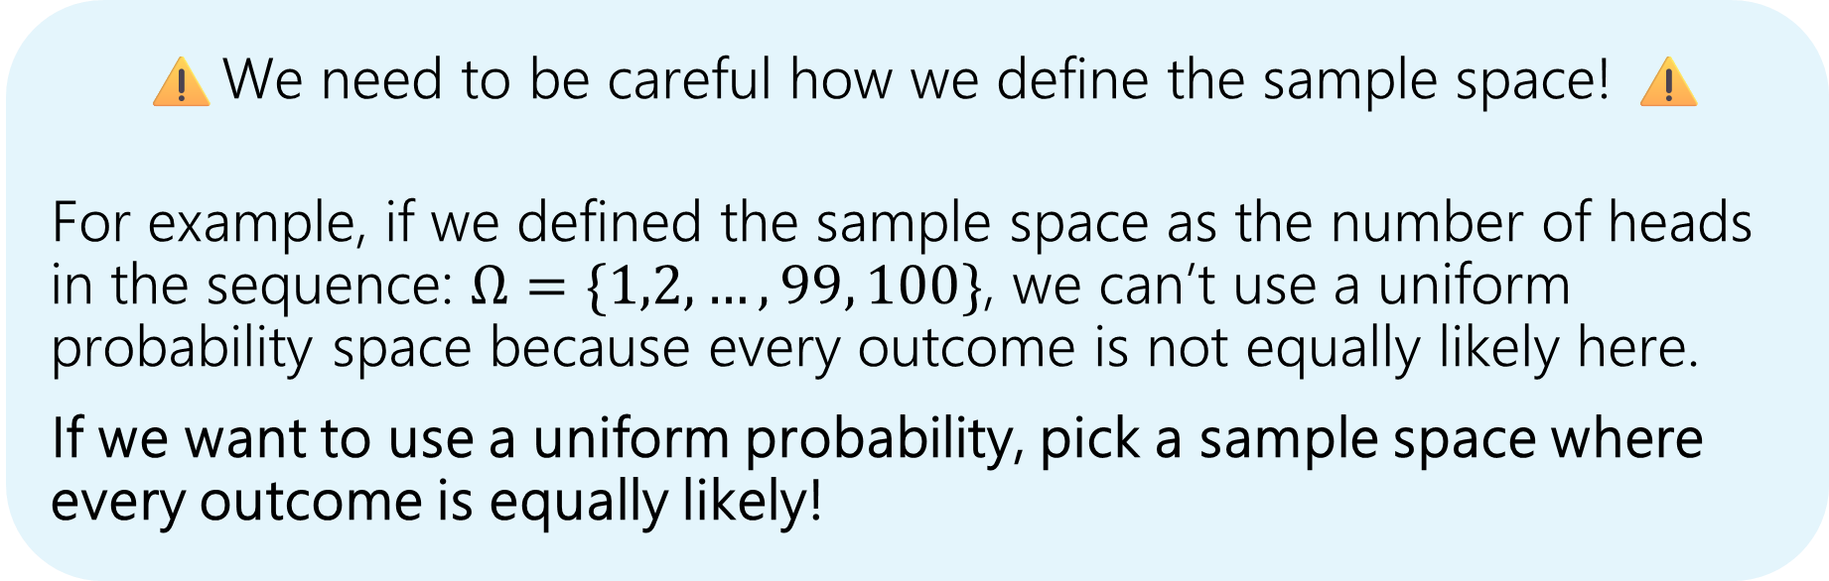
Uniform Probability Space
Let your sample space be all possible outcomes of a sequence of 100 coin tosses. Assign the uniform measure to this sample space. What is the probability of the event “there are exactly 50 heads?
⚠️We need to be careful how we define the sample space! ⚠️
For example, if we defined the sample space as the number of heads in the sequence: $Ω=\{1,2,…,99, 100\}$, we can’t use a uniform probability space because every outcome is not equally likely here.
If we want to use a uniform probability, pick a sample space where every outcome is equally likely!

Slide 44
More examples
Mainly focusing on uniform probability spaces

Slide 45
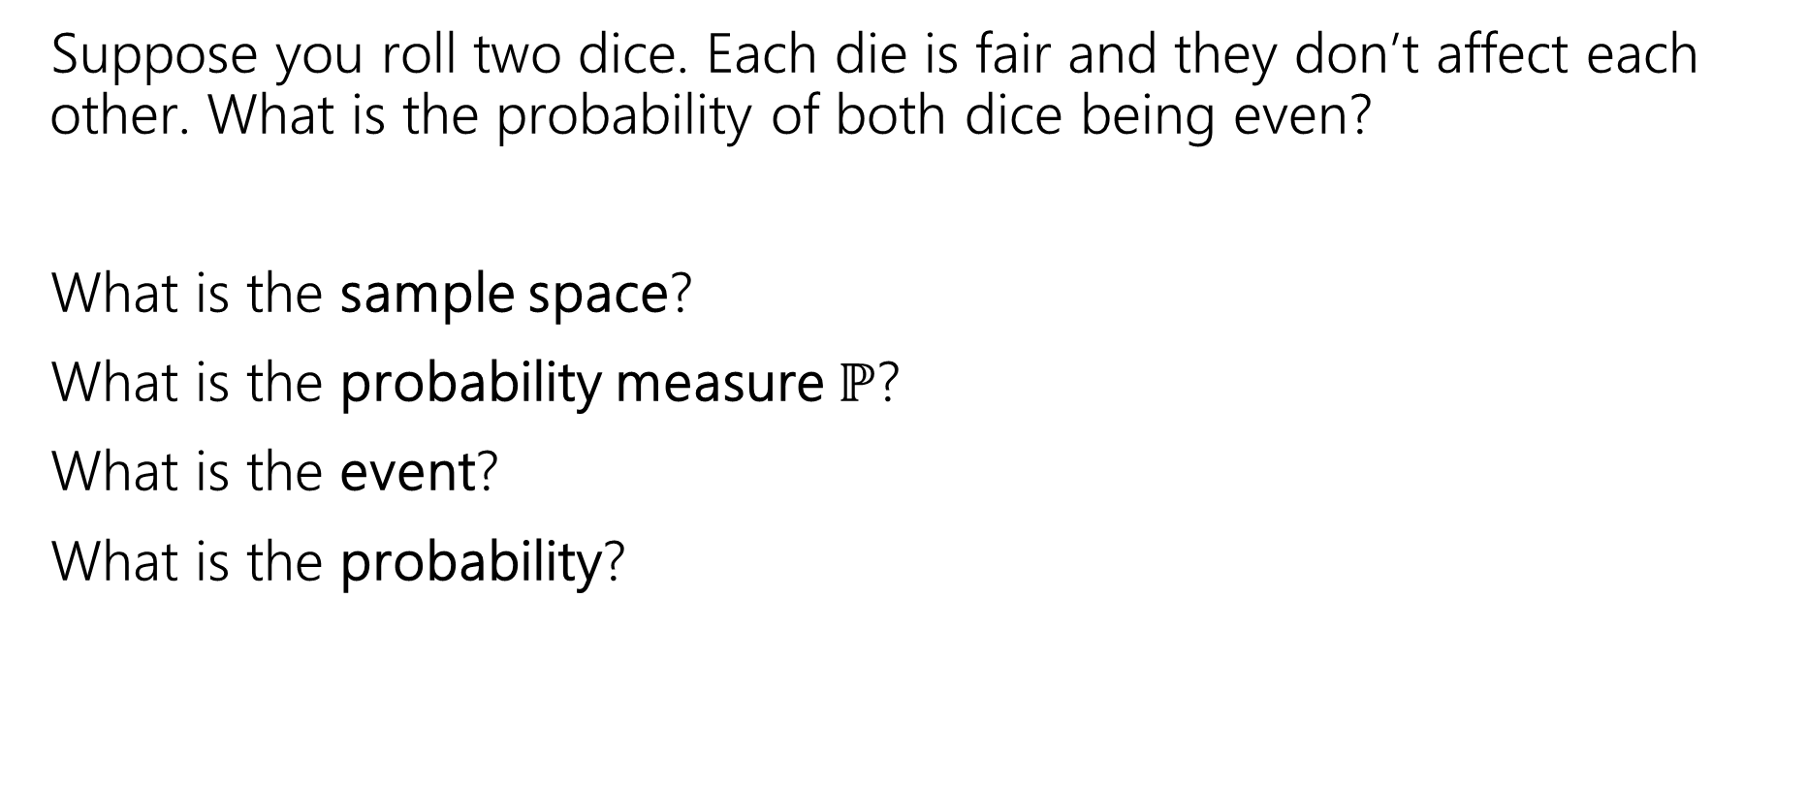
More Examples!
Suppose you roll two dice. Each die is fair and they don’t affect each other. What is the probability of both dice being even?
What is the sample space?
What is the probability measure $ℙ$?
What is the event?
What is the probability?

Slide 46
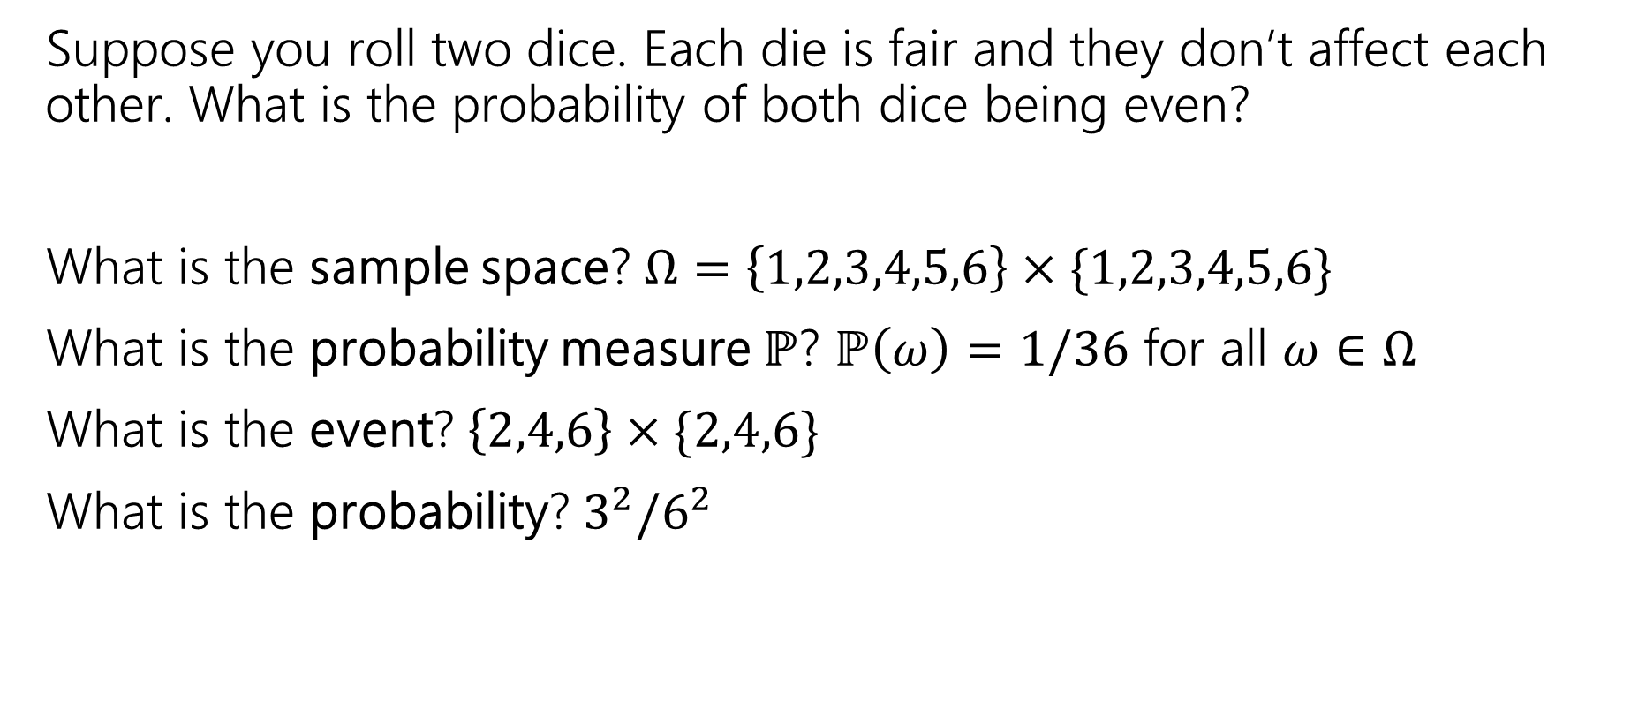
More Examples!
Suppose you roll two dice. Each die is fair and they don’t affect each other. What is the probability of both dice being even?
What is the sample space? $Ω=\left\{1,2,3,4,5,6\right\}×\{1,2,3,4,5,6\}$
What is the probability measure $ℙ$? $ℙ\left(ω\right)=1/36$ for all $ω∈Ω$
What is the event? $\left\{2,4,6\right\}×\{2,4,6\}$
What is the probability? $3^{2}/6^{2}$

Slide 47
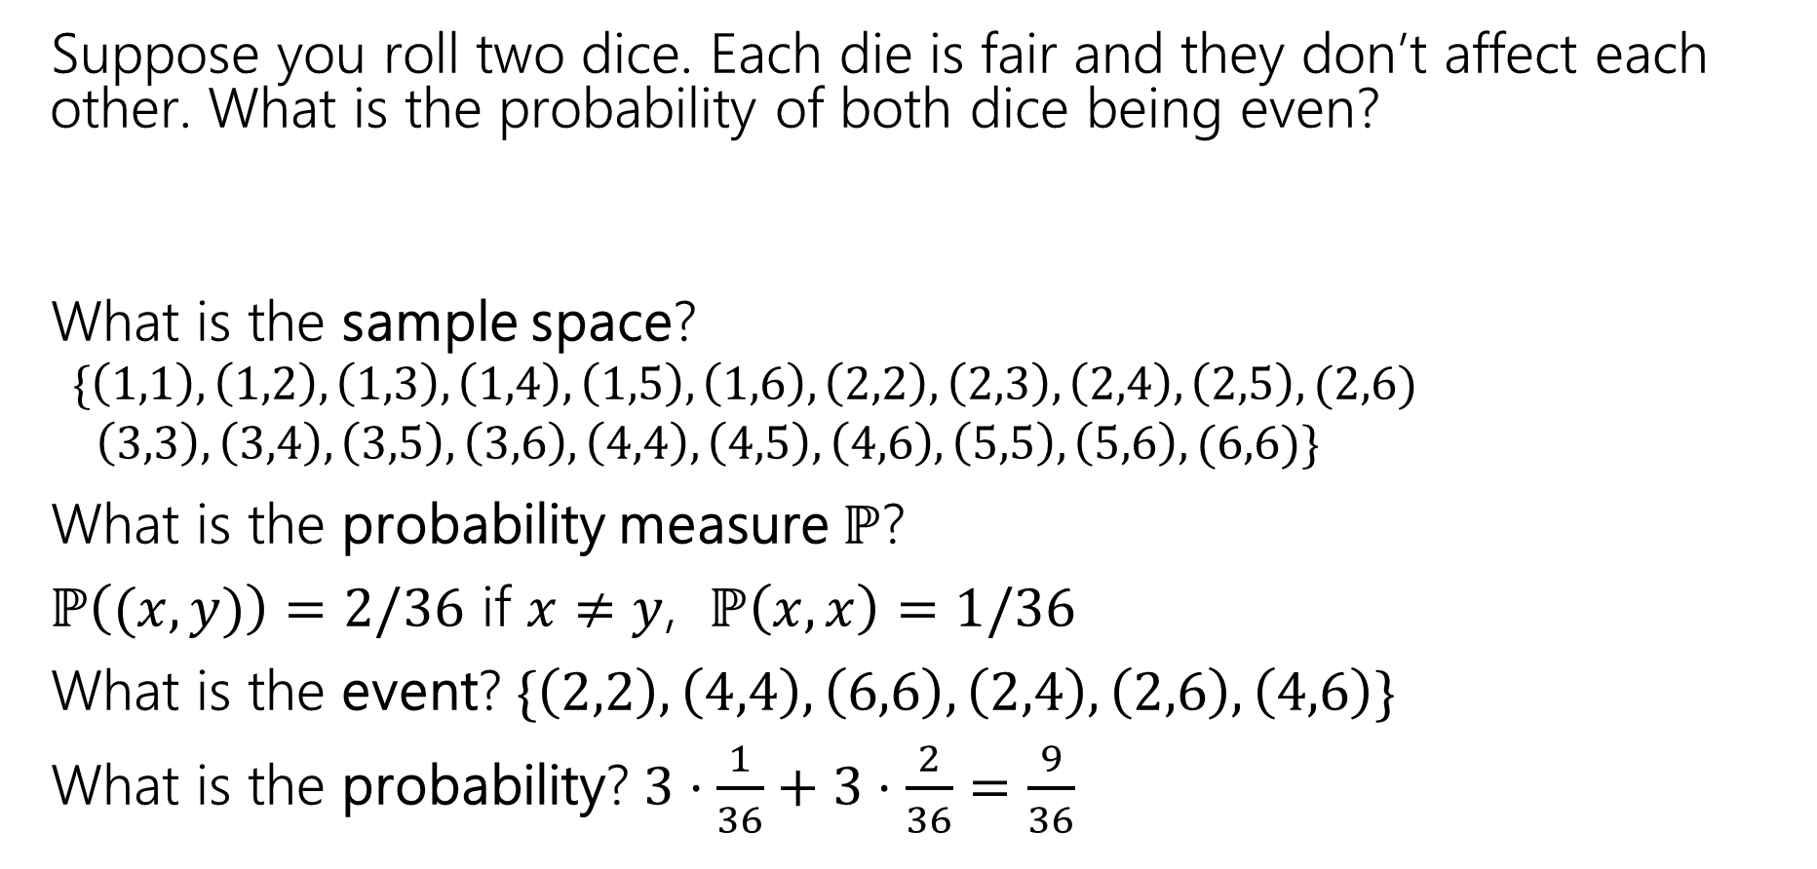
More Examples!
Suppose you roll two dice. Each die is fair and they don’t affect each other. What is the probability of both dice being even?
What is the sample space?
  $$\{\left(1,1\right),\left(1,2\right),\left(1,3\right),\left(1,4\right),\left(1,5\right),\left(1,6\right), \left(2,2\right),\left(2,3\right), \left(2,4\right),\left(2,5\right), (2,6)$$
  $\left(3,3\right),\left(3,4\right),\left(3,5\right),\left(3,6\right),\left(4,4\right),\left(4,5\right),\left(4,6\right),\left(5,5\right),\left(5,6\right), (6,6)\}$
What is the probability measure $ℙ$?
$ℙ\left((x,y)\right)=2/36$ if $x≠y$, $ℙ\left(x,x\right)=1/36$
What is the event? $\{\left(2,2\right),\left(4,4\right),\left(6,6\right), \left(2,4\right),\left(2,6\right),\left(4,6\right)\}$
What is the probability? $3⋅\frac{1}{36}+3⋅\frac{2}{36}=\frac{9}{36}$
What if we defined our sample space as the unordered pairs of the die?

Slide 48
Takeaways
There is often more than one sample space possible! But one is probably easier than the others.
Finding a sample space that will make the uniform measure correct will usually make finding the probabilities easier to calculate.
  This often involves deciding what kind of information we need to encode in the sample space (e.g., should we care about order or not?)

Slide 49
Another Example
Suppose you shuffle a deck of cards so any arrangement is equally likely. What is the probability that the top two cards have the same value?
Sample Space:
Probability Measure:
Event:
Probability:

Slide 50
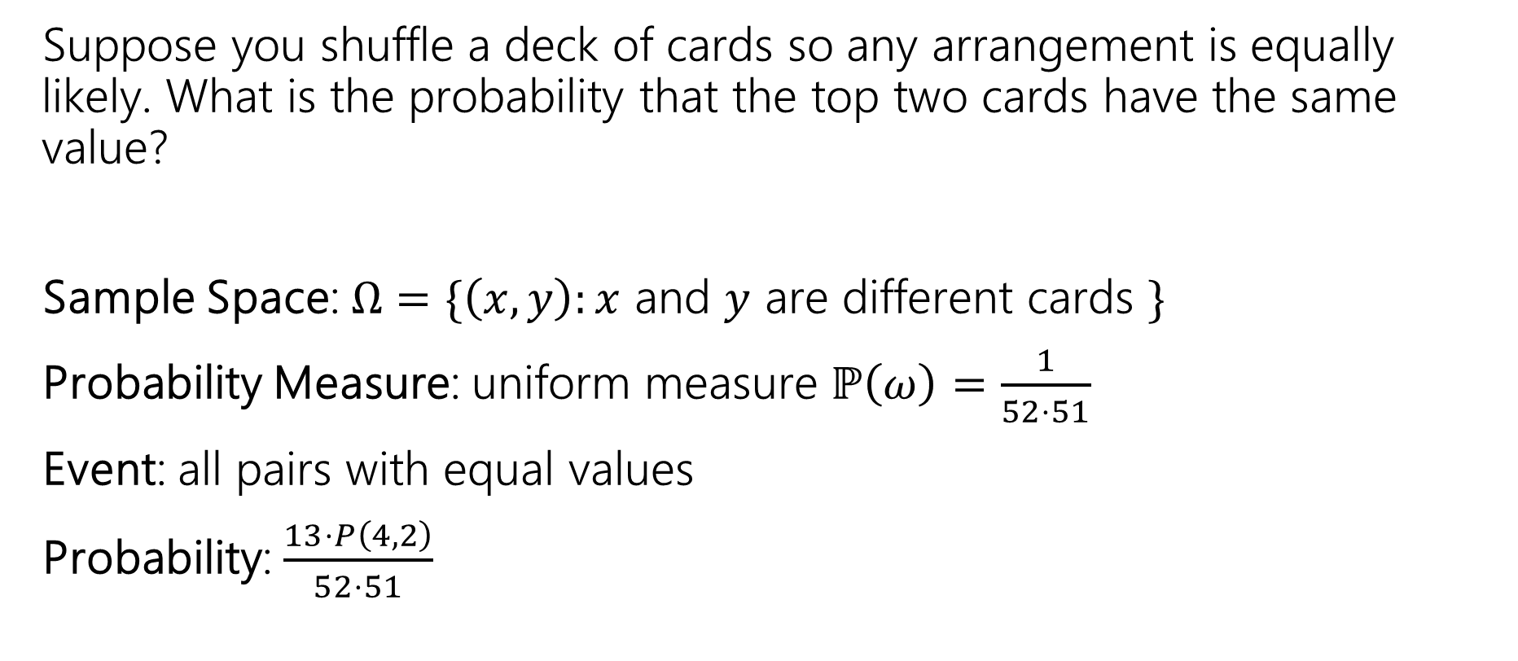
Another Example
Suppose you shuffle a deck of cards so any arrangement is equally likely. What is the probability that the top two cards have the same value?
Sample Space: $Ω=\{\left(x,y\right):x$ and $y$ are different cards $\}$
Probability Measure: uniform measure $ℙ\left(ω\right)=\frac{1}{52⋅51}$
Event: all pairs with equal values
Probability: $\frac{13⋅P\left(4,2\right)}{52⋅51}$

Slide 51
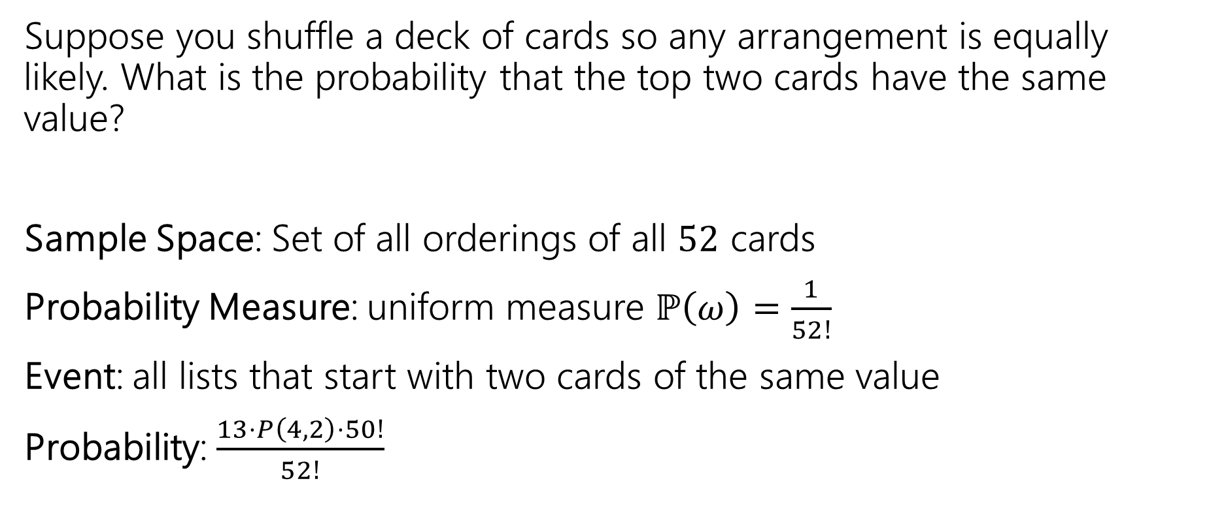
Another Example
Suppose you shuffle a deck of cards so any arrangement is equally likely. What is the probability that the top two cards have the same value?
Sample Space: Set of all orderings of all $52$ cards
Probability Measure: uniform measure $ℙ\left(ω\right)=\frac{1}{52!}$
Event: all lists that start with two cards of the same value
Probability: $\frac{13⋅P\left(4,2\right)⋅50!}{52!}$

Slide 52
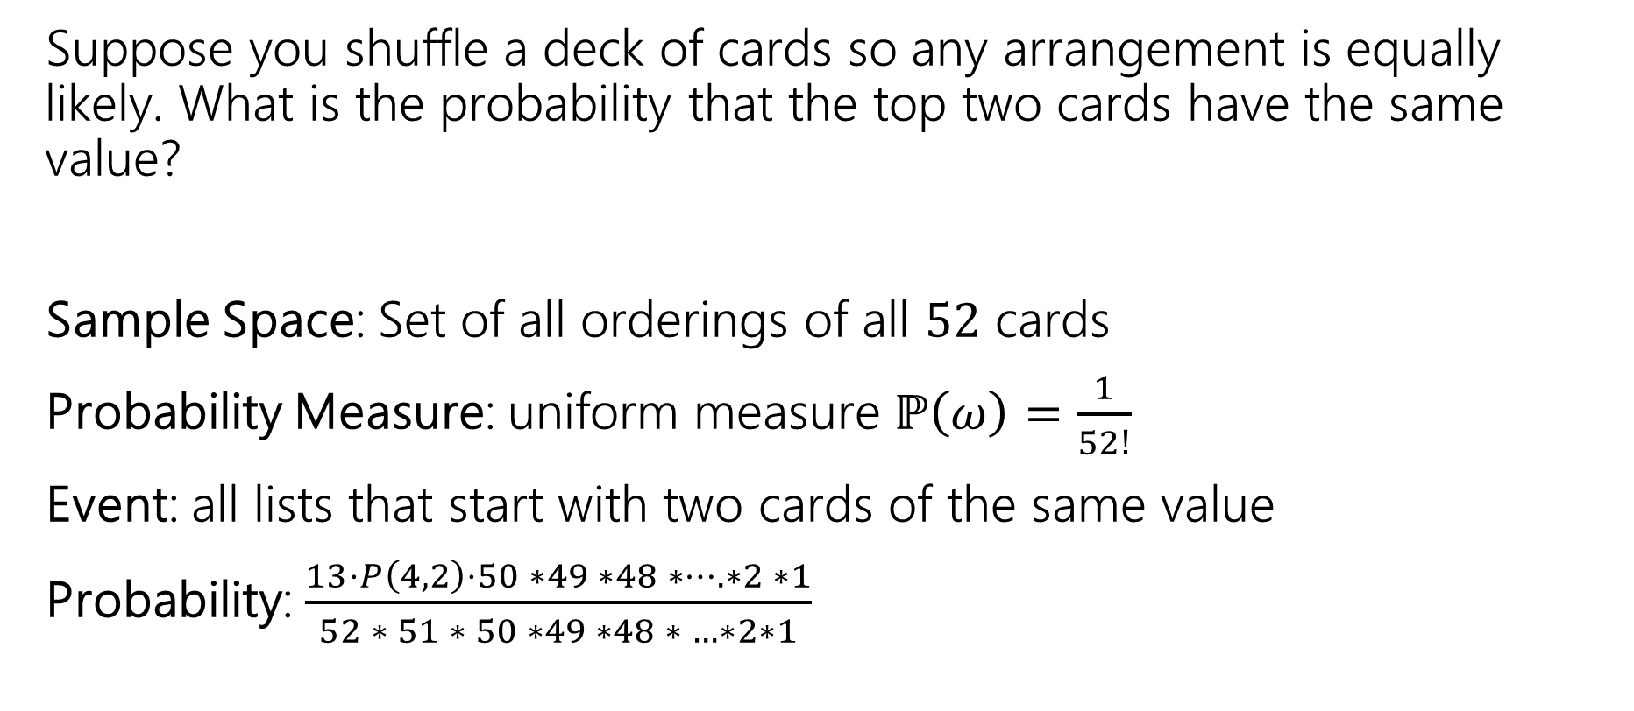
Another Example
Suppose you shuffle a deck of cards so any arrangement is equally likely. What is the probability that the top two cards have the same value?
Sample Space: Set of all orderings of all $52$ cards
Probability Measure: uniform measure $ℙ\left(ω\right)=\frac{1}{52!}$
Event: all lists that start with two cards of the same value
Probability: $\frac{13⋅P\left(4,2\right)⋅50 ∗49 ∗48 ∗…. ∗2 ∗1}{52 ∗ 51 ∗ 50 ∗49 ∗48 ∗ …∗2∗1}$

Slide 53
Takeaway
There’s often information you “don’t need” in your sample space.
It won’t give you the wrong answer.
But it sometimes makes for extra work/a harder counting problem,
Good indication: you cancelled A LOT of stuff that was common in the numerator and denominator.

Slide 54
Few notes about events and samples spaces
If you’re dealing with a situation where you may be able to use a uniform probability space, make sure to set up the sample space in a way that every outcome is equally likely.
Try not overcomplicate the sample space – only include the information that you need in it.
When you define an event, make sure it is a subset of the sample space!
  e.g., if order matters in the sample space, it should also matter in the event space

Slide 55

Some Quick Observations
For discrete probability spaces (the kind we’ve seen so far)
$ℙ\left(E\right)=0$ if and only if ?
$ℙ\left(E\right)=1$ if and only if ?

Slide 56

Some Quick Observations
For discrete probability spaces (the kind we’ve seen so far)
$ℙ\left(E\right)=0$ if and only if an event can’t happen.
$ℙ\left(E\right)=1$ if and only if an event is guaranteed (every outcome outside $E$has probability $0$).

Slide 57
Birthday Paradox

Slide 58

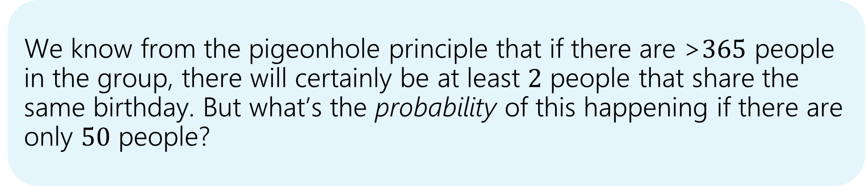
Sharing Birthdays🎂
There are about $50$ people in this class. What is the probability that at least $2$ of us share a birthday? Assume that there are exactly $365$ possible birthdays, and each possibility is equally likely.
We know from the pigeonhole principle that if there are >$365$ people in the group, there will certainly be at least $2$ people that share the same birthday. But what’s the probability of this happening if there are only $50$ people?

Slide 59
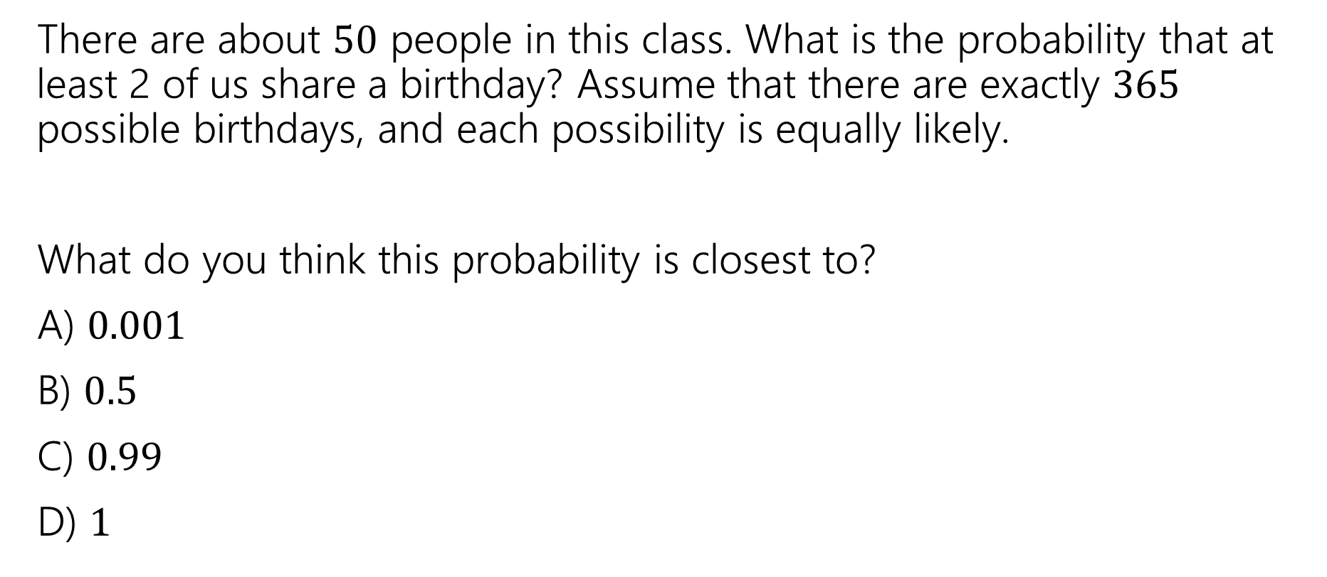
Sharing Birthdays🎂
There are about $50$ people in this class. What is the probability that at least 2 of us share a birthday? Assume that there are exactly $365$ possible birthdays, and each possibility is equally likely.
What do you think this probability is closest to?
A) $0.001$
B) $0.5$
C) $0.99$
D) $1$
Let’s do another poll!
pollev.com/cse312

Slide 60
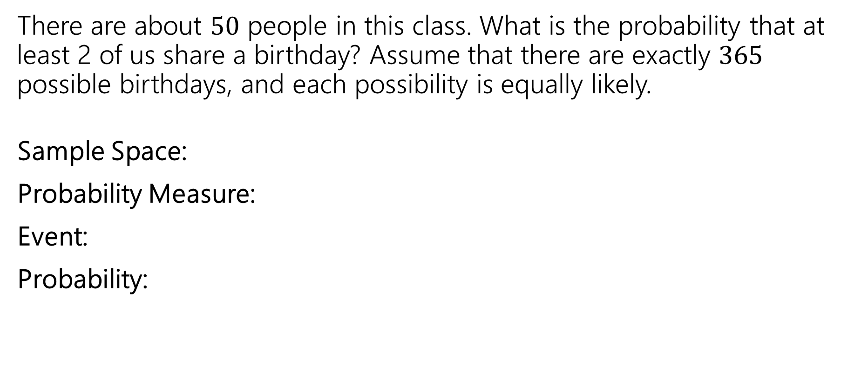
Sharing Birthdays🎂
There are about $50$ people in this class. What is the probability that at least 2 of us share a birthday? Assume that there are exactly $365$ possible birthdays, and each possibility is equally likely.
Sample Space:
Probability Measure:
Event:
Probability:

Slide 61

Sharing Birthdays🎂
There are about $50$ people in this class. What is the probability that at least 2 of us share a birthday? Assume that there are exactly $365$ possible birthdays, and each possibility is equally likely.
ℙ (at least 2 people out of 50 people share a birthday)
= 1 - ℙ (no one out of 50 people share a birthday)

Slide 62

What’s our sample space?
ℙ (no one out of 50 people share a birthday)
Sample space is the set of possible birthdays that 50 people can have.
- Birthdays can be repeated.
$\left|Ω\right|=\text{number} \text{of} \text{possible} \text{birthday} \text{assignments}={365}^{50}$

Slide 63

What’s our sample space and event?
ℙ (no one out of 50 people share a birthday)
Event is set of birthday assignments such that no one shares a birthday.
$\left|E\right|=P\left(365, 50\right)=\frac{365!}{\left(365−50\right)!}$

Slide 64

Sharing Birthdays🎂
There are about $50$ people in this class. What is the probability that at least 2 of us share a birthday? Assume that there are exactly $365$ possible birthdays, and each possibility is equally likely.
Sample Space: Set of assignments of birthdays to people.$\left|Ω\right|={365}^{50}$
Probability Measure: Uniform probability measure. $ℙ\left(ω\right)=\frac{1}{{365}^{50}}$ for $ω∈Ω$
Event: Let $E$ be the event that at least 2 people share a birthday.
Probability: $ℙ\left(E\right)=1−ℙ\left(\overline{E}\right)$.$\overline{E}$ is the event that no one shares a birthday.
$ℙ\left(\overline{E}\right)=\frac{\left|\overline{E}\right|}{\left|Ω\right|}=\frac{P(365,50)}{{365}^{50}}$.
  We use a permutation for $\left|\overline{E}\right|$because birthdays are “selected” without replacement, (all have different birthdays) and order matters (my birthday is different from your birthday, etc.)
  $$ℙ\left(E\right)=1−\frac{P\left(365,50\right)}{{365}^{50}}≈0.97.$$

Slide 65

Sharing Birthdays🎂
There are about $50$ people in this class. What is the probability that at least 2 of us share a birthday? Assume that there are exactly $365$ possible birthdays, and each possibility is equally likely.
  $$ℙ\left(E\right)=1−\frac{P\left(365,50\right)}{{365}^{50}}≈0.97.$$
This is pretty high! So almost definitely, two of us here share the same birthday 🥳

Slide 66

Sharing Birthdays Among n People🎂
Suppose there are $n$ people in this class. What is the probability that at least 2 of us share a birthday? Assume that there are exactly $365$ possible birthdays, and each possibility is equally likely.
  $$ℙ\left(E\right)=1−\frac{P\left(365,n\right)}{{365}^{n}}$$

Slide 67

Sharing Birthdays Among n People🎂

Slide 68
Sharing Birthdays Among n People🎂
We hit 50% with just 23 people!

Slide 69
Sharing Birthdays Among n People🎂
Probability over 99% with just 57 people!

Slide 70

That’s very likely! Why?
It turns out that human brains find thinking about probabilities difficult!
Our brains are a bit selfish! When it comes to the probability that someone shares our birthday, that would be $\frac{1}{365}$ - not quite so likely.
But if we’re looking at any pair’s birthday in a group of $n$ people, there are $\left({n \atop 2}\right)$ pairs of people, which grows quadratically with $n$. So the probability of at least one pair of people sharing a birthday approaches 1 pretty fast!

Slide 71

Summary
Probability allows us to assign a value between 0 and 1 to outomces
A random experiment is any process where the outcome is not known for certain
The sample space of an experiment is the set of all possible outcomes
An event is a subset of the sample space (some set of outcomes)
The probability space is the pair $(Ω,ℙ)$ where $Ω$ is the sample space and $ℙ$ is the probability measure (a function that assigns probabilities to every outcome $ω$ in the sample space)
  A uniform probability space is a common type of probability space where every outcome is equally likely. To find the probability of an event in a uniform probability space, we find the size of the event divided by the size of the sample space

Slide 72
More Examples

Slide 73
Example 3
Suppose I had a two, fair, 6-sided dice that we roll, one green, one red. What is the probability that we see at least one 3 in the two rolls?
Sample Space:
Probability Measure:
Event:
Probability:

Slide 74

Example 3
Suppose I had a two, fair, 6-sided dice that we roll, one green, one red. What is the probability that we see at least one 3 in the two rolls?
Sample Space: $\left\{1,2,3,4,5,6\right\}×\{1,2,3,4,5,6\}$
  $|Ω|$ is $6⋅6=36$ because each of the dice rolls have 6 options.
Probability Measure: $ℙ\left(ω\right)=\frac{1}{6^{2}}=\frac{1}{36}$
Event: Let $A$ be the event that we see at least one 3 in the two rolls
Probability: $ℙ\left(A\right)=1−ℙ(\overline{A})$.$\overline{A}$ is the event that neither of the two rolls is a 3.$\left|\overline{A}\right|=5^{2}=25$ because each roll has $5$ options. $ℙ\left(\overline{A}\right)=\frac{\left|\overline{A}\right|}{\left|Ω\right|}=\frac{25}{36}$. So, $ℙ\left(A\right)=1−\frac{25}{36}=\frac{15}{36}$

