Slide 1
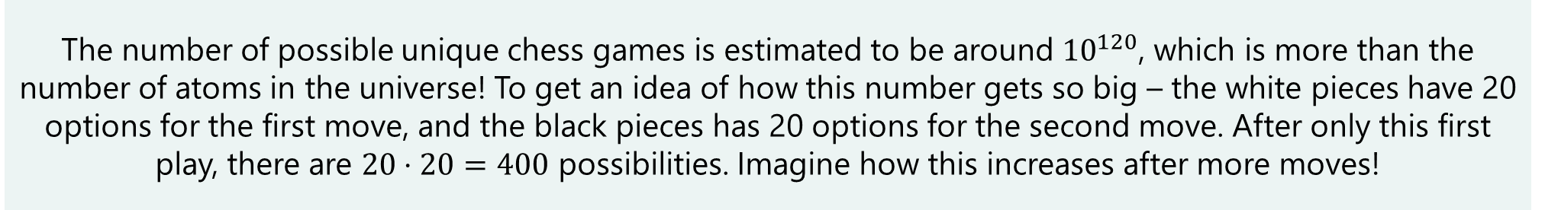
Even More Counting
CSE 312 26Su
Lecture 3
Fun Fact
The number of possible unique chess games is estimated to be around ${10}^{120}$, which is more than the number of atoms in the universe! To get an idea of how this number gets so big – the white pieces have 20 options for the first move, and the black pieces has 20 options for the second move. After only this first play, there are $20⋅20=400$ possibilities. Imagine how this increases after more moves!

Slide 2
Quiz 1
Notes:
Let’s jump right in with another counting rule, called the stars and bars approach

Slide 3
Announcements
> HW1 is out and due on Wednesday
  > Remember to do concept checks!
  > Office hours starts today, after lecture
  > Also, please start on the homework early. Remember you need to have a meaningful attempt to utilize the penalty free late days.
Notes:
Also, thank you for the feedback on the lecture notes – I’ve tried to address this in Fridays and today notes but if u have more feedback don’t hesitate to send it in thru the anonymous feedback or just lmk.

Slide 4
Where Are We?
Last time:
  More about combinations
  Applications of combinations
    Path counting
    Rearranging strings
    Multinomial coefficients
    Binomial theorem
  Inclusion-exclusion
  Sleuth’s criterion
Today:
  Stars and Bars
  Combinatorial Proofs
  Pigeonhole Principle

Slide 5
Stars and Bars
The last counting rule in a while! :’)
Notes:
Let’s jump right in with another counting rule, called the stars and bars approach

Slide 6
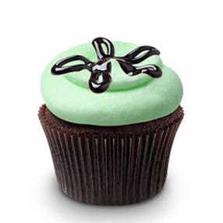
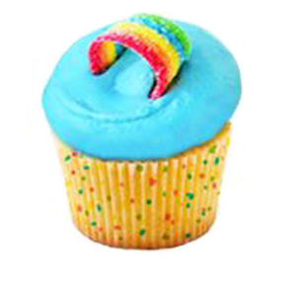
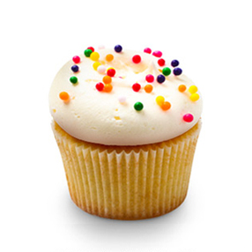
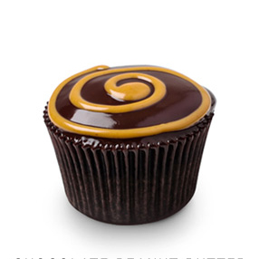

Cupcakes
You’re buying one-dozen cupcakes (i.e., 12 cupcakes) for a party.
There’s vanilla, peanut butter, mint, confetti, and rainbow (i.e., 5 types)
How many different cupcake boxes can you buy?
  > There are unlimited cupcakes of each type
  > Cupcakes of the same type are indistinguishable
  > Order of the cupcakes in the box does not matter
Notes:
Let’s look at an example. Here we’re going to buy 12 donuts, and we have 5 types. We want to know how many donut boxes we can buy. Couple of important restrictions here.
First, there are unlimited donuts of each type available, just like in homer price if you’ve ever read that
second thing is we don’t care about which specific donuts we pick of each donut type. If we want 2 chocolate donuts, and 10 strawberry donuts, there’s only one way to do that … another way to say this is that donuts of the same type are indistinguishable. We don’t care abt which specific donuts we pick.
Lastly we don’t care about the order of the donuts.. So first picking strawberry then choco is the same as chocol then strawber.

Slide 7

Cupcakes (an incorrect approach)
You’re buying one-dozen cupcakes (i.e., 12 cupcakes) for a party.
There’s vanilla, peanut butter, mint, confetti, and rainbow (i.e., 5 types)
How many different cupcake boxes can you buy?
Idea: $5^{12}$ -- choose one of 5 types for each of the 12 cupcakes
But the order of the cupcakes in the box doesn’t matter so these should be considered the same outcome.
Notes:
Let’s look at an example. Here we’re going to buy 12 donuts, and we have 5 types. We want to know how many donut boxes we can buy. Couple of important restrictions here.
First, there are unlimited donuts of each type available, just like in homer price if you’ve ever read that
second thing is we don’t care about which specific donuts we pick of each donut type. If we want 2 chocolate donuts, and 10 strawberry donuts, there’s only one way to do that … another way to say this is that donuts of the same type are indistinguishable. We don’t care abt which specific donuts we pick.
Lastly we don’t care about the order of the donuts.. So first picking strawberry then choco is the same as chocol then strawber.

Slide 8
Cupcakes (an incorrect approach)
You’re buying one-dozen cupcakes (i.e., 12 cupcakes) for a party.
There’s vanilla, peanut butter, mint, confetti, and rainbow (i.e., 5 types)
How many different cupcake boxes can you buy?
Idea: $5^{12}$ -- choose one of 5 types for each of the 12 cupcakes
2 vanilla, 1 PB, 3 mint, 2 confetti, 4 rainbow
Notes:
Let’s look at an example. Here we’re going to buy 12 donuts, and we have 5 types. We want to know how many donut boxes we can buy. Couple of important restrictions here.
First, there are unlimited donuts of each type available, just like in homer price if you’ve ever read that
second thing is we don’t care about which specific donuts we pick of each donut type. If we want 2 chocolate donuts, and 10 strawberry donuts, there’s only one way to do that … another way to say this is that donuts of the same type are indistinguishable. We don’t care abt which specific donuts we pick.
Lastly we don’t care about the order of the donuts.. So first picking strawberry then choco is the same as chocol then strawber.

Slide 9
Cupcakes
You’re buying one-dozen cupcakes (i.e., 12 cupcakes) for a party.
There’s vanilla, peanut butter, mint, confetti, and rainbow (i.e., 5 types)
How many different cupcake boxes can you buy?
All we care about is how many of each cupcake is ordered!
2 vanilla, 1 PB, 3 mint, 2 confetti, 4 rainbow
Notes:
Let’s look at an example. Here we’re going to buy 12 donuts, and we have 5 types. We want to know how many donut boxes we can buy. Couple of important restrictions here.
First, there are unlimited donuts of each type available, just like in homer price if you’ve ever read that
second thing is we don’t care about which specific donuts we pick of each donut type. If we want 2 chocolate donuts, and 10 strawberry donuts, there’s only one way to do that … another way to say this is that donuts of the same type are indistinguishable. We don’t care abt which specific donuts we pick.
Lastly we don’t care about the order of the donuts.. So first picking strawberry then choco is the same as chocol then strawber.

Slide 10


Cupcakes
You’re buying one-dozen cupcakes (i.e., 12 cupcakes) for a party.
There’s vanilla, peanut butter, mint, confetti, and rainbow (i.e., 5 types)
How many different cupcake boxes can you buy?
All we care about is how many of each cupcake is ordered!
2 vanilla, 1 PB, 3 mint, 2 confetti, 4 rainbow
Notes:
Let’s look at an example. Here we’re going to buy 12 donuts, and we have 5 types. We want to know how many donut boxes we can buy. Couple of important restrictions here.
First, there are unlimited donuts of each type available, just like in homer price if you’ve ever read that
second thing is we don’t care about which specific donuts we pick of each donut type. If we want 2 chocolate donuts, and 10 strawberry donuts, there’s only one way to do that … another way to say this is that donuts of the same type are indistinguishable. We don’t care abt which specific donuts we pick.
Lastly we don’t care about the order of the donuts.. So first picking strawberry then choco is the same as chocol then strawber.

Slide 11
Cupcakes
You’re buying one-dozen cupcakes (i.e., 12 cupcakes) for a party.
There’s vanilla, peanut butter, mint, confetti, and rainbow (i.e., 5 types)
How many different cupcake boxes can you buy?
All we care about is how many of each cupcake is ordered!
2 vanilla, 1 PB, 3 mint, 2 confetti, 4 rainbow
Notes:
Let’s look at an example. Here we’re going to buy 12 donuts, and we have 5 types. We want to know how many donut boxes we can buy. Couple of important restrictions here.
First, there are unlimited donuts of each type available, just like in homer price if you’ve ever read that
second thing is we don’t care about which specific donuts we pick of each donut type. If we want 2 chocolate donuts, and 10 strawberry donuts, there’s only one way to do that … another way to say this is that donuts of the same type are indistinguishable. We don’t care abt which specific donuts we pick.
Lastly we don’t care about the order of the donuts.. So first picking strawberry then choco is the same as chocol then strawber.

Slide 12
Cupcakes
You’re buying one-dozen cupcakes (i.e., 12 cupcakes) for a party.
There’s vanilla, peanut butter, mint, confetti, and rainbow (i.e., 5 types)
How many different cupcake boxes can you buy?
All we care about is how many of each cupcake is ordered!
We only need $5−1=4$ dividers to divide this set of 12 cupcakes into $5$ groups
2 vanilla, 1 PB, 3 mint, 2 confetti, 4 rainbow
Notes:
Let’s look at an example. Here we’re going to buy 12 donuts, and we have 5 types. We want to know how many donut boxes we can buy. Couple of important restrictions here.
First, there are unlimited donuts of each type available, just like in homer price if you’ve ever read that
second thing is we don’t care about which specific donuts we pick of each donut type. If we want 2 chocolate donuts, and 10 strawberry donuts, there’s only one way to do that … another way to say this is that donuts of the same type are indistinguishable. We don’t care abt which specific donuts we pick.
Lastly we don’t care about the order of the donuts.. So first picking strawberry then choco is the same as chocol then strawber.

Slide 13
Cupcakes
You’re buying one-dozen cupcakes (i.e., 12 cupcakes) for a party.
There’s vanilla, peanut butter, mint, confetti, and rainbow (i.e., 5 types)
How many different cupcake boxes can you buy?
All we care about is how many of each cupcake is ordered!
We only need $5−1=4$ dividers to divide this set of 12 cupcakes into $5$ groups
0 vanilla, 0 PB, 0 mint, 2 confetti, 10 rainbow
Notes:
Let’s look at an example. Here we’re going to buy 12 donuts, and we have 5 types. We want to know how many donut boxes we can buy. Couple of important restrictions here.
First, there are unlimited donuts of each type available, just like in homer price if you’ve ever read that
second thing is we don’t care about which specific donuts we pick of each donut type. If we want 2 chocolate donuts, and 10 strawberry donuts, there’s only one way to do that … another way to say this is that donuts of the same type are indistinguishable. We don’t care abt which specific donuts we pick.
Lastly we don’t care about the order of the donuts.. So first picking strawberry then choco is the same as chocol then strawber.

Slide 14
Cupcakes
You’re buying one-dozen cupcakes (i.e., 12 cupcakes) for a party.
There’s vanilla, peanut butter, mint, confetti, and rainbow (i.e., 5 types)
How many different cupcake boxes can you buy?
All we care about is how many of each cupcake is ordered!
We only need $5−1=4$ dividers to divide this set of 12 cupcakes into $5$ groups
3 vanilla, 4 PB, 0 mint, 4 confetti, 1 rainbow
Notes:
Let’s look at an example. Here we’re going to buy 12 donuts, and we have 5 types. We want to know how many donut boxes we can buy. Couple of important restrictions here.
First, there are unlimited donuts of each type available, just like in homer price if you’ve ever read that
second thing is we don’t care about which specific donuts we pick of each donut type. If we want 2 chocolate donuts, and 10 strawberry donuts, there’s only one way to do that … another way to say this is that donuts of the same type are indistinguishable. We don’t care abt which specific donuts we pick.
Lastly we don’t care about the order of the donuts.. So first picking strawberry then choco is the same as chocol then strawber.

Slide 15
Cupcakes
You’re buying cupcakes (i.e., 12 cupcakes) from vanilla, PB, mint, confetti, and rainbow (i.e., 5 types). How many different boxes can you buy?
  1. Define an arbitrary ordering of the flavors
  in our example, our ordering is vanilla, PB, mint, confetti, rainbow
  2. Place bars between the cupcakes to demarcate flavor
  = How many ways to assign 4 dividers among the 12 cupcakes?
3 vanilla, 4 PB, 0 mint, 4 confetti, 1 rainbow
Notes:
Let’s look at an example. Here we’re going to buy 12 donuts, and we have 5 types. We want to know how many donut boxes we can buy. Couple of important restrictions here.
First, there are unlimited donuts of each type available, just like in homer price if you’ve ever read that
second thing is we don’t care about which specific donuts we pick of each donut type. If we want 2 chocolate donuts, and 10 strawberry donuts, there’s only one way to do that … another way to say this is that donuts of the same type are indistinguishable. We don’t care abt which specific donuts we pick.
Lastly we don’t care about the order of the donuts.. So first picking strawberry then choco is the same as chocol then strawber.

Slide 16
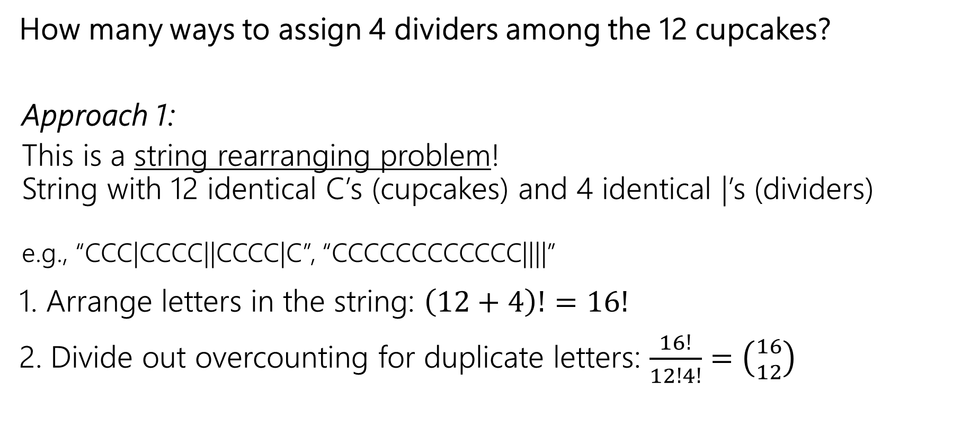
Cupcakes = A String Rearrangement
How many ways to assign 4 dividers among the 12 cupcakes?
  Approach 1:
  This is a string rearranging problem!
  String with 12 identical C’s (cupcakes) and 4 identical |’s (dividers)
  e.g., “CCC|CCCC||CCCC|C”, “CCCCCCCCCCCC||||”
1. Arrange letters in the string: $\left(12+4\right)!=16!$
2. Divide out overcounting for duplicate letters: $\frac{16!}{12!4!}=$ $\left({16 \atop 12}\right)$
Notes:
Let’s look at an example. Here we’re going to buy 12 donuts, and we have 5 types. We want to know how many donut boxes we can buy. Couple of important restrictions here.
First, there are unlimited donuts of each type available, just like in homer price if you’ve ever read that
second thing is we don’t care about which specific donuts we pick of each donut type. If we want 2 chocolate donuts, and 10 strawberry donuts, there’s only one way to do that … another way to say this is that donuts of the same type are indistinguishable. We don’t care abt which specific donuts we pick.
Lastly we don’t care about the order of the donuts.. So first picking strawberry then choco is the same as chocol then strawber.

Slide 17
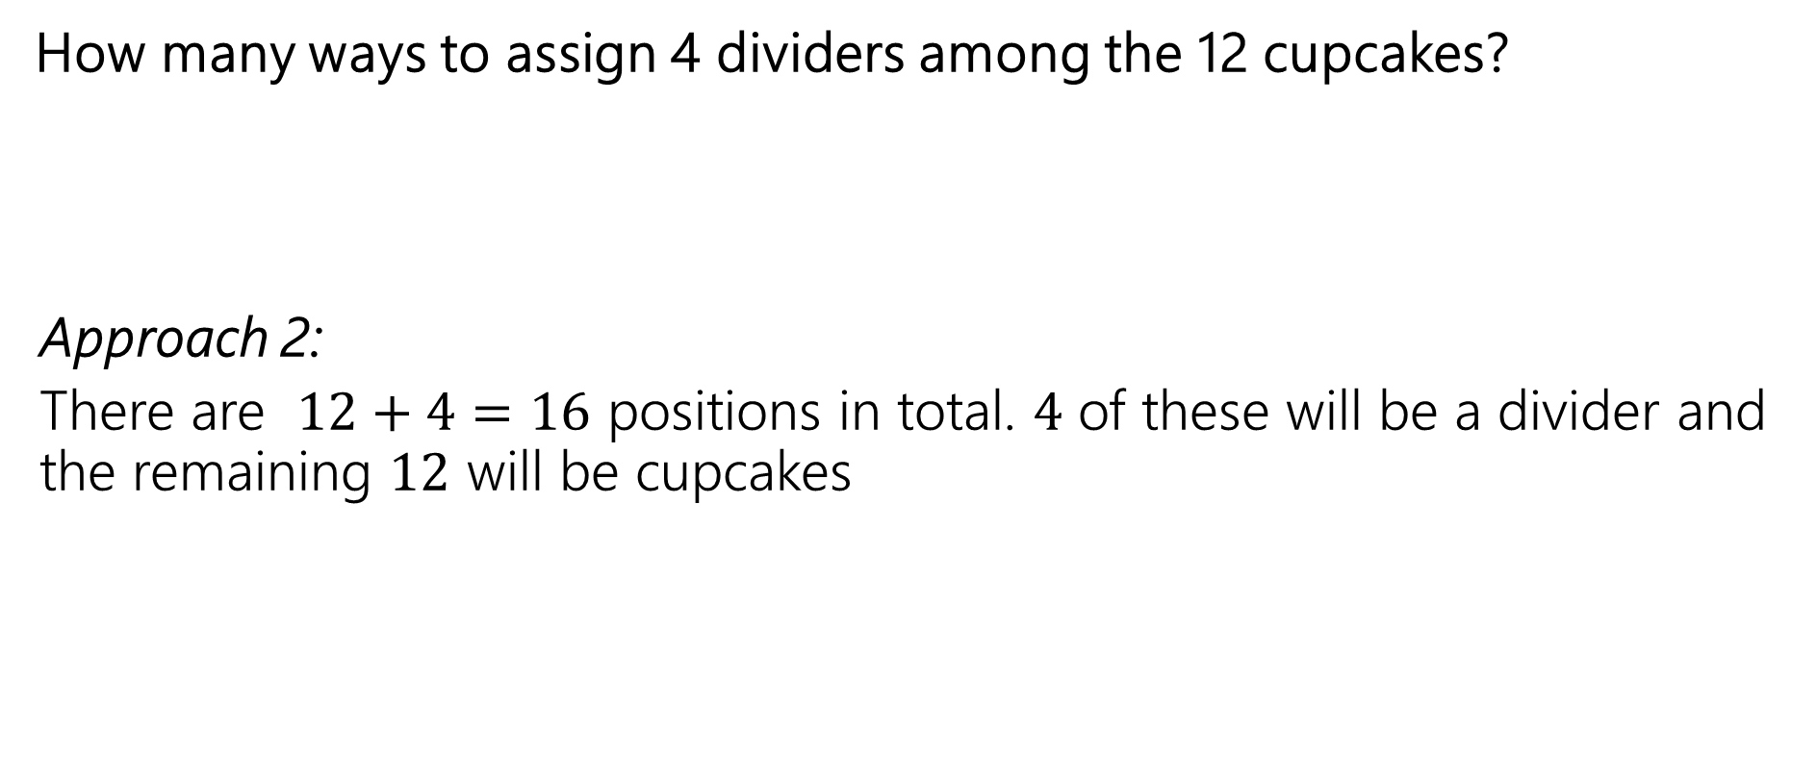
Cupcakes = Placing Dividers
How many ways to assign 4 dividers among the 12 cupcakes?
  Approach 2:
  There are $12+4=16$ positions in total. $4$ of these will be a divider and the remaining $12$ will be cupcakes
_ _ _ _ _ _ _ _ _ _ _ _ _ _ _ _
Notes:
Let’s look at an example. Here we’re going to buy 12 donuts, and we have 5 types. We want to know how many donut boxes we can buy. Couple of important restrictions here.
First, there are unlimited donuts of each type available, just like in homer price if you’ve ever read that
second thing is we don’t care about which specific donuts we pick of each donut type. If we want 2 chocolate donuts, and 10 strawberry donuts, there’s only one way to do that … another way to say this is that donuts of the same type are indistinguishable. We don’t care abt which specific donuts we pick.
Lastly we don’t care about the order of the donuts.. So first picking strawberry then choco is the same as chocol then strawber.

Slide 18

Cupcakes = Placing Dividers
How many ways to assign 4 dividers among the 12 cupcakes?
  Approach 2:
  There are $12+4=16$ positions in total. $4$ of these will be a divider and the remaining $12$ will be cupcakes
  1. Pick 12 of the 16 positions to be cupcakes: $\left({16 \atop 12}\right)$
  2. Pick 4 of the remaining 4 positions to be dividers: $\left(\begin{aligned}4 \\ 4\end{aligned}\right)=1$
  $\left({16 \atop 12}\right)$ ways in total – same as with previous approach!
_ _ _ _ _ _ _ _ _ _ _ _ _ _ _ _
Notes:
Let’s look at an example. Here we’re going to buy 12 donuts, and we have 5 types. We want to know how many donut boxes we can buy. Couple of important restrictions here.
First, there are unlimited donuts of each type available, just like in homer price if you’ve ever read that
second thing is we don’t care about which specific donuts we pick of each donut type. If we want 2 chocolate donuts, and 10 strawberry donuts, there’s only one way to do that … another way to say this is that donuts of the same type are indistinguishable. We don’t care abt which specific donuts we pick.
Lastly we don’t care about the order of the donuts.. So first picking strawberry then choco is the same as chocol then strawber.

Slide 19
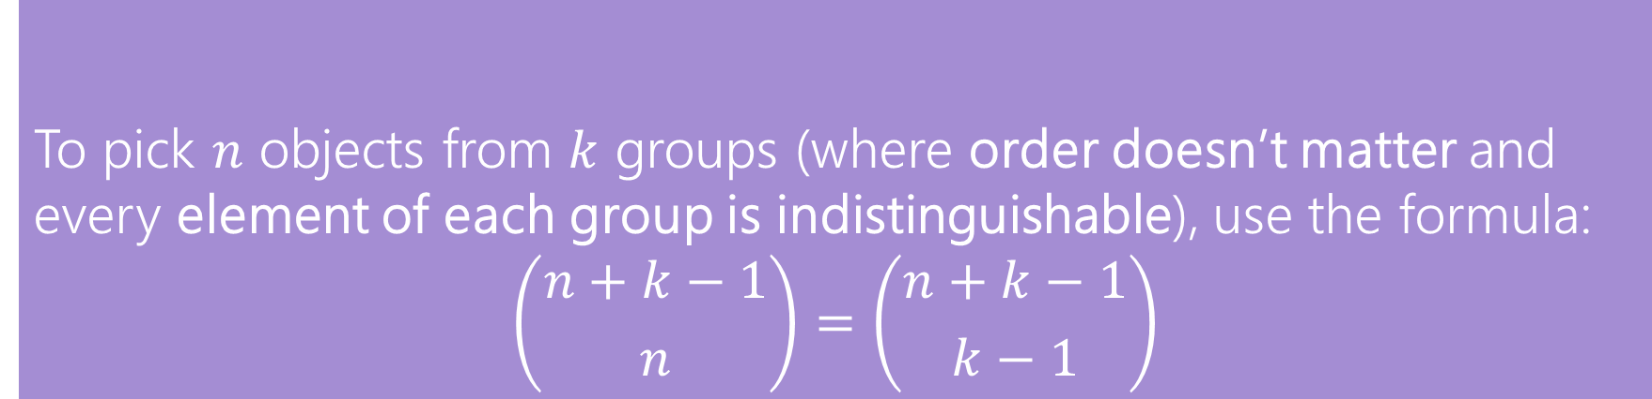
In General
To pick $n$ objects from $k$ groups (where order doesn’t matter and every element of each group is indistinguishable), use the formula:
$$\left({n+k−1 \atop n}\right)=\left({n+k−1 \atop k−1}\right)$$
Stars and Bars
This counting technique is often called “stars and bars”
  using a “star” instead of a cupcake, and calling the dividers “bars”
  > What often hints to use the stars-and-bars approach is when we’re dealing with picking a set from objects where objects from the same types are indistinguishable
Notes:
To generalize this, we call this the stars and bars approach… kind of like using star instead of a donut… .. I know kinda a boring name but I didn’t’ naeme ..
What this tells us in general is if we have k groups (in our case donut flavors) and we want to pick n objects from these groups where obejcts of the same type are indistinguishable and order dones’t matter, number of ways for that is …. k – 1 dividers that we need to separate these n objects into k rups and then we pick either n or them to be the objects (stars) and the remaining k-1 to be the divdiers.
We use this when indistinguishable… all we care abt is how much of each type we get (u see the word indistinguishable most likely think abt stars and bars)

Slide 20
Proofs Using Counting Techniques
Notes:
What we’re going to talk about now is not really any counting rules, we’re kinda doen with counting rules for a bit now. .. You all have learned a lot . We’re going to now talk abt using these coutnign thecniques that we’ve learned about to do some proofs.

Slide 21
Combinatorial Proofs
Let’s first look at some combination facts…
Notes:
Combinatorial proofs. First look at some combination facts.

Slide 22

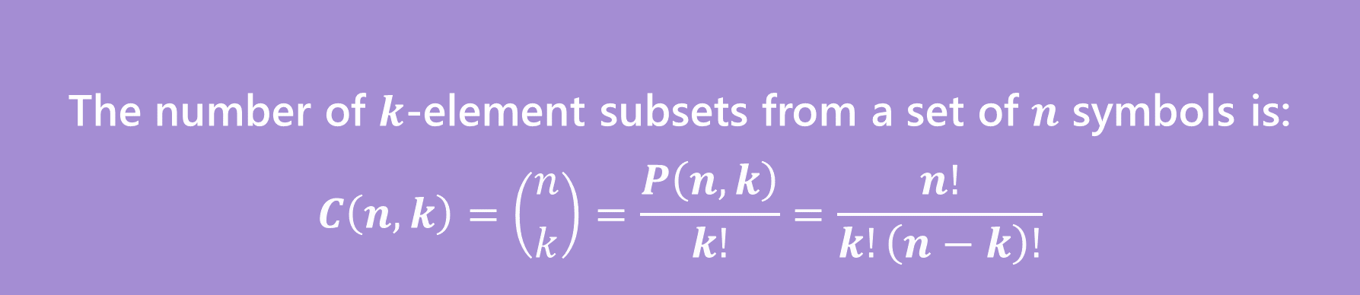
Reminder - $k$-combination
The number of $k$-element subsets from a set of $n$ symbols is:
$$C\left(n,k\right)=\left({n \atop k}\right)=\frac{P\left(n,k\right)}{k!}=\frac{n!}{k!\left(n−k\right)!}$$
$k$-combination
Notes:
As a reminder, this is a k combination. N choose k number of ways to choose an unorder subset of k things from a group of n things in total

Slide 23

Some Facts about combinations
Here are some known facts about combinations:
> Symmetry of combinations: $\left({n \atop k}\right)=\left({n \atop n−k}\right)$
> Pascal’s Rule: $\left({n \atop k}\right)=\left({n−1 \atop k−1}\right)+\left({n−1 \atop k}\right)$
Notes:
Here are some facts about combinations…. Symetry …..

Slide 24
Some Facts about combinations
Here are some known facts about combinations:
> Symmetry of combinations: $\left({n \atop k}\right)=\left({n \atop n−k}\right)$
> Pascal’s Rule: $\left({n \atop k}\right)=\left({n−1 \atop k−1}\right)+\left({n−1 \atop k}\right)$
How do we prove these equations are true?
Notes:
Great! But how do we prove these equations are true?

Slide 25

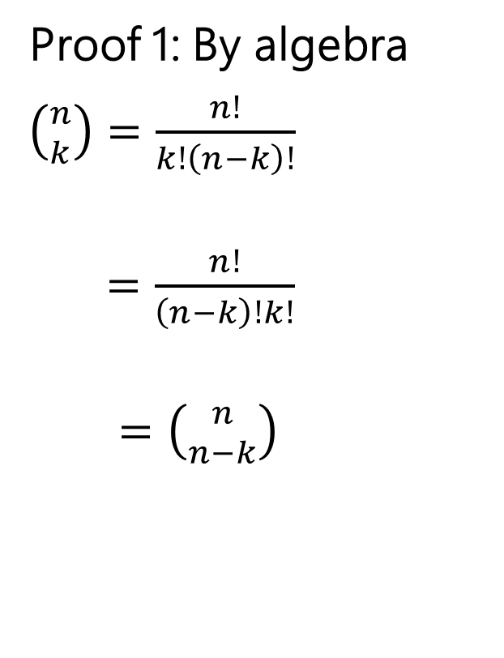
First Proof of Symmetry ($\left({n \atop k}\right)=\left({n \atop n−k}\right)$)
Proof 1: By algebra
$\left({n \atop k}\right)=\frac{n!}{k!\left(n−k\right)!}$
$=\frac{n!}{\left(n−k\right)!k!}$
$=\left({n \atop n−k}\right)$
Definition of Combination
Algebra (commutativity of multiplication)
Definition of Combination
Notes:
Let’s do some algebra…

Slide 26
First Proof of Symmetry ($\left({n \atop k}\right)=\left({n \atop n−k}\right)$)
Wasn’t that a great proof.
Airtight. No disputing it.
Got to say “commutativity of multiplication.”
But…do you know why? Can you feel why it’s true?
Notes:
Great agin but this doesn’t give any intuitaion about why this is tue. Why is n choose k same as n cho…. Let’s see

Slide 27
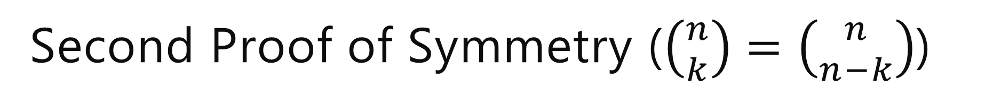

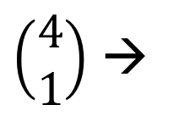
Second Proof of Symmetry ($\left({n \atop k}\right)=\left({n \atop n−k}\right)$)
Both sides of this count the same set of outcomes! For example….
LHS: choose $k$ things to include in the set
$\left(\begin{aligned}4 \\ 1\end{aligned}\right)$ →
Notes:
So we are going to show that both of these sides count the same set of outcomes. … when we do n choose k .. Like in this picture 4 choose 1.. We are picking k thins to include in some set…. Well we can think abtout n choose n – k as the same thing but now we’re picking the n-k things not to include in the set.. This gives us the same set of outcomes, we’re just constructing it different ways.. Since both these sides count the same set of otucomes, they must be equal to each other..

Slide 28

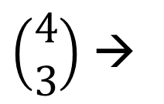
Second Proof of Symmetry ($\left({n \atop k}\right)=\left({n \atop n−k}\right)$)
Both sides of this count the same set of outcomes! For example….
LHS: choose $k$ things to include in the set
RHS: choose $n−k$ things to not include in the set
$\left(\begin{aligned}4 \\ 1\end{aligned}\right)$ →
$\left(\begin{aligned}4 \\ 3\end{aligned}\right)$ →
Notes:
So we are going to show that both of these sides count the same set of outcomes. … when we do n choose k .. Like in this picture 4 choose 1.. We are picking k thins to include in some set…. Well we can think abtout n choose n – k as the same thing but now we’re picking the n-k things not to include in the set.. This gives us the same set of outcomes, we’re just constructing it different ways.. Since both these sides count the same set of otucomes, they must be equal to each other..

Slide 29


Second Proof of Symmetry ($\left({n \atop k}\right)=\left({n \atop n−k}\right)$) more formal – combinatorial proof
Suppose you have $n$ people, and need to choose $k$ people to be on your team. We will count the number of possible teams two different ways.
Way 1 (LHS): We choose the $k$ people to be on the team. Since order doesn’t matter (you’re on the team or not), there are $\left({n \atop k}\right)$ possible teams.
Notes:
Let’s write this a bit more formally… let’s say we have n peo….. Goal is to count the number ofpossible teams. We are only interested in the people on the team, not the order in which they are chosen…. Let’s start with the left hand side… we’re choosing k people to be on the team…. On the rhs we’re not going to choose the n-k to not be on the team. Once we do this… there’s only one way tot pick the remaining k people to be on the team. So this also counts the number of ways to have…. These two expressions count the exact same things. So they must be equal to each other! This is what we call a combinatorial proof. Intsead of using math and lots of algrebra… we use what we know abt counting to prove that both sides coutn the number of options in the same situtaiton so the ymust be equal..

Slide 30
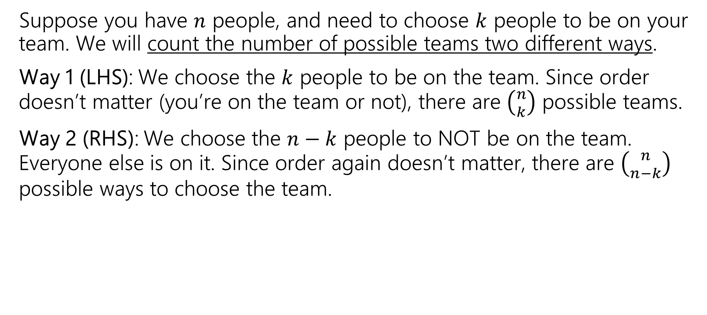
Second Proof of Symmetry ($\left({n \atop k}\right)=\left({n \atop n−k}\right)$) more formal – combinatorial proof
Suppose you have $n$ people, and need to choose $k$ people to be on your team. We will count the number of possible teams two different ways.
Way 1 (LHS): We choose the $k$ people to be on the team. Since order doesn’t matter (you’re on the team or not), there are $\left({n \atop k}\right)$ possible teams.
Way 2 (RHS): We choose the $n−k$ people to NOT be on the team. Everyone else is on it. Since order again doesn’t matter, there are $\left({n \atop n−k}\right)$ possible ways to choose the team.
Notes:
Let’s write this a bit more formally… let’s say we have n peo….. Goal is to count the number ofpossible teams. We are only interested in the people on the team, not the order in which they are chosen…. Let’s start with the left hand side… we’re choosing k people to be on the team…. On the rhs we’re not going to choose the n-k to not be on the team. Once we do this… there’s only one way tot pick the remaining k people to be on the team. So this also counts the number of ways to have…. These two expressions count the exact same things. So they must be equal to each other! This is what we call a combinatorial proof. Intsead of using math and lots of algrebra… we use what we know abt counting to prove that both sides coutn the number of options in the same situtaiton so the ymust be equal..

Slide 31
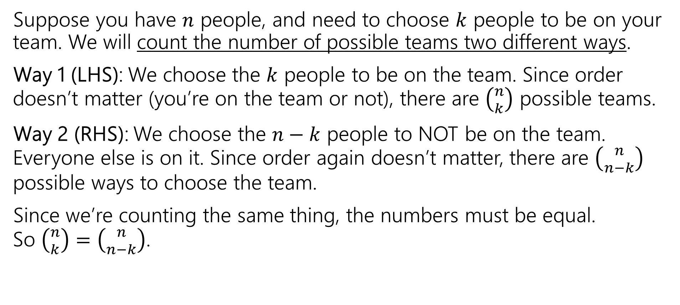
Second Proof of Symmetry ($\left({n \atop k}\right)=\left({n \atop n−k}\right)$) more formal – combinatorial proof
Suppose you have $n$ people, and need to choose $k$ people to be on your team. We will count the number of possible teams two different ways.
Way 1 (LHS): We choose the $k$ people to be on the team. Since order doesn’t matter (you’re on the team or not), there are $\left({n \atop k}\right)$ possible teams.
Way 2 (RHS): We choose the $n−k$ people to NOT be on the team. Everyone else is on it. Since order again doesn’t matter, there are $\left({n \atop n−k}\right)$ possible ways to choose the team.
Since we’re counting the same thing, the numbers must be equal.
So $\left({n \atop k}\right)=\left({n \atop n−k}\right)$.
Notes:
Let’s write this a bit more formally… let’s say we have n peo….. Goal is to count the number ofpossible teams. We are only interested in the people on the team, not the order in which they are chosen…. Let’s start with the left hand side… we’re choosing k people to be on the team…. On the rhs we’re not going to choose the n-k to not be on the team. Once we do this… there’s only one way tot pick the remaining k people to be on the team. So this also counts the number of ways to have…. These two expressions count the exact same things. So they must be equal to each other! This is what we call a combinatorial proof. Intsead of using math and lots of algrebra… we use what we know abt counting to prove that both sides coutn the number of options in the same situtaiton so the ymust be equal..

Slide 32
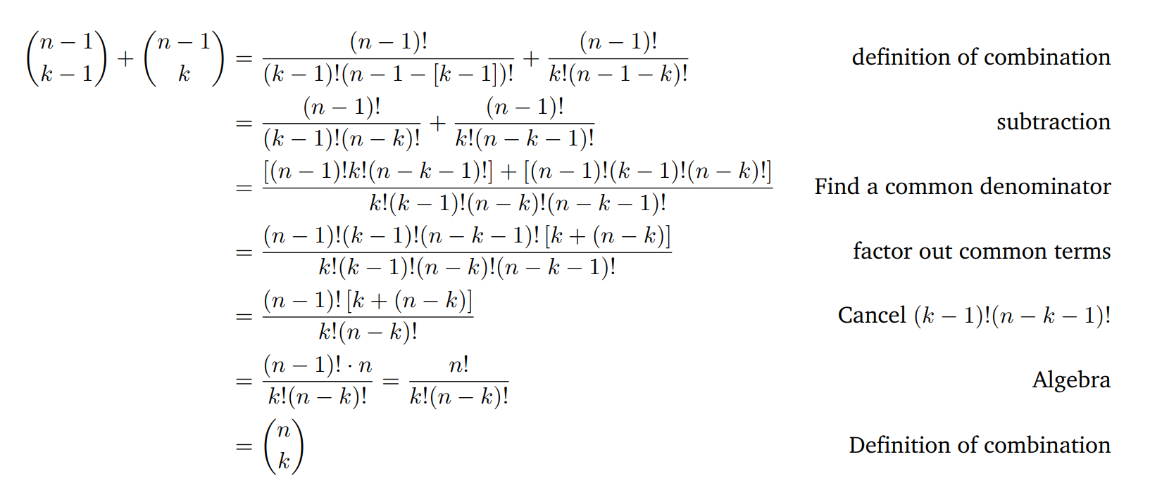

Pascal’s Rule: $\left({n \atop k}\right)=\left({n−1 \atop k−1}\right)+\left({n−1 \atop k}\right)$ algebraic proof
Notes:
Let’s try another one! This is pascal’s rule and this is the algebraic proof. Honestly idk how this even works, this si not fun… and with all the factorials especially the algebra is a pain

Slide 33


Pascal’s Rule: $\left({n \atop k}\right)=\left({n−1 \atop k−1}\right)+\left({n−1 \atop k}\right)$ combinatorial proof
Suppose you have $n$ people (one of whom is Krisha), and need to choose $k$ people to be on your team.
Notes:
Say that we’re starting with the lhs bc It looks easier… let’s do …. Our goal is to show that both sides of these count the number of options in this same situation.
Start with the lhs…
In the rhs we see that we’re summing together two things. This looksl ike an application of the sum rule – there are some disjoint cases – in each case, we still need to pick k people in total… in this second case we’re chososing k people from n-1 people, this is the case when when Michael is not on the team… this other case, Michael Is on the team….. These cases are disjoint and cover all posibiliets of team formations sol…

Slide 34

Pascal’s Rule: $\left({n \atop k}\right)=\left({n−1 \atop k−1}\right)+\left({n−1 \atop k}\right)$ combinatorial proof
Suppose you have $n$ people (one of whom is Krisha), and need to choose $k$ people to be on your team.
Way 1: There are $n$ people total, of which we’re choosing $k$ (and since it’s a team order doesn’t matter) $\left({n \atop k}\right)$.
Notes:
Say that we’re starting with the lhs bc It looks easier… let’s do …. Our goal is to show that both sides of these count the number of options in this same situation.
Start with the lhs…
In the rhs we see that we’re summing together two things. This looksl ike an application of the sum rule – there are some disjoint cases – in each case, we still need to pick k people in total… in this second case we’re chososing k people from n-1 people, this is the case when when Michael is not on the team… this other case, Michael Is on the team….. These cases are disjoint and cover all posibiliets of team formations sol…

Slide 35
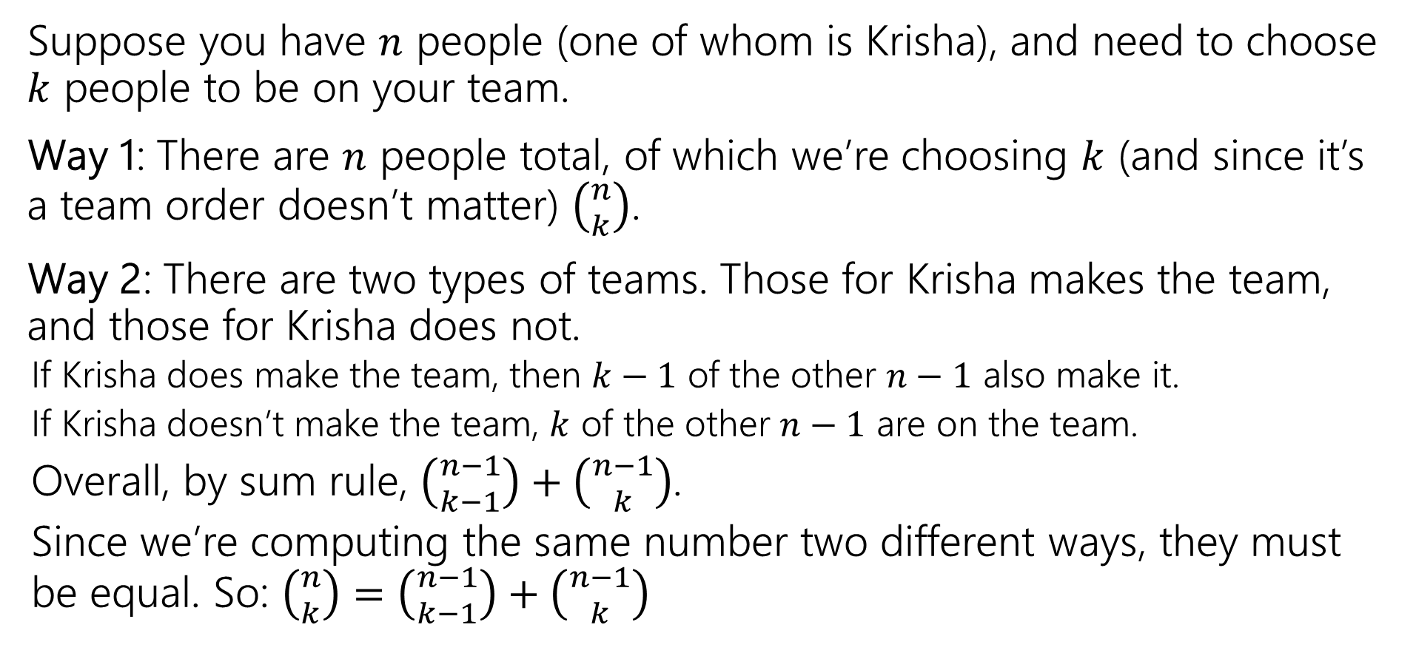
Pascal’s Rule: $\left({n \atop k}\right)=\left({n−1 \atop k−1}\right)+\left({n−1 \atop k}\right)$ combinatorial proof
Suppose you have $n$ people (one of whom is Krisha), and need to choose $k$ people to be on your team.
Way 1: There are $n$ people total, of which we’re choosing $k$ (and since it’s a team order doesn’t matter) $\left({n \atop k}\right)$.
Way 2: There are two types of teams. Those for Krisha makes the team, and those for Krisha does not.
  If Krisha does make the team, then $k−1$ of the other $n−1$ also make it.
  If Krisha doesn’t make the team, $k$ of the other $n−1$ are on the team.
  Overall, by sum rule, $\left({n−1 \atop k−1}\right)+\left({n−1 \atop k}\right)$.
  Since we’re computing the same number two different ways, they must be equal. So: $\left({n \atop k}\right)=\left({n−1 \atop k−1}\right)+\left({n−1 \atop k}\right)$
Notes:
Say that we’re starting with the lhs bc It looks easier… let’s do …. Our goal is to show that both sides of these count the number of options in this same situation.
Start with the lhs…
In the rhs we see that we’re summing together two things. This looksl ike an application of the sum rule – there are some disjoint cases – in each case, we still need to pick k people in total… in this second case we’re chososing k people from n-1 people, this is the case when when Michael is not on the team… this other case, Michael Is on the team….. These cases are disjoint and cover all posibiliets of team formations sol…

Slide 36
Combinatorial Proofs
1. Describe a scenario
2. Explain how the LHS counts the outcomes in that scenario
3. Explain how the RHS counts the outcomes in that same scenario
4. State that “because the LHS and RHS both count the number of outcomes in the same scenario, they must be equal”
Notes:
In general, this format of proofs is called a combinatorial proof. We describe tsome scenario, a situation or set of outcomes that we are trying to count.
We explain how l….., ….
When do we use this? Combinoato…. Also gives us better intuition abt why two equations are equal to each other.

Slide 37
Combinatorial Proofs
When to use?
> Algebraic proofs are often difficult and don’t give us an “intuitive” reason for why the equation holds
> Combinatorial proofs are used for proving an equation that may involve combinations, factorials, permutations, etc.
1. Describe a scenario
2. Explain how the LHS counts the outcomes in that scenario
3. Explain how the RHS counts the outcomes in that same scenario
4. State that “because the LHS and RHS both count the number of outcomes in the same scenario, they must be equal”
Notes:
In general, this format of proofs is called a combinatorial proof. We describe tsome scenario, a situation or set of outcomes that we are trying to count.
We explain how l….., ….
When do we use this? Combinoato…. Also gives us better intuition abt why two equations are equal to each other.

Slide 38
Combinatorial Proofs – tips!
> Start with the side that “looks simpler”
> Multiplying terms together indicates some sequential process (the product rule)
> A summation/adding terms indicates some disjoint cases that are added together using the sum rule
Notes:
Couple of tips…. Think abt what sequential process might be being used to cont.. Kinda like doing a counting problem backwords, explaining why an answer coutsn…

Slide 39
Pigeonhole Principle
A counting property that will be helpful in many proofs!
Notes:
We’re going to …

Slide 40
A Hairy Question
Are there at least two people in Seattle with the same number of hairs on their head?
A. Yes
B. No
C. ???
D. How would I know?
Join at slido.com
#3482 919
Notes:
What do y’all think? Im excluding bald people by the way in this problem, no offense

Slide 41

Pigeonhole Principle
If you have $5$ pigeons, and place them into $4$ holes, then…
Notes:
Before we talk abt the answer to this question, ewe need to first learn smth called the pigeonhole principle.. This gives some guarantees about the number of things that fall into the same bucket when we are assigne things to a bucket. So let’s think about this. So we have 5 pigoens that are being placed into 4 holes.. Let’s try to spread these out as muchas possible avoid having these placed in the same hole.

Slide 42

Pigeonhole Principle
If you have $5$ pigeons, and place them into $4$ holes, then…
At least $2$ pigeons are in the same hole.
Notes:
We’re going to see, that regardless of how we place the pigeons into the holes, there will be at least one hole pigeon in the same hole. In this case we have 2 pigons. We could also have more than that.. Because there are more pigeons than number of holes, we know for sure that at least one of holes will have at least 2 pigeons

Slide 43

Pigeonhole Principle
If you have $5$ pigeons, and place them into $4$ holes, then…
At least $2$ pigeons are in the same hole.
Notes:
We’re going to see, that regardless of how we place the pigeons into the holes, there will be at least one hole pigeon in the same hole. In this case we have 2 pigons. We could also have more than that.. Because there are more pigeons than number of holes, we know for sure that at least one of holes will have at least 2 pigeons

Slide 44
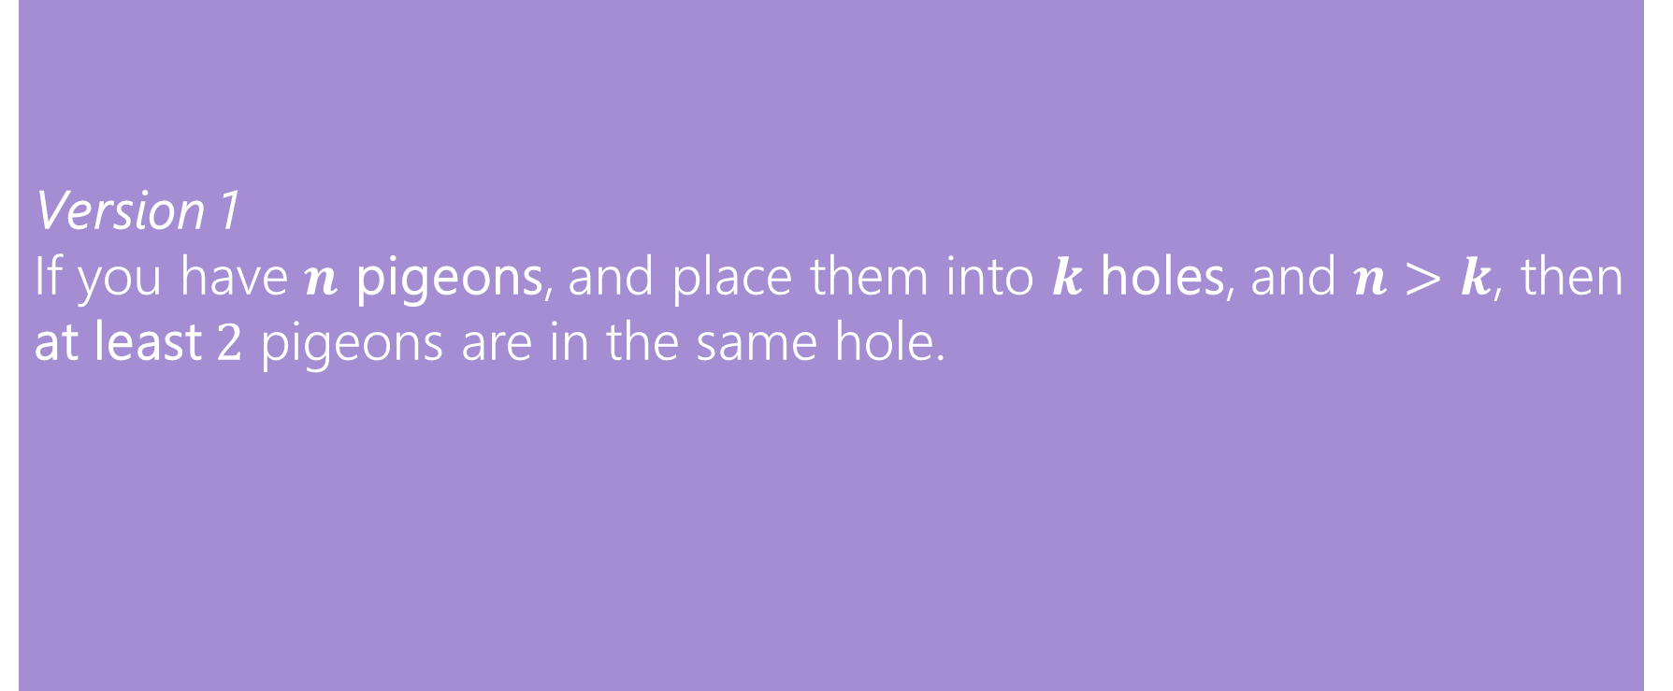
Pigeonhole Principle
Version 1
If you have $n$ pigeons, and place them into $k$ holes, and $n>k$, then at least $2$ pigeons are in the same hole.
Pigeonhole Principle
Note: we’re not making guarantees about every pigeonhole – we’re just guaranteeing that there is at least one hole with at least a certain number of pigeons
Notes:
This is known as the pigeonhole….

Slide 45
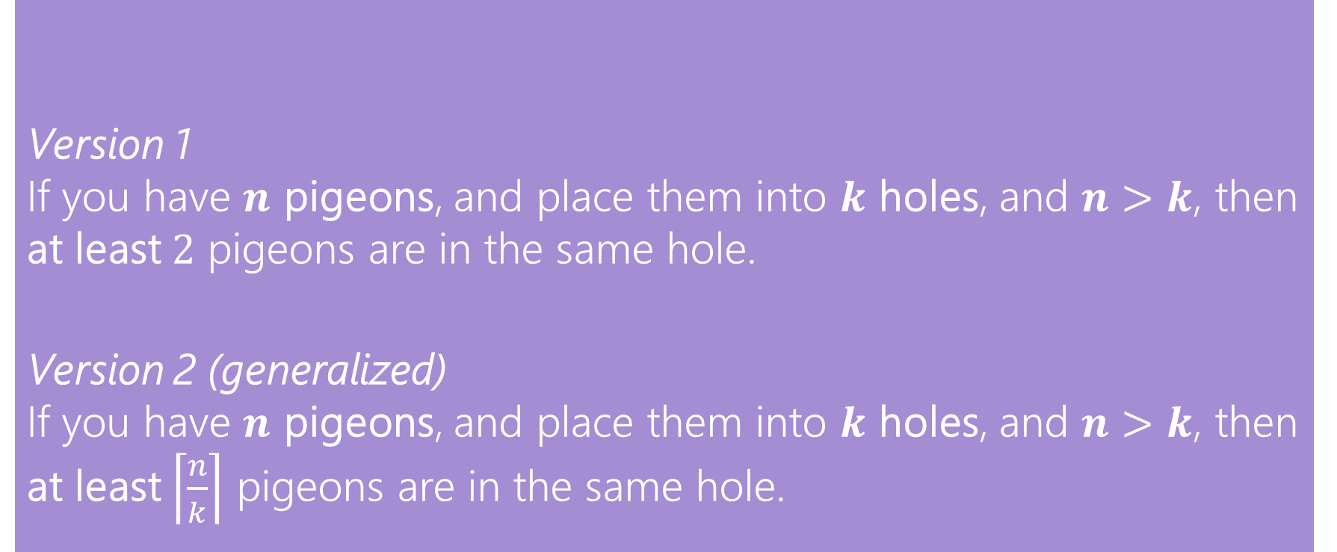
Pigeonhole Principle
Version 1
If you have $n$ pigeons, and place them into $k$ holes, and $n>k$, then at least $2$ pigeons are in the same hole.
Version 2 (generalized)
If you have $n$ pigeons, and place them into $k$ holes, and $n>k$, then at least $\left\lceil \frac{n}{k}\right\rceil$ pigeons are in the same hole.
Pigeonhole Principle
Note: we’re not making guarantees about every pigeonhole – we’re just guaranteeing that there is at least one hole with at least a certain number of pigeons
Notes:
To generalize this…. If we have more pgieons than holes and each pigeon is going to be in one of the holes, there is going to be at least one hole with at least … pigeons in the same hole…

Slide 46
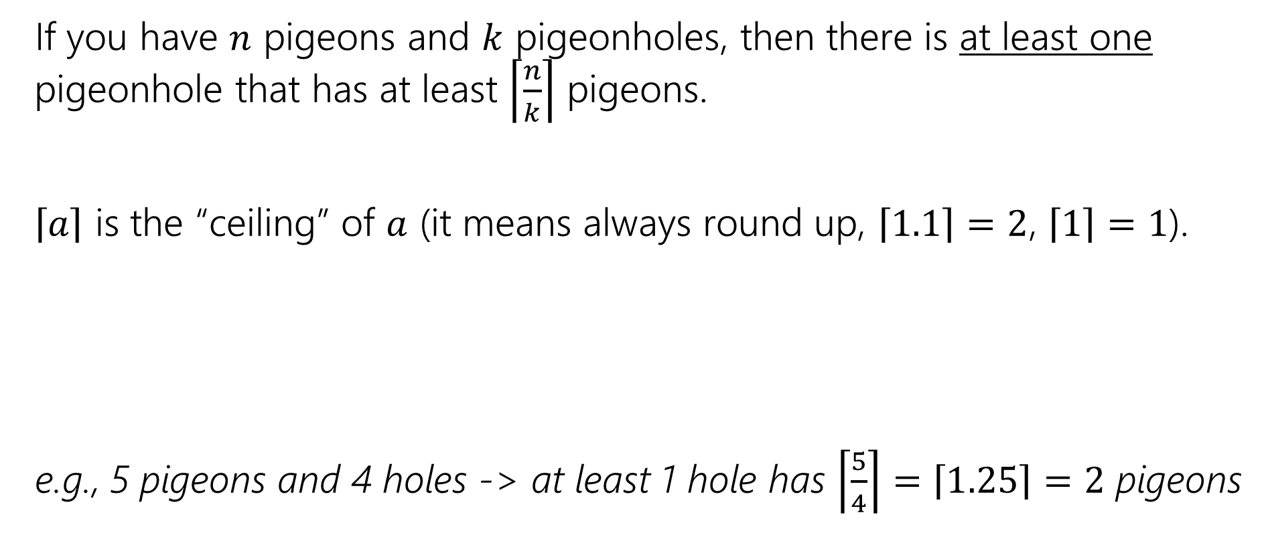
Pigeonhole Principle (generalized)
If you have $n$ pigeons and $k$ pigeonholes, then there is at least one pigeonhole that has at least $\left\lceil \frac{n}{k}\right\rceil$ pigeons.
$\left\lceil a\right\rceil$ is the “ceiling” of $a$ (it means always round up, $\left\lceil 1.1\right\rceil =2$, $\left\lceil 1\right\rceil =1$).
e.g., 5 pigeons and 4 holes -> at least 1 hole has $\left\lceil \frac{5}{4}\right\rceil =\left\lceil 1.25\right\rceil =2$ pigeons
Notes:
This is the celing of … … let’s look at example to put this rule feel kinda abstract into practice

Slide 47
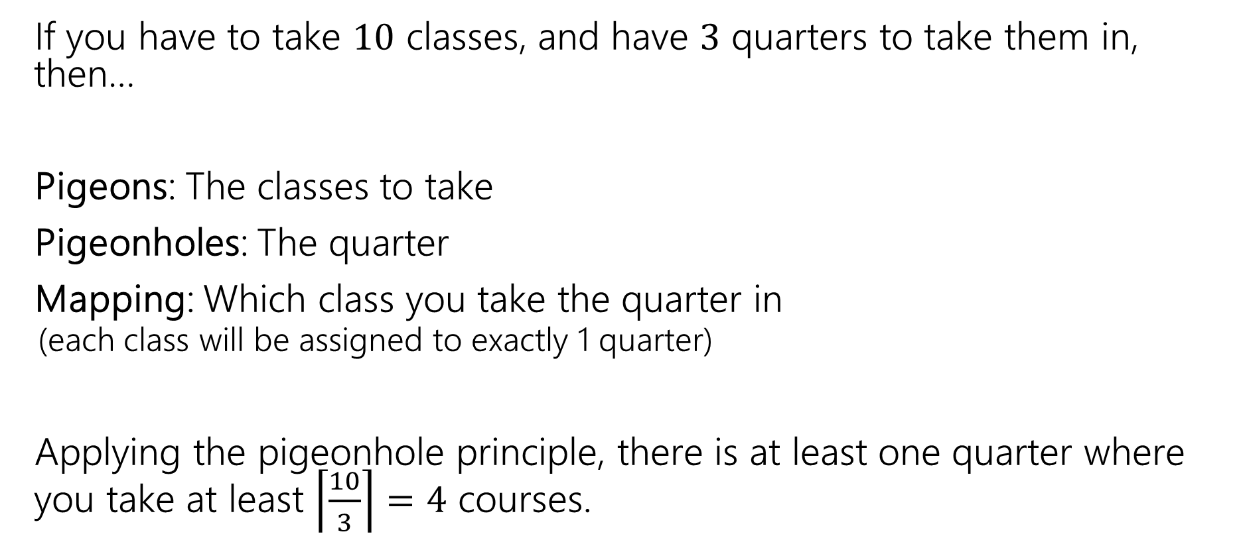
An example
If you have to take $10$ classes, and have $3$ quarters to take them in, then…
Pigeons: The classes to take
Pigeonholes: The quarter
Mapping: Which class you take the quarter in
  (each class will be assigned to exactly 1 quarter)
Applying the pigeonhole principle, there is at least one quarter where you take at least $\left\lceil \frac{10}{3}\right\rceil =4$ courses.
Notes:
….now, we’er going to see how to apply pigonehole to this problem. We let he pigeons the … be the classes to take.a nd the hole …. Each pigon is going to fall of is a particupar. This is assuming that you are going to take all classes at some point. We have the pigeons that are going to be each assigned to one of the pigeonholes… n = 10, k=3.

Slide 48
An example
If you have to take $10$ classes, and have $3$ quarters to take them in, then…
Pigeons: The classes to take
Pigeonholes: The quarter
Mapping: Which class you take the quarter in
  (each class will be assigned to exactly 1 quarter)
Applying the pigeonhole principle, there is at least one quarter where you take at least $\left\lceil \frac{10}{3}\right\rceil =4$ courses.
Remember!
When defining pigeons and pigeonholes, every pigeon must be assigned to one pigeonhole
Notes:
….now, we’er going to see how to apply pigonehole to this problem. We let he pigeons the … be the classes to take.a nd the hole …. Each pigon is going to fall of is a particupar. This is assuming that you are going to take all classes at some point. We have the pigeons that are going to be each assigned to one of the pigeonholes… n = 10, k=3.

Slide 49
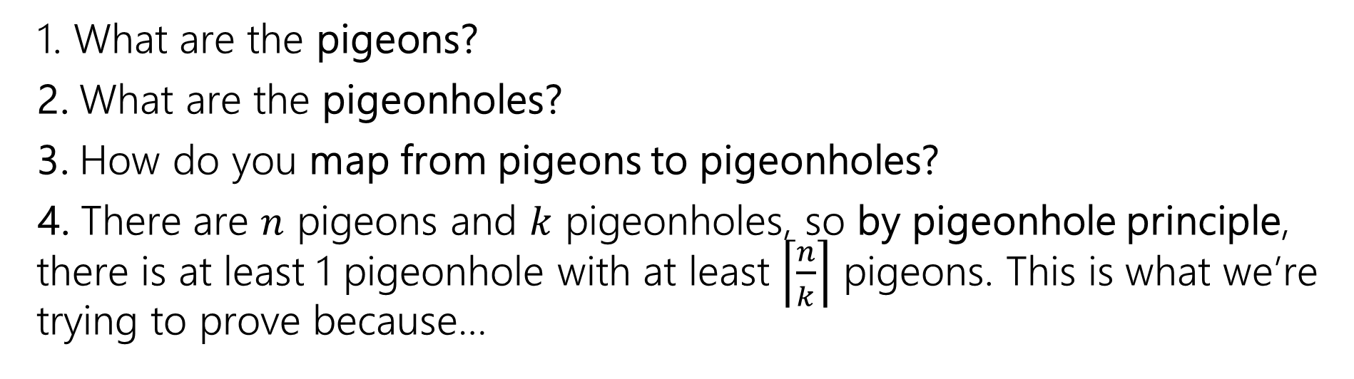
Practical Tips
1. What are the pigeons?
2. What are the pigeonholes?
3. How do you map from pigeons to pigeonholes?
4. There are $n$ pigeons and $k$ pigeonholes, so by pigeonhole principle, there is at least 1 pigeonhole with at least $\left\lceil \frac{n}{k}\right\rceil$ pigeons. This is what we’re trying to prove because…
Notes:
The general process to use when .. Is identifying how to apply the pigeonhole principle to the problem.. So we first define what the pgieons are …. How we map in the context of the problem…

Slide 50
Practical Tips
When to use pigeonhole principle?
> When we’re trying to prove or make some guarantee about a certain number of things sharing some property.
> For tricky ones, we’ll warn you in advance that pigeonhole principle is the right method (you’ll see one in the section handout).
1. What are the pigeons?
2. What are the pigeonholes?
3. How do you map from pigeons to pigeonholes?
4. There are $n$ pigeons and $k$ pigeonholes, so by pigeonhole principle, there is at least 1 pigeonhole with at least $\left\lceil \frac{n}{k}\right\rceil$ pigeons. This is what we’re trying to prove because…
Notes:
The general process to use when .. Is identifying how to apply the pigeonhole principle to the problem.. So we first define what the pgieons are …. How we map in the context of the problem…

Slide 51
Practical Tips
Look for – a set you’re trying to divide into groups, where collisions would help you somehow.
“Prove that there are at least x A’s that have the same B”
  > Pigeons: all possible A’s
  > Pigeonholes: all possible B’s
  > Mapping: each A is assigned to one possible B
  The pigeonhole principle tells us that there are at least x pigeons that fall into the same hole -> there are at least x A’s that have the same B
Notes:
How to know to … if you’re trying to rpove something… think about what

Slide 52
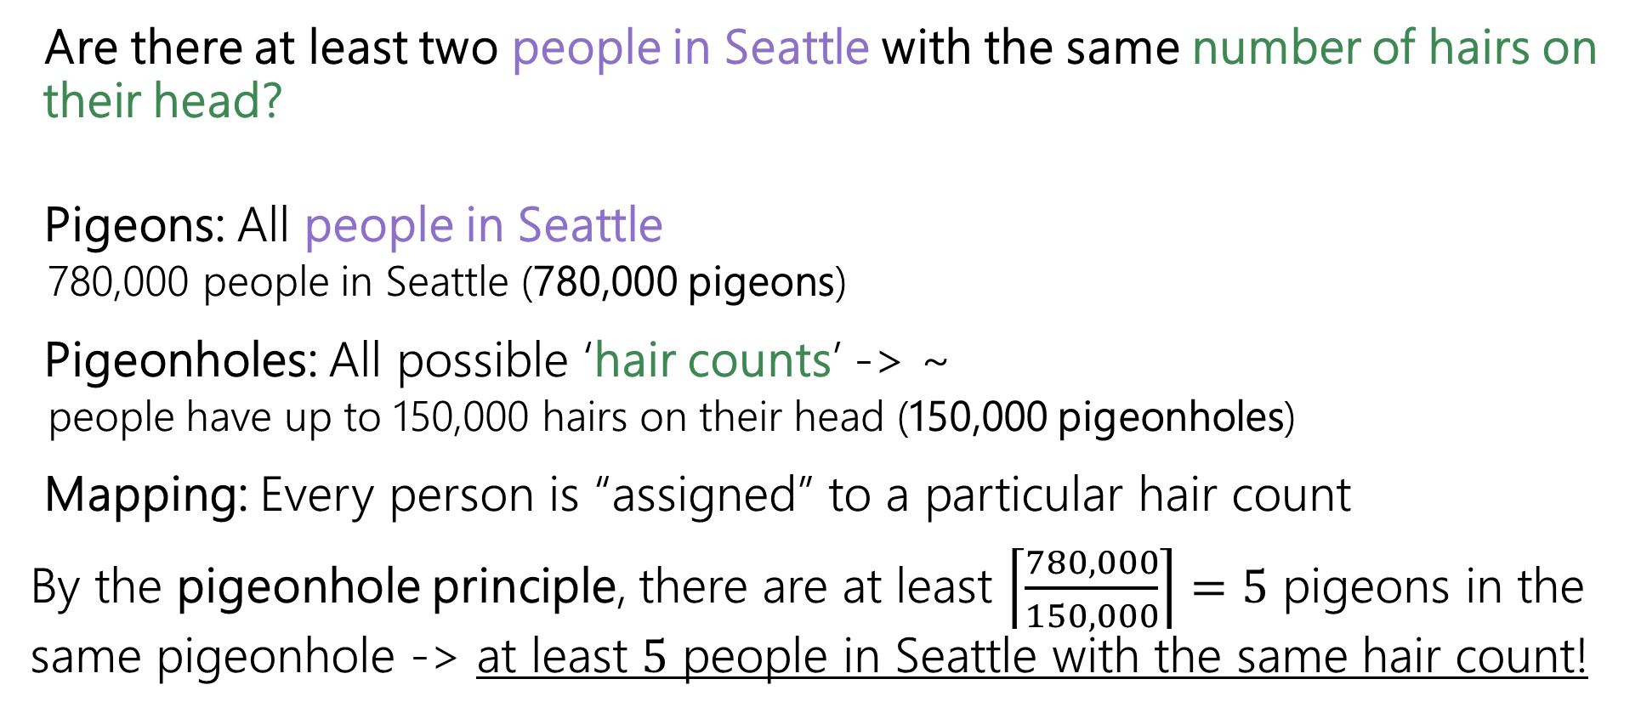
Back to the hairy question….
Are there at least two people in Seattle with the same number of hairs on their head?
Pigeons: All people in Seattle
  780,000 people in Seattle (780,000 pigeons)
Pigeonholes: All possible ‘hair counts’ -> ~
  people have up to 150,000 hairs on their head (150,000 pigeonholes)
Mapping: Every person is “assigned” to a particular hair count
By the pigeonhole principle, there are at least $\left\lceil \frac{780,000}{150,000}\right\rceil =5$ pigeons in the same pigeonhole -> at least $5$ people in Seattle with the same hair count!
Notes:
Let’s go back to our problem that w’ere all very excited to know the answer… we know that find if there are at least two people with the same number of hairs. To apply the pigeonhole principle, we want to have some pgioens

Slide 53
But actually…what’s the point of this?
We can prove some pretty fun statements!
Hashing Algorithms: Ensuring that collisions will occur when hashing more items than there are available hash slots, which helps in designing effective collision resolution strategies. (you’ll learn about hashing in 332!)
Resource Allocation: Ensuring that in systems with more requests than resources, some resources will be shared (e.g., tasks and processors)
Data Compression: Demonstrating that lossless compression of sufficiently large files must lead to some files being larger after compression due to limited encoding space
It is also the basis of proving that a language is not regular, as you may remember from 311!
Notes:
Prove fun statements, and you can show off to your friends with some fun facts…. There are applications in other cs stuff.. For example, how many of you heard about hashing.. Learn about it in 332 so no worries if this doesn’t’ make sense, but u can analyze the collisions that happen when more items than hash slots..
Also useful with things like resource allocation and data compression.
Questions?

Slide 54
Thinking about Counting
Notes:
Ok, so that’s the end of the counting rules yay.let’s review these ways that we’ve talked abt, practice, and talk abt how to figure out how to approach counting problems.

Slide 55
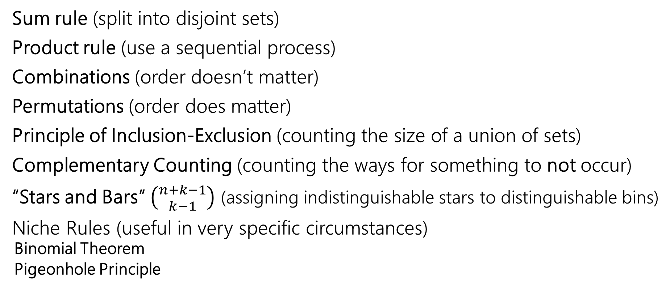
We’ve seen lots of ways to count
Sum rule (split into disjoint sets)
Product rule (use a sequential process)
Combinations (order doesn’t matter)
Permutations (order does matter)
Principle of Inclusion-Exclusion (counting the size of a union of sets)
Complementary Counting (counting the ways for something to not occur)
“Stars and Bars” $\left({n+k−1 \atop k−1}\right)$ (assigning indistinguishable stars to distinguishable bins)
Niche Rules (useful in very specific circumstances)
  Binomial Theorem
  Pigeonhole Principle
Notes:
We’ve talked about a bunch of rules, let’s review them.
Cases that don’t overlap with each other
When coming up with a sequential process, think abouthwat sequentaial process would I use to construct these kind of outcomes.. Ifur able to think about of one, product rule
Selecting distinct objects from a group….
So ABC CBA, etc. count as one …
|A u B|
Key word is indistinguishable…

Slide 56
How to tell which approach(es) to take?
Identify keywords in the problem, and key properties, and think about what techniques match those patterns
If an approach isn’t working or things are getting out of control, try a different approach!
There are often multiple ways to solve the same problem ☺
In some harder problems, we might need to start by…
  solving a simplified version of the problem first,
  and then dividing/subtracting out overcounting
This all takes practice so don’t be hard on yourself if you don’t think of the correct answer at first glance!

Slide 57
How to tell which approach(es) to take?
> Can we break this into some disjoint cases? (sum rule)
> Can we create our desired outcomes with a clear sequential process? (product rule)
> Are we counting the ways for something not to occur? (complementary counting)
> Are we dealing with the union of some sets? (inclusion-exclusion)
> Does order matter or not in this problem? (permutation or combination)
> Are the objects distinguishable or indistinguishable (stars and bars if indistinguishable)
These approaches often work together! E.g., to compute the number of options in one of the disjoint cases, you may need another approach

