Slide 1
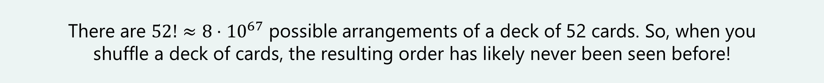
More Counting!
CSE 312 26Su
Lecture 2
Fun Fact
There are $52!≈8⋅{10}^{67}$ possible arrangements of a deck of 52 cards. So, when you
shuffle a deck of cards, the resulting order has likely never been seen before!

Slide 2
Announcements
Homework 1 will be released tonight, due next Wednesday (7/1)
> All content for the homework will be covered by today’s lecture
> Collaboration is encouraged but follow collaboration policy (syllabus)
> Justify your answers! We want to see your thought process
  Not a proof (unless we say to prove something). But enough explanation that someone who followed lecture but hasn’t seen the problem would fully understand where your answer came from (and believe it’s correct)
> Coding question
> We’re here to help!
  Office hour schedule posted on the course website
  Edstem discussion board

Slide 3
Announcements
2 penalty-free late days per assignment if you submit a meaningful attempt by the original deadline. Failure to submit a meaningful attempt will result in 25% penalty per day.
This policy is intended for “normal” things during the quarter.
If you have an unusual or extended or extreme issue, please let us know. The sooner you let us know, the more options we have for accommodations.

Slide 4
Where Are We?
Last time:
  Sum rule
  Product rule
  Permutations
  Combinations
  Complementary counting
Today:
  More about combinations
  Applications of combinations
    Path counting
    Rearranging strings
    Multinomial coefficients
    Binomial theorem
  Inclusion-exclusion
  Sleuth’s criterion

Slide 5

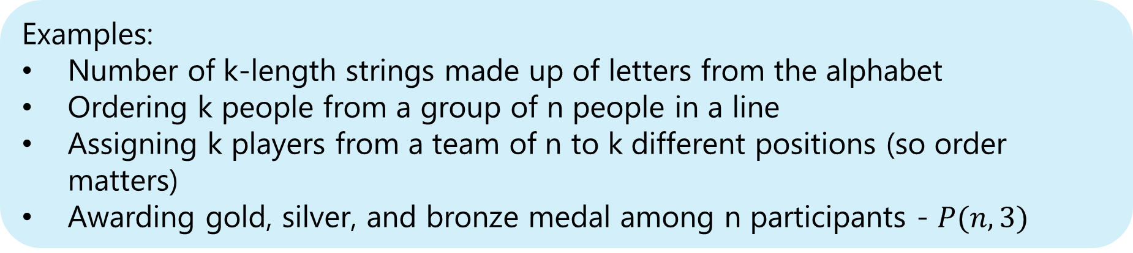
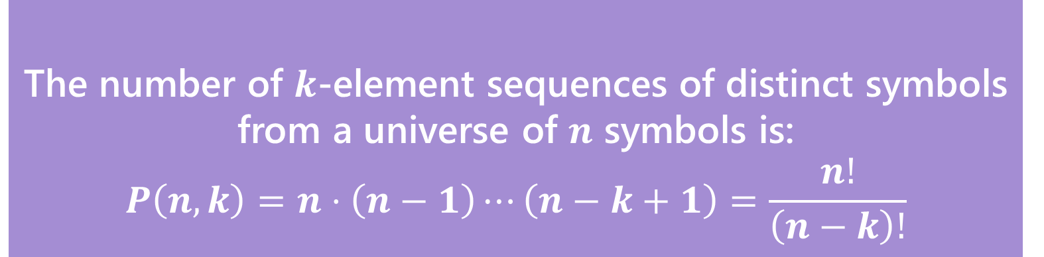
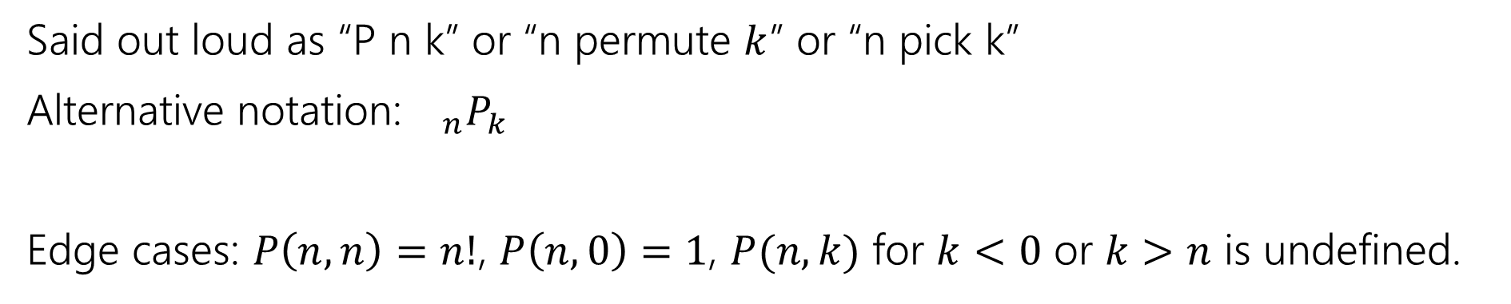
Recap: $k$-permutation
The number of $k$-element sequences of distinct symbols from a universe of $n$ symbols is:
$$P\left(n,k\right)=n⋅\left(n−1\right)⋯\left(n−k+1\right)=\frac{n!}{\left(n−k\right)!}$$
$k$-permutation
Examples:
Number of k-length strings made up of letters from the alphabet
Ordering k people from a group of n people in a line
Assigning k players from a team of n to k different positions (so order matters)
Awarding gold, silver, and bronze medal among n participants - $P(n, 3)$
Said out loud as “P n k” or “n permute $k$” or “n pick k”
Alternative notation:${}_{n}P_{k}$
Edge cases: $P\left(n,n\right)=n!$, $P\left(n,0\right)=1$, $P(n,k)$ for $k<0$ or $k>n$ is undefined.

Slide 6
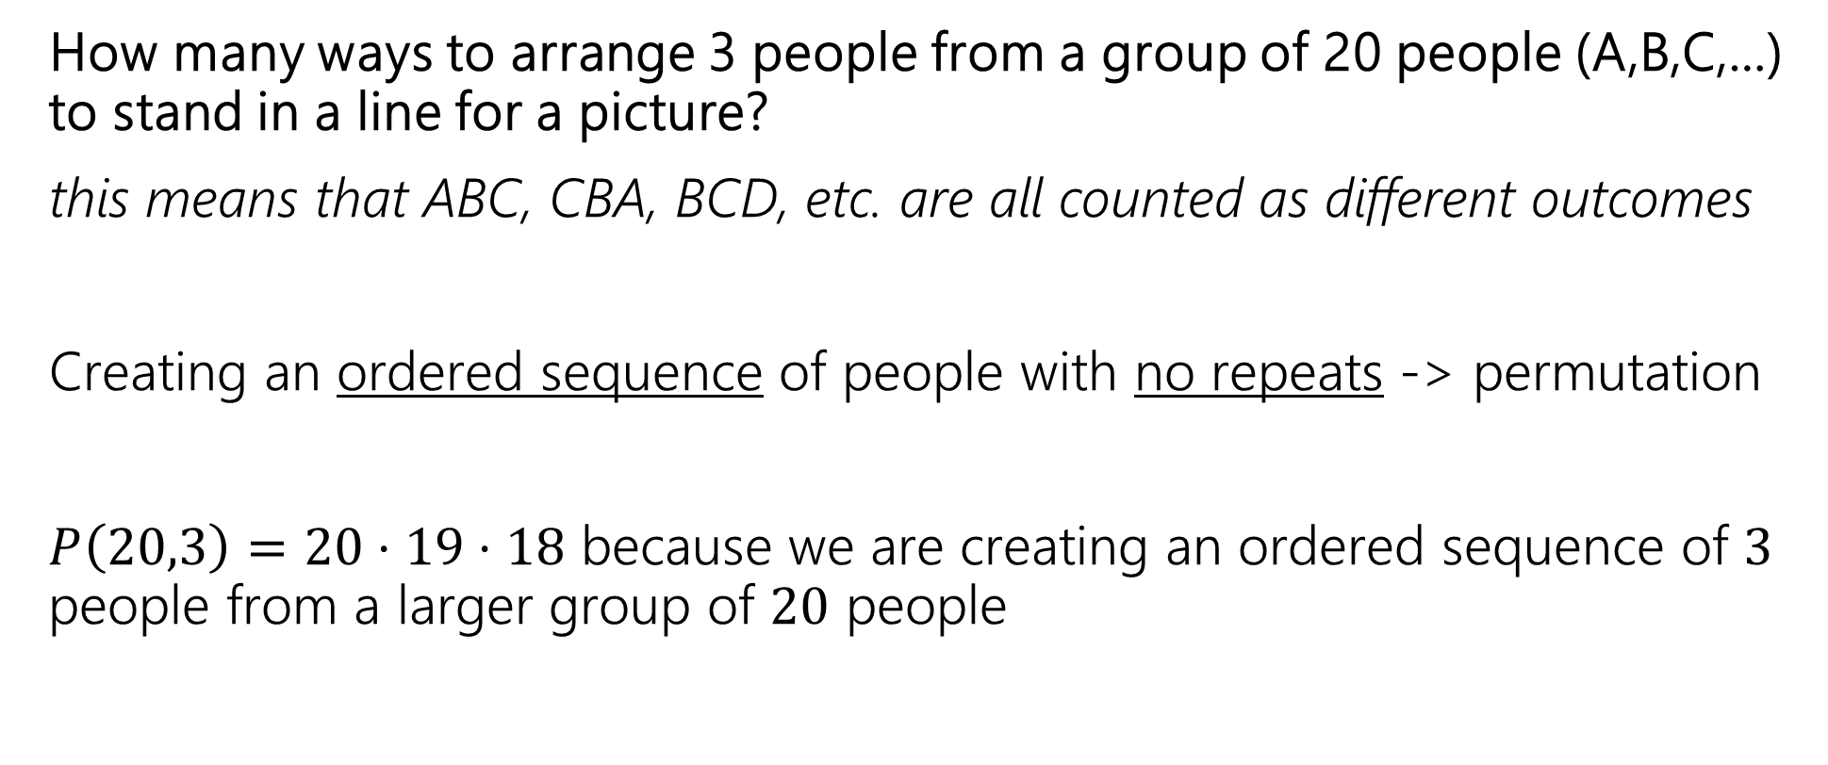
Picture Time 📸
How many ways to arrange 3 people from a group of 20 people (A,B,C,…) to stand in a line for a picture?
this means that ABC, CBA, BCD, etc. are all counted as different outcomes
Creating an ordered sequence of people with no repeats -> permutation
$P\left(20,3\right)=20⋅19⋅18$ because we are creating an ordered sequence of $3$ people from a larger group of $20$ people

Slide 7
Picture Time 📸 (but change it slightly)
How many ways to select 3 people from a group of 20 people (A,B,C,…) to be in a picture, but we don’t care about the order they stand in?
this means ABC, CDF, BCD, etc. are all counted as different outcomes, but ABC, BCA,CBA, etc. are counted as the same outcome
Same as before but now we do not care about order!
Looking for the number of possible subsets of 3 from the group of 20

Slide 8
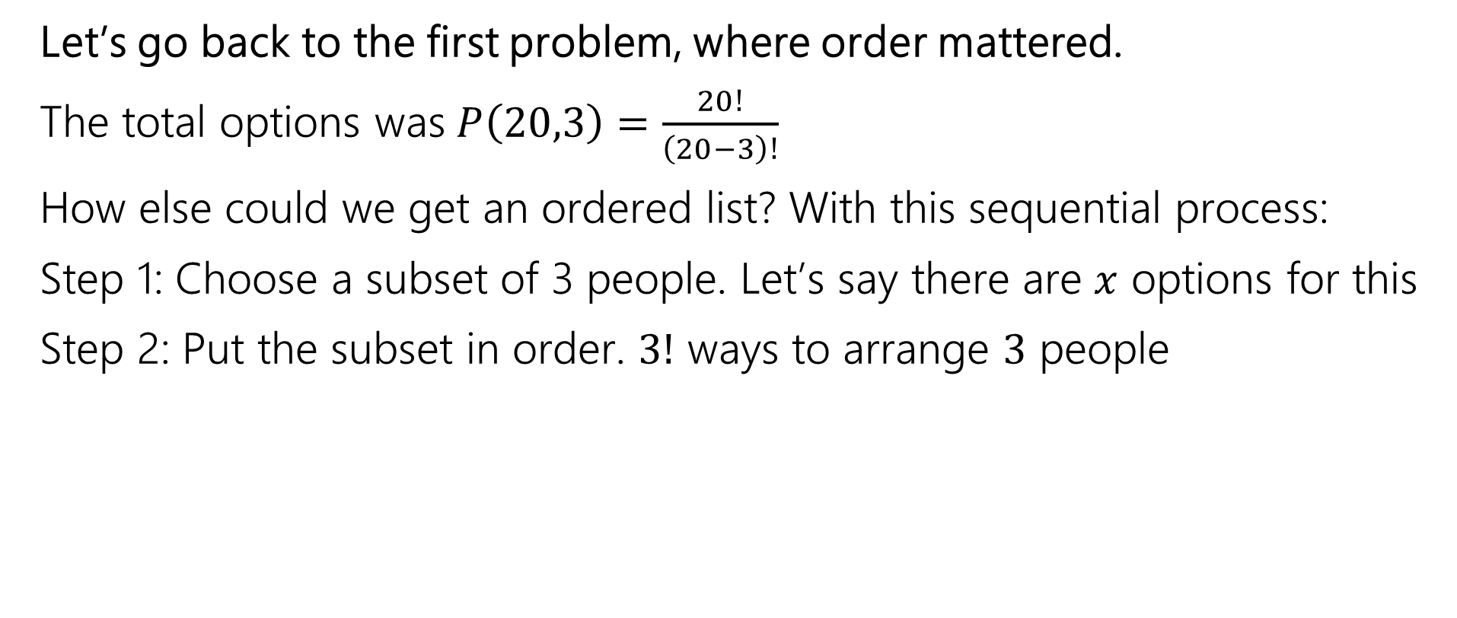
Clever approach – count two ways
Let’s go back to the first problem, where order mattered.
The total options was$P\left(20,3\right)=\frac{20!}{\left(20−3\right)!}$
How else could we get an ordered list? With this sequential process:
Step 1: Choose a subset of 3 people. Let’s say there are $x$ options for this
Step 2: Put the subset in order. $3!$ ways to arrange $3$ people

Slide 9
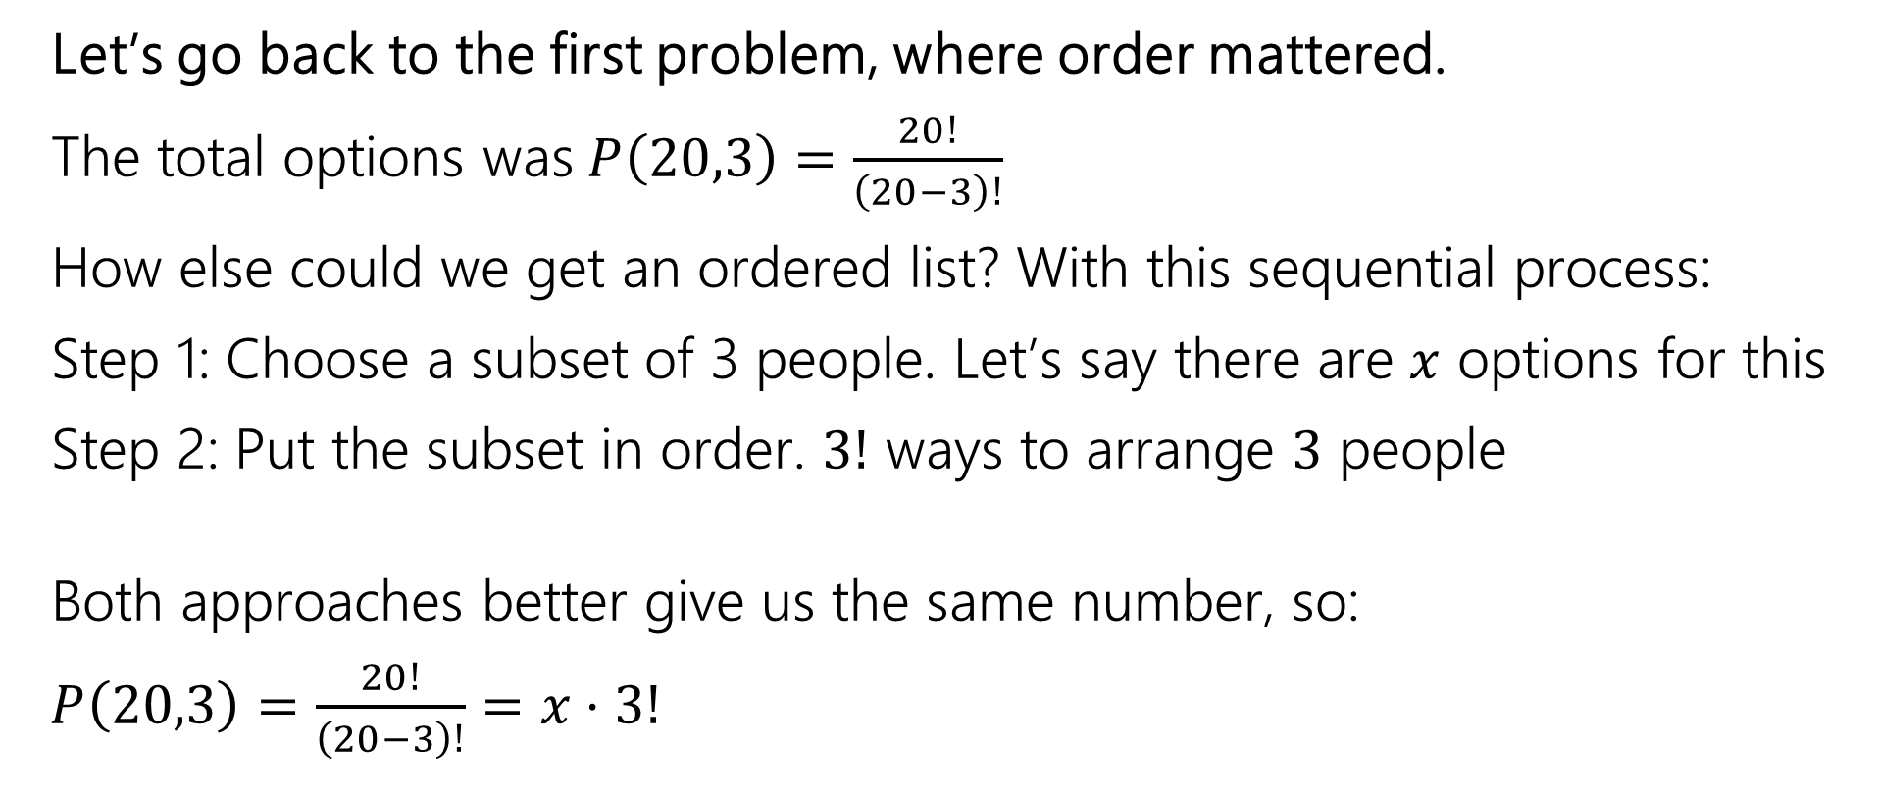
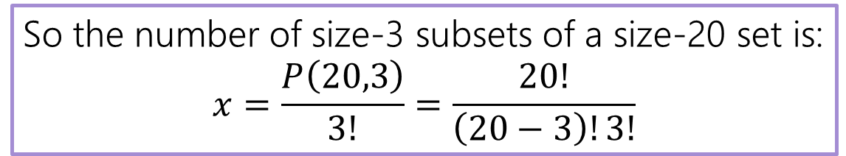
Clever approach – count two ways
Let’s go back to the first problem, where order mattered.
The total options was$P\left(20,3\right)=\frac{20!}{\left(20−3\right)!}$
How else could we get an ordered list? With this sequential process:
Step 1: Choose a subset of 3 people. Let’s say there are $x$ options for this
Step 2: Put the subset in order. $3!$ ways to arrange $3$ people
Both approaches better give us the same number, so:
$P\left(20,3\right)=\frac{20!}{\left(20−3\right)!}=x⋅3!$
So the number of size-3 subsets of a size-20 set is:
$$x=\frac{P\left(20,3\right)}{3!}=\frac{20!}{\left(20−3\right)!3!}$$

Slide 10
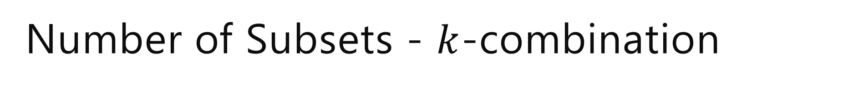
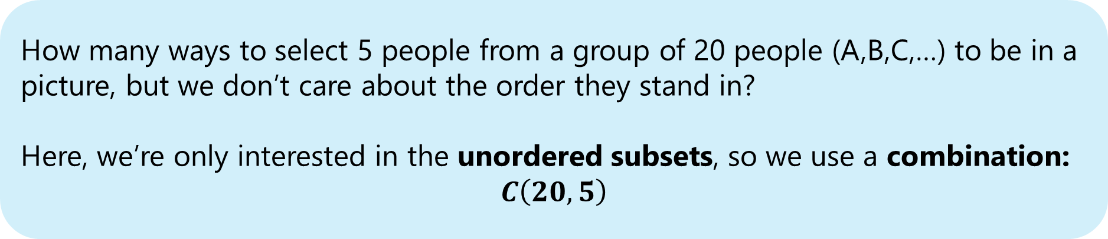
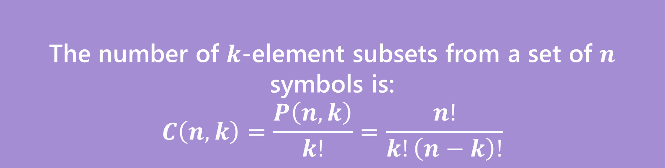
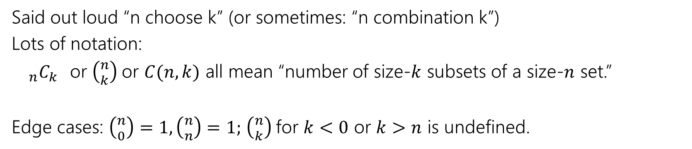
Number of Subsets - $k$-combination
The number of $k$-element subsets from a set of $n$ symbols is:
$$C\left(n,k\right)=\frac{P\left(n,k\right)}{k!}=\frac{n!}{k!\left(n−k\right)!}$$
$k$-combination
How many ways to select 5 people from a group of 20 people (A,B,C,…) to be in a picture, but we don’t care about the order they stand in?
Here, we’re only interested in the unordered subsets, so we use a combination:
$$C\left(20, 5\right)$$
Said out loud “n choose k” (or sometimes: “n combination k”)
Lots of notation:
${}_{n}C_{k}$or $\left({n \atop k}\right)$or $C(n,k)$ all mean “number of size-$k$ subsets of a size-$n$ set.”
Edge cases: $\left({n \atop 0}\right)=1,\left({n \atop n}\right)=1;$ $\left({n \atop k}\right)$for $k<0$ or $k>n$ is undefined.

Slide 11
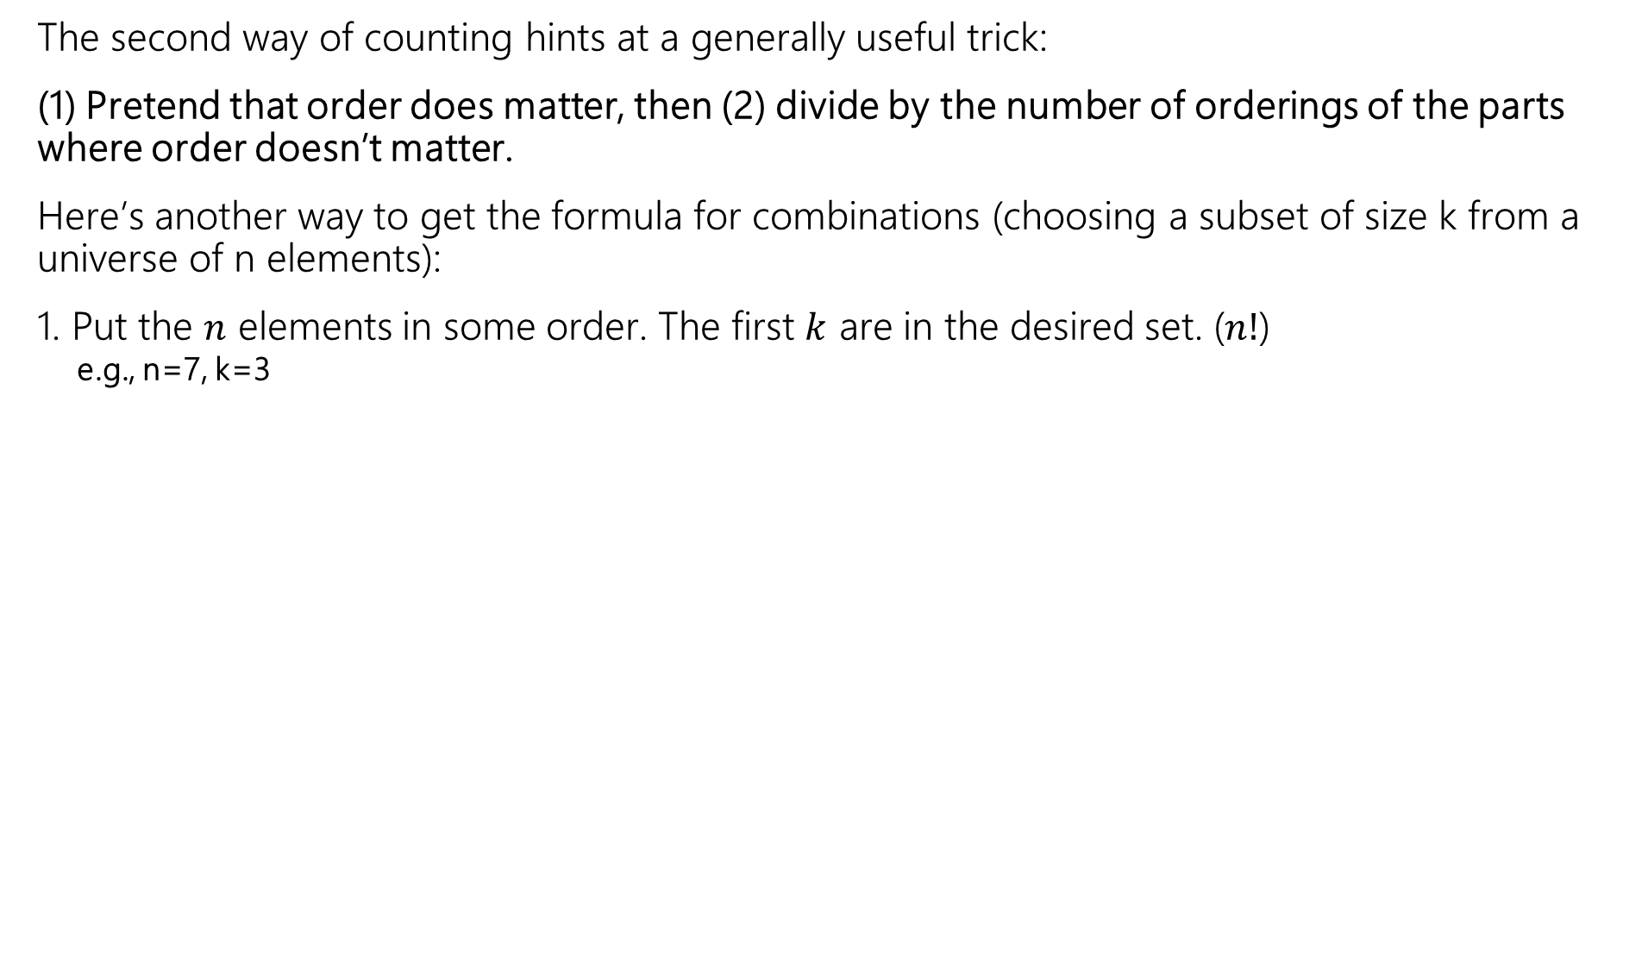
Another approach for deriving k-combinations
The second way of counting hints at a generally useful trick:
(1) Pretend that order does matter, then (2) divide by the number of orderings of the parts where order doesn’t matter.
Here’s another way to get the formula for combinations (choosing a subset of size k from a universe of n elements):
1. Put the $n$ elements in some order. The first $k$ are in the desired set. ($n!$)
e.g., n=7, k=3
A
B
C
D
E
F
G

Slide 12


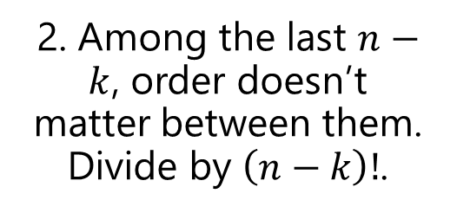
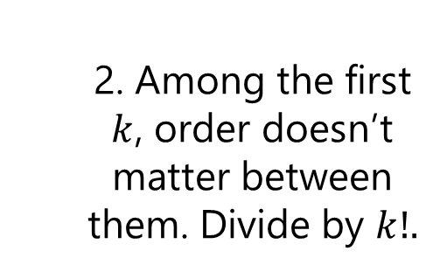
Another approach for deriving k-combinations
The second way of counting hints at a generally useful trick:
(1) Pretend that order does matter, then (2) divide by the number of orderings of the parts where order doesn’t matter.
Here’s another way to get the formula for combinations (choosing a subset of size k from a universe of n elements):
1. Put the $n$ elements in some order. The first $k$ are in the desired set. ($n!$)
A
B
C
D
E
F
G
$$\frac{n!}{k!\left(n−k\right)!}$$
  2. Among the first $k$, order doesn’t matter between them. Divide by $k!.$
2. Among the last $n−k$, order doesn’t matter between them. Divide by $\left(n−k\right)!$.

Slide 13
Path Counting 🏔️

Slide 14

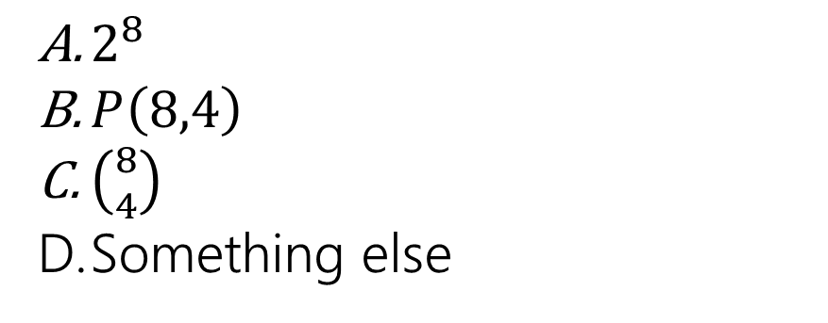
Path Counting
We’re in the lower-left corner, and want to get to the upper-right corner.
Each step either goes right or up.
How many different paths are there?
$2^{8}$
$P\left(8,4\right)$
$\left({8 \atop 4}\right)$
Something else
Join at: slido.com, #6868 301

Slide 15

Path Counting
Go from lower-left corner to the upper-right corner.
Each step either goes right or up.
We’re going to take $8$ steps.
Maybe…$2^{8}$ options because on each step we either go right or up?
Move 1: (R/U) $2$ Move 5: (R/U) $2$
Move 2:(R/U)$2$ Move 6: (R/U) $2$
Move 3: (R/U) $2$ Move 7: (R/U) $2$
Move 4: (R/U) $2$ Move 8: (R/U) $2$

Slide 16

Path Counting
Go from lower-left corner to the upper-right corner.
Each step either goes right or up.
We’re going to take $8$ steps.
Maybe…$2^{8}$ options because on each step we either go right or up?
But this includes paths that don’t take us to the goal! ☹
Move 1: (R/U) $2$ Move 5: (R/U) $2$
Move 2:(R/U)$2$ Move 6: (R/U) $2$
Move 3: (R/U) $2$ Move 7: (R/U) $2$
Move 4: (R/U) $2$ Move 8: (R/U) $2$

Slide 17

Path Counting
Go from lower-left corner to the upper-right corner.
Each step either goes right or up.
We’re going to take $8$ steps.
Exactly 4 of the steps must be up and the rest to the right to reach the goal
Move 1: Move 5:
Move 2: Move 6:
Move 3: Move 7:
Move 4: Move 8:

Slide 18

Path Counting
Go from lower-left corner to the upper-right corner.
Each step either goes right or up.
We’re going to take $8$ steps.
Exactly 4 of the steps must be up and the rest to the right to reach the goal
E.g. $\{1,2,7,8\}$
Move 1: $↑$ Move 5: $→$
Move 2: $↑$ Move 6: $→$
Move 3: $→$ Move 7: $↑$
Move 4: $→$ Move 8: $↑$

Slide 19

Path Counting
Go from lower-left corner to the upper-right corner.
Each step either goes right or up.
We’re going to take $8$ steps.
Exactly 4 of the steps must be up and the rest to the right to reach the goal
E.g. $\{2,4,5,7\}$
Move 1:$→$ Move 5: $↑$
Move 2: $↑$ Move 6: $→$
Move 3: $→$ Move 7: $↑$
Move 4:$↑$ Move 8: $→$

Slide 20

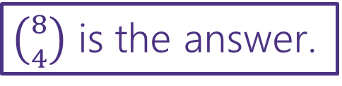
Path Counting
Go from lower-left corner to the upper-right corner.
Each step either goes right or up.
We’re going to take $8$ steps.
Exactly 4 of the steps must be up and the rest to the right to reach the goal
Choose which SET of 4 of the moves will be up (the others will be right).
How many size-4 subsets of $\{1,2,3,4,5,6,7,8\}$ are there?
$\left({8 \atop 4}\right)$ is the answer.

Slide 21
Binomial Theorem another application of combinations!

Slide 22
Binomial Theorem
In high school you might have had to expand these:
(x+y)² = (x+y)(x+y)
= xx +xy + yx + yy
= x² + 2xy + y²
(x+y)⁴= (x+y)(x+y)(x+y)(x+y)
= xxxx +yyyy+ xyxy +yxyy + …

Slide 23

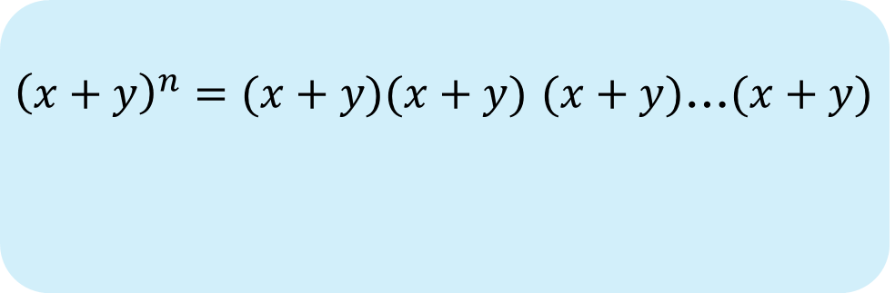
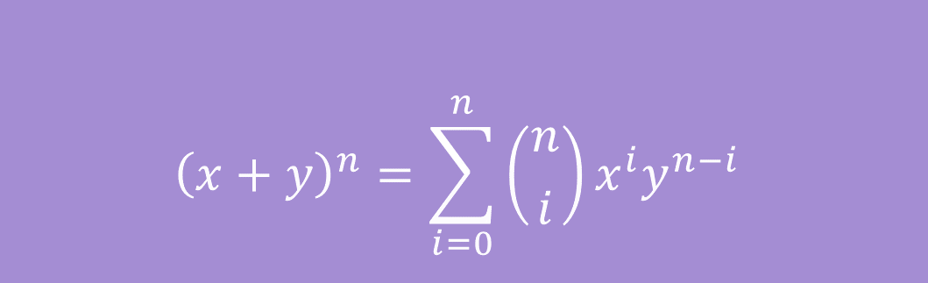
Binomial Theorem
In high school you might have memorized
${\left(x+y\right)}^{2}=x^{2}+2xy+y^{2}$
${\left(x+y\right)}^{3}=x^{3}+3x^{2}y+3xy^{2}+y^{3}$
The Binomial Theorem tells us what happens for every $n$:
$${\left(x+y\right)}^{n}=\sum_{i=0}^{n}{\left({n \atop i}\right)x^{i}y^{n−i}}$$
${\left(x+y\right)}^{n}=(x+y)(x+y)$ $(x+y)$…$(x+y)$
The Binomial Theorem

Slide 24

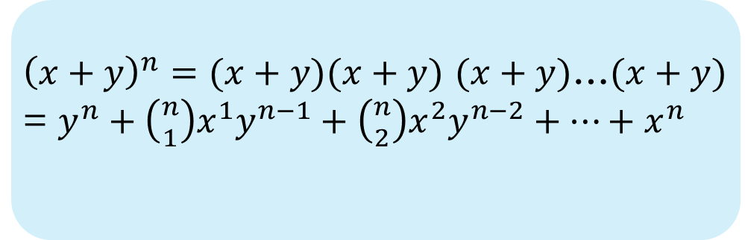
Binomial Theorem
In high school you might have memorized
${\left(x+y\right)}^{2}=x^{2}+2xy+y^{2}$
${\left(x+y\right)}^{3}=x^{3}+3x^{2}y+3xy^{2}+y^{3}$
The Binomial Theorem tells us what happens for every $n$:
$${\left(x+y\right)}^{n}=\sum_{i=0}^{n}{\left({n \atop i}\right)x^{i}y^{n−i}}$$
${\left(x+y\right)}^{n}=(x+y)(x+y)$ $(x+y)$…$(x+y)$
= $y^{n}+\left({n \atop 1}\right)x^{1}y^{n−1}+\left({n \atop 2}\right)x^{2}y^{n−2}+…+x^{n}$
The Binomial Theorem

Slide 25
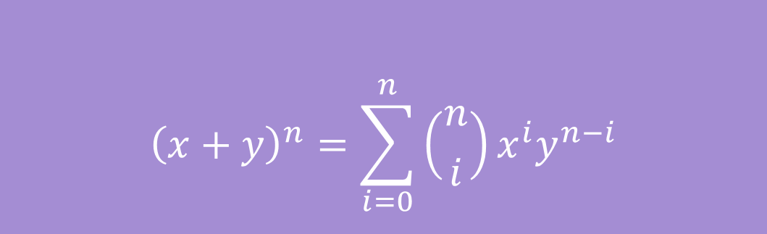

Some intuition
$${\left(x+y\right)}^{n}=\sum_{i=0}^{n}{\left({n \atop i}\right)x^{i}y^{n−i}}$$
The Binomial Theorem
Each term is of the form $x^{i}y^{n−i}$, since each term is made by multiplying exactly n variables, either x or y.

Slide 26
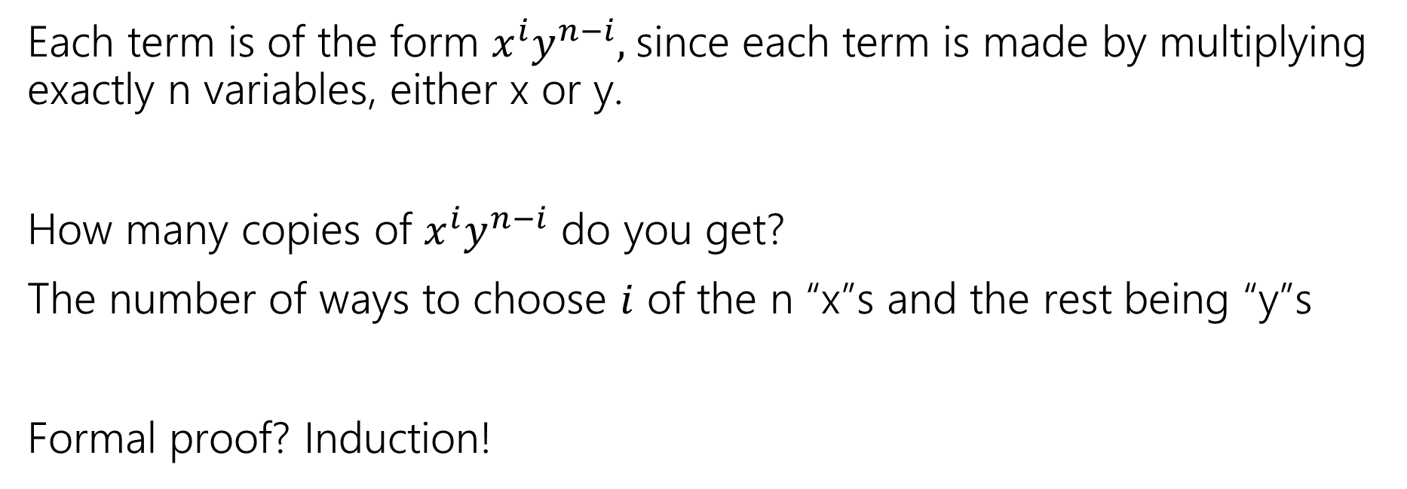
Some intuition
$${\left(x+y\right)}^{n}=\sum_{i=0}^{n}{\left({n \atop i}\right)x^{i}y^{n−i}}$$
The Binomial Theorem
Each term is of the form $x^{i}y^{n−i}$, since each term is made by multiplying exactly n variables, either x or y.
How many copies of $x^{i}y^{n−i}$ do you get?
The number of ways to choose $i$ of the n “x”s and the rest being “y”s
Formal proof? Induction!

Slide 27
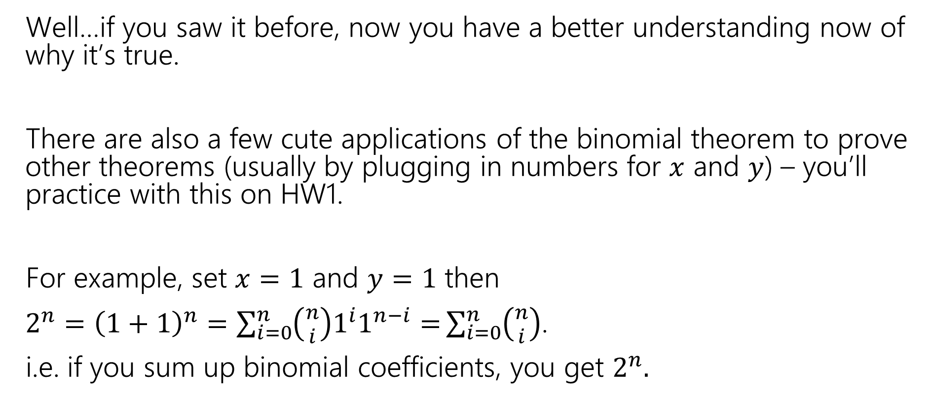
So What?
Well…if you saw it before, now you have a better understanding now of why it’s true.
There are also a few cute applications of the binomial theorem to prove other theorems (usually by plugging in numbers for $x$ and $y$) – you’ll practice with this on HW1.
For example, set $x=1$ and $y=1$ then
$2^{n}={\left(1+1\right)}^{n}=\sum_{i=0}^{n}{\left({n \atop i}\right)1^{i}1^{n−i}=}\sum_{i=0}^{n}{\left({n \atop i}\right)}$.
i.e. if you sum up binomial coefficients, you get $2^{n}.$

Slide 28
What if there are some duplicate/identical items and the rest are distinct?

Slide 29
Rearranging Distinct Elements
How many anagrams are there of COMPUTER?
(an anagram is a rearrangement of letters).

Slide 30
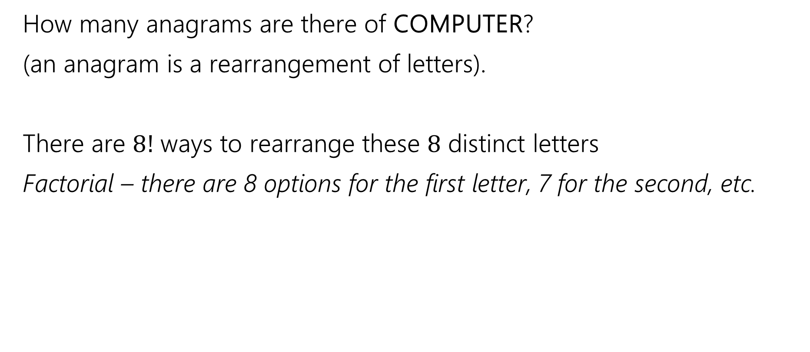
Rearranging Distinct Elements
How many anagrams are there of COMPUTER?
(an anagram is a rearrangement of letters).
There are $8!$ ways to rearrange these $8$ distinct letters
Factorial – there are 8 options for the first letter, 7 for the second, etc.

Slide 31
Rearranging With Duplicates
How many anagrams are there of SEATTLE?
(an anagram is a rearrangement of letters).

Slide 32
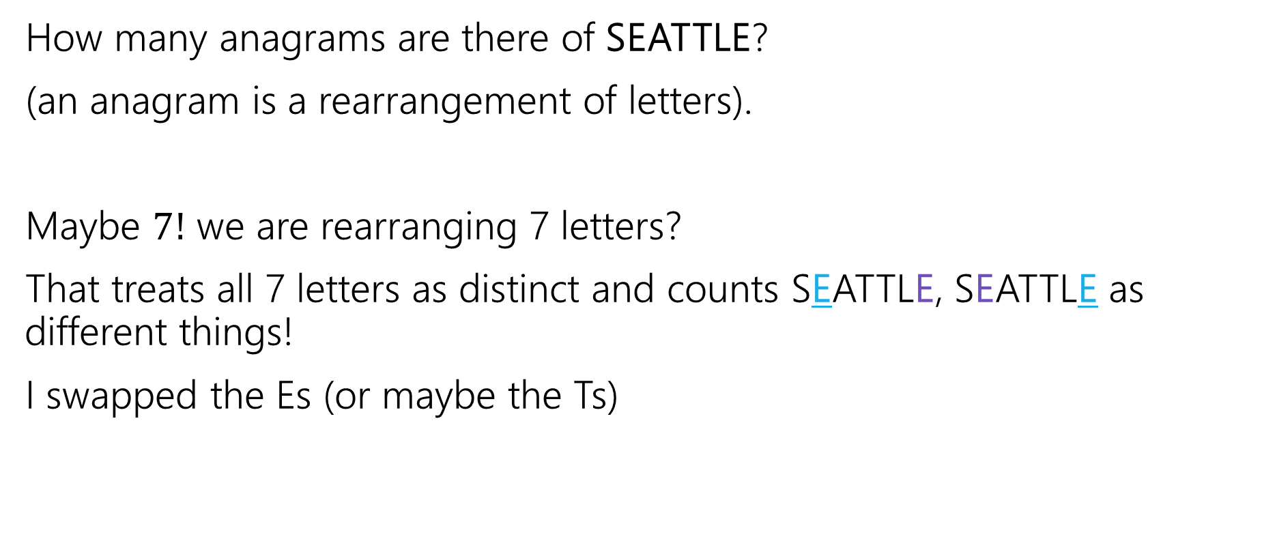
Rearranging With Duplicates
How many anagrams are there of SEATTLE?
(an anagram is a rearrangement of letters).
Maybe $7!$ we are rearranging 7 letters?
That treats all 7 letters as distinct and counts SEATTLE, SEATTLE as different things!
I swapped the Es (or maybe the Ts)

Slide 33

Rearranging With Duplicates (approach 1)
How many anagrams are there of SEATTLE?
1. Pretend all the letters are distinct (e.g., E₁ different from E₂)
  How many arrangements of SE₁AT₁T₂LE₂? $7!$

Slide 34
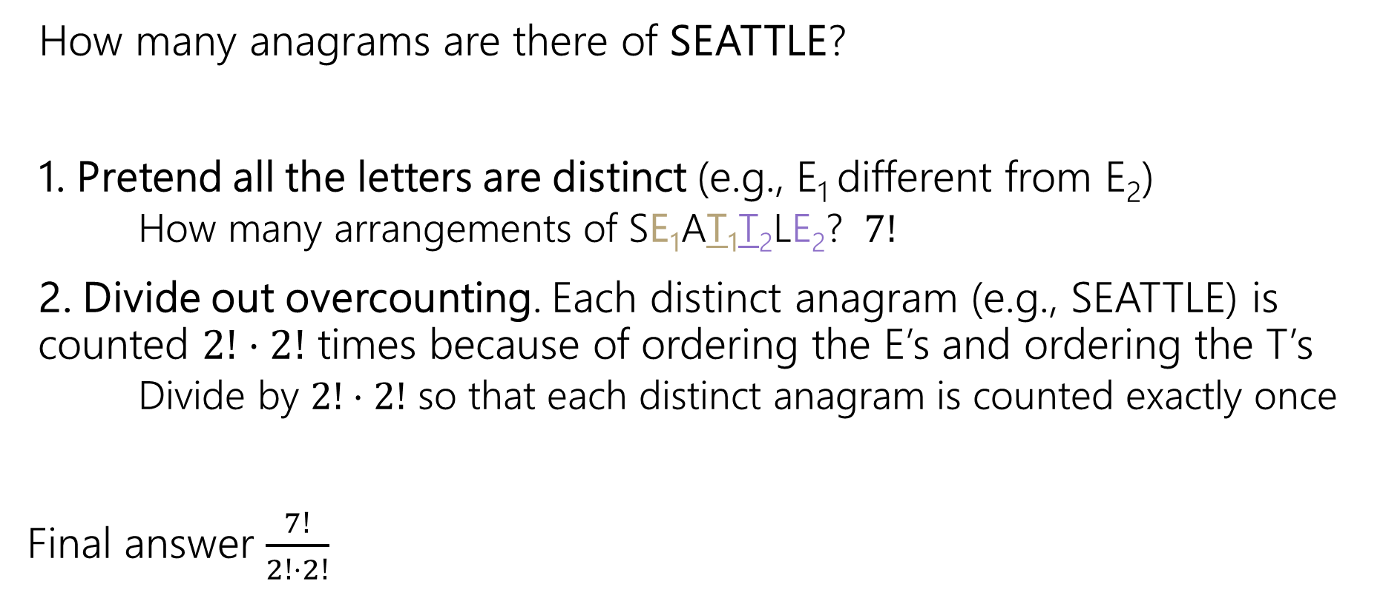
Rearranging With Duplicates (approach 1)
How many anagrams are there of SEATTLE?
1. Pretend all the letters are distinct (e.g., E₁ different from E₂)
  How many arrangements of SE₁AT₁T₂LE₂? $7!$
2. Divide out overcounting. Each distinct anagram (e.g., SEATTLE) is counted $2!⋅2!$ times because of ordering the E’s and ordering the T’s
  Divide by $2!⋅2!$ so that each distinct anagram is counted exactly once
Final answer $\frac{7!}{2!⋅2!}$

Slide 35

Rearranging With Duplicates (approach 2)
How many anagrams are there of SEATTLE?
1. Pick positions for the 2 E’s. $\left({7 \atop 2}\right)$ because the E’s are identical
  (e.g., {2, 5} -> __ E __ __ E __ __)

Slide 36
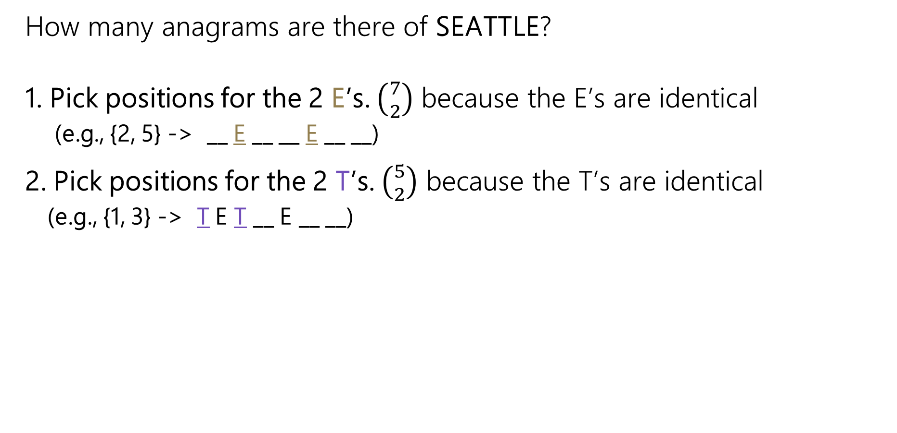
Rearranging With Duplicates (approach 2)
How many anagrams are there of SEATTLE?
1. Pick positions for the 2 E’s. $\left({7 \atop 2}\right)$ because the E’s are identical
  (e.g., {2, 5} -> __ E __ __ E __ __)
2. Pick positions for the 2 T’s. $\left({5 \atop 2}\right)$ because the T’s are identical
  (e.g., {1, 3} -> T E T __ E __ __)

Slide 37
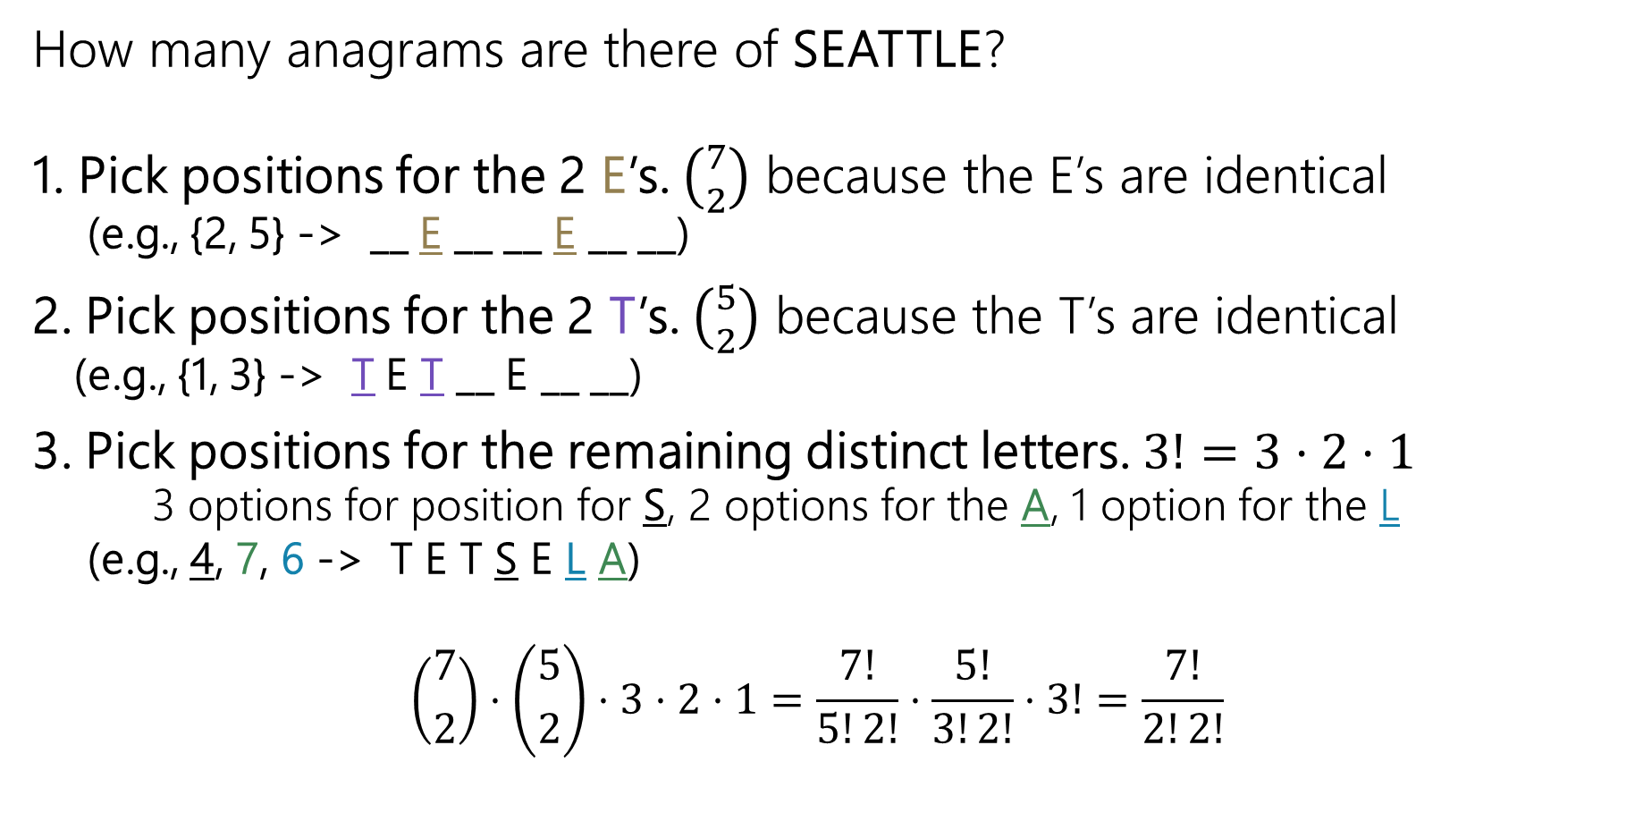
Rearranging With Duplicates (approach 2)
How many anagrams are there of SEATTLE?
1. Pick positions for the 2 E’s. $\left({7 \atop 2}\right)$ because the E’s are identical
  (e.g., {2, 5} -> __ E __ __ E __ __)
2. Pick positions for the 2 T’s. $\left({5 \atop 2}\right)$ because the T’s are identical
  (e.g., {1, 3} -> T E T __ E __ __)
3. Pick positions for the remaining distinct letters. $3!=3⋅2⋅1$
  3 options for position for S, 2 options for the A, 1 option for the L
  (e.g., 4, 7, 6 -> T E T S E L A)
  $$\left({7 \atop 2}\right)⋅\left({5 \atop 2}\right)⋅3⋅2⋅1=\frac{7!}{5!2!}⋅\frac{5!}{3!2!}⋅3!=\frac{7!}{2!2!}$$

Slide 38
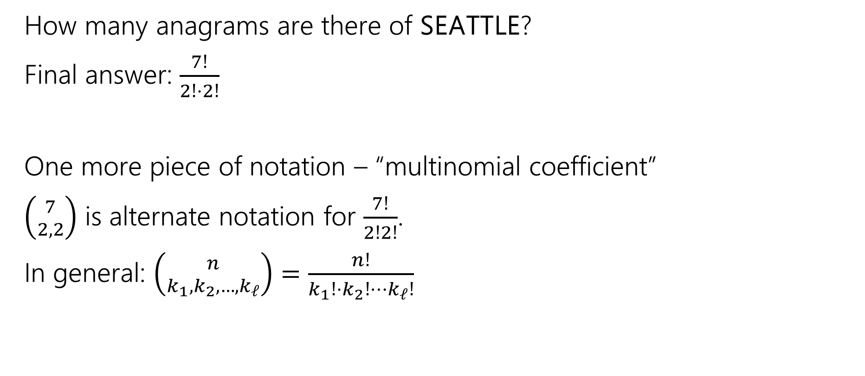
Rearranging With Duplicates
How many anagrams are there of SEATTLE?
Final answer: $\frac{7!}{2!⋅2!}$
One more piece of notation – “multinomial coefficient”
$\left({7 \atop 2,2}\right)$ is alternate notation for $\frac{7!}{2!2!}$.
In general: $\left({n \atop k_{1},k_{2},…,k_{ℓ}}\right)=\frac{n!}{k_{1}!{⋅k}_{2}!⋯k_{ℓ}!}$
Notes:
This can be a little confusing notation with the binomial coeffitient notation

Slide 39
Principle of Inclusion-Exclusion

Slide 40
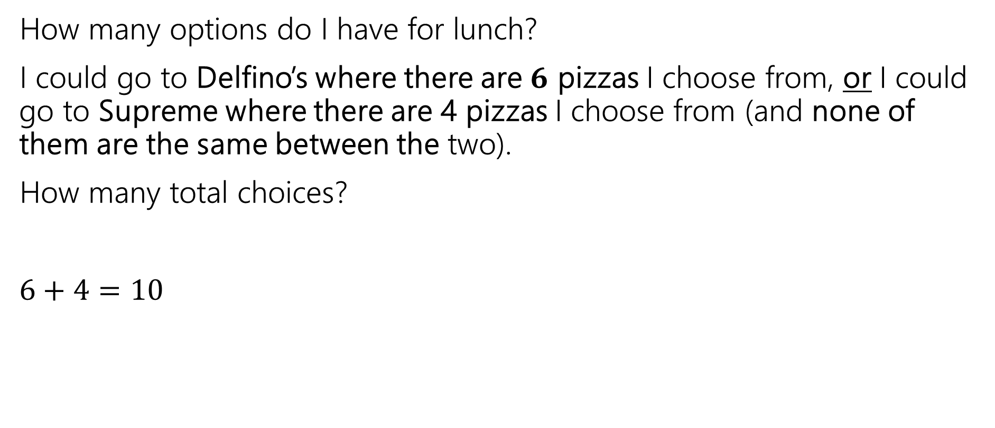
Recall: Sum Rule
How many options do I have for lunch?
I could go to Delfino’s where there are $6$ pizzas I choose from, or I could go to Supreme where there are 4 pizzas I choose from (and none of them are the same between the two).
How many total choices?
$6+4=10$
Sum Rule: If you are choosing one thing between $n$ options in one group and $m$in another group with no overlap, the total number of options is: $n+m$.

Slide 41

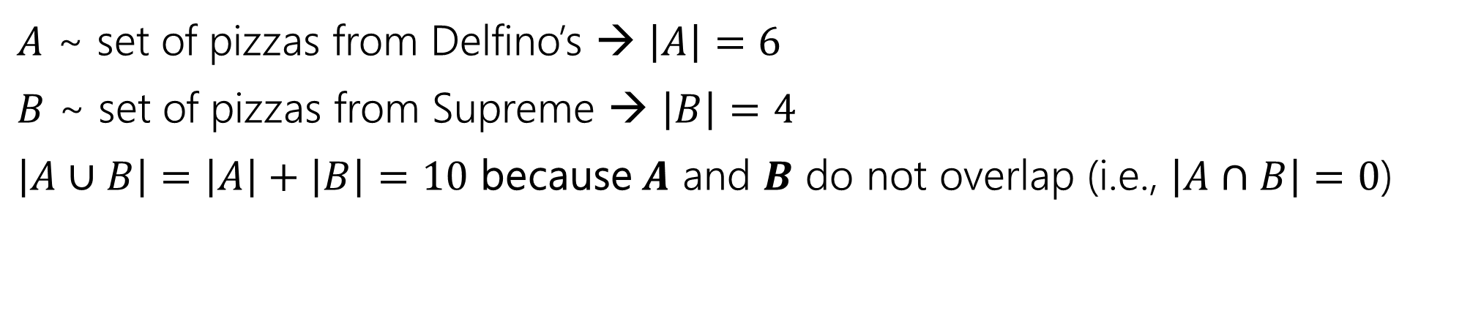

Recall: Sum Rule
$$A$$
$$B$$
$A$ ~ set of pizzas from Delfino’s → $\left|A\right|=6$
$B$ ~ set of pizzas from Supreme → $\left|B\right|=4$
$\left|A∪B\right|=\left|A\right|+\left|B\right|=10$ because $A$ and $B$ do not overlap (i.e., $\left|A∩B\right|=0$)

Slide 42

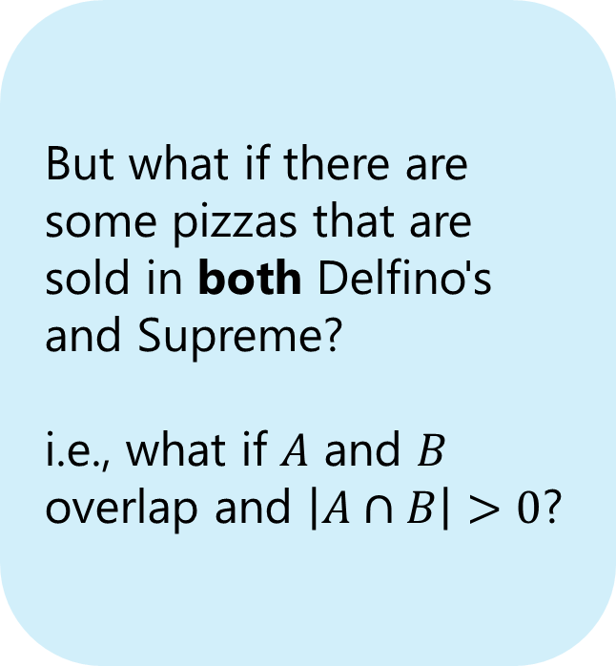
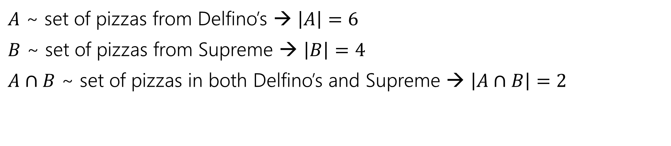

What if the sets overlap?
$$A∩B$$
$$B$$
$$A$$
But what if there are some pizzas that are sold in both Delfino's and Supreme?
i.e., what if $A$ and $B$ overlap and $\left|A∩B\right|>0$?
$A$ ~ set of pizzas from Delfino’s → $\left|A\right|=6$
$B$ ~ set of pizzas from Supreme → $\left|B\right|=4$
$A∩B$ ~ set of pizzas in both Delfino’s and Supreme → $\left|A∩B\right|=2$

Slide 43
What if the sets overlap?
$$A∩B$$
$$B$$
$$A$$
$A$ ~ set of pizzas from Delfino’s → $\left|A\right|=6$
$B$ ~ set of pizzas from Supreme → $\left|B\right|=4$
$A∩B$ ~ set of pizzas in both Delfino’s and Supreme → $\left|A∩B\right|=2$

Slide 44
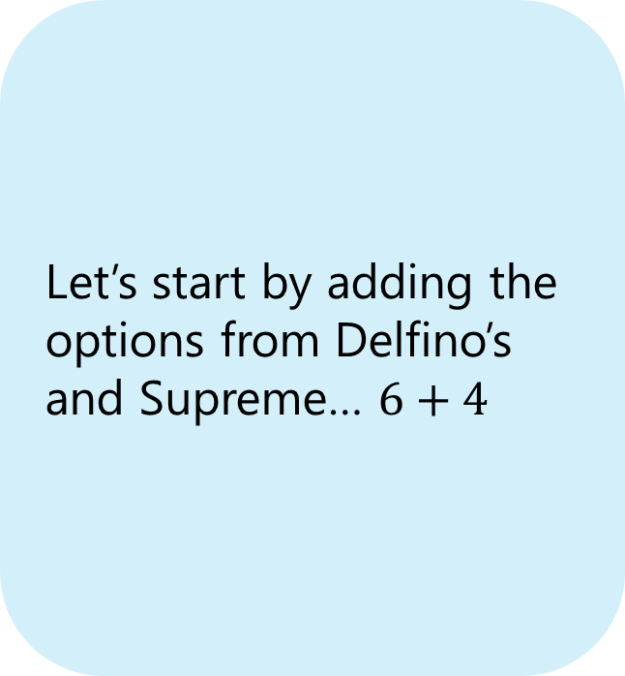
What if the sets overlap?
$$A∩B$$
$$B$$
$$A$$
Let’s start by adding the options from Delfino’s and Supreme… $6+4$
$A$ ~ set of pizzas from Delfino’s → $\left|A\right|=6$
$B$ ~ set of pizzas from Supreme → $\left|B\right|=4$
$A∩B$ ~ set of pizzas in both Delfino’s and Supreme → $\left|A∩B\right|=2$

Slide 45
What if the sets overlap?
$$A∩B$$
$$B$$
$$A$$
Let’s start by adding the options from Delfino’s and Supreme… $6+4$
$A$ ~ set of pizzas from Delfino’s → $\left|A\right|=6$
$B$ ~ set of pizzas from Supreme → $\left|B\right|=4$
$A∩B$ ~ set of pizzas in both Delfino’s and Supreme → $\left|A∩B\right|=2$

Slide 46
What if the sets overlap?
$$A∩B$$
$$B$$
$$A$$
Let’s start by adding the options from Delfino’s and Supreme… $6+4$
$A$ ~ set of pizzas from Delfino’s → $\left|A\right|=6$
$B$ ~ set of pizzas from Supreme → $\left|B\right|=4$
$A∩B$ ~ set of pizzas in both Delfino’s and Supreme → $\left|A∩B\right|=2$

Slide 47


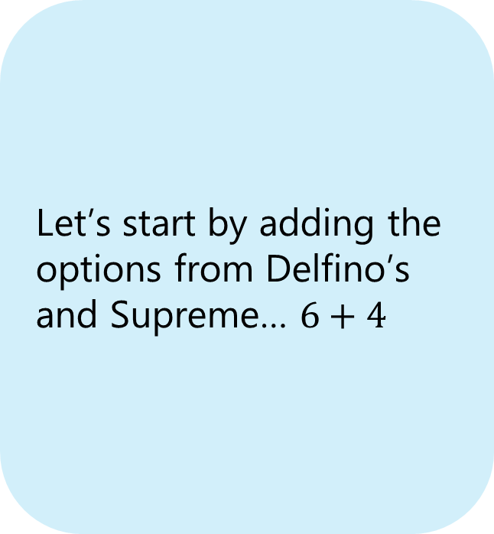


What if the sets overlap?
$$A∩B$$
$$B$$
$$A$$
Let’s start by adding the options from Delfino’s and Supreme… $6+4$
This region $A∩B$ has been counted twice!
$A$ ~ set of pizzas from Delfino’s → $\left|A\right|=6$
$B$ ~ set of pizzas from Supreme → $\left|B\right|=4$
$A∩B$ ~ set of pizzas in both Delfino’s and Supreme → $\left|A∩B\right|=2$

Slide 48
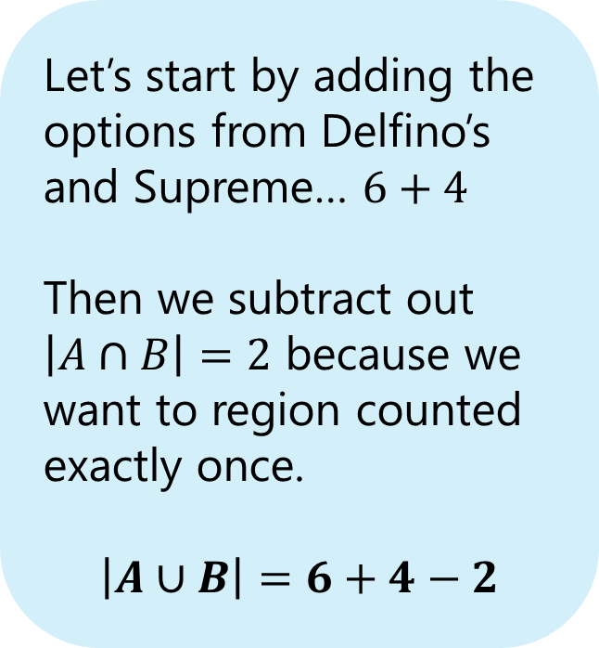
What if the sets overlap?
$$A∩B$$
$$B$$
$$A$$
Let’s start by adding the options from Delfino’s and Supreme… $6+4$
Then we subtract out $\left|A∩B\right|=2$ because we want to region counted exactly once.
$$\left|A∪B\right|=6+4−2$$
This region $A∩B$ has been counted twice!
$A$ ~ set of pizzas from Delfino’s → $\left|A\right|=6$
$B$ ~ set of pizzas from Supreme → $\left|B\right|=4$
$A∩B$ ~ set of pizzas in both Delfino’s and Supreme → $\left|A∩B\right|=2$

Slide 49





Principle of Inclusion-Exclusion
The sum rule says when $A$and $B$ are disjoint (no intersection), then $\left|A∪B\right|=\left|A\right|+|B|$.
What about when $A$ and $B$ aren’t disjoint?
For any two sets $A$ and $B$:
$$\left|A∪B\right|=\left|A\right|+\left|B\right|−|A∩B|$$
Principle of Inclusion-Exclusion
$$A$$
$$A∩B$$
$$B$$

Slide 50
Principle of Inclusion-Exclusion
The sum rule says when $A$and $B$ are disjoint (no intersection), then $\left|A∪B\right|=\left|A\right|+|B|$.
What about when $A$ and $B$ aren’t disjoint?
For any two sets $A$ and $B$:
$$\left|A∪B\right|=\left|A\right|+\left|B\right|−|A∩B|$$
Principle of Inclusion-Exclusion
$$A$$
$$A∩B$$
$$B$$

Slide 51
Principle of Inclusion-Exclusion
The sum rule says when $A$and $B$ are disjoint (no intersection), then $\left|A∪B\right|=\left|A\right|+|B|$.
What about when $A$ and $B$ aren’t disjoint?
For any two sets $A$ and $B$:
$$\left|A∪B\right|=\left|A\right|+\left|B\right|−|A∩B|$$
Principle of Inclusion-Exclusion
$$A$$
$$A∩B$$
$$B$$

Slide 52
Principle of Inclusion-Exclusion
The sum rule says when $A$and $B$ are disjoint (no intersection), then $\left|A∪B\right|=\left|A\right|+|B|$.
What about when $A$ and $B$ aren’t disjoint?
For any two sets $A$ and $B$:
$$\left|A∪B\right|=\left|A\right|+\left|B\right|−|A∩B|$$
Principle of Inclusion-Exclusion
$$A$$
$$A∩B$$
$$B$$

Slide 53

Principle of Inclusion-Exclusion
For three sets:
$\left|A∪B∪C\right|=\left|A\right|+\left|B\right|+\left|C\right|−\left|A∩B\right|−\left|B∩C\right|−\left|A∩C\right|+|A∩B∩C|$

Slide 54
Principle of Inclusion-Exclusion
For three sets:
$\left|A∪B∪C\right|=\left|A\right|+\left|B\right|+\left|C\right|−\left|A∩B\right|−\left|B∩C\right|−\left|A∩C\right|+|A∩B∩C|$
1
1
1
1

Slide 55
Principle of Inclusion-Exclusion
For three sets:
$\left|A∪B∪C\right|=\left|A\right|+\left|B\right|+\left|C\right|−\left|A∩B\right|−\left|B∩C\right|−\left|A∩C\right|+|A∩B∩C|$
1
1
2
2
1
1

Slide 56
Principle of Inclusion-Exclusion
For three sets:
$\left|A∪B∪C\right|=\left|A\right|+\left|B\right|+\left|C\right|−\left|A∩B\right|−\left|B∩C\right|−\left|A∩C\right|+|A∩B∩C|$
1
2
2
3
1
2
1

Slide 57
Principle of Inclusion-Exclusion
For three sets:
$\left|A∪B∪C\right|=\left|A\right|+\left|B\right|+\left|C\right|−\left|A∩B\right|−\left|B∩C\right|−\left|A∩C\right|+|A∩B∩C|$
1
2
1
2
1
2
1

Slide 58
Principle of Inclusion-Exclusion
For three sets:
$\left|A∪B∪C\right|=\left|A\right|+\left|B\right|+\left|C\right|−\left|A∩B\right|−\left|B∩C\right|−\left|A∩C\right|+|A∩B∩C|$
1
2
1
1
1
1
1

Slide 59
Principle of Inclusion-Exclusion
For three sets:
$\left|A∪B∪C\right|=\left|A\right|+\left|B\right|+\left|C\right|−\left|A∩B\right|−\left|B∩C\right|−\left|A∩C\right|+|A∩B∩C|$
1
1
1
0
1
1
1

Slide 60
Principle of Inclusion-Exclusion
For three sets:
$\left|A∪B∪C\right|=\left|A\right|+\left|B\right|+\left|C\right|−\left|A∩B\right|−\left|B∩C\right|−\left|A∩C\right|+|A∩B∩C|$
1
1
1
1
1
1
1

Slide 61

In general:
$\left|A_{1}∪A_{2}∪⋯∪A_{n}\right|=$
$\left|A_{1}\right|+\left|A_{2}\right|+⋯+\left|A_{n}\right|$
$−\left( \left|A_{1}∩A_{2}\right|+\left|A_{1}∩A_{3}\right|+…+\left|A_{1}∩A_{n}\right|+\left|A_{2}∩A_{3}\right|+…+\left|A_{n−1}∩A_{n}\right|\right)$
$+( \left|A_{1}∩A_{2}∩A_{3}\right|+…+\left|A_{n−2}∩A_{n−1}∩A_{n}\right|)$
$− …$
$+{\left(−1\right)}^{n+1}|A_{1}∩A_{2}∩…∩A_{n}|$
Add the individual sets, subtract all pairwise intersections, add all three-wise intersections, subtract all four-wise intersections,…, [add/subtract] the $n$-wise intersection.

Slide 62

Principle of Inclusion-Exclusion
For any two sets $A$ and $B$:
$$\left|A∪B\right|=\left|A\right|+\left|B\right|−\left|A∩B\right|$$
For three sets:
$$\left|A∪B∪C\right|=\left|A\right|+\left|B\right|+\left|C\right|−\left|A∩B\right|−\left|B∩C\right|−\left|A∩C\right|+|A∩B∩C|$$
For any number of sets:
$\left|A∪B∪C∪…\right|=$ singles – doubles + triples – quadruples + ….
Principle of Inclusion-Exclusion

Slide 63

Example
How many length 5 strings over the alphabet $\{a,b,c,…,z\}$ contain:
Exactly 2 ‘a’s OR
Exactly 1 ‘b’ OR
No ‘x’s
For what $A,B,C$ do we want $|A∪B∪C|$?
$A$ ~ set of length 5 strings with exactly 2 a’s
$B$ ~ set of length 5 strings with exactly 1 b
$C$~ set of length 5 strings with no x’s
$A∪B∪C$ ~ set of strings that fall into at least one of the above sets
  ^ we are interested in the size of this set!

Slide 64


Example
$A=\{$length $5$ strings that contain exactly 2 ‘a’s$\}$
$B=\{$length $5$ strings that contain exactly 1 ‘b’s$\}$
$C=\{$length $5$ strings that contain no ‘x’s $\}$
$$\left|A∪B∪C\right|=\left|A\right|+\left|B\right|+\left|C\right|−\left|A∩B\right|−\left|B∩C\right|−\left|A∩C\right|+|A∩B∩C|$$
$$\left|A\right|=$$
$$\left|B\right|=$$
$$\left|C\right|=$$
$$\left|A∩B\right|=$$
$$\left|A∩C\right|=$$
$$\left|B∩C\right|=$$
$$\left|A∩B∩C\right|=$$

Slide 65

Example
$A=\{$length $5$ strings that contain exactly 2 ‘a’s$\}$
$B=\{$length $5$ strings that contain exactly 1 ‘b’s$\}$
$C=\{$length $5$ strings that contain no ‘x’s $\}$
$$\left|A∪B∪C\right|=\left|A\right|+\left|B\right|+\left|C\right|−\left|A∩B\right|−\left|B∩C\right|−\left|A∩C\right|+|A∩B∩C|$$
$\left|A\right|=\left({5 \atop 2}\right)⋅{25}^{3}$ (choose ‘a’ spots, remaining chars)
$\left|B\right|= \left({5 \atop 1}\right)⋅{25}^{4}$ (choose ‘b’ spot, remaining chars)
$\left|C\right|={25}^{5}$ (select [non-’x’] characters for each spot)
$$\left|A∩B\right|=$$
$$\left|A∩C\right|=$$
$$\left|B∩C\right|=$$
$$\left|A∩B∩C\right|=$$

Slide 66


Example
$A=\{$length $5$ strings that contain exactly 2 ‘a’s$\}$
$B=\{$length $5$ strings that contain exactly 1 ‘b’s$\}$
$C=\{$length $5$ strings that contain no ‘x’s $\}$
$$\left|A∪B∪C\right|=\left|A\right|+\left|B\right|+\left|C\right|−\left|A∩B\right|−\left|B∩C\right|−\left|A∩C\right|+|A∩B∩C|$$
$\left|A\right|=\left({5 \atop 2}\right)⋅{25}^{3}$ (choose ‘a’ spots, remaining chars)
$\left|B\right|= \left({5 \atop 1}\right)⋅{25}^{4}$ (choose ‘b’ spot, remaining chars)
$\left|C\right|={25}^{5}$ (select [non-’x’] characters for each spot)
$\left|A∩B\right|=\left({5 \atop 2}\right)⋅\left({3 \atop 1}\right)⋅{24}^{2}$ (choose ‘a’ spots, ‘b’ spot, remaining chars)
$\left|A∩C\right|=\left({5 \atop 2}\right)⋅{24}^{3}$ (choose ‘a’ spots, remaining [non-’x’] chars)
$\left|B∩C\right|=\left({5 \atop 1}\right)⋅{24}^{4}$
$$\left|A∩B∩C\right|=$$

Slide 67

Example
$A=\{$length $5$ strings that contain exactly 2 ‘a’s$\}$
$B=\{$length $5$ strings that contain exactly 1 ‘b’s$\}$
$C=\{$length $5$ strings that contain no ‘x’s $\}$
$$\left|A∪B∪C\right|=\left|A\right|+\left|B\right|+\left|C\right|−\left|A∩B\right|−\left|B∩C\right|−\left|A∩C\right|+|A∩B∩C|$$
$\left|A\right|=\left({5 \atop 2}\right)⋅{25}^{3}$ (choose ‘a’ spots, remaining chars)
$\left|B\right|= \left({5 \atop 1}\right)⋅{25}^{4}$ (choose ‘b’ spot, remaining chars)
$\left|C\right|={25}^{5}$ (select [non-’x’] characters for each spot)
$\left|A∩B\right|=\left({5 \atop 2}\right)⋅\left({3 \atop 1}\right)⋅{24}^{2}$ (choose ‘a’ spots, ‘b’ spot, remaining chars)
$\left|A∩C\right|=\left({5 \atop 2}\right)⋅{24}^{3}$ (choose ‘a’ spots, remaining [non-’x’] chars)
$\left|B∩C\right|=\left({5 \atop 1}\right)⋅{24}^{4}$
$\left|A∩B∩C\right|=\left({5 \atop 2}\right)⋅\left({3 \atop 1}\right)⋅{23}^{2}$ (choose ‘a’ spots, ‘b’ spot, remaining [non-’x’] chars)

Slide 68


Example
$A=\{$length $5$ strings that contain exactly 2 ‘a’s$\}$
$B=\{$length $5$ strings that contain exactly 1 ‘b’s$\}$
$C=\{$length $5$ strings that contain no ‘x’s $\}$
$$\left|A∪B∪C\right|=\left|A\right|+\left|B\right|+\left|C\right|−\left|A∩B\right|−\left|B∩C\right|−\left|A∩C\right|+|A∩B∩C|$$
$\left|A\right|=\left({5 \atop 2}\right)⋅{25}^{3}$
$\left|B\right|= \left({5 \atop 1}\right)⋅{25}^{4}$
$\left|C\right|={25}^{5}$
$\left|A∩B\right|=\left({5 \atop 2}\right)⋅\left({3 \atop 1}\right)⋅{24}^{2}$
$\left|A∩C\right|=\left({5 \atop 2}\right)⋅{24}^{3}$
$\left|B∩C\right|=\left({5 \atop 1}\right)⋅{24}^{4}$
$\left|A∩B∩C\right|=\left({5 \atop 2}\right)⋅\left({3 \atop 1}\right)⋅{23}^{2}$
$\left|A∪B∪C\right|$
= $\left({5 \atop 2}\right)⋅{25}^{3}$+ $\left({5 \atop 1}\right)⋅{25}^{4}+{25}^{5}$- $\left({5 \atop 2}\right)⋅\left({3 \atop 1}\right)⋅{24}^{2}$-
$\left({5 \atop 2}\right)⋅{24}^{3}$ - $\left({5 \atop 1}\right)⋅{24}^{4}$ + $\left({5 \atop 2}\right)⋅\left({3 \atop 1}\right)⋅{23}^{2}$
= $10,076,470$

Slide 69

Practical tips
How do I know I’m looking for the size of a union of some sets?
“how many ways for A or B or C to happen” → $|A∪B∪C|$
“how many ways for at least one of A, B, or C” → $|A∪B∪C|$
“how many ways for none of A, B, C” → $\overline{A}∩\overline{B}∩\overline{C}=\overline{A∪B∪C}$
  maybe use complementary counting + inclusion-exclusion (total – # at least 1 occur)

Slide 70

Practical tips
Give yourself clear definitions of $A,B,C.$
Make a list of all the formulas you need before you start calculating.
Calculate “size-by-size” and incorporate into the total.
Basic check: If (in an intermediate step) you ever:
1. Get a negative value
2. Calculate that $\left|A∩B\right|>|A|$
Then something has gone wrong! Recheck calculations ☺

Slide 71
Summary
Permutations (order matters) and Combinations (order doesn’t matter)
Applications of Combinations
  Path Counting
  Rearranging Strings / Multinomial Coefficients
  Binomial Theorem
Inclusion-Exclusion
A useful trick for counting is to pretend order matters, then account for the overcounting at the end (by dividing out repetitions)

Slide 72
More examples
Putting it all together!

Slide 73

Cards
A lot of counting problems deal with cards!
A “standard” deck of cards has 52 cards ($13⋅4=52$).
Each card has one of 4 suits
  diamonds ️♦,
  hearts ♥️,
  clubs ♧,
  spades ♠️
and one of 13 values/ranks (Ace,2,3,4,5,6,7,8,9,10,Jack,Queen, King).
  e.g., Ace♦, 5♦, 5♧, 10♠️ are all possible cards
A “$k$-card-hand” is an unordered set of $k$ cards

Slide 74

Cards
A lot of counting problems deal with cards!
A “standard” deck of cards has 52 cards ($13⋅4=52$).
Each card has one of 4 suits
  diamonds ️♦,
  hearts ♥️,
  clubs ♧,
  spades ♠️
and one of 13 values/ranks (Ace,2,3,4,5,6,7,8,9,10,Jack,Queen, King).
  e.g., Ace♦, 5♦, 5♧, 10♠️ are all possible cards
A “$k$-card-hand” is an unordered set of $k$ cards
How many five-card “flushes” are there? – a flush is a hand of cards all of the same suit. (e.g., {A♠️, 3♠️, 5♠️, 6♠️, Q♠️})

Slide 75

Five-card “flushes”
How many five-card “flushes” are there? – a flush is a hand of cards all of the same suit.
  Think: How would I create a set of cards that is a flush?
Way 1:
1. Pick the suit (e.g., ♠️) – $\left({4 \atop 1}\right)$
2. Pick the specific values/cards from that suit (e.g., {A,3,5,6,Q}) - $\left({13 \atop 5}\right)$
Now we’ve created an unordered 5-card flush! (e.g., {A♠️, 3♠️, 5♠️, 6♠️, Q♠️})
$\left({4 \atop 1}\right)⋅$ $\left({13 \atop 5}\right)$

Slide 76

Five-card “flushes”
Way 2:
Pretend order matters.
1. Pick any first card – $52$ options
2. All remaining cards must be from the same suit of that first suit:
  $12$ options for the 2nd card, $11$ options for the 3rd card, etc.
Divide out the overcounting - divide by $5!$, since order isn’t supposed to matter (i.e., only count each unordered flush once)
$\frac{52⋅12⋅11⋅10⋅9}{5!}$
This equals the same number as what we got on the last slide!

Slide 77

How many 5-card hands have at least 3 aces?
There are 4 Aces (and 48 non aces) in a deck of cards
1. Choose $3$ aces: $\left({4 \atop 3}\right)$
2. Then pick $2$ of the $49$ remaining cards to form a $5$(the last ace is allowed as well, because we’re allowed to have all$4$): $\left({49 \atop 2}\right)$
$\left({4 \atop 3}\right)⋅\left({49 \atop 2}\right)$
What’s wrong with this calculation? Does it,
A) Overcount B) Undercount C) It’s correct! D) I have no idea :)
Join at: slido.com, #6868 301
Notes:
I have a new problem:
Here is my proposed way:

Slide 78
Sleuth’s Criterion
How to check if we counted correctly?
For each outcome that we want to count, there should be exactly one set of choices in the sequential process that will lead to that outcome.
> If there are no sequence of choices that will lead to the outcome, we have undercounted.
> If there is more than one sequence of choices that will lead to the outcome, we have overcounted.

Slide 79
Sleuth’s Criterion (in context)
How to check if we counted correctly?
For each “5-card hands with at least 3 aces” that we want to count, there should be exactly one set of choices in the sequential process that will lead to that outcome.
> If there are no sequence of choices that will lead to a particular 5-card hand with at least 3 aces, we have undercounted.
> If there is more than one sequence of choices that will lead to a particular 5-card hand with at least 3 aces, we have overcounted.

Slide 80
How many 5-card hands have at least 3 aces?
For each “5-card hands with at least 3 aces” that we want to count, there should be exactly one set of choices in the sequential process that will lead to that outcome.
A♧, A♠️, A♦️, Q♥️, K ♠️ is a valid outcome should counted exactly once.
Step 1 (choose 3 aces): {A♧, A♠️, A♦️}
Step 2 (pick 2 of remaining 49): {Q♥️, K ♠️}
Great! There’s no other set of choices that will lead to this hand.

Slide 81
How many 5-card hands have at least 3 aces?
For each “5-card hands with at least 3 aces” that we want to count, there should be exactly one set of choices in the sequential process that will lead to that outcome.
A♧, A♠️, A♦️, A♥️, K ♠️ is a valid outcome should counted exactly once.
But…
Step 1 (choose 3 aces): {A♧, A♠️, A♦️}
Step 2 (pick 2 of remaining 49): {A♥️, K ♠️}
Both of these are different choices in the sequential process and are counted separately, but they are the same hand!
This is overcounting ☹
Step 1 (choose 3 aces): {A♧, A♥️, A♦️}
Step 2 (pick 2 of remaining 49): {A ♠️, K ♠️}

Slide 82
Fixing The Overcounting

Slide 83
How many 5-card hands have at least 3 aces?
Way 1: We could start with our incorrect solution & subtract the overcounting.
What kinds of hands do we overcount (counted many times in the sequential process)?
> 5-card hands with 4 Aces (i.e., a hand like {A♧, A♠️, A♦️, A♥️, X})
> This hand is counted 4 different times (each row below is a different set of choices)
{A♧, A♠️, A♦️}, {A♥️, X}
{A♧, A♠️, A♥️}, {A♦️, X}
{A♧, A♥️, A♦️}, {A♠️, X}
{A♥️, A♠️, A♦️}, {A♧, X}
Our original incorrect solution:
1. Choose $3$ aces: $\left({4 \atop 3}\right)$, 2. Then pick $2$ of the $49$ remaining cards: $\left({49 \atop 2}\right)$→$\left({4 \atop 3}\right)⋅\left({49 \atop 2}\right)$

Slide 84

How many 5-card hands have at least 3 aces?
Way 1: We could start with our incorrect solution & subtract the overcounting.
What kinds of hands do we overcount (counted many times in the sequential process)?
> 5-card hands with 4 Aces (i.e., a hand like {A♧, A♠️, A♦️, A♥️, X})
So, how many outcomes are overcounted?
>There are $\left({4 \atop 4}\right)⋅48=48$ 5-card hands with all 4 Aces
> Each of these hands is counted 4 times, but we only want to count it once
> So we’ve counted $\left(4−1\right)⋅48=3⋅48$ processes that shouldn’t count.
That would give a corrected total of $\left({4 \atop 3}\right)⋅\left({49 \atop 2}\right)−3⋅48$
Our original incorrect solution:
1. Choose $3$ aces: $\left({4 \atop 3}\right)$, 2. Then pick $2$ of the $49$ remaining cards: $\left({49 \atop 2}\right)$→$\left({4 \atop 3}\right)⋅\left({49 \atop 2}\right)$
{A♧, A♠️, A♦️}, {A♥️, X}
{A♧, A♠️, A♥️}, {A♦️, X}
{A♧, A♥️, A♦️}, {A♠️, X}
{A♥️, A♠️, A♦️}, {A♧, X}

Slide 85

How many 5-card hands have at least 3 aces?
Way 1: We could subtract out the overcounting - count exactly which hands are overcounted in our sequential process, and how many times each of those hands are overcounted, and subtract that from our initial count.
  $$\left({4 \atop 3}\right)⋅\left({49 \atop 2}\right)−3⋅48$$
Way 2: Try a different approach! The problem with our original solutions was trying to account for the “at least” - come up with disjoint sets and count separately.
Case 1: There are exactly 3 aces: $\left({4 \atop 3}\right)⋅\left({48 \atop 2}\right)$
Case 2: There are exactly (all) 4 aces: $\left({4 \atop 4}\right)⋅\left({48 \atop 1}\right)$
Applying the sum rule: $\left({4 \atop 3}\right)⋅\left({48 \atop 2}\right)+ \left({4 \atop 4}\right)⋅\left({48 \atop 1}\right)$

Slide 86

How many 5-card hands have at least 3 aces?
Way 2: Try a different approach! The problem with our original solutions was trying to account for the “at least” - come up with disjoint sets and count separately.
Case 1: There are exactly 3 aces: $\left({4 \atop 3}\right)⋅\left({48 \atop 2}\right)$
Case 2: There are exactly (all) 4 aces: $\left({4 \atop 4}\right)⋅\left({48 \atop 1}\right)$
Applying the sum rule: $\left({4 \atop 3}\right)⋅\left({48 \atop 2}\right)+ \left({4 \atop 4}\right)⋅\left({48 \atop 1}\right)$
Does this overcount/undercount?
For a valid outcome, there should be exactly 1 set of choices leading to that outcome:
A♧, A♠️, A♦️, Q ♧, K ♠️ - this will fall under the first case. The only possible set of choices leading to this is {A♧, A♠️, A♦️} in the 1st step and {Q ♧, K ♠️} in the 2nd

Slide 87
How many 5-card hands have at least 3 aces?
Way 2: Try a different approach! The problem with our original solutions was trying to account for the “at least” - come up with disjoint sets and count separately.
Case 1: There are exactly 3 aces: $\left({4 \atop 3}\right)⋅\left({48 \atop 2}\right)$
Case 2: There are exactly (all) 4 aces: $\left({4 \atop 4}\right)⋅\left({48 \atop 1}\right)$
Applying the sum rule: $\left({4 \atop 3}\right)⋅\left({48 \atop 2}\right)+ \left({4 \atop 4}\right)⋅\left({48 \atop 1}\right)$
Does this overcount/undercount?
For a valid outcome, there should be exactly 1 set of choices leading to that outcome:
A♧, A♠️, A♦️, A♥️, K ♠️ - this will fall under the second case. The only possible set of choices leading to this is {A♧, A♠️, A♦️, A♥️} in the 1st step and {K ♠️} in the 2nd

Slide 88
Takeaway
It’s hard to count sets where one of the conditions is “at least X”
Depending on the problem, you may have to:
- Break into need to break those conditions up into disjoint sets and use the sum rule
- Take the complement and find the total ways to have <X things
  usually more helpful when we’re asking for ways for “at least 1 thing occur”
- If we want at least 1 of some conditions to be met, may be able to write as a union of sets and use inclusion exclusion

Slide 89
Extra Practice

Slide 90
Books, revisited
Remember the books problem from lecture 1? Books 1,2,3,4,5 need to be assigned to Alice, Bob, and Charlie (each book to exactly one person).
Now that we know combinations, try a sequential process approach. It won’t be as nice as the change of perspective, but we can make it work.
Break into cases based on how many books Alice gets, use the sum rule to combine.

Slide 91

Books, revisited
Step 1: give Alice gets $0$ books (1 way to do this)
Step 2: give Bob a subset of the remaining books $2^{5}$ ways.
Step 3: give Charlie the remaining books (no choice – 1 way)
$+$
Step 1: give Alice $1$ book ($\left({5 \atop 1}\right)$ ways to do this)
Step 2: give Bob a subset of the $4$ remaining books $2^{4}$ ways.
Step 3: give Charlie the remaining books (no choice – 1 way)
$+ …$

Slide 92

Books, revisited
Add all the options together
$1⋅2^{5}⋅1+\left({5 \atop 1}\right)⋅2^{4}⋅1+\left({5 \atop 2}\right)⋅2^{3}⋅1+\left({5 \atop 3}\right)⋅2^{2}⋅1+\left({5 \atop 4}\right)⋅2^{1}⋅1+\left({5 \atop 5}\right)⋅2^{0}⋅1$
If you plug and chug, you’ll get the number we got last time. It took quite a bit of work, but we got there!

