Slide 1
Welcome to 312! 🥳 You’re early!
Want a copy of these slides to take notes?
  You can download them from the webpage cs.uw.edu/312
Feel free to introduce yourself to the people sitting around you!

Slide 2
Introduction and Counting
CSE 312 26Su
Lecture 1

Slide 3

Staff
TAs
Escher Crawford | Krisha Khandelwal
Darin Ershov | Vlad Murad
Instructor: Jolie Zhou
Graduate student in CS at UW
Email: joliez@cs.washington.edu
Office hours: WF 1:15-2:30pm

Slide 4
Logistics - Lecture
Lectures are MWF
  12:00-1:00pm in HRC 155
  Slides will be posted on the website
  Recorded on Panopto
  Please participate and ask questions!

Slide 5
Logistics - Section
Sections on Thursdays starting this week
Both sections are at 12pm (different locations)
Sections will not be recorded – we want you to be able to ask question and give feedback without worrying about being recorded.
Handouts and solutions will be posted.
Bring laptop/phone and pencil/pen to section. (We will bring paper for you to write on.)

Slide 6
Concept checks
Concept checks after each lecture
  Released by 1:30pm (30 mins after lecture). Must be done before the next lecture.
  Simple questions to reinforce concepts taught in each class.
  Keep you engaged and on top of the material throughout the week, so that homework becomes less of a hurdle.
  Do them as soon as you can after lecture. Really important.
Important!
  If you don’t submit by the due date, you won’t be able to see the solutions until at least a week later.
  Submit, even if you don’t answer any of the questions!! You can resubmit as many times as you want before the deadline.

Slide 7
Exams
6 quizzes in lecture (15 minutes each)
  First 15 minutes of Friday lectures, see specific days on course calendar
  2 lowest dropped
  Quiz 1: this week on Friday June 26th
  Midterm: Wednesday July 22nd
  More resources to be posted later
  Final Exam (2 parts): Thursday August 20th , Friday August 21st
  More resources to be posted later

Slide 8
Grading
Concept checks (15%)
7 Homeworks / Psets (20%)
  Mostly math. A few will have coding components. Pset 1 out on Wednesday.
6 Quizzes (15%): select Friday lectures
Midterm (20%): Wednesday, July 22, 12-1pm in lecture
Final (30%): Thursday, August 20, 12-1pm in section
  Friday, August 21, 12-1pm in lecture
Small extra credit opportunities
Notes:
See syllabus for details on how grades are assigned and for how we deal with conflict.
Put exam times on your calendars now!

Slide 9
Syllabus
Late submission
2 penalty free late days on every homework
Must have meaningful submission by deadline
Grade guarantees
Must meet minimum exam averages to guarantee grades
See specific breakdown on syllabus
See syllabus for more info on academic integrity, course tools, etc.
Ask questions on Ed!

Slide 10
Accommodations
If you have something significant happen during the quarter, please
reach out to use as soon as possible!
For now:
• Fill out DRS accommodations if needed
• Fill out religious accommodations request form if needed
• Email me if you have other accessibility concerns that are not
covered by DRS (!)

Slide 11

What is this class about?
Foundations of Computing II
=
Introduction to Probability & Statistics
for computer scientists
What is probability?? Why probability?!
Notes:
Probability is a precise mathematical way of measuring and analyzing uncertainty.

Slide 12
Connections
+ much more!
Complexity theory
Data compression
Computational Biology
Machine Learning, NLP
Quantum computing
Fault-tolerant systems
Algorithms
Probability & Statistics
Data Structures
Congestion control
LLMs
Cryptography
Load Balancing
Error-correcting codes
Notes:
As you know, we are living through a technological revolution dominated by Generative AI (GenAI). Tools like ChatGPT, Claude, and Gemini seem like magic but they aren’t.
At their core, these systems are massive probabilistic inference engines.
When you ask an AI a question, it is not "looking up" the answer. It is calculating a conditional probability distribution over a vocabulary of tokens. It is answering the question:
Given the words that have come before, what is the probability distribution over the next word?
This course is about understanding the mathematics that powers the most transformative technology of your lifetime.
Checked reading order

Slide 13
Beyond important applications in computer science and engineering
Two additional arguments for studying hard and really learning the material in this class:
The economic argument (the “need”)
The “fun/useful in real life” argument (the “want”)
Notes:
And beyond just these important applications
Maybe you find it really fun learning probability
I’ll also talk about why you’ll need to learn this material well considering the context of LLMs

Slide 14
The economic argument and the elephant in the room
Generative AI (like ChatGPT, Claude or Gemini) can solve 95% of the homework problems in this class in seconds.
Thus, the market value of “getting the answer” is effectively $0.00
Employers do not pay humans for skills that are free via an API
So why are you here?
Notes:
You are here to learn how to be the Pilot, not the Passenger.
Let me give you 5 views on why “outsourcing” your thinking is career suicide.

Slide 15
The economic argument and the elephant in the room
Generative AI (like ChatGPT, Claude or Gemini) can solve 95% of the homework problems in this class in seconds.
Thus, the market value of “getting the answer” is effectively $0.00
Employers do not pay humans for skills that are free via an API
So why are you here?
You are here to learn how to be the Pilot, not the Passenger
Notes:
You are here to learn how to be the Pilot, not the Passenger.
Let me give you 5 views on why “outsourcing” your thinking is career suicide.

Slide 16
The Pilot vs Autopilot Analogy
Flying a plane on autopilot is easy. Pilots are paid high salaries not for the 99% of the time the weather is clear, but for the 1% of the time the system fails.
The gap
  AI is excellent at the “average” case. It fails catastrophically at “edge cases” – tail risks and black swan events.
The skill
  Probability is your instrument panel. If you don’t know how to read the instruments (e.g., variance, conditional probability, Bayes theorem), you cannot take over when the AI enters turbulence (e.g., spot a subtle probabilistic error in outputs, a hallucinated confidence interval)
Notes:
Words in italics are things we will learn about in this course.
Tail risk is the probability of rare, extreme investment losses exceeding three standard deviations from the mean, lying in the "tails" of a probability distribution. Often underestimated by traditional models, these "fat tail" events include market crashes, geopolitical crises, or pandemics, causing significant portfolio damage.
A black swan event is an extremely rare, unpredictable occurrence with severe, widespread consequences that is often inappropriately rationalized in hindsight as having been predictable. Popularized by Nassim Nicholas Taleb, these events are outliers that fall outside the realm of normal expectations, making them impossible to forecast, yet they fundamentally alter history or markets.

Slide 17
The Changing Interview Landscape
Interviews are adapting to the post-AI world too.
The test
  An interviewer might not ask you to solve a problem. They might ask you to defend a solution.
  Example: “Why did you model this as a Poisson distribution? What happens to your risk model if the correlation shifts by 0.1?”
The result.
  An LLM can give you the formula, but it cannot give you the intuition to defend it under pressure.
Notes:
Companies are moving back to Oral Exams and Whiteboarding.

Slide 18
For us: AI in education
For all these above reasons, you are NOT allowed to use AI tools on homeworks in this class (ChatGPT, Gemini, Claude, etc.)
At the same time, using AI carefully for learning and as a collaborator can be helpful, like a teaching assistant. It can:
help explain the material we are covering
walk through section worksheet solutions
generate extra practice problems
But it’s hard to tell what you may be cognitively offloading
Consider it a tool for conceptual questions and not to automate your workload.
Notes:
But if you want help getting started on homework, you need to first make a sincere and serious effort to solve it on your own. If you don’t do that, you won’t really learn.

Slide 19
Summary: why you should take this course seriously
Important applications in computer science and engineering.
Crucial for success in future CSE (and other) courses.
Crucial for success in your future career, aka the economic argument (the “need”)
The “fun/useful in real life” argument (the “want”)

Slide 20
Content
Combinatorics (fancy counting)
  Permutations, combinations, inclusion-exclusion, pigeonhole principle
Formal definitions for Probability
  Probability space, events, conditional probability, independence, expectation, variance
Common patterns in probability
  Equations and inequalities, “zoo” of common random variables, tail bounds
Continuous Probability
  pdf, cdf, sample distributions, central limit theorem, estimating probabilities
Applications
  Across CS, but with some focus on ML.
Notes:
Outline of topics for the quarter

Slide 21
Themes
Precise mathematical communication
  Both reading and writing dense statements.
Probability in the “real world”
  A mix of CS applications
  And some actual “real life” ones.
Refine your intuition
  Most people have some base level feeling of what the chances of some event are.
  We’re going to train you to have better gut feelings.

Slide 22
Counting

Slide 23
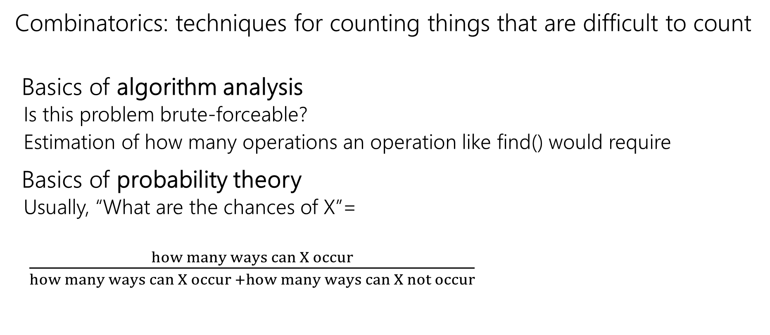
Why Counting?
We can’t always just list out possible options and count it up!
Combinatorics: techniques for counting things that are difficult to count
Basics of algorithm analysis
  Is this problem brute-forceable?
  Estimation of how many operations an operation like find() would require
Basics of probability theory
  Usually, “What are the chances of X”=
  $\frac{how many ways can X occur}{how many ways can X occur +how many ways can X not occur}$
Notes:
Count the ways for something to occur, we can’t always just list out all the possible options and enumerate.
Combinatorics is a fancy word for counting techniques. It gives us methods to count more complex situations where we can’t just directly count the number of options.
Where is this useful? Algorithmic analysis? For example, what is the max number of things we might need to search over till we find what we’re looking for
Brute force – checking every possible outcome until we find the .. Counting techniques to count the number of things we might need to search over. . Tells u kh==e
Basics of probability theory. We’re going to get to this in the next few lectures, but generally we’re looking of how likely something ocures..

Slide 24

Remember sets from 311?
A set is an unordered list of elements, ignoring repeats.
$\{1,2,3\}$ is a set. It’s the same set as $\{2,1,3\}$.
$\{1,1,2,3\}$ is a very confusing way of writing the set $\{1,2,3\}$.
Notes:
What’s a set anyone remember from 311?
It’s a unorderd listes of elements, don’t have repeats.
Does anyone remember what the cardinality of a set is? It’s the number of elements in it!
This set has cardinalizty of 3, it’s size is 3. why is this relevant? Well when we’re talking about counting, we’re really talking about counting the size of set. We’re going to talk in the next few lectures,techniques for counting the size of more complex sets, where we can’t just list out all the options and count it up

Slide 25
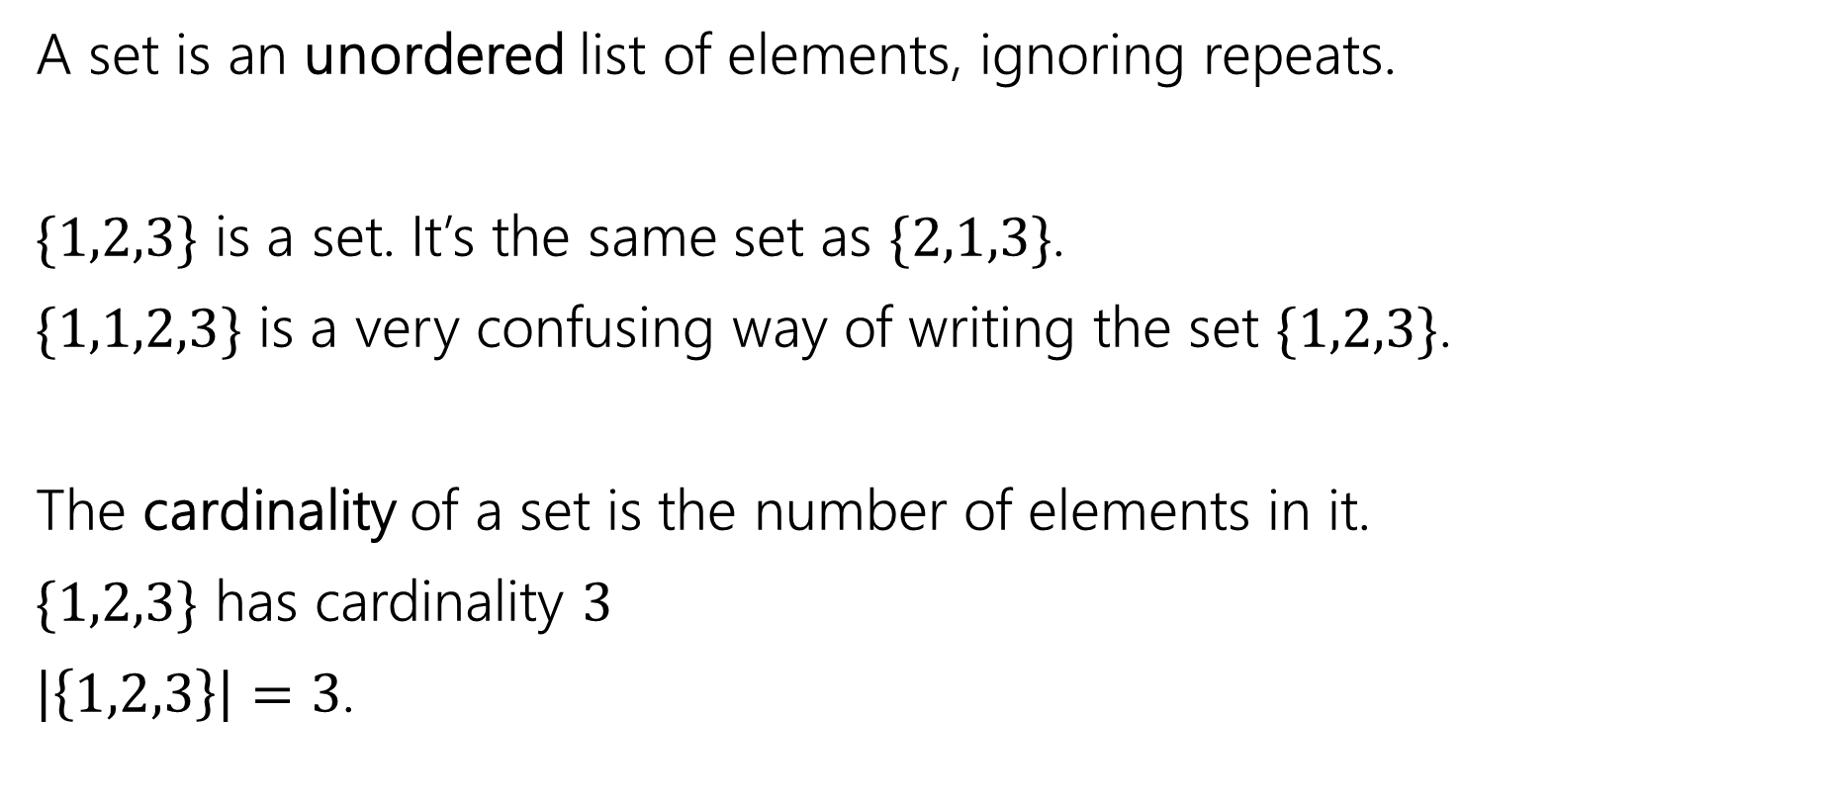
Remember sets from 311?
A set is an unordered list of elements, ignoring repeats.
$\{1,2,3\}$ is a set. It’s the same set as $\{2,1,3\}$.
$\{1,1,2,3\}$ is a very confusing way of writing the set $\{1,2,3\}$.
The cardinality of a set is the number of elements in it.
$\{1,2,3\}$ has cardinality $3$
$\left|\left\{1,2,3\right\}\right|=3$.
Notes:
What’s a set anyone remember from 311?
It’s a unorderd listes of elements, don’t have repeats.
Does anyone remember what the cardinality of a set is? It’s the number of elements in it!
This set has cardinalizty of 3, it’s size is 3. why is this relevant? Well when we’re talking about counting, we’re really talking about counting the size of set. We’re going to talk in the next few lectures,techniques for counting the size of more complex sets, where we can’t just list out all the options and count it up

Slide 26
Remember sets from 311?
A set is an unordered list of elements, ignoring repeats.
$\{1,2,3\}$ is a set. It’s the same set as $\{2,1,3\}$.
$\{1,1,2,3\}$ is a very confusing way of writing the set $\{1,2,3\}$.
The cardinality of a set is the number of elements in it.
$\{1,2,3\}$ has cardinality $3$
$\left|\left\{1,2,3\right\}\right|=3$.
We’re going to learn counting techniques to count the size of more complex sets!
Notes:
What’s a set anyone remember from 311?
It’s a unorderd listes of elements, don’t have repeats. For example here, 1,2,3 is a set, all we care abt is which elements are in it – these are all equivalent.
Does anyone remember what the cardinality of a set is? It’s the number of elements in it!
This set has cardinalizty of 3, it’s size is 3.
why is this relevant? Well when we’re talking about counting, we’re really talking about counting the size of set. We’re going to talk in the next few lectures,techniques for counting the size of more complex sets, where we can’t just list out all the options and count it up. Let’s start by talking abousome counting rules. First,

Slide 27

Counting Rule #1 (lunchtime!)
How many options do I have for lunch?
I could go to Delfino’s where there are $6$ pizzas I choose from, or I could go to Supreme where there are 4 pizzas I choose from (and none of them are the same between the two).
How many total choices?
Notes:
It’s lunch time! So let’s see how many options we have for lunch…… before we go on, what exactly are we trying to do here? We’re counting the size of a set. Here’ the set is the set of all possible meals I could have for lunch, we’re interested in the size or cardinality of this set
Write set notation as well

Slide 28
Counting Rule #1 (lunchtime!)
What are we counting here?
We’re counting the size/cardinality of the set of all possible lunches
How many options do I have for lunch?
I could go to Delfino’s where there are $6$ pizzas I choose from, or I could go to Supreme where there are 4 pizzas I choose from (and none of them are the same between the two).
How many total choices?
Notes:
It’s lunch time! So let’s see how many options we have for lunch…… before we go on, what exactly are we trying to do here? We’re counting the size of a set. Here’ the set is the set of all possible meals I could have for lunch, we’re interested in the size or cardinality of this set
Write set notation as well

Slide 29
Counting Rule #1 (lunchtime!)
How many options do I have for lunch?
I could go to Delfino’s where there are $6$ pizzas I choose from, or I could go to Supreme where there are 4 pizzas I choose from (and none of them are the same between the two).
How many total choices?
Notes:
It’s lunch time! So let’s see how many options we have for lunch…… before we go on, what exactly are we trying to do here? We’re counting the size of a set. Here’ the set is the set of all possible meals I could have for lunch, we’re interested in the size or cardinality of this set
Write set notation as well

Slide 30
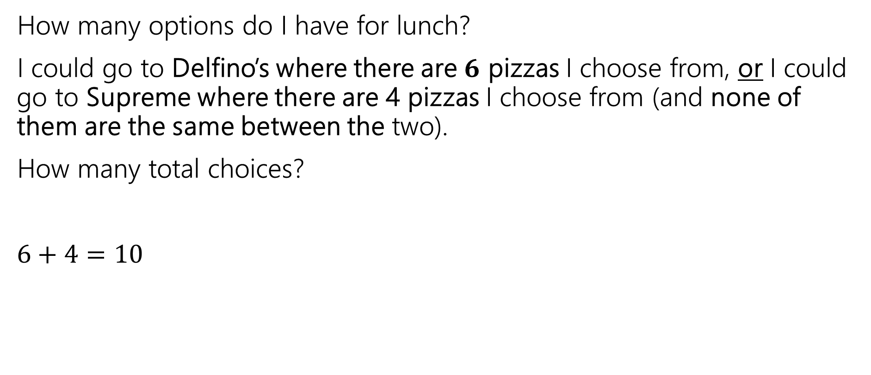
Counting Rule #1 (lunchtime!)
How many options do I have for lunch?
I could go to Delfino’s where there are $6$ pizzas I choose from, or I could go to Supreme where there are 4 pizzas I choose from (and none of them are the same between the two).
How many total choices?
$6+4=10$
Notes:
It’s lunch time! So let’s see how many options we have for lunch…… before we go on, what exactly are we trying to do here? We’re counting the size of a set. Here’ the set is the set of all possible meals I could have for lunch, we’re interested in the size or cardinality of this set
Write set notation as well

Slide 31
Counting Rule #1 (lunchtime!)
How many options do I have for lunch?
I could go to Delfino’s where there are $6$ pizzas I choose from, or I could go to Supreme where there are 4 pizzas I choose from (and none of them are the same between the two).
How many total choices?
$6+4=10$
Sum Rule: If you are choosing one thing between $n$ options in one group and $m$in another group with no overlap, the total number of options is: $n+m$.
Notes:
It’s lunch time! So let’s see how many options we have for lunch…… before we go on, what exactly are we trying to do here? We’re counting the size of a set. Here the set is the set of all possible pizzas I could have for lunch, and we’re interested in the size or cardinality of this set. What do you think? What’s the toal number of options we have here?
Either have 6 or 4 10 in total.
To generalize this, if we’re choosing between n options in one group, m options in a different group. These groups do not overlap, the total options is the sum options in each group. So n+m.
Here we’re going to Delifines OR supreme, and these set’s don’t’ overlap. We’re picking only 1 pizza, so we sue this sum rule here.
Write set notation as well. D, S.. |D U S|=|D|+|S|

Slide 32
Counting Rule #2 (coffee)
Now I’m sleepy!
I decide to get coffee. My coffee is always:
  One of three bases (latte, americano, cappuccino).
  One of two preparations (iced or hot)
  One of four syrups (caramel, peppermint, hazelnut, gingerbread)
How many possible coffee orders do I have?
Notes:
Now I ad a good lunch amd I’m feeling sleepy. To get coffee, w…. Any ideas?

Slide 33
Counting Rule #2 (coffee)
Step 1: choose one of the three bases.
Latte
Cappuccino
Americano
Notes:
We can think of this like a sequential process. So to construct our coffee order, we first choose… now, we choose .. Note how for each of these “bases’, there are two options for the preparation. This give 6 options for these first 2 steps. Now. 3rd step.. Gives 4 additonla options for each of those 6 optiosnf rom those first two steps. Putting it all together, there are 24 options. We’re multiplying the number of options in each them. To generalize this, product rule step says that if we’re counting the number of options whereeach option is constructed by some sequential process, the number of total options is the product of the number of options in each step. So.. You can think of this as a tree, for every additional step, we multiply by that number of options because each option has that many more possibilities.

Slide 34
Counting Rule #2 (coffee)
Step 1: choose one of the three bases.
Step 2: regardless of step 1, choose one of the two preparations.
Latte
Cappuccino
Americano
Iced
Hot
Iced
Iced
Hot
Hot
Notes:
We can think of this like a sequential process. So to construct our coffee order, we first choose… now, we choose .. Note how for each of these “bases’, there are two options for the preparation. This give 6 options for these first 2 steps. Now. 3rd step.. Gives 4 additonla options for each of those 6 optiosnf rom those first two steps. Putting it all together, there are 24 options. We’re multiplying the number of options in each them. To generalize this, product rule step says that if we’re counting the number of options whereeach option is constructed by some sequential process, the number of total options is the product of the number of options in each step. So.. You can think of this as a tree, for every additional step, we multiply by that number of options because each option has that many more possibilities.

Slide 35

Counting Rule #2 (coffee)
Step 1: choose one of the three bases.
Step 2: regardless of step 1, choose one of the two preparations.
Step 3: regardless of steps 1 and 2, choose one of the four syrups.
Latte
Cappuccino
Americano
Iced
Hot
Iced
Iced
Hot
Hot
C
C
P
H
G
P
H
G
Notes:
We can think of this like a sequential process. So to construct our coffee order, we first choose… now, we choose .. Note how for each of these “bases’, there are two options for the preparation. This give 6 options for these first 2 steps. Now. 3rd step.. Gives 4 additonla options for each of those 6 optiosnf rom those first two steps. Putting it all together, there are 24 options. We’re multiplying the number of options in each them. To generalize this, product rule step says that if we’re counting the number of options whereeach option is constructed by some sequential process, the number of total options is the product of the number of options in each step. So.. You can think of this as a tree, for every additional step, we multiply by that number of options because each option has that many more possibilities.

Slide 36
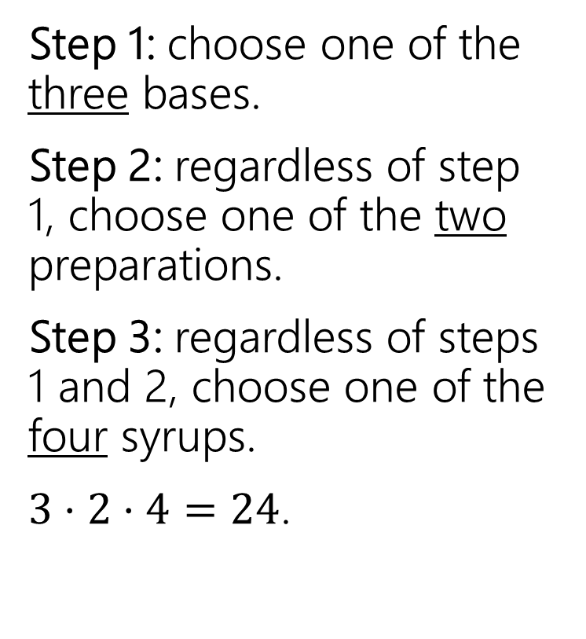
Counting Rule #2 (coffee)
Step 1: choose one of the three bases.
Step 2: regardless of step 1, choose one of the two preparations.
Step 3: regardless of steps 1 and 2, choose one of the four syrups.
$3⋅2⋅4=24$.
Latte
Cappuccino
Americano
Iced
Hot
Iced
Iced
Hot
Hot
C
C
P
H
G
P
H
G
Notes:
We can think of this like a sequential process. So to construct our coffee order, we first choose… now, we choose .. Note how for each of these “bases’, there are two options for the preparation. This give 6 options for these first 2 steps. Now. 3rd step.. Gives 4 additonla options for each of those 6 optiosnf rom those first two steps. Putting it all together, there are 24 options. We’re multiplying the number of options in each them. To generalize this, product rule step says that if we’re counting the number of options whereeach option is constructed by some sequential process, the number of total options is the product of the number of options in each step. So.. You can think of this as a tree, for every additional step, we multiply by that number of options because each option has that many more possibilities.

Slide 37
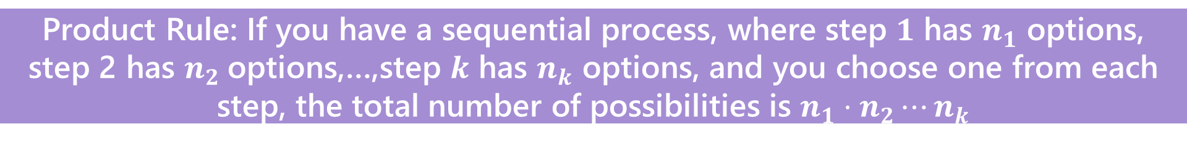
Counting Rule #2 (coffee)
Step 1: choose one of the three bases.
Step 2: regardless of step 1, choose one of the two preparations.
Step 3: regardless of steps 1 and 2, choose one of the four syrups.
$3⋅2⋅4=24$.
Latte
Cappuccino
Americano
Iced
Hot
Iced
Iced
Hot
Hot
C
C
P
H
G
P
H
G
Product Rule: If you have a sequential process, where step $1$ has $n_{1}$ options, step 2 has $n_{2}$options,…,step $k$ has $n_{k}$ options, and you choose one from each step, the total number of possibilities is $n_{1}⋅n_{2}⋯n_{k}$
Notes:
We can think of this like a sequential process. So to construct our coffee order, we first choose… now, we choose .. Note how for each of these “bases’, there are two options for the preparation. This give 6 options for these first 2 steps. Now. 3rd step.. Gives 4 additonla options for each of those 6 optiosnf rom those first two steps. Putting it all together, there are 24 options. We’re multiplying the number of options in each them. To generalize this, product rule step says that if we’re counting the number of options whereeach option is constructed by some sequential process, the number of total options is the product of the number of options in each step. So.. You can think of this as a tree, for every additional step, we multiply by that number of options because each option has that many more possibilities.

Slide 38
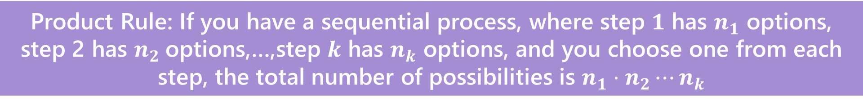
Counting Rules
Sum Rule: If you are choosing one thing between $n$ options in one group and $m$in another group with no overlap, the total number of options is: $n+m$.
⭐Used when we’re counting something when we have cases that don’t overlap ⭐
Product Rule: If you have a sequential process, where step $1$ has $n_{1}$ options, step 2 has $n_{2}$options,…,step $k$ has $n_{k}$ options, and you choose one from each step, the total number of possibilities is $n_{1}⋅n_{2}⋯n_{k}$
⭐Used when we’re counting something with a sequential process⭐
Notes:
To summarize what we just talked about… sum rule… product rule when we have a sequential process. And we’re going to choose 1 from all of the steps, multiply ..

Slide 39
Application of the Product Rule
Notes:
Let’s look at some applications of the product rule

Slide 40

Example – Cartesian Products
Remember Cartesian products?
$S×T=\{\left(x,y\right):x∈S, y∈T\}$
$\left\{1,2\right\}×\left\{a,b,c\right\}=\{\left(1,a\right),\left(1,b\right),\left(1,c\right),\left(2,a\right),\left(2,b\right),\left(2,c\right)\}$
Notes:
Write down |S x T| how many elements are there in the cross product of these sets. Each element in this cartesian product going to have one

Slide 41
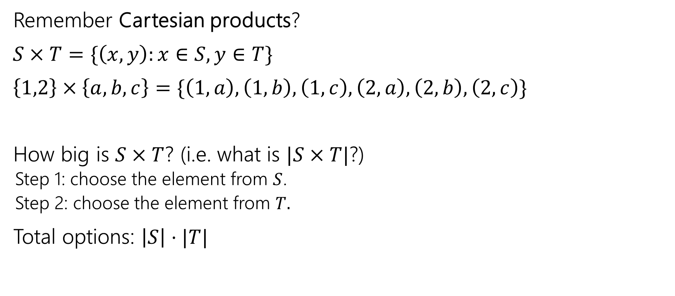
Example – Cartesian Products
Remember Cartesian products?
$S×T=\{\left(x,y\right):x∈S, y∈T\}$
$\left\{1,2\right\}×\left\{a,b,c\right\}=\{\left(1,a\right),\left(1,b\right),\left(1,c\right),\left(2,a\right),\left(2,b\right),\left(2,c\right)\}$
How big is $S×T$? (i.e. what is $|S×T|$?)
  Step 1: choose the element from $S$.
  Step 2: choose the element from $T.$
Total options: $\left|S\right|⋅|T|$

Slide 42

Example – Power Sets
$𝒫\left(S\right)=\{X:S⊆X\}$
$𝒫\left(\left\{1,2,3\right\}\right)=\{ ∅, \left\{1\right\},\left\{2\right\},\left\{3\right\}, \left\{1,2\right\},\left\{1,3\right\},\left\{2,3\right\}, \left\{1,2,3\right\} \}$
How many subsets are there of $S$, i.e. what is $\left|𝒫\left(S\right)\right|$?
x
x
x
x …
=
Notes:
Power set is a set that contains all possible subsets of a particular set. So X, we have this set X that consists of 1,2,3. the power set is the set of al lpossbile subsets of this..
What’s the size of an arbitray power set? Think about using the product rule! We’re counting the number of possible subsets. What sequential process u could use o create a subset of S

Slide 43
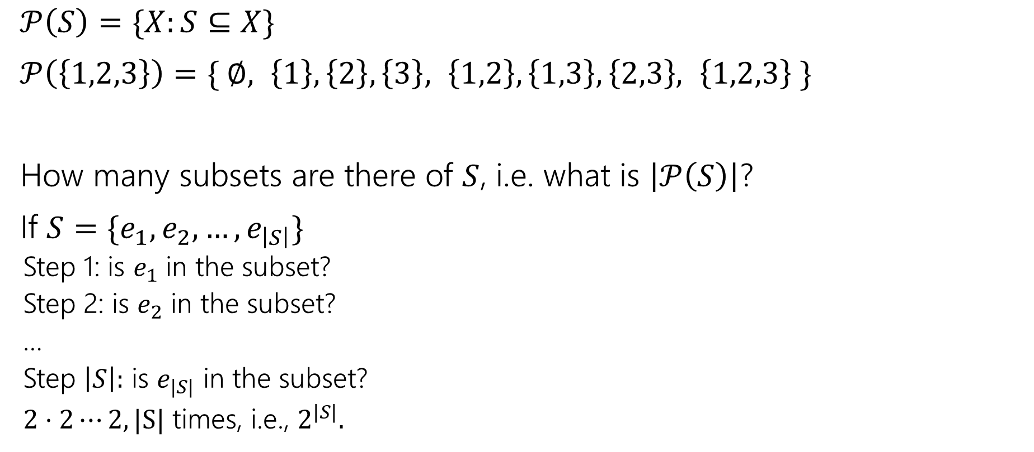
Example – Power Sets
$𝒫\left(S\right)=\{X:S⊆X\}$
$𝒫\left(\left\{1,2,3\right\}\right)=\{ ∅, \left\{1\right\},\left\{2\right\},\left\{3\right\}, \left\{1,2\right\},\left\{1,3\right\},\left\{2,3\right\}, \left\{1,2,3\right\} \}$
How many subsets are there of $S$, i.e. what is $\left|𝒫\left(S\right)\right|$?
If $S=\{e_{1},e_{2},…,e_{\left|S\right|}\}$
  Step 1: is $e_{1}$ in the subset?
  Step 2: is $e_{2}$ in the subset?
  …
  Step $\left|S\right|:$ is $e_{|S|}$ in the subset?
  $2⋅2⋯2, |S|$ times, i.e., $2^{|S|}.$

Slide 44
Example – Assigning Books
We have 5 books to split to 3 people (Alice, Bob, and Charlie)
Every book goes to exactly one person, but each person could end up with no books (or all of them, or something in between).
1
Alice
2
Bob
3
4
Charlie
5

Slide 45
Example – Assigning Books
There are 3 people (Alice, Bob, and Charlie) split up 5 books
Every book goes to exactly one person, but each person could end up with no books (or all of them, or something in between).
1
Alice
2
Bob
3
4
Charlie
5
Notes:
Describe it in terms of people first
Alice gets the set of books with 1

Slide 46
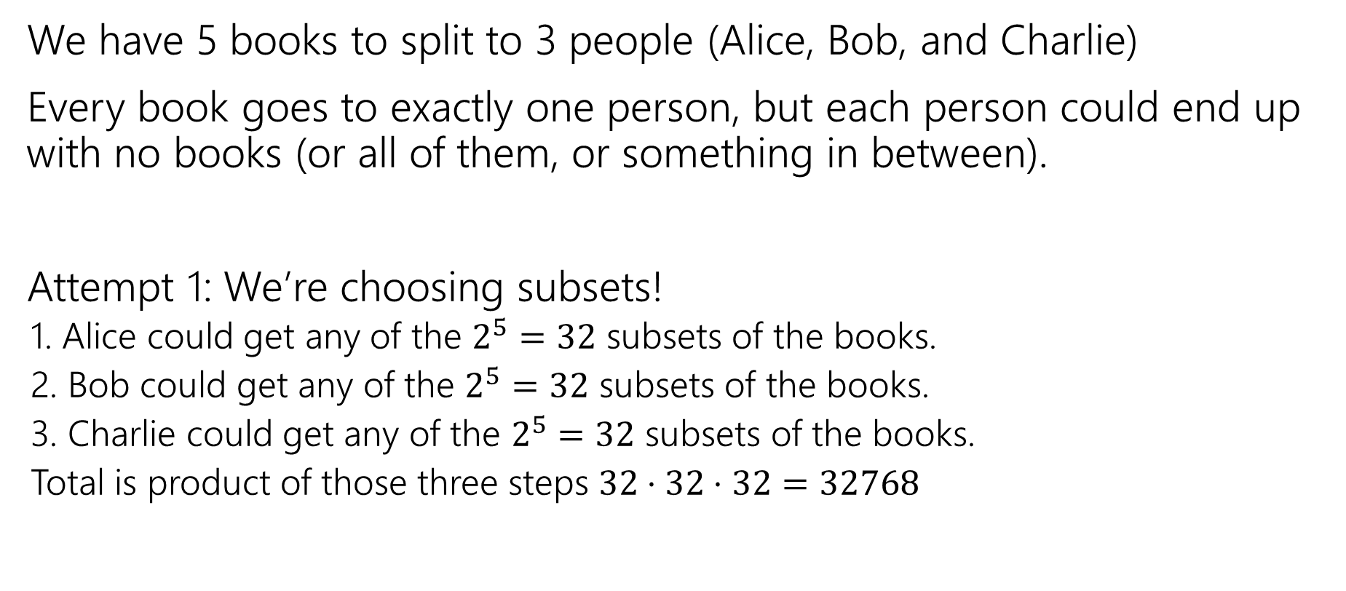
Example – Assigning Books
We have 5 books to split to 3 people (Alice, Bob, and Charlie)
Every book goes to exactly one person, but each person could end up with no books (or all of them, or something in between).
Attempt 1: We’re choosing subsets!
  1. Alice could get any of the $2^{5}=32$ subsets of the books.
  2. Bob could get any of the $2^{5}=32$ subsets of the books.
  3. Charlie could get any of the $2^{5}=32$ subsets of the books.
  Total is product of those three steps $32⋅32⋅32=32768$
Notes:
Let’s try this. We’re going to think about choosing which subset of books is assigned to each perons. Because alice bob and Charlie are each going to get some set of books. We have a sequential process – first pick subset of books for alice. There are 2^5 number of possible subsets of the 5 books using what we just talked about with power sets. Each of the 5 books have 2 options of whether are not they will be assigned to Alice. .. Same thing for bob and Charlie. Using the product rule
..does it overcount? Does it count some option more than once? Does it undercount, miss out some possibilities? Or is it just right?
This is an attempt! Take a few min. what do u think
PAUSE AND GET STUDENT ANSWER

Slide 47
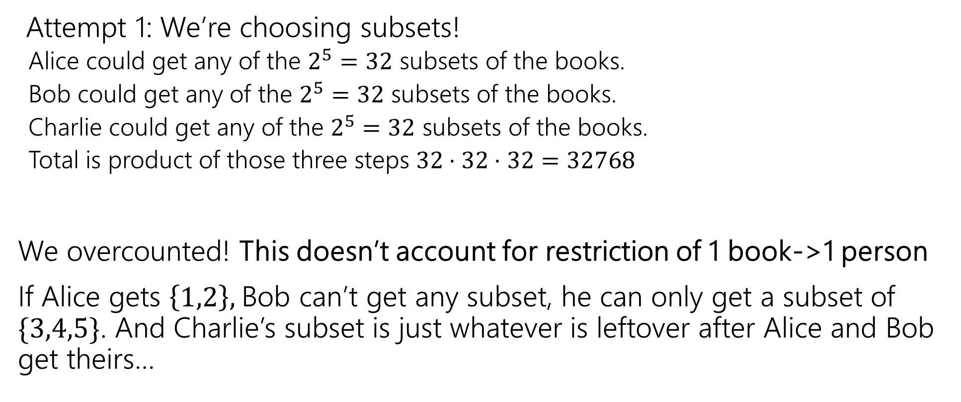
Example – Assigning Books
Attempt 1: We’re choosing subsets!
  Alice could get any of the $2^{5}=32$ subsets of the books.
  Bob could get any of the $2^{5}=32$ subsets of the books.
  Charlie could get any of the $2^{5}=32$ subsets of the books.
  Total is product of those three steps $32⋅32⋅32=32768$
We overcounted! This doesn’t account for restriction of 1 book->1 person
If Alice gets $\left\{1,2\right\},$Bob can’t get any subset, he can only get a subset of $\{3,4,5\}$. And Charlie’s subset is just whatever is leftover after Alice and Bob get theirs…
Notes:
Our approach would allow any combination of subsets of books,

Slide 48
Example – Fixing All The Books
You could
List out all the options for Alice.
For each of those (separately), list all the possible options for Bob and Charlie.
Use the Sum rule to combine.
~OR~ you could come at the problem from a different angle.
Notes:
Fix this! One way is start by listing out the options for alice. For example, 1,2, 245 as options. For eac h of these, list out the options for bob and charlier. This is totally fine and valid. It’s just a lot of manual work that I don’t trust myself to do.
Or we can try approaching this from a different angle. Oftentimes if ur doing a problem and with one approach it’s kind of leading u to a dead end making u have to do a lot of manual listing out of outcomes, that’s totally fine and normal, it’s probably a sign to try something new

Slide 49
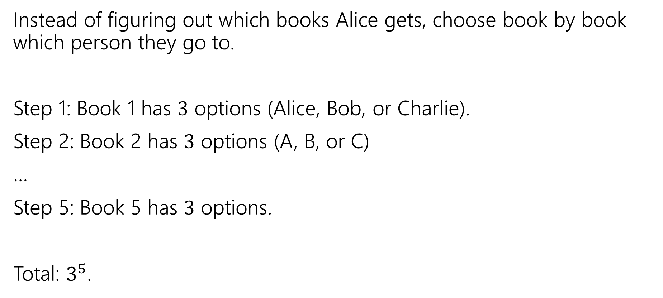
Example – Fixing All The Books
Instead of figuring out which books Alice gets, choose book by book which person they go to.
Step 1: Book 1 has $3$ options (Alice, Bob, or Charlie).
Step 2: Book 2 has $3$ options (A, B, or C)
…
Step 5: Book 5 has $3$ options.
Total: $3^{5}$.
Notes:
Instead of tyring to assign subsets of books to person, we can think abt assigning each book to a person. We said that each book can only go to one person. So out sequential process can be each of the books picking which person to go to. so the first book has 3 options. 2nd bok … we mutlill together to get 3^5

Slide 50
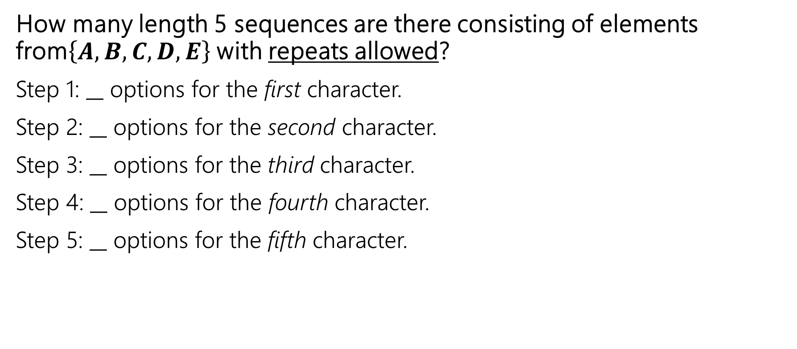
Example – Repeated letters
How many length 5 sequences are there consisting of elements from$\left\{A,B,C, D, E\right\}$ with repeats allowed?
Step 1: $__$ options for the first character.
Step 2: $__$ options for the second character.
Step 3: $__$ options for the third character.
Step 4: $__$ options for the fourth character.
Step 5: $__$ options for the fifth character.
Notes:
Ok! Let’s try another example, but now we’re going to introduce some more restrictions into our counting process..
This applies for any positive values of n and k

Slide 51
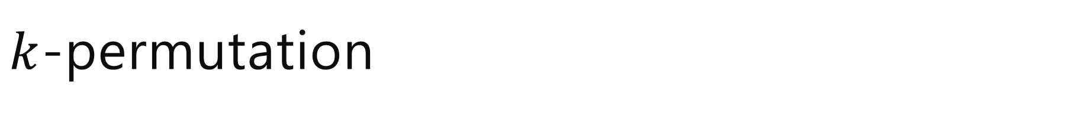
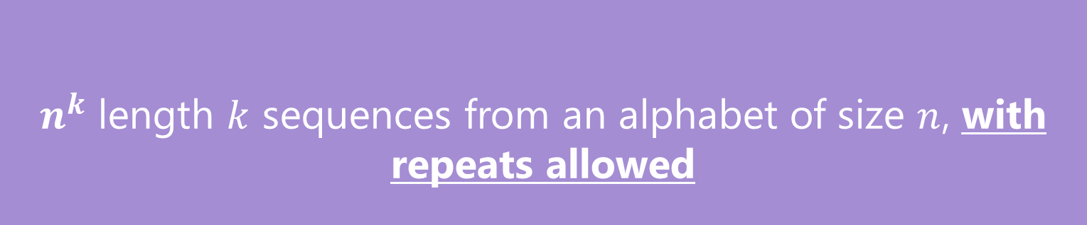
$k$-permutation
$n^{k}$ length $k$ sequences from an alphabet of size $n$, with repeats allowed
$k$-sequences

Slide 52
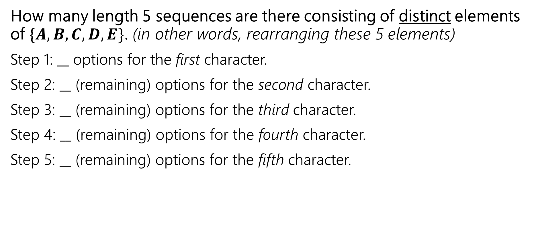
Example – Distinct letters
How many length 5 sequences are there consisting of distinct elements of $\{A,B,C, D, E\}$. (in other words, rearranging these 5 elements)
Step 1: $__$ options for the first character.
Step 2: $__$ (remaining) options for the second character.
Step 3: $__$ (remaining) options for the third character.
Step 4: $__$ (remaining) options for the fourth character.
Step 5: $__$ (remaining) options for the fifth character.
Notes:
Ok! Let’s try another example, but now we’re going to introduce some more restrictions into our counting process.. Here we want distinct elements, so repeats are NOT allowed. For example, 14253 … essentially we’re rearranging.. Let’s how amnay options in each of these steps?

Slide 53
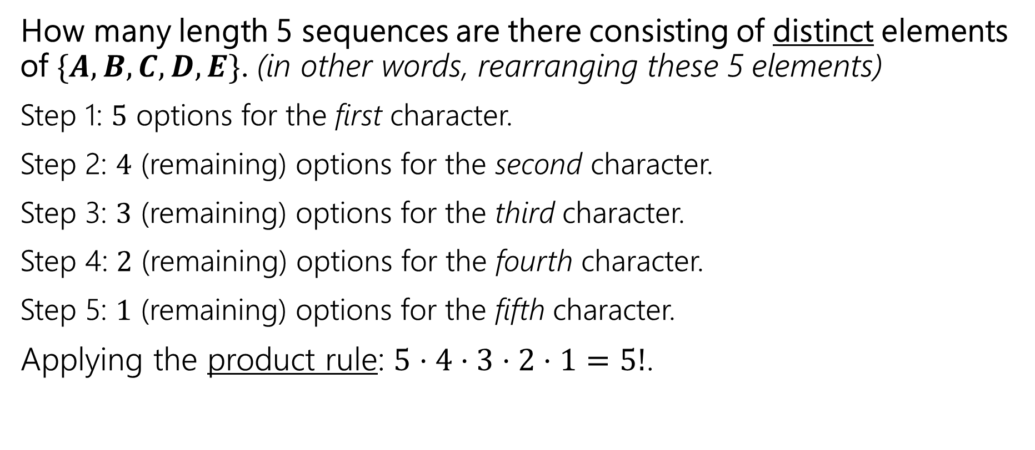
Example – Distinct letters
How many length 5 sequences are there consisting of distinct elements of $\{A,B,C, D, E\}$. (in other words, rearranging these 5 elements)
Step 1: $5$ options for the first character.
Step 2: $4$ (remaining) options for the second character.
Step 3: $3$ (remaining) options for the third character.
Step 4: $2$ (remaining) options for the fourth character.
Step 5: $1$ (remaining) options for the fifth character.
Applying the product rule: $5⋅4⋅3⋅2⋅1=5!$.
Notes:
Generalizing this. We call this a factorial. So fo r example 10! Is 10 * 9 * 8… alt the way down to 1.. Generally, the number of ways to arrange, n distinc elements is n!

Slide 54

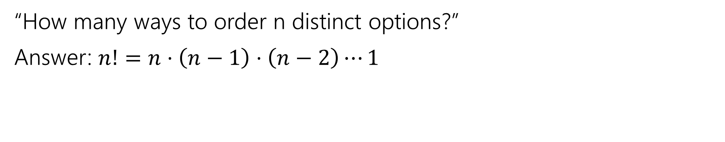

Permutations
“How many ways to order n distinct options?”
Answer: $n!=n⋅\left(n−1\right)⋅\left(n−2\right)⋯1$
$$n!=n⋅\left(n−1\right)⋅\left(n−2\right)⋯1$$
$n$ factorial
We only define 𝑛! for natural numbers 𝑛.
Note 0!=1

Slide 55
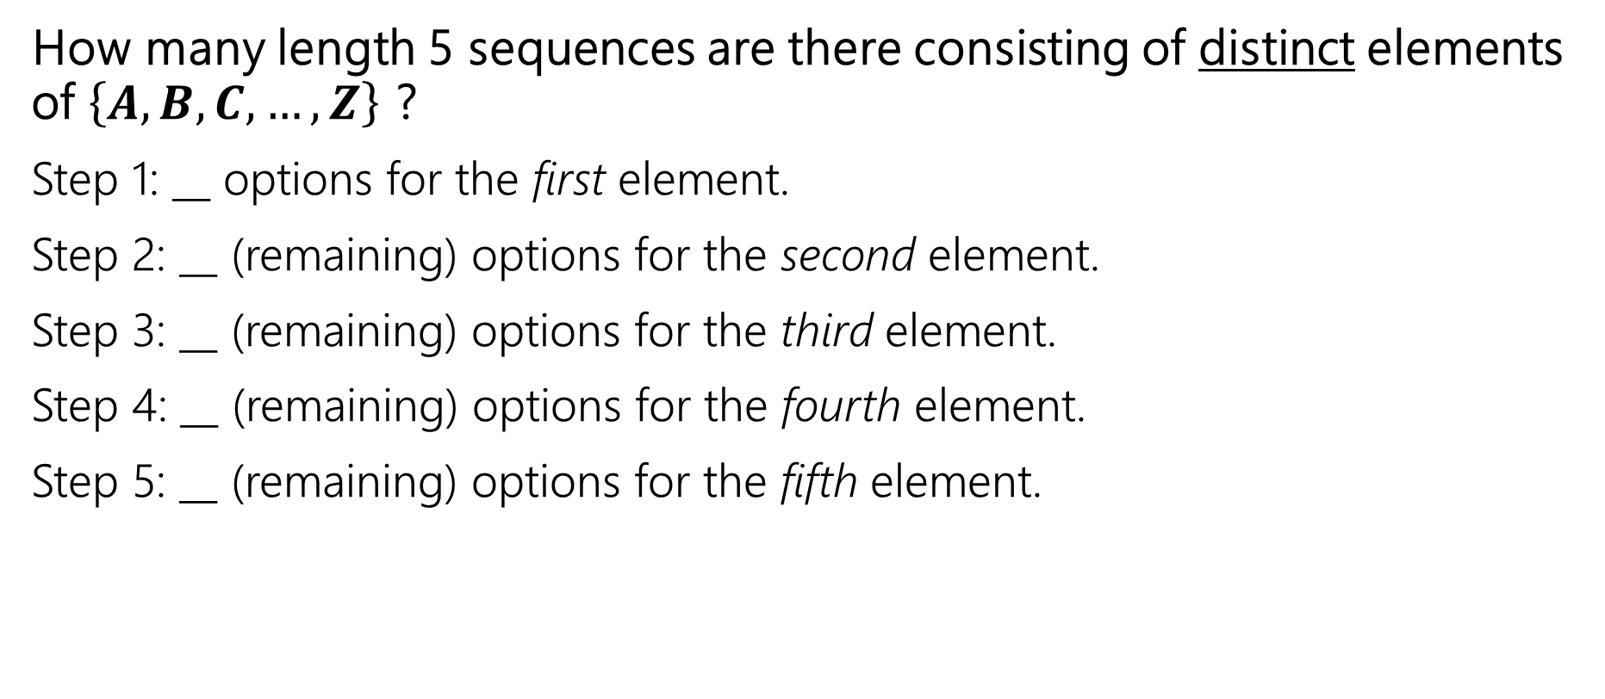
Example – Distinct letters 2
How many length 5 sequences are there consisting of distinct elements of $\left\{A,B,C, …, Z\right\}$ ?
Step 1: __ options for the first element.
Step 2: __ (remaining) options for the second element.
Step 3: __ (remaining) options for the third element.
Step 4: __ (remaining) options for the fourth element.
Step 5: __ (remaining) options for the fifth element.
Notes:
Here we still are selecting distinct elements, so repeats are not allowed, but we’re only doing a subset. So we want

Slide 56
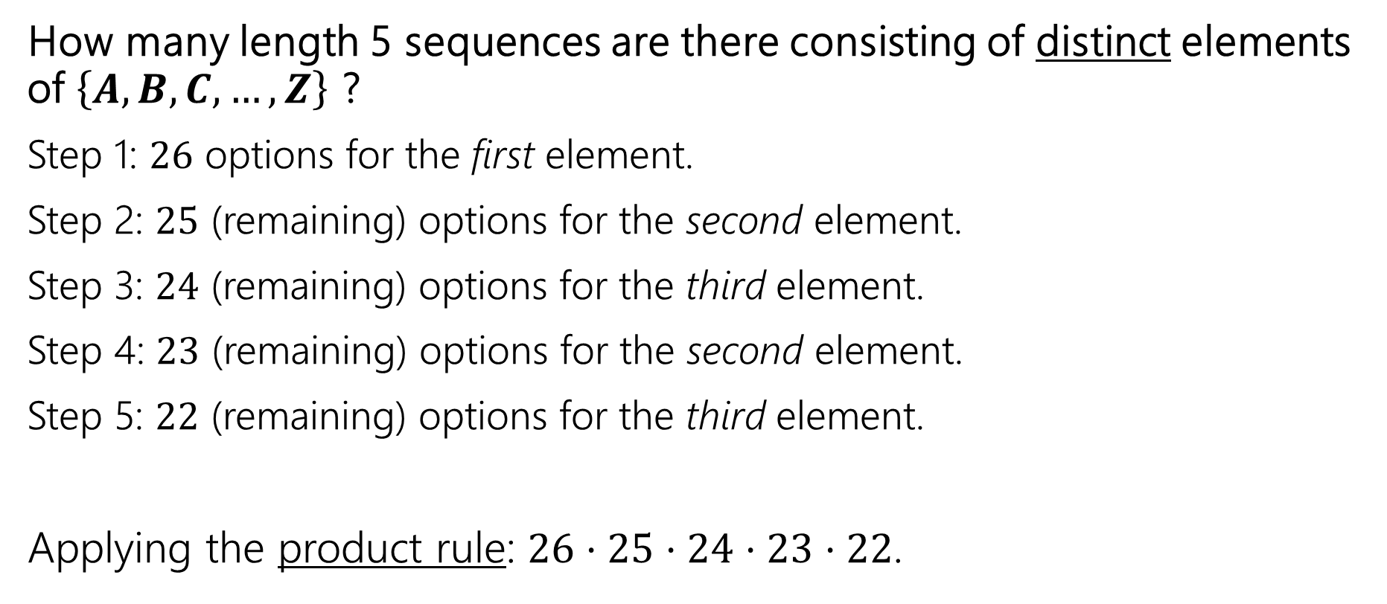
Example – Distinct letters 2
How many length 5 sequences are there consisting of distinct elements of $\left\{A,B,C, …, Z\right\}$ ?
Step 1: $26$ options for the first element.
Step 2: $25$ (remaining) options for the second element.
Step 3: $24$ (remaining) options for the third element.
Step 4: $23$ (remaining) options for the second element.
Step 5: $22$ (remaining) options for the third element.
Applying the product rule: $26⋅25⋅24⋅23⋅22$.
Notes:
Here we still are selecting distinct elements, so repeats are not allowed, but we’re only doing a subset. So we want

Slide 57
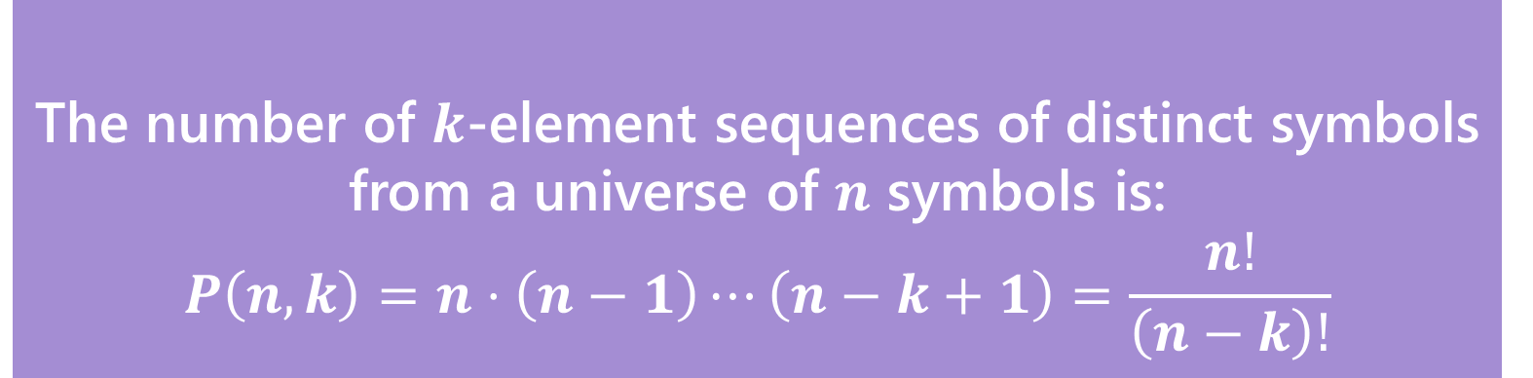
$k$-permutation
The number of $k$-element sequences of distinct symbols from a universe of $n$ symbols is:
$$P\left(n,k\right)=n⋅\left(n−1\right)⋯\left(n−k+1\right)=\frac{n!}{\left(n−k\right)!}$$
$k$-permutation

Slide 58

Number of Subsets
How many size-5 subsets are there consisting of distinct elements of $\left\{A,B,C, …, Z\right\}$ ?
e.g., {A,Z,U,R,E}, {B,I,N,G,O}, {T,A,N,G,O}. But not: {R,A,I,N}, {Z,Q,F},…
Notes:
Ok! Let’s try another example, but now we’re going to introduce some more restrictions into our counting process..

Slide 59
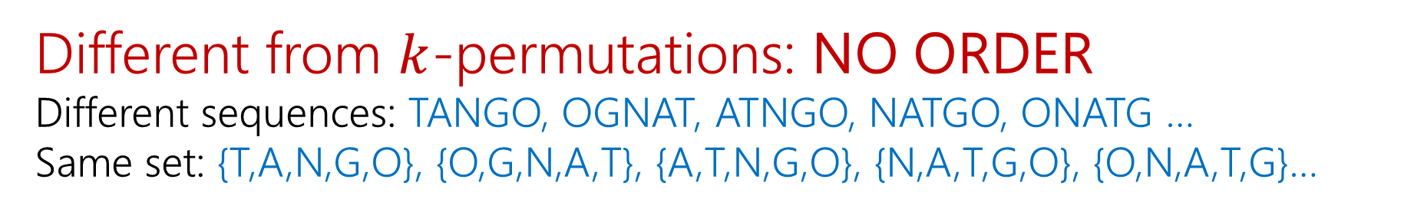
Number of Subsets
How many size-5 subsets are there consisting of distinct elements of $\left\{A,B,C, …, Z\right\}$ ?
e.g., {A,Z,U,R,E}, {B,I,N,G,O}, {T,A,N,G,O}. But not: {R,A,I,N}, {Z,Q,F},…
Different from $k$-permutations: NO ORDER
Different sequences: TANGO, OGNAT, ATNGO, NATGO, ONATG …
Same set: {T,A,N,G,O}, {O,G,N,A,T}, {A,T,N,G,O}, {N,A,T,G,O}, {O,N,A,T,G}…
Notes:
Ok! Let’s try another example, but now we’re going to introduce some more restrictions into our counting process..

Slide 60
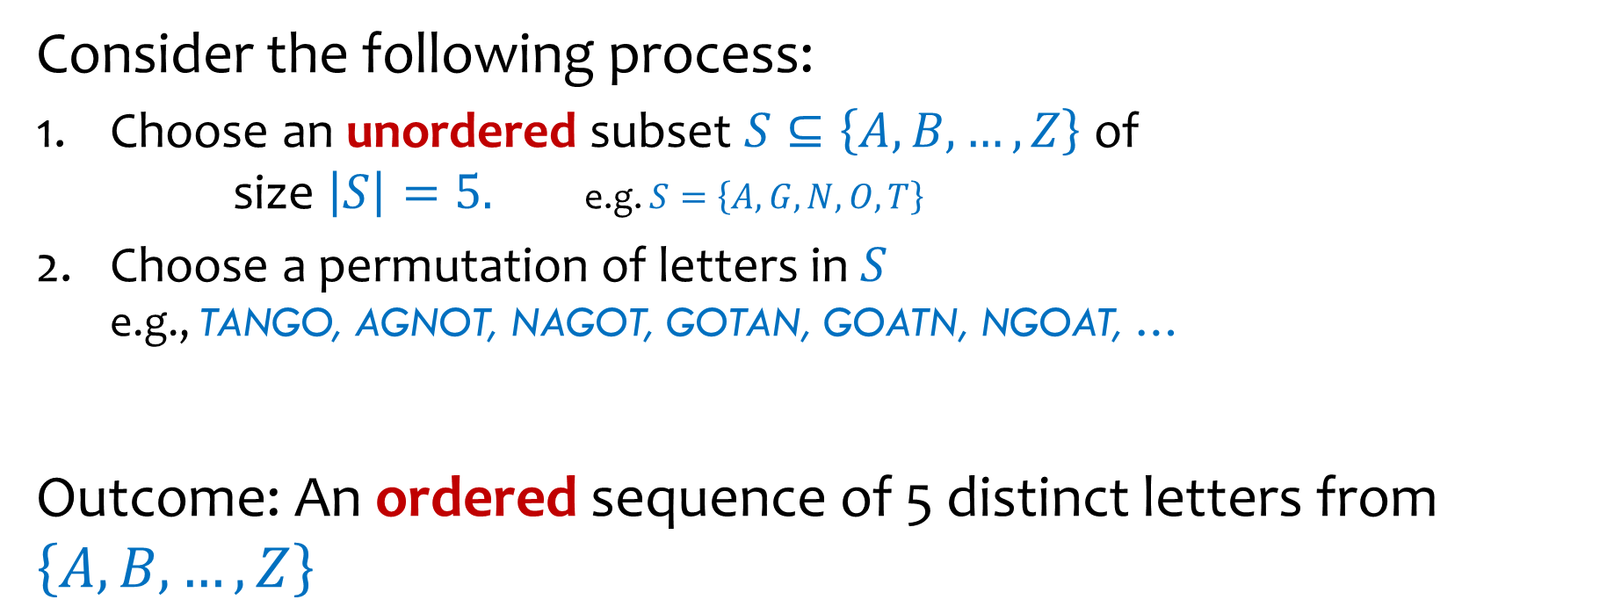


Number of Subsets – Fill in what we know
Consider the following process:
Choose an unordered subset $S⊆\left\{A,B,…,Z\right\}$ of
size $\left|S\right|=5.$ e.g. $S=\left\{A,G,N,O,T\right\}$
Choose a permutation of letters in $S$
e.g., TANGO, AGNOT, NAGOT, GOTAN, GOATN, NGOAT, …
Outcome: An ordered sequence of 5 distinct letters from $\left\{A,B,…,Z\right\}$
$$\text{???}$$
x
=
$$\text{???}=$$

Slide 61
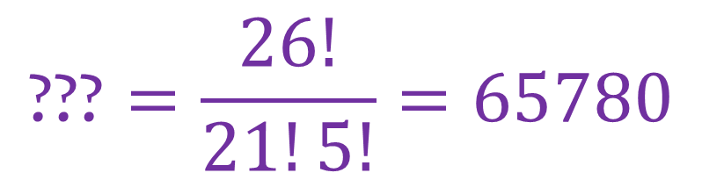


Number of Subsets – Fill in what we know
Consider the following process:
Choose an unordered subset $S⊆\left\{A,B,…,Z\right\}$ of
size $\left|S\right|=5.$ e.g. $S=\left\{A,G,N,O,T\right\}$
Choose a permutation of letters in $S$
e.g., TANGO, AGNOT, NAGOT, GOTAN, GOATN, NGOAT, …
Outcome: An ordered sequence of 5 distinct letters from $\left\{A,B,…,Z\right\}$
$$\text{???}$$
x
$$5!$$
=
$$\frac{26!}{21!}$$
$$\text{???}=\frac{26!}{21!5!}=65780$$

Slide 62
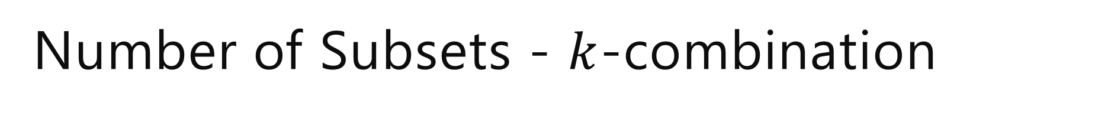
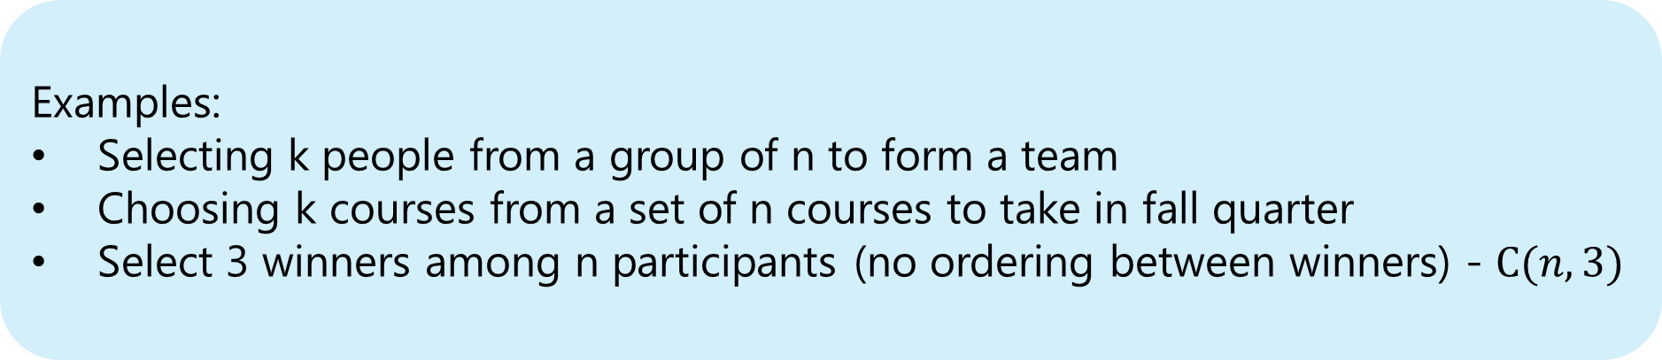
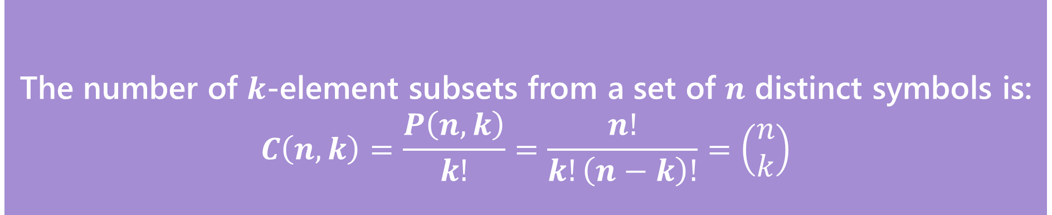
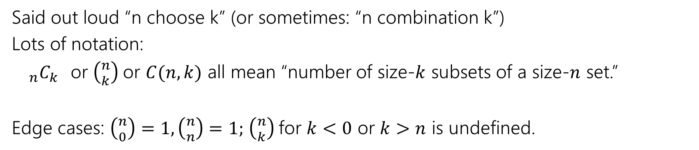
Number of Subsets - $k$-combination
The number of $k$-element subsets from a set of $n$ distinct symbols is:
$$C\left(n,k\right)=\frac{P\left(n,k\right)}{k!}=\frac{n!}{k!\left(n−k\right)!}=\left(\begin{matrix}n \\ k\end{matrix}\right)$$
$k$-combination
Examples:
Selecting k people from a group of n to form a team
Choosing k courses from a set of n courses to take in fall quarter
Select 3 winners among n participants (no ordering between winners) - $C(n, 3)$
Said out loud “n choose k” (or sometimes: “n combination k”)
Lots of notation:
${}_{n}C_{k}$or $\left({n \atop k}\right)$or $C(n,k)$ all mean “number of size-$k$ subsets of a size-$n$ set.”
Edge cases: $\left({n \atop 0}\right)=1,\left({n \atop n}\right)=1;$ $\left({n \atop k}\right)$for $k<0$ or $k>n$ is undefined.
Notes:
On Friday we’re going to talk more about this formula, and why it’s true, but for now

Slide 63
Pause
Questions in combinatorics and probability are often dense. A single word can totally change the answer. Does order matter or not? Are repeats allowed or not? What makes two things “count the same” or “count as different”?
Let’s look for some keywords

Slide 64
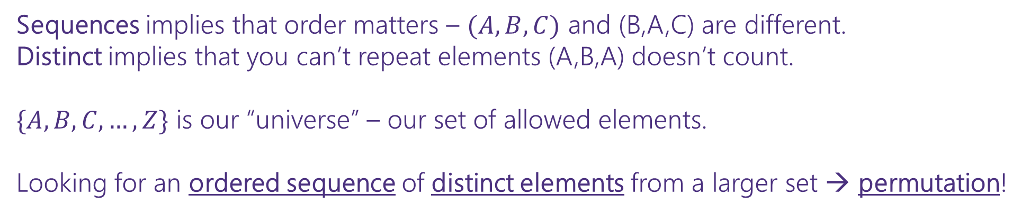

Pause – looking for keywords!
How many length 5 sequences are there consisting of distinct elements of $\left\{A,B,C, …, Z\right\}$ ?
Sequences implies that order matters – $(A,B,C)$ and (B,A,C) are different.
Distinct implies that you can’t repeat elements (A,B,A) doesn’t count.
$\{A,B,C,…,Z\}$ is our “universe” – our set of allowed elements.
Looking for an ordered sequence of distinct elements from a larger set → permutation!

Slide 65

One more counting technique!
How many length 5 strings are there over $\{a, b, …, z\}$ with at least 1 $a$?
Notes:
I know this is a double negative, which in 311 is terrible, we’re going to let it slide here ok? Don’t tell anyone
Ink an example
A valid string would look like this
Valid of 1 a
Valid of 2 a
An invalid string would look like this

Slide 66

One more counting technique!
How many length 5 strings are there over $\{a, b, …, z\}$ with at least 1 $a$?
  we can rephrase this as: “How many length 5 strings are there that do not have no $a$’s?
Notes:
I know this is a double negative, which in 311 is terrible, we’re going to let it slide here ok? Don’t tell anyone

Slide 67
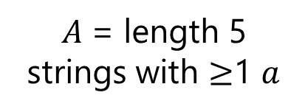
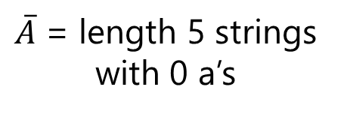

One more counting technique!
How many length 5 strings are there over $\{a, b, …, z\}$ with at least 1 $a$?
  we can rephrase this as: “How many length 5 strings are there that do not have no $a$’s?
$𝒰$ = all possible length 5 strings
$\overline{A}$ = length 5 strings with 0 a’s
$A$= length 5 strings with $≥$1 $a$
Notes:
I know this is a double negative, which in 311 is terrible, we’re going to let it slide here ok? Don’t tell anyone

Slide 68

One more counting technique!
How many length 5 strings are there over $\{a, b, …, z\}$ with at least 1 $a$?
  we can rephrase this as: “How many length 5 strings are there that do not have no $a$’s?
$𝒰$ = all possible length 5 strings
We’re interested in $|A|$ -
$\left|A\right| =\left|𝒰\backslash \overline{A}\right|=\left|𝓤\right|−|\overline{A}$|
$\overline{A}$ = length 5 strings with 0 a’s
$A$= length 5 strings with $≥$1 $a$
Notes:
I know this is a double negative, which in 311 is terrible, we’re going to let it slide here ok? Don’t tell anyone

Slide 69

One more counting technique!
How many length 5 strings are there over $\{a, b, …, z\}$ with at least 1 $a$?
  we can rephrase this as: “How many length 5 strings are there that do not have no $a$’s?
$𝒰$ = all possible length 5 strings
We’re interested in $|A|$ -
$\left|A\right| =\left|𝒰\backslash \overline{A}\right|=\left|𝓤\right|−|\overline{A}$|
$={26}^{5} −{25}^{5}$
$\overline{A}$ = length 5 strings with 0 a’s
$A$= length 5 strings with $≥$1 $a$
Notes:
I know this is a double negative, which in 311 is terrible, we’re going to let it slide here ok? Don’t tell anyone

Slide 70

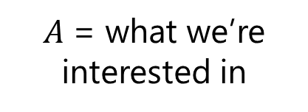
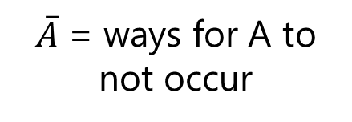

Complementary Counting
$\left|A\right| =\left|𝒰\backslash \overline{A}\right|=\left|𝓤\right|−|\overline{A}$|
total options – options for A to not occur = options for A to occur
$𝒰$ = all possible options
Phrases that might indicate complementary counting:
..options so that __ does not occur
..ways for at least one __ to occur = total – ways for none of _ to occur
$\overline{A}$ = ways for A to not occur
$A$= what we’re interested in

Slide 71
That was a lot!!
“High level” counting approaches
Sum rule – counts options where we have disjoint cases
Product rule – counts options when we have a sequential process
Complementary counting – we count the options by finding that total options and subtracting the non-desired options
These may be used together! And may be used with the following --

Slide 72
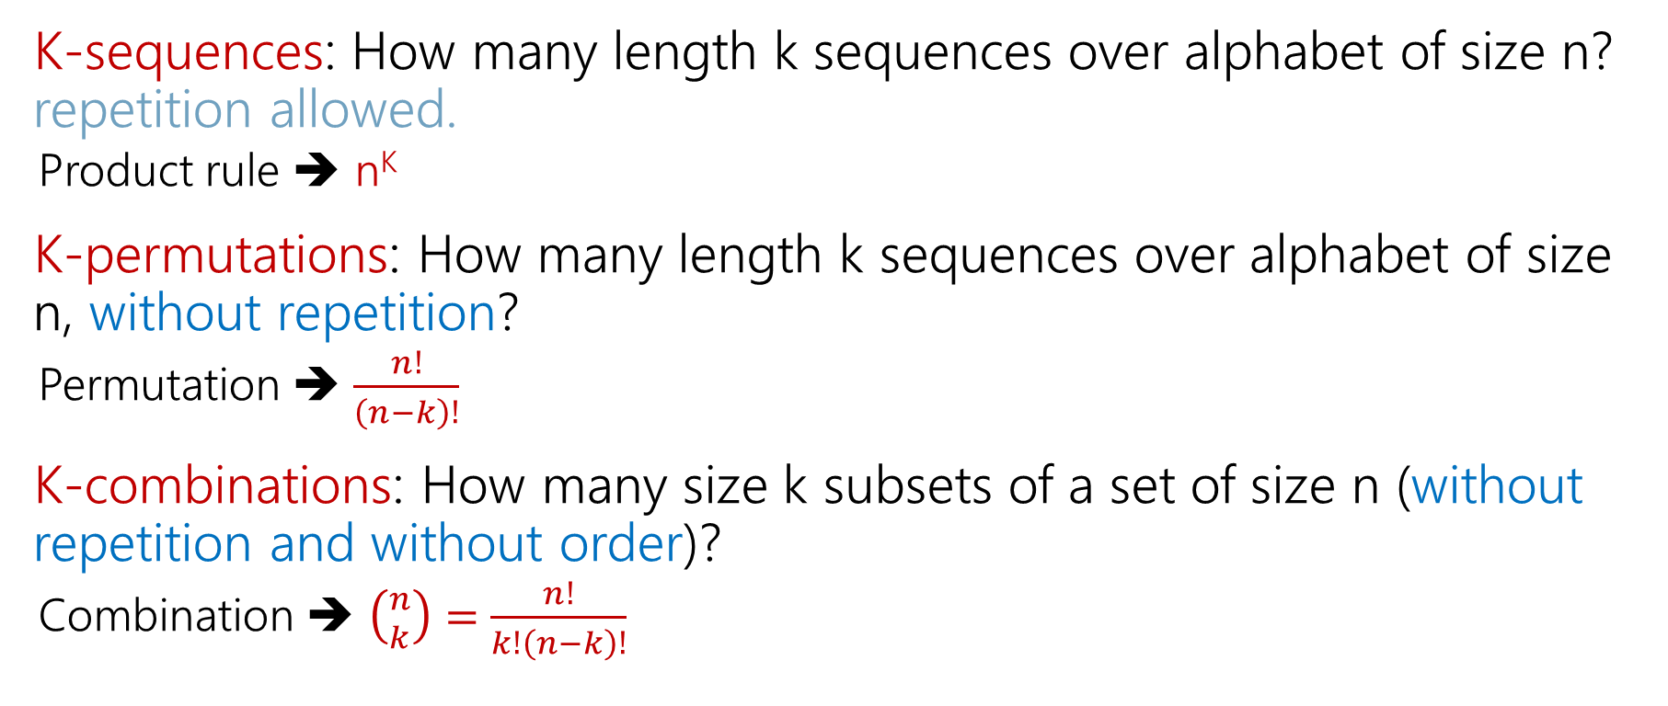
That was a lot!!
K-sequences: How many length k sequences over alphabet of size n? repetition allowed.
  Product rule ➔ n^{K}
K-permutations: How many length k sequences over alphabet of size n, without repetition?
  Permutation ➔ $\frac{n!}{\left(n−k\right)!}$
K-combinations: How many size k subsets of a set of size n (without repetition and without order)?
  Combination ➔ $\left({n \atop k}\right)=$ $\frac{n!}{k!\left(n−k\right)!}$

Slide 73
TODOs from today
⭐ read through syllabus + agreement in Gradescope
⭐ make sure DRS accommodations are set up
⭐ email me with other accessibility concerns
⭐ first concept check will be released after class and due Friday 12pm
⭐ PSet1 will be released on Wednesday
⭐ Quiz 1 will be on Friday

Slide 74
More Practice

Slide 75
Baseball Outfits (setup)
The Husky baseball team has three hats (purple, black, gray)
Three jerseys (pinstripe, purple, gold)
And three pairs of pants (gray, white, black)
How many outfits are there (consisting of one hat, jersey, and pair of pants) if
  the pinstripe jersey cannot be worn with gray pants,
  the purple jersey cannot be worn with white pants,
  and the gold jersey cannot be worn with black pants.

Slide 76
Baseball Outfits (attempt 1)
Step 1: 3 choices for hats.
Step 2: 3 choices for jerseys
Step 3:…

Slide 77
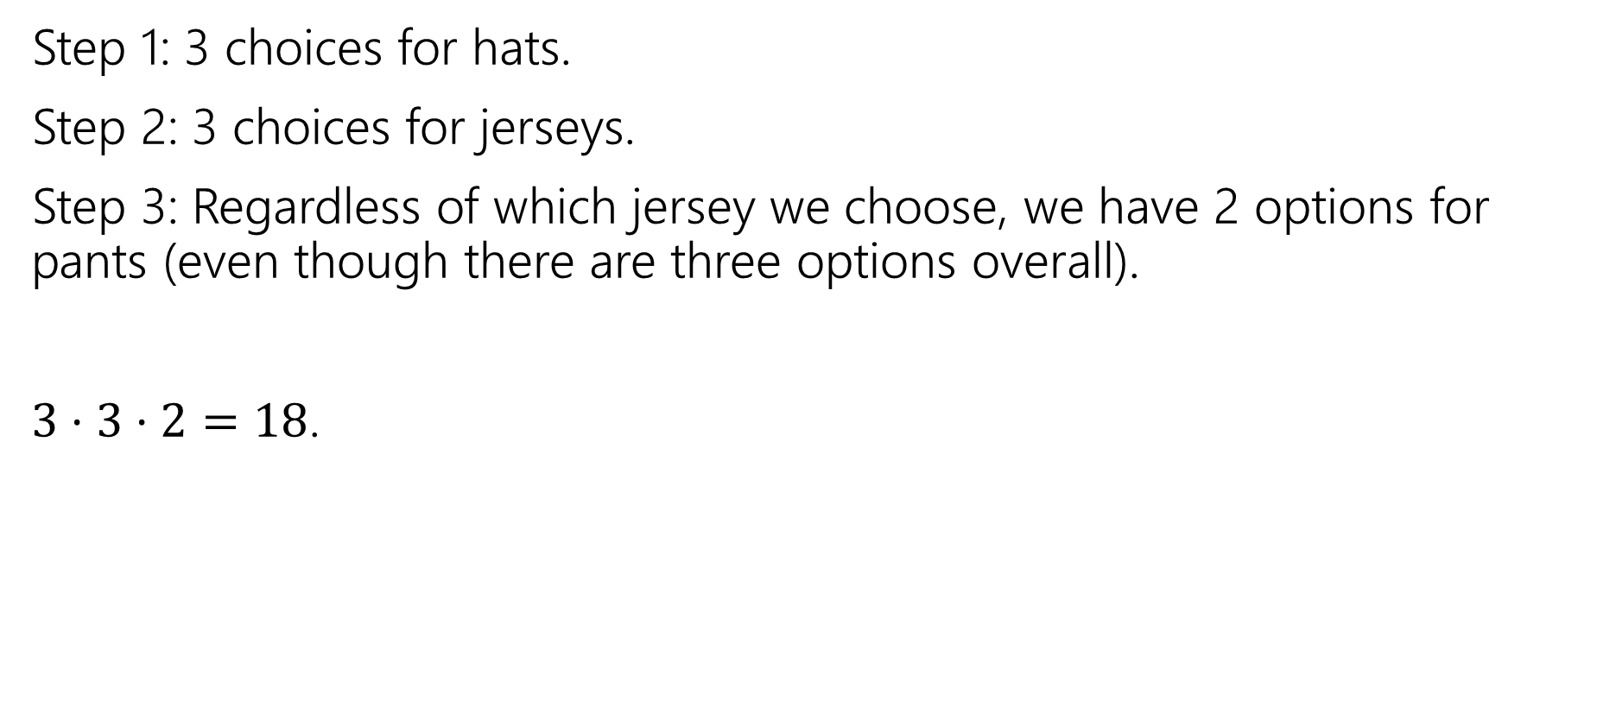
Baseball Outfits (answer 1)
Step 1: 3 choices for hats.
Step 2: 3 choices for jerseys.
Step 3: Regardless of which jersey we choose, we have 2 options for pants (even though there are three options overall).
$3⋅3⋅2=18$.

