Slide 1
Random variables:
Expectation and Linearity of Expectation
CSE 312 Spring 26
Lecture 9

Slide 2

Where we are
Last Class:
Random Variables
Probability Mass Function (PMF)
Cumulative Distribution Function (CDF)
Today:
Recap
Expectation
Linearity of Expectation
Indicator Random Variables
Kandinsky
This Photo by Unknown Author is licensed under CC BY-SA

Slide 3
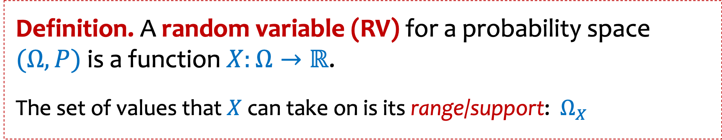
Review Random Variables
Definition. A random variable (RV) for a probability space $(Ω, P)$ is a function $X:Ω→ℝ$.
The set of values that $X$ can take on is its range/support:$Ω_{X}$

Slide 4

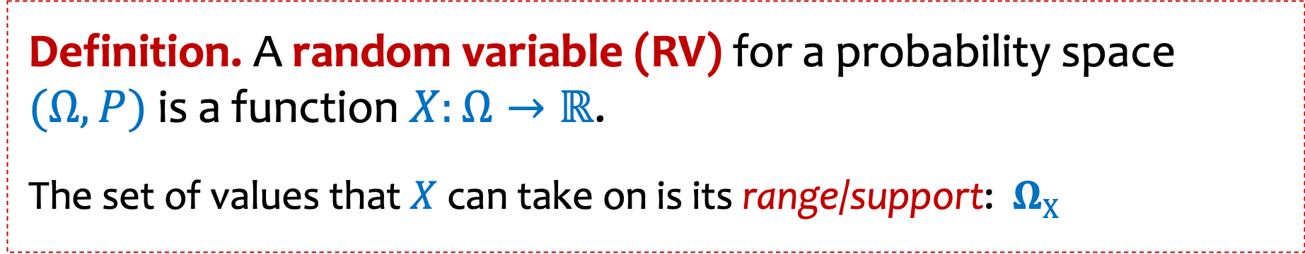





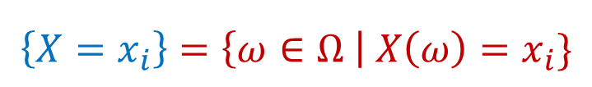
Review Random Variables and Associated Events
Definition. A random variable (RV) for a probability space $(Ω, P)$ is a function $X:Ω→ℝ$.
The set of values that $X$ can take on is its range/support:$ΩX$
$$\left\{X=x_{i}\right\}=\left\{ω∈Ω \right| X\left(ω\right)=x_{i}\}$$
$$X\left(ω\right)=x_{1}$$
$$X\left(ω\right)=x_{4}$$
Random variables partition the sample space.
$$X\left(ω\right)=x_{3}$$
$$Ω$$
$$Σ_{x∈ΩX}P\left(X=x\right)=1$$
$$X\left(ω\right)=x_{2}$$
Notes:
Checked reading order

Slide 5







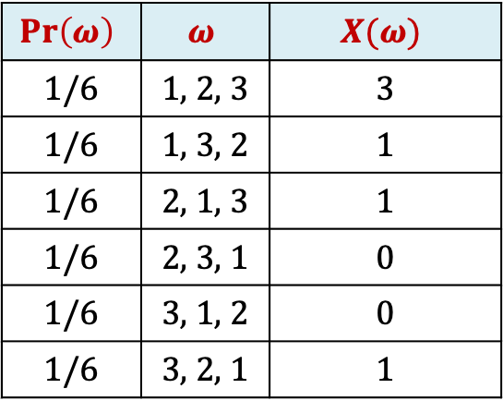

Example: Returning Homeworks
Class with 3 students, randomly hand back homeworks. All permutations equally likely.
Let $X$ be the number of students who get their own HW
$$Ω$$
2, 3, 1
2, 3, 1
3, 1, 2
$$Pr\left(ω\right)$$ | $$ω$$ | $$X(ω)$$
1/6 | 1, 2, 3 | 3
1/6 | 1, 3, 2 | 1
1/6 | 2, 1, 3 | 1
1/6 | 2, 3, 1 | 0
1/6 | 3, 1, 2 | 0
1/6 | 3, 2, 1 | 1
$$P\left(X=0\right)=1/3$$
$$X\left(ω\right)=0$$
2, 3, 1
1, 3, 2
2, 1, 3
3, 2, 1
$$P\left(X=1\right)=1/2$$
$$X\left(ω\right)=1$$
$$P\left(X=3\right)=1/6$$
2, 3, 1
1, 2, 3
$$X\left(ω\right)=3$$
Notes:
Color code the table next time

Slide 6

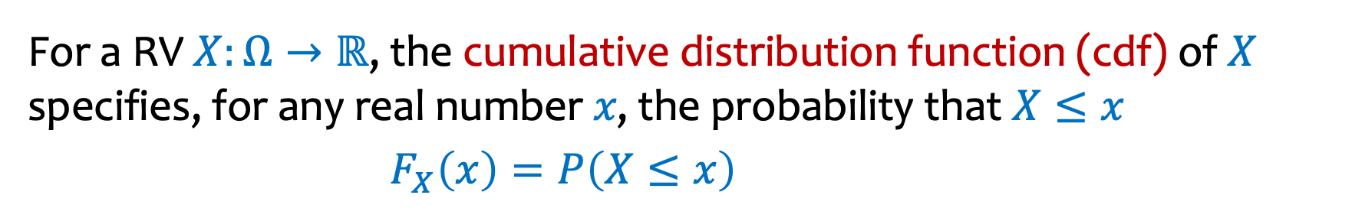
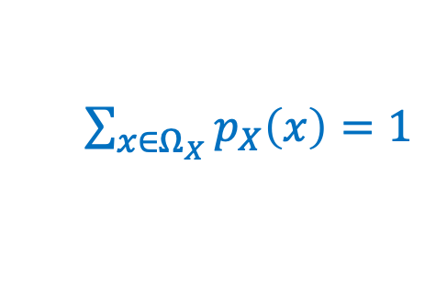
Review PMF and CDF
Definitions:
For a RV $X:Ω→ℝ$, the probability mass function (pmf) of 𝑋 specifies, for any real number 𝑥, the probability that $X=x$
$p_{X}\left(x\right)=P\left(X=x\right)=P(\left\{ω∈Ω \right| X(ω)=x\})$
$\sum_{x∈Ω_{X}}{p_{X}\left(x\right)=1}$
For a RV $X:Ω→ℝ$, the cumulative distribution function (cdf) of 𝑋 specifies, for any real number 𝑥, the probability that $X≤x$
$F_{X}\left(x\right)=P\left(X≤x\right)$
Notes:
Checked reading order

Slide 7



Example – Two fair independent coin flips
$X=$ number of heads
Probability Mass Function
PMF
Cumulative Distribution Function
CDF
$$p_{X}$$
$$F_{X}$$
1
3/4
1/2
1/4
-1
0
1
2
3
-1
0
1
2
3

Slide 8


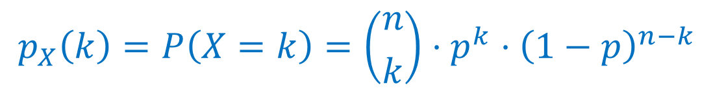
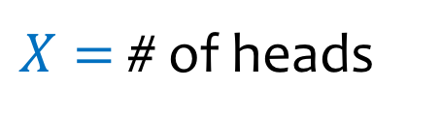
Example – Number of Heads - pmdf
We flip $n$ coins, independently, each heads with probability $p$
$Ω=\{HH⋯HH,HH⋯HT,HH⋯TH,…,TT⋯TT\}$
$X=$ # of heads
$$p_{X}\left(k\right)=P\left(X=k\right)=\left({n \atop k}\right)⋅p^{k}⋅{\left(1−p\right)}^{n−k}$$
# of sequences with $k$ heads
Prob of sequence w/ $k$ heads

Slide 9
Agenda
Expectation
Linearity of Expectation
Indicator Random Variables

Slide 10
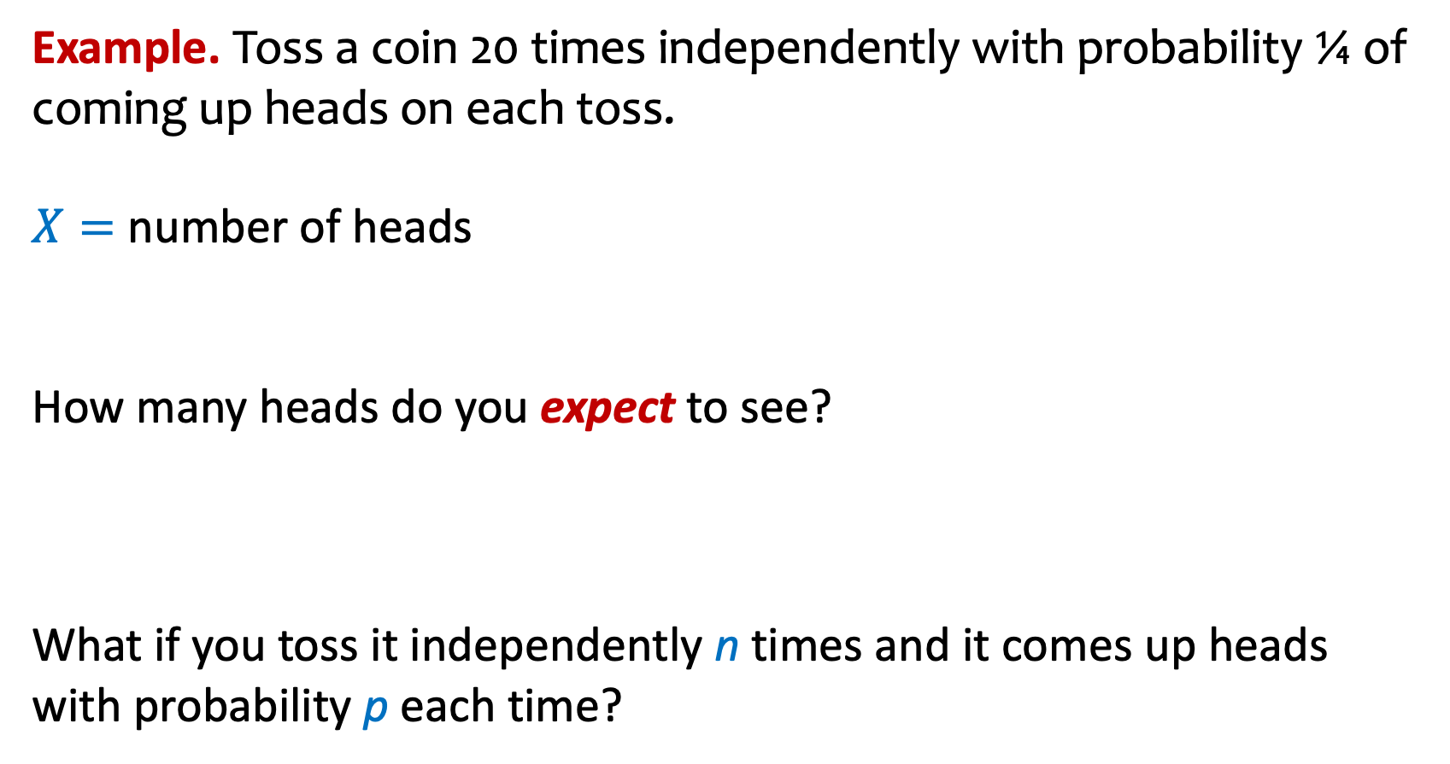
Expectation (Idea)
Example. Toss a coin 20 times independently with probability ¼ of coming up heads on each toss.
$X=$ number of heads
How many heads do you expect to see?
What if you toss it independently n times and it comes up heads with probability p each time?

Slide 11
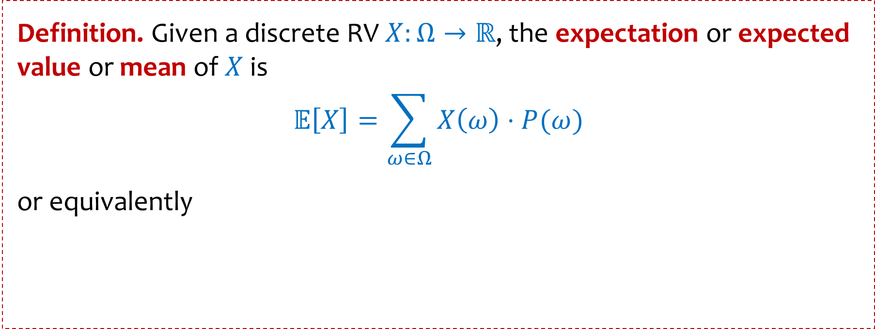
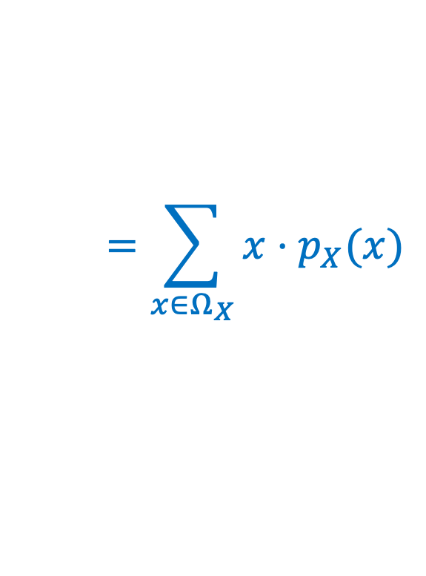
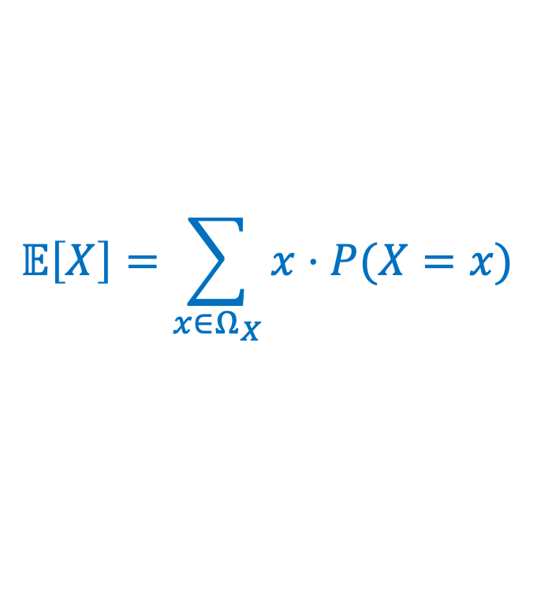
Expected Value of a Random Variable
Definition. Given a discrete RV $X:Ω→ℝ$, the expectation or expected value or mean of $X$ is
$$𝔼\left[X\right]=\sum_{ω∈Ω}{X\left(ω\right)⋅P⁡(ω)}$$
or equivalently
$$𝔼\left[X\right]=\sum_{x∈Ω_{X}}{x⋅P⁡(X=x)}$$
$$=\sum_{x∈Ω_{X}}{x⋅p_{X}(x)}$$
Intuition: “Weighted average” of the possible outcomes (weighted by probability)
Notes:
Checked reading order

Slide 12
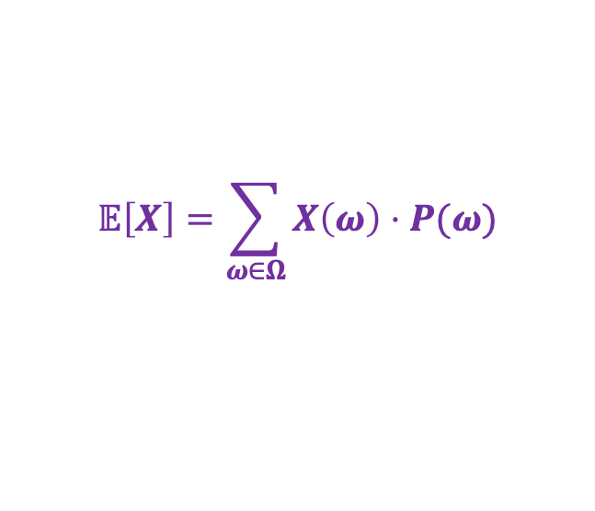
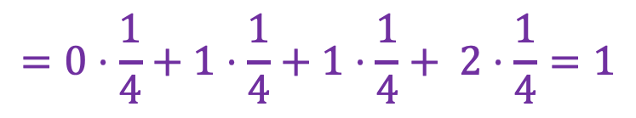
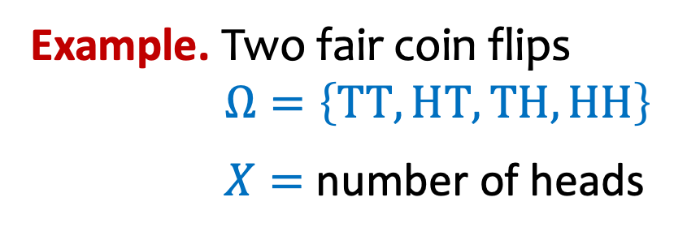
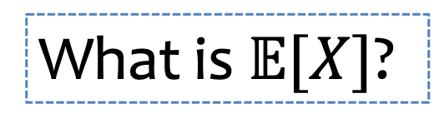
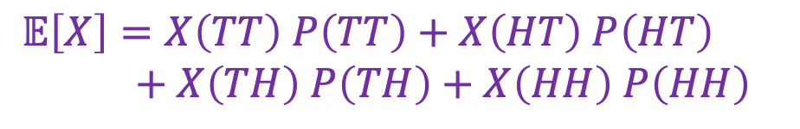
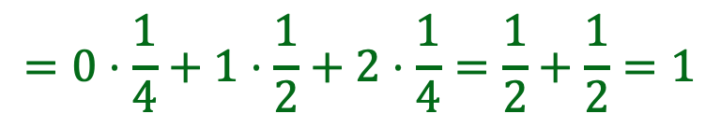

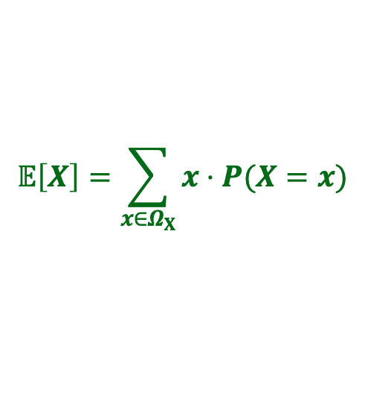
Expectation
$$𝔼\left[X\right]=\sum_{ω∈Ω}{X\left(ω\right)⋅P⁡(ω)}$$
$$𝔼\left[X\right]=\sum_{x∈Ω_{X}}{x⋅P⁡(X=x)}$$
Example. Two fair coin flips
$Ω=\left\{TT, HT, TH,HH\right\}$
$X=$ number of heads
What is $𝔼[X]$?
$𝔼\left[X\right]=X\left(TT\right) P\left(TT\right)+X\left(HT\right) P\left(HT\right)$
$+ X\left(TH\right) P\left(TH\right)$ $+ X\left(HH\right) P\left(HH\right)$
$$p_{X}$$
1
$$=0⋅\frac{1}{4}+1⋅\frac{1}{4}+1⋅\frac{1}{4}+ 2⋅\frac{1}{4}=1$$
3/4
1/2
1/4
$$𝔼\left[X\right]=0⋅p_{X}\left(0\right)+1⋅p_{X}\left(1\right)+2⋅p_{X}(2)$$
$$=0⋅\frac{1}{4}+1⋅\frac{1}{2}+2⋅\frac{1}{4}=\frac{1}{2}+\frac{1}{2}=1$$
-1
0
1
2
3
Notes:
Checked reading order

Slide 13
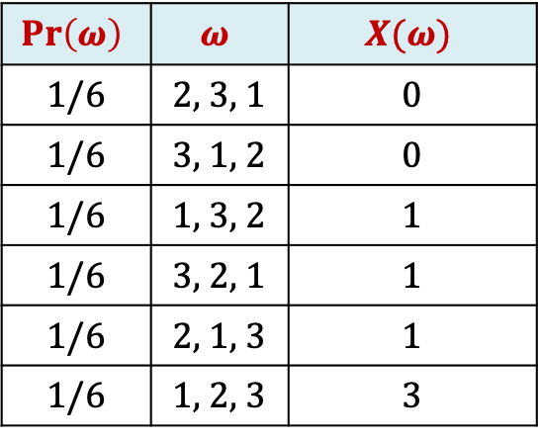

Example: Returning Homeworks
$$𝔼\left[X\right]=\sum_{ω∈Ω}{X\left(ω\right)⋅P⁡(ω)}$$
$$𝔼\left[X\right]=\sum_{x∈Ω_{X}}{x⋅P⁡(X=x)}$$
Class with 3 students, randomly hand back homeworks. All permutations equally likely.
Let $X$ be the number of students who get their own HW
What is $𝔼\left[X\right]$?
$$Pr\left(ω\right)$$ | $$ω$$ | $$X(ω)$$
1/6 | 2, 3, 1 | 0
1/6 | 3, 1, 2 | 0
1/6 | 1, 3, 2 | 1
1/6 | 3, 2, 1 | 1
1/6 | 2, 1, 3 | 1
1/6 | 1, 2, 3 | 3

Slide 14
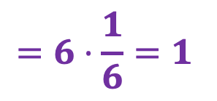

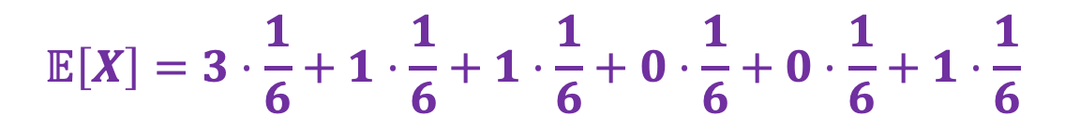
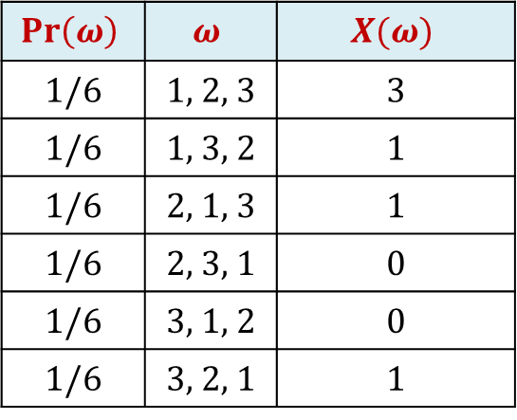
Returning Homeworks - Expectation
$$𝔼\left[X\right]=\sum_{ω∈Ω}{X\left(ω\right)⋅P⁡(ω)}$$
$$𝔼\left[X\right]=\sum_{x∈Ω_{X}}{x⋅P⁡(X=x)}$$
Class with 3 students, randomly hand back homeworks. All permutations equally likely.
Let $X$ be the number of students who get their own HW
$$Pr\left(ω\right)$$ | $$ω$$ | $$X(ω)$$
1/6 | 1, 2, 3 | 3
1/6 | 1, 3, 2 | 1
1/6 | 2, 1, 3 | 1
1/6 | 2, 3, 1 | 0
1/6 | 3, 1, 2 | 0
1/6 | 3, 2, 1 | 1
$$𝔼\left[X\right]=3⋅\frac{1}{6}+1⋅\frac{1}{6}+1⋅\frac{1}{6}+0⋅\frac{1}{6}+0⋅\frac{1}{6}+1⋅\frac{1}{6}$$
$$=6⋅\frac{1}{6}=1$$
Notes:
Checked reading order

Slide 15




Returning Homeworks – Expectation other way
$$𝔼\left[X\right]=\sum_{ω∈Ω}{X\left(ω\right)⋅P⁡(ω)}$$
$$𝔼\left[X\right]=\sum_{x∈Ω_{X}}{x⋅P⁡(X=x)}$$
Class with 3 students, randomly hand back homeworks. All permutations equally likely.
Let $X$ be the number of students who get their own HW
$$Ω$$
$$Pr\left(ω\right)$$ | $$ω$$ | $$X(ω)$$
1/6 | 1, 2, 3 | 3
1/6 | 1, 3, 2 | 1
1/6 | 2, 1, 3 | 1
1/6 | 2, 3, 1 | 0
1/6 | 3, 1, 2 | 0
1/6 | 3, 2, 1 | 1
2, 3, 1
2, 3, 1
3, 1, 2
$$X\left(ω\right)=0$$
2, 3, 1
1, 3, 2
2, 1, 3
3, 2, 1
$$X\left(ω\right)=1$$
2, 3, 1
1, 2, 3
$$X\left(ω\right)=3$$
$𝔼\left[X\right]=0⋅P⁡(X=0)+1⋅P⁡(X=1)+$ $3⋅P⁡(X=3) =0⋅\frac{2}{6}+1⋅\frac{3}{6}+3⋅\frac{1}{6}$
$$=1$$
Notes:
Checked reading order

Slide 16

Example – Coin Tosses
We flip $n$ coins, each toss independent, probability $p$ of coming up heads.
$Z$ is the number of heads, what is $𝔼(Z)$?

Slide 17

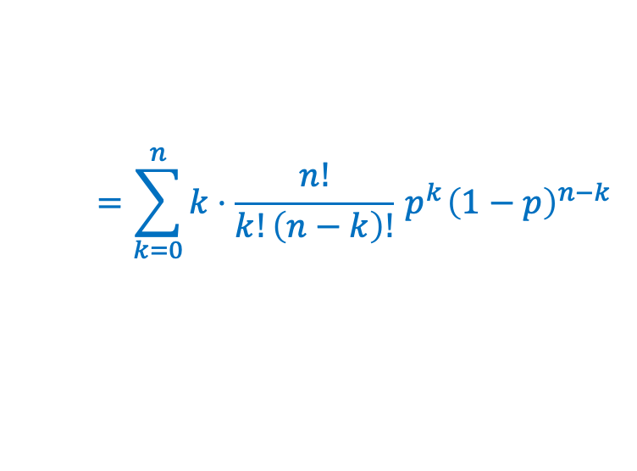
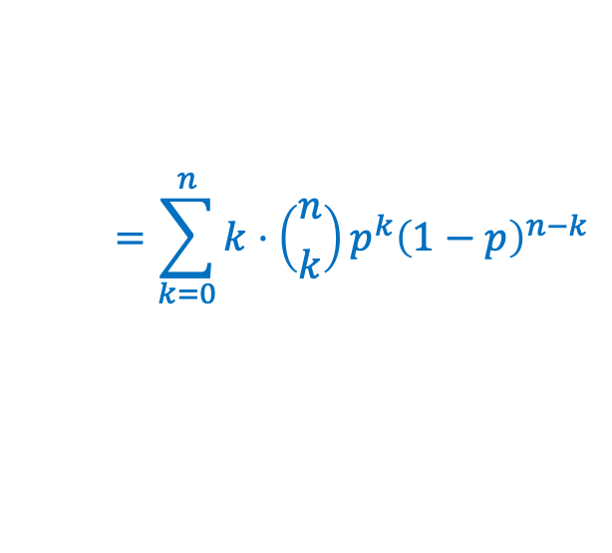
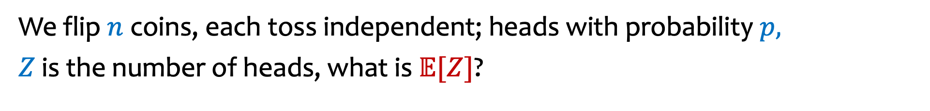
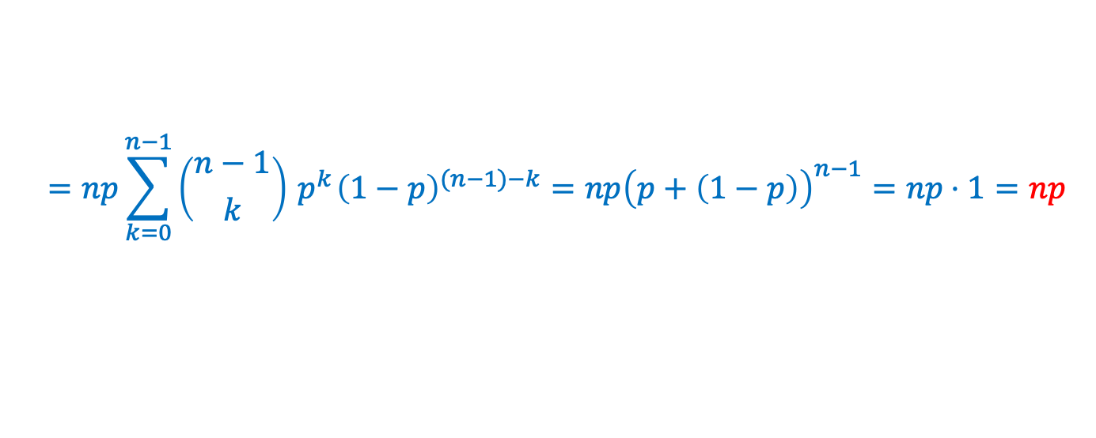
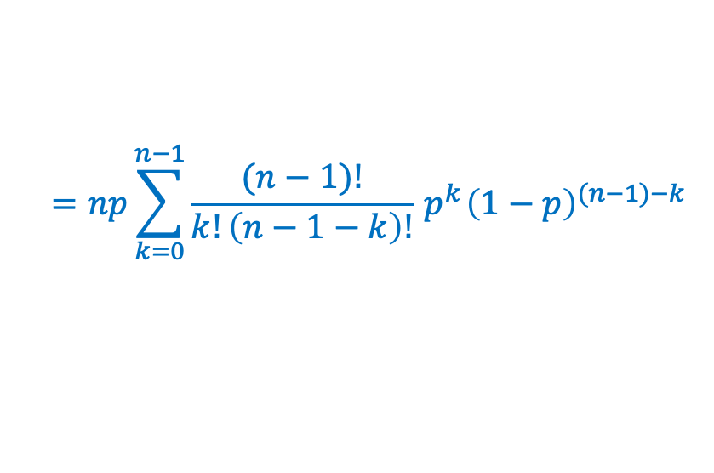
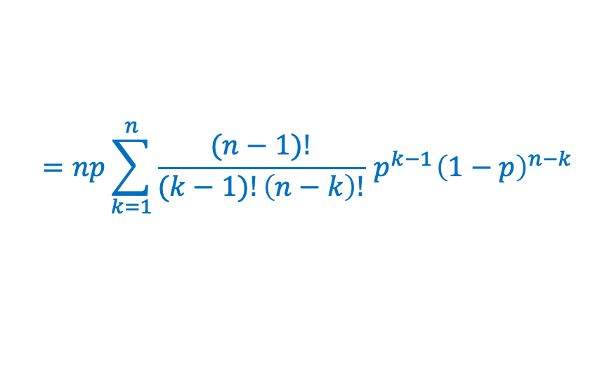
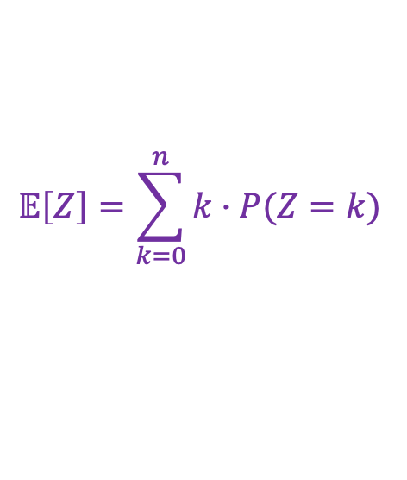
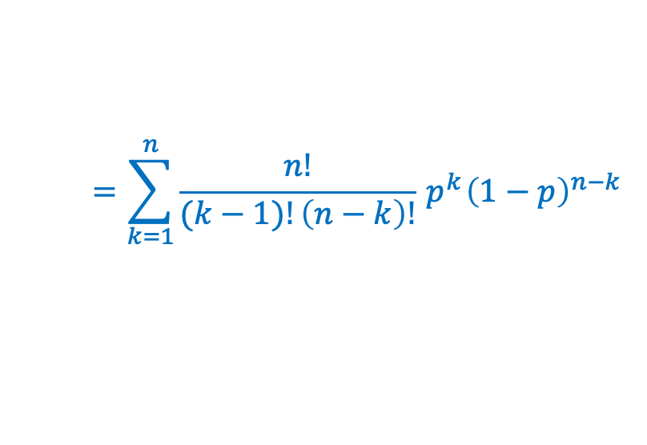
Coin Tosses – Computing Expectation
We flip $n$ coins, each toss independent; heads with probability $p,$
$Z$ is the number of heads, what is $𝔼[Z]$?
$$𝔼\left[Z\right]=\sum_{k=0}^{n}{k⋅P(Z=k)}$$
$$=\sum_{k=0}^{n}{k⋅\left({n \atop k}\right)p^{k}{\left(1−p\right)}^{n−k}}$$
$$=\sum_{k=0}^{n}{k⋅\frac{n!}{k!\left(n−k\right)!}{ p}^{k}{\left(1−p\right)}^{n−k}}$$
$$=\sum_{k=1}^{n}{\frac{n!}{(k−1)!\left(n−k\right)!}{ p}^{k}{\left(1−p\right)}^{n−k}}$$
$$=np\sum_{k=1}^{n}{\frac{(n−1)!}{(k−1)!\left(n−k\right)!}{ p}^{k−1}{\left(1−p\right)}^{n−k}}$$
This Photo by Unknown Author is licensed under CC BY-NC
Can we solve it more elegantly, please?
$$=np\sum_{k=0}^{n−1}{\frac{(n−1)!}{k!\left(n−1−k\right)!}{ p}^{k}{\left(1−p\right)}^{(n−1)−k}}$$
$$=np\sum_{k=0}^{n−1}{\left({n−1 \atop k}\right){ p}^{k}{\left(1−p\right)}^{(n−1)−k}}=np{\left(p+\left(1−p\right)\right)}^{n−1}=np⋅1=np$$
Notes:
Checked reading order

Slide 18
Agenda (2)
Expectation
Linearity of Expectation
Indicator Random Variables

Slide 19
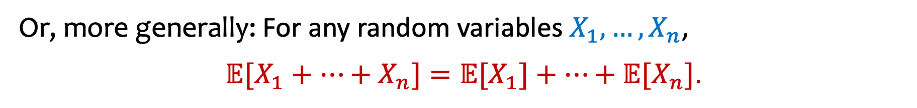
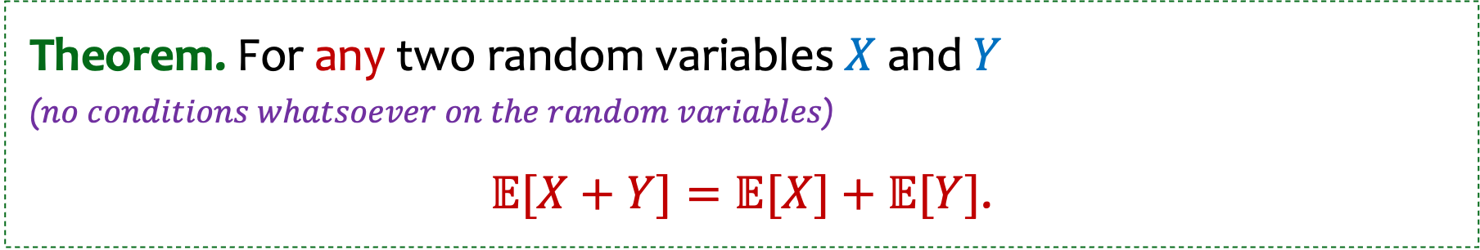
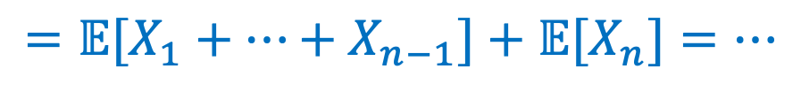
Linearity of Expectation
Theorem. For any two random variables $X$ and $Y$
($no conditions whatsoever on the random variables$)
$𝔼[X+Y]=𝔼[X]+𝔼[Y]$.
Or, more generally: For any random variables $X_{1},…,X_{n}$,
$𝔼[X_{1}+⋯+X_{n}]=𝔼[X_{1}]+⋯+𝔼[X_{n}]$.
Because: $𝔼[X_{1}+⋯+X_{n}]=𝔼[{(X}_{1}+⋯+X_{n−1})+X_{n}]$
$$=𝔼[X_{1}+⋯+X_{n−1}]+𝔼[X_{n}]=…$$

Slide 20
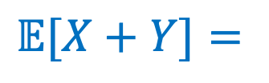
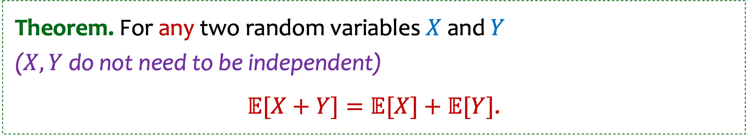

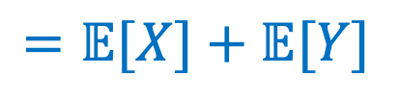
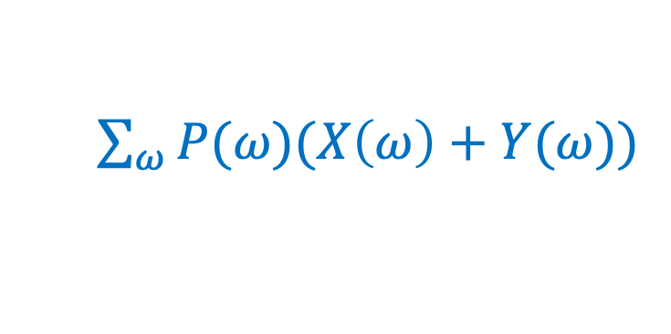
Linearity of Expectation – Proof
Theorem. For any two random variables $X$ and $Y$
($X, Y$ do not need to be independent)
$𝔼[X+Y]=𝔼[X]+𝔼[Y]$.
$𝔼[X+Y]=$
$\sum_{ω}{P(ω)(X\left(ω\right)+Y(ω))}$
$=\sum_{ω}{P\left(ω\right)X\left(ω\right)+}$ $\sum_{ω}{P\left(ω\right)Y\left(ω\right)}$
$$=𝔼[X]+𝔼[Y]$$

Slide 21
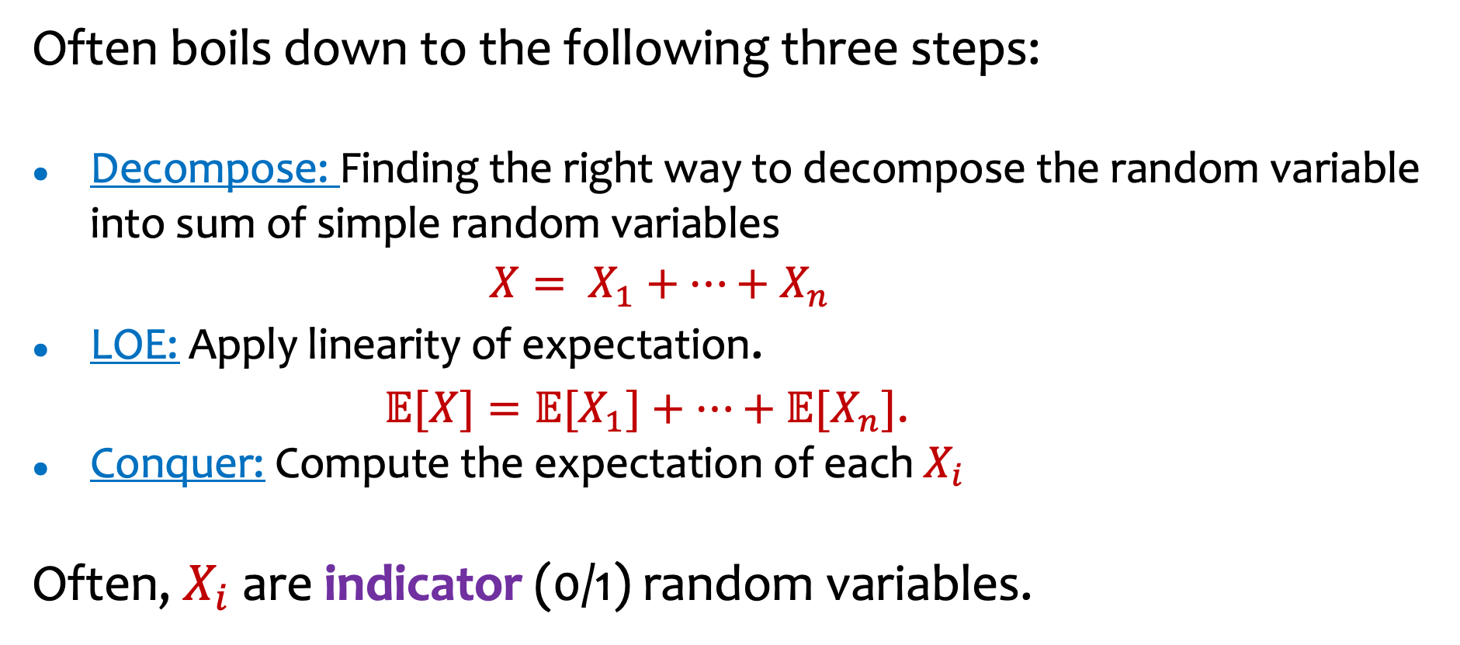
Using LOE to compute complicated expectations
Often boils down to the following three steps:
Decompose: Finding the right way to decompose the random variable into sum of simple random variables
$X= X_{1}+⋯+X_{n}$
LOE: Apply linearity of expectation.
$𝔼[X]=𝔼[X_{1}]+⋯+𝔼[X_{n}]$.
Conquer: Compute the expectation of each $X_{i}$
Often, $X_{i}$ are indicator (0/1) random variables.

Slide 22

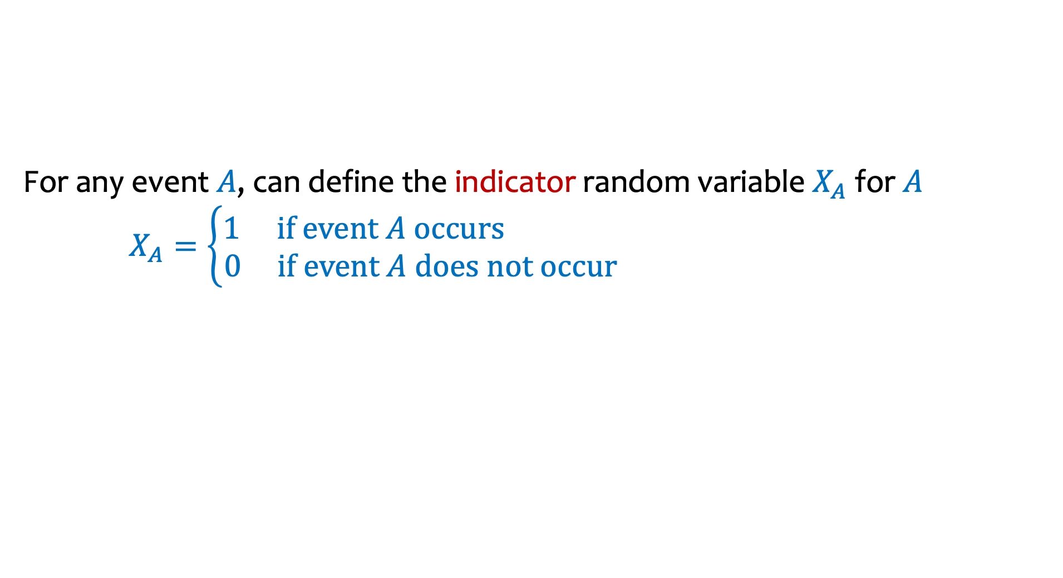


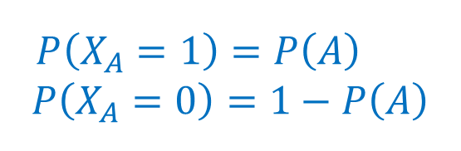
Indicator random variables – 0/1 valued
For any event $A$, can define the indicator random variable $X_{A}$ for $A$ $X_{A}=\left\{\begin{aligned}1 if event A occurs \\ 0 if event A does not occur\end{aligned}\right.$
$$P\left(X_{A}=1\right)=P\left(A\right)$$
$$P\left(X_{A}=0\right)=1−P\left(A\right)$$
0.55
1
$$A$$
0.05
$$Ω$$
0.05
0.1
0
0.45
0
0.3
0.2
0.3
$$ℝ$$
Notes:
X_A(w) = 1 if w in A
0 otherwise.

Slide 23
Back to our example
We flip $n$ coins, each toss independent; heads with probability $p,$
$Z$ is the number of heads, what is $𝔼[Z]$?
$$𝔼\left[Z\right]=\sum_{k=0}^{n}{k⋅P(Z=k)}$$
$$=\sum_{k=0}^{n}{k⋅\left({n \atop k}\right)p^{k}{\left(1−p\right)}^{n−k}}$$
$$=\sum_{k=0}^{n}{k⋅\frac{n!}{k!\left(n−k\right)!}{ p}^{k}{\left(1−p\right)}^{n−k}}$$
$$=\sum_{k=1}^{n}{\frac{n!}{(k−1)!\left(n−k\right)!}{ p}^{k}{\left(1−p\right)}^{n−k}}$$
$$=np\sum_{k=1}^{n}{\frac{(n−1)!}{(k−1)!\left(n−k\right)!}{ p}^{k−1}{\left(1−p\right)}^{n−k}}$$
This Photo by Unknown Author is licensed under CC BY-NC
Can we solve it more elegantly, please?
$$=np\sum_{k=0}^{n−1}{\frac{(n−1)!}{k!\left(n−1−k\right)!}{ p}^{k}{\left(1−p\right)}^{(n−1)−k}}$$
$$=np\sum_{k=0}^{n−1}{\left({n−1 \atop k}\right){ p}^{k}{\left(1−p\right)}^{(n−1)−k}}=np{\left(p+\left(1−p\right)\right)}^{n−1}=np⋅1=np$$
Notes:
Checked reading order

Slide 24
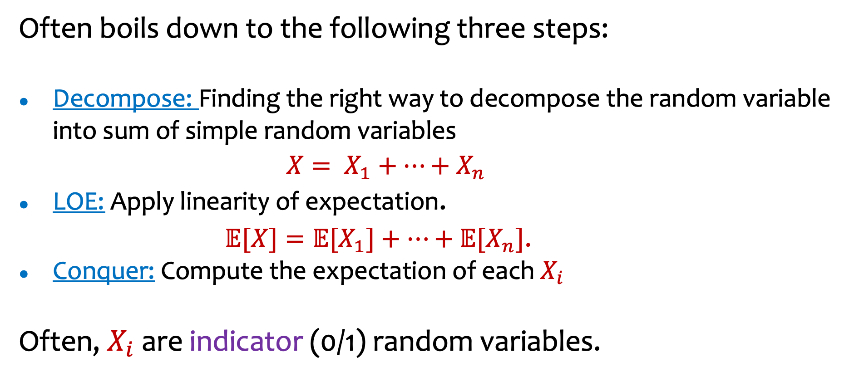
Computing complicated expectations
Often boils down to the following three steps:
Decompose: Finding the right way to decompose the random variable into sum of simple random variables
$X= X_{1}+⋯+X_{n}$
LOE: Apply linearity of expectation.
$𝔼[X]=𝔼[X_{1}]+⋯+𝔼[X_{n}]$.
Conquer: Compute the expectation of each $X_{i}$
Often, $X_{i}$ are indicator (0/1) random variables.

Slide 25
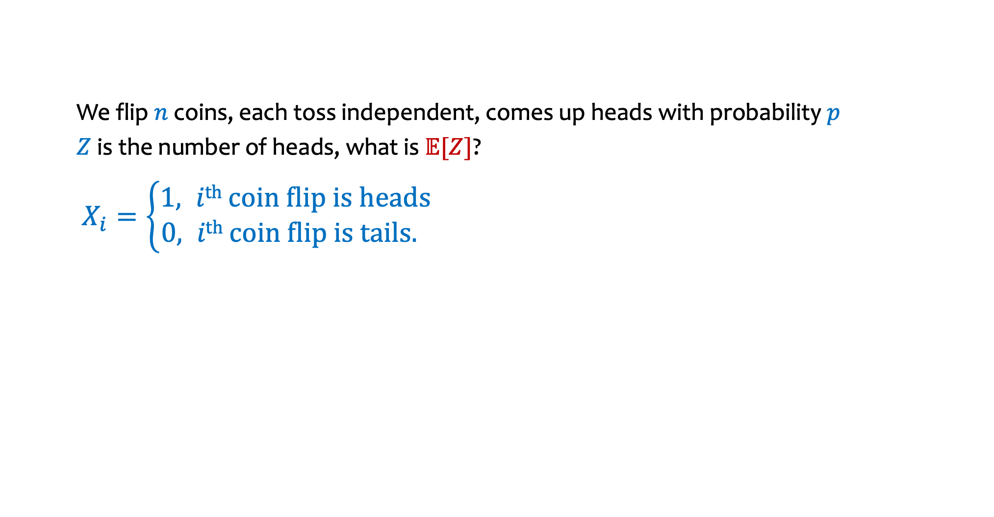

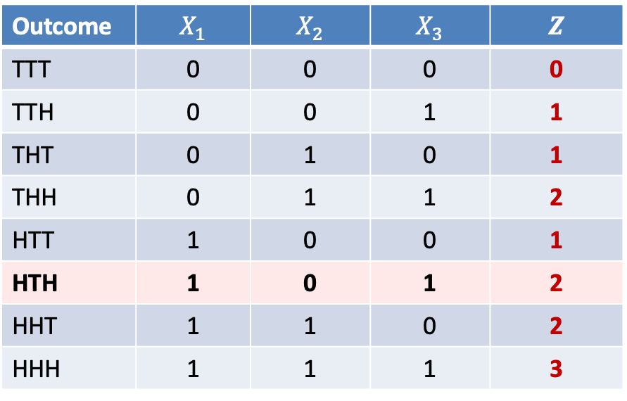
Indicator Random Variables for Counting Heads
We flip $n$ coins, each toss independent, comes up heads with probability $p$
$Z$ is the number of heads, what is $𝔼[Z]$?
$X_{i}=\left\{\begin{aligned}1, i\text{th} \text{coin} \text{flip} \text{is} \text{heads} \\ &0, i\text{th} \text{coin} \text{flip} \text{is} \text{tails}. \end{aligned}\right.$
Fact. $Z=X_{1}+⋯+X_{n}$
Outcome | $$X_{1}$$ | $$X_{2}$$ | $$X_{3}$$ | $$Z$$
TTT | 0 | 0 | 0 | 0
TTH | 0 | 0 | 1 | 1
THT | 0 | 1 | 0 | 1
THH | 0 | 1 | 1 | 2
HTT | 1 | 0 | 0 | 1
HTH | 1 | 0 | 1 | 2
HHT | 1 | 1 | 0 | 2
HHH | 1 | 1 | 1 | 3
Notes:
Checked reading order

Slide 26

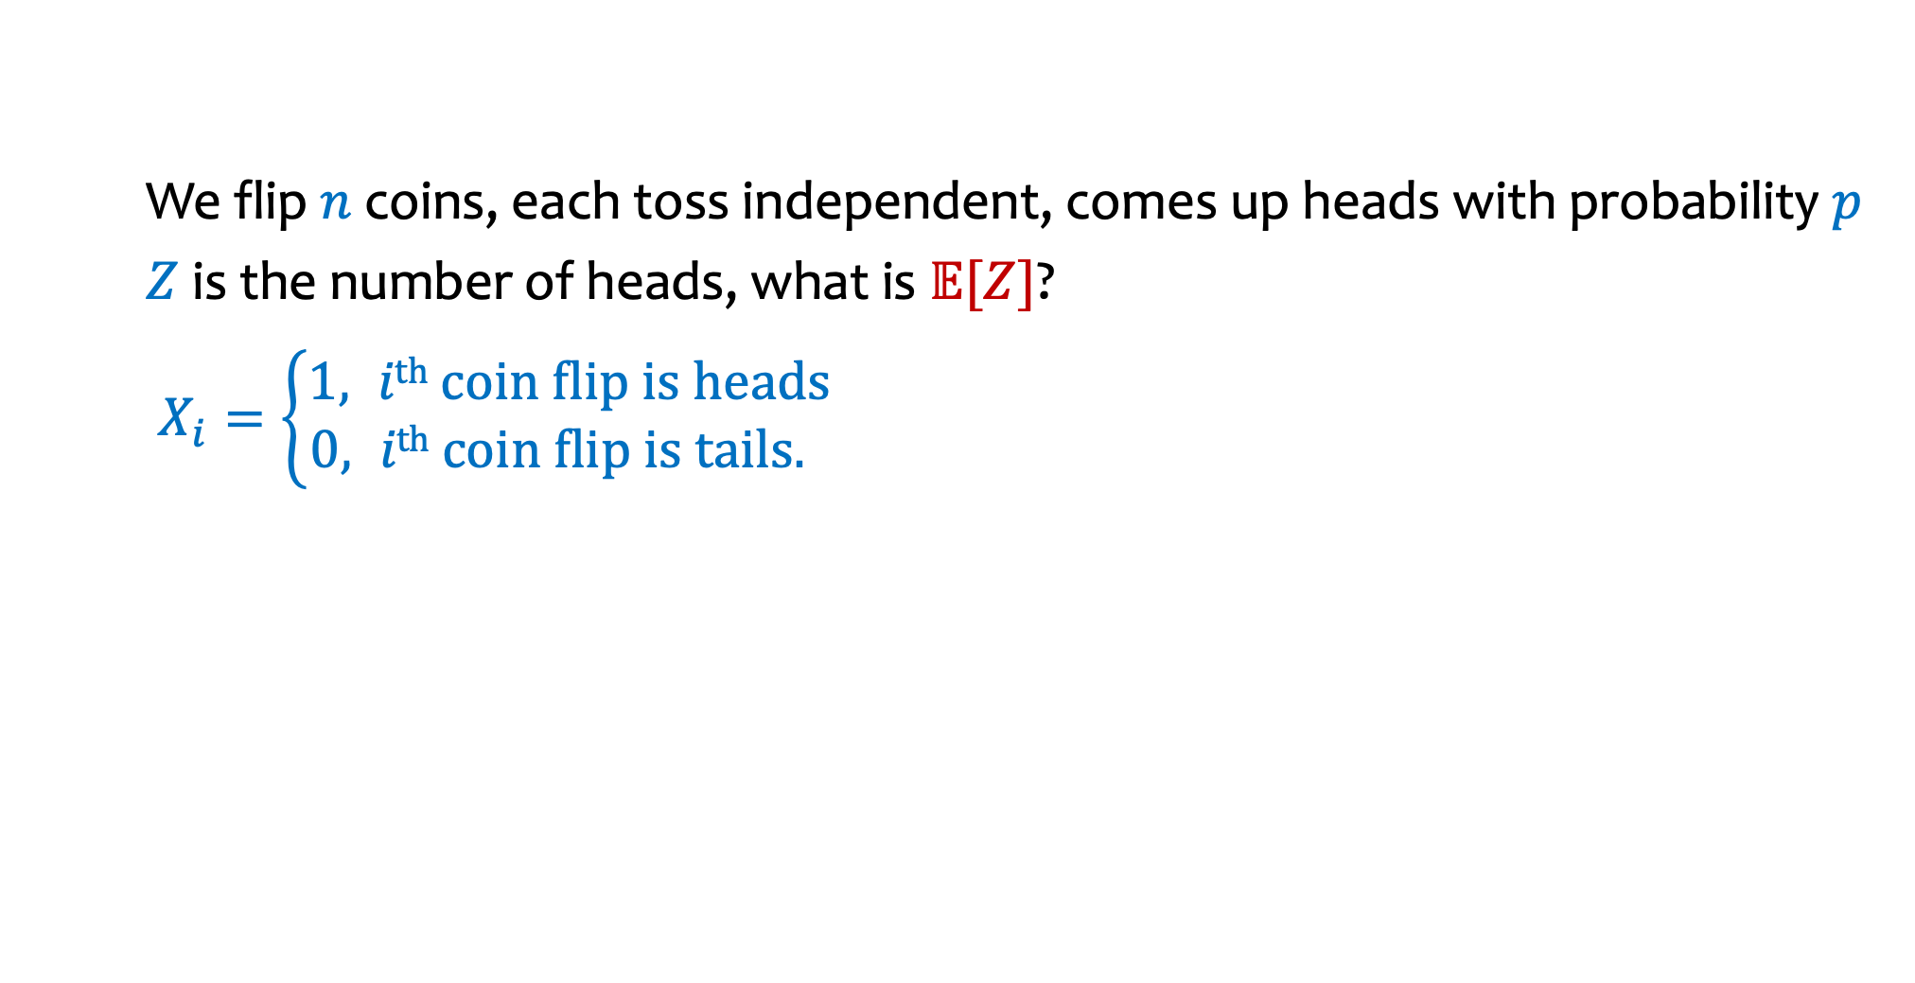
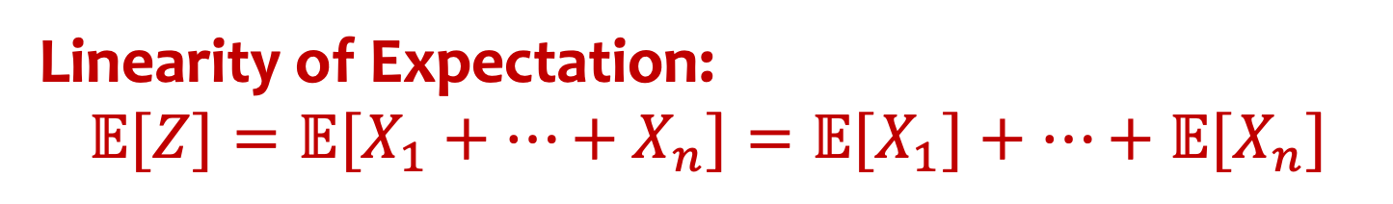
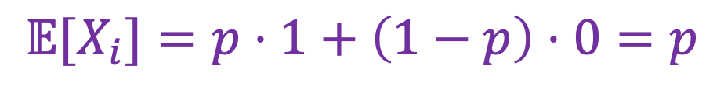
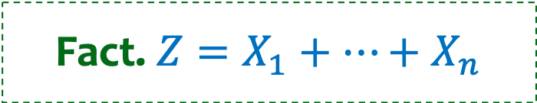

Wrapping up calculation using LOE
We flip $n$ coins, each toss independent, comes up heads with probability $p$
$Z$ is the number of heads, what is $𝔼[Z]$?
$X_{i}=\left\{\begin{aligned}1, i\text{th} \text{coin} \text{flip} \text{is} \text{heads} \\ &0, i\text{th} \text{coin} \text{flip} \text{is} \text{tails}. \end{aligned}\right.$
Fact. $Z=X_{1}+⋯+X_{n}$
Linearity of Expectation:
$$𝔼[Z]=𝔼[X_{1}+…+X_{n}]=𝔼[X_{1}]+⋯+𝔼[X_{n}]$$
$=n⋅p$
$P\left(X_{i}=1\right)=p$
$P\left(X_{i}=0\right)=1−p$
$$𝔼[X_{i}]=p⋅1+\left(1−p\right)⋅0=p$$
Notes:
Checked reading order

Slide 27





Returning Homeworks – more students
$$𝔼\left[X\right]=\sum_{ω∈Ω}{X\left(ω\right)⋅P⁡(ω)}$$
$$𝔼\left[X\right]=\sum_{x∈Ω_{X}}{x⋅P⁡(X=x)}$$
Class with 3 students, randomly hand back homeworks.
All permutations equally likely.
Let $X$ be the number of students who get their own HW
What if there are $n$ students?
$$Pr\left(ω\right)$$ | $$ω$$ | $$X(ω)$$
1/6 | 1, 2, 3 | 3
1/6 | 1, 3, 2 | 1
1/6 | 2, 1, 3 | 1
1/6 | 2, 3, 1 | 0
1/6 | 3, 1, 2 | 0
1/6 | 3, 2, 1 | 1
$$𝔼\left[X\right]=3⋅\frac{1}{6}+1⋅\frac{1}{6}+1⋅\frac{1}{6}+0⋅\frac{1}{6}+0⋅\frac{1}{6}+1⋅\frac{1}{6}$$
$$=6⋅\frac{1}{6}=1$$
$𝔼\left[X\right]=0⋅P⁡(X=0)+1⋅P⁡(X=1)+$ $3⋅P\left(X=3\right)$
$$=0⋅\frac{2}{6}+1⋅\frac{3}{6}+3⋅\frac{1}{6}$$
$$=1$$

Slide 28

Returning Homeworks - $n$ students
$$𝔼\left[X\right]=\sum_{ω∈Ω}{X\left(ω\right)⋅P⁡(ω)}$$
$$𝔼\left[X\right]=\sum_{x∈Ω_{X}}{x⋅P⁡(X=x)}$$
Class with 3 students, randomly hand back homeworks.
All permutations equally likely.
Let $X$ be the number of students who get their own HW
What if there are $n$ students?
$$Pr\left(ω\right)$$ | $$ω$$ | $$X(ω)$$
1/6 | 1, 2, 3 | 3
1/6 | 1, 3, 2 | 1
1/6 | 2, 1, 3 | 1
1/6 | 2, 3, 1 | 0
1/6 | 3, 1, 2 | 0
1/6 | 3, 2, 1 | 1
$$𝔼\left[X\right]=\sum_{k=0}^{n}{k⋅P(X=k)}$$
What is $P(X=k)?$

Slide 29




Returning Homeworks using LOE
Class with $n$ students, randomly hand back homeworks. All permutations equally likely.
Let $X$ be the number of students who get their own HW
What is $𝔼[X]$? Use linearity of expectation!
Decompose: Find the right way to
decompose the random variable into
sum of simple random variables
$X= X_{1}+⋯+X_{n}$
$$Pr\left(ω\right)$$ | $$ω$$ | $$X(ω)$$
$$1/6$$ | $$1, 2, 3$$ | $$3$$
$$1/6$$ | $$1, 3, 2$$ | $$1$$
$$1/6$$ | $$2, 1, 3$$ | $$1$$
$$1/6$$ | $$2, 3, 1$$ | $$0$$
$$1/6$$ | $$3, 1, 2$$ | $$0$$
$$1/6$$ | $$3, 2, 1$$ | $$1$$
LOE: Apply linearity of expectation.
$𝔼[X]=𝔼[X_{1}]+⋯+𝔼[X_{n}]$.
Conquer: Compute the expectation of each $X_{i}$ and sum!

Slide 30


Returning Homeworks using LOE – indicator random variables
Class with $n$ students, randomly hand back homeworks. All permutations equally likely.
Let $X$ be the number of students who get their own HW
What is $𝔼[X]$?
$$Pr\left(ω\right)$$ | $$ω$$ | $$X(ω)$$ | $$X1(ω)$$ | $$X2(ω)$$ | $$X3(ω)$$
$$1/6$$ | $$1, 2, 3$$ | $$3$$ | 1 | 1 | 1
$$1/6$$ | $$1, 3, 2$$ | $$1$$ | 1 | 0 | 0
$$1/6$$ | $$2, 1, 3$$ | $$1$$ | 0 | 0 | 1
$$1/6$$ | $$2, 3, 1$$ | $$0$$ | 0 | 0 | 0
$$1/6$$ | $$3, 1, 2$$ | $$0$$ | 0 | 0 | 0
$$1/6$$ | $$3, 2, 1$$ | $$1$$ | 0 | 1 | 0

Slide 31


Returning Homeworks using LOE (2)
Class with $n$ students, randomly hand back homeworks. All permutations equally likely.
Let $X$ be the number of students who get their own HW
What is $𝔼[X]$? Use linearity of expectation!
Decompose:
$$Pr\left(ω\right)$$ | $$ω$$ | $$X(ω)$$
$$1/6$$ | $$1, 2, 3$$ | $$3$$
$$1/6$$ | $$1, 3, 2$$ | $$1$$
$$1/6$$ | $$2, 1, 3$$ | $$1$$
$$1/6$$ | $$2, 3, 1$$ | $$0$$
$$1/6$$ | $$3, 1, 2$$ | $$0$$
$$1/6$$ | $$3, 2, 1$$ | $$1$$
LOE:
Conquer:
Notes:
Checked reading order

Slide 32

Returning Homeworks using LOE (3)
Class with $n$ students, randomly hand back homeworks. All permutations equally likely.
Let $X$ be the number of students who get their own HW
What is $𝔼[Xi]$?
$$Pr\left(ω\right)$$ | $$ω$$ | $$X(ω)$$ | $$X1(ω)$$ | $$X2(ω)$$ | $$X3(ω)$$
$$1/6$$ | $$1, 2, 3$$ | $$3$$ | 1 | 1 | 1
$$1/6$$ | $$1, 3, 2$$ | $$1$$ | 1 | 0 | 0
$$1/6$$ | $$2, 1, 3$$ | $$1$$ | 0 | 0 | 1
$$1/6$$ | $$2, 3, 1$$ | $$0$$ | 0 | 0 | 0
$$1/6$$ | $$3, 1, 2$$ | $$0$$ | 0 | 0 | 0
$$1/6$$ | $$3, 2, 1$$ | $$1$$ | 0 | 1 | 0

Slide 33


Returning Homeworks using LOE (4)
Class with $n$ students, randomly hand back homeworks. All permutations equally likely.
Let $X$ be the number of students who get their own HW
What is $𝔼[X]$? Use linearity of expectation!
Decompose: What is $X_{i}$?
$$Pr\left(ω\right)$$ | $$ω$$ | $$X(ω)$$
$$1/6$$ | $$1, 2, 3$$ | $$3$$
$$1/6$$ | $$1, 3, 2$$ | $$1$$
$$1/6$$ | $$2, 1, 3$$ | $$1$$
$$1/6$$ | $$2, 3, 1$$ | $$0$$
$$1/6$$ | $$3, 1, 2$$ | $$0$$
$$1/6$$ | $$3, 2, 1$$ | $$1$$
$X_{i}=1$ iff $ith$ student gets own HW back; 0 o.w.
LOE: $𝔼[X]=𝔼[X_{1}]+⋯+𝔼[X_{n}]$
Conquer: ${ 𝔼[X}_{i}]$ = $\frac{1}{n}$
Therefore, $𝔼\left[X\right]=n⋅\frac{1}{n}$ $=$ 1

Slide 34

Pairs with the same birthday
In a class of $m$ students, on average how many pairs of people have the same birthday (assuming 365 equally likely birthdays)?
Each person’s birthday is equally likely to be any of the 365 possibilities and different people’s bdays are independent.
Notes:
Sum_k k Pr(exactly k pairs of people have the same birthday

Slide 35


Pairs with the same birthday - LOE
In a class of $m$ students, on average how many pairs of people have the same birthday (assuming 365 equally likely birthdays)?
Each person’s birthday is equally likely to be any of the 365 possibilities and different people’s bdays are independent.
Decompose: Find the right way to
decompose the random variable into
sum of simple random variables
$X= X_{1}+⋯+X_{n}$
LOE: Apply linearity of expectation.
$𝔼[X]=𝔼[X_{1}]+⋯+𝔼[X_{n}]$.
Conquer: Compute the expectation of each $X_{i}$ and sum!
Notes:
Sum_k k Pr(exactly k pairs of people have the same birthday

Slide 36


Pairs with the same birthday – LOE (2)
In a class of $m$ students, let $X$ be the number of pairs of people with the same birthday (assuming 365 equally likely birthdays)?
What is $𝔼[X]$?
Decompose: Indicator events involve pairs of students $(i,j)$for $i≠j$ $X_{ij}=1 iff$ students $i$ and $j$ have the same birthday
LOE: $\left(\begin{matrix}m \\ 2\end{matrix}\right)$ indicator variables $X_{ij}$
Conquer: $𝔼\left[X_{ij}\right]=\frac{1}{365}$ so total expectation is $\frac{\left(\begin{matrix}m \\ 2\end{matrix}\right)}{365}$ pairs
Notes:
Sum_k k Pr(exactly k pairs of people have the same birthday

Slide 37

Linearity of Expectation – Even stronger
Theorem. For any random variables $X_{1},…,X_{n}$, and real numbers $a_{1},…,a_{n}∈ℝ$,
$𝔼[{a_{1}X}_{1}+⋯+{a_{n}X}_{n}]=a_{1}𝔼[X_{1}]+⋯+a_{n}𝔼[X_{n}]$.
Very important: In general, we do not have $𝔼[X⋅Y]=𝔼[X]⋅𝔼[Y]$

