Slide 1
Conditional Independence; Random variables
CSE 312 Spring 26
Lecture 8

Slide 2

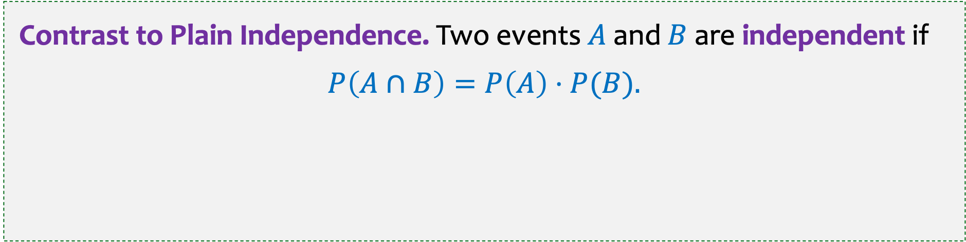
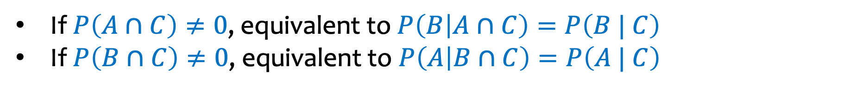
Conditional Independence
Definition. Two events $A$and $B$are independent conditioned on $C$ if $P\left(C\right)≠0$and $P\left(A∩B | C\right)=P\left(A | C\right)⋅P\left(B \right| C).$
If $P\left(A∩C\right)≠0$, equivalent to $P\left(B | A∩C\right)=P\left(B | C\right)$
If $P\left(B∩C\right)≠0$, equivalent to $P\left(A | B∩C\right)=P\left(A | C\right)$
Contrast to Plain Independence. Two events $A$and $B$are independent if
$$P\left(A∩B\right)=P\left(A\right)⋅P(B).$$

Slide 3
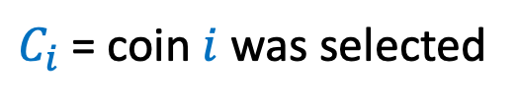
Example – Tossing Coins (1)
Suppose that Coin 1 has probability of heads 0.3
and Coin 2 has probability of head 0.9. We choose one of the coins randomly with equal probability and flip that coin 2 times independently. What is the probability we get all heads?
$C_{i}$ = coin $i$ was selected
Notes:
Checked reading order

Slide 4

Tossing Coins (2)
Suppose that Coin 1 has probability of heads 0.3
and Coin 2 has probability of head 0.9. We choose one of the coins randomly with equal probability and flip that coin 2 times independently. What is the probability we get all heads?
$C_{i}$ = coin $i$ was selected
$$P⁡(HH) =P\left(HH \right|C_{1})⋅P⁡(C_{1}) +P(HH \left| C_{2}\right)⋅P⁡(C_{2})$$
Law of Total Probability
(LTP)
$$=P{\left(H | C_{1}\right)}^{2} P⁡(C_{1}) +P⁡(H {\left| C_{2}\right)}^{2} P(C_{2})$$
Conditional Independence
$$={0.3}^{2}⋅0.5 +{0.9}^{2}⋅0.5=0.45$$
Notes:
Checked reading order

Slide 5
Tossing coins (3)
Suppose that Coin 1 has probability of heads 0.3
and Coin 2 has probability of head 0.9. We choose one coin randomly with equal probability and flip that coin 2 times independently. How does the probability we get all heads compare to P(H)² ?

Slide 6


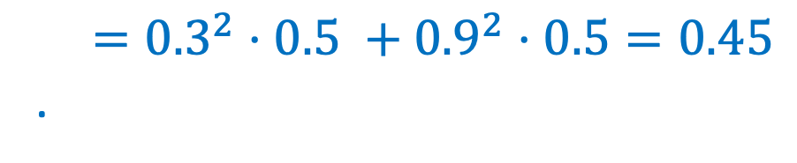
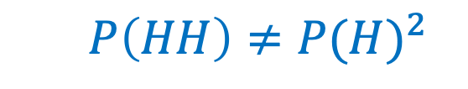
Example – Tossing coins (4)
Suppose that Coin 1 has probability of heads 0.3
and Coin 2 has probability of head 0.9. We choose one coin randomly with equal probability and flip that coin 2 times independently. How does the probability we get all heads compare to P(H)² ?
$$P\left(HH \right|C_{1})= P{\left(H | C_{1}\right)}^{2}$$
$$P\left(HH\right)≠P{(H)}^{2}$$
$$P(HH)=P{\left(H | C_{1}\right)}^{2} P⁡(C_{1}) +P⁡(H {\left| C_{2}\right)}^{2} P(C_{2})$$
$={0.3}^{2}⋅0.5 +{0.9}^{2}⋅$ $0.5=0.45$
.
$$P\left(H\right)=P\left(H | C_{1}\right)⋅P\left(C_{1}\right)+P\left(H | C_{2}\right)⋅P\left(C_{2}\right)=0.6$$
$$P\left(HH\right)=0.36$$
Notes:
Checked reading order.

Slide 7

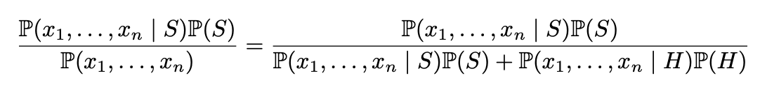
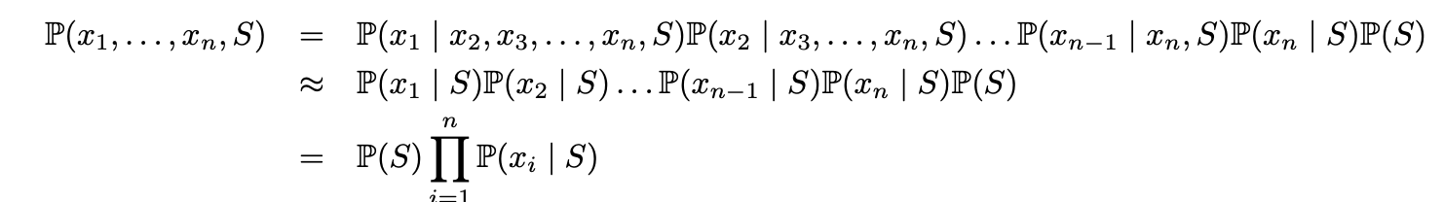
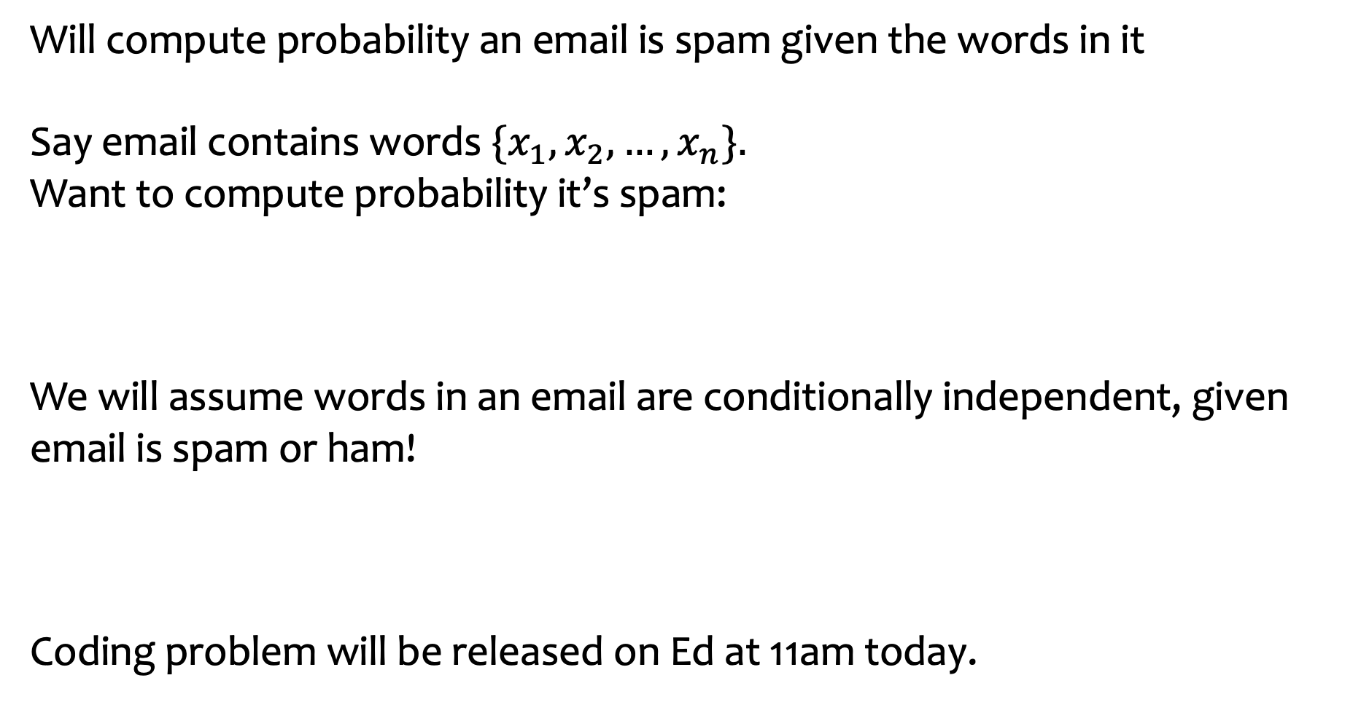
Pset 3 Coding – Naïve Bayes (Algorithm for Spam Detection)
Will compute probability an email is spam given the words in it
Say email contains words ${\{x}_{1},x_{2},…,x_{n}\}.$
Want to compute probability it’s spam:
We will assume words in an email are conditionally independent, given email is spam or ham!
Coding problem will be released on Ed at 11am today.

Slide 8
Agenda (1)
Random Variables
Probability Mass Function (PMF)
Cumulative Distribution Function (CDF)

Slide 9
Random Variables (Idea)
Often: We want to capture quantitative properties of the outcome of a random experiment, e.g.:
What is the total of two dice rolls?
What is the number of coin tosses needed to see the first head?
What is the number of heads among 5 coin tosses?
Notes:
Draw example of \Omega for 2 coin flips, mapping to outputs X(\omega)

Slide 10
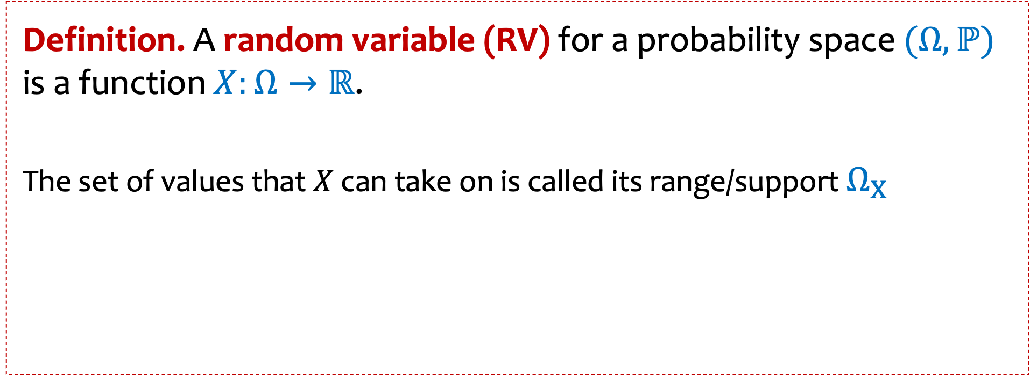
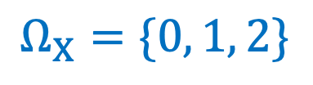
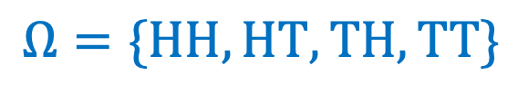
Random Variables
Definition. A random variable (RV) for a probability space $(Ω, ℙ)$ is a function $X:Ω→ℝ$.
The set of values that $X$ can take on is called its range/support $Ω_{X}$
Example. Number of heads in 2 independent coin flips
$$Ω=\{HH, HT, TH, TT\}$$
$$Ω_{X}=\{0, 1, 2\}$$
Notes:
For today and next week, will talk about the case where the outputs are discrete

Slide 11

Drawing Balls
20 balls labeled 1, 2, …, 20 in an urn
Draw a subset of 3 uniformly at random
What is $|Ω$| ?
Notes:
20 choose 3

Slide 12
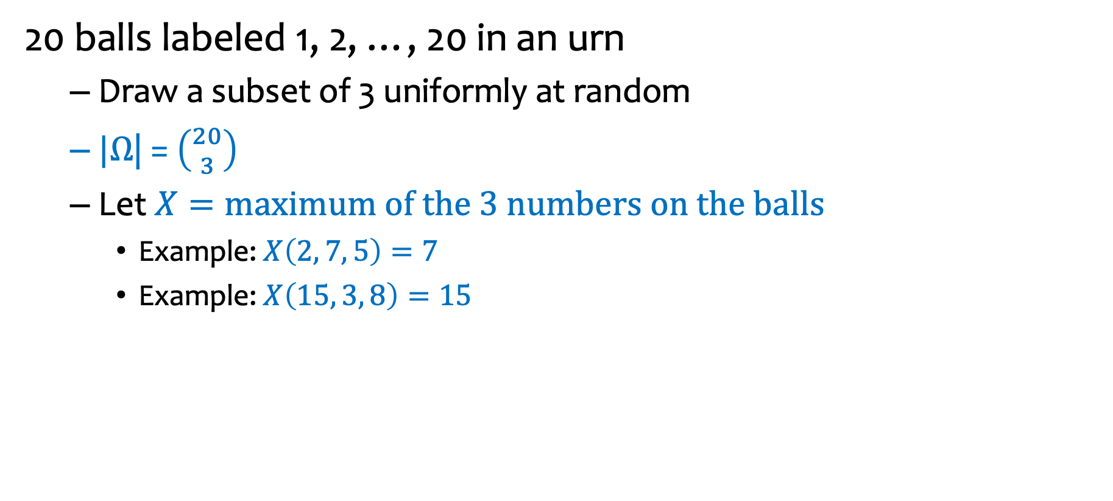
Drawing Balls – new random variable
20 balls labeled 1, 2, …, 20 in an urn
Draw a subset of 3 uniformly at random
$|Ω$| = $\left({20 \atop 3}\right)$
Let $X=\text{maximum} \text{of} \text{the}\text{ 3 }\text{numbers} \text{on} \text{the} \text{balls}$
Example: $X\left(2, 7, 5\right)=7$
Example: $X\left(15, 3, 8\right)=15$
Notes:
20 choose 3

Slide 13

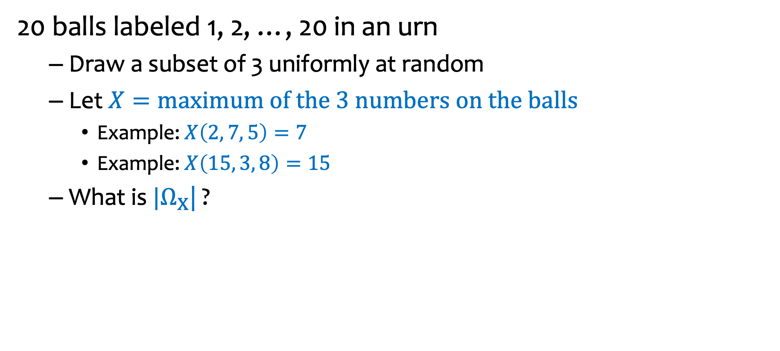
Drawing Balls – what is $|Ω_{X}$| ?
20 balls labeled 1, 2, …, 20 in an urn
Draw a subset of 3 uniformly at random
Let $X=\text{maximum} \text{of} \text{the}\text{ 3 }\text{numbers} \text{on} \text{the} \text{balls}$
Example: $X\left(2, 7, 5\right)=7$
Example: $X\left(15, 3, 8\right)=15$
What is $|Ω_{X}$| ?
https://pollev.com/ annakarlin185
${20}^{3}$
$20$
$18$
$\left({20 \atop 3}\right)$
Notes:
Write \Omega
P(omega)

Slide 14

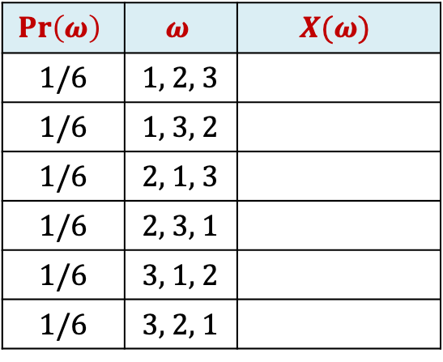
Example: Returning Homeworks
Class with 3 students, randomly hand back homeworks. All permutations equally likely.
Let $X$ be the number of students who get their own HW
$$Pr\left(ω\right)$$ | $$ω$$ | $$X(ω)$$
1/6 | 1, 2, 3
1/6 | 1, 3, 2
1/6 | 2, 1, 3
1/6 | 2, 3, 1
1/6 | 3, 1, 2
1/6 | 3, 2, 1
Notes:
See next slide for answer.

Slide 15




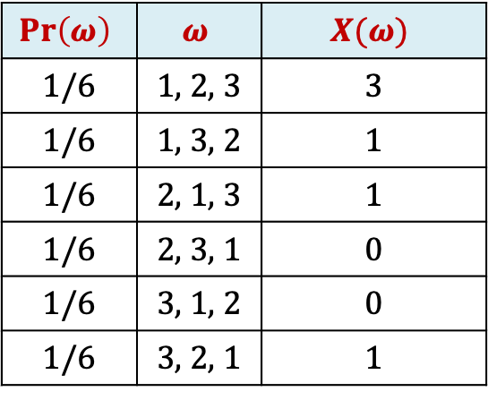
Example: Returning Homeworks (2)
Class with 3 students, randomly hand back homeworks. All permutations equally likely.
Let $X$ be the number of students who get their own HW
$$Ω$$
2, 3, 1
2, 3, 1
3, 1, 2
$$Pr\left(ω\right)$$ | $$ω$$ | $$X(ω)$$
1/6 | 1, 2, 3 | 3
1/6 | 1, 3, 2 | 1
1/6 | 2, 1, 3 | 1
1/6 | 2, 3, 1 | 0
1/6 | 3, 1, 2 | 0
1/6 | 3, 2, 1 | 1
$$X\left(ω\right)=0$$
2, 3, 1
1, 3, 2
2, 1, 3
3, 2, 1
$$X\left(ω\right)=1$$
2, 3, 1
1, 2, 3
$$X\left(ω\right)=3$$
Notes:
Color code the table next time

Slide 16

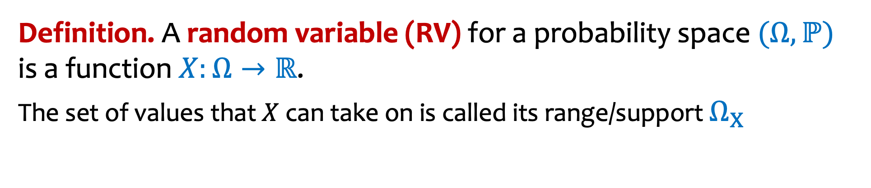





Random variables partition sample space
Definition. A random variable (RV) for a probability space $(Ω, ℙ)$ is a function $X:Ω→ℝ$.
The set of values that $X$ can take on is called its range/support $Ω_{X}$
Random variables partition the sample space.
$$X\left(ω\right)=x_{1}$$
$$X\left(ω\right)=x_{4}$$
$$X\left(ω\right)=x_{3}$$
$$Ω$$
$$X\left(ω\right)=x_{2}$$
Definition. For a RV $X:Ω→ℝ$, we define the event
$$\left\{X=x\right\}≝\left\{ω∈Ω \right| X\left(ω\right)=x\}$$
Notes:
Define a function p_X(s)

Slide 17
Agenda (2)
Random Variables
Probability Mass Function (pmf)
Cumulative Distribution Function (CDF)

Slide 18
Probability Mass Function (PMF)
Definition. For a RV $X:Ω→ℝ$, we define the event
$$\left\{X=x\right\}≝\left\{ω∈Ω \right| X\left(ω\right)=x\}$$
The probability mass function (PMF) of $X$ tells us the probabilities of these events, i.e., the probability that $X$takes each value in $Ω_{X}$
We use the notation
For the probability mass function
$$p_{X}(x)=ℙ\left(X=x\right)=ℙ(\left\{ω∈Ω \right| X\left(ω\right)=x\})$$
$$\sum_{x∈Ω_{X}}{ℙ\left(X=x\right)=1}$$

Slide 19

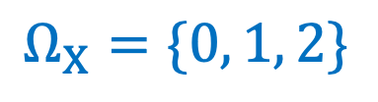

Probability Mass Function – example 1
$$Ω=\{HH, HT, TH, TT\}$$
Flipping two independent coins
$X=\text{number} \text{of} \text{heads} \text{in} \text{the} \text{two} \text{flips}$
$X\left(HH\right)=2$ $X\left(HT\right)=1$ $X\left(TH\right)=1$ $X\left(TT\right)=0$
What is the pmf of $X$?
$$Ω_{X}=\{0, 1, 2\}$$
Notes:
Checked reading order

Slide 20
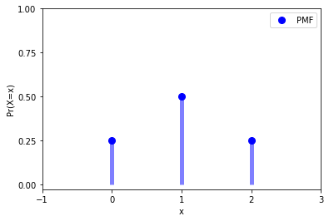


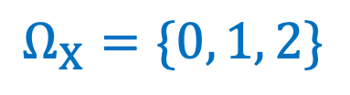

Probability Mass Function
Flipping two independent coins
$X=\text{number} \text{of} \text{heads} \text{in} \text{the} \text{two} \text{flips}$
$X\left(HH\right)=2$ $X\left(HT\right)=1$ $X\left(TH\right)=1$ $X\left(TT\right)=0$
$$Ω=\{HH, HT, TH, TT\}$$
$$Ω_{X}=\{0, 1, 2\}$$
$$pX(x) =Pr\left(X=x\right)=\left\{\begin{aligned}\frac{1}{4}, x=0 \\ \frac{1}{2}, x=1 \\ \frac{1}{4}, x=2 \\ 0, o.w.\end{aligned}\right.$$
Notes:
Checked reading ordr

Slide 21

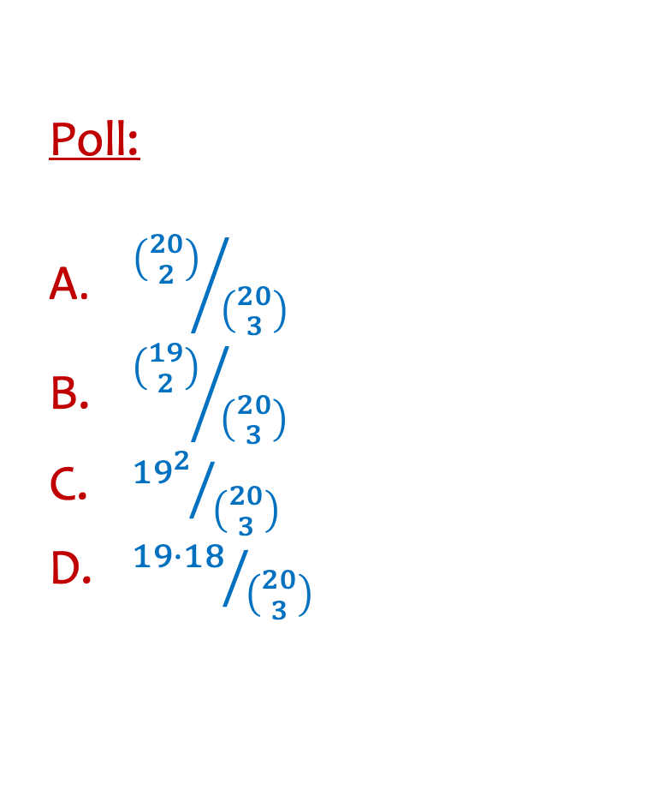
RV Example
20 balls labeled 1, 2, …, 20 in a bin
Draw a subset of 3 uniformly at random
Let $X=\text{maximum} \text{of} \text{the}\text{ 3 }\text{numbers} \text{on} \text{the} \text{balls}$
What is $p_{X}(20)= P(X=20)$?
https://pollev.com/ annakarlin185
Poll:
${\left({20 \atop 2}\right)}/{\left({20 \atop 3}\right)}$
${\left({19 \atop 2}\right)}/{\left({20 \atop 3}\right)}$
${{19}^{2}}/{\left({20 \atop 3}\right)}$
${19⋅18}/{\left({20 \atop 3}\right)}$

Slide 22
Agenda (3)
Random Variables
Probability Mass Function (PMF)
Cumulative Distribution Function (CDF)

Slide 23
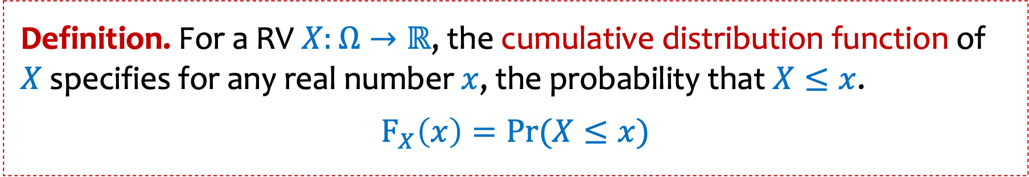
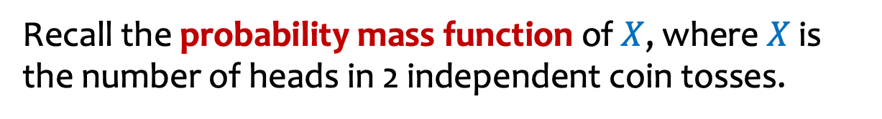
Cumulative Distribution Function (CDF)
Definition. For a RV $X:Ω→ℝ$, the cumulative distribution function of $X$ specifies for any real number $x$, the probability that $X≤x$.
$$F_{X}\left(x\right)=Pr⁡(X≤x)$$
Recall the probability mass function of $X$, where $X$ is the number of heads in 2 independent coin tosses.
$$pX(x) =Pr\left(X=x\right)=\left\{\begin{aligned}\frac{1}{4}, x=0 \\ \frac{1}{2}, x=1 \\ \frac{1}{4}, x=2 \\ 0, o.w.\end{aligned}\right.$$

Slide 24



Example – Two fair independent coin flips
$X=$ number of heads
Probability Mass Function
PMF
Cumulative Distribution Function
CDF
$$p_{X}$$
$$F_{X}$$
1
3/4
1/2
1/4
-1
0
1
2
3
-1
0
1
2
3

Slide 25
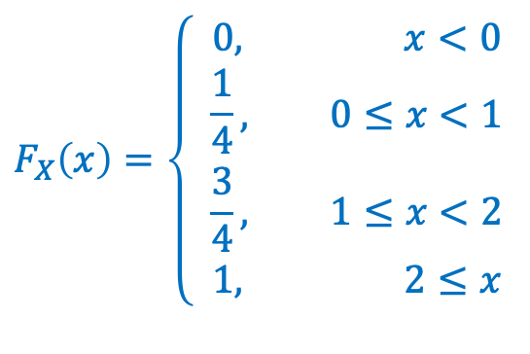
Cumulative Distribution Function (pmf and CDF for two coin tosses)
Definition. For a RV $X:Ω→ℝ$, the cumulative distribution function of $X$ specifies for any real number $x$, the probability that $X≤x$.
$$F_{X}\left(x\right)=Pr⁡(X≤x)$$
Go back to 2 coin clips, where $X$ is the number of heads
$$pX(x) =Pr\left(X=x\right)=\left\{\begin{aligned}\frac{1}{4}, x=0 \\ \frac{1}{2}, x=1 \\ \frac{1}{4}, x=2 \\ 0, o.w.\end{aligned}\right.$$
$$F_{X}\left(x\right)=\left\{ \begin{aligned}0, x<0 \\ \frac{1}{4}, 0≤x<1 \\ \frac{3}{4}, 1≤x<2 \\ 1, 2≤x\end{aligned}\right.$$

Slide 26
Example: Returning Homeworks – Partition of sample space
Class with 3 students, randomly hand back homeworks. All permutations equally likely.
Let $X$ be the number of students who get their own HW
$$Ω$$
2, 3, 1
2, 3, 1
3, 1, 2
$$Pr\left(ω\right)$$ | $$ω$$ | $$X(ω)$$
1/6 | 1, 2, 3 | 3
1/6 | 1, 3, 2 | 1
1/6 | 2, 1, 3 | 1
1/6 | 2, 3, 1 | 0
1/6 | 3, 1, 2 | 0
1/6 | 3, 2, 1 | 1
$$X\left(ω\right)=0$$
2, 3, 1
1, 3, 2
2, 1, 3
3, 2, 1
$$X\left(ω\right)=1$$
2, 3, 1
1, 2, 3
$$X\left(ω\right)=3$$
Notes:
Color code the table next time

Slide 27





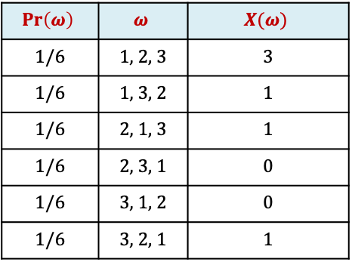

Example: Returning Homeworks –pmf and CDF
$$Pr\left(ω\right)$$ | $$ω$$ | $$X(ω)$$
1/6 | 1, 2, 3 | 3
1/6 | 1, 3, 2 | 1
1/6 | 2, 1, 3 | 1
1/6 | 2, 3, 1 | 0
1/6 | 3, 1, 2 | 0
1/6 | 3, 2, 1 | 1
Class with 3 students, randomly hand back homeworks.
All permutations equally likely.
Let $X$ be the number of students who get their own HW
Probability Mass Fn
PMF
Cumulative Distribution Fn
CDF
$$p_{X}$$
$$F_{X}$$
1
$$p_{X}(0)=P\left(X=0\right)=1/3$$
$$p_{X}(1)=P\left(X=1\right)=1/2$$
1/2
$${ p}_{X}(2)=P\left(X=3\right)=1/6$$
0
-1
0
1
2
3
-1
0
1
2
3
Notes:
Checked reading order

Slide 28


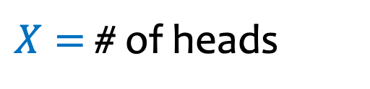
Example – Number of Heads
We flip $n$ coins, independently, each heads with probability $p$
$Ω=\{HH⋯HH,HH⋯HT,HH⋯TH,…,TT⋯TT\}$
$X=$ # of heads
$$Ω_{X}=$$
$$p_{X}\left(k\right)=P\left(X=k\right)=$$
Notes:
Checked reading order

Slide 29


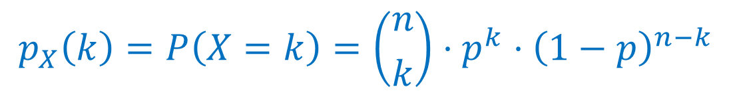
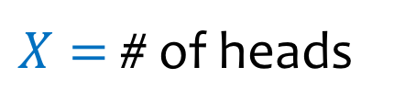
Example – Number of Heads - pmdf
We flip $n$ coins, independently, each heads with probability $p$
$Ω=\{HH⋯HH,HH⋯HT,HH⋯TH,…,TT⋯TT\}$
$X=$ # of heads
$$p_{X}\left(k\right)=P\left(X=k\right)=\left({n \atop k}\right)⋅p^{k}⋅{\left(1−p\right)}^{n−k}$$
# of sequences with $k$ heads
Prob of sequence w/ $k$ heads

Slide 30
Agenda (4)
Random Variables
Probability Mass Function (PMF)
Cumulative Distribution Function (CDF)
Expectation

Slide 31
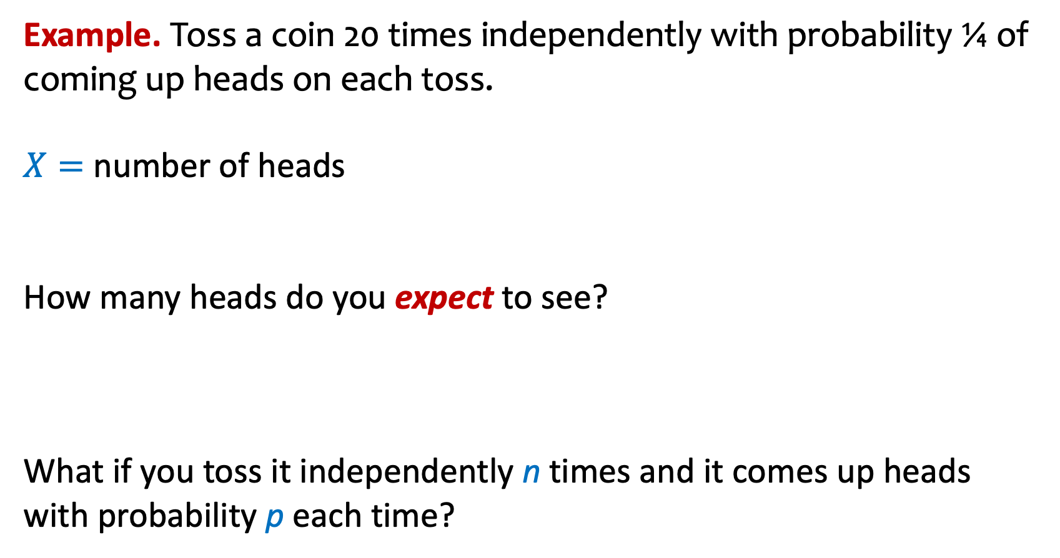
Expectation (Idea)
Example. Toss a coin 20 times independently with probability ¼ of coming up heads on each toss.
$X=$ number of heads
How many heads do you expect to see?
What if you toss it independently n times and it comes up heads with probability p each time?

Slide 32
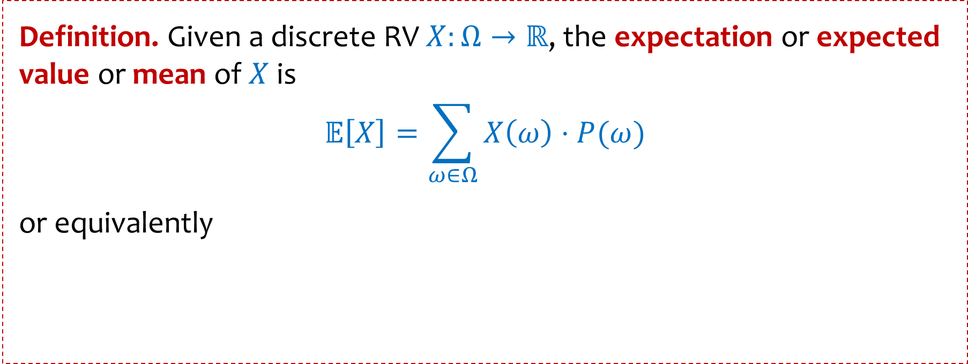

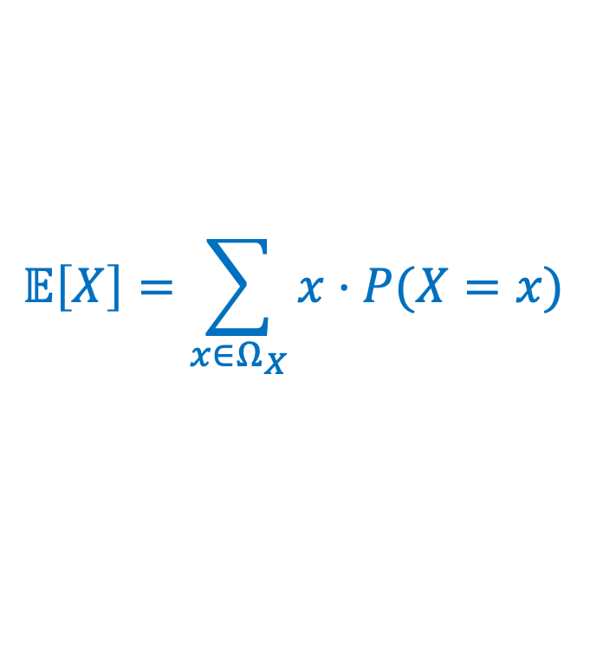
Expected Value of a Random Variable
Definition. Given a discrete RV $X:Ω→ℝ$, the expectation or expected value or mean of $X$ is $$𝔼\left[X\right]=\sum_{ω∈Ω}{X\left(ω\right)⋅P⁡(ω)}$$
or equivalently
$$𝔼\left[X\right]=\sum_{x∈Ω_{X}}{x⋅P⁡(X=x)}$$
$$=\sum_{x∈Ω_{X}}{x⋅p_{X}(x)}$$
Intuition: “Weighted average” of the possible outcomes (weighted by probability)

Slide 33
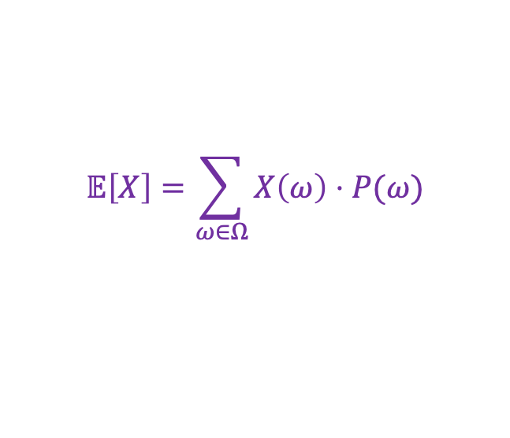

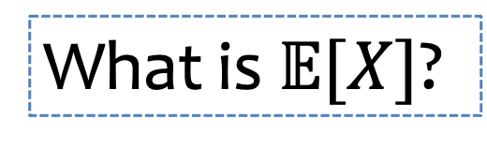
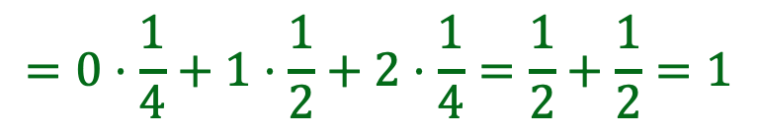
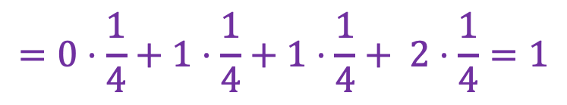
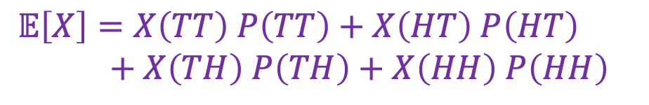
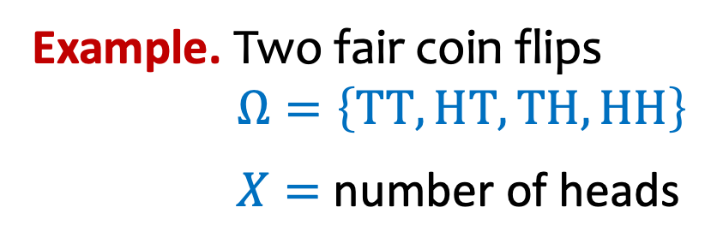
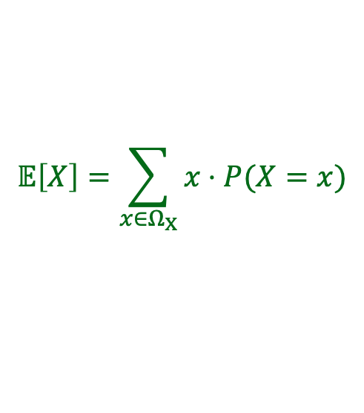
Expectation
$$𝔼\left[X\right]=\sum_{ω∈Ω}{X\left(ω\right)⋅P⁡(ω)}$$
$$𝔼\left[X\right]=\sum_{x∈Ω_{X}}{x⋅P⁡(X=x)}$$
Example. Two fair coin flips
$Ω=\left\{TT, HT, TH,HH\right\}$
$X=$ number of heads
What is $𝔼[X]$?
$𝔼\left[X\right]=X\left(TT\right) P\left(TT\right)+X\left(HT\right) P\left(HT\right)$
$+ X\left(TH\right) P\left(TH\right)$ $+ X\left(HH\right) P\left(HH\right)$
$$p_{X}$$
1
$$=0⋅\frac{1}{4}+1⋅\frac{1}{4}+1⋅\frac{1}{4}+ 2⋅\frac{1}{4}=1$$
3/4
1/2
1/4
$$𝔼\left[X\right]=0⋅p_{X}\left(0\right)+1⋅p_{X}\left(1\right)+2⋅p_{X}(2)$$
$$=0⋅\frac{1}{4}+1⋅\frac{1}{2}+2⋅\frac{1}{4}=\frac{1}{2}+\frac{1}{2}=1$$
-1
0
1
2
3

