Slide 1
More on Independence
CSE 312 Spring 26
Lecture 7

Slide 2

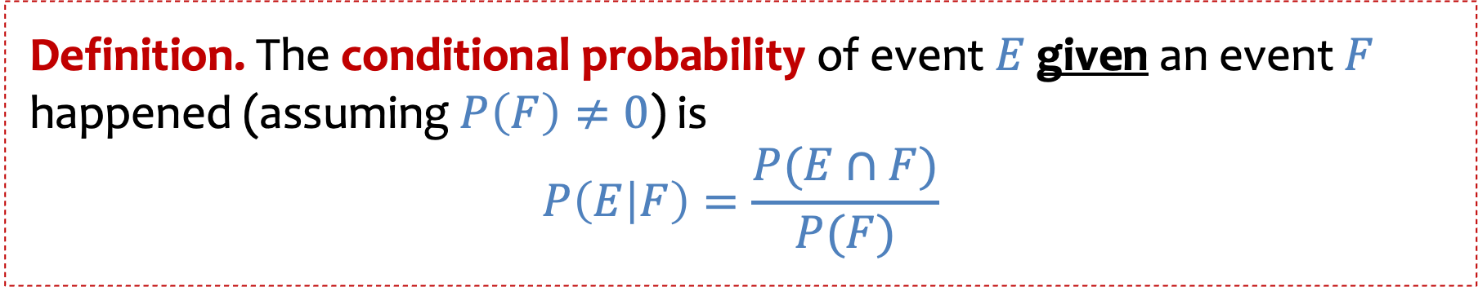
Review - Conditional Probability
Definition. The conditional probability of event $E$given an event $F$ happened (assuming $P\left(F\right)≠0$) is
$$P\left(E | F\right)=\frac{P(E∩F)}{P(F)}$$
If the probability space is uniform, then $P\left(E|F\right)=\frac{|E∩F|}{|F|}$

Slide 3

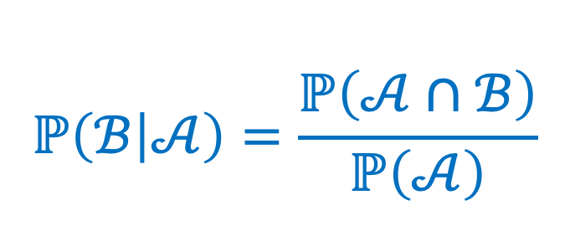
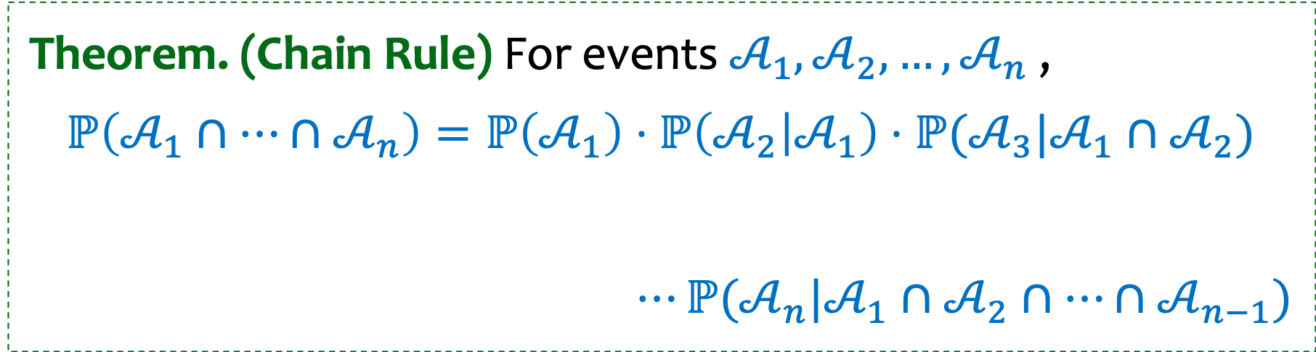
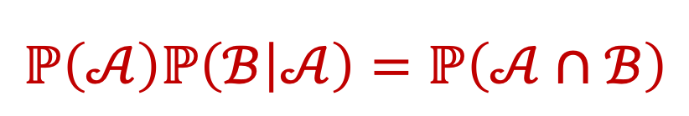
Review - Chain Rule (general case)
$$ℙ\left(ℬ | 𝒜\right)=\frac{ℙ\left(𝒜∩ℬ\right)}{ℙ\left(𝒜\right)}$$
$$ℙ\left(𝒜\right)ℙ\left(ℬ | 𝒜\right)=ℙ\left(𝒜∩ℬ\right)$$
Theorem. (Chain Rule) For events $𝒜_{1},𝒜_{2},…,𝒜_{n}$ ,
$$ℙ\left(𝒜_{1}∩⋯∩𝒜_{n}\right)=ℙ\left(𝒜_{1}\right)⋅ℙ\left(𝒜_{2} | 𝒜_{1}\right)⋅ℙ(𝒜_{3}|𝒜_{1}∩𝒜_{2})$$
$$⋯ℙ(𝒜_{n}|𝒜_{1}∩𝒜_{2}∩⋯∩𝒜_{n−1})$$
An easy way to remember: We have n tasks and we can do them sequentially, conditioning on the outcome of previous tasks
Notes:
Checked reading order

Slide 4
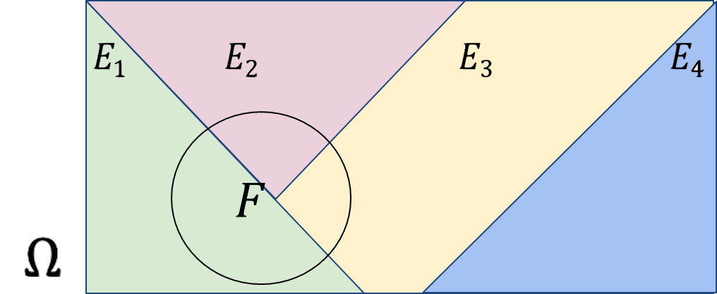
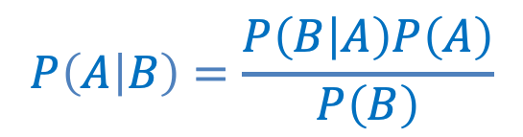

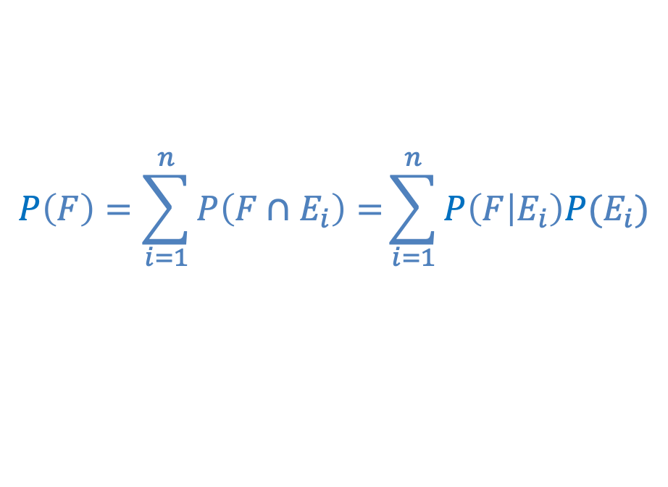
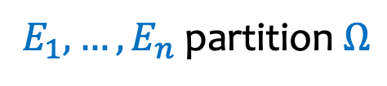
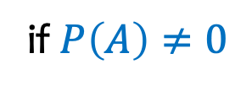
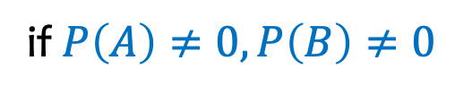
Review: Conditional & Total Probabilities
$$P\left(B | A\right)=\frac{P\left(A∩B\right)}{P\left(A\right)}$$
Conditional Probability
Law of Total Probability
Bayes Theorem
if $P\left(A\right)≠0$
$E_{1},…,E_{n}$partition $Ω$
$$P\left(F\right)=\sum_{i=1}^{n}{P\left(F∩E_{i}\right)=}\sum_{i=1}^{n}{P\left(F | E_{i}\right)P(E_{i})}$$
$$P\left(A | B\right)=\frac{P\left(B | A\right)P\left(A\right)}{P\left(B\right)}$$
if $P\left(A\right)≠0,P\left(B\right)≠0$
Notes:
Checked reading order

Slide 5
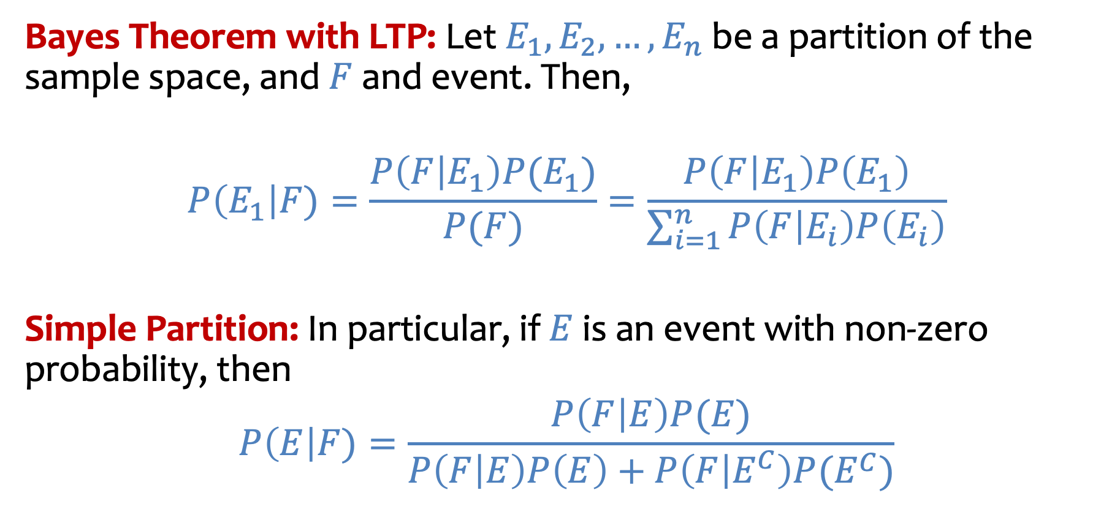
Review: Bayes Theorem with Law of Total Probability
Bayes Theorem with LTP: Let $E_{1}, E_{2}, …, E_{n}$ be a partition of the sample space, and $F$ and event. Then,
$$P\left(E_{1}\right|F)=\frac{P\left(F | E_{1}\right)P(E_{1})}{P(F)}=\frac{P\left(F | E_{1}\right)P\left(E_{1}\right)}{\sum_{i=1}^{n}{P\left(F | E_{i}\right)P\left(E_{i}\right)}}$$
Simple Partition: In particular, if $E$ is an event with non-zero probability, then
$$P\left(E\right|F)=\frac{P\left(F | E\right)P(E)}{P\left(F | E\right)P\left(E\right)+P\left(F | E^{C}\right)P(E^{C})}$$
Notes:
The Birthday Principle also famously comes into play as the
basis of “birthday attacks” that crack certain cryptographic systems.

Slide 6
Agenda
Recap
The Monty Hall Problem
Conditional Probability Defines Probability Space
More on independence
Example using Law of Total Probability
Independence of many events
Independence not always obvious
Defining a probability space using independence
Independence as an assumption not always justified

Slide 7
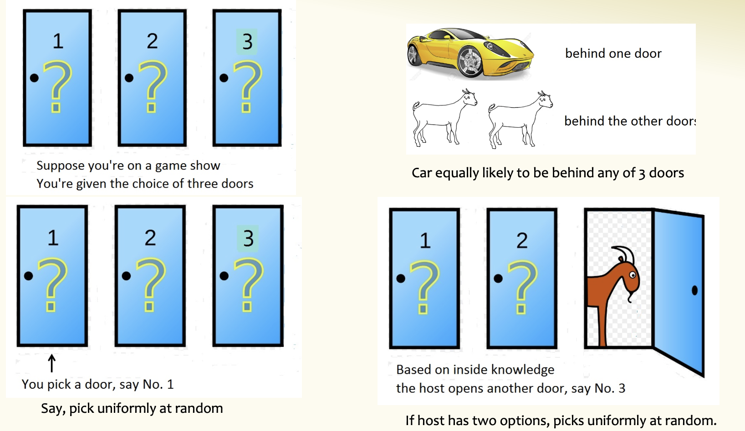
The Monty Hall Problem
Finally, you are offered the option to switch to door 2. Should you?
Notes:
https://probabilityandstats.wordpress.com/2017/05/11/monty-hall-problem/

Slide 8
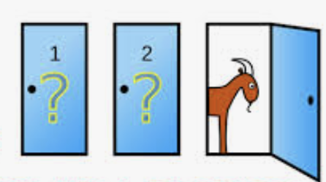
In words….
Suppose you’re on a game show, and you’re given the choice of three doors. Behind one of the doors is a car, behind the other, goats. You pick a door, say number 1, and the host, who knows what’s behind the doors, opens another door, say number 3, which has a goat. He says to you, “Do you want to switch to door number 2?” Is it to your advantage to switch your choice of doors?
Assumptions
The player is equally likely to pick each of the three doors, say door 1.
After the player picks a door, the host must open a different door with a goat behind it and offer the player the choice of staying with the original door he selected or switching to the other unopened door
If the host has two options, he picks one at random.

Slide 9



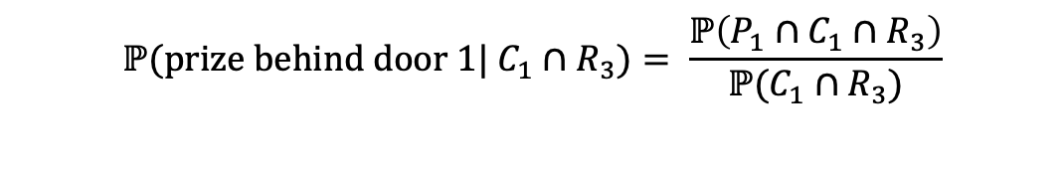
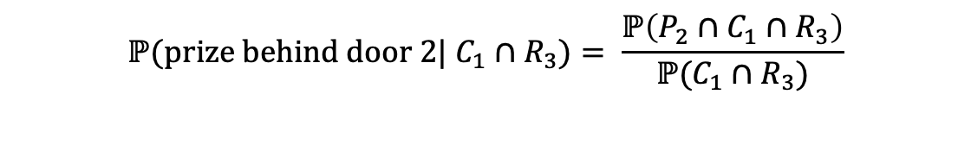
Should you stay or should you switch?
$P_{i}$= the prize is behind door i.
$C_{i}$= the contestant picks door i, say door 1.
$R_{i}$= the host reveals door i, say door 3.
$C_{1} =$ Contestant picks door 1
$R_{3} =$Host reveals door 3
$$ℙ(prize behind door 2| C_{1}∩R_{3})= \frac{ℙ\left(P_{2}∩C_{1}∩R_{3}\right)}{ℙ(C_{1}∩R_{3})}$$
$$ℙ(prize behind door 1| C_{1}∩R_{3})= \frac{ℙ\left(P_{1}∩C_{1}∩R_{3}\right)}{ℙ(C_{1}∩R_{3})}$$

Slide 10
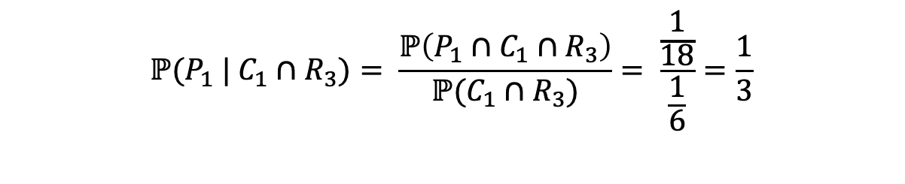
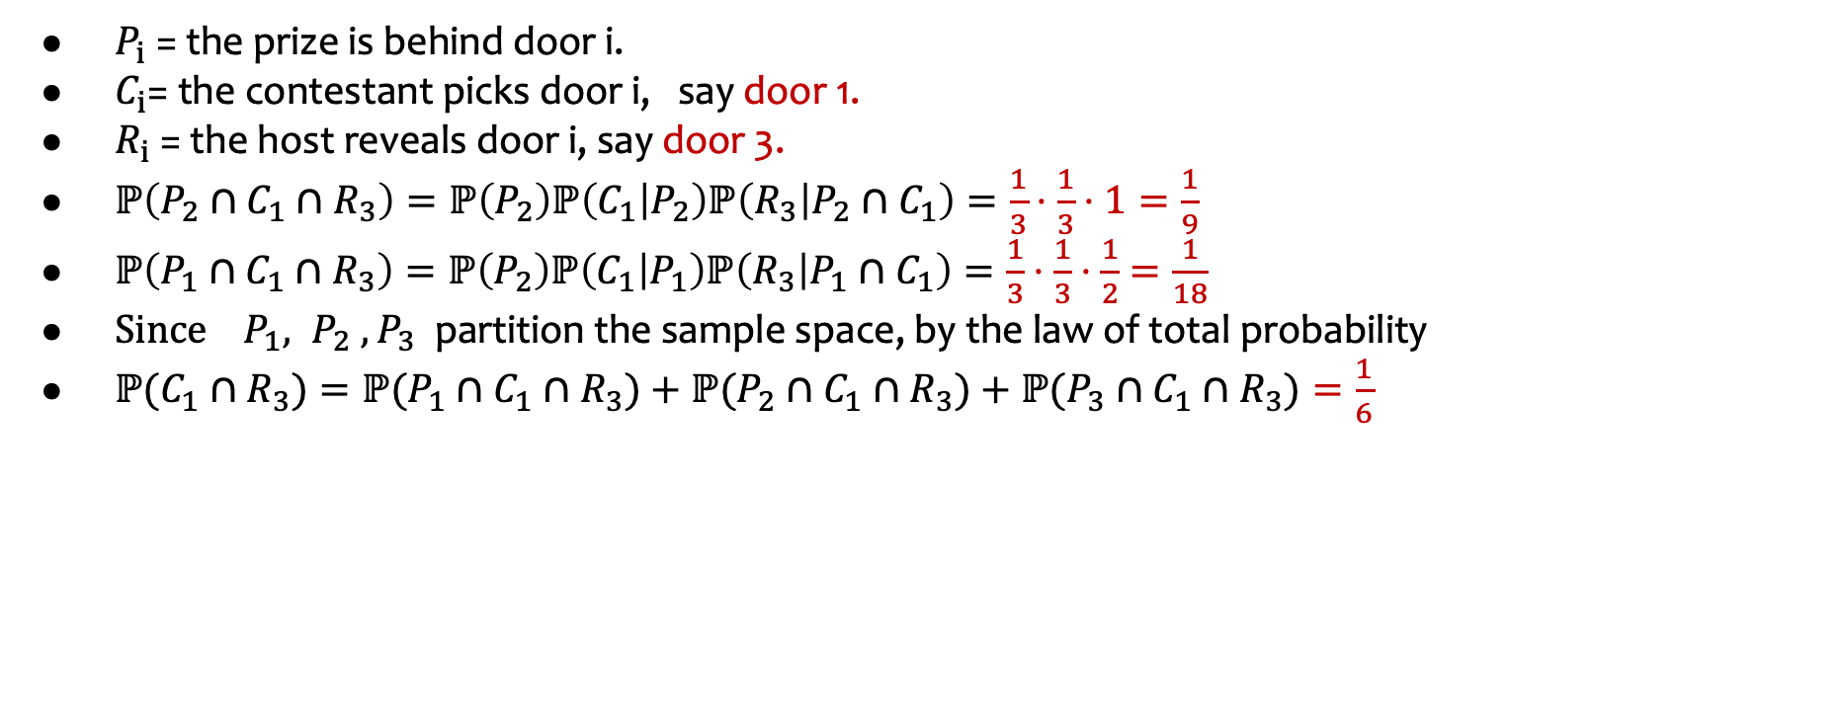
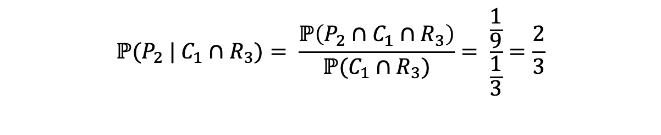



Should you stay or should you switch (written out)?
$P_{i}$= the prize is behind door i.
$C_{i}$= the contestant picks door i, say door 1.
$R_{i}$= the host reveals door i, say door 3.
$ℙ\left(P_{2}∩C_{1}∩R_{3}\right)=ℙ\left(P_{2}\right)ℙ\left(C_{1} | P_{2}\right)ℙ\left(R_{3} | P_{2}∩C_{1}\right)=\frac{1}{3}⋅\frac{1}{3}⋅1=\frac{1}{9}$
$ℙ\left(P_{1}∩C_{1}∩R_{3}\right)=ℙ\left(P_{2}\right)ℙ\left(C_{1} | P_{1}\right)ℙ\left(R_{3} | P_{1}∩C_{1}\right)=\frac{1}{3}⋅\frac{1}{3}⋅\frac{1}{2}=\frac{1}{18}$
$Since { P}_{1}, P_{2}{ ,P}_{3}$ partition the sample space, by the law of total probability
$ℙ(C_{1}∩R_{3})=ℙ(P_{1}∩C_{1}∩R_{3})+ℙ(P_{2}∩C_{1}∩R_{3})+ℙ(P_{3}∩C_{1}∩R_{3})=\frac{1}{6}$
$$\frac{1}{18}$$
$$\frac{1}{9}$$
$$0$$
$$ℙ(P_{2} | C_{1}∩R_{3})= \frac{ℙ\left(P_{2}∩C_{1}∩R_{3}\right)}{ℙ(C_{1}∩R_{3})}= \frac{\frac{1}{9}}{\frac{1}{3}}=\frac{2}{3}$$
Hence, the contestant would be better off switching to door 3!!
$$ℙ(P_{1} | C_{1}∩R_{3})= \frac{ℙ\left(P_{1}∩C_{1}∩R_{3}\right)}{ℙ(C_{1}∩R_{3})}= \frac{\frac{1}{18}}{\frac{1}{6}}=\frac{1}{3}$$
Notes:
Checked reading order

Slide 11
Agenda (2)
Recap
The Monty Hall Problem
Conditional Probability Defines Probability Space
More on independence

Slide 12



Zika Testing – different question
Z = you have Zika
T = you test positive for Zika
P($T$ | $Z$) = 0.98
P($T$ | $\overline{Z}$) = 0.01
P ($Z$) = 0.005
Suppose we know the following Zika stats
A test is 98% effective at detecting Zika (“true positive”)
However, the test may yield a “false positive” 1% of the time
0.5% of the US population has Zika.
What is the probability you test negative (event $\overline{T}$) if you have Zika (event $Z$)?
https://pollev.com/ annakarlin185
Pr ($\overline{T} |Z$)
0.02
0.99
0.02 x 0.005
0.02 x 0.995
Notes:
Last time we computer Pr (have Zika | test positive) using Bayes Rule.

Slide 13
Conditional Probability Define a Probability Space
Example. $ℙ\left(ℬ^{c} | 𝒜\right)=1 −ℙ(ℬ|𝒜)$
Notes:
checked

Slide 14

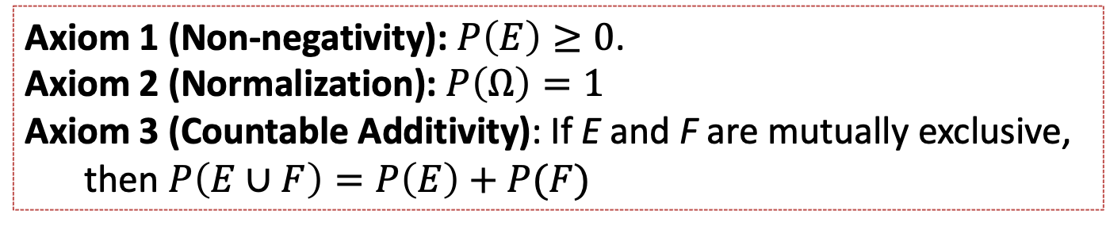

Conditional Probability Define a Probability Space (2)
The probability conditioned on $A$ follows the same properties as (unconditional) probability.
Example. $ℙ\left(ℬ^{c} | 𝒜\right)=1 −ℙ(ℬ|𝒜)$
Formally. $(Ω, ℙ)$ is a probability space + $ℙ\left(𝒜\right)>0$
$(𝒜,ℙ(⋅|𝒜))$ is a probability space
Axiom 1 (Non-negativity): $P\left(E\right)≥0$.
Axiom 2 (Normalization): $P\left(Ω\right)=1$
Axiom 3 (Countable Additivity): If E and F are mutually exclusive, then $P\left(E∪F\right)=P\left(E\right)+P(F)$

Slide 15
Agenda (3)
Recap
The Monty Hall Problem
Conditional Probability Defines Probability Space
More on independence
Example using Law of Total Probability
Independence of many events
Independence not always obvious
Defining a probability space using independence

Slide 16

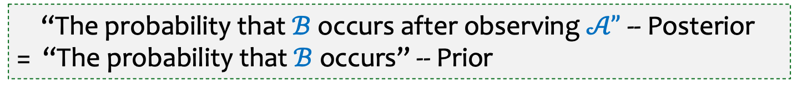
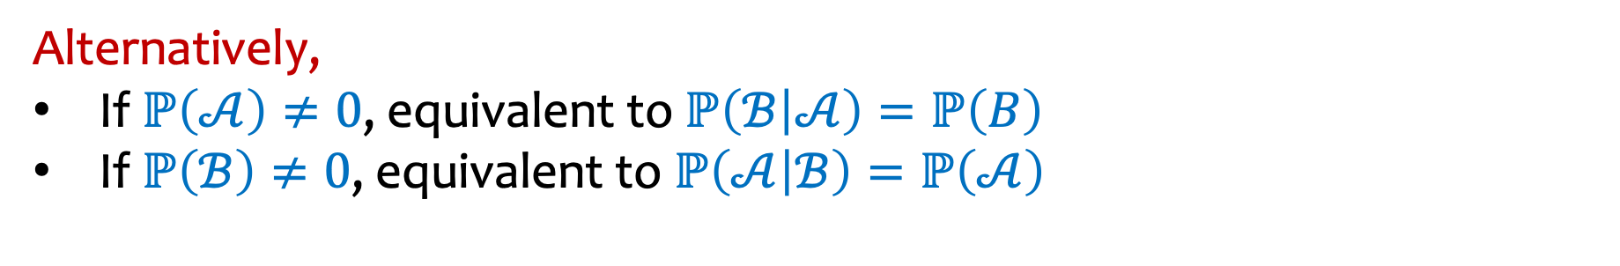
Independence
Definition. Two events $𝒜$and $ℬ$are independent if
$$ℙ\left(𝒜∩ℬ\right)=ℙ\left(𝒜\right)⋅ℙ(ℬ).$$
Alternatively,
If $ℙ\left(𝒜\right)≠0$, equivalent to $ℙ\left(ℬ | 𝒜\right)=ℙ\left(B\right)$
If $ℙ\left(ℬ\right)≠0$, equivalent to $ℙ\left(𝒜 | ℬ\right)=ℙ\left(𝒜\right)$
“The probability that $ℬ$ occurs after observing $𝒜”$ -- Posterior
= “The probability that $ℬ$ occurs” -- Prior
Notes:
Can check independence using any of these 3.

Slide 17


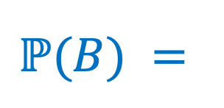
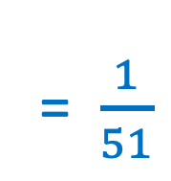
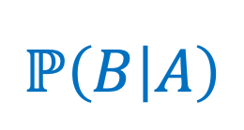
Are A and B independent?
Have a Standard 52-Card Deck. Shuffle It, and draw the top 2 cards in order:
Step 1: Draw a uniformly random card.
Step 2: Draw a uniformly random card from remaining cards.
A: Ace of Spades First
B: 10 of Clubs Second
= $\frac{1}{51}$
Are the events A and B independent?
$$ℙ\left(B | A\right)$$
$$ℙ(B) =$$
Notes:
Probability second card is 10 of clubs = \sum_{first card possibilities} Pr (first card ) Pr (second card 10 clubs | first card) = 51 x 1/52 x 1/51. = 1/52
Checked reading order

Slide 18
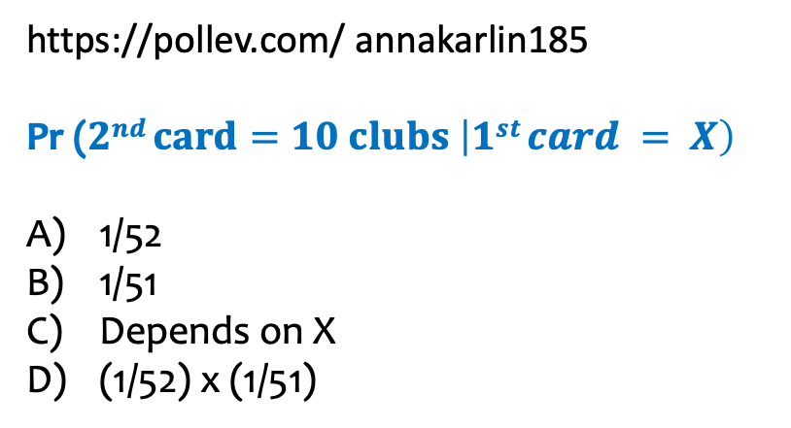
Calculation
https://pollev.com/ annakarlin185
Pr ($2nd card=10 clubs \left|1st card = X\right)$
1/52
1/51
Depends on X
(1/52) x (1/51)

Slide 19
Agenda (4)
Recap
The Monty Hall Problem
Conditional Probability Defines Probability Space
More on independence
Example using Law of Total Probability
Independence of many events
Independence not always obvious
Defining a probability space using independence

Slide 20
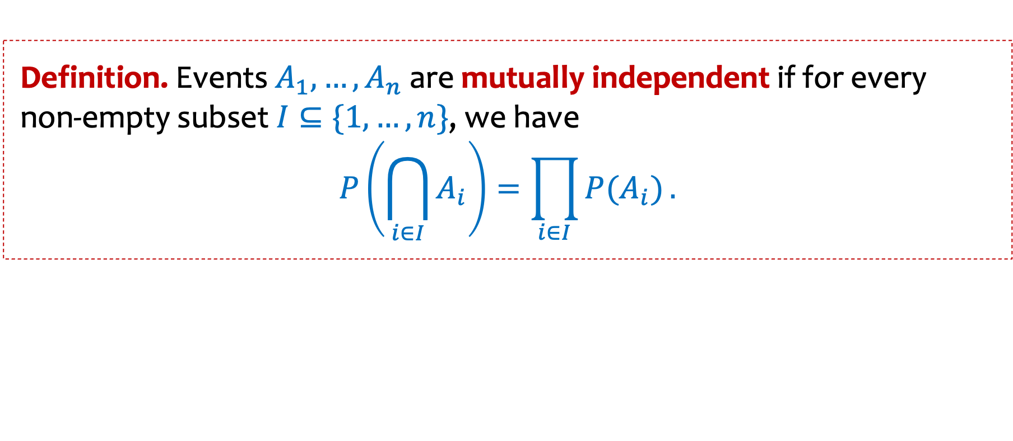
Multiple Events – Mutual Independence
Definition. Events $A_{1},…,A_{n}$ are mutually independent if for every non-empty subset $I⊆\{1,…,n\}$, we have
$$P\left(\bigcap_{i∈I}{A_{i}}\right)=\prod_{i∈I}{P(A_{i})}.$$

Slide 21
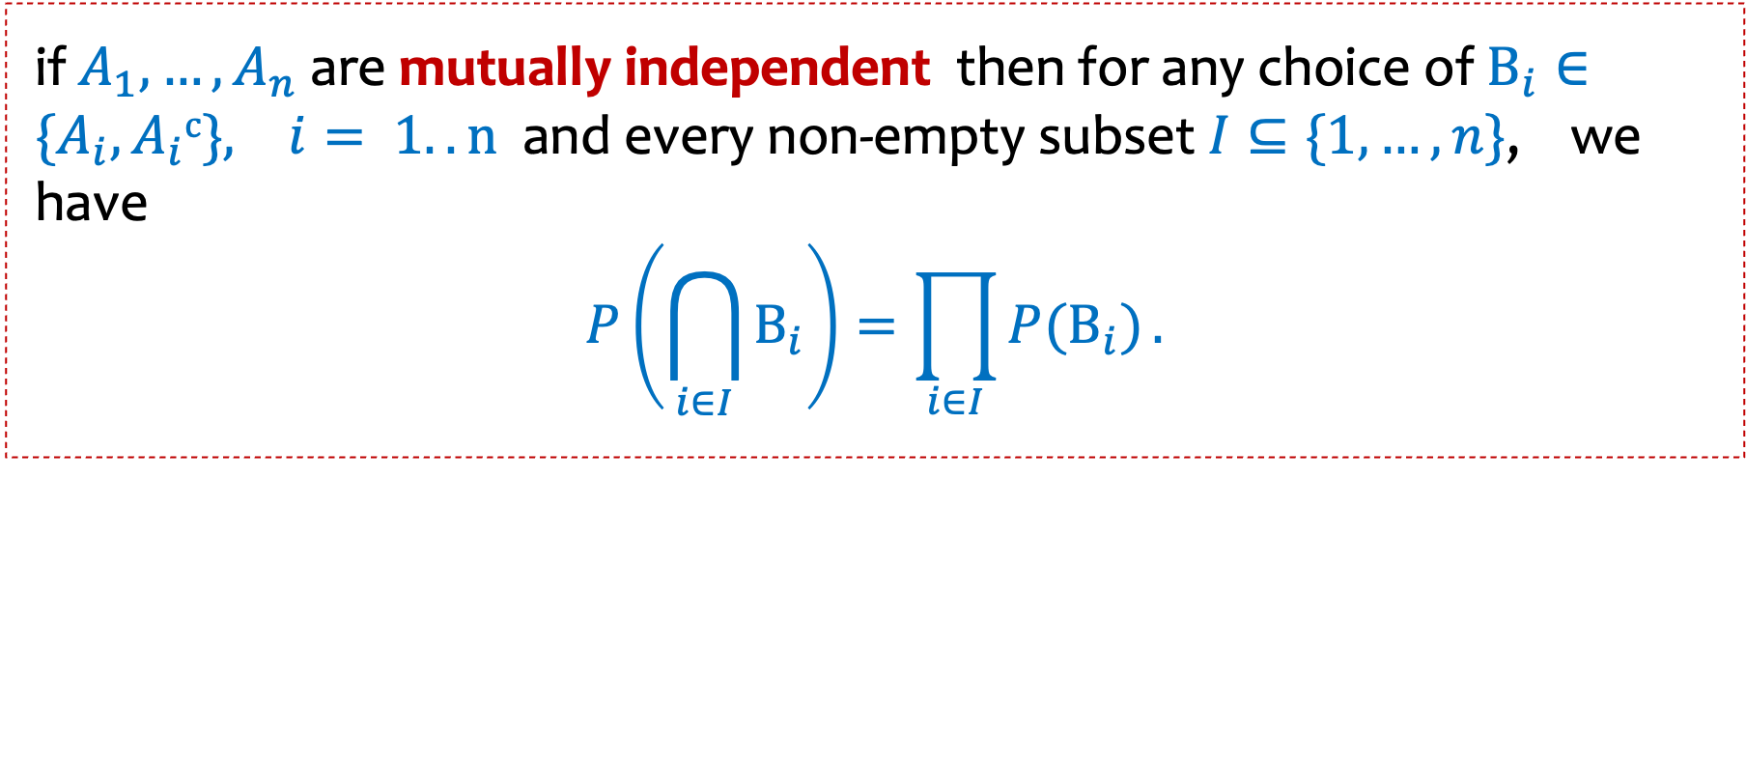
Multiple Events – Mutual Independence - corollary
if$A_{1},…,A_{n}$ are mutually independent then for any choice of $B_{i}∈{\{A}_{i},A_{i}c\}, i= 1..n$ and every non-empty subset $I⊆\{1,…,n\}$, we have
$$P\left(\bigcap_{i∈I}{B_{i}}\right)=\prod_{i∈I}{P(B_{i})}.$$

Slide 22

An example
You are routing a packet from the source to the destination.
But each of the 16 edges in the network works with probability $p, independently.$
s =
d =
Q: Pr(edge (s,3) works, edge (5,d) works, edge (s,7) doesn’t work)?
Notes:
Reading order checked

Slide 23
An example (2)
You are routing a packet from the source to the destination.
But each of the 16 edges in the network works with probability $p, independently.$
Q: What is the probability that you can get the packet from the source to the destination?

Slide 24
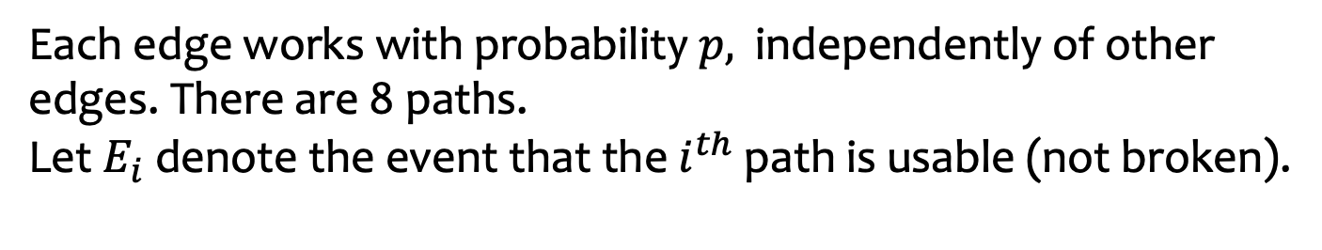
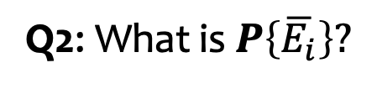

Let’s break it down
Each edge works with probability $p,$ independently of other edges. There are 8 paths.
Let $E_{i}$ denote the event that the $i^{th}$ path is usable (not broken).
Q1: What is $P\left\{E_{i}\right\}?$
Q2: What is $P\left\{\overline{E_{i}}\right\}?$
Notes:
Q1: p^2
Q2: 1-p^2
Checked reading order

Slide 25
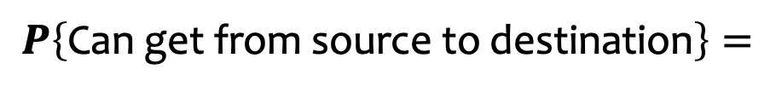


More calculations
Each edge works with probability $p,$ independently of other edges. There are 8 paths.
Let $E_{i}$ denote the event that the $i^{th}$ path is usable (not broken).
$$P\left\{E_{i}\right\}=p^{2}$$
$$P\left\{\overline{E_{i}}\right\}=1−p^{2}$$
What is $P\left\{\text{Can} \text{get} \text{from} \text{source} \text{to} \text{destination}\right\}?$
$$P\left\{\text{Can} \text{get} \text{from} \text{source} \text{to} \text{destination}\right\}=$$
Notes:
Q1: p
Q2: 1-p
Checked reading order

Slide 26
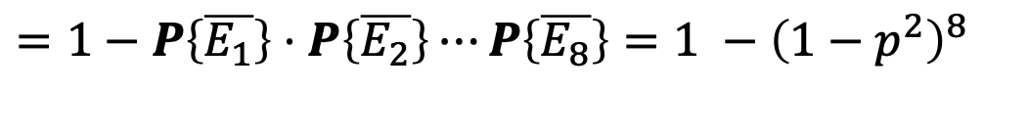
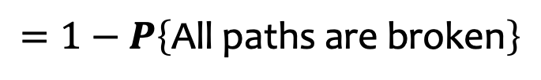

Answer
Each edge works with probability $p,$ independently of other edges. There are 8 paths.
Let $E_{i}$ denote the event that the $i^{th}$ path is usable (not broken).
$$P\left\{E_{i}\right\}=p^{2}$$
$$P\left\{\overline{E_{i}}\right\}=1−p^{2}$$
What is $P\left\{\text{Can} \text{get} \text{from} \text{source} \text{to} \text{destination}\right\}?$
$$P\left\{\text{Can} \text{get} \text{from} \text{source} \text{to} \text{destination}\right\}= P\left\{\text{At} \text{least} \text{one} \text{path} \text{works}\right\}$$
$$=P\left\{E_{1}∪E_{2}∪⋯∪E_{8}\right\}$$
$$=1−P\left\{\text{All} \text{paths} \text{are} \text{broken}\right\}$$
$=1−P\left\{\overline{E_{1}}\right\}⋅$ $P\left\{\overline{E_{2}}\right\}⋯P\left\{\overline{E_{8}}\right\}=1 −{\left(1−p^{2}\right)}^{8}$
Notes:
Q1: p
Q2: 1-p

Slide 27
Agenda (5)
Recap
The Monty Hall Problem
Conditional Probability Defines Probability Space
More on independence
Example using Law of Total Probability
Independence of many events
Independence not always obvious
Defining a probability space using independence

Slide 28

Defining a probability space
Often probability space $\left(Ω, ℙ\right)$ is defined using independence

Slide 29



Example – Biased coin
We have a biased coin comes up Heads with probability 2/3; Each flip is independent of all other fips. Suppose it is tossed 3 times.
$ℙ\left(HHH\right)$ $=$
$ℙ\left(TTT\right)$ $=$
$ℙ\left(HTT\right)$ $=$

Slide 30

Example – Biased coin – let’s do a calculation
We have a biased coin comes up Heads with probability 2/3, independently of other flips. Suppose it is tossed 3 times.
$ℙ\left(2 heads in 3 tosses\right)$ $=$
https://pollev.com/ annakarlin185
(2/3)² 1/3
2/3
3 (2/3)² 1/3
(1/3)²

Slide 31
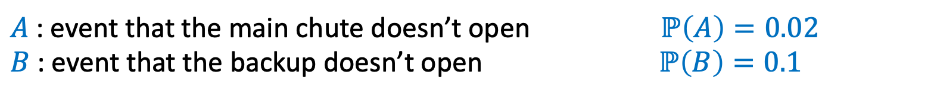
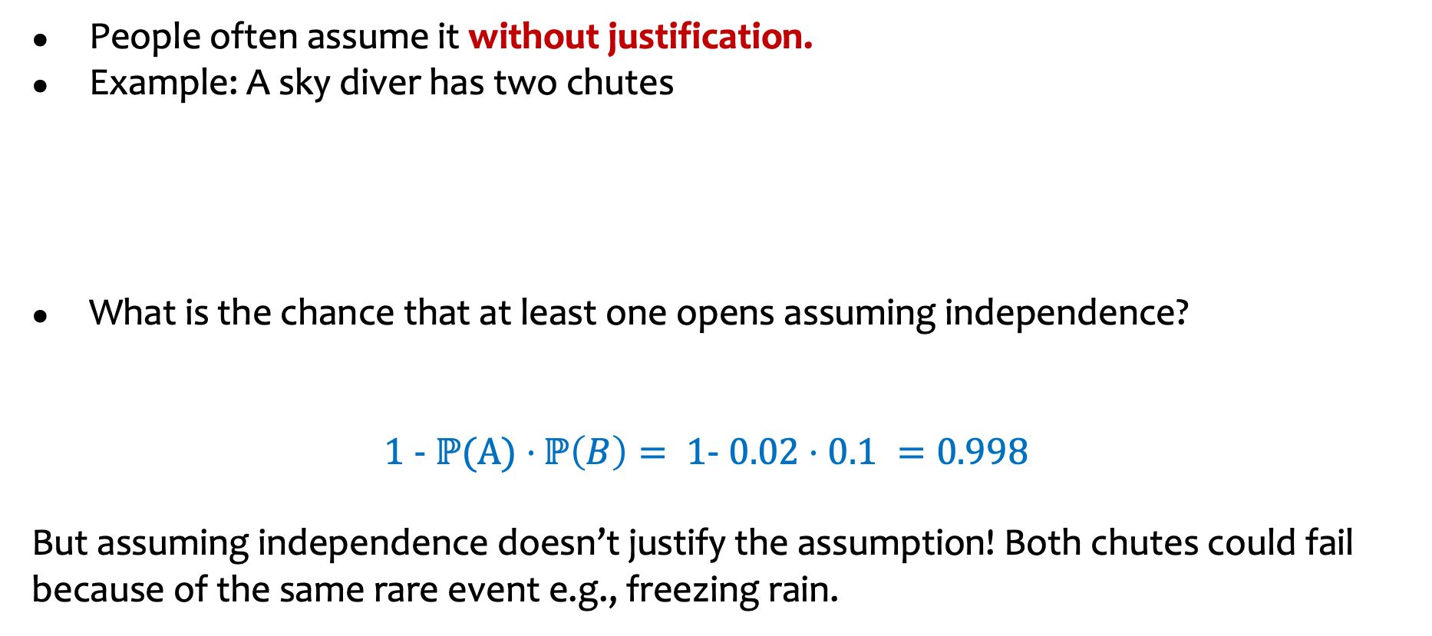
Independence as an assumption
People often assume it without justification.
Example: A sky diver has two chutes
What is the chance that at least one opens assuming independence?
$$1 − ℙ{(A)⋅}ℙ\left(B\right)= 1− 0.02⋅0.1 =0.998$$
But assuming independence doesn’t justify the assumption! Both chutes could fail because of the same rare event e.g., freezing rain.
$A$: event that the main chute doesn’t open $ℙ\left(A\right)=0.02$
$B$: event that the backup doesn’t open $ℙ\left(B\right)=0.1$

Slide 32
Agenda (6)
Recap
The Monty Hall Problem
Conditional Probability Defines Probability Space
More on Independence
Conditional independence

Slide 33

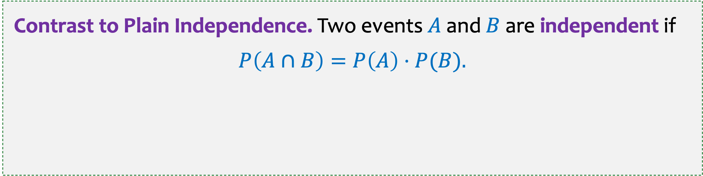
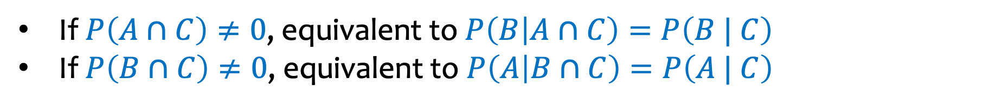
Conditional Independence
Definition. Two events $A$and $B$are independent conditioned on $C$ if $P\left(C\right)≠0$and $P\left(A∩B | C\right)=P\left(A | C\right)⋅P\left(B \right| C).$
If $P\left(A∩C\right)≠0$, equivalent to $P\left(B | A∩C\right)=P\left(B | C\right)$
If $P\left(B∩C\right)≠0$, equivalent to $P\left(A | B∩C\right)=P\left(A | C\right)$
Contrast to Plain Independence. Two events $A$and $B$are independent if
$$P\left(A∩B\right)=P\left(A\right)⋅P(B).$$

Slide 34
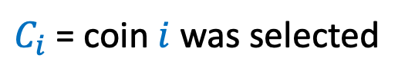
Example – Tossing Coins
Suppose that Coin 1 has probability of heads 0.3
and Coin 2 has probability of head 0.9. We choose one of the coins randomly with equal probability and flip that coin 2 times independently. What is the probability we get all heads?
$C_{i}$ = coin $i$ was selected
Notes:
Checked reading order

Slide 35

Example – Tossing Coins
Suppose that Coin 1 has probability of heads 0.3
and Coin 2 has probability of head 0.9. We choose one of the coins randomly with equal probability and flip that coin 2 times independently. What is the probability we get all heads?
$C_{i}$ = coin $i$ was selected
$$P⁡(HH) =P\left(HH \right|C_{1})⋅P⁡(C_{1}) +P(HH \left| C_{2}\right)⋅P⁡(C_{2})$$
Law of Total Probability
(LTP)
$$=P{\left(H | C_{1}\right)}^{2} P⁡(C_{1}) +P⁡(H {\left| C_{2}\right)}^{2} P(C_{2})$$
Conditional Independence
$$={0.3}^{2}⋅0.5 +{0.9}^{2}⋅0.5=0.45$$
Notes:
Checked reading order

Slide 36
Example – Tossing coins (2)
Suppose that Coin 1 has probability of heads 0.3
and Coin 2 has probability of head 0.9. We choose one coin randomly with equal probability and flip that coin 2 times independently. How does the probability we get all heads compare to P(H)² ?

Slide 37


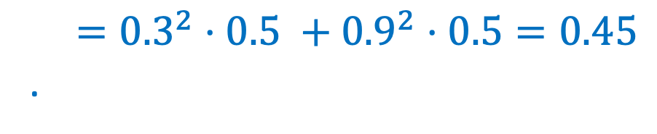
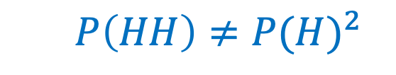
Example – Tossing coins (2)
Suppose that Coin 1 has probability of heads 0.3
and Coin 2 has probability of head 0.9. We choose one coin randomly with equal probability and flip that coin 2 times independently. How does the probability we get all heads compare to P(H)² ?
$$P\left(HH \right|C_{1})= P{\left(H | C_{1}\right)}^{2}$$
$$P\left(HH\right)≠P{(H)}^{2}$$
$$P(HH)=P{\left(H | C_{1}\right)}^{2} P⁡(C_{1}) +P⁡(H {\left| C_{2}\right)}^{2} P(C_{2})$$
$={0.3}^{2}⋅0.5 +{0.9}^{2}⋅$ $0.5=0.45$
.
$$P\left(H\right)=P\left(H | C_{1}\right)⋅P\left(C_{1}\right)+P\left(H | C_{2}\right)⋅P\left(C_{2}\right)=0.6$$
$$P\left(HH\right)=0.36$$
Notes:
Checked reading order.

