Slide 1
Law of Total Probability, Bayes Rule and More on Independence
CSE 312 Spring 26
Lecture 6

Slide 2
Thank you for your feedback!!!
Some people mentioned that I was going too fast in parts and would like more examples in class.
How do we address this?
What I can do and what I will try to do:
  I will try to be more consistent in my pacing and go over the examples a little bit slower.
  I will try to give more examples.
What you can do:
  Slow me down! Ask questions!!!
  Give me feedback between classes. (I’ve added feedback as a category on Ed.)
  Do the concept checks!!
  Please come to office hours.
  Ask the 312 Learning Assistant to explain anything that is confusing.
  Form study groups and go over all the section problems together.
  Do the readings.

Slide 3
Agenda
Recap
Law of Total Probability
Bayes Theorem
More on Independence

Slide 4


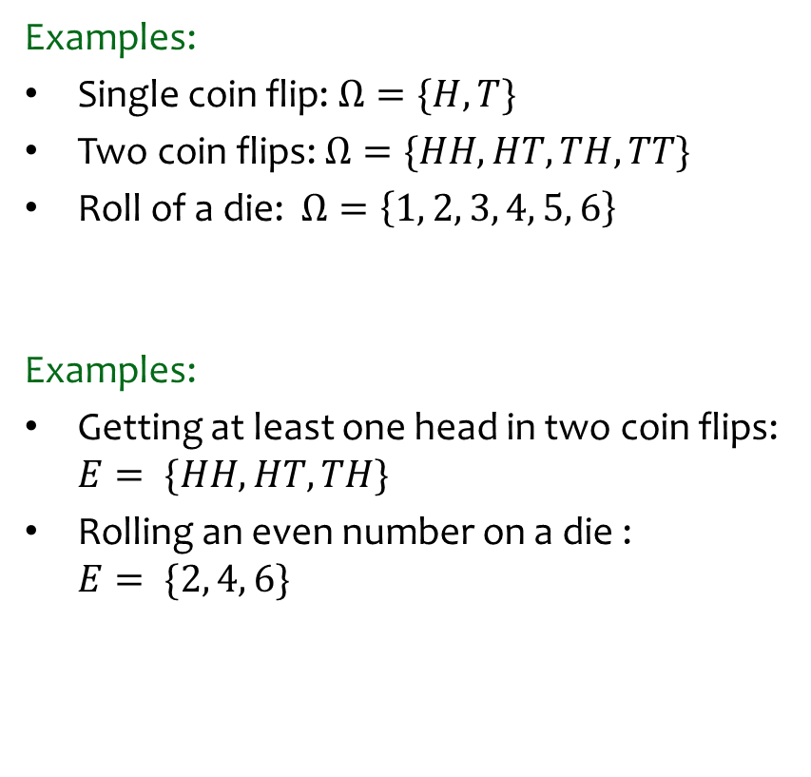
Review - Probability
Definition. A sample space $Ω$ is the set of all possible outcomes of an experiment.
Examples:
Single coin flip: $Ω=\{H, T\}$
Two coin flips: $Ω=\{HH, HT, TH, TT\}$
Roll of a die: $Ω=\left\{1, 2, 3, 4, 5, 6\right\}$
Examples:
Getting at least one head in two coin flips: $E= \{HH, HT, TH\}$
Rolling an even number on a die :
$E= \{2, 4, 6\}$
Definition. An event $E⊆Ω$ is a subset of possible outcomes.

Slide 5
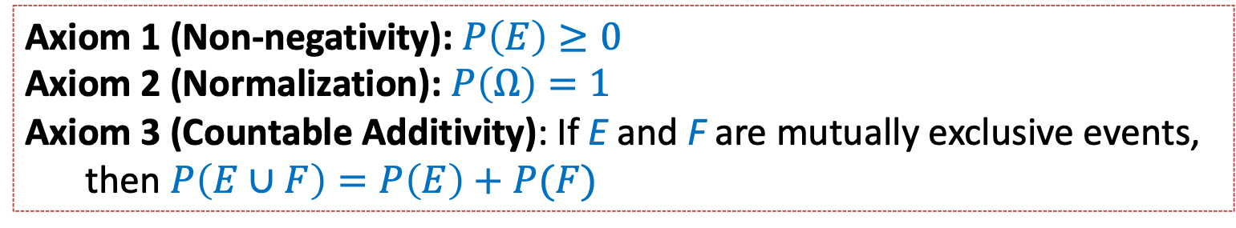

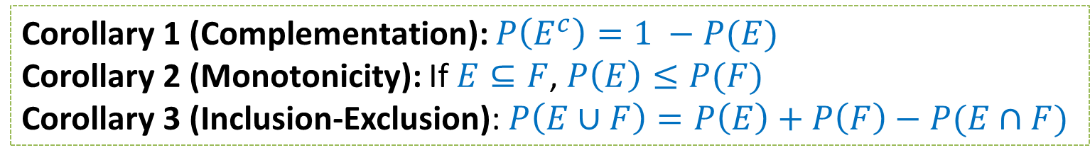
Review - Axioms of Probability
Let $Ω$ denote the sample space and $E, F⊆Ω$ be events.
Axiom 1 (Non-negativity): $P\left(E\right)≥0$
Axiom 2 (Normalization): $P\left(Ω\right)=1$
Axiom 3 (Countable Additivity): If E and F are mutually exclusive events,
then $P\left(E∪F\right)=P\left(E\right)+P(F)$
Corollary 1 (Complementation): $P\left(E^{c}\right)=1 −P(E)$
Corollary 2 (Monotonicity): If $E⊆F$, $P\left(E\right)≤P(F)$
Corollary 3 (Inclusion-Exclusion): $P\left(E∪F\right)=P\left(E\right)+P\left(F\right)−P(E∩F)$

Slide 6
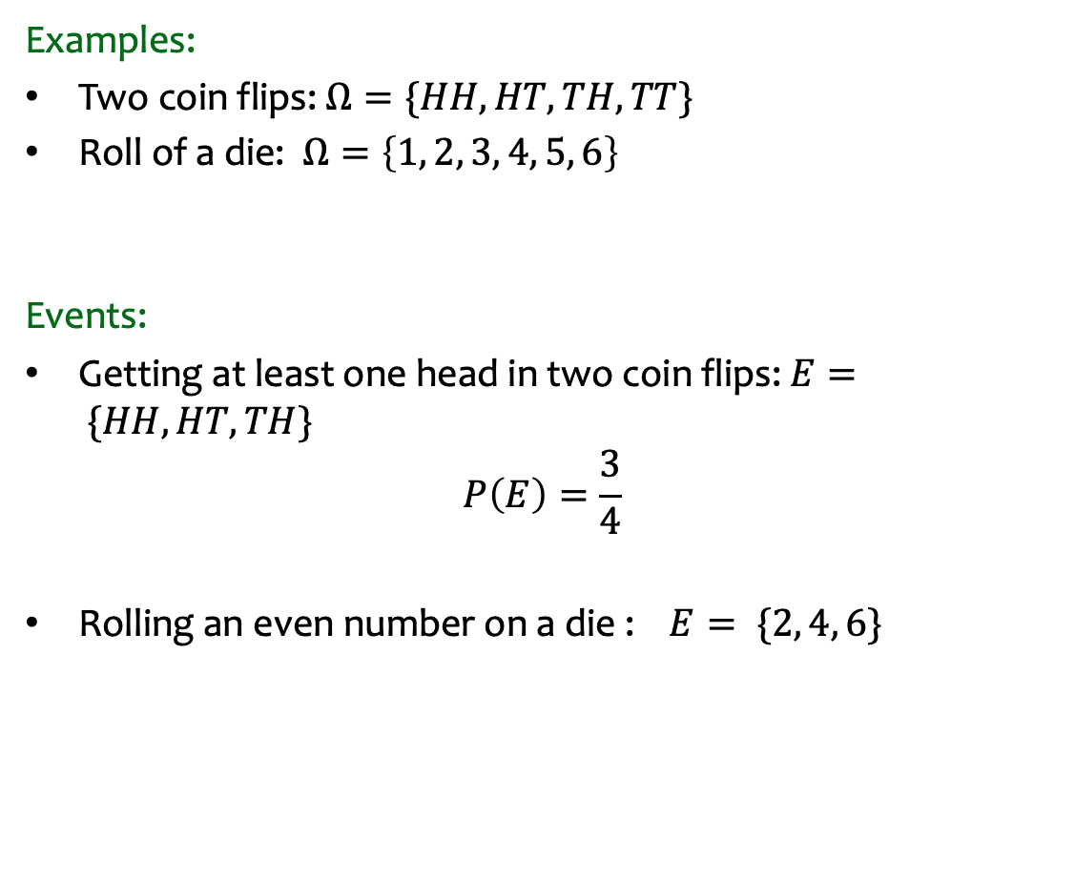
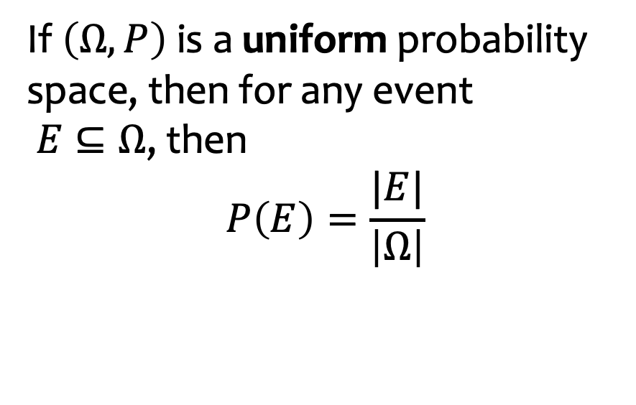

Review: Equally Likely Outcomes
Examples:
Two coin flips: $Ω=\{HH, HT, TH, TT\}$
Roll of a die: $Ω=\left\{1, 2, 3, 4, 5, 6\right\}$
Events:
Getting at least one head in two coin flips: $E= \{HH, HT, TH\}$
$$P\left(E\right)=\frac{3}{4}$$
Rolling an even number on a die :$E= \{2, 4, 6\}$
If $\left(Ω, P\right)$ is a uniform probability space, then for any event
$E⊆Ω$, then
$$P\left(E\right)=\frac{|E|}{\left|Ω\right|}$$
$P\left(E\right)=\frac{3}{6}$ = $\frac{1}{2}$

Slide 7
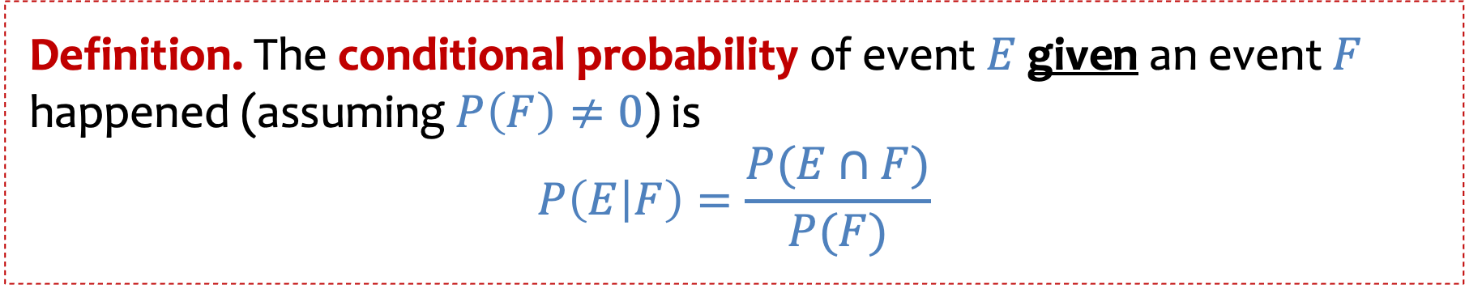
Review - Conditional Probability
Definition. The conditional probability of event $E$given an event $F$ happened (assuming $P\left(F\right)≠0$) is
$$P\left(E | F\right)=\frac{P(E∩F)}{P(F)}$$

Slide 8
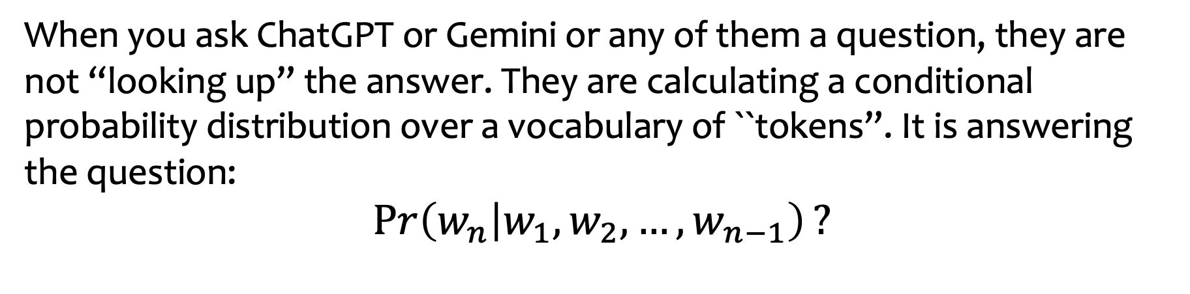
A relevant example
When you ask ChatGPT or Gemini or any of them a question, they are not “looking up” the answer. They are calculating a conditional probability distribution over a vocabulary of ``tokens”. It is answering the question:
$$\operatorname{Pr}\left(w_{n} | w_{1},w_{2},…,w_{n−1}\right)?$$
``Given the words that have come before, what is the probability of the next word?”
Notes:
Generative AI tools are probabilistic inference engines
Checked reading order

Slide 9

Review - Conditional Probability (uniform case)
Definition. The conditional probability of event $E$given an event $F$ happened (assuming $P\left(F\right)≠0$) is
$$P\left(E | F\right)=\frac{P(E∩F)}{P(F)}$$
If the probability space is uniform, then $P\left(E|F\right)=\frac{|E∩F|}{|F|}$

Slide 10

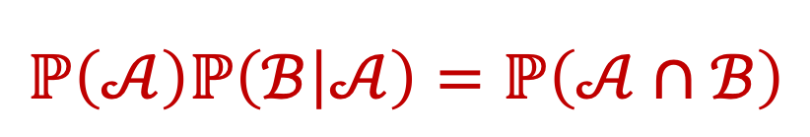
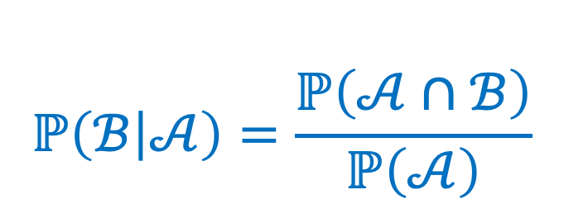
Review - Chain Rule
$$ℙ\left(ℬ | 𝒜\right)=\frac{ℙ\left(𝒜∩ℬ\right)}{ℙ\left(𝒜\right)}$$
$$ℙ\left(𝒜\right)ℙ\left(ℬ | 𝒜\right)=ℙ\left(𝒜∩ℬ\right)$$

Slide 11
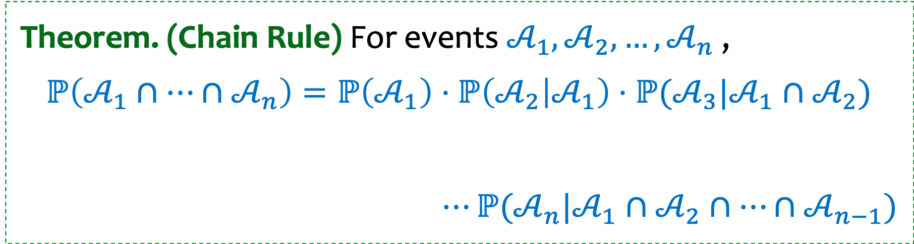
Review - Chain Rule (general case)
$$ℙ\left(ℬ | 𝒜\right)=\frac{ℙ\left(𝒜∩ℬ\right)}{ℙ\left(𝒜\right)}$$
$$ℙ\left(𝒜\right)ℙ\left(ℬ | 𝒜\right)=ℙ\left(𝒜∩ℬ\right)$$
Theorem. (Chain Rule) For events $𝒜_{1},𝒜_{2},…,𝒜_{n}$ ,
$$ℙ\left(𝒜_{1}∩⋯∩𝒜_{n}\right)=ℙ\left(𝒜_{1}\right)⋅ℙ\left(𝒜_{2} | 𝒜_{1}\right)⋅ℙ(𝒜_{3}|𝒜_{1}∩𝒜_{2})$$
$$⋯ℙ(𝒜_{n}|𝒜_{1}∩𝒜_{2}∩⋯∩𝒜_{n−1})$$
An easy way to remember: We have n tasks and we can do them sequentially, conditioning on the outcome of previous tasks
Notes:
Checked reading order

Slide 12

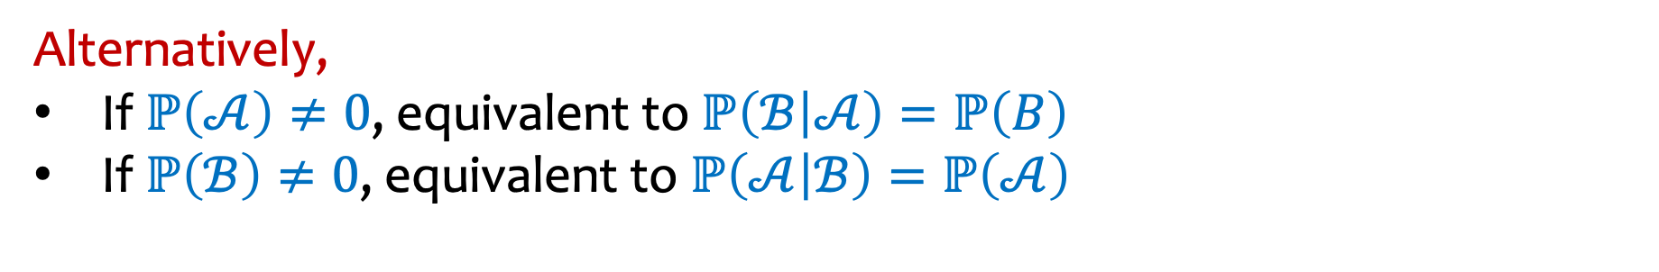
Review - Independence
Definition. Two events $𝒜$and $ℬ$are independent if
$$ℙ\left(𝒜∩ℬ\right)=ℙ\left(𝒜\right)⋅ℙ(ℬ).$$
Alternatively,
If $ℙ\left(𝒜\right)≠0$, equivalent to $ℙ\left(ℬ | 𝒜\right)=ℙ\left(B\right)$
If $ℙ\left(ℬ\right)≠0$, equivalent to $ℙ\left(𝒜 | ℬ\right)=ℙ\left(𝒜\right)$
Notes:
Can check independence using any of these 3.
If $E$and $F$are independent, so are $\overline{E}$and $F, E \text{and}\overline{ F}\text{, }\text{an}\text{d} \overline{E} \text{and} \overline{ F}$

Slide 13
Agenda (2)
Recap
Law of Total Probability
Bayes Theorem
More on independence

Slide 14
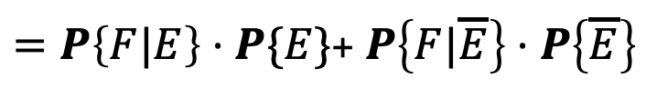
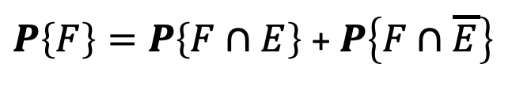

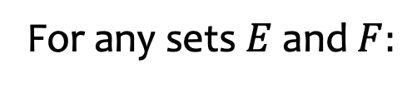
Law of Total Probability
For any sets $E$and $F:$
$$F=\left(F∩E\right)∪(F∩\overline{E})$$
$P\left\{F\right\}=P\left\{F∩E\right\}$ + $P\left\{F∩\overline{E}\right\}$
$=P\left\{F|E\right\}⋅P\{E\}$+ $P\left\{F|\overline{E}\right\}⋅P\left\{\overline{E}\right\}$

Slide 15
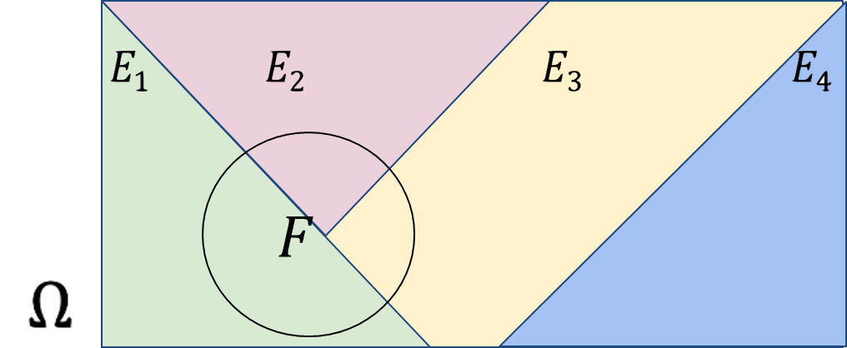
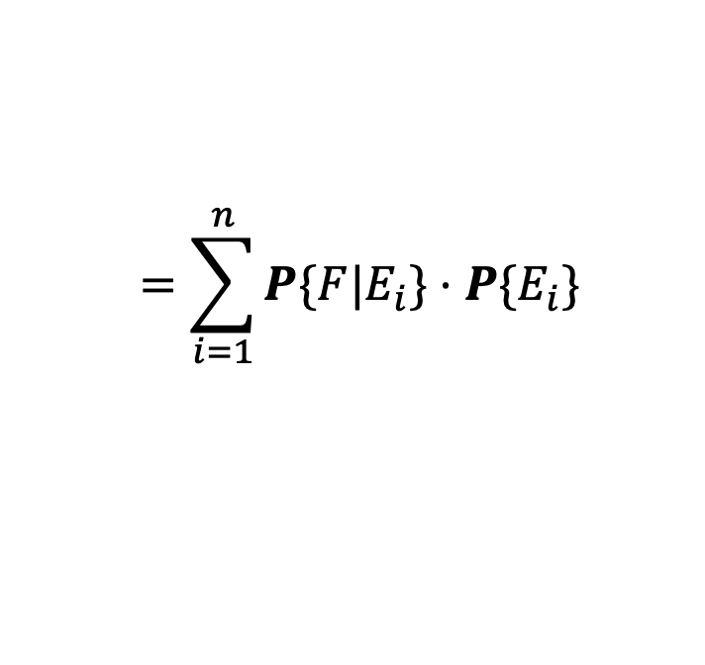
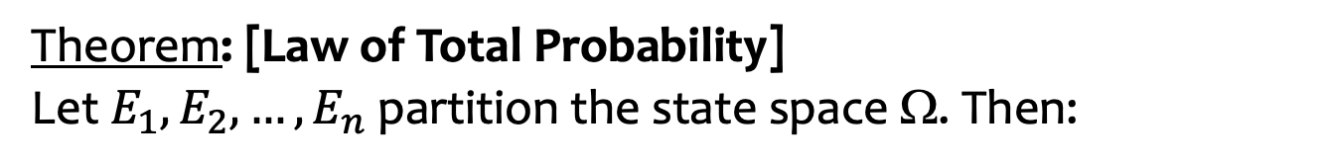
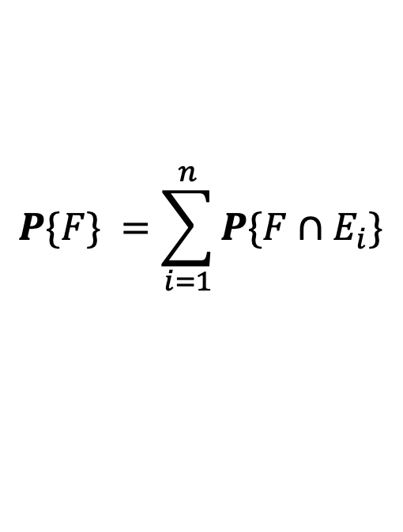
Law of Total Probability (General case)
For any sets $E$and $F:$
$$F=\left(F∩E\right)∪(F∩\overline{E})$$
$P\left\{F\right\}=P\left\{F∩E\right\}$ + $P\left\{F∩\overline{E}\right\}$
$=P\left\{F|E\right\}⋅P\{E\}$+ $P\left\{F|\overline{E}\right\}⋅P\left\{\overline{E}\right\}$
Generalizing, we have:
Theorem: [Law of Total Probability]
Let $E_{1},E_{2},…, E_{n}$ partition the state space Ω. Then:
$$P\{F\} =\sum_{i=1}^{n}{P\{F∩E_{i}\}}$$
$$=\sum_{i=1}^{n}{P\{F|E_{i}\}⋅P\{E_{i}\} }$$

Slide 16

Dance party?
Your friend is having a party. The music will either be:
  Playlist (PL) – probability 0.6
  DJ - probability 0.3
  Live band (LB) – probability 0.1
You are very picky about what music you will dance to. If they go with their playlist, you will dance with probability 0.2, if they go with a DJ, you’ll dance with probability 0.6 and if they go with a live band, you’ll dance with probability 0.9.
What’s the probability you dance and the music is a DJ?
Notes:
Pr (PL) = 0.6
Pr (DJ) = 0.3
Pr (LB) = 0.1
Pr (D | PL) = 0.2
Pr (D | DJ ) = 0.6
Pr (D | LB) = 0.9

Slide 17
Dance Party (2)
https://pollev.com/ annakarlin185
What is Pr (Dance and DJ)?
0.3
0.3 x 0.6
0.3²
0.6
Pr (PL) = 0.6
Pr (DJ) = 0.3
Pr (LB) = 0.1
D=Dance
Pr (D | PL) = 0.2
Pr (D | DJ ) = 0.6
Pr (D | LB) = 0.9
Notes:
Pr (PL) = 0.6
Pr (DJ) = 0.3
Pr (LB) = 0.1
Pr (D | PL) = 0.2
Pr (D | DJ ) = 0.6
Pr (D | LB) = 0.9

Slide 18
What is the probability you dance?
Theorem: [Law of Total Probability]
Let $E_{1},E_{2},…, E_{n}$ partition the state space Ω. Then:
$$P\{F\} =\sum_{i=1}^{n}{P\{F∩E_{i}\}}$$
$$=\sum_{i=1}^{n}{P\{F|E_{i}\}⋅P\{E_{i}\} }$$

Slide 19
Dance party (4)
Your friend is having a party. The music will either be:
  Playlist (PL) – probability 0.6
  DJ - probability 0.3
  Live band (LB) – probability 0.1
You are very picky about what music you will dance to. If they go with their playlist, you will dance with probability 0.2, if they go with a DJ, you’ll dance with probability 0.6 and if they go with a live band, you’ll dance with probability 0.9.
What’s the probability you dance?
Pr (Dance) = Pr (D | PL) Pr(PL) + Pr(D |DJ) Pr (DJ) + Pr (D | LB) Pr (LB)
Notes:
Pr (PL) = 0.6
Pr (DJ) = 0.3
Pr (LB) = 0.1
Pr (D | PL) = 0.2
Pr (D | DJ ) = 0.6
Pr (D | LB) = 0.9

Slide 20
Agenda (3)
Recap
Law of Total Probability
Bayes Theorem
More on Independence

Slide 21
Our First Machine Learning Task: Spam Filtering
Subject: “FREE $$$ CLICK HERE”
Suppose you know that 80% of emails you receive are spam.
So a priori, our belief is that any email has an 80% chance of being spam.
How do you update that belief when you see that the subject line contains the phrase “FREE $$$”?

Slide 22
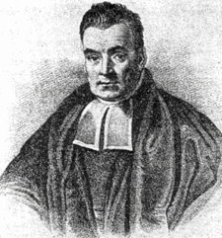
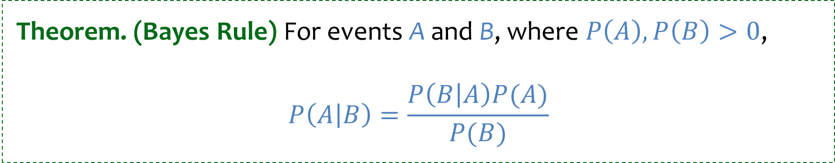

Bayes Theorem
A formula to let us “reverse” the conditional.
$P\left(A\right)$ is called the prior (our belief without knowing anything)
$P\left(A | B\right)$ is called the posterior (our belief after learning $B$)
Theorem. (Bayes Rule) For events A and B, where $P\left(A\right), P\left(B\right)>0$,
$$P\left(A | B\right)=\frac{P\left(B | A\right)P(A)}{P(B)}$$

Slide 23
Back to Spam Filtering - 1
Subject: “FREE $$$ CLICK HERE”
What is the probability this email is spam, given the subject contains “FREE”?
Some useful stats:
  10% of ham (i.e., not spam) emails contain the word “FREE” in the subject.
  70% of spam emails contain the word “FREE” in the subject.
  80% of emails you receive are spam.
Notes:
Pr (F | not S) = 0.1
Pr (F | S) = 0.7
Pr(S) = 0.8
Question: Pr (S | F) ?
Pr (S|F) = Pr (F |S) Pr (S)/ Pr(F)
Numerator: 0.7 x 0.8
Denominator: Pr(F) = Pr (F|S) Pr(S) + Pr (F |not S) Pr (not S) = 0.7 x 0.8 + 0.1 x 0.2

Slide 24
Back to Spam Filtering - 2
Subject: “FREE $$$ CLICK HERE”
What is the probability this email is spam, given the subject contains “FREE”?
Some useful stats:
  10% of ham (i.e., not spam) emails contain the word “FREE” in the subject.
  70% of spam emails contain the word “FREE” in the subject.
  80% of emails you receive are spam.
You receive a random email:
Let S be event that the email is spam
Let F be the event that the email contains the word “FREE”.
Notes:
Pr (F | not S) = 0.1
Pr (F | S) = 0.7
Pr(S) = 0.8
Question: Pr (S | F) ?
Pr (S|F) = Pr (F |S) Pr (S)/ Pr(F)
Numerator: 0.7 x 0.8
Denominator: Pr(F) = Pr (F|S) Pr(S) + Pr (F |not S) Pr (not S) = 0.7 x 0.8 + 0.1 x 0.2

Slide 25
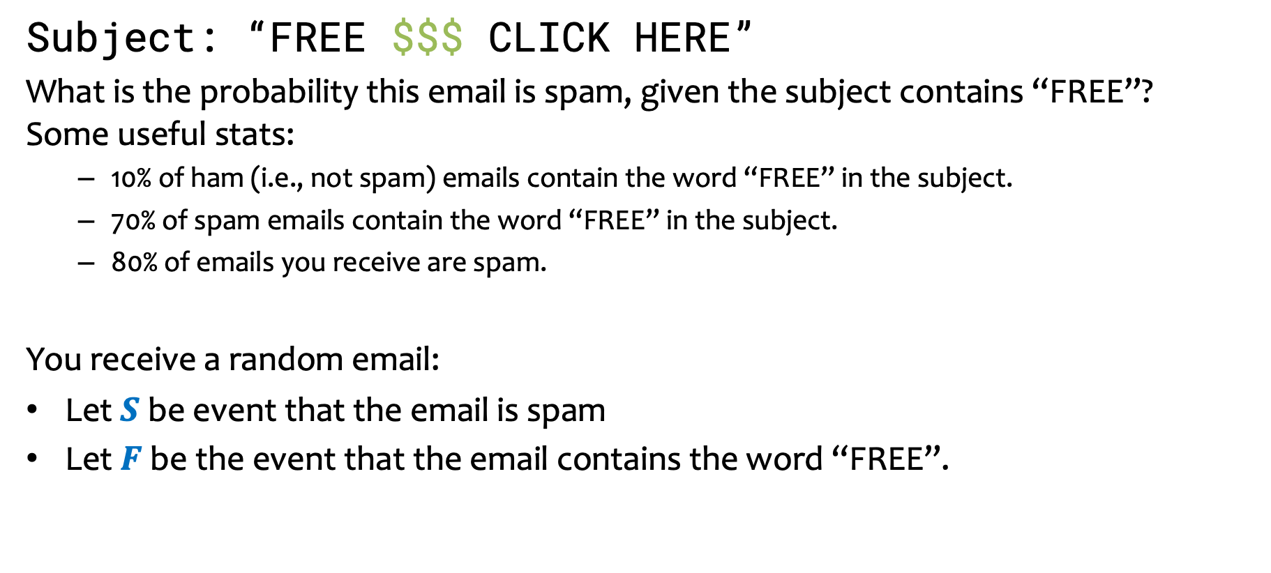



Back to Spam Filtering - 3
Subject: “FREE $$$ CLICK HERE”
What is the probability this email is spam, given the subject contains “FREE”?
Some useful stats:
  10% of ham (i.e., not spam) emails contain the word “FREE” in the subject.
  70% of spam emails contain the word “FREE” in the subject.
  80% of emails you receive are spam.
You receive a random email:
Let $S$ be event that the email is spam
Let $F$ be the event that the email contains the word “FREE”.
$$P\left(F | \overline{S }\right)=0.1$$
$$P\left(F | S \right)=0.7$$
$$P(S)=0.8$$
Notes:
Of the ham emails, 10% contain the word “FREE”
Pr (F | not S) = 0.1
Pr (F | S) = 0.7
Pr(S) = 0.8
Question: Pr (S | F) ?
Pr (S|F) = Pr (F |S) Pr (S)/ Pr(F)
Numerator: 0.7 x 0.8
Denominator: Pr(F) = Pr (F|S) Pr(S) + Pr (F |not S) Pr (not S) = 0.7 x 0.8 + 0.1 x 0.2
Checked reading order

Slide 26
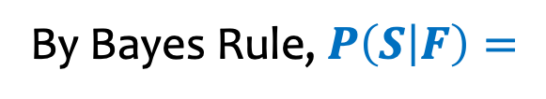
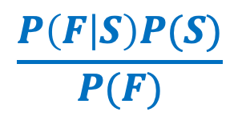
Back to Spam Filtering - 4
Subject: “FREE $$$ CLICK HERE”
What is the probability this email is spam, given the subject contains “FREE”?
Some useful stats:
  10% of ham (i.e., not spam) emails contain the word “FREE” in the subject.
  70% of spam emails contain the word “FREE” in the subject.
  80% of emails you receive are spam.
You receive a random email:
Let $S$ be event that the email is spam
Let $F$ be the event that the email contains the word “FREE”.
$$P\left(F | \overline{S }\right)=0.1$$
$$P\left(F | S \right)=0.7$$
$$P(S)=0.8$$
$$\frac{P\left(F | S\right)P(S)}{P(F)}$$
By Bayes Rule, $P\left(S | F\right)=$
Notes:
Pr (F | not S) = 0.1
Pr (F | S) = 0.7
Pr(S) = 0.8
Question: Pr (S | F) ?
Pr (S|F) = Pr (F |S) Pr (S)/ Pr(F)
Numerator: 0.7 x 0.8
Denominator: Pr(F) = Pr (F|S) Pr(S) + Pr (F |not S) Pr (not S) = 0.7 x 0.8 + 0.1 x 0.2

Slide 27
Back to Spam Filtering - 5
Subject: “FREE $$$ CLICK HERE”
What is the probability this email is spam, given the subject contains “FREE”?
Some useful stats:
  10% of ham (i.e., not spam) emails contain the word “FREE” in the subject.
  70% of spam emails contain the word “FREE” in the subject.
  80% of emails you receive are spam.
You receive a random email:
Let $S$ be event that the email is spam
Let $F$ be the event that the email contains the word “FREE”.
$$P\left(F | \overline{S }\right)=0.1$$
$$P\left(F | S \right)=0.7$$
$$P(S)=0.8$$
$$\frac{P\left(F | S\right)P(S)}{P(F)}$$
By Bayes Rule, $P\left(S | F\right)=$
By the Law of Total Probability $P\left(F\right)=P\left(F | S\right)P\left(S\right)+P\left(F | \overline{S}\right)P\left(\overline{S}\right)$
Notes:
Pr (F | not S) = 0.1
Pr (F | S) = 0.7
Pr(S) = 0.8
Question: Pr (S | F) ?
Pr (S|F) = Pr (F |S) Pr (S)/ Pr(F)
Numerator: 0.7 x 0.8
Denominator: Pr(F) = Pr (F|S) Pr(S) + Pr (F |not S) Pr (not S) = 0.7 x 0.8 + 0.1 x 0.2
Pr (S|F ) = 0.9655
Checked reading order

Slide 28
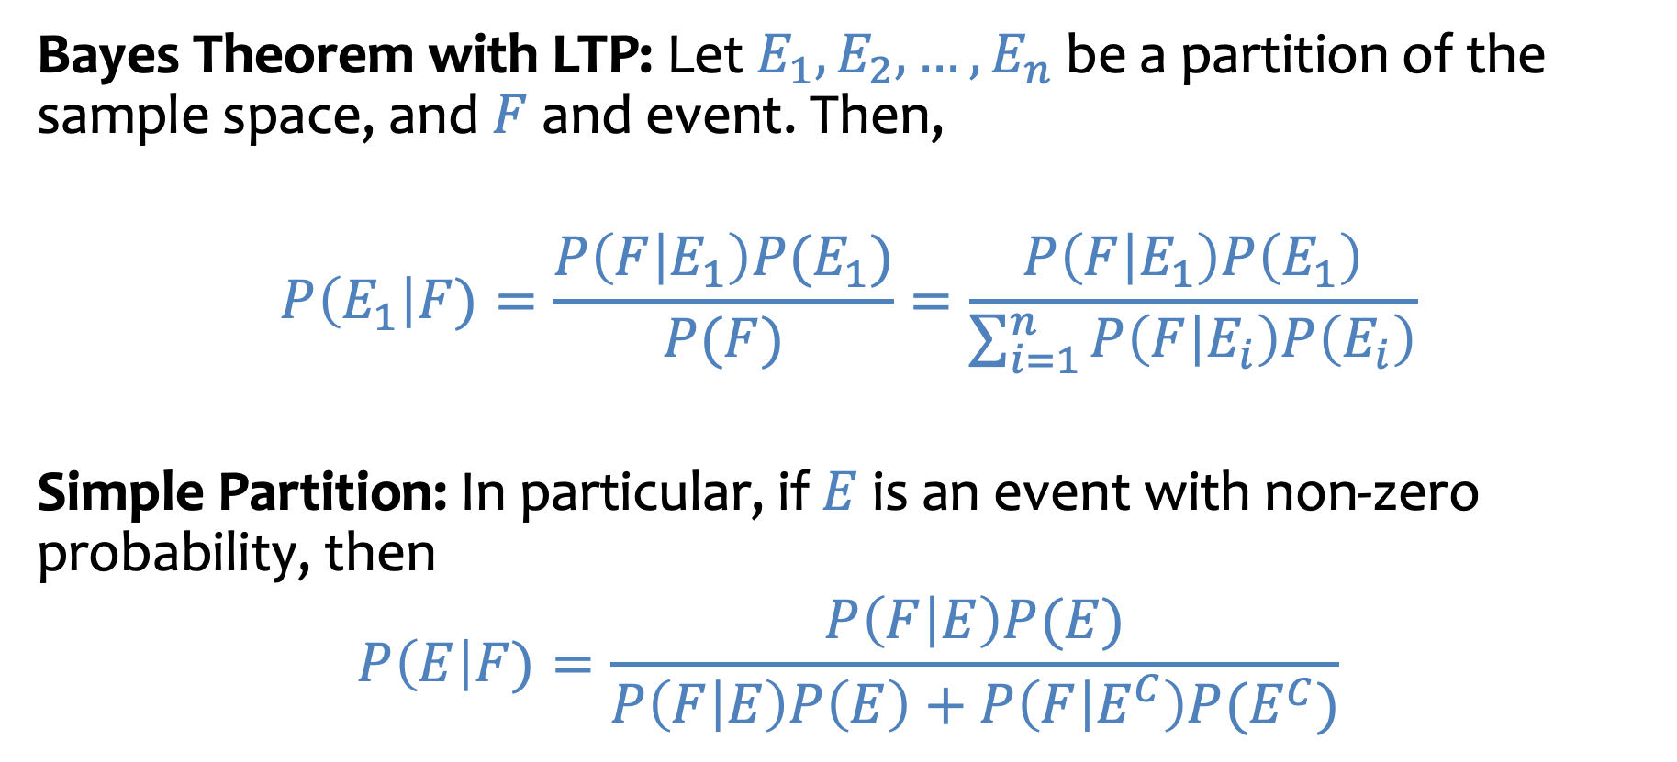
Bayes Theorem with Law of Total Probability
Bayes Theorem with LTP: Let $E_{1}, E_{2}, …, E_{n}$ be a partition of the sample space, and $F$ and event. Then,
$$P\left(E_{1}\right|F)=\frac{P\left(F | E_{1}\right)P(E_{1})}{P(F)}=\frac{P\left(F | E_{1}\right)P\left(E_{1}\right)}{\sum_{i=1}^{n}{P\left(F | E_{i}\right)P\left(E_{i}\right)}}$$
Simple Partition: In particular, if $E$ is an event with non-zero probability, then
$$P\left(E\right|F)=\frac{P\left(F | E\right)P(E)}{P\left(F | E\right)P\left(E\right)+P\left(F | E^{C}\right)P(E^{C})}$$

Slide 29
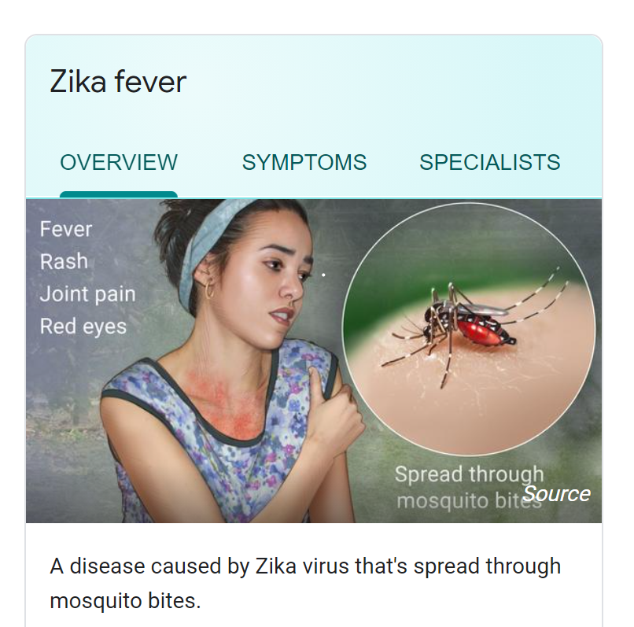
Example – Zika Testing
Usually no or mild symptoms (rash); sometimes severe symptoms (paralysis).
During pregnancy: may cause birth defects.
Suppose you took a Zika test, and it returns “positive”, what is the likelihood that you actually have the disease?
  Tests for diseases are rarely 100% accurate.
This example and following slides are from Lisa Yan (Stanford).
Notes:
What is the probability that you have disease X given that you test positive for X.
Probability that you test positive for X given that you have disease X.

Slide 30

Example – Zika Testing (1)
$$Z have Zika$$
$$T test positive$$
Suppose we know the following Zika stats
  A test is 98% effective at detecting Zika (“true positive”)
  However, the test yields a “false positive” 1% of the time
  0.5% of the US population has Zika.
What is the probability a random person in the US has Zika (event Z) given that they test positive (event T)?
Notes:
$$P\left(T | Z\right)=0.98$$
$$P(T|Z^{c})\text{=0.01}$$
$P(Z)$=0.005

Slide 31
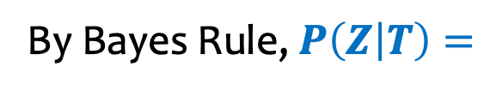


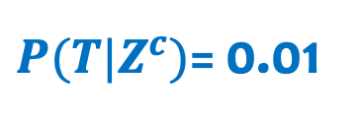


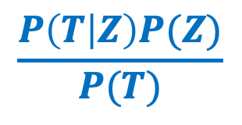
Example – Zika Testing (2)
$$Z have Zika$$
$$T test positive$$
Suppose we know the following Zika stats
  A test is 98% effective at detecting Zika (“true positive”)
  However, the test may yield a “false positive” 1% of the time
  0.5% of the US population has Zika.
What is the probability you have Zika (event $Z$) given that you test positive (event $T$)?
$$P\left(T | Z\right)=0.98$$
$P(T|Z^{c})$= 0.01
$P(Z)$=0.005
$$\frac{P\left(T | Z\right)P(Z)}{P(T)}$$
By Bayes Rule, $P\left(Z | T\right)=$
Notes:
P(Z|T) = P(Z) * P(T|Z) / P(Z)
Checked

Slide 32
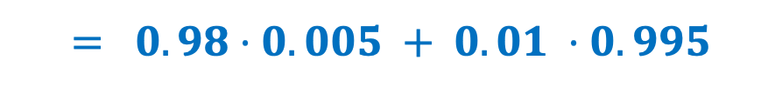
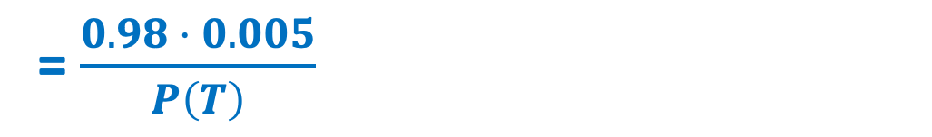

Example – Zika Testing (3)
$$Z have Zika$$
$$T test positive$$
Suppose we know the following Zika stats
  A test is 98% effective at detecting Zika (“true positive”)
  However, the test may yield a “false positive” 1% of the time
  0.5% of the US population has Zika.
What is the probability you have Zika (event $Z$) given that you test positive (event $T$)?
$$P\left(T | Z\right)=0.98$$
$P(T|Z^{c})$=0.01
$P(Z)$=0.005
$$\frac{P\left(T | Z\right)P(Z)}{P(T)}$$
= $\frac{0.98 ⋅ 0.005}{P\left(T\right)}$
By Bayes Rule, $P\left(Z | T\right)=$
By the Law of Total Probability, $P\left(T\right)=P\left(T | Z\right)P\left(Z\right)+P\left(T | Z^{c}\right)P(Z^{c})$
$$= 0.98⋅0.005 + 0.01 ⋅0.995$$
Notes:
= 0.32997

Slide 33



Philosophy – Updating Beliefs
While it’s not 98% that you have the disease, your beliefs changed significantly
$Z$ = you have Zika
$T$ = you test positive for Zika
I have a 0.5% chance of having Zika
Receive positive test result
I now have a 33% chance of having Zika after the test.
Prior: $P(Z)$
Posterior: $P(Z|T)$

Slide 34
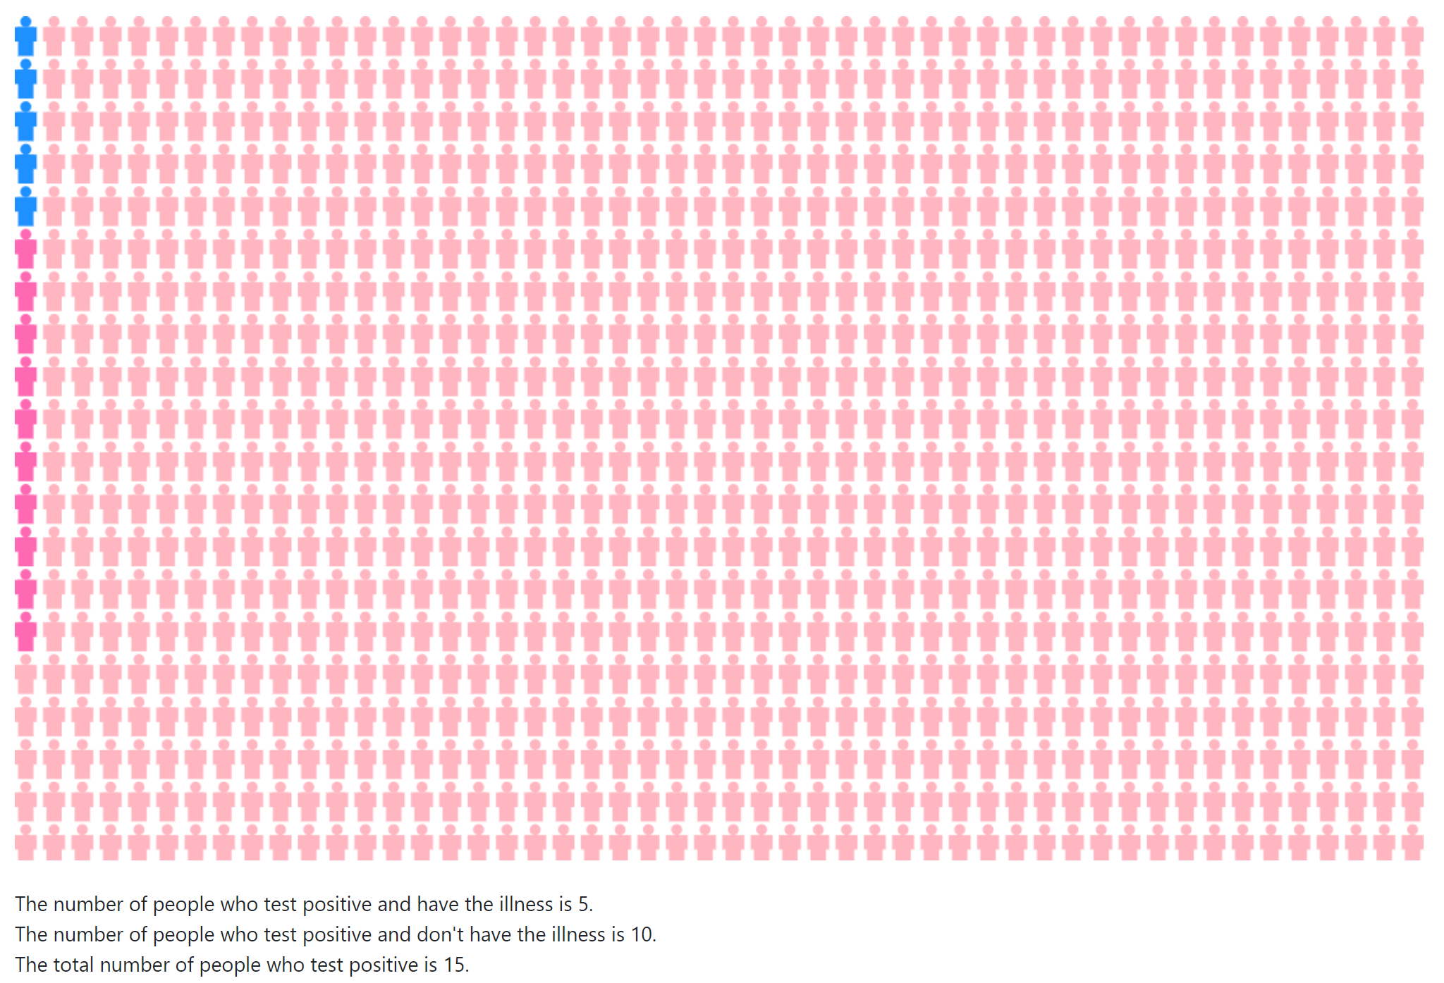
Example – Zika Testing (4)
Have zika blue, don’t pink
Suppose we had 1000 people:
  5 have Zika and all test positive
  985 do not have Zika and test negative
  10 do not have Zika and test positive
Notes:
Checked reading order

Slide 35
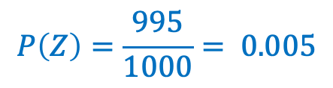
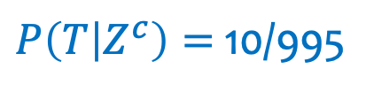

Example – Zika Testing (5)
Have zika blue, don’t pink
Picture below gives us the following Zika stats
  A test is 100% effective at detecting Zika (“true positive”).
  However, the test may yield a “false positive” 1% of the time
  0.5% of the US population has Zika. 5% have it.
What is the probability you have Zika (event Z) given that you test positive (event T)?
$$P\left(T | Z\right)=\text{5/5}=1$$
$P\left(T | Z^{c}\right)=$10/995
$$P\left(Z\right)=\frac{995}{1000}= 0.005$$
Suppose we had 1000 people:
  5 have Zika and and test positive
  985 do not have Zika and test negative
  10 do not have Zika and test positive
Notes:
Checked reading order

Slide 36

Example – Zika Testing (5)
Have zika blue, don’t pink
Picture below gives us the following Zika stats
  A test is 100% effective at detecting Zika (“true positive”).
  However, the test may yield a “false positive” 1% of the time
  0.5% of the US population has Zika. 5% have it.
What is the probability you have Zika (event Z) given that you test positive (event T)?
$$P\left(T | Z\right)=\text{5/5}=1$$
$P\left(T | Z^{c}\right)=$10/995
$$P\left(Z\right)=\frac{995}{1000}= 0.005$$
Suppose we had 1000 people:
  5 have Zika and and test positive
  985 do not have Zika and test negative
  10 do not have Zika and test positive
$$\frac{5}{5+10}=\frac{1}{3}≈0.33$$
Notes:
Checked reading order

Slide 37
Philosophy – Updating Beliefs - should be clearer
While it’s not 98% that you have the disease, your beliefs changed drastically
Z = you have Zika
T = you test positive for Zika
I have a 0.5% chance of having Zika
Receive positive test result
I now have a 33% chance of having Zika after the test.
Prior: P(Z)
Posterior: P(Z|T)

Slide 38



Zika Testing – different question
Z = you have Zika
T = you test positive for Zika
P($T$ | $Z$) = 0.98
P($T$ | $\overline{Z}$) = 0.01
P ($Z$) = 0.005
Suppose we know the following Zika stats
  A test is 98% effective at detecting Zika (“true positive”)
  However, the test may yield a “false positive” 1% of the time
  0.5% of the US population has Zika.
What is the probability you test negative (event $\overline{T}$) if you have Zika (event $Z$)?
https://pollev.com/ annakarlin185
Pr ($\overline{T} |Z$)
0.02
0.99
0.02 x 0.005
0.02 x 0.995

Slide 39
Conditional Probability Define a Probability Space
Example. $ℙ\left(ℬ^{c} | 𝒜\right)=1 −ℙ(ℬ|𝒜)$
Notes:
checked

Slide 40
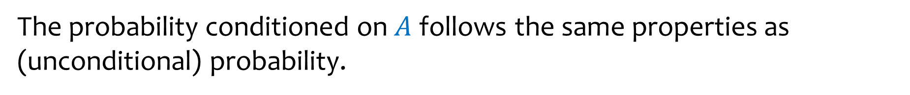
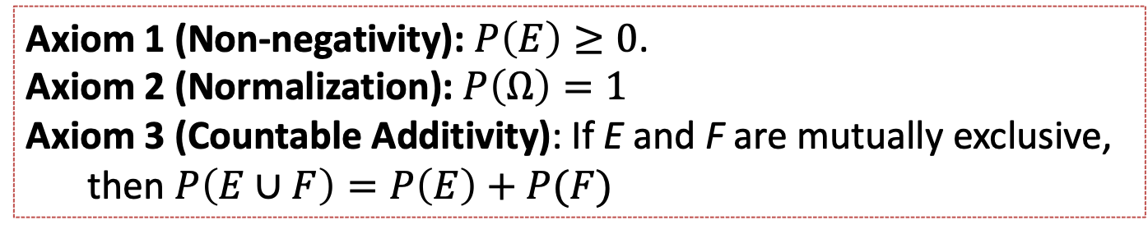

Conditional Probability Define a Probability Space (2)
The probability conditioned on $A$ follows the same properties as (unconditional) probability.
Example. $ℙ\left(ℬ^{c} | 𝒜\right)=1 −ℙ(ℬ|𝒜)$
Formally. $(Ω, ℙ)$ is a probability space + $ℙ\left(𝒜\right)>0$
$(𝒜,ℙ(⋅|𝒜))$ is a probability space
Axiom 1 (Non-negativity): $P\left(E\right)≥0$.
Axiom 2 (Normalization): $P\left(Ω\right)=1$
Axiom 3 (Countable Additivity): If E and F are mutually exclusive,
then $P\left(E∪F\right)=P\left(E\right)+P(F)$

Slide 41
Agenda (4)
Recap
Law of Total Probability
Bayes Theorem
More on independence
  Example using Law of Total Probability
  Independence of many events
  Independence not always obvious
  Defining a probability space using independence
  Independence as an assumption not always justified

Slide 42
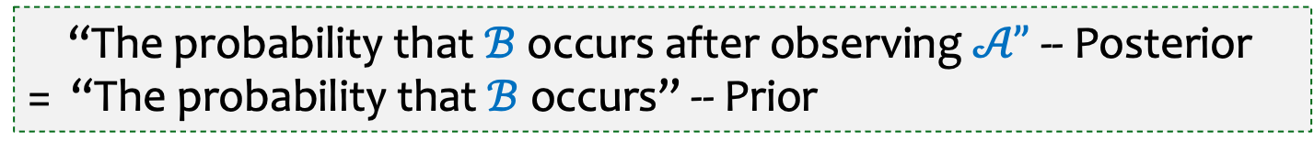
Independence
Definition. Two events $𝒜$and $ℬ$are independent if
$$ℙ\left(𝒜∩ℬ\right)=ℙ\left(𝒜\right)⋅ℙ(ℬ).$$
Alternatively,
If $ℙ\left(𝒜\right)≠0$, equivalent to $ℙ\left(ℬ | 𝒜\right)=ℙ\left(B\right)$
If $ℙ\left(ℬ\right)≠0$, equivalent to $ℙ\left(𝒜 | ℬ\right)=ℙ\left(𝒜\right)$
“The probability that $ℬ$ occurs after observing $𝒜”$ -- Posterior
= “The probability that $ℬ$ occurs” -- Prior
Notes:
Can check independence using any of these 3.

Slide 43


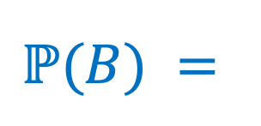
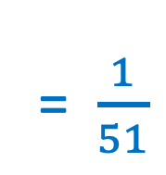
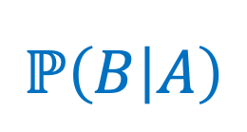
Are A and B independent?
Have a Standard 52-Card Deck. Shuffle It, and draw the top 2 cards in order:
Step 1: Draw a uniformly random card.
Step 2: Draw a uniformly random card from remaining cards.
A: Ace of Spades First
B: 10 of Clubs Second
= $\frac{1}{51}$
Are the events A and B independent?
$$ℙ\left(B | A\right)$$
$$ℙ(B) =$$
Notes:
Probability second card is 10 of clubs = \sum_{first card possibilities} Pr (first card ) Pr (second card 10 clubs | first card) = 51 x 1/52 x 1/51. = 1/52

Slide 44
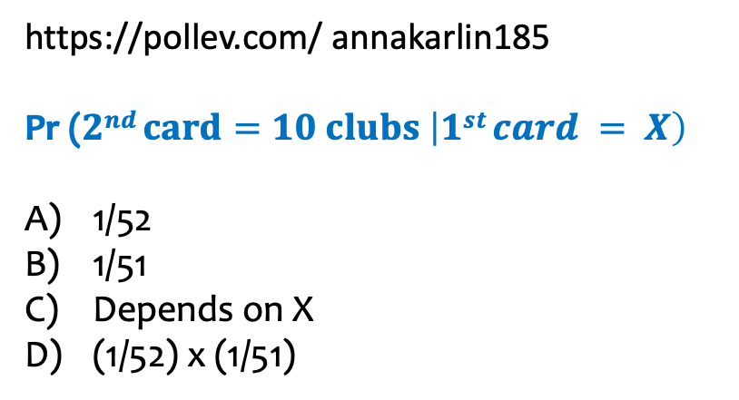
https://pollev.com/ annakarlin185
Pr ($2nd card=10 clubs \left|1st card = X\right)$
1/52
1/51
Depends on X
(1/52) x (1/51)

Slide 45
Agenda (5)
Recap
Law of Total Probability
Bayes Theorem
More on independence
  Example using Law of Total Probability
  Independence of many events
  Independence not always obvious
  Defining a probability space using independence
  Independence as an assumption not always justified

Slide 46

Multiple Events – Mutual Independence
Definition. Events $A_{1},…,A_{n}$ are mutually independent if for every non-empty subset $I⊆\{1,…,n\}$, we have
$$P\left(\bigcap_{i∈I}{A_{i}}\right)=\prod_{i∈I}{P(A_{i})}.$$

Slide 47

An example
You are routing a packet from the source to the destination.
But each of the 16 edges in the network works with probability $p, independently.$
s =
d =
Q: Pr(edge (s,3) works, edge (5,d) works, edge (s,7) doesn’t work)?

Slide 48
An example (2)
You are routing a packet from the source to the destination.
But each of the 16 edges in the network works with probability $p, independently.$
Q: What is the probability that you can get the packet from the source to the destination?

Slide 49



Let’s break it down
Each edge works with probability $p,$ independently of other edges. There are 8 paths.
Let $E_{i}$ denote the event that the $i^{th}$ path is usable (not broken).
Q1: What is $P\left\{E_{i}\right\}?$
Q2: What is $P\left\{\overline{E_{i}}\right\}?$
Notes:
Q1: p^2
Q2: 1-p^2

Slide 50



More calculations
Each edge works with probability $p,$ independently of other edges. There are 8 paths.
Let $E_{i}$ denote the event that the $i^{th}$ path is usable (not broken).
$$P\left\{E_{i}\right\}=p^{2}$$
$$P\left\{\overline{E_{i}}\right\}=1−p^{2}$$
What is $P\left\{\text{Can} \text{get} \text{from} \text{source} \text{to} \text{destination}\right\}?$
$$P\left\{\text{Can} \text{get} \text{from} \text{source} \text{to} \text{destination}\right\}=$$
Notes:
Q1: p
Q2: 1-p

Slide 51



Answer
Each edge works with probability $p,$ independently of other edges. There are 8 paths.
Let $E_{i}$ denote the event that the $i^{th}$ path is usable (not broken).
$$P\left\{E_{i}\right\}=p^{2}$$
$$P\left\{\overline{E_{i}}\right\}=1−p^{2}$$
What is $P\left\{\text{Can} \text{get} \text{from} \text{source} \text{to} \text{destination}\right\}?$
$$P\left\{\text{Can} \text{get} \text{from} \text{source} \text{to} \text{destination}\right\}= P\left\{\text{At} \text{least} \text{one} \text{path} \text{works}\right\}$$
$$=P\left\{E_{1}∪E_{2}∪⋯∪E_{8}\right\}$$
$$=1−P\left\{\text{All} \text{paths} \text{are} \text{broken}\right\}$$
$=1−P\left\{\overline{E_{1}}\right\}⋅$ $P\left\{\overline{E_{2}}\right\}⋯P\left\{\overline{E_{8}}\right\}=1 −{\left(1−p^{2}\right)}^{8}$
Notes:
Q1: p
Q2: 1-p

Slide 52
Agenda (6)
Recap
Law of Total Probability
Bayes Theorem
More on independence
  Example using Law of Total Probability
  Independence of many events
  Independence not always obvious
  Defining a probability space using independence
  Independence as an assumption not always justified

Slide 53


Independence – Another Look
Definition. Two events $A$and $B$independent if
$$P\left(A∩B\right)=P\left(A\right)⋅P(B).$$
“Equivalently.” $P\left(A|B\right)=P\left(A\right).$
Events generated independently ➔ their probabilities satisfy independence
But events can be independent without being generated by independent processes.
⬅
This can be counterintuitive!

Slide 54












Balls in Urns
Setting: An urn contains:
3 red and 3 blue balls w/ probability 3/5
3 red and 1 blue balls w/ probability 1/10
5 red and 7 blue balls w/ probability 3/10
We draw a ball at random from the urn.
R
$$1/2$$
3R3B
$$3/5$$
$$1/2$$
$$1/10$$
$$3/4$$
3R1B
B
$$1/4$$
$$3/10$$
Are $\text{R}$ and 3R3B independent?
$$5/12$$
$$7/12$$
5R7B
$P\left(\text{R} | \text{3}\text{R}\text{3}\text{B}\right)$ $=$
$$P\left(\text{R}\right)=$$
Notes:
$$\frac{3}{10}×a=\frac{1}{2}−\frac{3}{5}×\frac{1}{2}+\frac{1}{10}×\frac{3}{4}=\frac{20}{40}−\frac{12}{40}−\frac{3}{40}=\frac{5}{40}=\frac{1}{8}$$
$$a=\frac{1}{8}×\frac{10}{3}=\frac{1}{4}×\frac{5}{3}=\frac{5}{12}$$
checked

Slide 55













Balls in Urns- computation (1)
Ball drawn
Urn
R
$$1/2$$
Setting: An urn contains:
3 red and 3 blue balls w/ probability 3/5
3 red and 1 blue balls w/ probability 1/10
5 red and 7 blue balls w/ probability 3/10
We draw a ball at random from the urn.
3R3B
$$3/5$$
$$1/2$$
$$1/10$$
$$3/4$$
3R1B
B
$$1/4$$
$$3/10$$
$$5/12$$
$$7/12$$
5R7B
$P\left(\text{R} | \text{3}\text{R}\text{3}\text{B}\right)$ $=\frac{1}{2}$
Are $\text{R}$ and 3R3B independent?
Notes:
$$\frac{3}{10}×a=\frac{1}{2}−\frac{3}{5}×\frac{1}{2}+\frac{1}{10}×\frac{3}{4}=\frac{20}{40}−\frac{12}{40}−\frac{3}{40}=\frac{5}{40}=\frac{1}{8}$$
$$a=\frac{1}{8}×\frac{10}{3}=\frac{1}{4}×\frac{5}{3}=\frac{5}{12}$$

Slide 56







Balls in Urns - computation (2)
Ball drawn
Urn
R
Setting: An urn contains:
3 red and 3 blue balls w/ probability 3/5
3 red and 1 blue balls w/ probability 1/10
5 red and 7 blue balls w/ probability 3/10
We draw a ball at random from the urn.
$$1/2$$
3R3B
$$3/5$$
$$1/2$$
$$1/10$$
$$3/4$$
3R1B
B
$$1/4$$
$$P\left(\text{R}\right)=\frac{3}{5}×\frac{1}{2}+\frac{1}{10}×\frac{3}{4}+\frac{3}{10}×\frac{5}{12}=\frac{1}{2}$$
$$3/10$$
$$5/12$$
$$7/12$$
5R7B
$P\left(\text{R} | \text{3}\text{R}\text{3}\text{B}\right)$ $=\frac{1}{2}$
Are $\text{R}$ and 3R3B independent?
Independent! $P\left(\text{R}\right)=P\left(\text{R} | \text{3}\text{R}\text{3}\text{B}\right)$
Notes:
$$\frac{3}{10}×a=\frac{1}{2}−\frac{3}{5}×\frac{1}{2}+\frac{1}{10}×\frac{3}{4}=\frac{20}{40}−\frac{12}{40}−\frac{3}{40}=\frac{5}{40}=\frac{1}{8}$$
$$a=\frac{1}{8}×\frac{10}{3}=\frac{1}{4}×\frac{5}{3}=\frac{5}{12}$$

Slide 57
Agenda (7)
Recap
Law of Total Probability
Bayes Theorem
More on independence
  Example using Law of Total Probability
  Independence of many events
  Independence not always obvious
  Defining a probability space using independence

Slide 58

Defining a probability space
Often probability space $\left(Ω, ℙ\right)$ is defined using independence

Slide 59



Example – Biased coin
We have a biased coin comes up Heads with probability 2/3; Each flip is independent of all other fips. Suppose it is tossed 3 times.
$ℙ\left(HHH\right)$ $=$
$ℙ\left(TTT\right)$ $=$
$ℙ\left(HTT\right)$ $=$

Slide 60

Example – Biased coin – let’s do a calculation
We have a biased coin comes up Heads with probability 2/3, independently of other flips. Suppose it is tossed 3 times.
$ℙ\left(2 heads in 3 tosses\right)$ $=$
https://pollev.com/ annakarlin185
(2/3)² 1/3
2/3
3 (2/3)² 1/3
(1/3)²

