Slide 1
Am I going too fast in lecture? Your responses are anonymous.
https://pollev.com/ annakarlin185
A. Yes, you are going way too fast.
B. Yes, you are going a little bit too fast.
C. No, your pace is about right.
D. No, your pace is too slow.

Slide 2
The Birthday Paradox, Conditional Probability and more
CSE 312 Spring 26
Lecture 5

Slide 3


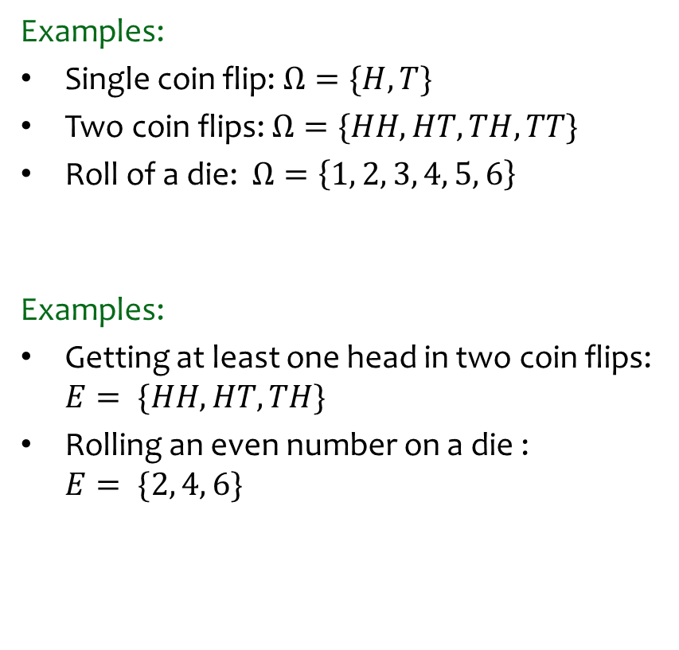
Review - Probability
Definition. A sample space $Ω$ is the set of all possible outcomes of an experiment.
Examples:
Single coin flip: $Ω=\{H, T\}$
Two coin flips: $Ω=\{HH, HT, TH, TT\}$
Roll of a die: $Ω=\left\{1, 2, 3, 4, 5, 6\right\}$
Examples:
Getting at least one head in two coin flips: $E= \{HH, HT, TH\}$
Rolling an even number on a die :
$E= \{2, 4, 6\}$
Definition. An event $E⊆Ω$ is a subset of possible outcomes.

Slide 4
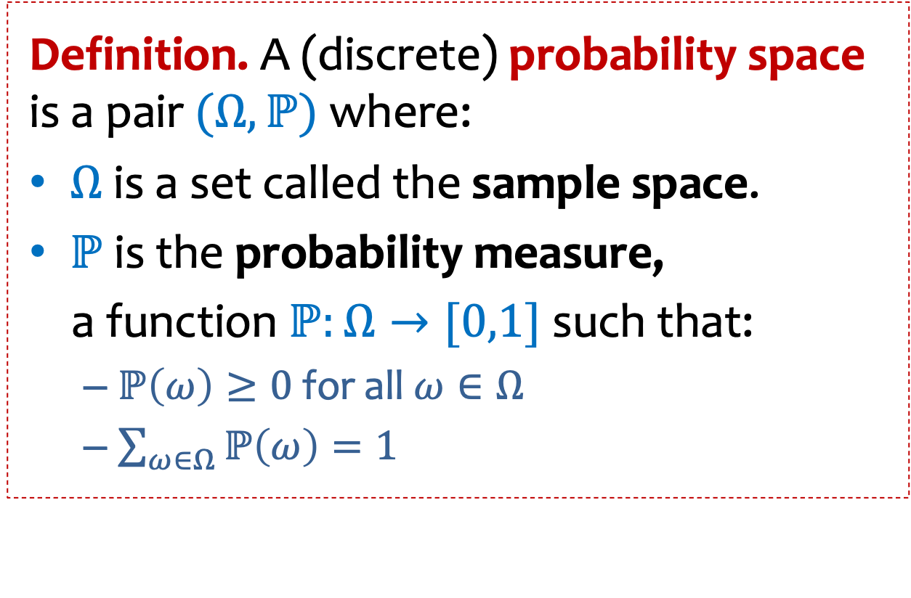

Probability space - more
Either finite or infinite countable (e.g., integers)
Definition. A (discrete) probability space is a pair $(Ω, ℙ)$ where:
$Ω$ is a set called the sample space.
$ℙ$ is the probability measure,
a function $ℙ:Ω→[0,1]$ such that:
  $ℙ\left(ω\right)≥0$ for all$ω∈Ω$
  $\sum_{ω∈Ω}{ℙ\left(ω\right)}=1$
Set of possible elementary outcomes
$$Ω$$
Specify Likelihood
(or probability) of each elementary outcome
Some outcome must show up
The likelihood (or probability) of each outcome is non-negative.

Slide 5
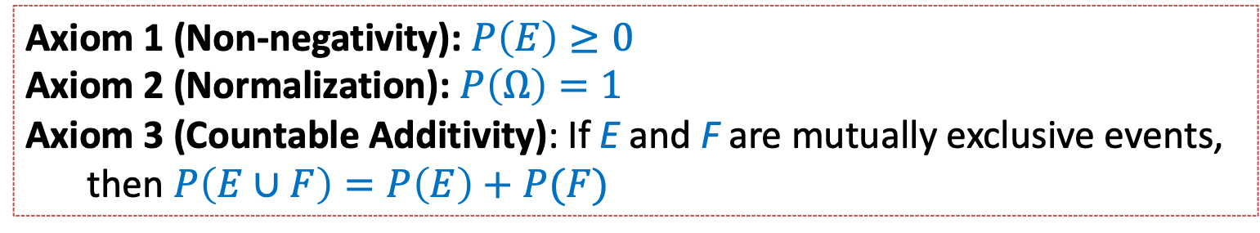

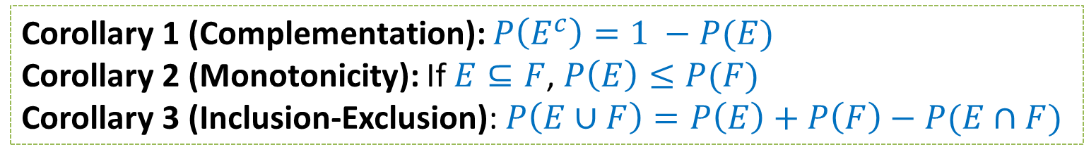
Review Axioms of Probability
Let $Ω$ denote the sample space and $E, F⊆Ω$ be events.
Axiom 1 (Non-negativity): $P\left(E\right)≥0$
Axiom 2 (Normalization): $P\left(Ω\right)=1$
Axiom 3 (Countable Additivity): If E and F are mutually exclusive events,
then $P\left(E∪F\right)=P\left(E\right)+P(F)$
Corollary 1 (Complementation): $P\left(E^{c}\right)=1 −P(E)$
Corollary 2 (Monotonicity): If $E⊆F$, $P\left(E\right)≤P(F)$
Corollary 3 (Inclusion-Exclusion): $P\left(E∪F\right)=P\left(E\right)+P\left(F\right)−P(E∩F)$

Slide 6
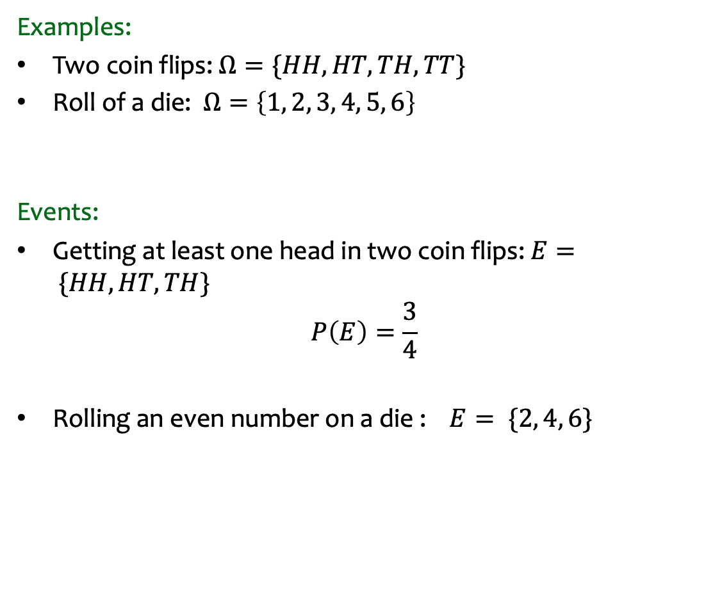
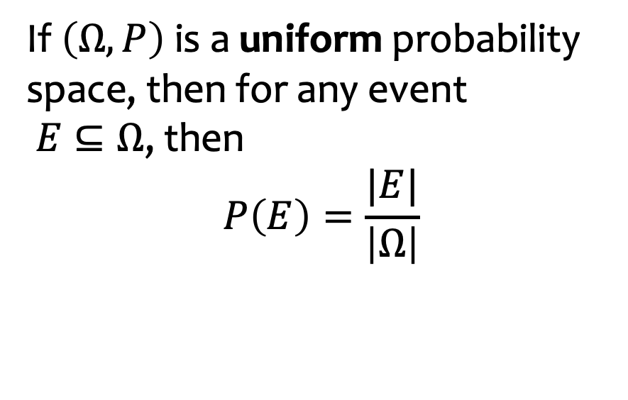

Review: Equally Likely Outcomes
Examples:
Two coin flips: $Ω=\{HH, HT, TH, TT\}$
Roll of a die: $Ω=\left\{1, 2, 3, 4, 5, 6\right\}$
Events:
Getting at least one head in two coin flips: $E= \{HH, HT, TH\}$
$$P\left(E\right)=\frac{3}{4}$$
Rolling an even number on a die :$E= \{2, 4, 6\}$
If $\left(Ω, P\right)$ is a uniform probability space, then for any event
$E⊆Ω$, then
$$P\left(E\right)=\frac{|E|}{\left|Ω\right|}$$
$P\left(E\right)=\frac{3}{6}$ = $\frac{1}{2}$

Slide 7
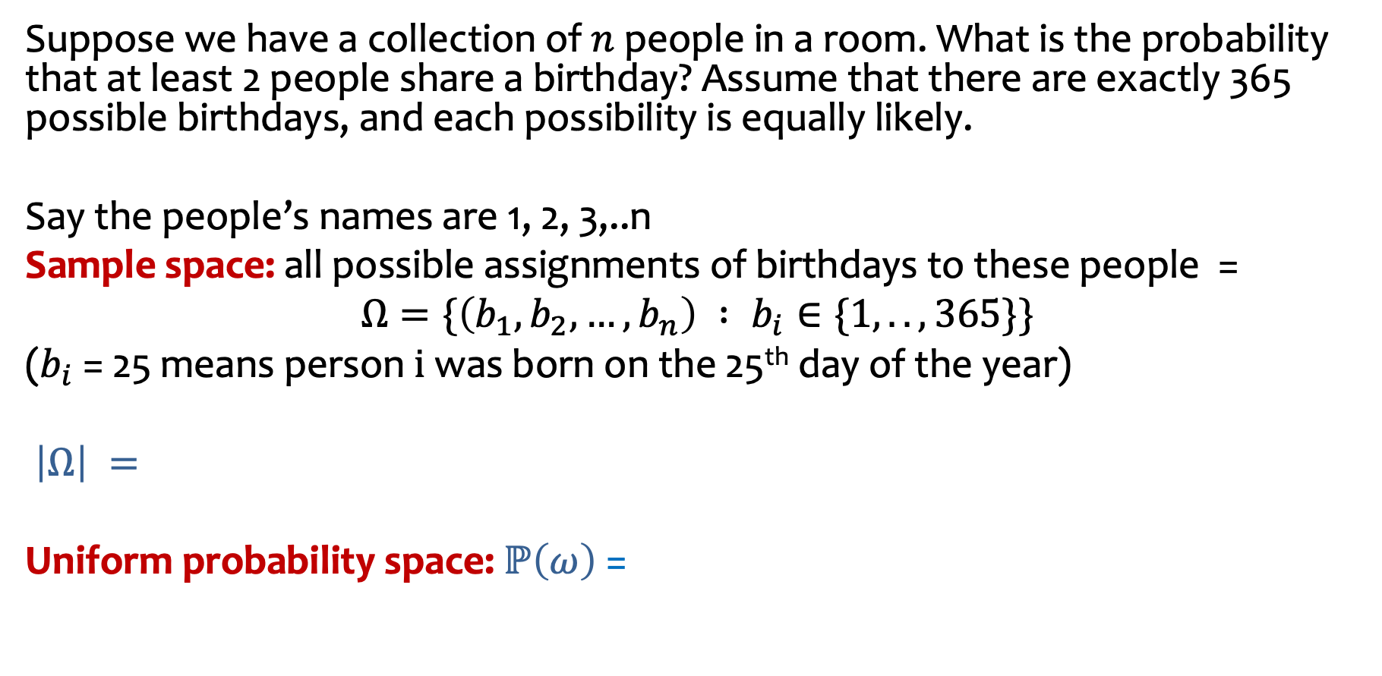
Example: Birthday “Paradox”
Suppose we have a collection of $n$ people in a room. What is the probability that at least 2 people share a birthday? Assume that there are exactly 365 possible birthdays, and each possibility is equally likely.
Say the people’s names are 1, 2, 3,..n
Sample space: all possible assignments of birthdays to these people =
$$Ω=\{\left(b_{1},b_{2},…,b_{n}\right) : b_{i}∈\{1,..,365\}\}$$
($b_{i}$ = 25 means person $i$was born on the 25th day of the year)
$\left|Ω\right| =$
Uniform probability space: $ℙ\left(ω\right)$ =
Notes:
For all the details, see the posted notes on the “Birthday “Paradox”.

Slide 8

Example: Birthday “Paradox”
$E$ = { at least 2 people share a birthday}
What is $ℙ\left(E \right)$?
Notes:
For all the details that I wrote out in class, see the posted notes on the “Birthday “Paradox”.

Slide 10
Agenda (1)
Conditional Probability
Chain Rule
Independence
Law of Total Probability
Bayes Theorem

Slide 11


Conditional Probability (Idea)
F
E
36
7
13
14
What’s the probability that a uniformly random person likes ice cream given they like donuts?
Notes:
70 total

Slide 12
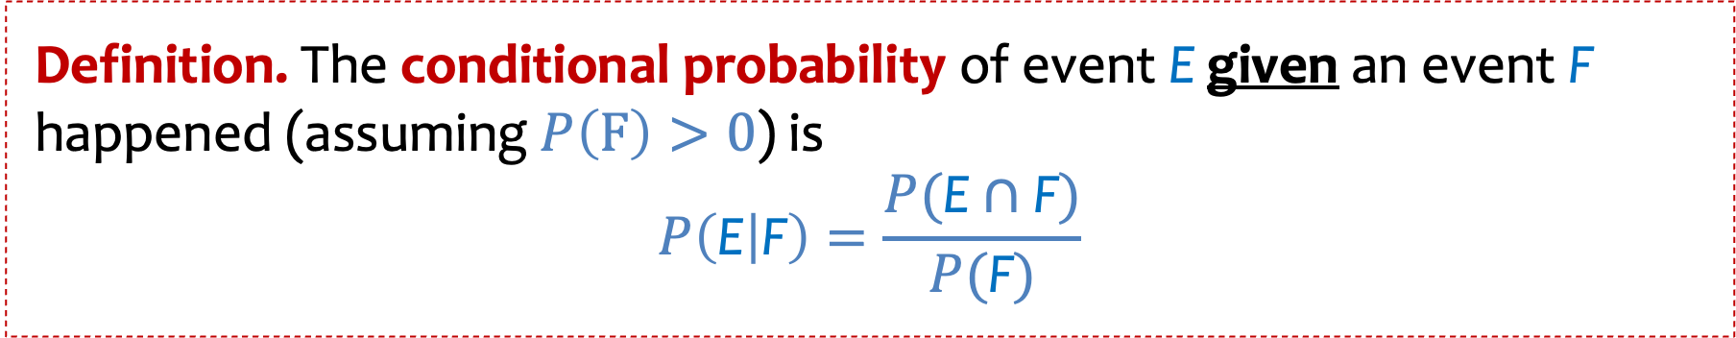
Conditional Probability
Definition. The conditional probability of event E given an event F happened (assuming $P\left(F\right)>0$) is
$$P\left(\text{E} | \text{F}\right)=\frac{P(\text{E}∩\text{F})}{P(\text{F})}$$

Slide 13
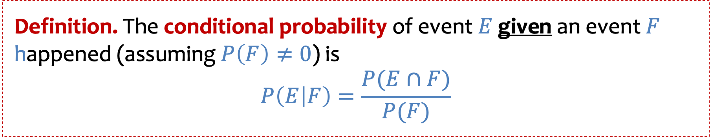
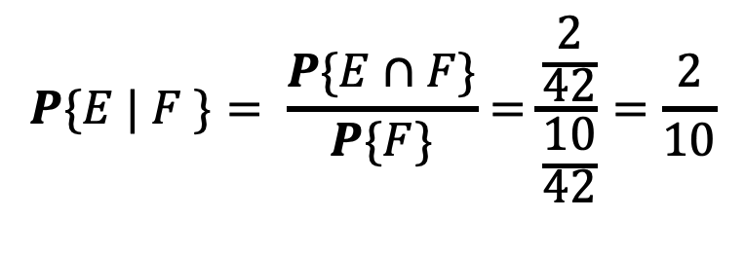
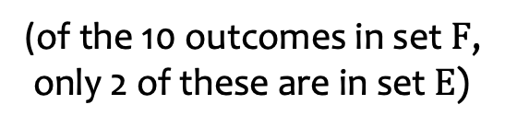
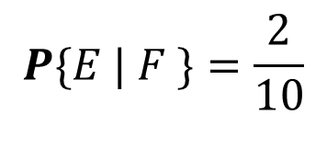
Conditional Probability
Definition. The conditional probability of event $E$given an event $F$ happened (assuming $P\left(F\right)≠0$) is
$$P\left(E | F\right)=\frac{P(E∩F)}{P(F)}$$
Two equivalent views for equally likely outcomes:
$$P\{E | F \}=\frac{2}{10}$$
(of the 10 outcomes in set $F$,
only 2 of these are in set $E$)
$$P\{E | F \}= \frac{P\{E∩F\}}{P\{F\}}=\frac{\frac{2}{42}}{\frac{10}{42}}=\frac{2}{10}$$

Slide 14


Conditional Probability on Events
Q: W$hat is P\{\text{both} \text{are} \text{colts}\text{\}}$ ?
The offspring of a horse is called a foal.
Horse couples have one foal at a time and each foal is either a “colt” or a “filly.”
We’re told that a horse couple had 2 foals and that each outcome is equally likely.

Slide 15
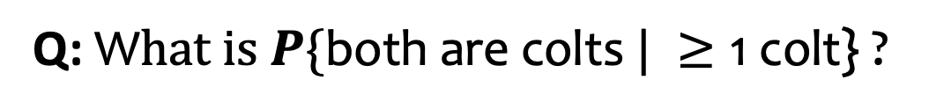
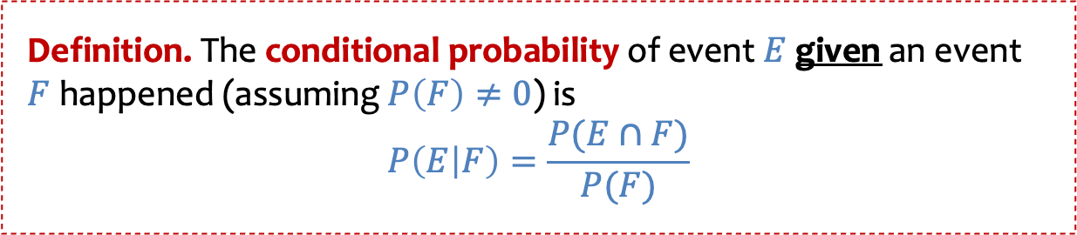
Conditional Probability on Events
Definition. The conditional probability of event $E$given an event $F$ happened (assuming $P\left(F\right)≠0$) is
$$P\left(E | F\right)=\frac{P(E∩F)}{P(F)}$$
Q: W$hat is P\{\text{both} \text{are} \text{colts} | ≥\text{1 }\text{colt}\text{\}}$ ?
The offspring of a horse is called a foal.
Horse couples have one foal at a time and each foal is either a “colt” or a “filly.”
We’re told that a horse couple had 2 foals and that each outcome is equally likely. We are also told that at least one of these is a colt.

Slide 16
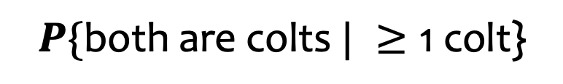
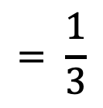
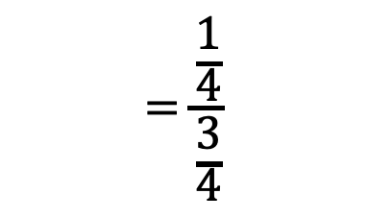
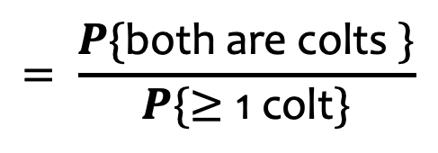
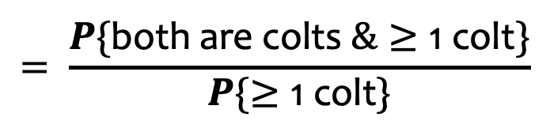
Conditional Probability on Events - Answer
$$P\{\text{both} \text{are} \text{colts} | ≥\text{1 }\text{colt}\text{\}}$$
$$= \frac{P\{\text{both} \text{are} \text{colts} \&≥\text{1 }\text{colt}\}}{P\{≥\text{1 }\text{colt}\}}$$
$$= \frac{P\{\text{both} \text{are} \text{colts} \}}{P\{≥\text{1 }\text{colt}\}}$$
The offspring of a horse is called a foal.
Horse couples have one foal at a time and each foal is either a “colt” or a “filly.”
We’re told that a horse couple had 2 foals and that each outcome is equally likely. We are also told that at least one of these is a colt.
$$=\frac{\frac{1}{4}}{\frac{3}{4}}$$
$$= \frac{1}{3}$$

Slide 17

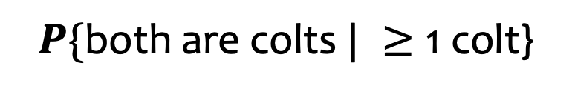

Conditional Probability on Events - picture
$$P\{\text{both} \text{are} \text{colts} | ≥\text{1 }\text{colt}\text{\}}$$
$$= \frac{1}{3}$$
The offspring of a horse is called a foal.
Horse couples have one foal at a time and each foal is either a “colt” or a “filly.”
We’re told that a horse couple had 2 foals and that each outcome is equally likely. We are also told that at least one of these is a colt.

Slide 18
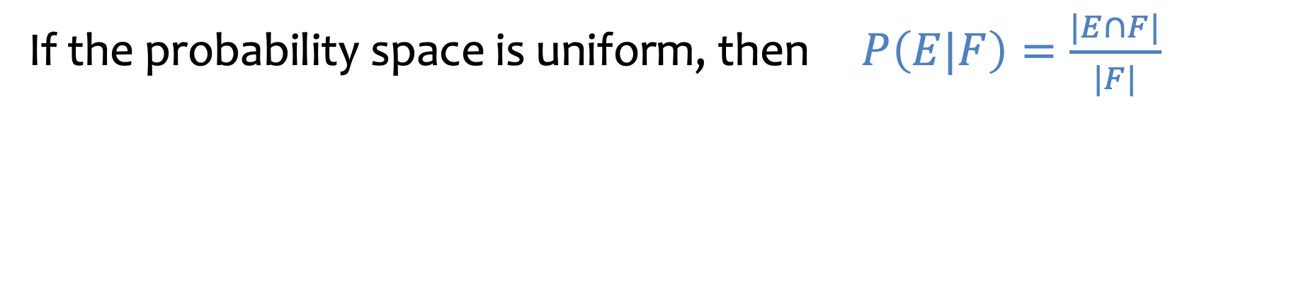

Conditional Probability in a uniform probability space
Definition. The conditional probability of event $E$given an event $F$ happened (assuming $P\left(F\right)≠0$) is
$$P\left(E | F\right)=\frac{P(E∩F)}{P(F)}$$
If the probability space is uniform, then $P\left(E|F\right)=\frac{|E∩F|}{|F|}$

Slide 19
Agenda (2)
Conditional Probability
Chain Rule
Independence
Law of Total Probability
Bayes Theorem

Slide 20

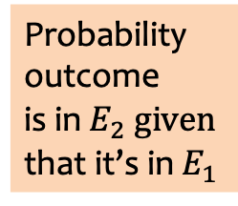
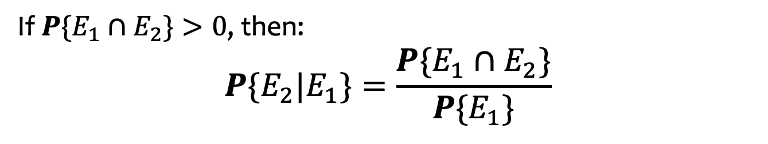
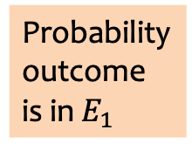
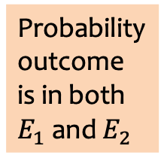
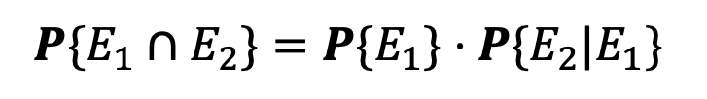

Chain Rule
If $P\{E_{1}∩E_{2}\}>0$, then:
$$P\{E_{2}|E_{1}\}=\frac{P\{E_{1}∩E_{2}\}}{P\{E_{1}\}}$$
Equivalently, we can write:
If $P\{E_{1}∩E_{2}\}>0$, then:
$$P\{E_{1}∩E_{2}\}=P\{E_{1}\}⋅P\{E_{2}|E_{1}\}$$
$$\text{Likewise}\text{:}$$
$$P\{E_{1}∩E_{2}\}=P\{E_{2}\}⋅P\{E_{1}|E_{2}\}$$
Probability
outcome
is in both
$E_{1}$ and $E_{2}$
Probability
outcome
is in $E_{1}$
Probability
outcome
is in $E_{2} given$
that it’s in $E_{1}$

Slide 21
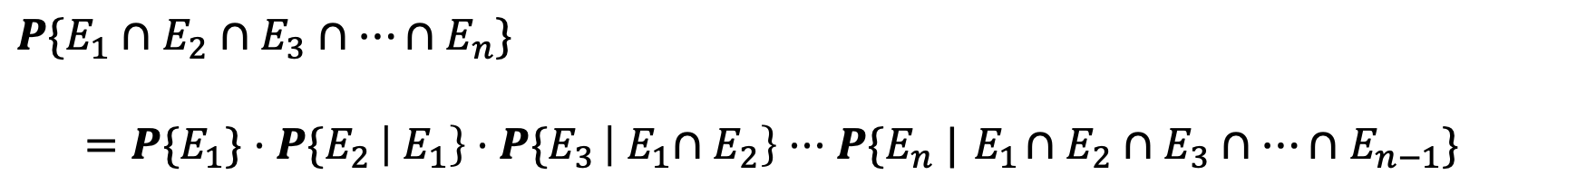
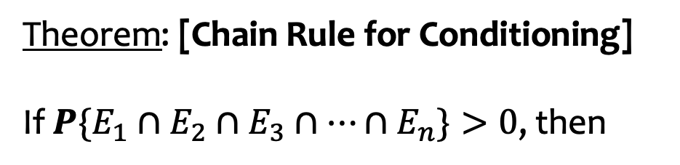

Chain Rule for Conditioning – general case.
If $P\{E_{1}∩E_{2}\}>0$, then:
$$P\{E_{1}∩E_{2}\}=P\{E_{1}\}⋅P\{E_{2}|E_{1}\}$$
This can be generalized!
Theorem: [Chain Rule for Conditioning]
If $P\{E_{1}∩E_{2}∩E_{3}∩⋯∩E_{n}\}>0$, then
$$P\{E_{1}∩E_{2}∩E_{3}∩⋯∩E_{n}\}$$
$=P\{E_{1}\}⋅P\{E_{2 }\left|{ E}_{1}\right\}⋅P\{E_{3 }\left|{{ E}_{1}∩E}_{2}\right\}⋅⋅⋅P\{E_{n} |{ E}_{1}∩E_{2}∩E_{3}∩⋯∩E_{n−1}\}$
Notes:
Checked reading order

Slide 22



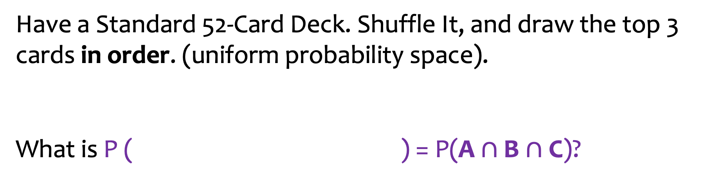
Chain Rule Example
Have a Standard 52-Card Deck. Shuffle It, and draw the top 3 cards in order. (uniform probability space).
What is P ( ) = P(A $∩$ B $∩$ C)?
A: Ace of Spades First
B: 10 of Clubs Second
C: 4 of Diamonds Third
Notes:
Probability that first card is A.
What’s the probability that the second card is 10 clubs given that first card is Ace of Spades?
Compare to Probability second card is 10 of clubs.

Slide 24
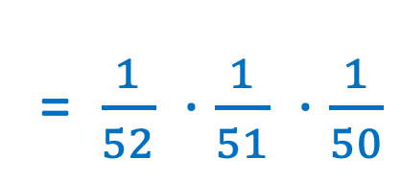
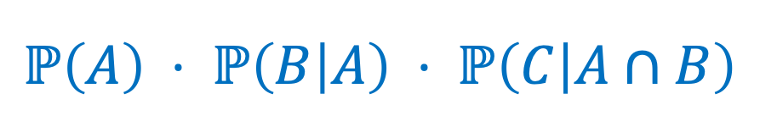
Chain Rule Example
Have a Standard 52-Card Deck. Shuffle It, and draw the top 3 cards in order. (uniform probability space).
What is P ( ) = P(A $∩$ B $∩$ C)?
A: Ace of Spades First
B: 10 of Clubs Second
C: 4 of Diamonds Third
$$ℙ\left(A\right) ⋅ ℙ\left(B | A\right) ⋅ ℙ\left(C | A∩B\right)$$
= $\frac{1}{52} ⋅\frac{1}{51} ⋅\frac{1}{50}$
Notes:
Probability that first card is A.
What’s the probability that the seond card is this
Compare to Probability second card is 10 of clubs.

Slide 25
Agenda (3)
Conditional Probability
Chain Rule
Independence
Law of Total Probability
Bayes Theorem

Slide 26


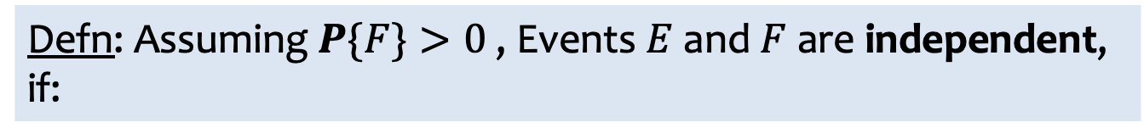
Independent Events
Defn: Events $E$and $F$are independent, written $E⊥F,$if:
$P\{E∩F\}=P\{E\}⋅P\{F\}$
Here’s an equivalent and perhaps more intuitive definition:
Defn: Assuming $P\{F\}>0$, Events $E$and $F$are independent, if:
$P\{E | F\}=P\{E\}$
If $E$and $F$are independent, so are $\overline{E}$and $F, E \text{and}\overline{ F}\text{, }\text{an}\text{d} \overline{E} \text{and} \overline{ F}$

Slide 28
Independent Events – example 1
Defn: Events $E$and $F$are independent, written $E⊥F,$if:
$P\{E∩F\}=P\{E\}⋅P\{F\}$
Here’s an equivalent and perhaps more intuitive definition:
Defn: Assuming $P\{F\}>0$, Events $E$and $F$are independent, if:
$P\{E | F\}=P\{E\}$
Q1: Can two mutually exclusive, non-null events be independent?

Slide 29
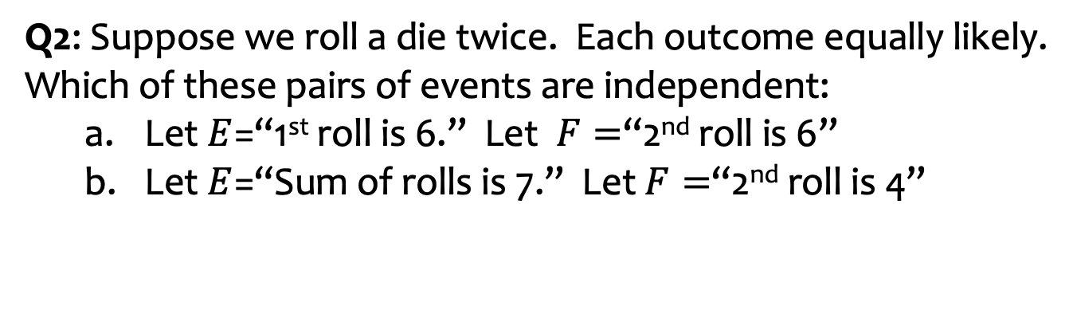
Independent Events – example 2
Defn: Events $E$and $F$are independent, written $E⊥F,$if:
$P\{E∩F\}=P\{E\}⋅P\{F\}$
Here’s an equivalent and perhaps more intuitive definition:
Defn: Assuming $P\{F\}>0$, Events $E$and $F$are independent, if:
$P\{E | F\}=P\{E\}$
Q2: Suppose we roll a die twice. Each outcome equally likely.
Which of these pairs of events are independent:
  Let $E$=“1st roll is 6.” Let $F=$“2nd roll is 6”
  Let $E$=“Sum of rolls is 7.” Let $F=$“2nd roll is 4”
Notes:
Sum of rolls = 7: is the event {(1,6), (2, 5), (3,4) (4. 3), (5, 2), (6, 1)

Slide 31
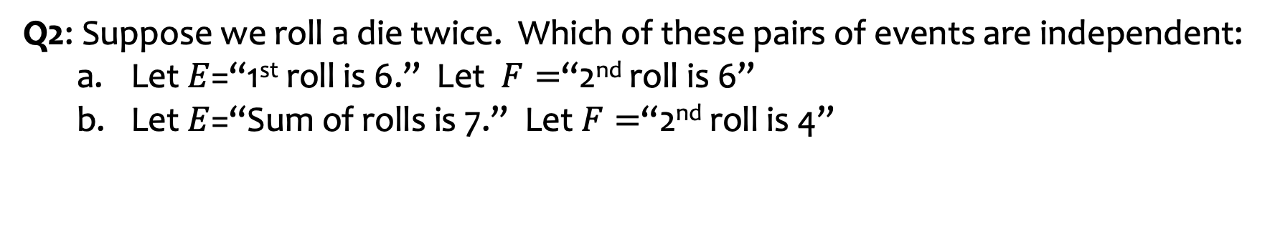
Independent Events - answers
Defn: Events $E$and $F$are independent, written $E⊥F,$if:
$P\{E∩F\}=P\{E\}⋅P\{F\}$
Here’s an equivalent and perhaps more intuitive definition:
Defn: Assuming $P\{F\}>0$, Events $E$and $F$are independent, if:
$P\{E | F\}=P\{E\}$
Q1: Can two mutually exclusive, non-null events be independent?
No!
Q2: Suppose we roll a die twice. Which of these pairs of events are independent:
  Let $E$=“1st roll is 6.” Let $F=$“2nd roll is 6”
  Let $E$=“Sum of rolls is 7.” Let $F=$“2nd roll is 4”
Both!
Notes:
Sum of rolls = 7: is the event {(1,6), (2, 5), (3,4) (4. 3), (5, 2), (6, 1)

Slide 32
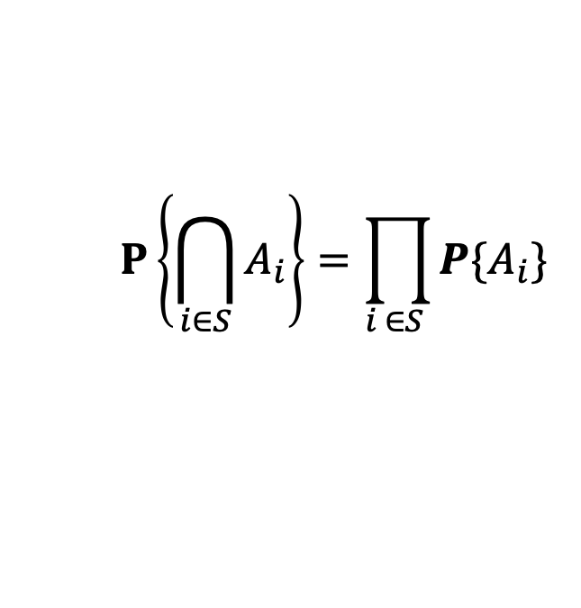
More Independence Definitions
Defn: Events $A_{1},A_{2},…, A_{n}$are independent if, for every subset $S$of $\left\{1, 2, …,n\right\}:$
$$P\left\{\bigcap_{i∈S}^{ }{A_{i}}\right\}=\prod_{i ∈S }{P\{A_{i}\} }$$

Slide 33
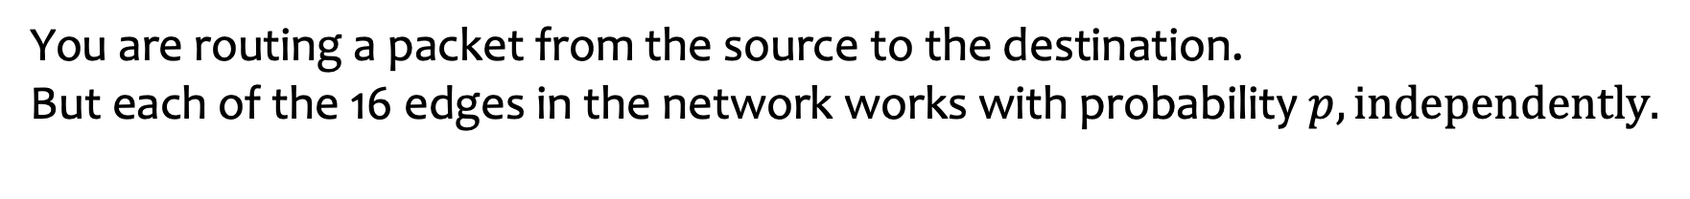
Another example
You are routing a packet from the source to the destination.
But each of the 16 edges in the network works with probability $p, independently.$
Q: What is the probability that you can get the packet from the source to the destination?

Slide 34
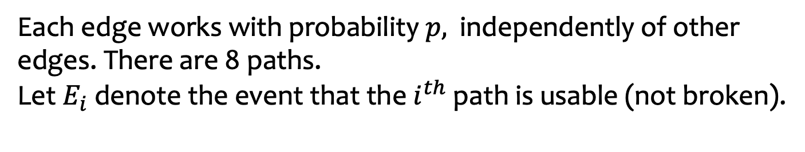
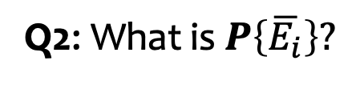
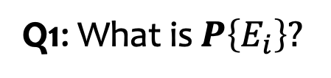
Let’s break it down
Each edge works with probability $p,$ independently of other edges. There are 8 paths.
Let $E_{i}$ denote the event that the $i^{th}$ path is usable (not broken).
Q1: What is $P\left\{E_{i}\right\}?$
Q2: What is $P\left\{\overline{E_{i}}\right\}?$
Notes:
Q1: p
Q2: 1-p

Slide 35
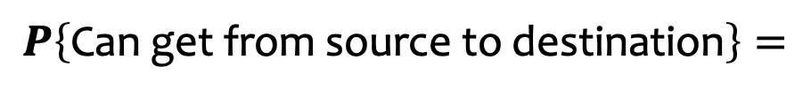


More calculations
Each edge works with probability $p,$ independently of other edges. There are 8 paths.
Let $E_{i}$ denote the event that the $i^{th}$ path is usable (not broken).
$$P\left\{E_{i}\right\}=p^{2}$$
$$P\left\{\overline{E_{i}}\right\}=1−p^{2}$$
What is $P\left\{\text{Can} \text{get} \text{from} \text{source} \text{to} \text{destination}\right\}?$
$$P\left\{\text{Can} \text{get} \text{from} \text{source} \text{to} \text{destination}\right\}=$$
Notes:
Q1: p
Q2: 1-p

Slide 36
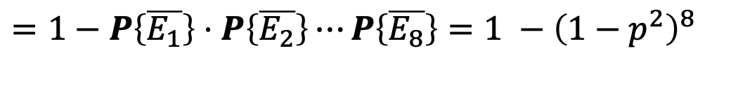
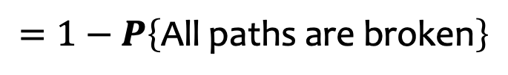

Answer
Each edge works with probability $p,$ independently of other edges. There are 8 paths.
Let $E_{i}$ denote the event that the $i^{th}$ path is usable (not broken).
$$P\left\{E_{i}\right\}=p^{2}$$
$$P\left\{\overline{E_{i}}\right\}=1−p^{2}$$
What is $P\left\{\text{Can} \text{get} \text{from} \text{source} \text{to} \text{destination}\right\}?$
$$P\left\{\text{Can} \text{get} \text{from} \text{source} \text{to} \text{destination}\right\}= P\left\{\text{At} \text{least} \text{one} \text{path} \text{works}\right\}$$
$$=P\left\{E_{1}∪E_{2}∪⋯∪E_{8}\right\}$$
$$=1−P\left\{\text{All} \text{paths} \text{are} \text{broken}\right\}$$
$=1−P\left\{\overline{E_{1}}\right\}⋅$ $P\left\{\overline{E_{2}}\right\}⋯P\left\{\overline{E_{8}}\right\}=1 −{\left(1−p^{2}\right)}^{8}$
Notes:
Q1: p
Q2: 1-p

Slide 37
Agenda (4)
Conditional Probability
Chain Rule
Independence
Law of Total Probability
Bayes Theorem

Slide 38
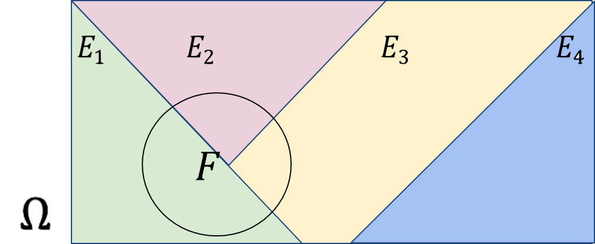
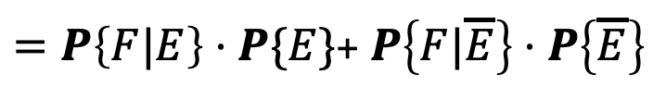
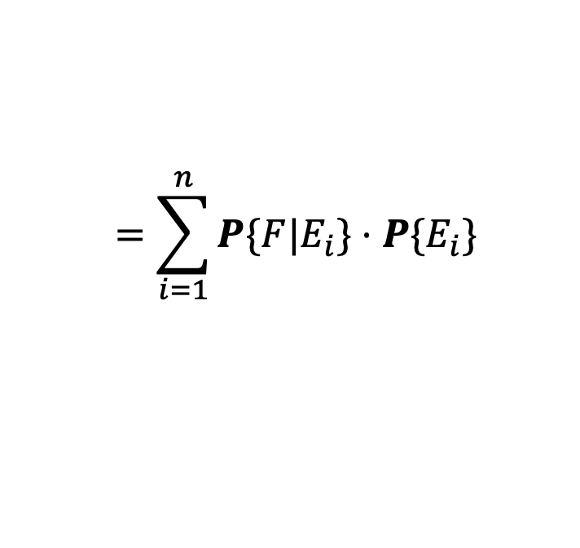
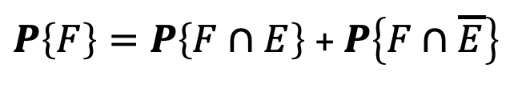




Law of Total Probability
For any sets $E$and $F:$
$$F=\left(F∩E\right)∪(F∩\overline{E})$$
$P\left\{F\right\}=P\left\{F∩E\right\}$ + $P\left\{F∩\overline{E}\right\}$
$=P\left\{F|E\right\}⋅P\{E\}$+ $P\left\{F|\overline{E}\right\}⋅P\left\{\overline{E}\right\}$
Generalizing, we have:
Theorem: [Law of Total Probability]
Let $E_{1},E_{2},…, E_{n}$ partition the state space Ω. Then:
$$P\{F\} =\sum_{i=1}^{n}{P\{F∩E_{i}\}}$$
$$=\sum_{i=1}^{n}{P\{F|E_{i}\}⋅P\{E_{i}\} }$$

Slide 39



Are A and B independent?
Have a Standard 52-Card Deck. Shuffle It, and draw the top 2 cards in order. (uniform probability space).
A: Ace of Spades First
B: 10 of Clubs Second
Are the events A and B independent?
= $\frac{1}{51}$
$$ℙ\left(B | A\right)$$
$$ℙ(B) =$$
Notes:
Probability second card is 10 of clubs = \sum_{first card possibilities} Pr (first card ) Pr (second card 10 clubs | first card) = 51 x 1/52 x 1/51. = 1/52

Slide 40
Agenda (5)
Conditional Probability
Chain Rule
Independence
Law of Total Probability
Bayes Theorem

Slide 41
Our First Machine Learning Task: Spam Filtering
Subject: “FREE $$$ CLICK HERE”
Suppose you know that 80% of emails you receive are spam.
So a priori, our belief is that any email has an 80% chance of being spam.
How do you update that belief when you see that the subject line contains the phrase “FREE $$$”?
Notes:
Probability that you test positive for X given that you have disease X.
What is the probability that you have disease X given that you test positive for X.

Slide 42



Bayes Theorem
A formula to let us “reverse” the conditional.
$P\left(A\right)$ is called the prior (our belief without knowing anything)
$P\left(A | B\right)$ is called the posterior (our belief after learning $B$)
Theorem. (Bayes Rule) For events A and B, where $P\left(A\right), P\left(B\right)>0$,
$$P\left(A | B\right)=\frac{P\left(B | A\right)P(A)}{P(B)}$$

Slide 43

Bayes Theorem follows from the definition of conditional probability
Definition. The conditional probability of event A given an event B happened (assuming $P\left(B\right)≠0$) is
$$P\left(A | B\right)=\frac{P(A∩B)}{P(B)}$$

Slide 44

Bayes Theorem Proof
By definition of conditional probability
$$P\left(A∩B\right)=P\left(A | B\right)P(B)$$
Swapping A, B gives
$$P\left(B∩A\right)=P\left(B | A\right)P\left(A\right)$$
But $P\left(A∩B\right)=P(B∩A)$, so
$$P\left(A | B\right)P\left(B\right)=P\left(B | A\right)P(A)$$
Dividing both sides by $P(B)$ gives
$$P\left(A | B\right)=\frac{P\left(B | A\right)P(A)}{P(B)}$$

Slide 45
Back to Spam Filtering
Subject: “FREE $$$ CLICK HERE”
What is the probability this email is spam, given the subject contains “FREE”?
Some useful stats:
  10% of ham (i.e., not spam) emails contain the word “FREE” in the subject.
  70% of spam emails contain the word “FREE” in the subject.
  80% of emails you receive are spam.
You receive a random email:
Let S be event that the email is spam
Let F be the event that the email contains the word “FREE”.
Notes:
Pr (F | not S) = 0.1
Pr (F | S) = 0.7
Pr(S) = 0.8
Question: Pr (S | F) ?
Pr (S|F) = Pr (F |S) Pr (S)/ Pr(F)
Numerator: 0.7 x 0.8
Denominator: Pr(F) = Pr (F|S) Pr(S) + Pr (F |not S) Pr (not S) = 0.7 x 0.8 + 0.1 x 0.2

Slide 46

Bayes Theorem with Law of Total Probability
Bayes Theorem with LTP: Let $E_{1}, E_{2}, …, E_{n}$ be a partition of the sample space, and $F$ and event. Then,
$$P\left(E_{1}\right|F)=\frac{P\left(F | E_{1}\right)P(E_{1})}{P(F)}=\frac{P\left(F | E_{1}\right)P\left(E_{1}\right)}{\sum_{i=1}^{n}{P\left(F | E_{i}\right)P\left(E_{i}\right)}}$$
Simple Partition: In particular, if $E$ is an event with non-zero probability, then
$$P\left(E\right|F)=\frac{P\left(F | E\right)P(E)}{P\left(F | E\right)P\left(E\right)+P\left(F | E^{C}\right)P(E^{C})}$$

