Slide 1
Intro to discrete probability
CSE 312 Spring 26
Lecture 4

Slide 2
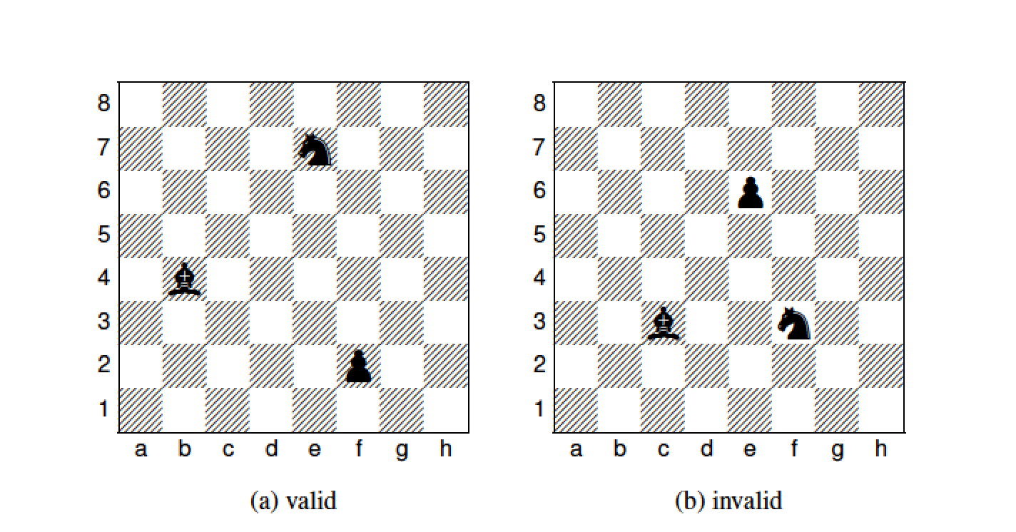

8 by 8 chessboard
How many ways to place a pawn, a bishop, and a knight so that none are in the same row or column ?
Poll:
$\left({64 \atop 3}\right)$
$\left({8 \atop 3}\right)⋅\left({8 \atop 3}\right)$
$8^{2}⋅7^{2}⋅6^{2}$
I don’t know.
Notes:
Configurations: column and row for each
Apply Generalized Product Rule. What is the sequence of choices you’re going to make.
cP rP, cN rN, cR rR
(8 x 7 x 6)^2
A 64 choose 3 undercounts in that treats them as the same whereas they are distinguishable. Overcounts in that allows them to be in same row and column
B undercounts

Slide 3
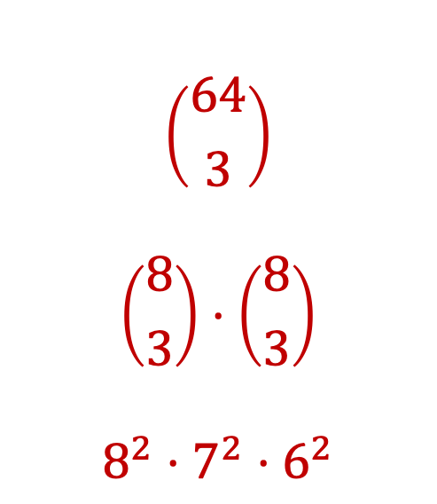
Possible answers
$$\left({64 \atop 3}\right)$$
$$\left({8 \atop 3}\right)⋅\left({8 \atop 3}\right)$$
$$8^{2}⋅7^{2}⋅6^{2}$$
Choose 3 positions on board
Choose 3 rows, then choose 3 cols
Choose row/col for pawn, then row/col for bishop, then row/col for knight.

Slide 4
Intro to discrete probability
CSE 312 Spring 26
Lecture 4

Slide 5
Probability (intro – 1)
We want to model uncertainty.
i.e., outcome not determined a-priori
E.g. throwing dice, flipping a coin…
We want to numerically measure likelihood of outcomes = probability.
We want to make complex statements about these likelihoods.

Slide 6
Probability (intro – 2)
We will not argue why a certain physical process realizes the probabilistic model we study
Why is the outcome of the coin flip really “random”?
First part of class: “Discrete” probability theory
Experiment with finite / discrete set of outcomes.
Will explore countably infinite and continuous outcomes later

Slide 7
Agenda
Sample Space and Events
Probability
Equally Likely Outcomes
Probability Axioms and Beyond Equally Likely Outcomes
More Examples

Slide 8


Sample Space
Examples:
Single coin flip: $Ω=\{H, T\}$
Two coin flips: $Ω=\{HH, HT, TH, TT\}$
Roll of a die: $Ω=\{1, 2, 3, 4, 5, 6\}$
Definition. A sample space $Ω$ is the set of all possible outcomes of an experiment.

Slide 9

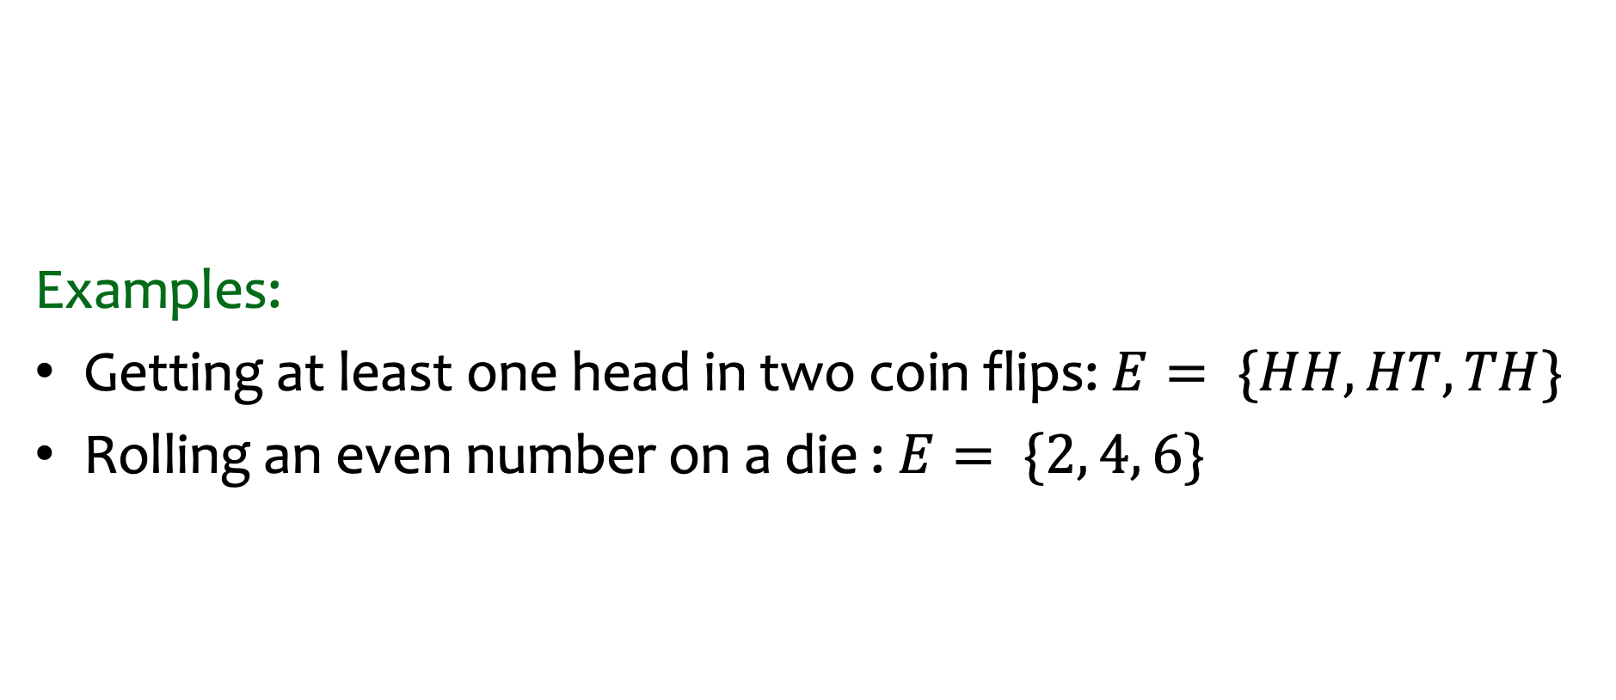
Events
Examples:
Getting at least one head in two coin flips: $E= \{HH, HT, TH\}$
Rolling an even number on a die : $E= \{2, 4, 6\}$
Definition. An event $E⊆Ω$ is a subset of possible outcomes.

Slide 10


Events (mutual exclusivity)
Examples:
Getting at least one head in two coin flips: $E= \{HH, HT, TH\}$
Rolling an even number on a die : $E= \{2, 4, 6\}$
Examples:
For dice rolls: If $E=\{2, 4, 6\}$ and $F=\{1, 5\}$, then $E∩F= ∅$
Definition. An event $E⊆Ω$ is a subset of possible outcomes.
Definition. Events E and F are mutually exclusive if $E∩F= ∅$ (i.e., can’t happen at same time)

Slide 11

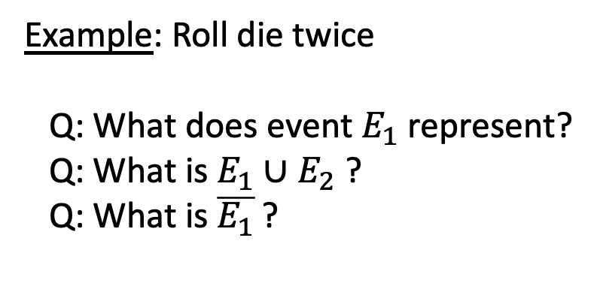
Example: rolling two dice
Probability is defined in terms of some experiment.
= Sample space of the experiment = Set of all possible outcomes
Defn: An event, $E,$is any subset of the sample space, Ω.
Example: Roll die twice
Q: What does event $E_{1}$represent?
Q: What is $E_{1}∪E_{2}$ ?
Q: What is $\overline{E_{1}}$ ?
Notes:
E1: the event that die number 2 came up showing the number 2
E2: the event that the first die is 1 and the second die is at least 4.
E1 union E2: the event that the first die is 2 or (the first die is 1 and the second die is at least 4)
E1 and E2 NO
Event that die 1 and die 2 have values that sum to 6?
Event that die 1 shows a number that is twice that of die 2?

Slide 12
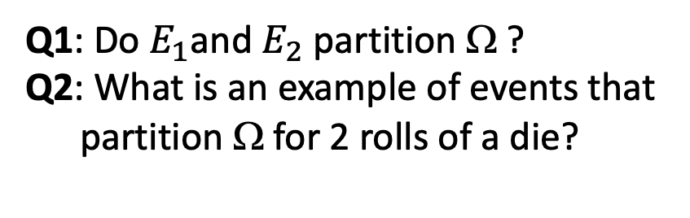
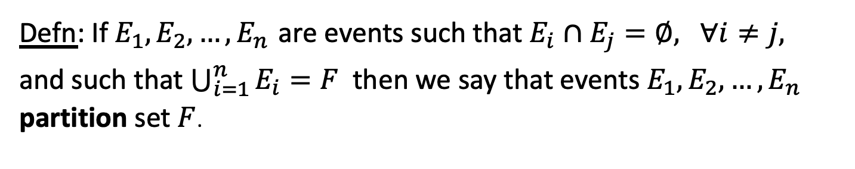
Sample space and events
Defn: If $E_{1}∩E_{2}=∅$, then $E_{1}$ and $E_{2}$ are mutually exclusive.
Defn: If $E_{1},E_{2},…,E_{n}$ are events such that $E_{i}∩E_{j}=∅,$ $∀i≠j,$
and such that $\bigcup_{i=1}^{n}{E_{i}=F}$then we say that events $E_{1},E_{2},…,E_{n}$ partition set $F$.
Q1: Do $E_{1}\text{an}\text{d} E_{2}$ partition Ω ?
Q2: What is an example of events that
partition Ω for 2 rolls of a die?
Notes:
E1: die 1 = 1
E2: die 1 > 1
E1: die 1 = die 2
E2: die 1 > die 2
E3: die 1 < die 2

Slide 13
Agenda (Part 2)
Sample Space and Events
Probability
Equally Likely Outcomes
Probability Axioms and Beyond Equally Likely Outcomes
More Examples

Slide 14
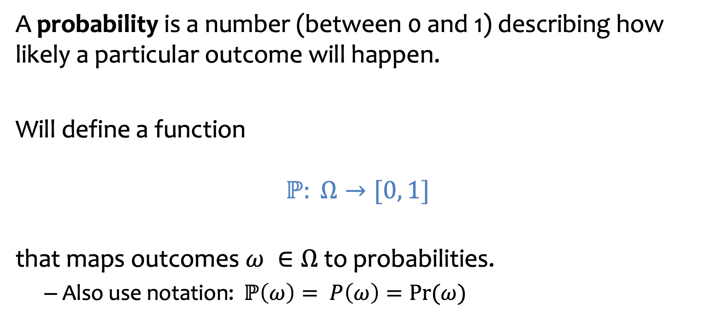
Idea: Probability
A probability is a number (between 0 and 1) describing how likely a particular outcome will happen.
Will define a function
$$ℙ: Ω→[0, 1]$$
that maps outcomes $ω ∈Ω$ to probabilities.
Also use notation: $ℙ\left(ω\right)= P\left(ω\right)=Pr⁡(ω)$

Slide 15

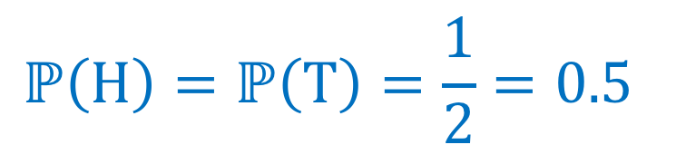


Example – Coin Tossing
Imagine we toss one coin – outcome can be heads or tails.
$$Ω=\{H, T\}$$
$ℙ$?
Depends! What do we want to model?!
Fair coin toss
$$ℙ\left(H\right)=ℙ\left(T\right)=\frac{1}{2}=0.5$$

Slide 16
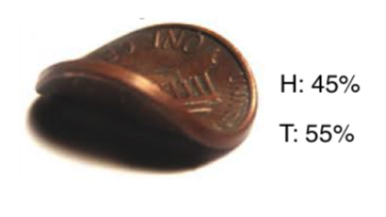

Example – Coin Tossing – biased coin
Imagine we toss one coin – outcome can be heads or tails.
$$Ω=\{H, T\}$$
$ℙ$?
Depends! What do we want to model?!
Bent coin toss (e.g., biased or unfair coin)
$$ℙ\left(H\right)=0.45, ℙ\left(T\right)=0.55$$

Slide 17
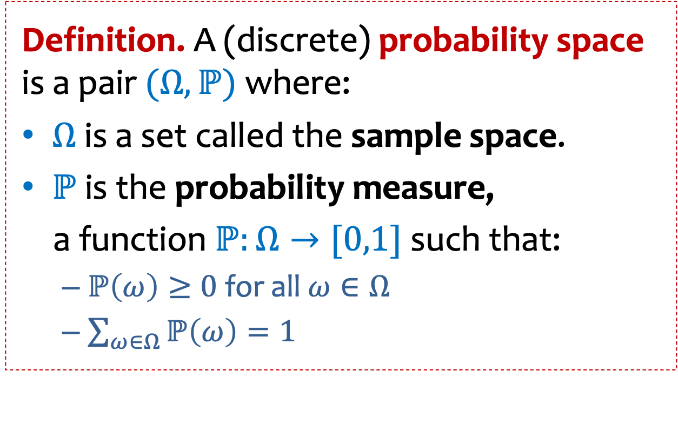
Probability space
Definition. A (discrete) probability space is a pair $(Ω, ℙ)$ where:
$Ω$ is a set called the sample space.
$ℙ$ is the probability measure,
a function $ℙ:Ω→[0,1]$ such that:
$ℙ\left(ω\right)≥0$ for all$ω∈Ω$
$\sum_{ω∈Ω}{ℙ\left(ω\right)}=1$

Slide 18


Probability space - more
Either finite or infinite countable (e.g., integers)
Definition. A (discrete) probability space is a pair $(Ω, ℙ)$ where:
$Ω$ is a set called the sample space.
$ℙ$ is the probability measure,
a function $ℙ:Ω→[0,1]$ such that:
$ℙ\left(ω\right)≥0$ for all$ω∈Ω$
$\sum_{ω∈Ω}{ℙ\left(ω\right)}=1$
Set of possible elementary outcomes
$$Ω$$
Specify Likelihood
(or probability) of each elementary outcome
Some outcome must show up
The likelihood (or probability) of each outcome is non-negative.

Slide 19
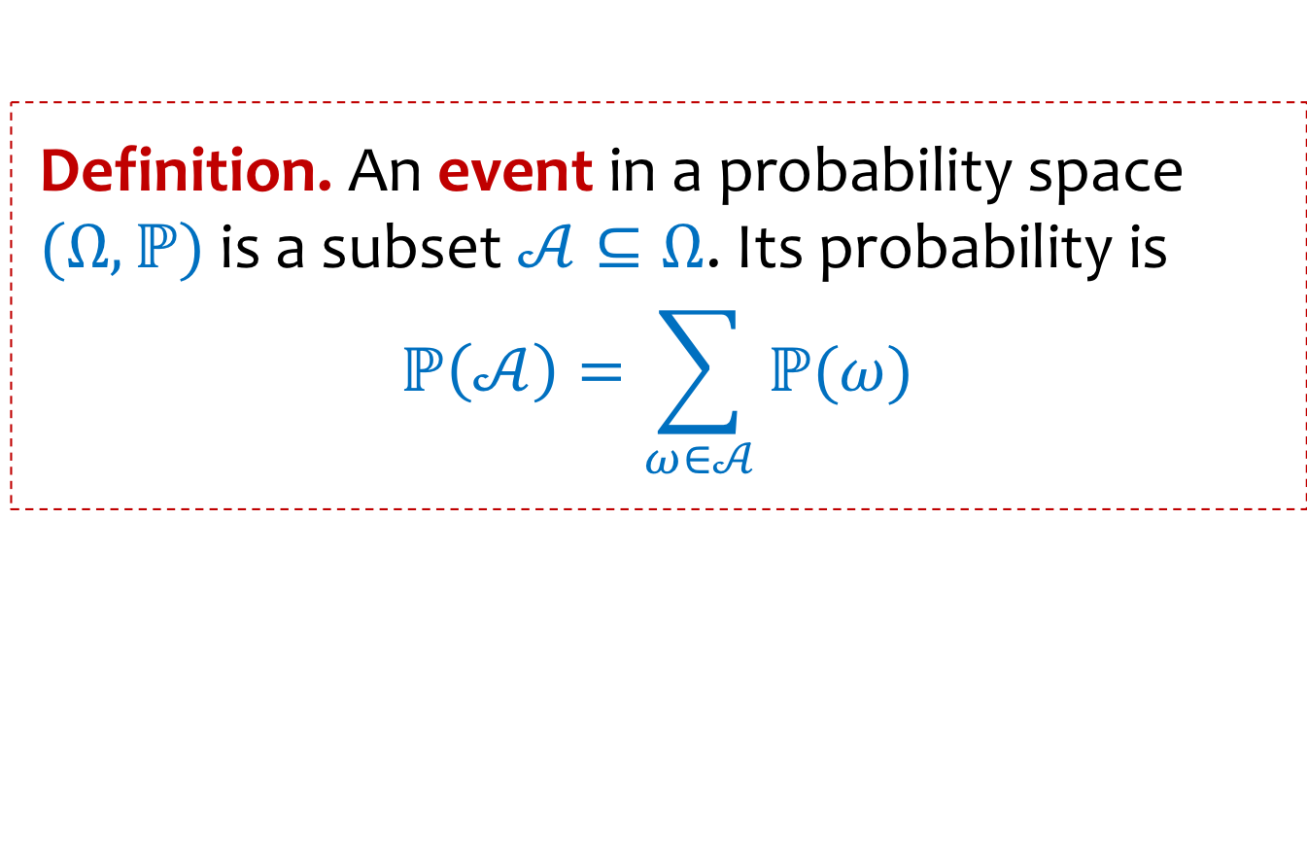



Events (more formally)
Definition. An event in a probability space $(Ω, ℙ)$ is a subset $𝒜⊆Ω$. Its probability is
$$ℙ\left(𝒜\right)=\sum_{ω∈𝒜}{ℙ(ω)}$$
$$𝒜$$
$$Ω$$
Convenient abuse of notation: $ℙ$ is extended to be defined over sets.
$$ℙ\left(ω\right)=ℙ(\left\{ω\right\})$$
Notes:
What is the probability of an event?

Slide 20
Agenda (Part 3)
Sample Space and Events
Probability
Equally Likely Outcomes
Probability Axioms and Beyond Equally Likely Outcomes
More Examples

Slide 21
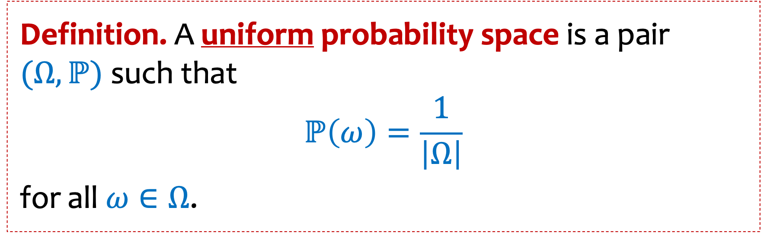
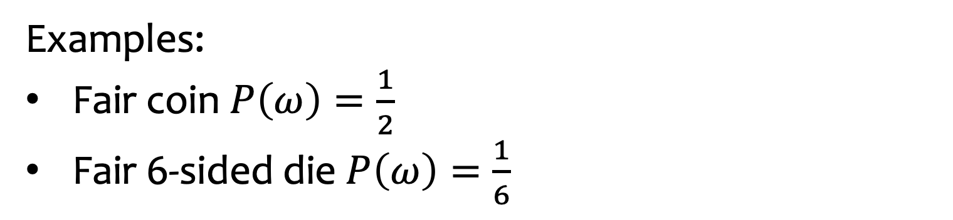
Uniform Probability Space = Equally Likely Outcomes
Definition. A uniform probability space is a pair $(Ω, ℙ)$ such that
$$ℙ\left(ω\right)=\frac{1}{\left|Ω\right|}$$
for all $ω∈Ω$.
Examples:
Fair coin $P\left(ω\right)=\frac{1}{2}$
Fair 6-sided die $P\left(ω\right)=\frac{1}{6}$

Slide 22

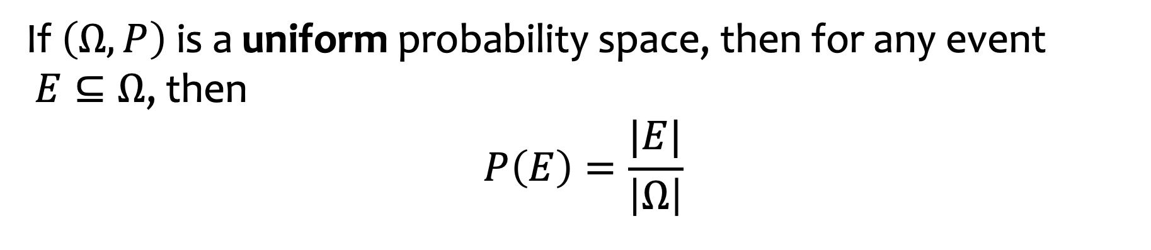
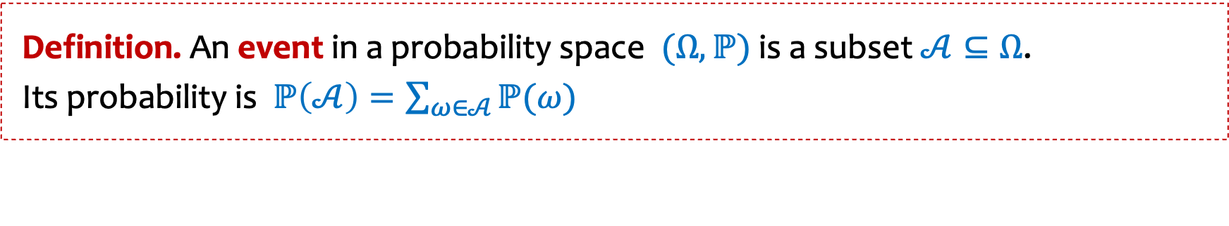
Uniform Probability Space - Corollary
Definition. A uniform probability space is a pair $(Ω, ℙ)$
such that $ℙ\left(ω\right)=\frac{1}{\left|Ω\right|}.$for all $ω∈Ω$.
Definition. An event in a probability space $(Ω, ℙ)$ is a subset $𝒜⊆Ω$.
Its probability is $ℙ\left(𝒜\right)=\sum_{ω∈𝒜}{ℙ(ω)}$
If $\left(Ω, P\right)$ is a uniform probability space, then for any event $E⊆Ω$, then
$$P\left(E\right)=\frac{|E|}{\left|Ω\right|}$$
Notes:
Reading order checked

Slide 23
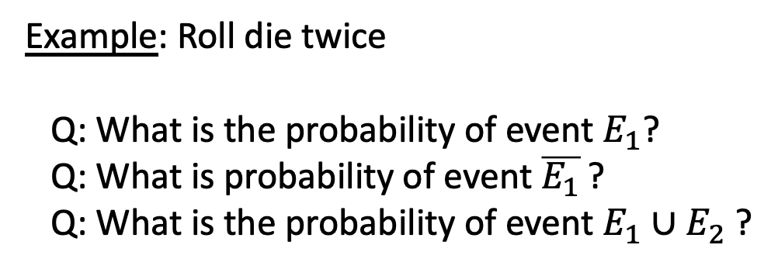
Example: rolling two dice (probabilities)
Back to the example of rolling a die twice.
Suppose that each outcome is equally likely
What is the size of the sample space Ω?
Example: Roll die twice
Q: What is the probability of event $E_{1}$?
Q: What is probability of event $\overline{E_{1}}$ ?
Q: What is the probability of event $E_{1}∪E_{2}$ ?
Notes:
Size of sample space is 36.
Probability of event E1 is 6/36 = 1/6
Probability of event E1 complement is 5/6
Probability of event E1 union E2 is 9/36 = 1/4

Slide 24
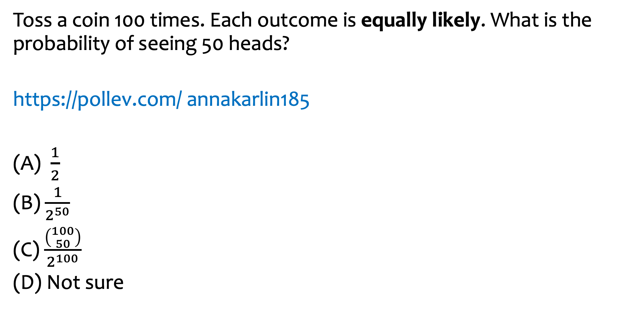
Example – Coin Tossing question
Toss a coin 100 times. Each outcome is equally likely. What is the probability of seeing 50 heads?
https://pollev.com/ annakarlin185
(A) $\frac{1}{2}$
(B) $\frac{1}{2^{50}}$
(C) $\frac{\left({100 \atop 50}\right)}{2^{100}}$
(D) Not sure
Notes:
The answer is C. Size of the sample space is 2^{100}. Size of the event (number of outcomes in it is 100 choose 50 (the number of sequences that contain exactly 50 Hs).

Slide 25
Agenda (Part 4)
Sample Space and Events
Probability
Equally Likely Outcomes
Probability Axioms and Beyond Equally Likely Outcomes
More Examples

Slide 26
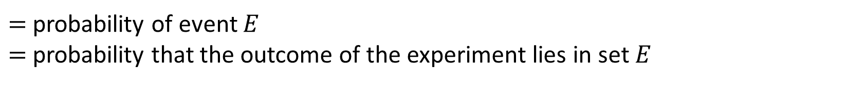

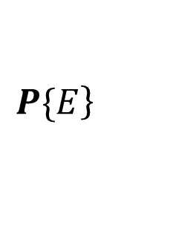
Axioms of Probability
$$\left.P\{E\right\}$$
$=$probability of event $E$
$=$probability that the outcome of the experiment lies in set $E$
The 3 Probability Axioms:
Non-negativity: $P\{E\}≥0$ for any event $E.$
Additivity: If $E_{1},E_{2},E_{3}, …$ is a countable sequence of disjoint events, then
$$P\{E_{1}∪E_{2}∪E_{3}∪…\}=P\{E_{1}\}+P\{E_{2}\}+P\{E_{3}\}+⋯$$
Normalization: $P\{\}=1$

Slide 27
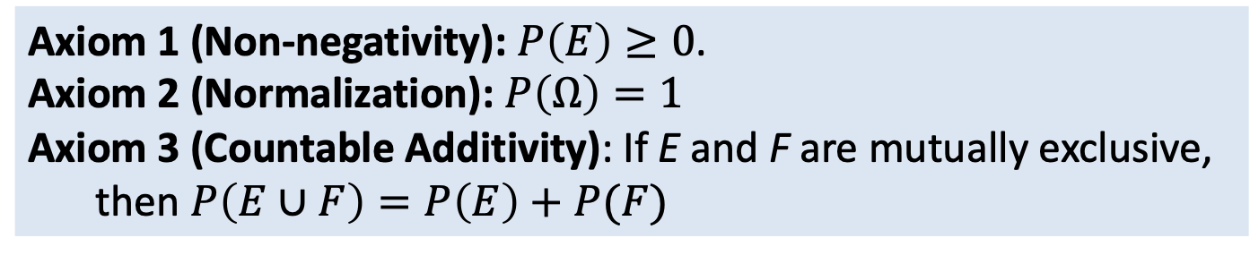

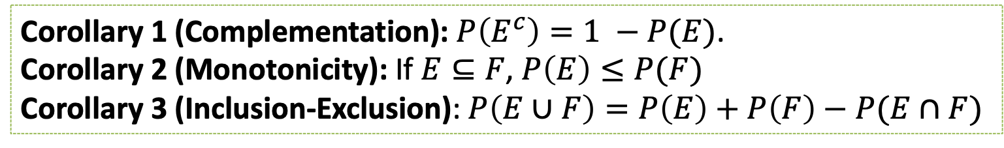
Corollaries of Axioms of Probability
Let $Ω$ denote the sample space and $E, F⊆Ω$ be events. Note this is applies to any probability space (not just uniform)
Axiom 1 (Non-negativity): $P\left(E\right)≥0$.
Axiom 2 (Normalization): $P\left(Ω\right)=1$
Axiom 3 (Countable Additivity): If E and F are mutually exclusive, then $P\left(E∪F\right)=P\left(E\right)+P(F)$
Corollary 1 (Complementation): $P\left(E^{c}\right)=1 −P(E)$.
Corollary 2 (Monotonicity): If $E⊆F$, $P\left(E\right)≤P(F)$
Corollary 3 (Inclusion-Exclusion): $P\left(E∪F\right)=P\left(E\right)+P\left(F\right)−P(E∩F)$

Slide 28
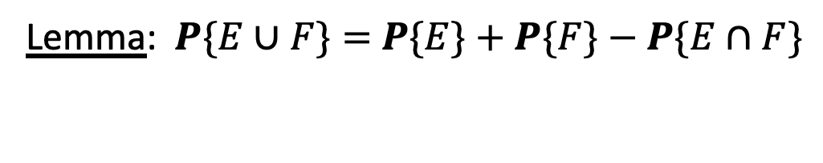

Inclusion-exclusion
Lemma: $P\{E∪F\}=$ $P\{E\}+P\{F\}−P\{E∩F\}$
Proof: (Hint: Think about Additivity Axiom)
$$\text{Express} E∪F \text{as} \text{a} \text{union} \text{of} \text{mutually} \text{exclusive} \text{sets}$$
$$E∪F=E∪\left(F∖\left(E∩F\right)\right)$$

Slide 29
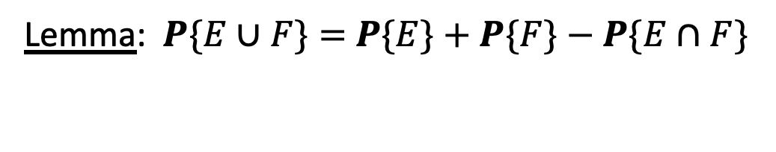

Inclusion- exclusion continued
Lemma: $P\{E∪F\}=$ $P\{E\}+P\{F\}−P\{E∩F\}$
Proof:
Express $E∪F$ as a union of mutually exclusive sets
$E∪F=$ $E∪\left(F \backslash \left(E∩F\right)\right)$
Then, by the Additivity Axiom we have 2 observations:
$P\{E∪F\}=$ $P\left\{E\right\}+P\{F \backslash \left(E∩F\right)$}
$P\{F\}=$ $P\left\{F \backslash \left(E∩F\right)\right\}+P\left\{E∩F\right\}$
Now substitute the 2nd equation into the 1st .

Slide 30

Corollary
Lemma: $P\{E∪F\}=$ $P\{E\}+P\{F\}−P\{E∩F\}$
Proof:
Express $E∪F$ as a union of mutually exclusive sets
$E∪F=$ $E∪\left(F \backslash \left(E∩F\right)\right)$
Then, by the Additivity Axiom we have 2 observations:
$P\{E∪F\}=$ $P\left\{E\right\}+P\{F \backslash \left(E∩F\right)$}
$P\{F\}=$ $P\left\{F \backslash \left(E∩F\right)\right\}+P\left\{E∩F\right\}$
Now substitute the 2nd equation into the 1st .
Lemma: $P\{E∪F\}≤$ $P\{E\}+P\{F\}$
Proof: WHY??

Slide 31
Review: Probability space
Either finite or infinite countable (e.g., integers)
Definition. A (discrete) probability space is a pair $(Ω, ℙ)$ where:
$Ω$ is a set called the sample space.
$ℙ$ is the probability measure,
a function $ℙ:Ω→[0,1]$ such that:
$ℙ\left(ω\right)≥0$ for all$ω∈Ω$
$\sum_{ω∈Ω}{ℙ\left(ω\right)}=1$
Set of possible elementary outcomes
$$Ω$$
Specify Likelihood
(or probability) of each elementary outcome
Some outcome must show up
The likelihood (or probability) of each outcome is non-negative.

Slide 32
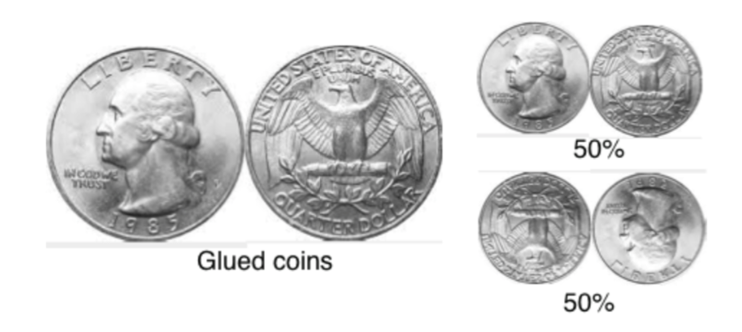
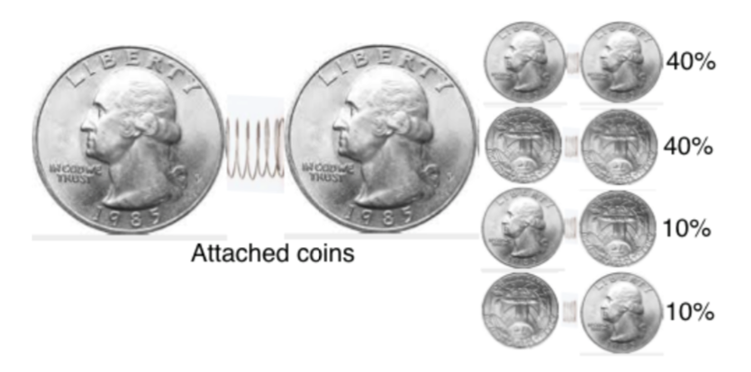
Non-equally Likely Outcomes
Probability spaces can have non-equally likely outcomes.
Notes:
Pictures from Berkeley CS 70

Slide 33
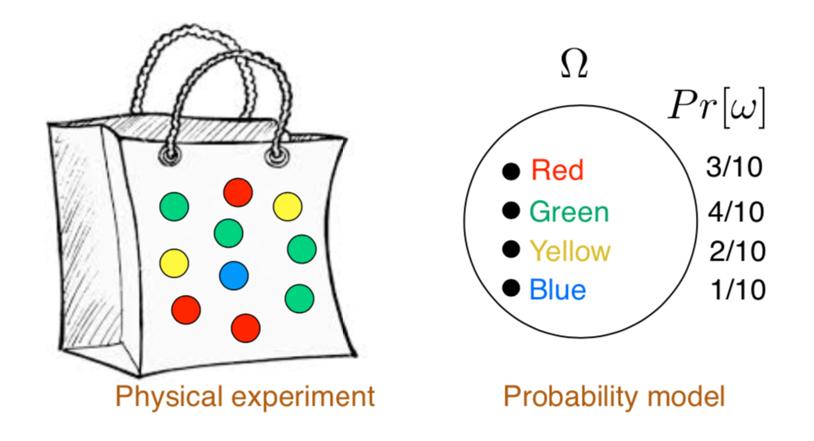
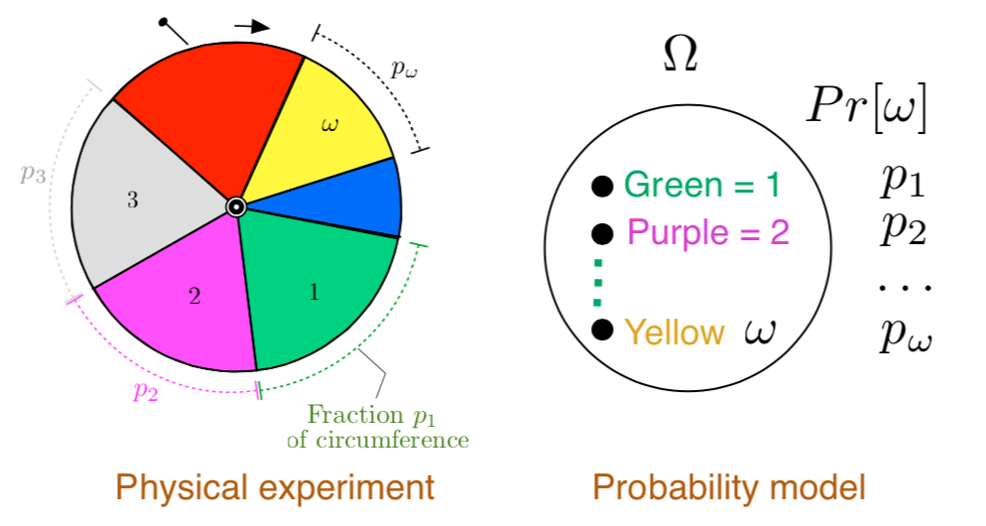
More Examples of Non-equally Likely Outcomes
Notes:
Pictures from Berkeley CS 70

Slide 34
Agenda (Part 5)
Events
Probability
Equally Likely Outcomes
Probability Axioms and Beyond Equally Likely Outcomes
More Examples

Slide 35
Example: Dice Rolls
Suppose I had two, fair, 6-sided dice, one green and one red. I roll them. What is the probability that we see at least one 3 in the two rolls?
Size of sample space:
Size of event:
Probability:
Notes:
Size of sample space is 36
Size of event = 11 = 36-25, since 25 is the number of outcomes where there is no 3.
So probability is 11/36

Slide 36

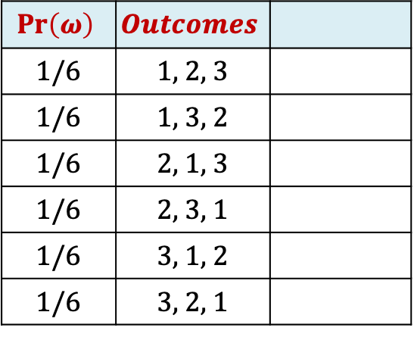
Example: Returning Homeworks
Class with n students, randomly hand back homeworks. All permutations equally likely.
Size of sample space?
$$Pr\left(ω\right)$$ | $$Outcomes$$
1/6 | 1, 2, 3
1/6 | 1, 3, 2
1/6 | 2, 1, 3
1/6 | 2, 3, 1
1/6 | 3, 1, 2
1/6 | 3, 2, 1
Notes:
Columns in table correspond to students: column 1 is student 1, column 2 is student 2 and column 3 is student 3.
The rows tell you who gets who’s homework.
So, for example, the second row tells you that student 1 got her own homework back, student 2 got student 3’s homework back and student 3 got student 2’s homework back.
Size of sample space = n!

Slide 37
Example: Returning Homeworks (n=3)
Class with n students, randomly hand back homeworks. All permutations equally likely.
If n=3, what is the probability that all 3 people get their own homework back?
$$Pr\left(ω\right)$$ | $$Outcomes$$
1/6 | 1, 2, 3
1/6 | 1, 3, 2
1/6 | 2, 1, 3
1/6 | 2, 3, 1
1/6 | 3, 1, 2
1/6 | 3, 2, 1
Notes:
Answer: 1/3! = 1/6

Slide 38
Example: Returning Homeworks (arbitrary n)
Class with n students, randomly hand back homeworks. All permutations equally likely.
For arbitrary n, what is the probability that all n people get their own homework back?
$$Pr\left(ω\right)$$ | $$Outcomes$$
1/6 | 1, 2, 3
1/6 | 1, 3, 2
1/6 | 2, 1, 3
1/6 | 2, 3, 1
1/6 | 3, 1, 2
1/6 | 3, 2, 1
Notes:
Answer: 1/n!

Slide 39
Example: Returning Homeworks (person 3)
Class with n students, randomly hand back homeworks. All permutations equally likely.
For n=3, what is the probability that person 3 gets their own homework back?
$$Pr\left(ω\right)$$ | $$Outcomes$$
1/6 | 1, 2, 3
1/6 | 1, 3, 2
1/6 | 2, 1, 3
1/6 | 2, 3, 1
1/6 | 3, 1, 2
1/6 | 3, 2, 1
Notes:
What is the probability that student 3 gets their own homework back

Slide 40
Example: Returning Homeworks (large n, person 17
Class with n students, randomly hand back homeworks. All permutations equally likely.
What is the probability that person 17 gets their own homework back?
$$Pr\left(ω\right)$$ | $$Outcomes$$
1/6 | 1, 2, 3
1/6 | 1, 3, 2
1/6 | 2, 1, 3
1/6 | 2, 3, 1
1/6 | 3, 1, 2
1/6 | 3, 2, 1
Notes:
Size of sample space = n!
E is the event that person 17 gets their homework back.
|E| = (n-1)!
So Pr ( E) = |E|/|sample space| = (n-1)!/n!= 1/n

Slide 41

Example: Birthday “Paradox”
Suppose we have a collection of $n$ people in a room. What is the probability that at least 2 people share a birthday? Assume that there are exactly 365 possible birthdays, and each possibility is equally likely.
Notes:
For the details, see the posted notes on the “Birthday “Paradox”.

