Slide 1
More Counting!
CSE 312 Spring 26
Lecture 3
We will use
PollEv.com/annakarlin185
Today again

Slide 2
Recap
Sum Rule, Product Rule
Combinations
Binomial Theorem
Multinomial Coefficients
Combinatorial Proofs
Inclusion-Exclusion

Slide 3
Today’s Agenda (1)
Sleuth’s Criterion
Stars and Bars
Pigeonhole Principle
More examples?

Slide 4
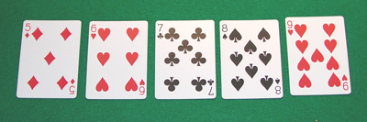
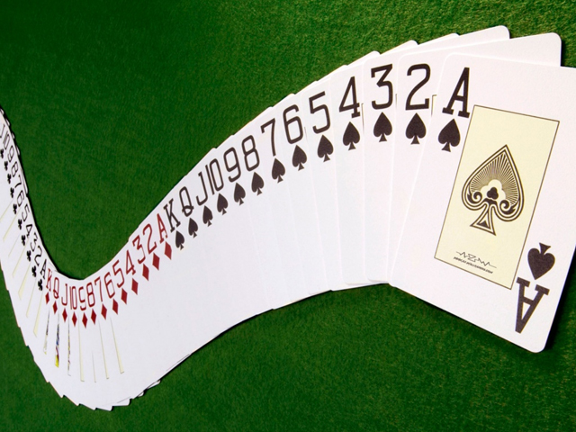
Quick Review of Cards
How many possible 5 card hands?
52 total cards
13 different ranks: 2,3,4,5,6,7,8,9,10,J,Q,K,A
4 different suits: Hearts, Diamonds, Clubs, Spades

Slide 5
Counting Cards I
52 total cards
13 different ranks: 2,3,4,5,6,7,8,9,10,J,Q,K,A
4 different suits: Hearts, Diamonds, Clubs, Spades
A straight is five consecutive rank cards of any suit. How many possible straights?
Notes:
Number of straights: number of ways of choosing the lowest rank and a suit for that card, at that point the rest of the ranks are determined.
10 x 4^5

Slide 6
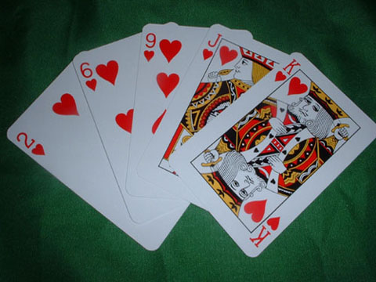
Counting Cards II
52 total cards
13 different ranks: 2,3,4,5,6,7,8,9,10,J,Q,K,A
4 different suits: Hearts, Diamonds, Clubs, Spades
A flush is a five card hand all of the same suit.
How many possible flushes?
Notes:
Number of flushes: Number of ways of choosing the suit and then 5 ranks. 4 x (13 choose 5)

Slide 7

Counting Cards III
52 total cards
13 different ranks: 2,3,4,5,6,7,8,9,10,J,Q,K,A
4 different suits: Hearts, Diamonds, Clubs, Spades
A flush is five card hand all of the same suit.
How many possible flushes?
How many flushes are NOT straights?
Notes:
Number of flushes: number of ways of choosing the suit and then 5 ranks. 4 x (13 choose 5)
Number of straights:
Checked reading order

Slide 8

Counting Cards IV
52 total cards
13 different ranks: 2,3,4,5,6,7,8,9,10,J,Q,K,A
4 different suits: Hearts, Diamonds, Clubs, Spades
A flush is five card hand all of the same suit.
How many possible flushes?
How many flushes are NOT straights?
= #flush - #flush and straight
Notes:
Number of ways of choosing the suit and then 5 ranks. 4 x (13 choose 5)

Slide 9
Sleuth’s Criterion (Rudich)
For each object constructed, it should be possible to reconstruct the unique sequence of choices that led to it.
No sequence ➔ under counting
Many sequences ➔ over counting
Notes:
Very easy to make mistakes when you’re counting!
Overcounts, undercounts, correct.

Slide 10
Sleuth’s Criterion (Rudich) - example
For each object constructed, it should be possible to reconstruct the unique sequence of choices that led to it.
No sequence ➔ under counting
Many sequences ➔ over counting
EXAMPLE: How many ways are there to choose a 5 card hand that contains at least 3 Aces?
First choose 3 Aces. Then
choose remaining two cards.

Slide 11
Sleuth’s Criterion (Rudich) – poll on example
For each object constructed, it should be possible to reconstruct the unique sequence of choices that led to it.
No sequence ➔ under counting
Many sequences ➔ over counting
EXAMPLE: How many ways are there to choose a 5 card hand that contains at least 3 Aces?
Poll:
Correct
Overcount
Undercount
1. First choose 3 Aces.
2. Then choose remaining two cards.
PollEv.com/annakarlin185

Slide 12
Sleuth’s Criterion (Rudich) – example – where is the error?
For each object constructed, it should be possible to reconstruct the unique sequence of choices that led to it.
No sequence ➔ under counting
Many sequences ➔ over counting
EXAMPLE: How many ways are there to choose a 5 card hand that contains at least 3 Aces?
1. First choose 3 Aces.
2. Then choose remaining two cards.
Notes:
Very easy to make mistakes when you’re counting!
AH AS AD KC 2H Such a hand is counted once
AH AS AD AC 2H
Each such hand is counted 4 times.
To correct this answer subtract 3 times 48.

Slide 13
Sleuth’s Criterion (Rudich) - a different way
For each object constructed, it should be possible to reconstruct the unique sequence of choices that led to it.
No sequence ➔ under counting
Many sequences ➔ over counting
EXAMPLE: How many ways are there to choose a 5 card hand that contains at least 3 Aces?
When in doubt, break up into disjoint sets you know how to count, and then use the sum rule.

Slide 14
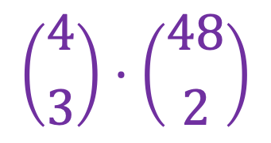
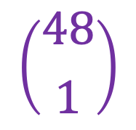
Sleuth’s Criterion (Rudich) – correct solution
For each object constructed, it should be possible to reconstruct the unique sequence of choices that led to it.
No sequence ➔ under counting
Many sequences ➔ over counting
EXAMPLE: How many ways are there to choose a 5 card hand that contains at least 3 Aces?
$$\left({4 \atop 3}\right)⋅\left({48 \atop 2}\right)$$
Use the sum rule
= # 5 card hand containing exactly 3 Aces
+ # 5 card hand containing exactly 4 Aces
$$\left({48 \atop 1}\right)$$

Slide 15
Agenda (1)
Sleuth’s Criterion
Stars and Bars
Pigeonhole Principle
More examples?

Slide 16


Example: Kids and Candies
How many ways can we give five indistinguishable candies to these three kids?
Notes:
Checked reading order

Slide 17

Kids + Candies

Slide 18
Kids + Candies
Idea: count something different

Slide 19

Kids + Candies: count something equivalent
Idea: Count something equivalent
5 “stars” for candies, 2 “bars” for dividers.
Notes:
Number of stars to the left of the first divider is number of candies kid 1 gets
Number of stars between 1st and 2nd is …
Reading order checked

Slide 20
Kids + Candies: another example
Idea: Count something equivalent
5 “stars” for candies, 2 “bars” for dividers.
Notes:
Reading order checked

Slide 21
Kids + Candies: bijection
For each candy distribution, there is exactly one corresponding way to arrange the stars and bars.
Conversely, for each arrangement of stars and bars, there is exactly one candy distribution it represents.
Notes:
Reading order checked

Slide 22
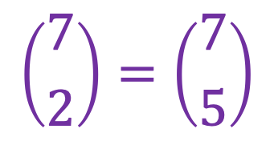
Kids + Candies: conclusion
Hence, the number of ways to distribute candies to the 3 kids is the number of arrangements of stars and bars.
This is
$$\left({7 \atop 2}\right)=\left({7 \atop 5}\right)$$

Slide 23
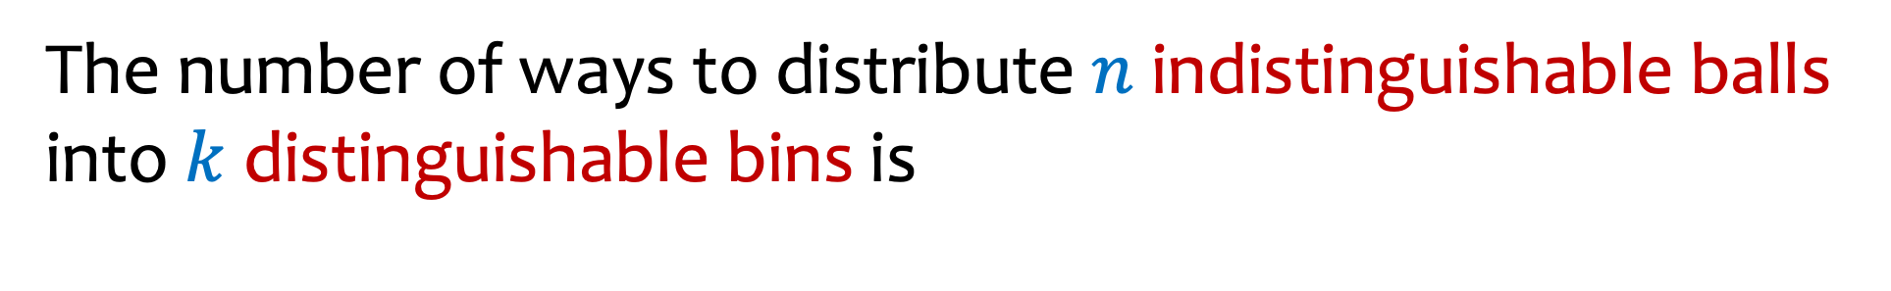
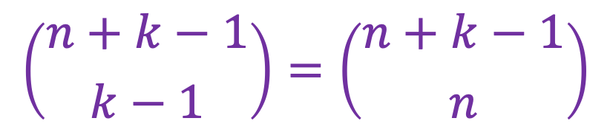
Stars and Bars / Divider method
The number of ways to distribute $n$ indistinguishable balls into $k$ distinguishable bins is
$$\left({n+k−1 \atop k−1}\right)=\left({n+k−1 \atop n}\right)$$

Slide 24
Agenda (3)
Sleuth’s Criterion
Stars and Bars
Pigeonhole Principle
More examples?

Slide 25
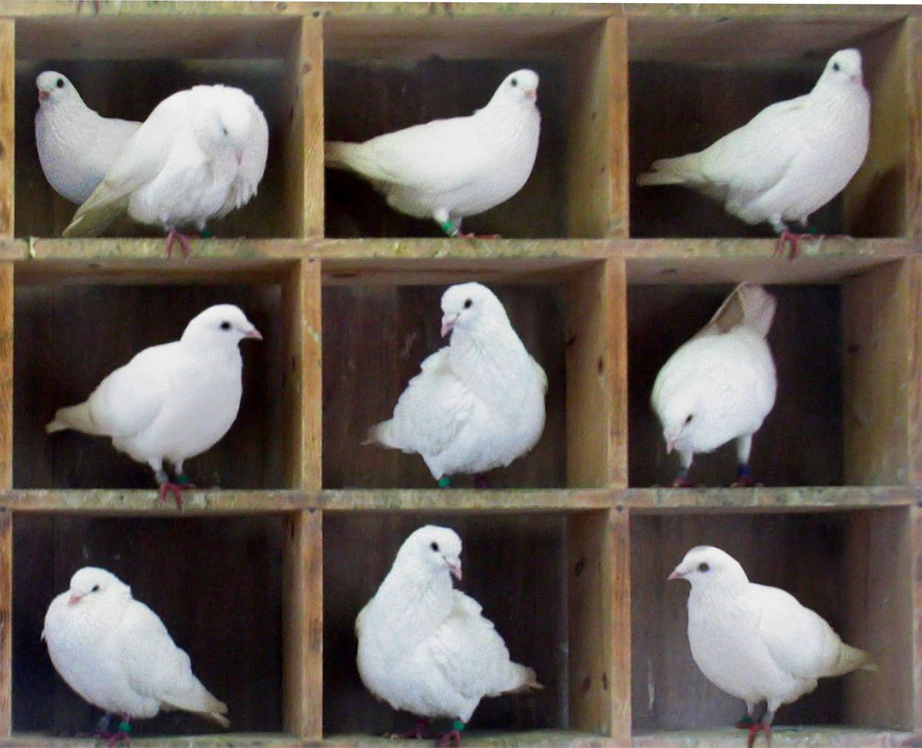
Pigeonhole Principle (PHP): Idea
10 pigeons into 9 pigeonholes
There must be at least one
pigeonhole with at least two
pigeons

Slide 26

Pigeonhole Principle
If there are $n$ pigeons in $n−1$ holes or fewer, then one hole must contain at least $2$pigeons!
Notes:
If each hole contained at most 1 pigeon, the total number of pigeons would be <= n-1. Contradiction, since there are n pigeons

Slide 27
Pigeonhole Principle – Example
In a room with 367 people, there are at least two with the same birthday.
Notes:
Solution:
367 pigeons = people
366 holes = possible birthdays
Person goes into hole corresponding to own birthday
By PHP, there must be two people with the same birthday

Slide 28
Pigeonhole Principle – example repeated
In a room with 367 people, there are at least two with the same birthday.
Solution:
367 pigeons = people
366 holes = possible birthdays (including leap day)
Person goes into hole corresponding to own birthday
By PHP, there must be two people with the same birthday

Slide 29
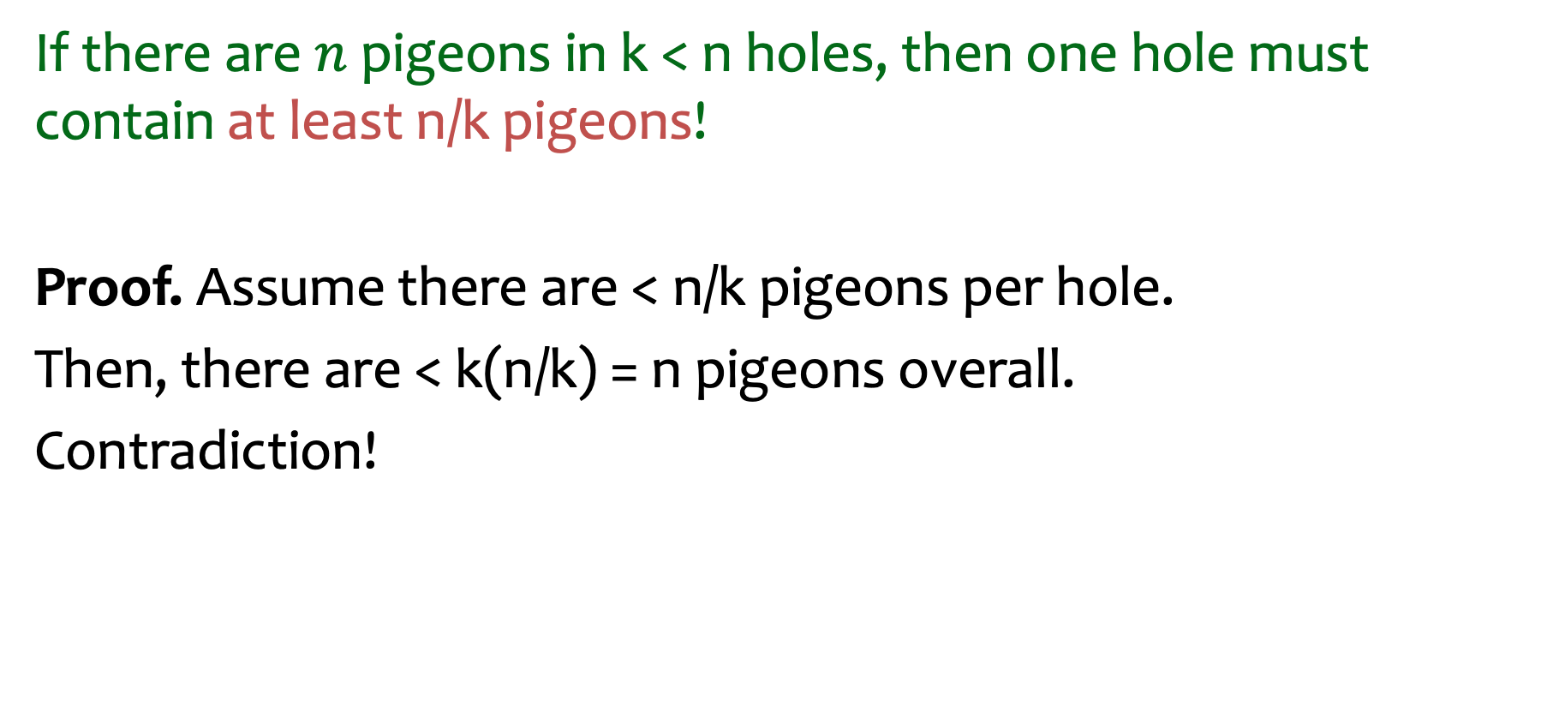
Pigeonhole Principle – More generally
If there are $n$ pigeons in k < n holes, then one hole must contain at least n/k pigeons!
Proof. Assume there are < n/k pigeons per hole.
Then, there are < k(n/k) = n pigeons overall.
Contradiction!

Slide 30
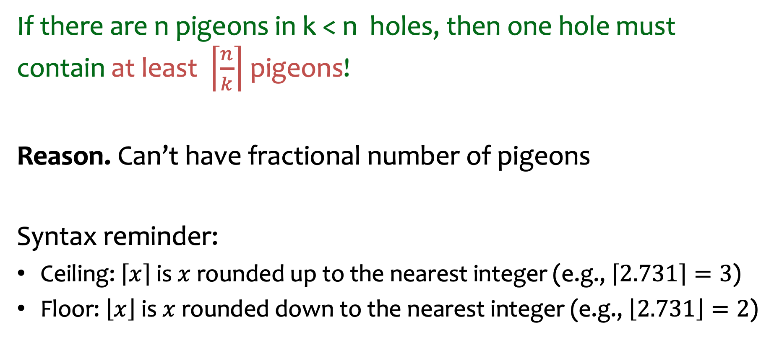
Pigeonhole Principle – Better version
If there are n pigeons in k < n holes, then one hole must contain at least $\left\lceil \frac{n}{k}\right\rceil$ pigeons!
Reason. Can’t have fractional number of pigeons
Syntax reminder:
Ceiling: $\left\lceil x\right\rceil$ is $x$ rounded up to the nearest integer (e.g., $\left\lceil 2.731\right\rceil =3$)
Floor: $\left\lfloor x\right\rfloor$ is $x$ rounded down to the nearest integer (e.g., $\left\lfloor 2.731\right\rfloor =2$)
Notes:
If there are n pigeons in k < n holes, then one hole must contain at least ceiling of n over k pigeons!

Slide 31



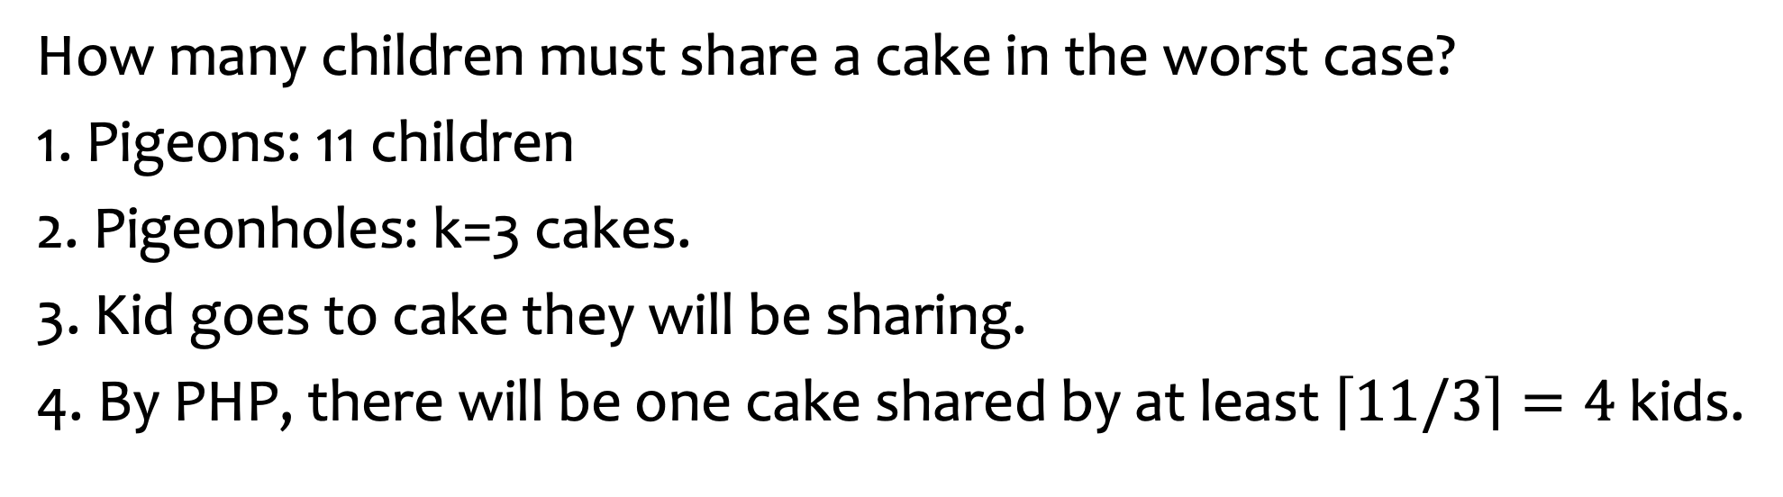
Pigeonhole Principle: Example 2
🎂
🎂
🎂
How many children must share a cake in the worst case?
1. Pigeons: 11 children
2. Pigeonholes: k=3 cakes.
3. Kid goes to cake they will be sharing.
4. By PHP, there will be one cake shared by at least $\left\lceil 11/3\right\rceil =4$ kids.

Slide 32
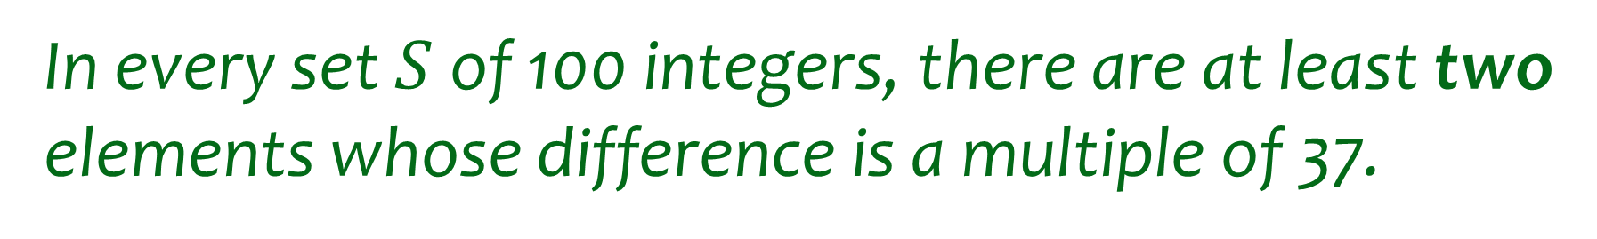
Pigeonhole Principle – Example 3
In every set $S$ of 100 integers, there are at least two elements whose difference is a multiple of 37.

Slide 33
Pigeonhole Principle – Example 3 - setup
In every set $S$ of 100 integers, there are at least two elements whose difference is a multiple of 37.
When solving a PHP problem:
Identify pigeons
Identify pigeonholes
Specify how pigeons are assigned to pigeonholes
Apply PHP

Slide 34
Pigeonhole Principle – Example 3 (Surprising?)
In every set $S$ of 100 integers, there are at least two elements whose difference is a multiple of 37.
When solving a PHP problem:
Identify pigeons integers in set S
Identify pigeonholes value mod 37
Specify how pigeons are x to hole x mod 37 assigned to pigeonholes
Apply PHP 100 pigeons to 37 PHs

Slide 35
Agenda (4)
Sleuth’s Criterion
Stars and Bars
Pigeonhole Principle
More examples?

Slide 36
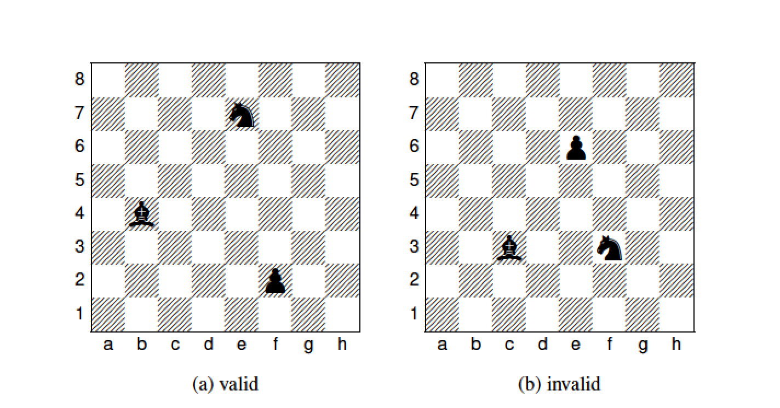

8 by 8 chessboard
How many ways to place a pawn, a bishop, and a knight so that none are in the same row or column ?
Poll:
$\left({64 \atop 3}\right)$
$\left({8 \atop 3}\right)⋅\left({8 \atop 3}\right)$
$8^{2}⋅7^{2}⋅6^{2}$
I don’t know.
https://pollev.com/ annakarlin185
Notes:
Configurations: column and row for each
Apply Generalized Product Rule. What is the sequence of choices you’re going to make.
cP rP, cN rN, cR rR
(8 x 7 x 6)^2
A 64 choose 3 undercounts in that treats them as the same whereas they are distinguishable. Overcounts in that allows them to be in same row and column
B undercounts

Slide 37

8 by 8 chessboard - solution
How many ways to place a pawn, a bishop, and a knight so that none are in the same row or column ?
Sequential process:
Column for pawn
Row for pawn
Column for bishop
Row for bishop
Column for knight
Row for knight
$${\left(8⋅7⋅6\right)}^{2}$$
Notes:
Configurations: column and row for each
Apply Generalized Product Rule. What is the sequence of choices you’re going to make.
cP rP, cN rN, cR rR
(8 x 7 x 6)^2

Slide 38
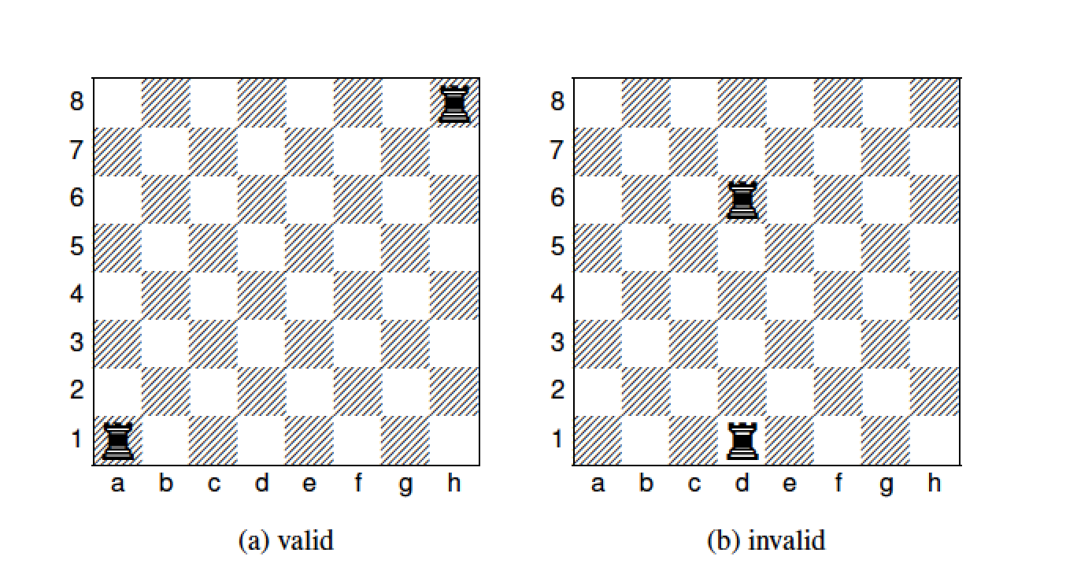

Rooks on chessboard
How many ways to place two identical rooks on a chessboard so that they don’t share a row or a column
Poll:
$8^{2}⋅7^{2}$
$\left({8 \atop 2}\right)⋅\left({8 \atop 2}\right)$
$\frac{8^{2}⋅7^{2}}{2}$
I don’t know.
https://pollev.com/ annakarlin185
Notes:
A. 8^2 7^2. -- first choose a row and column for first rook. Then choose a row and column for the second rook.
B. Choose a pair of rows for the two rooks. Then choose a pair of columns for the two rooks.
C. Overcounted. Treat the two rooks as different. Treating them as the same: pick number of ways. Then permute them.
A (1, 1, 8,8) same as (8,8, 1, 1) – overcount by factor of 2
Two different ways of describing the same configuration.
(8 choose 2) (7 choose 2) undercounts
(r, r’), (c, c’) → actually gives 2 configurations
(r, c), (r’, c’) and (r, c’) (r’,c)

Slide 39
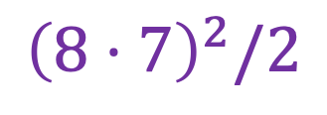

Rooks on chessboard - solution
How many ways to place two identical rooks on a chessboard so that they don’t share a row or a column
Pretend Rooks are different
Column for rook1
Row for rook1
Column for rook2
Row for rook2
$${\left(8⋅7\right)}^{2}$$
Remove the order between two rooks
$${\left(8⋅7\right)}^{2}/2$$
Notes:
Let A be the set of sequences (r1, c1, r2, c2)
Snag (1, 1, 8,8) (8,8, 1, 1)
Two different ways of describing the same configuration.
|A | = 2 |B|.
8^2 7^2 /2
(8 choose 2) (7 choose 2) wrong…. 8^2 7^2/2. 64 choose 2
(R1, r2) (c1, c2) → one configuration, but this actually gives 2 configurations
(r, c), (r’, c’) and (r, c’) (r’,c)

Slide 40
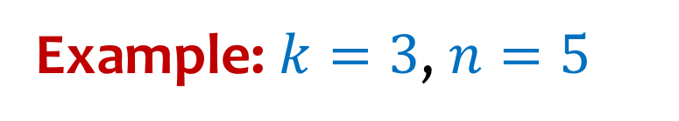
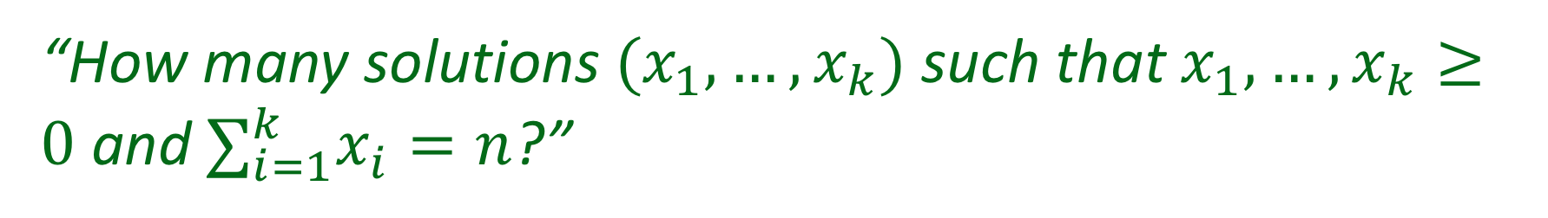
Example – Sum of integers
“How many solutions $(x_{1},…,x_{k})$ such that $x_{1},…,x_{k}≥0$ and $∑_{i=1}^{k}x_{i}=n$?”
Example: $k=3$, $n=5$
$$\left(0,0,5\right),\left(5,0,0\right),\left(1,0,4\right),\left(2,1,2\right),\left(3,1,1\right),\left(2,3,0\right),…$$

Slide 41

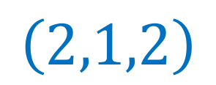
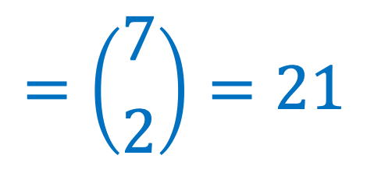
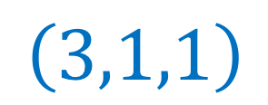
Example – Sum of integers (k=3, n=5) - solution
Example: $k=3$, $n=5$
$$=\left({7 \atop 2}\right)=21$$
# sols = # strings from ${\left\{0,1\right\}}^{7}$ w/ exactly two $0$s
Clever representation of solutions with stars and bars
$$\left(3,1,1\right)$$
$$\left(2,1,2\right)$$
Notes:
If instead k=4, n = 9, we would put 3 bars and 9 stars and the number of solutions would be 12 choose 3 (or 12 choose 9.

Slide 42
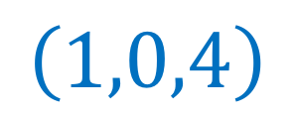
Example – Sum of integers (k=3, n=5)
Example: $k=3$, $n=5$
Clever representation of solutions (with stars and bars)
$$\left(3,1,1\right)$$
$$\left(2,1,2\right)$$
$$\left(1,0,4\right)$$
Notes:
(1,0,4) will be one star, then onebar, then another bar, then 4 stars.

Slide 43
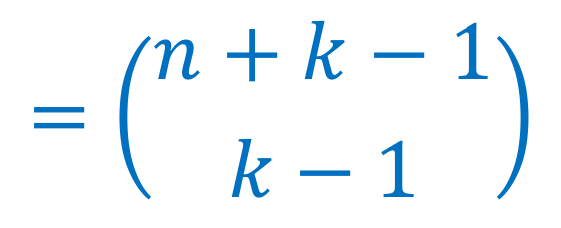
Example – Sum of integers – general case
“How many solutions $(x_{1},…,x_{k})$ such that $x_{1},…,x_{k}≥0$ and $∑_{i=1}^{k}x_{i}=n$?”
# sols = # strings from ${\left\{0,1\right\}}^{n+k−1}$ w/ $k−1$ 0s
$$=\left({n+k−1 \atop k−1}\right)$$
After a change in representation, the problem magically reduces to counting combinations.

Slide 44
Challenge problem
Use the stars and bars approach to count the number of ways to choose k out of n distinct objects if repetition is allowed (but don’t care about order)
Notes:
Same as x_1 + x_2 + … + x_n = k (x_i is the number of item i selected.
K stars, n-1 bars.

Slide 45
Tools and concepts
Sum rule, Product rule
Permutations, combinations
Inclusion-exclusion
Binomial Theorem
Combinatorial proofs
Sleuth’s criterion
Stars and bars
Pigeonhole principle
Notes:
Reading order checked

Slide 46


Counting is NOT for kindergarteners
Notes:
https://www.google.com/url?sa=i&url=https%3A%2F%2Fwww.youtube.com%2Fwatch%3Fv%3Denw0dsDpSNM&psig=AOvVaw3iQ4XtmdInmsMu7i36NxkH&ust=1584777648164000&source=images&cd=vfe&ved=0CAIQjRxqFwoTCPD5sITLqOgCFQAAAAAdAAAAABAQ

