Slide 1
More Maximum Likelihood Estimation
CSE 312 Spring 26
Lecture 24
Several slides by Mor Harchol-Balter from
Book “Intro to Probability for Computing”

Slide 2
Probability vs. Statistics
PROBABILITY
generate
Probabilistic Model
Data
infer
STATISTICS
Maximum Likelihood Estimation: Given some data drawn from a known distribution
with unknown parameters, estimate the parameters of the distribution

Slide 3
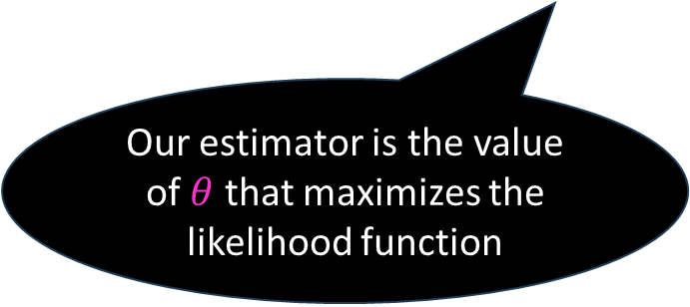
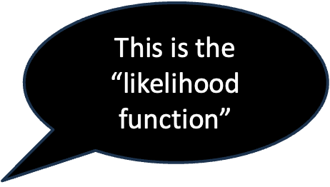
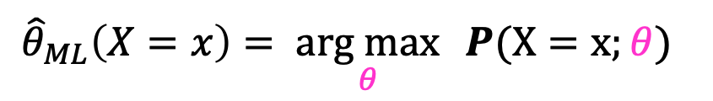
Creating an maximum likelihood estimator
Goal: Estimate an unknown value $θ$, given sample data $X \text{from} \text{known} \text{distribution} \text{with} \text{unknown} \text{parameter}\text{(}\text{s}\text{) }θ.$
This is the “likelihood function”
Step 1: Define
$${\hat{θ}}_{ML}\left(X=x\right)= \underset{θ}{arg max}{ P(X=x;θ) }$$
Our estimator is the value of $θ$ that maximizes the likelihood function

Slide 4


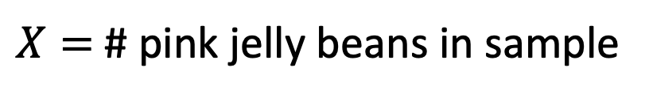
Example of MLE
Goal: Estimate $θ=$Number of pink jelly beans
Experiment: Randomly sample $n=20$ beans w/ replacement
1000 jelly beans total
$X=$# pink jelly beans in sample

Slide 5
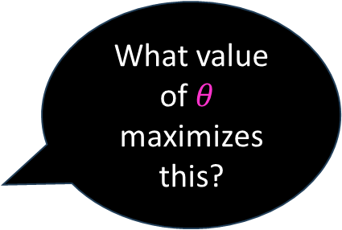
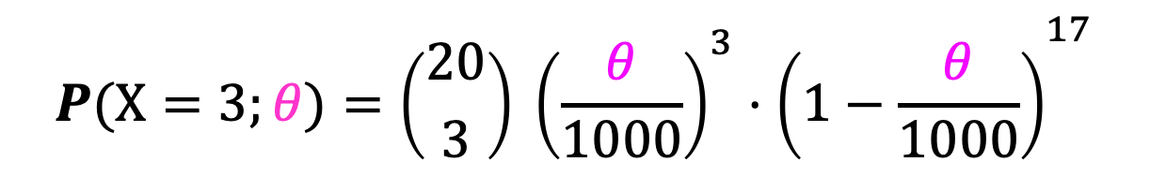
Example of MLE
Goal: Estimate $θ=$Number of pink jelly beans
Experiment: Randomly sample $n=20$ beans w/ replacement
1000 jelly beans total
$X=$# pink jelly beans in sample is Binomial (n, $θ$/1000)
Suppose we observe $X=3$ pinks in our sample with $n=20$ .
What value of $θ$
maximizes this?
$$P(X=3;θ)={\left({20 \atop 3}\right)}^{ }{{\left(\frac{θ}{1000}\right)}^{3}⋅\left(1−\frac{θ}{1000}\right)}^{17}$$

Slide 6
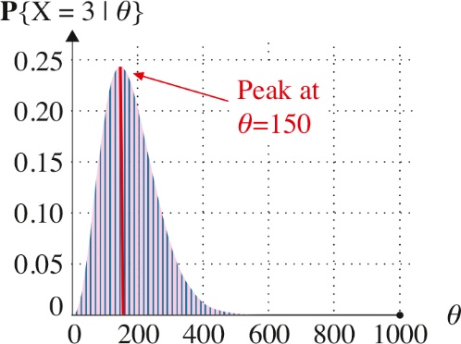


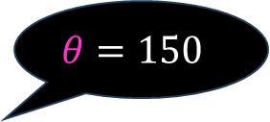
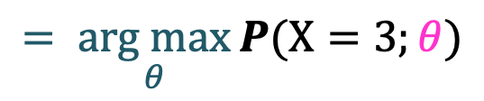

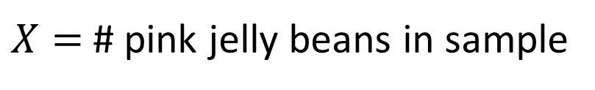

Example of MLE
Goal: Estimate $θ=$Number of pink jelly beans
Experiment: Randomly sample $n=20$ beans w/ replacement
1000 jelly beans total
$X=$# pink jelly beans in sample
Q: Suppose we observe $X=3$ pinks in our sample. What is$P(X=3;θ)?$
What value of $θ$
maximizes this?
$P(X=3;θ$)
$${\hat{θ}}_{ML}\left(X=3\right)$$
$$= \underset{θ}{arg max}{P(X=3;θ)}$$
$$θ=150$$
$$=150$$

Slide 7

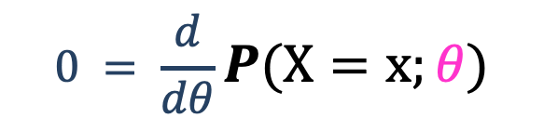
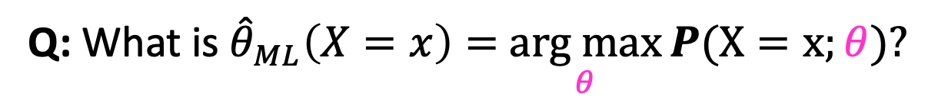
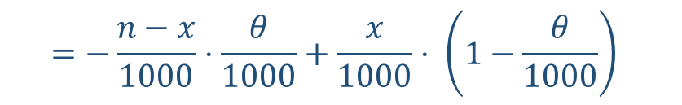
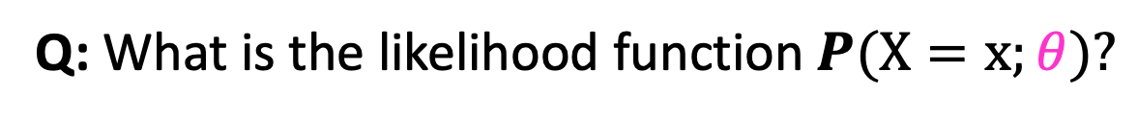

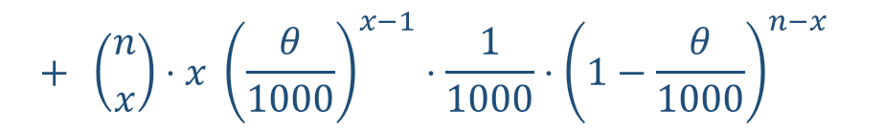

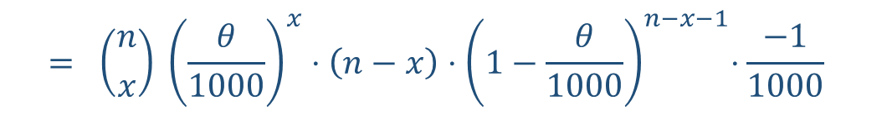
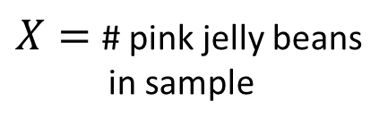
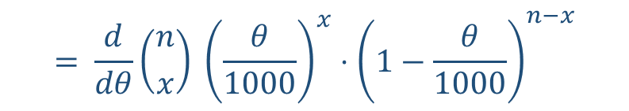
Example of MLE
Q: What is the likelihood function$P(X=x;θ)?$
$$P(X=x;θ)={\left({n \atop x}\right)}^{ }{{\left(\frac{θ}{1000}\right)}^{x}⋅\left(1−\frac{θ}{1000}\right)}^{n−x}$$
1000 jelly beans total
$X=$# pink jelly beans
in sample
Q: What is ${\hat{θ}}_{ML}\left(X=x\right)=$ $\underset{θ}{arg max}{P(X=x;θ)?}$
$$0 = \frac{d}{dθ}P(X=x;θ)$$
$$= \frac{d}{dθ}{\left({n \atop x}\right)}^{ }{{\left(\frac{θ}{1000}\right)}^{x}⋅\left(1−\frac{θ}{1000}\right)}^{n−x}$$
$$= {\left({n \atop x}\right)}^{ }{{\left(\frac{θ}{1000}\right)}^{x}⋅\left(n−x\right){⋅\left(1−\frac{θ}{1000}\right)}^{n−x−1}⋅\frac{−1}{1000} }^{ }$$
$$+ {\left({n \atop x}\right)⋅x}^{ }{{\left(\frac{θ}{1000}\right)}^{x−1}⋅\frac{1}{1000}{⋅\left(1−\frac{θ}{1000}\right)}^{n−x} }^{ }$$
$$=−\frac{n−x}{1000}{⋅\frac{θ}{1000}+\frac{x}{1000}⋅}^{ }{{\left(1−\frac{θ}{1000}\right)}^{ }}^{ }$$
2nd derivative is
negative,
so this is a max
Solving, we get:
$$θ=\frac{1000x}{n}$$

Slide 8
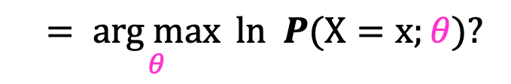
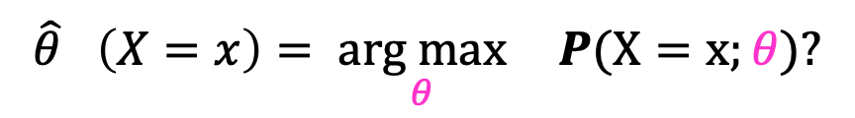
Maximizing Log likelihood Simpler
Goal: Estimate an unknown value $θ$, given sample data $X$
Define
This is the
likelihood
function
This is the
log likelihood
function
$${\hat{θ}}_{}\left(X=x\right)= \underset{θ}{arg max}{ P(X=x;θ)?}$$
$${=\underset{θ}{arg max}{ ln P(X=x;θ)?}}$$
equivalent
Why??

Slide 9


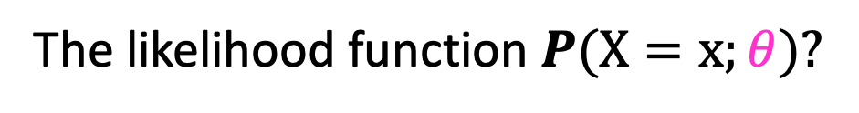
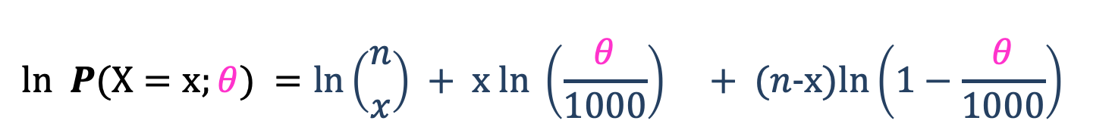
Example of MLE
$$\ln\left(ab\right)=\ln\left(a\right)+\ln\left(b\right)$$
$$\ln\left(a/b\right)=\ln\left(a\right)−ln⁡(b)$$
$$\ln\left(a^{b}\right)=b⋅\ln{(a)}$$
The likelihood function$P(X=x;θ)?$
$$P(X=x;θ)={\left({n \atop x}\right)}^{ }{{\left(\frac{θ}{1000}\right)}^{x}⋅\left(1−\frac{θ}{1000}\right)}^{n−x}$$
1000 jelly beans total
$X=$# pink jelly beans
in sample
$$ln P(X=x;θ) =ln{\left({n \atop x}\right) + x ln}^{ }{{\left(\frac{θ}{1000}\right)}^{} + (n−x)ln\left(1−\frac{θ}{1000}\right)}^{}$$
$$0 = \frac{d}{dθ}ln P(X=x;θ)$$

Slide 10
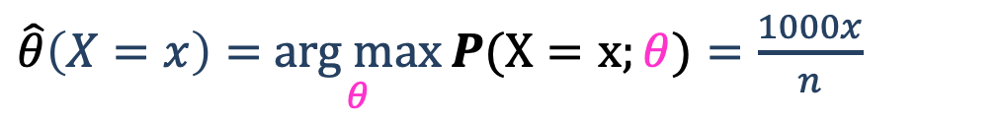

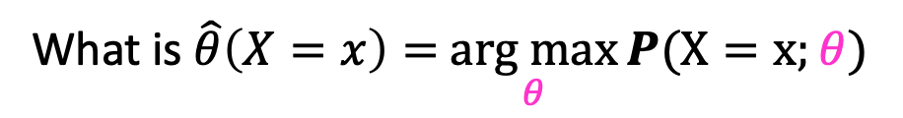

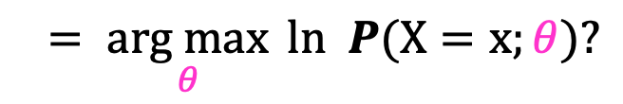
Example of MLE
What is the likelihood function $P\left\{X=x \right| θ\}?$
$$P(X=x;θ)={\left({n \atop x}\right)}^{ }{{\left(\frac{θ}{1000}\right)}^{x}⋅\left(1−\frac{θ}{1000}\right)}^{n−x}$$
1000 jelly beans total
$X=$# pink jelly beans
in sample
What is $\hat{θ}\left(X=x\right)=$ $\underset{θ}{arg max}{P(X=x;θ)}$
$${=\underset{θ}{arg max}{ ln P(X=x;θ)?}}$$
$\hat{θ}\left(X=x\right)=$ $\underset{θ}{arg max}{P(X=x;θ)=\frac{1000x}{n}}$
This holds
$$∀x$$

Slide 11
Agenda
MLE for Continuous Distributions
MLE for Normal Distribution
Unbiased and Consistent Estimators

Slide 12

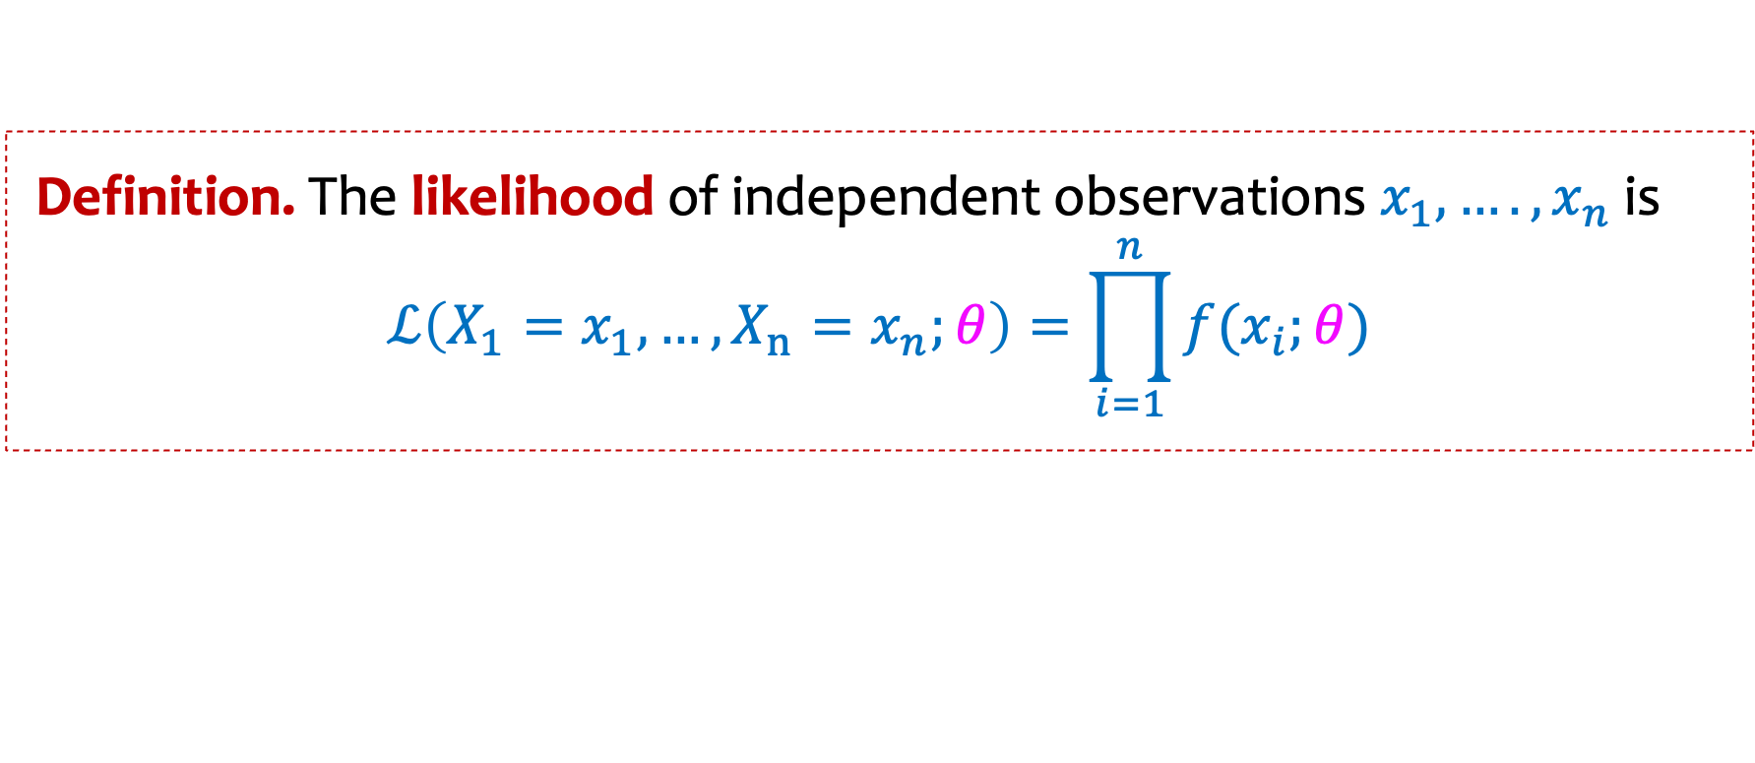
The Continuous Case
Given $n$ (independent) samples ${X_{1}=x}_{1},…, {X_{n}=x}_{n}$ from (continuous) parametric model $f\left(x_{i};θ\right)$ which is now a family of densities
Definition. The likelihood of independent observations $x_{1},….,x_{n}$is
$$ℒ\left({X_{1}=x}_{1},…, {X_{n}=x}_{n};θ\right)=\prod_{i=1}^{n}{f(x_{i};θ)}$$
Replace pmf with pdf!
Notes:
General, not just Gaussian?

Slide 13

Why density?
Density $≠$ probability, but:
  For maximizing likelihood, we really only care about relative likelihoods, and density captures that
  has desired property that likelihood increases with better fit to the model

Slide 14
Agenda
MLE for for Continuous Distributions
MLE for Normal Distribution
Unbiased and Consistent Estimators

Slide 15











$n$ samples${{ X}_{1}=x}_{1},…, {X_{n}=x}_{n}∈ℝ$ from Gaussian $𝒩(μ, 1)$. Most likely $μ$?
[i.e., we are given the promise that the variance is 1]
$$−4$$
$$−3$$
$$−2$$
$$−1$$
$$0$$
$$1$$
$$2$$
$$3$$
$$4$$
$$5$$
$$6$$

Slide 16
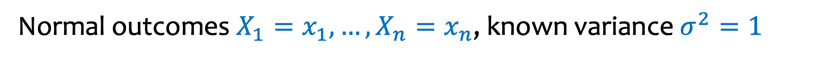

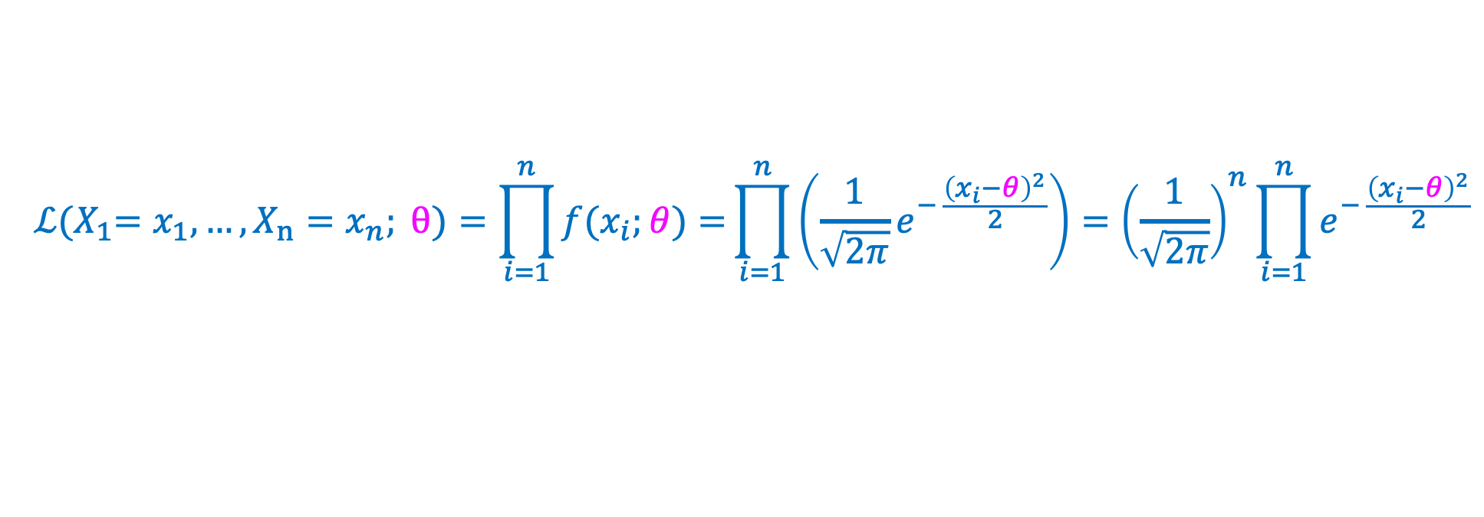
Example – Gaussian Parameters
$$\ln\left(ab\right)=\ln\left(a\right)+\ln\left(b\right)$$
$$\ln\left(a/b\right)=\ln\left(a\right)−ln⁡(b)$$
$$\ln\left(a^{b}\right)=b⋅\ln{(a)}$$
Normal outcomes ${X_{1}=x}_{1},…, {X_{n}=x}_{n}$, known variance $σ^{2}=1$
Goal: estimate $θ$, the unknown expectation
$${ℒ{{(X}_{1}=x}_{1},…, {X_{n}=x}_{n}; θ)=\prod_{i=1}^{n}{f(x_{i};θ)}=}\prod_{i=1}^{n}{\left(\frac{1}{\sqrt{2π}}e^{− \frac{{\left(x_{i}−θ\right)}^{2}}{2}}\right)}={\left(\frac{1}{\sqrt{2π}}\right)}^{n}\prod_{i=1}^{n}{e^{− \frac{{\left(x_{i}−θ\right)}^{2}}{2}}}$$

Slide 17

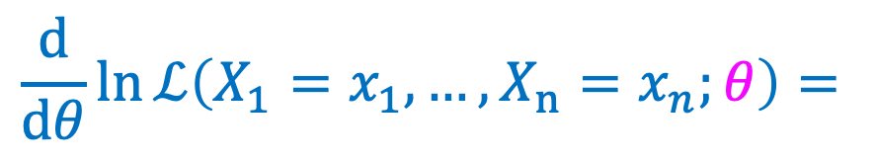
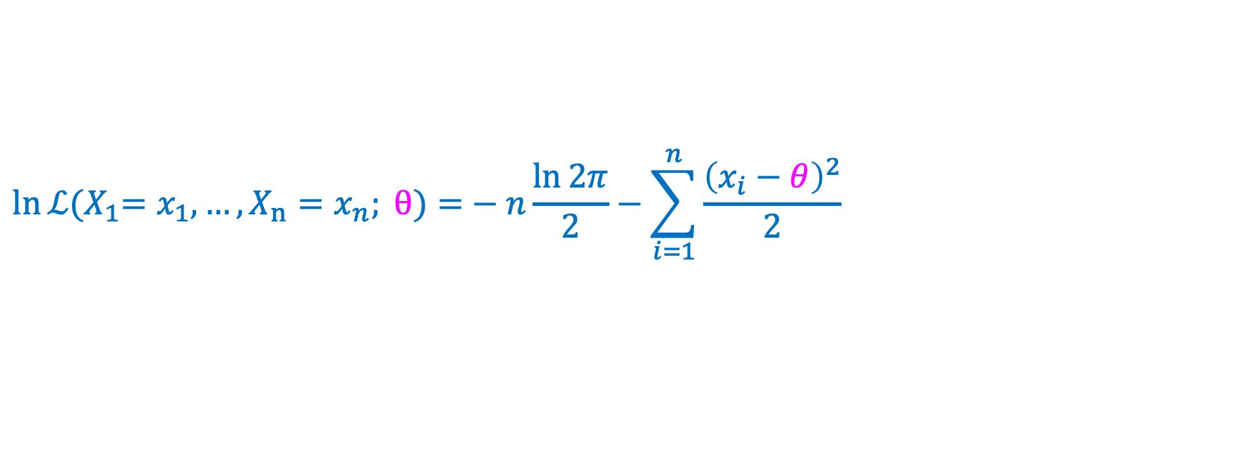

Example – Gaussian Parameters
Goal: estimate $θ$= expectation
Normal outcomes${{ X}_{1}=x}_{1},…, {X_{n}=x}_{n}$, known variance $σ^{2}=1$
$$\ln{ℒ{{(X}_{1}=x}_{1},…, {X_{n}=x}_{n}; θ)=}−n\frac{\ln{2π}}{2}−\sum_{i=1}^{n}{\frac{{\left(x_{i}−θ\right)}^{2}}{2}}$$
$$\frac{d}{dθ}ln{ℒ\left({X_{1}=x}_{1},…, {X_{n}=x}_{n};θ\right)=}$$
Note: $\frac{d}{dθ}\frac{{\left(x_{i}−θ\right)}^{2}}{2}=\frac{1}{2}⋅2⋅\left(x_{i}−θ\right)⋅\left(−1\right)=θ−x_{i}$

Slide 18
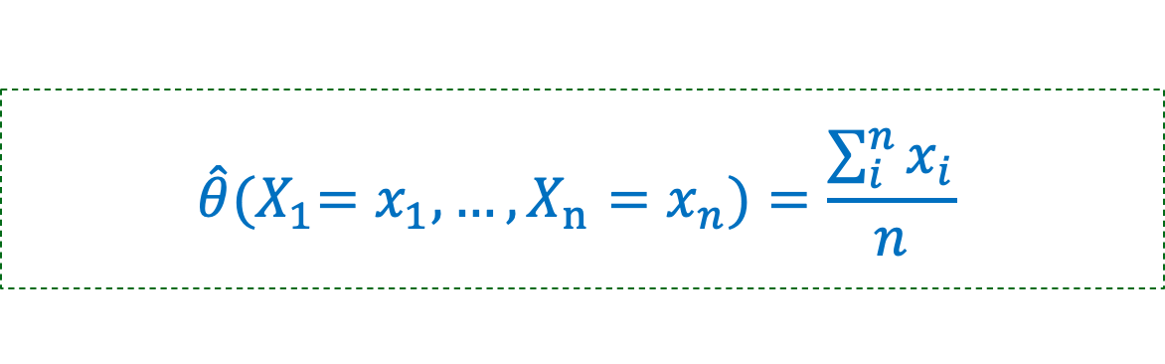
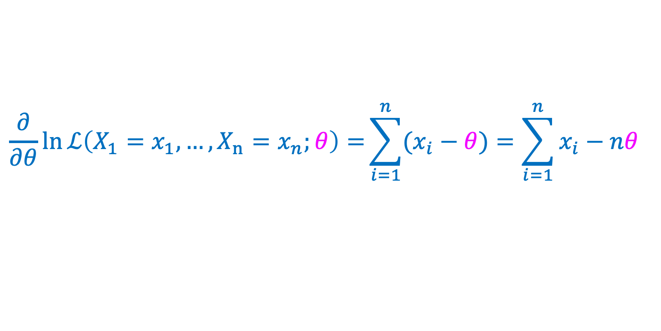


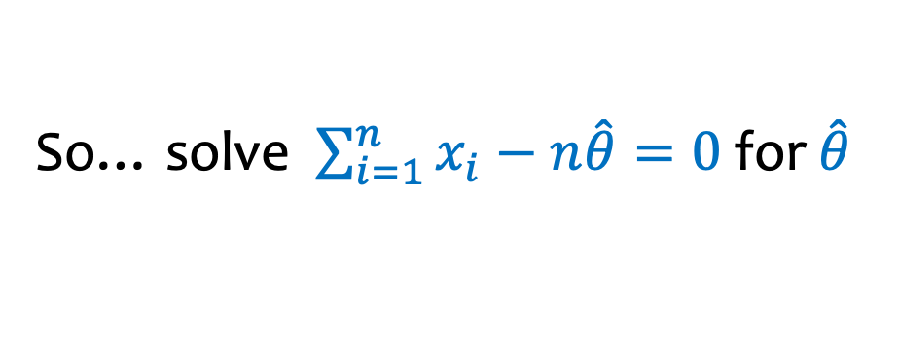
Example – Gaussian Parameters
Goal: estimate $θ$= expectation
Normal outcomes${{ X}_{1}=x}_{1},…, {X_{n}=x}_{n}$, known variance $σ^{2}=1$
$$\ln{ℒ{{(X}_{1}=x}_{1},…, {X_{n}=x}_{n}; θ)=}−n\frac{\ln{2π}}{2}−\sum_{i=1}^{n}{\frac{{\left(x_{i}−θ\right)}^{2}}{2}}$$
Note: $\frac{∂}{∂θ}\frac{{\left(x_{i}−θ\right)}^{2}}{2}=\frac{1}{2}⋅2⋅\left(x_{i}−θ\right)⋅\left(−1\right)=θ−x_{i}$
$$\frac{∂}{∂θ}ln{ℒ\left({X_{1}=x}_{1},…, {X_{n}=x}_{n};θ\right)=}\sum_{i=1}^{n}{(x_{i}−θ})=\sum_{i=1}^{n}{x_{i}}−nθ$$
So… solve $\sum_{i=1}^{n}{x_{i}}−n\hat{θ}=0$ for $\hat{θ}$
$$\hat{θ}{{(X}_{1}=x}_{1},…, {X_{n}=x}_{n})=\frac{\sum_{i}^{n}{x_{i}}}{n}$$
In other words, MLE is the sample mean of the data.

Slide 19
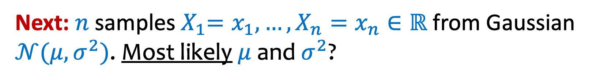
Next: $n$ samples${{ X}_{1}=x}_{1},…, {X_{n}=x}_{n}∈ℝ$ from Gaussian $𝒩(μ, σ^{2})$. Most likely $μ$ and $σ^{2}$?
$$−4$$
$$−3$$
$$−2$$
$$−1$$
$$0$$
$$1$$
$$2$$
$$3$$
$$4$$
$$5$$
$$6$$

Slide 20
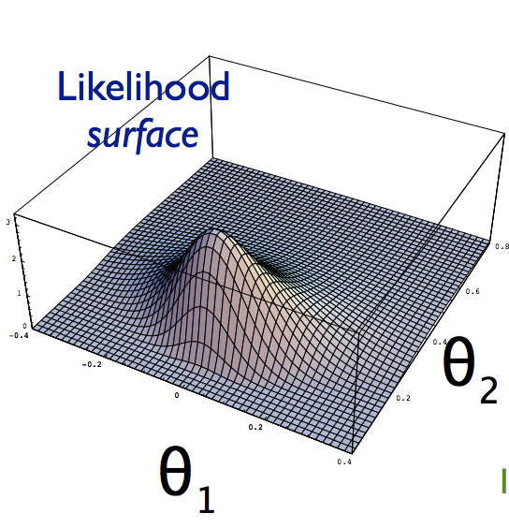

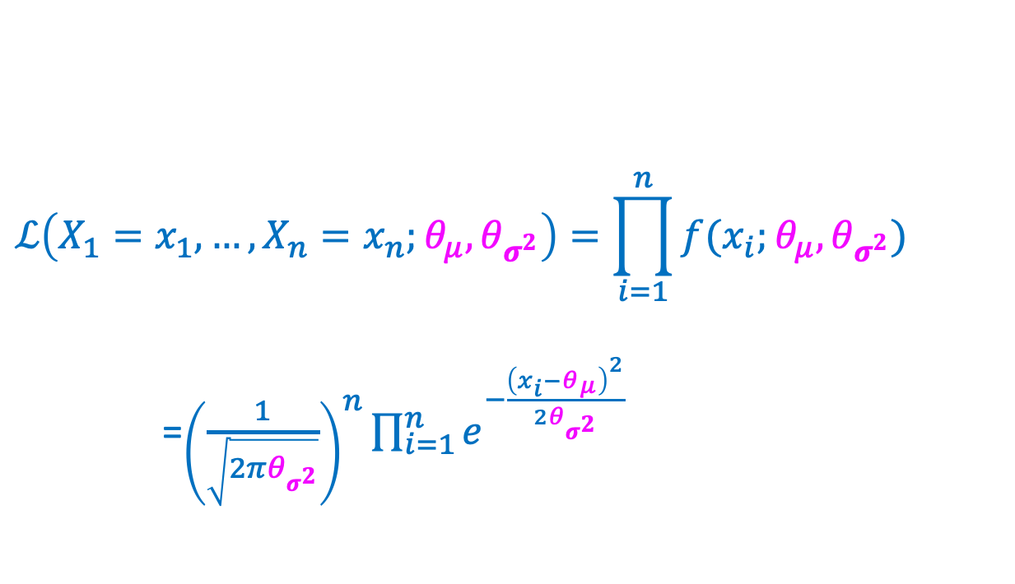
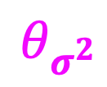
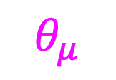
Two-parameter optimization
$$\ln\left(ab\right)=\ln\left(a\right)+\ln\left(b\right)$$
$$\ln\left(a/b\right)=\ln\left(a\right)−ln⁡(b)$$
$$\ln\left(a^{b}\right)=b⋅\ln{(a)}$$
Normal outcomes${{ X}_{1}=x}_{1},…, {X_{n}=x}_{n}$
Goal: estimate $θ_{μ}$ = expectation and $θ_{σ^{2}}$= variance
$$ℒ\left({X_{1}=x}_{1},…, {X_{n}=x}_{n};θ_{μ},θ_{σ^{2}}\right)=\prod_{i=1}^{n}{f(x_{i};θ_{μ},θ_{σ^{2}})}$$
=${\left(\frac{1}{\sqrt{2πθ_{σ^{2}}}}\right)}^{n}\prod_{i=1}^{n}{e^{−\frac{{\left(x_{i}−θ_{μ}\right)}^{2}}{2θ_{σ^{2}}}}}$
$$θ_{σ^{2}}$$
$$θ_{μ}$$

Slide 21
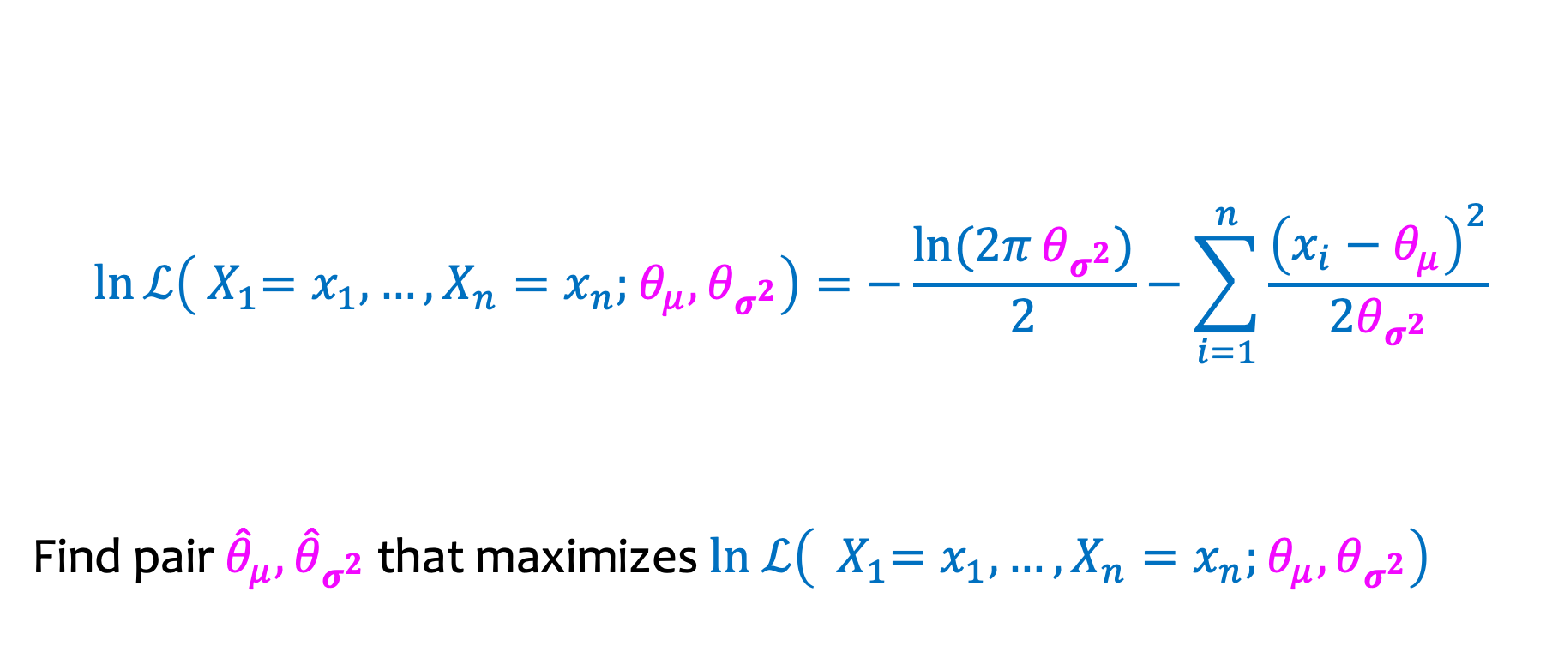
Two-parameter estimation
$$\ln{ℒ\left({{ X}_{1}=x}_{1},…, {X_{n}=x}_{n};θ_{μ},θ_{σ^{2}}\right)=−\frac{\ln{(2π}θ_{σ^{2}})}{2}−\sum_{i=1}^{n}{\frac{{\left(x_{i}−θ_{μ}\right)}^{2}}{2θ_{σ^{2}}}}}$$
Find pair ${\hat{θ}}_{μ},{\hat{θ}}_{σ^{2}}$ that maximizes $ln ℒ\left({{ X}_{1}=x}_{1},…, {X_{n}=x}_{n};θ_{μ},θ_{σ^{2}}\right)$

Slide 22
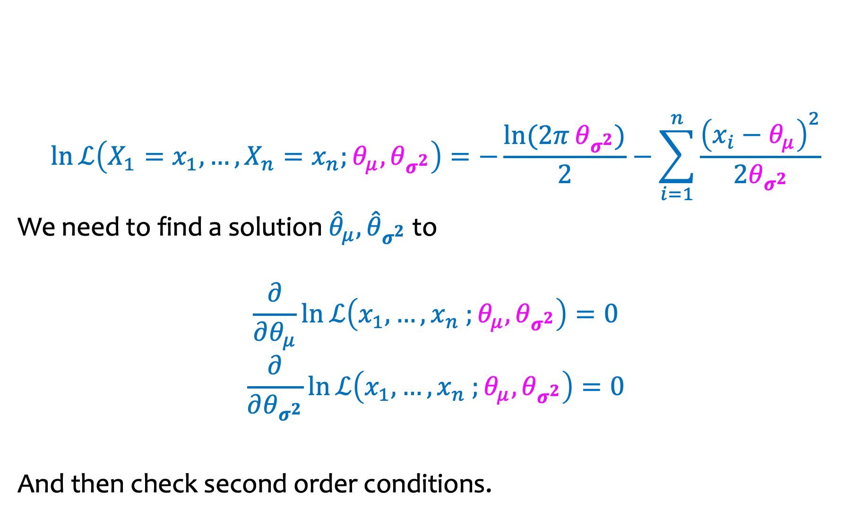
Two-parameter estimation
$$\ln{ℒ\left({X_{1}=x}_{1},…, {X_{n}=x}_{n};θ_{μ},θ_{σ^{2}}\right)=−\frac{\ln{(2π}θ_{σ^{2}})}{2}−\sum_{i=1}^{n}{\frac{{\left(x_{i}−θ_{μ}\right)}^{2}}{2θ_{σ^{2}}}}}$$
We need to find a solution ${\hat{θ}}_{μ},{\hat{θ}}_{σ^{2}}$ to
$$\frac{∂}{∂θ_{μ}}ln{ℒ\left(x_{1},…, x_{n} ;θ_{μ},θ_{σ^{2}}\right)}=0$$
$$\frac{∂}{∂θ_{σ^{2}}}ln{ℒ\left(x_{1},…, x_{n} ;θ_{μ},θ_{σ^{2}}\right)}=0$$
And then check second order conditions.

Slide 23
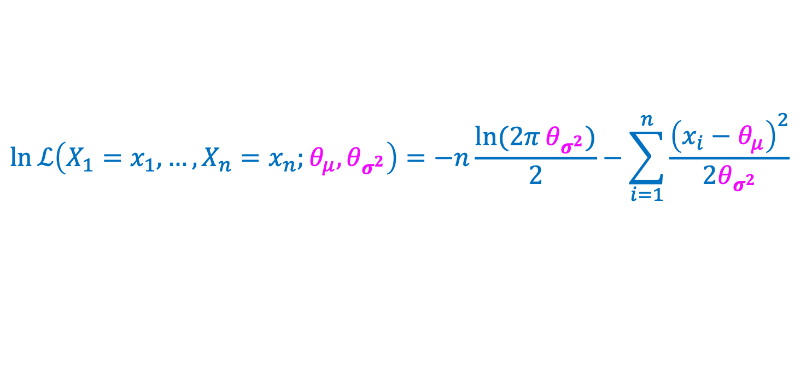
MLE for Expectation
$$\ln{ℒ\left({X_{1}=x}_{1},…, {X_{n}=x}_{n};θ_{μ},θ_{σ^{2}}\right)=−n\frac{\ln{(2π}θ_{σ^{2}})}{2}−\sum_{i=1}^{n}{\frac{{\left(x_{i}−θ_{μ}\right)}^{2}}{2θ_{σ^{2}}}}}$$

Slide 24
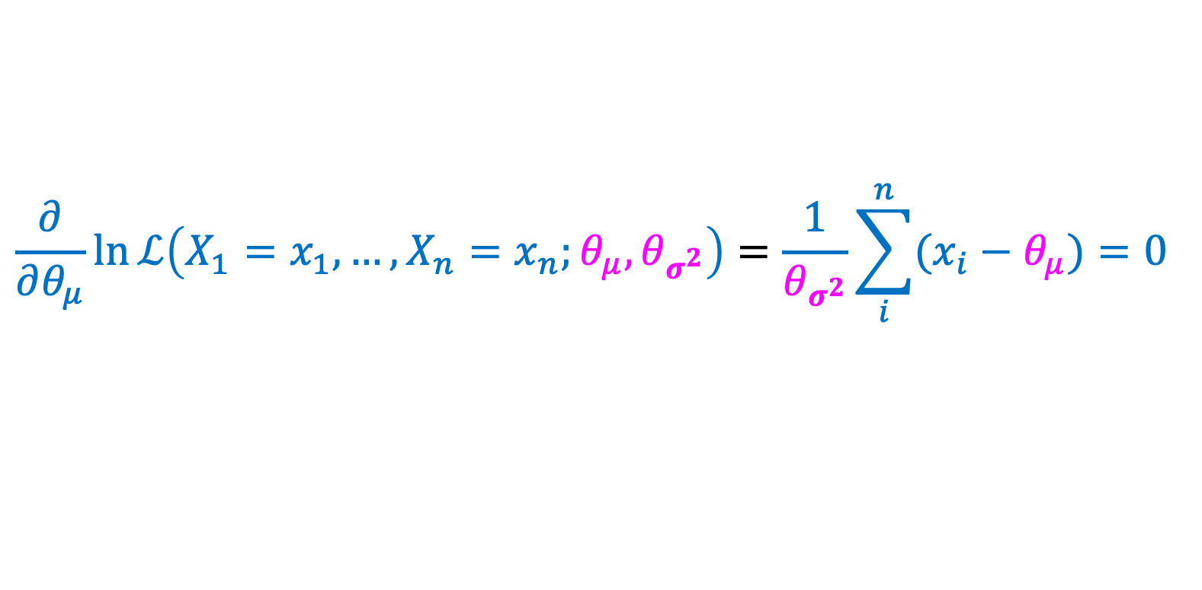
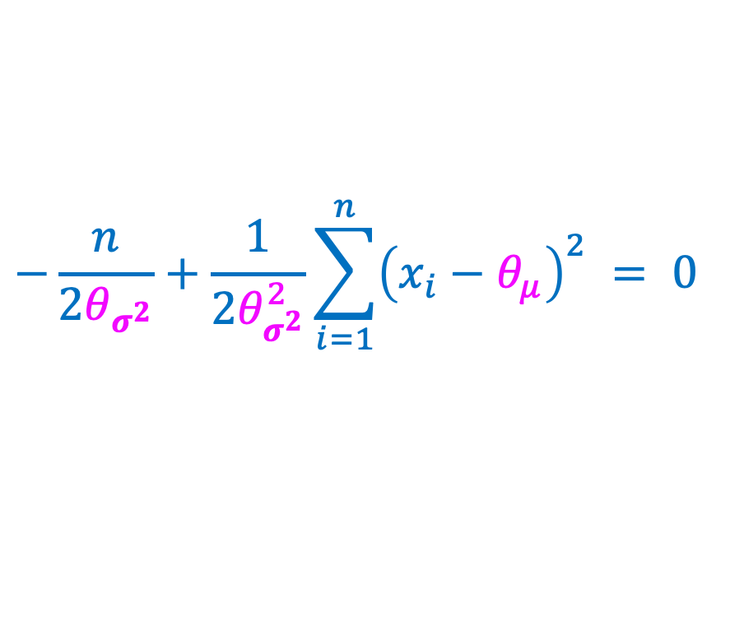
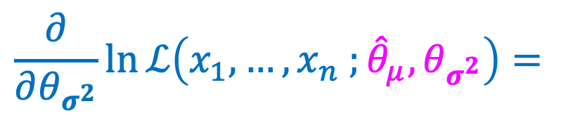
MLE for Expectation
$$\ln{ℒ\left({X_{1}=x}_{1},…, {X_{n}=x}_{n};θ_{μ},θ_{σ^{2}}\right)=−n\frac{\ln{(2π}θ_{σ^{2}})}{2}−\sum_{i=1}^{n}{\frac{{\left(x_{i}−θ_{μ}\right)}^{2}}{2θ_{σ^{2}}}}}$$
$$\frac{∂}{∂θ_{μ}}\ln{ℒ\left({X_{1}=x}_{1},…, {X_{n}=x}_{n};θ_{μ},θ_{σ^{2}}\right)}=\frac{1}{θ_{σ^{2}}}\sum_{i}^{n}{(x_{i}−θ_{μ})}=0$$
$$\frac{∂}{∂θ_{σ^{2}}}\ln{ℒ\left(x_{1},…, x_{n} ;{\hat{θ}}_{μ},θ_{σ^{2}}\right)}=$$
$$−\frac{n}{2θ_{σ^{2}}}+\frac{1}{2θ_{σ^{2}}^{2}}\sum_{i=1}^{n}{{\left(x_{i}−θ_{μ}\right)}^{2}} = 0$$

Slide 25
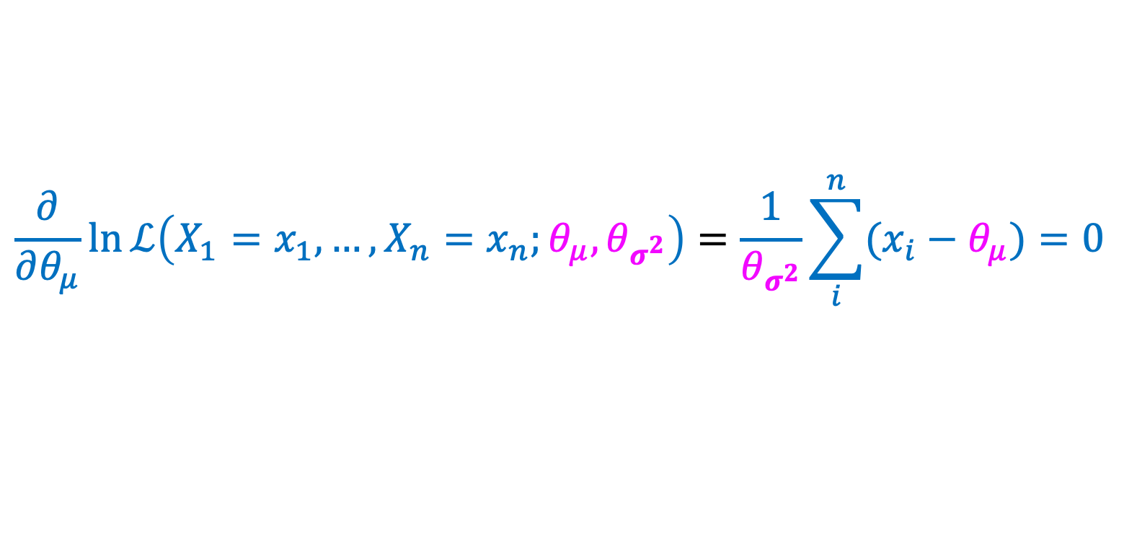

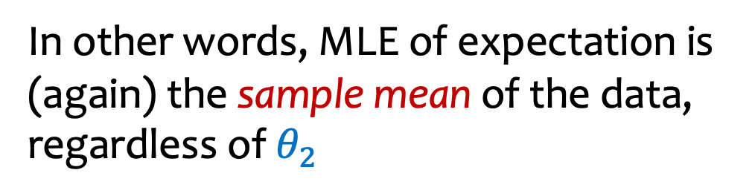
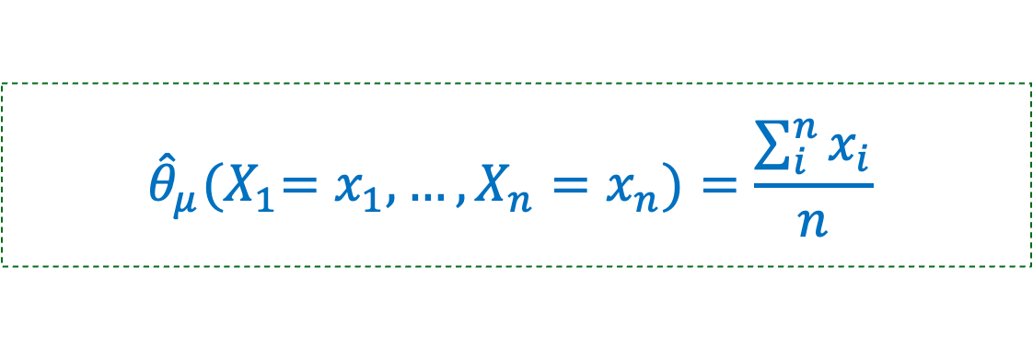
MLE for Expectation
$$\ln{ℒ\left({X_{1}=x}_{1},…, {X_{n}=x}_{n};θ_{μ},θ_{σ^{2}}\right)=−n\frac{\ln{(2π}θ_{σ^{2}})}{2}−\sum_{i=1}^{n}{\frac{{\left(x_{i}−θ_{μ}\right)}^{2}}{2θ_{σ^{2}}}}}$$
$$\frac{∂}{∂θ_{μ}}\ln{ℒ\left({X_{1}=x}_{1},…, {X_{n}=x}_{n};θ_{μ},θ_{σ^{2}}\right)}=\frac{1}{θ_{σ^{2}}}\sum_{i}^{n}{(x_{i}−θ_{μ})}=0$$
$${\hat{θ}}_{μ}{{(X}_{1}=x}_{1},…, {X_{n}=x}_{n})=\frac{\sum_{i}^{n}{x_{i}}}{n}$$
In other words, MLE of expectation is (again) the sample mean of the data, regardless of $θ_{2}$
What about the variance?

Slide 26
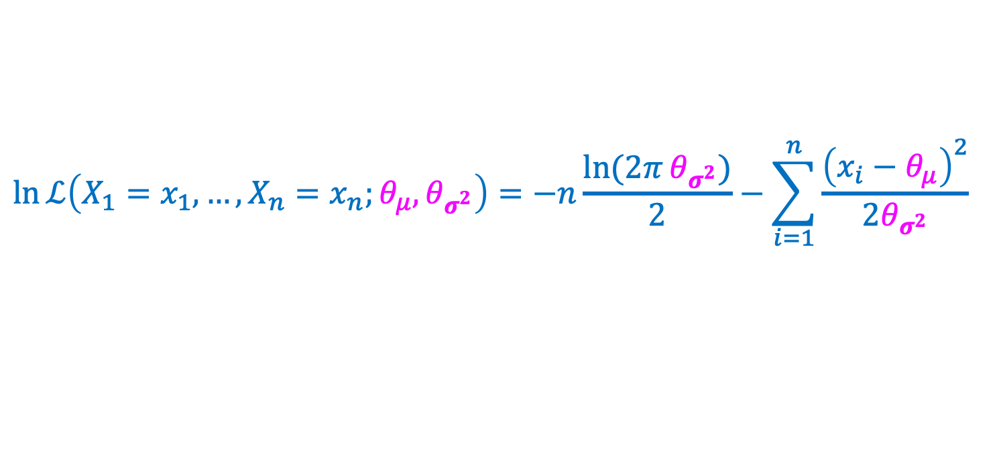





MLE for Variance
$$\ln{ℒ\left({X_{1}=x}_{1},…, {X_{n}=x}_{n};θ_{μ},θ_{σ^{2}}\right)=−n\frac{\ln{(2π}θ_{σ^{2}})}{2}−\sum_{i=1}^{n}{\frac{{\left(x_{i}−θ_{μ}\right)}^{2}}{2θ_{σ^{2}}}}}$$
$$=−n\frac{\ln{2π}}{2}−n\frac{\ln{θ_{σ^{2}}}}{2}−\frac{1}{2θ_{σ^{2}}}\sum_{i=1}^{n}{{\left(x_{i}−{\hat{θ}}_{μ}\right)}^{2}}$$
$$−\frac{n}{2θ_{σ^{2}}}+\frac{1}{2θ_{σ^{2}}^{2}}\sum_{i=1}^{n}{{\left(x_{i}−{\hat{θ}}_{μ}\right)}^{2}}$$
$$\frac{∂}{∂θ_{σ^{2}}}\ln{ℒ\left(x_{1},…, x_{n} ;{\hat{θ}}_{μ},θ_{σ^{2}}\right)}=$$
$$Set =0$$
$${\hat{θ}}_{σ^{2}}{{ (X}_{1}=x}_{1},…, {X_{n}=x}_{n})=\frac{1}{n}\sum_{i=1}^{n}{{\left(x_{i}−{\hat{θ}}_{μ}\right)}^{2}}$$
In other words, MLE of variance is the population variance of the data.

Slide 27



Likelihood – Continuous Case
Definition. The likelihood of independent observations $x_{1},….,x_{n}$is
$$ℒ\left({{ X}_{1}=x}_{1},…, {X_{n}=x}_{n};θ\right)=\prod_{i=1}^{n}{f(x_{i};θ)}$$
Normal outcomes ${{ (X}_{1}=x}_{1},…, {X_{n}=x}_{n}$)
$${\hat{θ}}_{σ^{2}}=\frac{1}{n}\sum_{i=1}^{n}{{\left(x_{i}−{\hat{θ}}_{μ}\right)}^{2}}$$
$${\hat{θ}}_{μ}{{ (X}_{1}=x}_{1},…, {X_{n}=x}_{n})=\frac{\sum_{i}^{n}{x_{i}}}{n}$$
MLE estimator for expectation
MLE estimator for variance

Slide 28

General Recipe (single parameter)
1. Input Given $n$ i.i.d. samples $X_{1}=x_{1}, X_{2}=x_{2}, {…, X}_{n}=x_{n}$from parametric model with parameter $θ$.
2. Likelihood Define your likelihood $ℒ$ ($X_{1}=x_{1}, X_{2}=x_{2}, {…, X}_{n}=x_{n}; θ)$.
  For discrete $ℒ\left(x_{1},…, x_{n} ; θ\right)=\prod_{i=1}^{n}{P\left(x_{i} ;θ\right)}$
  For continuous $ℒ\left(x_{1},…, x_{n} ; θ\right)=\prod_{i=1}^{n}{f\left(x_{i} ; θ\right)}$
3. Log Compute $lnℒ\left(x_{1},…, x_{n} ; θ\right)$
4. Differentiate Compute $\frac{d}{dθ}\ln{ℒ\left(x_{1},…, x_{n} ; θ \right)}$
5. Solve for $\hat{θ}$ by setting derivative to $0$ and solving for max.
Do a second derivative test to verify it is a maximum, but we won’t ask you to do that in CSE 312.

Slide 29

General Recipe (multiple parrameters)
1. Input Given $n$ i.i.d. samples $X_{1}=x_{1}, X_{2}=x_{2}, {…, X}_{n}=x_{n}$from parametric model with parameters $\vec{θ}=(θ_{1},…, θ_{k}$).
2. Likelihood Define your likelihood $ℒ$ ($X_{1}=x_{1}, X_{2}=x_{2}, {…, X}_{n}=x_{n};\vec{ θ})$.
  For discrete $ℒ\left(x_{1},…, x_{n} ;\vec{θ}\right)=\prod_{i=1}^{n}{P\left(x_{i} ;\vec{θ}\right)}$
  For continuous $ℒ\left(x_{1},…, x_{n} ;\vec{θ}\right)=\prod_{i=1}^{n}{f\left(x_{i} ;\vec{θ}\right)}$
3. Log Compute $lnℒ\left(x_{1},…, x_{n} ;\vec{θ}\right)$
4. Differentiate Compute $\frac{∂}{∂θi}\ln{ℒ\left(x_{1},…, x_{n} ;\vec{θ}\right)}$
5. Solve for $\hat{θ}$ by setting all the derivatives to $0$ and solving.
Check second order conditions, but we won’t ask you to do that in CSE 312.

Slide 30

This Photo by Unknown Author is licensed under CC BY-SA

Slide 31
Agenda
MLE for for Continuous Distributions
Normal Distribution
Unbiased and Consistent Estimators

Slide 32







Definition of Estimator
e.g. $θ=parameter of a Bernoulli distin$
$θ:$quantity we’re trying to estimate
think of these as
$$i.i.d. instances of X∼Ber(θ)$$
This is a
constant
$X_{1}, X_{2}, …, X_{n}:$i.i.d. data
$\hat{θ}\left(X_{1}=x_{1}, X_{2}=x_{2}, …, X_{n}=x_{n}\right)$: e$stimation of θ \text{based} \text{on}$
$\text{specific} \text{instantiation} \text{of} \text{the} \text{data}$
This is a r.v. because it’s a function of r.v.s
Sometimes just write $\hat{θ}$
$\hat{θ}\left(X_{1}, X_{2}, …, X_{n}\right)$: estimator of the unknown $θ$

Slide 33




MLE for pink jelly beans
Q: What is the likelihood function $P\left\{X=x \right| θ\}?$
$$P(X=x;θ)={\left({n \atop x}\right)}^{ }{{\left(\frac{θ}{1000}\right)}^{x}⋅\left(1−\frac{θ}{1000}\right)}^{n−x}$$
1000 jelly beans total
$X=$# pink jelly beans
in sample
Q: What is ${\hat{θ}}_{ML}\left(X=x\right)=$ $\underset{θ}{arg max}{P(X=x;θ)?}$
${\hat{θ}}_{ML}\left(X=x\right)=$ $\underset{θ}{arg max}{P(X=x;θ)=\frac{1000x}{n}}$
This holds
$$∀x$$
➔
${\hat{θ}}_{ML}\left(X\right)=$ $\underset{ }{\frac{1000X}{n}}{ }$

Slide 34





MLE estimation for normal distribution
These hold for all
$$x_{1},…,x_{n}$$
$${{\hat{θ}}_{μ}}_{ }\left(X_{1}=x_{1}, X_{2}=x_{2}, {…, X}_{n}=x_{n}\right)=\frac{x_{1}+x_{2}+⋯+x_{n}}{n}$$
$${\hat{θ}}_{σ^{2}}\left(X_{1}=x_{1}, X_{2}=x_{2}, {…, X}_{n}=x_{n}\right)=\frac{1}{n }\sum_{i=1}^{n}{{\left( x_{i }−\frac{x_{1}+x_{2}+⋯+x_{n}}{n}\right)}^{2}}$$
$${{\hat{θ}}_{μ}}_{ }\left(X_{1}, X_{2}, {…, X}_{n}\right)=\frac{X_{1}+X_{2}+⋯+X_{n}}{n}$$
➔
$${\hat{θ}}_{σ^{2}}\left(X_{1}, X_{2}, {…, X}_{n}\right)=\frac{1}{n }\sum_{i=1}^{n}{{\left( X_{i }−\frac{X_{1}+X_{2}+⋯+X_{n}}{n}\right)}^{2}}$$
➔

Slide 35





When is an estimator good?
Parameter estimate
Independent samples $X_{1},…, X_{n}$ from $P(x;θ)$
Distribution $P(x;θ)$
EstimationAlgorithm
$${\hat{θ}}_{n}$$
$θ$ = unknown parameter
Definition. An estimator of parameter $θ$ is an unbiased estimator if
$𝔼\left[{\hat{θ}}_{n}(X_{1},…,X_{n})\right]=θ$.
Note: This expectation is over the samples $X_{1},…,X_{n}$

Slide 36






MLE for pink jelly beans
Q: What is the likelihood function $P\left\{X=x \right| θ\}?$
$$P(X=x;θ)={\left({n \atop x}\right)}^{ }{{\left(\frac{θ}{1000}\right)}^{x}⋅\left(1−\frac{θ}{1000}\right)}^{n−x}$$
1000 jelly beans total
$X=$# pink jelly beans
in sample
Q: What is ${\hat{θ}}_{ML}\left(X=x\right)=$ $\underset{θ}{arg max}{P(X=x;θ)?}$
${\hat{θ}}_{ML}\left(X=x\right)=$ $\underset{θ}{arg max}{P(X=x;θ)=\frac{1000x}{n}}$
This holds
$$∀x$$
➔
${\hat{θ}}_{ML}\left(X\right)=$ $\underset{ }{\frac{1000X}{n}}{ }$
Fact. ${\hat{θ}}_{ML}\left(X\right)$is unbiased

Slide 37
Three samples from $U(0, θ)$

Slide 38

When is an estimator good?
Parameter estimate
Independent samples $X_{1},…, X_{n}$ from $P(x;θ)$
Distribution $P(x;θ)$
EstimationAlgorithm
$${\hat{θ}}_{n}$$
$θ$ = unknown parameter
Definition. An estimator is unbiased if $𝔼\left[{\hat{θ}}_{n}\right]=θ$ for all $n≥1$.
Definition. An estimator is consistent if $\lim_{n→∞}𝔼\left[{\hat{θ}}_{n}\right]=θ$.
Theorem. MLE estimators are consistent.
(But not necessarily unbiased)

Slide 39



Example – Consistency
Normal outcomes $X_{1},…, X_{n}$ i.i.d. according to $𝒩(μ,σ^{2})$
Assume: $σ^{2}>0$
$${\hat{Θ}}_{σ^{2}}=\frac{1}{n}\sum_{i=1}^{n}{{\left(X_{i}−{\hat{Θ}}_{μ}\right)}^{2}}$$
Population variance – Biased!
${\hat{Θ}}_{σ^{2}}$ is “consistent”

Slide 40

Example – Consistency
Normal outcomes $X_{1},…, X_{n}$ i.i.d. according to $𝒩(μ,σ^{2})$
Assume: $σ^{2}>0$
$${\hat{Θ}}_{σ^{2}}=\frac{1}{n}\sum_{i=1}^{n}{{\left(X_{i}−{\hat{Θ}}_{μ}\right)}^{2}}$$
$$S_{n}^{2}=\frac{1}{n−1}\sum_{i=1}^{n}{{\left(X_{i}−{\hat{Θ}}_{μ}\right)}^{2}}$$
Population variance – Biased!
Sample variance – Unbiased!
${\hat{Θ}}_{σ^{2}}$ converges to same value as $S_{n}^{2}$, i.e., $σ^{2}$, as $n→∞.$
${\hat{Θ}}_{σ^{2}}$ is “consistent”

Slide 41
Why does it matter?
When statisticians are estimating a variance from a sample, they usually divide by 𝑛−1 instead of 𝑛.
They and we not only want good estimators (unbiased, consistent)
  They/we also want confidence bounds
    Upper bounds on the probability that these estimators are far the truth about the underlying distributions
  Confidence bounds are just like what we wanted for our polling problems, but CLT is usually not the best thing to use to get them (unless the variance is known)

