Slide 1
More on Law of Total Expectation
+ Intro Maximum Likelihood Estimation
CSE 312 Spring 26
Lecture 23

Slide 2
Agenda
Recap + more on Law of Total Expectation
Introduction to statistical estimation
Maximum Likelihood Estimation

Slide 3
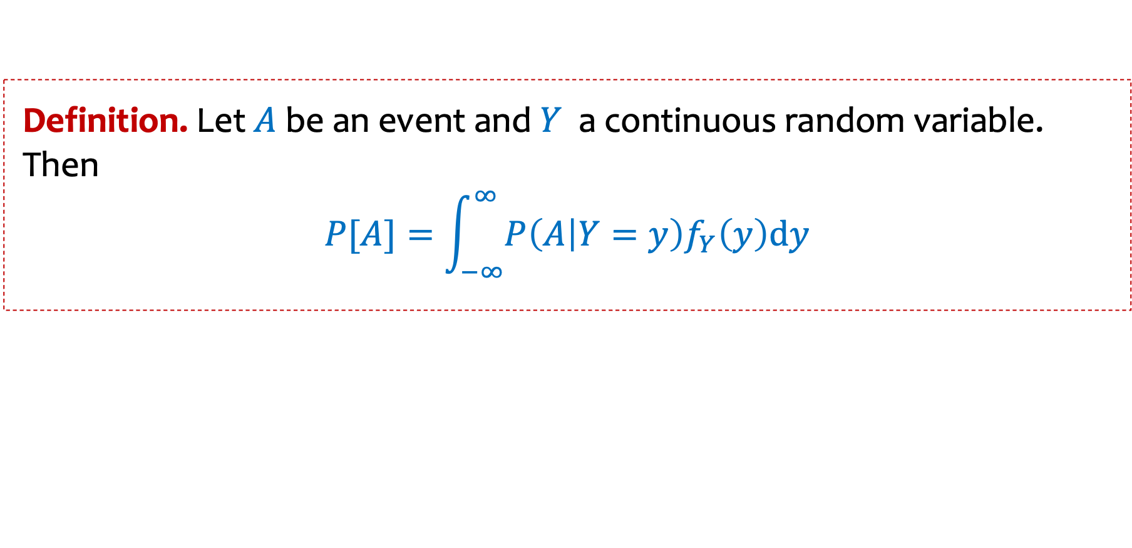
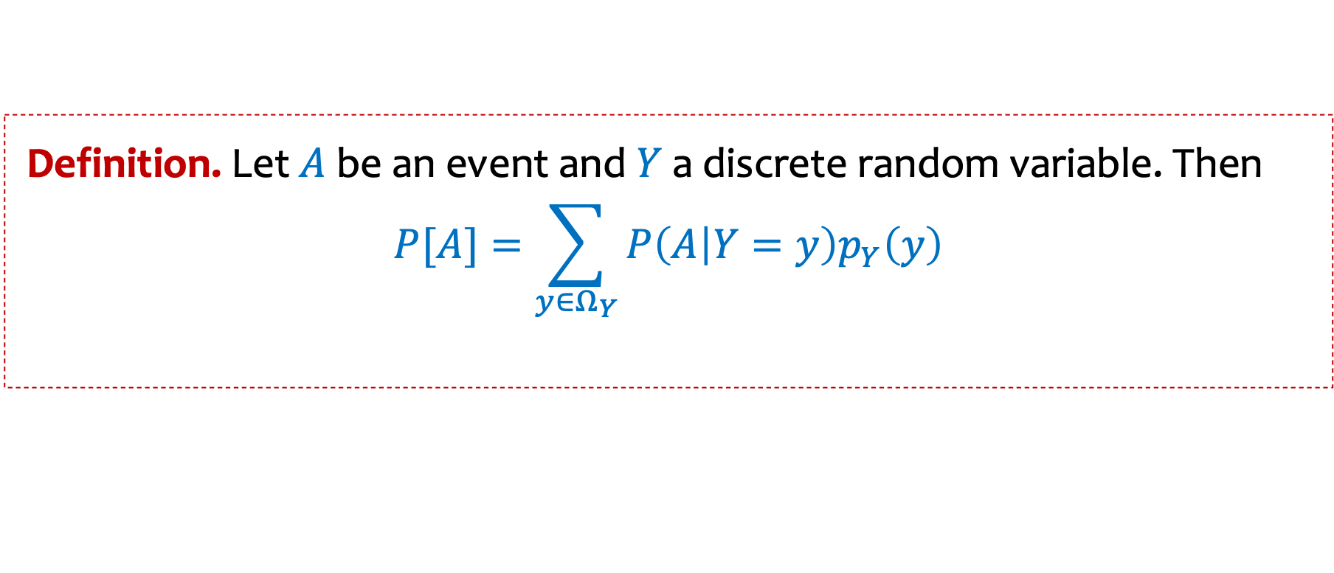
Law of total probability
Definition. Let$A$ be an event and$Y$ a discrete random variable. Then
$$P[A]=\sum_{\begin{aligned}y∈Ω_{Y} \\ \end{aligned}}{P\left(A | Y=y\right)p_{Y}\left(y\right)}$$
Definition. Let$A$ be an event and$Y$ a continuous random variable. Then
$$P[A]=\int_{−∞}^{∞}{P\left(A | Y=y\right)f_{Y}\left(y\right)dy}$$

Slide 4
Conditional Expectation
Definition. Let $X$ be a discrete random variable then the conditional expectation of $X$given event $A$ is
$$𝔼\left[X \right| A]=\sum_{x ∈ Ω_{X}}{x⋅P\left(X=x \right|A)}$$
Notes:
  Can be phrased as a “random variable version”
  $𝔼\left[X\right| Y=y]$
  Linearity of expectation still applies here
  $𝔼\left[aX+bY+c \right| A]=a 𝔼\left[X \right| A]+b 𝔼\left[Y \right| A]+c$

Slide 5
Law of Total Expectation
Law of Total Expectation (event version). Let $X$ be a random variable and let events $A_{1}, …, A_{n}$ partition the sample space. Then,
$$𝔼[X]=\sum_{i=1}^{n}{𝔼\left[X | { A}_{i}\right]⋅P⁡(A_{i})}$$
Law of Total Expectation (random variable version). Let $X$ be a random variable and $Y$ be a discrete random variable. Then,
$$𝔼[X]=\sum_{y ∈Ω_{Y}}{𝔼\left[X | Y=y\right]⋅P⁡(Y=y)}$$

Slide 6
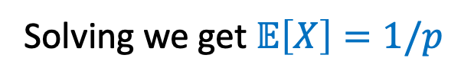
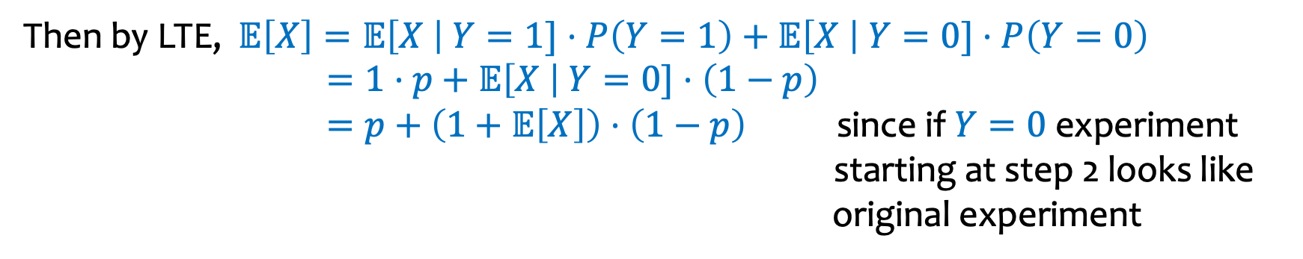
Example – Computer Failures (a familiar example)
Suppose your computer operates in a sequence of steps, and that at each step $i$ your computer will fail with probability $p$ (independently of other steps).
Let $X$ be the number of steps it takes your computer to fail.
What is $𝔼[X]$?
Let $Y$ be the indicator random variable for the event of failure in step $1$
Then by LTE, $𝔼\left[X\right]=𝔼\left[X \right| Y=1]⋅P\left(Y=1\right)+𝔼\left[X \right| Y=0]⋅P\left(Y=0\right)$
$=1⋅p+$ $𝔼\left[X \right| Y=0]⋅\left(1−p\right)$
$=p+$ $\left(1+𝔼\left[X\right]\right)⋅\left(1−p\right)$ since if $Y=0$ experiment starting at step 2 looks like original experiment
Solving we get $𝔼\left[X\right]=1/p$

Slide 7
Example -- Elevator rides
The number $X$of people who enter an elevator on the ground floor is a Poisson random variable with mean 10. If there are N floors above the ground floor, and if each person is equally likely to get off at any one of the N floors, independently of where others get off, compute the expected number of stops the elevator will make before discharging all the passengers.

Slide 9
Example -- Elevator rides
The number $X$of people who enter an elevator on the ground floor is a Poisson random variable with mean 10. If there are N floors above the ground floor, and if each person is equally likely to get off at any one of the N floors, independently of where others get off, compute the expected number of stops the elevator will make before discharging all the passengers.
$$𝔼\left[S\right]=\sum_{i≥0}{𝔼\left[S| N=i\right]⋅}P(N=i)$$
$=\sum_{i}{( 1−{\left(1−\frac{1}{N}\right)}^{i})⋅e^{−10}⋅\frac{{10}^{i}}{i!}}$

Slide 10
E[X] = E[E[X|Y]]

Slide 11
Agenda
Recap + more on Law of Total Expectation
Introduction to statistical estimation
Maximum Likelihood Estimation

Slide 12






Probability vs Statistics
Probability
Given model, predict data
$$Ber\left(p=0.5\right)$$
$$P(THHTHH)$$
Statistics
Given data, predict model
$$Ber\left(p=??\right)$$
$$THHTHH$$

Slide 13
Recap Formalizing Polls
We assume that poll answers $X_{1},…,X_{n} \sim Ber(p)$ i.i.d. for unknown $p$
Goal: Estimate $p$
We did this by computing $\hat{p}=\frac{1}{n}\sum_{i=1}^{n}{X_{i}}$

Slide 14
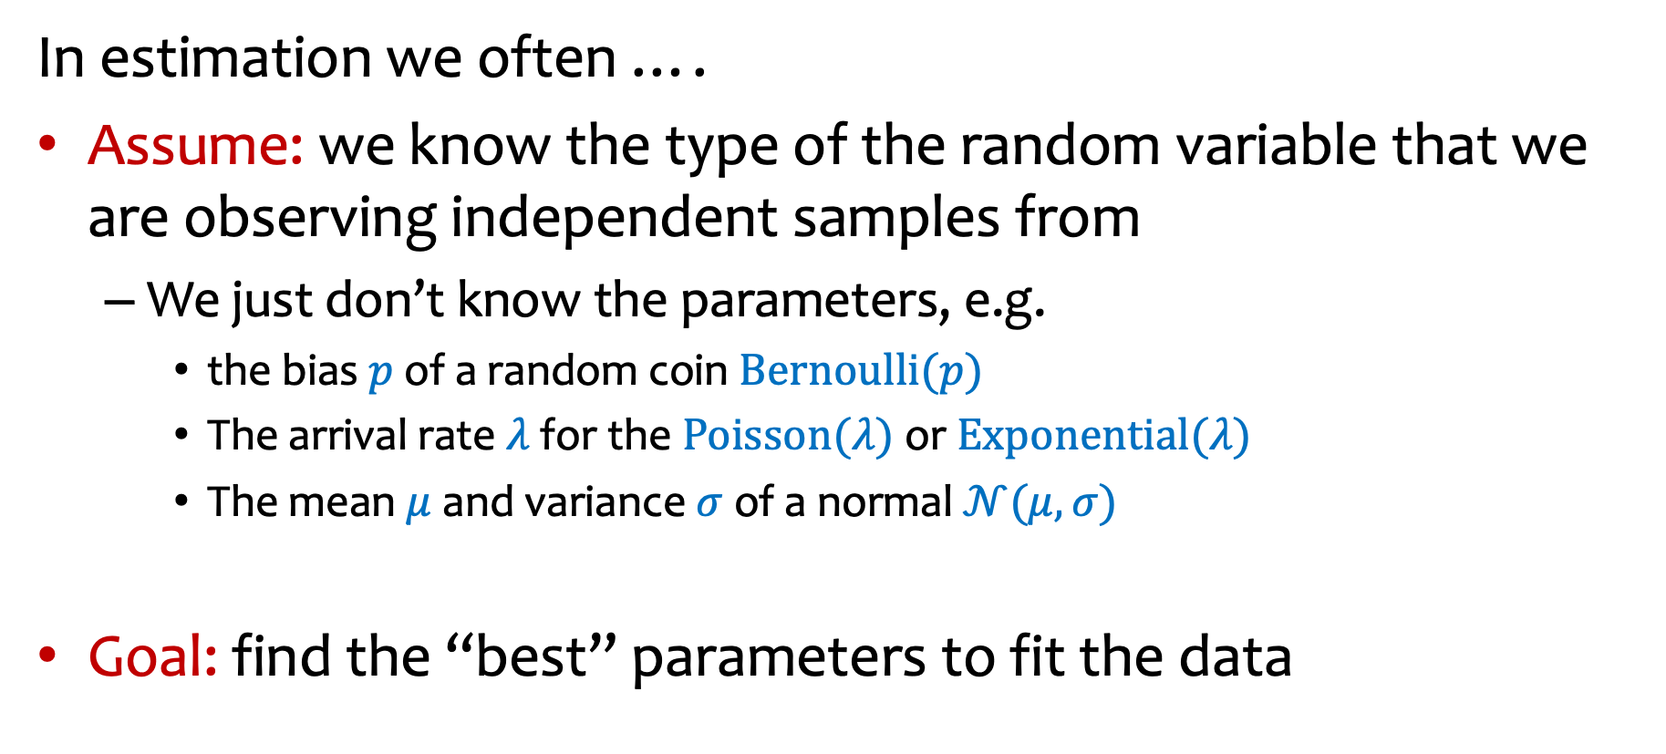
Recap More generally …
In estimation we often ….
Assume: we know the type of the random variable that we are observing independent samples from
  We just don’t know the parameters, e.g.
    the bias $p$ of a random coin $Bernoulli(p)$
    The arrival rate $λ$ for the $Poisson(λ)$or $Exponential(λ)$
    The mean $μ$ and variance $σ$ of a normal $𝒩(μ,σ)$
Goal: find the “best” parameters to fit the data

Slide 15
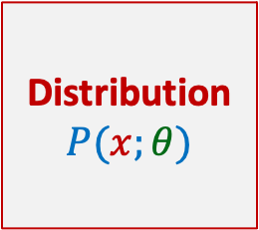


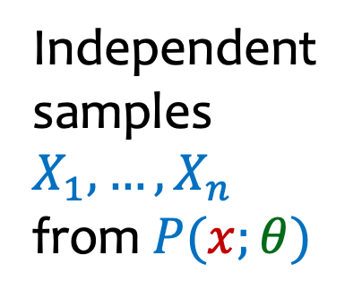

Statistics: Parameter Estimation – Workflow
Parameter estimate
Independent samples $X_{1},…, X_{n}$ from $P(x;θ)$
Distribution $P(x;θ)$
EstimationAlgorithm
$$\hat{θ}$$
$θ$ = unknown parameter
Example: coin flip distribution with unknown $θ$ = probability of heads
Observation: $HTTHHHTHTHTTTTHTHTTTTTHT$
Goal: Estimate $θ$

Slide 16
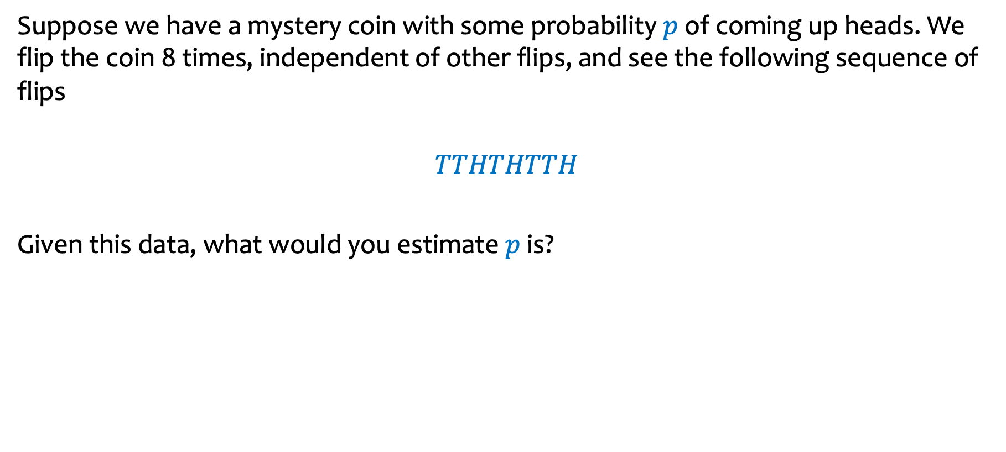
Example
Suppose we have a mystery coin with some probability $p$ of coming up heads. We flip the coin 8 times, independent of other flips, and see the following sequence of flips
$$TTHTHTTH$$
Given this data, what would you estimate $p$ is?
How can you argue “objectively” that this your estimate is the best estimate?

Slide 17
Agenda
Recap + more on Law of Total Expectation
Introduction to statistical estimation
Maximum Likelihood Estimation

Slide 18
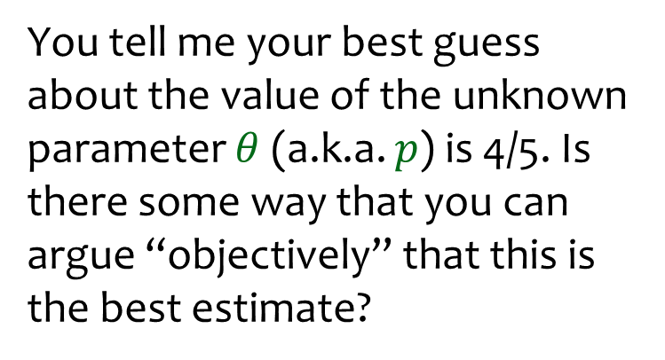

Likelihood
Say we see outcome $HHTHH$.
You tell me your best guess about the value of the unknown parameter $θ$ (a.k.a. $p$) is 4/5. Is there some way that you can argue “objectively” that this is the best estimate?

Slide 19
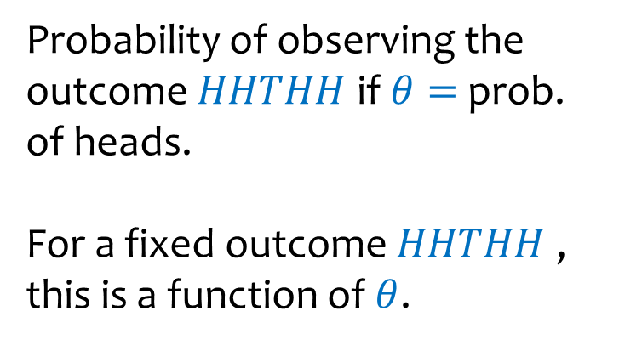
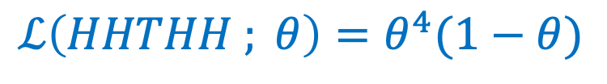


Likelihood
Max Prob of seeing HHTHH
Say we see outcome $HHTHH$.
$$ℒ\left(HHTHH ; θ\right)=θ^{4}(1−θ)$$
Probability of observing the outcome $HHTHH$ if $θ=$ prob. of heads.
For a fixed outcome $HHTHH$, this is a function of $θ$.
$$θ$$

Slide 20
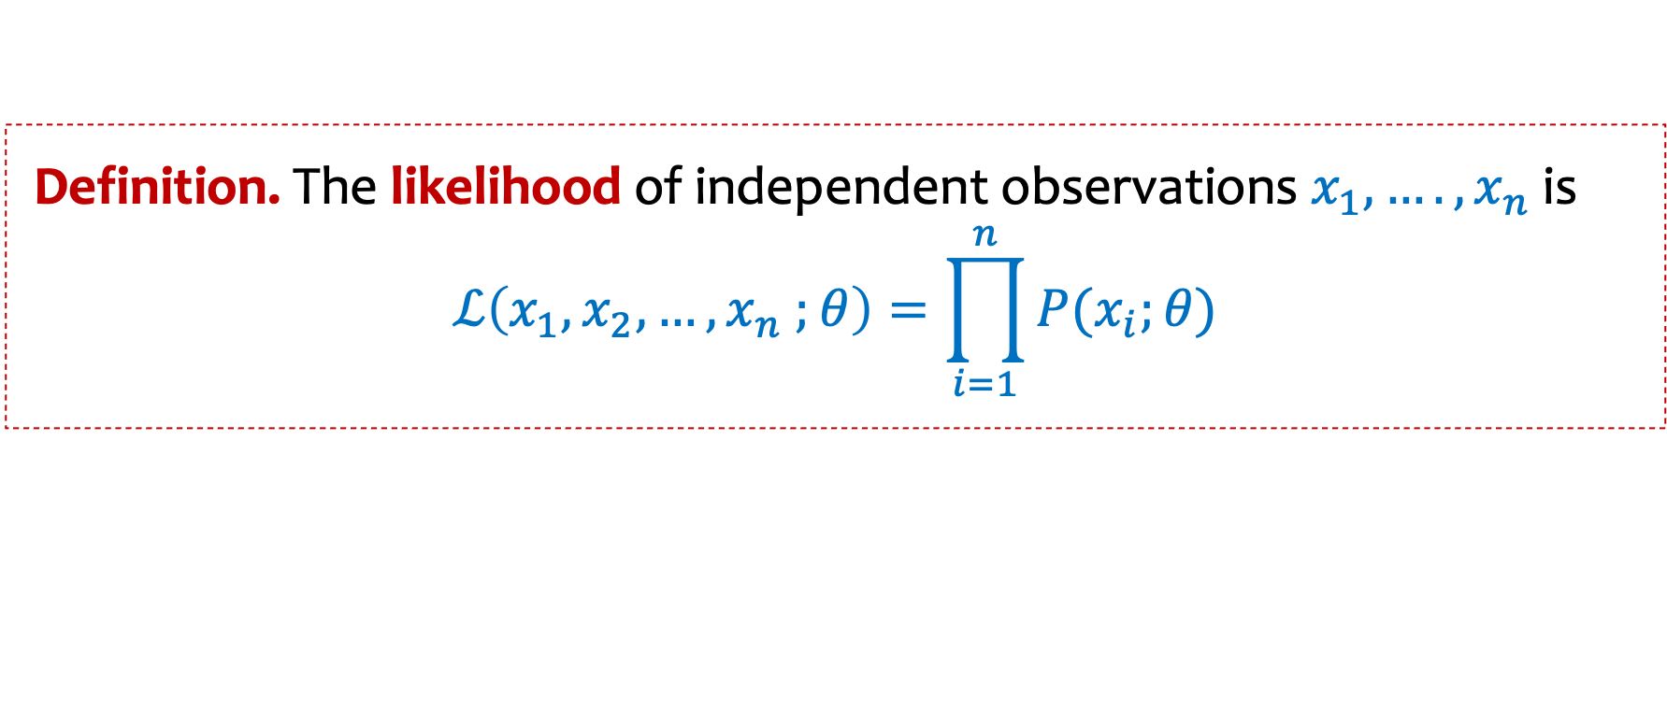

Likelihood of Different Observations
(Discrete case)
Definition. The likelihood of independent observations $x_{1},….,x_{n}$is
$$ℒ\left(x_{1},x_{2},…, x_{n} ;θ\right)=\prod_{i=1}^{n}{P(x_{i};θ)}$$
Example:
Say we see outcome $HHTHH$.
$$ℒ\left(HHTHH ;θ\right)={P\left(H;θ\right)⋅P\left(H;θ\right)⋅P\left(T;θ\right)⋅P\left(H;θ\right)⋅P\left(H;θ\right)= θ}^{4}(1−θ)$$

Slide 21
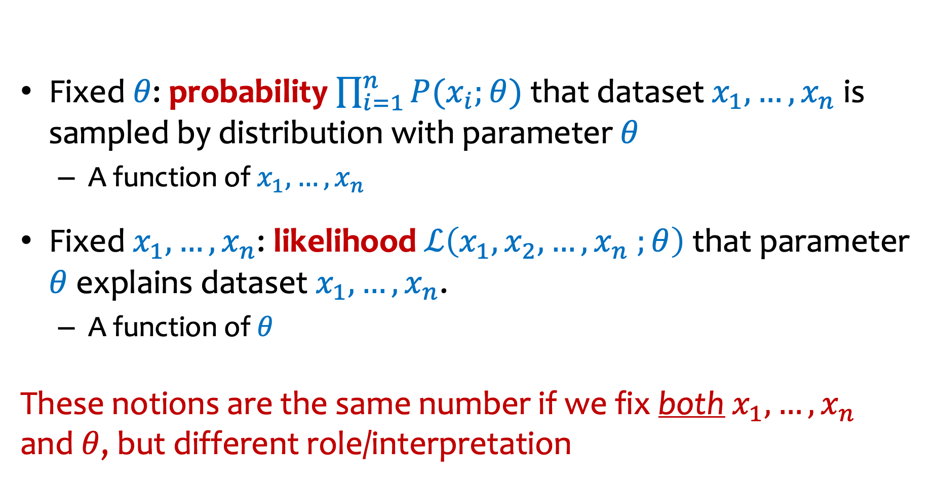
Likelihood vs. Probability
Fixed $θ$: probability $\prod_{i=1}^{n}{P(x_{i};θ)}$that dataset $x_{1},…,x_{n}$ is sampled by distribution with parameter $θ$
  A function of $x_{1},…,x_{n}$
Fixed $x_{1},…,x_{n}$: likelihood $ℒ\left(x_{1},x_{2},…, x_{n} ;θ\right)$that parameter $θ$ explains dataset $x_{1},…,x_{n}$.
  A function of $θ$
These notions are the same number if we fix both $x_{1},…,x_{n}$ and $θ$, but different role/interpretation
Notes:
REDO

Slide 22
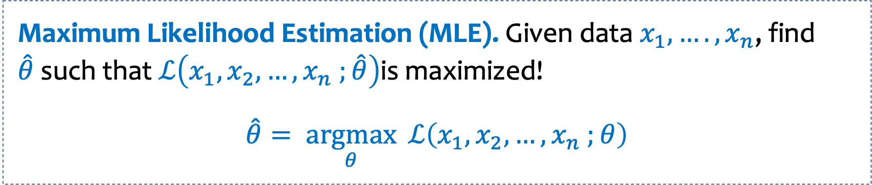
Likelihood of Different Observations
(Discrete case)
Definition. The likelihood of independent observations $x_{1},….,x_{n}$is
$$ℒ\left(x_{1},x_{2},…, x_{n} ;θ\right)=\prod_{i=1}^{n}{P(x_{i};θ)}$$
Maximum Likelihood Estimation (MLE). Given data $x_{1},….,x_{n}$, find $\hat{θ}$such that $ℒ\left(x_{1},x_{2},…, x_{n} ;\hat{θ}\right)$is maximized!
$$\hat{θ}= \underset{θ}{argmax}{ℒ\left(x_{1},x_{2},…, x_{n} ;θ\right)}$$

Slide 23

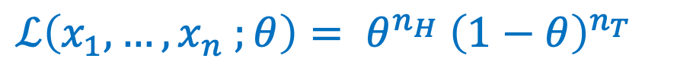

Example – Coin Flips
Observe: Coin-flip outcomes $x_{1},…, x_{n}$, with $n_{H}$ heads, $n_{T}$ tails
  i.e., $n_{H}+n_{T}=n$
  Goal: find $θ$ that maximizes$ℒ\left(x_{1},…, x_{n} ;θ\right)$
Goal: estimate $θ$ = prob. heads.
$$ℒ\left(x_{1},…, x_{n} ;θ\right)= θ^{n_{H}}{ \left(1−θ\right)}^{n_{T}}$$

Slide 24

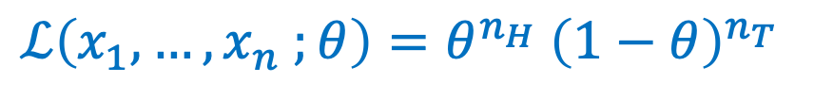
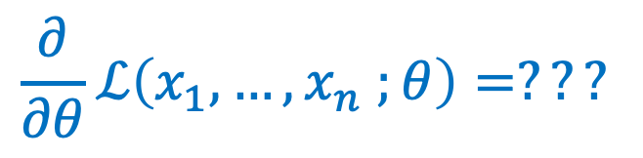
Example – Coin Flips
Observe: Coin-flip outcomes $x_{1},…, x_{n}$, with $n_{H}$ heads, $n_{T}$ tails
  i.e., $n_{H}+n_{T}=n$
Goal: estimate $θ$ = prob. heads.
$$ℒ\left(x_{1},…, x_{n} ;θ\right)=θ^{n_{H}}{ \left(1−θ\right)}^{n_{T}}$$
$$\frac{∂}{∂θ}ℒ\left(x_{1},…, x_{n} ;θ\right)=???$$
While it is possible to compute this derivative, it’s not always nice since we are working with products.

Slide 25
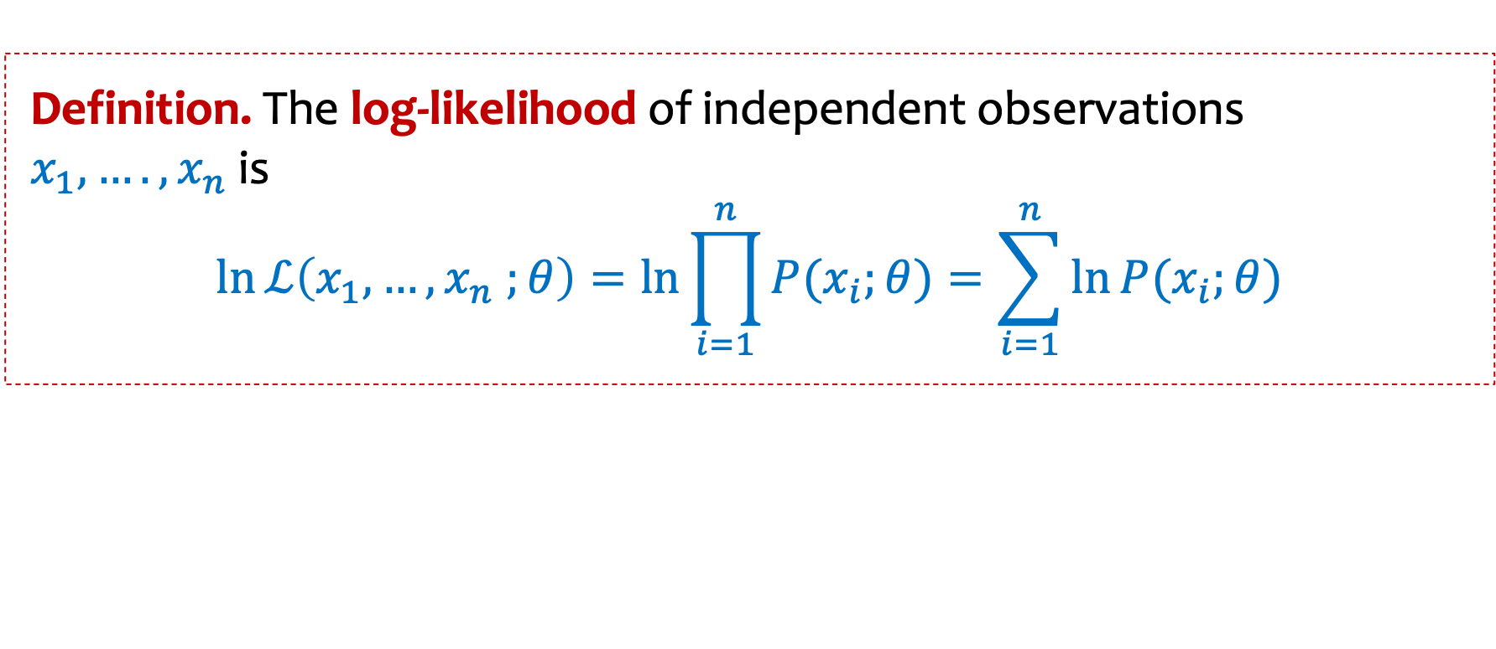

Log-Likelihood
We can save some work if we use the log-likelihood instead of the likelihood directly.
Useful log properties
$$\ln\left(ab\right)=\ln\left(a\right)+\ln\left(b\right)$$
$$\ln\left(a/b\right)=\ln\left(a\right)−ln⁡(b)$$
$$\ln\left(a^{b}\right)=b⋅\ln{(a)}$$
Definition. The log-likelihood of independent observations $x_{1},….,x_{n}$is
$$\ln{ℒ\left(x_{1},…, x_{n} ;θ\right)}=\ln{\prod_{i=1}^{n}{P(x_{i};θ)}=\sum_{i=1}^{n}{\ln{P(x_{i};θ)}}}$$

Slide 26

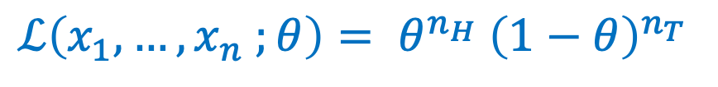
Example – Coin Flips
$$\ln\left(ab\right)=\ln\left(a\right)+\ln\left(b\right)$$
$$\ln\left(a/b\right)=\ln\left(a\right)−ln⁡(b)$$
$$\ln\left(a^{b}\right)=b⋅\ln{(a)}$$
Observe: Coin-flip outcomes $x_{1},…, x_{n}$, with $n_{H}$ heads, $n_{T}$ tails
  i.e., $n_{H}+n_{T}=n$
Goal: estimate $θ$ = prob. heads.
$$ℒ\left(x_{1},…, x_{n} ;θ\right)= θ^{n_{H}}{ \left(1−θ\right)}^{n_{T}}$$

Slide 27
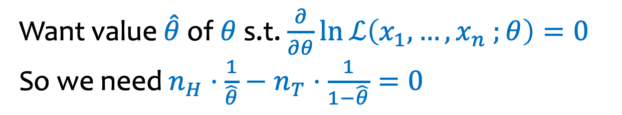
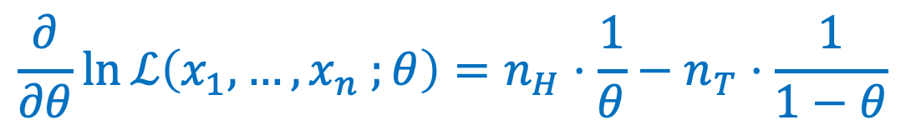


Example – Coin Flips
Observe: Coin-flip outcomes $x_{1},…, x_{n}$, with $n_{H}$ heads, $n_{T}$ tails
  i.e., $n_{H}+n_{T}=n$
Goal: estimate $θ$ = prob. heads.
$$ℒ\left(x_{1},…, x_{n} ;θ\right){=θ}^{n_{H}}{ \left(1−θ\right)}^{n_{T}}$$
$$\ln{ℒ\left(x_{1},…, x_{n} ;θ\right)}=n_{H}\ln{θ}+n_{T}\ln{(1−θ)}$$
$$\frac{∂}{∂θ}\ln{ℒ\left(x_{1},…, x_{n} ;θ\right)}=n_{H}⋅\frac{1}{θ}−n_{T}⋅\frac{1}{1−θ}$$
Solving gives $\hat{θ}=\frac{n_{H}}{n}$
Want value $\hat{θ}$ of $θ$ s.t. $\frac{∂}{∂θ}\ln{ℒ\left(x_{1},…, x_{n} ;θ\right)}=0$ So we need $n_{H}⋅\frac{1}{\hat{θ}}−n_{T}⋅\frac{1}{1−\hat{θ}}=0$

Slide 28
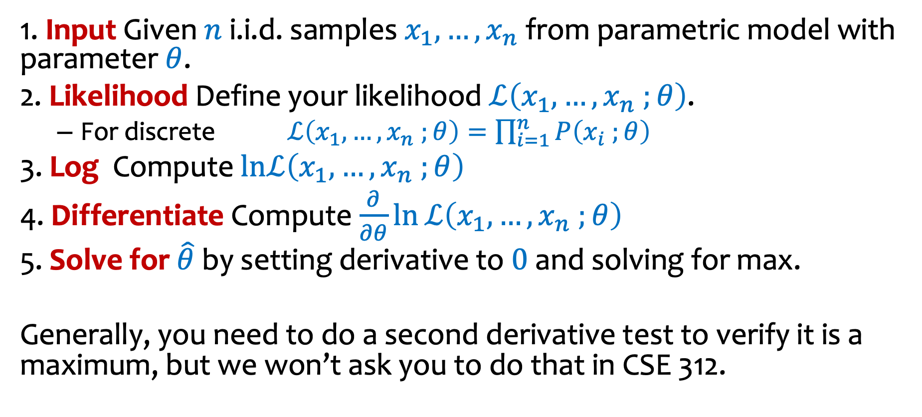
General Recipe
1. Input Given $n$ i.i.d. samples $x_{1},…, x_{n}$ from parametric model with parameter $θ$.
2. Likelihood Define your likelihood $ℒ\left(x_{1},…, x_{n} ;θ\right)$.
  For discrete $ℒ\left(x_{1},…, x_{n} ;θ\right)=\prod_{i=1}^{n}{P\left(x_{i} ;θ\right)}$
3. Log Compute $lnℒ\left(x_{1},…, x_{n} ;θ\right)$
4. Differentiate Compute $\frac{∂}{∂θ}\ln{ℒ\left(x_{1},…, x_{n} ;θ\right)}$
5. Solve for $\hat{θ}$ by setting derivative to $0$ and solving for max.
Generally, you need to do a second derivative test to verify it is a maximum, but we won’t ask you to do that in CSE 312.

Slide 29

Example – Geometric distribution
$$\ln\left(ab\right)=\ln\left(a\right)+\ln\left(b\right)$$
$$\ln\left(a/b\right)=\ln\left(a\right)−ln⁡(b)$$
$$\ln\left(a^{b}\right)=b⋅\ln{(a)}$$
You see data $x_{1},…, x_{n}$ from a geometric distribution with unknown parameter $θ$
What is the maximum likelihood estimate $\hat{θ}\text{?}$

Slide 31
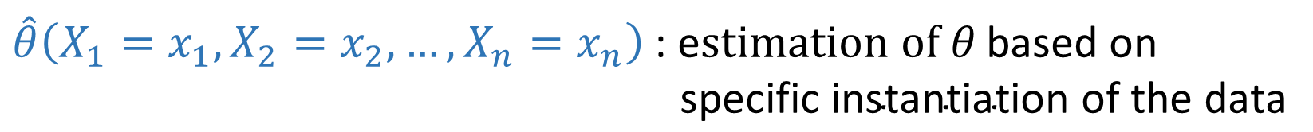
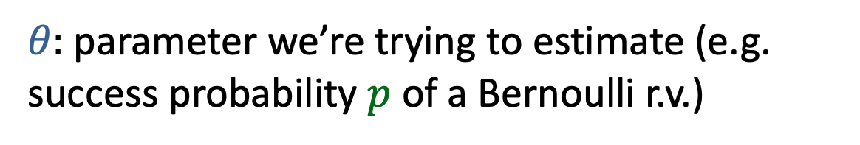
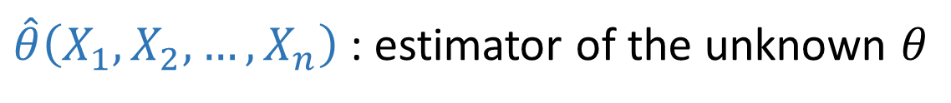

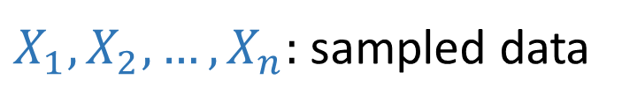

Definition of Estimator
$θ:$parameter we’re trying to estimate (e.g. success probability $p$ of a Bernoulli r.v.)
These are
$$i.i.d. instances of X$$
This is a r.v. because it’s a function of r.v.s
$X_{1}, X_{2}, …, X_{n}:$sampled data
Sometimes just write $\hat{θ}$
This is a
constant
$\hat{θ}\left(X_{1}, X_{2}, …, X_{n}\right)$: estimator of the unknown $θ$
$\hat{θ}\left(X_{1}=x_{1}, X_{2}=x_{2}, …, X_{n}=x_{n}\right)$: e$stimation of θ \text{based} \text{on}$
$\text{specific} \text{instantiation} \text{of} \text{the} \text{data}$

Slide 32
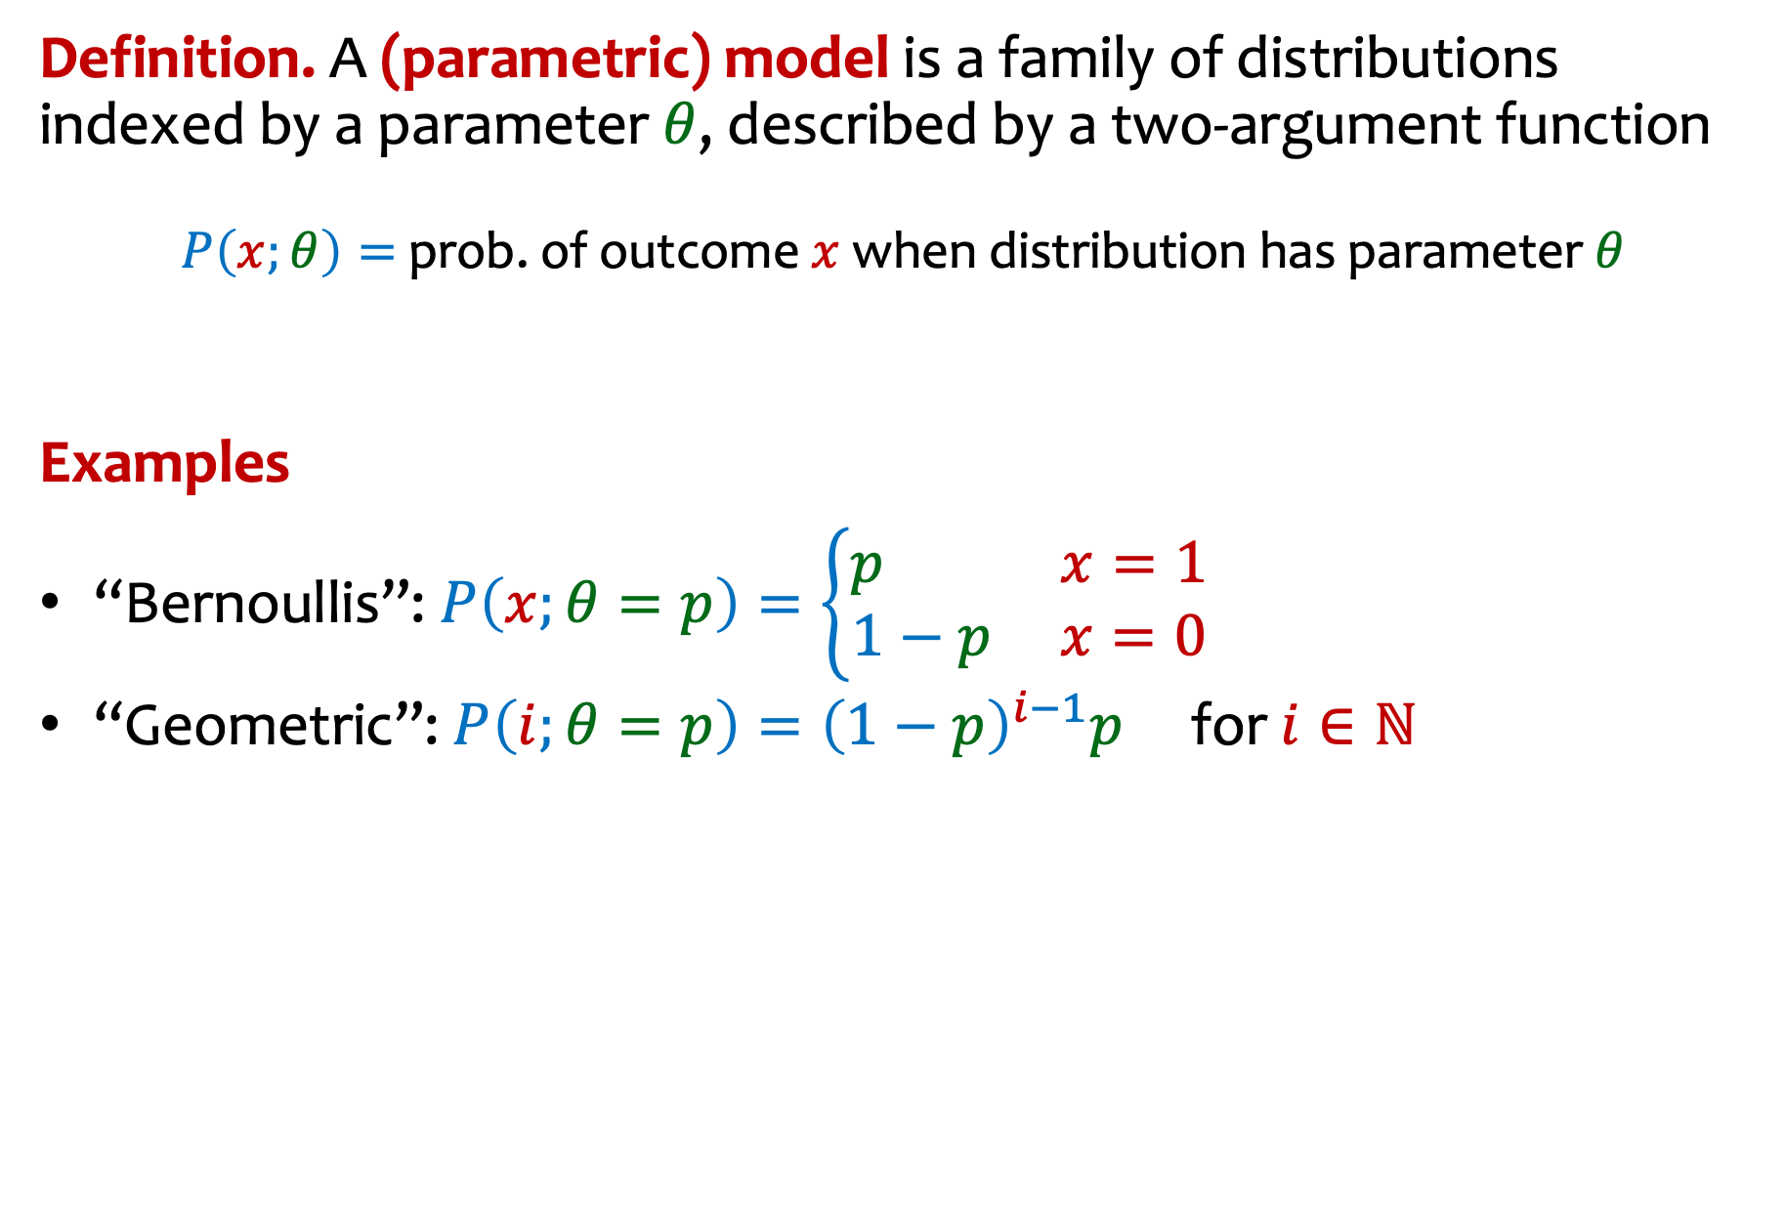
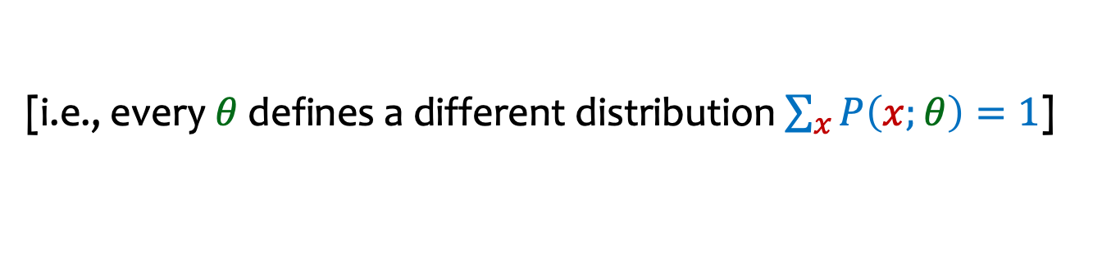
Notation – Parametric Model (discrete case)
Definition. A (parametric) model is a family of distributions indexed by a parameter $θ$, described by a two-argument function
$P\left(x;θ\right)=$ prob. of outcome $x$ when distribution has parameter $θ$
Examples
“Bernoullis”: $P\left(x;θ=p\right)=\left\{\begin{matrix}p x=1 \\ 1−p x=0\end{matrix}\right.$
“Geometric”: $P\left(i;θ=p\right)={\left(1−p\right)}^{i−1}p$ for $i∈ℕ$
[i.e., every $θ$ defines a different distribution $\sum_{x}{P\left(x;θ\right)=1}$]

