Slide 1
Recap Continuous Joint Distributions,
Law of Total Probability (continuous)
Law of Total Expectation
CSE 312 Spring 26
Lecture 22

Slide 2
Agenda
Recap – joint continuous distns
Continuous law of total probability
Law of total expectation

Slide 3
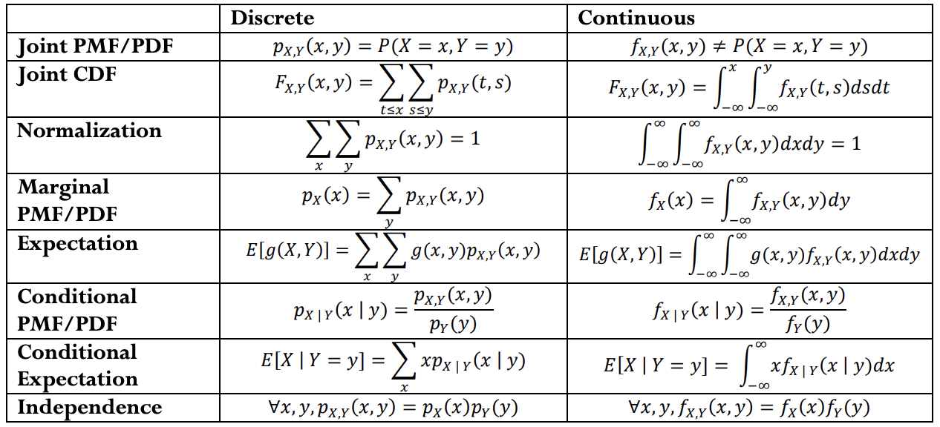

Reference Sheet

Slide 4
Example – Uniform distribution on a unit disk
Suppose that a pair of random variables $(X,Y)$is chosen uniformly
from the set of real points $(x,y)$such that $x^{2}+y^{2}≤1$
1
What is the joint density?
-1
1
0
$$f_{X,Y}\left(x,y\right)=\left\{\begin{aligned} c if x^{2}+y^{2}≤1 \\ 0 otherwise \end{aligned}\right.$$
-1

Slide 5
Example – Uniform distribution on a unit disk
Suppose that a pair of random variabes $(X,Y)$is chosen uniformly
from the set of real points $(x,y)$such that $x^{2}+y^{2}≤1$
1
This is a disk of radius $1$ which has area $π$
-1
1
$$f_{X,Y}\left(x,y\right)=\left\{\begin{aligned} \frac{1}{π} if x^{2}+y^{2}≤1 \\ 0 otherwise \end{aligned}\right.$$
0
-1
What is $f_{X}\left(x\right)$ ?

Slide 6

Example – Uniform distribution on a unit disk
Suppose that a pair of random variables $(X,Y)$is chosen uniformly
from the set of real points $(x,y)$such that $x^{2}+y^{2}≤1$
1
This is a disk of radius $1$ which has area $π$
-1
1
$$f_{X,Y}\left(x,y\right)=\left\{\begin{aligned} \frac{1}{π} if x^{2}+y^{2}≤1 \\ 0 otherwise \end{aligned}\right.$$
0
-1
What is $f_{X}\left(x\right)$ ?
$$f_{X}\left(x\right)=\int_{−\sqrt{1−x^{2}}}^{\sqrt{1−x^{2}}}{\frac{1}{π}dy}$$
$$=2\sqrt{1−x^{2}}/π$$

Slide 7
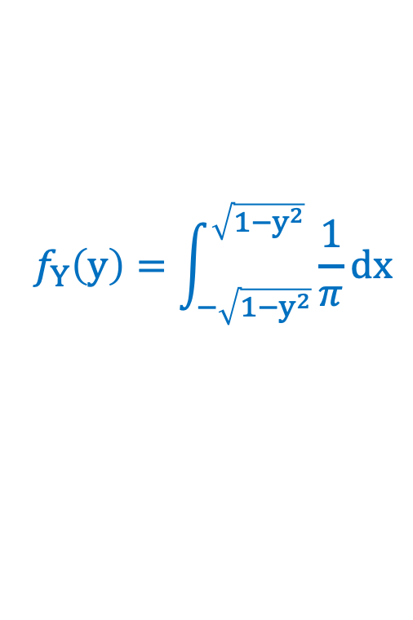
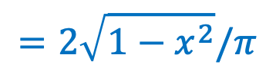
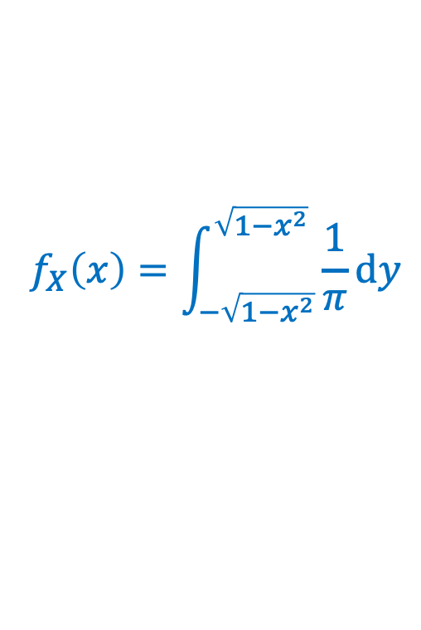
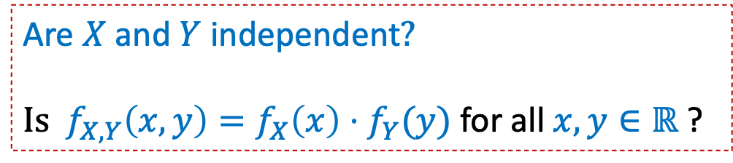
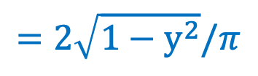
Example – Uniform distribution on a unit disk
Suppose that a pair of random variables $(X,Y)$is chosen uniformly
from the set of real points $(x,y)$such that $x^{2}+y^{2}≤1$
1
This is a disk of radius $1$ which has area $π$
-1
1
$$f_{X,Y}\left(x,y\right)=\left\{\begin{aligned} \frac{1}{π} if x^{2}+y^{2}≤1 \\ 0 otherwise \end{aligned}\right.$$
0
-1
$$f_{X}\left(x\right)=\int_{−\sqrt{1−x^{2}}}^{\sqrt{1−x^{2}}}{\frac{1}{π}dy}$$
$$f_{Y}\left(y\right)=\int_{−\sqrt{1−y^{2}}}^{\sqrt{1−y^{2}}}{\frac{1}{π}dx}$$
Are $X$ and $Y$ independent$?$
${Is f}_{X,Y}\left(x,y\right)=f_{X}\left(x\right)⋅f_{Y}(y)$ for all $x,y∈ℝ \text{?}$
$$=2\sqrt{1−x^{2}}/π$$
$$=2\sqrt{1−y^{2}}/π$$

Slide 8


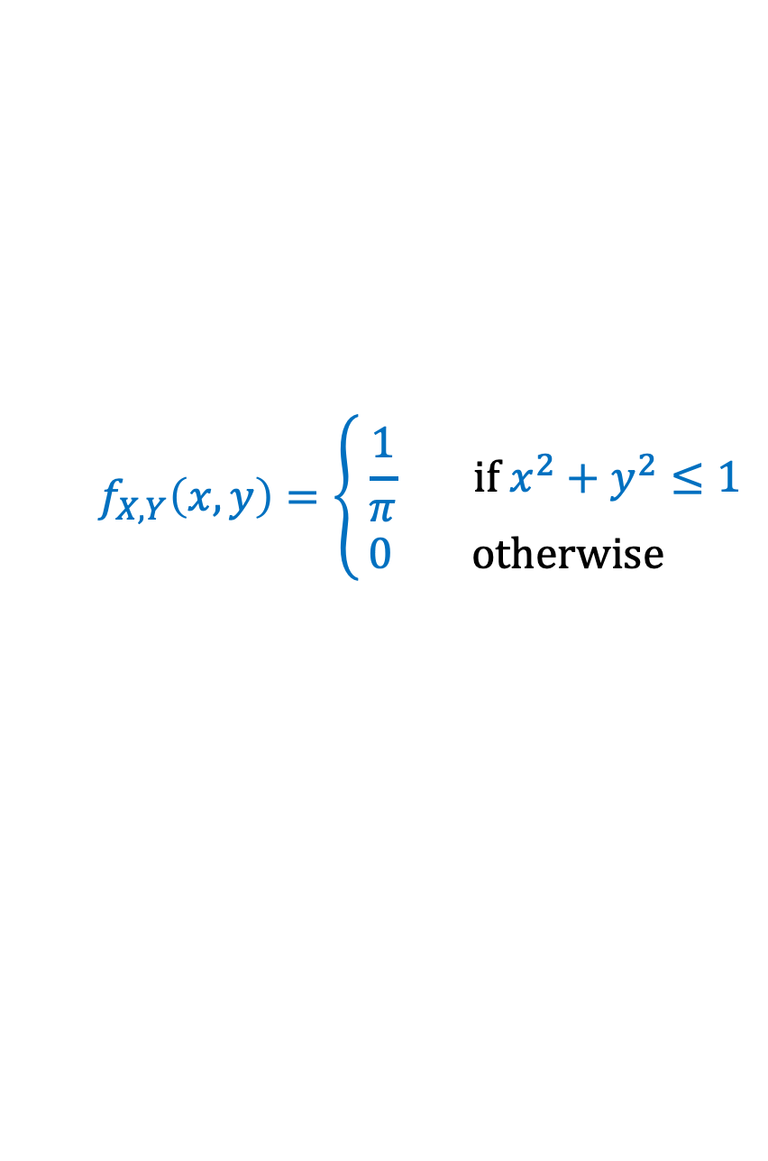
Example – Uniform distribution on a unit disk
Suppose that a pair of random variables $(X,Y)$is chosen uniformly
from the set of real points $(x,y)$such that $x^{2}+y^{2}≤1$
1
This is a disk of radius $1$ which has area $π$
-1
1
$$f_{X,Y}\left(x,y\right)=\left\{\begin{aligned} \frac{1}{π} if x^{2}+y^{2}≤1 \\ 0 otherwise \end{aligned}\right.$$
0
-1
Let D be the distance of the point $(X,Y)$ from the origin.
What is $P(D ≤ d)$? What is $f_{D}(d)$ ? What is $E(D)$ ?

Slide 9
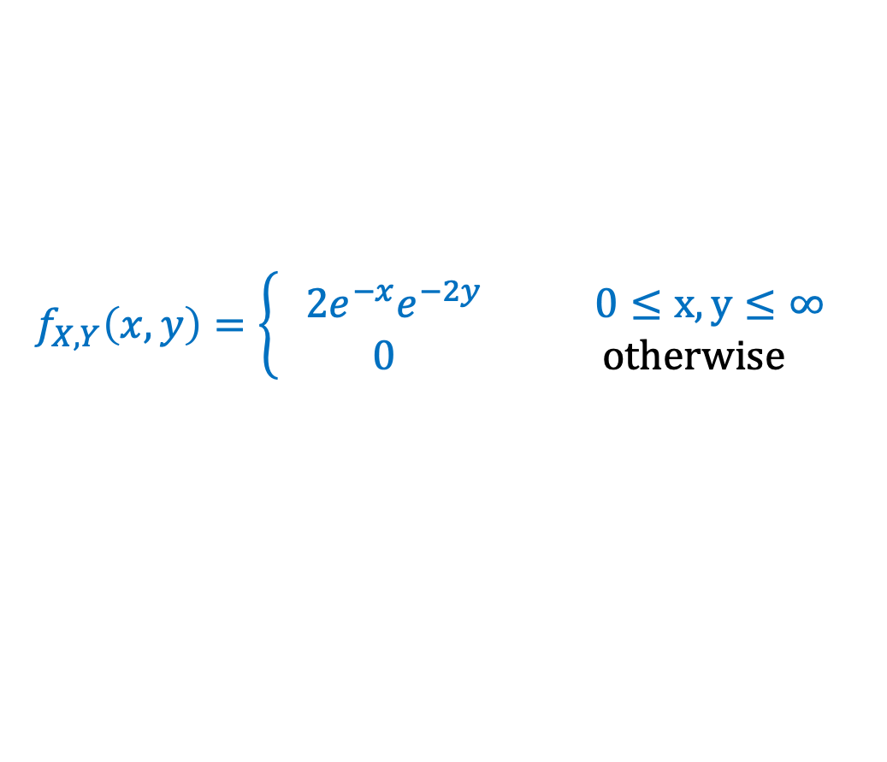

Example – More joint densities
The joint density of $X and Y$is
$$f_{X,Y}\left(x,y\right)=\left\{\begin{aligned}2e^{−x}e^{−2y} 0≤x,y≤∞ \\ 0 otherwise \end{aligned}\right.$$
What is $P(X> 1,Y< 1)$? What is ${P(X>Y)\text{?} \text{What} \text{is} f}_{X}\left(x\right)?$

Slide 10
Reference Sheet

Slide 11
Agenda
Recap – joint continuous distns
Continuous law of total probability
Law of total expectation

Slide 12
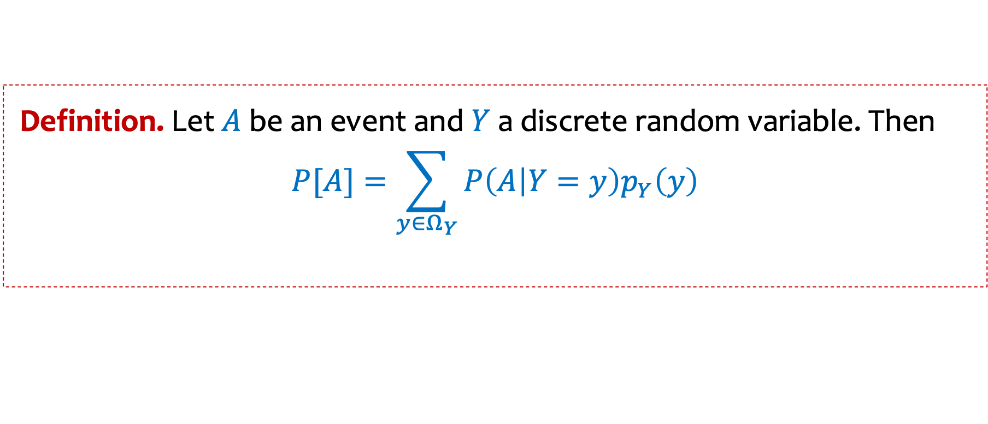
Law of total probability
Definition. Let$A$ be an event and$Y$ a discrete random variable. Then
$$P[A]=\sum_{\begin{aligned}y∈Ω_{Y} \\ \end{aligned}}{P\left(A | Y=y\right)p_{Y}\left(y\right)}$$

Slide 13
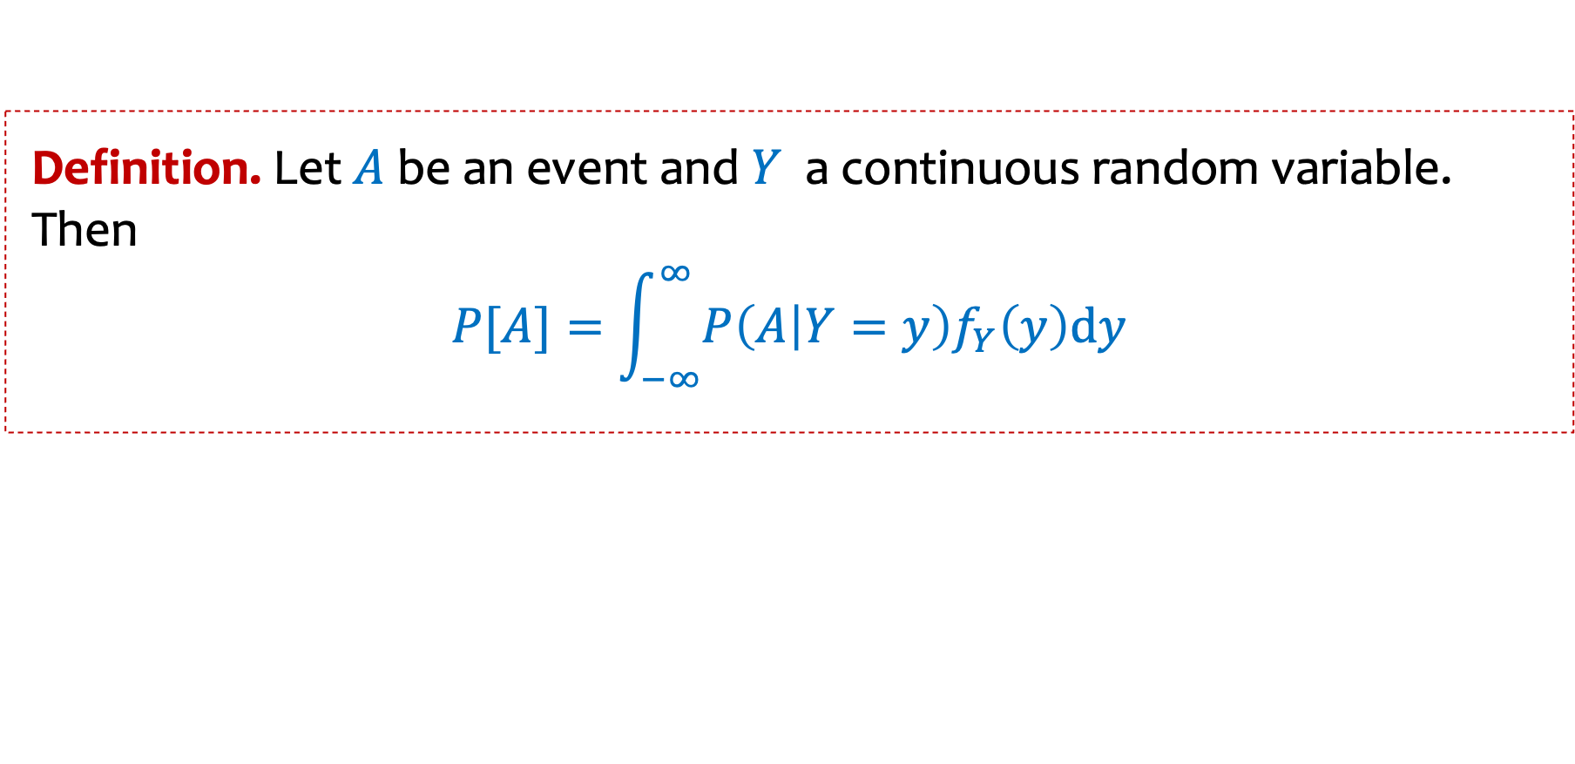
Law of total probability
Definition. Let$A$ be an event and$Y$ a discrete random variable. Then
$$P[A]=\sum_{\begin{aligned}y∈Ω_{Y} \\ \end{aligned}}{P\left(A | Y=y\right)p_{Y}\left(y\right)}$$
Definition. Let$A$ be an event and$Y$ a continuous random variable. Then
$$P[A]=\int_{−∞}^{∞}{P\left(A | Y=y\right)f_{Y}\left(y\right)dy}$$

Slide 14
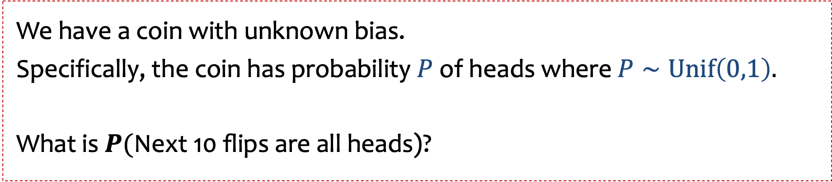

Example 1: use of law of total probability
We have a coin with unknown bias.
Specifically, the coin has probability $P$of heads where $P∼Unif\left(0,1\right).$
What is $P(\text{Next}\text{ 10 }\text{flips} \text{are} \text{all} \text{heads}\text{)}$?
Definition. Let$A$ be an event and$Y$ a continuous random variable. Then
$$P[A]=\int_{−∞}^{∞}{P\left(A | Y=y\right)f_{Y}\left(y\right)dy}$$

Slide 15
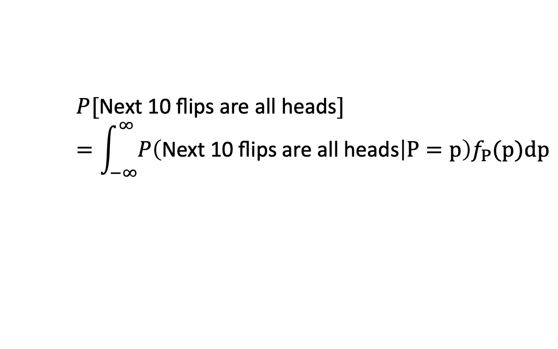
Example 1: use of law of total probability
We have a coin with unknown bias.
Specifically, the coin has probability $P$of heads where $P∼Unif\left(0,1\right).$
What is $P(\text{Next}\text{ 10 }\text{flips} \text{are} \text{all} \text{heads}\text{)}$?
$$P[\text{Next}\text{ 10 }\text{flips} \text{are} \text{all} \text{heads}]=\int_{−∞}^{∞}{P\left(\text{Next}\text{ 10 }\text{flips} \text{are} \text{all} \text{heads} | P=p\right)f_{P}(p)dp}$$

Slide 16
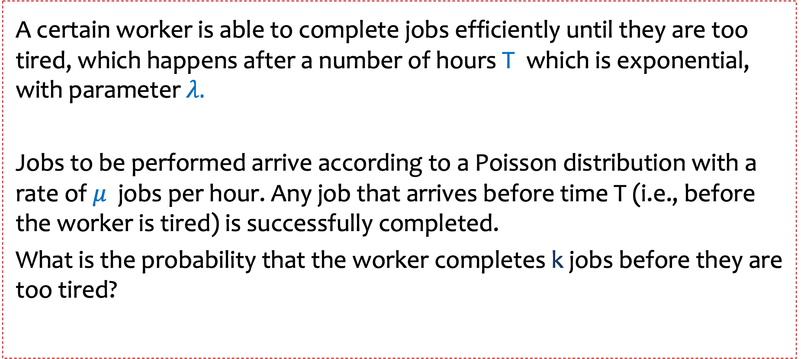
Example 2: use of law of total probability
A certain worker is able to complete jobs efficiently until they are too tired, which happens after a number of hours T which is exponential, with parameter $λ.$
Jobs to be performed arrive according to a Poisson distribution with a rate of $μ$ jobs per hour. Any job that arrives before time T (i.e., before the worker is tired) is successfully completed.
What is the probability that the worker completes k jobs before they are too tired?

Slide 18
Agenda
Recap – joint continuous distns
Continuous law of total probability
Conditional expectation and Law of Total Expectation

Slide 19

Conditional Expectation and Law of Total Expectation
Suppose someone gave us $Y∼Poi(5)$ fair coins and we wanted to compute the expected number of heads $X$ from flipping those coins.

Slide 20
Conditional Expectation
Definition. Let $X$ be a discrete random variable then the conditional expectation of $X$given event $A$ is
$$𝔼\left[X \right| A]=\sum_{x ∈ Ω_{X}}{x⋅P\left(X=x \right|A)}$$
Notes:
  Can be phrased as a “random variable version”
  $𝔼\left[X\right| Y=y]$
  Linearity of expectation still applies here
  $𝔼\left[aX+bY+c \right| A]=a 𝔼\left[X \right| A]+b 𝔼\left[Y \right| A]+c$

Slide 21
Law of Total Expectation
Law of Total Expectation (event version). Let $X$ be a random variable and let events $A_{1}, …, A_{n}$ partition the sample space. Then,
$$𝔼[X]=\sum_{i=1}^{n}{𝔼\left[X | { A}_{i}\right]⋅P⁡(A_{i})}$$
Law of Total Expectation (random variable version). Let $X$ be a random variable and $Y$ be a discrete random variable. Then,
$$𝔼[X]=\sum_{y ∈Ω_{Y}}{𝔼\left[X | Y=y\right]⋅P⁡(Y=y)}$$

Slide 22
Proof of Law of Total Expectation
Follows from Law of Total Probability and manipulating sums
$$𝔼\left[X\right]=\sum_{x ∈Ω_{X}}{x⋅P{(X=x)}}$$
$$=\sum_{x ∈Ω_{X}}{x⋅\sum_{i=1}^{n}{P\left(X=x \right|A_{i})⋅P⁡(A_{i})}}$$
$$=\sum_{i=1}^{n}{P\left(A_{i}\right)\sum_{x∈Ω_{X}}{x⋅P\left(X=x \right|A_{i})}}$$
$$=\sum_{i=1}^{n}{P\left(A_{i}\right)⋅𝔼\left[X\right|A_{i}]}$$
(by LTP)
(change order of sums)
(def of cond. expect.)

Slide 23
Example – Flipping a Random Number of Coins
Suppose someone gave us $Y∼Poi(5)$ fair coins and we wanted to compute the expected number of heads $X$ from flipping those coins.
By the Law of Total Expectation
$$𝔼\left[X\right]=\sum_{i=0}^{∞}{𝔼\left[X \right| Y=i]⋅P\left(Y=i\right)=\sum_{i=0}^{∞}{\frac{i}{2}⋅P(Y=i)}}$$
$$=\frac{1}{2}⋅\sum_{i=0}^{∞}{i⋅P\left(Y=i\right)}$$
$=\frac{1}{2}⋅𝔼\left[Y\right]=\frac{1}{2}⋅5=2.5$

Slide 24
Example – Computer Failures (a familiar example)
Suppose your computer operates in a sequence of steps, and that at each step $i$ your computer will fail with probability $p$ (independently of other steps).
Let $X$ be the number of steps it takes your computer to fail.
What is $𝔼[X]$?

Slide 25
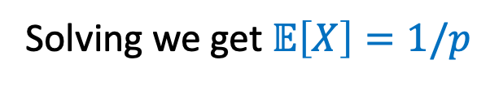
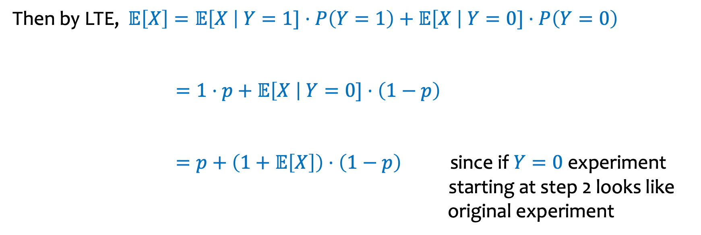
Let $Y$ be the indicator random variable for the event of failure in step $1$
Then by LTE, $𝔼\left[X\right]=𝔼\left[X \right| Y=1]⋅P\left(Y=1\right)+𝔼\left[X \right| Y=0]⋅P\left(Y=0\right)$
$=1⋅p+$ $𝔼\left[X \right| Y=0]⋅\left(1−p\right)$
$=p+$ $\left(1+𝔼\left[X\right]\right)⋅\left(1−p\right)$ since if $Y=0$ experiment starting at step 2 looks like original experiment
Solving we get $𝔼\left[X\right]=1/p$

Slide 26
Example -- Elevator rides
The number $X$of people who enter an elevator on the ground floor is a Poisson random variable with mean 10. If there are N floors above the ground floor, and if each person is equally likely to get off at any one of the N floors, independently of where others get off, compute the expected number of stops the elevator will make before discharging all the passengers.

Slide 28
Example -- Elevator rides
The number $X$of people who enter an elevator on the ground floor is a Poisson random variable with mean 10. If there are N floors above the ground floor, and if each person is equally likely to get off at any one of the N floors, independently of where others get off, compute the expected number of stops the elevator will make before discharging all the passengers.
$$𝔼\left[S\right]=\sum_{i≥0}{𝔼\left[S| N=i\right]⋅}P(N=i)$$
$=\sum_{i}{( 1−{\left(1−\frac{1}{N}\right)}^{i})⋅e^{−10}⋅\frac{{10}^{i}}{i!}}$

Slide 29
Reference Sheet (with continuous RVs)

