Slide 1
Application: Distinct Elements
CSE 312 Spring 26
Lecture 21

Slide 2
Data mining – Stream Model
In many data mining situations, data often not known ahead of time.
Examples: Google queries, Twitter or Facebook status updates, YouTube video views
Think of the data as an infinite stream
Input elements (e.g. Google queries) enter/arrive one at a time.
We cannot possibly store the stream.
Question: How do we make critical calculations about the data stream using a limited amount of memory?

Slide 3
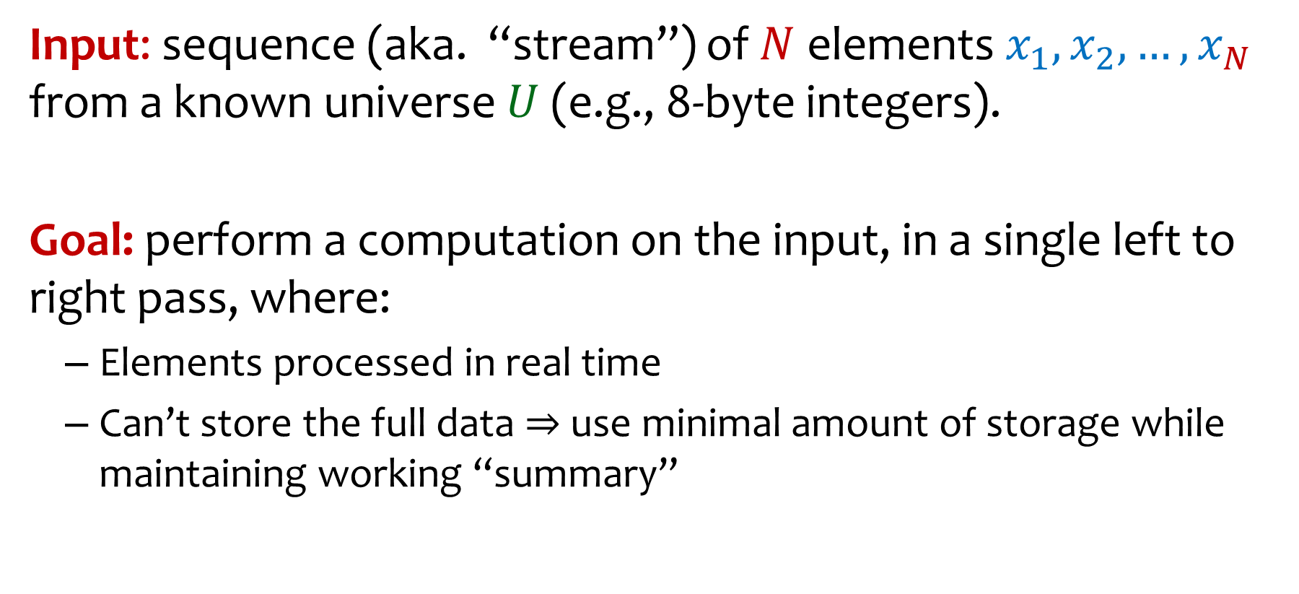
Stream Model – Problem Setup
Input: sequence (aka. “stream”) of $N$ elements$x_{1},x_{2},…, x_{N}$ from a known universe $U$(e.g., 8-byte integers).
Goal: perform a computation on the input, in a single left to right pass, where:
Elements processed in real time
Can’t store the full data ⇒ use minimal amount of storage while maintaining working “summary”

Slide 4
What can we compute?
Some functions are easy:
Min
Max
Sum
Average
32, 12, 14, 32, 7, 12, 32, 7, 32, 12, 4

Slide 5

Today: Counting distinct elements
32, 12, 14, 32, 7, 12, 32, 7, 32, 12, 4
Application
You are the content manager at YouTube, and you are trying to figure out the distinct view count for a video. How do we do that?
Note: A person can view their favorite videos several times, but they only count as 1 distinct view!
Notes:
Let’s consider the example problem of determining the number of distinct views a video gets. That is not the number of times a video has been viewed (as people may watch videos they like multiple times), but rather the number of people who have viewed it.

Slide 6
Other applications
IP packet streams: How many distinct IP addresses or IP flows (source+destination IP, port, protocol)
Anomaly detection, traffic monitoring
Search: How many distinct search queries on Google on a certain topic yesterday (users identified by IP address)
Web services: how many distinct users (cookies) searched/browsed a certain term/item
Advertising, marketing trends, etc.

Slide 7
Counting distinct elements
32, 12, 14, 32, 7, 12, 32, 7, 32, 12, 4
$N =$ # of IDs in the stream = 11, $m =$ # of distinct IDs in the stream = 5
Want to compute number of distinct IDs in the stream.
How?

Slide 8
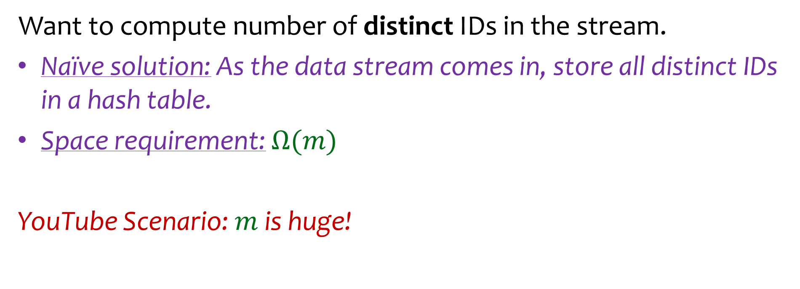
Counting distinct elements
32, 12, 14, 32, 7, 12, 32, 7, 32, 12, 4
$N =$ # of IDs in the stream = 11, $m =$ # of distinct IDs in the stream = 5
Want to compute number of distinct IDs in the stream.
Naïve solution: As the data stream comes in, store all distinct IDs in a hash table.
Space requirement: $Ω(m)$
YouTube Scenario: $m$ is huge!

Slide 9
Counting distinct elements
32, 12, 14, 32, 7, 12, 32, 7, 32, 12, 4
$N =$ # of IDs in the stream = 11, $m =$ # of distinct IDs in the stream = 5
Want to compute (at least approximately) the number of distinct IDs in the stream.
How to do this without storing all the elements?

Slide 10

Detour – I.I.D. Uniforms
If $Y_{1}, ⋯, Y_{m}\sim Unif\left(0,1\right)$ (i.i.d.) where do we expect the points to end up?
$$m=1$$
x
0
1

Slide 11


Detour – I.I.D. Uniforms
If $Y_{1}, ⋯, Y_{m}\sim Unif\left(0,1\right)$ (i.i.d.) where do we expect the points to end up?
$$m=1$$
x
0
1
x
x
$$m=2$$
0
1

Slide 12


Detour – I.I.D. Uniforms
If $Y_{1}, ⋯, Y_{m}\sim Unif\left(0,1\right)$ (i.i.d.) where do we expect the points to end up?
“Evenly spread out”
$$m=1$$
x
0
1
$$m=2$$
x
x
0
1
$$m=4$$
x
x
x
x
0
1

Slide 13
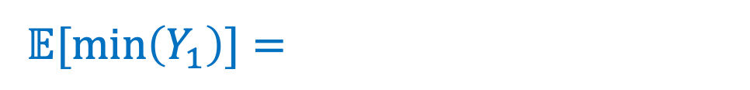
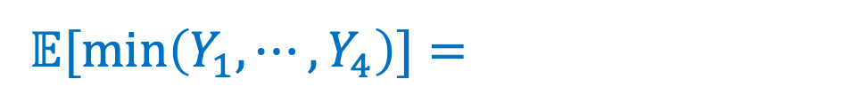


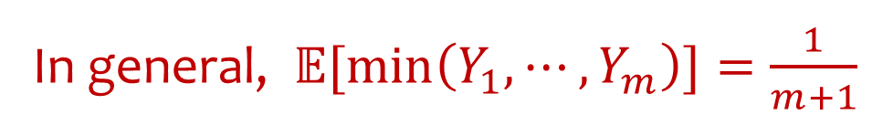

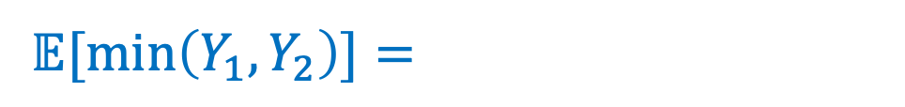
Detour – Min of I.I.D. Uniforms
If $Y_{1}, ⋯, Y_{m}\sim Unif\left(0,1\right)$ (iid) where do we expect the points to end up?
In general, $𝔼[min\left(Y_{1}, ⋯, Y_{m}\right)]=\frac{1}{m+1}$
$𝔼[min\left(Y_{1}\right)]=$
$$m=1$$
x
0
1
$𝔼[min\left(Y_{1},Y_{2}\right)]=$
$$m=2$$
x
x
0
1
$𝔼[min\left(Y_{1}, ⋯, Y_{4}\right)]=$
$$m=4$$
x
x
x
x
0
1
Notes:
Let’s suppose we knew how many unique user IDs we anticipate seeing, m, then where do we expect the hashes to end up in the distribution? Well, since they are evenly distributed, they will be expected to be spread out along the range relatively evenly. This is not the actual spread necessarily, but on average what we would anticipate. Now, consider based on m, where do we expect the minimum hash value to be? Try this on Ed (you will later prove it on your homework).
Whats the formula for expected minimum of n variables? 1/n, 1/(n+1), 1/(n-1), n -> done

Slide 14
Detour – Min of I.I.D. Uniforms
If $Y_{1}, ⋯, Y_{m}\sim Unif\left(0,1\right)$ (iid) where do we expect the points to end up?
In general, $𝔼[min\left(Y_{1}, ⋯, Y_{m}\right)]=\frac{1}{m+1}$
What is some intuition for this?

Slide 15
Detour – Min of I.I.D. Uniforms
If $Y_{1}, ⋯, Y_{m}\sim Unif\left(0,1\right)$ (i.i.d.) where do we expect the points to end up?
e.g., what is $𝔼[min\left\{Y_{1}, ⋯, Y_{m}\right\}]$?
CDF: Observe that $min\left\{Y_{1}, ⋯, Y_{m}\right\}≥y$ if and only if $Y_{1}≥y,…,Y_{m}≥y$

Slide 16

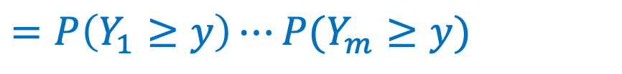

Detour – Min of I.I.D. Uniforms
If $Y_{1}, ⋯, Y_{m}\sim Unif\left(0,1\right)$ (i.i.d.) where do we expect the points to end up?
e.g., what is $𝔼[min\left\{Y_{1}, ⋯, Y_{m}\right\}]$?
CDF: Observe that $min\left\{Y_{1}, ⋯, Y_{m}\right\}≥y$ if and only if $Y_{1}≥y,…,Y_{m}≥y$
$$P\left(min\left\{Y_{1}, ⋯, Y_{m}\right\}≥y\right)=P(Y_{1}≥y,…,Y_{m}≥y)$$
$$y∈[0,1]$$
$$=P\left(Y_{1}≥y\right)⋯P(Y_{m}≥y)$$
(Independence)
$$={\left(1−y\right)}^{m}$$
$⇒P\left(min\left\{Y_{1}, ⋯, Y_{m}\right\}≤y\right)=1−{\left(1−y\right)}^{m}$

Slide 17
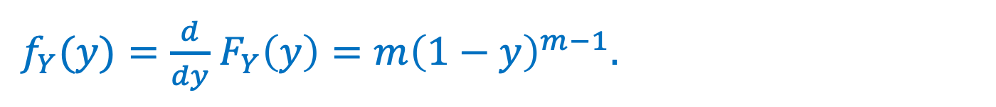
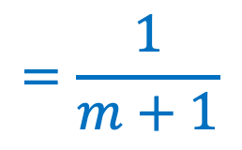
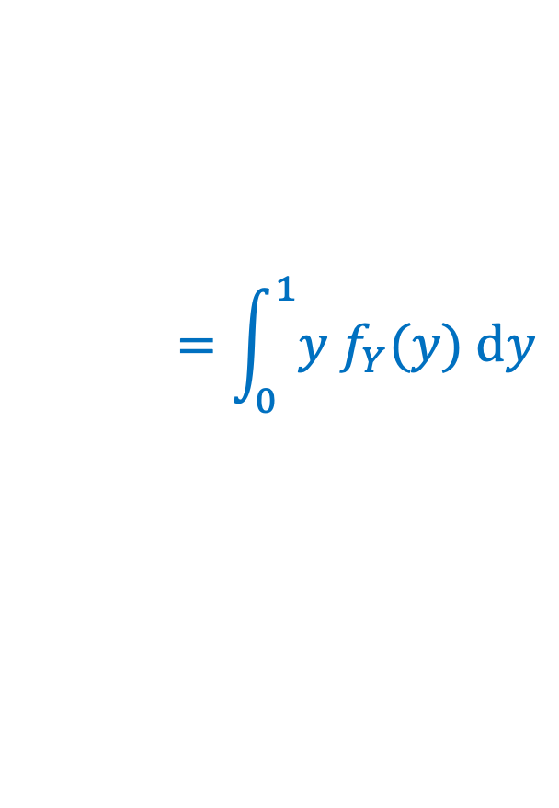
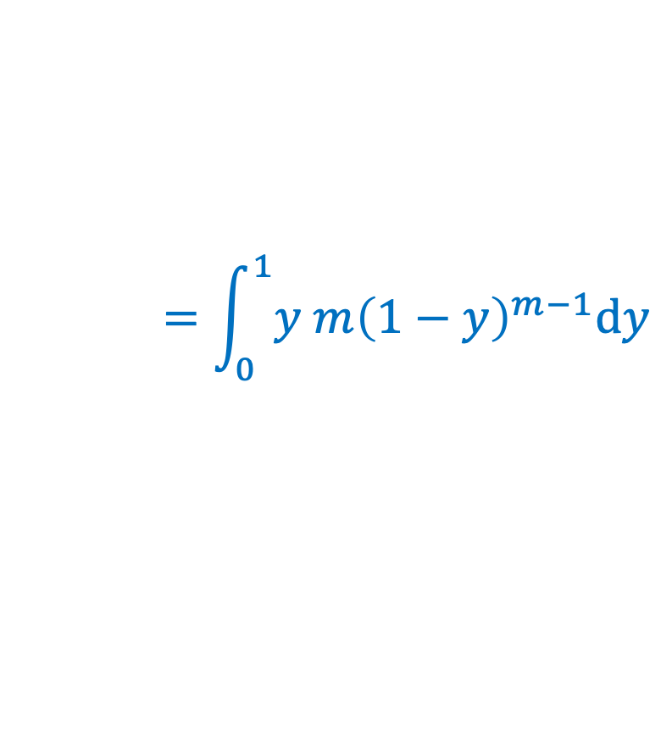

$F_{Y}\left(y\right)=P\left(min\left\{Y_{1}, ⋯, Y_{m}\right\}≤y\right)=1−{\left(1−y\right)}^{m}.$
$f_{Y}(y)=\frac{d}{dy}$ $F_{Y}\left(y\right)=m{\left(1−y\right)}^{m−1}.$
$$=\int_{0}^{1}{y f_{Y}(y) dy}$$
$$=\int_{0}^{1}{y m{\left(1−y\right)}^{m−1}dy}$$
$$=\frac{1}{m+1}$$
$$𝔼\left[Y\right]$$

Slide 18
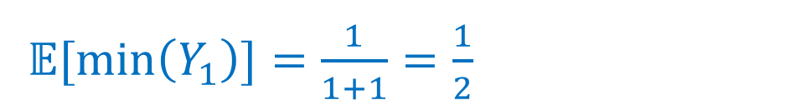
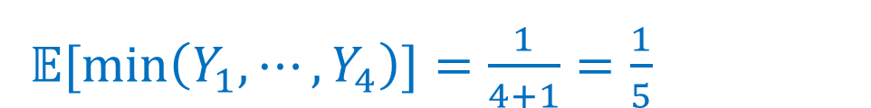
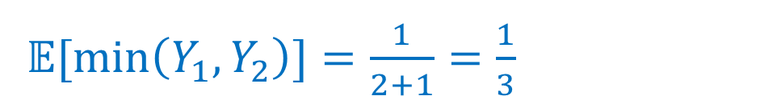
Detour – Min of I.I.D. Uniforms
If $Y_{1}, ⋯, Y_{m}\sim Unif\left(0,1\right)$ (iid) where do we expect the points to end up?
In general, $𝔼[min\left(Y_{1}, ⋯, Y_{m}\right)]=\frac{1}{m+1}$
$𝔼[min\left(Y_{1}\right)]=\frac{1}{1+1}=\frac{1}{2}$
$$m=1$$
x
1
$𝔼[min\left(Y_{1},Y_{2}\right)]=\frac{1}{2+1}=\frac{1}{3}$
0
$$m=2$$
x
x
0
1
$𝔼[min\left(Y_{1}, ⋯, Y_{4}\right)]=\frac{1}{4+1}=\frac{1}{5}$
$$m=4$$
x
x
x
x
0
1

Slide 19
Back to counting distinct elements
32, 12, 14, 32, 7, 12, 32, 7, 32, 12, 4
$N =$ # of IDs in the stream = 11, $m =$ # of distinct IDs in the stream = 5
Want to compute number of distinct IDs in the stream, at least approximately.
How to do this without storing all the elements?

Slide 20
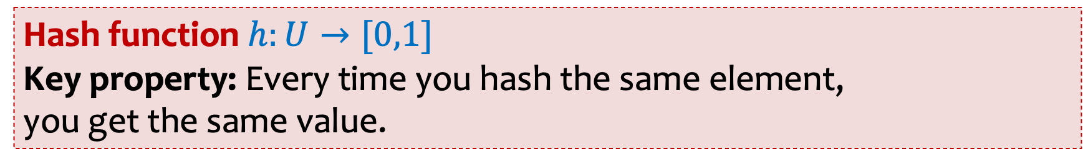
Distinct Elements – Hashing into $[0,1]$
Hash function $h:U→[0,1]$
Key property: Every time you hash the same element,
you get the same value.
32, 12, 14, 32, 7, 12, 32, 7
h(32), h(12), h(14), h(32), h(7), h(12), h(32), h(7)
Notes:
Pi

Slide 21
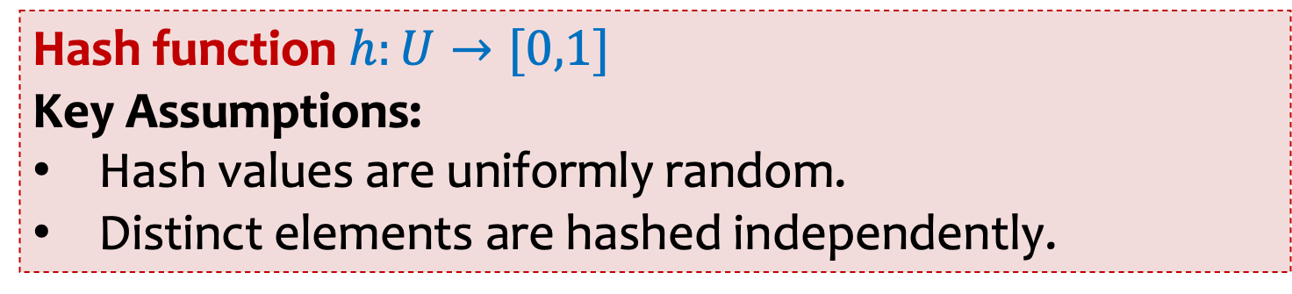
Distinct Elements – Hashing into $[0,1]$
Hash function $h:U→[0,1]$
Key Assumptions:
Hash values are uniformly random.
Distinct elements are hashed independently.
32, 12, 14, 32, 7, 12, 32, 7
h(32), h(12), h(14), h(32), h(7), h(12), h(32), h(7)
Notes:
Pi

Slide 22
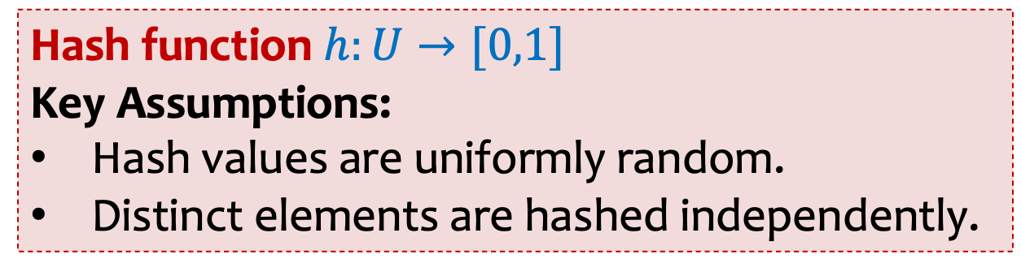
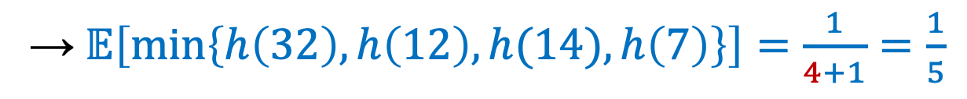
Hash function $h:U→[0,1]$
Key Assumptions:
Hash values are uniformly random.
Distinct elements are hashed independently.
32, 12, 14, 32, 7, 12, 32, 7
h(32), h(12), h(14), h(32), h(7), h(12), h(32), h(7)
Stream of length N=8, m=4 distinct elements
→ 4 i.i.d. RVs $h\left(32\right),h\left(12\right),h(14),h\left(7\right) \sim Unif\left(0,1\right)$
→ $𝔼\left[min\left\{h\left(32\right),h\left(12\right),h(14),h\left(7\right)\right\}\right]=\frac{1}{4+1}=\frac{1}{5}$

Slide 23


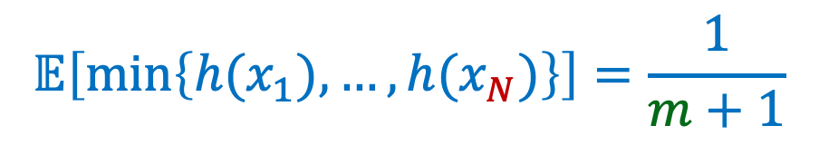
Distinct Elements – Hashing into $[0,1]$
Hash function $h:U→[0,1]$
Key Assumptions:
Hash values are uniformly random.
Distinct elements are hashed independently.
$x_{1},x_{2},…,x_{N}$ contains $m$ distinct elements
${h(x}_{1}),h\left(x_{2}\right),…,h(x_{N})$ contains $m$ i.i.d. rvs $\sim Unif\left(0,1\right)$
and $N−m$ repeats
$$𝔼\left[min\left\{{h(x}_{1}),…,h(x_{N})\right\}\right]=\frac{1}{m+1}$$

Slide 24

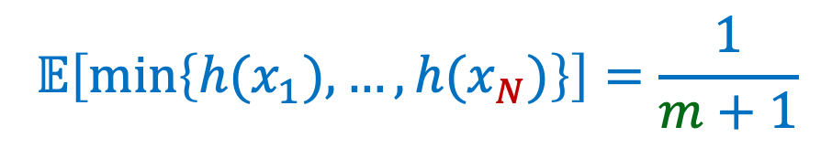
A super duper clever idea!!!!
We can track $min\left\{{h(x}_{1}),…,h(x_{N})\right\}$ by storing only a single element.
Suppose that $min\left\{{h(x}_{1}),…,h(x_{N})\right\}$ is $≈𝔼\left[min\left\{{h(x}_{1}),…,h(x_{N})\right\}\right]$ .
Then we would be golden because
$$𝔼\left[min\left\{{h(x}_{1}),…,h(x_{N})\right\}\right]=\frac{1}{m+1}$$

Slide 25
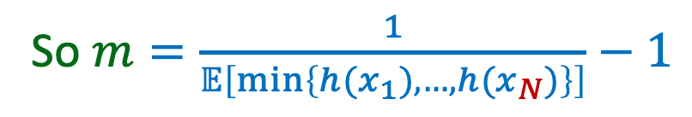

A super duper clever idea!!!!
We can track $min\left\{{h(x}_{1}),…,h(x_{N})\right\}$ by storing only a single element.
Suppose that $min\left\{{h(x}_{1}),…,h(x_{N})\right\}$ is $≈𝔼\left[min\left\{{h(x}_{1}),…,h(x_{N})\right\}\right]$ .
Then we would be golden!
$$𝔼\left[min\left\{{h(x}_{1}),…,h(x_{N})\right\}\right]=\frac{1}{m+1}$$
So $m=\frac{1}{𝔼\left[min\left\{{h(x}_{1}),…,h(x_{N})\right\}\right]}−1$

Slide 26
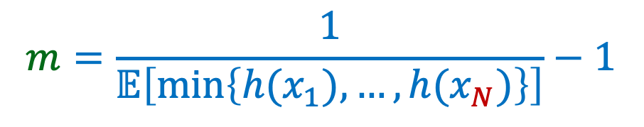

The MinHash Algorithm – Idea
$$m=\frac{1}{𝔼\left[min\left\{{h(x}_{1}),…,h(x_{N})\right\}\right]}−1$$
Compute $val=\min{\{{h(x}_{1}),…,h(x_{N})\}}$
Assume that $val≈𝔼\left[min\left\{{h(x}_{1}),…,h(x_{N})\right\}\right]$
Output as estimate for $m: round\left(\frac{1}{val}−1\right)$

Slide 27
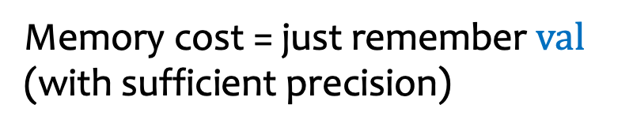
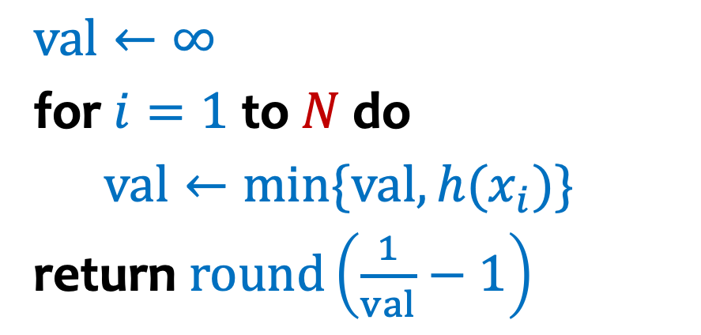
The MinHash Algorithm – Implementation
Algorithm MinHash$(x_{1},x_{2},…,x_{N})$
$$val←∞$$
for $i=1$ to $N$ do
$val←\min{\{val,h(x_{i})\}}$
return $round\left(\frac{1}{val}−1\right)$
Memory cost = just remember $val$ (with sufficient precision)

Slide 28
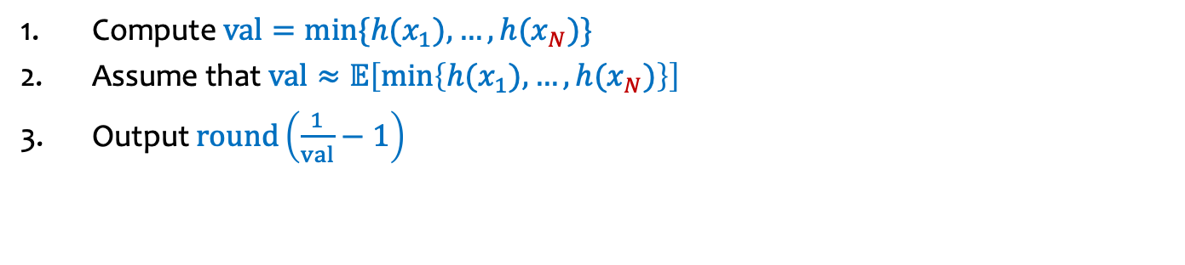
MinHash Example
Compute $val=\min{\{{h(x}_{1}),…,h(x_{N})\}}$
Assume that $val≈𝔼\left[min\left\{{h(x}_{1}),…,h(x_{N})\right\}\right]$
Output $round\left(\frac{1}{val}−1\right)$
Stream: 13, 25, 19, 25, 19, 19
Hashes: 0.51, 0.26, 0.79, 0.26, 0.79, 0.79
What does MinHash return?
Notes:
Then, to make an estimate, we return the rounded 1 / val - 1. In this case we got lucky and it was 3, the right answer!

Slide 29
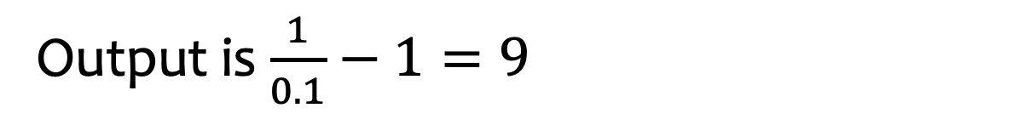
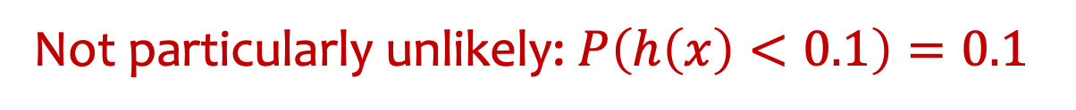
MinHash Example II
Stream: 11, 34, 89, 11, 89, 23
Hashes: 0.5, 0.21, 0.94, 0.5, 0.94, 0.1
Output is $\frac{1}{0.1}−1=9$
Clearly, not a very good answer!
Not particularly unlikely: $P\left(h\left(x\right)<0.1\right)=0.1$
Notes:
This time, the estimate of 9 is a bit off of the truth of 5 distinct elements. We didn’t get as lucky, but still it isn’t horrible. In the homework, you will implement a way to improve this!

Slide 30
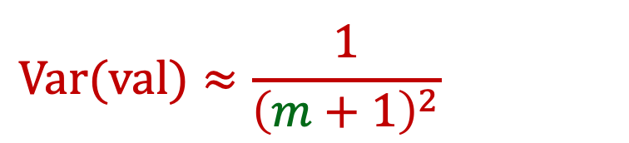
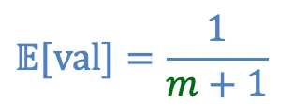
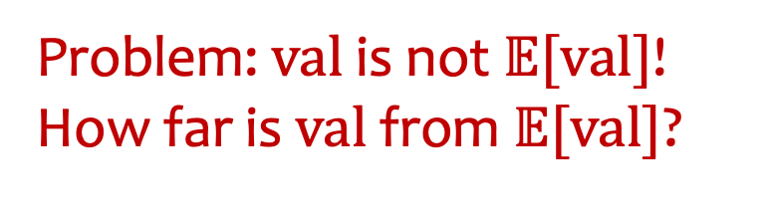


The MinHash Algorithm – Problem
Algorithm MinHash$(x_{1},x_{2},…,x_{N})$
$$val←∞$$
for $i=1$ to $N$ do
$val←\min{\{val,h(x_{i})\}}$
return $round\left(\frac{1}{val}−1\right)$
Problem: $val$ is not $𝔼[val]$! How far is $val$ from $𝔼[val]$?
$$Var(val)≈\frac{1}{{\left(m+1\right)}^{2}}$$
$$𝔼[val]=\frac{1}{m+1}$$
$$val=\min{\{{h(x}_{1}),…,h(x_{N})\}}$$

Slide 31
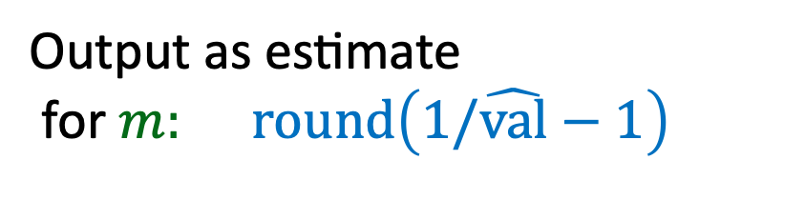
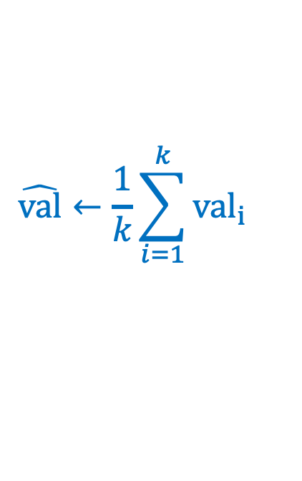


How can we reduce the variance?
Idea: Repetition to reduce variance!
Use $k$ independent hash functions $h^{1}, h^{2},⋯h^{k}$
$${val}_{1}=\min{\{{h^{1}(x}_{1}),…,h^{1}(x_{N})\}}$$
$${val}_{2}=\min{\{{h^{2}(x}_{1}),…,h^{2}(x_{N})\}}$$
…
$${val}_{k}=\min{\{{h^{k}(x}_{1}),…,h^{k}(x_{N})\}}$$
$$\hat{val}←\frac{1}{k}\sum_{i=1}^{k}{{val}_{i}}$$
$$\text{Output} \text{as} \text{estimate} \text{for} m: round\left(1/\hat{val}−1\right)$$

Slide 32
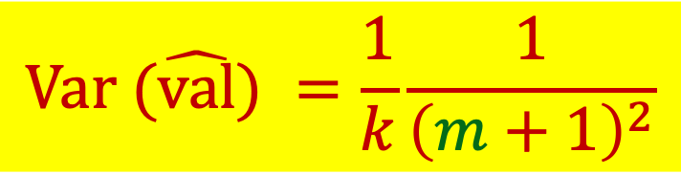
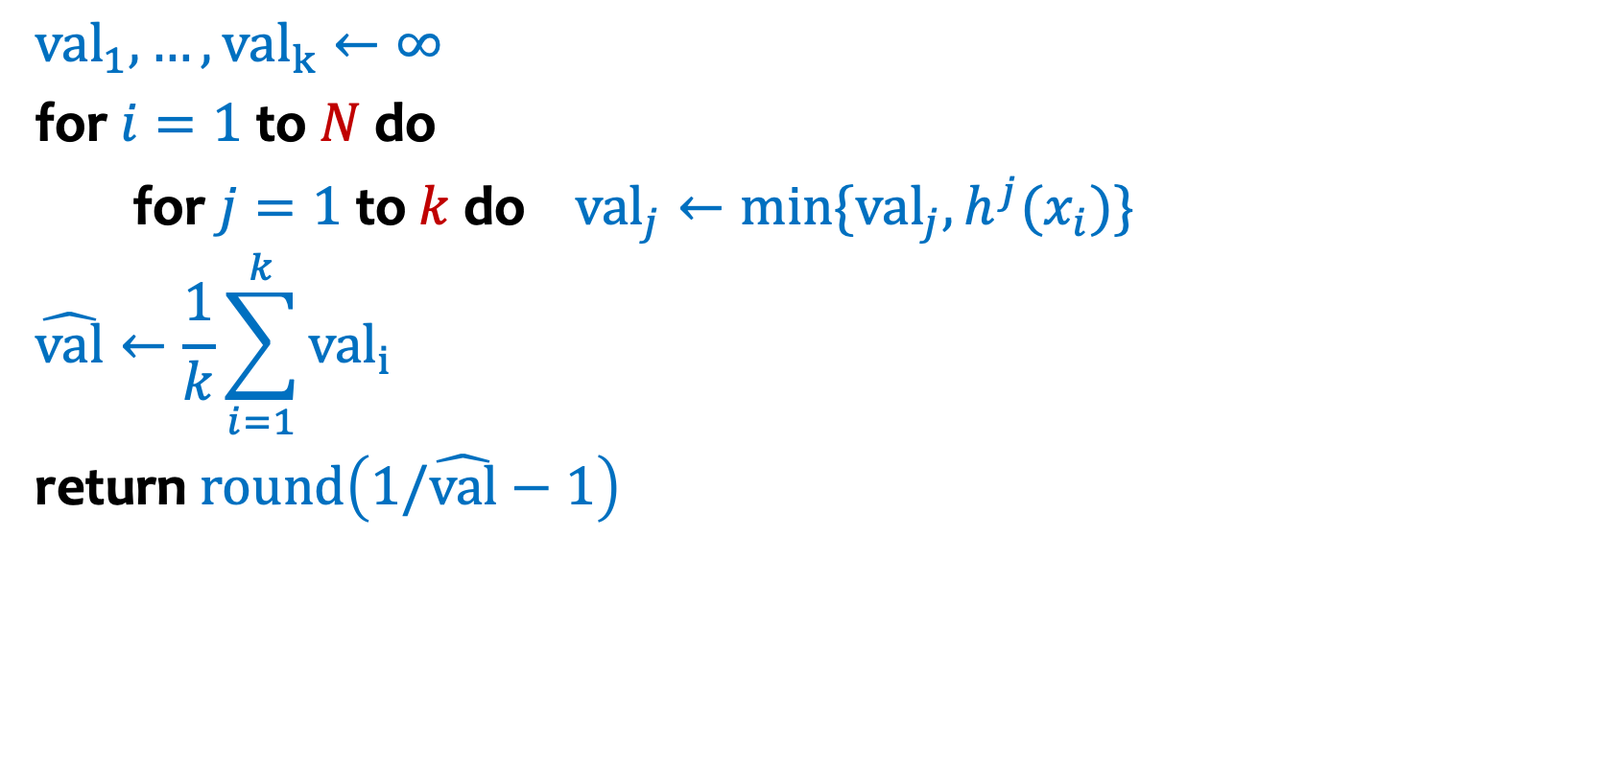

How can we reduce the variance?
Idea: Repetition to reduce variance!
Use $k$ independent hash functions $h^{1}, h^{2},⋯h^{k}$
Algorithm MinHash$(x_{1},x_{2},…,x_{N})$
$${val}_{1},…,{val}_{k}←∞$$
for $i=1$ to $N$ do
for $j=1$ to $k$ do ${val}_{j}←\min{\{{val}_{j},h^{j}(x_{i})\}}$
$$\hat{val}←\frac{1}{k}\sum_{i=1}^{k}{{val}_{i}}$$
return $round\left(1/\hat{val}−1\right)$
$$Var (\hat{val}) =\frac{1}{k}\frac{1}{{\left(m+1\right)}^{2}}$$

Slide 33
How do we get a handle on how many hash functions to use?
CLT
Tail bounds

Slide 34
Tail Bounds (Idea)
Bounding the probability a random variable is far from its mean. Usually statements of the form:
$$\operatorname{Pr}\left(X≥a\right)≤b$$
$$\operatorname{Pr}\left(|X−E\left[X\right]|≥a\right)≤b$$
Useful tool when
An approximation that is easy to compute is sufficient
The process is too complex to analyze exactly

Slide 35
Key point
A random variable might almost never be at least its expectation.
Similarly, a random variable might almost always be at least its expectation or even much bigger.

Slide 36
Tail Bounds
Generally, the more you know about your random variable the better tail bounds you can get.
Markov’s Inequality
Chebyshev’s Inequality

Slide 37
Markov’s Inequality
Theorem. Let $X$ be a random variable taking only non-negative values. Then, for any $t>0$,
$ℙ\left(X≥t\right)≤\frac{𝔼\left(X\right)}{t}$.
$ℙ\left(X≥t⋅𝔼\left(X\right)\right)≤\frac{1}{t}$.
Incredibly simplistic – only requires that the random variable is non-negative and only needs you to know expectation. You don’t need to know anything else about the distribution of $X$.

Slide 38
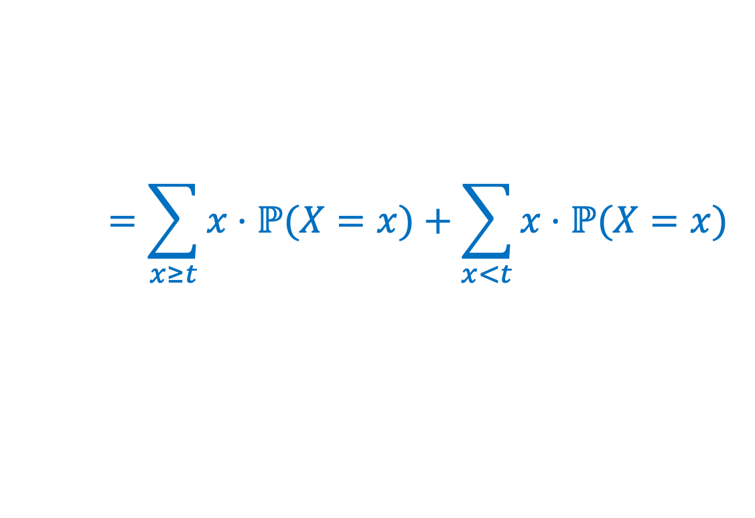
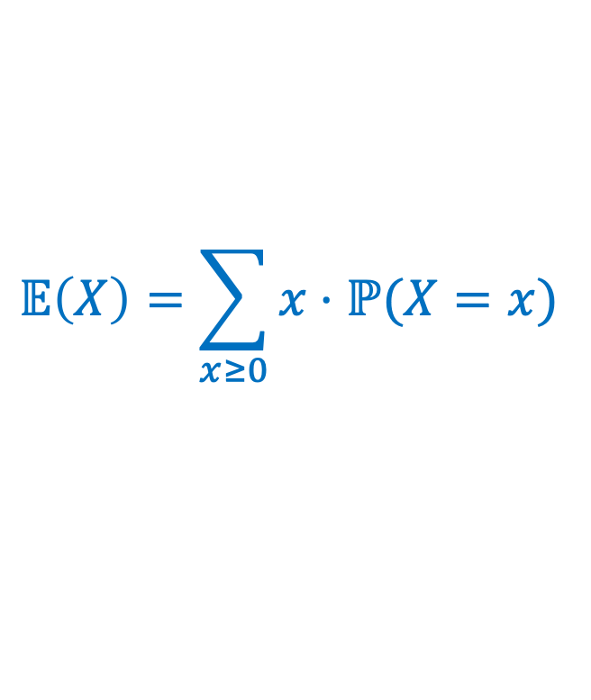
Markov’s Inequality – Proof
Theorem. Let $X$ be a (discrete) random variable taking only non-negative values. Then, for any $t>0$,
$ℙ\left(X≥t\right)≤\frac{𝔼\left(X\right)}{t}$.
$$𝔼\left(X\right)=\sum_{x≥0}{x⋅ℙ(X=x)}$$
$$=\sum_{x≥t}{x⋅ℙ(X=x)}+\sum_{x<t}{x⋅ℙ(X=x)}$$

Slide 39
Markov’s Inequality – Proof
Theorem. Let $X$ be a (discrete) random variable taking only non-negative values. Then, for any $t>0$,
$ℙ\left(X≥t\right)≤\frac{𝔼\left(X\right)}{t}$.
$$𝔼\left(X\right)=\sum_{x}{x⋅ℙ(X=x)}$$
$≥0$ because $x≥0$ whenever $ℙ\left(X=x\right)≥0$ (takes only non-negative values)
$$=\sum_{x≥t}{x⋅ℙ(X=x)}+\sum_{x<t}{x⋅ℙ(X=x)}$$
$$≥\sum_{x≥t}{x⋅ℙ(X=x)}$$
$$≥\sum_{x≥t}{t⋅ℙ(X=x)}$$
$$=t⋅ℙ(X≥t)$$
Follows by re-arranging terms …

Slide 40
Example – Binomial Random Variable
Markov’s inequality
$ℙ\left(X≥t\right)≤\frac{𝔼\left(X\right)}{t}$.
Let $X$ be Binomial RV with parameters. $n, p=0.5$
$$𝔼\left(X\right)=\frac{n}{2}$$
What is the probability that $X≥\frac{3n}{4}$?
Markov’s inequality: $ℙ\left(X≥\frac{3n}{4}\right)≤ \frac{4}{3n}⋅\frac{n}{2}=\frac{2}{3}$
Can we do better?

Slide 41
Some tail bounds
Markov’s Inequality
Chebyshev’s Inequality

Slide 42
Using variance
If we know more about the random variable, e.g. its variance, we can get a better bound!

Slide 43
Chebyshev’s Inequality
Markov’s inequality
$ℙ\left(X≥t\right)≤\frac{𝔼\left(X\right)}{t}$.
Theorem. Let $X$ be a random variable. Then, for any $t>0$,
$ℙ\left(|X−𝔼\left(X\right)|≥t\right)≤\frac{Var\left(X\right)}{t^{2}}$.
Proof: Define $Z=X−𝔼\left(X\right)$
Definition of Variance
$$ℙ\left(|Z|≥t\right)=ℙ\left(Z^{2}≥t^{2}\right)≤\frac{𝔼\left(Z^{2}\right)}{t^{2}}=\frac{Var\left(X\right)}{t^{2}}$$
Markov’s inequality ($Z^{2}≥0$)
$|Z|≥t$iff $Z^{2}≥t^{2}$

Slide 44
Example – Binomial Random Variable
Chebychev’s Inequality
$ℙ\left(|X−𝔼\left(X\right)|≥t\right)≤\frac{Var\left(X\right)}{t^{2}}$.
Let $X$ be Binomial RV with parameters. $n, p=0.5$
$$𝔼\left(X\right)=\frac{n}{2}$$
$$Var\left(X\right)=$$
What is the probability that $X≥\frac{3n}{4}$?
Chebychev’s inequality: $ℙ\left(X≥\frac{3n}{4}\right)≤$
Markov’s inequality: $ℙ\left(X≥\frac{3n}{4}\right)≤ \frac{4}{3n}⋅\frac{n}{2}=\frac{2}{3}$

Slide 45
Chevychev gives us a pretty good bound. But still not great.
Chebychev’s inequality: $ℙ\left(X≥\frac{3n}{4}\right)≤ \frac{4}{n}$
For 1000 flips, probability of getting at least 750 heads is at most 0.02
The truth for n = 1000:
$ℙ\left(X≥\frac{3n}{4}\right)<$ 0.0000000000000000000000000000000000000000000067

Slide 46
Tail Bounds
Useful for approximations of complex systems. How good the approximation is depends on the actual distribution and the context you are using it in.
Usually loose upper-bounds are okay when designing for worst-case
Generally, the more you know about your random variable the better tail bounds you can get.

Slide 47
And one more thing….

Slide 48

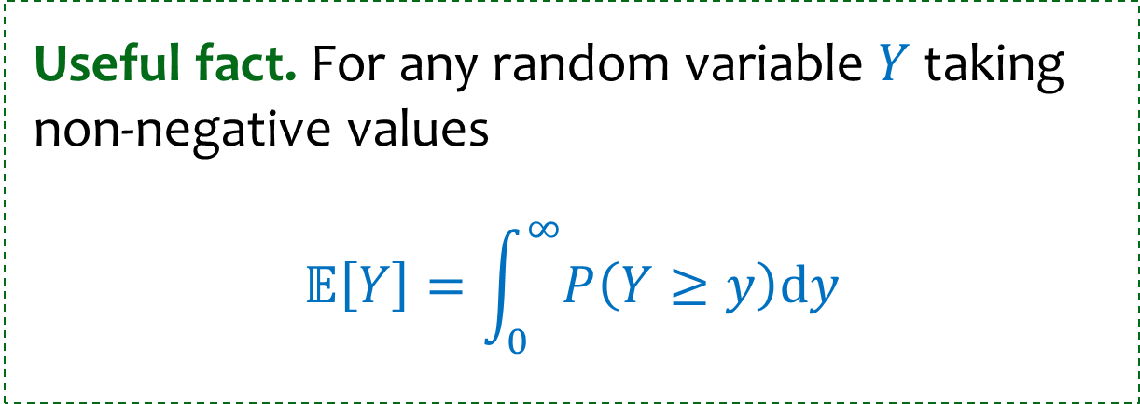
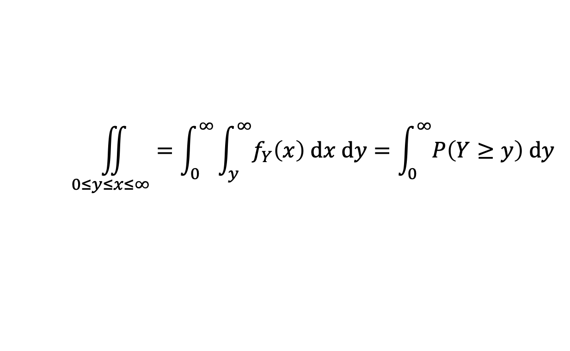
Detour – Min of I.I.D. Uniforms
Useful fact. For any random variable $Y$ taking non-negative values
$$𝔼\left[Y\right]=\int_{0}^{∞}{P\left(Y≥y\right)dy}$$
Proof
$$𝔼\left[Y\right]=\int_{0}^{∞}{x⋅f_{Y}\left(x\right) dx=\int_{0}^{∞}{\left(\int_{0}^{x}{1}dy\right)⋅f_{Y}\left(x\right) dx=\int_{0}^{∞}{\int_{0}^{x}{f_{Y}\left(x\right) dy dx}}}}$$
$$\iint_{0≤y≤x≤∞}{=\int_{0}^{∞}{\int_{y}^{∞}{f_{Y}\left(x\right) dx dy}}}=\int_{0}^{∞}{P\left(Y≥y\right) dy}$$

Slide 49
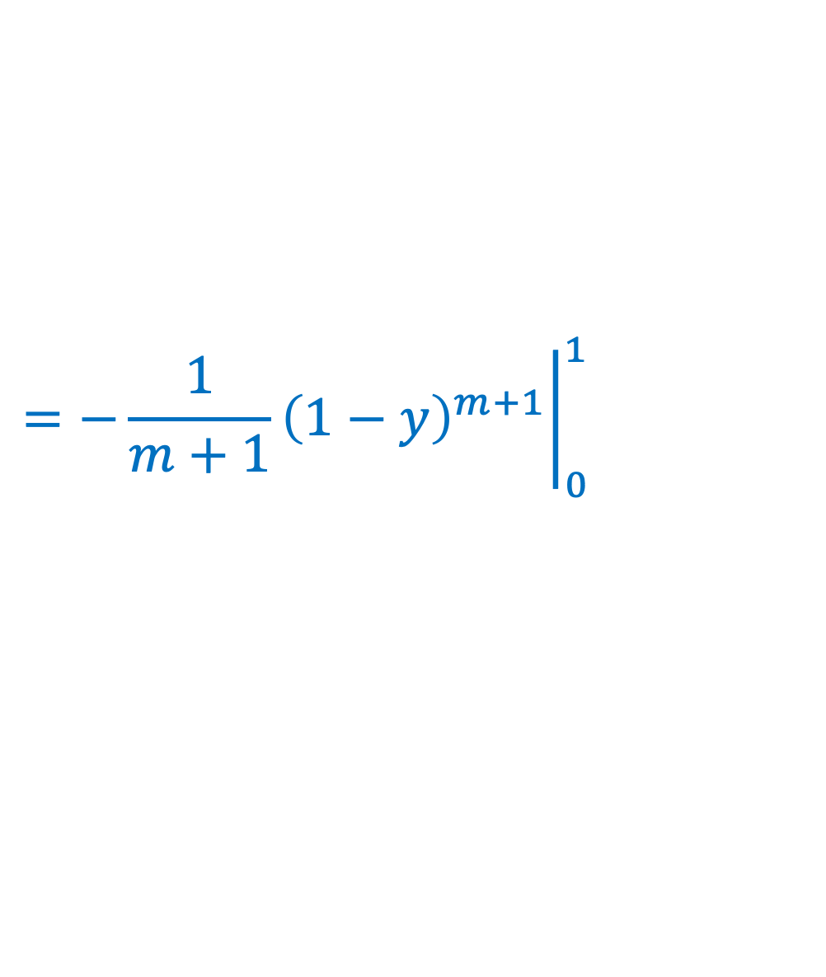

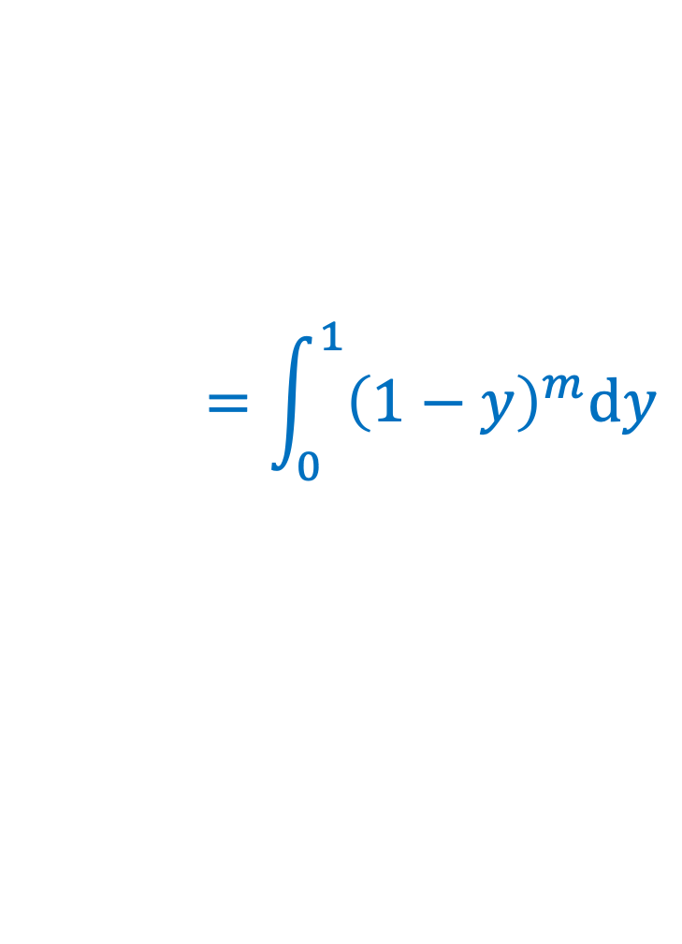
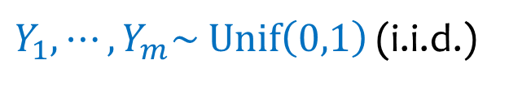
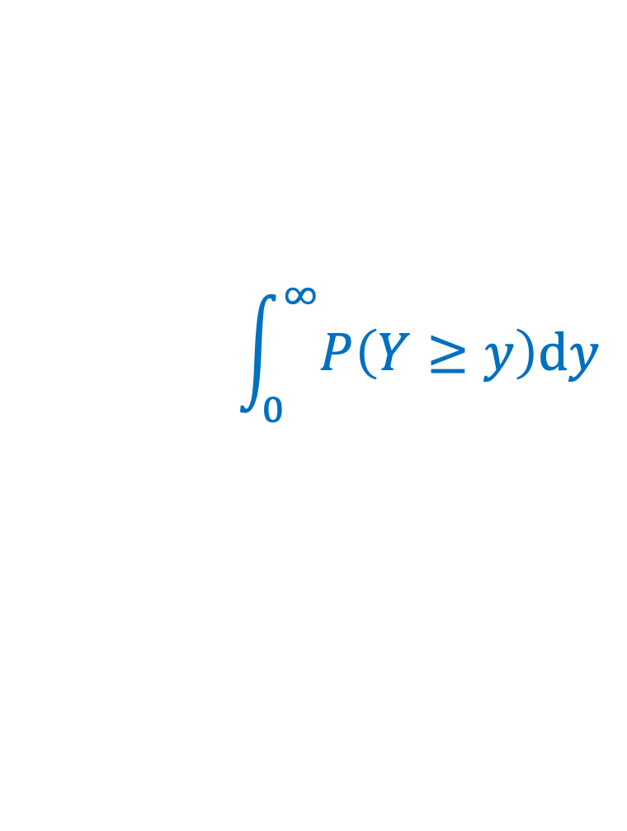

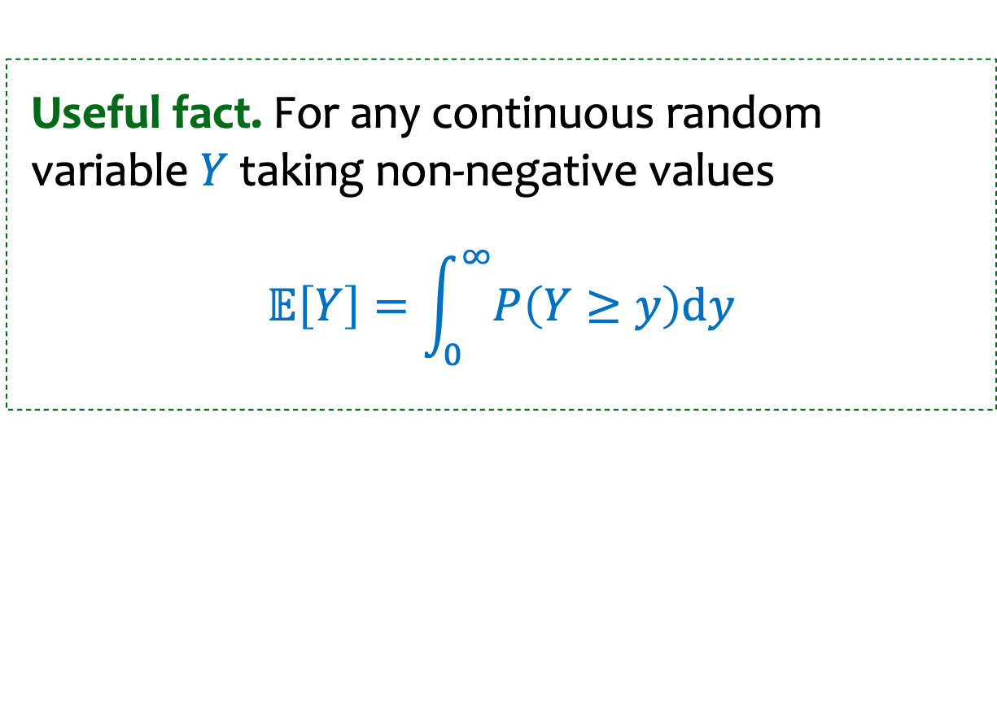
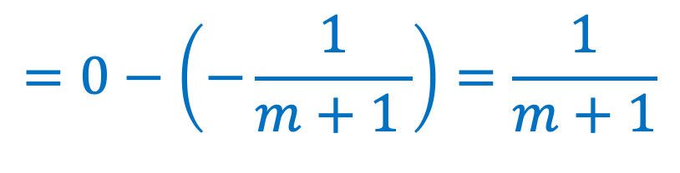
Detour – Min of I.I.D. Uniforms
$Y_{1}, ⋯, Y_{m}\sim Unif\left(0,1\right)$ (i.i.d.)
$$Y=min\left\{Y_{1}, ⋯, Y_{m}\right\}$$
Useful fact. For any continuous random variable $Y$ taking non-negative values
$$𝔼\left[Y\right]=\int_{0}^{∞}{P\left(Y≥y\right)dy}$$
$$\int_{0}^{∞}{P\left(Y≥y\right)dy}$$
$$=\int_{0}^{1}{{\left(1−y\right)}^{m}dy}$$
$$𝔼\left[Y\right]=$$
$$={\left.{−\frac{1}{m+1}\left(1−y\right)}^{m+1}\right|}_{0}^{1}$$
$$=0−\left(−\frac{1}{m+1 }\right)=\frac{1}{m+1}$$

Slide 50
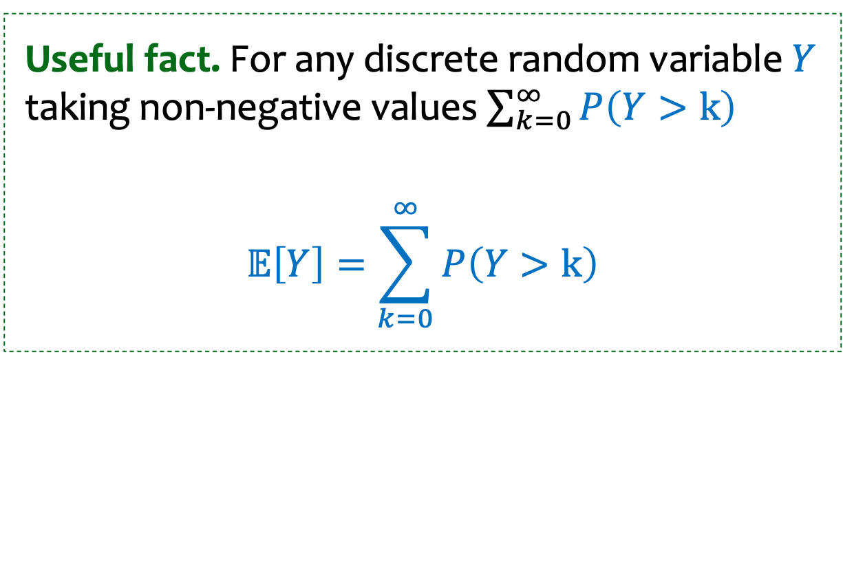
Useful fact. For any discrete random variable $Y$ taking non-negative values $\sum_{k=0}^{∞}{P\left(Y>k\right)}$
$$𝔼\left[Y\right]=\sum_{k=0}^{∞}{P\left(Y>k\right)}$$

