Slide 1
More Counting
We will use pollev today.
PollEv.com/annakarlin185
CSE 312 Spring 26
Lecture 2

Slide 2
Questions, etc.
We will use pollev today.
PollEv.com/annakarlin185
About syllabus?
Anything else?
Midterm on Thursday, May 14 from 6- 7:30pm
Full Pset 1 out this evening.
Take note of readings linked from the schedule page.
Notes:
: take it seriously; we will work with you to get

Slide 3
Quick Recap
Sum Rule
If you can choose from
Either one of n options,
OR one of m options with NO overlap with the previous n,
then the number of possible outcomes of the experiment is n+m
Product Rule
In a sequential process, if there are
n₁ choices for the first step,
n₂ choices for the second step (given the first choice), …, and
n_{k} choices for the k step (given the previous choices),
then the total number of outcomes is n₁ x n₂ x … x n_{k}
Complementary Counting

Slide 4
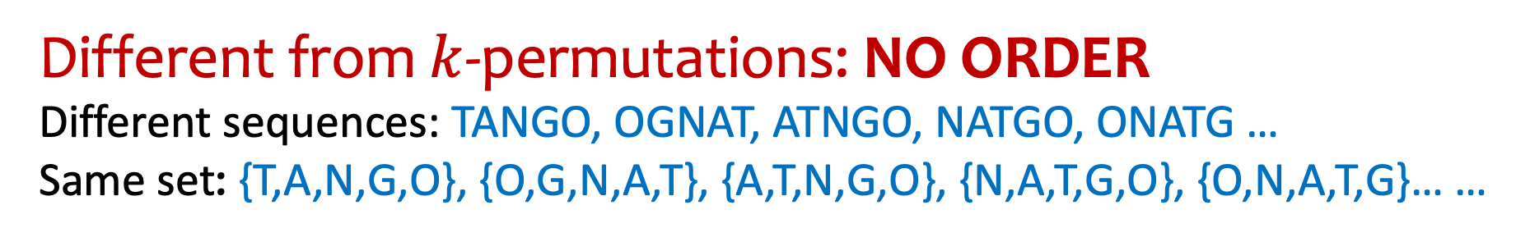
Number of Subsets – Not the same as k-permutations.
“How many size-5 subsets of $\left\{A,B,…,Z\right\}$?”
E.g., {A,Z,U,R,E}, {B,I,N,G,O}, {T,A,N,G,O}. But not: {S,T,E,V}, {S,A,R,H},…
Different from $k$-permutations: NO ORDER
Different sequences: TANGO, OGNAT, ATNGO, NATGO, ONATG …
Same set: {T,A,N,G,O}, {O,G,N,A,T}, {A,T,N,G,O}, {N,A,T,G,O}, {O,N,A,T,G}… …

Slide 5

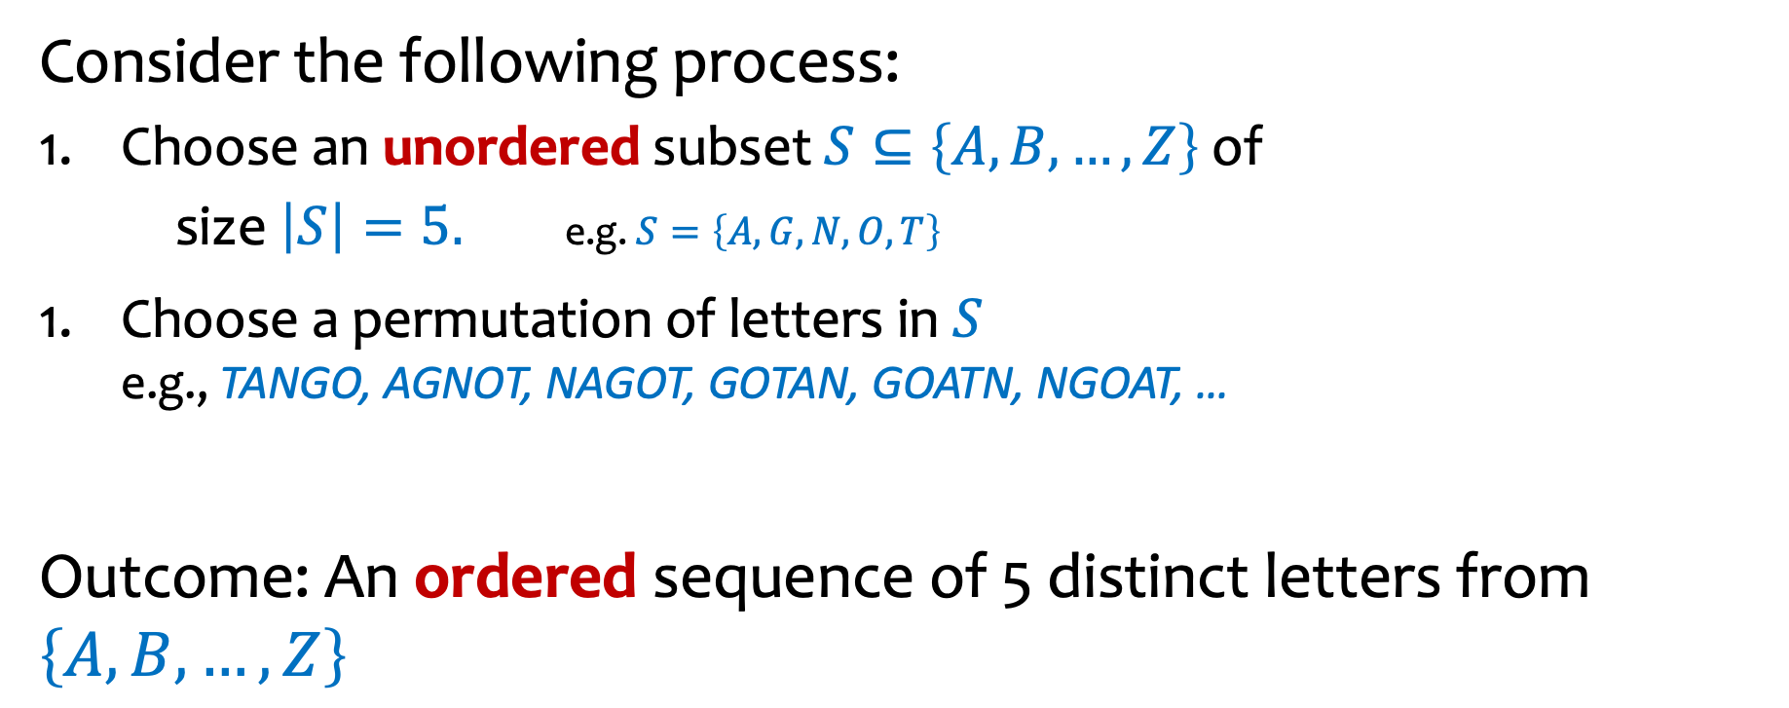
How to count number of 5 element subsets of $\left\{A,B,…,Z\right\}$?
Consider the following process:
Choose an unordered subset $S⊆\left\{A,B,…,Z\right\}$ of
size $\left|S\right|=5.$ e.g. $S=\left\{A,G,N,O,T\right\}$
Choose a permutation of letters in $S$ e.g., TANGO, AGNOT, NAGOT, GOTAN, GOATN, NGOAT, …
Outcome: An ordered sequence of 5 distinct letters from $\left\{A,B,…,Z\right\}$
$$\text{???}$$
x
=

Slide 6
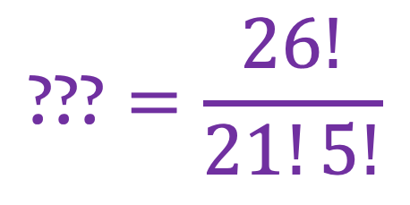
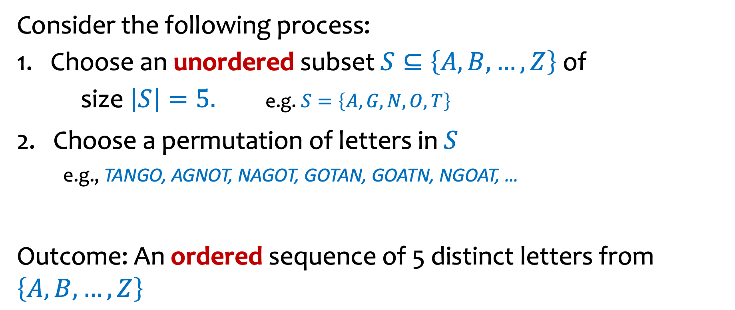

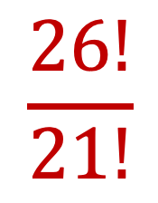
Number of Subsets of size 5 from alphabet of 26
Consider the following process:
Choose an unordered subset $S⊆\left\{A,B,…,Z\right\}$ of
size $\left|S\right|=5.$ e.g. $S=\left\{A,G,N,O,T\right\}$
2. Choose a permutation of letters in $S$ e.g., TANGO, AGNOT, NAGOT, GOTAN, GOATN, NGOAT, …
Outcome: An ordered sequence of 5 distinct letters from $\left\{A,B,…,Z\right\}$
$$\text{???}$$
x
$$5!$$
=
$$\frac{26!}{21!}$$
$$\text{???}=\frac{26!}{21!5!}$$

Slide 7
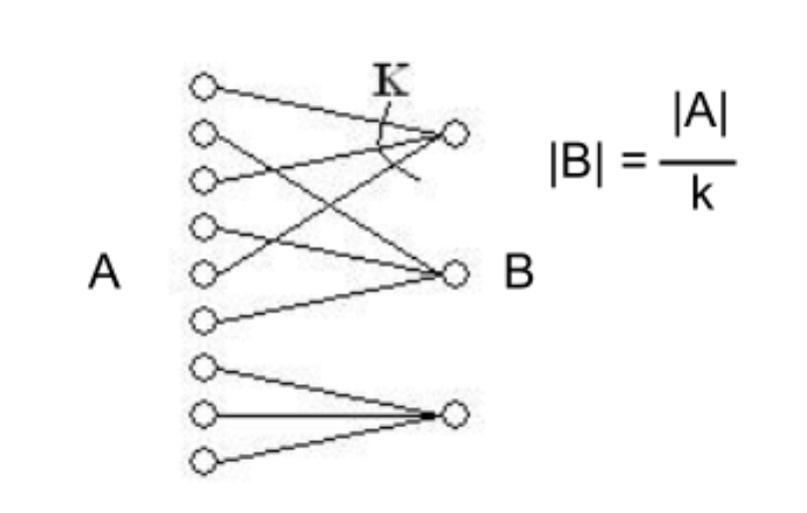
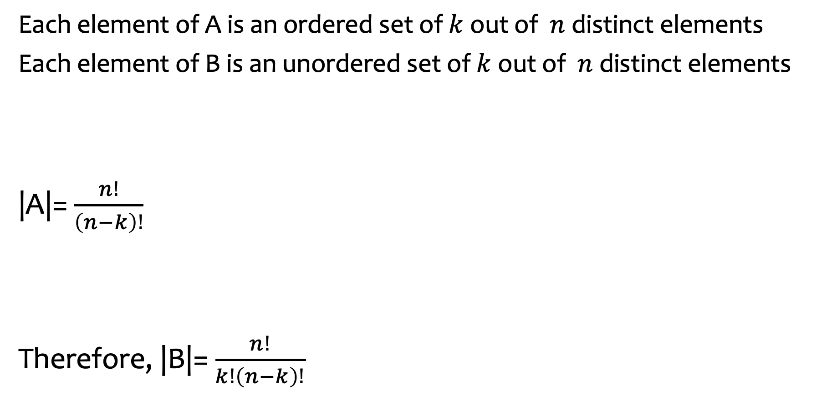
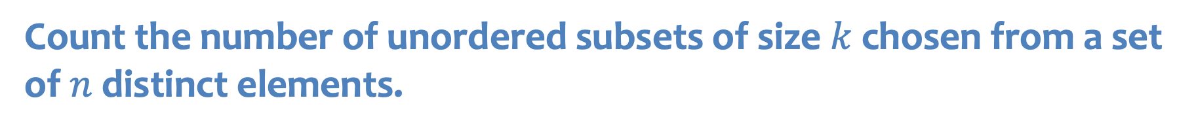


Count the number of unordered subsets of size$k$ chosen from a set of $n$ distinct elements.
Each element of A is an ordered set of $k$ out of $n$ distinct elements
Each element of B is an unordered set of $k$ out of $n$ distinct elements
|A|= $\frac{n!}{\left(n−k\right)!}$
Therefore, |B|= $\frac{n!}{k!\left(n−k\right)!}$
$k$!
|B| = |A|/ $k$!

Slide 8
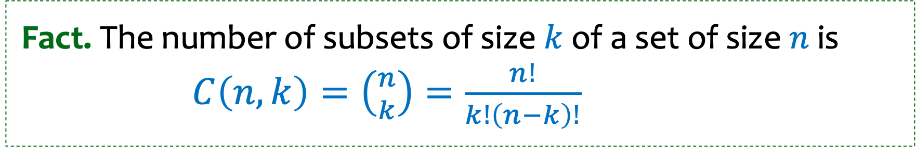
Number of Subsets -- don’t care about order
Fact. The number of subsets of size $k$ of a set of size $n$ is $C\left(n,k\right)=\left({n \atop k}\right)=\frac{n!}{k!\left(n−k\right)!}$
we say “$n$ choose $k$”
[also called combinations or binomial coefficients]

Slide 9
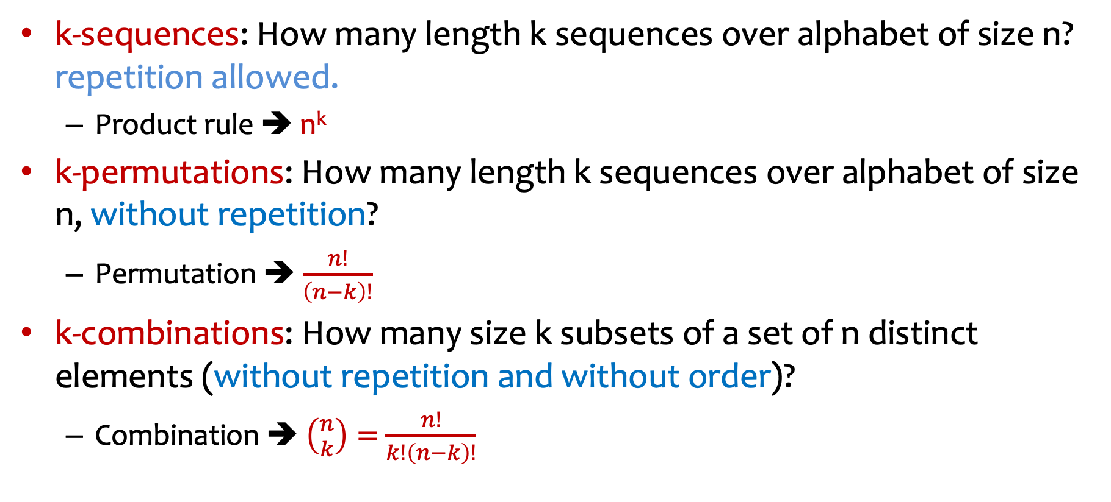
Summary so far
k-sequences: How many length k sequences over alphabet of size n? repetition allowed.
Product rule ➔ n^{k}
k-permutations: How many length k sequences over alphabet of size n, without repetition?
Permutation ➔ $\frac{n!}{\left(n−k\right)!}$
k-combinations: How many size k subsets of a set of n distinct elements (without repetition and without order)?
Combination ➔ $\left({n \atop k}\right)=$ $\frac{n!}{k!\left(n−k\right)!}$
Notes:
Number of k-permutations is n factorial divided by (n-k) factorial
Number of k –combinations is “n choose k”, i.e., n factorial divided by (n-k) factorial divided by k factorial.
How many size k subsets of a set of size n (with repetition and without order)

Slide 10
Assigning Books
We have 5 books to split among 3 people (Alice, Bob, and Charlie)
Every book goes to exactly one person, but each person could end up with no books (or all of them, or something in between).
1
Alice
2
Bob
3
4
Charlie
5

Slide 11
Assigning Books – first try
We have 5 books to split among 3 people (Alice, Bob, and Charlie)
Every book goes to exactly one person, but each person could end up with no books (or all of them, or something in between).
First try: apply product rule, count number of possibilities for how many books Alice gets, then number of possibilities for how many books Bob gets, then number of possibilities for how many books Charlie gets
1
Alice
2⁵ = 32 choices
2⁵ = 32 choices
2⁵ = 32 choices
Product =2¹⁵
2
Bob
3
4
Charlie
5
Notes:
Attempt 1: We’re choosing subsets!
Alice could get any of the $2^{5}=32$ subsets of the books.
Bob could get any of the $2^{5}=32$ subsets of the books.
Charlie could get any of the $2^{5}=32$ subsets of the books.
Total is product of those three steps $32⋅32⋅32=32768$
Is this correct?

Slide 12
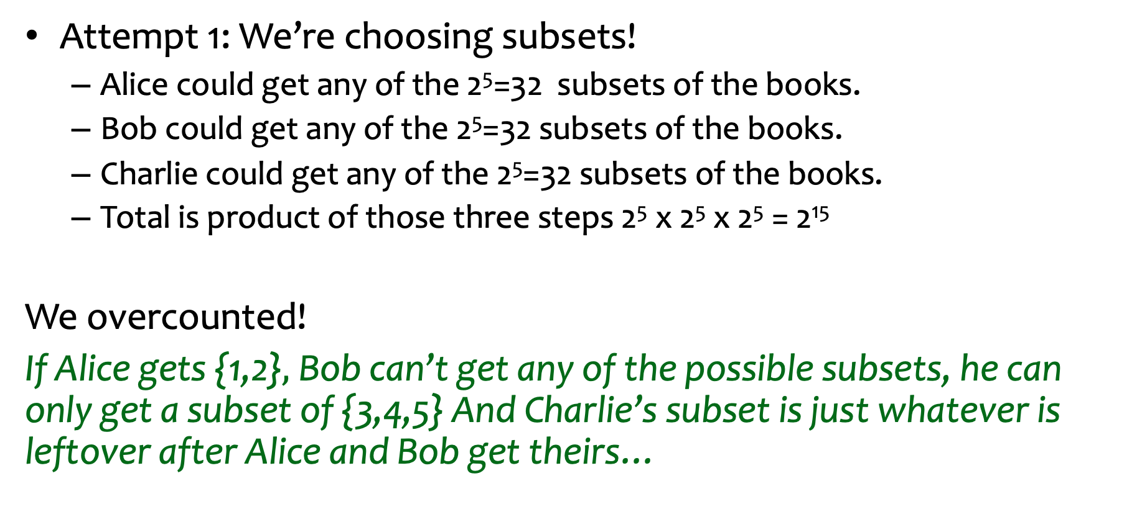
Assigning Books (first try): correct, overcount or undercount?
Attempt 1: We’re choosing subsets!
Alice could get any of the 2⁵=32 subsets of the books.
Bob could get any of the 2⁵=32 subsets of the books.
Charlie could get any of the 2⁵=32 subsets of the books.
Total is product of those three steps 2⁵ x 2⁵ x 2⁵ = 2¹⁵
We overcounted!
If Alice gets {1,2}$,$Bob can’t get any of the possible subsets, he can only get a subset of {3,4,5} And Charlie’s subset is just whatever is leftover after Alice and Bob get theirs…

Slide 13
Assigning Books – second try
We have 5 books to split among 3 people (Alice, Bob, and Charlie)
Every book goes to exactly one person, but each person could end up with no books (or all of them, or something in between).
Apply product rule the other way: count number of possibilities for who gets book 1, then number of possibilities for who gets book 2, etc.
3 choices
1
Alice
3 choices
2
3 choices
Bob
3
3 choices
4
Charlie
3 choices
Product = 3⁵
5
Notes:
Instead of thinking about the choices as considering the people one by one, let’s think about the choices as considering the books one by one.
Checked reading order

Slide 14
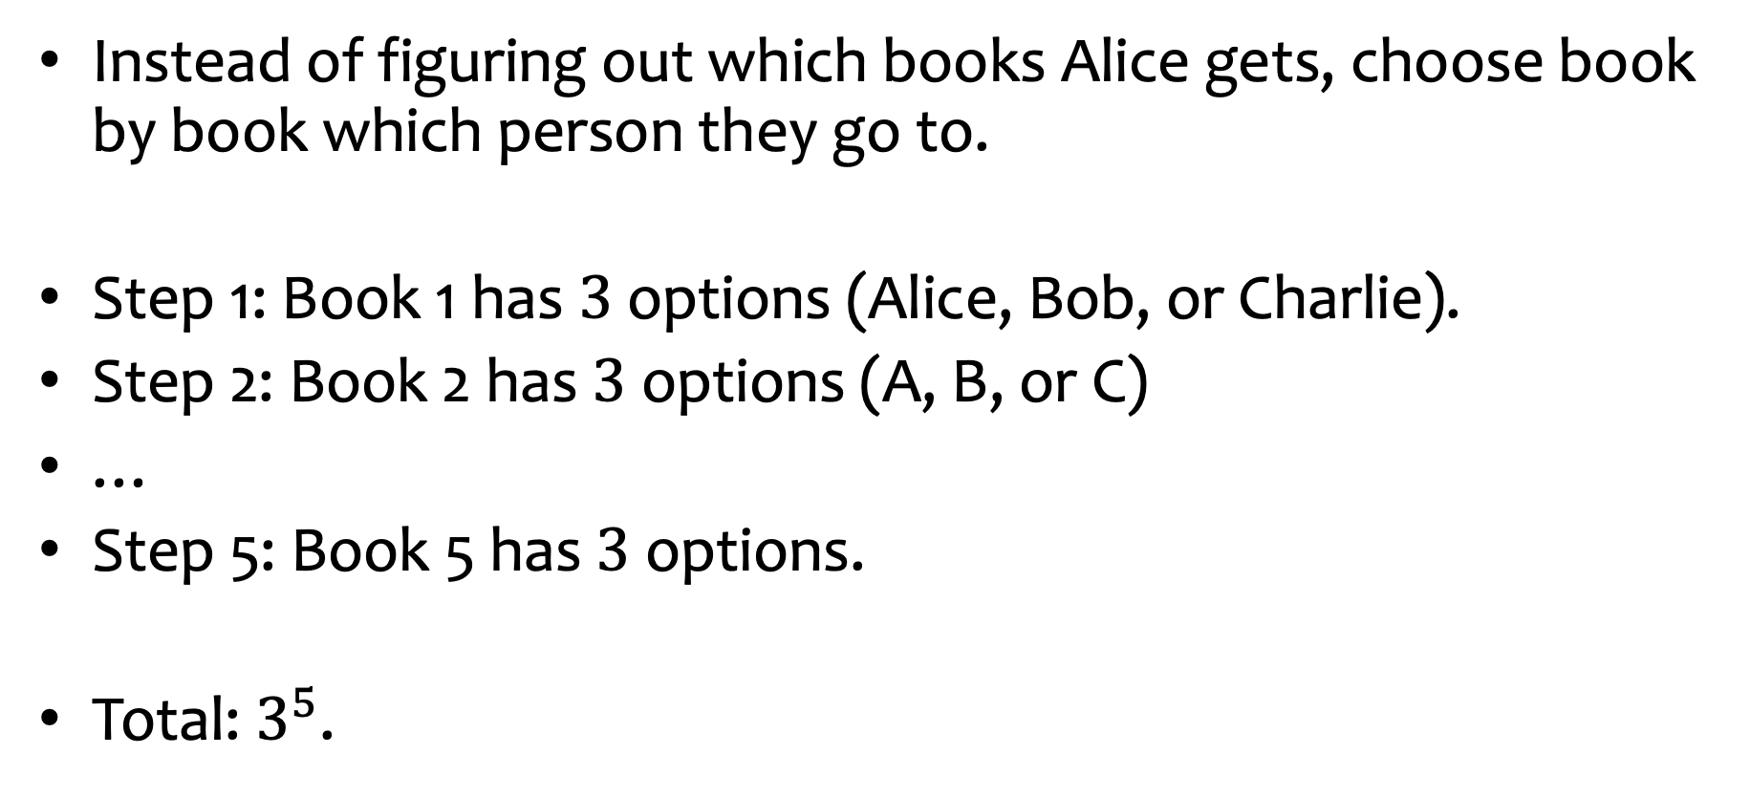
Assigning books – second try, in words.
Instead of figuring out which books Alice gets, choose book by book which person they go to.
Step 1: Book 1 has $3$ options (Alice, Bob, or Charlie).
Step 2: Book 2 has $3$ options (A, B, or C)
…
Step 5: Book 5 has $3$ options.
Total: $3^{5}$.

Slide 15
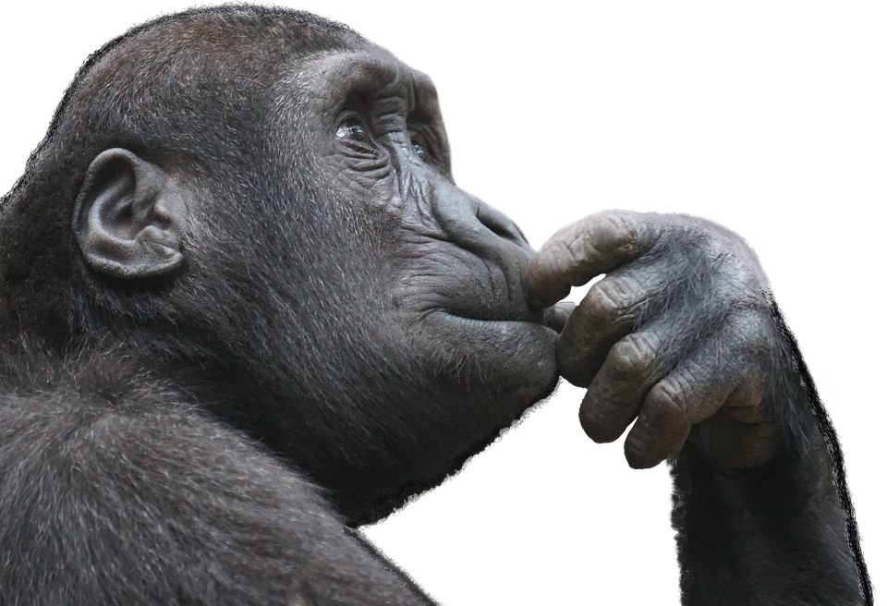
Lesson: Representation of what we are counting is very important!
Think about the various possible ways you could make a sequence of choices that leads to an outcome in the set of outcomes you are trying to count.
This Photo by Unknown Author is licensed under CC BY-NC
Notes:
We just saw that if we try to make the choices by deciding which books A gets, then which books B gets and so on, we can’t apply the product rule.
But if we make choice by deciding which person the red book gets assigned to, then which person the green book gets assigned to and so on, we can apply the product rule.

Slide 16

Counting Paths
How many ways are there to walk from 1st and Spring to 5th and Pine only travelling north or east?
Pine
Pike
Union
Spring
1st
2nd
3rd
4th
5th
E N N E N E E

Slide 17
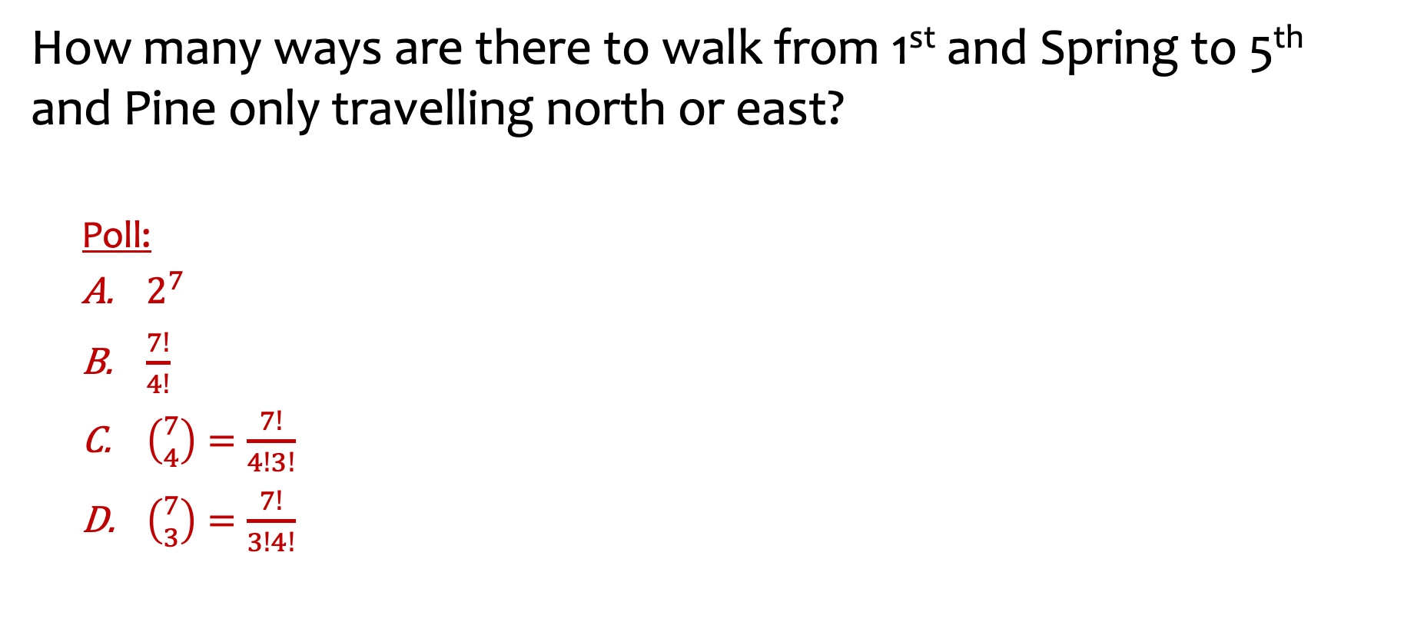
Counting Paths - possible answers?
PollEv.com/annakarlin185
How many ways are there to walk from 1st and Spring to 5th and Pine only travelling north or east?
Poll:
$2^{7}$
$\frac{7!}{4!}$
$\left({7 \atop 4}\right)=\frac{7!}{4!3!}$
$\left({7 \atop 3}\right)=\frac{7!}{3!4!}$
Pine
Pike
Union
Spring
1st
2nd
3rd
4th
5th
E N N E N E E
Notes:
Poll, 4 possible answers:
2 to the 7th
7!/4!
7 choose 4
7 choose 3

Slide 18

Counting Paths - answers?
PollEv.com/annakarlin185
How many ways are there to walk from 1st and Spring to 5th and Pine only travelling north or east?
Poll:
$2^{7}$
$\frac{7!}{4!}$
$\left({7 \atop 4}\right)=\frac{7!}{4!3!}$
$\left({7 \atop 3}\right)=\frac{7!}{3!4!}$
Pine
Pike
Union
$$✅$$
Spring
1st
2nd
3rd
4th
5th
$$✅$$
E N N E N E E
Notes:
Poll, 4 possible answers:
2 to the 7th
7!/4!
7 choose 4
7 choose 3

Slide 19


Symmetry in binomial coefficients
Fact. The number of subsets of size $k$ of a set of size $n$ is $C\left(n,k\right)=\left({n \atop k}\right)=\frac{n!}{k!\left(n−k\right)!}$
Fact: $\left({n \atop k}\right)=\left({n \atop n−k}\right)$
Notes:
Fact: n choose k is the same as n choose n-k

Slide 20

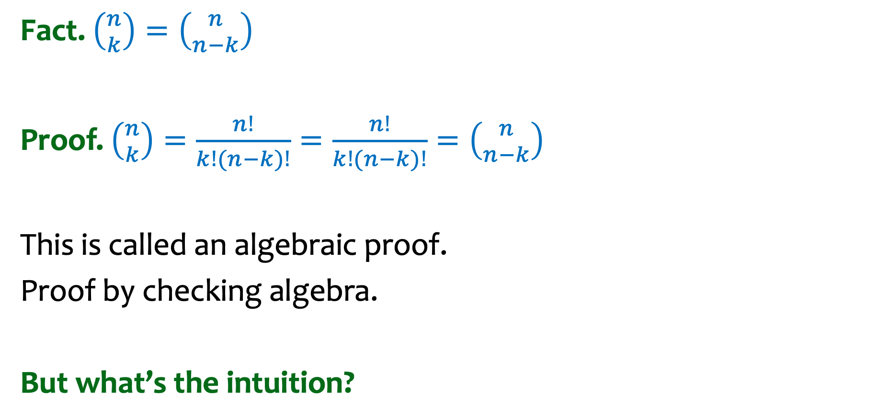
Symmetry in binomial coefficients – first proof
Fact. $\left({n \atop k}\right)=\left({n \atop n−k}\right)$
Proof. $\left({n \atop k}\right)=\frac{n!}{k!(n−k)!}=\frac{n!}{k!(n−k)!}=\left({n \atop n−k}\right)$
This is called an algebraic proof.
Proof by checking algebra.
But what’s the intuition?
Notes:
Fact: n choose k is the same as n choose n-k
Proof: plug in the definition of n choose k, plug in the definition of n choose n-k and observe algebraically that these are actually the same.

Slide 21
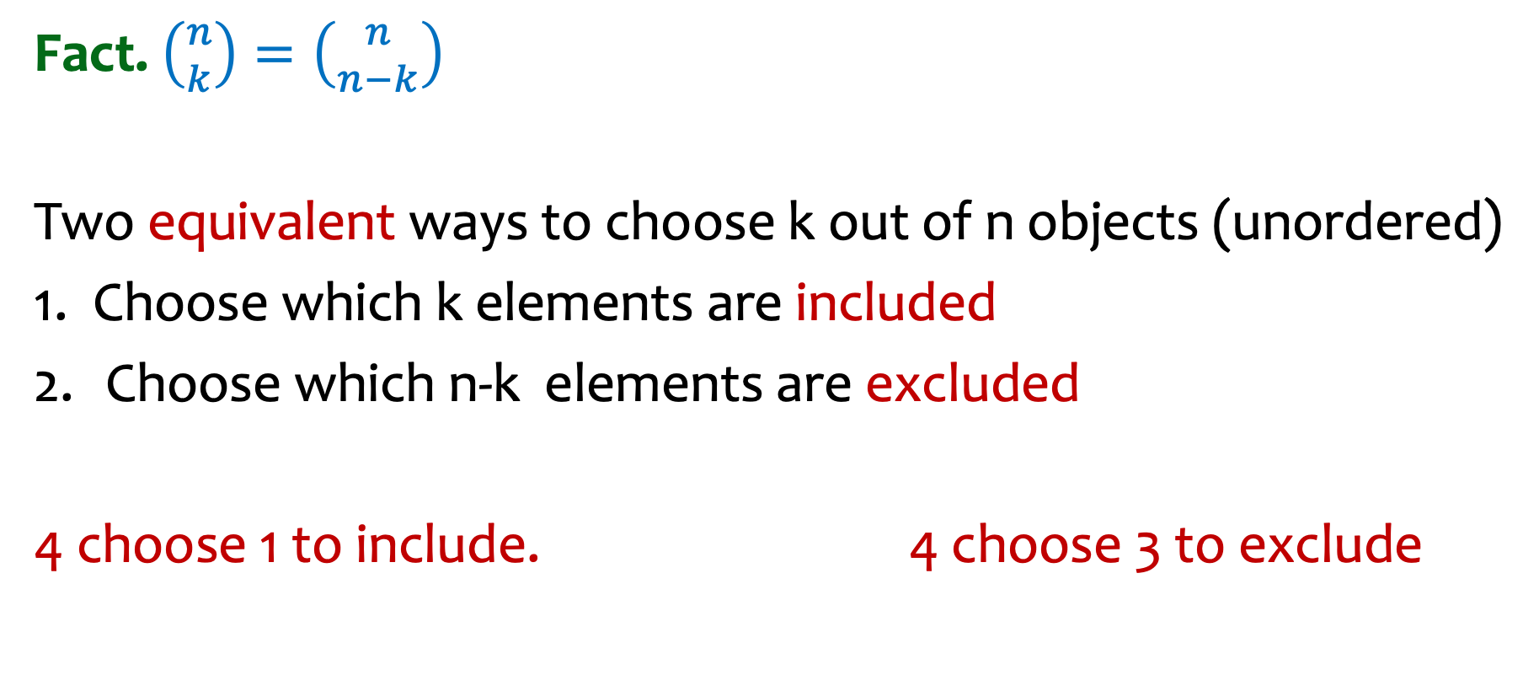
Symmetry in binomial coefficients – a more intuitive proof
Fact. $\left({n \atop k}\right)=\left({n \atop n−k}\right)$
Two equivalent ways to choose k out of n objects (unordered)
1. Choose which k elements are included
Choose which n-k elements are excluded
4 choose 1 to include. 4 choose 3 to exclude
Notes:
Fact: n choose k is the same as n choose n-k
Proof: plug in the definition of n choose k, plug in the definition of n choose n-k and observe that these are actually the same.

Slide 22
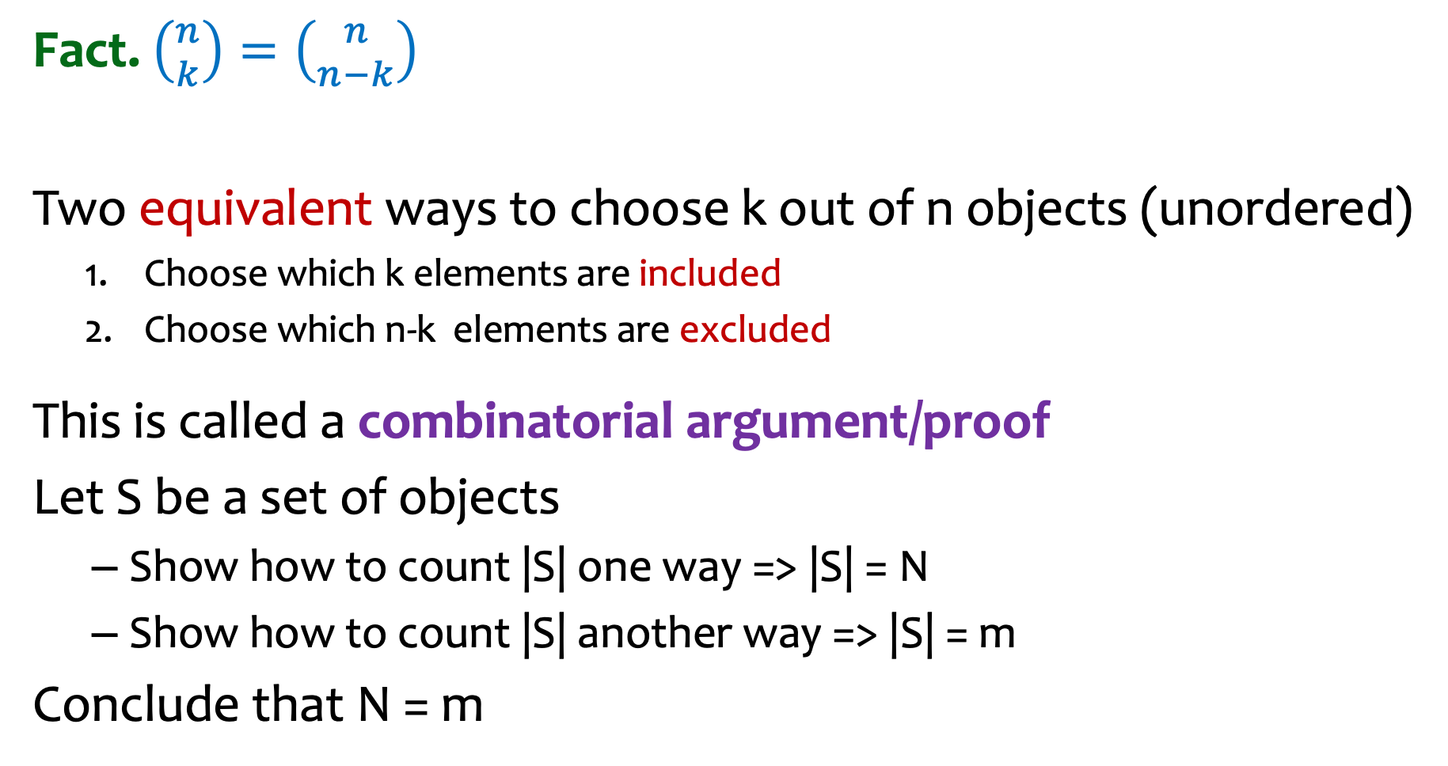
Symmetry in binomial coefficients – summary of combinatorial proof
Fact. $\left({n \atop k}\right)=\left({n \atop n−k}\right)$
Two equivalent ways to choose k out of n objects (unordered)
Choose which k elements are included
Choose which n-k elements are excluded
This is called a combinatorial argument/proof
Let S be a set of objects
Show how to count |S| one way => |S| = N
Show how to count |S| another way => |S| = m
Conclude that N = m
Notes:
More examples of combinatorial proofs coming soon!

Slide 23
Counting Paths – with stop at Starbucks
How many ways are there to walk from 1st and Spring to 5th and Pine only travelling north or east if you want to also stop at Starbucks on 3rd and Pike?
Pine
Pike
Union
Spring
1st
2nd
3rd
4th
5th

Slide 24
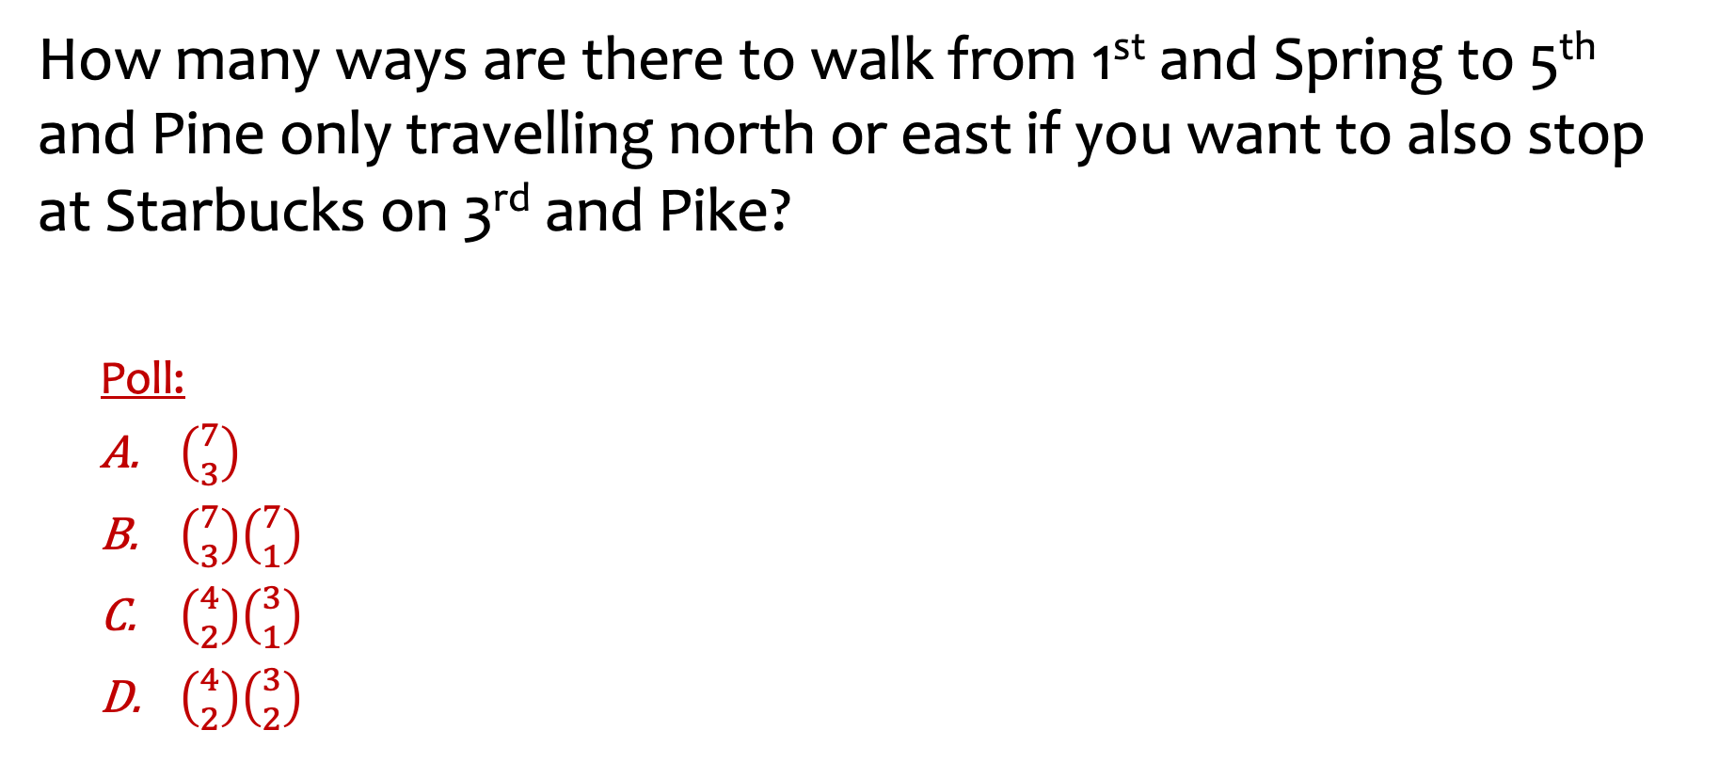
Counting Paths with stop at Starbucks -- possible answers
How many ways are there to walk from 1st and Spring to 5th and Pine only travelling north or east if you want to also stop at Starbucks on 3rd and Pike?
Poll:
$\left({7 \atop 3}\right)$
$\left({7 \atop 3}\right)\left({7 \atop 1}\right)$
$\left({4 \atop 2}\right)\left({3 \atop 1}\right)$
$\left({4 \atop 2}\right)\left({3 \atop 2}\right)$
Pine
Pike
Union
Spring
1st
2nd
3rd
4th
5th
PollEv.com/annakarlin185
Notes:
Checked reading order

Slide 25

Counting Paths with stop at Starbucks -- answers
How many ways are there to walk from 1st and Spring to 5th and Pine only travelling north or east if you want to also stop at Starbucks on 3rd and Pike?
Poll:
$\left({7 \atop 3}\right)$
$\left({7 \atop 3}\right)\left({7 \atop 1}\right)$
$\left({4 \atop 2}\right)\left({3 \atop 1}\right)$
$\left({4 \atop 2}\right)\left({3 \atop 2}\right)$
Pine
Pike
Union
Spring
$$✅$$
1st
2nd
3rd
4th
5th
$$✅$$
Notes:
Checked reading order

Slide 26
Agenda (part 2)
Recap & Examples
Binomial Theorem
Multinomial Coefficients
Inclusion-Exclusion
Combinatorial Proofs

Slide 27
Binomial Theorem: Idea
(x + y)² = (x+y)(x+y)
= xx +xy + yx + yy
= x² + 2xy + y²
(x+y)⁴= (x+y)(x+y)(x+y)(x+y)
= xxxx +yyyy+ xyxy +yxyy + …

Slide 28

Binomial Theorem: Let’s figure out one coefficient
(x+y)⁴= (x+y)(x+y)(x+y)(x+y)
= xxxx +yyyy+ xyxy +yxyy + …
What is the coefficient of xy³?
$4$
$\left({4 \atop 1}\right)$
$\left({4 \atop 3}\right)$
$3$
PollEv.com/annakarlin185
Notes:
All of A, B, C

Slide 29
Binomial Theorem: Another example coefficient
(x+y)^{n}= (x+y)(x+y)(x+y)….(x+y)
Each term is of the form x^{k}y^{n-k}, since each term is is made by multiplying exactly n variables, either x or y.
How many times do we get x^{k}y^{n-k} ?

Slide 30
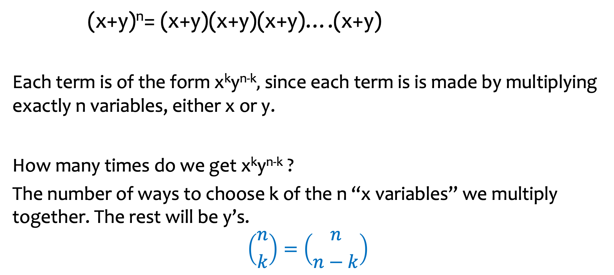
Binomial Theorem: coefficients of C(n,k)
(x+y)^{n}= (x+y)(x+y)(x+y)….(x+y)
Each term is of the form x^{k}y^{n-k}, since each term is is made by multiplying exactly n variables, either x or y.
How many times do we get x^{k}y^{n-k} ?
The number of ways to choose k of the n “x variables” we multiply together. The rest will be y’s.
$$\left({n \atop k}\right)=\left({n \atop n−k}\right)$$
Notes:
The number of times we get x to the k, y to the n-k is equal to n choose k (or equivalently n choose n-k)

Slide 31
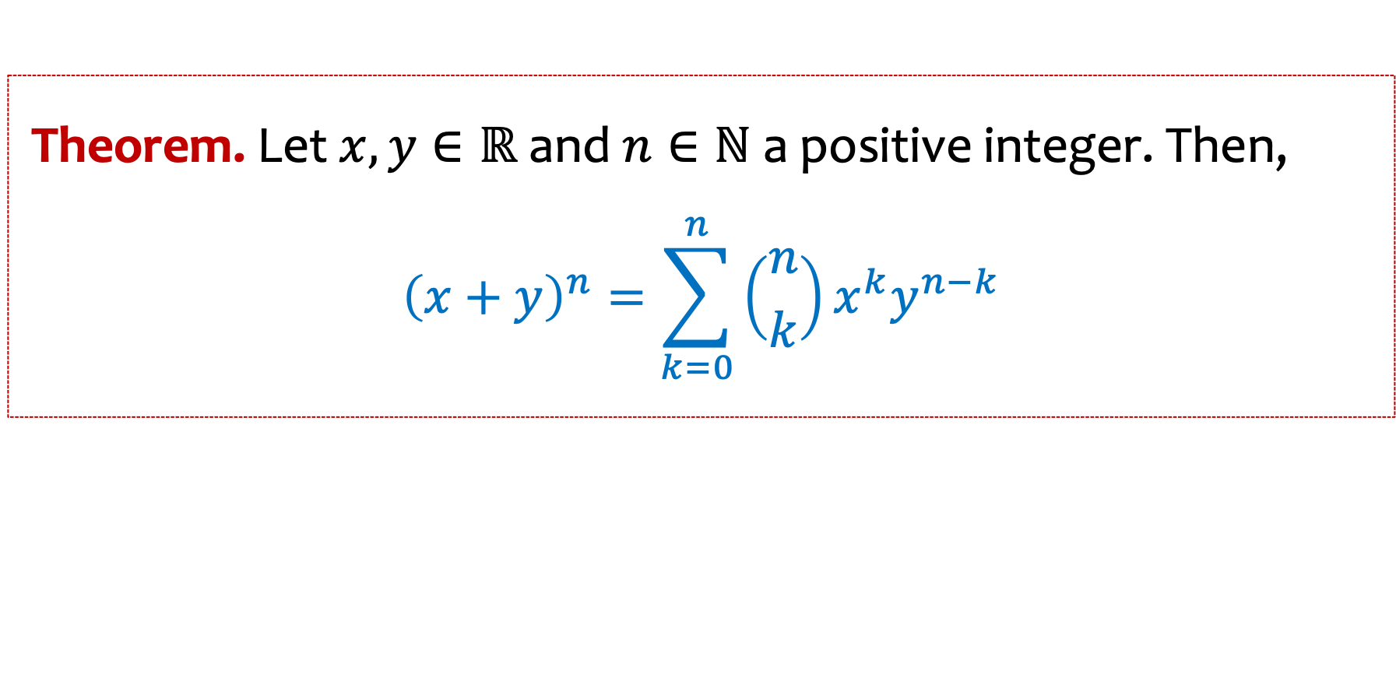
Binomial Theorem
Theorem. Let $x, y∈ℝ$and $n∈ℕ$ a positive integer. Then,
$${\left(x+y\right)}^{n}=\sum_{k=0}^{n}{\left({n \atop k}\right)x^{k}y^{n−k}}$$
Notes:
Theorem:
Let x and y be real numbers and n a positive integer. Then (x+y) to the power n is equal to the sum from k=0 to n of n choose k times x to the k times y to the n-k.

Slide 32
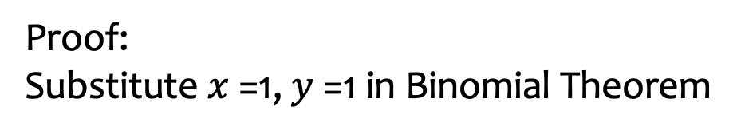
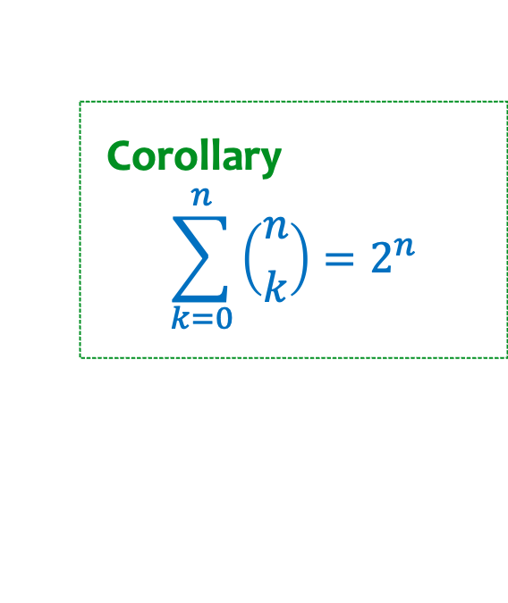
Binomial Theorem – a corollary
Theorem. Let $x, y∈ℝ$and $n∈ℕ$ a positive integer. Then,
$${\left(x+y\right)}^{n}=\sum_{k=0}^{n}{\left({n \atop k}\right)x^{k}y^{n−k}}$$
Corollary
$$\sum_{k=0}^{n}{\left({n \atop k}\right)=2^{n}}$$
Proof:
Substitute $x$ =1, $y$ =1 in Binomial Theorem
Notes:
Corollary: the sum from k = 0 to n of n choose k is exactly equal to 2 to the n.
To prove this just substitute x=1, y=1.

Slide 33
Agenda (part 3)
Recap & Examples
Binomial Theorem
Multinomial Coefficients
Inclusion-Exclusion
Combinatorial Proofs

Slide 34

Permutations of word MATH
How many ways to rearrange the letters in the word ”MATH”?
Poll:
$\left({26 \atop 4}\right)$
$4^{4}$
$4!$
I don’t know
PollEv.com/annakarlin185
Notes:
A. 26 choose 4
B. 4 to the 4
C. 4 factorial
D. I don’t know

Slide 35

Permutations of word MATH (answer)
How many ways to rearrange the letters in the word ”MATH”?
Poll:
$\left({26 \atop 4}\right)$
$4^{4}$
$4!$
I don’t know
$$✅$$
Notes:
A. 26 choose 4
B. 4 to the 4
C. 4 factorial
D. I don’t know

Slide 36
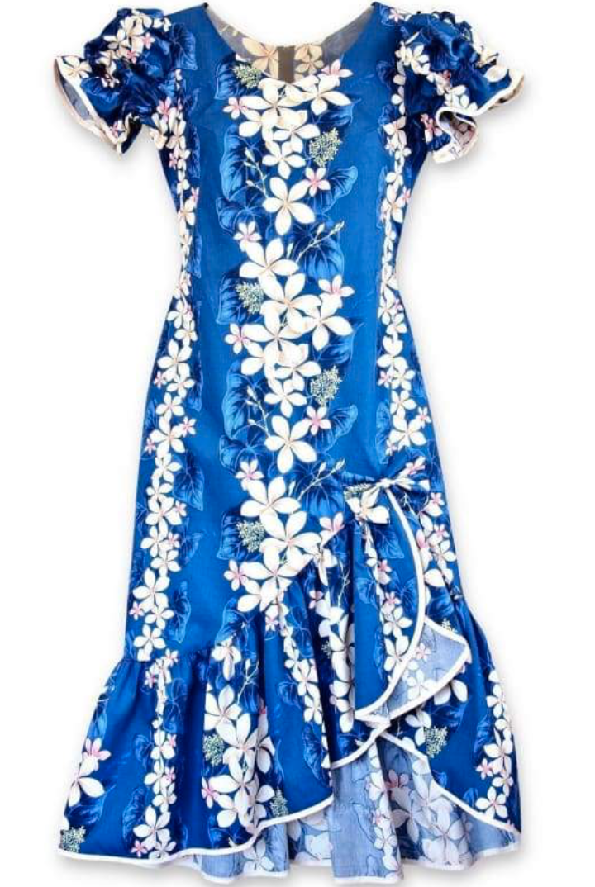
Permutations of word MUUMUU
How many ways to rearrange the letters in the word ”MUUMUU”?

Slide 37
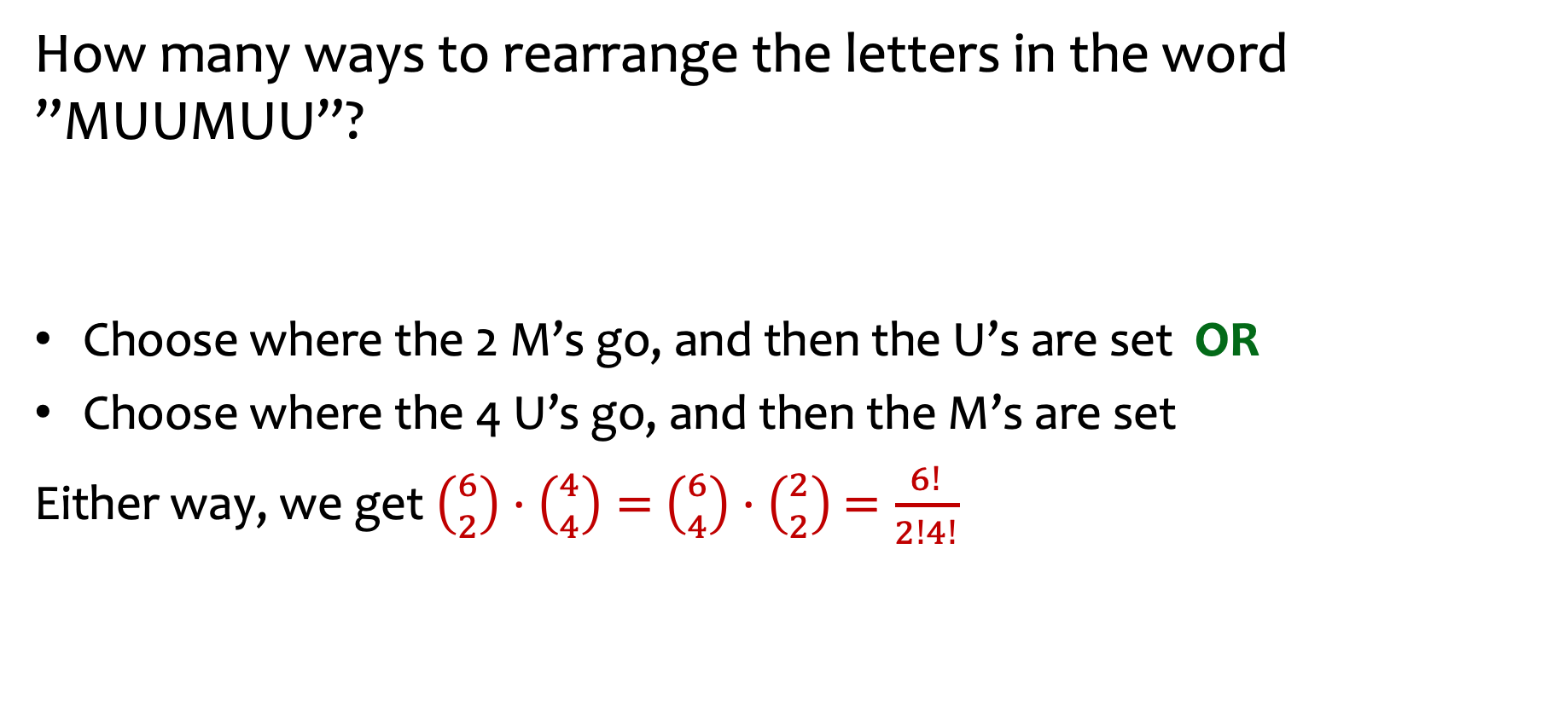
Example 2 – Word Permutations
How many ways to rearrange the letters in the word ”MUUMUU”?
Choose where the 2 M’s go, and then the U’s are set OR
Choose where the 4 U’s go, and then the M’s are set
Either way, we get $\left({6 \atop 2}\right)⋅\left({4 \atop 4}\right)=$ $\left({6 \atop 4}\right)⋅\left({2 \atop 2}\right)$ $=\frac{6!}{2!4!}$
Notes:
Choose where the 2 M’s go, and then the U’s are set . This gives 6 choose 2 times 4 choose 4,
Choose where the 4 U’s go, and then the M’s are set This gives 6 choose 4 times 2 choose 2.

Slide 38
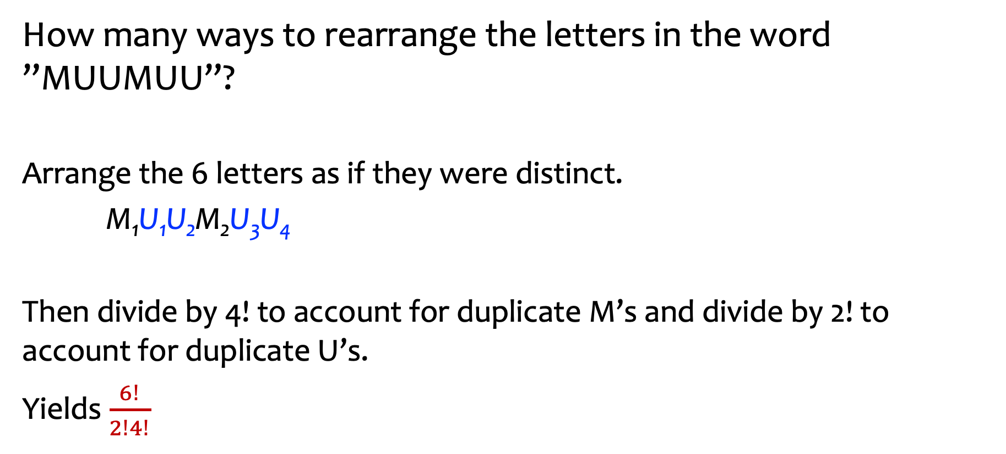
Example 2 – Word Permutations (another way to count)
How many ways to rearrange the letters in the word ”MUUMUU”?
Arrange the 6 letters as if they were distinct.
M₁U₁U₂M₂U₃U₄
Then divide by 4! to account for duplicate M’s and divide by 2! to account for duplicate U’s.
Yields $\frac{6!}{2!4!}$
Notes:
Final answer is 6 factorial divided by 2 factorial divided by 4 factorial.

Slide 39


Example 3 – Word Permutations
How many ways to rearrange the letters in the word ”GODOGGY”?
Poll:
$7!$
$\frac{7!}{3!}$
$\frac{7!}{3!2!1!1!}$
$\left({7 \atop 3}\right)⋅\left({4 \atop 2}\right)⋅2$!
PollEv.com/annakarlin185
Notes:
7 factorial
7 factorial divided by 3 factorial
7 factorial divided by 3 factorial divided by 2 factorial divided by 1 factorial divided by 1 factorial
7 choose 3 times 4 choose 2 times 2 factorial

Slide 40


Example 3 – Word Permutations (answer)
How many ways to rearrange the letters in the word ”GODOGGY”?
(3 G’s, 2 O’s, 1 D, 1 Y)
Poll:
$7!$
$\frac{7!}{3!}$
$\frac{7!}{3!2!1!1!}$
$\left({7 \atop 3}\right)⋅\left({4 \atop 2}\right)⋅2$!
$$✅$$
$$✅$$
Notes:
7 factorial
7 factorial divided by 3 factorial
7 factorial divided by 3 factorial divided by 2 factorial divided by 1 factorial divided by 1 factorial
7 choose 3 times 4 choose 2 times 2 factorial
Checked reading order

Slide 41
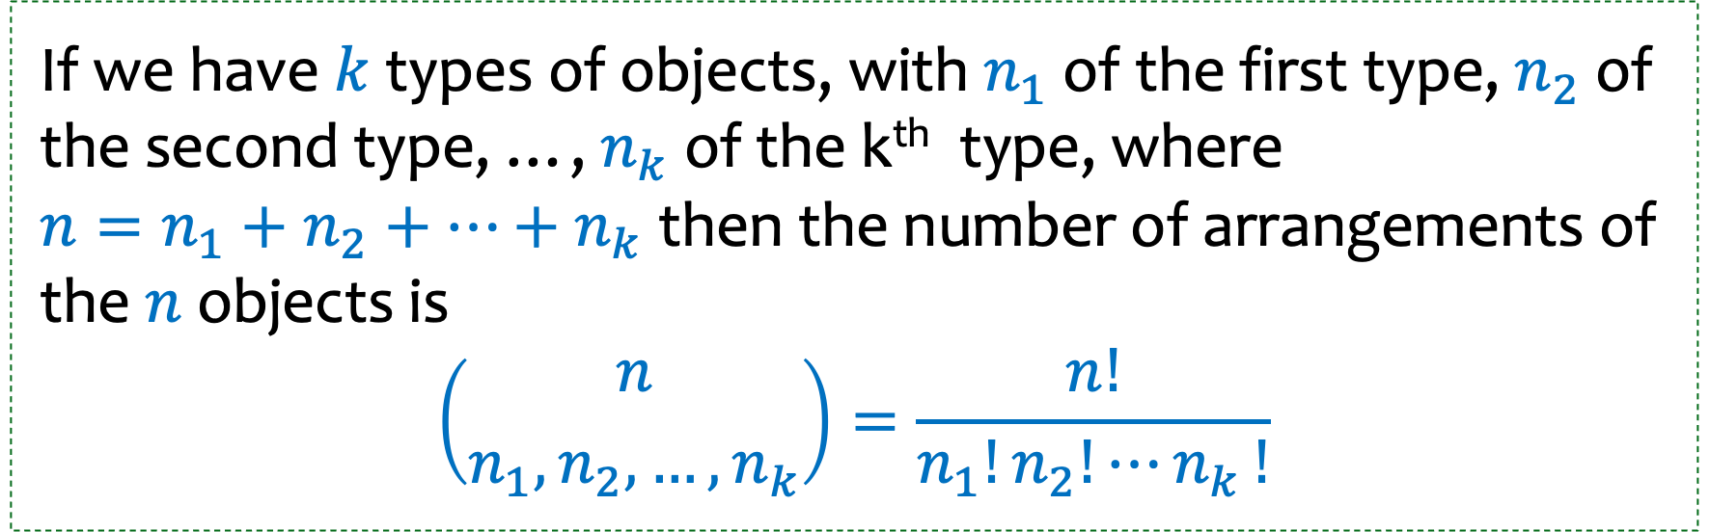
Multinomial coefficients
If we have $k$ types of objects, with $n_{1}$of the first type, $n_{2}$of the second type, …, $n_{k}$of the k^{th} type, where ${n=n_{1}+n_{2}+…+n}_{k}$ then the number of arrangements of the $n$objects is
$$\left({n \atop n_{1}, n_{2},…,n_{k}}\right)=\frac{n!}{n_{1}!n_{2}!{⋯n}_{k}!}$$
Note that objects of the same type are indistinguishable.
Notes:
If we k types of objects with n1 of the first type, n2 of the second type,…, nk of the k-th type, where n = n1 + n2+ … + nk, then the number of arrangments of the n objects is n factorial divided by the product of n1 factorial, n2 factorial,…, nk factorial.

Slide 42
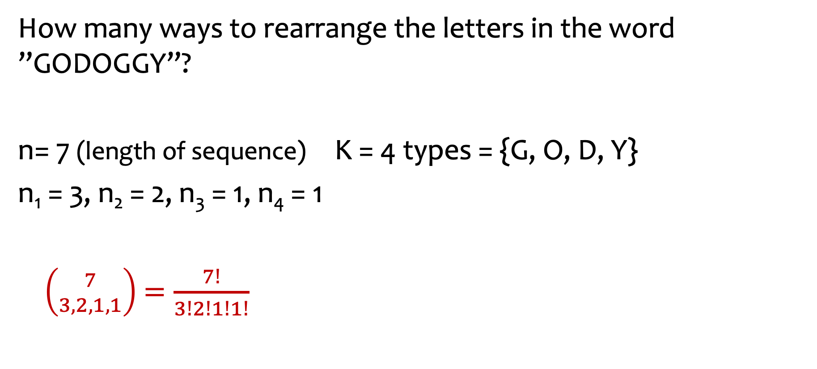
Example 3 – Word Permutations (apply multinomial coefficients)
How many ways to rearrange the letters in the word ”GODOGGY”?
n= 7 (length of sequence) K = 4 types = {G, O, D, Y}
n₁ = 3, n₂ = 2, n₃ = 1, n₄ = 1
$\left({7 \atop 3,2,1,1}\right)$ $=\frac{7!}{3!2!1!1!}$
Notes:
7 choose 3,2,1,1. = 7 factorial divided by 3 factorial divided by 2 factorial divided by 1 factorial divided by 1 factorial.

Slide 43
Agenda (part 4)
Recap & Examples
Binomial Theorem
Multinomial Coefficients
Inclusion-Exclusion
Combinatorial Proofs

Slide 44
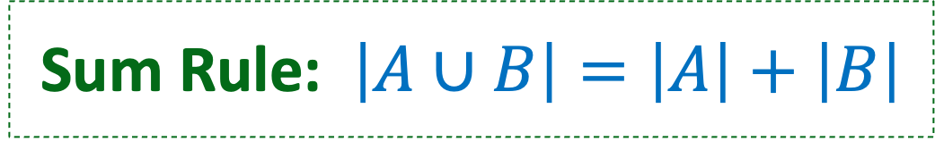


Recap Disjoint Sets
Sets that do not contain common elements ($A∩B= ∅$)
$$B$$
$$A$$
Sum Rule: $\left|A∪B\right|=\left|A\right|+\left|B\right|$
Notes:
Disjoint sets are sets that have no common elements, that is A intersect B is the empty set.
Sum Rule: if A and B are disjoint sets, then the size of their union is the sum of their sizes.

Slide 45

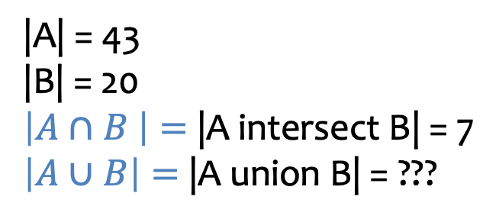
Inclusion-Exclusion
But what if the sets are not disjoint?
$$B$$
|A| = 43
|B| = 20
$\left|A∩B \right|=$|A intersect B| = 7
$\left|A∪B\right|=$|A union B| = ???
$$A$$
🍩
🍦
Fact. $\left|A∪B\right|=\left|A\right|+\left|B\right|−|A∩B|$

Slide 46
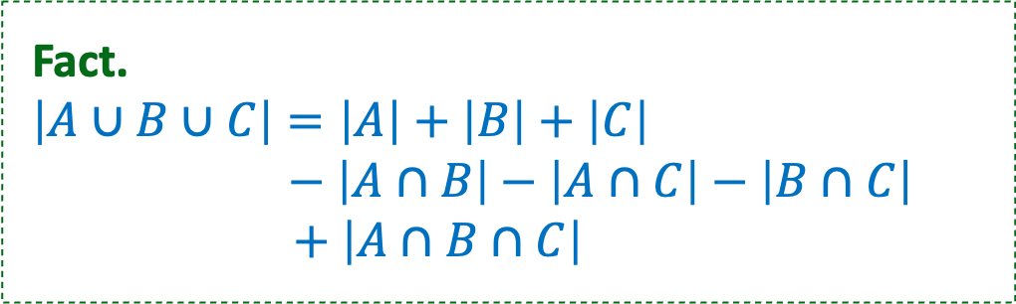

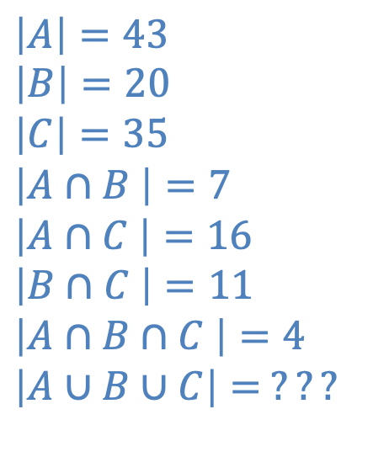
Inclusion-Exclusion (3 sets)
Not drawn to scale
$$\left|A\right|=43$$
$$\left|B\right|=20 \\ \left|C\right|=35$$
$$\left|A∩B \right|=7$$
$$\left|A∩C \right|=16$$
$\left|B∩C \right|=11$
$$\left|A∩B∩C \right|=4$$
$$\left|A∪B∪C\right|= ???$$
What if there are three sets?
$$B$$
$$A$$
🍩
🍦
$$C$$
🥮
Fact.
$$\left|A∪B∪C\right|=\left|A\right|+\left|B\right|+\left|C\right|$$ $− \left|A∩B\right|$ $− \left|A∩C\right|−\left|B∩C\right|$ $$+ \left|A∩B∩C\right|$$
Notes:
Fact
|union of A, B, C | = |A| + |B|+|C| - |A intersect B| - |A intersect C| - |B intersect C| + |the intersection of all of A, B, C|

Slide 47
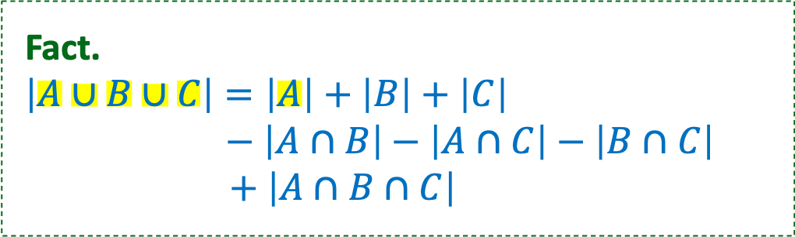
Inclusion-Exclusion (3 sets) – example 1
$$\left|A\right|=43$$
$$\left|B\right|=20 \\ \left|C\right|=35$$
$$\left|A∩B \right|=7$$
$$\left|A∩C \right|=16$$
$\left|B∩C \right|=11$
$$\left|A∩B∩C \right|=4$$
$$\left|A∪B∪C\right|= ???$$
What if there are three sets?
$$B$$
$$A$$
🍩
🍦
$$C$$
🥮
Fact.
$$\left|A∪B∪C\right|=\left|A\right|+\left|B\right|+\left|C\right|$$ $− \left|A∩B\right|$ $− \left|A∩C\right|−\left|B∩C\right|$ $$+ \left|A∩B∩C\right|$$
Notes:
Fact
|union of A, B, C | = |A| + |B|+|C| - |A intersect B| - |A intersect C| - |B intersect C| + |the intersection of all of A, B, C|

Slide 48
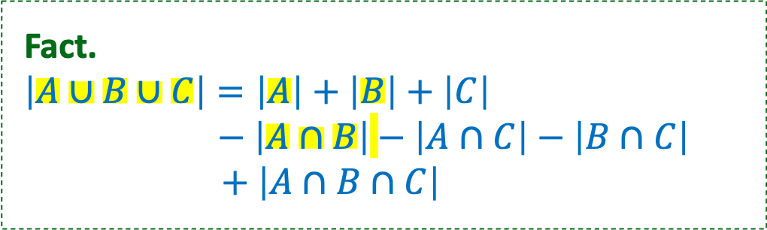
Inclusion-Exclusion (3 sets) – example 2
$$\left|A\right|=43$$
$$\left|B\right|=20 \\ \left|C\right|=35$$
$$\left|A∩B \right|=7$$
$$\left|A∩C \right|=16$$
$\left|B∩C \right|=11$
$$\left|A∩B∩C \right|=4$$
$$\left|A∪B∪C\right|= ???$$
What if there are three sets?
$$B$$
$$A$$
🍩
🍦
$$C$$
🥮
Fact.
$$\left|A∪B∪C\right|=\left|A\right|+\left|B\right|+\left|C\right|$$ $− \left|A∩B\right|$ $− \left|A∩C\right|−\left|B∩C\right|$ $$+ \left|A∩B∩C\right|$$
Notes:
Fact
|union of A, B, C | = |A| + |B|+|C| - |A intersect B| - |A intersect C| - |B intersect C| + |the intersection of all of A, B, C|

Slide 49
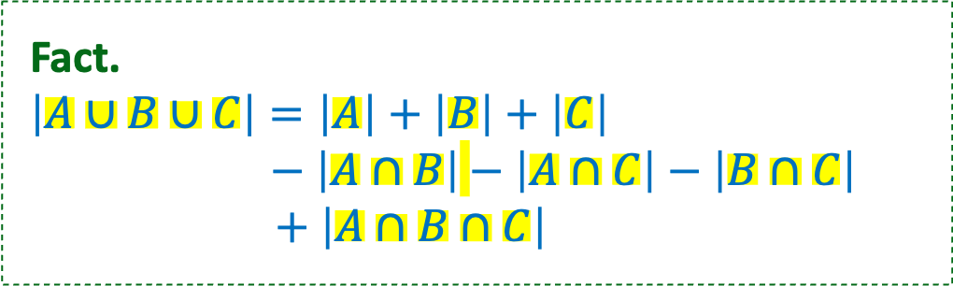
Inclusion-Exclusion (3 sets) – example 3
$$\left|A\right|=43$$
$$\left|B\right|=20 \\ \left|C\right|=35$$
$$\left|A∩B \right|=7$$
$$\left|A∩C \right|=16$$
$\left|B∩C \right|=11$
$$\left|A∩B∩C \right|=4$$
$$\left|A∪B∪C\right|= ???$$
What if there are three sets?
$$B$$
$$A$$
🍩
🍦
$$C$$
🥮
Fact.
$$\left|A∪B∪C\right|=\left|A\right|+\left|B\right|+\left|C\right|$$ $− \left|A∩B\right|$ $− \left|A∩C\right|−\left|B∩C\right|$ $$+ \left|A∩B∩C\right|$$
Notes:
Fact
|union of A, B, C | = |A| + |B|+|C| - |A intersect B| - |A intersect C| - |B intersect C| + |the intersection of all of A, B, C|

Slide 50
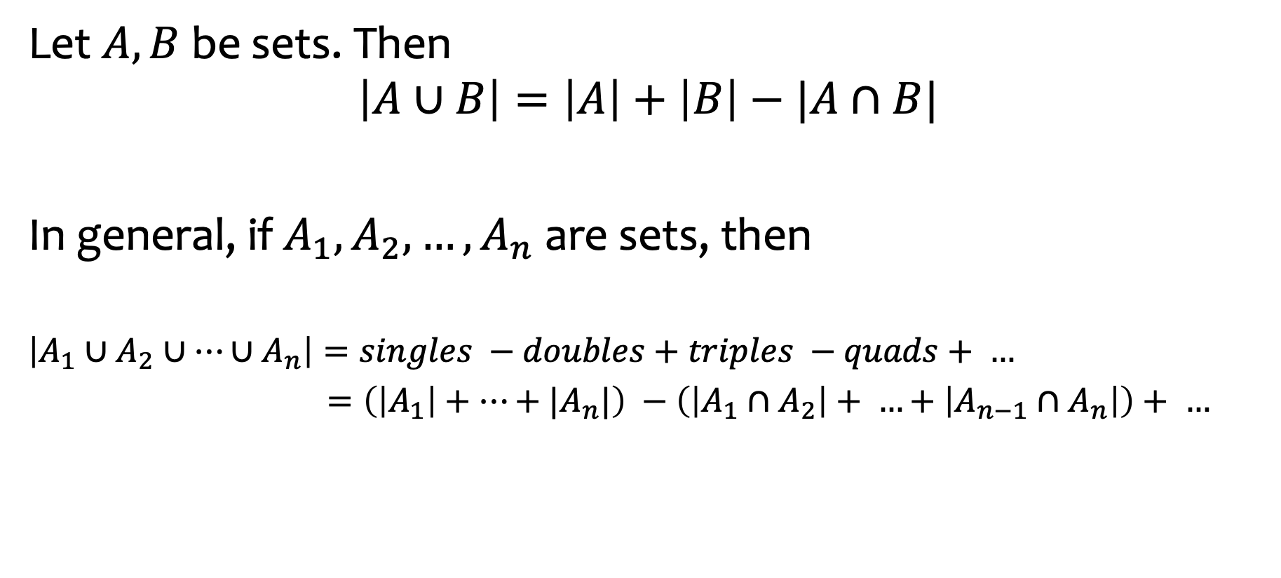
Inclusion-Exclusion (formulae)
Let $A, B$ be sets. Then
$$\left|A∪B\right|=\left|A\right|+\left|B\right|−|A∩B|$$
In general, if $A_{1}, A_{2},…, A_{n}$ are sets, then
$$\left|A_{1}∪A_{2}∪…∪A_{n}\right|=singles −doubles+triples −quads+ …$$
$=\left(\left|A_{1}\right|+…+|A_{n}|\right) −\left(\left|A_{1}∩A_{2}\right|+ …+\left|A_{n−1}∩A_{n}\right|\right)+ …$
Notes:
The size of the union of n sets = sum of sizes of individual sets – sum of sizes of pairwise intersections + sum of sizes of three way intersections - ….

Slide 51
Agenda (Part 5)
Recap & Examples
Binomial Theorem
Multinomial Coefficients
Inclusion-Exclusion
Combinatorial Proofs

Slide 52
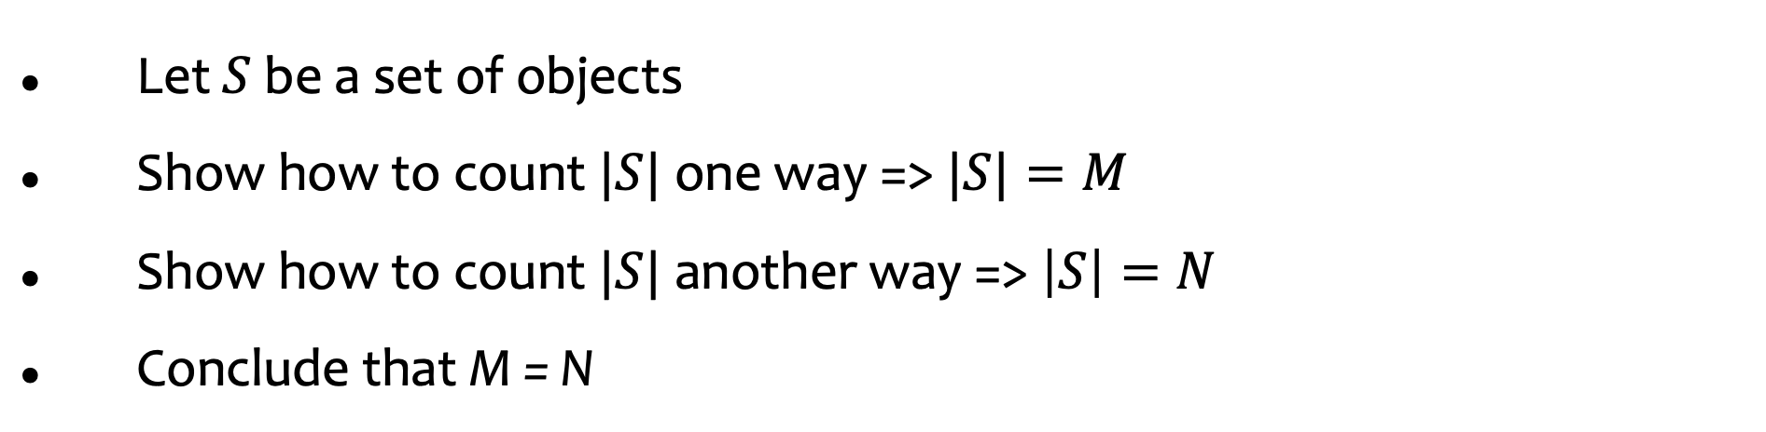
Combinatorial proof: Show that M = N
Let $S$ be a set of objects
Show how to count $|S|$one way => $|S|=M$
Show how to count $|S|$another way => $\left|S\right|=N$
Conclude that M = N
Notes:
But the number of ways to choose n-k that are excluded = number of ways to choose n-k that are included (just swap what you call included and excluded.

Slide 53

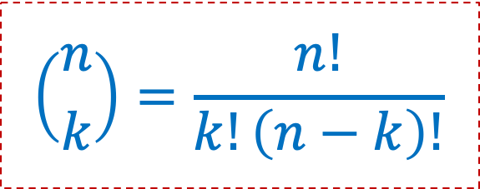
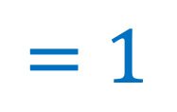
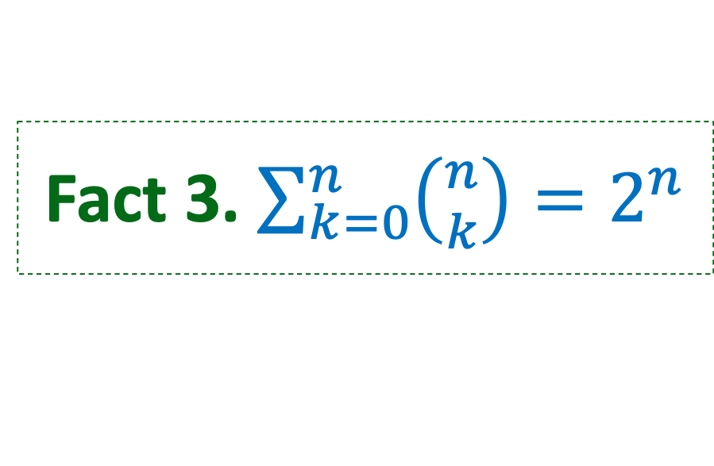
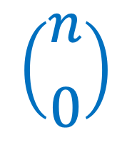
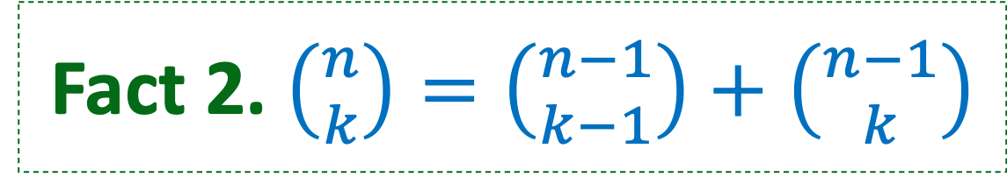

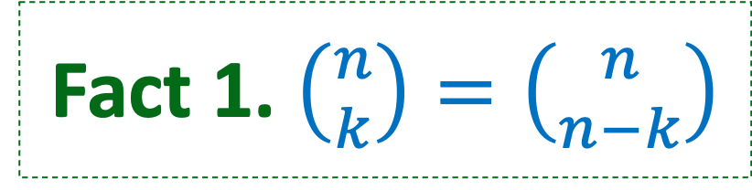

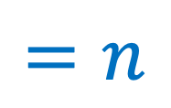
Binomial Coefficient – Many interesting and useful properties
$$\left({n \atop k}\right)=\frac{n!}{k!\left(n−k\right)!}$$
$$\left({n \atop n}\right)$$
$$\left({n \atop 1}\right)$$
$$\left({n \atop 0}\right)$$
$$=1$$
$$=n$$
$$=1$$
Fact 1. $\left({n \atop k}\right)=\left({n \atop n−k}\right)$
Symmetry in Binomial Coefficients
Fact 2. $\left({n \atop k}\right)=\left({n−1 \atop k−1}\right)+\left({n−1 \atop k}\right)$
Pascal’s Identity
Fact 3. $\sum_{k=0}^{n}{\left({n \atop k}\right)}=2^{n}$
Follows from Binomial theorem
Notes:
Many of these can be proved using combinatorial arguments

Slide 54
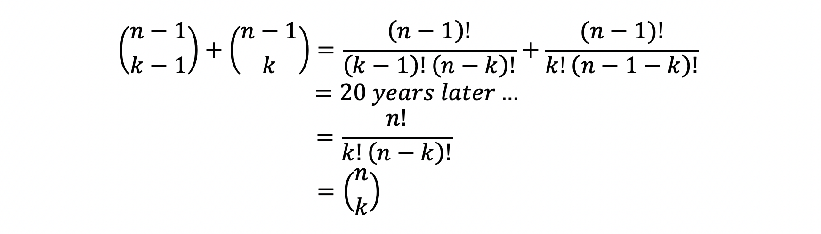

Pascal’s Identities (Fact 2)
Fact. $\left({n \atop k}\right)=\left({n−1 \atop k−1}\right)+\left({n−1 \atop k}\right)$
How to prove Pascal’s identity?
Algebraic argument:
Hard work and not intuitive
Let’s see a combinatorial argument

Slide 55










Fact 2 – Binomial Identity
Fact. $\left({n \atop k}\right)=\left({n−1 \atop k−1}\right)+\left({n−1 \atop k}\right)$
$$B$$
$$A$$
|S|
$$=$$
$$|A|$$
$$+$$
$$|B|$$
$S=A∪B,$disjoint
S: the set of size k subsets of [n] = {1, 2,., n} ➔ |S| = $\left({n \atop k}\right)$
A: the set of size k subsets of [n] that contain n.
Sum rule:
$\left|A∪B\right|=\left|A\right|+\left|B\right|$
B: the set of size k subsets of [n] that do NOT contain n.
Notes:
Another way to count the number of subsets of size k. Split it into two disjoint sets. Show how to count each of those subsets. Then apply the sum rule

Slide 56


Fact 2 – Binomial Identity - example
Fact. $\left({n \atop k}\right)=\left({n−1 \atop k−1}\right)+\left({n−1 \atop k}\right)$
$$B$$
$$A$$
|S|
$$=$$
$$|A|$$
$$+$$
$$|B|$$
$S=A∪B,$disjoint
S: the set of size k subsets of [n] = {1, 2,., n} ➔ |S| = $\left({n \atop k}\right)$
e.g.: $n=4,k=2, S=\{\left\{1,2\right\},\left\{1,3\right\},\left\{1,4\right\},\left\{2,3\right\},\left\{2,4\right\},\left\{3,4\right\}\}$
A: the set of size k subsets of [n] that contain n.
$$A=\left\{\left\{1,4\right\},\left\{2,4\right\}, \left\{3,4\right\}\right\}. n=4$$
B: the set of size k subsets of [n] that do NOT contain n.
$$B=\{\left\{1,2\right\},\left\{1,3\right\}, \left\{2,3\right\}\}$$

Slide 57

Fact 2 – Binomial Identity - proof
Fact. $\left({n \atop k}\right)=\left({n−1 \atop k−1}\right)+\left({n−1 \atop k}\right)$
$$B$$
$$A$$
|S|
$$=$$
$$|A|$$
$$+$$
$$|B|$$
$S=A∪B,$disjoint
S: the set of size k subsets of [n] = {1, 2,., n} ➔ |S| = $\left({n \atop k}\right)$
A: the set of size k subsets of [n] that contain n.
Sum rule:
$\left|A∪B\right|=\left|A\right|+\left|B\right|$
B: the set of size k subsets of [n] that do NOT contain n.

Slide 58



Fact 2 – Binomial Identity – combinatorial proof
$$B$$
Fact. $\left({n \atop k}\right)=\left({n−1 \atop k−1}\right)+\left({n−1 \atop k}\right)$
$$A$$
|S|
$$=$$
$$|A|$$
$$+$$
$$|B|$$
$S=A∪B,$disjoint
S: the set of size k subsets of [n] = {1, 2,., n} ➔ |S| = $\left({n \atop k}\right)$
How many?
A: the set of size k subsets of [n] that contain n.
B: the set of size k subsets of [n] that do NOT contain n.

Slide 59

Fact 2 – Binomial Identity – combinatorial proof
$$B$$
Fact. $\left({n \atop k}\right)=\left({n−1 \atop k−1}\right)+\left({n−1 \atop k}\right)$
$$A$$
|S|
$$=$$
$$|A|$$
$$+$$
$$|B|$$
$S=A∪B,$disjoint
$n$ is in set, need to choose $k−1$ elements from $[n−1]$
$$\left|A\right|=\left({n−1 \atop k−1}\right)$$
S: the set of size k subsets of [n] = {1, 2,., n} ➔ |S| = $\left({n \atop k}\right)$
A: the set of size k subsets of [n] that contain n.
B: the set of size k subsets of [n] that do NOT contain n.

Slide 60
Fact 2 – Binomial Identity – combinatorial proof…
$$B$$
Fact. $\left({n \atop k}\right)=\left({n−1 \atop k−1}\right)+\left({n−1 \atop k}\right)$
$$A$$
|S|
$$=$$
$$|A|$$
$$+$$
$$|B|$$
$S=A∪B,$disjoint
$n$ is in set, need to choose $k−1$ elements from $[n−1]$
$$\left|A\right|=\left({n−1 \atop k−1}\right)$$
S: the set of size k subsets of [n] = {1, 2,., n} ➔ |S| = $\left({n \atop k}\right)$
A: the set of size k subsets of [n] that contain n.
B: the set of size k subsets of [n] that do NOT contain n.
How many?

Slide 61

Fact 2 – Binomial Identity – sizes of subsets
$$B$$
Fact. $\left({n \atop k}\right)=\left({n−1 \atop k−1}\right)+\left({n−1 \atop k}\right)$
$$A$$
|S|
$$=$$
$$|A|$$
$$+$$
$$|B|$$
$S=A∪B,$disjoint
$n$ is in set, need to choose $k−1$ elements from $[n−1]$
$$\left|A\right|=\left({n−1 \atop k−1}\right)$$
S: the set of size k subsets of [n] = {1, 2,., n} ➔ |S| = $\left({n \atop k}\right)$
A: the set of size k subsets of [n] that contain n.
$n$ not in set, need to choose $k$ elements from $[n−1]$
$$\left|B\right|=\left({n−1 \atop k}\right)$$
B: the set of size k subsets of [n] that do NOT contain n.

Slide 62









Pascal’s triangle
$$\left({n \atop k}\right)=\left({n−1 \atop k−1}\right)+\left({n−1 \atop k}\right)$$
$n$=0
$n$=1
$n$=2
$n$=3
$n$=4
$n$=5
Notes:
Pascal’s triangle which you may have seen illustrates this identity for all the binomial coeffients.
Row gives you the value of n. As you move across the row, k goes from 0 to n

Slide 63


Summary: combinatorial vs algebraic arguments
combinatorial argument/proof
Elegant
Simple
Intuitive
Algebraic argument
Brute force
Less Intuitive
This Photo by Unknown Author is licensed under CC BY-SA
This Photo by Unknown Author is licensed under CC BY-SA

