Slide 1
Joint Distributions
CSE 312 Spring 26
Lecture 19

Slide 2
Announcements
The midterm exam will be on Thursday May 14th starting at 6 PM. We will be split between two classrooms.
Bagley 131 - if your last name starts with the letters A-P
John 102 - if your last name starts with the letters Q-Z
You must bring a photo ID with you to the exam.
Aim to be there by 5:50pm
More info on webpage about exams
Wednesday in class - review

Slide 3
Agenda
CLT – wrap up, continuity correction
Joint Distributions
Cartesian Products
Joint PMFs and Joint Range
Marginal Distribution
Analogues for continuous distributions
LOTUS for joint distns

Slide 4
Summary Central Limit Theorem
$X_{1},…,X_{n}$ i.i.d., each with expectation $μ$ and variance $σ^{2}$
$$Y_{n}=\frac{S_{n}−nμ}{σ\sqrt{n}}$$
Define $S_{n}={X_{1}+⋯+X}_{n}$ and $\overline{X}=\frac{1}{n}\sum_{i=1}^{n}{X_{i}. }$and
$$S_{n}$$
$$\overline{X}$$
$$Y_{n}$$
mean
$$nμ$$
$$μ$$
$$0$$
$$\frac{σ^{2}}{n}$$
variance
$$nσ2$$
$$1$$
$$→𝒩\left(μ,\frac{σ^{2}}{n}\right)$$
CLT:
$$≈𝒩\left(nμ ,nσ2 \right)$$
$$→𝒩\left(0,1\right)$$

Slide 5
Outline of how CLT is used
Write the event you are interested in, in terms of a sum of i.i.d. random variables.
Normalize RV to have mean 0 and standard deviation 1.
Write event in terms of $Φ$, the CDF of a $𝒩\left(0,1\right).$
Look up in table.

Slide 6


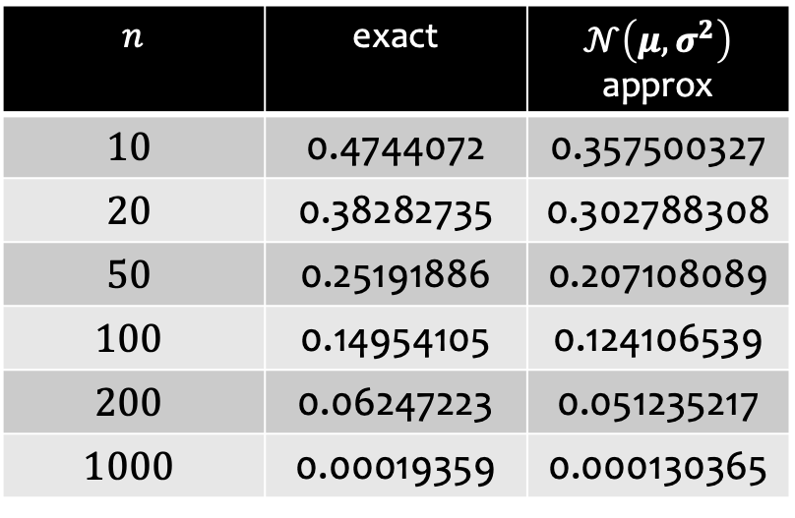
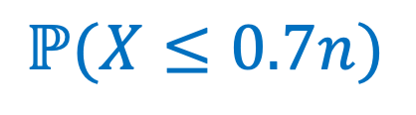
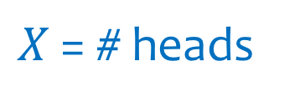
Using CLT to estimate Binomial probabilities
We flip $n$ independent coins, heads with probability $p=0.75$.
$X$ = # heads
$$μ=𝔼\left(X\right)=0.75n$$
$$σ^{2}=Var\left(X\right)=p\left(1−p\right)n=0.1875n$$
$$n$$ | exact | $𝒩\left(μ,σ^{2}\right)$ approx
$$10$$ | 0.4744072 | 0.357500327
$$20$$ | 0.38282735 | 0.302788308
$$50$$ | 0.25191886 | 0.207108089
$$100$$ | 0.14954105 | 0.124106539
$$200$$ | 0.06247223 | 0.051235217
$$1000$$ | 0.00019359 | 0.000130365
$$ℙ(X≤0.7n)$$

Slide 7

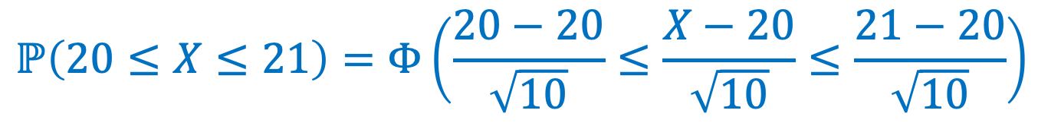

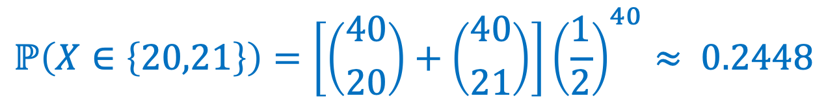
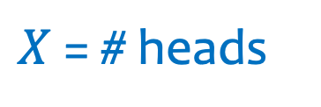

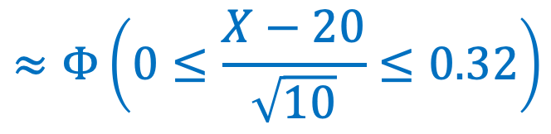
Example – Naive Approximation
Fair coin flipped (independently) 40 times. Probability of 20 or 21 heads?
$$ℙ\left(X∈\left\{20,21\right\}\right)=\left[\left({40 \atop 20}\right)+\left({40 \atop 21}\right)\right]{\left(\frac{1}{2}\right)}^{40}≈ 0.2448$$
Exact.
Approx.
$X$ = # heads
$$μ=𝔼\left(X\right)=0.5n=20$$
$$σ^{2}=Var\left(X\right)=0.25n=10$$
$$ℙ\left(20≤X≤21\right)=Φ\left(\frac{20−20}{\sqrt{10}}≤\frac{X−20}{\sqrt{10}}≤\frac{21−20}{\sqrt{10}}\right)$$
$$≈Φ\left(0≤\frac{X−20}{\sqrt{10}}≤0.32\right)$$
😢
$$=Φ\left(0.32\right)−Φ\left(0\right)≈0.1241$$

Slide 8

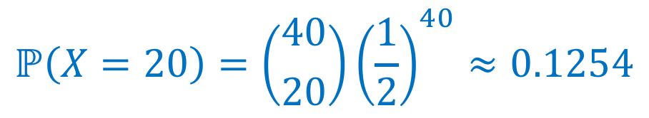
Example – Even Worse Approximation
Fair coin flipped (independently) 40 times. Probability of 20 heads?
$$ℙ\left(X=20\right)=\left({40 \atop 20}\right){\left(\frac{1}{2}\right)}^{40}≈0.1254$$
Exact.
Approx.
😢
$$ℙ\left(20≤X≤20\right)=0$$

Slide 9
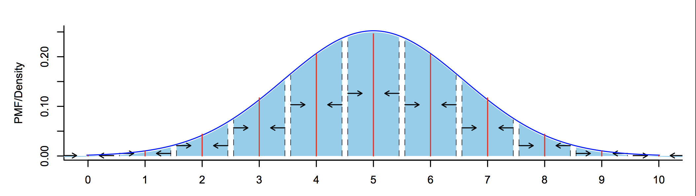
Solution – Continuity Correction
Probability estimate for $i$: Probability for all $x$ that round to $i$!
To estimate probability that discrete RV lands in (integer) interval $\{a,…,b\}$, compute probability continuous approximation lands in interval $[a−\frac{1}{2},b+\frac{1}{2}]$

Slide 10
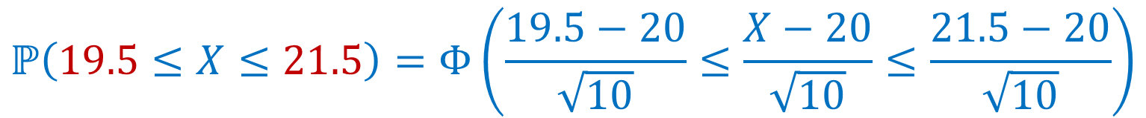
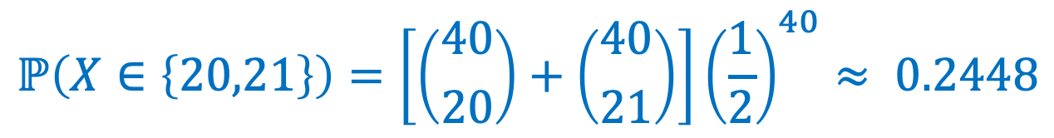
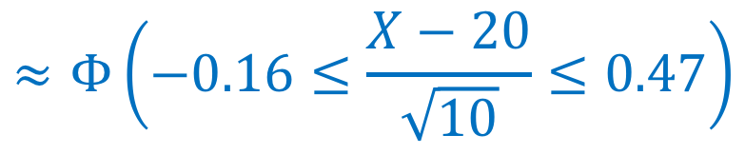
Example – Continuity Correction
Fair coin flipped (independently) 40 times. Probability of 20 or 21 heads?
$$ℙ\left(X∈\left\{20,21\right\}\right)=\left[\left({40 \atop 20}\right)+\left({40 \atop 21}\right)\right]{\left(\frac{1}{2}\right)}^{40}≈ 0.2448$$
Exact.
Approx.
$X$ = # heads
$$μ=𝔼\left(X\right)=0.5n=20$$
$$σ^{2}=Var\left(X\right)=0.25n=10$$
$$ℙ\left(19.5≤X≤21.5\right)=Φ\left(\frac{19.5−20}{\sqrt{10}}≤\frac{X−20}{\sqrt{10}}≤\frac{21.5−20}{\sqrt{10}}\right)$$
$$≈Φ\left(−0.16≤\frac{X−20}{\sqrt{10}}≤0.47\right)$$
👍
$$=Φ\left(0.47\right)−Φ\left(−0.16\right)≈0.2452$$

Slide 11
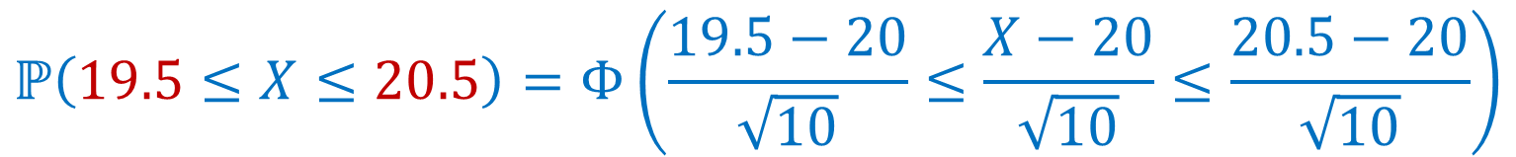
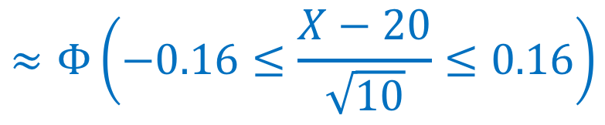
Example – Continuity Correction
Fair coin flipped (independently) 40 times. Probability of 20 heads?
$$ℙ\left(X=20\right)=\left({40 \atop 20}\right){\left(\frac{1}{2}\right)}^{40}≈0.1254$$
Exact.
$$ℙ\left(19.5≤X≤20.5\right)=Φ\left(\frac{19.5−20}{\sqrt{10}}≤\frac{X−20}{\sqrt{10}}≤\frac{20.5−20}{\sqrt{10}}\right)$$
Approx.
$$≈Φ\left(−0.16≤\frac{X−20}{\sqrt{10}}≤0.16\right)$$
$$=Φ\left(0.16\right)−Φ\left(−0.16\right)≈0.1272$$

Slide 12
Agenda
CLT and Polling
Joint Distributions
Cartesian Products
Joint PMFs and Joint Range
Marginal Distribution
Analogues for continuous distributions
LOTUS for joint distns

Slide 13
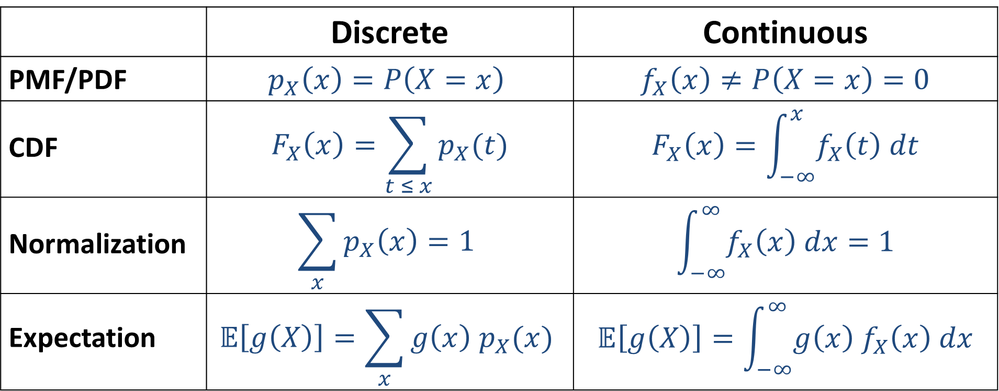
Discrete to Continuous
 | Discrete | Continuous
PMF/PDF | $$p_{X}\left(x\right)=P\left(X=x\right)$$ | $$f_{X}\left(x\right)≠P\left(X=x\right)=0$$
CDF | $$F_{X}\left(x\right)=\sum_{t ≤ x}{p_{X}(t)}$$ | $$F_{X}\left(x\right)=\int_{−∞}^{x}{f_{X}\left(t\right) dt}$$
Normalization | $$\sum_{x}{p_{X}\left(x\right)=1}$$ | $$\int_{−∞}^{∞}{f_{X}\left(x\right) dx=1}$$
Expectation | $$𝔼\left[g\left(X\right)\right]=\sum_{x}{g\left(x\right) p_{X}(x)}$$ | $$𝔼\left[g\left(X\right)\right]=\int_{−∞}^{∞}{g\left(x\right){ f}_{X}\left(x\right) dx}$$

Slide 14
Why joint distributions?
Given all of its user’s ratings for different movies, and any preferences you have expressed, Netflix wants to recommend a new movie for you.
Given a large amount of medical data correlating symptoms and personal history with diseases, predict what is ailing a person with a particular medical history and set of symptoms.
Given current traffic, pedestrian locations, weather, lights, etc. decide whether a self-driving car should slow down or come to a stop

Slide 15
Jointly distributed random variables
$$X$$ | $$Y$$
Grade on exam | Amount of sleep the night before
Performance of Microsoft stock | Performance of Amazon stock
Grade of person A on exam in 312 | Grade of person B on exam in 332
Number of job interviews to get a job | State of the economy
$X_{1}$blood pressure
$X_{2}$ temperature
$X_{3}$blood glucose
$X_{4}$ kidney function

Slide 16
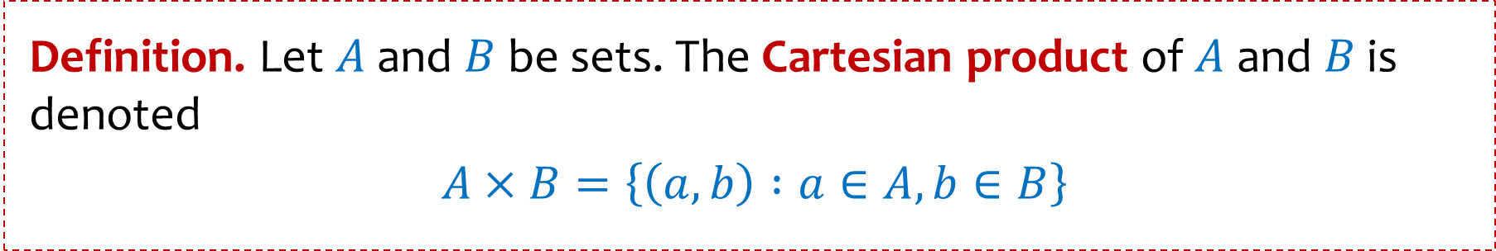
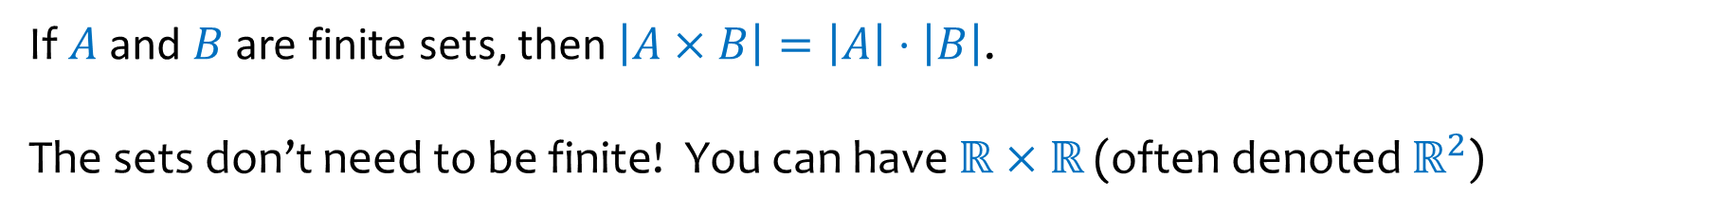

Review Cartesian Product
Definition. Let $A$ and $B$ be sets. The Cartesian product of $A$ and $B$ is denoted
$A×B=\left\{\left(a, b\right) :a∈A, b∈B\right\}$
Example.
$$\left\{1,2,3\right\}×\left\{4, 5\right\}=\left\{\left(1, 4\right), \left(1,5\right),\left(2,4\right), \left(2,5\right), \left(3, 4\right), (3,5)\right\}$$
If $A$ and $B$ are finite sets, then $\left|A×B\right|=\left|A\right|⋅\left|B\right|$.
The sets don’t need to be finite! You can have $ℝ×ℝ$ (often denoted $ℝ^{2}$)

Slide 17
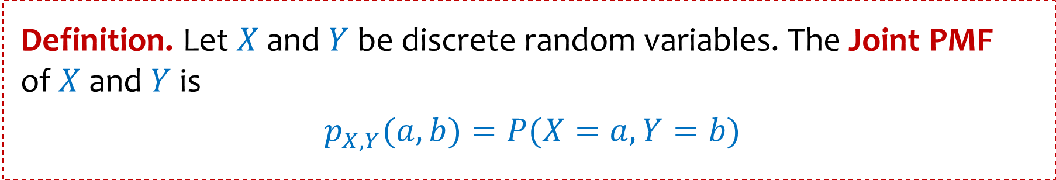


Joint PMFs and Joint Range
Definition. Let $X$ and $Y$ be discrete random variables. The Joint PMF of $X$ and $Y$ is
$p_{X, Y}(a,b)=P⁡(X=a, Y=b)$
Definition. The joint range of $p_{X, Y}$ is
$Ω_{X, Y}=\left\{\left(c, d\right) :p_{X, Y}\left(c, d\right)>0\right\}⊆Ω_{X}×Ω_{Y}$
Note that
$$\sum_{\left(s, t\right)∈Ω_{X,Y}}{p_{X, Y}\left(s, t\right)=1}$$

Slide 18
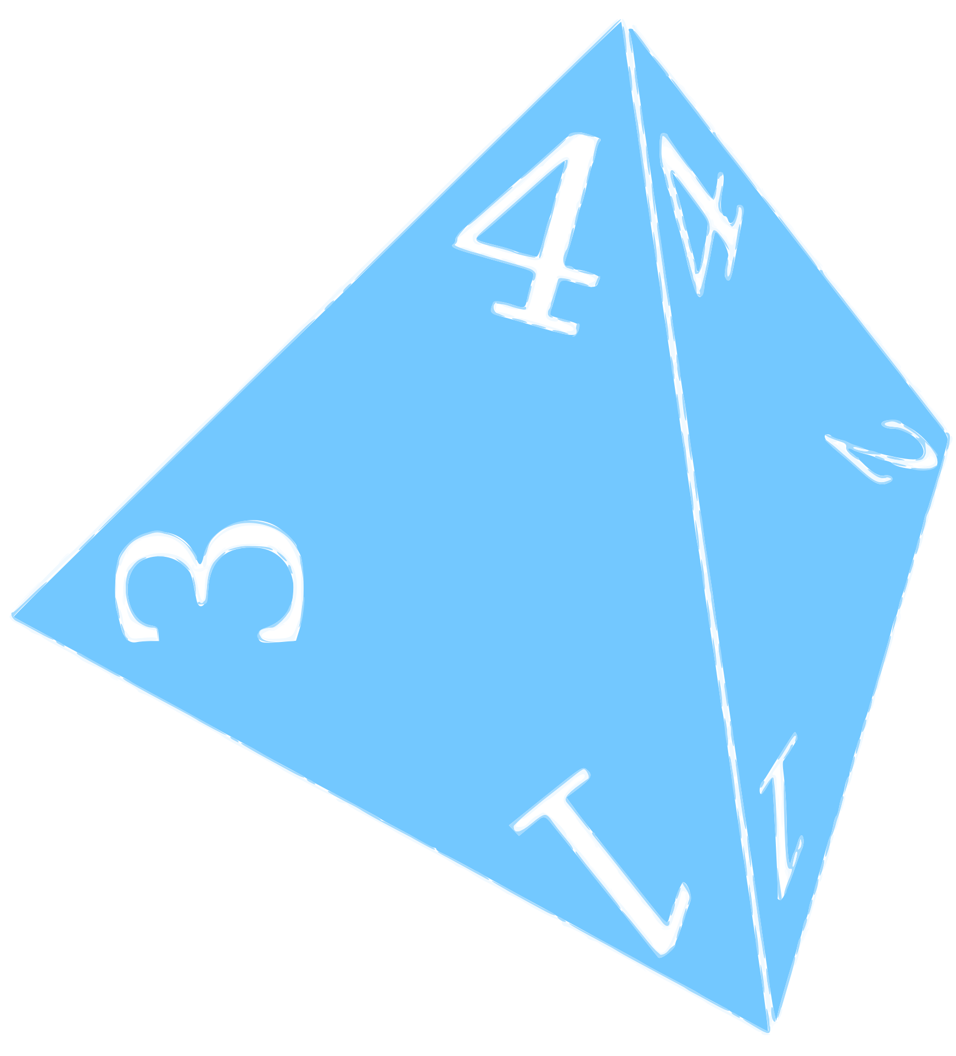
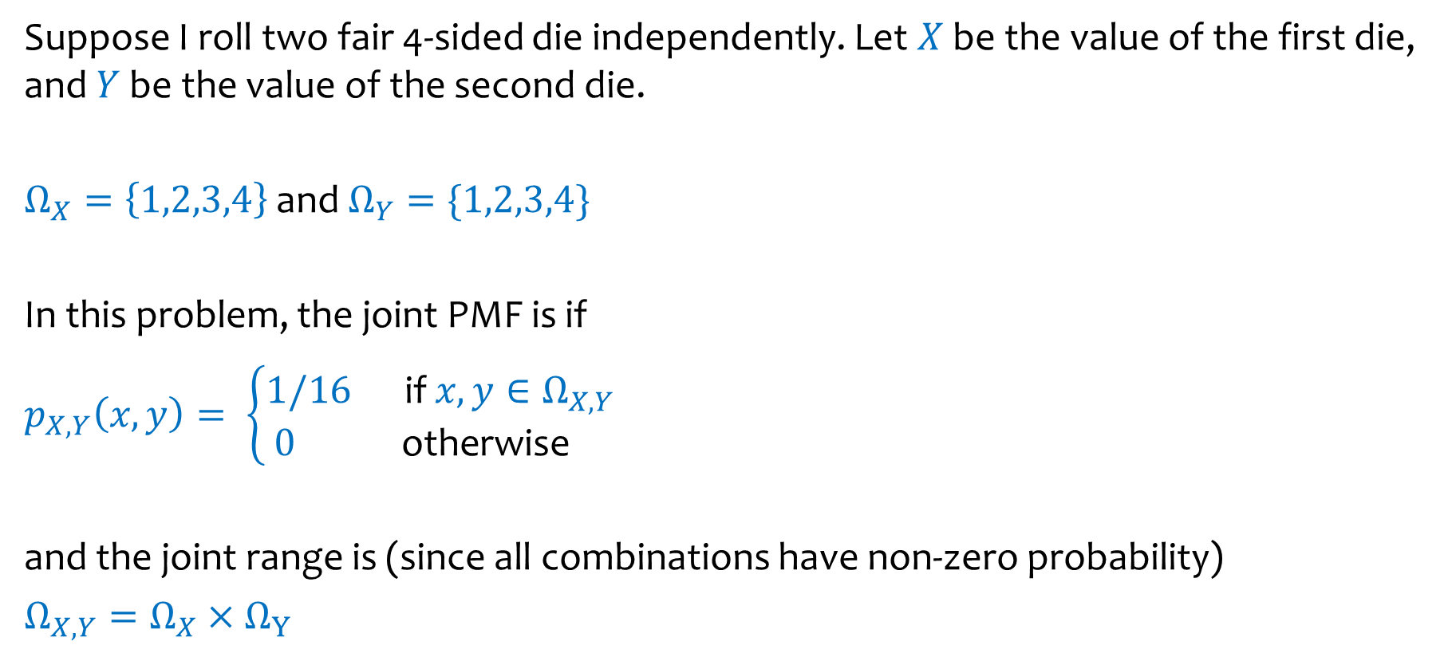
Example – Weird Dice
Suppose I roll two fair 4-sided die independently. Let $X$ be the value of the first die, and $Y$ be the value of the second die.
$Ω_{X}=\left\{1,2,3,4\right\}$ and $Ω_{Y}=\{1,2,3,4\}$
In this problem, the joint PMF is if
$p_{X, Y}\left(x, y\right)= \left\{\begin{aligned}1/16 \text{if} x, y∈Ω_{X,Y } \\ 0 \text{otherwise} \end{aligned}\right.$
and the joint range is (since all combinations have non-zero probability)
$Ω_{X,Y}=Ω_{X}×{ Ω}_{Y}$
X\Y | 1 | 2 | 3 | 4
1 | 1/16 | 1/16 | 1/16 | 1/16
2 | 1/16 | 1/16 | 1/16 | 1/16
3 | 1/16 | 1/16 | 1/16 | 1/16
4 | 1/16 | 1/16 | 1/16 | 1/16

Slide 19


Example – Weirder Dice
Suppose I roll two fair 4-sided die independently. Let $X$ be the value of the first die, and $Y$ be the value of the second die. Let $U=\min\left(X, Y\right)$ and $W=max⁡(X, Y)$
$Ω_{U}=\left\{1,2,3,4\right\}$ and $Ω_{W}=\{1,2,3,4\}$
$Ω_{U,W}=\left\{\left(u, w\right)∈Ω_{U}×Ω_{W}:u≤w \right\}≠Ω_{U}×Ω_{W}$
U\W | 1 | 2 | 3 | 4
1
2
3
4
What is $p_{U, W}\left(1, 3\right)=P{(U=1, W=3)}?$

Slide 20
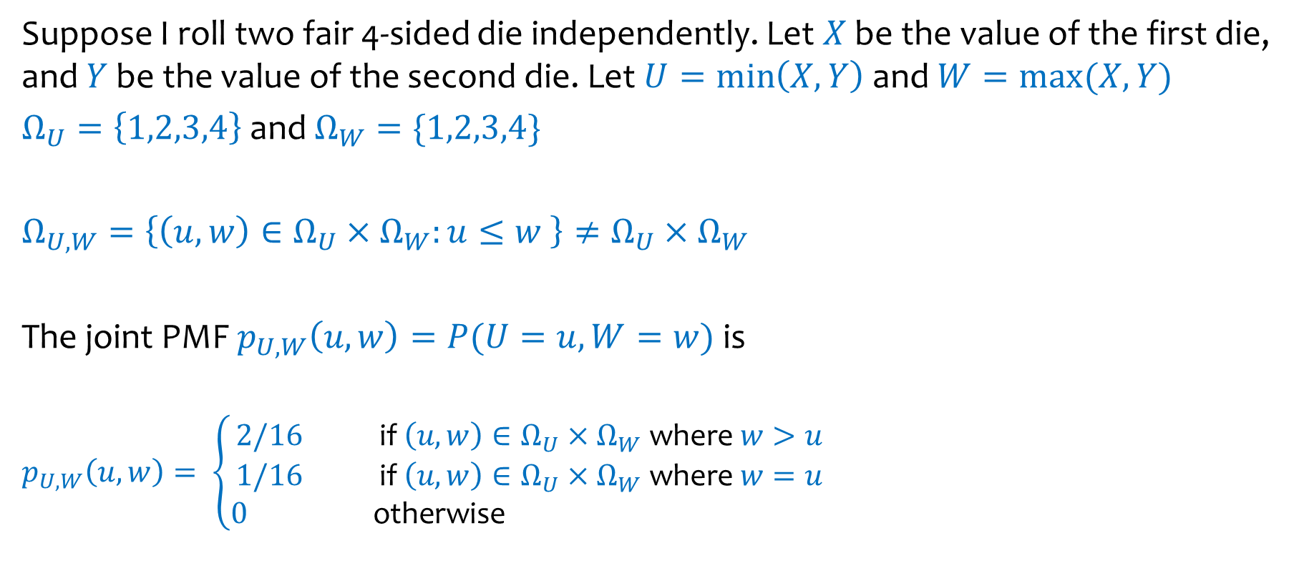
Example – Weirder Dice
Suppose I roll two fair 4-sided die independently. Let $X$ be the value of the first die, and $Y$ be the value of the second die. Let $U=\min\left(X, Y\right)$ and $W=max⁡(X, Y)$
$Ω_{U}=\left\{1,2,3,4\right\}$ and $Ω_{W}=\{1,2,3,4\}$
$Ω_{U,W}=\left\{\left(u, w\right)∈Ω_{U}×Ω_{W}:u≤w \right\}≠Ω_{U}×Ω_{W}$
The joint PMF $p_{U, W}\left(u, w\right)=P{(U=u, W=w)}$ is
$$p_{U, W}\left(u, w\right)= \left\{\begin{aligned}2/16 \text{if} \left(u, w\right)∈Ω_{U}×Ω_{W} \text{where} w>u \\ 1/16 \text{if} \left(u, w\right)∈Ω_{U}×Ω_{W} \text{where} w=u \\ 0 \text{otherwise} \end{aligned}\right.$$
U\W | 1 | 2 | 3 | 4
1 | 1/16 | 2/16 | 2/16 | 2/16
2 | 0 | 1/16 | 2/16 | 2/16
3 | 0 | 0 | 1/16 | 2/16
4 | 0 | 0 | 0 | 1/16

Slide 21

Example – Weirder Dice
Suppose I roll two fair 4-sided die independently. Let $X$ be the value of the first die, and $Y$ be the value of the second die. Let $U=\min\left(X, Y\right)$ and $W=max⁡(X, Y)$
Suppose we didn’t know how to compute $P{(U=u)}$ directly. Can we figure it out if we know $p_{U, W}(u, w)$?
U\W | 1 | 2 | 3 | 4
1 | 1/16 | 2/16 | 2/16 | 2/16
2 | 0 | 1/16 | 2/16 | 2/16
3 | 0 | 0 | 1/16 | 2/16
4 | 0 | 0 | 0 | 1/16

Slide 22









Example – Weirder Dice
Suppose I roll two fair 4-sided die independently. Let $X$ be the value of the first die, and $Y$ be the value of the second die. Let $U=\min\left(X, Y\right)$ and $W=max⁡(X, Y)$
Suppose we didn’t know how to compute $P{(U=u)}$ directly. Can we figure it out if we know $p_{U, W}(u, w)$?
Just apply LTP over the possible values of $W$:
U\W | 1 | 2 | 3 | 4
1 | 1/16 | 2/16 | 2/16 | 2/16
2 | 0 | 1/16 | 2/16 | 2/16
3 | 0 | 0 | 1/16 | 2/16
4 | 0 | 0 | 0 | 1/16
$$p_{U}\left(1\right)=$$
$$7/16$$
$$p_{U}\left(2\right)=$$
$$5/16$$
$$p_{U}\left(3\right)=$$
$$3/16$$
$$p_{U}\left(4\right)=$$
$$1/16$$

Slide 23
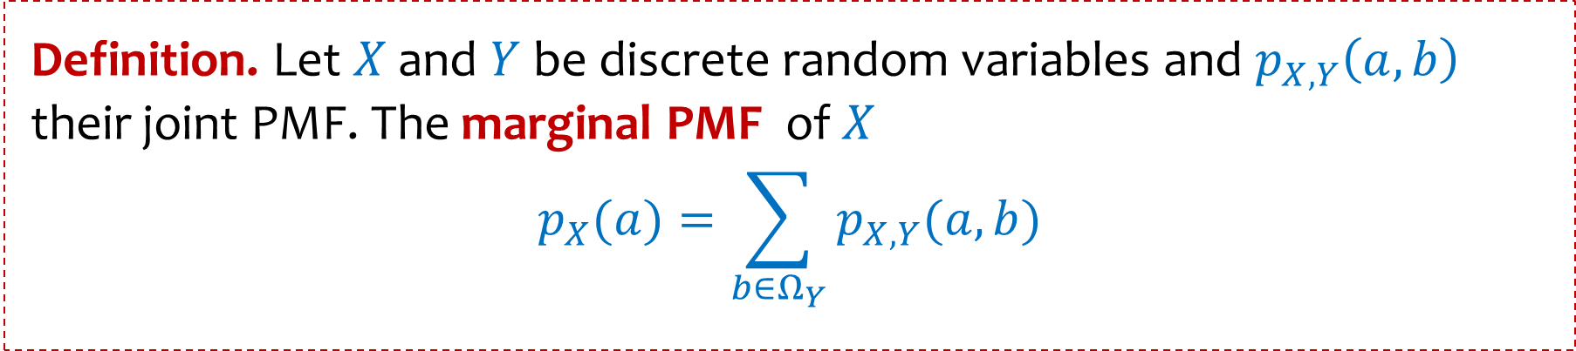
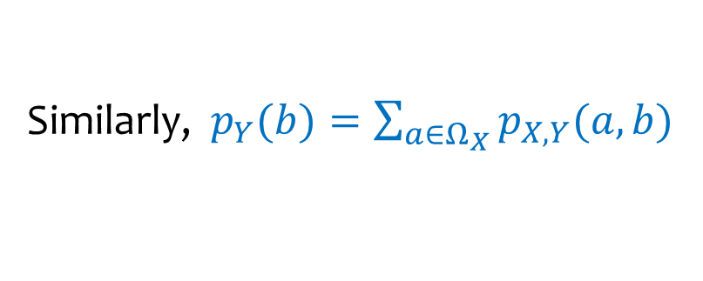
Marginal PMF
Definition. Let $X$ and $Y$ be discrete random variables and $p_{X, Y}\left(a,b\right)$ their joint PMF. The marginal PMF of $X$
$$p_{X}(a)=\sum_{b∈Ω_{Y}}{p_{X, Y}(a, b)}$$
Similarly, $p_{Y}(b)=\sum_{a∈Ω_{X}}{p_{X, Y}(a, b)}$

Slide 24
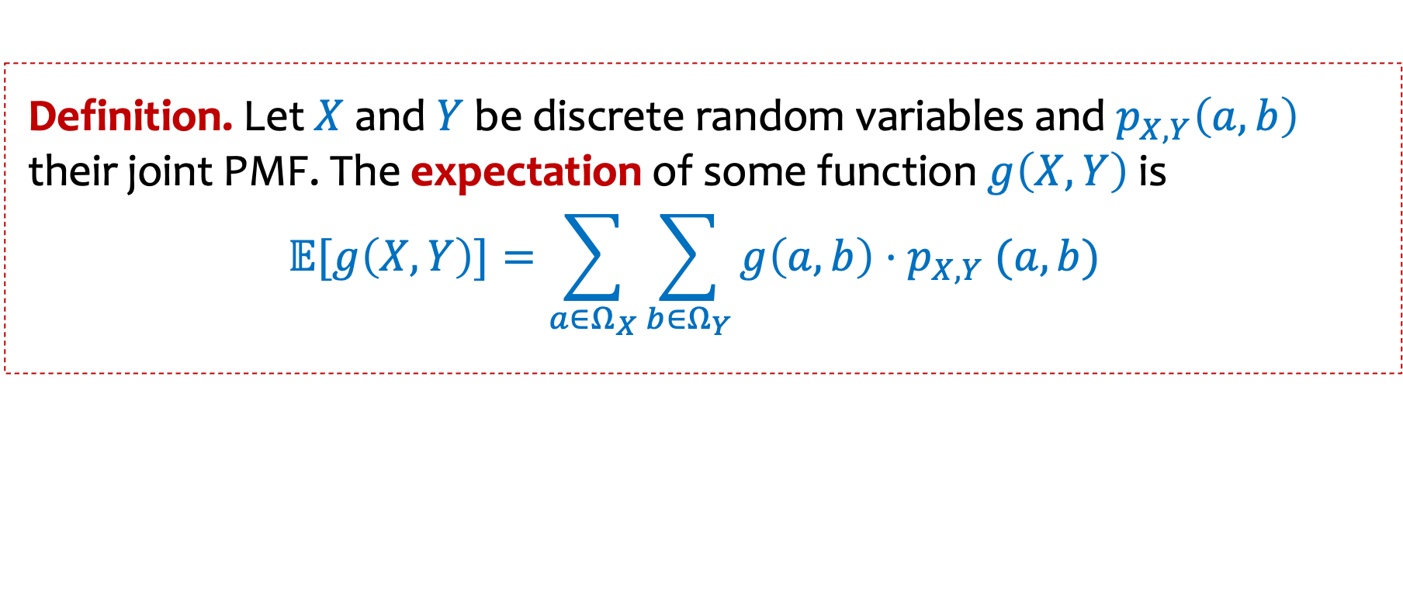
Joint Expectation
Definition. Let $X$ and $Y$ be discrete random variables and $p_{X, Y}\left(a,b\right)$ their joint PMF. The expectation of some function $g\left(X, Y\right)$is
$$𝔼[g\left(X, Y\right)]=\sum_{a∈Ω_{X}}{\sum_{b∈Ω_{Y}}{g\left(a,b\right){⋅p}_{X, Y}(a, b)} }$$

Slide 25
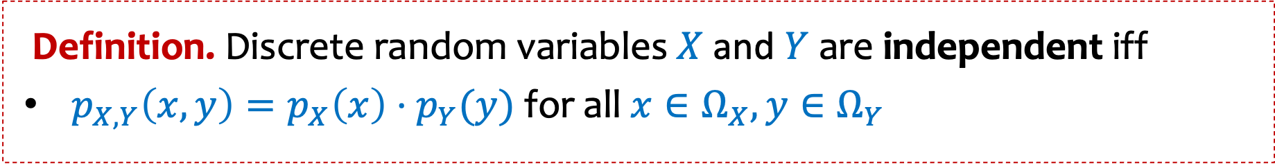
Independence and joint distributions
Definition. Discrete random variables $X$ and $Y$ are independent iff
$p_{X,Y}\left(x,y\right)=p_{X}\left(x\right)⋅p_{Y}(y)$ for all $x∈Ω_{X},y∈Ω_{Y}$
Notes:
What does this say about Pr(X=x|Y=y)

Slide 26
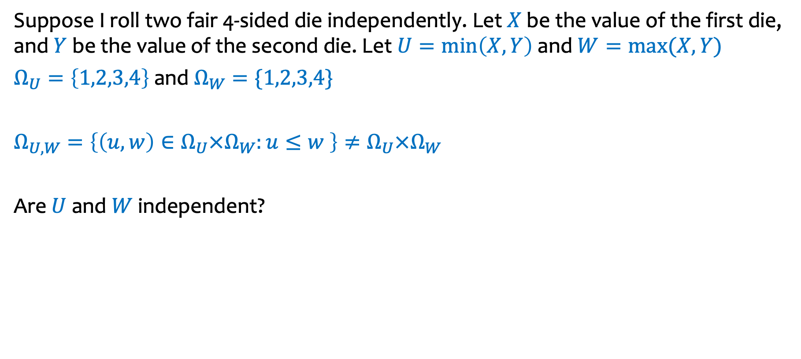
Example – Weirder Dice
Suppose I roll two fair 4-sided die independently. Let $X$ be the value of the first die, and $Y$ be the value of the second die. Let $U=\min\left(X, Y\right)$ and $W=max⁡(X, Y)$
$Ω_{U}=\left\{1,2,3,4\right\}$ and $Ω_{W}=\{1,2,3,4\}$
$Ω_{U,W}=\left\{\left(u, w\right)∈Ω_{U}×Ω_{W}:u≤w \right\}≠Ω_{U}×Ω_{W}$
Are $U$ and $W$independent?
U\W | 1 | 2 | 3 | 4
1 | 1/16 | 2/16 | 2/16 | 2/16
2 | 0 | 1/16 | 2/16 | 2/16
3 | 0 | 0 | 1/16 | 2/16
4 | 0 | 0 | 0 | 1/16

Slide 27
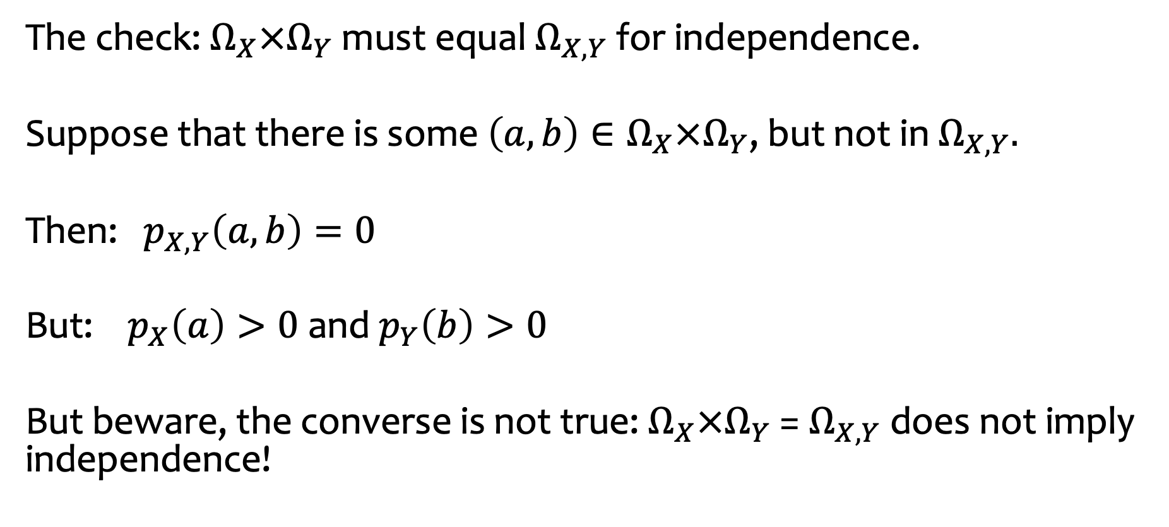
A quick check for independence
The check: $Ω_{X}×Ω_{Y}$ must equal $Ω_{X,Y}$ for independence.
Suppose that there is some $\left(a, b\right)∈Ω_{X}×Ω_{Y}$, but not in $Ω_{X,Y}.$
Then: $p_{X,Y}\left(a,b\right)=0$
But: $p_{X}\left(a\right)>0$ and $p_{Y}\left(b\right)>0$
But beware, the converse is not true: $Ω_{X}×Ω_{Y}$ =$Ω_{X,Y}$does not imply independence!

Slide 28
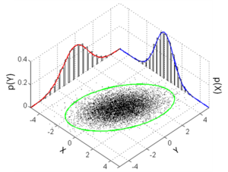
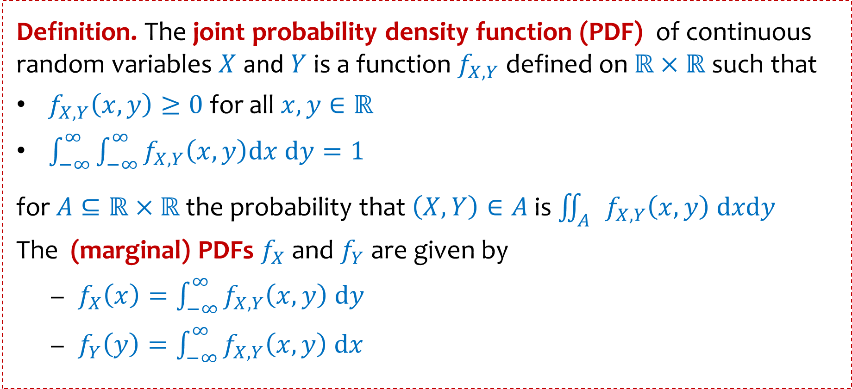
Continuous distributions on $ℝ×ℝ$
Definition. The joint probability density function (PDF) of continuous random variables $X$ and $Y$ is a function $f_{X, Y}$ defined on $ℝ×ℝ$ such that
$f_{X,Y}\left(x,y\right)≥0$ for all $x,y∈ℝ$
$\int_{−∞}^{∞}{\int_{−∞}^{∞}{f_{X,Y}\left(x,y\right)dx dy=1}}$
for $A⊆ℝ×ℝ$ the probability that $\left(X,Y\right)∈A$ is $\iint_{A}{f_{X,Y}\left(x,y\right) dxdy}$
The (marginal) PDFs $f_{X}$ and $f_{Y}$ are given by
$f_{X}\left(x\right)=\int_{−∞}^{∞}{f_{X,Y}\left(x,y\right) dy}$
$f_{Y}\left(y\right)=\int_{−∞}^{∞}{f_{X,Y}\left(x,y\right) dx}$
Notes:
$$\int_{c}^{d}{\int_{a}^{b}{f_{X,Y}\left(x,y\right)dxdy=P\{a≤X≤b \& c≤Y≤d\}}}$$

Slide 29
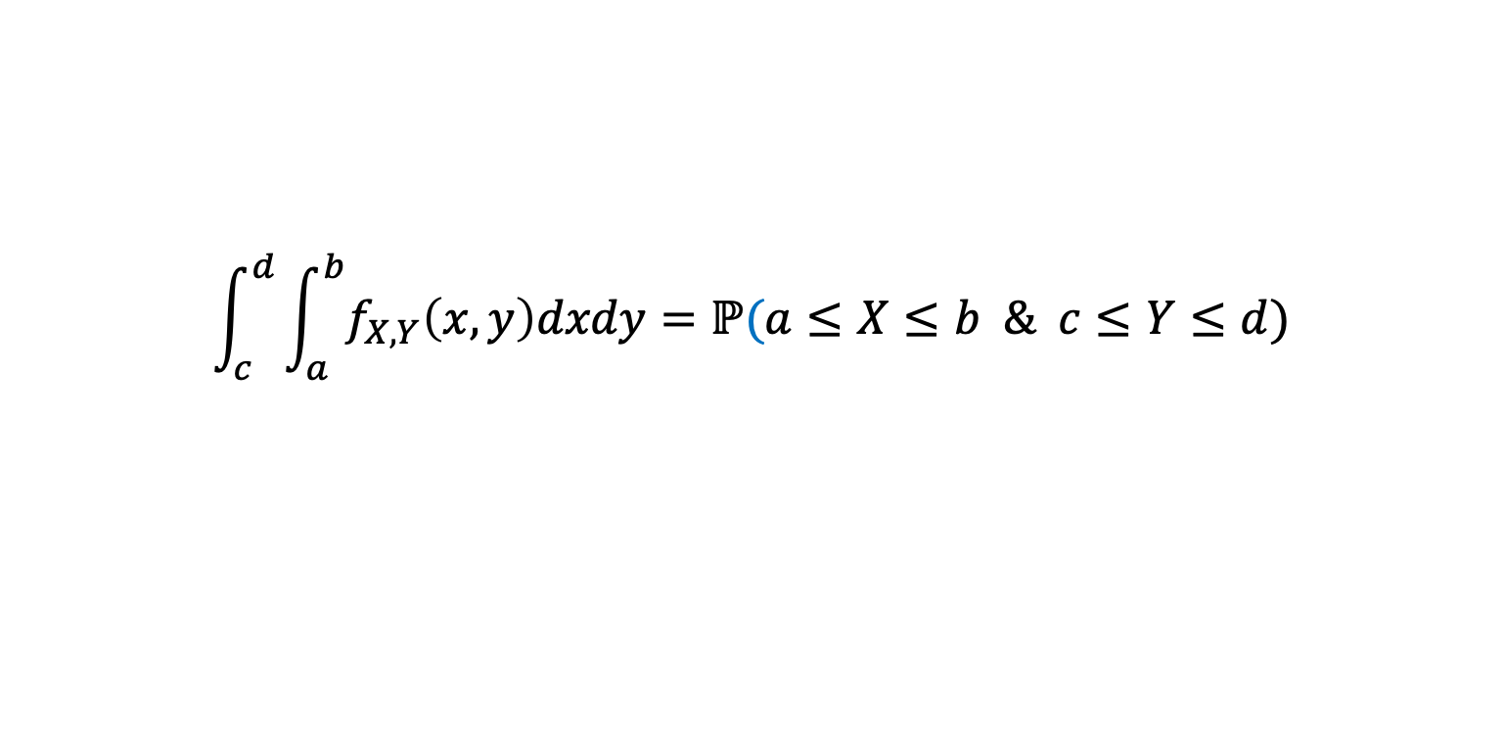
Joint Densities
Volume under the curve equals:
$$\int_{c}^{d}{\int_{a}^{b}{f_{X,Y}\left(x,y\right)dxdy=ℙ(a≤X≤b \& c≤Y≤d) }}$$

Slide 30
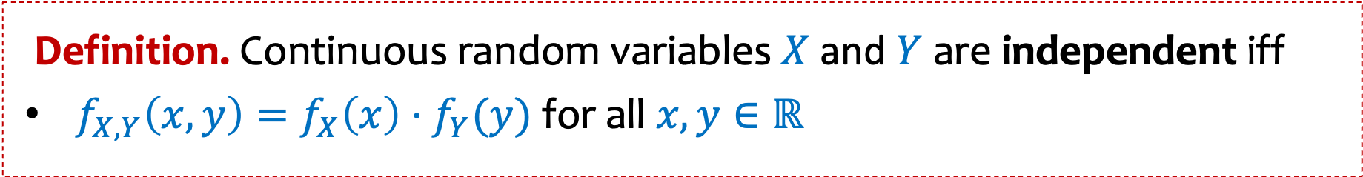
Independence and joint distributions
Definition. Continuous random variables $X$ and $Y$ are independent iff
$f_{X,Y}\left(x,y\right)=f_{X}\left(x\right)⋅f_{Y}(y)$ for all $x,y∈ℝ$
Notes:
What does this say about Pr(X=x|Y=y)

Slide 31

Example
$$f_{X,Y}(x,y)=\left\{\begin{matrix}x+y & \text{if} 0≤x,y≤1 & \\ \begin{aligned} \\ 0\end{aligned} & \begin{aligned} \\ \text{otherwise}\end{aligned} & \end{matrix}\right.$$
Q: What is $E[X]$?

Slide 32

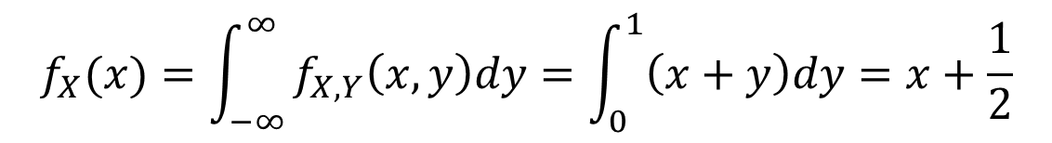
Example
$$f_{X,Y}(x,y)=\left\{\begin{matrix}x+y & \text{if} 0≤x,y≤1 & \\ \begin{aligned} \\ 0\end{aligned} & \begin{aligned} \\ \text{otherwise}\end{aligned} & \end{matrix}\right.$$
Q What is $E[X]$?
A:
$$f_{X}(x)=\int_{−∞}^{∞}{f_{X,Y}\left(x,y\right)dy=\int_{0}^{1}{\left(x+y\right)dy=x+\frac{1}{2}}}$$
$$E\left[X\right]=\int_{−∞}^{∞}{f_{X}\left(x\right)⋅xdx=\int_{0}^{1}{\left(x+\frac{1}{2}\right)⋅x dx=\frac{7}{12}}}$$

Slide 33
Example
$$f_{X,Y}(x,y)=\left\{\begin{matrix}x+y & \text{if} 0≤x,y≤1 & \\ \begin{aligned} \\ 0\end{aligned} & \begin{aligned} \\ \text{otherwise}\end{aligned} & \end{matrix}\right.$$
Are X and Y independent?

Slide 34



Example
$$f_{X,Y}(x,y)=\left\{\begin{matrix}x+y & \text{if} 0≤x,y≤1 & \\ \begin{aligned} \\ 0\end{aligned} & \begin{aligned} \\ \text{otherwise}\end{aligned} & \end{matrix}\right.$$
Q: Are X and Y independent?
A: part (b)
$$f_{X}(x)=\int_{−∞}^{∞}{f_{X,Y}\left(x,y\right)dy=x+\frac{1}{2}}$$
$$f_{Y}(y)=\int_{−∞}^{∞}{f_{X,Y}\left(x,y\right)dx=y+\frac{1}{2}}$$
Clearly, $f_{X,Y}\left(x,y\right)≠f_{X}\left(x\right)⋅f_{Y}\left(y\right)$

Slide 35
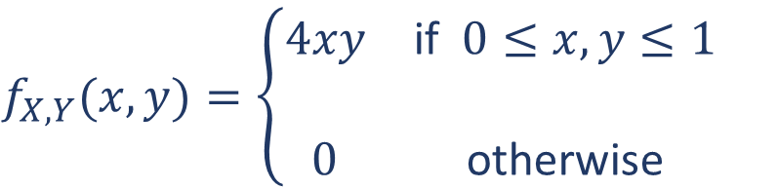
Example
$$f_{X,Y}(x,y)=\left\{\begin{matrix}4xy & \text{if} 0≤x,y≤1 & \\ \begin{aligned} \\ 0\end{aligned} & \begin{aligned} \\ \text{otherwise}\end{aligned} & \end{matrix}\right.$$
Q: Are X and Y independent?

Slide 36



Example
$$f_{X,Y}(x,y)=\left\{\begin{matrix}4xy & \text{if} 0≤x,y≤1 & \\ \begin{aligned} \\ 0\end{aligned} & \begin{aligned} \\ \text{otherwise}\end{aligned} & \end{matrix}\right.$$
Q: Are X and Y independent?
A:
$$f_{X}(x)=\int_{0}^{1}{4xy dy=2x}$$
$$f_{Y}(y)=\int_{0}^{1}{4xy dx=2y}$$
Clearly, $f_{X,Y}\left(x,y\right)=f_{X}\left(x\right)⋅f_{Y}\left(y\right)$

Slide 37

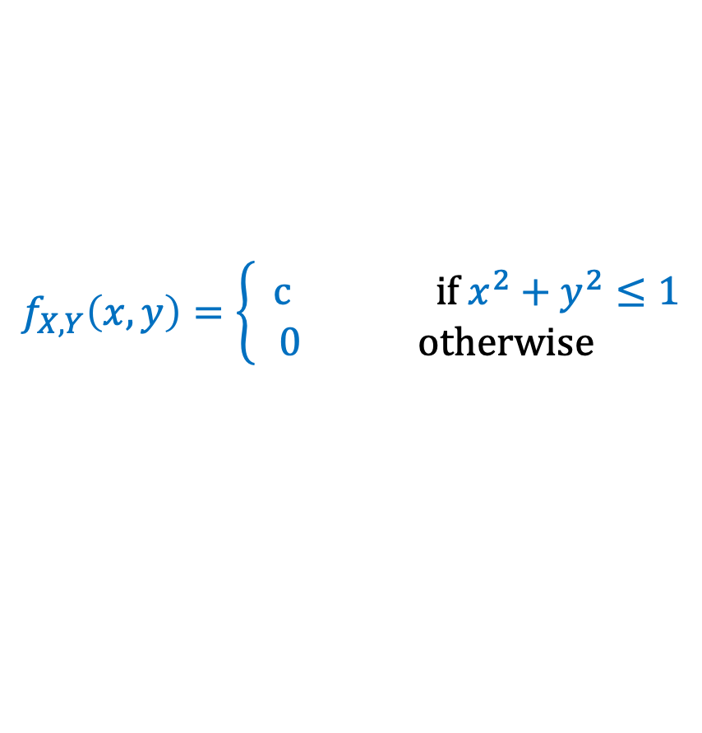
Example – Uniform distribution on a unit disk
Suppose that a pair of random variables $(X,Y)$is chosen uniformly
from the set of real points $(x,y)$such that $x^{2}+y^{2}≤1$
1
What is the joint density?
-1
1
0
$$f_{X,Y}\left(x,y\right)=\left\{\begin{aligned} c if x^{2}+y^{2}≤1 \\ 0 otherwise \end{aligned}\right.$$
-1

Slide 38
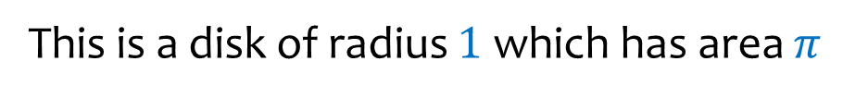

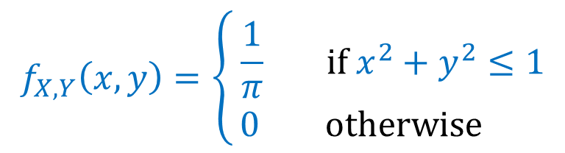
Example – Uniform distribution on a unit disk
Suppose that a pair of random variables $(X,Y)$is chosen uniformly
from the set of real points $(x,y)$such that $x^{2}+y^{2}≤1$
1
This is a disk of radius $1$ which has area $π$
-1
1
$$f_{X,Y}\left(x,y\right)=\left\{\begin{aligned} \frac{1}{π} if x^{2}+y^{2}≤1 \\ 0 otherwise \end{aligned}\right.$$
0
-1
Are $X$ and $Y$ independent$?$

Slide 39

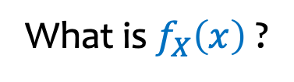
Example – Uniform distribution on a unit disk
Suppose that a pair of random variabes $(X,Y)$is chosen uniformly
from the set of real points $(x,y)$such that $x^{2}+y^{2}≤1$
1
This is a disk of radius $1$ which has area $π$
-1
1
$$f_{X,Y}\left(x,y\right)=\left\{\begin{aligned} \frac{1}{π} if x^{2}+y^{2}≤1 \\ 0 otherwise \end{aligned}\right.$$
0
-1
What is $f_{X}\left(x\right)$ ?

Slide 40

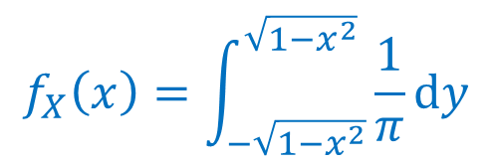
Example – Uniform distribution on a unit disk
Suppose that a pair of random variabes $(X,Y)$is chosen uniformly
from the set of real points $(x,y)$such that $x^{2}+y^{2}≤1$
1
This is a disk of radius $1$ which has area $π$
-1
1
$$f_{X,Y}\left(x,y\right)=\left\{\begin{aligned} \frac{1}{π} if x^{2}+y^{2}≤1 \\ 0 otherwise \end{aligned}\right.$$
0
-1
What is $f_{X}\left(x\right)$ ?
$$f_{X}\left(x\right)=\int_{−\sqrt{1−x^{2}}}^{\sqrt{1−x^{2}}}{\frac{1}{π}dy}$$
$$=2\sqrt{1−x^{2}}/π$$

Slide 41
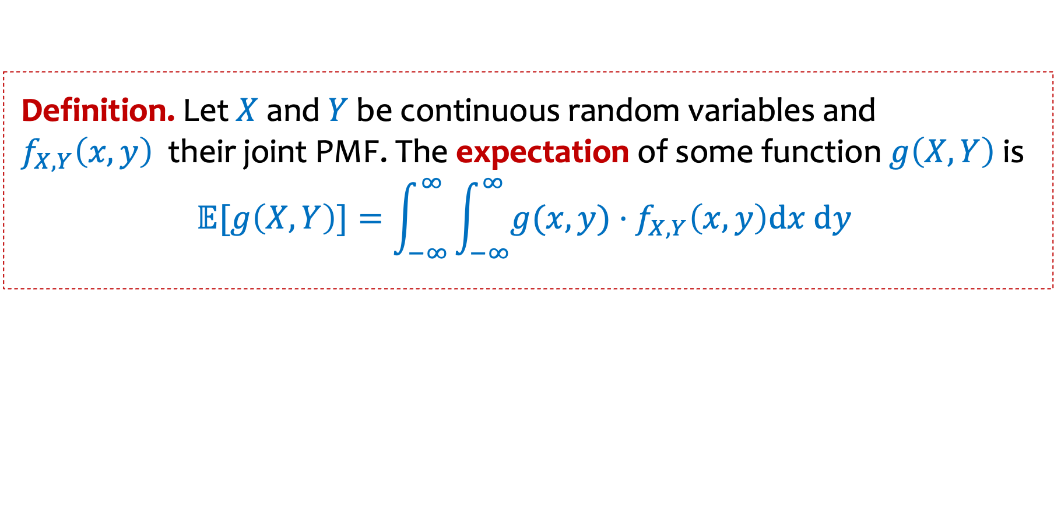
LOTUS
Definition. Let $X$ and $Y$ be continuous random variables and $f_{X,Y}\left(x,y\right)$their joint PMF. The expectation of some function $g\left(X, Y\right) \text{is}$
$$𝔼[g\left(X, Y\right)]=\int_{−∞}^{∞}{\int_{−∞}^{∞}{{g(x, y)⋅f}_{X,Y}\left(x,y\right)dx dy }}$$

Slide 42
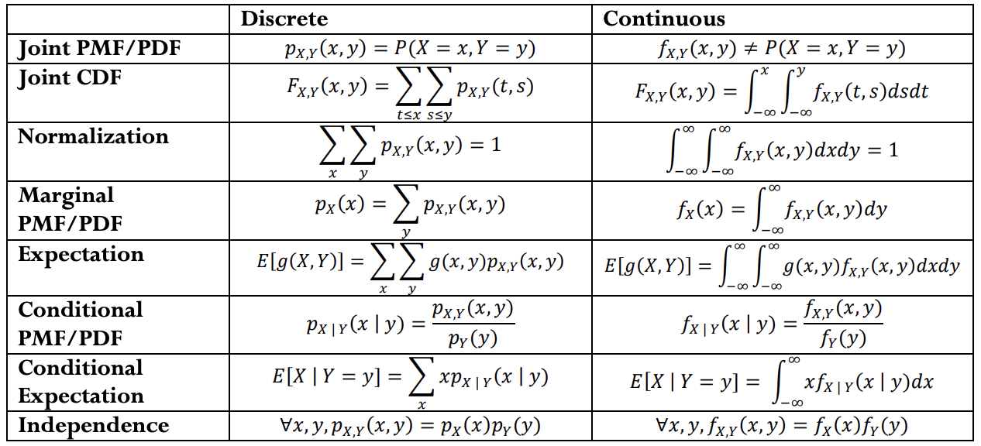

Reference Sheet

