Slide 1
Normal distribution + Central Limit Theorem
CSE 312 Spring 26
Lecture 17

Slide 2


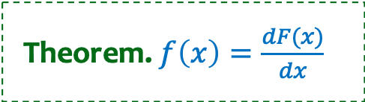



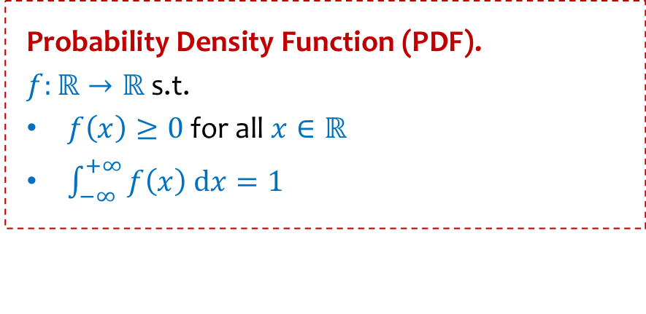

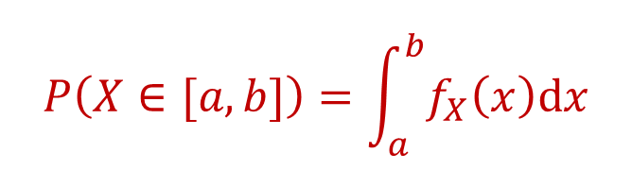
Recap – Continuous RVs
Probability Density Function (PDF).
$f:ℝ→ℝ$ s.t.
$f\left(x\right)≥0$ for all $x∈ℝ$
$\int_{−∞}^{+∞}{f\left(x\right) dx}=1$
Cumulative Distribution Function (CDF).
$$F\left(y\right)=\int_{−∞}^{y}{f(x) dx}$$
Theorem. $f\left(x\right)=\frac{dF(x)}{dx}$
$$f(x)$$
$$y$$
Density $≠$ Probability !
$$P\left(X∈[a,b]\right)=\int_{a}^{b}{f_{X}\left(x\right)dx}$$
$$F_{X}\left(y\right)=P\left(X≤y\right)$$
$$=F_{X}\left(b\right)−F_{X}(a)$$

Slide 3
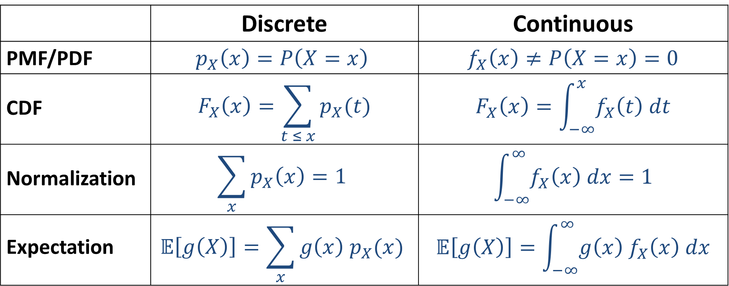
Recap: From Discrete to Continuous
 | Discrete | Continuous
PMF/PDF | $$p_{X}\left(x\right)=P\left(X=x\right)$$ | $$f_{X}\left(x\right)≠P\left(X=x\right)=0$$
CDF | $$F_{X}\left(x\right)=\sum_{t ≤ x}{p_{X}(t)}$$ | $$F_{X}\left(x\right)=\int_{−∞}^{x}{f_{X}\left(t\right) dt}$$
Normalization | $$\sum_{x}{p_{X}\left(x\right)=1}$$ | $$\int_{−∞}^{∞}{f_{X}\left(x\right) dx=1}$$
Expectation | $$𝔼\left[g\left(X\right)\right]=\sum_{x}{g\left(x\right) p_{X}(x)}$$ | $$𝔼\left[g\left(X\right)\right]=\int_{−∞}^{∞}{g\left(x\right){ f}_{X}\left(x\right) dx}$$

Slide 4



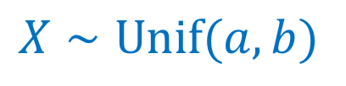

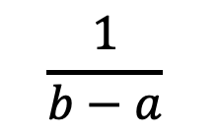
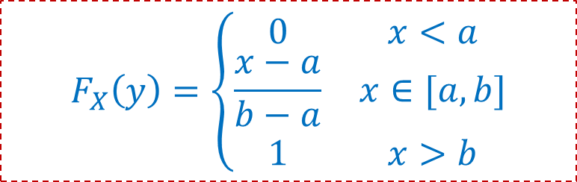
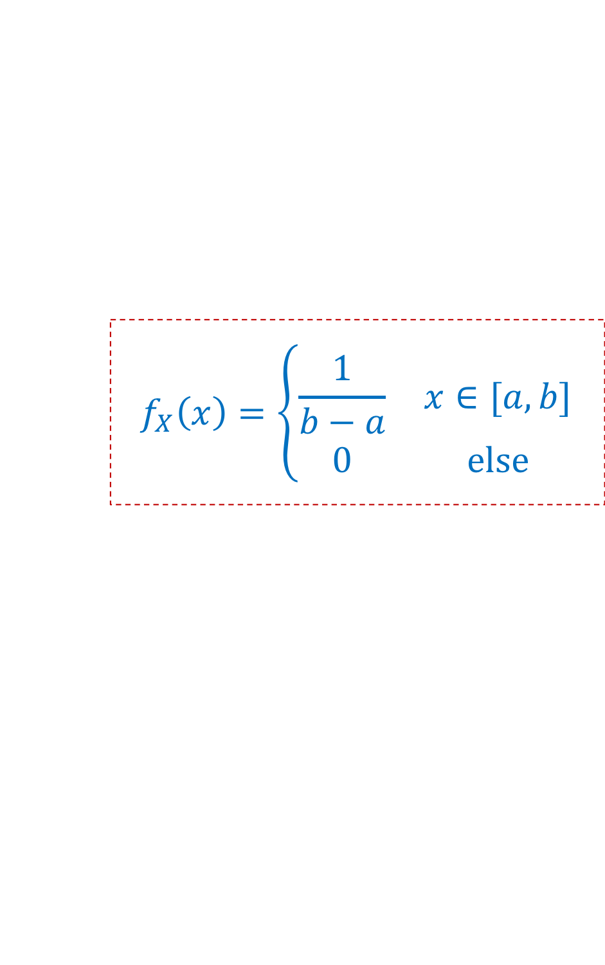

Uniform Distribution Summary
$$f_{X}\left(x\right)=\left\{\begin{matrix}\frac{1}{b−a} & x∈[a,b] \\ 0 & else\end{matrix}\right.$$
$X∼Unif(a,b)$
$$F_{X}\left(y\right)=\left\{\begin{matrix}0 & x<a \\ \frac{x−a}{b−a} & x∈[a,b] \\ 1 & x>b\end{matrix}\right.$$
$$\frac{1}{b−a}$$
$$𝔼\left[X\right]=\frac{a+b}{2}$$
$$Var\left(X\right)=\frac{{\left(b−a\right)}^{2}}{12}$$
0
$$a$$
$$b$$

Slide 5

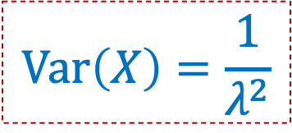
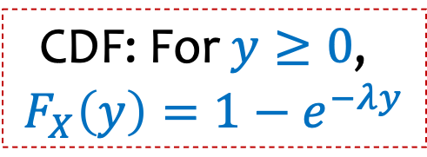

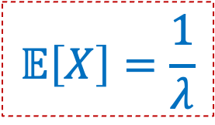
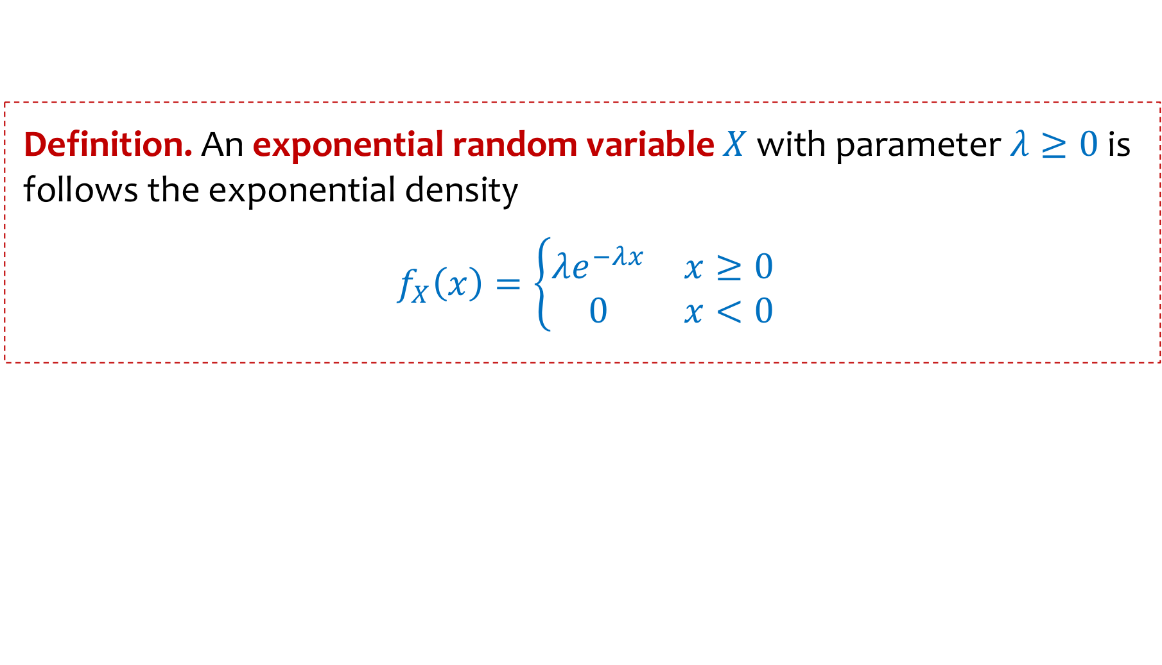



Exponential Distribution
$$P\left(X>t\right)=e^{−tλ}$$
We write $X∼Exp\left(λ\right)$ and say $X$that follows the exponential distribution.
Definition. An exponential random variable $X$with parameter $λ≥0$ is follows the exponential density
$f_{X}\left(x\right)=\left\{\begin{matrix}λe^{−λx} & x≥0 \\ 0 & x<0\end{matrix}\right.$
$$\text{CDF}\text{: }\text{For} y≥0\text{, }$$
$$F_{X}\left(y\right)={1−e}^{−λy}$$
$$λ=2$$
$$𝔼\left[X\right]=\frac{1}{λ}$$
$$λ=1.5$$
$$λ=1$$
$$Var\left(X\right)=\frac{1}{λ^{2}}$$
$$λ=0.5$$

Slide 6
Agenda
Normal Distribution Practice with Normals
Central Limit Theorem (CLT)

Slide 7
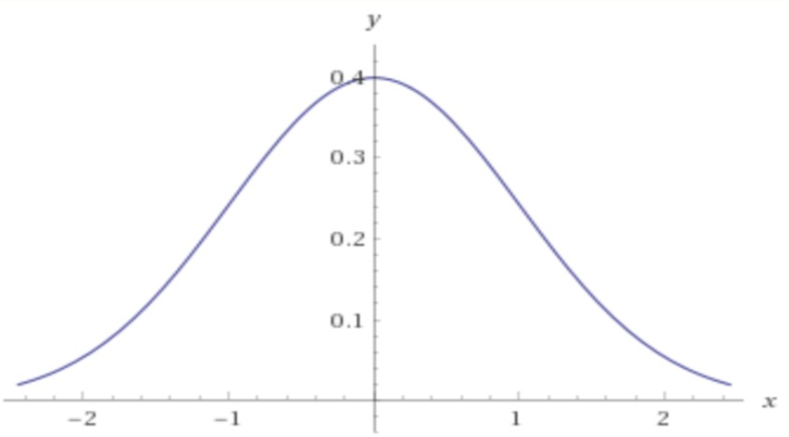
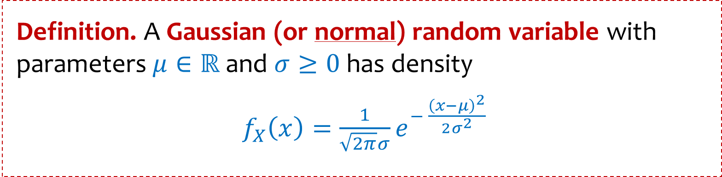
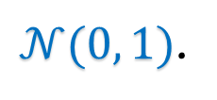
The Normal Distribution
Definition. A Gaussian (or normal) random variable with parameters $μ∈ℝ$ and $σ≥0$has density
$f_{X}\left(x\right)=\frac{1}{\sqrt{2π}σ}e^{− \frac{{\left(x−μ\right)}^{2}}{2σ^{2}}}$
Carl Friedrich Gauss
We say that $X$ follows the Normal Distribution, and write $X∼𝒩(μ, σ^{2})$.
$𝒩(0, 1)$.

Slide 8
The Normal Distribution
Definition. A Gaussian (or normal) random variable with parameters $μ∈ℝ$ and $σ≥0$has density
$f_{X}\left(x\right)=\frac{1}{\sqrt{2π}σ}e^{− \frac{{\left(x−μ\right)}^{2}}{2σ^{2}}}$
Carl Friedrich Gauss
We say that $X$ follows the Normal Distribution, and write $X∼𝒩(μ, σ^{2})$.
Fact. If $X∼𝒩\left(μ, σ^{2}\right)$, then $𝔼[X]=μ$, and $Var\left(X\right)=σ^{2}$

Slide 9
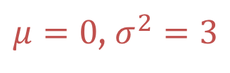

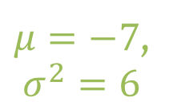

The Normal Distribution
Aka a “Bell Curve” (imprecise name)
$μ=7$,
$σ^{2}=1$
$μ=0$, $σ^{2}=3$
$μ=−7$,
$σ^{2}=6$
$μ=0$,
$σ^{2}=8$

Slide 10
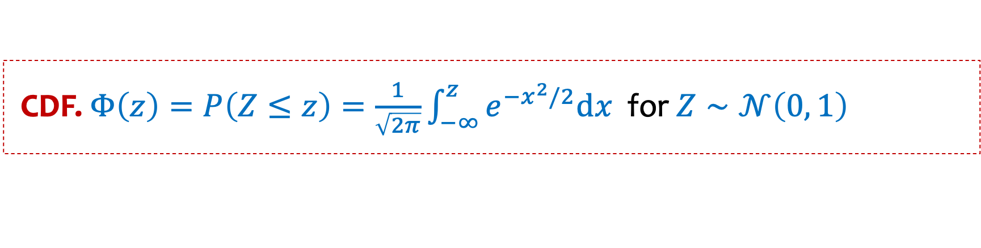
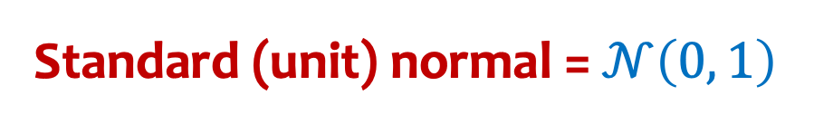
Standard normal distribution
Standard (unit) normal = $𝒩\left(0, 1\right)$
CDF. $Φ\left(z\right)=P\left(Z≤z\right)=\frac{1}{\sqrt{2π}}\int_{−∞}^{z}{e^{−x^{2}/2}dx}$ for $Z∼𝒩\left(0, 1\right)$
Note: $Φ\left(z\right)$has no closed form – generally given via tables

Slide 11
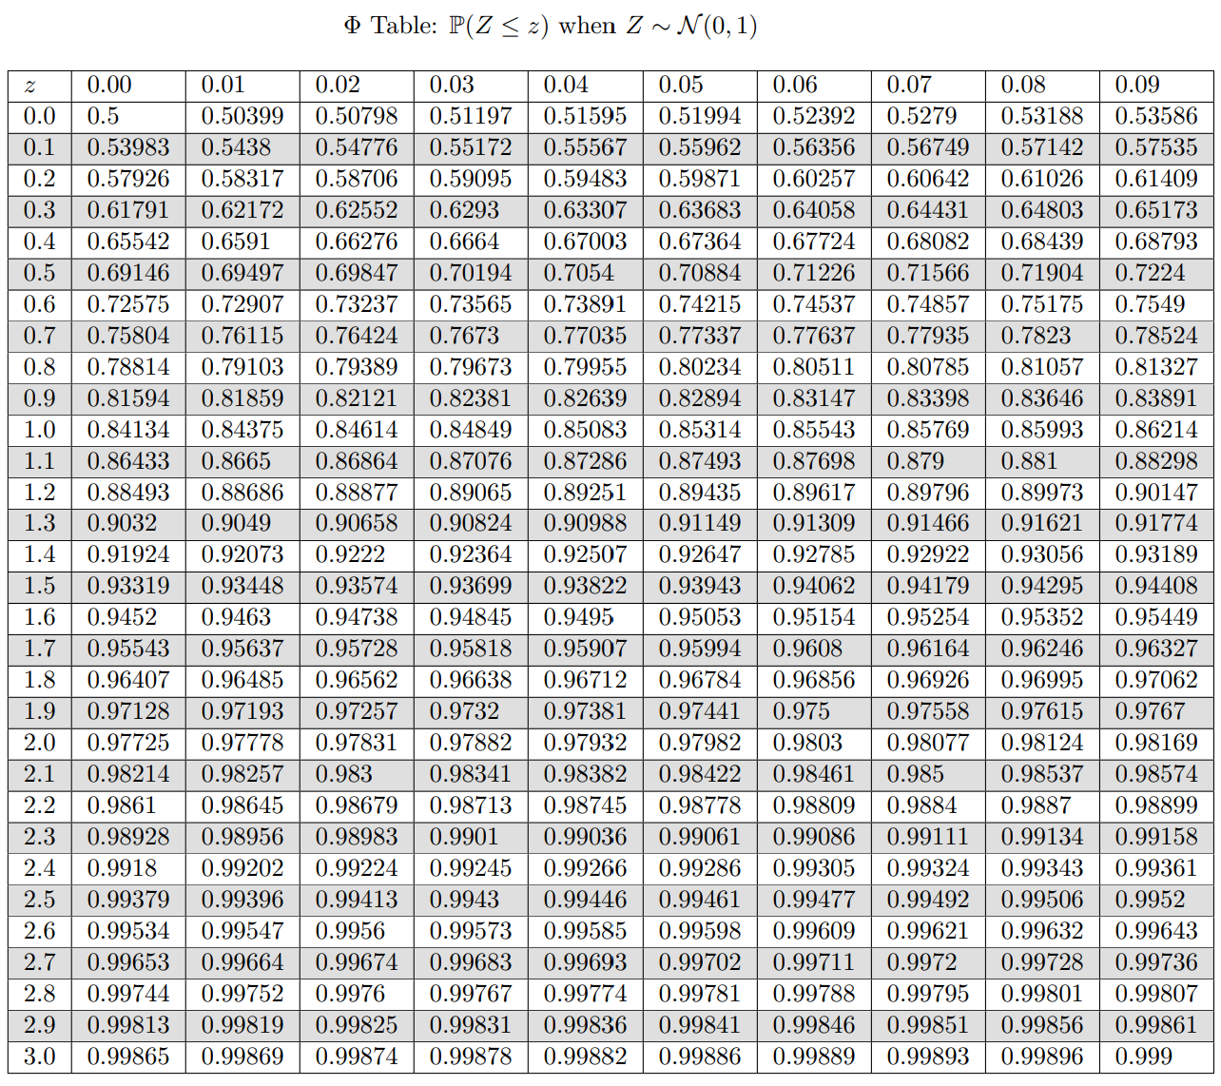
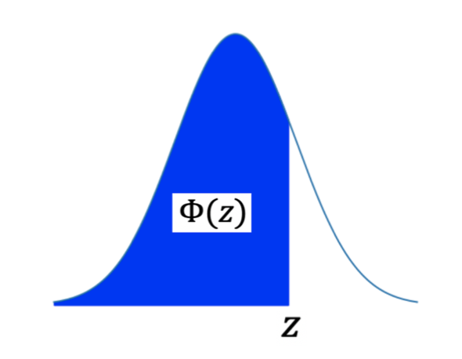




Review Table of $Φ(z)$ CDF of Standard Normal
$$P\left(Z≤0.98\right)$$
$$=Φ\left(0.98\right)$$
$$≈0.8365$$
For what $a$ is
$$P\left(Z>a\right) ≤0.01 ?$$

Slide 12

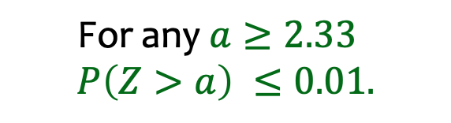
Review Table of $Φ(z)$ CDF of Standard Normal
$$P\left(Z≤0.98\right)$$
$$=Φ\left(0.98\right)$$
$$≈0.8365$$
For what $a$ is
$$P\left(Z≥a\right) ≤0.01 ?$$
$$\text{For} \text{any} a≥2.33$$
$$P\left(Z>a\right) ≤0.01.$$

Slide 13
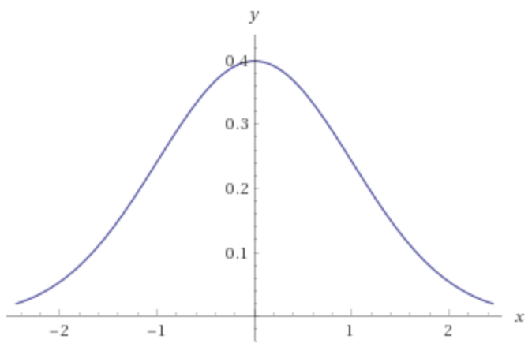

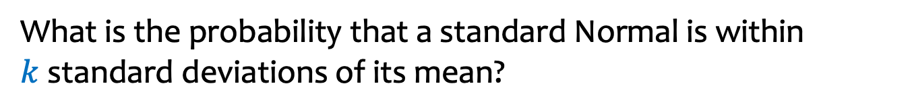

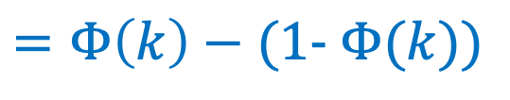

The Standard Normal CDF
What is the probability that a standard Normal is within $k$standard deviations of its mean?
$$P\left(−k<Z<k\right)$$
$$=Φ\left(k\right)−Φ(−k)$$
$$=Φ\left(k\right)−(1- Φ(k))$$
$$=2⋅Φ\left(k\right)−1$$

Slide 14
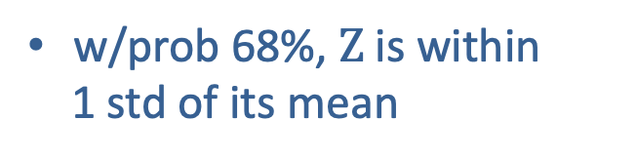
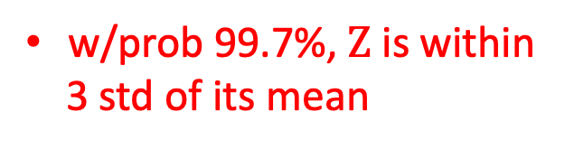

Deviation from the Mean
If$Z∼𝒩\left(μ,σ^{2}\right)$, then $P\left\{−k<Z<k\right\}= 2Φ\left(k\right)−1$
w/prob 68%, $Z$is within
1 std of its mean
w/prob 95%, $Z$is within
2 std of its mean
w/prob 99.7%, $Z$is within
3 std of its mean
-3
-2
-1
0
1
2
3

Slide 15
Closure of normal distribution – Under Shifting and Scaling
Fact. If $X∼𝒩\left(μ, σ^{2}\right)$, then $\frac{X−μ}{σ}∼𝒩\left(0, 1\right)$
Fact. If $X∼𝒩\left(μ, σ^{2}\right)$, then $Y=aX+b∼𝒩\left(aμ+b, {a^{2}σ}^{2}\right)$
Mean and variance follow from properties you know! The fact that result of shifting and scaling still normal is not obvious, but not too difficult

Slide 16

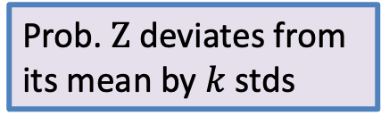

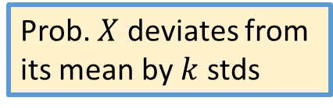

But what if we don’t have a standard Normal?
Bottom line: Deviations from mean we saw for a standard Normal holds for
general Normal (provided it’s phrased in terms of standard deviations).
$$Z=\frac{X−μ}{σ}∼𝒩\left(0, 1\right)$$
$$X∼ 𝒩\left(μ,σ^{2}\right)$$
$$P\left\{−kσ<X −μ<kσ\right\}=P\left\{−k<\frac{X−μ}{σ}<k\right\}=P\{−k<Z<k\}$$
Prob. $X$ deviates from
its mean by $k$ stds
Prob. $Z$ deviates from
its mean by $k$ stds

Slide 17
Agenda
Normal Distribution
Practice with Normals
The Central Limit Theorem

Slide 18
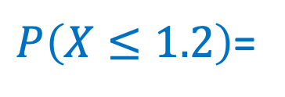
Example
Let $X∼𝒩\left(0.4, 4=2^{2}\right)$.
$P\left(X≤1.2\right)$=

Slide 19
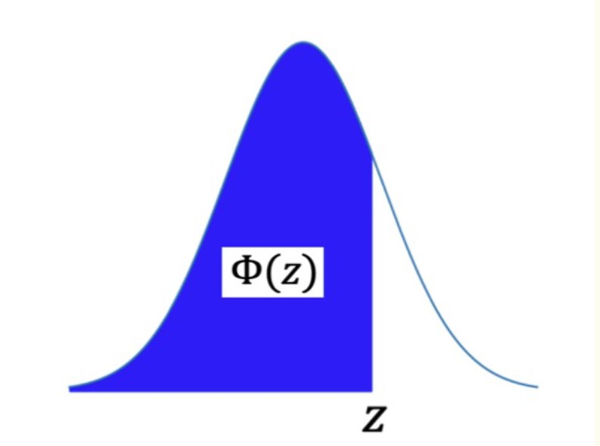
Table of Standard Cumulative Normal Density

Slide 20
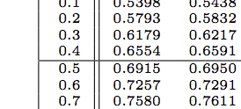


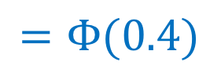

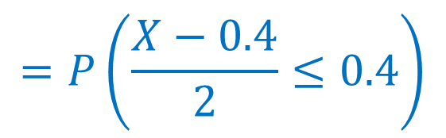
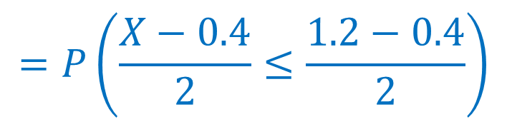
Example
Let $X∼𝒩\left(0.4, 4=2^{2}\right)$.
$$=P\left(\frac{X−0.4}{2}≤\frac{1.2−0.4}{2}\right)$$
$$P\left(X≤1.2\right)$$
$$=P\left(\frac{X−0.4}{2}≤0.4\right)$$
$$=Φ(0.4)$$
$$≈0.6554$$
$$∼𝒩\left(0, 1\right)$$

Slide 21

Example
Let $X∼𝒩\left(3, 16\right)$.
$P\left(2<X<5\right)$ $=$

Slide 22
Table of Standard Cumulative Normal Density

Slide 23
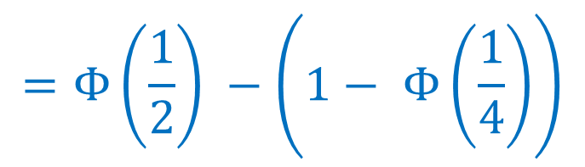


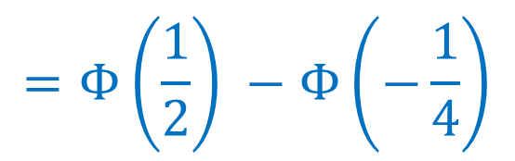
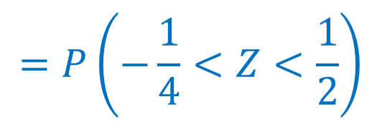
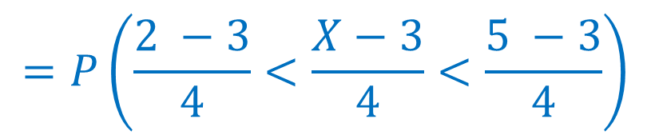
Example
Let $X∼𝒩\left(3, 16\right)$.
$$=P\left(\frac{2 −3}{4}<\frac{X−3}{4}<\frac{5 −3}{4}\right)$$
$$P\left(2<X<5\right)$$
$$=P\left(−\frac{1}{4}<Z<\frac{1}{2}\right)$$
$$=Φ\left(\frac{1}{2}\right) −Φ\left(−\frac{1}{4}\right)$$
$$=Φ\left(\frac{1}{2}\right) −\left(1− Φ\left(\frac{1}{4}\right)\right)$$
$$≈0.29017$$

Slide 24
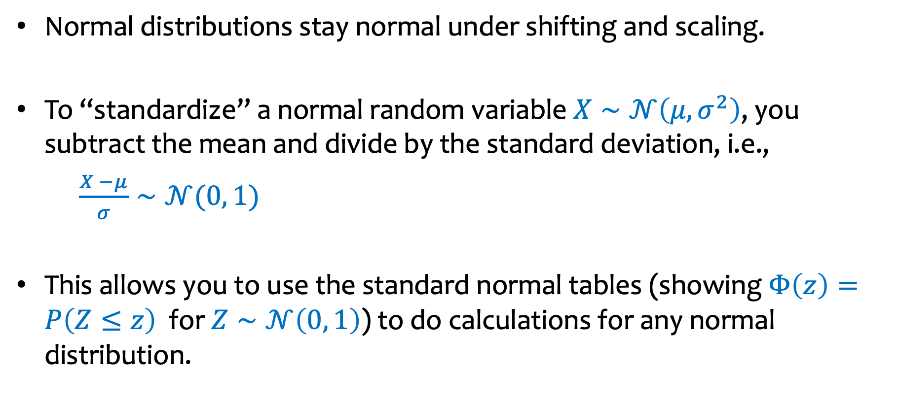
Summary so far
Normal distributions stay normal under shifting and scaling.
To “standardize” a normal random variable $X∼𝒩\left(μ,σ^{2}\right)$, you subtract the mean and divide by the standard deviation, i.e.,
$\frac{X −μ}{σ}∼𝒩(0, 1)$
This allows you to use the standard normal tables (showing $Φ\left(z\right)=P\left(Z≤z\right)$ for $Z∼𝒩\left(0, 1\right)$) to do calculations for any normal distribution.

Slide 25
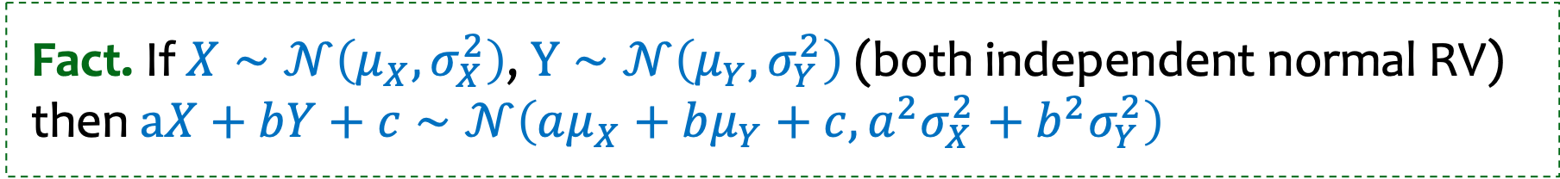
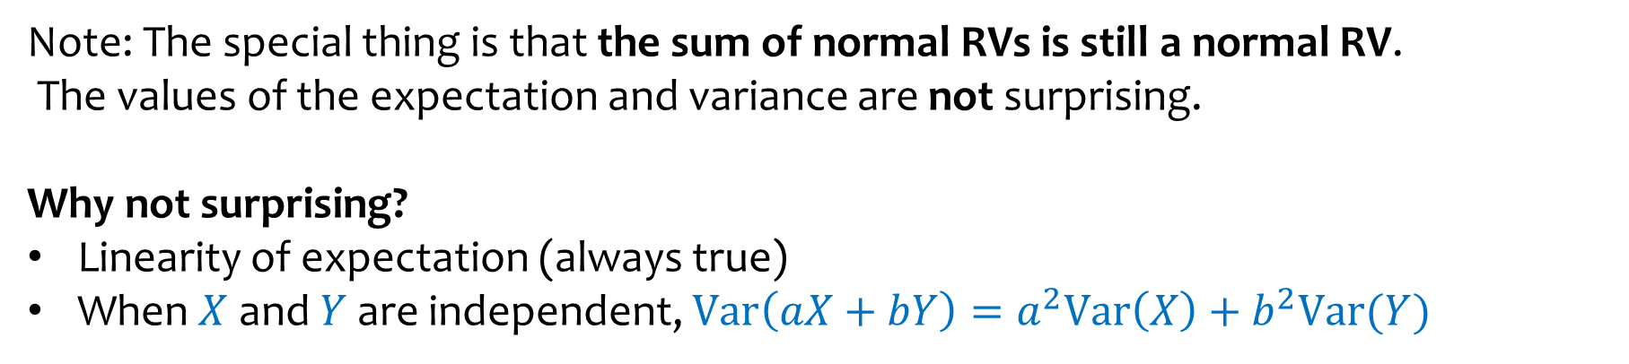
Another important property: closure under addition
Fact. If $X∼𝒩\left(μ_{X}, σ_{X}^{2}\right)$, $Y∼𝒩\left(μ_{Y}, σ_{Y}^{2}\right)$ (both independent normal RV) then $aX+bY+c∼𝒩\left(aμ_{X}+bμ_{Y}+c, {a^{2}σ}_{X}^{2}+b^{2}σ_{Y}^{2}\right)$
Note: The special thing is that the sum of normal RVs is still a normal RV.
The values of the expectation and variance are not surprising.
Why not surprising?
Linearity of expectation (always true)
When $X$ and $Y$ are independent, $Var\left(aX+bY\right)=a^{2}Var\left(X\right)+b^{2}Var(Y)$

Slide 26
Agenda
Normal Distribution
Practice with Normals
Central Limit Theorem (CLT)

Slide 27
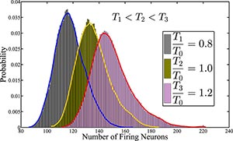
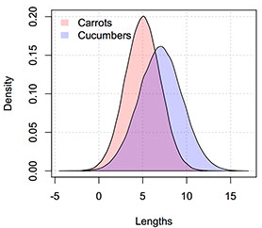
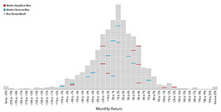
Normal Distributions EVERYWHERE – why?
Neuron Activity
Vegetables
S&P 500 Returns after Elections
Examples from:
https://galtonboard.com/probabilityexamplesinlife

Slide 28

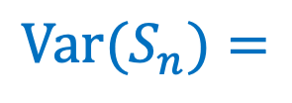
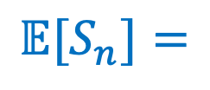
Sums of i.i.d. RVs look normal!
i.i.d. = independent and identically distributed
$X_{1},…,X_{n}$ i.i.d. with expectation $μ$ and variance $σ^{2}$
$$S_{n}={X_{1}+⋯+X}_{n}$$
Consider
$$𝔼[S_{n}]=$$
$$Var(S_{n})=$$
Empirical observation:
$S_{n}$ looks like a normal RV as $n$grows.

Slide 29
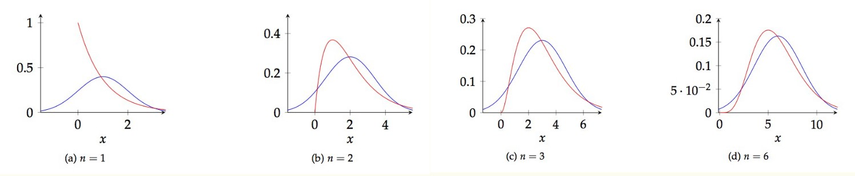

Example: Sum of $n$ i.i.d. $Exp(1)$ random variables

Slide 30

Example: avg of uniform r.v.s

Slide 31

CLT : Avg of some other weird i.i.d. r.v.s

Slide 32


Suppose that what we see in nature results from combining (summing) many independent random observations…
Then distribution might look normal.
e.g. Height distribution resembles Gaussian.
R.A.Fisher (1918) observed that the height is likely the outcome of the sum of many independent random parameters, i.e., can written as
${{X=X}_{1}+⋯+X}_{n}$

Slide 33





Sums of i.i.d. RVs
i.i.d. = independent and identically distributed
$X_{1},…,X_{n}$ i.i.d. with expectation $μ$ and variance $σ^{2}$
$$S_{n}={X_{1}+⋯+X}_{n}$$
Define
$$𝔼[S_{n}]=$$
$$𝔼[X_{1}]+⋯+𝔼[X_{n}]$$
$$=nμ$$
$$Var(S_{n})=$$
$$Var\left(X_{1}\right)+⋯+Var\left(X_{n}\right)$$
$$=nσ^{2}$$
Empirical observation:
$S_{n}$ looks like a normal RV as $n$grows, but…

Slide 34








Central Limit Theorem
$X_{1},…,X_{n}$ i.i.d., each with expectation $μ$ and variance $σ^{2}$
Define $S_{n}={X_{1}+⋯+X}_{n}$ and
$$𝔼[S_{n}]=$$
$$𝔼[X_{1}]+⋯+𝔼[X_{n}]$$
$$=nμ$$
$$Y_{n}=\frac{S_{n}−nμ}{σ\sqrt{n}}$$
$$Var(S_{n})=$$
$$Var\left(X_{1}\right)+⋯+Var\left(X_{n}\right)$$
$$=nσ^{2}$$
$$𝔼[Y_{n}]=$$
$$Var(Y_{n})=$$

Slide 35





Central Limit Theorem
$X_{1},…,X_{n}$ i.i.d., each with expectation $μ$ and variance $σ^{2}$
Define $S_{n}={X_{1}+⋯+X}_{n}$ and
$$𝔼[S_{n}]=$$
$$𝔼[X_{1}]+⋯+𝔼[X_{n}]$$
$$=nμ$$
$$Y_{n}=\frac{S_{n}−nμ}{σ\sqrt{n}}$$
$$Var(S_{n})=$$
$$Var\left(X_{1}\right)+⋯+Var\left(X_{n}\right)$$
$$=nσ^{2}$$
$$\frac{1}{σ\sqrt{n}}\left(𝔼[S_{n}]−nμ\right)$$
$$=\frac{1}{σ\sqrt{n}}\left(nμ−nμ\right)=0$$
$$𝔼[Y_{n}]=$$
$$\frac{1}{σ^{2}n}\left(Var\left(S_{n}−nμ\right)\right)$$
$$=\frac{Var(S_{n})}{σ^{2}n}$$
$$=\frac{σ^{2}n}{σ^{2}n}=1$$
$$Var(Y_{n})=$$

Slide 36


Central Limit Theorem
$X_{1},…,X_{n}$ i.i.d., each with expectation $μ$ and variance $σ^{2}$
$$Y_{n}=\frac{S_{n}−nμ}{σ\sqrt{n}}$$
Define $S_{n}={X_{1}+⋯+X}_{n}$ ,
Then distribution of $Y_{n}=\frac{S_{n}−nμ}{σ\sqrt{n}}$ converges to that of a normal distribution with mean 0 and variance 1 as $n→∞$.

Slide 37


Central Limit Theorem
$$Y_{n}=\frac{{X_{1}+⋯+X}_{n}−nμ}{σ\sqrt{n}}$$
Theorem. (Central Limit Theorem) The CDF of $Y_{n}$ converges to the CDF of the standard normal $𝒩(0,1)$, i.e.,
$$\lim_{n→∞}{P\left(Y_{n}≤y\right)=\frac{1}{\sqrt{2π}}\int_{−∞}^{y}{e^{−x^{2}/2}dx}}$$

Slide 38

Central Limit Theorem
$$Y_{n}=\frac{{X_{1}+⋯+X}_{n}−nμ}{σ\sqrt{n}}$$
Theorem. (Central Limit Theorem) The CDF of $Y_{n}$ converges to the CDF of the standard normal $𝒩(0,1)$, i.e.,
$$\lim_{n→∞}{P\left(Y_{n}≤y\right)=\frac{1}{\sqrt{2π}}\int_{−∞}^{y}{e^{−x^{2}/2}dx}}$$
Also stated as:
$\lim_{n→∞}{Y_{n}→}$ $𝒩(0,1)$
$\lim_{n→∞}{\frac{1}{n}\sum_{i=1}^{n}{X_{i}→}}$ $𝒩\left(μ,\frac{σ^{2}}{n}\right)$ for $μ=𝔼[X_{i}]$ and $σ^{2}=Var\left(X_{i}\right)$

Slide 39




Summary Central Limit Theorem
$X_{1},…,X_{n}$ i.i.d., each with expectation $μ$ and variance $σ^{2}$
$$Y_{n}=\frac{S_{n}−nμ}{σ\sqrt{n}}$$
Define $S_{n}={X_{1}+⋯+X}_{n}$ and $\overline{X}=\frac{1}{n}\sum_{i=1}^{n}{X_{i}. }$and
$$S_{n}$$
$$\overline{X}$$
$$Y_{n}$$
mean
variance
CLT:

Slide 40
CLT application
Suppose lightbulbs have a lifetime that is exponential with a mean of 5 hours.
You buy a pack of 10 light bulbs. As soon as one burns out you replace it with another. What is the probability you still have a working light bulb after 70 hours?
Estimate using the Central Limit Theorem.

Slide 41
Table of Standard Cumulative Normal Density

Slide 42

Outline of how CLT is used
Write the event you are interested in, in terms of a sum of i.i.d. random variables.
Normalize RV to have mean 0 and standard deviation 1.
Write event in terms of $Φ$, the CDF of a $𝒩\left(0,1\right).$
Look up in table.

Slide 43
Agenda
Applying CLT to discrete random variables – continuity correction

Slide 44





Using CLT to estimate Binomial probabilities
We flip $n$ independent coins, heads with probability $p=0.75$.
$X$ = # heads
$$μ=𝔼\left(X\right)=0.75n$$
$$σ^{2}=Var\left(X\right)=p\left(1−p\right)n=0.1875n$$
$$n$$ | exact | $𝒩\left(μ,σ^{2}\right)$ approx
$$10$$ | 0.4744072 | 0.357500327
$$20$$ | 0.38282735 | 0.302788308
$$50$$ | 0.25191886 | 0.207108089
$$100$$ | 0.14954105 | 0.124106539
$$200$$ | 0.06247223 | 0.051235217
$$1000$$ | 0.00019359 | 0.000130365
$$ℙ(X≤0.7n)$$

Slide 45







Example – Naive Approximation
Fair coin flipped (independently) 40 times. Probability of 20 or 21 heads?
$$ℙ\left(X∈\left\{20,21\right\}\right)=\left[\left({40 \atop 20}\right)+\left({40 \atop 21}\right)\right]{\left(\frac{1}{2}\right)}^{40}≈ 0.2448$$
Exact.
Approx.
$X$ = # heads
$$μ=𝔼\left(X\right)=0.5n=20$$
$$σ^{2}=Var\left(X\right)=0.25n=10$$
$$ℙ\left(20≤X≤21\right)=Φ\left(\frac{20−20}{\sqrt{10}}≤\frac{X−20}{\sqrt{10}}≤\frac{21−20}{\sqrt{10}}\right)$$
$$≈Φ\left(0≤\frac{X−20}{\sqrt{10}}≤0.32\right)$$
😢
$$=Φ\left(0.32\right)−Φ\left(0\right)≈0.1241$$

Slide 46


Example – Even Worse Approximation
Fair coin flipped (independently) 40 times. Probability of 20 heads?
$$ℙ\left(X=20\right)=\left({40 \atop 20}\right){\left(\frac{1}{2}\right)}^{40}≈0.1254$$
Exact.
Approx.
😢
$$ℙ\left(20≤X≤20\right)=0$$

Slide 47

Solution – Continuity Correction
Probability estimate for $i$: Probability for all $x$ that round to $i$!
To estimate probability that discrete RV lands in (integer) interval $\{a,…,b\}$, compute probability continuous approximation lands in interval $[a−\frac{1}{2},b+\frac{1}{2}]$

Slide 48



Example – Continuity Correction
Fair coin flipped (independently) 40 times. Probability of 20 or 21 heads?
$$ℙ\left(X∈\left\{20,21\right\}\right)=\left[\left({40 \atop 20}\right)+\left({40 \atop 21}\right)\right]{\left(\frac{1}{2}\right)}^{40}≈ 0.2448$$
Exact.
Approx.
$X$ = # heads
$$μ=𝔼\left(X\right)=0.5n=20$$
$$σ^{2}=Var\left(X\right)=0.25n=10$$
$$ℙ\left(19.5≤X≤21.5\right)=Φ\left(\frac{19.5−20}{\sqrt{10}}≤\frac{X−20}{\sqrt{10}}≤\frac{21.5−20}{\sqrt{10}}\right)$$
$$≈Φ\left(−0.16≤\frac{X−20}{\sqrt{10}}≤0.47\right)$$
👍
$$=Φ\left(0.47\right)−Φ\left(−0.16\right)≈0.2452$$

Slide 49


Example – Continuity Correction
Fair coin flipped (independently) 40 times. Probability of 20 heads?
$$ℙ\left(X=20\right)=\left({40 \atop 20}\right){\left(\frac{1}{2}\right)}^{40}≈0.1254$$
Exact.
$$ℙ\left(19.5≤X≤20.5\right)=Φ\left(\frac{19.5−20}{\sqrt{10}}≤\frac{X−20}{\sqrt{10}}≤\frac{20.5−20}{\sqrt{10}}\right)$$
Approx.
$$≈Φ\left(−0.16≤\frac{X−20}{\sqrt{10}}≤0.16\right)$$
$$=Φ\left(0.16\right)−Φ\left(−0.16\right)≈0.1272$$

Slide 50

Normal Distribution
Paranormal Distribution

