Slide 1
Continuous Random Variables: Exponential and Normal
CSE 312 Spring 26
Lecture 16

Slide 2
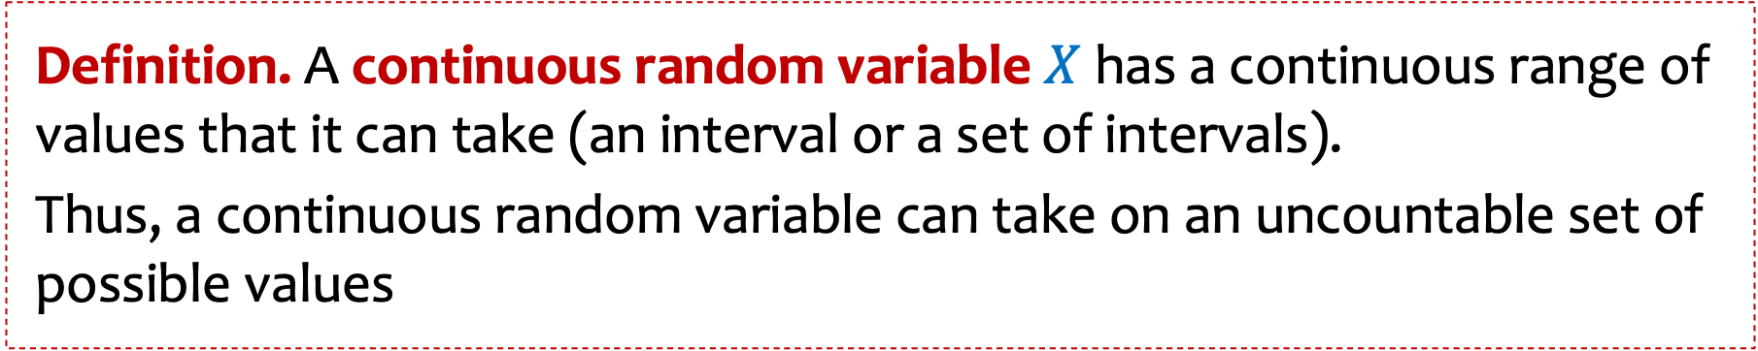
Definition. A continuous random variable $X$ has a continuous range of values that it can take (an interval or a set of intervals).
Thus, a continuous random variable can take on an uncountable set of possible values
Examples:
Time of an event
Response time of a job
Speed of a device
Location of a satellite
Distance between people’s eyeballs

Slide 3


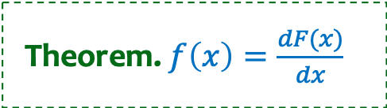



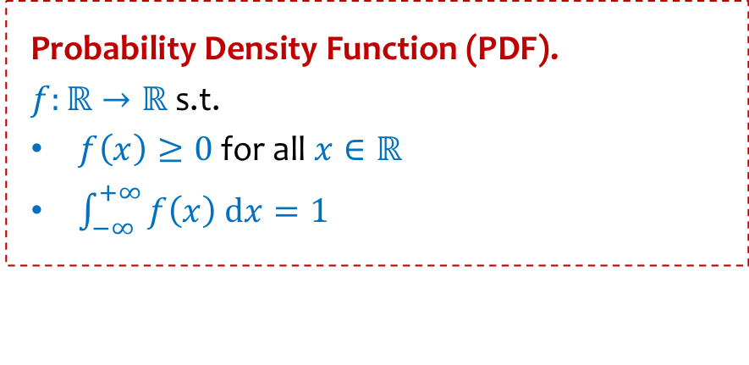

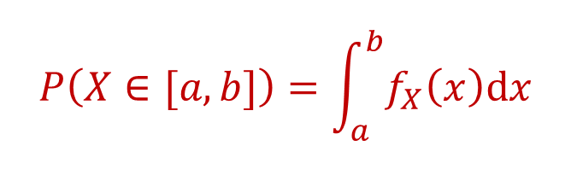
Recap – Continuous RVs
Probability Density Function (PDF).
$f:ℝ→ℝ$ s.t.
$f\left(x\right)≥0$ for all $x∈ℝ$
$\int_{−∞}^{+∞}{f\left(x\right) dx}=1$
Cumulative Distribution Function (CDF).
$$F\left(y\right)=\int_{−∞}^{y}{f(x) dx}$$
Theorem. $f\left(x\right)=\frac{dF(x)}{dx}$
$$f(x)$$
$$y$$
Density $≠$ Probability !
$$P\left(X∈[a,b]\right)=\int_{a}^{b}{f_{X}\left(x\right)dx}$$
$$F_{X}\left(y\right)=P\left(X≤y\right)$$
$$=F_{X}\left(b\right)−F_{X}(a)$$

Slide 4


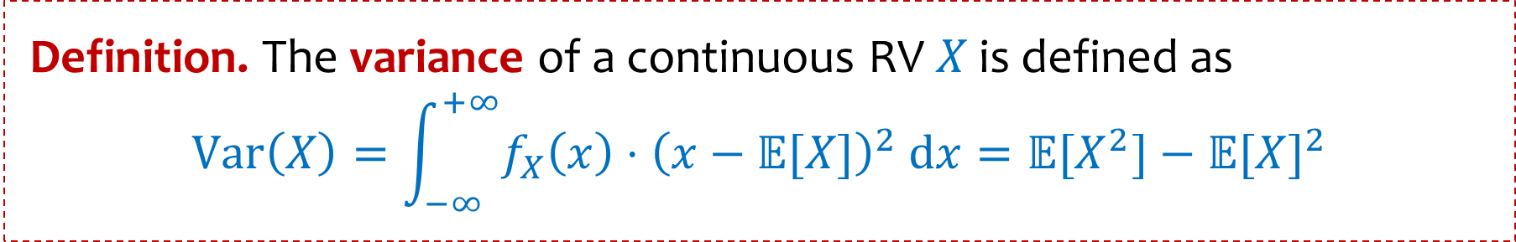
Expectation of a Continuous RV
Definition. The expected value of a continuous RV $X$ is defined as
$$𝔼[X]=\int_{−∞}^{+∞}{f_{X}\left(x\right)⋅x dx}$$
Fact. $𝔼[aX+bY+c]=a𝔼[X]+b𝔼[Y]+c$
Proofs follow same ideas as discrete case
Definition. The variance of a continuous RV $X$ is defined as
$$Var\left(X\right)=\int_{−∞}^{+∞}{f_{X}\left(x\right)⋅{\left(x−𝔼[X]\right)}^{2} dx}=𝔼[X^{2}]−𝔼{[X]}^{2}$$

Slide 5
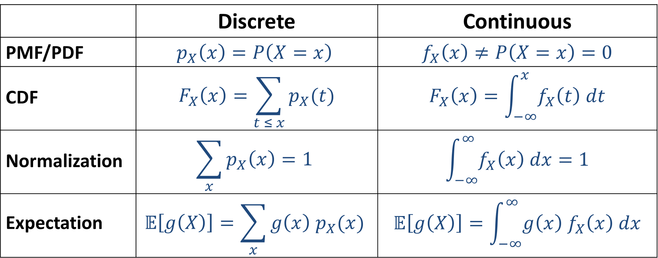
Recap: From Discrete to Continuous
 | Discrete | Continuous
PMF/PDF | $$p_{X}\left(x\right)=P\left(X=x\right)$$ | $$f_{X}\left(x\right)≠P\left(X=x\right)=0$$
CDF | $$F_{X}\left(x\right)=\sum_{t ≤ x}{p_{X}(t)}$$ | $$F_{X}\left(x\right)=\int_{−∞}^{x}{f_{X}\left(t\right) dt}$$
Normalization | $$\sum_{x}{p_{X}\left(x\right)=1}$$ | $$\int_{−∞}^{∞}{f_{X}\left(x\right) dx=1}$$
Expectation | $$𝔼\left[g\left(X\right)\right]=\sum_{x}{g\left(x\right) p_{X}(x)}$$ | $$𝔼\left[g\left(X\right)\right]=\int_{−∞}^{∞}{g\left(x\right){ f}_{X}\left(x\right) dx}$$

Slide 6



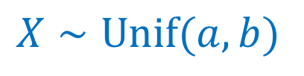

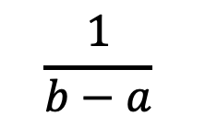
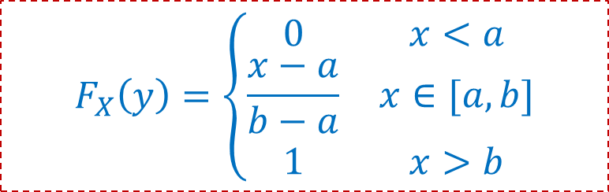
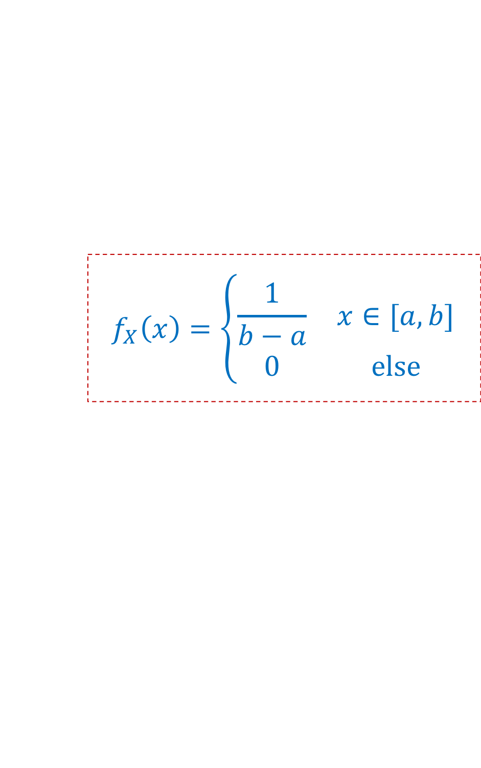

Uniform Distribution Summary
$$f_{X}\left(x\right)=\left\{\begin{matrix}\frac{1}{b−a} & x∈[a,b] \\ 0 & else\end{matrix}\right.$$
$X∼Unif(a,b)$
$$F_{X}\left(y\right)=\left\{\begin{matrix}0 & x<a \\ \frac{x−a}{b−a} & x∈[a,b] \\ 1 & x>b\end{matrix}\right.$$
$$\frac{1}{b−a}$$
$$𝔼\left[X\right]=\frac{a+b}{2}$$
$$Var\left(X\right)=\frac{{\left(b−a\right)}^{2}}{12}$$
0
$$a$$
$$b$$

Slide 7

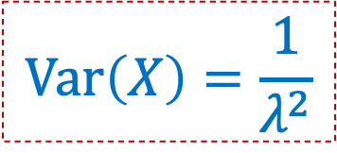
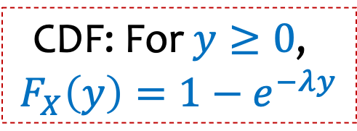

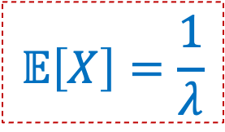
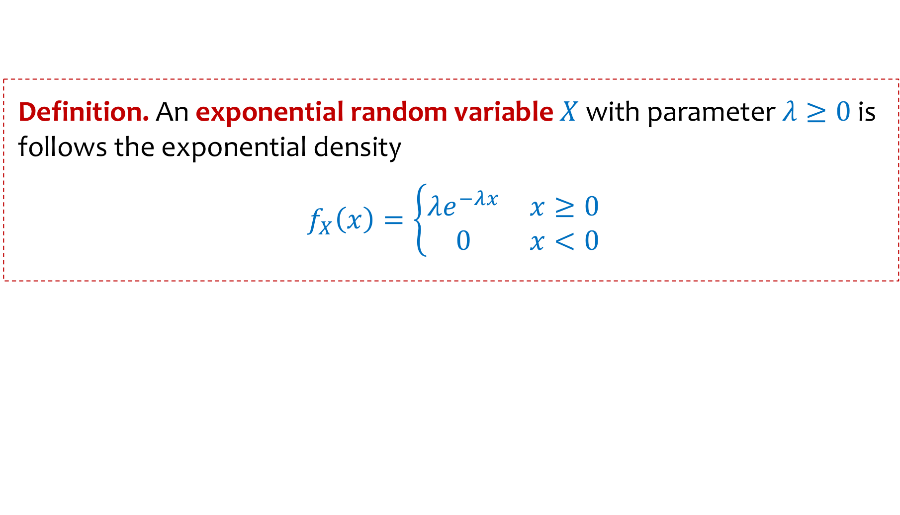



Exponential Distribution
$$P\left(X>t\right)=e^{−tλ}$$
We write $X∼Exp\left(λ\right)$ and say $X$that follows the exponential distribution.
Definition. An exponential random variable $X$with parameter $λ≥0$ is follows the exponential density
$f_{X}\left(x\right)=\left\{\begin{matrix}λe^{−λx} & x≥0 \\ 0 & x<0\end{matrix}\right.$
$$\text{CDF}\text{: }\text{For} y≥0\text{, }$$
$$F_{X}\left(y\right)={1−e}^{−λy}$$
$$λ=2$$
$$𝔼\left[X\right]=\frac{1}{λ}$$
$$λ=1.5$$
$$λ=1$$
$$Var\left(X\right)=\frac{1}{λ^{2}}$$
$$λ=0.5$$

Slide 8
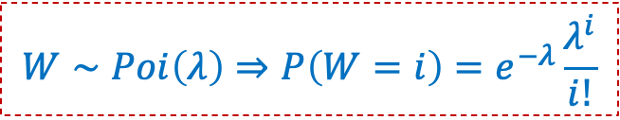
The Exponential PDF/CDF
$$W∼Poi\left(λ\right)⇒P\left(W=i\right)=e^{−λ}\frac{λ^{i}}{i!}$$
Assume expected # of occurrences of an event per unit of time is $λ$ (independently)
Numbers of occurrences of event: Poisson distribution
How long to wait until next event?
Exponential density!
The exponential RV has range $[0,∞]$, unlike Poisson with range $\{0,1,2,…\}$
Let $X\sim Exp\left(λ\right)$ be the time till the first event. We will compute $F_{X}\left(t\right)$ and $f_{X}\left(t\right)$
We know $Z_{t}\sim Poi\left(tλ\right)$ be the # of events in the first $t$ units of time, for $t≥0.$
$P\left(X>t\right)=P\left(no event in the first t units\right)=P\left(Z_{t}=0\right)=e^{−tλ}\frac{({tλ)}^{0}}{0!}=e^{−tλ}$
$F_{X}\left(t\right)=P(X≤t)=1−P\left(Y>t\right)=1−e^{−tλ}$
$f_{X}\left(t\right)=\frac{d}{dt}F_{X}\left(t\right)={λe}^{−tλ}$

Slide 9


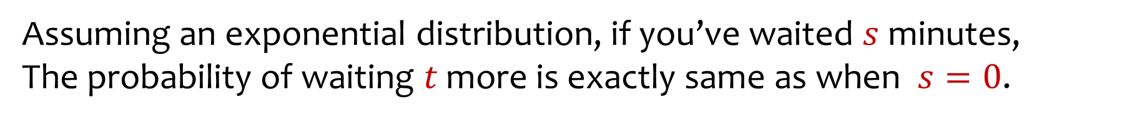
Memorylessness
Definition. A random variable is memoryless if for all $s,t>0$,
$$P\left(X>s+t \right| X>s)=P\left(X>t\right).$$
Fact. $X∼Exp(λ)$ is memoryless.
Assuming an exponential distribution, if you’ve waited $s$ minutes,
The probability of waiting $t$ more is exactly same as when $s=0$.

Slide 10
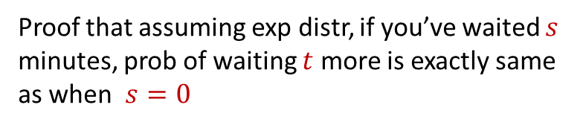
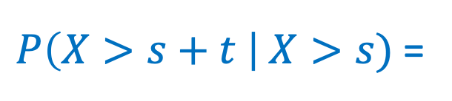


Memorylessness of Exponential
$$P\left(X>t\right)=e^{−λt}$$
Proof that assuming exp distr, if you’ve waited $s$ minutes, prob of waiting $t$ more is exactly same as when $s=0$
Fact. $X∼Exp(λ)$ is memoryless.
Proof.
$P\left(X>s+t \right| X>s)$ =

Slide 11
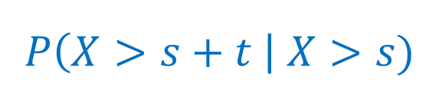

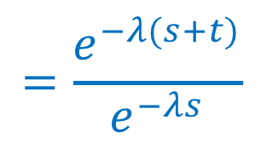
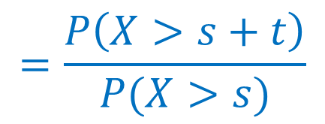
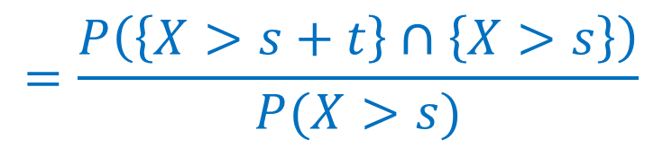
Memorylessness of Exponential
$$P\left(X>t\right)=e^{−λt}$$
Proof that assuming exp distr, if you’ve waited $s$ minutes, prob of waiting $t$ more is exactly same as when $s=0$
Fact. $X∼Exp(λ)$ is memoryless.
Proof.
$$P\left(X>s+t \right| X>s)$$
$$=\frac{P\left(\left\{X>s+t\right\}∩\left\{X>s\right\}\right)}{P(X>s)}$$
$$=\frac{P\left(X>s+t\right)}{P(X>s)}$$
$$=\frac{e^{−λ(s+t)}}{e^{−λs}}$$
$$=e^{−λt}=P(X>t)$$
The only memoryless RVs are the geometric RV (discrete) and Exp RV (continuous)

Slide 13
Example
Time it takes to check someone out at a grocery store is exponential with an expected value of 10 mins.
Independent for different customers
If there is one person currently being served, what is the probability that you will have to wait between 10 and 20 mins until you start getting service?

Slide 15
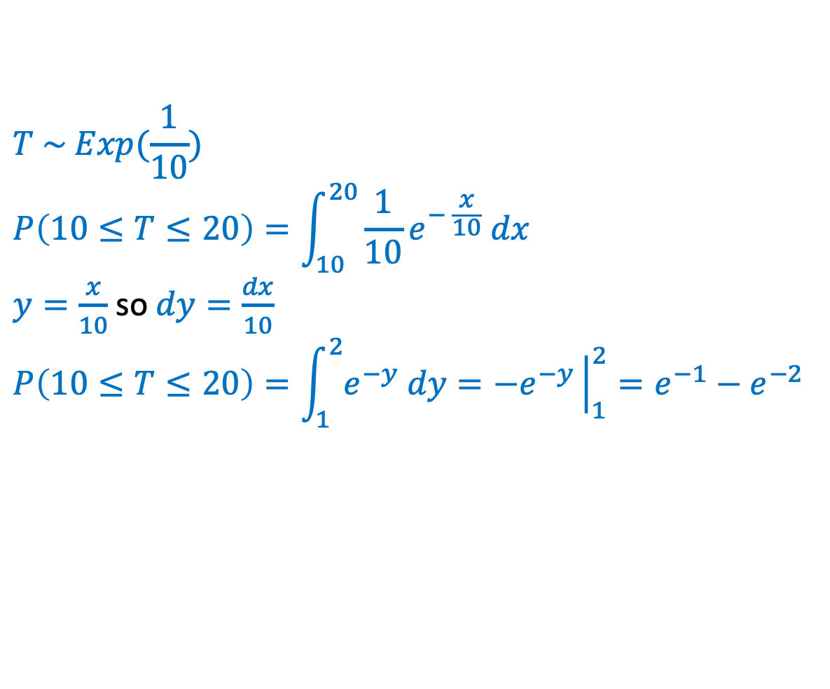
Example
Time it takes to check someone out at a grocery store is exponential with an expected value of 10 mins.
Independent for different customers
If there is one person currently being served, what is the probability that you will have to wait between 10 and 20 mins until you start getting service?
$$T \sim Exp(\frac{1}{10})$$
$$P\left(10≤T≤20\right)=\int_{10}^{20}{\frac{1}{10}e^{− \frac{x}{10}} dx}$$
$y=\frac{x}{10}$ so $dy=\frac{dx}{10}$
$$P\left(10≤T≤20\right)=\int_{1}^{2}{e^{−y} dy}={−e}^{−y}{\left.​\right|}_{1}^{2}=e^{−1}−e^{−2}$$

Slide 16
Agenda
Zoo
Exponential Distribution
Normal Distribution

Slide 17
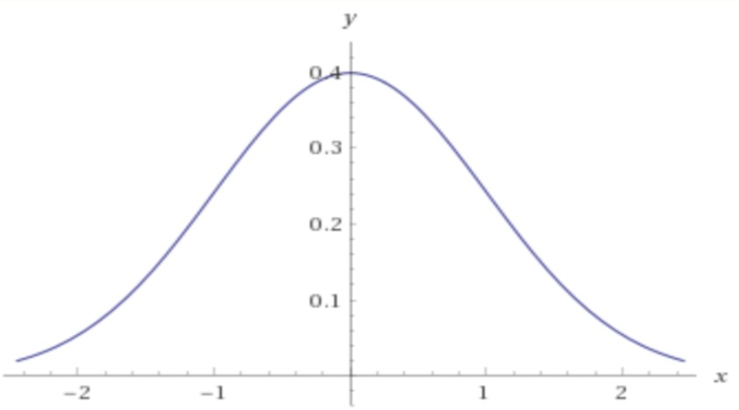
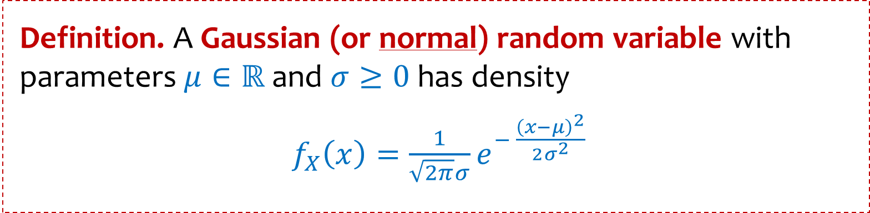
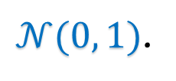
The Normal Distribution
Definition. A Gaussian (or normal) random variable with parameters $μ∈ℝ$ and $σ≥0$has density
$f_{X}\left(x\right)=\frac{1}{\sqrt{2π}σ}e^{− \frac{{\left(x−μ\right)}^{2}}{2σ^{2}}}$
Carl Friedrich Gauss
We say that $X$ follows the Normal Distribution, and write $X∼𝒩(μ, σ^{2})$.
$𝒩(0, 1)$.

Slide 18
The Normal Distribution
Definition. A Gaussian (or normal) random variable with parameters $μ∈ℝ$ and $σ≥0$has density
$f_{X}\left(x\right)=\frac{1}{\sqrt{2π}σ}e^{− \frac{{\left(x−μ\right)}^{2}}{2σ^{2}}}$
Carl Friedrich Gauss
We say that $X$ follows the Normal Distribution, and write $X∼𝒩(μ, σ^{2})$.
Fact. If $X∼𝒩\left(μ, σ^{2}\right)$, then $𝔼[X]=μ$, and $Var\left(X\right)=σ^{2}$

Slide 19
The Normal Distribution
Definition. A Gaussian (or normal) random variable with parameters $μ∈ℝ$ and $σ≥0$has density
$f_{X}\left(x\right)=\frac{1}{\sqrt{2π}σ}e^{− \frac{{\left(x−μ\right)}^{2}}{2σ^{2}}}$
Carl Friedrich Gauss
We say that $X$ follows the Normal Distribution, and write $X∼𝒩(μ, σ^{2})$.
Fact. If $X∼𝒩\left(μ, σ^{2}\right)$, then $𝔼[X]=μ$, and $Var\left(X\right)=σ^{2}$
Proof of expectation is easy because density curve is symmetric around $μ$,
$f_{X}\left(μ−x\right)=f_{X}(μ+x)$, but proof for variance requires integration of $e^{−x^{2}/2}$
We will see next time why the normal distribution is (in some sense) the most important distribution.

Slide 20
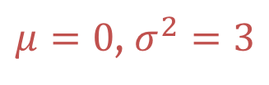

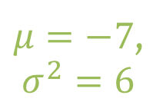

The Normal Distribution
Aka a “Bell Curve” (imprecise name)
$μ=7$,
$σ^{2}=1$
$μ=0$, $σ^{2}=3$
$μ=−7$,
$σ^{2}=6$
$μ=0$,
$σ^{2}=8$

Slide 21
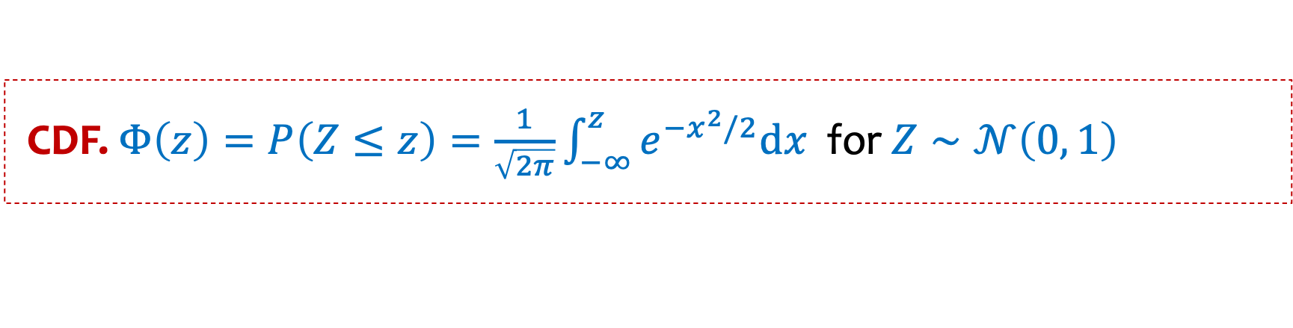
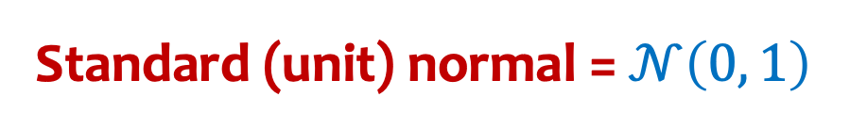
Standard normal distribution
Standard (unit) normal = $𝒩\left(0, 1\right)$
CDF. $Φ\left(z\right)=P\left(Z≤z\right)=\frac{1}{\sqrt{2π}}\int_{−∞}^{z}{e^{−x^{2}/2}dx}$ for $Z∼𝒩\left(0, 1\right)$
Note: $Φ\left(z\right)$has no closed form – generally given via tables

Slide 22
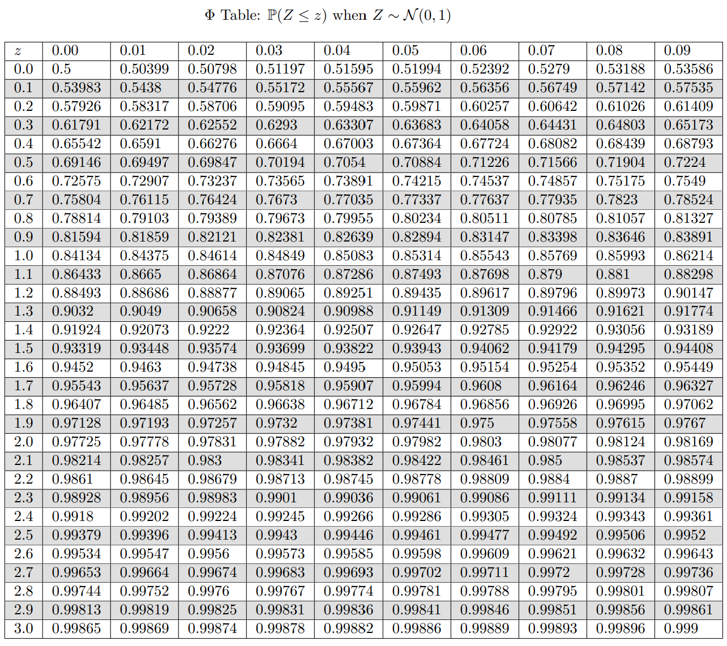
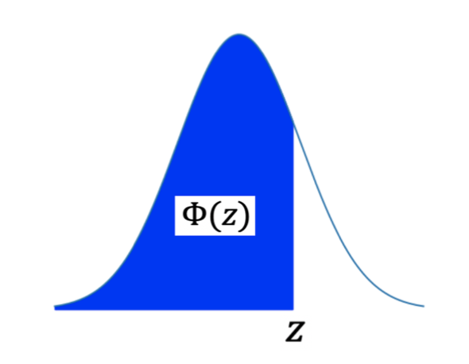






Table of Standard Cumulative Normal Density $𝒩\left(0, 1\right)$
$$P\left(Z≤0.98\right)$$
$$=Φ\left(0.98\right)$$
$$≈0.8365$$
$$P\left(Z≤1\right)$$
$$=Φ\left(1.00\right)$$
$$≈0.84134$$

Slide 23
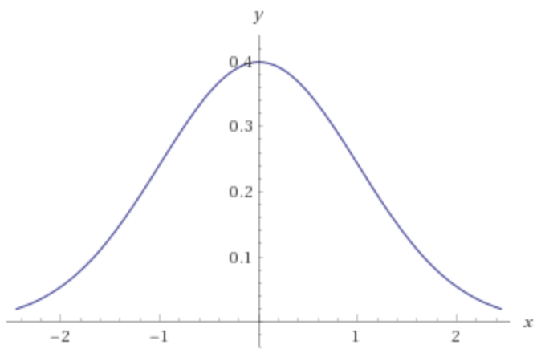

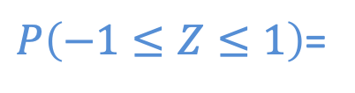


The Standard Normal CDF
$$P\left(Z≤1\right)$$
$$=Φ\left(1.00\right)$$
$$≈0.84$$
What is the probability that a standard Normal is within one standard deviation of its mean?
$P\left(−1≤Z≤1\right)$=

Slide 24
Important facts about normal distributions
Fact: Normal distributions stay normal under shifting and scaling.
Fact. If $X∼𝒩\left(μ, σ^{2}\right)$, then $\frac{X−μ}{σ}∼𝒩\left(0, 1\right)$

Slide 25
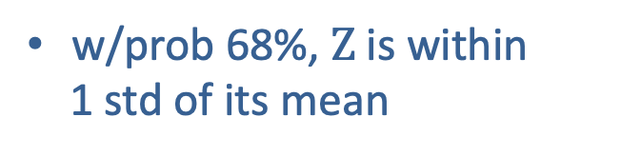
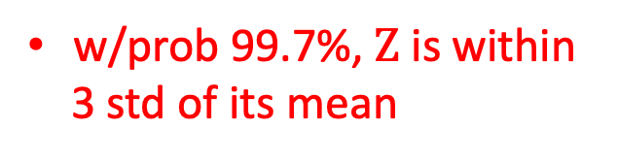
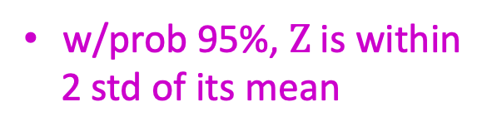
Deviation from the Mean
If $Z∼Normal\left(0, 1\right)$, then $P\left\{−k<Z<k\right\}= 2Φ\left(k\right)−1$
w/prob 68%, $Z$is within
1 std of its mean
w/prob 95%, $Z$is within
2 std of its mean
w/prob 99.7%, $Z$is within
3 std of its mean
-3
-2
-1
0
1
2
3

Slide 26
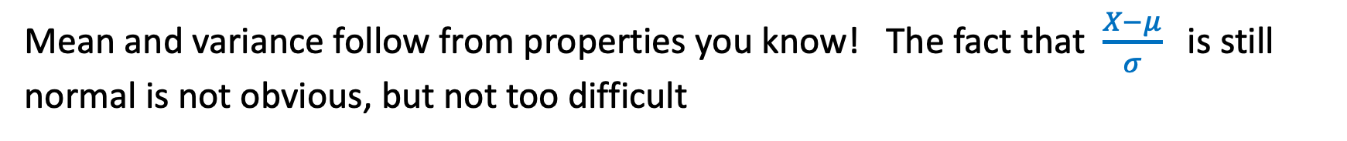
Closure of normal distribution – Under Shifting and Scaling
Fact. If $X∼𝒩\left(μ, σ^{2}\right)$, then $\frac{X−μ}{σ}∼𝒩\left(0, 1\right)$
Mean and variance follow from properties you know! The fact that $\frac{X−μ}{σ}$is still normal is not obvious, but not too difficult

Slide 27
Closure of normal distribution – Under Shifting and Scaling
Fact. If $X∼𝒩\left(μ, σ^{2}\right)$, then $\frac{X−μ}{σ}∼𝒩\left(0, 1\right)$
Fact. If $X∼𝒩\left(μ, σ^{2}\right)$, then $Y=aX+b∼𝒩\left(aμ+b, {a^{2}σ}^{2}\right)$
Mean and variance follow from properties you know! The fact that result of shifting and scaling still normal is not obvious, but not too difficult

Slide 28

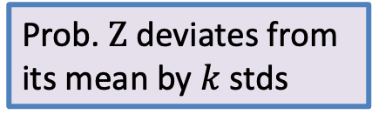
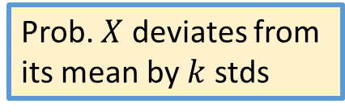
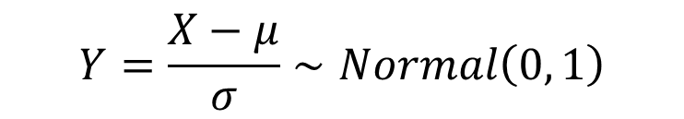

But what if we don’t have a standard Normal?
Bottom line: Deviations from mean we saw for a standard Normal holds for
general Normal (provided it’s phrased in terms of standard deviations.
$$Y=\frac{X−μ}{σ}∼Normal\left(0, 1\right)$$
$$X∼Normal\left(μ, σ^{2}\right)$$
$$P\left\{−kσ<X −μ<kσ\right\}=P\left\{−k<\frac{X−μ}{σ}<k\right\}=P\{−k<Z<k\}$$
Prob. $X$ deviates from
its mean by $k$ stds
Prob. $Z$ deviates from
its mean by $k$ stds

Slide 29
Agenda
Normal Distribution
Practice with Normals

Slide 30
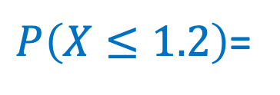
Example
Let $X∼𝒩\left(0.4, 4=2^{2}\right)$.
$P\left(X≤1.2\right)$=

Slide 31
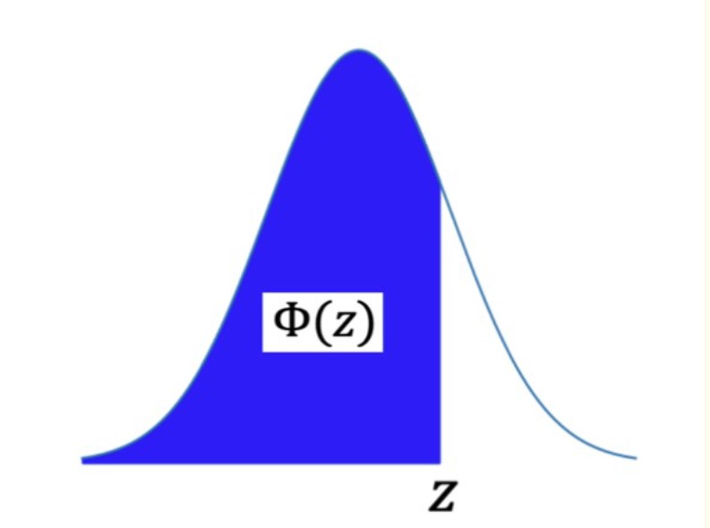
Table of Standard Cumulative Normal Density

Slide 32
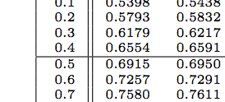


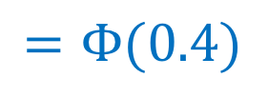

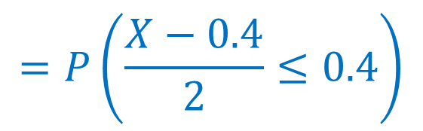
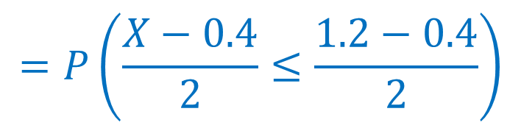
Example
Let $X∼𝒩\left(0.4, 4=2^{2}\right)$.
$$=P\left(\frac{X−0.4}{2}≤\frac{1.2−0.4}{2}\right)$$
$$P\left(X≤1.2\right)$$
$$=P\left(\frac{X−0.4}{2}≤0.4\right)$$
$$=Φ(0.4)$$
$$≈0.6554$$
$$∼𝒩\left(0, 1\right)$$

Slide 33

Example
Let $X∼𝒩\left(3, 16\right)$.
$P\left(2<X<5\right)$ $=$

Slide 34
Table of Standard Cumulative Normal Density

Slide 35
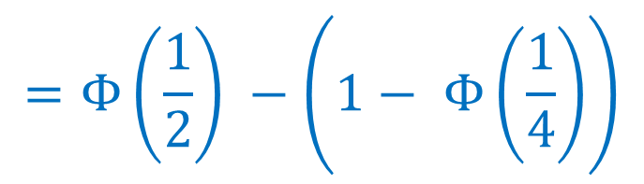





Example
Let $X∼𝒩\left(3, 16\right)$.
$$=P\left(\frac{2 −3}{4}<\frac{X−3}{4}<\frac{5 −3}{4}\right)$$
$$P\left(2<X<5\right)$$
$$=P\left(−\frac{1}{4}<Z<\frac{1}{2}\right)$$
$$=Φ\left(\frac{1}{2}\right) −Φ\left(−\frac{1}{4}\right)$$
$$=Φ\left(\frac{1}{2}\right) −\left(1− Φ\left(\frac{1}{4}\right)\right)$$
$$≈0.29017$$

Slide 36

Summary so far
Normal distributions stay normal under shifting and scaling.
To “standardize” a normal random variable $X∼𝒩\left(μ,σ^{2}\right)$, you subtract the mean and divide by the standard deviation, i.e.,
$\frac{X −μ}{σ}∼𝒩(0, 1)$
This allows you to use the standard normal tables (showing $Φ\left(z\right)=P\left(Z≤z\right)$ for $Z∼𝒩\left(0, 1\right)$) to do calculations for any normal distribution.

Slide 37


Another important property: closure under addition
Fact. If $X∼𝒩\left(μ_{X}, σ_{X}^{2}\right)$, $Y∼𝒩\left(μ_{Y}, σ_{Y}^{2}\right)$ (both independent normal RV) then $aX+bY+c∼𝒩\left(aμ_{X}+bμ_{Y}+c, {a^{2}σ}_{X}^{2}+b^{2}σ_{Y}^{2}\right)$
Note: The special thing is that the sum of normal RVs is still a normal RV.
The values of the expectation and variance are not surprising.
Why not surprising?
Linearity of expectation (always true)
When $X$ and $Y$ are independent, $Var\left(aX+bY\right)=a^{2}Var\left(X\right)+b^{2}Var(Y)$

Slide 38

Normal Distribution
Paranormal Distribution

