Slide 1
Continuous Random Variables
CSE 312 Spring 26
Lecture 15

Slide 2
Agenda
Continuous Random Variables
Probability Density Function
Cumulative Distribution Function
Expectation and Variance of continuous r.v.
Introduction to continuous zoo
Often we want to model experiments where the outcome is not discrete.

Slide 3
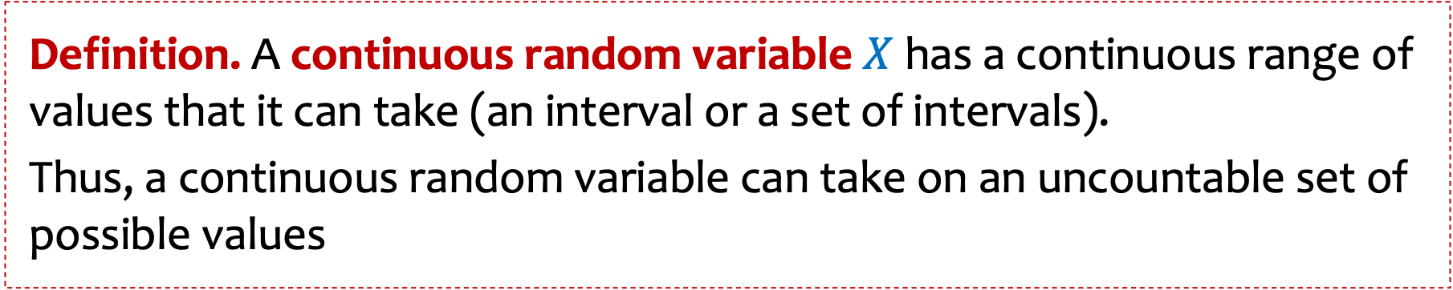
Definition. A continuous random variable $X$ has a continuous range of values that it can take (an interval or a set of intervals).
Thus, a continuous random variable can take on an uncountable set of possible values
Examples:
Time of an event
Response time of a job
Speed of a device
Location of a satellite
Distance between people’s eyeballs

Slide 4

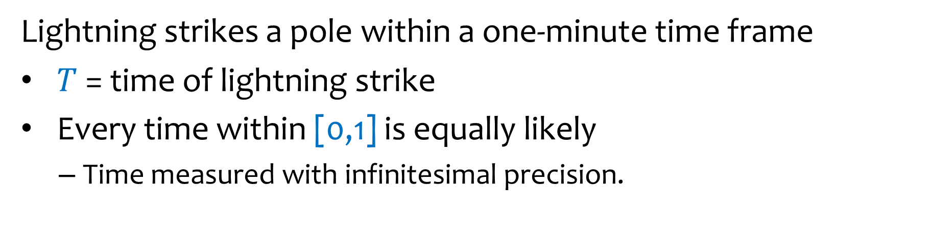

Example – Lightning Strike
Lightning strikes a pole within a one-minute time frame
$T$ = time of lightning strike
Every time within [0,1] is equally likely
  Time measured with infinitesimal precision.
0
$$T=0.71237131931129576…$$
1
The outcome space is not discrete

Slide 5
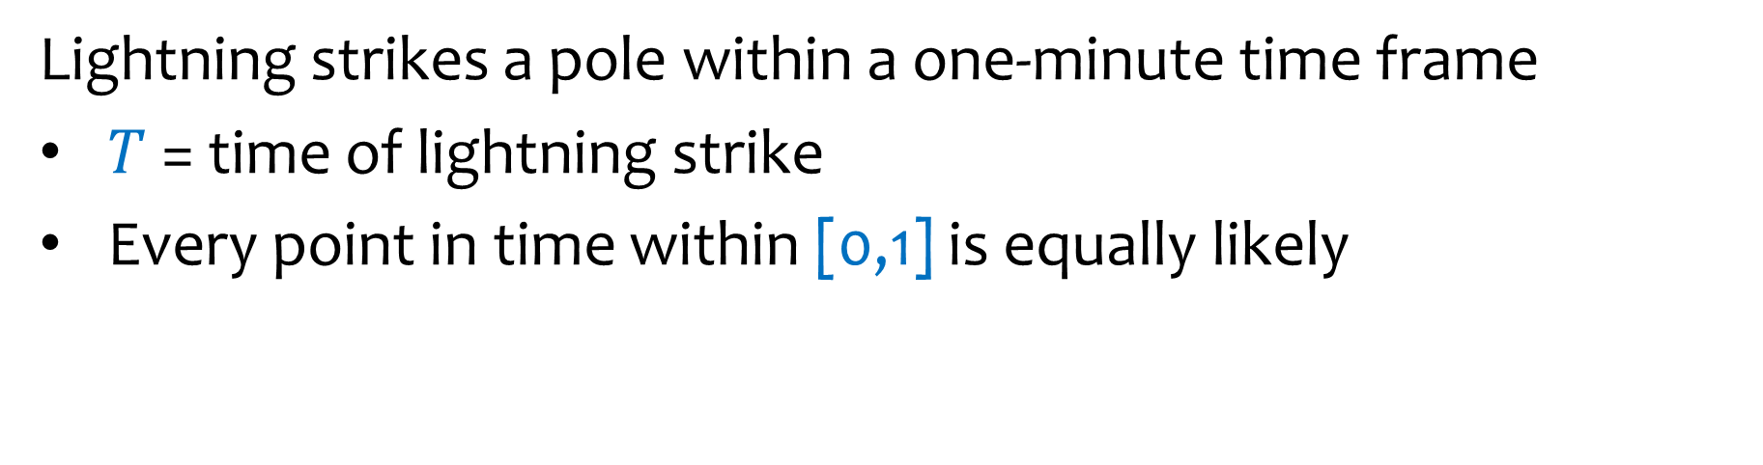

Lightning strikes a pole within a one-minute time frame
$T$ = time of lightning strike
Every point in time within [0,1] is equally likely
$$P\left(T≥0.5\right)=$$
0
0.5
1

Slide 6

Lightning strikes a pole within a one-minute time frame
$T$ = time of lightning strike
Every point in time within [0,1] is equally likely
0
0.2
0.5
1
$$P\left(0.2≤T≤0.5\right)=$$

Slide 7


Lightning strikes a pole within a one-minute time frame
$T$ = time of lightning strike
Every point in time within [0,1] is equally likely
0
0.5
1
$$P\left(T=0.5\right)=$$

Slide 8
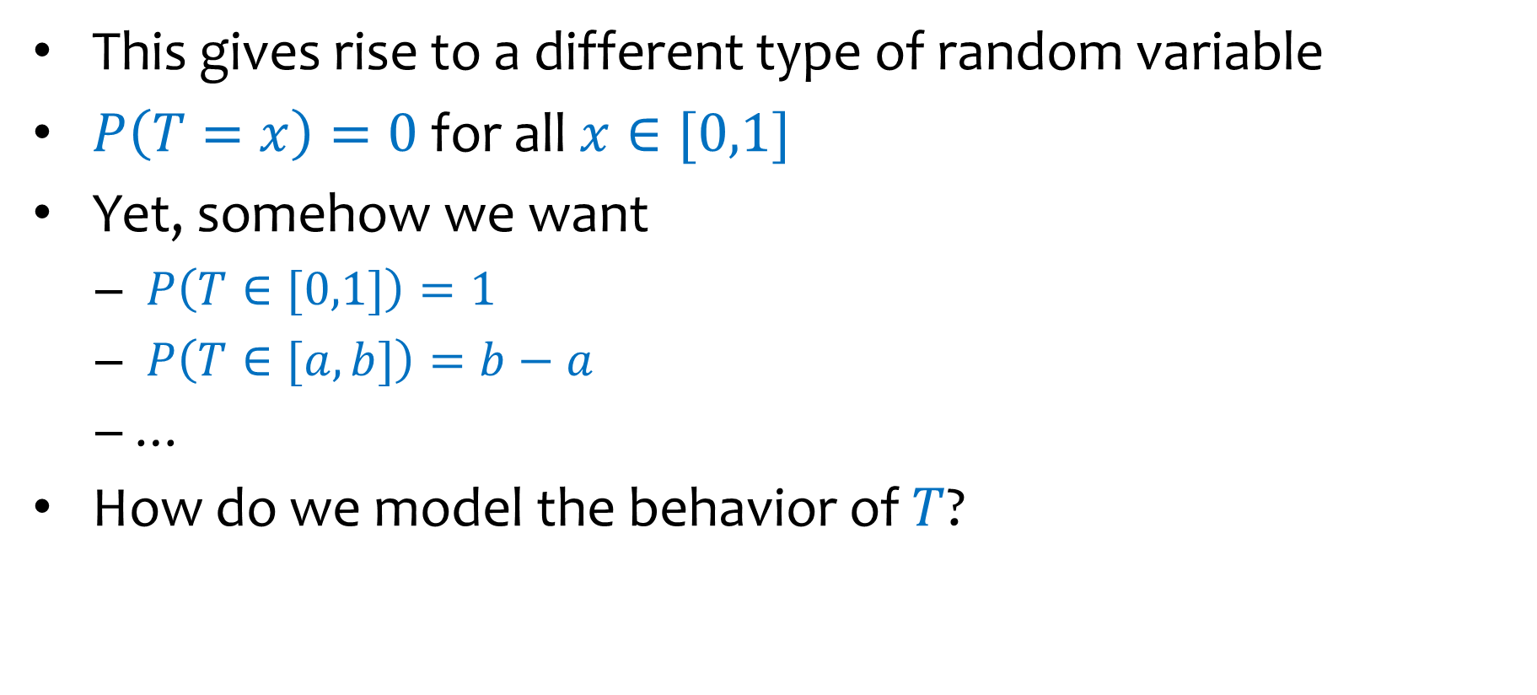
Bottom line
This gives rise to a different type of random variable
$P\left(T=x\right)=0$ for all $x∈[0,1]$
Yet, somehow we want
  $P\left(T∈[0,1]\right)=1$
  $P\left(T∈[a,b]\right)=b−a$
  …
How do we model the behavior of $T$?
First try: A discrete approximation

Slide 9


Example – Lightning Strike
Lightning strikes a pole within a one-minute time frame
$X$ = time of lightning strike
Every time within [0,1] is equally likely
  Time measured with infinitesimal precision.
0
$$X=0.71237131931129576…$$
1
Discrete approximation?

Slide 10

















A Discrete Approximation
Probability Mass Function
PMF
$$1$$
$$p_{X}$$
$$i/n$$
$$3/n$$
$$2/n$$
$$1/n$$
$$\frac{1}{n}$$
$$\frac{2}{n}$$
$$\frac{3}{n}$$
$$\frac{i}{n}$$
$$\frac{1}{n}$$
$$\frac{2}{n}$$
$$\frac{3}{n}$$
$$\frac{i}{n}$$
$$1$$
$$1$$

Slide 11
A Discrete Approximation
Probability Mass Function
PMF
Cumulative Distribution Function
CDF
$$1$$
$$p_{X}$$
$$i/n$$
$$3/n$$
$$2/n$$
$$1/n$$
$$\frac{1}{n}$$
$$\frac{2}{n}$$
$$\frac{3}{n}$$
$$\frac{i}{n}$$
$$\frac{1}{n}$$
$$\frac{2}{n}$$
$$\frac{3}{n}$$
$$\frac{i}{n}$$
$$1$$
$$1$$

Slide 12
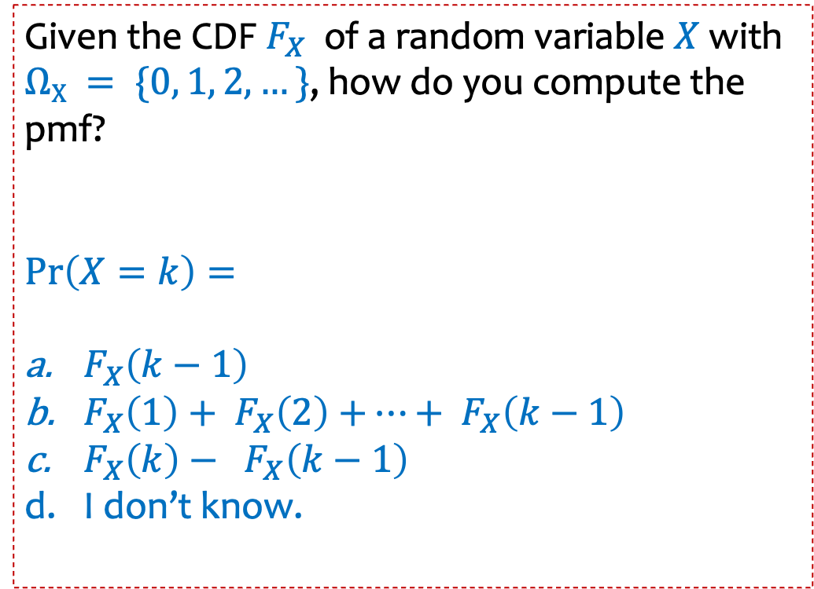
Given the CDF $F_{X}$of a random variable $X$with $ΩX = \{0, 1, 2,…\}$, how do you compute the pmf?
$\operatorname{Pr}\left(X=k\right)=$
$F_{X}\left(k−1\right)$
$F_{X}\left(1\right)+$ $F_{X}\left(2\right)$ $+…+$ $F_{X}\left(k−1\right)$
$F_{X}\left(k\right)− F_{X}\left(k−1\right)$
I don’t know.

Slide 13


Definition. A continuous random variable $X$ is defined by a probability density function (PDF) $f_{X}:ℝ→ℝ$, such that
Non-negativity: $f_{X}\left(x\right)≥0$ for all $x∈ℝ$

Slide 14

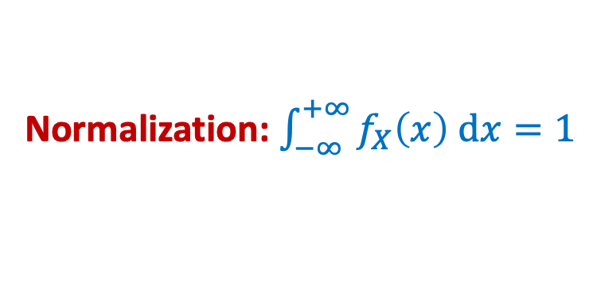
Probability Density Function - Intuition
Non-negativity: $f_{X}\left(x\right)≥0$ for all $x∈ℝ$
Normalization: $\int_{−∞}^{+∞}{f_{X}\left(x\right) dx}=1$

Slide 15
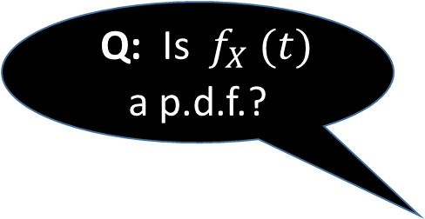
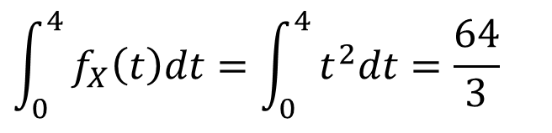
Density as a rate
Density functions are not necessarily related to probability.
Example: Filling a bathtub at rate $f_{X}\left(t\right)=t^{2} \text{gallons}\text{/}\text{sec}\text{, }\text{where} t≥0$
Q: How much water after 4 seconds?
Q: Is ${f_{X}}_{ }(t)$ a p.d.f.?
A:
$${\int_{0}^{4}{f_{X}\left(t\right)dt=\int_{0}^{4}{t^{2}dt=\frac{64}{3}}}}_{ }$$
gallons
Notes:
No, for f(t) to be a pdf it has to integrate to 1, which is not rue here. (and it has no relation to probability here.

Slide 16
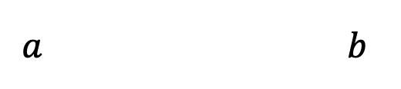
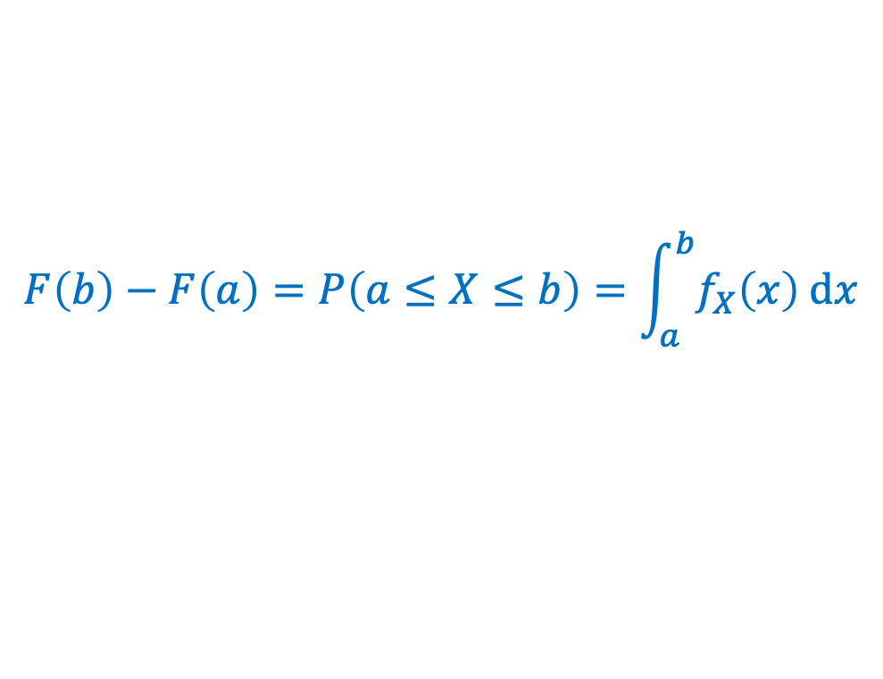
Probability Density Function - Intuition
Non-negativity: $f_{X}\left(x\right)≥0$ for all $x∈ℝ$
Normalization: $\int_{−∞}^{+∞}{f_{X}\left(x\right) dx}=1$
$$F\left(b\right)−F\left(a\right)=P\left(a≤X≤b\right)=\int_{a}^{b}{f_{X}\left(x\right) dx}$$

Slide 17


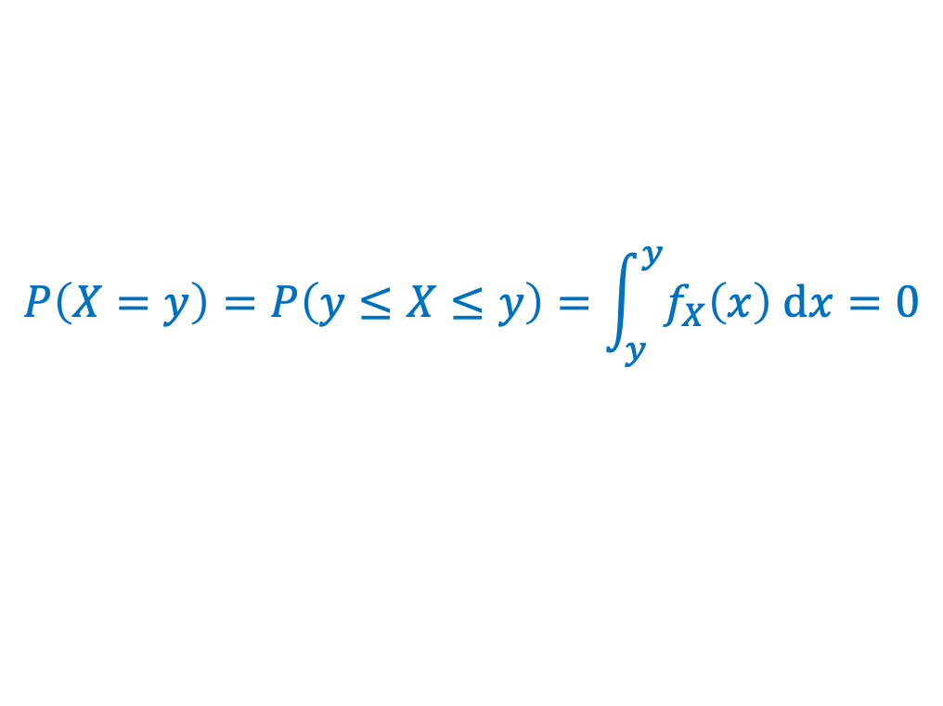


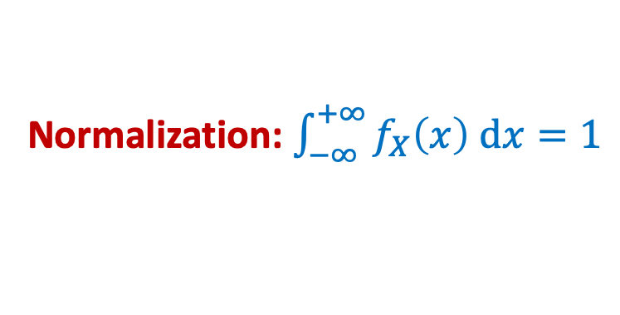


Probability Density Function - Intuition
Non-negativity: $f_{X}\left(x\right)≥0$ for all $x∈ℝ$
Normalization: $\int_{−∞}^{+∞}{f_{X}\left(x\right) dx}=1$
$$F\left(b\right)−F\left(a\right)=P\left(a≤X≤b\right)=\int_{a}^{b}{f_{X}\left(x\right) dx}$$
$$P\left(X=y\right)=P\left(y≤X≤y\right)=\int_{y}^{y}{f_{X}\left(x\right) dx}=0$$
Density $≠$ Probability
$$y$$
$$f_{X}\left(y\right)≠0$$
$$P\left(X=y\right)=0$$

Slide 18

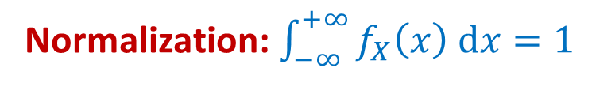


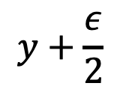
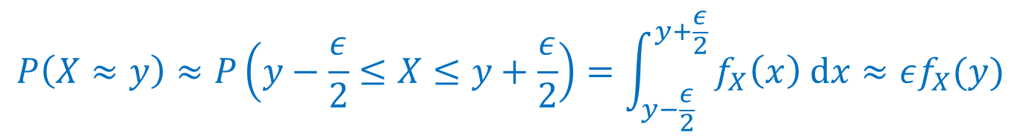
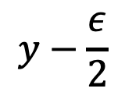
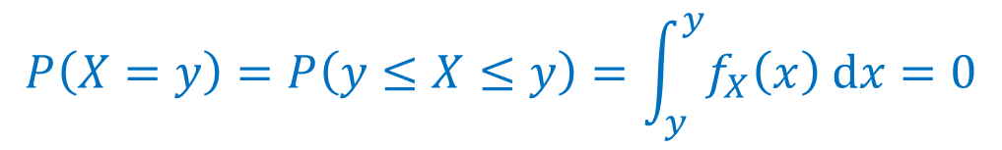
Probability Density Function - Intuition
Non-negativity: $f_{X}\left(x\right)≥0$ for all $x∈ℝ$
Normalization: $\int_{−∞}^{+∞}{f_{X}\left(x\right) dx}=1$
$$F\left(b\right)−F\left(a\right)=P\left(a≤X≤b\right)=\int_{a}^{b}{f_{X}\left(x\right) dx}$$
$$P\left(X=y\right)=P\left(y≤X≤y\right)=\int_{y}^{y}{f_{X}\left(x\right) dx}=0$$
$$P\left(X≈y\right)≈P\left(y−\frac{ε}{2}≤X≤y+\frac{ε}{2}\right)=\int_{y−\frac{ε}{2}}^{y+\frac{ε}{2}}{f_{X}\left(x\right) dx}≈εf_{X}(y)$$
$$y−\frac{ε}{2}$$
$$y+\frac{ε}{2}$$
$$y$$
What $f_{X}(x)$ measures: The local rate at which probability accumulates

Slide 19
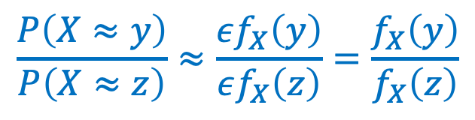
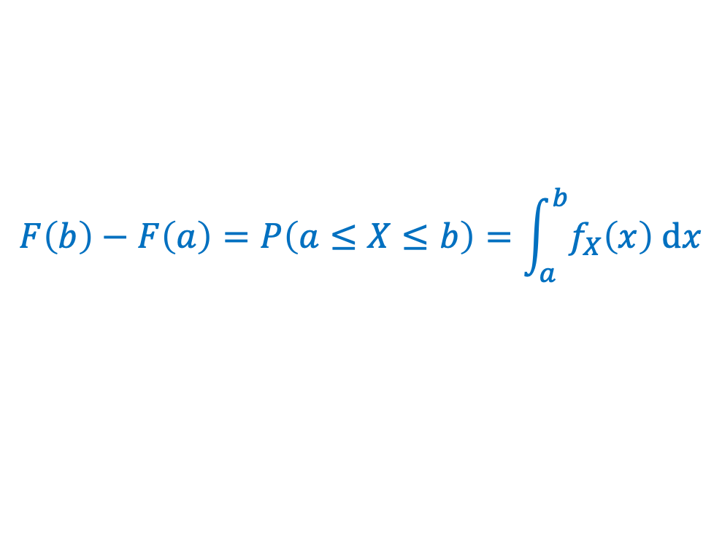



Probability Density Function - Intuition
Non-negativity: $f_{X}\left(x\right)≥0$ for all $x∈ℝ$
$$\frac{P\left(X≈y\right)}{P\left(X≈z\right)}=2$$
Normalization: $\int_{−∞}^{+∞}{f_{X}\left(x\right) dx}=1$
$$F\left(b\right)−F\left(a\right)=P\left(a≤X≤b\right)=\int_{a}^{b}{f_{X}\left(x\right) dx}$$
$$P\left(X=y\right)=P\left(y≤X≤y\right)=\int_{y}^{y}{f_{X}\left(x\right) dx}=0$$
$$y$$
$$z$$
$$P\left(X≈y\right)≈P\left(y−\frac{ε}{2}≤X≤y+\frac{ε}{2}\right)=\int_{y−\frac{ε}{2}}^{y+\frac{ε}{2}}{f_{X}\left(x\right) dx}≈εf_{X}(y)$$
$$\frac{P\left(X≈y\right)}{P\left(X≈z\right)}≈\frac{εf_{X}\left(y\right)}{εf_{X}\left(z\right)}=\frac{f_{X}\left(y\right)}{f_{X}\left(z\right)}$$

Slide 20
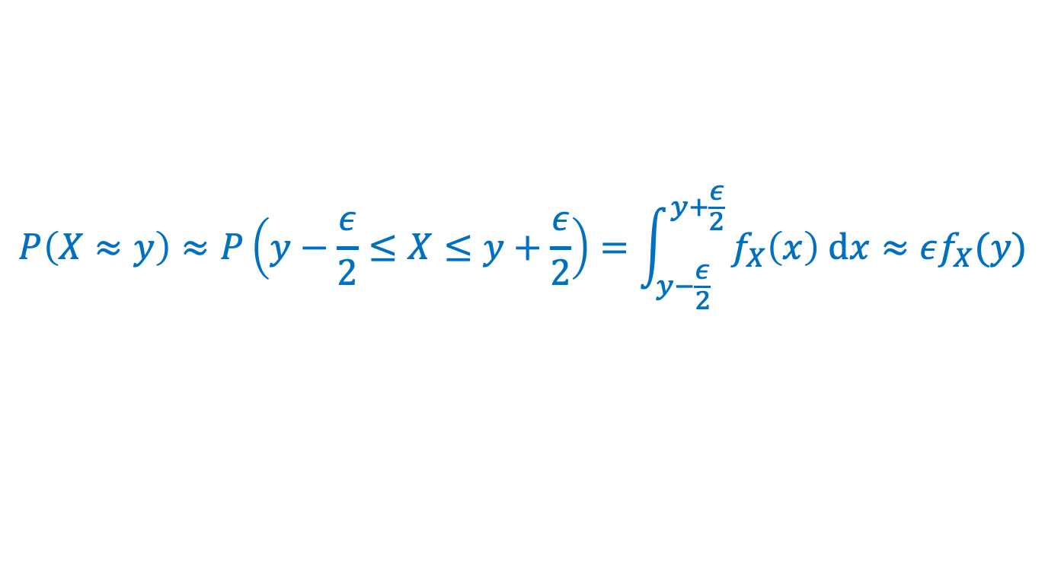

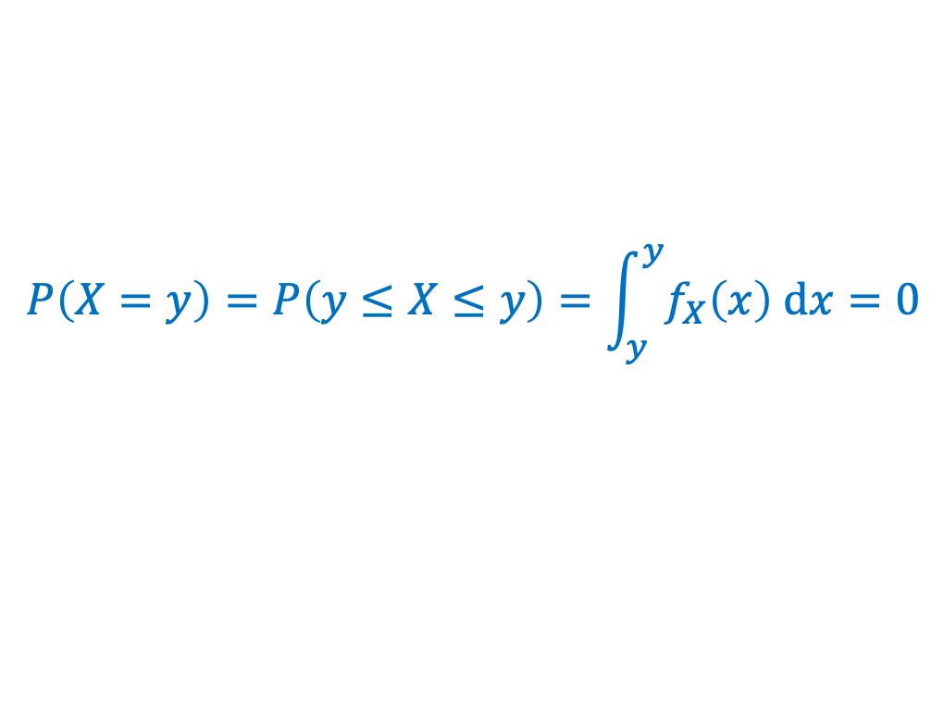

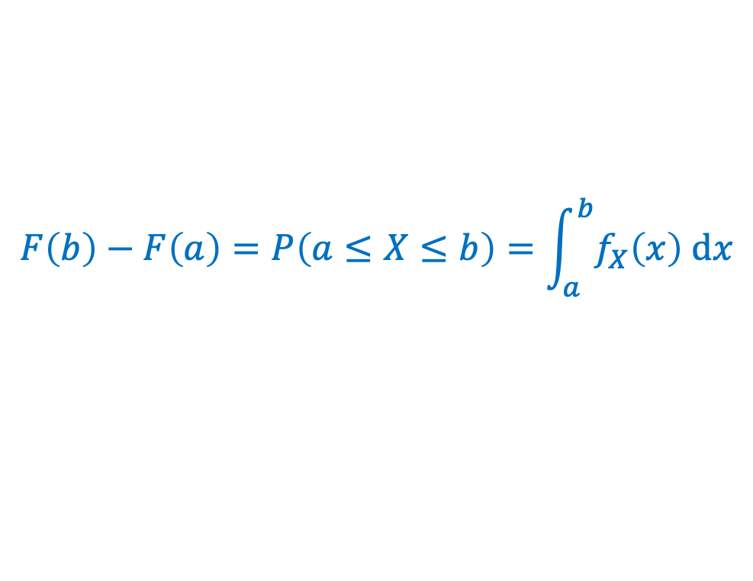

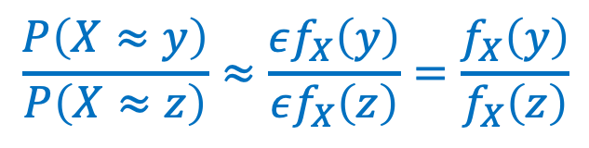
Definition. A continuous random variable $X$ is defined by a probability density function (PDF) $f_{X}:ℝ→ℝ$, such that
Non-negativity: $f_{X}\left(x\right)≥0$ for all $x∈ℝ$
Normalization: $\int_{−∞}^{+∞}{f_{X}\left(x\right) dx}=1$
$$F\left(b\right)−F\left(a\right)=P\left(a≤X≤b\right)=\int_{a}^{b}{f_{X}\left(x\right) dx}$$
$$P\left(X=y\right)=P\left(y≤X≤y\right)=\int_{y}^{y}{f_{X}\left(x\right) dx}=0$$
$$P\left(X≈y\right)≈P\left(y−\frac{ε}{2}≤X≤y+\frac{ε}{2}\right)=\int_{y−\frac{ε}{2}}^{y+\frac{ε}{2}}{f_{X}\left(x\right) dx}≈εf_{X}(y)$$
$$\frac{P\left(X≈y\right)}{P\left(X≈z\right)}≈\frac{εf_{X}\left(y\right)}{εf_{X}\left(z\right)}=\frac{f_{X}\left(y\right)}{f_{X}\left(z\right)}$$

Slide 21
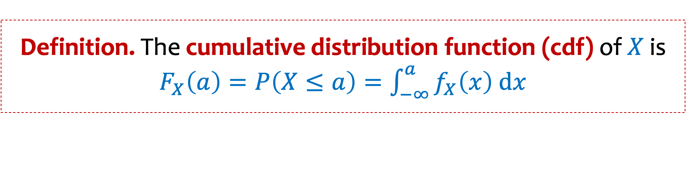
Cumulative Distribution Function
Definition. The cumulative distribution function (cdf) of $X$ is $F_{X}\left(a\right)=P\left(X≤a\right)=\int_{−∞}^{a}{f_{X}\left(x\right) dx}$
By the fundamental theorem of Calculus $f_{X}\left(x\right)=\frac{d}{dx}F_{X}(x)$

Slide 22

Cumulative Distribution Function
Definition. The cumulative distribution function (cdf) of $X$ is $F_{X}\left(a\right)=P\left(X≤a\right)=\int_{−∞}^{a}{f_{X}\left(x\right) dx}$
By the fundamental theorem of Calculus $f_{X}\left(x\right)=\frac{d}{dx}F_{X}(x)$
Therefore: $P\left(X∈[a,b]\right)=F_{X}\left(b\right)−F_{X}(a)$
$F_{X}$ is monotone increasing, since $f_{X}\left(x\right)≥0$. That is $F_{X}\left(c\right)≤F_{X}\left(d\right)$ for $c≤d$
$$\lim_{a→−∞}{ F}_{X}\left(a\right)=P\left(X≤−∞\right)=0$$
$$\lim_{a→+∞}{ F}_{X}\left(a\right)=P\left(X≤+∞\right)=1$$

Slide 23

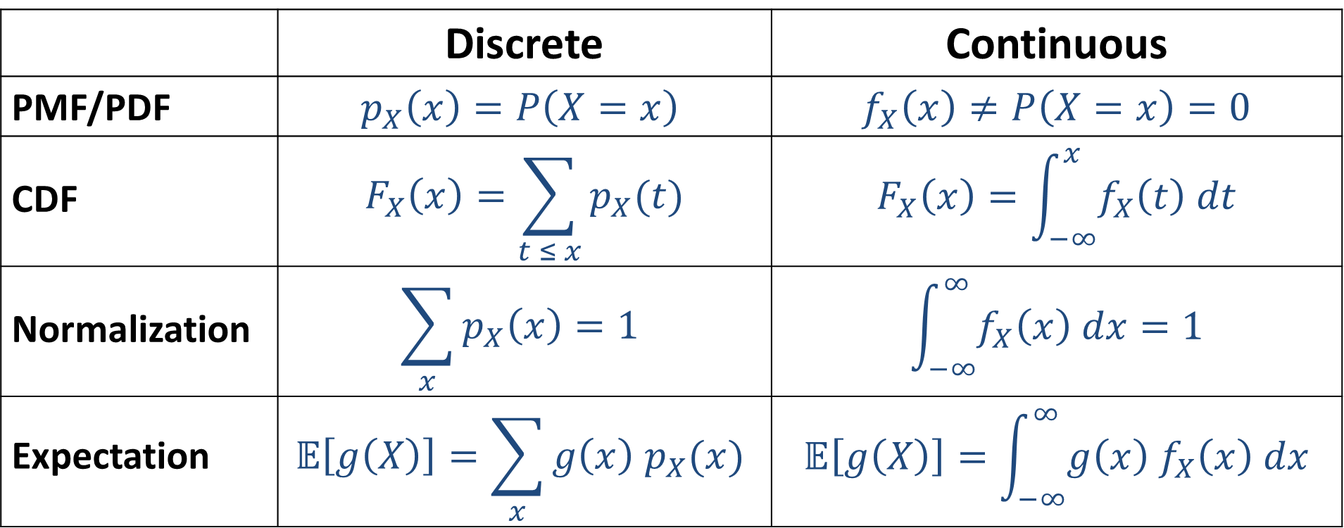
From Discrete to Continuous
 | Discrete | Continuous
PMF/PDF | $$p_{X}\left(x\right)=P\left(X=x\right)$$ | $$f_{X}\left(x\right)≠P\left(X=x\right)=0$$
CDF | $$F_{X}\left(x\right)=\sum_{t ≤ x}{p_{X}(t)}$$ | $$F_{X}\left(x\right)=\int_{−∞}^{x}{f_{X}\left(t\right) dt}$$
Normalization | $$\sum_{x}{p_{X}\left(x\right)=1}$$ | $$\int_{−∞}^{∞}{f_{X}\left(x\right) dx=1}$$
Expectation | $$𝔼\left[g\left(X\right)\right]=\sum_{x}{g\left(x\right) p_{X}(x)}$$ | $$𝔼\left[g\left(X\right)\right]=\int_{−∞}^{∞}{g\left(x\right){ f}_{X}\left(x\right) dx}$$

Slide 24


A Discrete Approximation
Probability Mass Function
PMF
Cumulative Distribution Function
CDF
$$1$$
$$p_{X}$$
$$i/n$$
$$3/n$$
$$2/n$$
$$1/n$$
$$1$$
$$\frac{1}{n}$$
$$\frac{2}{n}$$
$$\frac{3}{n}$$
$$\frac{i}{n}$$
$$\frac{1}{n}$$
$$\frac{2}{n}$$
$$\frac{3}{n}$$
$$\frac{i}{n}$$
$$1$$

Slide 25

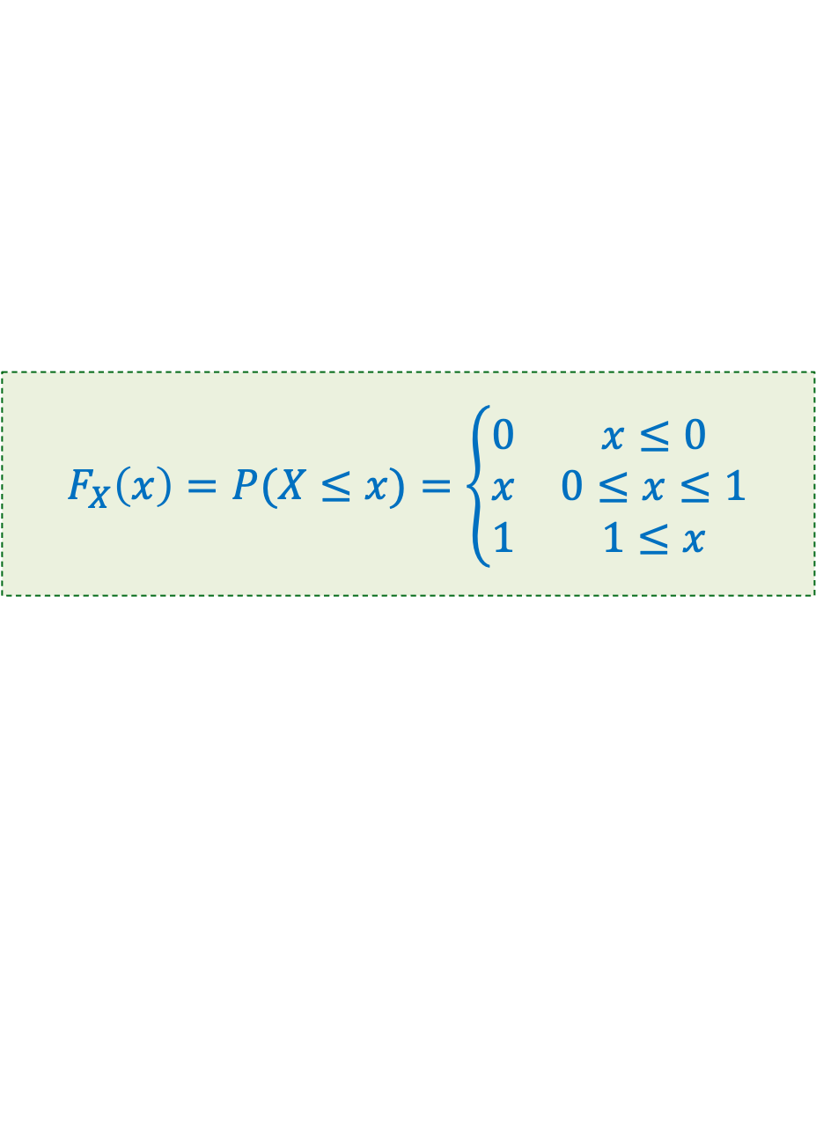
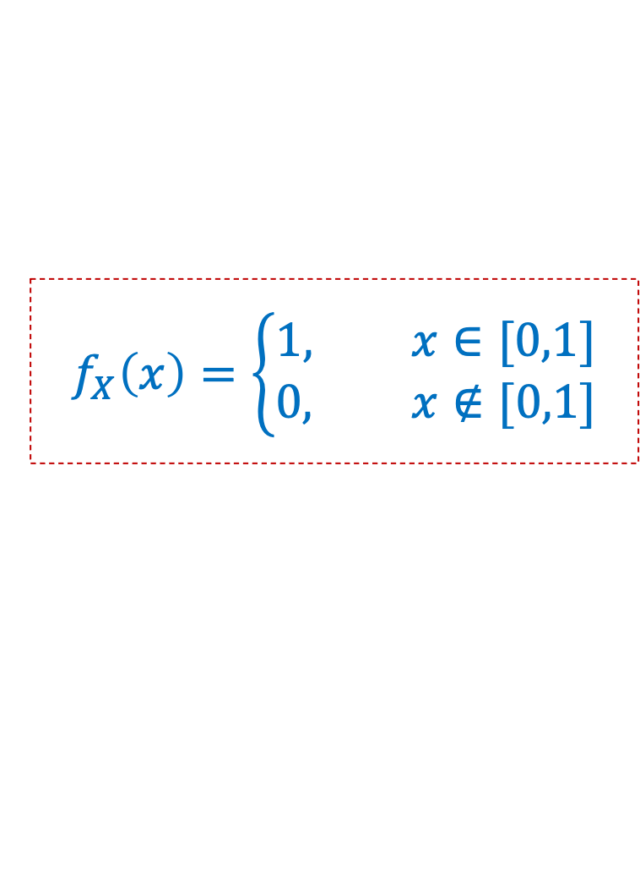
PDF of Uniform RV
$$F_{X}\left(x\right)=P(X≤x)=\left\{\begin{matrix}0 & x≤0 \\ x & 0≤x≤1 \\ 1 & 1≤x\end{matrix}\right.$$
$$X∼Unif(0,1)$$
$$f_{X}\left(x\right)=\left\{\begin{aligned}1, x∈[0,1] \\ &0, x∉[0,1]\end{aligned}\right.$$
1
0
0
1

Slide 26

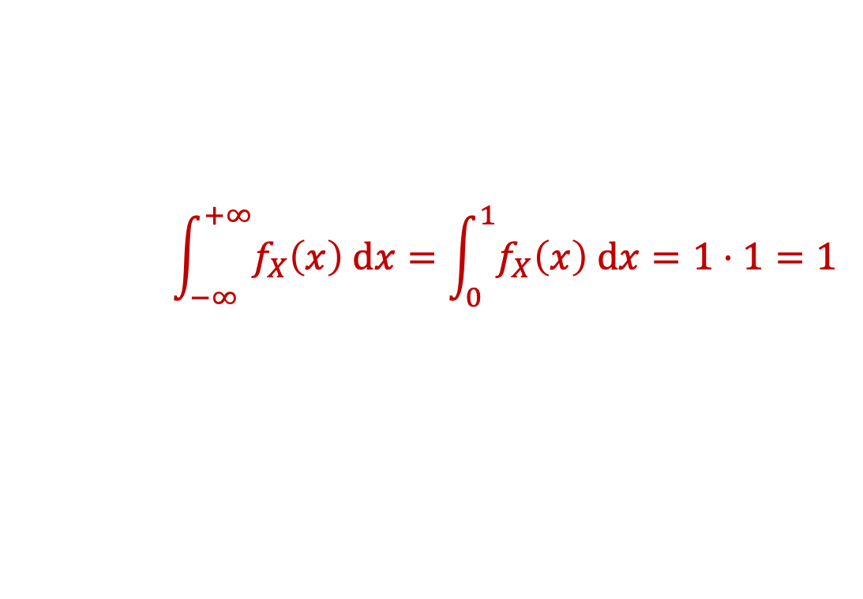
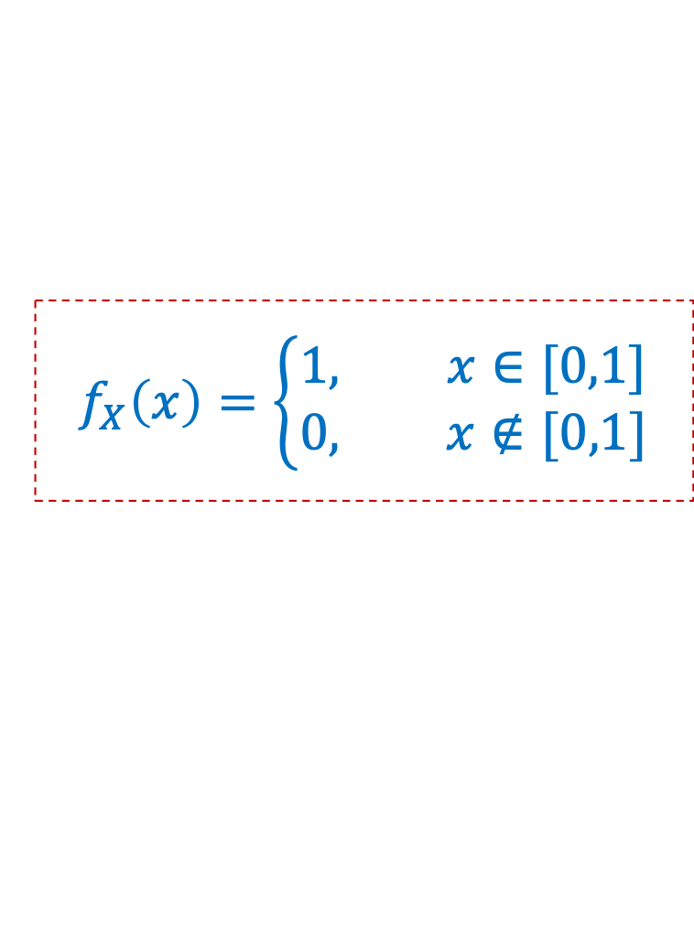
PDF of Uniform RV
$X∼Unif(0,1)$
Non-negativity: $f_{X}\left(x\right)≥0$ for all $x∈ℝ$
$$f_{X}\left(x\right)=\left\{\begin{aligned}1, x∈[0,1] \\ &0, x∉[0,1]\end{aligned}\right.$$
Normalization: $\int_{−∞}^{+∞}{f_{X}\left(x\right) dx}=1$
1
$$\int_{−∞}^{+∞}{f_{X}\left(x\right) dx}=\int_{0}^{1}{f_{X}\left(x\right) dx}=1⋅1=1$$
0
0
1

Slide 27


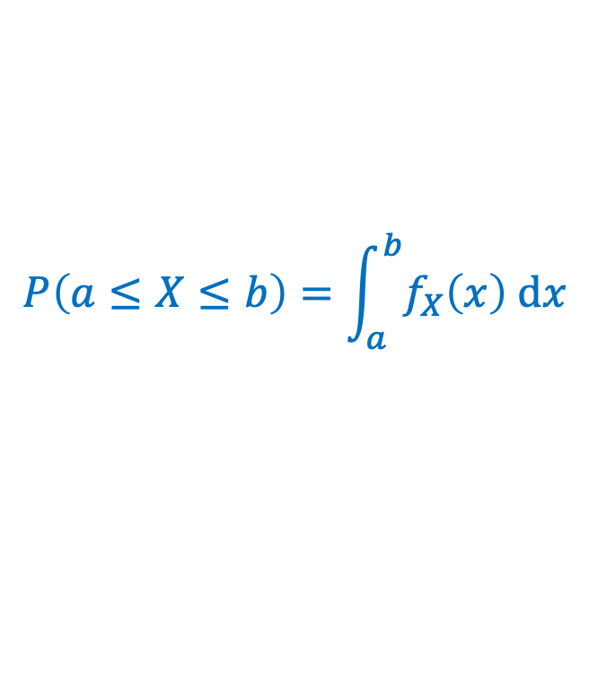
Probability of Event
$X∼Unif(0,1)$
Non-negativity: $f_{X}\left(x\right)≥0$ for all $x∈ℝ$
$$f_{X}\left(x\right)=\left\{\begin{aligned}1, x∈[0,1] \\ &0, x∉[0,1]\end{aligned}\right.$$
Normalization: $\int_{−∞}^{+∞}{f_{X}\left(x\right) dx}=1$
$$P\left(a≤X≤b\right)=\int_{a}^{b}{f_{X}\left(x\right) dx}$$
1
0
0
$$a$$
$$b$$
1

Slide 28
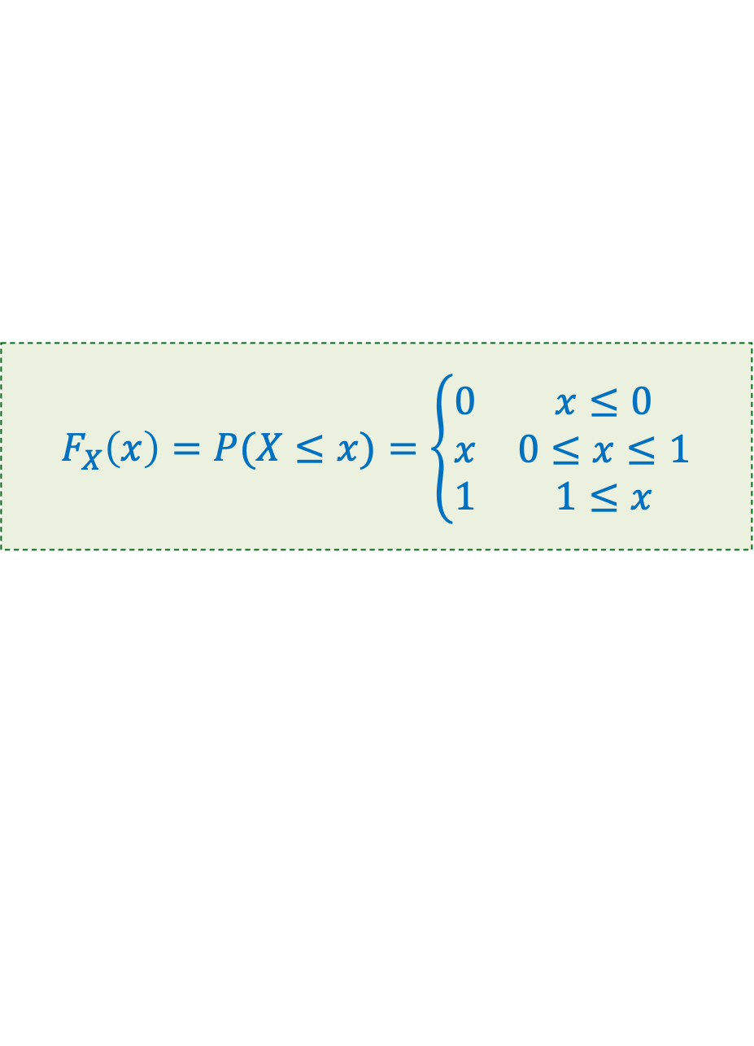




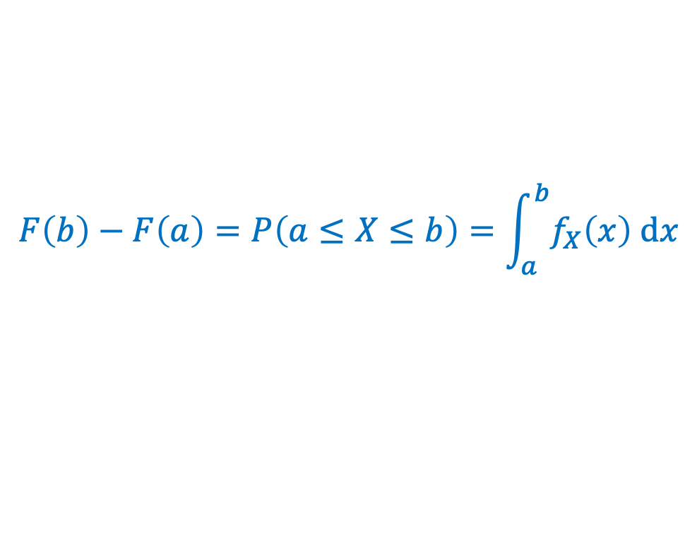

$$f_{X}\left(x\right)=\left\{\begin{aligned}1, x∈[0,1] \\ &0, x∉[0,1]\end{aligned}\right.$$
$$X∼Unif(0,1)$$
$$F_{X}\left(x\right)=P(X≤x)=\left\{\begin{matrix}0 & x≤0 \\ x & 0≤x≤1 \\ 1 & 1≤x\end{matrix}\right.$$
Non-negativity: $f_{X}\left(x\right)≥0$ for all $x∈ℝ$
Normalization: $\int_{−∞}^{+∞}{f_{X}\left(x\right) dx}=1$
$$F\left(b\right)−F\left(a\right)=P\left(a≤X≤b\right)=\int_{a}^{b}{f_{X}\left(x\right) dx}$$
$$P\left(X=y\right)=P\left(y≤X≤y\right)=\int_{y}^{y}{f_{X}\left(x\right) dx}=0$$
$$P\left(X≈y\right)≈εf_{X}(y)$$
$$\frac{P\left(X≈y\right)}{P\left(X≈z\right)}≈\frac{εf_{X}\left(y\right)}{εf_{X}\left(z\right)}=\frac{f_{X}\left(y\right)}{f_{X}\left(z\right)}$$

Slide 29
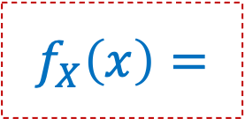
PDF of Uniform RV
$X∼Unif(0,0.5)$
$$f_{X}\left(x\right)=$$
0
0
0.5
1

Slide 30
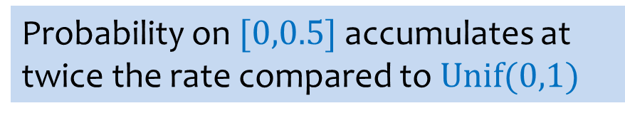
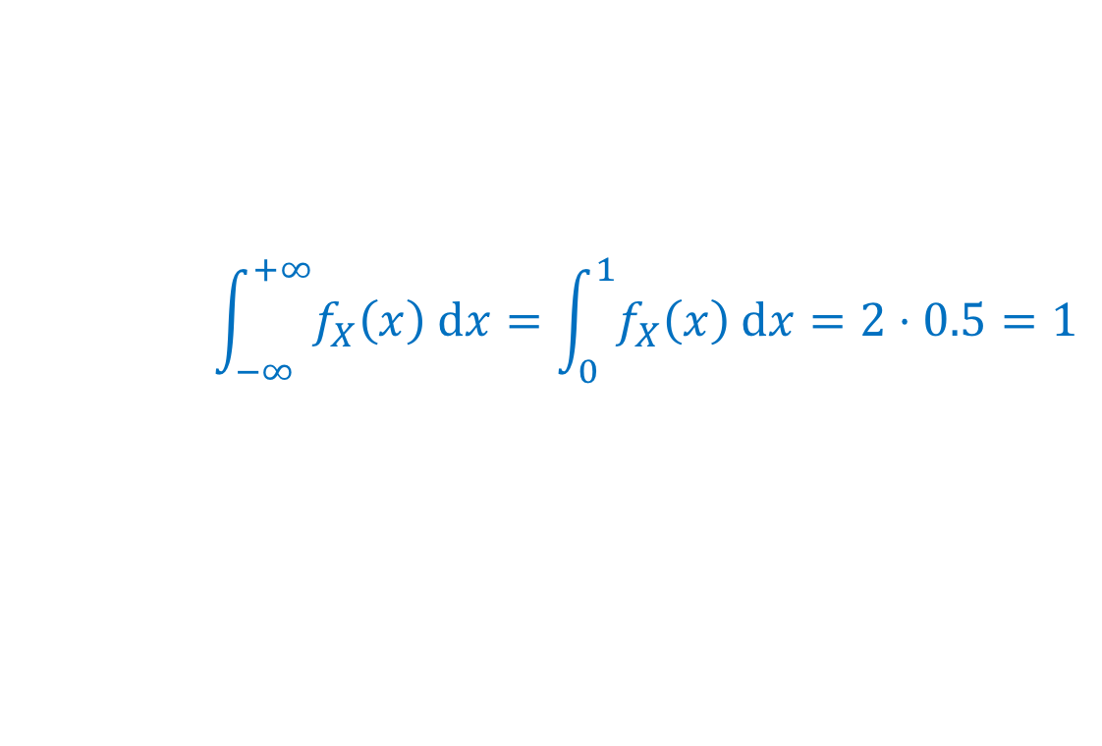
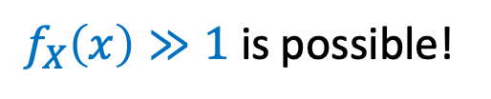
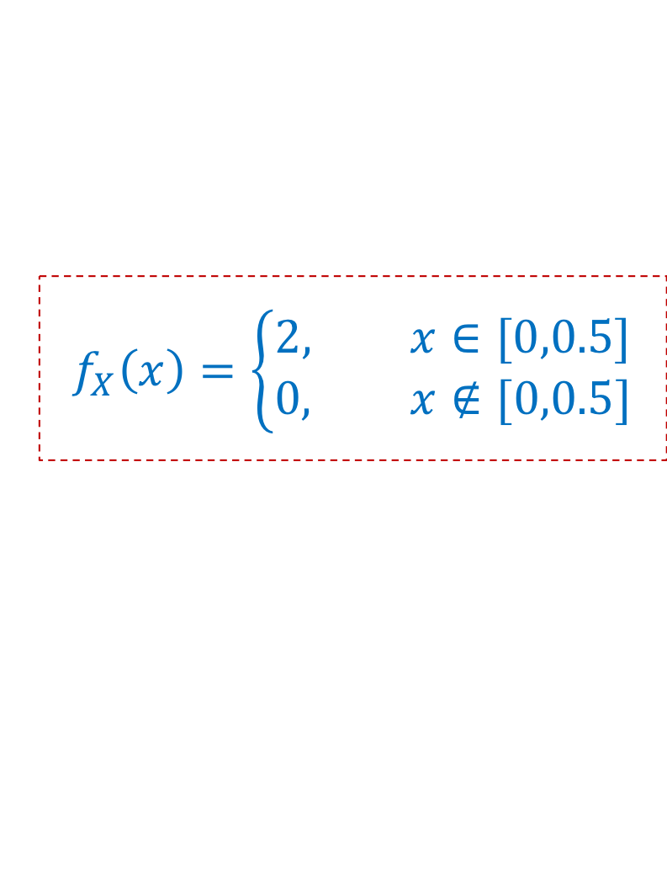
PDF of Uniform RV
Density $≠$ Probability
$f_{X}\left(x\right)≫1$ is possible!
$X∼Unif(0,0.5)$
$$f_{X}\left(x\right)=\left\{\begin{aligned}2, x∈[0,0.5] \\ &0, x∉[0,0.5]\end{aligned}\right.$$
2
$$\int_{−∞}^{+∞}{f_{X}\left(x\right) dx}=\int_{0}^{1}{f_{X}\left(x\right) dx}=2⋅0.5=1$$
1
Probability on $[0,0.5]$accumulates at twice the rate compared to $Unif(0,1)$
0
0
0.5
1

Slide 31
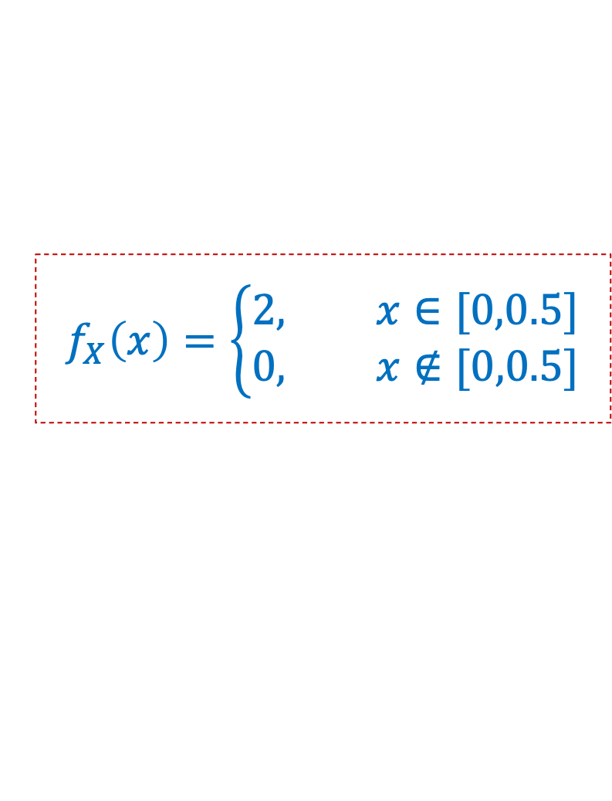
PDF of Uniform RV
$X∼Unif(0,0.5)$
$$f_{X}\left(x\right)=\left\{\begin{aligned}2, x∈[0,0.5] \\ &0, x∉[0,0.5]\end{aligned}\right.$$
0
0
0.5
1

Slide 32

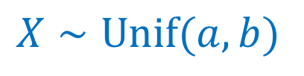
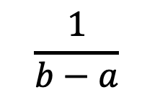
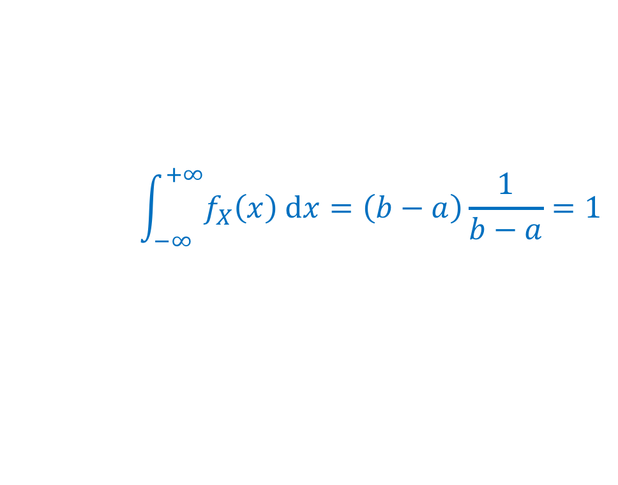
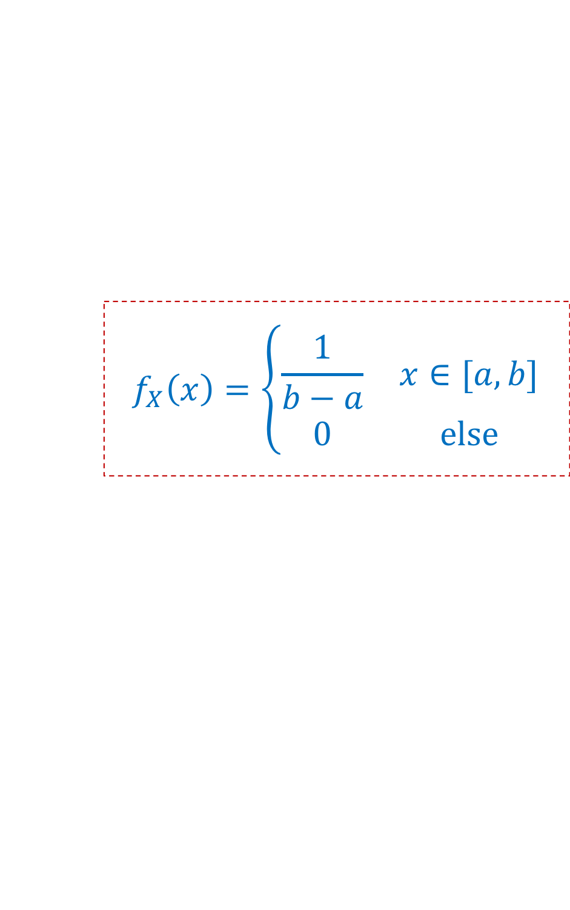

Uniform Distribution
$$f_{X}\left(x\right)=\left\{\begin{matrix}\frac{1}{b−a} & x∈[a,b] \\ 0 & else\end{matrix}\right.$$
$X∼Unif(a,b)$
$$\frac{1}{b−a}$$
$$\int_{−∞}^{+∞}{f_{X}\left(x\right) dx}=\left(b−a\right)\frac{1}{b−a}=1$$
0
$$a$$
$$b$$

Slide 33
Agenda
Continuous Random Variables
Probability Density Function
Cumulative Distribution Function
Expectation and Variance of continuous r.v.
Introduction to continuous zoo

Slide 34

Expectation of a Continuous RV
Definition. The expected value of a continuous RV $X$ is defined as
$$𝔼[X]=\int_{−∞}^{+∞}{f_{X}\left(x\right)⋅x dx}$$

Slide 35

Expectation of a Continuous RV
Definition. The expected value of a continuous RV $X$ is defined as
$$𝔼[X]=\int_{−∞}^{+∞}{f_{X}\left(x\right)⋅x dx}$$
Fact. $𝔼[aX+bY+c]=a𝔼[X]+b𝔼[Y]+c$
Proof follows same ideas as discrete case

Slide 36
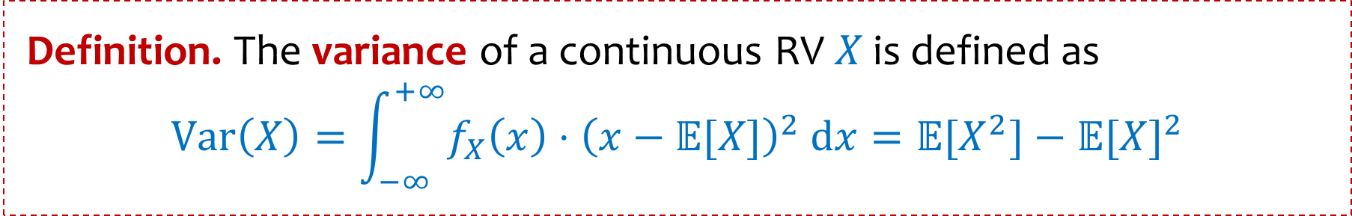
Expectation of a Continuous RV
Definition. The expected value of a continuous RV $X$ is defined as
$$𝔼[X]=\int_{−∞}^{+∞}{f_{X}\left(x\right)⋅x dx}$$
Fact. $𝔼[aX+bY+c]=a𝔼[X]+b𝔼[Y]+c$
Proofs follow same ideas as discrete case
Definition. The variance of a continuous RV $X$ is defined as
$$Var\left(X\right)=\int_{−∞}^{+∞}{f_{X}\left(x\right)⋅{\left(x−𝔼[X]\right)}^{2} dx}=𝔼[X^{2}]−𝔼{[X]}^{2}$$

Slide 37
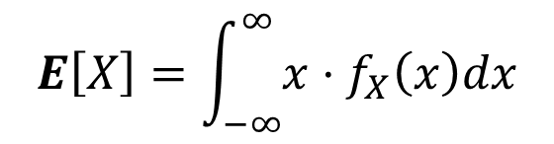
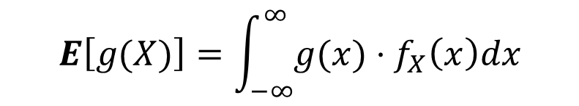
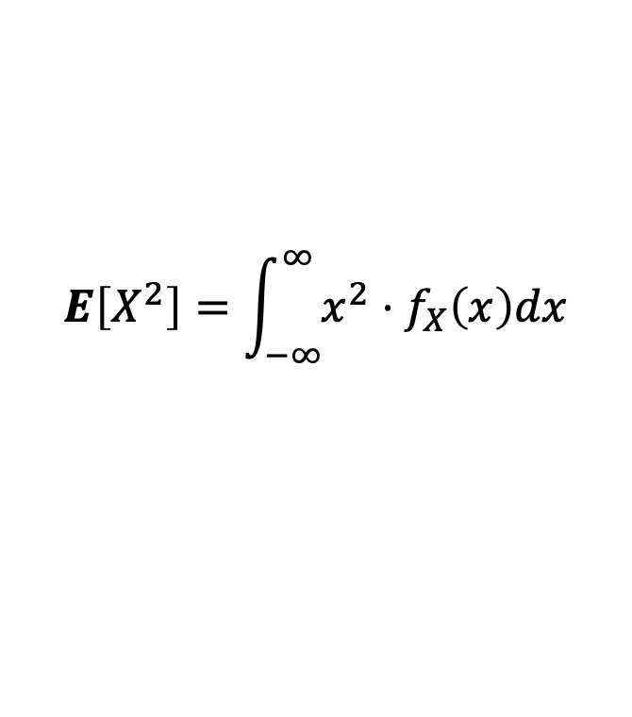
Expectation, Variance, and LOTUS
Defn: For a continuous r.v. $X$with p.d.f. $f_{X}(⋅)$, we have:
$$E\left[X\right]=\int_{−∞}^{∞}{{x⋅f}_{X}\left(x\right)dx}$$
$$E\left[X^{2}\right]=\int_{−∞}^{∞}{{x^{2}⋅f}_{X}\left(x\right)dx}$$
$$E\left[g(X)\right]=\int_{−∞}^{∞}{g({x)⋅f}_{X}\left(x\right)dx}$$
$$Var\left(X\right)=E\left[{\left(X−E\left[X\right]\right)}^{2} \right]=\int_{−∞}^{∞}{{\left(x −E\left[X\right]\right)}^{2}f_{X}(x)dx}=E\left[X^{2}\right]−E{\left[X\right]}^{2}$$

Slide 38
Agenda
Zoo of continuous random variables
  Uniform Distribution
  Exponential Distribution
  Normal Distribution

Slide 39

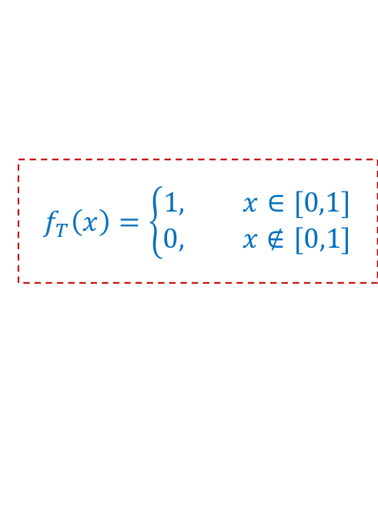
Expectation of a Continuous RV
Definition.
$$𝔼[X]=\int_{−∞}^{+∞}{f_{X}\left(x\right)⋅x dx}$$
Example. $T∼Unif(0,1)$
$$f_{T}\left(x\right)=\left\{\begin{aligned}1, x∈[0,1] \\ &0, x∉[0,1]\end{aligned}\right.$$
1
0
0
1

Slide 40


Expectation of a Continuous RV
Definition.
$$𝔼[X]=\int_{−∞}^{+∞}{f_{X}\left(x\right)⋅x dx}$$
Example. $T∼Unif(0,1)$
$$f_{T}\left(x\right)=\left\{\begin{aligned}1, x∈[0,1] \\ &0, x∉[0,1]\end{aligned}\right.$$
1
0
0
1
$$f_{T}\left(x\right)⋅x=\left\{\begin{aligned}x, x∈[0,1] \\ &0, x∉[0,1]\end{aligned}\right.$$
$$𝔼[X]=\frac{1}{2}1^{2}=\frac{1}{2}$$
1
Area of triangle
0
0
1

Slide 41






Uniform Density – Expectation
$$f_{X}\left(x\right)=\left\{\begin{matrix}\frac{1}{b−a} & x∈[a,b] \\ 0 & else\end{matrix}\right.$$
$X∼Unif(a,b)$
$$𝔼[X]=\int_{−∞}^{+∞}{f_{X}\left(x\right)⋅x dx}$$
$$=\frac{1}{b−a}{\left.\left(\frac{x^{2}}{2}\right)\right|}_{a}^{b}$$
$$=\frac{1}{b−a}\int_{a}^{b}{x dx}$$
$$=\frac{1}{b−a}\left(\frac{b^{2}−a^{2}}{2}\right)$$
$$=\frac{(b−a)(a+b)}{2(b−a)}$$
$$=\frac{a+b}{2}$$

Slide 42

Uniform Density – Variance
$$f_{X}\left(x\right)=\left\{\begin{matrix}\frac{1}{b−a} & x∈[a,b] \\ 0 & else\end{matrix}\right.$$
$X∼Unif(a,b)$
$$𝔼[X^{2}]=$$

Slide 43






Uniform Density – Variance
$$f_{X}\left(x\right)=\left\{\begin{matrix}\frac{1}{b−a} & x∈[a,b] \\ 0 & else\end{matrix}\right.$$
$X∼Unif(a,b)$
$$𝔼[X^{2}]=\int_{−∞}^{+∞}{f_{X}\left(x\right)⋅x^{2} dx}$$
$$=\frac{1}{b−a}{\left.\left(\frac{x^{3}}{3}\right)\right|}_{a}^{b}$$
$$=\frac{1}{b−a}\int_{a}^{b}{x^{2} dx}$$
$$=\frac{b^{3}−a^{3}}{3(b−a)}$$
$$=\frac{(b−a)(b^{2}+ab+a^{2})}{3(b−a)}$$
$$=\frac{b^{2}+ab+a^{2}}{3}$$

Slide 44



Uniform Density – Variance
$$𝔼[X^{2}]=\frac{b^{2}+ab+a^{2}}{3}$$
$$𝔼[X]=\frac{a+b}{2}$$
$X∼Unif(a,b)$
$$Var\left(X\right)=𝔼[X^{2}]−𝔼{[X]}^{2}$$

Slide 45



Uniform Density – Variance
$$𝔼[X^{2}]=\frac{b^{2}+ab+a^{2}}{3}$$
$$𝔼[X]=\frac{a+b}{2}$$
$X∼Unif(a,b)$
$$Var\left(X\right)=𝔼[X^{2}]−𝔼{[X]}^{2}$$
$$=\frac{b^{2}+ab+a^{2}}{3}−\frac{a^{2}+2ab+b^{2}}{4}$$
$$=\frac{{4b}^{2}+4ab+{4a}^{2}}{12}−\frac{{3a}^{2}+6ab+3b^{2}}{12}$$
$$=\frac{b^{2}−2ab+a^{2}}{12}=\frac{{\left(b−a\right)}^{2}}{12}$$

Slide 46



Uniform Distribution Summary
$$f_{X}\left(x\right)=\left\{\begin{matrix}\frac{1}{b−a} & x∈[a,b] \\ 0 & else\end{matrix}\right.$$
$X∼Unif(a,b)$
$$F_{X}\left(y\right)=\left\{\begin{matrix}0 & x<a \\ \frac{x−a}{b−a} & x∈[a,b] \\ 1 & x>b\end{matrix}\right.$$
$$\frac{1}{b−a}$$
$$𝔼\left[X\right]=\frac{a+b}{2}$$
$$Var\left(X\right)=\frac{{\left(b−a\right)}^{2}}{12}$$
0
$$a$$
$$b$$

Slide 47
Agenda
Zoo of continuous random variables
  Uniform Distribution
  Exponential Distribution

Slide 48

Recall Poisson
Assume expected # of occurrences of an event per unit of time is $λ$ (independently)
Cars going through intersection
Number of lightning strikes
Requests to web server
Patients admitted to ER
Rate of radioactive decay
Numbers of occurrences of event in one unit of time: Poisson distribution
$$P\left(W=i\right)=e^{−λ}\frac{λ^{i}}{i!}$$
(Discrete)
How long to wait until next event?
Exponential density!
Let’s define it and then derive it!

Slide 49

Exponential Density - Warmup
$$W∼Poi\left(λ\right)⇒P\left(W=i\right)=e^{−λ}\frac{λ^{i}}{i!}$$
Assume expected # of occurrences of an event per unit of time is $λ$ (independently)
What is $𝔼\left[Z_{t}\right]$where $Z_{t}$= # occurrences of event per $t$ units of time?

Slide 50



Exponential Density - Warmup
$$W∼Poi\left(λ\right)⇒P\left(W=i\right)=e^{−λ}\frac{λ^{i}}{i!}$$
Assume expected # of occurrences of an event per unit of time is $λ$ (independently)
What is the distribution of $Z_{t}$= # occurrences of event per $t$ units of time?
$$𝔼\left[Z_{t}\right]=tλ$$
$Z_{t}$ is independent over disjoint intervals
So $Z_{t}∼Poi(tλ)$

Slide 51
The Exponential PDF/CDF
$$W∼Poi\left(λ\right)⇒P\left(W=i\right)=e^{−λ}\frac{λ^{i}}{i!}$$
Assume expected # of occurrences of an event per unit of time is $λ$ (independently)
Numbers of occurrences of event: Poisson distribution
How long to wait until next event?
Exponential density!
Let $X$ be the time till the first event. We will compute $F_{X}\left(t\right)$ and $f_{X}\left(t\right)$
We know $Z_{t}\sim Poi\left(tλ\right)$ is the # of events in the first $t$ units of time, for $t≥0.$

Slide 52
The Exponential PDF/CDF
$$W∼Poi\left(λ\right)⇒P\left(W=i\right)=e^{−λ}\frac{λ^{i}}{i!}$$
Assume expected # of occurrences of an event per unit of time is $λ$ (independently)
Numbers of occurrences of event: Poisson distribution
How long to wait until next event?
Exponential density!
The exponential RV has range $[0,∞]$, unlike Poisson with range $\{0,1,2,…\}$
Let $X\sim Exp\left(λ\right)$ be the time till the first event. We will compute $F_{X}\left(t\right)$ and $f_{X}\left(t\right)$
We know $Z_{t}\sim Poi\left(tλ\right)$ be the # of events in the first $t$ units of time, for $t≥0.$
$P\left(X>t\right)=P\left(no event in the first t units\right)=P\left(Z_{t}=0\right)=e^{−tλ}\frac{({tλ)}^{0}}{0!}=e^{−tλ}$
$F_{X}\left(t\right)=P(X≤t)=1−P\left(Y>t\right)=1−e^{−tλ}$
$f_{X}\left(t\right)=\frac{d}{dt}F_{X}\left(t\right)={λe}^{−tλ}$

Slide 53







Exponential Distribution
$$P\left(X>t\right)=e^{−tλ}$$
Definition. An exponential random variable $X$with parameter $λ≥0$ is follows the exponential density
$f_{X}\left(x\right)=\left\{\begin{matrix}λe^{−λx} & x≥0 \\ 0 & x<0\end{matrix}\right.$
We write $X∼Exp\left(λ\right)$ and say $X$that follows the exponential distribution.
$$\text{CDF}\text{: }\text{For} y≥0\text{, }$$
$$F_{X}\left(y\right)={1−e}^{−λy}$$
$$λ=2$$
$$λ=1.5$$
$$λ=1$$
$$λ=0.5$$

Slide 54



Expectation
$$f_{X}\left(x\right)=\left\{\begin{matrix}λe^{−λx} & x≥0 \\ 0 & x<0\end{matrix}\right.$$
$$𝔼[X]=\int_{−∞}^{+∞}{f_{X}\left(x\right)⋅x dx}$$
$$P\left(X>t\right)=e^{−tλ}$$

Slide 55




Expectation
$$f_{X}\left(x\right)=\left\{\begin{matrix}λe^{−λx} & x≥0 \\ 0 & x<0\end{matrix}\right.$$
$$𝔼[X]=\int_{−∞}^{+∞}{f_{X}\left(x\right)⋅x dx}$$
$$P\left(X>t\right)=e^{−tλ}$$
$$𝔼[X]=\frac{1}{λ}$$
$$=\int_{0}^{+∞}{λe^{−λx}⋅x dx}$$
$$={\left.\left(−(x+\frac{1}{λ})e^{−λx}\right)\right|}_{0}^{∞ }=\frac{1}{λ}⁡$$
$$Var\left(X\right)=\frac{1}{λ^{2}}$$
Somewhat complex calculation
use integral by parts

Slide 56



Exponential Distribution
$$P\left(X>t\right)=e^{−tλ}$$
We write $X∼Exp\left(λ\right)$ and say $X$that follows the exponential distribution.
Definition. An exponential random variable $X$with parameter $λ≥0$ is follows the exponential density
$f_{X}\left(x\right)=\left\{\begin{matrix}λe^{−λx} & x≥0 \\ 0 & x<0\end{matrix}\right.$
$$\text{CDF}\text{: }\text{For} y≥0\text{, }$$
$$F_{X}\left(y\right)={1−e}^{−λy}$$
$$λ=2$$
$$𝔼\left[X\right]=\frac{1}{λ}$$
$$λ=1.5$$
$$λ=1$$
$$Var\left(X\right)=\frac{1}{λ^{2}}$$
$$λ=0.5$$

Slide 57



Memorylessness
Definition. A random variable is memoryless if for all $s,t>0$,
$$P\left(X>s+t \right| X>s)=P\left(X>t\right).$$
Fact. $X∼Exp(λ)$ is memoryless.
Assuming an exponential distribution, if you’ve waited $s$ minutes,
The probability of waiting $t$ more is exactly same as when $s=0$.

Slide 58




Memorylessness of Exponential
$$P\left(X>t\right)=e^{−λt}$$
Proof that assuming exp distr, if you’ve waited $s$ minutes, prob of waiting $t$ more is exactly same as when $s=0$
Fact. $X∼Exp(λ)$ is memoryless.
Proof.
$P\left(X>s+t \right| X>s)$ =

Slide 59





Memorylessness of Exponential
$$P\left(X>t\right)=e^{−λt}$$
Proof that assuming exp distr, if you’ve waited $s$ minutes, prob of waiting $t$ more is exactly same as when $s=0$
Fact. $X∼Exp(λ)$ is memoryless.
Proof.
$$P\left(X>s+t \right| X>s)$$
$$=\frac{P\left(\left\{X>s+t\right\}∩\left\{X>s\right\}\right)}{P(X>s)}$$
$$=\frac{P\left(X>s+t\right)}{P(X>s)}$$
$$=\frac{e^{−λ(s+t)}}{e^{−λs}}$$
$$=e^{−λt}=P(X>t)$$
The only memoryless RVs are the geometric RV (discrete) and Exp RV (continuous)

Slide 60
Example
Time it takes to check someone out at a grocery store is exponential with an expected value of 10 mins.
Independent for different customers
If there is one person currently being served, what is the probability that you will have to wait between 10 and 20 mins until you start getting service?

Slide 62

Example
Time it takes to check someone out at a grocery store is exponential with an expected value of 10 mins.
Independent for different customers
If there is one person currently being served, what is the probability that you will have to wait between 10 and 20 mins until you start getting service?
$$T \sim Exp(\frac{1}{10})$$
$$P\left(10≤T≤20\right)=\int_{10}^{20}{\frac{1}{10}e^{− \frac{x}{10}} dx}$$
$y=\frac{x}{10}$ so $dy=\frac{dx}{10}$
$$P\left(10≤T≤20\right)=\int_{1}^{2}{e^{−y} dy}={−e}^{−y}{\left.​\right|}_{1}^{2}=e^{−1}−e^{−2}$$

Slide 63

Example
Time it takes to check someone out at a grocery store is exponential with an expected value of 10 mins.
Independent for different customers
If there is one person currently being served, what is the probability that you will have to wait between 10 and 20 mins until you start getting service?
$$T \sim Exp(\frac{1}{10})$$
so $F_{T}\left(t\right)=1−e^{− \frac{t}{10}}$
$$P\left(10≤T≤20\right)=F_{T}\left(20\right)−F_{T}(10)$$
$=1−e^{− \frac{20}{10}}−\left(1−e^{− \frac{10}{10}}\right)=e^{−1}−e^{−2}$

Slide 64









Recap – Continuous RVs
Probability Density Function (PDF).
$f:ℝ→ℝ$ s.t.
$f\left(x\right)≥0$ for all $x∈ℝ$
$\int_{−∞}^{+∞}{f\left(x\right) dx}=1$
Cumulative Distribution Function (CDF).
$$F\left(y\right)=\int_{−∞}^{y}{f(x) dx}$$
Theorem. $f\left(x\right)=\frac{dF(x)}{dx}$
$$f(x)$$
$$y$$
Density $≠$ Probability !
$$P\left(X∈[a,b]\right)=\int_{a}^{b}{f_{X}\left(x\right)dx}$$
$$F_{X}\left(y\right)=P\left(X≤y\right)$$
$$=F_{X}\left(b\right)−F_{X}(a)$$

Slide 65
Recap: From Discrete to Continuous
 | Discrete | Continuous
PMF/PDF | $$p_{X}\left(x\right)=P\left(X=x\right)$$ | $$f_{X}\left(x\right)≠P\left(X=x\right)=0$$
CDF | $$F_{X}\left(x\right)=\sum_{t ≤ x}{p_{X}(t)}$$ | $$F_{X}\left(x\right)=\int_{−∞}^{x}{f_{X}\left(t\right) dt}$$
Normalization | $$\sum_{x}{p_{X}\left(x\right)=1}$$ | $$\int_{−∞}^{∞}{f_{X}\left(x\right) dx=1}$$
Expectation | $$𝔼\left[g\left(X\right)\right]=\sum_{x}{g\left(x\right) p_{X}(x)}$$ | $$𝔼\left[g\left(X\right)\right]=\int_{−∞}^{∞}{g\left(x\right){ f}_{X}\left(x\right) dx}$$

