Slide 1
Wrap Poisson Distribution + Problems
CSE 312 Spring 26
Lecture 14

Slide 2
Announcements
No concept check today
Material for midterm ends today.
Midterm covers
everything from class up till and including today
All concept checks through today
Problem Sets 1-5
Sections 1-5
I will post practice tests tomorrow.

Slide 3
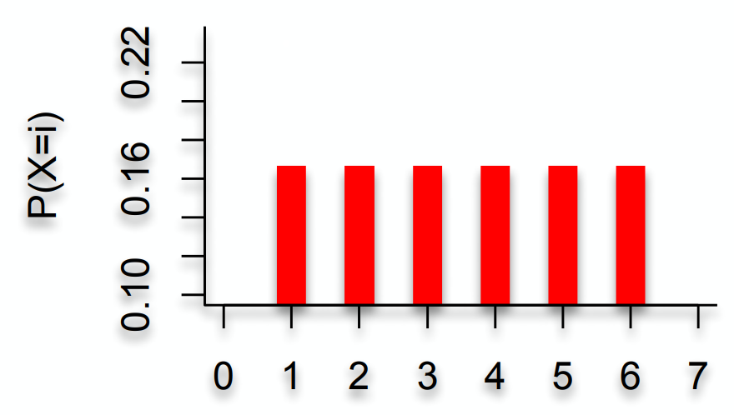
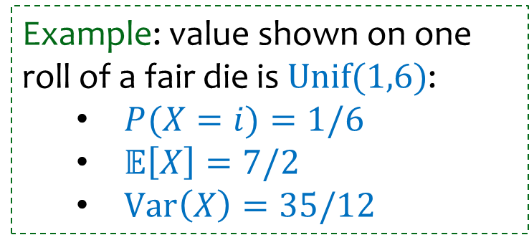
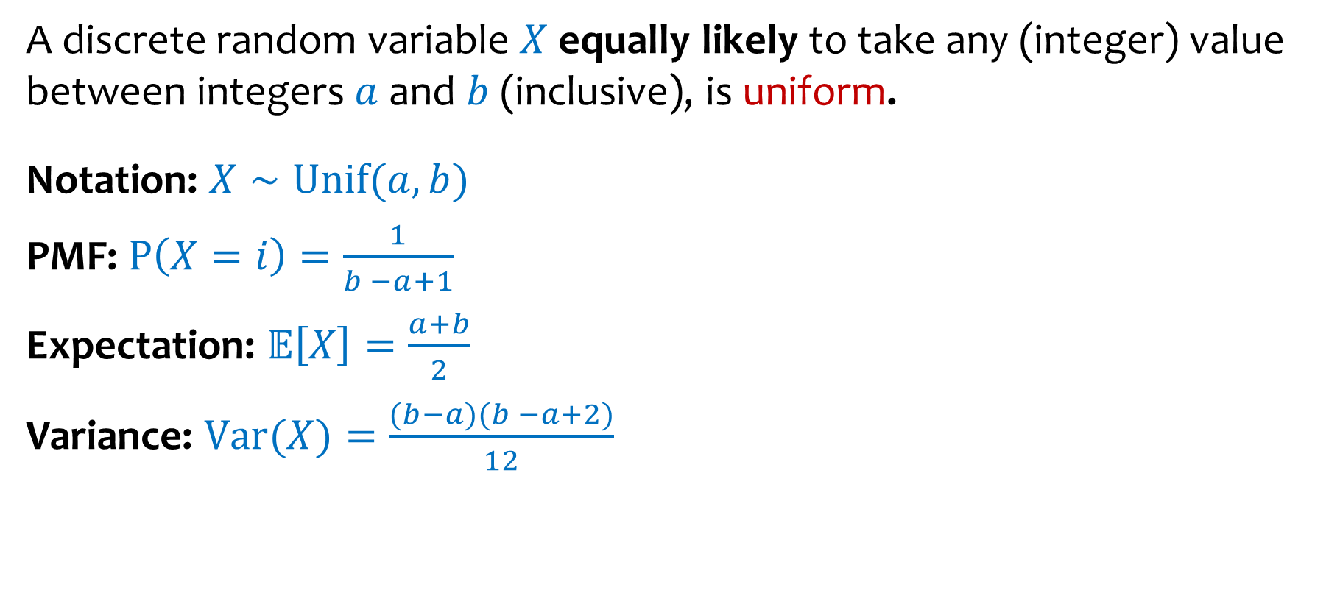
Discrete Uniform Random Variables
A discrete random variable $X$ equally likely to take any (integer) value between integers $a$ and $b$ (inclusive), is uniform.
Notation: $X∼Unif(a,b)$
PMF: $P\left(X=i\right)=\frac{1}{b −a+1}$
Expectation: $𝔼\left[X\right]=\frac{a+b}{2}$
Variance: $Var(X)=\frac{(b−a)(b −a+2)}{12}$
Example: value shown on one roll of a fair die is $Unif(1,6)$:
$P(X=i)=1/6$
$𝔼\left[X\right]=7/2$
$Var\left(X\right)=35/12$

Slide 4
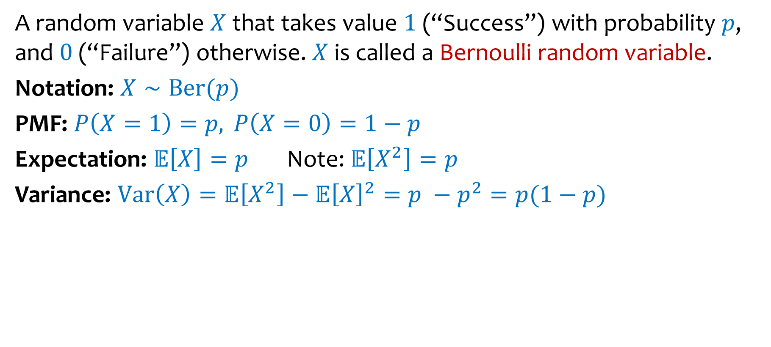
Bernoulli Random Variables
A random variable $X$ that takes value $1$ (“Success”) with probability $p$, and $0$ (“Failure”) otherwise. $X$ is called a Bernoulli random variable.
Notation: $X∼Ber(p)$
PMF: $P\left(X=1\right)=p,P\left(X=0\right)=1−p$
Expectation: $𝔼\left[X\right]=p$ Note: $𝔼\left[X^{2}\right]=p$
Variance: $Var\left(X\right)=𝔼\left[X^{2}\right]−𝔼{\left[X\right]}^{2}=p −p^{2}=p(1−p)$
Examples:
Coin flip
Randomly guessing on a MC test question
A server in a cluster fails
Whether or not a share of a particular stock pays off or not
Any indicator r.v.

Slide 5

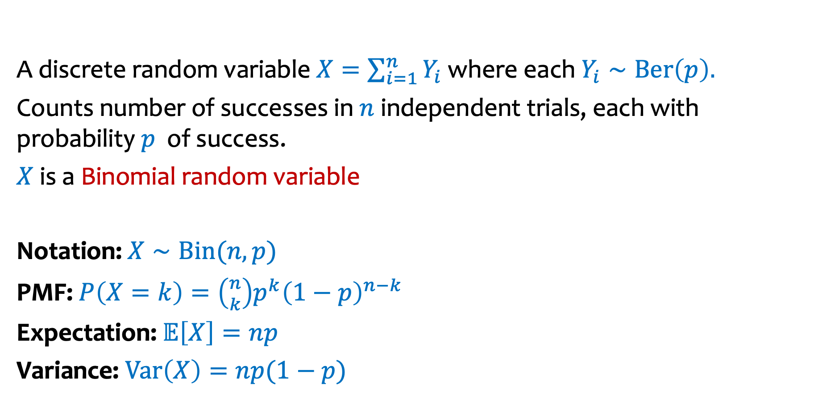
Binomial Random Variables
A discrete random variable $X=\sum_{i=1}^{n}{Y_{i}}$ where each $Y_{i}∼Ber\left(p\right).$
Counts number of successes in $n$ independent trials, each with probability $p$ of success.
$X$ is a Binomial random variable
Notation: $X∼Bin(n,p)$
PMF: $P\left(X=k\right)=\left({n \atop k}\right)p^{k}{\left(1−p\right)}^{n−k}$
Expectation: $𝔼\left[X\right]=np$
Variance: $Var\left(X\right)=np(1−p)$
Examples:
# of heads in $n$ indep coin flips
# of 1s in a randomly generated n bit string
# of servers that fail in a cluster of $n$computers
# of bit errors in file written to disk
# of elements in a bucket of a large hash table
# of $n$ different stocks that “pay off”

Slide 6
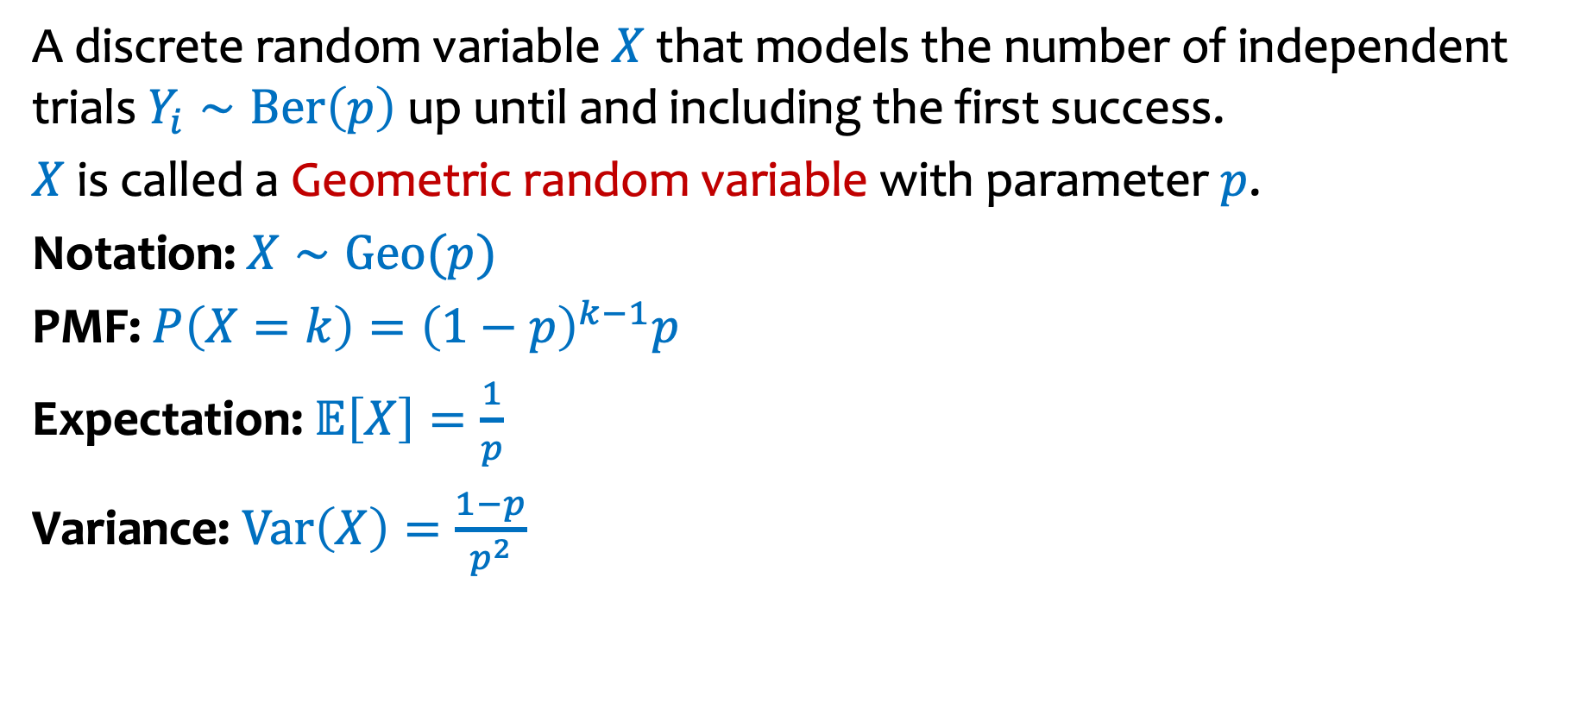
Geometric Random Variables
A discrete random variable $X$ that models the number of independent trials $Y_{i}∼Ber\left(p\right)$ up until and including the first success.
$X$ is called a Geometric random variable with parameter $p$.
Notation: $X∼Geo(p)$
PMF: $P\left(X=k\right)={\left(1−p\right)}^{k−1}p$
Expectation: 𝔼$\left[X\right]=\frac{1}{p}$
Variance: $Var\left(X\right)=\frac{1−p}{p^{2}}$
Examples:
# of coin flips until first head
# of random guesses on MC questions until you get one right
# of random guesses at a password until you hit it
# hash trials until a miner successfully mines a Bitcoin

Slide 8
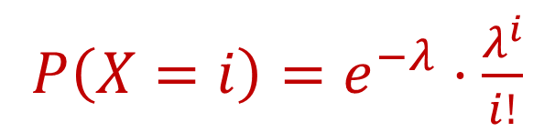
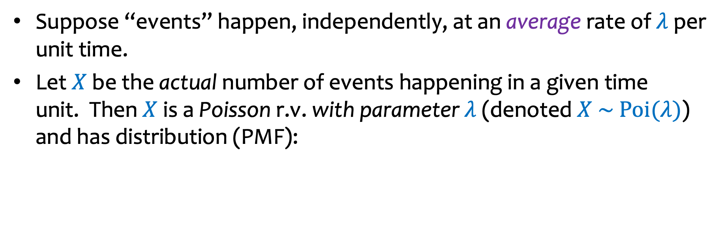

Poisson Distribution
Siméon Denis Poisson
1781-1840
Suppose “events” happen, independently, at an average rate of $λ$ per unit time.
Let $X$ be the actual number of events happening in a given time unit. Then $X$ is a Poisson r.v. with parameter $λ$ (denoted $X \sim Poi(λ)$) and has distribution (PMF):
$P\left(X=i\right)=e^{−λ}⋅\frac{λ^{i}}{i!}$
$$i=0, 1, 2,…$$
Some examples of “Poisson processes”:
# of cars passing through a traffic light in 1 hour
# of requests to web servers in an hour
# of photons hitting a light detector in a given interval
# of patients arriving to ER within an hour
Assume
fixed average rate

Slide 9
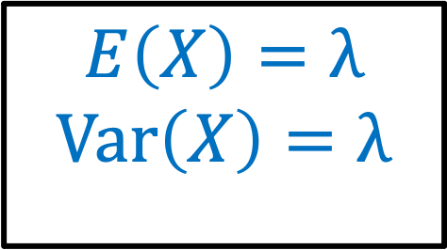
Poisson Distribution – summary (1)
Siméon Denis Poisson
1781-1840
Suppose “events” happen, independently, at an average rate of $λ$ per unit time.
Let $X$ be the actual number of events happening in a given time unit. Then $X$ is a Poisson r.v. with parameter $λ$ (denoted $X \sim Poi(λ)$) and has distribution (PMF):
$P\left(X=i\right)=e^{−λ}⋅\frac{λ^{i}}{i!}$
$$i=0, 1, 2,…$$
$$E\left(X\right)=λ$$
$$Var\left(X\right)=λ$$

Slide 10





From Binomial to Poisson
$$n→∞$$
$$np=λ$$
$$p=\frac{λ}{n}→0$$
$$X∼Bin(n,p)$$
$$X∼Poi(λ)$$
$$P\left(X=k\right)=e^{−λ}⋅\frac{λ^{k}}{k!} \\ E\left[X\right]=λ \\ Var\left(X\right)=λ$$
$$P\left(X=k\right)=\left({n \atop k}\right)p^{k}{\left(1−p\right)}^{n−k} \\ E\left[X\right]=np \\ Var\left(X\right)=np(1−p)$$
Notes:
CRO

Slide 11
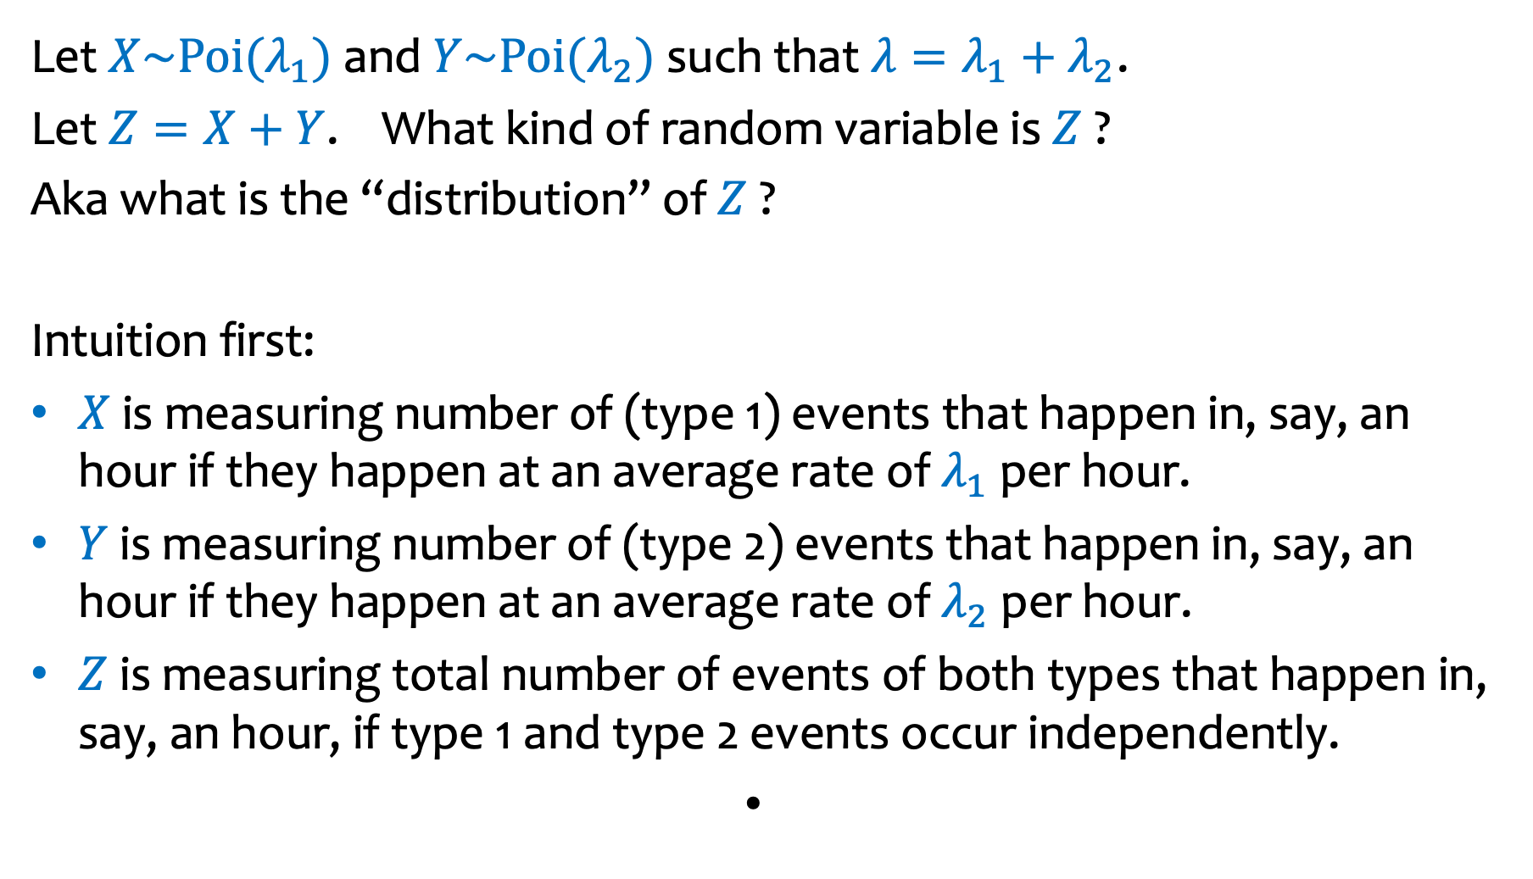
Sum of Independent Poisson RVs
Let $X\sim Poi(λ_{1})$ and $Y\sim Poi(λ_{2})$such that $λ=λ_{1}+λ_{2}$.
Let $Z=X+Y$. What kind of random variable is $Z$ ?
Aka what is the “distribution” of $Z$ ?
Intuition first:
$X$ is measuring number of (type 1) events that happen in, say, an hour if they happen at an average rate of $λ_{1}$ per hour.
$Y$ is measuring number of (type 2) events that happen in, say, an hour if they happen at an average rate of $λ_{2}$ per hour.
$Z$ is measuring total number of events of both types that happen in, say, an hour, if type 1 and type 2 events occur independently.

Slide 12
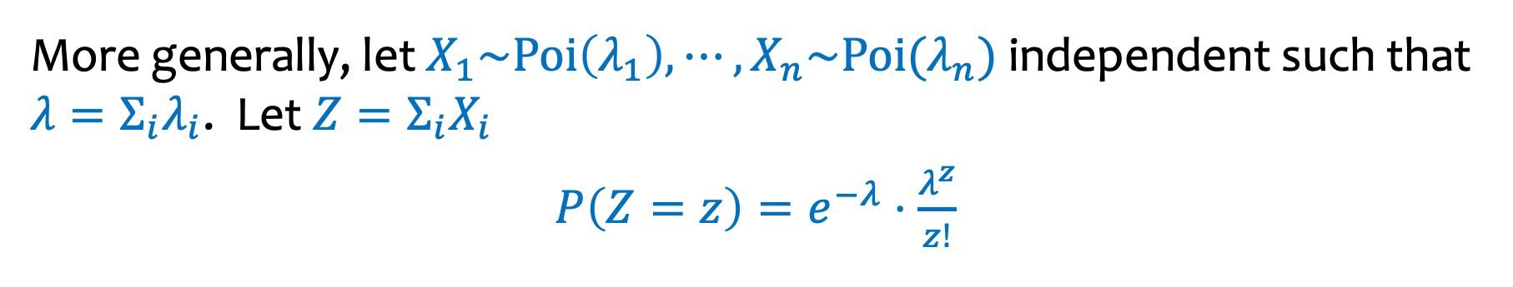
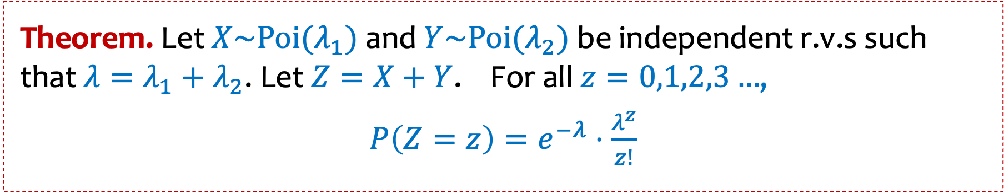
Sum of Independent Poisson RVs (2)
Theorem. Let $X\sim Poi(λ_{1})$ and $Y\sim Poi(λ_{2})$be independent r.v.s such that $λ=λ_{1}+λ_{2}$. Let $Z=X+Y$. For all $z=0,1,2,3…$,
$P\left(Z=z\right)=e^{−λ}⋅\frac{λ^{z}}{z!}$
More generally, let $X_{1}\sim Poi\left(λ_{1}\right), ⋯,X_{n}\sim Poi(λ_{n})$ independent such that $λ=Σ_{i}λ_{i}$. Let $Z=Σ_{i}X_{i}$
$P\left(Z=z\right)=e^{−λ}⋅\frac{λ^{z}}{z!}$

Slide 13
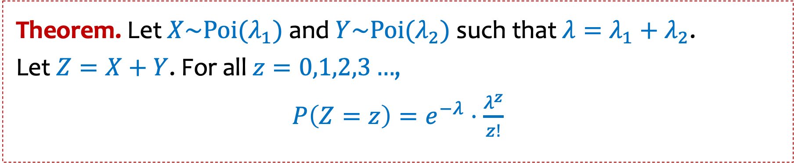
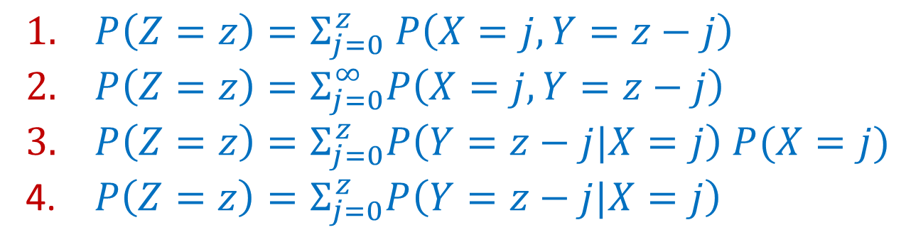

Sum of Independent Poisson RVs (3)
Theorem. Let $X\sim Poi(λ_{1})$ and $Y\sim Poi(λ_{2})$such that $λ=λ_{1}+λ_{2}$.
Let $Z=X+Y$. For all $z=0,1,2,3…$,
$P\left(Z=z\right)=e^{−λ}⋅\frac{λ^{z}}{z!}$
$P\left(Z=z\right)= ?$
https://pollev.com/ annakarlin185
All of them are right
The first 3 are right
Only 1 is right
Don’t know
$P\left(Z=z\right)=Σ_{j=0}^{z} P\left(X=j, Y=z−j\right)$
$P\left(Z=z\right)=Σ_{j=0}^{∞}P\left(X=j, Y=z−j\right)$
$P\left(Z=z\right)=Σ_{j=0}^{z}P\left(Y=z−j|X=j\right) P(X=j)$
$P\left(Z=z\right)=Σ_{j=0}^{z}P\left(Y=z−j|X=j\right)$

Slide 14
Law of Total Probability

Slide 15
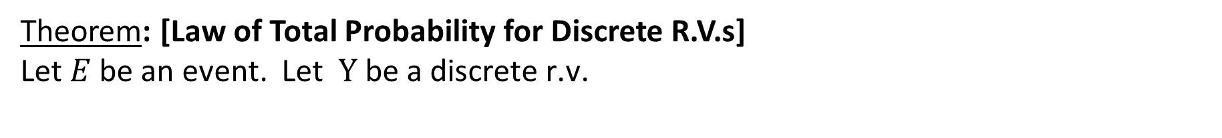
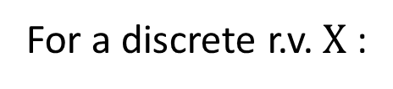
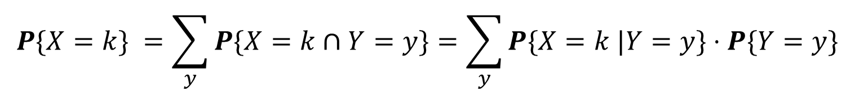
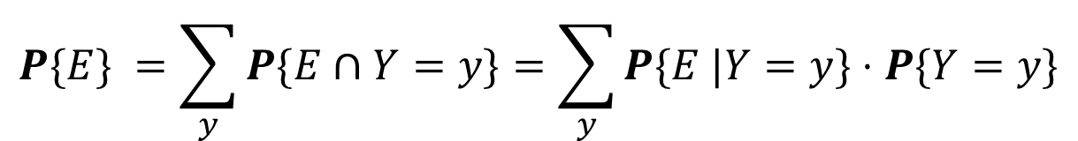
Law of Total Probability – the details
Theorem: [Law of Total Probability for Discrete R.V.s]
Let $E$be an event. Let$Y \text{be} \text{a} \text{discrete} \text{r}\text{.}\text{v}\text{.}$
$$P\{E\} =\sum_{y}^{ }{P\{E∩Y=y\}=\sum_{y}^{ }{P\{E |Y=y\}⋅P\{Y=y\}}}$$
For a discrete r.v. $X$:
$$P\{X=k\} =\sum_{y}^{ }{P\{X=k∩Y=y\}=\sum_{y}^{ }{P\{X=k |Y=y\}⋅P\{Y=y\}}}$$
Proof: Follows immediately from Law of Total Probability for Events, if we realize
that $Y=y$ represents an event and the set of events $Y=y$ over all $y$ form a partition.

Slide 16

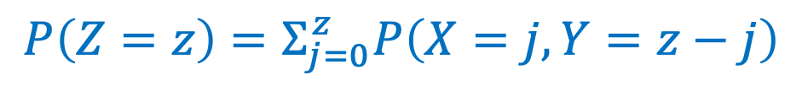
Proof
Theorem. Let $X\sim Poi(λ_{1})$ and $Y\sim Poi(λ_{2})$such that $λ=λ_{1}+λ_{2}$.
Let $Z=X+Y$. For all $z=0,1,2,3…$,
$P\left(Z=z\right)=e^{−λ}⋅\frac{λ^{z}}{z!}$
$$P\left(Z=z\right)=Σ_{j=0}^{z}P\left(X=j, Y=z−j\right)$$
Law of total probability

Slide 17
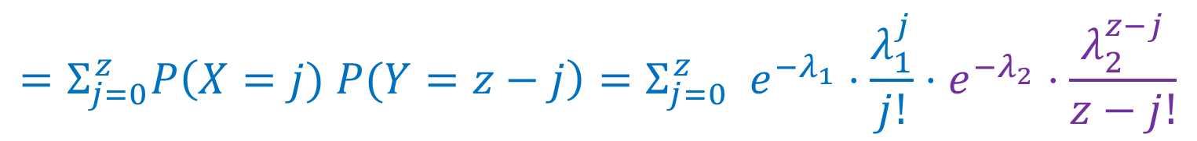

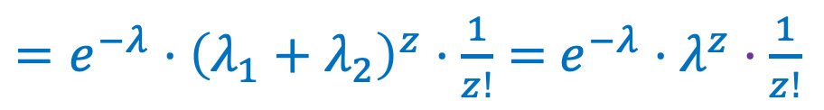
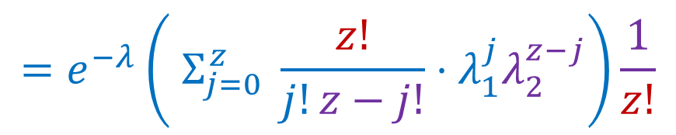
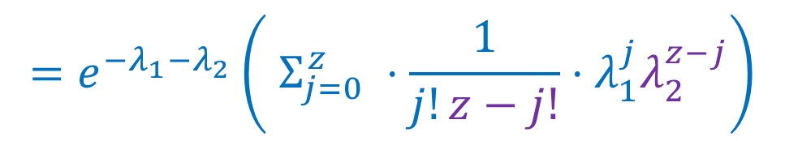
Proof. Written out
$$P\left(Z=z\right)=Σ_{j=0}^{z}P\left(X=j, Y=z−j\right)$$
Law of total probability
$$=Σ_{j=0}^{z}P\left(X=j) P(Y=z−j\right)=Σ_{j=0}^{z} e^{−λ_{1}}⋅\frac{λ_{1}^{j}}{j!}⋅e^{−λ_{2}}⋅\frac{λ_{2}^{z−j}}{z−j!}$$
Independence
$$=e^{−λ_{1}−λ_{2}}\left( Σ_{j=0}^{z} ⋅\frac{1}{j!z−j!}⋅λ_{1}^{j}λ_{2}^{z−j}\right)$$
$$=e^{−λ}\left( Σ_{j=0}^{z} \frac{z!}{j!z−j!}⋅λ_{1}^{j}λ_{2}^{z−j}\right)\frac{1}{z!}$$
Binomial Theorem
$=e^{−λ}⋅{\left(λ_{1}+λ_{2}\right)}^{z}⋅\frac{1}{z!}=$ $e^{−λ}⋅λ^{z}⋅\frac{1}{z!}$

Slide 18
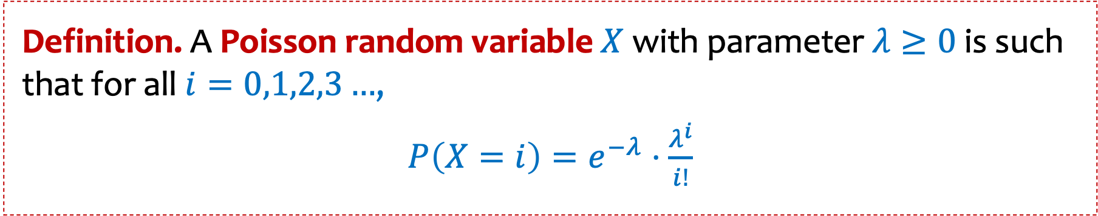
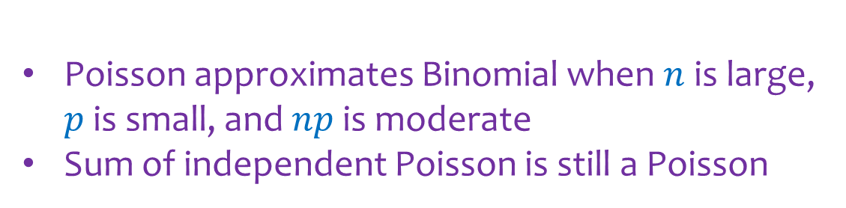
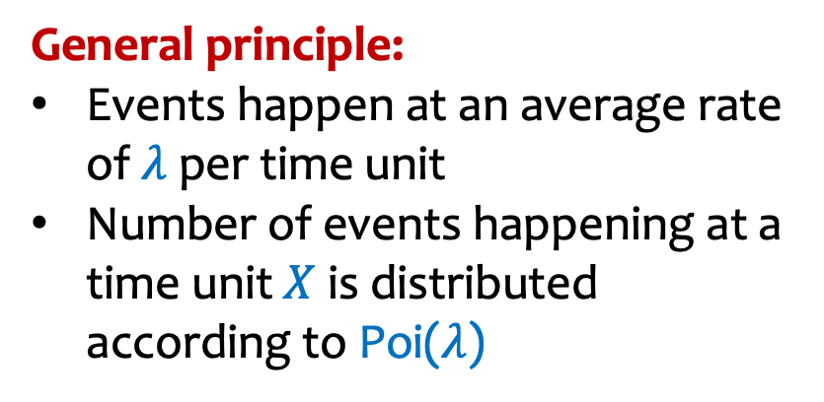
Poisson Random Variables - Summary
Definition. A Poisson random variable $X$with parameter $λ≥0$ is such that for all $i=0,1,2,3…$,
$P\left(X=i\right)=e^{−λ}⋅\frac{λ^{i}}{i!}$
General principle:
Events happen at an average rate of $λ$ per time unit
Number of events happening at a time unit $X$ is distributed according to Poi($λ$)
Poisson approximates Binomial when $n$ is large, $p$ is small, and $np$ is moderate
Sum of independent Poisson is still a Poisson
Notes:
CRO

Slide 19





Who Fails First?
You have a disk with probability $p_{1}$of failing each day, and a CPU which independently has probability $p_{2}$of failing each day.
$$p_{1}$$
$$p_{2}$$
Q: What is the probability that the disk fails before the CPU?

Slide 20


Who Fails First? (1)
Disk with prob. $p_{1}$of failing each day, and a CPU with indpt. prob. $p_{2}$of failing each day.
Q: What is the probability that the disk fails before the CPU? (Redo using conditioning!)
$$X_{1}=\text{days} \text{until} \text{disk} \text{fails}∼Geometric(p_{1})$$
$$X_{2}=\text{days} \text{until} \text{CPU} \text{fails}∼Geometric(p_{2})$$
$$X_{1}⊥X_{2}$$
$$P\left\{X_{1}<X_{2}\right\}=$$

Slide 21
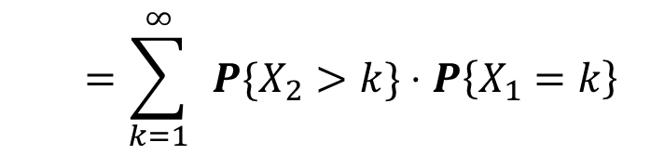
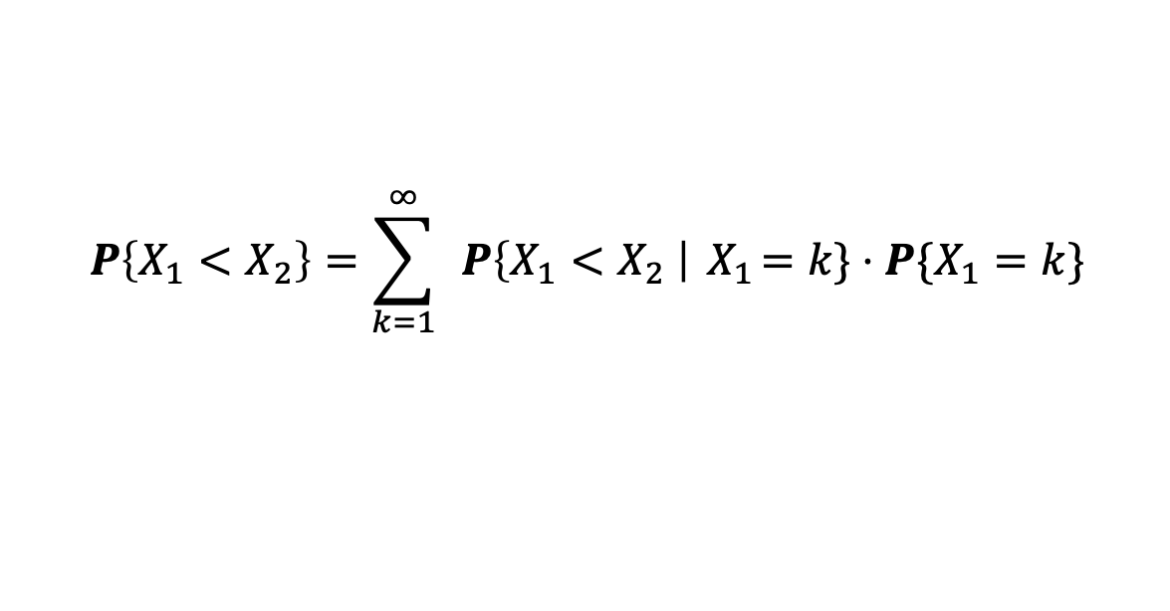
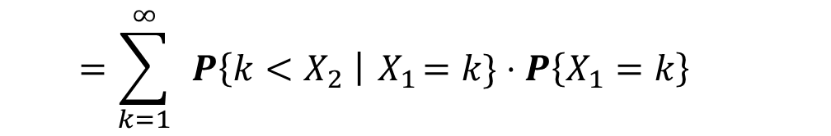
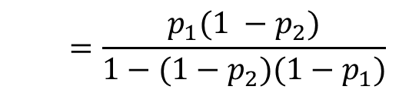
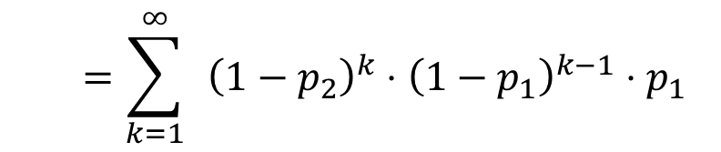
Who Fails First? (2)
Disk with prob. $p_{1}$of failing each day, and a CPU with indpt. prob. $p_{2}$of failing each day.
Q: What is the probability that the disk fails before the CPU? (Redo using conditioning!)
$$X_{1}=\text{days} \text{until} \text{disk} \text{fails}∼Geometric(p_{1})$$
$$X_{2}=\text{days} \text{until} \text{CPU} \text{fails}∼Geometric(p_{2})$$
$$P\left\{X_{1}<X_{2}\right\}=\sum_{k=1}^{∞}{ }P\left\{X_{1}<X_{2} \right|{ X}_{1}=k\}⋅P\{X_{1}=k\}$$
$$X_{1}⊥X_{2}$$
$$=\sum_{k=1}^{∞}{ }P\left\{k<X_{2} \right|{ X}_{1}=k\}⋅P\left\{X_{1}=k\right\}$$
$$=\sum_{k=1}^{∞}{ }P\{X_{2}>k\}⋅P\left\{X_{1}=k\right\}$$
$$=\sum_{k=1}^{∞}{ }{\left(1−p_{2}\right)}^{k}⋅{\left(1−p_{1}\right)}^{k−1}⋅p_{1}$$
$$=\frac{p_{1}(1 −p_{2})}{1−(1−p_{2})(1−p_{1})}$$

Slide 22



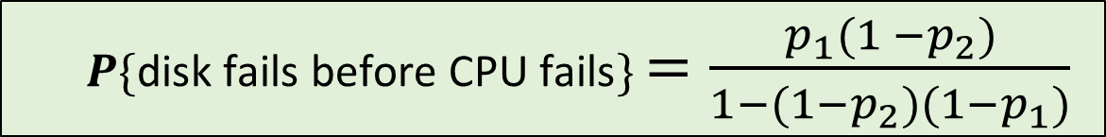
Who Fails First? (3)
You have a disk with probability $p_{1}$of failing each day, and a CPU which independently has probability $p_{2}$of failing each day.
$$p_{1}$$
$$p_{2}$$
$P\{\text{disk} \text{fails} \text{before} \text{CPU} \text{fails}\}$ $=\frac{p_{1}(1 −p_{2})}{1−(1−p_{2})(1−p_{1})}$
But WHY?

Slide 23


Who Fails First? (4)
You have a disk with probability $p_{1}$of failing each day, and a CPU which independently has probability $p_{2}$of failing each day.
$P\{\text{disk} \text{fails} \text{before} \text{CPU} \text{fails}\}$ $=\frac{p_{1}(1 −p_{2})}{1−(1−p_{2})(1−p_{1})}$
Intuition: Think about flipping 2 coins each day.
There may be many days where both coins are heads.
We only care about the first day where the coins are not both heads.
Given that both coins are not heads, what’s the probability that coin 1 is H and coin 2 is T?
$P\{\text{coin}\text{ 1 }\text{is} \text{H}\text{ \& }\text{coin}\text{ 2 }\text{is} \text{T}\text{ | }\text{not} \text{both} \text{tails}\}$ $=$

Slide 24
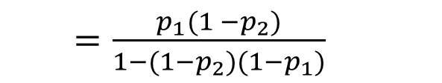
Who Fails First? (5)
You have a disk with probability $p_{1}$of failing each day, and a CPU which independently has probability $p_{2}$of failing each day.
$P\{\text{disk} \text{fails} \text{before} \text{CPU} \text{fails}\}$ $=\frac{p_{1}(1 −p_{2})}{1−(1−p_{2})(1−p_{1})}$
Intuition: Think about flipping 2 coins each day.
There may be many days where both coins are heads.
We only care about the first day where the coins are not both heads.
Given that both coins are not heads, what’s the probability that coin 1 is H and coin 2 is T?
$P\{\text{coin}\text{ 1 }\text{is} \text{H}\text{ \& }\text{coin}\text{ 2 }\text{is} \text{T}\text{ | }\text{not} \text{both} \text{tails}\}$ $=\frac{P\{\text{coin}\text{ 1 }\text{is} \text{H}\text{ \& }\text{coin}\text{ 2 }\text{is} \text{T}\}}{P\{\text{not} \text{both} \text{tails}\}}$
$=\frac{p_{1}(1 −p_{2})}{1−(1−p_{2})(1−p_{1})}$

Slide 25
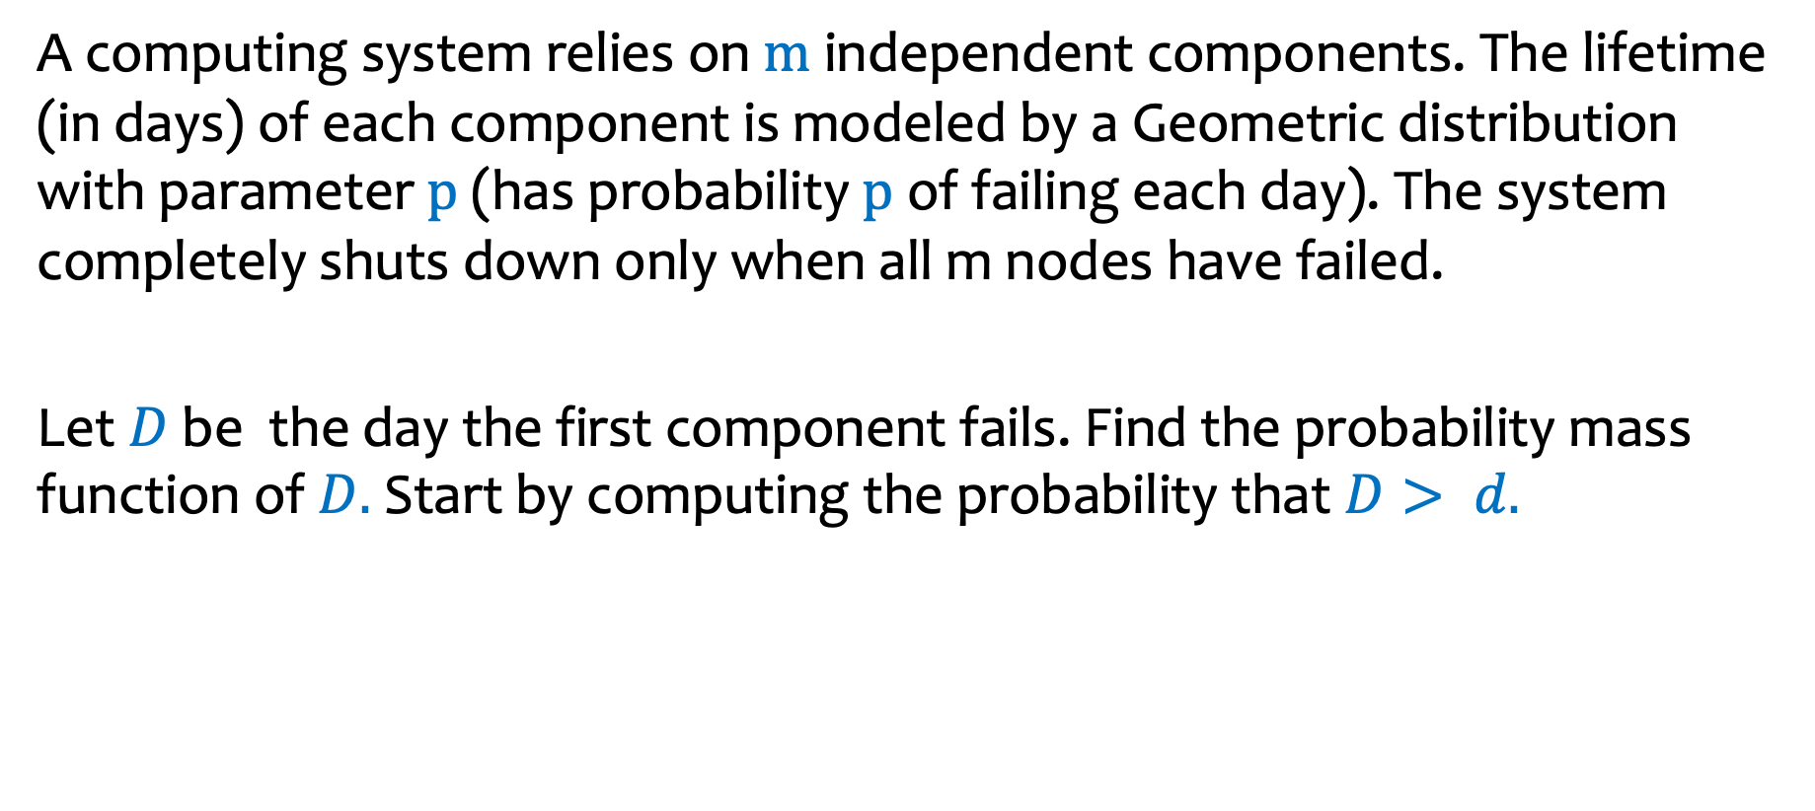
Parallel Server Failures (on section 5 worksheet)
A computing system relies on $m$ independent components. The lifetime (in days) of each component is modeled by a Geometric distribution with parameter $p$ (has probability $p$ of failing each day). The system completely shuts down only when all m nodes have failed.
Let $D$be the day the first component fails. Find the probability mass function of$D.$Start by computing the probability that $D> d.$

Slide 27
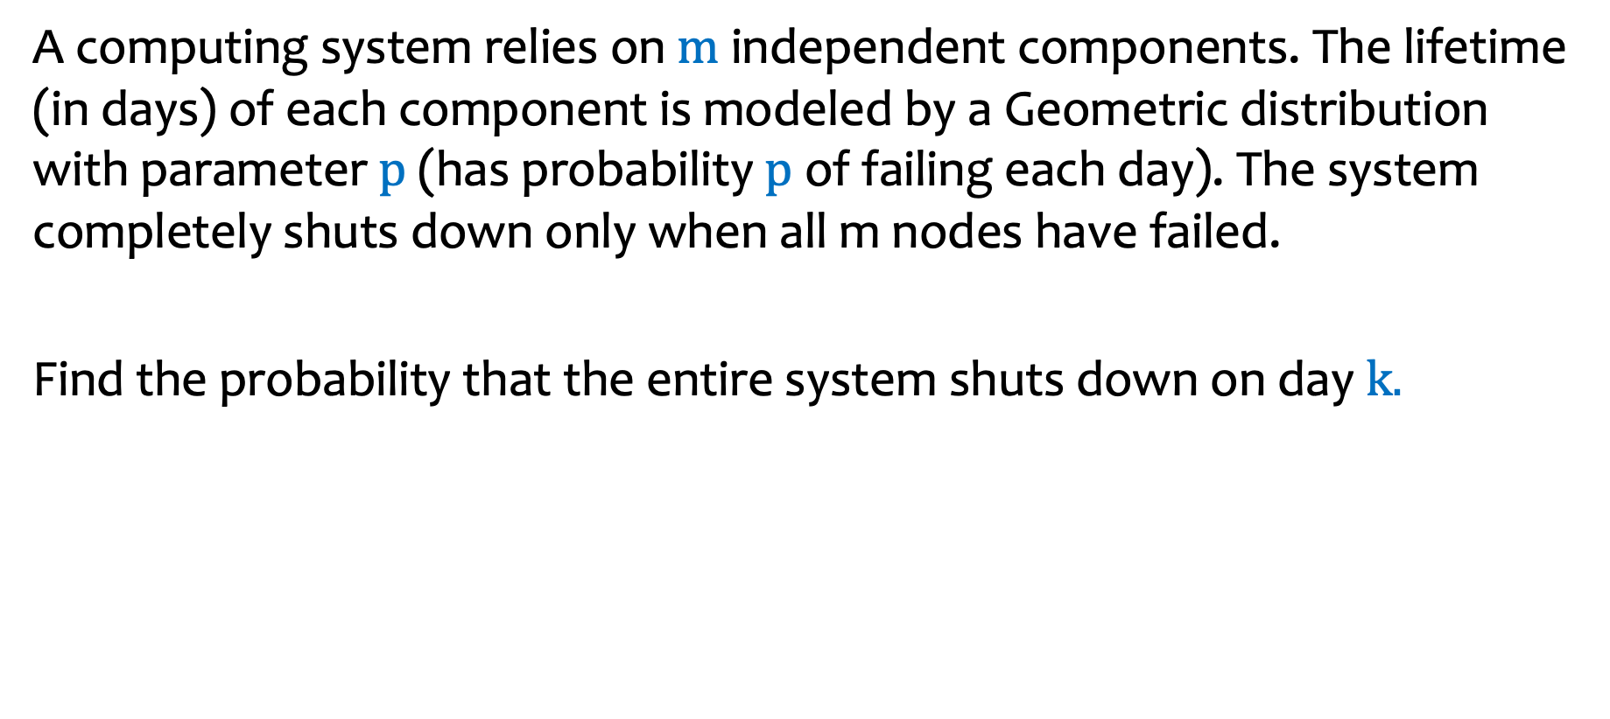
Parallel Server Failures (on section 5 worksheet)
A computing system relies on $m$ independent components. The lifetime (in days) of each component is modeled by a Geometric distribution with parameter $p$ (has probability $p$ of failing each day). The system completely shuts down only when all m nodes have failed.
Find the probability that the entire system shuts down on day $k.$

Slide 29
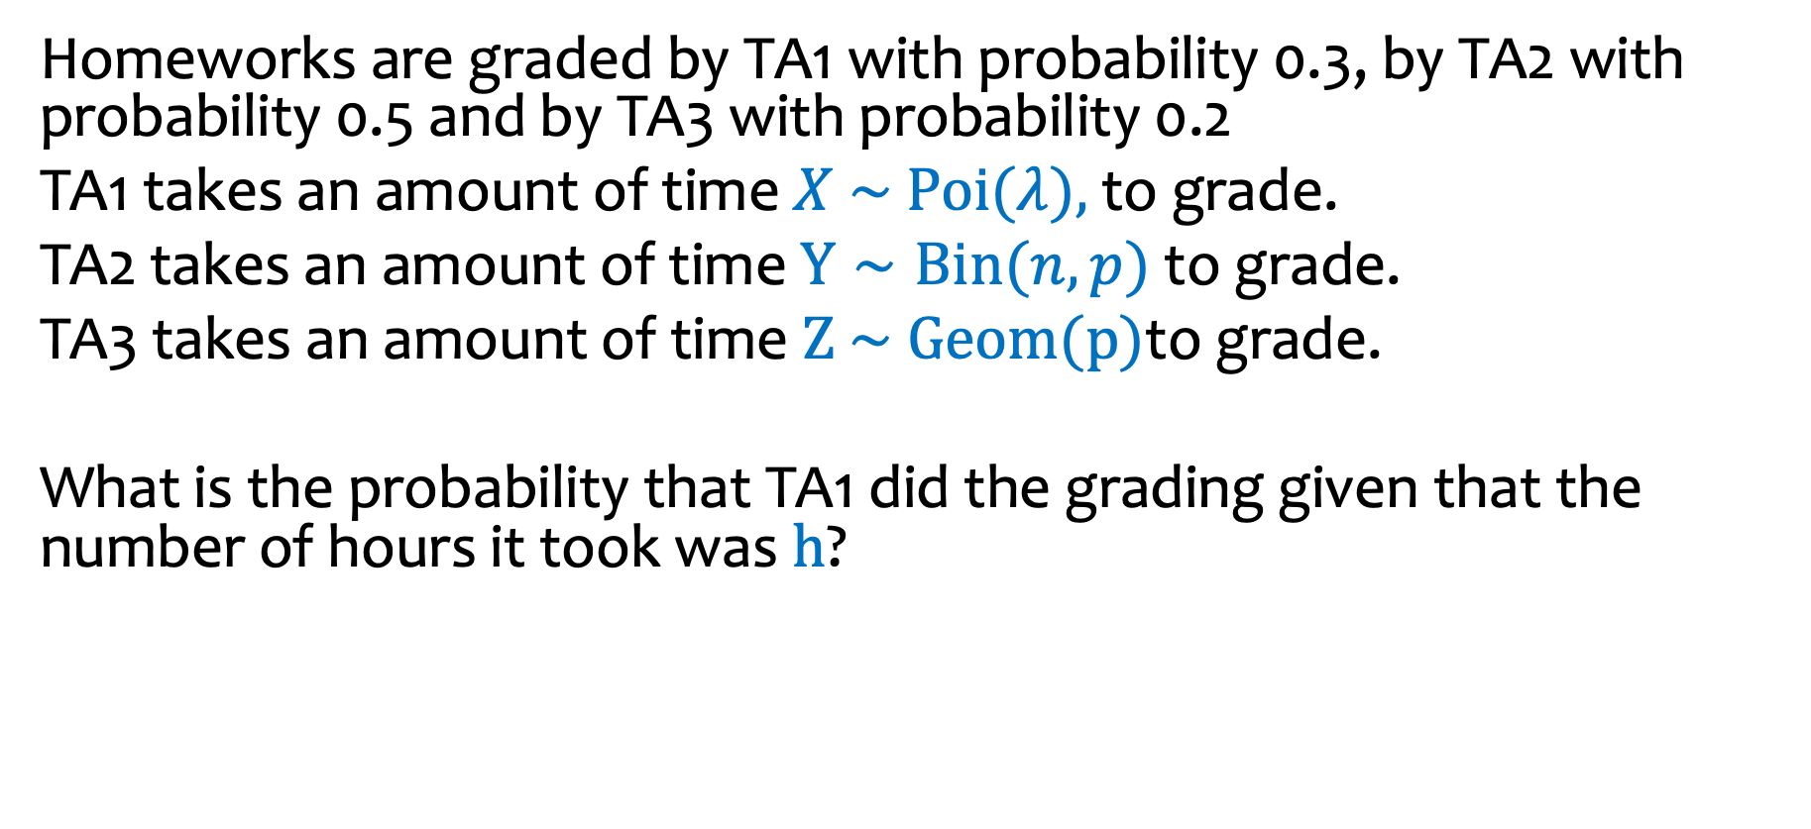
Homework grading (on section 5 worksheet)
Homeworks are graded by TA1 with probability 0.3, by TA2 with probability 0.5 and by TA3 with probability 0.2
TA1 takes an amount of time $X \sim Poi(λ),$ to grade.
TA2 takes an amount of time $Y∼Bin(n,p)$ to grade.
TA3 takes an amount of time $Z \sim Geom(p)\text{to} \text{grade}\text{.}$
What is the probability that TA1 did the grading given that the number of hours it took was $h$?

Slide 31
End of material for midterm!!!
Next time: continuous random variables!

