Slide 1
The Poisson Distribution
CSE 312 Spring 26
Lecture 13

Slide 2
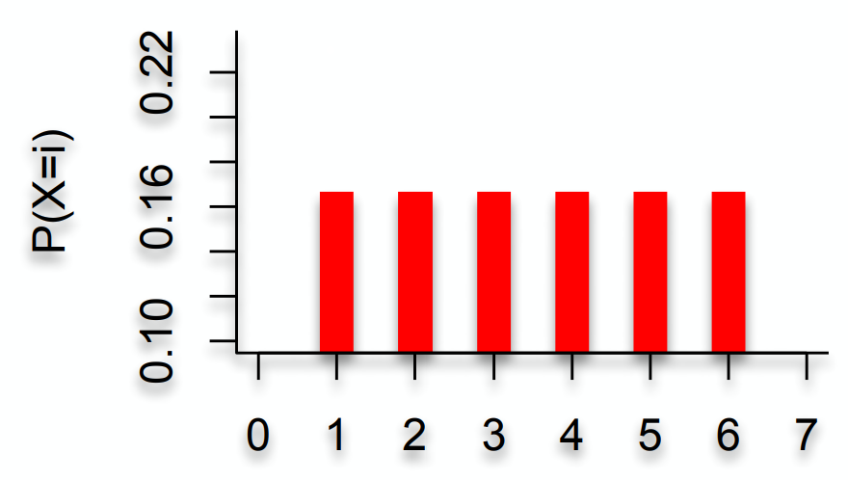
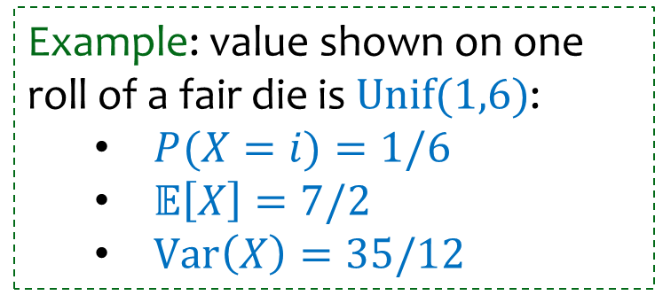
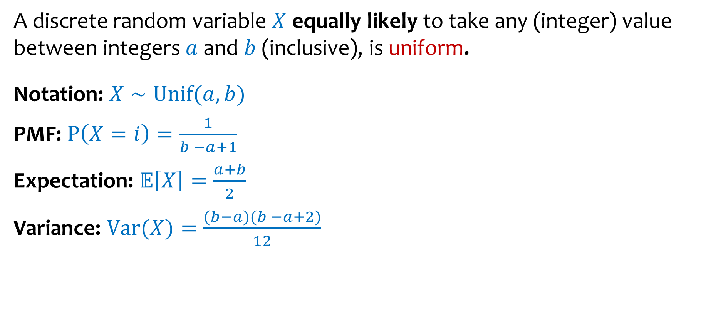
Discrete Uniform Random Variables (2)
A discrete random variable $X$ equally likely to take any (integer) value between integers $a$ and $b$ (inclusive), is uniform.
Notation: $X∼Unif(a,b)$
PMF: $P\left(X=i\right)=\frac{1}{b −a+1}$
Expectation: $𝔼\left[X\right]=\frac{a+b}{2}$
Variance: $Var(X)=\frac{(b−a)(b −a+2)}{12}$
Example: value shown on one roll of a fair die is $Unif(1,6)$:
$P(X=i)=1/6$
$𝔼\left[X\right]=7/2$
$Var\left(X\right)=35/12$

Slide 3
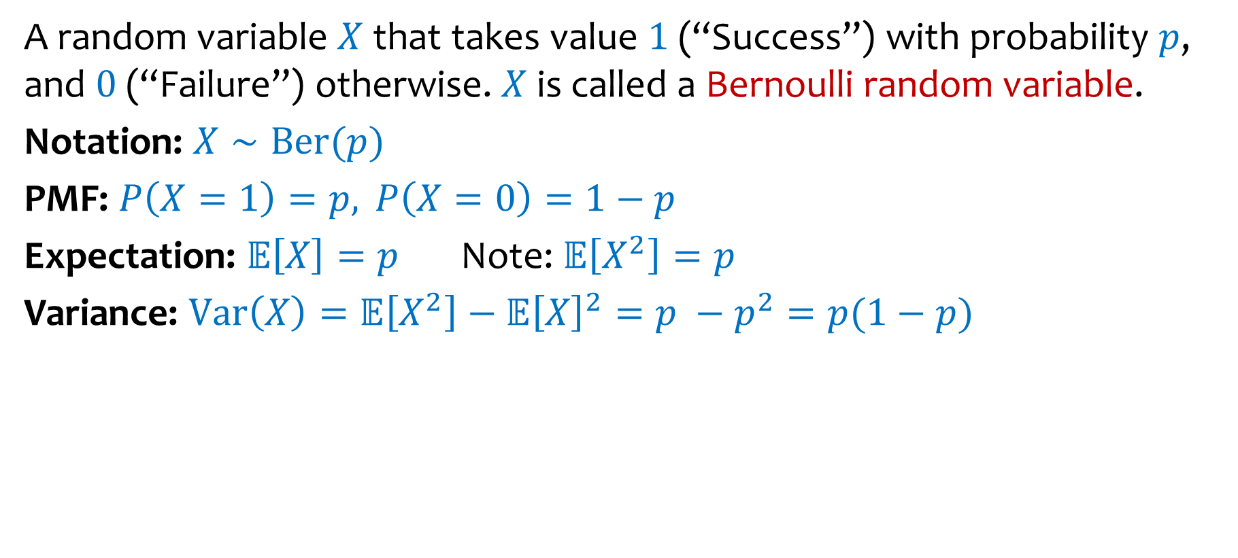
Bernoulli Random Variables (2)
A random variable $X$ that takes value $1$ (“Success”) with probability $p$, and $0$ (“Failure”) otherwise. $X$ is called a Bernoulli random variable.
Notation: $X∼Ber(p)$
PMF: $P\left(X=1\right)=p,P\left(X=0\right)=1−p$
Expectation: $𝔼\left[X\right]=p$ Note: $𝔼\left[X^{2}\right]=p$
Variance: $Var\left(X\right)=𝔼\left[X^{2}\right]−𝔼{\left[X\right]}^{2}=p −p^{2}=p(1−p)$
Examples:
Coin flip
Randomly guessing on a MC test question
A server in a cluster fails
Whether or not a share of a particular stock pays off or not
Any indicator r.v.

Slide 4

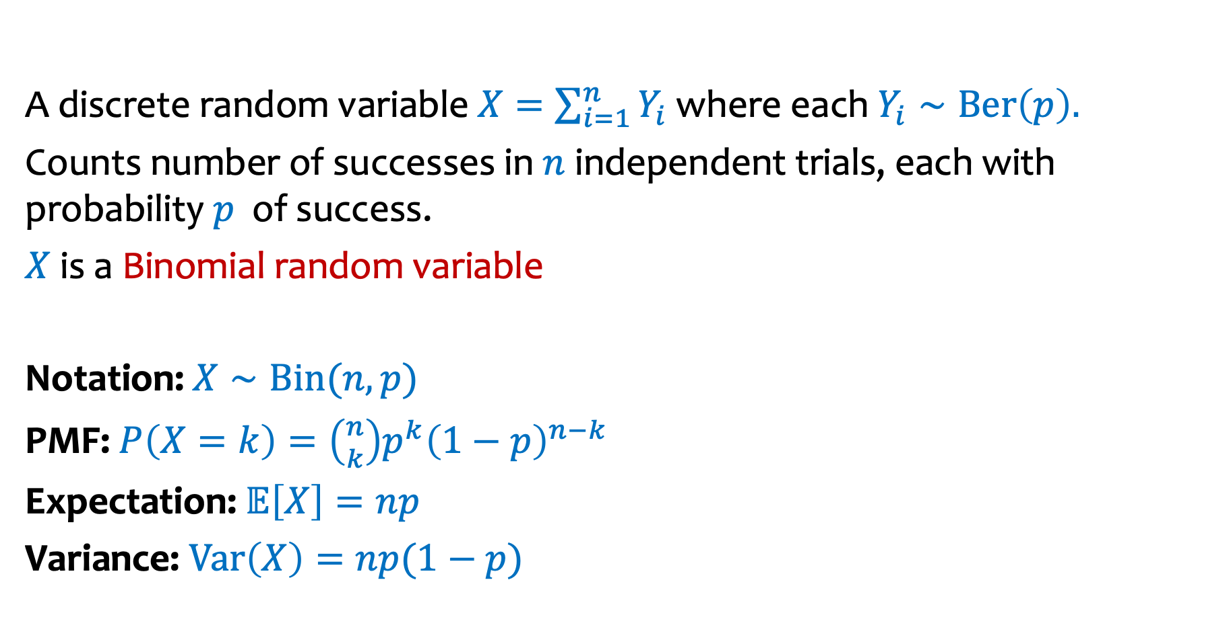
Binomial Random Variables (3)
A discrete random variable $X=\sum_{i=1}^{n}{Y_{i}}$ where each $Y_{i}∼Ber\left(p\right).$
Counts number of successes in $n$ independent trials, each with probability $p$ of success.
$X$ is a Binomial random variable
Notation: $X∼Bin(n,p)$
PMF: $P\left(X=k\right)=\left({n \atop k}\right)p^{k}{\left(1−p\right)}^{n−k}$
Expectation: $𝔼\left[X\right]=np$
Variance: $Var\left(X\right)=np(1−p)$
Examples:
# of heads in $n$ indep coin flips
# of 1s in a randomly generated n bit string
# of servers that fail in a cluster of $n$computers
# of bit errors in file written to disk
# of elements in a bucket of a large hash table
# of $n$ different stocks that “pay off”

Slide 5
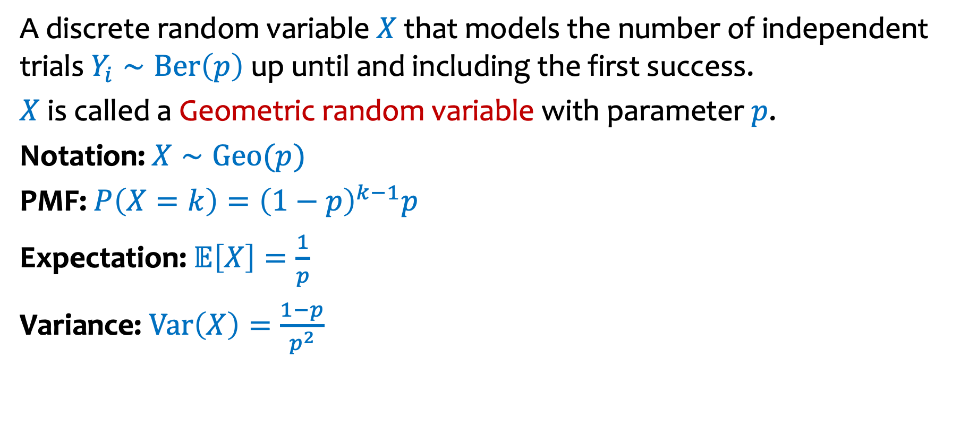
Geometric Random Variables (2)
A discrete random variable $X$ that models the number of independent trials $Y_{i}∼Ber\left(p\right)$ up until and including the first success.
$X$ is called a Geometric random variable with parameter $p$.
Notation: $X∼Geo(p)$
PMF: $P\left(X=k\right)={\left(1−p\right)}^{k−1}p$
Expectation: 𝔼$\left[X\right]=\frac{1}{p}$
Variance: $Var\left(X\right)=\frac{1−p}{p^{2}}$
Examples:
# of coin flips until first head
# of random guesses on MC questions until you get one right
# of random guesses at a password until you hit it
# hash trials until a miner successfully mines a Bitcoin

Slide 6
Today
Poisson Random Variables

Slide 7
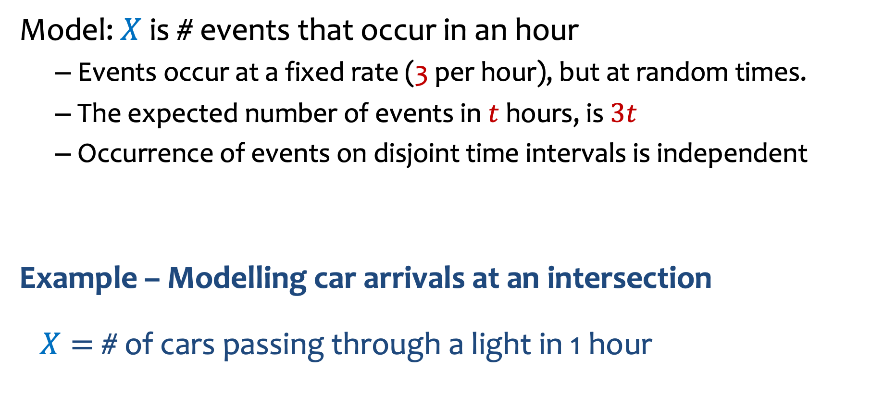
Preview: Poisson
Model: $X$is # events that occur in an hour
Events occur at a fixed rate (3 per hour), but at random times.
The expected number of events in $t$ hours, is $3t$
Occurrence of events on disjoint time intervals is independent
Example – Modelling car arrivals at an intersection
$X=$# of cars passing through a light in 1 hour

Slide 8


How to model?
$X$ = # cars passing through an intersection in $1$ hour. Constant rate of arrival.
Disjoint time intervals are independent.
Know: $𝔼[X]=3$
$1$ hour
0
1
0
1
0
1
0
0
0
1
1
0

Slide 9
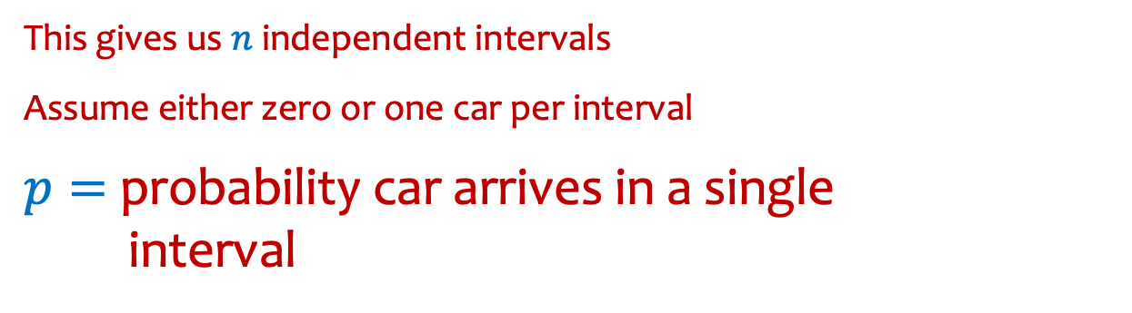



Example – Model the process of cars passing through a light in 1 hour
$X$ = # cars passing through a light in $1$ hour.
$$𝔼[X]=3$$
Assume: Occurrence of events on disjoint time intervals is independent
Approximation idea:
Divide hour into $n$ intervals of length $1/n$
$$1/n$$
This gives us $n$ independent intervals
Assume either zero or one car per interval
$p=$probability car arrives in a single
interval

Slide 10
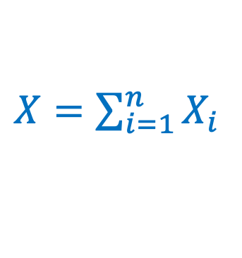


Model as Binomial
$X$ = # cars passing through a light in $1$ hour. Disjoint time intervals are independent.
Know: $𝔼[X]=3$
$1$ hour
$$1/n$$
0
1
0
1
0
1
0
0
0
1
1
0
Discrete version: $n$ intervals, each of length $1/n$ .
In each interval, there is a car with probability $p=3/n$ (assume $≤1$ car can pass by)
Each interval is Bernoulli: $X_{i}=1$ if car in $i$^{th} interval (0 otherwise). ${P(X}_{i}=1)=3 /n$
$X=\sum_{i=1}^{n}{X_{i}}$

Slide 11
More generally
$X$ = # cars passing through a light in $1$ hour. Disjoint time intervals are independent.
Know: $𝔼[X]=λ$ for some given $λ>0$
$1$ hour
$$1/n$$
0
1
0
1
0
1
0
0
0
1
1
0
Discrete version: $n$ intervals, each of length $1/n$ .
In each interval, there is a car with probability $p=λ/n$ (assume $≤1$ car can pass by)
Each interval is Bernoulli: $X_{i}=1$ if car in $i$^{th} interval (0 otherwise). ${P(X}_{i}=1)=λ /n$
$X=\sum_{i=1}^{n}{X_{i}}$

Slide 12

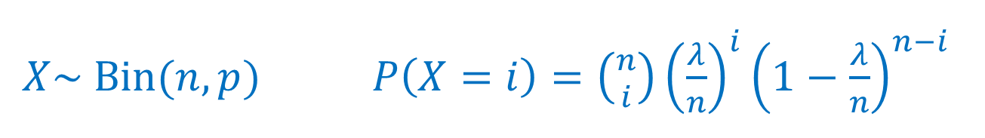
Model as Binomial
$X$ = # cars passing through a light in $1$ hour. Disjoint time intervals are independent.
Know: $𝔼[X]=λ$ for some given $λ>0$
$1$ hour
$$1/n$$
0
1
0
1
0
1
0
0
0
1
1
0
Discrete version: $n$ intervals, each of length $1/n$ .
In each interval, there is a car with probability $p=λ/n$ (assume $≤1$ car can pass by)
Each interval is Bernoulli: $X_{i}=1$ if car in $i$^{th} interval (0 otherwise). ${P(X}_{i}=1)=λ /n$
$X\sim Bin(n,p)$ $P\left(X=i\right)=\left({n \atop i}\right){\left(\frac{λ}{n}\right)}^{i}{\left(1−\frac{λ}{n}\right)}^{n−i}$
$X=\sum_{i=1}^{n}{X_{i}}$
indeed! $𝔼\left[X\right]=pn=λ$

Slide 13

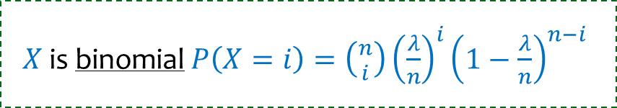
Don’t like discretization
$X$ is binomial $P\left(X=i\right)=\left({n \atop i}\right){\left(\frac{λ}{n}\right)}^{i}{\left(1−\frac{λ}{n}\right)}^{n−i}$
$$1/n$$
0
1
0
1
0
1
0
0
0
1
1
0
$$P\left(X=i\right)=\left({n \atop i}\right){\left(\frac{λ}{n}\right)}^{i}{\left(1−\frac{λ}{n}\right)}^{n−i}$$
We want now $n→∞$

Slide 14

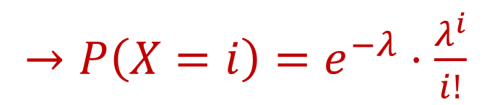


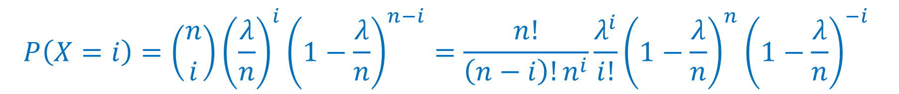

Take the limit
$X$ is binomial $P\left(X=i\right)=\left({n \atop i}\right){\left(\frac{λ}{n}\right)}^{i}{\left(1−\frac{λ}{n}\right)}^{n−i}$
$$1/n$$
0
1
0
1
0
1
0
0
0
1
1
0
We want now $n→∞$
$$P\left(X=i\right)=\left({n \atop i}\right){\left(\frac{λ}{n}\right)}^{i}{\left(1−\frac{λ}{n}\right)}^{n−i}=\frac{n!}{\left(n−i\right)!n^{i}}\frac{λ^{i}}{i!}{\left(1−\frac{λ}{n}\right)}^{n}{\left(1−\frac{λ}{n}\right)}^{−i}$$
$→P\left(X=i\right)=e^{−λ}⋅\frac{λ^{i}}{i!}$
$$→1$$
$$→e^{−λ}$$
$$→1$$

Slide 15
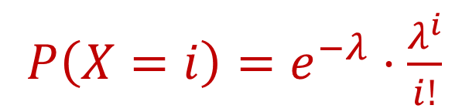
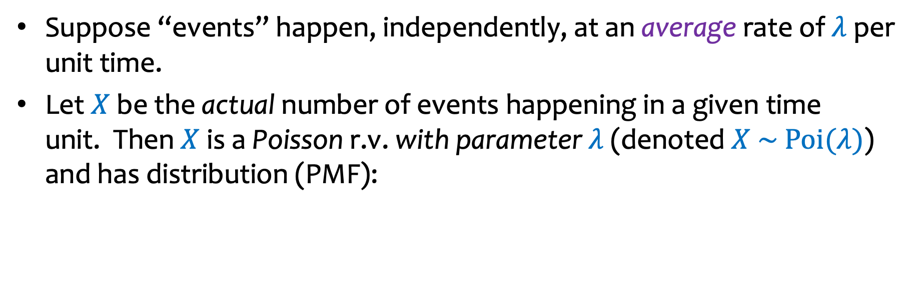

Poisson Distribution
Siméon Denis Poisson
1781-1840
Suppose “events” happen, independently, at an average rate of $λ$ per unit time.
Let $X$ be the actual number of events happening in a given time unit. Then $X$ is a Poisson r.v. with parameter $λ$ (denoted $X \sim Poi(λ)$) and has distribution (PMF):
$P\left(X=i\right)=e^{−λ}⋅\frac{λ^{i}}{i!}$
$$i=0, 1, 2,…$$
Some examples of “Poisson processes”:
# of cars passing through a traffic light in 1 hour
# of requests to web servers in an hour
# of photons hitting a light detector in a given interval
# of patients arriving to ER within an hour
Assume
fixed average rate

Slide 16
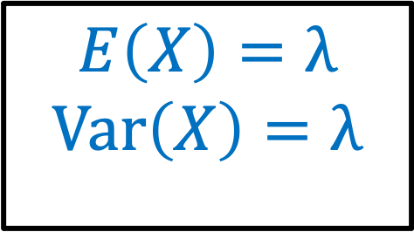
Poisson Distribution
Siméon Denis Poisson
1781-1840
Suppose “events” happen, independently, at an average rate of $λ$ per unit time.
Let $X$ be the actual number of events happening in a given time unit. Then $X$ is a Poisson r.v. with parameter $λ$ (denoted $X \sim Poi(λ)$) and has distribution (PMF):
$P\left(X=i\right)=e^{−λ}⋅\frac{λ^{i}}{i!}$
$$i=0, 1, 2,…$$
$$E\left(X\right)=λ$$
$$Var\left(X\right)=λ$$

Slide 17
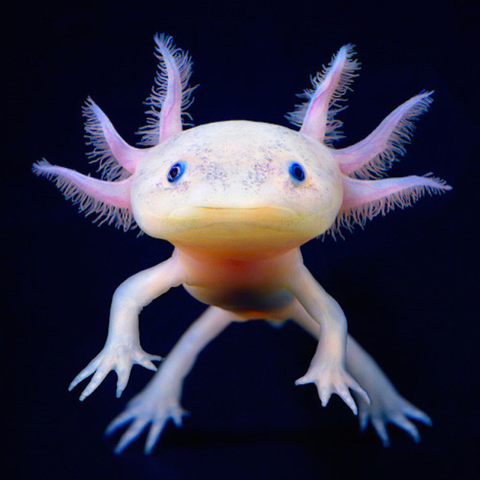




Probability Mass Function
$P\left(X=i\right)=e^{−λ}⋅\frac{λ^{i}}{i!}$
$λ=2$
$λ=5$
$λ=10$
This Photo by Unknown Author is licensed under CC BY-NC

Slide 18
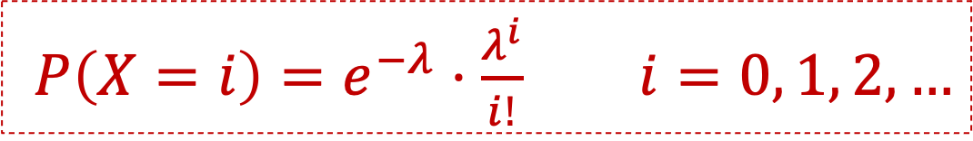
Validity of Distribution
$P\left(X=i\right)=e^{−λ}⋅\frac{λ^{i}}{i!} i=0, 1, 2, …$
Is this a valid probability mass function?
(How do you show that a pmf is valid?)

Slide 19
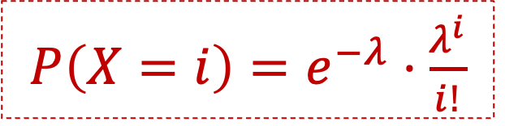

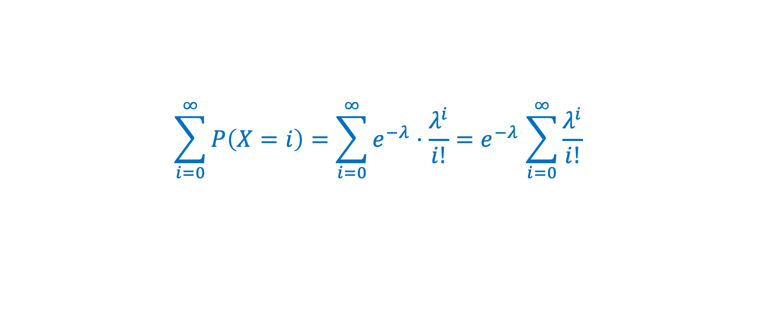
Calculate sum
$P\left(X=i\right)=e^{−λ}⋅\frac{λ^{i}}{i!}$
To show that a pmf is valid, need to check that it takes nonnegative values and that the probabilities sum up to 1.
$$\sum_{i=0}^{∞}{P\left(X=i\right)}=\sum_{i=0}^{∞}{e^{−λ}⋅\frac{λ^{i}}{i!}}{=e}^{−λ}\sum_{i=0}^{∞}{\frac{λ^{i}}{i!}}$$
Fact (Taylor series expansion):
$$e^{x}=\sum_{i=0}^{∞}{\frac{x^{i}}{i!}}$$
Notes:
CRO

Slide 20


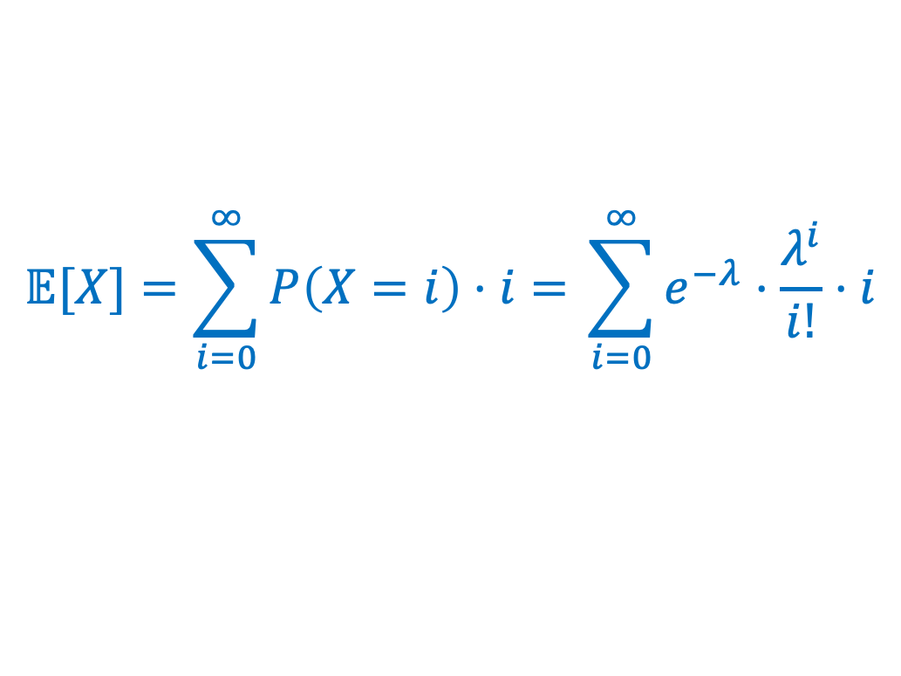
Expectation
$P\left(X=i\right)=e^{−λ}⋅\frac{λ^{i}}{i!}$
Theorem. If $X$ is a Poisson RV with parameter $λ≥0$, then
$$𝔼\left[X\right]= ?$$
$$𝔼[X]=\sum_{i=0}^{∞}{P\left(X=i\right)⋅i= }\sum_{i=0}^{∞}{e^{−λ}⋅\frac{λ^{i}}{i!}⋅i}$$
Proof.

Slide 21
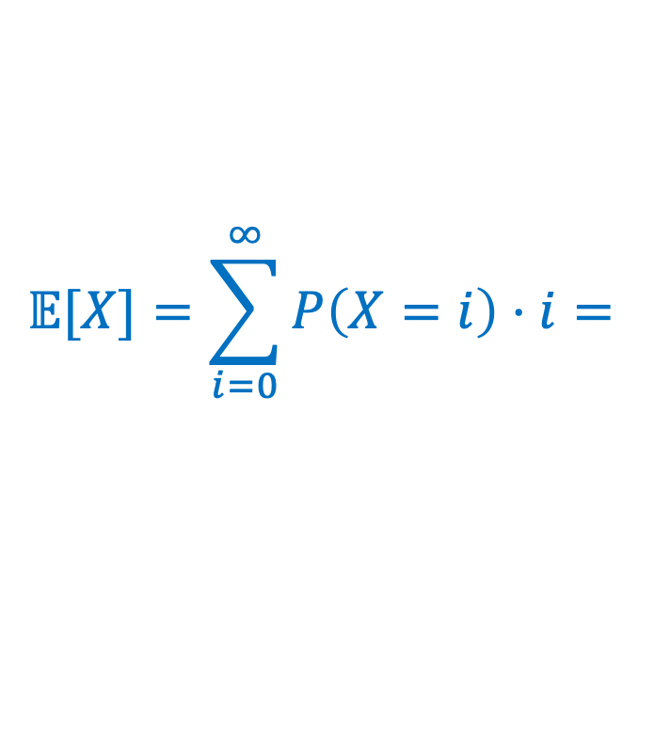

Expectation calculation
$P\left(X=i\right)=e^{−λ}⋅\frac{λ^{i}}{i!}$
Theorem. If $X$ is a Poisson RV with parameter $λ$, then
$$𝔼\left[X\right]=λ$$
$$𝔼[X]=\sum_{i=0}^{∞}{P\left(X=i\right)⋅i= }$$
Proof.

Slide 22
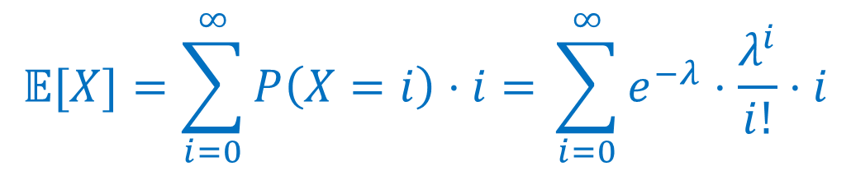


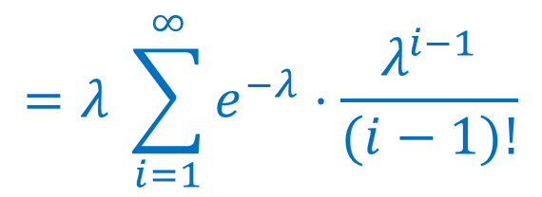
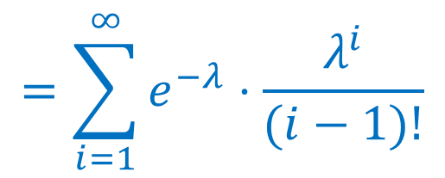
Expectation calculation
$P\left(X=i\right)=e^{−λ}⋅\frac{λ^{i}}{i!}$
Theorem. If $X$ is a Poisson RV with parameter $λ$, then
$$𝔼\left[X\right]=λ$$
$$𝔼[X]=\sum_{i=0}^{∞}{P\left(X=i\right)⋅i= }\sum_{i=0}^{∞}{e^{−λ}⋅\frac{λ^{i}}{i!}⋅i}$$
$$=\sum_{i=1}^{∞}{e^{−λ}⋅\frac{λ^{i}}{(i−1)!}}$$
Proof.
$$=λ \sum_{i=1}^{∞}{e^{−λ}⋅\frac{λ^{i−1}}{(i−1)!}}$$
$$=λ \sum_{i=0}^{∞}{e^{−λ}⋅\frac{λ^{i}}{i!}}$$
= $1$ (see prior slides!)
$$=λ⋅1=λ$$

Slide 23
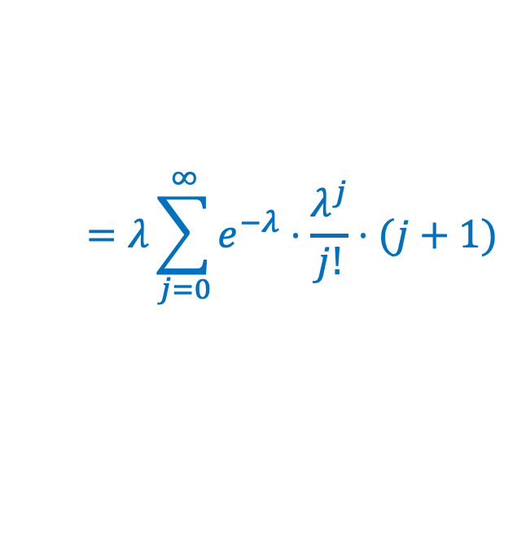
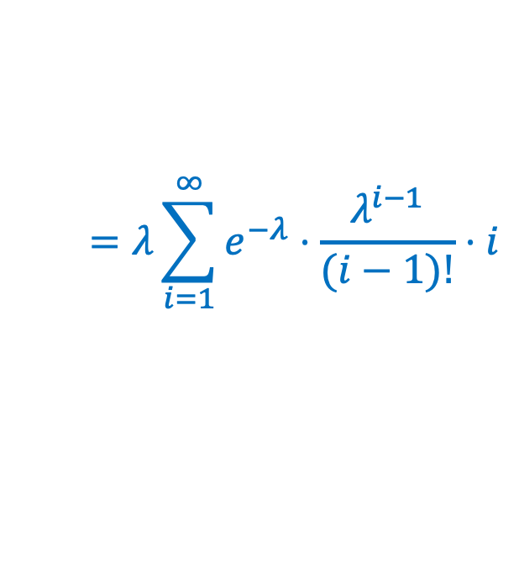

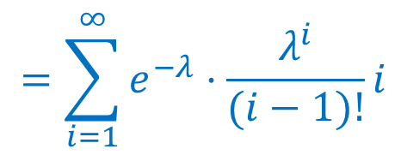

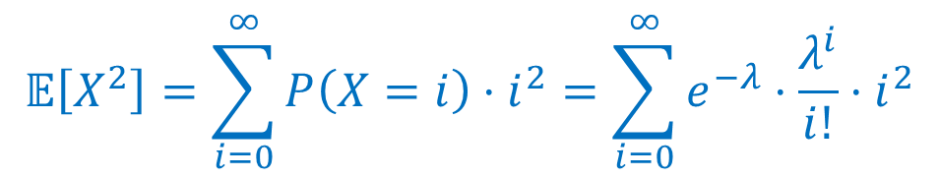

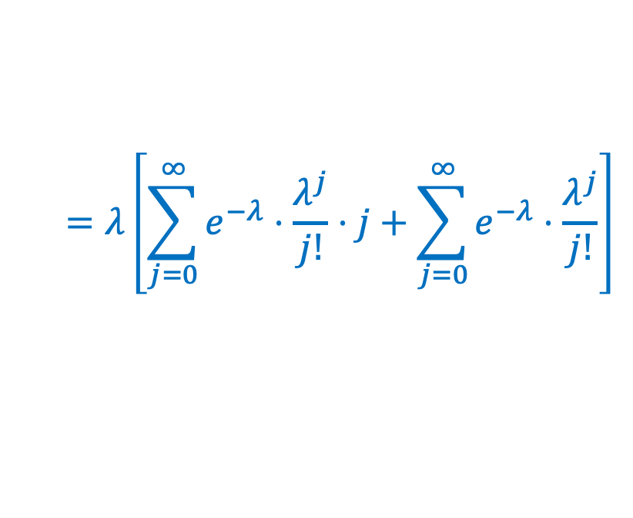
Variance
$P\left(X=i\right)=e^{−λ}⋅\frac{λ^{i}}{i!}$
Theorem. If $X$ is a Poisson RV with parameter $λ$, then $Var(X)=λ$
$$𝔼\left[X^{2}\right]=\sum_{i=0}^{∞}{P\left(X=i\right)⋅i^{2}}=\sum_{i=0}^{∞}{e^{−λ}⋅\frac{λ^{i}}{i!}⋅i^{2}}$$
$$=\sum_{i=1}^{∞}{e^{−λ}⋅\frac{λ^{i}}{(i−1)!}}i$$
Proof.
$$=λ\sum_{i=1}^{∞}{e^{−λ}⋅\frac{λ^{i−1}}{(i−1)!}}⋅i$$
$$=λ\sum_{j=0}^{∞}{e^{−λ}⋅\frac{λ^{j}}{j!}⋅(j+1)}$$
$$=λ\left[\sum_{j=0}^{∞}{e^{−λ}⋅\frac{λ^{j}}{j!}⋅j}+\sum_{j=0}^{∞}{e^{−λ}⋅\frac{λ^{j}}{j!}}\right]$$
$$=λ^{2}+λ$$
Similar to the previous proof
Verify offline.
$$=𝔼[X]=λ$$
$$=1$$
$$Var\left(X\right)=𝔼[X^{2}]−𝔼{[X]}^{2}=λ^{2}+λ−λ^{2}=λ$$
Notes:
CRO

Slide 24
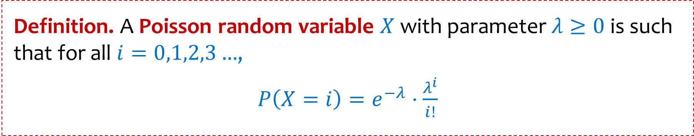
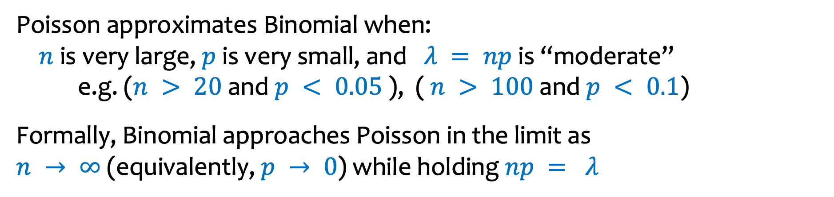
Poisson Random Variables
Definition. A Poisson random variable $X$with parameter $λ≥0$ is such that for all $i=0,1,2,3…$,
$P\left(X=i\right)=e^{−λ}⋅\frac{λ^{i}}{i!}$
Poisson approximates Binomial when:
$n$ is very large, $p$ is very small, and $λ = np$is “moderate”
e.g. ($n > 20$and $p < 0.05$ ), ( $n > 100$and $p < 0.1$)
Formally, Binomial approaches Poisson in the limit as $n → ∞$(equivalently, $p → 0$) while holding $np = λ$
This Photo by Unknown Author is licensed under CC BY-NC

Slide 25




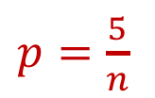

Probability Mass Function – Convergence of Binomials
$λ=5$
$p=\frac{5}{n}$
$$Bin(10,0.5)$$
$$n=10,15,20$$
$$Bin(15,1/3)$$
$$Bin(20,0.25)$$
$$Poi(5)$$
$as n→∞,$ Binomial(n, $p= λ/n$) $→poi(λ)$

Slide 26





From Binomial to Poisson
$$n→∞$$
$$np=λ$$
$$p=\frac{λ}{n}→0$$
$$X∼Bin(n,p)$$
$$X∼Poi(λ)$$
$$P\left(X=k\right)=e^{−λ}⋅\frac{λ^{k}}{k!} \\ E\left[X\right]=λ \\ Var\left(X\right)=λ$$
$$P\left(X=k\right)=\left({n \atop k}\right)p^{k}{\left(1−p\right)}^{n−k} \\ E\left[X\right]=np \\ Var\left(X\right)=np(1−p)$$
Notes:
CRO

Slide 27
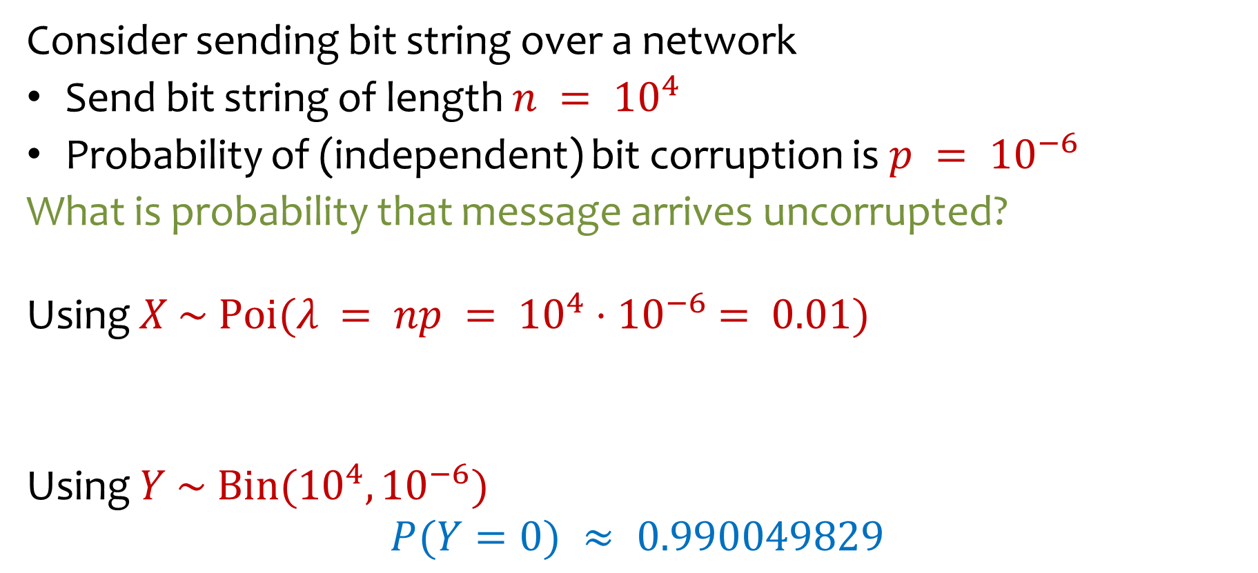
Example -- Approximate Binomial Using Poisson
Consider sending bit string over a network
Send bit string of length $n = {10}^{4}$
Probability of (independent) bit corruption is $p = {10}^{−6}$
What is probability that message arrives uncorrupted?
Using $X \sim Poi(λ = np = {10}^{4}{⋅10}^{−6} = 0.01)$
Using $Y \sim Bin({10}^{4}, {10}^{−6})$
$$P(Y=0) ≈ 0.990049829$$
$$P\left(X=0\right)=e^{−λ}⋅\frac{λ^{0}}{0!}=e^{−0.01}⋅\frac{{0.01}^{0}}{0!}≈0.990049834$$

Slide 28
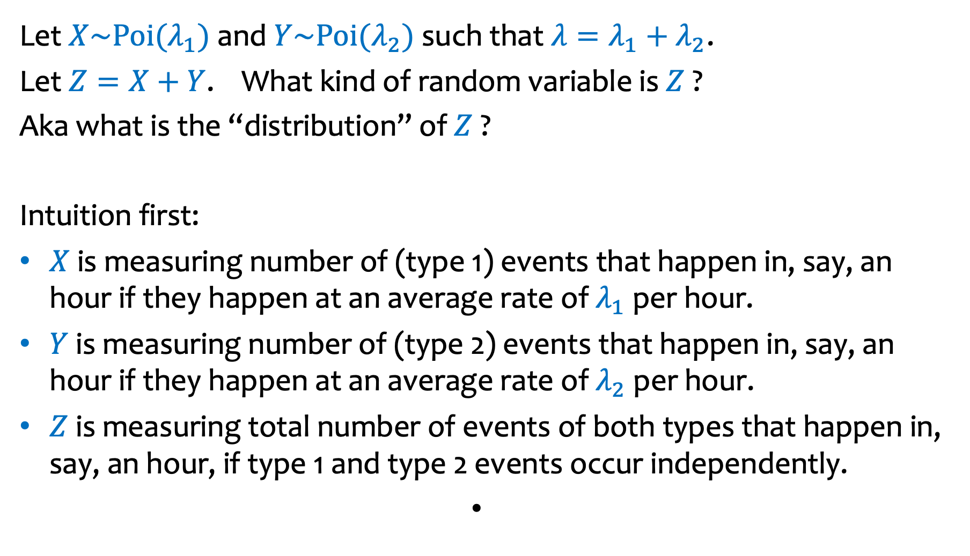
Sum of Independent Poisson RVs
Let $X\sim Poi(λ_{1})$ and $Y\sim Poi(λ_{2})$such that $λ=λ_{1}+λ_{2}$.
Let $Z=X+Y$. What kind of random variable is $Z$ ?
Aka what is the “distribution” of $Z$ ?
Intuition first:
$X$ is measuring number of (type 1) events that happen in, say, an hour if they happen at an average rate of $λ_{1}$ per hour.
$Y$ is measuring number of (type 2) events that happen in, say, an hour if they happen at an average rate of $λ_{2}$ per hour.
$Z$ is measuring total number of events of both types that happen in, say, an hour, if type 1 and type 2 events occur independently.

Slide 29
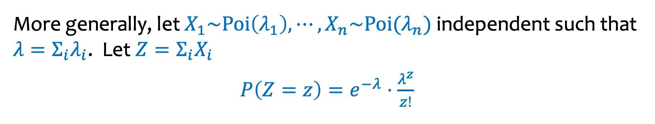
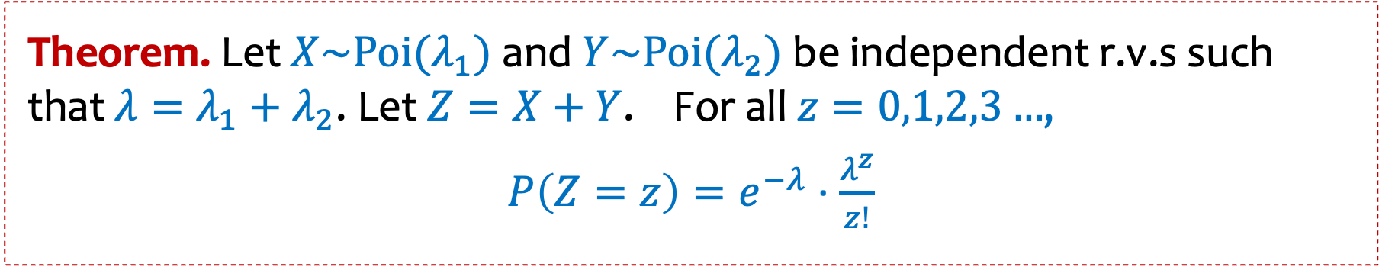
Sum of Independent Poisson RVs (2)
Theorem. Let $X\sim Poi(λ_{1})$ and $Y\sim Poi(λ_{2})$be independent r.v.s such that $λ=λ_{1}+λ_{2}$. Let $Z=X+Y$. For all $z=0,1,2,3…$,
$P\left(Z=z\right)=e^{−λ}⋅\frac{λ^{z}}{z!}$
More generally, let $X_{1}\sim Poi\left(λ_{1}\right), ⋯,X_{n}\sim Poi(λ_{n})$ independent such that $λ=Σ_{i}λ_{i}$. Let $Z=Σ_{i}X_{i}$
$P\left(Z=z\right)=e^{−λ}⋅\frac{λ^{z}}{z!}$

Slide 30
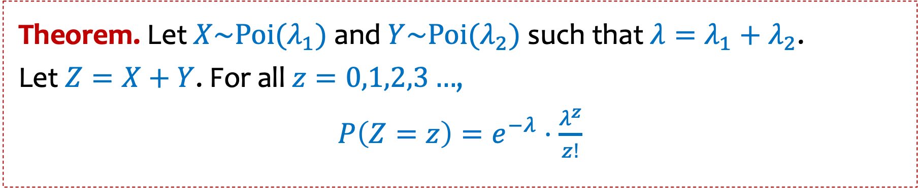
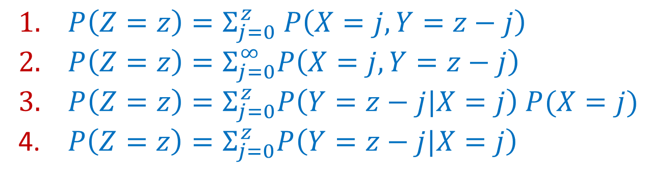

Sum of Independent Poisson RVs (3)
Theorem. Let $X\sim Poi(λ_{1})$ and $Y\sim Poi(λ_{2})$such that $λ=λ_{1}+λ_{2}$.
Let $Z=X+Y$. For all $z=0,1,2,3…$,
$P\left(Z=z\right)=e^{−λ}⋅\frac{λ^{z}}{z!}$
$P\left(Z=z\right)= ?$
https://pollev.com/ annakarlin185
All of them are right
The first 3 are right
Only 1 is right
Don’t know
$P\left(Z=z\right)=Σ_{j=0}^{z} P\left(X=j, Y=z−j\right)$
$P\left(Z=z\right)=Σ_{j=0}^{∞}P\left(X=j, Y=z−j\right)$
$P\left(Z=z\right)=Σ_{j=0}^{z}P\left(Y=z−j|X=j\right) P(X=j)$
$P\left(Z=z\right)=Σ_{j=0}^{z}P\left(Y=z−j|X=j\right)$

Slide 31

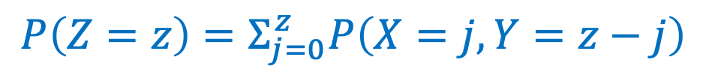
Proof
Theorem. Let $X\sim Poi(λ_{1})$ and $Y\sim Poi(λ_{2})$such that $λ=λ_{1}+λ_{2}$.
Let $Z=X+Y$. For all $z=0,1,2,3…$,
$P\left(Z=z\right)=e^{−λ}⋅\frac{λ^{z}}{z!}$
$$P\left(Z=z\right)=Σ_{j=0}^{z}P\left(X=j, Y=z−j\right)$$
Law of total probability

Slide 32
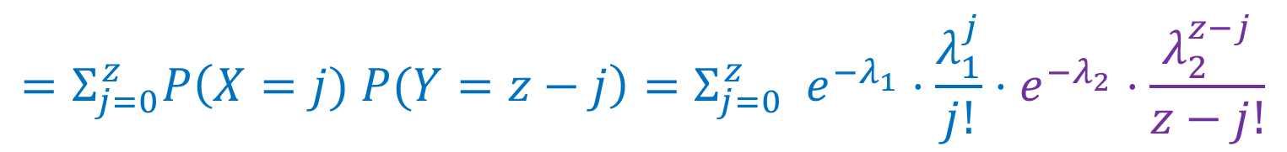

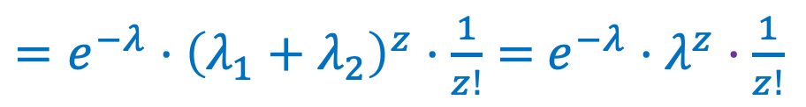


Proof
$$P\left(Z=z\right)=Σ_{j=0}^{z}P\left(X=j, Y=z−j\right)$$
Law of total probability
$$=Σ_{j=0}^{z}P\left(X=j) P(Y=z−j\right)=Σ_{j=0}^{z} e^{−λ_{1}}⋅\frac{λ_{1}^{j}}{j!}⋅e^{−λ_{2}}⋅\frac{λ_{2}^{z−j}}{z−j!}$$
Independence
$$=e^{−λ_{1}−λ_{2}}\left( Σ_{j=0}^{z} ⋅\frac{1}{j!z−j!}⋅λ_{1}^{j}λ_{2}^{z−j}\right)$$
$$=e^{−λ}\left( Σ_{j=0}^{z} \frac{z!}{j!z−j!}⋅λ_{1}^{j}λ_{2}^{z−j}\right)\frac{1}{z!}$$
Binomial Theorem
$=e^{−λ}⋅{\left(λ_{1}+λ_{2}\right)}^{z}⋅\frac{1}{z!}=$ $e^{−λ}⋅λ^{z}⋅\frac{1}{z!}$

Slide 33



Poisson Random Variables - Summary
Definition. A Poisson random variable $X$with parameter $λ≥0$ is such that for all $i=0,1,2,3…$,
$P\left(X=i\right)=e^{−λ}⋅\frac{λ^{i}}{i!}$
General principle:
Events happen at an average rate of $λ$ per time unit
Number of events happening at a time unit $X$ is distributed according to Poi($λ$)
Poisson approximates Binomial when $n$ is large, $p$ is small, and $np$ is moderate
Sum of independent Poisson is still a Poisson

Slide 34





Who Fails First?
You have a disk with probability $p_{1}$of failing each day, and a CPU which independently has probability $p_{2}$of failing each day.
$$p_{1}$$
$$p_{2}$$
Q: What is the probability that the disk fails before the CPU?

Slide 35
Law of Total Probability

Slide 36




Law of Total Probability
Theorem: [Law of Total Probability for Discrete R.V.s]
Let $E$be an event. Let$Y \text{be} \text{a} \text{discrete} \text{r}\text{.}\text{v}\text{.}$
$$P\{E\} =\sum_{y}^{ }{P\{E∩Y=y\}=\sum_{y}^{ }{P\{E |Y=y\}⋅P\{Y=y\}}}$$
For a discrete r.v. $X$:
$$P\{X=k\} =\sum_{y}^{ }{P\{X=k∩Y=y\}=\sum_{y}^{ }{P\{X=k |Y=y\}⋅P\{Y=y\}}}$$
Proof: Follows immediately from Law of Total Probability for Events, if we realize
that $Y=y$ represents an event and the set of events $Y=y$ over all $y$ form a partition.

Slide 37


Who Fails First?
Disk with prob. $p_{1}$of failing each day, and a CPU with indpt. prob. $p_{2}$of failing each day.
Q: What is the probability that the disk fails before the CPU? (Redo using conditioning!)
$$X_{1}=\text{days} \text{until} \text{disk} \text{fails}∼Geometric(p_{1})$$
$$X_{2}=\text{days} \text{until} \text{CPU} \text{fails}∼Geometric(p_{2})$$
$$X_{1}⊥X_{2}$$
$$P\left\{X_{1}<X_{2}\right\}=$$

Slide 38





Who Fails First?
Disk with prob. $p_{1}$of failing each day, and a CPU with indpt. prob. $p_{2}$of failing each day.
Q: What is the probability that the disk fails before the CPU? (Redo using conditioning!)
$$X_{1}=\text{days} \text{until} \text{disk} \text{fails}∼Geometric(p_{1})$$
$$X_{2}=\text{days} \text{until} \text{CPU} \text{fails}∼Geometric(p_{2})$$
$$P\left\{X_{1}<X_{2}\right\}=\sum_{k=1}^{∞}{ }P\left\{X_{1}<X_{2} \right|{ X}_{1}=k\}⋅P\{X_{1}=k\}$$
$$X_{1}⊥X_{2}$$
$$=\sum_{k=1}^{∞}{ }P\left\{k<X_{2} \right|{ X}_{1}=k\}⋅P\left\{X_{1}=k\right\}$$
$$=\sum_{k=1}^{∞}{ }P\{X_{2}>k\}⋅P\left\{X_{1}=k\right\}$$
$$=\sum_{k=1}^{∞}{ }{\left(1−p_{2}\right)}^{k}⋅{\left(1−p_{1}\right)}^{k−1}⋅p_{1}$$
$$=\frac{p_{1}(1 −p_{2})}{1−(1−p_{2})(1−p_{1})}$$

Slide 39




Who Fails First?
You have a disk with probability $p_{1}$of failing each day, and a CPU which independently has probability $p_{2}$of failing each day.
$$p_{1}$$
$$p_{2}$$
$P\{\text{disk} \text{fails} \text{before} \text{CPU} \text{fails}\}$ $=\frac{p_{1}(1 −p_{2})}{1−(1−p_{2})(1−p_{1})}$
But WHY?

Slide 40


Who Fails First?
You have a disk with probability $p_{1}$of failing each day, and a CPU which independently has probability $p_{2}$of failing each day.
$P\{\text{disk} \text{fails} \text{before} \text{CPU} \text{fails}\}$ $=\frac{p_{1}(1 −p_{2})}{1−(1−p_{2})(1−p_{1})}$
Intuition: Think about flipping 2 coins each day.
There may be many days where both coins are heads.
We only care about the first day where the coins are not both heads.
Given that both coins are not heads, what’s the probability that coin 1 is H and coin 2 is T?
$P\{\text{coin}\text{ 1 }\text{is} \text{H}\text{ \& }\text{coin}\text{ 2 }\text{is} \text{T}\text{ | }\text{not} \text{both} \text{tails}\}$ $=$

Slide 41

Who Fails First?
You have a disk with probability $p_{1}$of failing each day, and a CPU which independently has probability $p_{2}$of failing each day.
$P\{\text{disk} \text{fails} \text{before} \text{CPU} \text{fails}\}$ $=\frac{p_{1}(1 −p_{2})}{1−(1−p_{2})(1−p_{1})}$
Intuition: Think about flipping 2 coins each day.
There may be many days where both coins are heads.
We only care about the first day where the coins are not both heads.
Given that both coins are not heads, what’s the probability that coin 1 is H and coin 2 is T?
$P\{\text{coin}\text{ 1 }\text{is} \text{H}\text{ \& }\text{coin}\text{ 2 }\text{is} \text{T}\text{ | }\text{not} \text{both} \text{tails}\}$ $=\frac{P\{\text{coin}\text{ 1 }\text{is} \text{H}\text{ \& }\text{coin}\text{ 2 }\text{is} \text{T}\}}{P\{\text{not} \text{both} \text{tails}\}}$
$=\frac{p_{1}(1 −p_{2})}{1−(1−p_{2})(1−p_{1})}$

