Slide 1
Zoo of random variables
CSE 312 Spring 26
Lecture 12

Slide 2
Variance - summary
Definition. The variance of a (discrete) RV $X$is
$Var\left(X\right)=𝔼\left[{\left(X−𝔼[X]\right)}^{2}\right]=\sum_{x∈ΩX}{p_{X}\left(x\right)⋅{\left(x−𝔼[X]\right)}^{2}}$
Standard deviation: $σ\left(X\right)=\sqrt{Var(X)}$
Recall $𝔼[X]$ is a constant, not a random variable itself.
Intuition: Variance (or standard deviation) is a quantity that measures, in expectation, how “far” the random variable is from its expectation.

Slide 3
Variance – Properties (3)
$$𝔼\left[X\right]=\sum_{x∈Ω_{X}}{x⋅P⁡(X=x)}$$
$$𝔼\left[g(X)\right]=\sum_{x∈Ω_{X}}{g(x)⋅P⁡(X=x)}$$
Definition. The variance of a (discrete) RV $X$is
$Var\left(X\right)=𝔼\left[{\left(X−𝔼[X]\right)}^{2}\right]=\sum_{x∈Ω_{X}}{p_{X}\left(x\right)⋅{\left(x−𝔼[X]\right)}^{2}}$
Theorem. $Var\left(X\right)=𝔼[X^{2}]−𝔼{\left[X\right]}^{2}$
Theorem. For any $a,b∈ℝ$, $Var\left(a⋅X+b\right)=a^{2}⋅Var\left(X\right)$
Notes:
Checked reading order

Slide 4
Multiple Random Variables and Independence
Comma is shorthand for AND
Definition. Two random variables $X,Y$ are (mutually) independent if for all $x,y,$
$$P\left(X=x,Y=y\right)=P\left(X=x\right)⋅P(Y=y)$$
Intuition: Knowing $X$ doesn’t help you guess $Y$ and vice versa
Definition. The random variables $X_{1},…,X_{n}$ are (mutually) independent if for all $x_{1},…,x_{n}$,
$$P\left(X_{1}=x_{1},…,X_{n}=x_{n}\right)=P\left(X_{1}=x_{1}\right)⋯P(X_{n}=x_{n})$$
Note: No need to check for all subsets, but need to check for all outcomes!
Notes:
Sometimes written as P(X=x|Y=y) = P(X=x) (assuming

Slide 5
Important Facts about Independent Random Variables
Theorem. If $X$, $Y$ independent, $𝔼[X⋅Y]=𝔼[X]⋅𝔼[Y]$
Theorem. If $X$, $Y$ independent, $Var\left(X+Y\right)=Var\left(X\right)+$ $Var\left(Y\right)$
Corollary. If $X_{1}$, $X_{2}$, …, $X_{n}$ mutually independent,
$$Var\left(\sum_{i=1}^{n}{X_{i}}\right)=\sum_{i}^{n}{Var(X_{i})}$$

Slide 6
Agenda
Zoo of Discrete RVs, Part I
  Uniform Random Variables
  Bernoulli Random Variables
  Binomial Random Variables
  Geometric Random Variables

Slide 7
Motivation for “Named” Random Variables
Random Variables that show up all over the place.
  Easily solve a problem by recognizing it’s a special case of one of these random variables.
Each RV introduced today will show:
  A general situation it models
  Its name and parameters
  Its PMF, Expectation, and Variance
  Example scenarios you can use it

Slide 8












Welcome to the Zoo! (Preview) 🦍🐘🦁🐅🦓🐪🦒
$$X∼Unif(a,b)$$
$$X∼Ber(p)$$
$$X∼Bin(n,p)$$
$$P\left(X=k\right)=\frac{1}{b −a+1} \\ 𝔼\left[X\right]=\frac{a+b}{2} \\ Var\left(X\right)=\frac{(b−a)(b−a+2)}{12}$$
$$P\left(X=1\right)=p, P\left(X=0\right)=1−p \\ 𝔼\left[X\right]=p \\ Var\left(X\right)=p(1−p)$$
$$P\left(X=k\right)=\left({n \atop k}\right)p^{k}{\left(1−p\right)}^{n−k} \\ 𝔼\left[X\right]=np \\ Var\left(X\right)=np(1−p)$$
$$X∼Geo(p)$$
$$X∼NegBin(r,p)$$
$$X∼HypGeo(N,K, n)$$
$$P\left(X=k\right)=\left({k−1 \atop r−1}\right)p^{r}{\left(1−p\right)}^{k−r} \\ 𝔼\left[X\right]=\frac{r}{p} \\ Var\left(X\right)=\frac{r(1−p)}{p^{2}}$$
$$P\left(X=k\right)=\frac{\left({K \atop k}\right)\left({N−K \atop n−k}\right)}{\left({N \atop n}\right)} \\ 𝔼\left[X\right]=n\frac{K}{N} \\ Var\left(X\right)=n\frac{K(N−K)(N−n)}{N^{2}(N−1)}$$
$$P\left(X=k\right)={\left(1−p\right)}^{k−1}p \\ 𝔼\left[X\right]=\frac{1}{p} \\ Var\left(X\right)=\frac{1−p}{p^{2}}$$
Notes:
CRO

Slide 9
Zoo of Discrete RVs, Part I
Uniform Random Variables
Bernoulli Random Variables
Binomial Random Variables
Geometric Random Variables

Slide 10
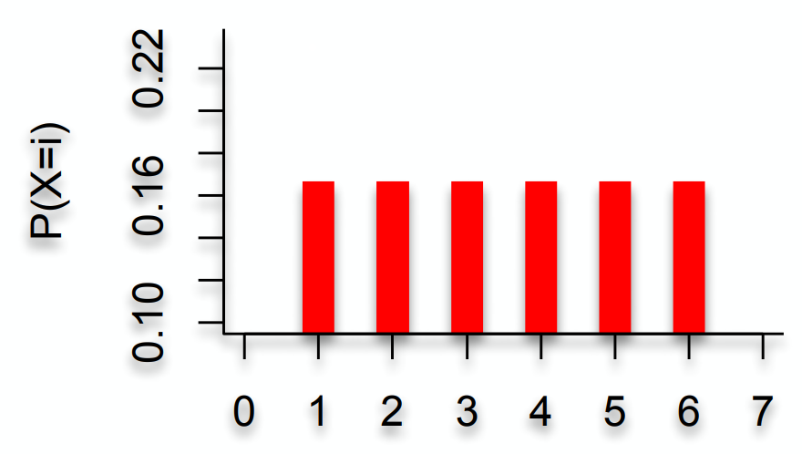
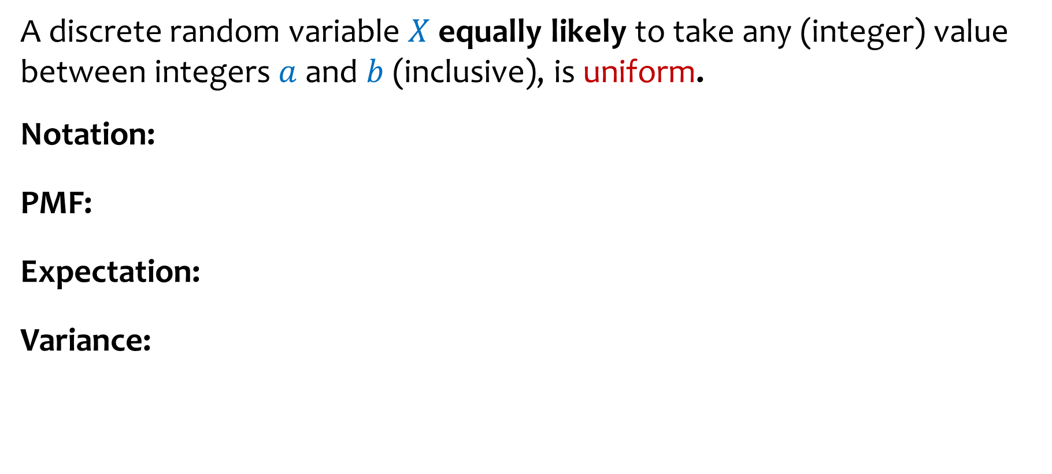
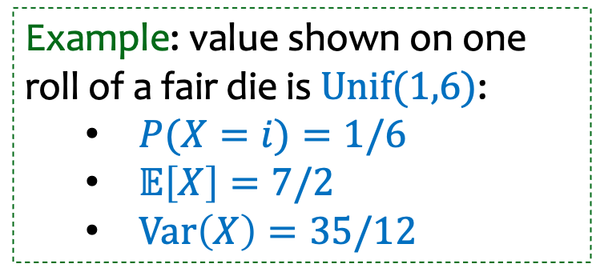
Discrete Uniform Random Variables
A discrete random variable $X$ equally likely to take any (integer) value between integers $a$ and $b$ (inclusive), is uniform.
Notation:
PMF:
Expectation:
Variance:
Example: value shown on one roll of a fair die is $Unif(1,6)$:
  $P(X=i)=1/6$
  $𝔼\left[X\right]=7/2$
  $Var\left(X\right)=35/12$

Slide 11
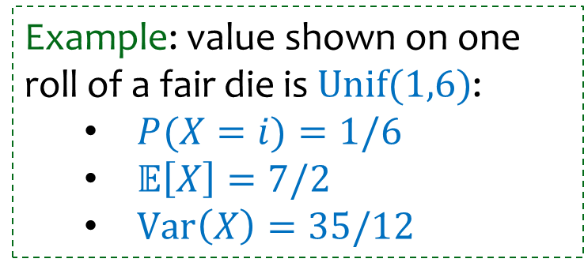
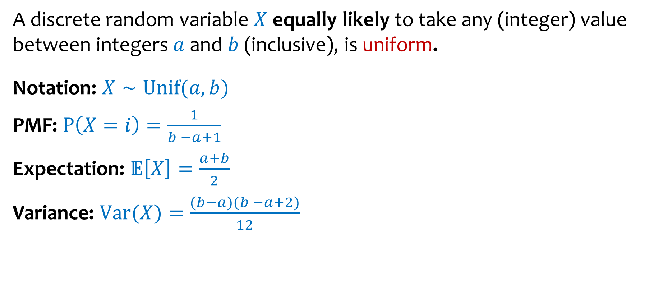
Discrete Uniform Random Variables (2)
A discrete random variable $X$ equally likely to take any (integer) value between integers $a$ and $b$ (inclusive), is uniform.
Notation: $X∼Unif(a,b)$
PMF: $P\left(X=i\right)=\frac{1}{b −a+1}$
Expectation: $𝔼\left[X\right]=\frac{a+b}{2}$
Variance: $Var(X)=\frac{(b−a)(b −a+2)}{12}$
Example: value shown on one roll of a fair die is $Unif(1,6)$:
  $P(X=i)=1/6$
  $𝔼\left[X\right]=7/2$
  $Var\left(X\right)=35/12$

Slide 12
Zoo (2)
Zoo of Discrete RVs
  Uniform Random Variables
  Bernoulli Random Variables
  Binomial Random Variables
  Geometric Random Variables

Slide 13

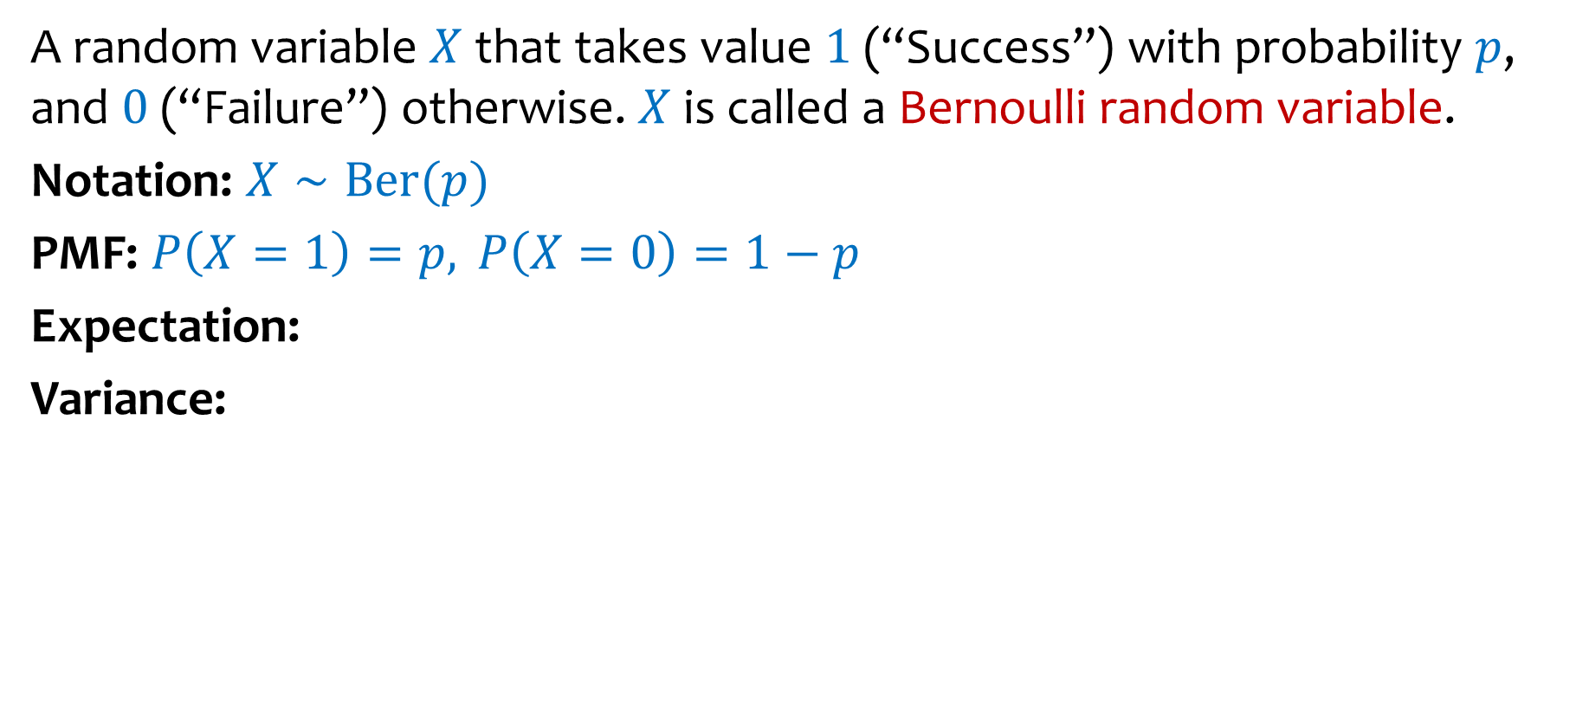
Bernoulli Random Variables
A random variable $X$ that takes value $1$ (“Success”) with probability $p$, and $0$ (“Failure”) otherwise. $X$ is called a Bernoulli random variable.
Notation: $X∼Ber(p)$
PMF: $P\left(X=1\right)=p,P\left(X=0\right)=1−p$
Expectation:
Variance:
Poll:
https://pollev.com/ annakarlin185
Mean Variance
$p$ $p$
$p$ $1−p$
$p$ $p(1−p)$
$p$ $p^{2}$

Slide 14
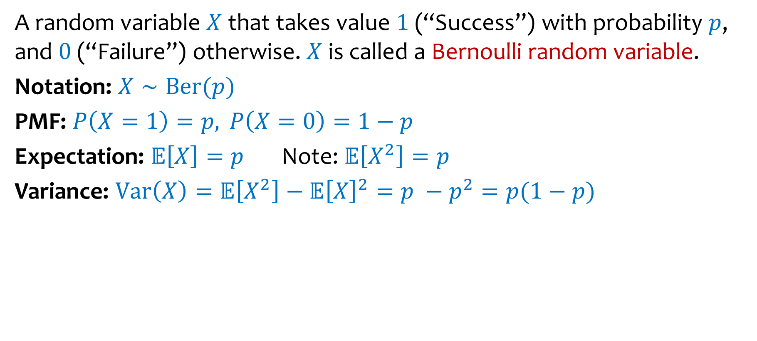
Bernoulli Random Variables (2)
A random variable $X$ that takes value $1$ (“Success”) with probability $p$, and $0$ (“Failure”) otherwise. $X$ is called a Bernoulli random variable.
Notation: $X∼Ber(p)$
PMF: $P\left(X=1\right)=p,P\left(X=0\right)=1−p$
Expectation: $𝔼\left[X\right]=p$ Note: $𝔼\left[X^{2}\right]=p$
Variance: $Var\left(X\right)=𝔼\left[X^{2}\right]−𝔼{\left[X\right]}^{2}=p −p^{2}=p(1−p)$
Examples:
  Coin flip
  Randomly guessing on a MC test question
  A server in a cluster fails
  Whether or not a share of a particular stock pays off or not
  Any indicator r.v.

Slide 15
Zoo (3)
Zoo of Discrete RVs, Part I
  Uniform Random Variables
  Bernoulli Random Variables
  Binomial Random Variables
  Geometric Random Variables

Slide 16
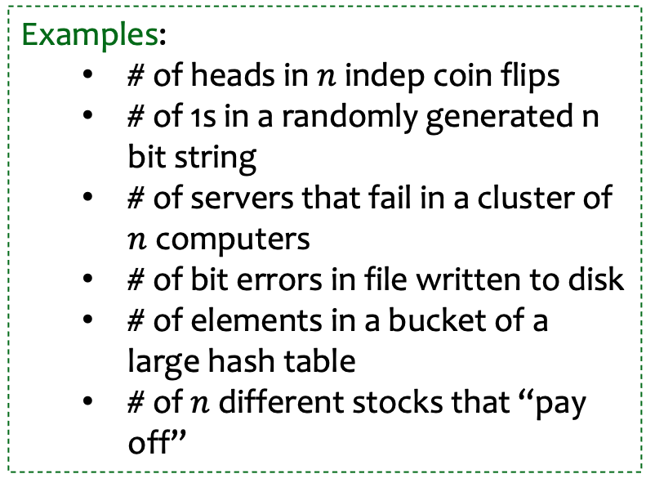
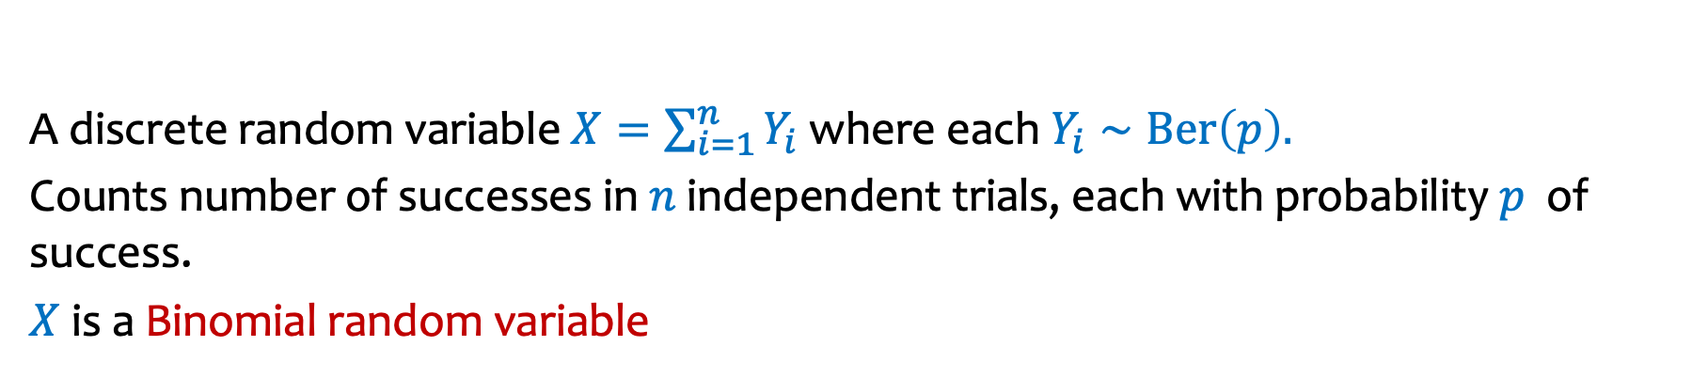

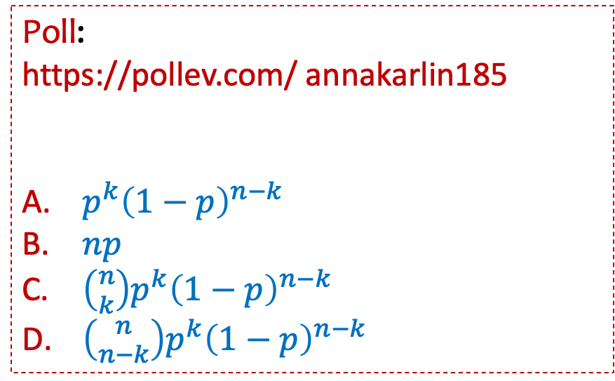
Binomial Random Variables
A discrete random variable $X=\sum_{i=1}^{n}{Y_{i}}$ where each $Y_{i}∼Ber\left(p\right).$
Counts number of successes in $n$ independent trials, each with probability $p$ of success.
$X$ is a Binomial random variable
Examples:
  # of heads in $n$ indep coin flips
  # of 1s in a randomly generated n bit string
  # of servers that fail in a cluster of $n$computers
  # of bit errors in file written to disk
  # of elements in a bucket of a large hash table
  # of $n$ different stocks that “pay off”
Poll:
https://pollev.com/ annakarlin185
$p^{k}{\left(1−p\right)}^{n−k}$
$np$
$\left({n \atop k}\right)p^{k}{\left(1−p\right)}^{n−k}$
$\left({n \atop n−k}\right)p^{k}{\left(1−p\right)}^{n−k}$
$$P\left(X=k\right)=$$

Slide 17

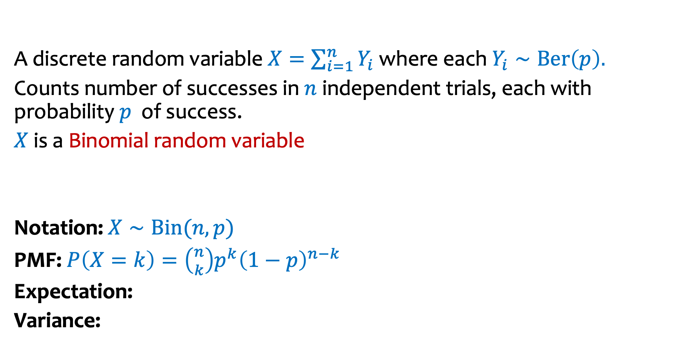
Binomial Random Variables (2)
A discrete random variable $X=\sum_{i=1}^{n}{Y_{i}}$ where each $Y_{i}∼Ber\left(p\right).$
Counts number of successes in $n$ independent trials, each with probability $p$ of success.
$X$ is a Binomial random variable
Notation: $X∼Bin(n,p)$
PMF: $P\left(X=k\right)=\left({n \atop k}\right)p^{k}{\left(1−p\right)}^{n−k}$
Expectation:
Variance:
Poll:
https://pollev.com/ annakarlin185
Mean Variance
$p$ $p$
$np$ $np(1−p)$
$np$ $np^{2}$
$np$ $n^{2}p$

Slide 18
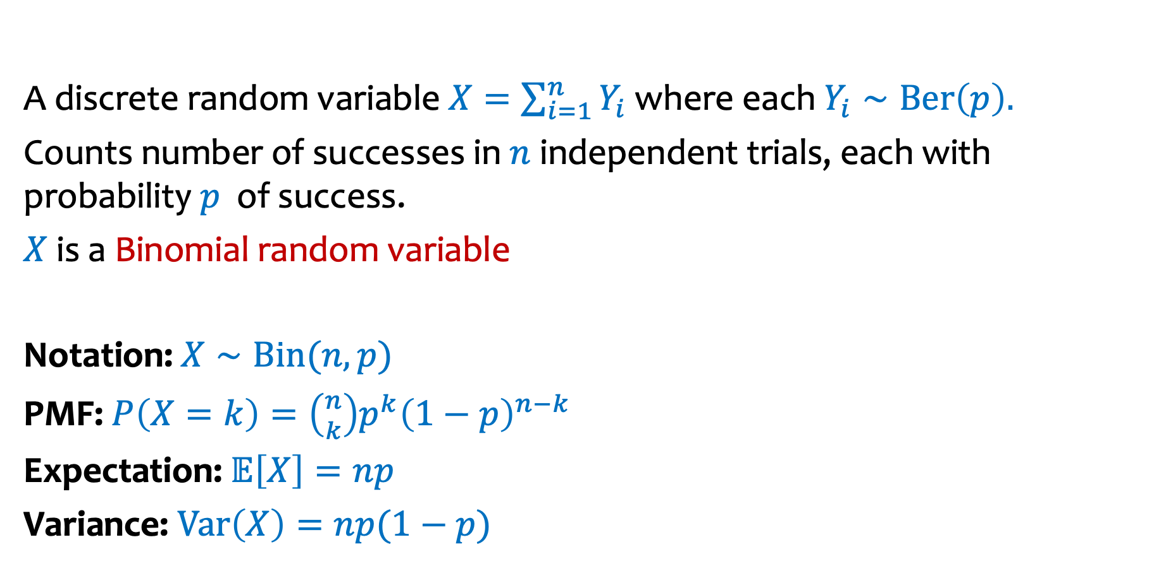
Binomial Random Variables (3)
A discrete random variable $X=\sum_{i=1}^{n}{Y_{i}}$ where each $Y_{i}∼Ber\left(p\right).$
Counts number of successes in $n$ independent trials, each with probability $p$ of success.
$X$ is a Binomial random variable
Notation: $X∼Bin(n,p)$
PMF: $P\left(X=k\right)=\left({n \atop k}\right)p^{k}{\left(1−p\right)}^{n−k}$
Expectation: $𝔼\left[X\right]=np$
Variance: $Var\left(X\right)=np(1−p)$

Slide 19
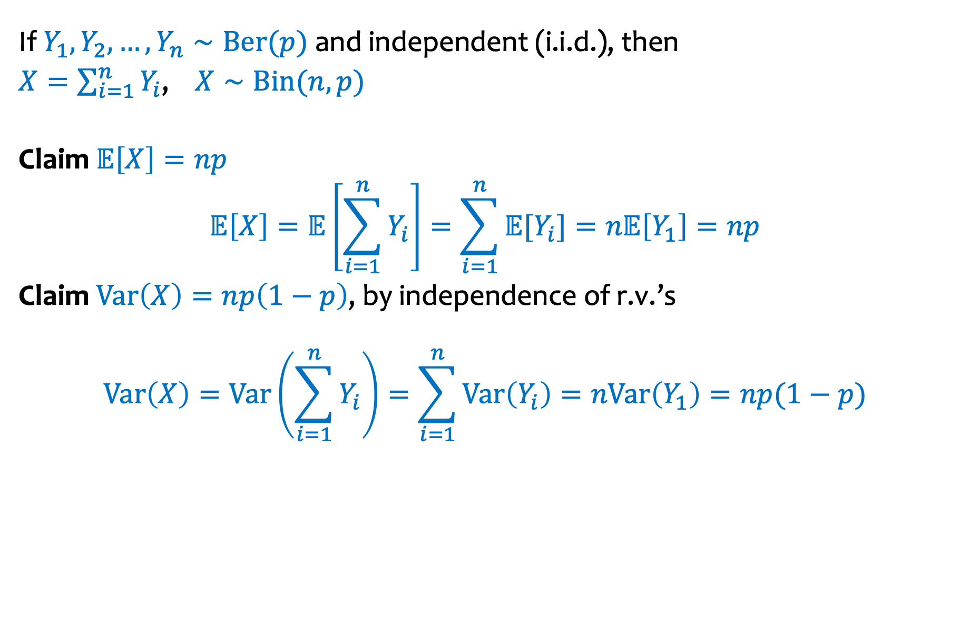
Mean, Variance of the Binomial
“i.i.d.” is a commonly used phrase.
It means “independent & identically distributed”
If $Y_{1},Y_{2}, …,Y_{n}∼Ber(p)$ and independent (i.i.d.), then
$X=\sum_{i=1}^{n}{Y_{i}}$, $X∼Bin(n,p)$
Claim $𝔼\left[X\right]=np$
$$𝔼\left[X\right]=𝔼\left[\sum_{i=1}^{n}{Y_{i}}\right]=\sum_{i=1}^{n}{𝔼[Y_{i}]}=n𝔼\left[Y_{1}\right]=np$$
Claim $Var\left(X\right)=np\left(1−p\right)$, by independence of r.v.’s
$$Var\left(X\right)=Var\left(\sum_{i=1}^{n}{Y_{i}}\right)=\sum_{i=1}^{n}{Var\left(Y_{i}\right)}=nVar\left(Y_{1}\right)=np(1−p)$$

Slide 20
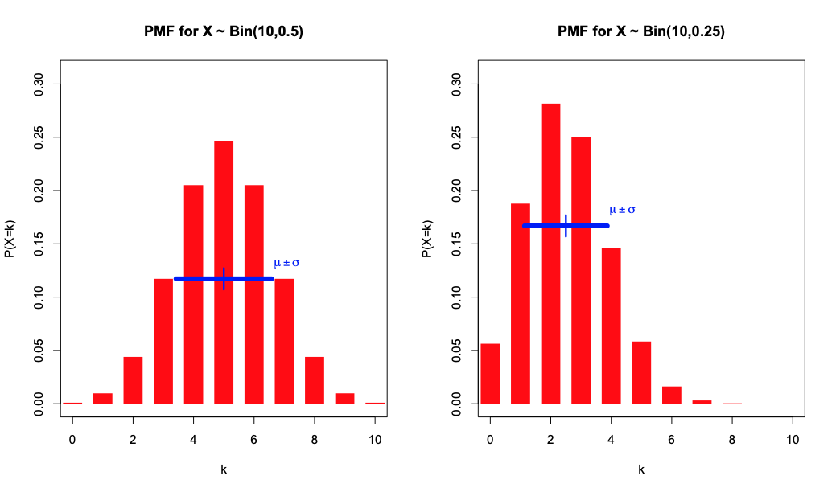
Binomial PMFs

Slide 21
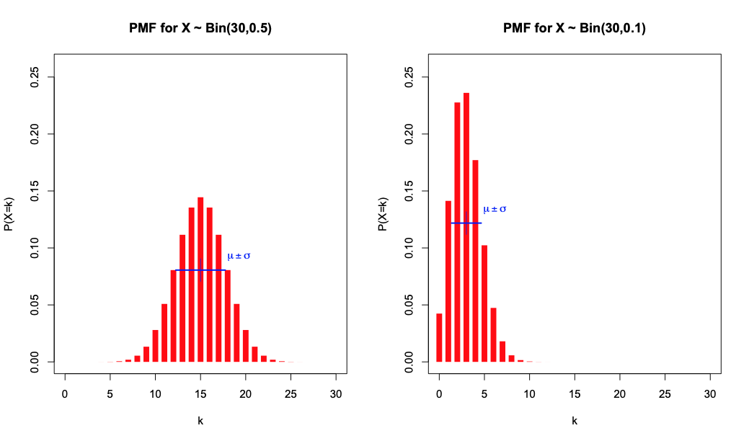
Binomial PMFs (2)

Slide 22
Zoo (4)
Zoo of Discrete RVs, Part I
  Uniform Random Variables
  Bernoulli Random Variables
  Binomial Random Variables
  Geometric Random Variables

Slide 23
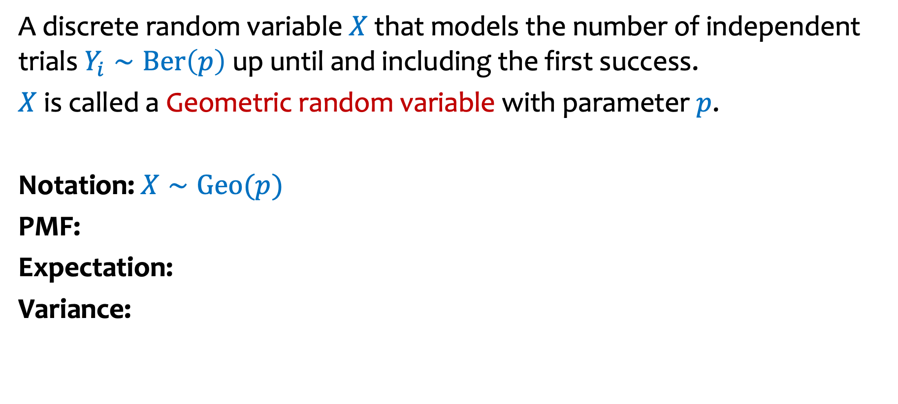
Geometric Random Variables
A discrete random variable $X$ that models the number of independent trials $Y_{i}∼Ber\left(p\right)$ up until and including the first success.
$X$ is called a Geometric random variable with parameter $p$.
Notation: $X∼Geo(p)$
PMF:
Expectation:
Variance:
Examples:
  # of coin flips until first head
  # of random guesses on MC questions until you get one right
  # of random guesses at a password until you hit it

Slide 24
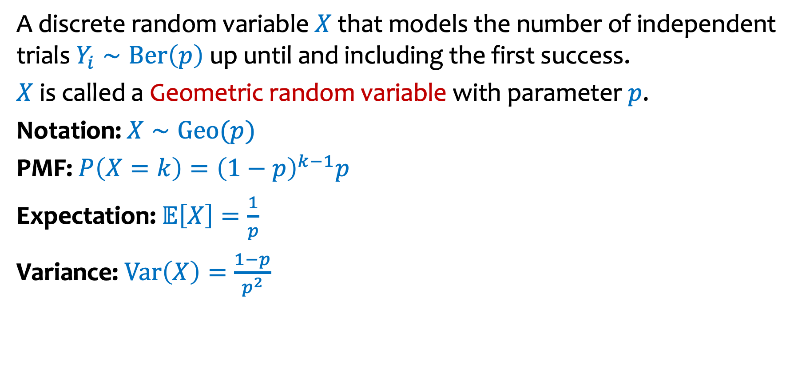
Geometric Random Variables (2)
A discrete random variable $X$ that models the number of independent trials $Y_{i}∼Ber\left(p\right)$ up until and including the first success.
$X$ is called a Geometric random variable with parameter $p$.
Notation: $X∼Geo(p)$
PMF: $P\left(X=k\right)={\left(1−p\right)}^{k−1}p$
Expectation: 𝔼$\left[X\right]=\frac{1}{p}$
Variance: $Var\left(X\right)=\frac{1−p}{p^{2}}$
Examples:
  # of coin flips until first head
  # of random guesses on MC questions until you get one right
  # of random guesses at a password until you hit it
  # hash trials until a miner successfully mines a Bitcoin

Slide 25
Zoo (5)
Zoo of Discrete RVs, Part I
  Uniform Random Variables
  Bernoulli Random Variables
  Binomial Random Variables
  Geometric Random Variables
  More examples

Slide 26

Example 1
Sending a binary message of length 1024 bits over a network with probability 0.999 of correctly sending each bit in the message without corruption (independent of other bits).
Let $X$ be the number of corrupted bits.
What kind of random variable is this and what is $𝔼[X]$?
Poll:
https://pollev.com/ annakarlin185
A 1022.99
B 1.024
C 1.02298
D. 1

Slide 27
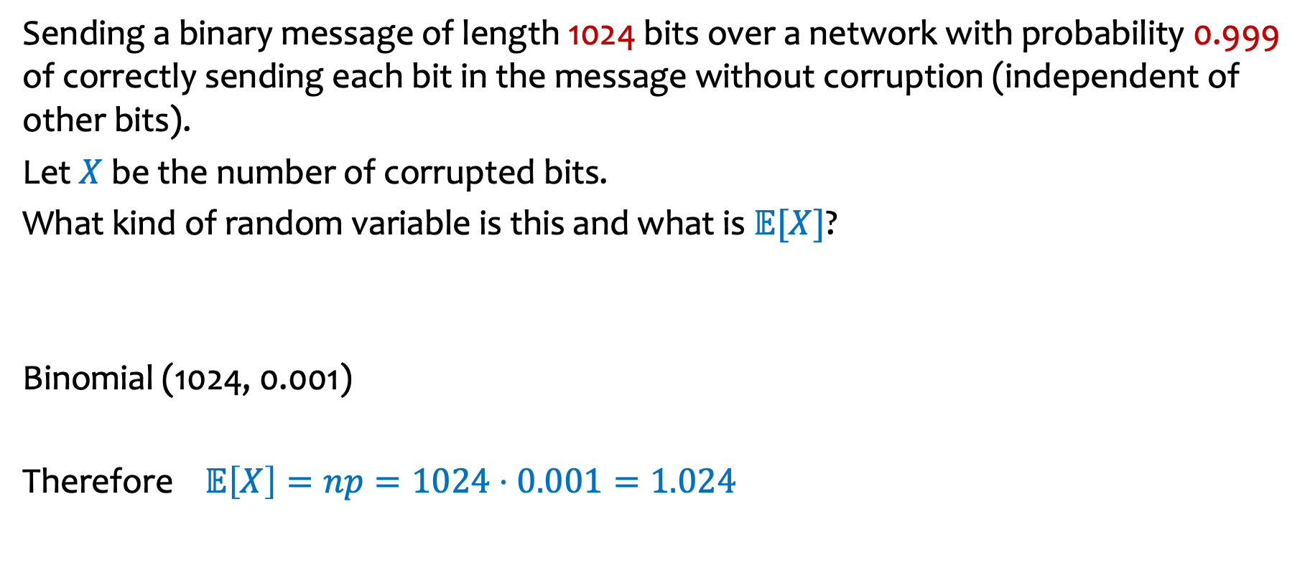
Example
Sending a binary message of length 1024 bits over a network with probability 0.999 of correctly sending each bit in the message without corruption (independent of other bits).
Let $X$ be the number of corrupted bits.
What kind of random variable is this and what is $𝔼[X]$?
Binomial (1024, 0.001)
Therefore $𝔼\left[X\right]=np=1024⋅0.001=1.024$

Slide 28

Example: Music Lessons
Your music teacher requires you to play a 1000 note song without mistake. You have been practicing, so you have a probability of 0.999 of getting each note correct (independent of the others). If you mess up a single note in the song, you must start over and play from the beginning. Let $X$ be the number of times you have to play the song from the start. What kind of random variable is this and what is $𝔼[X]$?

Slide 29
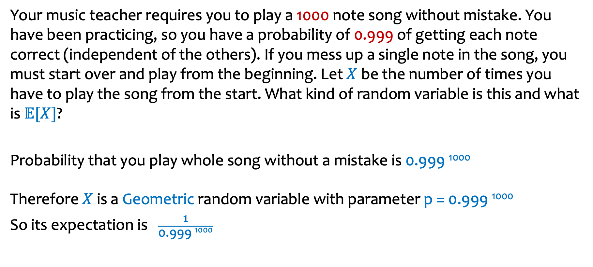
Example: Music Lessons - solution
Your music teacher requires you to play a 1000 note song without mistake. You have been practicing, so you have a probability of 0.999 of getting each note correct (independent of the others). If you mess up a single note in the song, you must start over and play from the beginning. Let $X$ be the number of times you have to play the song from the start. What kind of random variable is this and what is $𝔼[X]$?
Probability that you play whole song without a mistake is 0.999 ¹⁰⁰⁰
Therefore $X$ is a Geometric random variable with parameter p = 0.999 ¹⁰⁰⁰
So its expectation is $\frac{1}{\text{0.999 }\text{1000}}$

Slide 30
Zoo (6)
Zoo of Discrete RVs
  Uniform Random Variables
  Bernoulli Random Variables
  Binomial Random Variables
  Geometric Random variables
  Poisson Distribution

Slide 31
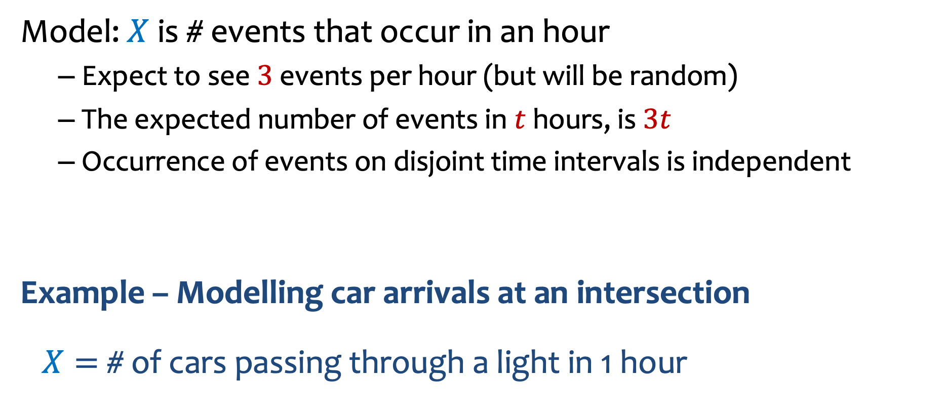
Preview: Poisson
Model: $X$is # events that occur in an hour
  Expect to see $3$ events per hour (but will be random)
  The expected number of events in $t$ hours, is $3t$
  Occurrence of events on disjoint time intervals is independent
Example – Modelling car arrivals at an intersection
$X=$# of cars passing through a light in 1 hour

Slide 32
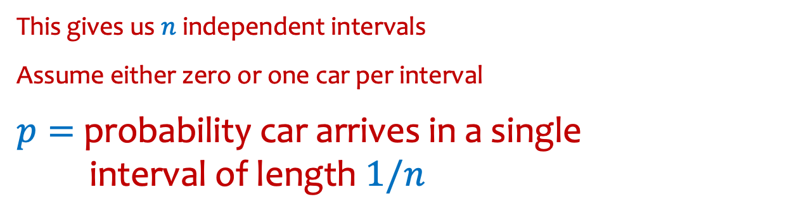
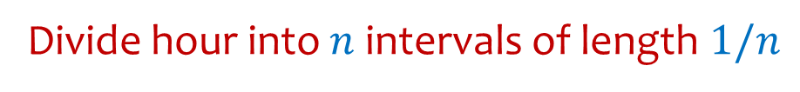


Example – Model the process of cars passing through a light in 1 hour
$X$ = # cars passing through a light in $1$ hour.
$$𝔼[X]=3$$
  Assume: Occurrence of events on disjoint time intervals is independent
Approximation idea:
Divide hour into $n$ intervals of length $1/n$
$$1/n$$
This gives us $n$ independent intervals
Assume either zero or one car per interval
$p=$probability car arrives in a single
interval of length $1/n$

Slide 33

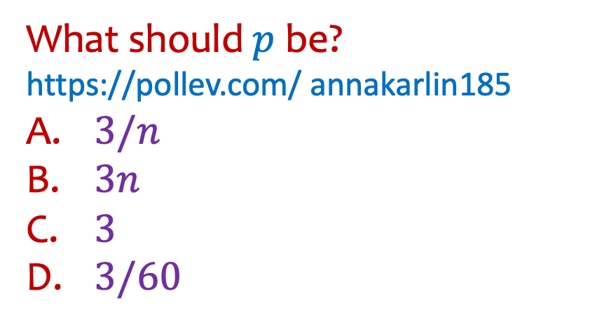
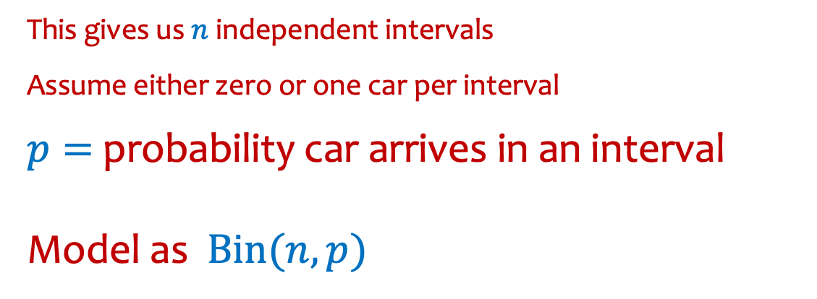


What should $p$ be?
$X$ = # cars passing through a light in $1$ hour. Disjoint time intervals are independent.
Know: $𝔼[X]=3$
$1$ hour
$$1/n$$
0
1
0
1
0
1
0
0
0
1
1
0
This gives us $n$ independent intervals
Assume either zero or one car per interval
$p=$probability car arrives in an interval
Model as $Bin(n,p)$
What should $p$ be?
https://pollev.com/ annakarlin185
$3/n$
$3n$
$3$
$3/60$

Slide 34
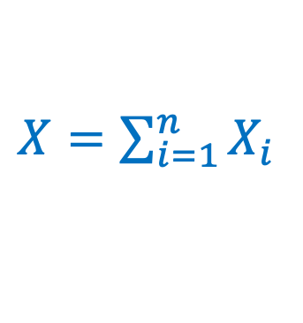
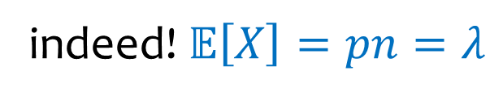
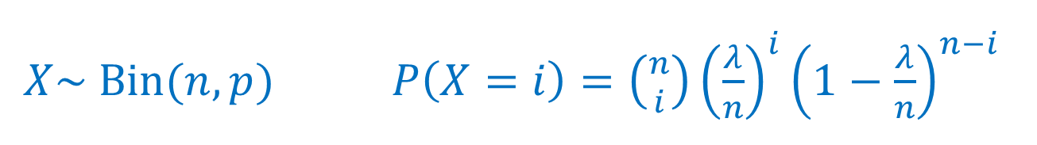
Model as Binomial
$X$ = # cars passing through a light in $1$ hour. Disjoint time intervals are independent.
Know: $𝔼[X]=λ$ for some given $λ>0$
$1$ hour
$$1/n$$
0
1
0
1
0
1
0
0
0
1
1
0
Discrete version: $n$ intervals, each of length $1/n$ .
In each interval, there is a car with probability $p=λ/n$ (assume $≤1$ car can pass by)
Each interval is Bernoulli: $X_{i}=1$ if car in $i$^{th} interval (0 otherwise). ${P(X}_{i}=1)=λ /n$
$X\sim Bin(n,p)$ $P\left(X=i\right)=\left({n \atop i}\right){\left(\frac{λ}{n}\right)}^{i}{\left(1−\frac{λ}{n}\right)}^{n−i}$
$X=\sum_{i=1}^{n}{X_{i}}$
indeed! $𝔼\left[X\right]=pn=λ$

Slide 35

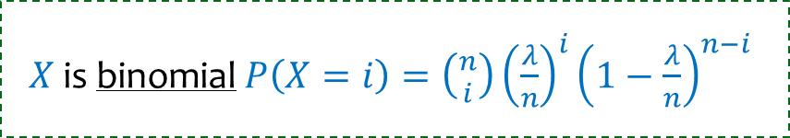
Don’t like discretization
$X$ is binomial $P\left(X=i\right)=\left({n \atop i}\right){\left(\frac{λ}{n}\right)}^{i}{\left(1−\frac{λ}{n}\right)}^{n−i}$
$$1/n$$
0
1
0
1
0
1
0
0
0
1
1
0
$$P\left(X=i\right)=\left({n \atop i}\right){\left(\frac{λ}{n}\right)}^{i}{\left(1−\frac{λ}{n}\right)}^{n−i}$$
We want now $n→∞$

Slide 36

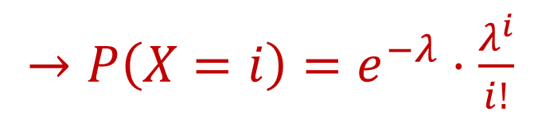


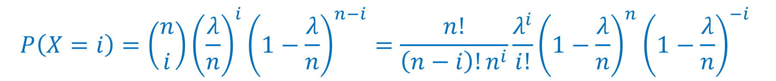

Take the limit
$X$ is binomial $P\left(X=i\right)=\left({n \atop i}\right){\left(\frac{λ}{n}\right)}^{i}{\left(1−\frac{λ}{n}\right)}^{n−i}$
$$1/n$$
0
1
0
1
0
1
0
0
0
1
1
0
We want now $n→∞$
$$P\left(X=i\right)=\left({n \atop i}\right){\left(\frac{λ}{n}\right)}^{i}{\left(1−\frac{λ}{n}\right)}^{n−i}=\frac{n!}{\left(n−i\right)!n^{i}}\frac{λ^{i}}{i!}{\left(1−\frac{λ}{n}\right)}^{n}{\left(1−\frac{λ}{n}\right)}^{−i}$$
$→P\left(X=i\right)=e^{−λ}⋅\frac{λ^{i}}{i!}$
$$→1$$
$$→e^{−λ}$$
$$→1$$

Slide 37
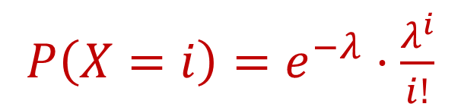
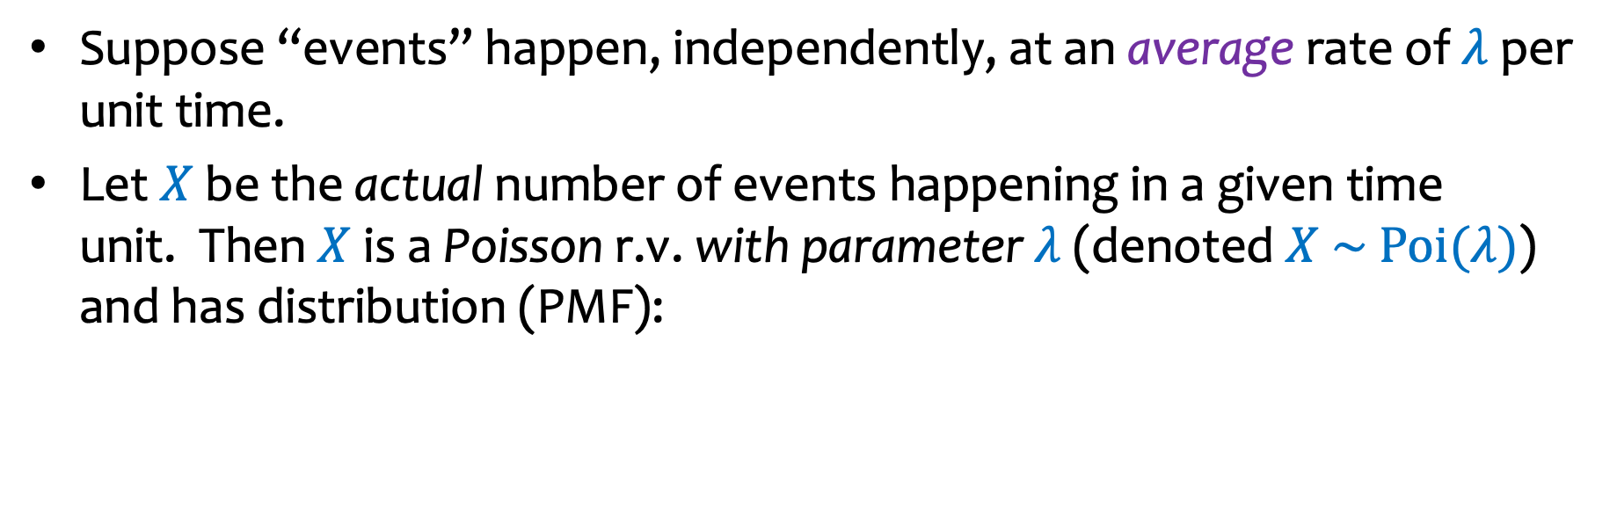

Poisson Distribution
Siméon Denis Poisson
1781-1840
Suppose “events” happen, independently, at an average rate of $λ$ per unit time.
Let $X$ be the actual number of events happening in a given time unit. Then $X$ is a Poisson r.v. with parameter $λ$ (denoted $X \sim Poi(λ)$) and has distribution (PMF):
$P\left(X=i\right)=e^{−λ}⋅\frac{λ^{i}}{i!}$
$$i=0, 1, 2,…$$
Several examples of “Poisson processes”:
# of cars passing through a traffic light in 1 hour
# of requests to web servers in an hour
# of photons hitting a light detector in a given interval
# of patients arriving to ER within an hour
Assume
fixed average rate

Slide 38
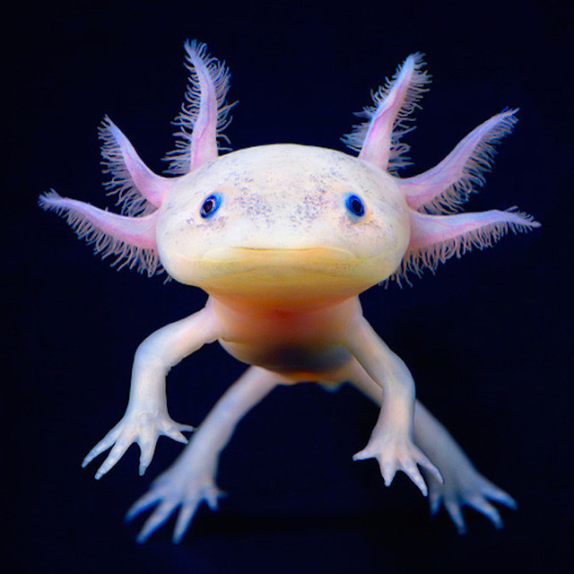

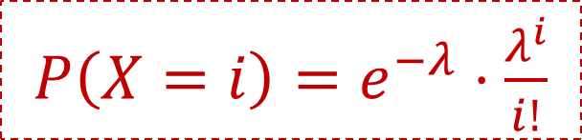


Probability Mass Function
$P\left(X=i\right)=e^{−λ}⋅\frac{λ^{i}}{i!}$
$λ=2$
$λ=5$
$λ=10$
This Photo by Unknown Author is licensed under CC BY-NC

Slide 39

Validity of Distribution
$P\left(X=i\right)=e^{−λ}⋅\frac{λ^{i}}{i!} i=0, 1, 2, …$
Is this a valid probability mass function?
(How do you show that a pmf is valid?)

Slide 40



Calculate sum
$P\left(X=i\right)=e^{−λ}⋅\frac{λ^{i}}{i!}$
To show that a pmf is valid, need to check that it takes nonnegative values and that the probabilities sum up to 1.
$$\sum_{i=0}^{∞}{P\left(X=i\right)}=\sum_{i=0}^{∞}{e^{−λ}⋅\frac{λ^{i}}{i!}}{=e}^{−λ}\sum_{i=0}^{∞}{\frac{λ^{i}}{i!}}$$
Fact (Taylor series expansion):
$$e^{x}=\sum_{i=0}^{∞}{\frac{x^{i}}{i!}}$$
Notes:
CRO

Slide 41



Expectation
$P\left(X=i\right)=e^{−λ}⋅\frac{λ^{i}}{i!}$
Theorem. If $X$ is a Poisson RV with parameter $λ≥0$, then
$$𝔼\left[X\right]= ?$$
$$𝔼[X]=\sum_{i=0}^{∞}{P\left(X=i\right)⋅i= }\sum_{i=0}^{∞}{e^{−λ}⋅\frac{λ^{i}}{i!}⋅i}$$
Proof.

Slide 42






Expectation calculation
$P\left(X=i\right)=e^{−λ}⋅\frac{λ^{i}}{i!}$
Theorem. If $X$ is a Poisson RV with parameter $λ$, then
$$𝔼\left[X\right]=λ$$
$$𝔼[X]=\sum_{i=0}^{∞}{P\left(X=i\right)⋅i= }\sum_{i=0}^{∞}{e^{−λ}⋅\frac{λ^{i}}{i!}⋅i}$$
$$=\sum_{i=1}^{∞}{e^{−λ}⋅\frac{λ^{i}}{(i−1)!}}$$
Proof.
$$=λ \sum_{i=1}^{∞}{e^{−λ}⋅\frac{λ^{i−1}}{(i−1)!}}$$
$$=λ \sum_{i=0}^{∞}{e^{−λ}⋅\frac{λ^{i}}{i!}}$$
= $1$ (see prior slides!)
$$=λ⋅1=λ$$

Slide 43








Variance
$P\left(X=i\right)=e^{−λ}⋅\frac{λ^{i}}{i!}$
Theorem. If $X$ is a Poisson RV with parameter $λ$, then $Var(X)=λ$
$$𝔼\left[X^{2}\right]=\sum_{i=0}^{∞}{P\left(X=i\right)⋅i^{2}}=\sum_{i=0}^{∞}{e^{−λ}⋅\frac{λ^{i}}{i!}⋅i^{2}}$$
$$=\sum_{i=1}^{∞}{e^{−λ}⋅\frac{λ^{i}}{(i−1)!}}i$$
Proof.
$$=λ\sum_{i=1}^{∞}{e^{−λ}⋅\frac{λ^{i−1}}{(i−1)!}}⋅i$$
$$=λ\sum_{j=0}^{∞}{e^{−λ}⋅\frac{λ^{j}}{j!}⋅(j+1)}$$
$$=λ\left[\sum_{j=0}^{∞}{e^{−λ}⋅\frac{λ^{j}}{j!}⋅j}+\sum_{j=0}^{∞}{e^{−λ}⋅\frac{λ^{j}}{j!}}\right]$$
$$=λ^{2}+λ$$
Similar to the previous proof
Verify offline.
$$=𝔼[X]=λ$$
$$=1$$
$$Var\left(X\right)=𝔼[X^{2}]−𝔼{[X]}^{2}=λ^{2}+λ−λ^{2}=λ$$
Notes:
CRO

