Slide 1
Variance, Independent Random Variables, Begin Zoo
CSE 312 Spring 26
Lecture 11

Slide 2
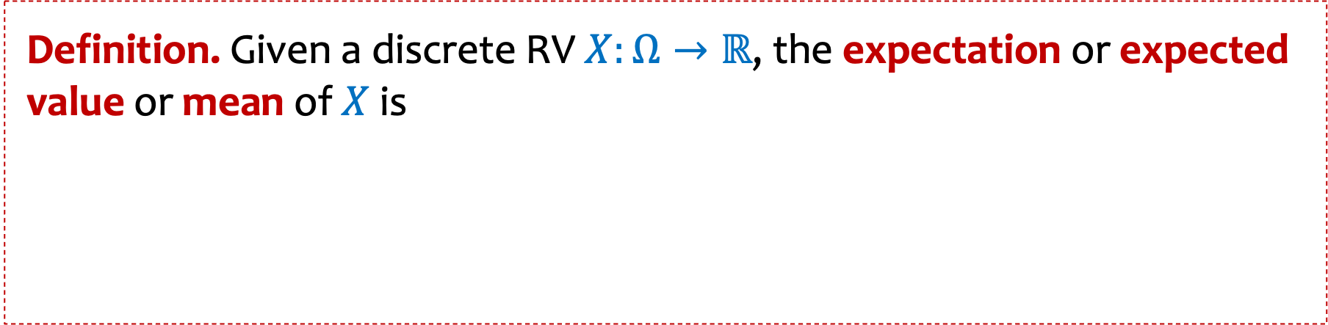
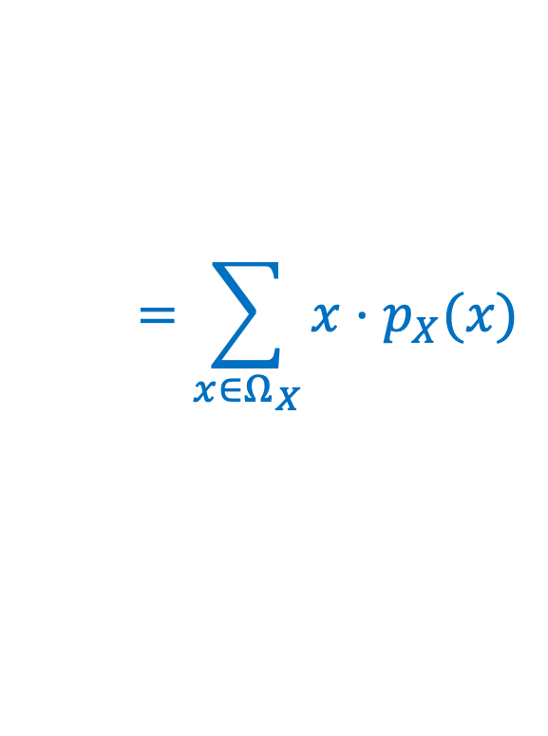
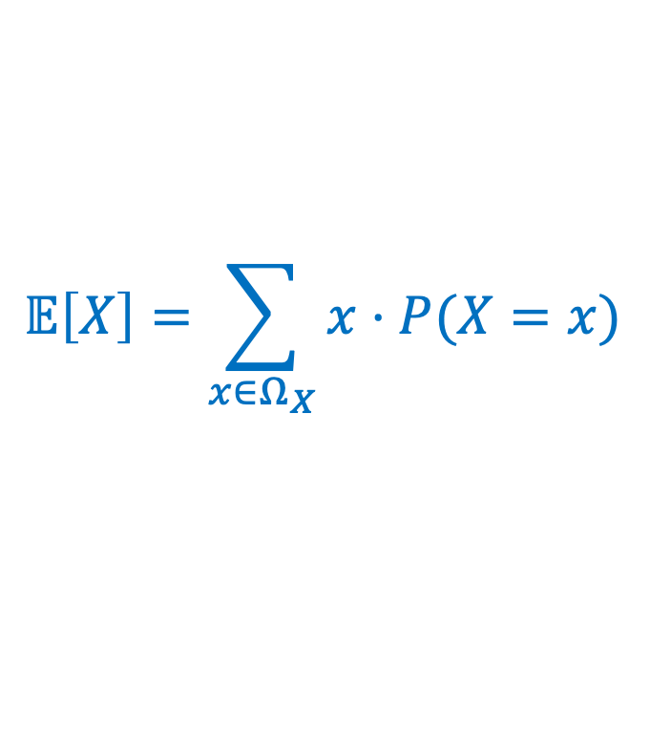
Review Expected Value of a Random Variable
Definition. Given a discrete RV $X:Ω→ℝ$, the expectation or expected value or mean of $X$ is
$$𝔼\left[X\right]=\sum_{x∈Ω_{X}}{x⋅P⁡(X=x)}$$
$$=\sum_{x∈Ω_{X}}{x⋅p_{X}(x)}$$
Intuition: “Weighted average” of the possible outcomes (weighted by probability)
Notes:
Checked reading order

Slide 3
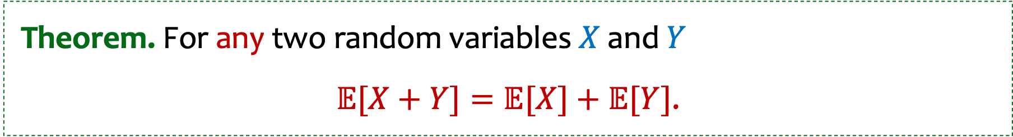
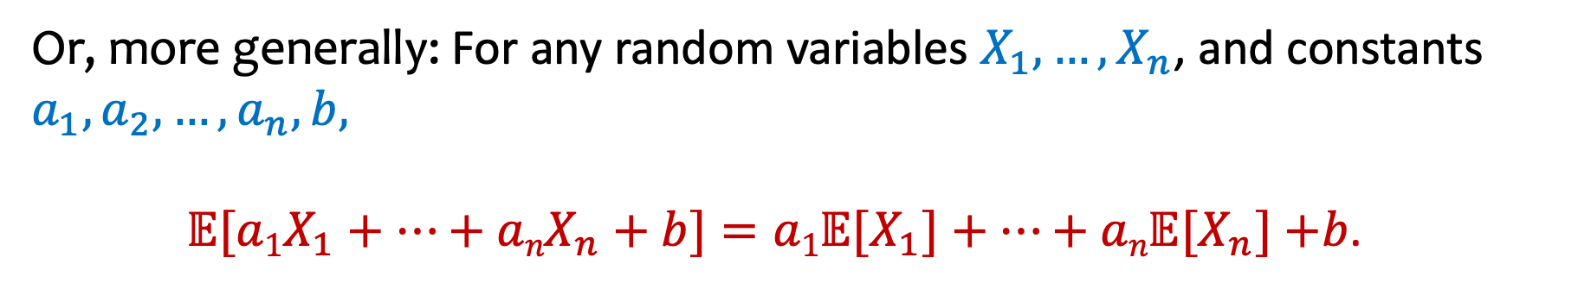
Recap Linearity of Expectation
Theorem. For any two random variables $X$ and $Y$
$𝔼[X+Y]=𝔼[X]+𝔼[Y]$.
Or, more generally: For any random variables $X_{1},…,X_{n}$, and constants $a_{1},a_{2},…,a_{n},b,$
$𝔼[{a1X}_{1}+⋯+{anX}_{n}+b]=a1𝔼[X_{1}]+⋯+an𝔼[X_{n}]$ $+b$.
Notes:
Write E[aX + bY + c] = aE[X] + bE[Y] + c
Write E[X] = P(X=1)

Slide 4
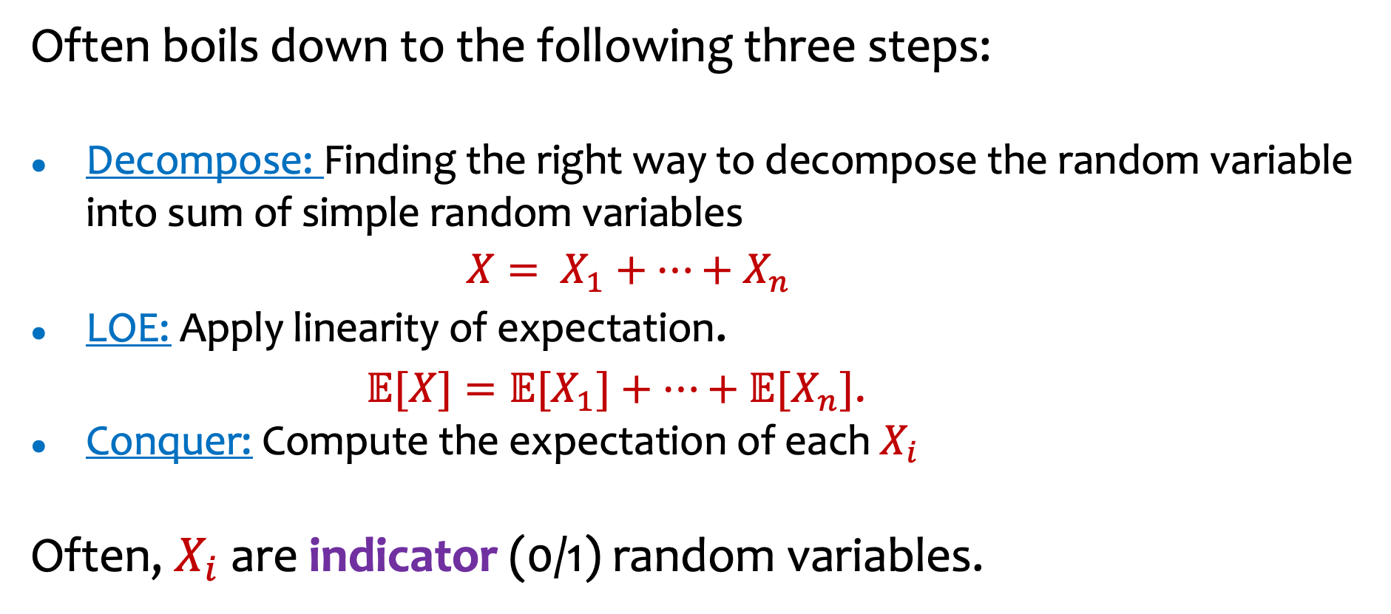
Recap Using LOE to compute complicated expectations
Often boils down to the following three steps:
Decompose: Finding the right way to decompose the random variable into sum of simple random variables
$X= X_{1}+⋯+X_{n}$
LOE: Apply linearity of expectation.
$𝔼[X]=𝔼[X_{1}]+⋯+𝔼[X_{n}]$.
Conquer: Compute the expectation of each $X_{i}$
Often, $X_{i}$ are indicator (0/1) random variables.

Slide 5
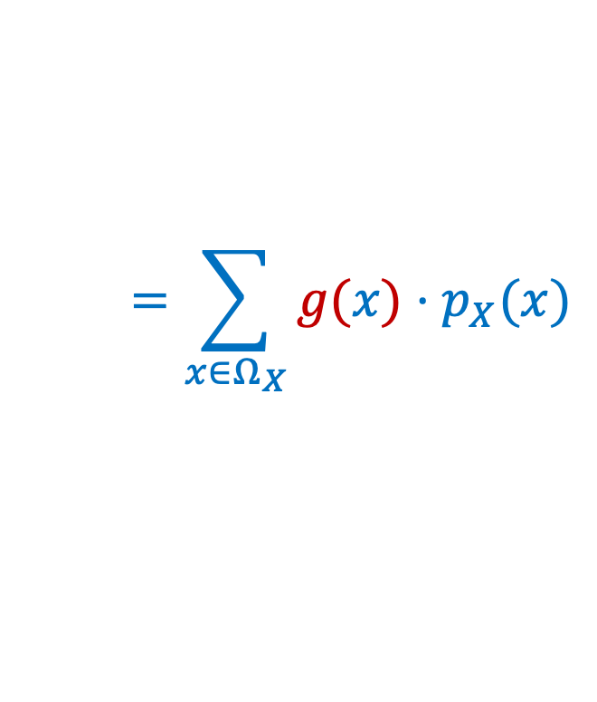
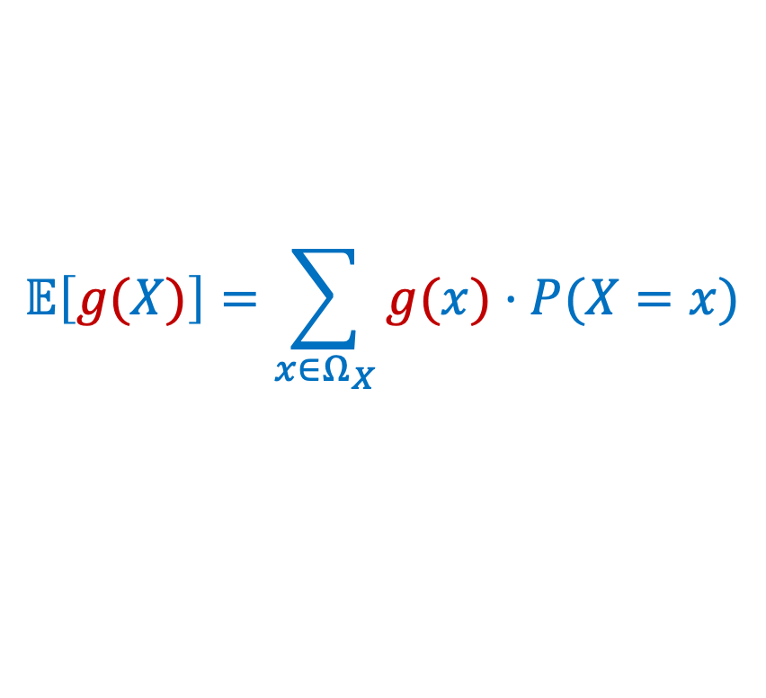
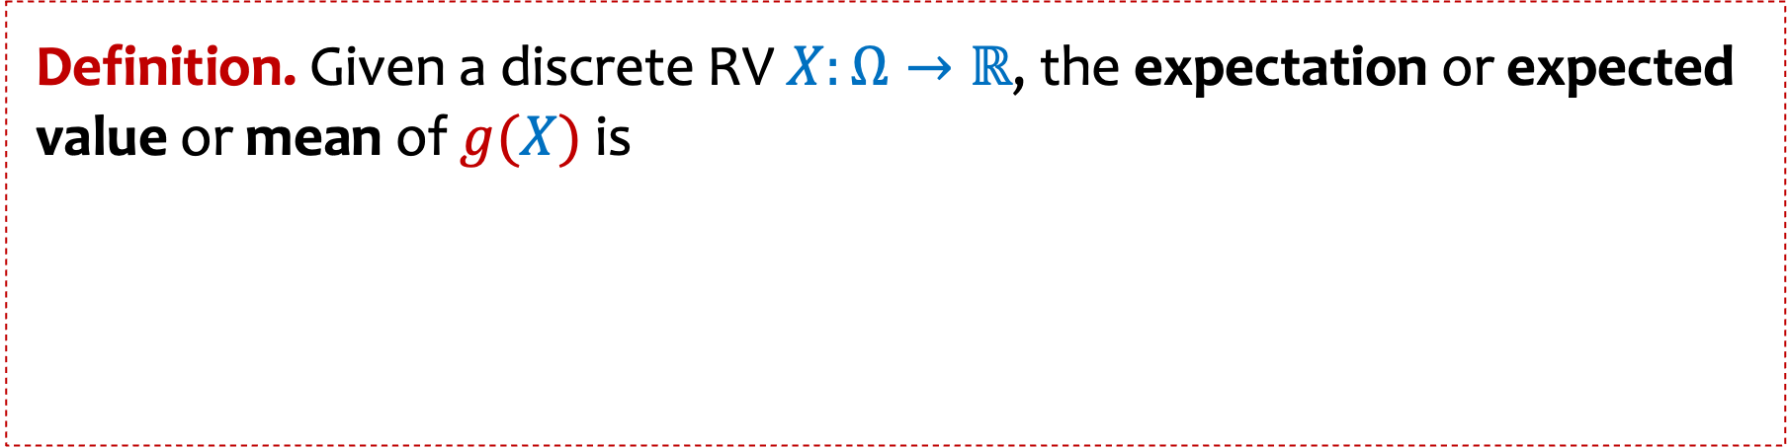
Recap Expected Value of $g(X)$ -- LOTUS
Definition. Given a discrete RV $X:Ω→ℝ$, the expectation or expected value or mean of $g(X)$ is
$$𝔼\left[g(X)\right]=\sum_{x∈Ω_{X}}{g(x)⋅P⁡(X=x)}$$
$$=\sum_{x∈Ω_{X}}{g(x)⋅p_{X}(x)}$$
Also known as LOTUS: “Law of the unconscious statistician
Notes:
CRO

Slide 6


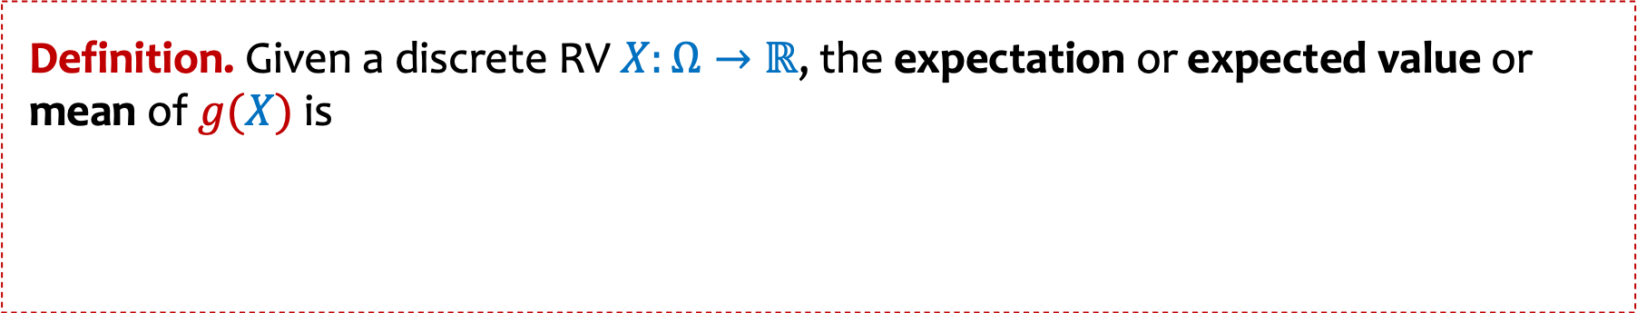


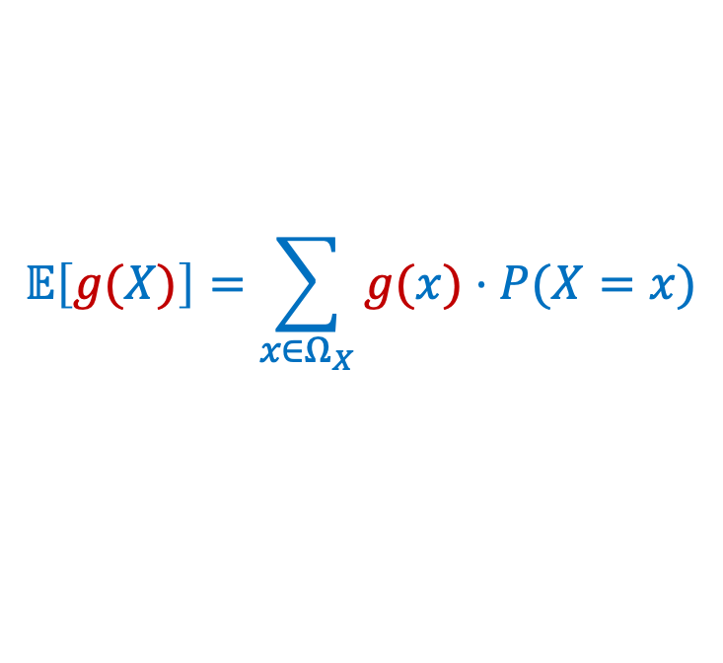
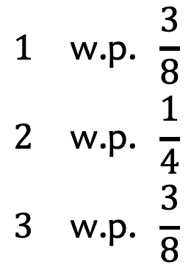
LOTUS Example
Definition. Given a discrete RV $X:Ω→ℝ$, the expectation or expected value or mean of $g(X)$ is
$$𝔼\left[g(X)\right]=\sum_{x∈Ω_{X}}{g(x)⋅P⁡(X=x)}$$
$$=\sum_{x∈Ω_{X}}{g(x)⋅p_{X}(x)}$$
Consider a sphere, whose radius is a random variable $R:$
$$R$$
$$\begin{matrix}1 & \text{w}\text{.}\text{p}\text{. }\frac{3}{8} \\ 2 & \text{w}\text{.}\text{p}\text{. }\frac{1}{4} \\ 3 & \text{w}\text{.}\text{p}\text{. }\frac{3}{8}\end{matrix}$$
Q: What is the expected
radius of the sphere?
$$R=$$
Q: What is the expected
volume of the sphere?
Notes:
CRO

Slide 7
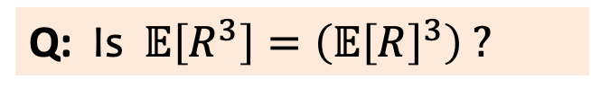
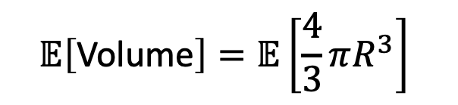
LOTUS example (2)
Definition. Given a discrete RV $X:Ω→ℝ$, the expectation or expected value or mean of $g(X)$ is
$$𝔼\left[g(X)\right]=\sum_{x∈Ω_{X}}{g(x)⋅P⁡(X=x)}$$
$$=\sum_{x∈Ω_{X}}{g(x)⋅p_{X}(x)}$$
Consider a sphere, whose radius is a random variable $R:$
$$\begin{matrix}1 & \text{w}\text{.}\text{p}\text{. }\frac{3}{8} \\ 2 & \text{w}\text{.}\text{p}\text{. }\frac{1}{4} \\ 3 & \text{w}\text{.}\text{p}\text{. }\frac{3}{8}\end{matrix}$$
$$R$$
$$𝔼\left[\text{Volume}\right]=𝔼\left[\frac{4}{3}πR^{3}\right]$$
$$R=$$
Q: Is$𝔼\left[R^{3}\right]=\left(𝔼{\left[R\right]}^{3}\right) ?$
Notes:
CRO

Slide 9
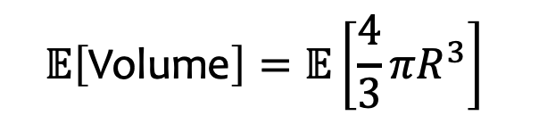
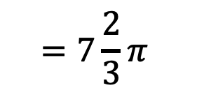
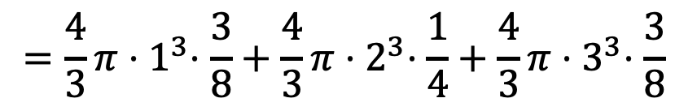
LOTUS example (3)
Definition. Given a discrete RV $X:Ω→ℝ$, the expectation or expected value or mean of $g(X)$ is
$$𝔼\left[g(X)\right]=\sum_{x∈Ω_{X}}{g(x)⋅P⁡(X=x)}$$
$$=\sum_{x∈Ω_{X}}{g(x)⋅p_{X}(x)}$$
Consider a sphere, whose radius is a random variable $R:$
$$R$$
$$\begin{matrix}1 & \text{w}\text{.}\text{p}\text{. }\frac{3}{8} \\ 2 & \text{w}\text{.}\text{p}\text{. }\frac{1}{4} \\ 3 & \text{w}\text{.}\text{p}\text{. }\frac{3}{8}\end{matrix}$$
$$𝔼\left[\text{Volume}\right]=𝔼\left[\frac{4}{3}πR^{3}\right]$$
$$R=$$
$$=\frac{4}{3}π{⋅1}^{3}⋅\frac{3}{8}+\frac{4}{3}π{⋅2}^{3}⋅\frac{1}{4}+\frac{4}{3}π{⋅3}^{3}⋅\frac{3}{8}$$
$$=7\frac{2}{3}π$$
Notes:
CRO

Slide 10
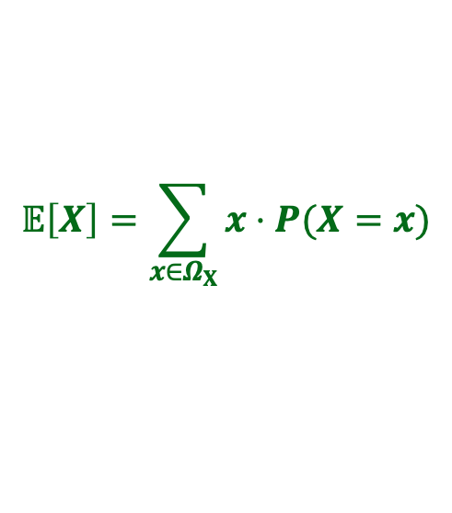
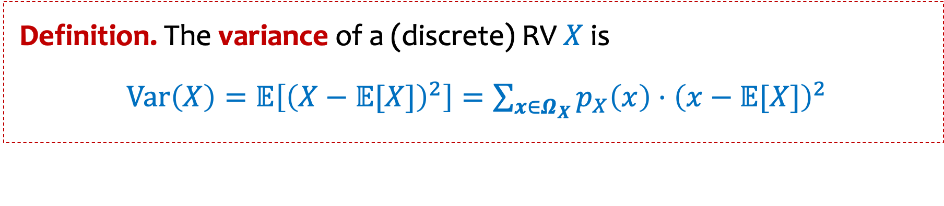
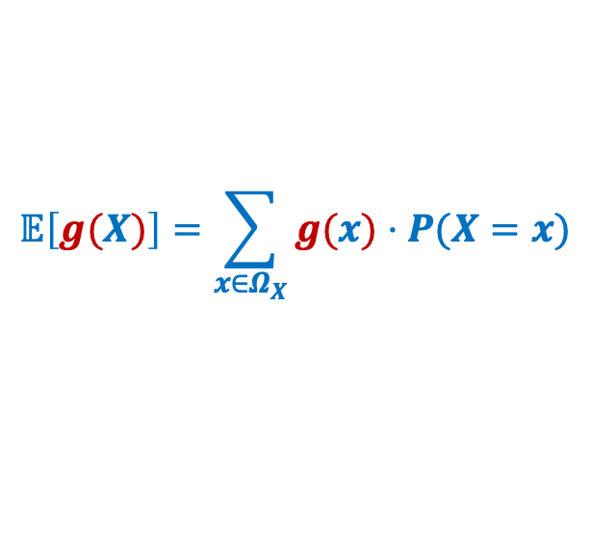
Variance – Properties
$$𝔼\left[X\right]=\sum_{x∈Ω_{X}}{x⋅P⁡(X=x)}$$
$$𝔼\left[g(X)\right]=\sum_{x∈Ω_{X}}{g(x)⋅P⁡(X=x)}$$
Definition. The variance of a (discrete) RV $X$is
$Var\left(X\right)=𝔼\left[{\left(X−𝔼[X]\right)}^{2}\right]=\sum_{x∈Ω_{X}}{p_{X}\left(x\right)⋅{\left(x−𝔼[X]\right)}^{2}}$
Intuition: Variance (or standard deviation) is a quantity that measures, in expectation, how “far” the random variable is from its expectation.
Notes:
Checked reading order

Slide 11
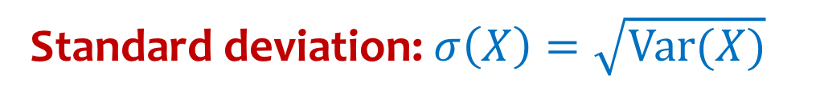
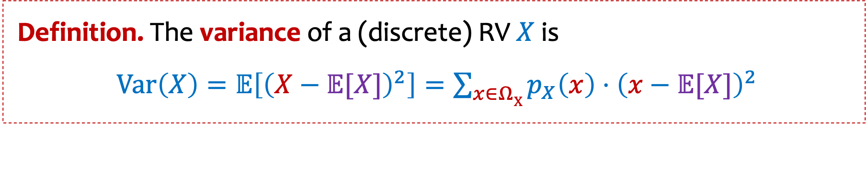
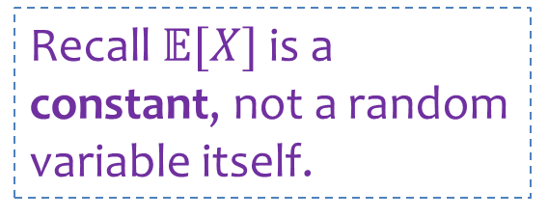
Variance - summary
Definition. The variance of a (discrete) RV $X$is
$Var\left(X\right)=𝔼\left[{\left(X−𝔼[X]\right)}^{2}\right]=\sum_{x∈ΩX}{p_{X}\left(x\right)⋅{\left(x−𝔼[X]\right)}^{2}}$
Standard deviation: $σ\left(X\right)=\sqrt{Var(X)}$
Recall $𝔼[X]$ is a constant, not a random variable itself.
Intuition: Variance (or standard deviation) is a quantity that measures, in expectation, how “far” the random variable is from its expectation.

Slide 12
Agenda
Recap
Properties of Variance
Independent Random Variables
Properties of Independent Random Variables

Slide 13
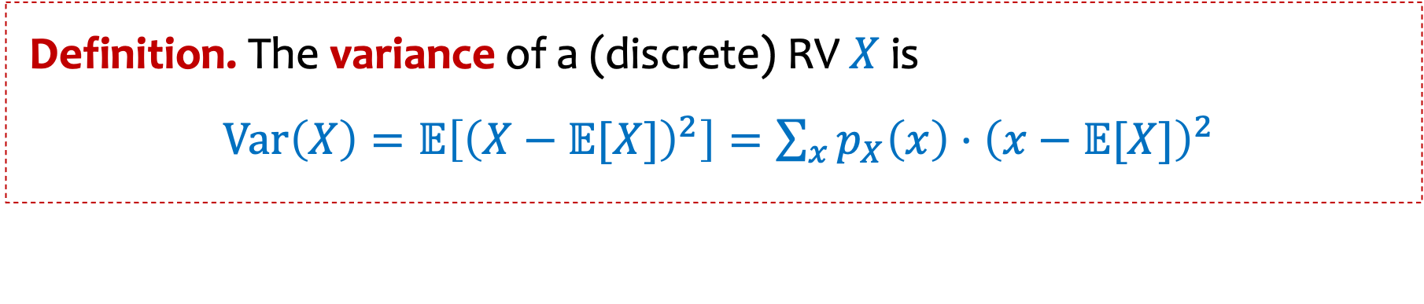

Variance – Properties (1)
Definition. The variance of a (discrete) RV $X$is
$Var\left(X\right)=𝔼\left[{\left(X−𝔼[X]\right)}^{2}\right]=\sum_{x}{p_{X}\left(x\right)⋅{\left(x−𝔼[X]\right)}^{2}}$
Theorem. $Var\left(X\right)=𝔼[X^{2}]−𝔼{\left[X\right]}^{2}$
Notes:
Checked reading order

Slide 14

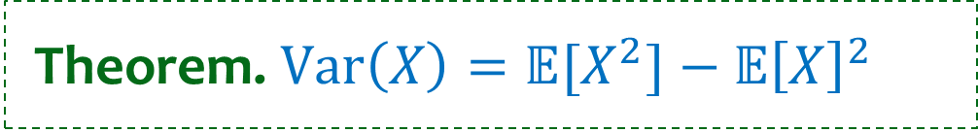
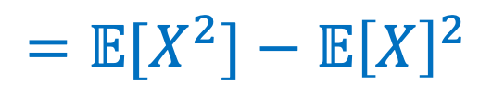
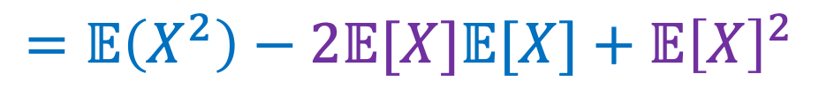
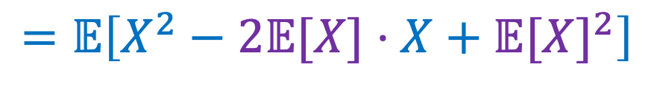
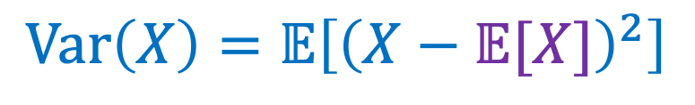
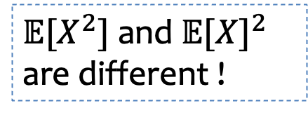
Variance – Properties (2)
Theorem. $Var\left(X\right)=𝔼[X^{2}]−𝔼{\left[X\right]}^{2}$
Proof:
Recall $𝔼[X]$ is a constant
$$Var\left(X\right)=𝔼\left[{\left(X−𝔼[X]\right)}^{2}\right]$$
$$=𝔼\left[X^{2}−2𝔼[X]⋅X+𝔼{[X]}^{2}\right]$$
$$=𝔼\left(X^{2}\right)−2𝔼[X]𝔼[X]+𝔼{\left[X\right]}^{2}$$
$$=𝔼[X^{2}]−𝔼{\left[X\right]}^{2}$$
(linearity of expectation!)
$𝔼[X^{2}]$ and $𝔼{[X]}^{2}$
are different !

Slide 15

Variance – Properties (3)
$$𝔼\left[X\right]=\sum_{x∈Ω_{X}}{x⋅P⁡(X=x)}$$
$$𝔼\left[g(X)\right]=\sum_{x∈Ω_{X}}{g(x)⋅P⁡(X=x)}$$
Definition. The variance of a (discrete) RV $X$is
$Var\left(X\right)=𝔼\left[{\left(X−𝔼[X]\right)}^{2}\right]=\sum_{x∈Ω_{X}}{p_{X}\left(x\right)⋅{\left(x−𝔼[X]\right)}^{2}}$
Theorem. $Var\left(X\right)=𝔼[X^{2}]−𝔼{\left[X\right]}^{2}$
Theorem. For any $a,b∈ℝ$, $Var\left(a⋅X+b\right)=a^{2}⋅Var\left(X\right)$
Notes:
Checked reading order

Slide 16

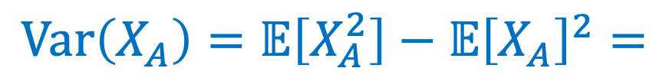

Variance of Indicator Random Variables
Suppose that $X_{A}$ is an indicator RV for event $A$ with $P(A)=p$so
$$𝔼\left[X_{A}\right]=P\left(A\right)=p$$
$$Var\left(X_{A}\right)=𝔼\left[X_{A}^{2}\right]−𝔼{\left[X_{A}\right]}^{2}=$$
Notes:
Checked reading order

Slide 17
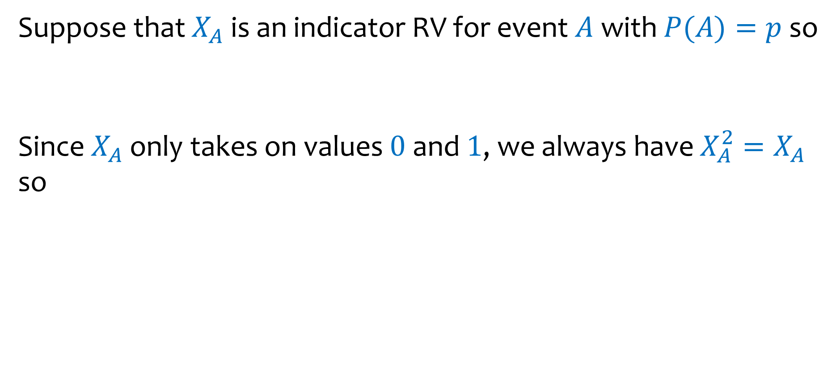
Variance of Indicator Random Variables - calculation
Suppose that $X_{A}$ is an indicator RV for event $A$ with $P(A)=p$so
Since $X_{A}$ only takes on values $0$ and $1$, we always have $X_{A}^{2}=X_{A}$ so
$$𝔼\left[X_{A}\right]=P\left(A\right)=p$$
$$Var\left(X_{A}\right)=𝔼\left[X_{A}^{2}\right]−𝔼{\left[X_{A}\right]}^{2}=𝔼\left[X_{A}\right]−𝔼{\left[X_{A}\right]}^{2}=p−p^{2}=p(1−p)$$
Notes:
Checked reading order

Slide 18
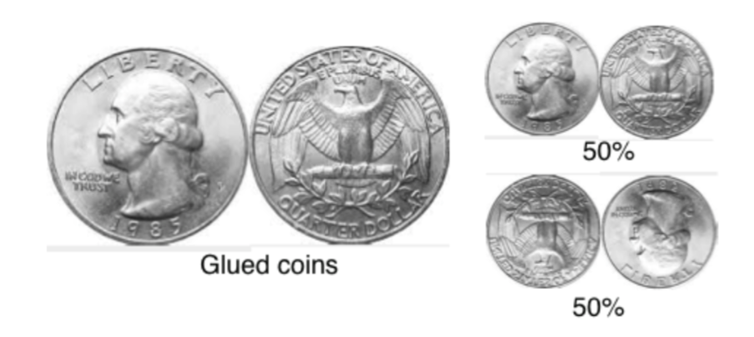

Another example: $Var\left(X+Y\right)≠Var\left(X\right)+Var(Y)$
Proof by counter-example:
Recall glued coins
Let $X_{1}$ be a r.v. that indicates if the first coin comes up heads.
Let $X_{2}$ be a r.v. that indicates if the second coin comes up heads.
Notes:
CRO

Slide 19
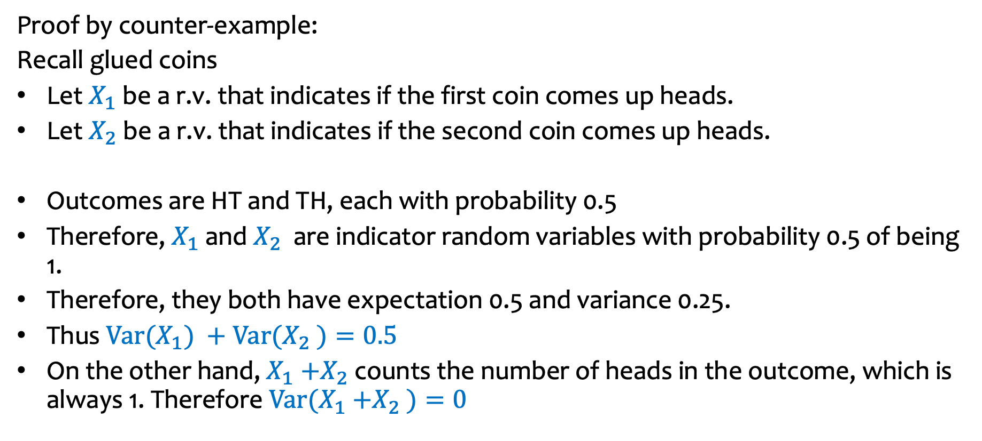
Another example: $Var\left(X+Y\right)≠Var\left(X\right)+Var(Y)$ (Explanation)
Proof by counter-example:
Recall glued coins
Let $X_{1}$ be a r.v. that indicates if the first coin comes up heads.
Let $X_{2}$ be a r.v. that indicates if the second coin comes up heads.
Outcomes are HT and TH, each with probability 0.5
Therefore, $X_{1}$ and $X_{2}$ are indicator random variables with probability 0.5 of being 1.
Therefore, they both have expectation 0.5 and variance 0.25.
Thus ${Var(X}_{1}{) +Var(X}_{2}$ $)=0.5$
On the other hand, $X_{1}{+X}_{2}$ counts the number of heads in the outcome, which is always 1. Therefore ${Var(X}_{1}{+X}_{2}$ $)=0$
Notes:
CRO

Slide 20
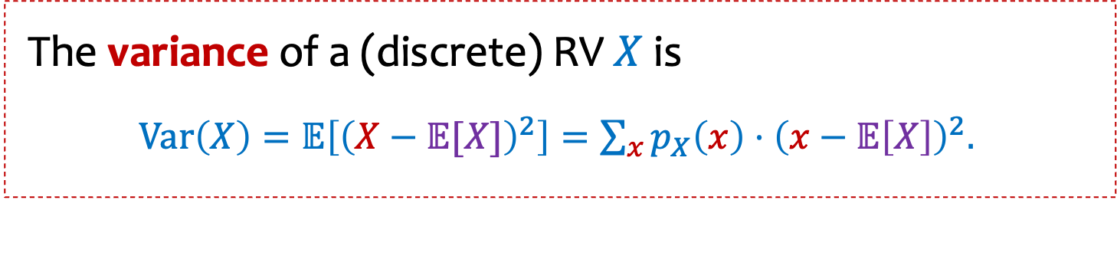
Question 1
The variance of a (discrete) RV $X$is
$Var\left(X\right)=𝔼\left[{\left(X−𝔼[X]\right)}^{2}\right]=\sum_{x}{p_{X}\left(x\right)⋅{\left(x−𝔼\left[X\right]\right)}^{2}. }$
Can the variance of a random variable be negative?
Poll:
https://pollev.com/ annakarlin185
Yes
No
It will take me too long to figure out.
I don’t know how/where to start.

Slide 21
Question 2
The variance of a (discrete) RV $X$is
$Var\left(X\right)=𝔼\left[{\left(X−𝔼[X]\right)}^{2}\right]=\sum_{x}{p_{X}\left(x\right)⋅{\left(x−𝔼\left[X\right]\right)}^{2}. }$
Is Var(X + 5) = Var (X) + 5?
Poll:
https://pollev.com/ annakarlin185
Yes
No
It will take me too long to figure out.
I don’t know how/where to start.

Slide 22
Question 3
The variance of a (discrete) RV $X$is
$Var\left(X\right)=𝔼\left[{\left(X−𝔼[X]\right)}^{2}\right]=\sum_{x}{p_{X}\left(x\right)⋅{\left(x−𝔼\left[X\right]\right)}^{2}. }$
Is it true that if Var(X) = 0, then X is a constant?
Poll:
https://pollev.com/ annakarlin185
Yes
No
It will take me too long to figure out.
I don’t know how/where to start.
Notes:
CRO

Slide 23


Question 4
The variance of a (discrete) RV $X$is
$Var\left(X\right)=𝔼\left[{\left(X−𝔼[X]\right)}^{2}\right]=𝔼[X^{2}]−𝔼{\left[X\right]}^{2}$
What is the relationship between E(X²) and [E(X)]² ?
Poll:
https://pollev.com/ annakarlin185
A. $𝔼[X^{2}]≥𝔼{\left[X\right]}^{2}$for all $X$
B. $𝔼\left[X^{2}\right]≤𝔼{\left[X\right]}^{2}$ for all $X$
C. $𝔼\left[X^{2}\right]=𝔼{\left[X\right]}^{2}$ for all $X$
D$. None of the above.$
Notes:
CRO

Slide 24
Agenda (2)
Variance
Properties of Variance
Independent Random Variables
Properties of Independent Random Variables

Slide 25
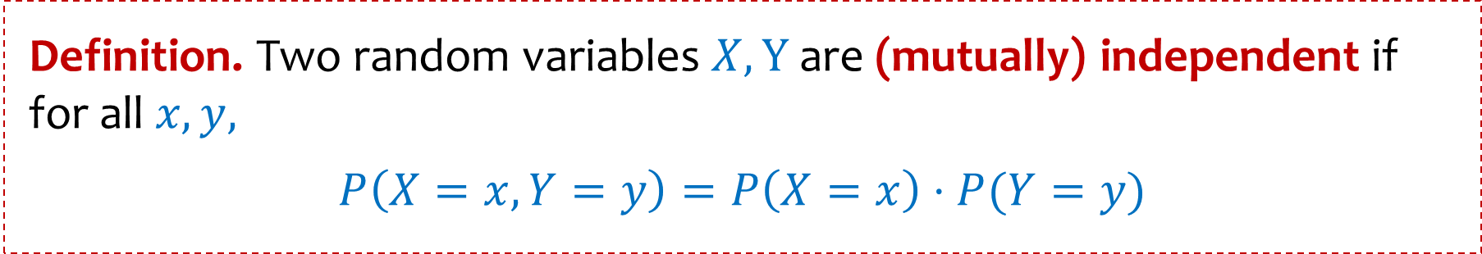
Random Variables and Independence
Comma is shorthand for AND
Definition. Two random variables $X,Y$ are (mutually) independent if for all $x,y,$
$$P\left(X=x,Y=y\right)=P\left(X=x\right)⋅P(Y=y)$$
Intuition: Knowing $X$ doesn’t help you guess $Y$ and vice versa
Notes:
Sometimes written as P(X=x|Y=y) = P(X=x) (assuming

Slide 26
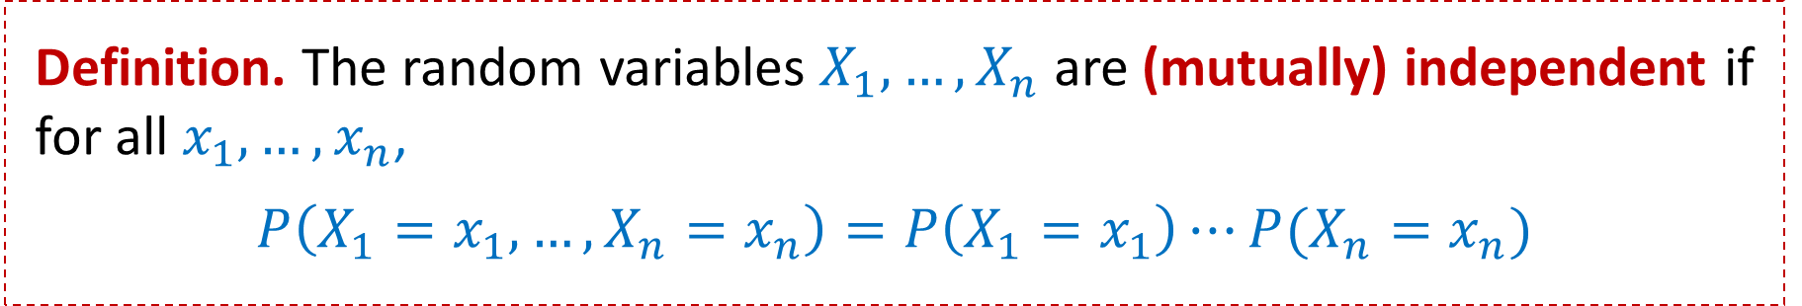
Multiple Random Variables and Independence
Comma is shorthand for AND
Definition. Two random variables $X,Y$ are (mutually) independent if for all $x,y,$
$$P\left(X=x,Y=y\right)=P\left(X=x\right)⋅P(Y=y)$$
Intuition: Knowing $X$ doesn’t help you guess $Y$ and vice versa
Definition. The random variables $X_{1},…,X_{n}$ are (mutually) independent if for all $x_{1},…,x_{n}$,
$$P\left(X_{1}=x_{1},…,X_{n}=x_{n}\right)=P\left(X_{1}=x_{1}\right)⋯P(X_{n}=x_{n})$$
Note: No need to check for all subsets, but need to check for all outcomes!
Notes:
Sometimes written as P(X=x|Y=y) = P(X=x) (assuming

Slide 27

These random variables are not independent
Recall glued coins
Let $X_{1}$ be a r.v. that indicates if the first coin comes up heads.
Let $X_{2}$ be a r.v. that indicates if the second coin comes up heads.

Slide 28

Example
Let $X$ be the number of heads in $n$ independent coin flips of the same coin. Let $Y=X mod 2$ be the parity (even/odd) of $X$.
Are $X$ and $Y$ independent?
Poll:
https://pollev.com/ annakarlin185
Yes
No
It will take me too long to figure out.
I don’t know how to start.

Slide 29

Example 2
Make $2n$ independent coin flips of the same coin.
Let $X$ be the number of heads in the first $n$ flips and $Y$ be the number of heads in the last $n$ flips.
Are $X$ and $Y$ independent?
Poll:
https://pollev.com/ annakarlin185
Yes
No
It will take me too long to figure out.
I don’t know how to start.

Slide 30
Agenda (3)
Variance
Properties of Variance
Independent Random Variables
Properties of Independent Random Variables

Slide 31
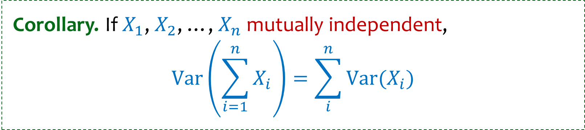
Important Facts about Independent Random Variables
Theorem. If $X$, $Y$ independent, $𝔼[X⋅Y]=𝔼[X]⋅𝔼[Y]$
Theorem. If $X$, $Y$ independent, $Var\left(X+Y\right)=Var\left(X\right)+$ $Var\left(Y\right)$
Corollary. If $X_{1}$, $X_{2}$, …, $X_{n}$ mutually independent, $$Var\left(\sum_{i=1}^{n}{X_{i}}\right)=\sum_{i}^{n}{Var(X_{i})}$$

Slide 32

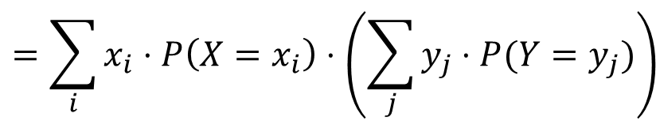
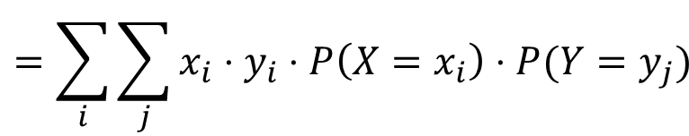
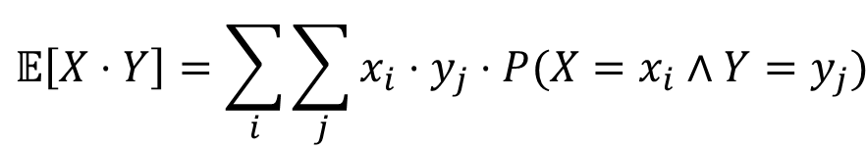
(Not Covered) Proof of $𝔼[X⋅Y]=𝔼[X]⋅𝔼[Y]$
Theorem. If $X$, $Y$ independent, $𝔼[X⋅Y]=𝔼[X]⋅𝔼[Y]$
Proof
Let $x_{i},y_{i},i=1, 2,…$be the possible values of $X, Y.$
$$𝔼\left[X⋅Y\right]=\sum_{i}{\sum_{j}{x_{i}⋅y_{j}⋅P(X=x_{i}∧Y=y_{j})}}$$
independence
$$=\sum_{i}{\sum_{j}{x_{i}⋅y_{i}⋅P\left(X=x_{i}\right)⋅P(Y=y_{j})}}$$
$$=\sum_{i}{x_{i}⋅P\left(X=x_{i}\right)⋅\left(\sum_{j}{y_{j}⋅P(Y=y_{j})}\right)}$$
$$=𝔼\left[X\right]⋅𝔼[Y]$$
Note: NOT true in general; see earlier example 𝔼[X²]≠𝔼[X]²

Slide 33
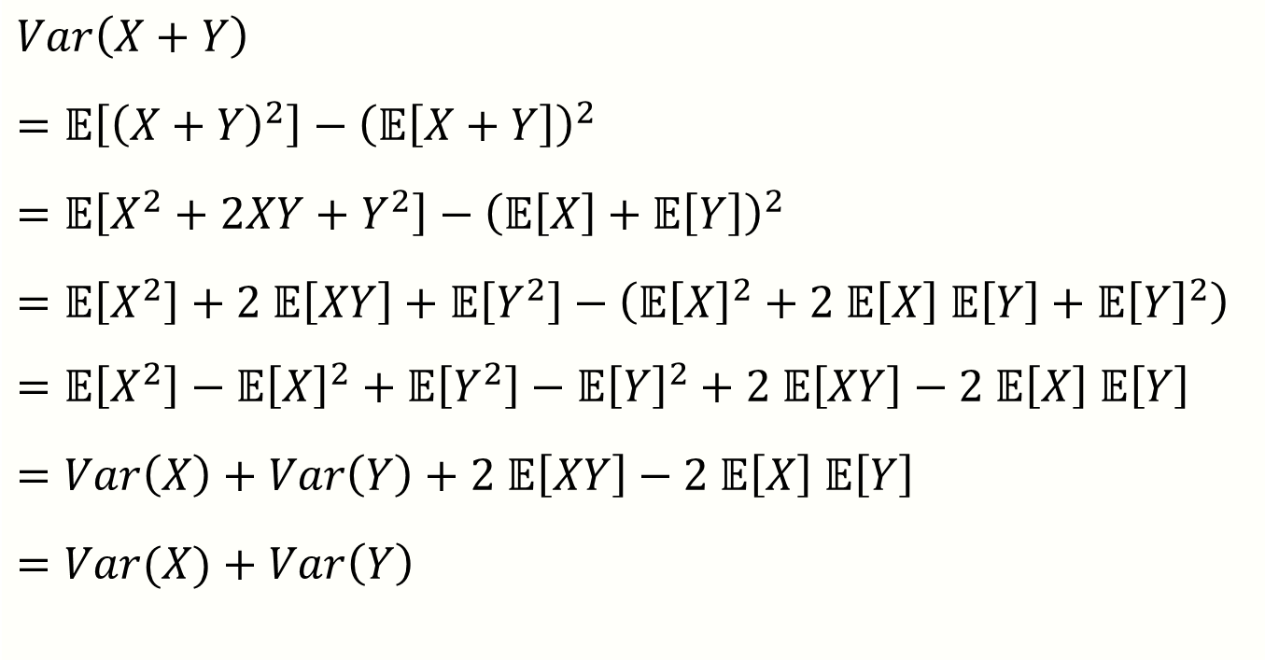
(Not Covered) Proof of $Var\left(X+Y\right)=Var\left(X\right)+$ $Var\left(Y\right)$
Theorem. If $X$, $Y$ independent, $Var\left(X+Y\right)=Var\left(X\right)+$ $Var\left(Y\right)$
Proof
$Var\left(X+Y\right)$
$=𝔼\left[{\left(X+Y\right)}^{2}\right]−{\left(𝔼\left[X+Y\right]\right)}^{2}$
$=𝔼\left[X^{2}+2XY+Y^{2}\right]−{\left(𝔼\left[X\right]+𝔼\left[Y\right]\right)}^{2}$
$=𝔼\left[X^{2}\right]+2 𝔼\left[XY\right]+𝔼\left[Y^{2}\right]−\left(𝔼{\left[X\right]}^{2}+2 𝔼\left[X\right] 𝔼\left[Y\right]+𝔼{\left[Y\right]}^{2}\right)$
$=𝔼\left[X^{2}\right]−𝔼{\left[X\right]}^{2}+𝔼\left[Y^{2}\right]−𝔼{\left[Y\right]}^{2}+2 𝔼\left[XY\right]−2 𝔼\left[X\right] 𝔼\left[Y\right]$
$=Var\left(X\right)+Var\left(Y\right)+2 𝔼\left[XY\right]−2 𝔼\left[X\right] 𝔼\left[Y\right]$
$=Var(X)+Var\left(Y\right)$
linearity
equal by independence
Notes:
CRO

Slide 34
Recap Random Variables and Independence
Comma is shorthand for AND
Definition. Two random variables $X,Y$ are (mutually) independent if for all $x,y,$
$$P\left(X=x,Y=y\right)=P\left(X=x\right)⋅P(Y=y)$$
Intuition: Knowing $X$ doesn’t help you guess $Y$ and vice versa
Definition. The random variables $X_{1},…,X_{n}$ are (mutually) independent if for all $x_{1},…,x_{n}$,
$$P\left(X_{1}=x_{1},…,X_{n}=x_{n}\right)=P\left(X_{1}=x_{1}\right)⋯P(X_{n}=x_{n})$$
Note: No need to check for all subsets, but need to check for all values!
Notes:
Sometimes written as P(X=x|Y=y) = P(X=x) (assuming

Slide 35
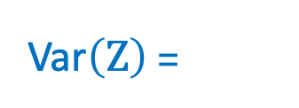
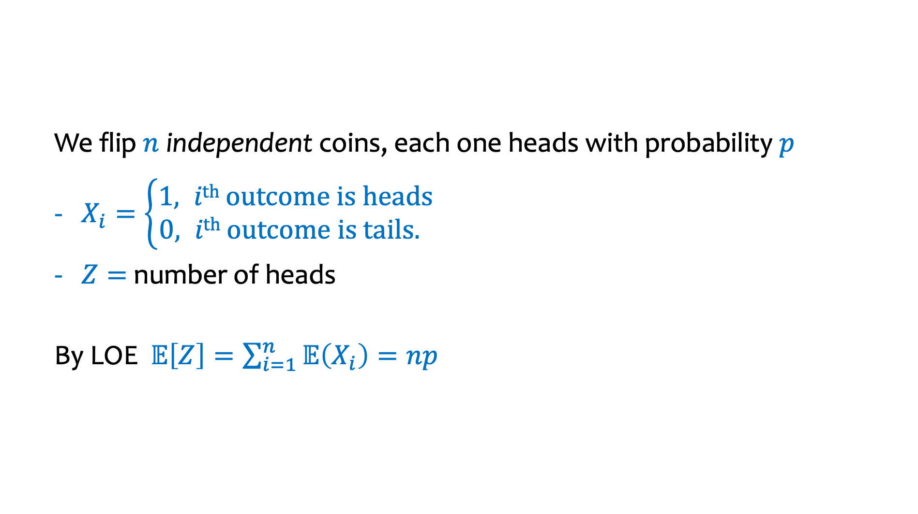




Example – Coin Tosses
We flip $n$ independent coins, each one heads with probability $p$
$X_{i}=\left\{\begin{aligned}1, i\text{th} \text{outcome} \text{is} \text{heads} \\ &0, i\text{th} \text{outcome} \text{is} \text{tails}. \end{aligned}\right.$
$Z=$ number of heads
By LOE $𝔼\left[Z\right]=\sum_{i=1}^{n}{𝔼\left(X_{i}\right)}=np$
Fact. $Z=\sum_{i=1}^{n}{X_{i}}$
$P\left(X_{i}=1\right)=p$
$$P\left(X_{i}=0\right)=1−p$$
$𝔼\left(X_{i}\right)=p$
$$P\left(Z=k\right)=$$
Var$\left(X_{i}\right)$ =
Var$\left(Z\right)$ =

Slide 36



Example – Coin Tosses (2)
We flip $n$ independent coins, each one heads with probability $p$
$X_{i}=\left\{\begin{aligned}1, i\text{th} \text{outcome} \text{is} \text{heads} \\ &0, i\text{th} \text{outcome} \text{is} \text{tails}. \end{aligned}\right.$
$Z=$ number of heads
By LOE $𝔼\left[Z\right]=\sum_{i=1}^{n}{𝔼\left(X_{i}\right)}=np$
Fact. $Z=\sum_{i=1}^{n}{X_{i}}$
$P\left(X_{i}=1\right)=p$
$$P\left(X_{i}=0\right)=1−p$$
$𝔼\left(X_{i}\right)=p$
$P\left(Z=k\right)=\left({n \atop k}\right)p^{k}{\left(1−p\right)}^{n−k}$
Note: $X_{1},…,X_{n}$ are mutually independent!
$$Var\left(Z\right)=\sum_{i=1}^{n}{Var\left(X_{i}\right)}=n⋅p(1−p)$$
Note Var$\left(X_{i}\right)=p(1−p)$

Slide 37
Agenda (if time)
Zoo of Discrete RVs, Part I
Uniform Random Variables
Bernoulli Random Variables
Binomial Random Variables
Geometric Random Variables

Slide 38
Motivation for “Named” Random Variables
Random Variables that show up all over the place.
Easily solve a problem by recognizing it’s a special case of one of these random variables.
Each RV introduced today will show:
A general situation it models
Its name and parameters
Its PMF, Expectation, and Variance
Example scenarios you can use it

Slide 39












Welcome to the Zoo! (Preview) 🦍🐘🦁🐅🦓🐪🦒
$$X∼Unif(a,b)$$
$$X∼Ber(p)$$
$$X∼Bin(n,p)$$
$$P\left(X=k\right)=\frac{1}{b −a+1} \\ 𝔼\left[X\right]=\frac{a+b}{2} \\ Var\left(X\right)=\frac{(b−a)(b−a+2)}{12}$$
$$P\left(X=1\right)=p, P\left(X=0\right)=1−p \\ 𝔼\left[X\right]=p \\ Var\left(X\right)=p(1−p)$$
$$P\left(X=k\right)=\left({n \atop k}\right)p^{k}{\left(1−p\right)}^{n−k} \\ 𝔼\left[X\right]=np \\ Var\left(X\right)=np(1−p)$$
$$X∼Geo(p)$$
$$X∼NegBin(r,p)$$
$$X∼HypGeo(N,K, n)$$
$$P\left(X=k\right)=\left({k−1 \atop r−1}\right)p^{r}{\left(1−p\right)}^{k−r} \\ 𝔼\left[X\right]=\frac{r}{p} \\ Var\left(X\right)=\frac{r(1−p)}{p^{2}}$$
$$P\left(X=k\right)=\frac{\left({K \atop k}\right)\left({N−K \atop n−k}\right)}{\left({N \atop n}\right)} \\ 𝔼\left[X\right]=n\frac{K}{N} \\ Var\left(X\right)=n\frac{K(N−K)(N−n)}{N^{2}(N−1)}$$
$$P\left(X=k\right)={\left(1−p\right)}^{k−1}p \\ 𝔼\left[X\right]=\frac{1}{p} \\ Var\left(X\right)=\frac{1−p}{p^{2}}$$
Notes:
CRO

Slide 40
Zoo of Discrete RVs, Part I
Uniform Random Variables
Bernoulli Random Variables
Binomial Random Variables
Geometric Random Variables

Slide 41



Discrete Uniform Random Variables
A discrete random variable $X$ equally likely to take any (integer) value between integers $a$ and $b$ (inclusive), is uniform.
Notation:
PMF:
Expectation:
Variance:
Example: value shown on one roll of a fair die is $Unif(1,6)$:
$P(X=i)=1/6$
$𝔼\left[X\right]=7/2$
$Var\left(X\right)=35/12$

Slide 42


Discrete Uniform Random Variables (2)
A discrete random variable $X$ equally likely to take any (integer) value between integers $a$ and $b$ (inclusive), is uniform.
Notation: $X∼Unif(a,b)$
PMF: $P\left(X=i\right)=\frac{1}{b −a+1}$
Expectation: $𝔼\left[X\right]=\frac{a+b}{2}$
Variance: $Var(X)=\frac{(b−a)(b −a+2)}{12}$
Example: value shown on one roll of a fair die is $Unif(1,6)$:
$P(X=i)=1/6$
$𝔼\left[X\right]=7/2$
$Var\left(X\right)=35/12$

Slide 43
Zoo (2)
Zoo of Discrete RVs
Uniform Random Variables
Bernoulli Random Variables
Binomial Random Variables
Geometric Random Variables

Slide 44


Bernoulli Random Variables
A random variable $X$ that takes value $1$ (“Success”) with probability $p$, and $0$ (“Failure”) otherwise. $X$ is called a Bernoulli random variable.
Notation: $X∼Ber(p)$
PMF: $P\left(X=1\right)=p,P\left(X=0\right)=1−p$
Expectation:
Variance:
Poll:
https://pollev.com/ annakarlin185
Mean Variance
$p$ $p$
$p$ $1−p$
$p$ $p(1−p)$
$p$ $p^{2}$

Slide 45

Bernoulli Random Variables (2)
A random variable $X$ that takes value $1$ (“Success”) with probability $p$, and $0$ (“Failure”) otherwise. $X$ is called a Bernoulli random variable.
Notation: $X∼Ber(p)$
PMF: $P\left(X=1\right)=p,P\left(X=0\right)=1−p$
Expectation: $𝔼\left[X\right]=p$ Note: $𝔼\left[X^{2}\right]=p$
Variance: $Var\left(X\right)=𝔼\left[X^{2}\right]−𝔼{\left[X\right]}^{2}=p −p^{2}=p(1−p)$
Examples:
Coin flip
Randomly guessing on a MC test question
A server in a cluster fails
Whether or not a share of a particular stock pays off or not
Any indicator r.v.

Slide 46
Zoo (3)
Zoo of Discrete RVs, Part I
Uniform Random Variables
Bernoulli Random Variables
Binomial Random Variables
Geometric Random Variables

Slide 47




Binomial Random Variables
A discrete random variable $X=\sum_{i=1}^{n}{Y_{i}}$ where each $Y_{i}∼Ber\left(p\right).$
Counts number of successes in $n$ independent trials, each with probability $p$ of success.
$X$ is a Binomial random variable
Examples:
# of heads in $n$ indep coin flips
# of 1s in a randomly generated n bit string
# of servers that fail in a cluster of $n$computers
# of bit errors in file written to disk
# of elements in a bucket of a large hash table
# of $n$ different stocks that “pay off”
Poll:
https://pollev.com/ annakarlin185
$p^{k}{\left(1−p\right)}^{n−k}$
$np$
$\left({n \atop k}\right)p^{k}{\left(1−p\right)}^{n−k}$
$\left({n \atop n−k}\right)p^{k}{\left(1−p\right)}^{n−k}$
$$P\left(X=k\right)=$$

Slide 48


Binomial Random Variables (2)
A discrete random variable $X=\sum_{i=1}^{n}{Y_{i}}$ where each $Y_{i}∼Ber\left(p\right).$
Counts number of successes in $n$ independent trials, each with probability $p$ of success.
$X$ is a Binomial random variable
Notation: $X∼Bin(n,p)$
PMF: $P\left(X=k\right)=\left({n \atop k}\right)p^{k}{\left(1−p\right)}^{n−k}$
Expectation:
Variance:
Poll:
https://pollev.com/ annakarlin185
Mean Variance
$p$ $p$
$np$ $np(1−p)$
$np$ $np^{2}$
$np$ $n^{2}p$

Slide 49

Binomial Random Variables (3)
A discrete random variable $X=\sum_{i=1}^{n}{Y_{i}}$ where each $Y_{i}∼Ber\left(p\right).$
Counts number of successes in $n$ independent trials, each with probability $p$ of success.
$X$ is a Binomial random variable
Notation: $X∼Bin(n,p)$
PMF: $P\left(X=k\right)=\left({n \atop k}\right)p^{k}{\left(1−p\right)}^{n−k}$
Expectation: $𝔼\left[X\right]=np$
Variance: $Var\left(X\right)=np(1−p)$

Slide 50

Mean, Variance of the Binomial
“i.i.d.” is a commonly used phrase.
It means “independent & identically distributed”
If $Y_{1},Y_{2}, …,Y_{n}∼Ber(p)$ and independent (i.i.d.), then
$X=\sum_{i=1}^{n}{Y_{i}}$, $X∼Bin(n,p)$
Claim $𝔼\left[X\right]=np$
$$𝔼\left[X\right]=𝔼\left[\sum_{i=1}^{n}{Y_{i}}\right]=\sum_{i=1}^{n}{𝔼[Y_{i}]}=n𝔼\left[Y_{1}\right]=np$$
Claim $Var\left(X\right)=np\left(1−p\right)$, by independence of r.v.’s
$$Var\left(X\right)=Var\left(\sum_{i=1}^{n}{Y_{i}}\right)=\sum_{i=1}^{n}{Var\left(Y_{i}\right)}=nVar\left(Y_{1}\right)=np(1−p)$$

Slide 51

Binomial PMFs

Slide 52

Binomial PMFs (2)

Slide 53
Zoo (4)
Zoo of Discrete RVs, Part I
Uniform Random Variables
Bernoulli Random Variables
Binomial Random Variables
Geometric Random Variables

Slide 54

Geometric Random Variables
A discrete random variable $X$ that models the number of independent trials $Y_{i}∼Ber\left(p\right)$ up until and including the first success.
$X$ is called a Geometric random variable with parameter $p$.
Notation: $X∼Geo(p)$
PMF:
Expectation:
Variance:
Examples:
# of coin flips until first head
# of random guesses on MC questions until you get one right
# of random guesses at a password until you hit it

Slide 55

Geometric Random Variables (2)
A discrete random variable $X$ that models the number of independent trials $Y_{i}∼Ber\left(p\right)$ up until and including the first success.
$X$ is called a Geometric random variable with parameter $p$.
Notation: $X∼Geo(p)$
PMF: $P\left(X=k\right)={\left(1−p\right)}^{k−1}p$
Expectation: 𝔼$\left[X\right]=\frac{1}{p}$
Variance: $Var\left(X\right)=\frac{1−p}{p^{2}}$
Examples:
# of coin flips until first head
# of random guesses on MC questions until you get one right
# of random guesses at a password until you hit it
# hash trials until a miner successfully mines a Bitcoin

Slide 56
Zoo (5)
Zoo of Discrete RVs, Part I
Uniform Random Variables
Bernoulli Random Variables
Binomial Random Variables
Geometric Random Variables
More examples

Slide 57

Example 1
Sending a binary message of length 1024 bits over a network with probability 0.999 of correctly sending each bit in the message without corruption (independent of other bits).
Let $X$ be the number of corrupted bits.
What kind of random variable is this and what is $𝔼[X]$?
Poll:
https://pollev.com/ annakarlin185
A 1022.99
B 1.024
C 1.02298
D. 1

Slide 58

Example: Music Lessons
Your music teacher requires you to play a 1000 note song without mistake. You have been practicing, so you have a probability of 0.999 of getting each note correct (independent of the others). If you mess up a single note in the song, you must start over and play from the beginning. Let $X$ be the number of times you have to play the song from the start. What kind of random variable is this and what is $𝔼[X]$?

