Slide 1
Linearity of Expectation, LOTUS and Variance
CSE 312 Spring 26
Lecture 10

Slide 2

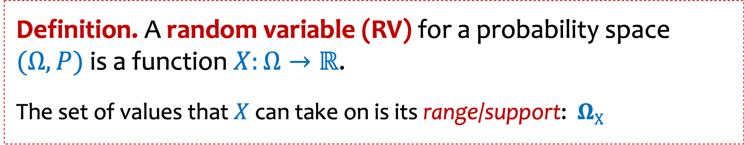





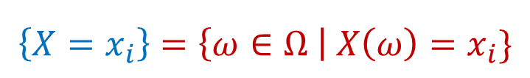
Review Random Variables and Associated Events
Definition. A random variable (RV) for a probability space $(Ω, P)$ is a function $X:Ω→ℝ$.
The set of values that $X$ can take on is its range/support:$ΩX$
$$\left\{X=x_{i}\right\}=\left\{ω∈Ω \right| X\left(ω\right)=x_{i}\}$$
$$X\left(ω\right)=x_{1}$$
$$X\left(ω\right)=x_{4}$$
Random variables partition the sample space.
$$X\left(ω\right)=x_{3}$$
$$Ω$$
$$Σ_{x∈ΩX}P\left(X=x\right)=1$$
$$X\left(ω\right)=x_{2}$$
Notes:
Checked reading order

Slide 3
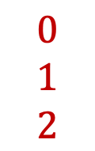
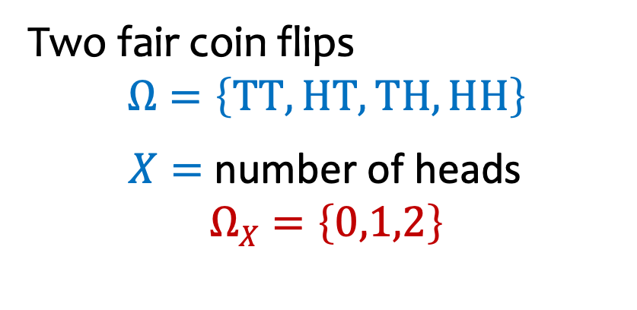







Example
$$Ω$$
$$ΩX$$
Two fair coin flips
$$Ω=\left\{TT, HT, TH,HH\right\}$$
$X=$ number of heads
$$ΩX=\left\{0,1,2\right\}$$
$$TT$$
$$HT$$
$$TH$$
$$HH$$
$$0$$
$$1$$
$$2$$
$$p_{X}$$
$$p_{X}\left(0\right) =Pr(X=0) = Pr(TT)$$
1
3/4
$$p_{X}\left(1\right) = Pr(X=1) = Pr(\{TH, HT\})$$
1/2
$$p_{X}\left(2\right) = Pr(X=2) = Pr(HH)$$
1/4
-1
0
1
2
3
Notes:
Checked reading order

Slide 4



Example – Two fair independent coin flips
$X=$ number of heads
Probability Mass Function
PMF
Cumulative Distribution Function
CDF
$$p_{X}$$
$$F_{X}$$
1
3/4
1/2
1/4
-1
0
1
2
3
-1
0
1
2
3

Slide 5

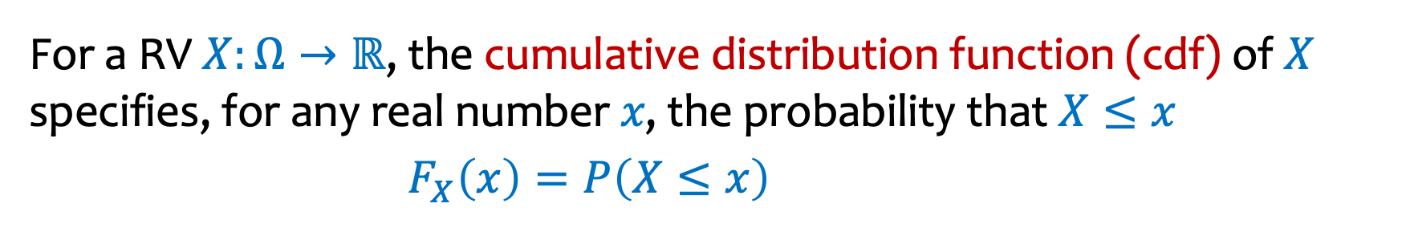
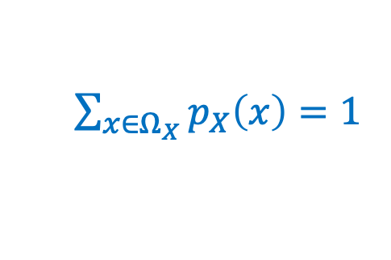
Review PMF and CDF
Definitions:
For a RV $X:Ω→ℝ$, the probability mass function (pmf) of 𝑋 specifies, for any real number 𝑥, the probability that $X=x$
$p_{X}\left(x\right)=P\left(X=x\right)=P(\left\{ω∈Ω \right| X(ω)=x\})$
$\sum_{x∈Ω_{X}}{p_{X}\left(x\right)=1}$
For a RV $X:Ω→ℝ$, the cumulative distribution function (cdf) of 𝑋 specifies, for any real number 𝑥, the probability that $X≤x$
$F_{X}\left(x\right)=P\left(X≤x\right)$
Notes:
Checked reading order

Slide 6
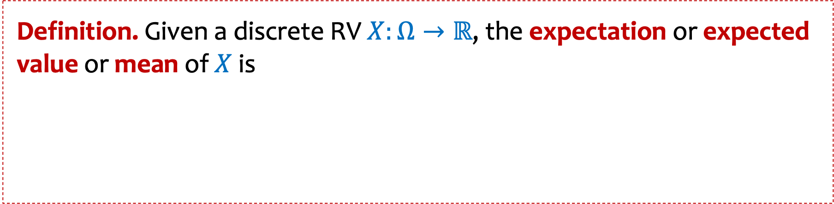
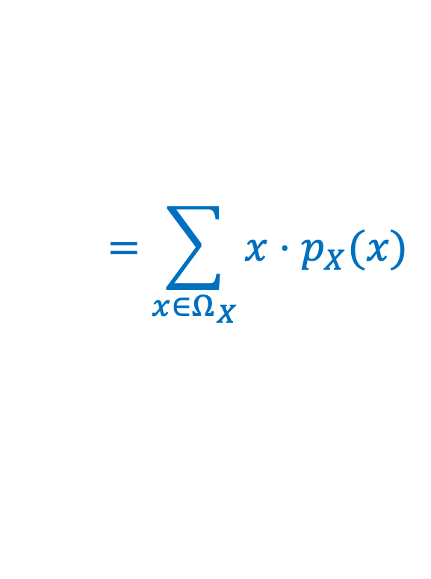
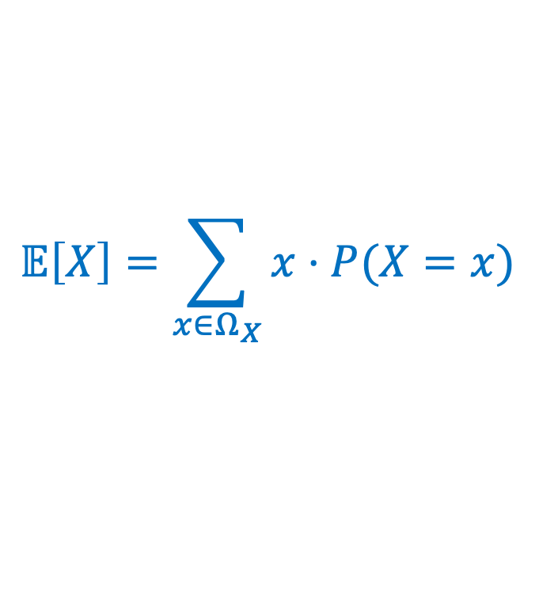
Review Expected Value of a Random Variable
Definition. Given a discrete RV $X:Ω→ℝ$, the expectation or expected value or mean of $X$ is
$$𝔼\left[X\right]=\sum_{x∈Ω_{X}}{x⋅P⁡(X=x)}$$
$$=\sum_{x∈Ω_{X}}{x⋅p_{X}(x)}$$
Intuition: “Weighted average” of the possible outcomes (weighted by probability)
Notes:
Checked reading order

Slide 7
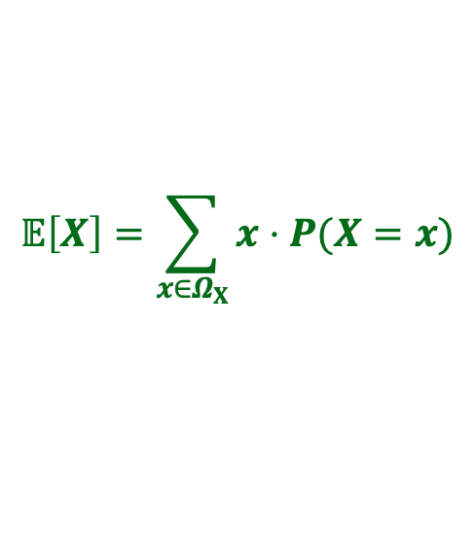



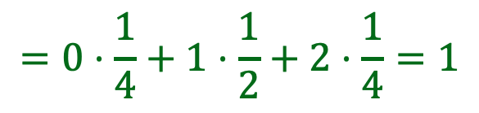
Example calculation
$$𝔼\left[X\right]=\sum_{x∈Ω_{X}}{x⋅P⁡(X=x)}$$
$$Ω$$
$$ΩX$$
Two fair coin flips
$$Ω=\left\{TT, HT, TH,HH\right\}$$
$X=$ number of heads
$$ΩX=\left\{0,1,2\right\}$$
$$TT$$
$$HT$$
$$TH$$
$$HH$$
$$0$$
$$1$$
$$2$$
$$p_{X}\left(0\right) =Pr(X=0) = Pr(TT)$$
$$p_{X}$$
$$p_{X}\left(1\right) = Pr(X=1) = Pr(\{TH, HT\})$$
1
$$p_{X}\left(2\right) = Pr(X=2) = Pr(HH)$$
3/4
1/2
$$𝔼\left[X\right]=0⋅p_{X}\left(0\right)+1⋅p_{X}\left(1\right)+2⋅p_{X}(2)$$
1/4
$$=0⋅\frac{1}{4}+1⋅\frac{1}{2}+2⋅\frac{1}{4}=1$$
-1
0
1
2
3
Notes:
Checked reading order

Slide 8
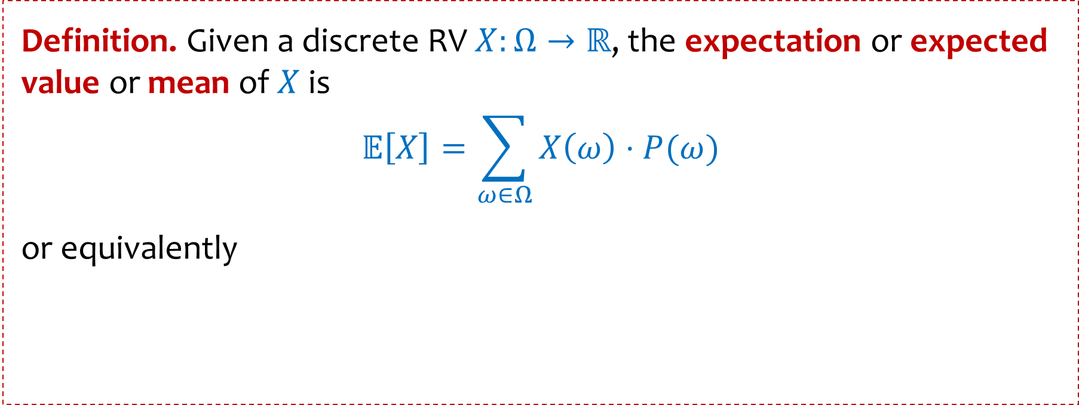


Expected Value of a Random Variable
Definition. Given a discrete RV $X:Ω→ℝ$, the expectation or expected value or mean of $X$ is
$$𝔼\left[X\right]=\sum_{ω∈Ω}{X\left(ω\right)⋅P⁡(ω)}$$
or equivalently
$$𝔼\left[X\right]=\sum_{x∈Ω_{X}}{x⋅P⁡(X=x)}$$
$$=\sum_{x∈Ω_{X}}{x⋅p_{X}(x)}$$
Intuition: “Weighted average” of the possible outcomes (weighted by probability)
Notes:
Checked reading order

Slide 9
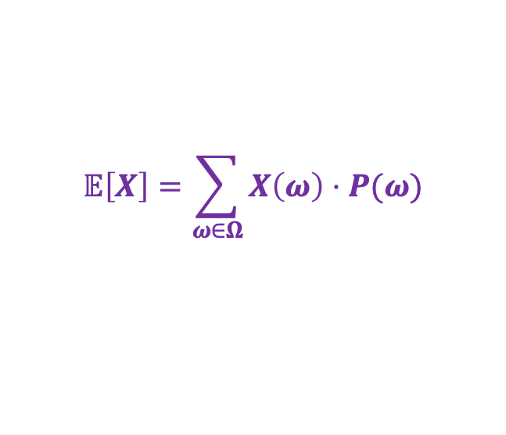
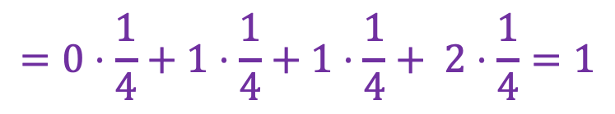
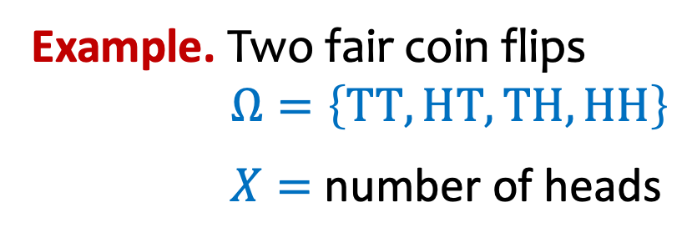
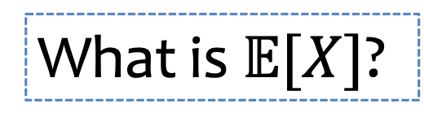
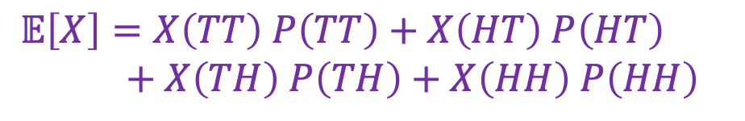
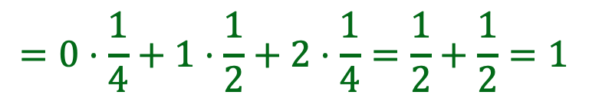
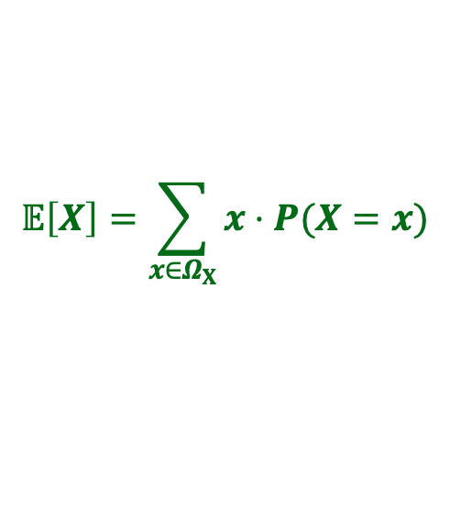
Expectation
$$𝔼\left[X\right]=\sum_{ω∈Ω}{X\left(ω\right)⋅P⁡(ω)}$$
$$𝔼\left[X\right]=\sum_{x∈Ω_{X}}{x⋅P⁡(X=x)}$$
Example. Two fair coin flips
$Ω=\left\{TT, HT, TH,HH\right\}$
$X=$ number of heads
What is $𝔼[X]$?
$𝔼\left[X\right]=X\left(TT\right) P\left(TT\right)+X\left(HT\right) P\left(HT\right)$
$+ X\left(TH\right) P\left(TH\right)$ $+ X\left(HH\right) P\left(HH\right)$
$$p_{X}$$
1
$$=0⋅\frac{1}{4}+1⋅\frac{1}{4}+1⋅\frac{1}{4}+ 2⋅\frac{1}{4}=1$$
3/4
1/2
1/4
$$𝔼\left[X\right]=0⋅p_{X}\left(0\right)+1⋅p_{X}\left(1\right)+2⋅p_{X}(2)$$
$$=0⋅\frac{1}{4}+1⋅\frac{1}{2}+2⋅\frac{1}{4}=\frac{1}{2}+\frac{1}{2}=1$$
-1
0
1
2
3
Notes:
Checked reading order

Slide 10
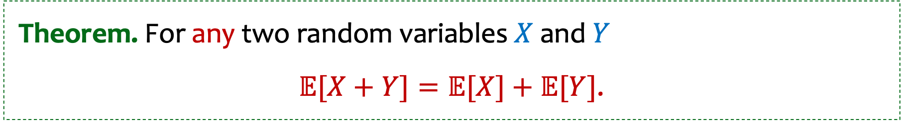
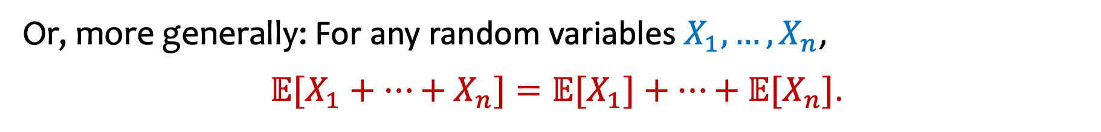
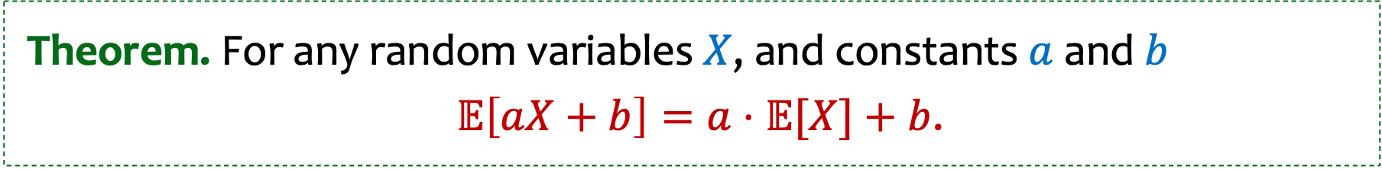
Recap Linearity of Expectation
Theorem. For any two random variables $X$ and $Y$
$𝔼[X+Y]=𝔼[X]+𝔼[Y]$.
Or, more generally: For any random variables $X_{1},…,X_{n}$,
$𝔼[X_{1}+⋯+X_{n}]=𝔼[X_{1}]+⋯+𝔼[X_{n}]$.
Theorem. For any random variables $X$, and constants$a$ and $b$
$𝔼\left[aX+b\right]=a⋅𝔼[X]+b$.
Notes:
Write E[aX + bY + c] = aE[X] + bE[Y] + c
Write E[X] = P(X=1)

Slide 11
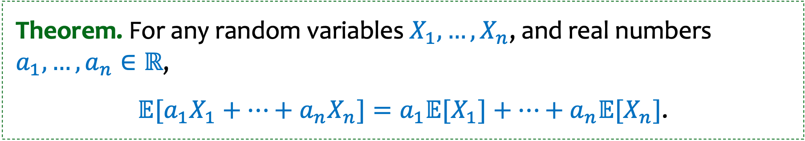
Recap Linearity of Expectation (more)
Theorem. For any two random variables $X$ and $Y$
$𝔼[X+Y]=𝔼[X]+𝔼[Y]$.
Or, more generally: For any random variables $X_{1},…,X_{n}$,
$𝔼[X_{1}+⋯+X_{n}]=𝔼[X_{1}]+⋯+𝔼[X_{n}]$.
Theorem. For any random variables $X$, and constants$a$ and $b$
$𝔼\left[aX+b\right]=a⋅𝔼[X]+b$.
Theorem. For any random variables $X_{1},…,X_{n}$, and real numbers $a_{1},…,a_{n}∈ℝ$,
$𝔼[{a_{1}X}_{1}+⋯+{a_{n}X}_{n}]=a_{1}𝔼[X_{1}]+⋯+a_{n}𝔼[X_{n}]$.
Notes:
Write E[aX + bY + c] = aE[X] + bE[Y] + c
Write E[X] = P(X=1)

Slide 12
Agenda
Recap
Linearity of expectation
LOTUS
Variance

Slide 13
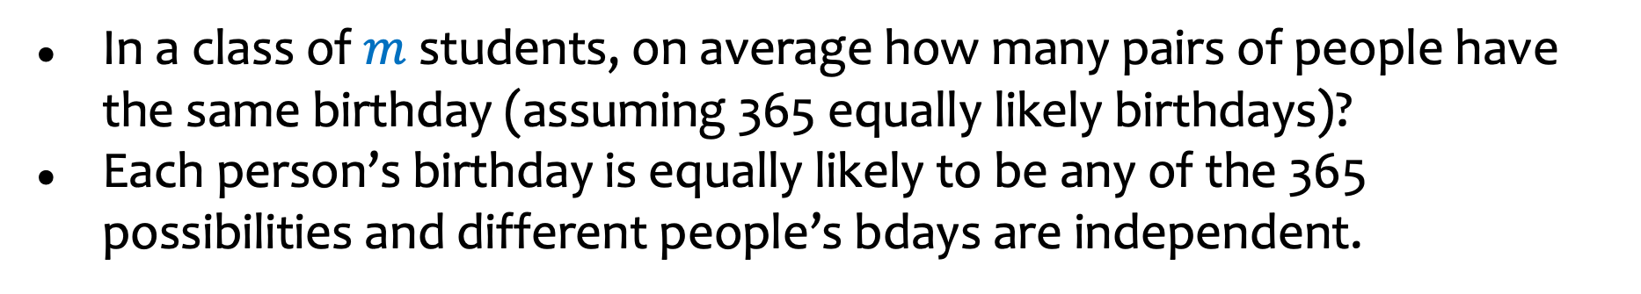
Pairs with the same birthday
In a class of $m$ students, on average how many pairs of people have the same birthday (assuming 365 equally likely birthdays)?
Each person’s birthday is equally likely to be any of the 365 possibilities and different people’s bdays are independent.
Notes:
Sum_k k Pr(exactly k pairs of people have the same birthday

Slide 14
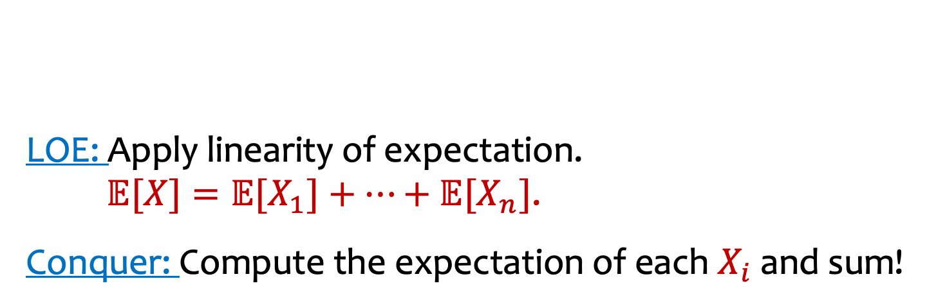

Pairs with the same birthday - LOE
In a class of $m$ students, on average how many pairs of people have the same birthday (assuming 365 equally likely birthdays)?
Each person’s birthday is equally likely to be any of the 365 possibilities and different people’s bdays are independent.
Decompose: Find the right way to
decompose the random variable into
sum of simple random variables
$X= X_{1}+⋯+X_{n}$
LOE: Apply linearity of expectation.
$𝔼[X]=𝔼[X_{1}]+⋯+𝔼[X_{n}]$.
Conquer: Compute the expectation of each $X_{i}$ and sum!
Notes:
Sum_k k Pr(exactly k pairs of people have the same birthday

Slide 15
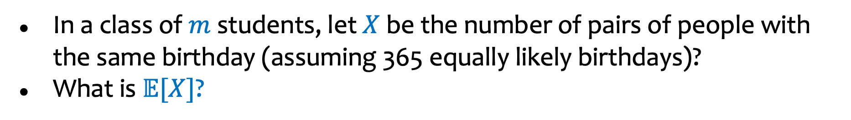
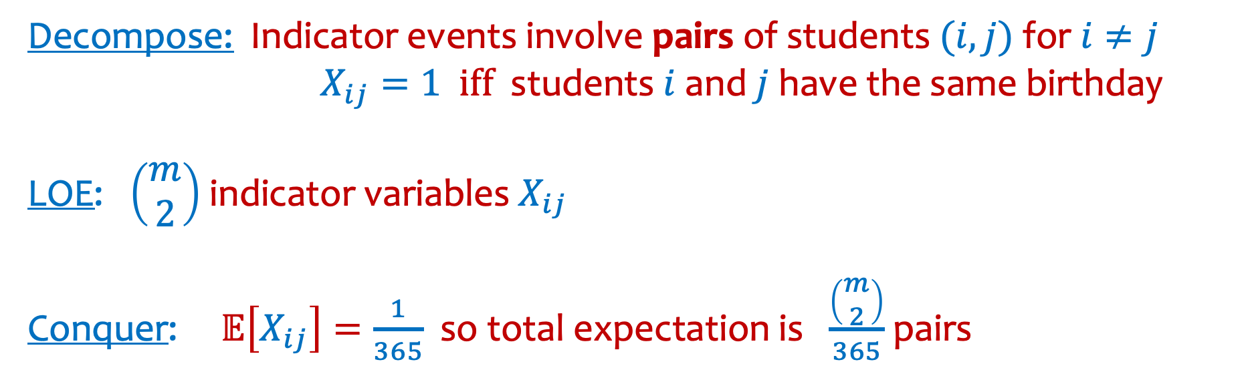
Pairs with the same birthday – LOE (2)
In a class of $m$ students, let $X$ be the number of pairs of people with the same birthday (assuming 365 equally likely birthdays)?
What is $𝔼[X]$?
Decompose: Indicator events involve pairs of students $(i,j)$for $i≠j$ $X_{ij}=1 iff$ students $i$ and $j$ have the same birthday
LOE: $\left(\begin{matrix}m \\ 2\end{matrix}\right)$ indicator variables $X_{ij}$
Conquer: $𝔼\left[X_{ij}\right]=\frac{1}{365}$ so total expectation is $\frac{\left(\begin{matrix}m \\ 2\end{matrix}\right)}{365}$ pairs
Notes:
Sum_k k Pr(exactly k pairs of people have the same birthday

Slide 16
Agenda (2)
Recap
Linearity of expectation
LOTUS
Variance

Slide 17
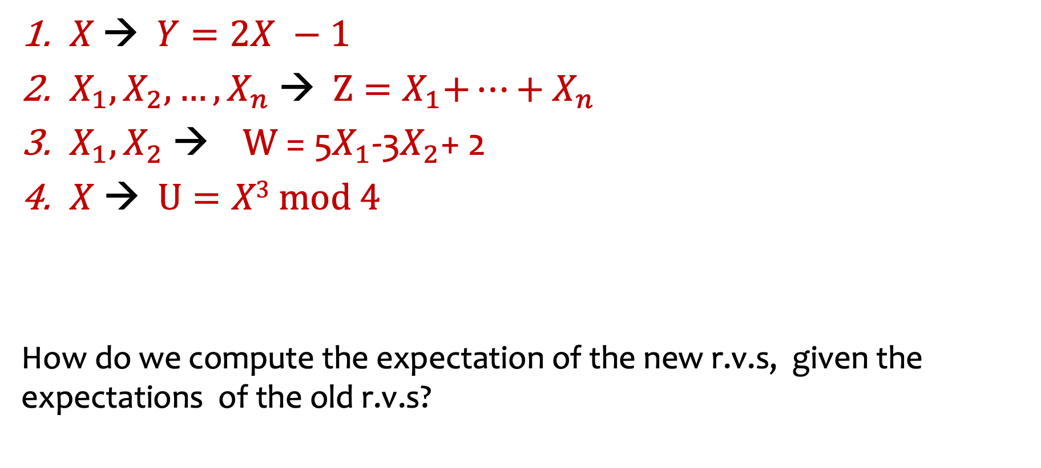
Constructing new random variables from old ones.
$X \text{→} Y=2X −1$
$X_{1},{X_{2}, …,X}_{n}$ → ${ Z=X}_{1}+⋯+X_{n}$
$X_{1},X_{2} \text{→} W \text{= 5}X_{1}\text{-3}X_{2}\text{+ 2}$
$X$ → $U=X3 mod 4$
How do we compute the expectation of the new r.v.s, given the expectations of the old r.v.s?

Slide 18
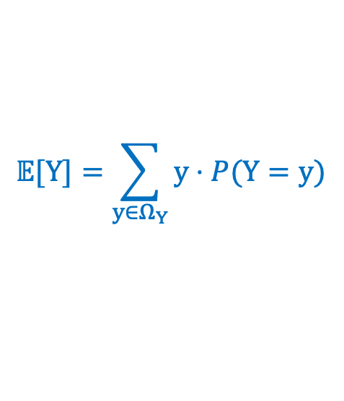
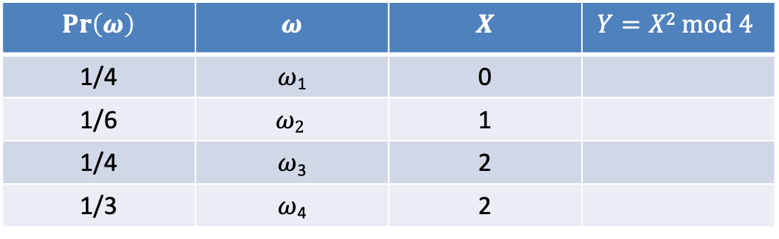
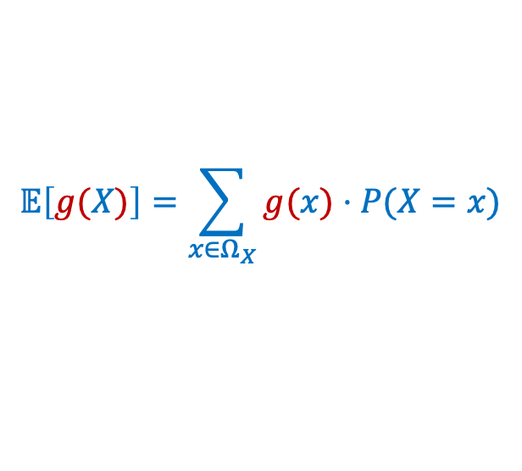
Example of constructing new r.v.
$$Pr\left(ω\right)$$ | $$ω$$ | $$X$$ | $$Y=X2 mod 4$$
1/4 | $ω$₁ | 0
1/6 | $$ω2$$ | 1
1/4 | $ω$₃ | 2
1/3 | $ω$₄ | 2
$$𝔼[Y]=\sum_{y∈Ω_{Y}}{y⋅P⁡(Y=y)}$$
$$𝔼\left[g(X)\right]=\sum_{x∈Ω_{X}}{g(x)⋅P⁡(X=x)}$$

Slide 19

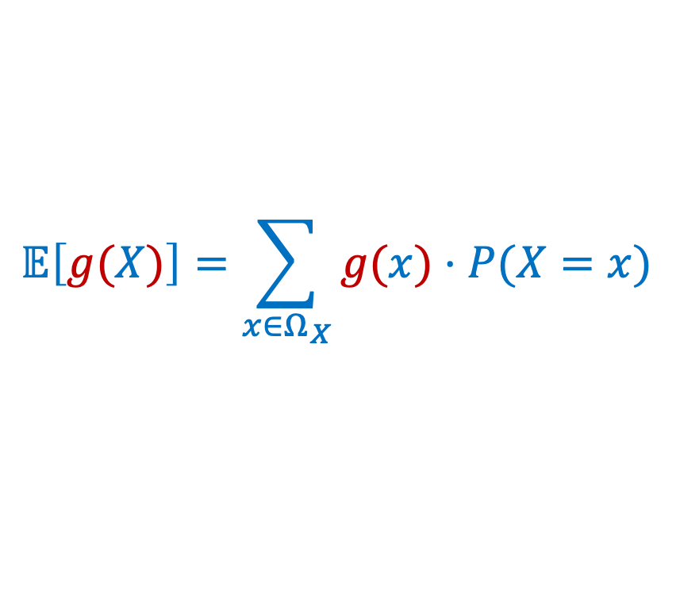
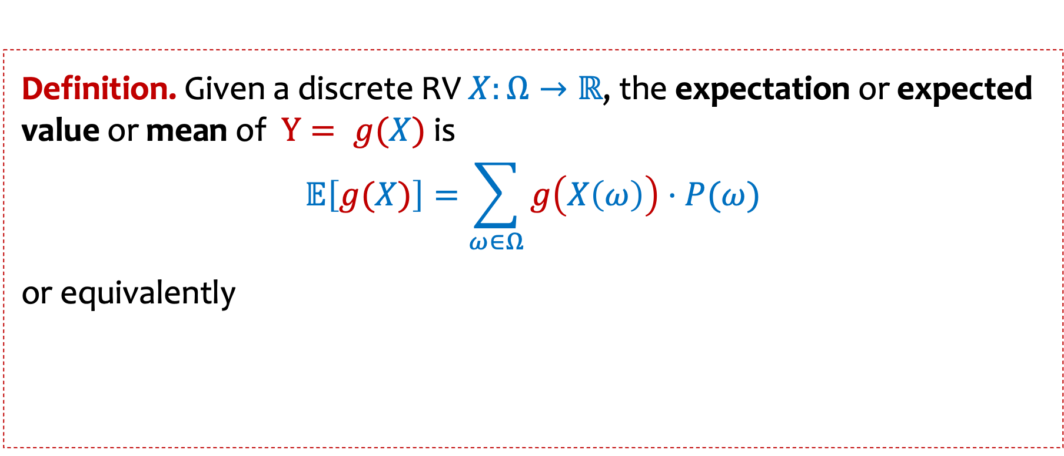
Expected Value of $g(X)$
Definition. Given a discrete RV $X:Ω→ℝ$, the expectation or expected value or mean of $Y= g(X)$ is
$$𝔼\left[g(X)\right]=\sum_{ω∈Ω}{g\left(X\left(ω\right)\right)⋅P⁡(ω)}$$
or equivalently
$$𝔼\left[g(X)\right]=\sum_{x∈Ω_{X}}{g(x)⋅P⁡(X=x)}$$
$$=\sum_{x∈Ω_{X}}{g(x)⋅p_{X}(x)}$$
Also known as LOTUS: “Law of the unconscious statistician
Notes:
Checked reading order

Slide 20
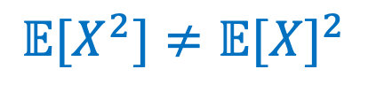
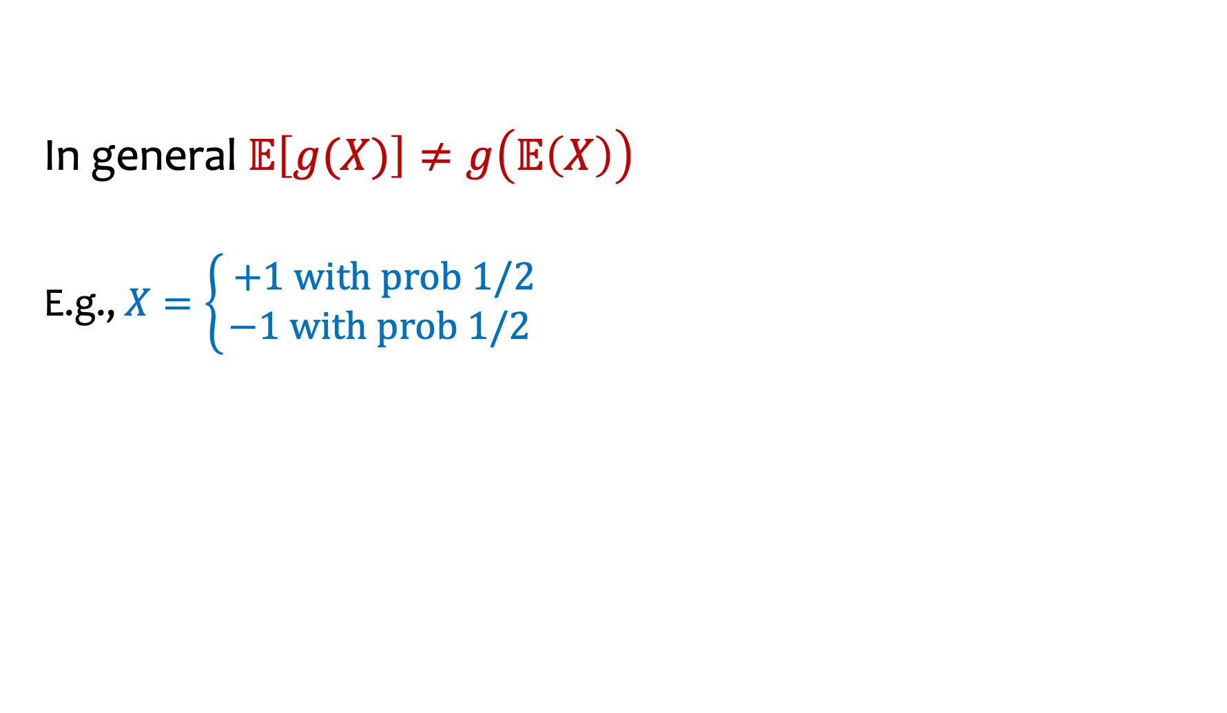
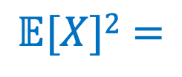
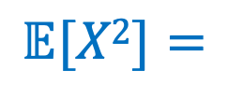

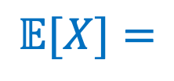
Linearity is special!
$$𝔼\left[g(X)\right]=\sum_{x∈Ω_{X}}{g(x)⋅P⁡(X=x)}$$
In general $𝔼\left[g(X)\right]≠g\left(𝔼\left(X\right)\right)$
E.g., $X=\left\{\begin{aligned} +1 with prob 1/2 \\ −1 with prob 1/2\end{aligned}\right.$
$$𝔼[X]=$$
$$𝔼[X2]=$$
$$𝔼[X]2=$$
$$𝔼[X^{2}]≠𝔼{[X]}^{2}$$
Notes:
X = \begin{cases}
1 & \text{with prob } 1/2\\
-1 & \text{with prob } 1/2
\end{cases}
Checked reading order

Slide 21
Agenda (3)
Recap
Linearity of expectation
LOTUS
Variance

Slide 22
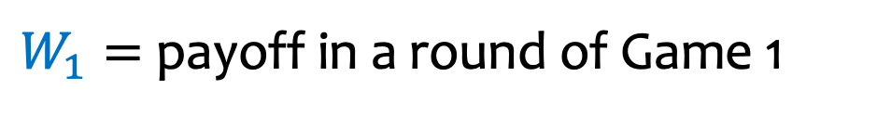
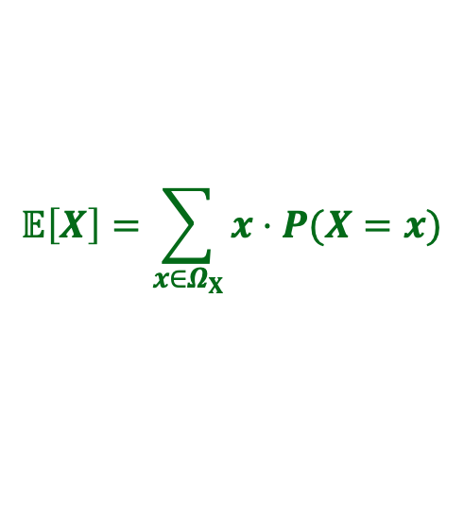

A game
$$𝔼\left[X\right]=\sum_{x∈Ω_{X}}{x⋅P⁡(X=x)}$$
Game 1: In every round, you win $2 with probability 1/3,
lose $1 with probability 2/3.
$W_{1}=$ payoff in a round of Game 1
$P\left(W_{1}=2\right)=\frac{1}{3} , P\left(W_{1}=−1\right)=\frac{2}{3}$

Slide 23

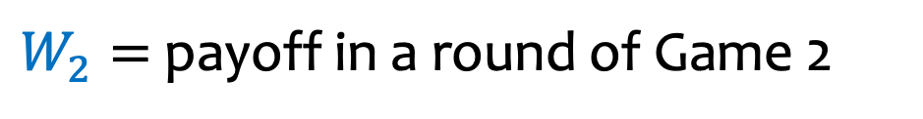
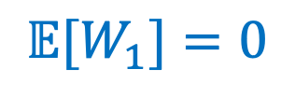

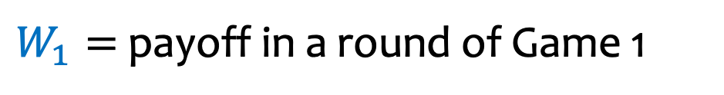
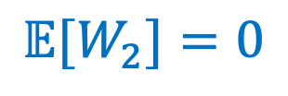
Which game would you rather play?
$$𝔼\left[X\right]=\sum_{x∈Ω_{X}}{x⋅P⁡(X=x)}$$
Game 1: In every round, you win $2 with probability 1/3, lose $1 with probability 2/3.
$W_{1}=$ payoff in a round of Game 1
$P\left(W_{1}=2\right)=\frac{1}{3} , P\left(W_{1}=−1\right)=\frac{2}{3}$
$${𝔼[W}_{1}]=0$$
Game 2: In every round, you win $10 with probability 1/3, lose $5 with probability 2/3.
$W_{2}=$ payoff in a round of Game 2
$P\left(W_{2}=10\right)=\frac{1}{3} , P\left(W_{2}=−5\right)=\frac{2}{3}$
$${𝔼[W}_{2}]=0$$
Notes:
Checked reading order

Slide 24


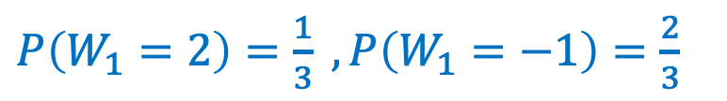











Two Games
Somehow, Game 2 has higher volatility / exposure!
$$2/3$$
$$1/3$$
$P\left(W_{1}=2\right)=\frac{1}{3} , P\left(W_{1}=−1\right)=\frac{2}{3}$
pmf of $W_{1}$
$$−1$$
$$0$$
$$2$$
$P\left(W_{2}=10\right)=\frac{1}{3} , P\left(W_{2}=−5\right)=\frac{2}{3}$
$$2/3$$
$$1/3$$
pmf of $W_{2}$
$$−5$$
$$0$$
$$+10$$
Same expectation, but clearly a very different distribution.
We want to capture the difference – New concept: Variance

Slide 25







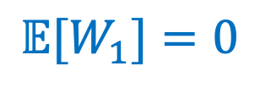
Variance (Intuition, First Try)
$$2/3$$
$$𝔼[W_{1}]=0$$
$P\left(W_{1}=2\right)=\frac{1}{3} , P\left(W_{1}=−1\right)=\frac{2}{3}$
$$1/3$$
$$−1$$
$$0$$
$$2$$
New quantity (random variable): How far from the expectation?
$W_{1}−𝔼[W_{1}$]
Notes:
Checked reading order

Slide 26
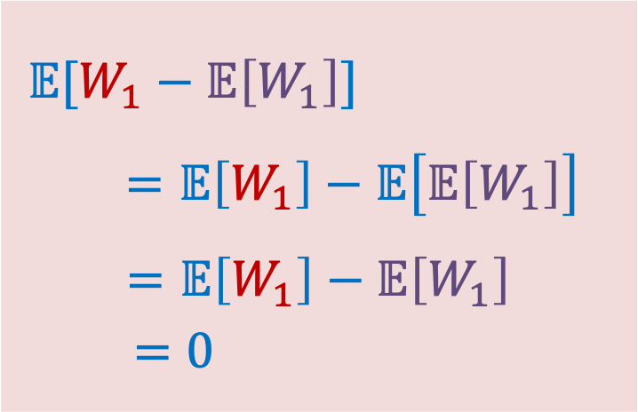
Variance (Intuition, First Try with calculation)
$$2/3$$
$$𝔼[W_{1}]=0$$
$P\left(W_{1}=2\right)=\frac{1}{3} , P\left(W_{1}=−1\right)=\frac{2}{3}$
$$1/3$$
$$−1$$
$$0$$
$$2$$
New quantity (random variable): How far from the expectation?
$W_{1}−𝔼[W_{1}$]
$$𝔼[W_{1}−𝔼\left[W_{1}\right]]$$
$$=𝔼\left[W_{1}\right]−𝔼\left[𝔼\left[W_{1}\right]\right]$$
$$=𝔼\left[W_{1}\right]−𝔼\left[W_{1}\right]$$
$=0$
Notes:
Checked reading order

Slide 27
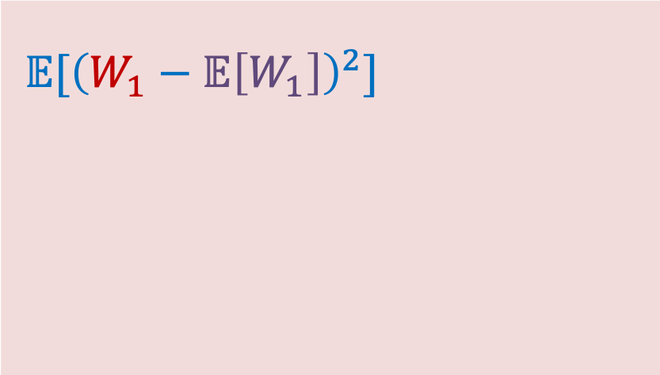

Variance (Intuition, Better Try)
$$2/3$$
$$𝔼[W_{1}]=0$$
$P\left(W_{1}=2\right)=\frac{1}{3} , P\left(W_{1}=−1\right)=\frac{2}{3}$
$$1/3$$
$$−1$$
$$0$$
$$2$$
New quantity (random variable): How far from the expectation?
$W_{1}−𝔼[W_{1}$]
$$𝔼[{\left(W_{1}−𝔼\left[W_{1}\right]\right)}^{2}]$$
$$𝔼\left[g(X)\right]=\sum_{x∈Ω_{X}}{g(x)⋅P⁡(X=x)}$$
Notes:
Checked reading order

Slide 28

Variance (Intuition, Better Try with calculation)
$$2/3$$
$$𝔼[W_{1}]=0$$
$P\left(W_{1}=2\right)=\frac{1}{3} , P\left(W_{1}=−1\right)=\frac{2}{3}$
$$1/3$$
$$−1$$
$$0$$
$$2$$
New quantity (random variable): How far from the expectation?
$W_{1}−𝔼[W_{1}$]
$$𝔼[{\left(W_{1}−𝔼\left[W_{1}\right]\right)}^{2}]$$
$=\frac{2}{3}⋅1+\frac{1}{3}⋅4$
$$=2$$
$$𝔼\left[g(X)\right]=\sum_{x∈Ω_{X}}{g(x)⋅P⁡(X=x)}$$
Notes:
Checked reading order

Slide 29








Variance (Intuition, Better Try – W₂)
$$𝔼[W_{2}]=0$$
$$2/3$$
$P\left(W_{2}=10\right)=\frac{1}{3} , P\left(W_{2}=−5\right)=\frac{2}{3}$
$$1/3$$
$$−5$$
$$0$$
$$+10$$
A better quantity (random variable): How far from the expectation?
$$𝔼[{\left(W_{2}−𝔼\left[W_{2}\right]\right)}^{2}]$$
$$=\frac{2}{3}⋅25+\frac{1}{3}⋅100$$
$$=50$$
$$𝔼\left[g(X)\right]=\sum_{x∈Ω_{X}}{g(x)⋅P⁡(X=x)}$$

Slide 30














Variance
$$2/3$$
$$1/3$$
$$𝔼[g\left(W_{1}\right)]=2$$
$$W_{1}$$
$$2/3$$
$$−1$$
$$0$$
$$2$$
$$1/3$$
$$𝔼[g\left(W_{2}\right)]=50$$
$$W_{2}$$
$$−5$$
$$0$$
$$+10$$
We say that $W_{2}$ has “higher variance” than $W_{1}$.
$$g(W)={\left(W−𝔼[W]\right)}^{2}$$

Slide 31



Variance - summary
Definition. The variance of a (discrete) RV $X$is
$Var\left(X\right)=𝔼\left[{\left(X−𝔼[X]\right)}^{2}\right]=\sum_{x∈ΩX}{p_{X}\left(x\right)⋅{\left(x−𝔼[X]\right)}^{2}}$
Standard deviation: $σ\left(X\right)=\sqrt{Var(X)}$
Recall $𝔼[X]$ is a constant, not a random variable itself.
Intuition: Variance (or standard deviation) is a quantity that measures, in expectation, how “far” the random variable is from its expectation.

Slide 32



Variance – Example 1
$$𝔼\left[g(X)\right]=\sum_{x∈Ω_{X}}{g(x)⋅P⁡(X=x)}$$
$X$ fair die
$P\left(X=1\right)=…=P\left(X=6\right)=1/6$
$𝔼\left[X\right]=3.5$
$$Var\left(X\right)=\sum_{x∈ΩX}{P\left(X=x\right)⋅{\left(x−𝔼[X]\right)}^{2}}$$

Slide 33


Variance – Example 1 (with calculation)
$X$ fair die
$P\left(X=1\right)=…=P\left(X=6\right)=1/6$
$𝔼[X]=3.5$
$Var\left(X\right)=$ $\sum_{x}{P\left(X=x\right)⋅{\left(x−𝔼[X]\right)}^{2}}$
$$\text{= }\frac{1}{6}\left[{\left(1−3.5\right)}^{2}+{\left(2−3.5\right)}^{2}+{\left(3−3.5\right)}^{2}+{\left(4−3.5\right)}^{2}+{\left(5−3.5\right)}^{2}+{\left(6−3.5\right)}^{2}\right]$$
$$=\frac{2}{6}\left[{2.5}^{2}+{1.5}^{2}+{0.5}^{2}\right]=\frac{2}{6}\left[\frac{25}{4}+\frac{9}{4}+\frac{1}{4}\right]=\frac{35}{12}≈2.91677…$$
Notes:
Checked reading order

Slide 34


Variance in Pictures
Captures how much
“spread’ there is in a pmf
All pmfs have same
expectation = 0

Slide 35
Agenda (4)
Variance
Properties of Variance

Slide 36



Variance – Properties
$$𝔼\left[X\right]=\sum_{x∈Ω_{X}}{x⋅P⁡(X=x)}$$
$$𝔼\left[g(X)\right]=\sum_{x∈Ω_{X}}{g(x)⋅P⁡(X=x)}$$
Definition. The variance of a (discrete) RV $X$is
$Var\left(X\right)=𝔼\left[{\left(X−𝔼[X]\right)}^{2}\right]=\sum_{x}{p_{X}\left(x\right)⋅{\left(x−𝔼[X]\right)}^{2}}$
Theorem. For any $a,b∈ℝ$, $Var\left(a⋅X+b\right)=a^{2}⋅Var\left(X\right)$
Notes:
Checked reading order

Slide 37

Variance – Properties (2)
$$𝔼\left[X\right]=\sum_{x∈Ω_{X}}{x⋅P⁡(X=x)}$$
$$𝔼\left[g(X)\right]=\sum_{x∈Ω_{X}}{g(x)⋅P⁡(X=x)}$$
Definition. The variance of a (discrete) RV $X$is
$Var\left(X\right)=𝔼\left[{\left(X−𝔼[X]\right)}^{2}\right]=\sum_{x}{p_{X}\left(x\right)⋅{\left(x−𝔼[X]\right)}^{2}}$
Theorem. For any $a,b∈ℝ$, $Var\left(a⋅X+b\right)=a^{2}⋅Var\left(X\right)$
Theorem. $Var\left(X\right)=𝔼[X^{2}]−𝔼{\left[X\right]}^{2}$
Notes:
Checked reading order

Slide 38







Variance (3)
Theorem. $Var\left(X\right)=𝔼[X^{2}]−𝔼{\left[X\right]}^{2}$
Proof:
Recall $𝔼[X]$ is a constant
$$Var\left(X\right)=𝔼\left[{\left(X−𝔼[X]\right)}^{2}\right]$$
$$=𝔼\left[X^{2}−2𝔼[X]⋅X+𝔼{[X]}^{2}\right]$$
$$=𝔼\left(X^{2}\right)−2𝔼[X]𝔼[X]+𝔼{\left[X\right]}^{2}$$
$$=𝔼[X^{2}]−𝔼{\left[X\right]}^{2}$$
(linearity of expectation!)
$𝔼[X^{2}]$ and $𝔼{[X]}^{2}$
are different !

Slide 39


Variance – Example 1 – calculated the other way
$X$ fair die
$ℙ\left(X=1\right)=…=ℙ\left(X=6\right)=1/6$
$𝔼\left[X\right]=\frac{21}{6}$
$𝔼[X^{2}]=\frac{91}{6}$
$$Var\left(X\right)=𝔼[X^{2}]−𝔼{[X]}^{2}=\frac{91}{6}−{\left(\frac{21}{6}\right)}^{2}=\frac{105}{36}≈2.91677$$
Notes:
Std Dev \approx. 1.7

Slide 40



Variance of Indicator Random Variables
Suppose that $X_{A}$ is an indicator RV for event $A$ with $P(A)=p$so
  $$𝔼\left[X_{A}\right]=P\left(A\right)=p$$
$$Var\left(X_{A}\right)=𝔼\left[X_{A}^{2}\right]−𝔼{\left[X_{A}\right]}^{2}=$$
Notes:
Checked reading order

Slide 41

Variance of Indicator Random Variables - calculation
Suppose that $X_{A}$ is an indicator RV for event $A$ with $P(A)=p$so
Since $X_{A}$ only takes on values $0$ and $1$, we always have $X_{A}^{2}=X_{A}$ so
  $$𝔼\left[X_{A}\right]=P\left(A\right)=p$$
$$Var\left(X_{A}\right)=𝔼\left[X_{A}^{2}\right]−𝔼{\left[X_{A}\right]}^{2}=𝔼\left[X_{A}\right]−𝔼{\left[X_{A}\right]}^{2}=p−p^{2}=p(1−p)$$
Notes:
Checked reading order

Slide 42



In General, $Var\left(X+Y\right)≠Var\left(X\right)+Var(Y)$
$$𝔼\left[X\right]=\sum_{x∈Ω_{X}}{x⋅P⁡(X=x)}$$
Let’s see a counter-example:
Let $X$ be a r.v. with pmf $P\left(X=1\right)=P\left(X=−1\right)=1/2$
  What is $𝔼[X]$ and $Var(X)$?
Let $Y=−X$
  What is $𝔼[Y]$ and $Var(Y)$?
What is $Var(X+Y)$?
$$Var\left(X\right)=𝔼\left[{\left(X−𝔼[X]\right)}^{2}\right]=\sum_{x}{p_{X}\left(x\right)⋅{\left(x−𝔼[X]\right)}^{2}}$$
Notes:
Checked reading order

