Slide 1
CSE 312
Foundations of Computing II
Anna R. Karlin
Welcome!
CSE 312 website – cs.uw.edu/312
Notes:
Web page has all the useful information for the class.

Slide 2
Staff
Instructor: Anna R Karlin
  Professor in the Allen School for n years.
  Email: karlin@cs.washington.edu
  Office: CSE1 (Allen) 586
Tas:
Siddharth Baasri | Ronald Lin
Escher Crawford | Arnav Mazumder
Darin Ershov | Medha Mittal
Yao Ching Hsieh | Mayee Sun
Zhiyuan Jia | Jolie Zhou (head TA)
Krisha Khandelwal

Slide 3
Lectures
Lectures MWF
  9:30- 10:20 am
  Recorded on Panopto
Ask questions during class
  I love it when the class is interactive! And trust me, you’ll like it more too.
  If you don’t understand something, ask!
  In addition, ask questions in office hours, on edstem, and on our 312 GPT (!!)
  Help each other out! Try to answer your fellow classmate’s questions on edstem!
Notes:
Can access slides via canvas (Panopto link) or there is a direct link on the webpage.

Slide 4
Questions and Discussions
Office hours throughout the week (starting this Friday). Find times on website.
Ed Discussion
  You should already have access (synchronized daily with the class roster)
  Use Ed discussion forum as much as possible. You can make private posts that only the staff can view! Email instructors for personal issues.

Slide 5
Sections
Sections on Thursdays
  Not recorded, for privacy of student discussion and to motivate you to ask questions.
  Important way to reinforce concepts and to prepare for doing problem sets.
  Bring laptop/phone and pencil or pen to section. (We will bring paper for you to write on.)

Slide 6
Concept checks
Concept checks after each lecture
  Released by 11am (30 mins after lecture). Must be done before the next lecture.
  Simple questions to reinforce concepts taught in each class.
  Keep you engaged and on top of the material throughout the week, so that homework becomes less of a hurdle.
  Do them as soon as you can after lecture. Really important.
Important!!!!
  If you don’t submit by the due date, you won’t be able to see the solutions until at least a week later. So submit, even if you don’t answer any of the questions!! You can resubmit as many times as you want before the deadline.

Slide 7
Grading etc.
Concept checks after each lecture 15%
8 Homeworks (submission on Gradescope) 35%
  Mostly math. A few will have coding component.
Midterm (20%): Thursday, May 18, 6-7:30pm
Final (30%): Wednesday, June 10, 8:30 - 10:20 am
Small extra credit opportunity: help your peers out by answering their questions on Edstem!
Notes:
See syllabus for details on how grades are assigned and for how we deal with conflict.
Put exam times on your calendars now!

Slide 8
Syllabus
Check out the syllabus for policies on late submission, grading breakdown, academic integrity, office hours, course tools, etc.
Bring questions about syllabus to class on Wednesday (or, better yet, ask on Ed).

Slide 9
Problem Sets
Part 1 of Pset1 will be out today!!
The rest of Pset1 will be out on Wednesday.
The whole thing is due 11:59pm the following Wednesday (April 8).
In general, every problem set is due one week after it’s released.
Notes:
Syllabus and integrity commitment, math review from prior courses, and your first introduction to python.

Slide 10

What is this class about?
Foundations of Computing II
=
Introduction to Probability & Statistics
for computer scientists
What is probability?? Why probability?!
Notes:
Probability is a precise mathematical way of measuring and analyzing uncertainty.

Slide 11
Connections
+ much more!
Complexity theory
Data compression
Computational Biology
Machine Learning, NLP
Quantum computing
Fault-tolerant systems
Algorithms
Probability & Statistics
Data Structures
Congestion control
LLMs
Cryptography
Load Balancing
Error-correcting codes
Notes:
As you know, we are living through a technological revolution dominated by Generative AI (GenAI). Tools like ChatGPT, Claude, and Gemini seem like magic but they aren’t.
At their core, these systems are massive probabilistic inference engines.
When you ask an AI a question, it is not "looking up" the answer. It is calculating a conditional probability distribution over a vocabulary of tokens. It is answering the question:
Given the words that have come before, what is the probability distribution over the next word?
This course is about understanding the mathematics that powers the most transformative technology of your lifetime.
Checked reading order

Slide 12
Beyond important applications in computer science and engineering
Two additional arguments for studying hard and really learning the material in this class:
The economic argument (the “need”)
The “fun/useful in real life” argument (the “want”)
Notes:
Why I think you should want to learn probability and why I think you need to learn probability
What I’m going to say might sound a bit tough, but I just want to be real with you.

Slide 13
The economic argument and the elephant in the room
Generative AI (like ChatGPT, Claude or Gemini) can solve 95% of the homework problems in this class in seconds.
Thus, the market value of “getting the answer” is effectively $0.00
Employers do not pay humans for skills that are free via an API
So why are you here?
Notes:
I want to acknowledge a simple truth: Generative AI (like ChatGPT, Claude, or Gemini) can solve 95% of the homework problems in this class in seconds.
If your goal is simply to "get the answer," you have been replaced by a script. The market value of "getting the answer" is effectively $0.00. Employers do not pay human salaries for skills that are free via an API.
So, why are you here?

Slide 14
The economic argument and the elephant in the room
Generative AI (like ChatGPT, Claude or Gemini) can solve 95% of the homework problems in this class in seconds.
Thus, the market value of “getting the answer” is effectively $0.00
Employers do not pay humans for skills that are free via an API
So why are you here?
You are here to learn how to be the Pilot, not the Passenger
Notes:
You are here to learn how to be the Pilot, not the Passenger.
Let me give you 5 views on why “outsourcing” your thinking is career suicide.

Slide 15
The Pilot vs Autopilot Analogy
Flying a plane on autopilot is easy. Pilots are paid high salaries not for the 99% of the time the weather is clear, but for the 1% of the time the system fails.
The gap
  AI is excellent at the “average” case. It fails catastrophically at “edge cases” – tail risks and black swan events.
The skill
  Probability is your instrument panel. If you don’t know how to read the instruments (e.g., variance, conditional probability, Bayes theorem), you cannot take over when the AI enters turbulence.
Notes:
Words in italics are things we will learn about in this course.
Tail risk is the probability of rare, extreme investment losses exceeding three standard deviations from the mean, lying in the "tails" of a probability distribution. Often underestimated by traditional models, these "fat tail" events include market crashes, geopolitical crises, or pandemics, causing significant portfolio damage.
A black swan event is an extremely rare, unpredictable occurrence with severe, widespread consequences that is often inappropriately rationalized in hindsight as having been predictable. Popularized by Nassim Nicholas Taleb, these events are outliers that fall outside the realm of normal expectations, making them impossible to forecast, yet they fundamentally alter history or markets.

Slide 16
The “Zero-Value” Proposition
If you use AI to bypass the struggle of learning probability, you are training yourself for a job that no longer exists.
The pivot
  In the future, it is unclear to what extent you will need to generate code/math from scratch. But you absolutely will need to verify code and math. And that requires serious training.
The reality
  In your first job, you will likely supervise AI agents. If you can not spot a subtle probabilistic error in their output (e.g., a hallucinated confidence interval), you are a liability, not an asset.

Slide 17
The Changing Interview Landscape
Tech interviews are adapting to the post-AI world.
The test
  An interviewer might not ask you to solve a problem. They might ask you to defend a solution.
  Example: “Why did you model this as a Poisson distribution? What happens to your risk model if the correlation shifts by 0.1?”
The result
  An LLM can give you the formula, but it cannot give you the intuition to defend it under pressure.
Notes:
Companies are moving back to Oral Exams and Whiteboarding.

Slide 18
Debugging AI Bugs
Traditional software bugs are logical (True/False). AI bugs are probabilistic (maybe/sometimes)
The challenge
  Debugging a deterministic loop is not necessarily that hard. Debugging a stochastic system that only fails 0.4% of the time requires deep statistical intuition.
The consequence
  If you don’t learn the 312 material, you will struggle to debug the systems of the future.

Slide 19
The “Human in the Loop” Premium
We are handing over critical decisions (loans, medical diagnoses, driving) to probabilistic algorithms.
The future
  The highest paid people will be the Risk Managers. These are the people who can mathematically quantify the risk of an algorithm – who can put a confidence interval on an AI’s hallucination.
For all of the above reasons, you are NOT allowed to use the usual AI tools in this class (ChatGPT, Gemini, Claude, etc)
BUT…..
Notes:
Risk manager– someone who identifies, assesses and mitigates potential threats.

Slide 20
We are experimenting with a 312 GPT!!
This course provides an AI learning assistant that works like a teaching assistant available 24/7.
It can
help explain the material we are covering
walk through section worksheet solutions
generate extra practice problems
help you get started if you are stuck on homework.
Like a human TA, the assistant is designed to guide your reasoning rather than provide solutions to graded homework problems.
Ps Don’t forget that AI systems make mistakes.
Notes:
But if you want help getting started on homework, you need to first make a sincere and serious effort to solve it on your own. If you don’t do that, you won’t really learn.

Slide 21
To pass this class, you must sign off on the following on Pset 1
I have read and understood the syllabus. In addition, I understand that we are entering an era where AI tools are ubiquitous and powerful. I acknowledge that using these tools to bypass the learning process is an act of self-sabotage.
1. If I use AI, I will use only the 312 Learning Assistant, and I will use it as a Tutor only, not as a Proxy. I may use it to explain concepts, generate practice problems, help me get started on homework, while keeping in mind that AI tools make errors. I will not use any AI to generate solutions. I understand that doing so constitutes academic misconduct.
2. I accept the “Audit” Standard: I understand that at any time, I may be asked to orally explain and defend a solution I submitted. If I cannot explain why a step was taken, I accept that I have not truly “solved” the problem and that I will get 0 points for that problem.
3. I am building my “mental model”: I recognize that my future value as a computer scientist depends, among other things, on my ability to detect errors in automated systems. I commit to doing the “heavy lifting” of learning and understanding the math now so that I possess the intuition and knowledge required to audit and debug the AI systems of tomorrow.
Notes:
I’ve put these last few things that I discussed into a “commitment” that you must sign as a requirement to pass this course. And you’ll be agreeing to this on problem set 1.
I understand that a requirement of this course is for me to work towards building my "Mental Model."

Slide 22
Summary: why you should take this course seriously
Important applications in computer science and engineering.
Crucial for success in future CSE (and other) courses.
Crucial for success in your future career, aka the economic argument (the “need”)
The “fun/useful in real life” argument (the “want”)

Slide 23
Content
Counting (basis of discrete probability)
  Counting, Permutation, Combination, inclusion-exclusion, Pigeonhole Principle
What is probability
  Probability space, events, basic properties of probabilities, conditional probability, independence, expectation, variance
Properties of probability
  Various inequalities, Zoo of discrete random variables, Concentration, Tail bounds
Continuous Probability & Statistics
  Probability Density Functions, Cumulative Density Functions, Uniform, Exponential, Normal distributions, Central Limit Theorem, Estimation
Applications
  A sample of randomized algorithms, machine learning, differential privacy, …

Slide 24

Counting
CSE 312 Spring 26
Lecture 1

Slide 25
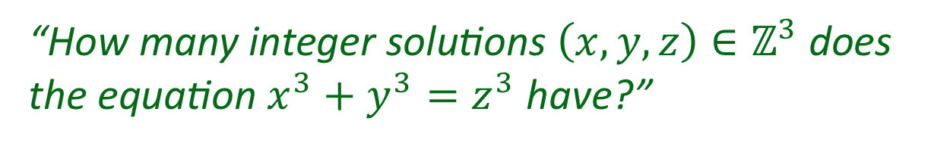
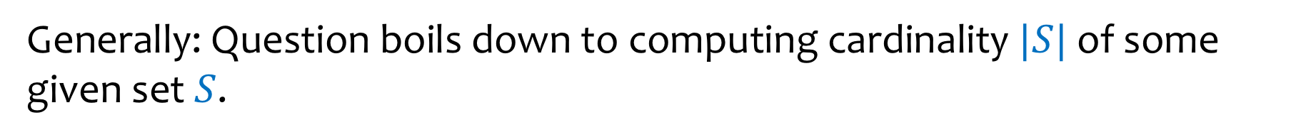
We are interested in counting the number of objects with a certain given property.
“How many ways are there to assign 7 TAs to 5 sections, such that each section is assigned to two TAs, and no TA is assigned to more than two sections?”
“How many integer solutions $\left(x,y,z\right)∈ℤ^{3}$ does the equation $x^{3}+y^{3}=z^{3}$ have?”
Generally: Question boils down to computing cardinality $|S|$ of some given set $S$.

Slide 26
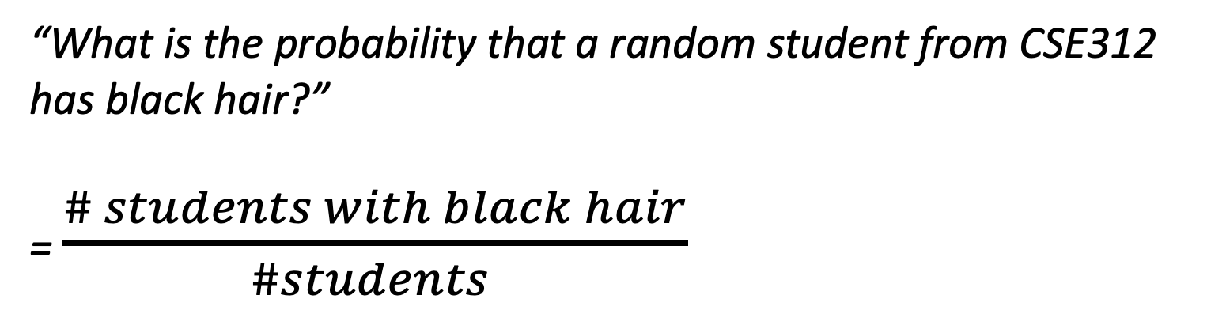
(Discrete) Probability and Counting are Twin Brothers
“What is the probability that a random student from CSE312 has black hair?”
= $\frac{\# students with black hair}{\#students }$

Slide 27
Today – Two basic rules
Sum rule
Product rule

Slide 28
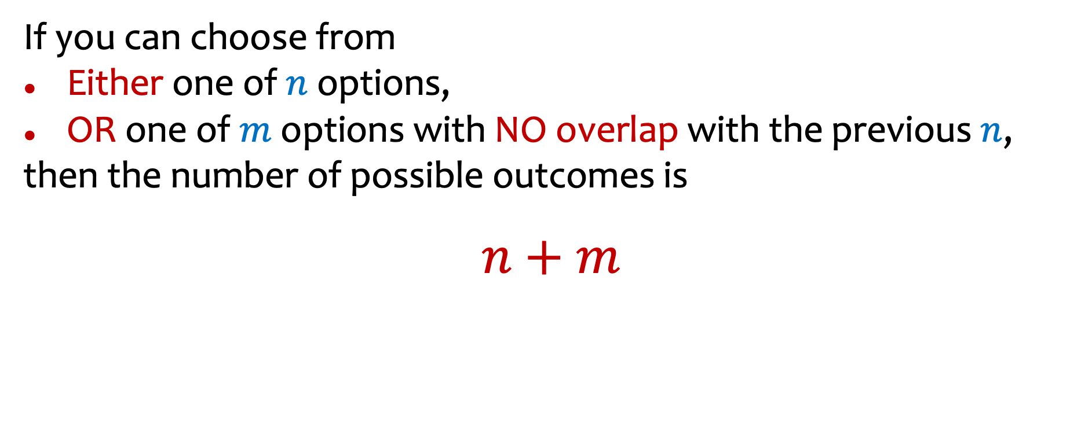
Sum Rule
If you can choose from
Either one of $n$ options,
OR one of $m$ options with NO overlap with the previous $n$,
then the number of possible outcomes is
$n+m$
Notes:
The first rule of counting and the simplest rule of counting is the sum rule.

Slide 29
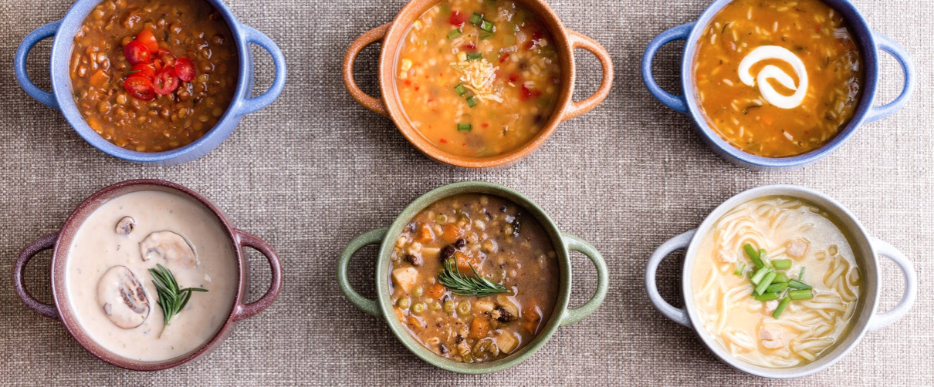
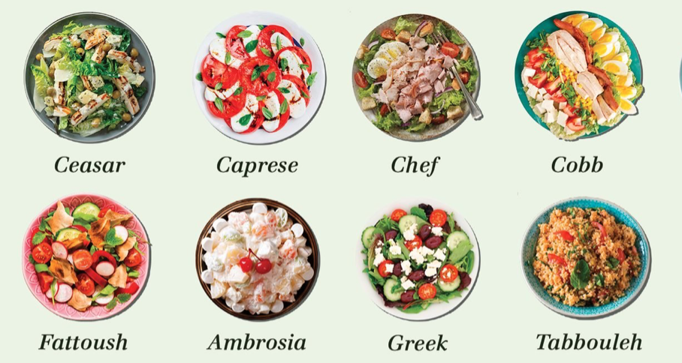
Counting “lunches”
If your starter can be either one soup (6 choices) or one salad (8 choices), how many possible starters?
Notes:
6 + 8 = 24.

Slide 30
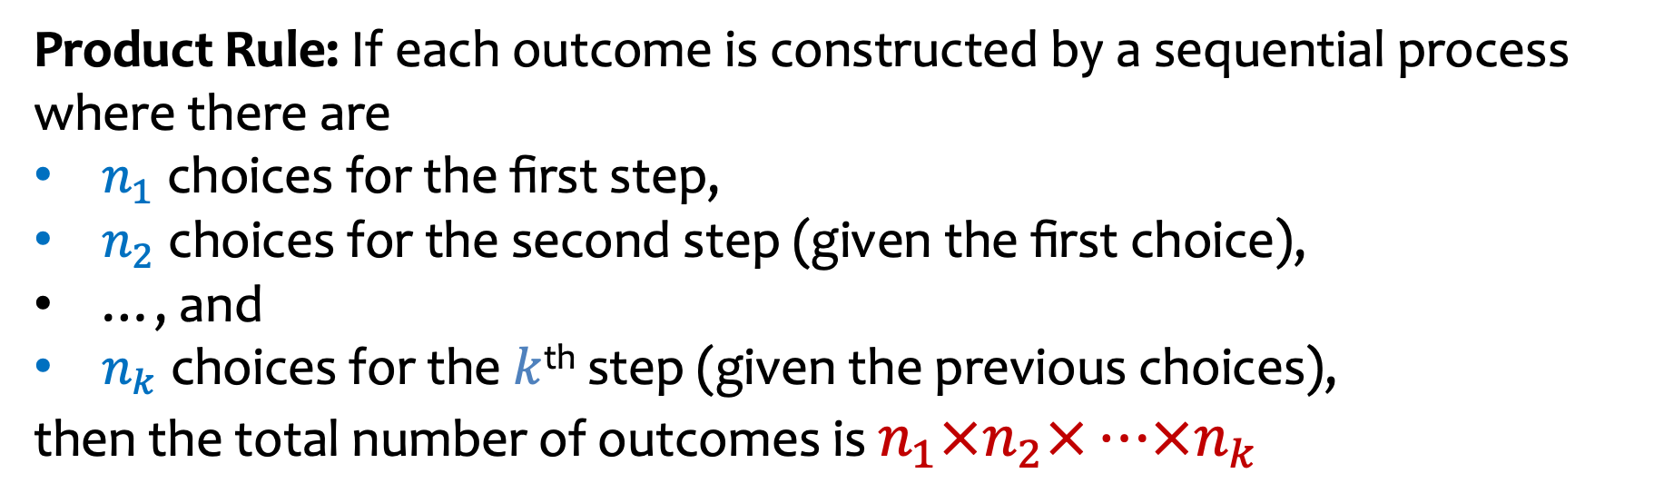
The Product Rule
Product Rule: If each outcome is constructed by a sequential process where there are
$n_{1}$ choices for the first step,
$n_{2}$ choices for the second step (given the first choice),
…, and
$n_{k}$ choices for the $k$^{th} step (given the previous choices),
then the total number of outcomes is $n_{1}×n_{2}×⋯×n_{k}$

Slide 31
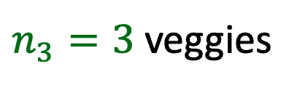
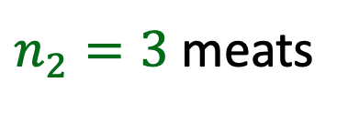
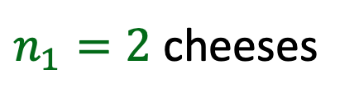
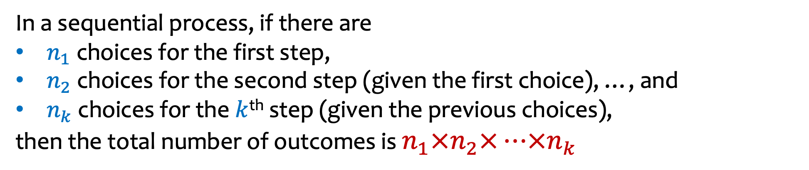
Product Rule (again)
In a sequential process, if there are
$n_{1}$ choices for the first step,
$n_{2}$ choices for the second step (given the first choice), …, and
$n_{k}$choices for the $k$^{th} step (given the previous choices),
then the total number of outcomes is $n_{1}×n_{2}×⋯×n_{k}$
$n_{1}=2$ cheeses
Example: “How many subways?”
x
x
=
$n_{2}=3$meats
$n_{3}=3$veggies
Notes:
2 x 3 x 3 = 18
Reading order checked

Slide 32
Product Rule (again)
In a sequential process, if there are
$n_{1}$ choices for the first step,
$n_{2}$ choices for the second step (given the first choice), …, and
$n_{k}$choices for the $k$^{th} step (given the previous choices),
then the total number of outcomes is $n_{1}×n_{2}×⋯×n_{k}$
$n_{1}=2$ cheeses
Example: “How many subways?”
x
x
=
$n_{2}=3$meats
$n_{3}=3$veggies
Notes:
2 x 3 x 3 = 18
Reading order checked

Slide 33
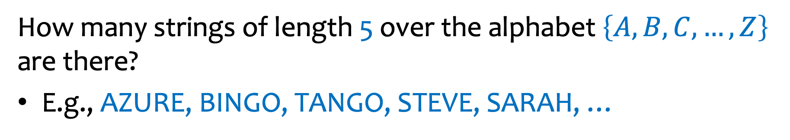
Example – Strings
How many strings of length 5 over the alphabet $\left\{A,B,C,…, Z\right\}$ are there?
E.g., AZURE, BINGO, TANGO, STEVE, SARAH, …
x
x
x
x
=
Notes:
26 choices for first letter, 26 choices for second, letter,…, 26 choices for the 5th letter, so 26 ^ 5.

Slide 34
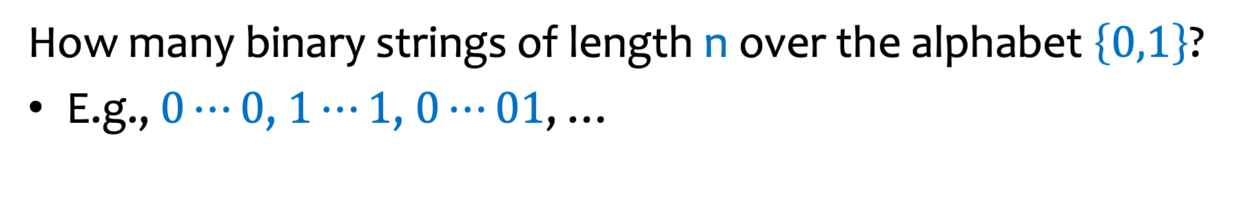
Example – Binary Strings
How many binary strings of length n over the alphabet $\left\{0,1\right\}$?
E.g., $0⋯0$, $1⋯1$, $0⋯01$, …
x
x
x
x
=
Notes:
2 choices for the first bit, 2 choices for the second bit…. 2 choices for the nth bit, so altogether 2 ^n

Slide 35

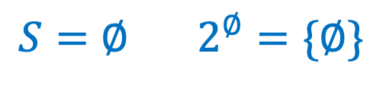

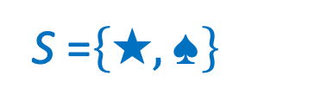
Example – Power set
Definition. The power set of $S$ is
$2^{S}≝\{X:X⊆S\}$
Example.
S =$\left\{★,♠︎\right\}$
$$2^{\left\{★,♠︎\right\}}=\{∅,\left\{★\right\},\left\{♠︎\right\},\{★,♠\}\}$$
$${S=∅ 2}^{∅}=\{∅\}$$
…
How many different subsets of $S$ are there if $|S|=n$?

Slide 36
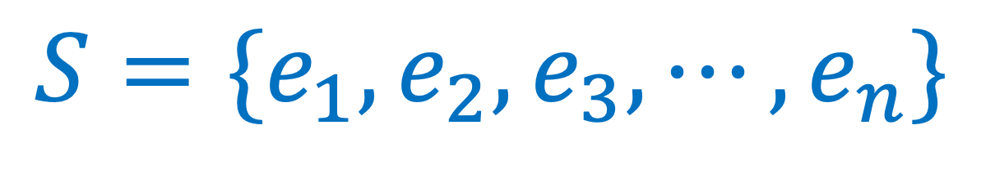
Example – Power set – number of subsets of S
$$S=\{e_{1},e_{2},e_{3},⋯, e_{n}\}$$
What is the number of subsets of $S\text{, } \text{i}\text{.}\text{e}\text{.,}{ |2}^{S}| ?$
x
x
x
x …
=
Notes:
First choose if e1 is in or out, then choose if e2 is in or out… finally choose whether en is in or out so altogether 2 ^n

Slide 37
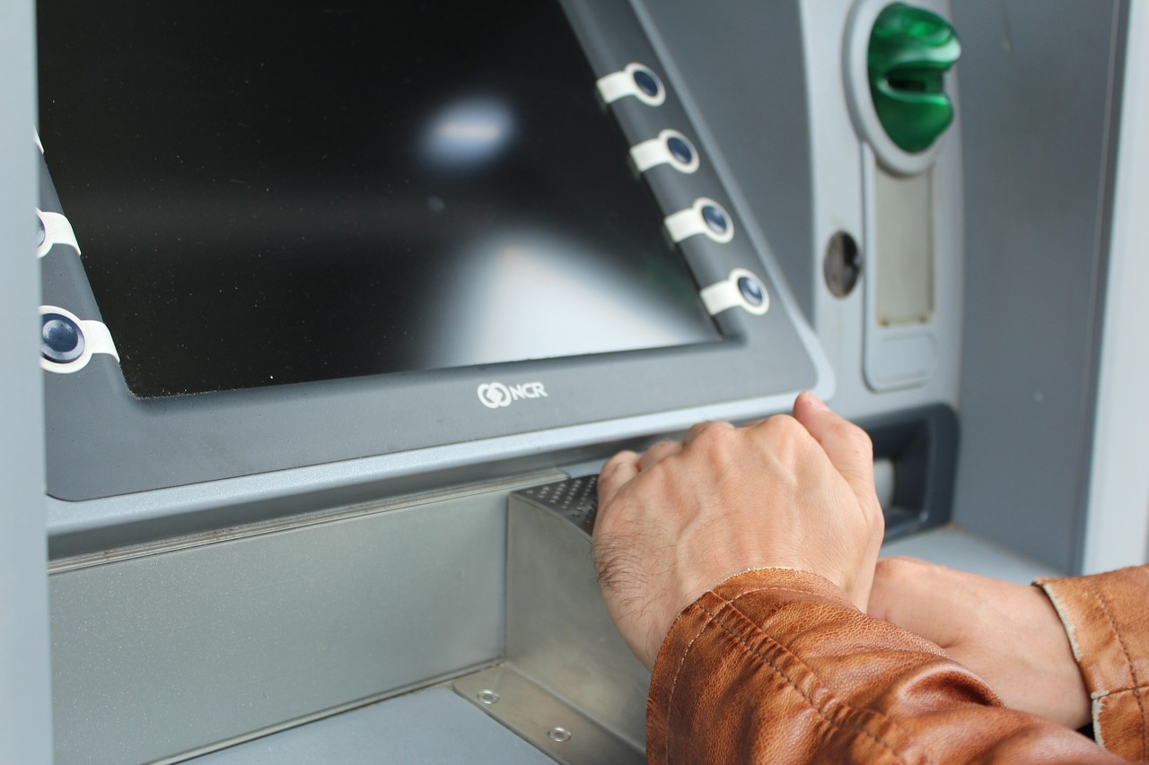

Example – ATMs and Pin codes
How many 4 –digit pin codes are there?
Each digit one of {0, 1, 2,…, 9}
x
x
x
=
# possible
first digits
# possible
second digits
# possible
third digits
# possible
fourth digits
# possible
pins
Notes:
10 choices for first digit, 10 choices for second digit….10 choices for 4th digit = 10^4
1 in 10,000 chance that a robber will guess your pin

Slide 38

Example – ATMs and Pin codes – Stronger Pins
How many 10–digit pin codes are there with no repeating digit?
Each digit one of {0, 1, 2,…, 9}; must use each digit exactly once
x
x
X … X
x
=
# possible
first digits
# possible
second digits
# possible
third digits
# possible
pins
…
Notes:
Choose first digit, then choose 2nd digit, then choose 3rd digit etc.
10 choices for first, 9 choices for second, 8 choices for 3’d and so on…

Slide 39
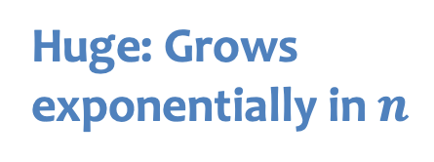
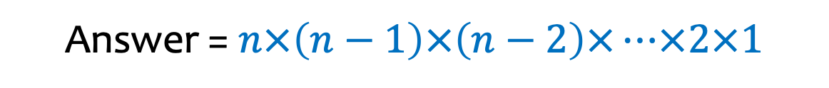


Permutations
“How many ways to order n distinct objects?”
Answer = $n×\left(n−1\right)×\left(n−2\right)×⋯×2×1$
Definition. The factorial function is
$$n!=n×\left(n−1\right)×⋯×2×1$$
Note: $0!=1$
Read as ``n factorial”
Huge: Grows
exponentially in $n$
Notes:
Define 0!

Slide 40

Example – ATMs and Pin codes – Tricky Pins
How many 10–digit pin codes with at least one digit repeated once?
Examples: 1111111111, 1234567889, 1353483595
x
x
X … X
x
=
# possible
first digits
# possible
second digits
# possible
third digits
# possible
pins
…
Notes:
On the second digit, it seems we have 10 choices… because we’re allowed to repeat a digit… but now we’re in trouble on the 3ird digit.
If we repeated on second digit, then we have 9 choices on the 3rd, but if we didn’t repeat a digit, it seems we have 10 choices…. All very confusing.
We cannot apply the product rule because the number of choices we have at each stage varies depending on the choices made up to that point.
What we can do in this case is called complementary counting.

Slide 41
Example – ATMs and Pin codes – Tricky Pins illustrated
How many 10–digit pin codes with at least one digit repeated once?
All 10 digit pins
10 digit pins with at least one repeat
10 digit pins with
no repeats
Notes:
10^{10} – 10!

Slide 42
Complementary Counting
Let U be a set and S a subset of interest
Let U \S denote the set difference (the part of U that is not in S)
Then |U\S| = |U| - |S|
Hint that you should consider using complementary counting:
When you see the phrases “at least” or “some”
Notes:
Hint that you should use complementary counting: when you see the phrase “at least”…
Or “some”
Checked reading order

Slide 43
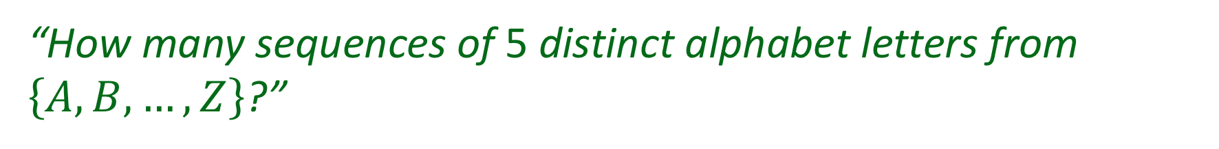
Distinct Letters
“How many sequences of 5 distinct alphabet letters from $\left\{A,B,…,Z\right\}$?”
E.g., AZURE, BINGO, TANGO. But not: STEVE, SARAH
x
x
x
x

Slide 44

Distinct Letters – answer
“How many sequences of 5 distinct alphabet letters from $\left\{A,B,…,Z\right\}$?”
E.g., AZURE, BINGO, TANGO. But not: STEVE, SARAH
Answer: $26×25×24×23×22=7893600$

Slide 45
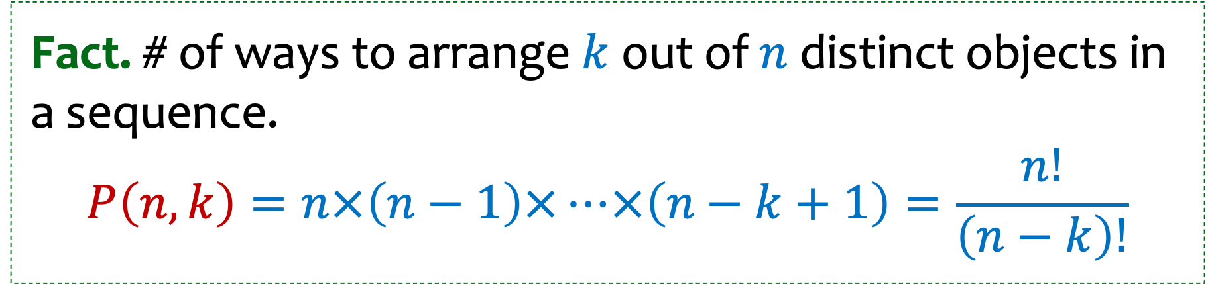


In general
Aka: $k$-permutations
Fact. # of ways to arrange $k$out of $n$distinct objects in a sequence.
$$P\left(n,k\right)=n×\left(n−1\right)×⋯×\left(n−k+1\right)=\frac{n!}{\left(n−k\right)!}$$
We sometimes say $``n pick k”$
Notes:
number of ways to arrange k out of n distinct objects

Slide 46
Number of Subsets
“How many size-5 subsets of $\left\{A,B,…,Z\right\}$?”
E.g., {A,Z,U,R,E}, {B,I,N,G,O}, {T,A,N,G,O}. But not: {S,T,E,V}, {S,A,R,H},…

Slide 47
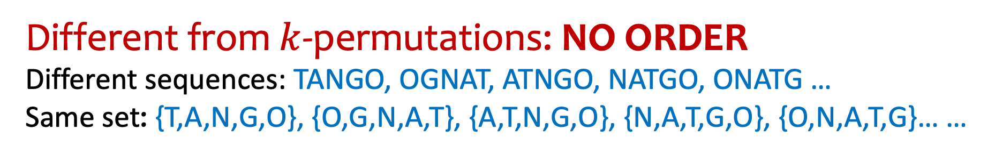
Number of Subsets – Not the same as k-permutations.
“How many size-5 subsets of $\left\{A,B,…,Z\right\}$?”
E.g., {A,Z,U,R,E}, {B,I,N,G,O}, {T,A,N,G,O}. But not: {S,T,E,V}, {S,A,R,H},…
Different from $k$-permutations: NO ORDER
Different sequences: TANGO, OGNAT, ATNGO, NATGO, ONATG …
Same set: {T,A,N,G,O}, {O,G,N,A,T}, {A,T,N,G,O}, {N,A,T,G,O}, {O,N,A,T,G}… …

Slide 48


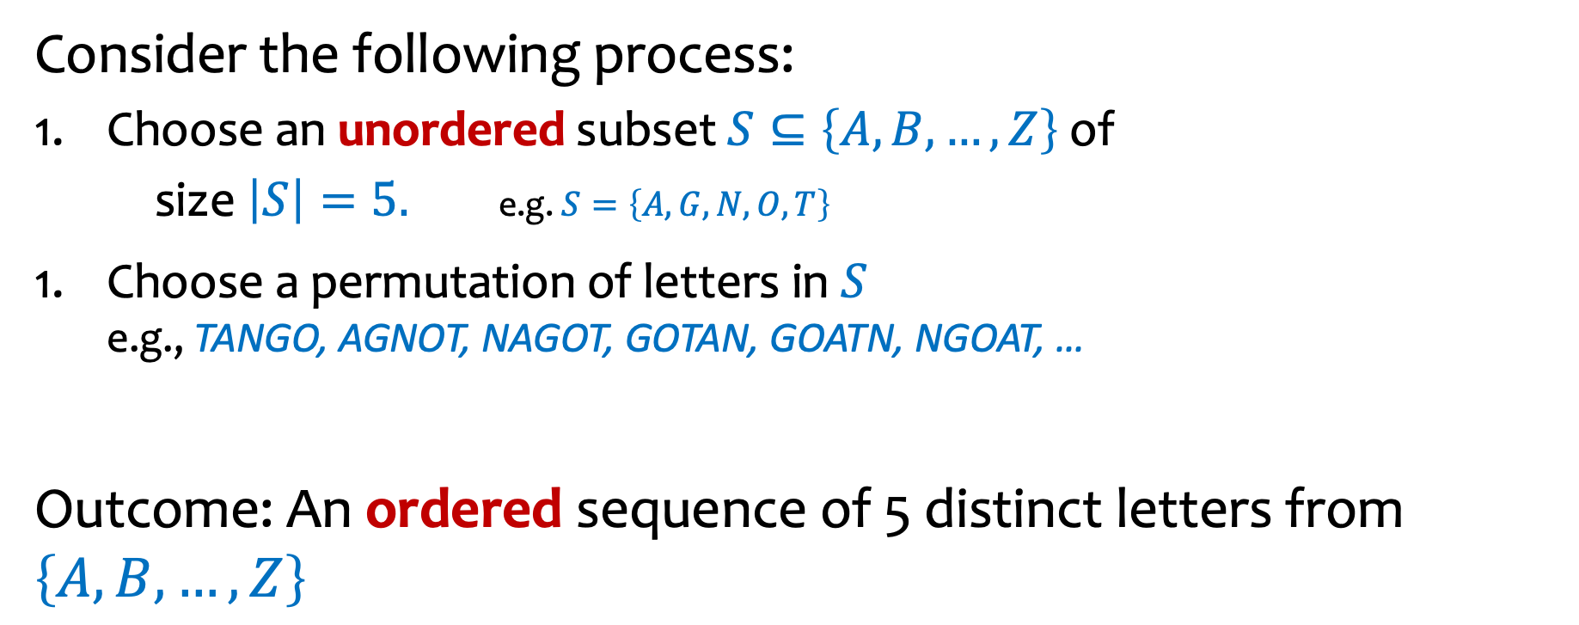
How to count number of 5 element subsets of $\left\{A,B,…,Z\right\}$?
Consider the following process:
Choose an unordered subset $S⊆\left\{A,B,…,Z\right\}$ of
size $\left|S\right|=5.$ e.g. $S=\left\{A,G,N,O,T\right\}$
Choose a permutation of letters in $S$
e.g., TANGO, AGNOT, NAGOT, GOTAN, GOATN, NGOAT, …
Outcome: An ordered sequence of 5 distinct letters from $\left\{A,B,…,Z\right\}$
$$\text{???}$$
x
=
$$\text{???}=$$

Slide 49
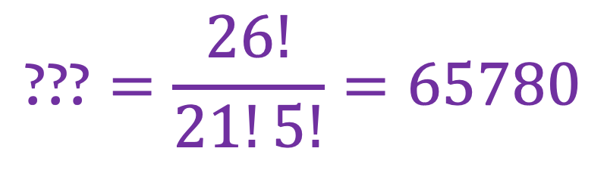
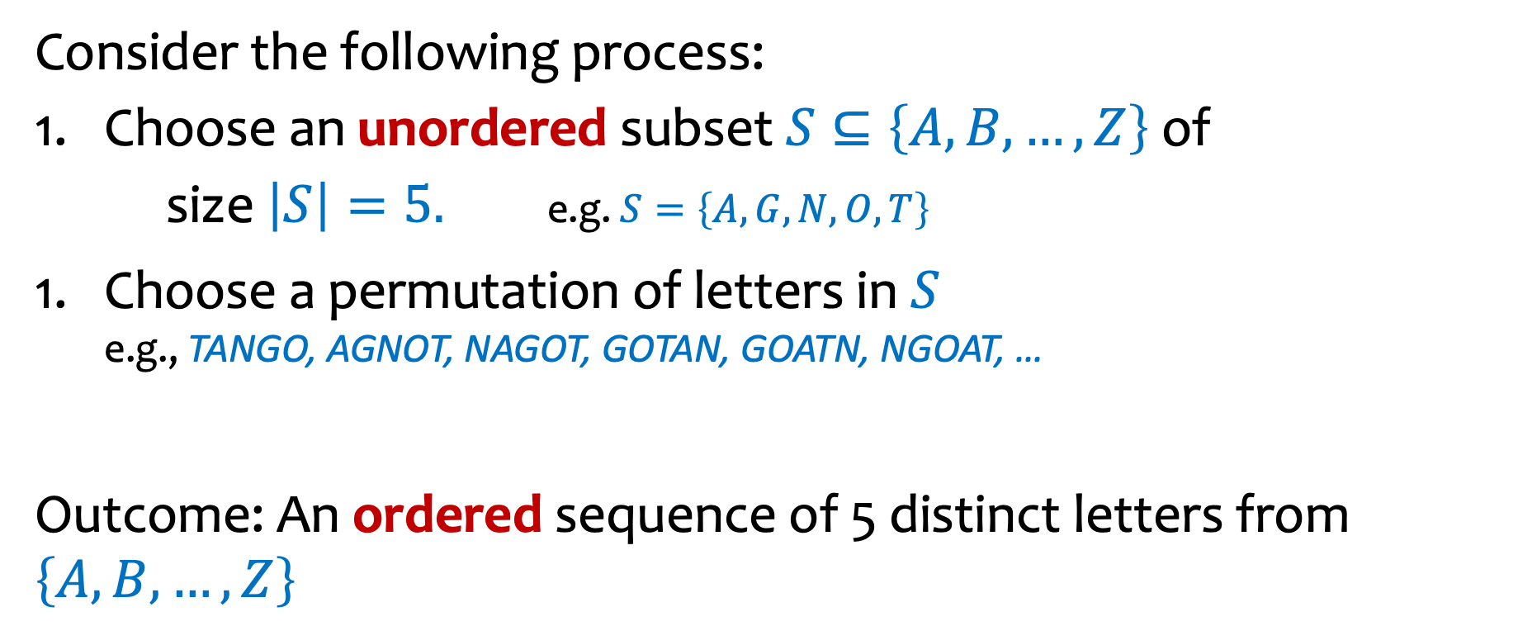

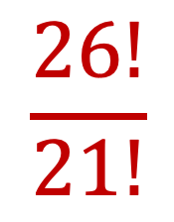
Number of Subsets – Fill in what we know
Consider the following process:
Choose an unordered subset $S⊆\left\{A,B,…,Z\right\}$ of
size $\left|S\right|=5.$ e.g. $S=\left\{A,G,N,O,T\right\}$
Choose a permutation of letters in $S$
e.g., TANGO, AGNOT, NAGOT, GOTAN, GOATN, NGOAT, …
Outcome: An ordered sequence of 5 distinct letters from $\left\{A,B,…,Z\right\}$
$$\text{???}$$
x
$$5!$$
=
$$\frac{26!}{21!}$$
$$\text{???}=\frac{26!}{21!5!}=65780$$

Slide 50
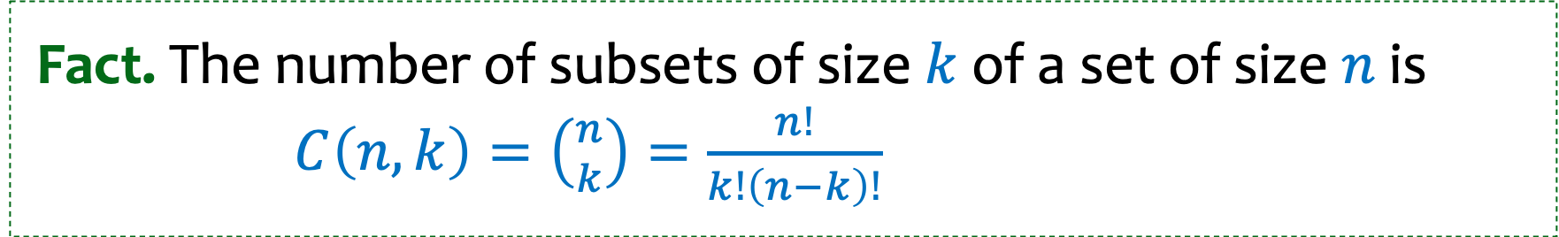
Number of Subsets -- don’t care about order
Fact. The number of subsets of size $k$ of a set of size $n$ is $C\left(n,k\right)=\left({n \atop k}\right)=\frac{n!}{k!\left(n−k\right)!}$
we say “$n$ choose $k$”
[also called combinations or binomial coefficients]

Slide 51
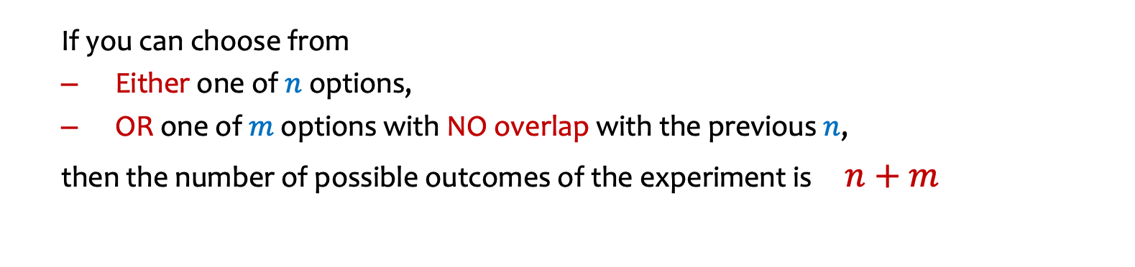
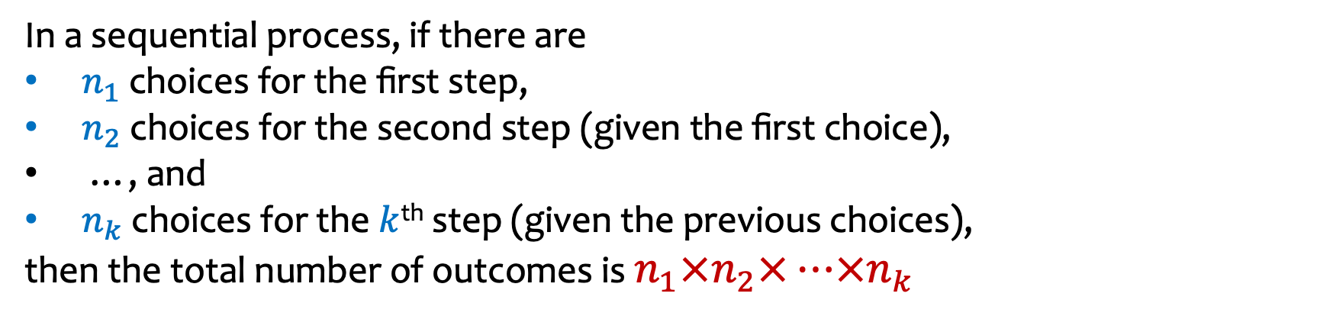
Quick Summary
Sum Rule
Product Rule
Complementary Counting
  If you can choose from
  Either one of $n$ options,
  OR one of $m$ options with NO overlap with the previous $n$,
  then the number of possible outcomes of the experiment is $n+m$
In a sequential process, if there are
$n_{1}$ choices for the first step,
$n_{2}$ choices for the second step (given the first choice),
…, and
$n_{k}$ choices for the $k$^{th} step (given the previous choices),
then the total number of outcomes is $n_{1}×n_{2}×⋯×n_{k}$

Slide 52
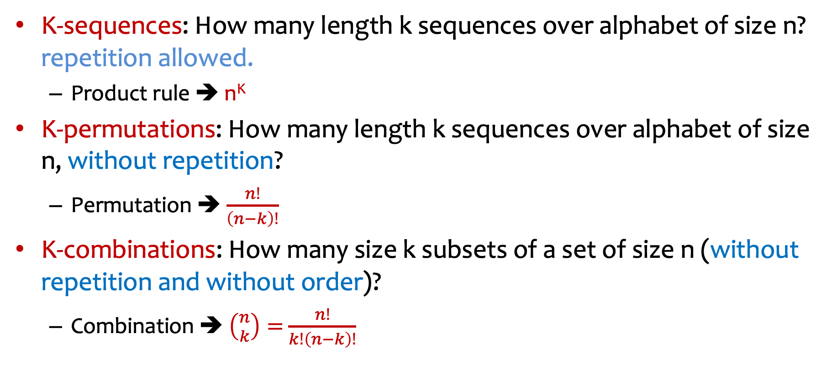
Quick Summary, continued
K-sequences: How many length k sequences over alphabet of size n? repetition allowed.
  Product rule ➔ n^{K}
K-permutations: How many length k sequences over alphabet of size n, without repetition?
  Permutation ➔ $\frac{n!}{\left(n−k\right)!}$
K-combinations: How many size k subsets of a set of size n (without repetition and without order)?
  Combination ➔ $\left({n \atop k}\right)=$ $\frac{n!}{k!\left(n−k\right)!}$

Slide 53
The first concept check (CC) will be out no later than 11am and is due by 9am on Wednesday
The concept checks are meant to help you immediately reinforce what is learned in each lecture. (Today’s CC also reviews summation and product notation.)
Students from previous quarters found them really useful!
Notes:
https://www.polleverywhere.com/activities

Slide 54
The fun/useful argument for learning probability
Probability is not just for calculating risk; it’s a “cheat code” for real life.
It gives you a sixth sense for how the world actually works.
It helps you make decisions.
And it’s fun!
Notes:
Let me give you a few fun examples.

Slide 55
Love!
Scenario: Say you want to find a life partner, but you don’t want to settle early or wait forever. You expect to seriously date, say, 10 people during your life.
The 37% rule
  If you expect to seriously date 10 people during your life, then you should date the first 3 or 4 to gather data (and ultimately reject them). Then, stick with the very next person who is better than the best of the first group
The result
  This strategy mathematically maximizes your probability of finding the best partner!
Notes:
Suppose you meet these people in a completely random order and your goal is to choose the best partner of the 10.
When should you decide that your current partner is the one you settle down with?
You could settle down with the first one, but you might imagine that someone better for you will come along. Say you break up with the first, and then the second one is not as good as the first.
Now you’re starting to panic. You’re definitely not going to settle down with that person. You know there is someone better. So you move on. Then say the third person is better than the first two. Should you setlle down? What’s your optimal strategy, knowing that they come in a completely random order?
Mathematically maximizes – provably so!

Slide 56
Sports: The “Hot Hand” Fallacy
Scenario: A player hits 3 shots in a row. Are they “on fire”?
The math
  Randomness is “clumpy”. A sequence like H-H-H-H is common in fair coin flips.
The lesson
  Probability saves you from inventing narratives (momentum, luck, curses) to explain simple variance.

Slide 57
Coincidences: The Birthday Paradox
Scenario: You are in a room with 23 people. Two of them have the same people. “What are the odds!?”
The math
  The odds are actually 50.7%. In a room of 70 people, it’s 99.9%
The lesson
  “Miracles” are often mathematical certainties if you understand combinatorics and probability.
Notes:
There are nearly 200 people in this room. I guarantee you that there are two people with the same birthday. In fact there are multiple pairs. I don’t know if you’ll ever find each other though.

Slide 58
Fear and BS detection
Headline: What is the chance you have disease if you test positive?
The reality
  If the base risk is miniscule, and there is a small chance that the test result is erroneous, testing positive might only increase it to miniscule +.
The power
  Probability makes you immune to fear-mongering and bad statistics in the news.

Slide 59
Gambling
Scenario: “I’ll just double my bet every time I lose. I’m guaranteed to win eventually!”
The practice
  Geometric growth (2^{n}) hits the table limit (or your bankruptcy) faster than you think.
The lesson
  The house always wins because they understand Expected Value. You should too.

