Slide 1
Victory Lap
CSE 312 Winter 25
Lecture 27

Slide 2
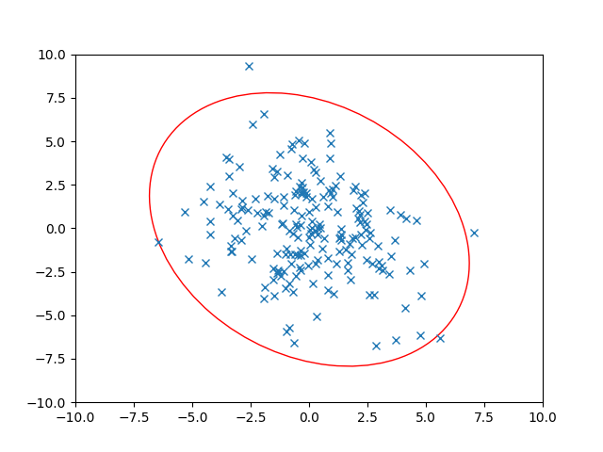
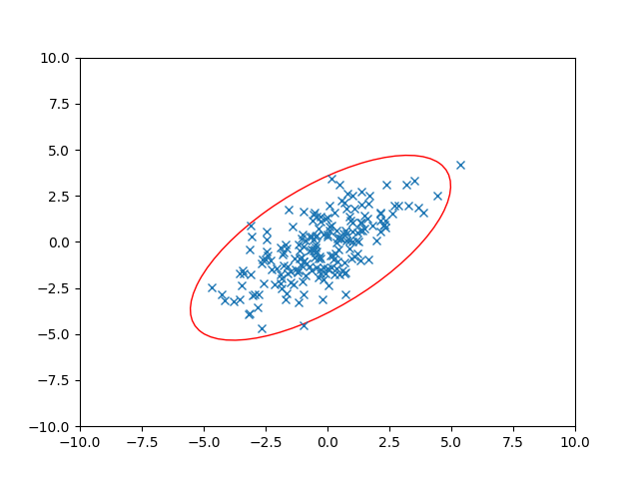
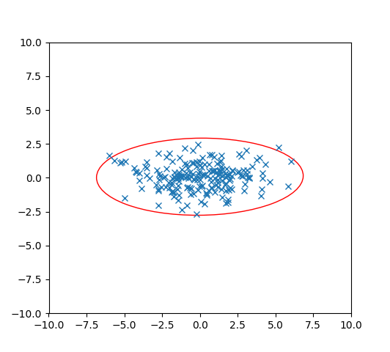
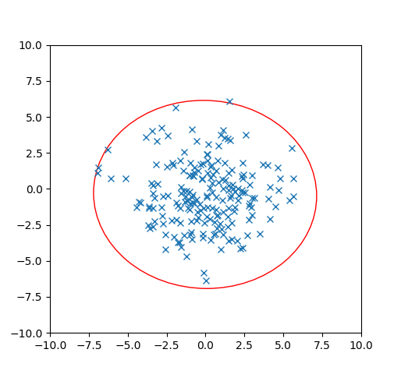
Dependence
Let’s think about 2 dimensions.
Let $X={\left[X_{1},X_{2}\right]}^{T}$ where $Var\left(X_{1}\right)=3$, $Var\left(X_{2}\right)=3$ BUT$X_{1}$ and $X_{2}$ are dependent. $Cov\left(X_{1},X_{2}\right)=2$
What is $Σ$? Which of these pictures are i.i.d. samples of $X$?

Slide 3
Dependence
Let’s think about 2 dimensions.
Let $X={\left[X_{1},X_{2}\right]}^{T}$ where $Var\left(X_{1}\right)=3$, $Var\left(X_{2}\right)=3$ BUT$X_{1}$ and $X_{2}$ are dependent. $Cov\left(X_{1},X_{2}\right)=2$
What is $Σ$? Which of these pictures are i.i.d. samples of $X$?
$$Σ=\left[\begin{matrix}3 & 2 \\ 2 & 3\end{matrix}\right]$$

Slide 4
Dependence
Let’s think about 2 dimensions.
Let $X={\left[X_{1},X_{2}\right]}^{T}$ where ${Var(X}_{1})=5$, $Var\left(X_{2}\right)=7$ BUT$X_{1}$ and $X_{2}$ are dependent. $Cov\left(X_{1},X_{2}\right)=−2$
What is $Σ$? Which of these pictures are i.i.d. samples of $X$?

Slide 5
Dependence
Let’s think about 2 dimensions.
Let $X={\left[X_{1},X_{2}\right]}^{T}$ where ${Var(X}_{1})=5$, $Var\left(X_{2}\right)=7$ BUT$X_{1}$ and $X_{2}$ are dependent. $Cov\left(X_{1},X_{2}\right)=−2$
What is $Σ$? Which of these pictures are i.i.d. samples of $X$?
$$Σ=\left[\begin{matrix}5 & −2 \\ −2 & 7\end{matrix}\right]$$

Slide 6
Using the Covariance Matrix
What were those ellipses in those datasets?
How do we know how many standard deviations from the mean a 2D point is, for the independent, variance $1$ ones
Well $(x_{1}−𝔼\left[X_{1}\right])$ is the distance from $x$ to the center in the $x$-direction.
And $(x_{2}−𝔼\left[x_{2}\right])$ is the distance from $x$ to the center in the $y$-direction.
So the number of standard deviations is $\sqrt{{\left(x_{1}−𝔼\left[X_{1}\right]\right)}^{2}+{\left(x_{2}−𝔼\left[x_{2}\right]\right)}^{2}}$
That’s just the distance!
In general, the major/minor axes of those ellipses were the eigenvectors of the covariance matrix. And the associated eigenvalues tell you how the directions should be weighted.
Notes:
Mention covariance matrix doesn’t depend on mean of distribution (it’s distance from mean we measure)

Slide 7
Victory Lap

Slide 8
What Have We Done?
Well let’s look back…

Slide 9
Content
Combinatorics (fancy counting)
Permutations, combinations, inclusion-exclusion, pigeonhole principle
Formal definitions for Probability
Probability space, events, conditional probability, independence, expectation, variance
Common patterns in probability
Equations and inequalities, “zoo” of common random variables, tail bounds
Continuous Probability
pdf, cdf, sample distributions, central limit theorem, estimating probabilities
Applications
Across CS, but with some focus on ML.

Slide 10
Themes
Precise mathematical communication
Both reading and writing dense statements.
Probability in the “real world”
A mix of CS applications
And some actual “real life” ones.
Refine your intuition
Most people have some base level feeling of what the chances of some event are.
We’re going to train you to have better gut feelings.

Slide 11
Use Your Powers Wisely
We’ve seen probability can be used in the real world!
But also that it:
Can be counter-intuitive/hard to explain (Bayes Rule/Real World)
Probability estimates can depend on the model you’re using (Real World)
Can be used to analyze ML applications, and think about the impacts of using them.

Slide 12
How (not to) lie with statistics
You now know a lot of the tools that people use to lie with statistics. (See also: INFO 270)
Some patterns to watch out for:
My smoke alarm is going off, please pay for my new house! (analogy from Matt Parker)
Make a model, find that an event that occurred had small probability/fails some statistical test, claim that the only explanation is something nefarious occurred.
Better response: could the model be wrong? Is this statistical test appropriate? Once in 100 year events do happen…about once in every hundred years, is this just the one?

Slide 13
How (not to) lie with statistics
See a story about testing?
Remember from Bayes’ Rule that you need three numbers to understand a test. (3 of prior, posterior, false positive rate, false negative rate).
Headlines usually give you one number, that often isn’t even one of the ones you need for Bayes (“this test is less accurate than a coin flip!”).
The article itself, if you’re lucky, might give you one or two of the numbers for Bayes – don’t forget the prior!

Slide 14
How (not to) lie with statistics
Before being impressed with a number, make sure you understand what it means.
Recent example for Robbie:
In baseball umpires decide whether a pitch is a strike or a ball (whether it goes through an (invisible) rectangle when thrown to the hitter)
There are camera systems built into stadiums that track the ball, and figure out where it went
In an infamous game an umpire missed 12% of the calls, according to an unofficial analysis of the data. Or possibly 4% of the calls, according to the official analysis of the data.
Notes:
It turns out the official analysis says “the systems have error of up to about an inch” if the estimate of where the ball is, is within 1 inch of the correct call, then assume it was correct. The unofficial analysis says “the computer said it was there, that was a wrong call” Which analysis is right? Well they both have benefits and drawbacks And is either of these numbers good or bad? That was a bad game, but what counts as bad depends on which evaluation system you’re using. https://www.youtube.com/watch?v=9o4weN6AkPY

Slide 15
How (not to) lie with statistics
We can apply our knowledge to the real world!
But if you’re applying in a new domain, get information from domain experts, don’t instantly assume because you know Bayes’ Rule that you know better than domain experts.
Don’t hesitate to use these tools to understand new domains better!
But do keep in mind some things can’t be quantified and just because we can use an algorithm doesn’t mean we always should.

Slide 16
What to take next?
ML (CSE 446) using probability, linear algebra, and other techniques to extract patterns from data and make predictions.
CSE 421 designing algorithms – very little direct probability, but the combinatorics we did at the beginning will be useful.
We also have a graduate level course in randomized algorithms, but it has a few more prereqs
CSE 447 Natural Language Processing
CSE 426 Cryptography
CSE 422 Modern Algorithms
Other things!

Slide 17
Conditional Expectation Practice

Slide 18
Practice with conditional expectations
Consider of the following process:
Flip a fair coin, if it’s heads, pick up a 4-sided die; if it’s tails, pick up a 6-sided die (both fair)
Roll that die independently 3 times. Let $X_{1},X_{2},X_{3}$ be the results of the three rolls.
What is $𝔼[X_{2}]$? $𝔼[X_{2}|X_{1}=5]$? $𝔼[X_{2}|X_{3}=1]$?

Slide 19
Using conditional expectations
Let $F$ be the event “the four sided die was chosen”
$𝔼\left[X_{2}\right]=ℙ(F)𝔼\left[X_{2} | F\right]+ℙ\left(\overline{F}\right)𝔼\left[X_{2} | \overline{F}\right]$
$=\frac{1}{2}⋅2.5+\frac{1}{2}⋅3.5=3$
$𝔼[X_{2}|X_{1}=5]$ event $X_{1}=5$ tells us we’re using the $6$-sided die.
$𝔼\left[X_{2} | X_{1}=5\right]=3.5$
$𝔼[X_{2}|X_{3}=1]$ We aren’t sure which die we got, but…is it still 50/50?

Slide 20
Setup
Let $E$ be the event “$X_{3}=1“$
$ℙ\left(E\right)=\frac{1}{2}⋅\frac{1}{6}+\frac{1}{2}⋅\frac{1}{4}=\frac{5}{24}$
$ℙ\left(F | E\right)=\frac{ℙ\left(E|F\right)⋅ℙ(F)}{ℙ(E)}$
$=\frac{\frac{1}{4}⋅\frac{1}{2}}{5/24}=\frac{3}{5}$
$ℙ\left(\overline{F} | E\right)=\frac{ℙ(E|\overline{F})⋅ℙ(\overline{F})}{ℙ(E)}$ $=\frac{\frac{1}{6}⋅\frac{1}{2}}{5/24}=\frac{2}{5}$ (we could also get this with LTP, but it’s good confirmation)

Slide 21
Analysis
$𝔼\left[X_{2} | X_{3}=1\right]=ℙ\left(F|X_{3}=1\right)𝔼\left[X_{2} | X_{3}=1∩F\right]+ℙ\left(\overline{F}|X_{3}=1\right)𝔼\left[X_{2} | X_{3}=1∩\overline{F}\right]$
Wait what?
This is the LTE, applied in the space where we’ve conditioned on $X_{3}=1$.
Everything is conditioned on $X_{3}=1$. Beyond that conditioning, it’s LTE.
$=\frac{3}{5}⋅2.5+\frac{2}{5}⋅3.5=2.9$.
A little lower than the unconditioned expectation. Because seeing a 1 has made it ever so slightly more probable that we’re using the 4-sided die.

