Slide 1
ML Hodgepodge
CSE 312 Winter 25
Lecture 26

Slide 2
Multidimensional Gaussians

Slide 3
Preliminary: Random Vectors
In ML, our data points are often multidimensional.
For example:
To predict housing prices, each data point might have: number of rooms, number of bathrooms, square footage, zip code, year built, …
To make movie recommendations, each data point might have: ratings of existing movies, whether you started a movie and stopped after 10 minutes,…
A single data point is a full vector

Slide 4
Preliminary: Random Vectors
A random vector $X$ is a vector where each entry is a random variable.
$𝔼[X]$ is a vector, where each entry is the expectation of that entry.
For example, if $X$ is a uniform vector from the sample space
$\left\{\left[\begin{matrix}1 \\ 2 \\ 3\end{matrix}\right],\left[\begin{matrix}−1 \\ 2 \\ 3\end{matrix}\right],\left[\begin{matrix}0 \\ 2 \\ 6\end{matrix}\right]\right\}$
$𝔼\left[X\right]={\left[0,2,4\right]}^{T}$

Slide 5
Covariance Matrix
Remember Covariance?
$Cov\left(X,Y\right)=𝔼\left[(X−𝔼[X])(Y−𝔼\left[Y\right])\right]=𝔼\left[XY\right]−𝔼[X]𝔼[Y]$
We’ll want to talk about covariance between entries:
Define the “covariance matrix”
$Σ=\left[\begin{matrix}Cov(X_{1},X_{1}) & ⋯ & Cov(X_{1},X_{n}) \\ ⋮ & Cov(X_{i},X_{j}) & ⋮ \\ Cov(X_{n},X_{1}) & ⋯ & Cov(X_{n},X_{n})\end{matrix}\right]$
Notes:
Maybe X_1 is the sq footage, X_2 is the number of bathrooms. Well X_1 and X_2 are probably positively correlated (bigger -> more people -> more bathrooms). We’ll try to come up with a combination of the features that will let us predict the price. It’s hard to do that without understanding the covariance! If you add 1 bathroom to a house, how much will the housing price go up? You really need to figure out the effect of “just” the bathroom, but because of covariance, if you look at data price increase could be from both the bigger size or the number of bathrooms

Slide 6
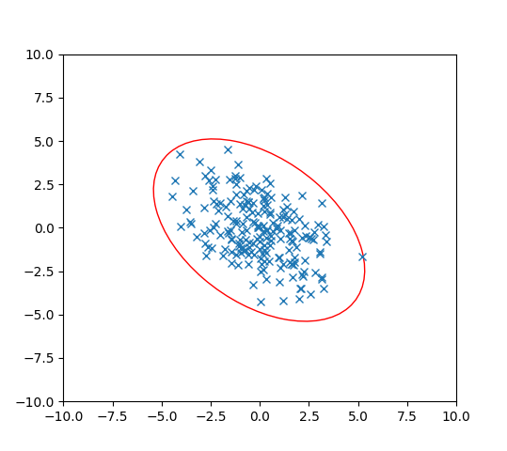
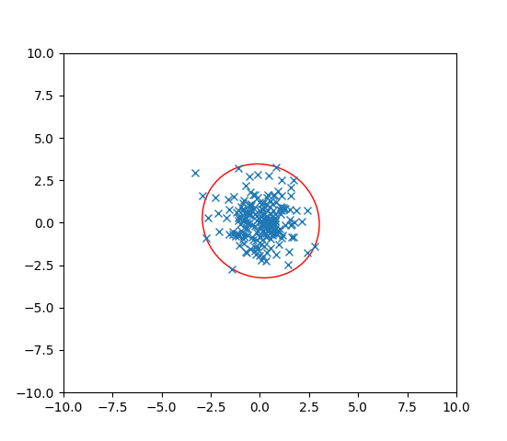
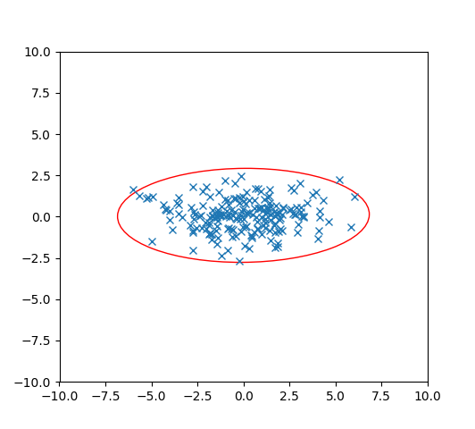
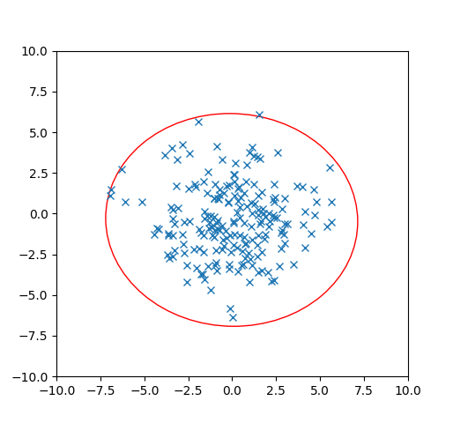
Covariance
Let’s think about 2 dimensions.
Let $X={\left[X_{1},X_{2}\right]}^{T}$ where $X_{i}\sim 𝒩(0,1)$ and $X_{1}$ and $X_{2}$ are independent.
What is $Σ$? Which of these pictures are 200 i.i.d. samples of $X$?

Slide 7
Covariance
Let’s think about 2 dimensions.
Let $X={\left[X_{1},X_{2}\right]}^{T}$ where $X_{i}\sim 𝒩(0,1)$ and $X_{1}$ and $X_{2}$ are independent.
What is $Σ$? Which of these pictures are 200 i.i.d. samples of $X$?
$$Σ=\left[\begin{matrix}1 & 0 \\ 0 & 1\end{matrix}\right]$$

Slide 8
Unequal Variances, Still Independent
Let’s think about 2 dimensions.
Let $X={\left[X_{1},X_{2}\right]}^{T}$ where $X_{1}\sim 𝒩(0,5)$, $X_{2}\sim 𝒩(0,1)$ and $X_{1}$ and $X_{2}$ are independent.
What is $Σ$? Which of these pictures are i.i.d. samples of $X$?

Slide 9
Unequal Variances, Still Independent
Let’s think about 2 dimensions.
Let $X={\left[X_{1},X_{2}\right]}^{T}$ where $X_{1}\sim 𝒩(0,5)$, $X_{2}\sim 𝒩(0,1)$ and $X_{1}$ and $X_{2}$ are independent.
What is $Σ$? Which of these pictures are i.i.d. samples of $X$?
$$Σ=\left[\begin{matrix}5 & 0 \\ 0 & 1\end{matrix}\right]$$

Slide 10
What about dependence.
When we introduce dependence, we need to know the mean vector and the covariance matrix to define the distribution
(instead of just the mean and the variance).
Let’s see a few examples…

Slide 11
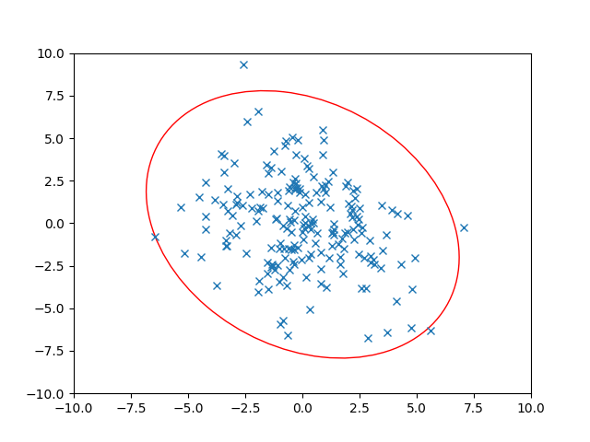
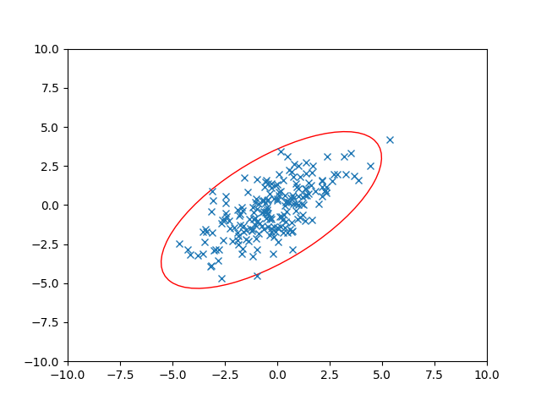
Dependence
Let’s think about 2 dimensions.
Let $X={\left[X_{1},X_{2}\right]}^{T}$ where $Var\left(X_{1}\right)=3$, $Var\left(X_{2}\right)=3$ BUT$X_{1}$ and $X_{2}$ are dependent. $Cov\left(X_{1},X_{2}\right)=2$
What is $Σ$? Which of these pictures are i.i.d. samples of $X$?

Slide 12
Dependence
Let’s think about 2 dimensions.
Let $X={\left[X_{1},X_{2}\right]}^{T}$ where $Var\left(X_{1}\right)=3$, $Var\left(X_{2}\right)=3$ BUT$X_{1}$ and $X_{2}$ are dependent. $Cov\left(X_{1},X_{2}\right)=2$
What is $Σ$? Which of these pictures are i.i.d. samples of $X$?
$$Σ=\left[\begin{matrix}3 & 2 \\ 2 & 3\end{matrix}\right]$$

Slide 13
Dependence
Let’s think about 2 dimensions.
Let $X={\left[X_{1},X_{2}\right]}^{T}$ where ${Var(X}_{1})=5$, $Var\left(X_{2}\right)=7$ BUT$X_{1}$ and $X_{2}$ are dependent. $Cov\left(X_{1},X_{2}\right)=−2$
What is $Σ$? Which of these pictures are i.i.d. samples of $X$?

Slide 14
Dependence
Let’s think about 2 dimensions.
Let $X={\left[X_{1},X_{2}\right]}^{T}$ where ${Var(X}_{1})=5$, $Var\left(X_{2}\right)=7$ BUT$X_{1}$ and $X_{2}$ are dependent. $Cov\left(X_{1},X_{2}\right)=−2$
What is $Σ$? Which of these pictures are i.i.d. samples of $X$?
$$Σ=\left[\begin{matrix}5 & −2 \\ −2 & 7\end{matrix}\right]$$

Slide 15
Using the Covariance Matrix
What were those ellipses in those datasets?
How do we know how many standard deviations from the mean a 2D point is, for the independent, variance $1$ ones
Well $(x_{1}−𝔼\left[X_{1}\right])$ is the distance from $x$ to the center in the $x$-direction.
And $(x_{2}−𝔼\left[x_{2}\right])$ is the distance from $x$ to the center in the $y$-direction.
So the number of standard deviations is $\sqrt{{\left(x_{1}−𝔼\left[X_{1}\right]\right)}^{2}+{\left(x_{2}−𝔼\left[x_{2}\right]\right)}^{2}}$
That’s just the distance!
In general, the major/minor axes of those ellipses were the eigenvectors of the covariance matrix. And the associated eigenvalues tell you how the directions should be weighted.

Slide 16
Probability and ML
Many problems in ML: Given a bunch of data points, you’ll find a function $f$ that you hope will predict future points well.
We usually assume there is some true distribution $𝒟$ of data points (e.g. all theoretical possible houses and their prices).
You get a dataset $S$ that you assume was sampled from $𝒟$ to find $f_{S}$
$f_{S}$ depends on the data (just like our MLEs depended on the data), so before you knew what $S$ was, $f$ was a random variable. You then want to figure out what the true error is if you knew $𝒟$.

Slide 17
Probability and ML
But $𝒟$ is a theoretical construct. I can’t calculate probabilities. What can we do instead? Get a second dataset $T$drawn from $𝒟$ (drawn independently of $S$)
(or actually save part of your database before you start).
Then $𝔼_{𝒟}\left[error of f\right]=𝔼_{T}\left[error of f_{S} | S\right]$
But how confident can you be? You can make confidence intervals
(statements like the true error is within 5% of our estimate with probability at least $.9$) using concentration inequalities.

Slide 18
One more ML preview

Slide 19
Experiments with the correct expectation
Gradient Descent
How did I “train” the model in the first place?
Lots of options…one is “gradient descent”
Think of the “error on the data-set” as a function we’re minimizing.
Take the gradient (derivative of the error with respect to every coefficient in your function), and move in the direction of lower error.
But finding the gradient is expensive…what if we could just estimate the gradient…like with a subset of the data.

Slide 20
Experiments with the correct expectation
We could find an unbiased estimator of the true gradient!
An experiment where the expectation of the vector we get is the true gradient (but might not be the true gradient itself).
Looking at a random subset of the full data-set would let us do that!
For many optimizations it’s faster to approximate the gradient. You’ll be less accurate in each step (since your gradient is less accurate), but each step is much faster, and that tradeoff can be worth it.

Slide 21
Conditional Expectation Practice

Slide 22
Practice with conditional expectations
Consider of the following process:
Flip a fair coin, if it’s heads, pick up a 4-sided die; if it’s tails, pick up a 6-sided die (both fair)
Roll that die independently 3 times. Let $X_{1},X_{2},X_{3}$ be the results of the three rolls.
What is $𝔼[X_{2}]$? $𝔼[X_{2}|X_{1}=5]$? $𝔼[X_{2}|X_{3}=1]$?

Slide 23
Using conditional expectations
Let $F$ be the event “the four sided die was chosen”
$𝔼\left[X_{2}\right]=ℙ(F)𝔼\left[X_{2} | F\right]+ℙ\left(\overline{F}\right)𝔼\left[X_{2} | \overline{F}\right]$
$=\frac{1}{2}⋅2.5+\frac{1}{2}⋅3.5=3$
$𝔼[X_{2}|X_{1}=5]$ event $X_{1}=5$ tells us we’re using the $6$-sided die.
$𝔼\left[X_{2} | X_{1}=5\right]=3.5$
$𝔼[X_{2}|X_{3}=1]$ We aren’t sure which die we got, but…is it still 50/50?

Slide 24
Setup
Let $E$ be the event “$X_{3}=1“$
$ℙ\left(E\right)=\frac{1}{2}⋅\frac{1}{6}+\frac{1}{2}⋅\frac{1}{4}=\frac{5}{24}$
$ℙ\left(F | E\right)=\frac{ℙ\left(E|F\right)⋅ℙ(F)}{ℙ(E)}$
$=\frac{\frac{1}{4}⋅\frac{1}{2}}{5/24}=\frac{3}{5}$
$ℙ\left(\overline{F} | E\right)=\frac{ℙ(E|\overline{F})⋅ℙ(\overline{F})}{ℙ(E)}$ $=\frac{\frac{1}{6}⋅\frac{1}{2}}{5/24}=\frac{2}{5}$ (we could also get this with LTP, but it’s good confirmation)

Slide 25
Analysis
$𝔼\left[X_{2} | X_{3}=1\right]=ℙ\left(F|X_{3}=1\right)𝔼\left[X_{2} | X_{3}=1∩F\right]+ℙ\left(\overline{F}|X_{3}=1\right)𝔼\left[X_{2} | X_{3}=1∩\overline{F}\right]$
Wait what?
This is the LTE, applied in the space where we’ve conditioned on $X_{3}=1$.
Everything is conditioned on $X_{3}=1$. Beyond that conditioning, it’s LTE.
$=\frac{3}{5}⋅2.5+\frac{2}{5}⋅3.5=2.9$.
A little lower than the unconditioned expectation. Because seeing a 1 has made it ever so slightly more probable that we’re using the 4-sided die.

