Slide 1
Randomized Algorithms
CSE 312 Winter 25
Lecture 25

Slide 2
What’s a randomized algorithm?
A randomized algorithm is an algorithm that uses randomness in the computation.
Well, ok.
Let’s get a little more specific.

Slide 3
Two common types of algorithms
Las Vegas Algorithm
  Always tells you the right answer
  Takes varying amounts of time.
Monte Carlo Algorithm
  Usually tells you the right answer. Sometimes the wrong one.

Slide 4
A classic Las Vegas Algorithm
Remember Quick Sort?
  Pick a “pivot” element
  Move all the elements smaller than the pivot to the left subarray (in no particular order)
  Move all elements greater than the pivot element to the right subarray (in no particular order)
  Make two recursive calls
It’s sometimes implemented as a Las Vegas Algorithm.
That is, you’ll always get the same answer (there’s only one sorted array) but the time can vary.

Slide 5
Quick Sort
https://www.youtube.com/watch?v=ywWBy6J5gz8
0 | 1 | 2 | 3 | 4 | 5 | 6
20 | 50 | 70 | 10 | 60 | 40 | 30
0
10
0 | 1 | 2 | 3 | 4
50 | 70 | 60 | 40 | 30
0 | 1
40 | 30
0 | 1
70 | 60
0
30
0
60
0 | 1
30 | 40
0 | 1
60 | 70
0 | 1 | 2 | 3 | 4
30 | 40 | 50 | 60 | 70
0 | 1 | 2 | 3 | 4 | 5 | 6
10 | 20 | 30 | 40 | 50 | 60 | 70

Slide 6
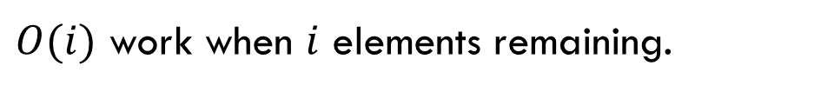


How long does it take?
Total time:
$$\sum_{i=1}^{n}{i}=O(n^{2})$$
Well…it depends on what pivots you pick.
About $n$ levels
…
$O(i)$ work when $i$ elements remaining.

Slide 7
For Simplicity
We’ll talk about how quicksort is really done at the end.
For now an easier-to-analyze version:
if(elements remaining > 1)
pick a pivot uniformly at random
split based on pivot
sortedLeft = QuickSort(left half)
sortedRight = QuickSort(right half)
return (sortedLeft pivot sortedRight)

Slide 8
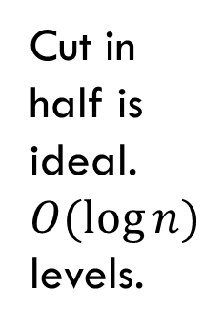
What leads to a good time?
Pivots closer to the middle would be better.
Cut in half is ideal.
$O(\log{n)}$levels.
$O(i)$ work when $i$ elements remaining. -- $O(n)$ per level

Slide 9
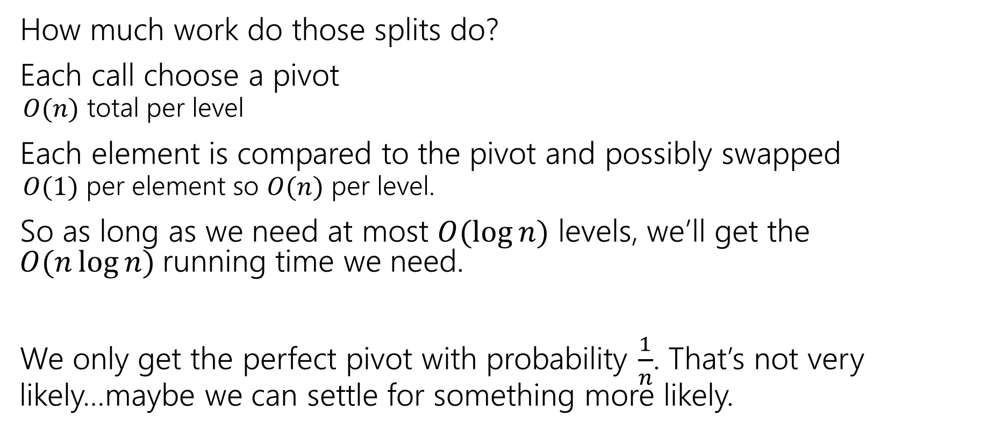
Work at each level
How much work do those splits do?
Each call choose a pivot
  $O(n)$ total per level
Each element is compared to the pivot and possibly swapped
  $O(1)$ per element so $O(n)$ per level.
So as long as we need at most $O(\log{n})$ levels, we’ll get the $O(n\log{n)}$running time we need.
We only get the perfect pivot with probability $\frac{1}{n}$. That’s not very likely…maybe we can settle for something more likely.

Slide 10
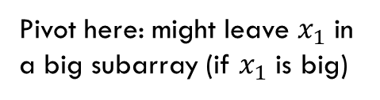
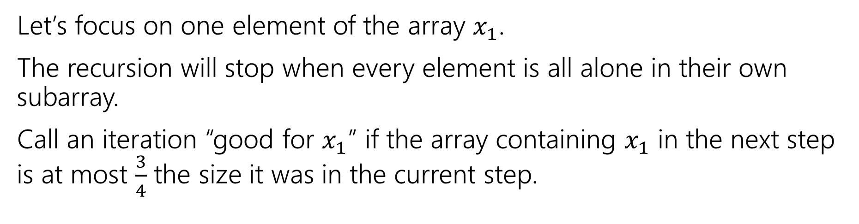

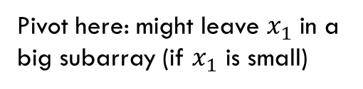
Focus on an element
Let’s focus on one element of the array $x_{1}$.
The recursion will stop when every element is all alone in their own subarray.
Call an iteration “good for $x_{1}$” if the array containing $x_{1}$ in the next step is at most $\frac{3}{4}$ the size it was in the current step.
Pivot here: might leave $x_{1}$ in a big subarray (if $x_{1}$ is big)
Pivot here: both subarrays $≤3/4$ size.
Must be good for $x_{1}$.
Pivot here: might leave $x_{1}$ in a big subarray (if $x_{1}$ is small)

Slide 11
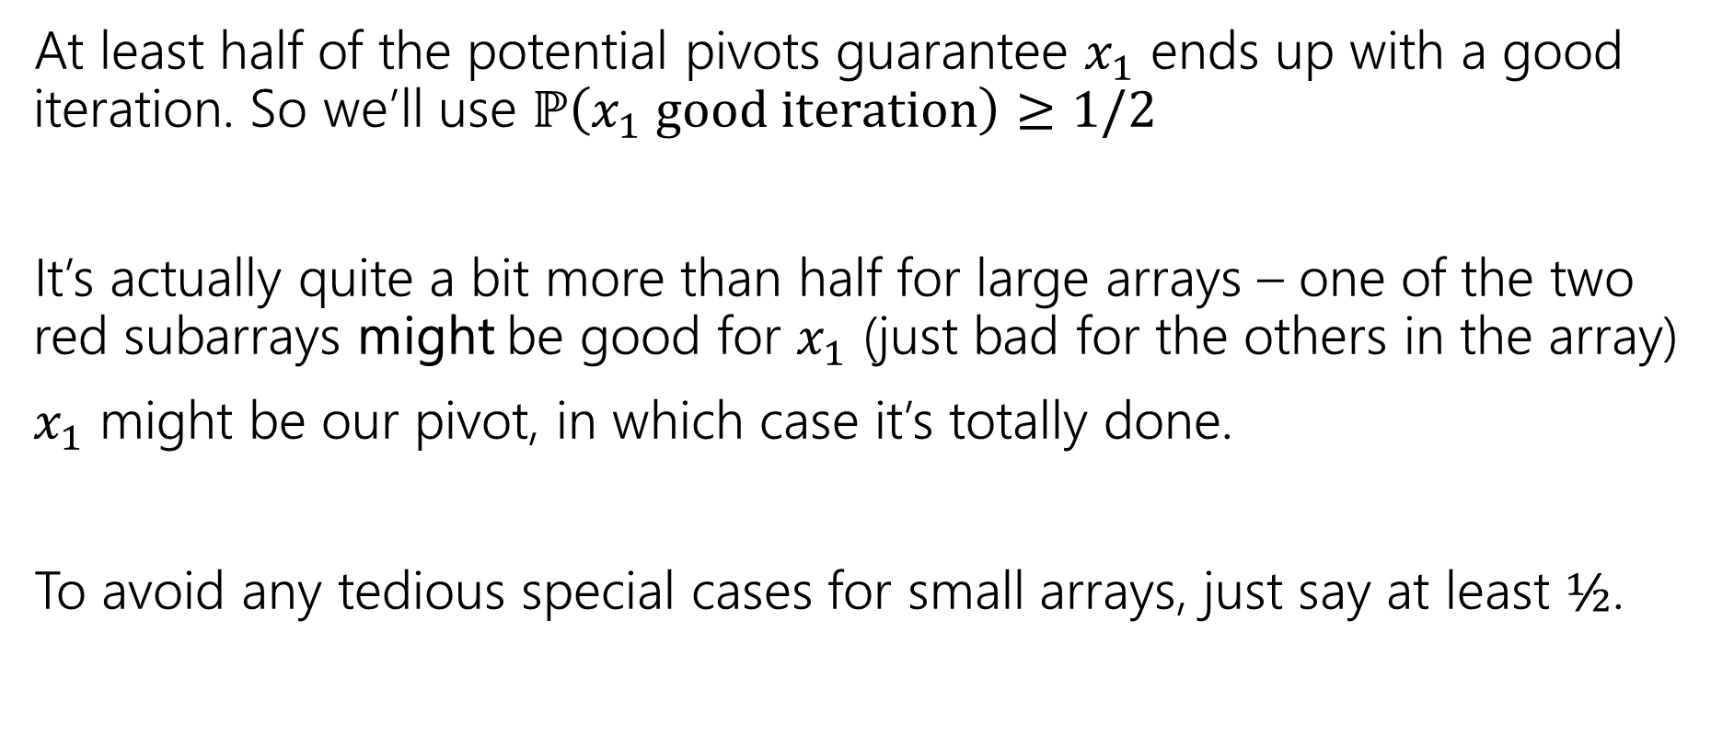

Good for $x_{i}$
At least half of the potential pivots guarantee $x_{1}$ ends up with a good iteration. So we’ll use $ℙ\left(x_{1} good iteration\right)≥1/2$
It’s actually quite a bit more than half for large arrays – one of the two red subarrays might be good for $x_{1}$ (just bad for the others in the array)
$x_{1}$ might be our pivot, in which case it’s totally done.
To avoid any tedious special cases for small arrays, just say at least $½$.

Slide 12
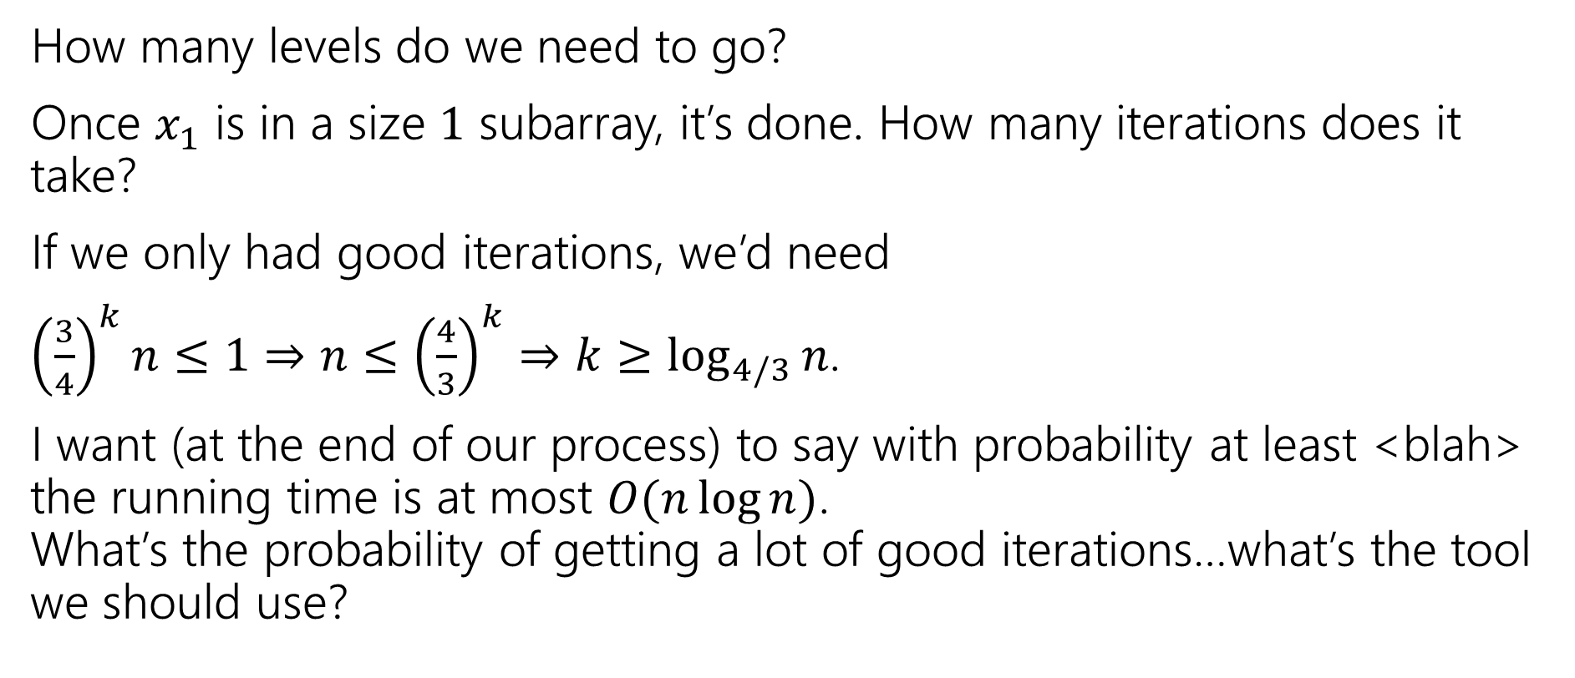
How many levels?
How many levels do we need to go?
Once $x_{1}$ is in a size $1$ subarray, it’s done. How many iterations does it take?
If we only had good iterations, we’d need
${\left(\frac{3}{4}\right)}^{k}n≤1⇒n≤{\left(\frac{4}{3}\right)}^{k}⇒k≥\log_{4/3}{n}$.
I want (at the end of our process) to say with probability at least <blah> the running time is at most $O(n\log{n)}$.
What’s the probability of getting a lot of good iterations…what’s the tool we should use?
pollev.com/robbie

Slide 13
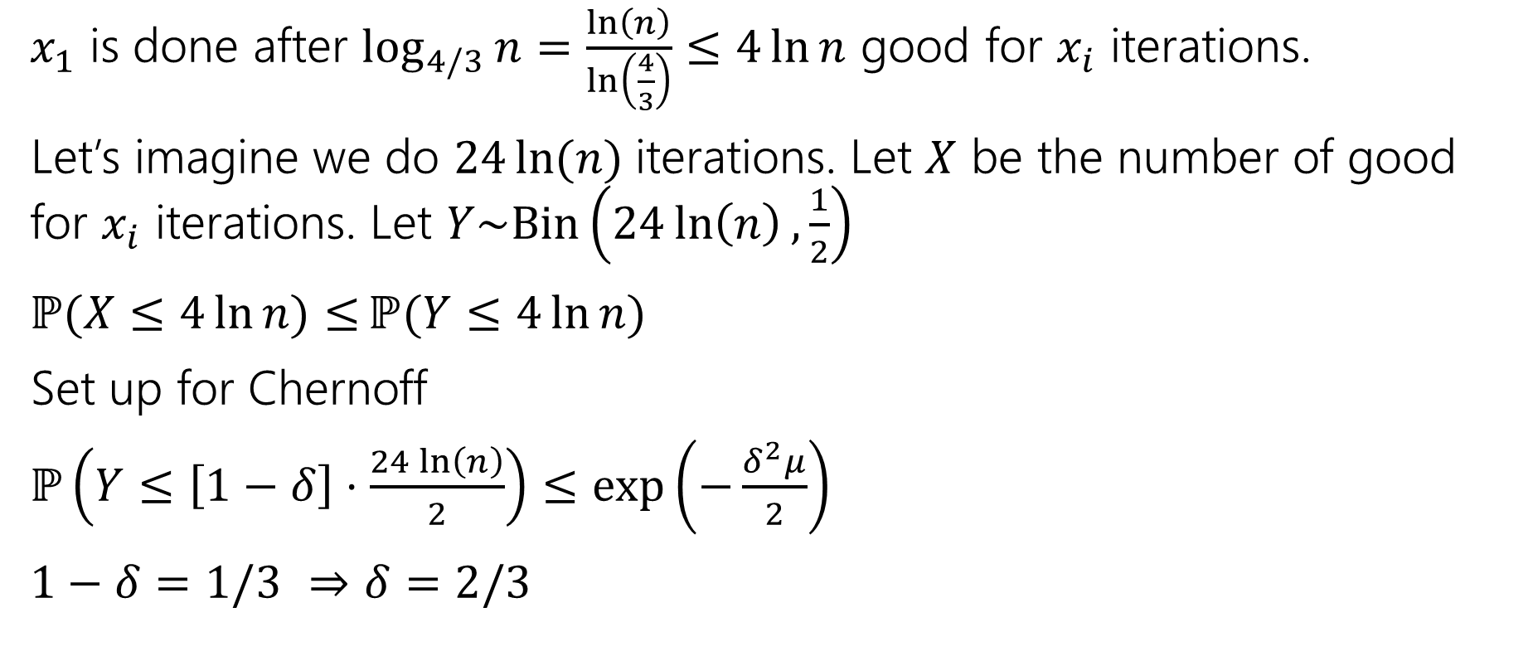
Needed iterations
$x_{1}$ is done after $\log_{4/3}{n}=\frac{\ln\left(n\right)}{\ln\left(\frac{4}{3}\right)}≤4\ln{n}$ good for $x_{i}$ iterations.
Let’s imagine we do $24\ln{(n)}$iterations. Let $X$ be the number of good for $x_{i}$ iterations. Let $Y\sim Bin\left(24\ln\left(n\right),\frac{1}{2}\right)$
$ℙ(X≤4\ln{n)≤}ℙ(Y≤4\ln{n) }$
Set up for Chernoff
$ℙ\left(Y≤\left[1−δ\right]⋅\frac{24\ln\left(n\right)}{2}\right)≤\exp\left(−\frac{δ^{2}μ}{2}\right)$
$1−δ=1/3$ $⇒δ=2/3$

Slide 14

Applying Chernoff
$ℙ\left(Y≤\left[1−δ\right]⋅\frac{24\ln\left(n\right)}{2}\right)≤\exp\left(−\frac{δ^{2}μ}{2}\right)≤\exp\left(−\frac{\frac{1}{3^{2}}⋅12\ln\left(n\right)}{2}\right)=e^{−\frac{8}{3}⋅ln⁡(n)}$
So, the probability that $x_{1}$ is not done after $24\ln{(n)}$iterations is at most $e^{−8ln⁡(n)/3}$ $=n^{−8/3}$

Slide 15
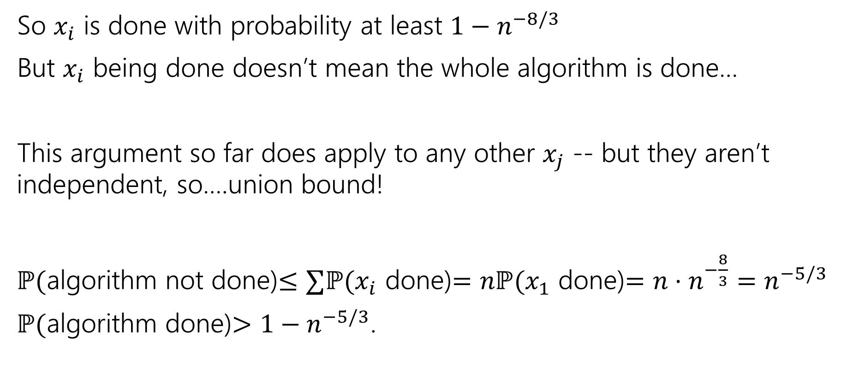
Finishing The bound
So $x_{i}$ is done with probability at least $1−n^{−8/3}$
But $x_{i}$ being done doesn’t mean the whole algorithm is done…
This argument so far does apply to any other $x_{j}$ -- but they aren’t independent, so….union bound!
$ℙ($algorithm not done)$≤∑ℙ(x_{i}$ done)$=nℙ(x_{1}$ done)$=n⋅n^{−\frac{8}{3}}=n^{−5/3}$
$ℙ($algorithm done)$>1−n^{−5/3}$.

Slide 16
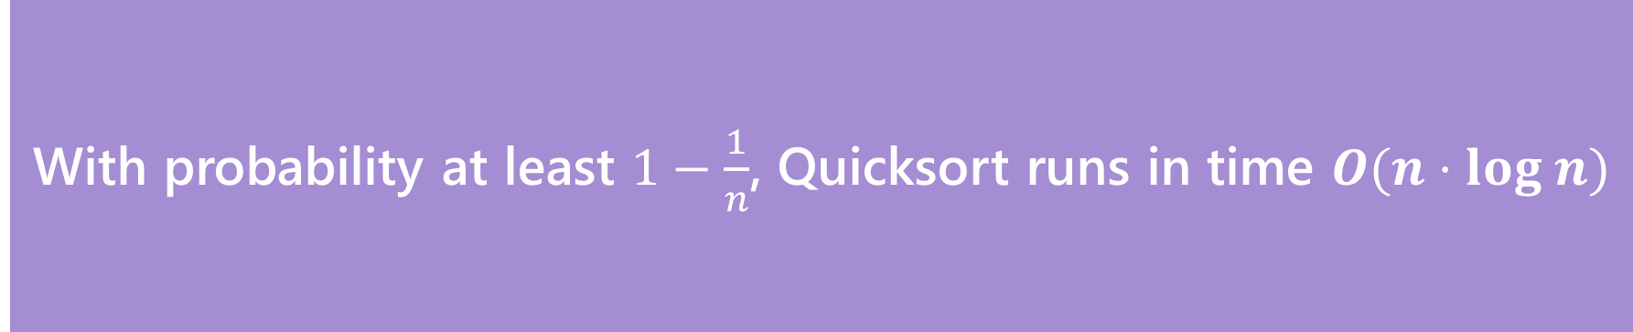

The Theorem
With probability at least $1−\frac{1}{n}$, Quicksort runs in time $O(n⋅log n)$
Quicksort
This kind of bound (with probability $→1$ as $n→∞$ is called a “high probability bound” we say quicksort needs $O(n\log{n)}$time “with high probability”
Better than finding a bound on the expected running time!

Slide 17
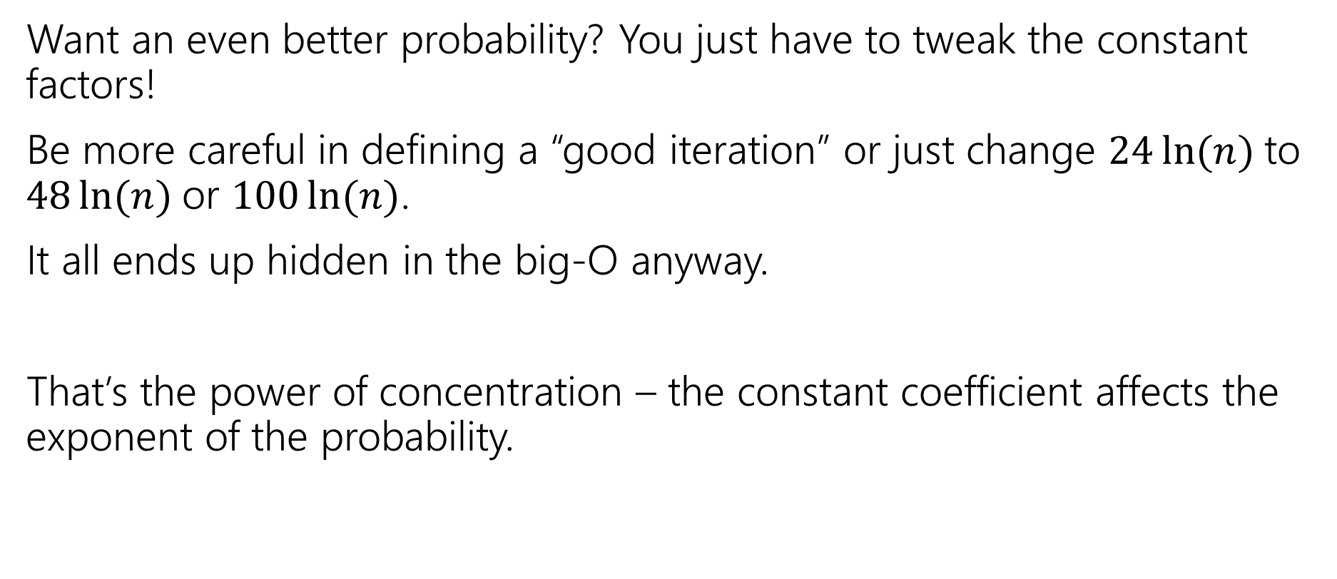
Want a different bound?
Want an even better probability? You just have to tweak the constant factors!
Be more careful in defining a “good iteration” or just change $24\ln{(n)}$to $48\ln{(n)}$or $100\ln{(n)}$.
It all ends up hidden in the big-O anyway.
That’s the power of concentration – the constant coefficient affects the exponent of the probability.

Slide 18
Common Quicksort Implementations
A common strategy in practice is the “median of three” rule.
Choose three elements (either at random or from specific spots). Take the median of those for your pivot
Guarantees you don’t have the worst possible pivot.
Only a small constant number of extra steps beyond the fixed pivot (find the median of three numbers is just a few comparisons).
Another strategy: find the true median (very fancy, very impractical: take 421)

Slide 19
Monte Carlo Algorithms
Just some intuition

Slide 20
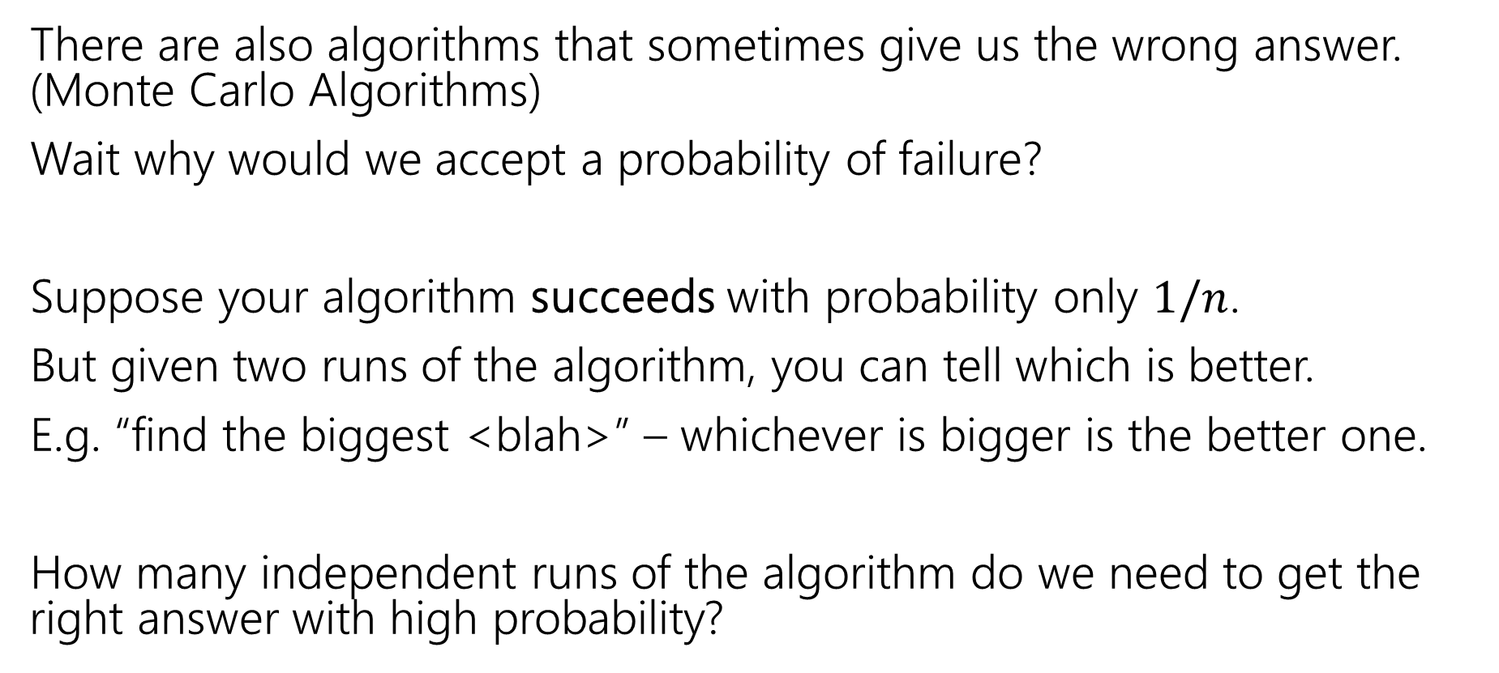
Algorithms with some probability of failure
There are also algorithms that sometimes give us the wrong answer. (Monte Carlo Algorithms)
Wait why would we accept a probability of failure?
Suppose your algorithm succeeds with probability only $1/n$.
But given two runs of the algorithm, you can tell which is better.
E.g. “find the biggest <blah>” – whichever is bigger is the better one.
How many independent runs of the algorithm do we need to get the right answer with high probability?

Slide 21
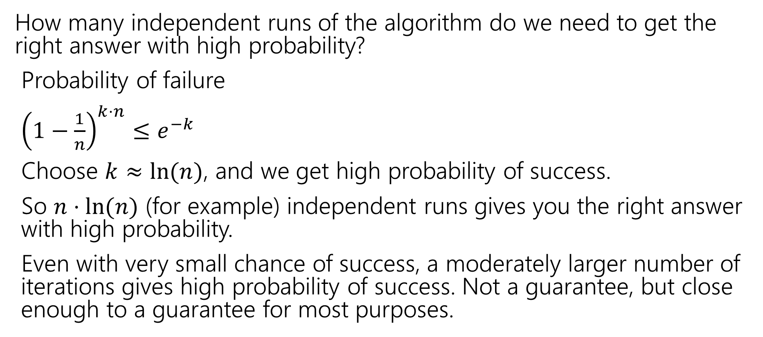
Small Probability of Failure
How many independent runs of the algorithm do we need to get the right answer with high probability?
Probability of failure
${\left(1−\frac{1}{n}\right)}^{k⋅n}≤e^{−k}$
Choose $k≈ln⁡(n)$, and we get high probability of success.
So $n⋅ln⁡(n)$ (for example) independent runs gives you the right answer with high probability.
Even with very small chance of success, a moderately larger number of iterations gives high probability of success. Not a guarantee, but close enough to a guarantee for most purposes.

