Slide 1
More MLE
CSE 312 Winter 25
Lecture 24

Slide 2
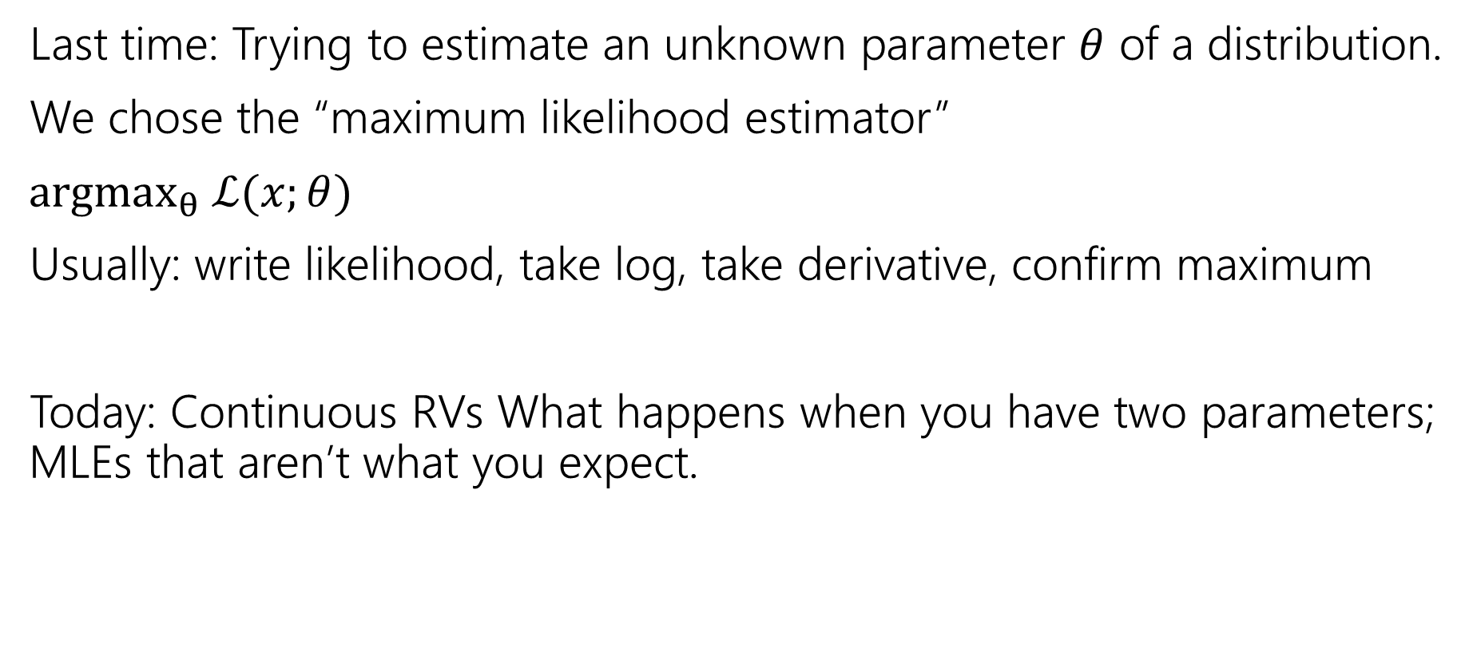
Outline
Last time: Trying to estimate an unknown parameter $θ$ of a distribution.
We chose the “maximum likelihood estimator”
$argmax_{θ} ℒ(x;θ)$
Usually: write likelihood, take log, take derivative, confirm maximum
Today: Continuous RVs What happens when you have two parameters; MLEs that aren’t what you expect.

Slide 3
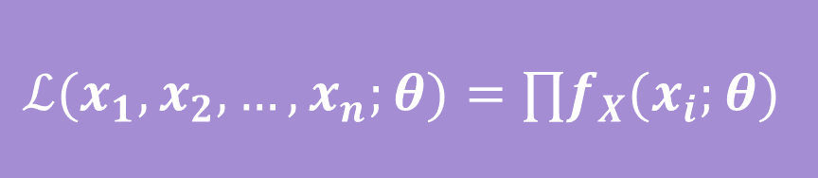
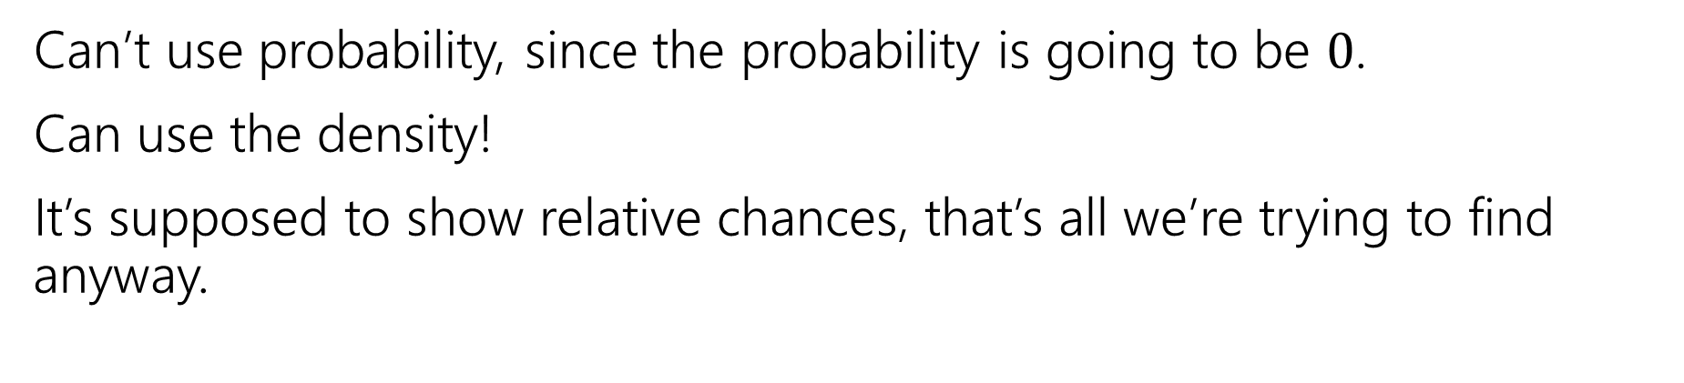
What about continuous random variables?
Can’t use probability, since the probability is going to be $0$.
Can use the density!
It’s supposed to show relative chances, that’s all we’re trying to find anyway.
$$ℒ(x_{1},x_{2},…,x_{n};θ)=∏f_{X}(x_{i};θ)$$

Slide 4
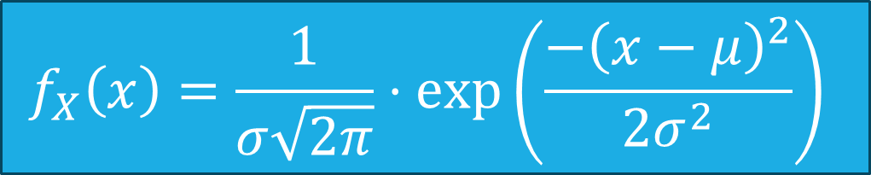
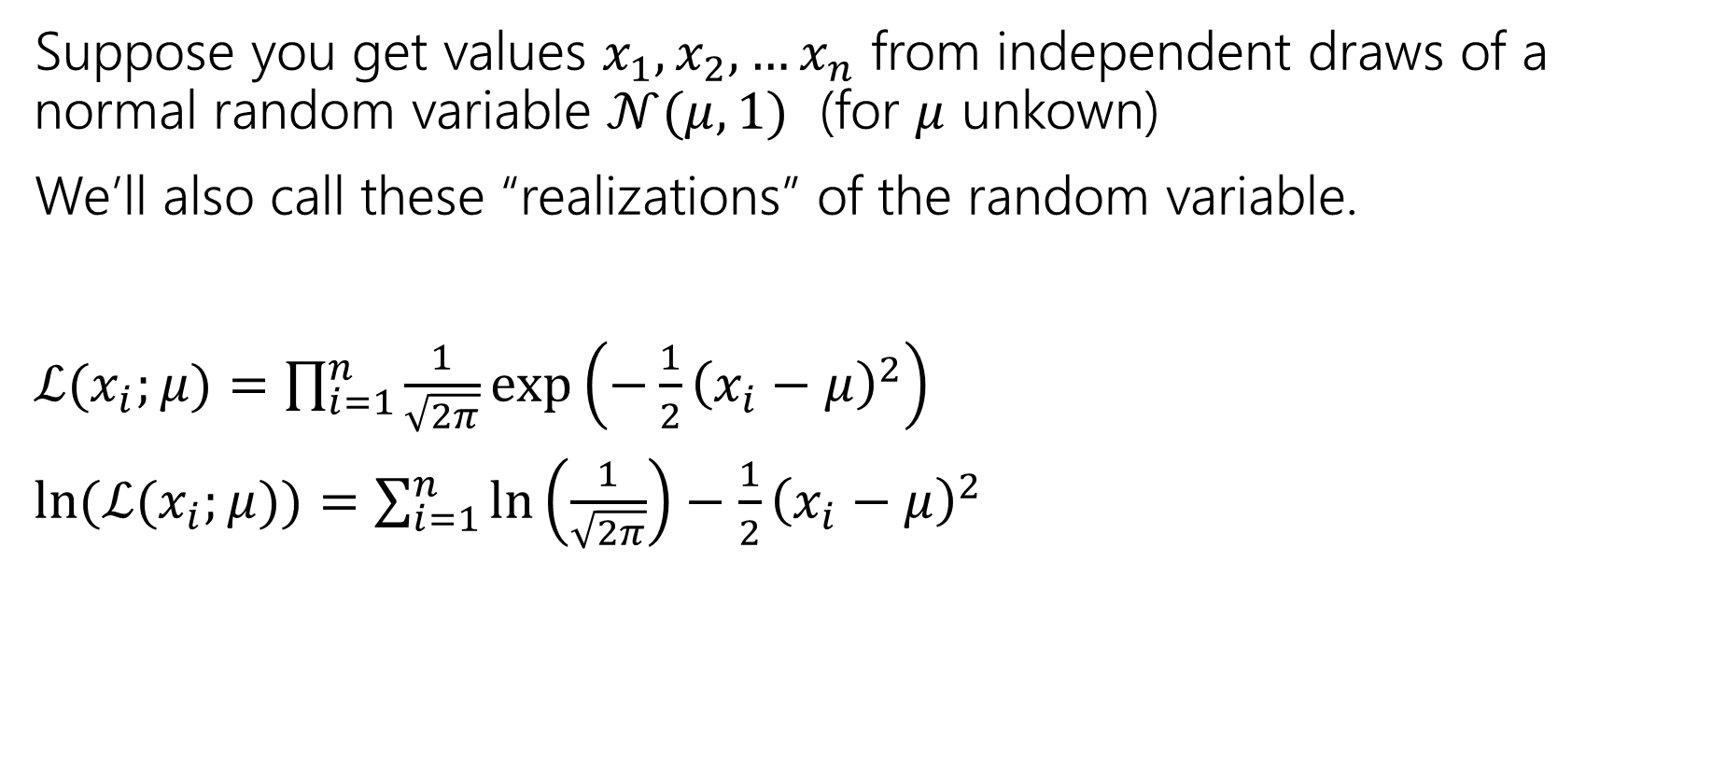
Continuous Example
Suppose you get values $x_{1},x_{2},…x_{n}$ from independent draws of a normal random variable $𝒩(μ,1)$ (for $μ$ unkown)
We’ll also call these “realizations” of the random variable.
$ℒ(x_{i};μ)=\prod_{i=1}^{n}{\frac{1}{\sqrt{2π}}\exp\left(−\frac{1}{2}{\left(x_{i}−μ\right)}^{2}\right)}$
$\ln{(ℒ(x_{i};μ))=\sum_{i=1}^{n}{\ln\left(\frac{1}{\sqrt{2π}}\right)−\frac{1}{2}{\left(x_{i}−μ\right)}^{2}}}$
$$f_{X}\left(x\right)=\frac{1}{σ\sqrt{2π}}⋅\exp\left(\frac{−{\left(x−μ\right)}^{2}}{2σ^{2}}\right)$$

Slide 5
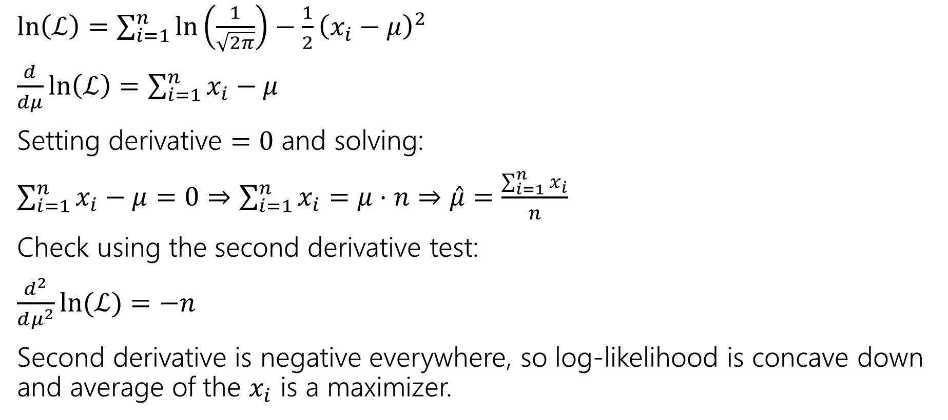

Finding $\hat{μ}$
$\ln\left(ℒ\right)=\sum_{i=1}^{n}{\ln\left(\frac{1}{\sqrt{2π}}\right)−\frac{1}{2}{\left(x_{i}−μ\right)}^{2}}$
$\frac{d}{dμ}\ln\left(ℒ\right)=\sum_{i=1}^{n}{x_{i}−μ}$
Setting derivative $=0$ and solving:
$\sum_{i=1}^{n}{x_{i}−μ}=0⇒\sum_{i=1}^{n}{x_{i}}=μ⋅n⇒\hat{μ}=\frac{\sum_{i=1}^{n}{x_{i}}}{n}$
Check using the second derivative test:
$\frac{d^{2}}{dμ^{2}}\ln{(ℒ)}=−n$
Second derivative is negative everywhere, so log-likelihood is concave down and average of the $x_{i}$ is a maximizer.

Slide 6
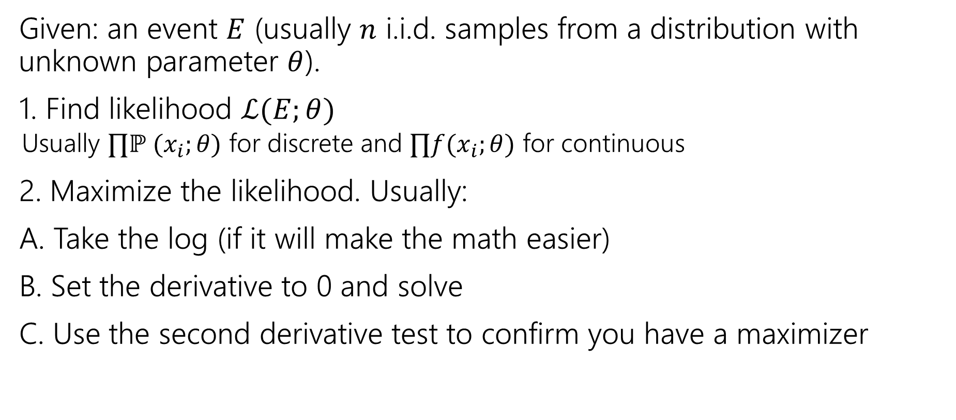
Summary
Given: an event $E$ (usually $n$ i.i.d. samples from a distribution with unknown parameter $θ$).
1. Find likelihood $ℒ(E;θ)$
  Usually $∏ℙ (x_{i};θ)$ for discrete and $∏f(x_{i};θ)$ for continuous
2. Maximize the likelihood. Usually:
A. Take the log (if it will make the math easier)
B. Set the derivative to 0 and solve
C. Use the second derivative test to confirm you have a maximizer

Slide 7

Generalizing Normals
We just saw to estimate $μ$ for $𝒩(μ,1)$ we get:
$\hat{μ}=∑x_{i}/n$
Now what happens if we know our data is $𝒩()$ but both the mean and the variance are unknown.?

Slide 8
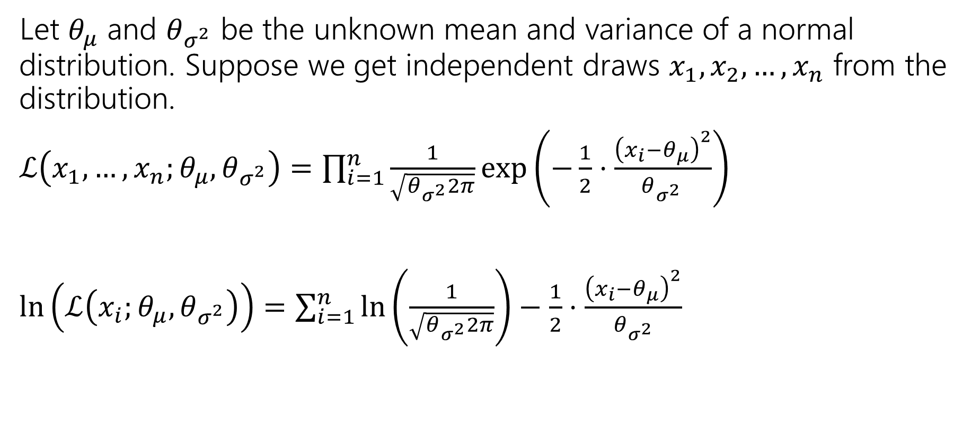
Log-likelihood
Let $θ_{μ}$ and $θ_{σ^{2}}$ be the unknown mean and variance of a normal distribution. Suppose we get independent draws $x_{1},x_{2},…, x_{n}$ from the distribution.
$ℒ\left(x_{1},…,x_{n};θ_{μ},θ_{σ^{2}}\right)=\prod_{i=1}^{n}{\frac{1}{\sqrt{θ_{σ^{2}}2π}}\exp\left(−\frac{1}{2}⋅\frac{{\left(x_{i}−θ_{μ}\right)}^{2}}{θ_{σ^{2} }}\right)}$
$\ln\left(ℒ\left(x_{i};θ_{μ},θ_{σ^{2}}\right)\right)=\sum_{i=1}^{n}{\ln\left(\frac{1}{\sqrt{θ_{σ^{2}}2π}}\right)−\frac{1}{2}⋅\frac{{\left(x_{i}−θ_{μ}\right)}^{2}}{θ_{σ^{2}}} }$
With multiple parameters, take partial derivatives to find maxima.

Slide 9

Expectation
$\ln\left(ℒ\left(x_{i};θ_{μ},θ_{σ^{2}}\right)\right)=\sum_{i=1}^{n}{\ln\left(\frac{1}{\sqrt{θ_{σ^{2}}2π}}\right)−\frac{1}{2}⋅\frac{{\left(x_{i}−θ_{μ}\right)}^{2}}{θ_{σ^{2}}} }$
$\frac{∂}{∂θ_{μ}}\ln\left(ℒ\right)=$
Setting equal to $0$ and solving

Slide 10
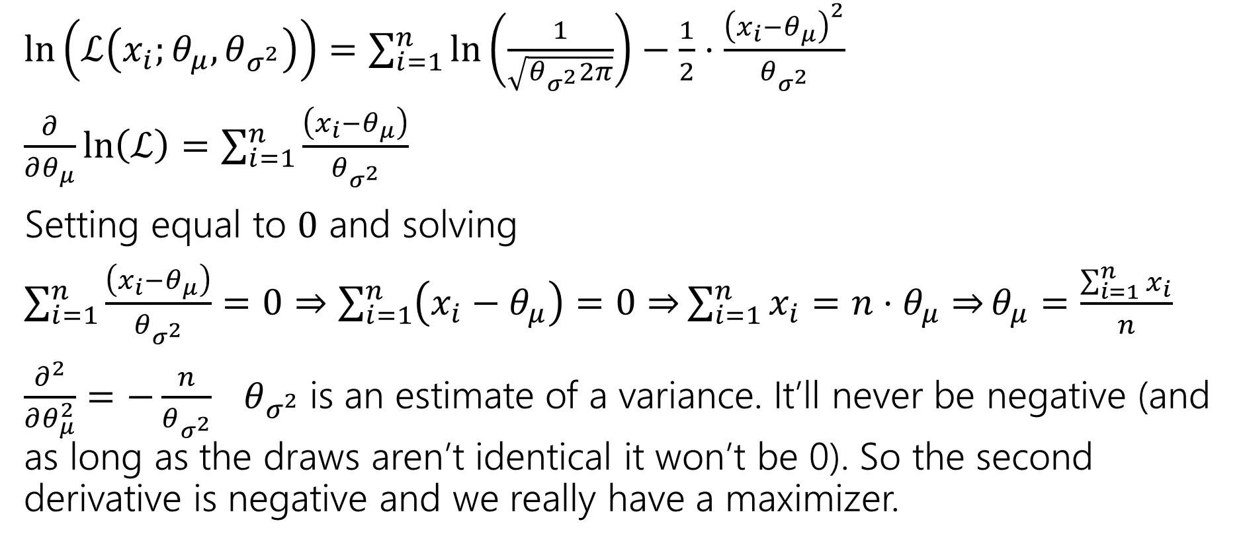
Expectation
Arithmetic is nearly identical to known variance case.
$\ln\left(ℒ\left(x_{i};θ_{μ},θ_{σ^{2}}\right)\right)=\sum_{i=1}^{n}{\ln\left(\frac{1}{\sqrt{θ_{σ^{2}}2π}}\right)−\frac{1}{2}⋅\frac{{\left(x_{i}−θ_{μ}\right)}^{2}}{θ_{σ^{2}}} }$
$\frac{∂}{∂θ_{μ}}\ln\left(ℒ\right)=\sum_{i=1}^{n}{\frac{\left(x_{i}−θ_{μ}\right)}{θ_{σ^{2}}}}$
Setting equal to $0$ and solving
$\sum_{i=1}^{n}{\frac{\left(x_{i}−θ_{μ}\right)}{θ_{σ^{2}}}}=0⇒\sum_{i=1}^{n}{\left(x_{i}−θ_{μ}\right)=0⇒}\sum_{i=1}^{n}{x_{i}=n⋅θ_{μ}⇒}θ_{μ}=\frac{\sum_{i=1}^{n}{x_{i}}}{n}$
$\frac{∂^{2}}{∂θ_{μ}^{2}}=−\frac{n}{θ_{σ^{2}}}$ $θ_{σ^{2}}$is an estimate of a variance. It’ll never be negative (and as long as the draws aren’t identical it won’t be 0). So the second derivative is negative and we really have a maximizer.

Slide 11
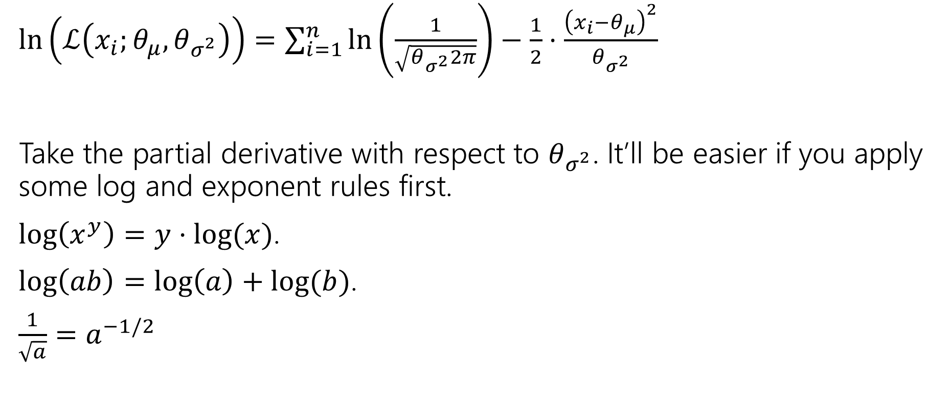
Variance
$\ln\left(ℒ\left(x_{i};θ_{μ},θ_{σ^{2}}\right)\right)=\sum_{i=1}^{n}{\ln\left(\frac{1}{\sqrt{θ_{σ^{2}}2π}}\right)−\frac{1}{2}⋅\frac{{\left(x_{i}−θ_{μ}\right)}^{2}}{θ_{σ^{2}}} }$
Take the partial derivative with respect to $θ_{σ^{2}}$. It’ll be easier if you apply some log and exponent rules first.
$\log\left(x^{y}\right)=y⋅\log{(x)}$.
$\log\left(ab\right)=\log\left(a\right)+log⁡(b)$.
$\frac{1}{\sqrt{a}}=a^{−1/2}$

Slide 12
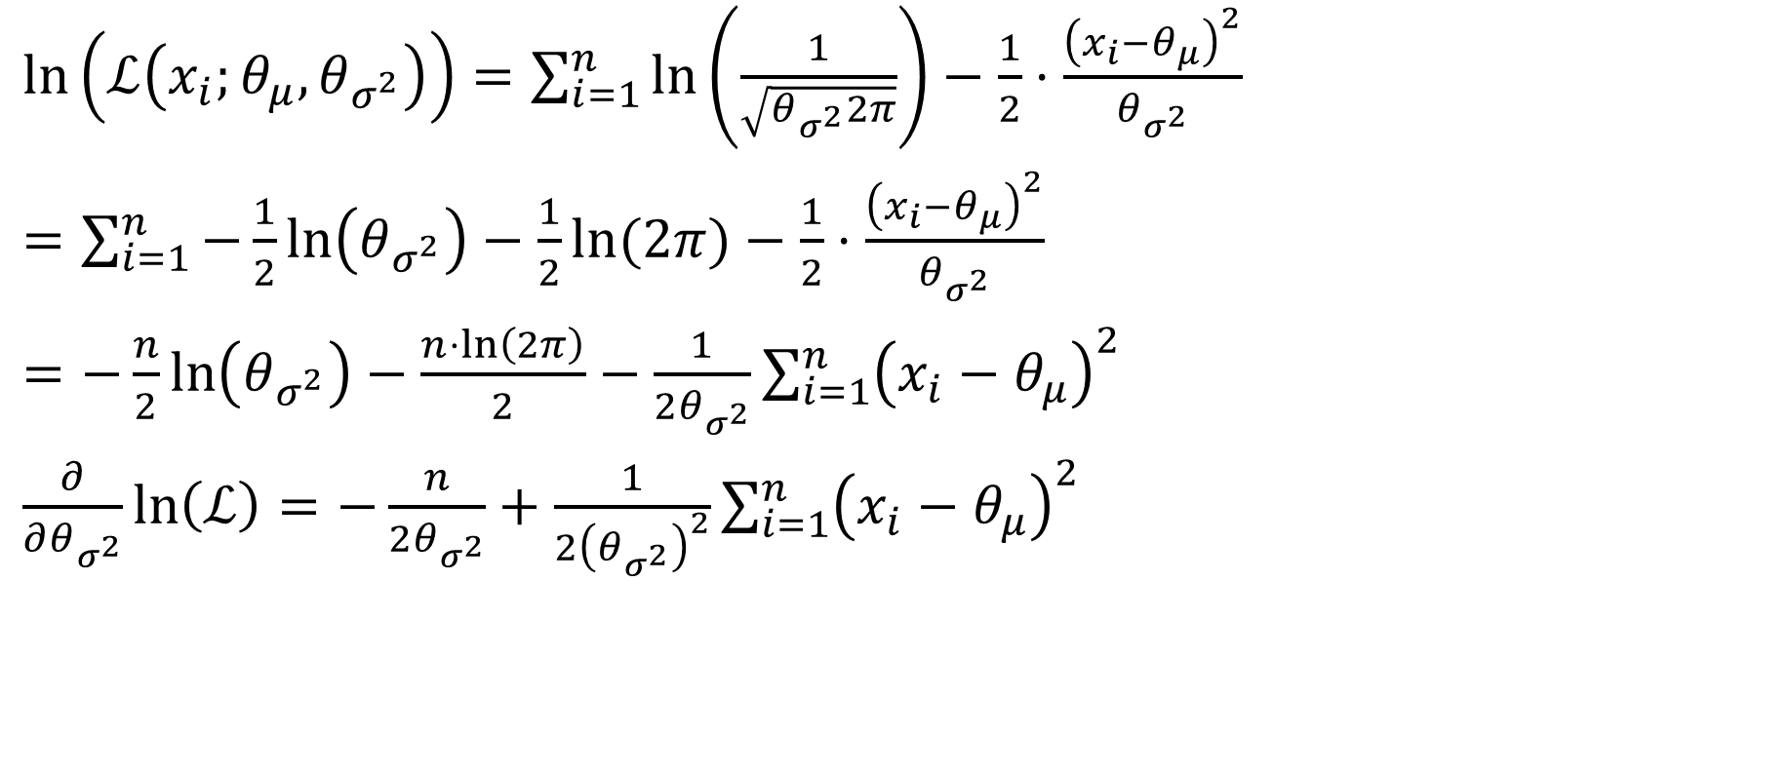
Variance
$\ln\left(ℒ\left(x_{i};θ_{μ},θ_{σ^{2}}\right)\right)=\sum_{i=1}^{n}{\ln\left(\frac{1}{\sqrt{θ_{σ^{2}}2π}}\right)−\frac{1}{2}⋅\frac{{\left(x_{i}−θ_{μ}\right)}^{2}}{θ_{σ^{2}}} }$
$=\sum_{i=1}^{n}{−\frac{1}{2}\ln\left(θ_{σ^{2}}\right)−\frac{1}{2}\ln{(2π)}}−\frac{1}{2}⋅\frac{{\left(x_{i}−θ_{μ}\right)}^{2}}{θ_{σ^{2}}}$
$=−\frac{n}{2}\ln\left(θ_{σ^{2}}\right)−\frac{n⋅\ln\left(2π\right)}{2}−\frac{1}{2θ_{σ^{2}}}\sum_{i=1}^{n}{{\left(x_{i}−θ_{μ}\right)}^{2}}$
$\frac{∂}{∂θ_{σ^{2}}}\ln\left(ℒ\right)=−\frac{n}{2θ_{σ^{2}}}+\frac{1}{2{\left(θ_{σ^{2}}\right)}^{2}}\sum_{i=1}^{n}{{\left(x_{i}−θ_{μ}\right)}^{2}}$

Slide 13
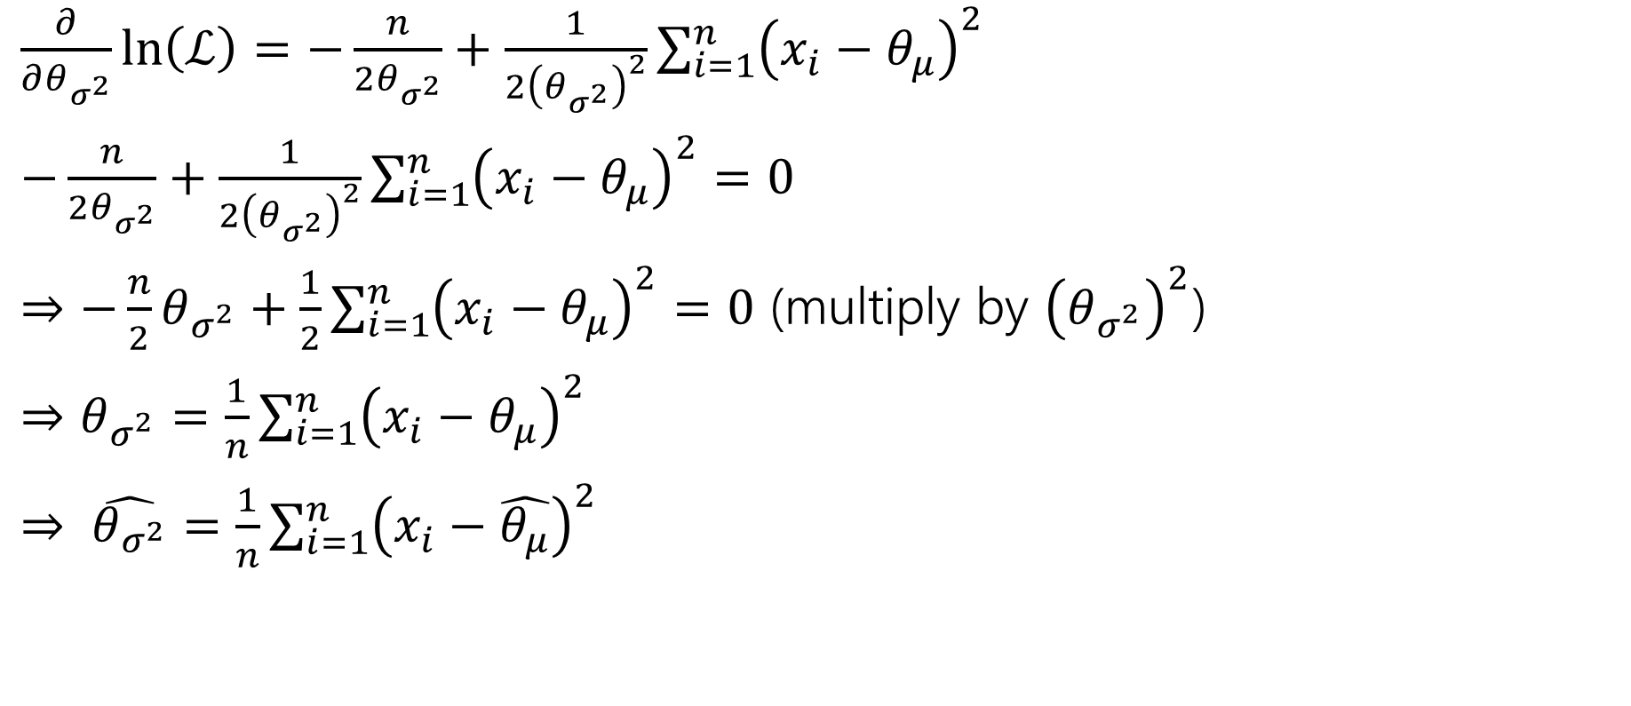
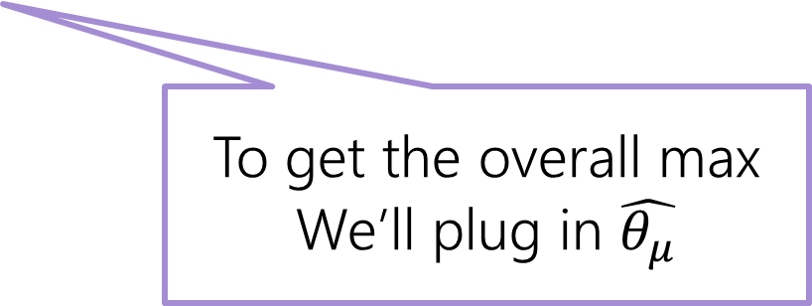
Variance part 2
$\frac{∂}{∂θ_{σ^{2}}}\ln\left(ℒ\right)=−\frac{n}{2θ_{σ^{2}}}+\frac{1}{2{\left(θ_{σ^{2}}\right)}^{2}}\sum_{i=1}^{n}{{\left(x_{i}−θ_{μ}\right)}^{2}}$
$−\frac{n}{2θ_{σ^{2}}}+\frac{1}{2{\left(θ_{σ^{2}}\right)}^{2}}\sum_{i=1}^{n}{{\left(x_{i}−θ_{μ}\right)}^{2}}=0$
$⇒−\frac{n}{2}θ_{σ^{2}}+\frac{1}{2}\sum_{i=1}^{n}{{\left(x_{i}−θ_{μ}\right)}^{2}}=0$ (multiply by ${\left(θ_{σ^{2}}\right)}^{2}$)
$⇒θ_{σ^{2}}=\frac{1}{n}\sum_{i=1}^{n}{{\left(x_{i}−θ_{μ}\right)}^{2}}$
$⇒ \hat{θ_{σ^{2}}}=\frac{1}{n}\sum_{i=1}^{n}{{\left(x_{i}−\hat{θ_{μ}}\right)}^{2}}$
To get the overall max
We’ll plug in $\hat{θ_{μ}}$
Notes:
Regardless of the value of $θ_{σ^{2}}$ that’s selected, the likelihood is maximized by setting $θ_{μ}$ to the value of $\hat{θ_{μ}}$ . So we should pick $θ_{μ}$ first (it’s without loss of generality to do so), then we can plug in the value and realize that the likelihood is overall maximized when $\hat{θ_{σ^{2}}}$ is selected as in the slide.

Slide 14
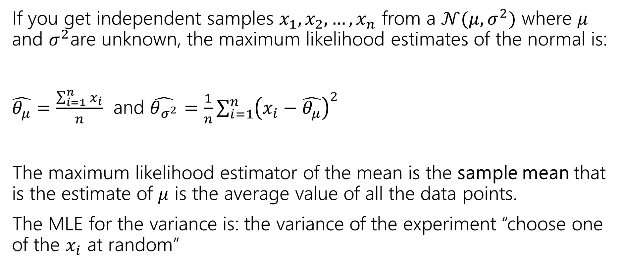
Summary
If you get independent samples $x_{1},x_{2},…,x_{n}$ from a $𝒩(μ,σ^{2})$ where $μ$ and $σ^{2}$are unknown, the maximum likelihood estimates of the normal is:
$\hat{θ_{μ}}=\frac{\sum_{i=1}^{n}{x_{i}}}{n}$ and $\hat{θ_{σ^{2}}}=\frac{1}{n}\sum_{i=1}^{n}{{\left(x_{i}−\hat{θ_{μ}}\right)}^{2}}$
The maximum likelihood estimator of the mean is the sample mean that is the estimate of $μ$ is the average value of all the data points.
The MLE for the variance is: the variance of the experiment “choose one of the $x_{i}$ at random”

Slide 15

Biased
One property we might want from an estimator is for it to be unbiased.
The expectation is taken over the randomness in the samples we drew.
  The formula is fixed, the data we draw to evaluate the formula becomes the source of the randomness.
So we’re not consistently overestimating or underestimating.
If an estimator isn’t unbiased then it’s biased.
An estimator $\hat{θ}$is “unbiased” if
$$𝔼\left[\hat{θ}\right]=θ$$

Slide 16
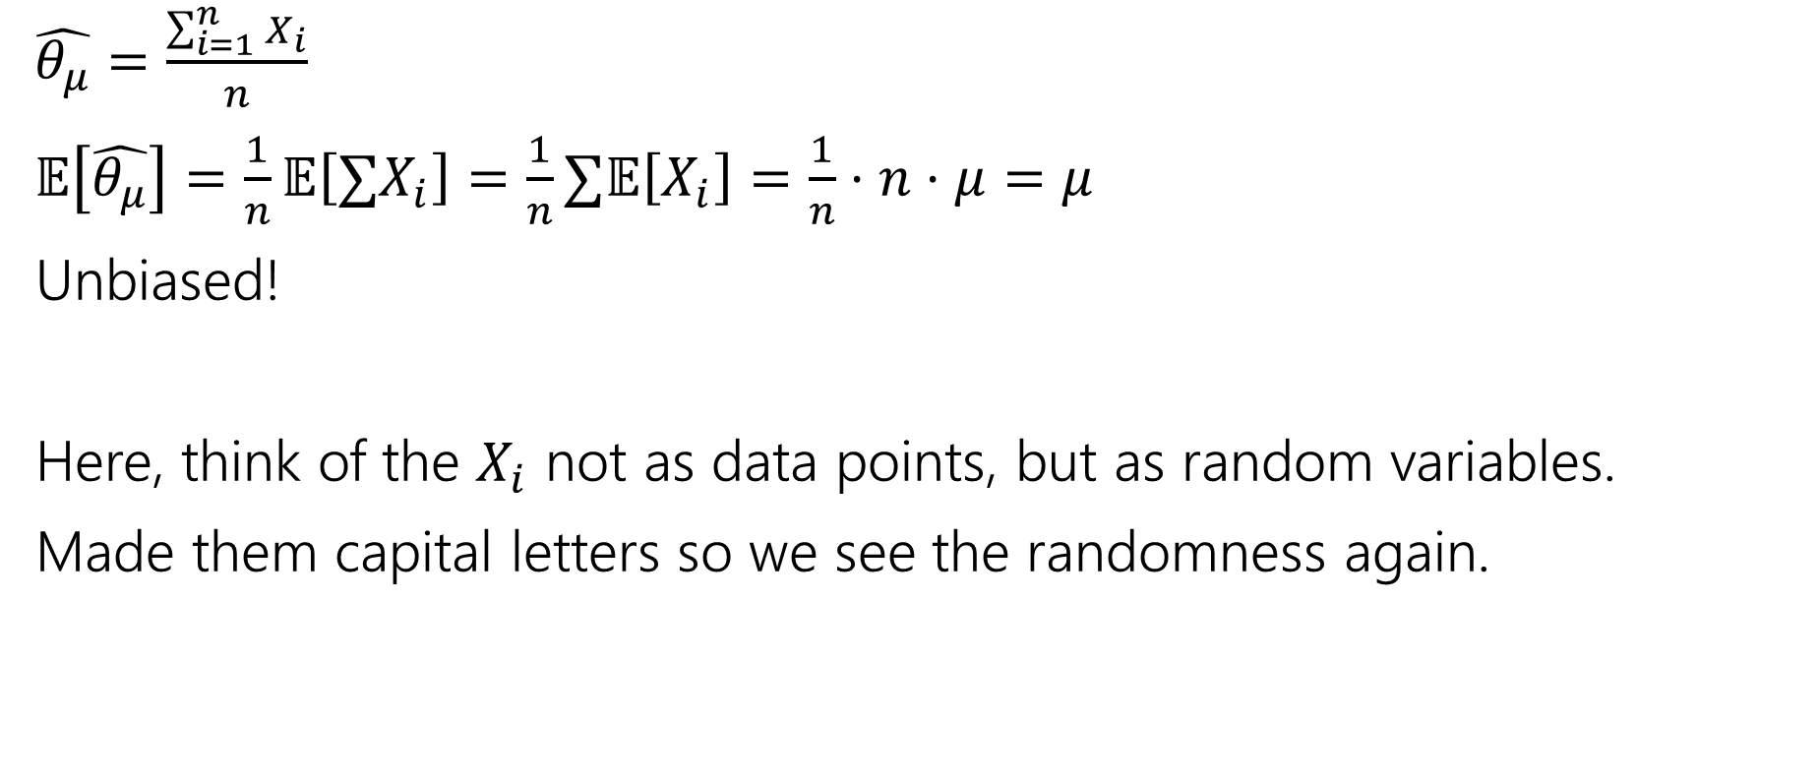
Are our MLEs unbiased?
$\hat{θ_{μ}}=\frac{\sum_{i=1}^{n}{X_{i}}}{n}$
$𝔼\left[\hat{θ_{μ}}\right]=\frac{1}{n}𝔼\left[∑X_{i}\right]=\frac{1}{n}∑𝔼\left[X_{i}\right]=\frac{1}{n}⋅n⋅μ=μ$
Unbiased!
Here, think of the $X_{i}$ not as data points, but as random variables.
Made them capital letters so we see the randomness again.
Notes:
Want to

Slide 17

Are our MLEs biased?
Our estimate for the coin-flips (if we generalized a bit) would be $\frac{num heads}{total flips}$
Is this biased or unbiased?

Slide 18

Are our MLEs biased?
Our estimate for the coin-flips (if we generalized a bit) would be $\frac{num heads}{total flips}$
What is $𝔼\left[\frac{num heads}{total flips}\right]=\frac{θ⋅n}{n}=θ$
Unbiased!

Slide 19
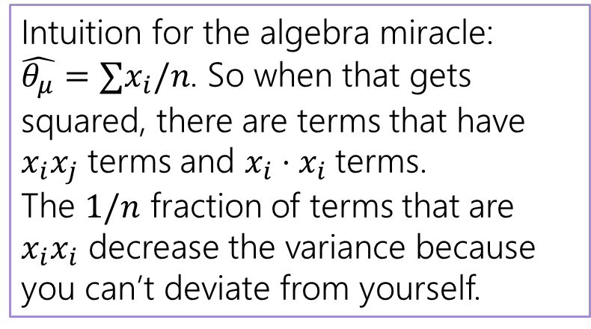

Unbiased?
$𝔼\left[θ_{σ^{2}}\right]=𝔼[\frac{1}{n}\sum_{i=1}^{n}{{\left(x_{i}−\hat{θ_{μ}}\right)}^{2}]}$
$=\frac{1}{n}𝔼\left[{∑\left(x_{i}−\hat{θ_{μ}}\right)}^{2}\right]$
$=\frac{1}{n}𝔼\left[∑x_{i}^{2}−2x_{i}\hat{θ_{μ}}+{\hat{θ_{μ}}}^{2}\right]$
$…$
Then an algebraic miracle occurs…
$=\frac{n−1}{n}⋅σ^{2}$ where $σ^{2}=𝔼\left[{(x}_{i}−𝔼\left[x_{i}\right])^2\right]$
Intuition for the algebra miracle:
$\hat{θ_{μ}}=∑x_{i}/n$. So when that gets squared, there are terms that have $x_{i}x_{j}$ terms and $x_{i}⋅x_{i}$terms.
The $1/n$ fraction of terms that are $x_{i}x_{i}$ decrease the variance because you can’t deviate from yourself.

Slide 20
Optional: Algebra
Showing MLE of Variance is biased

Slide 21

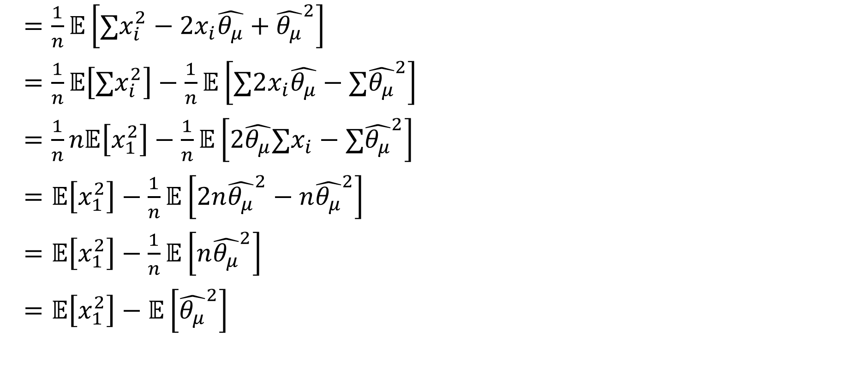
That Algebraic Miracle
$=\frac{1}{n}𝔼\left[∑x_{i}^{2}−2x_{i}\hat{θ_{μ}}+{\hat{θ_{μ}}}^{2}\right]$
$=\frac{1}{n}𝔼\left[∑x_{i}^{2}\right]−\frac{1}{n}𝔼\left[∑2x_{i}\hat{θ_{μ}}−{∑\hat{θ_{μ}}}^{2}\right]$
$=\frac{1}{n}n𝔼\left[x_{1}^{2}\right]−\frac{1}{n}𝔼\left[2\hat{θ_{μ}}∑x_{i}−{∑\hat{θ_{μ}}}^{2}\right]$
$=𝔼\left[x_{1}^{2}\right]−\frac{1}{n}𝔼\left[2n{\hat{θ_{μ}}}^{2}−n{\hat{θ_{μ}}}^{2}\right]$
$=𝔼\left[x_{1}^{2}\right]−\frac{1}{n}𝔼\left[n{\hat{θ_{μ}}}^{2}\right]$
$=𝔼\left[x_{1}^{2}\right]−𝔼\left[{\hat{θ_{μ}}}^{2}\right]$
$$\hat{θ_{μ}}=∑x_{i}/n$$

Slide 22
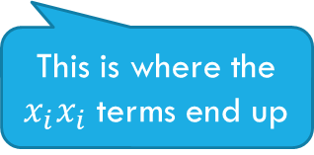
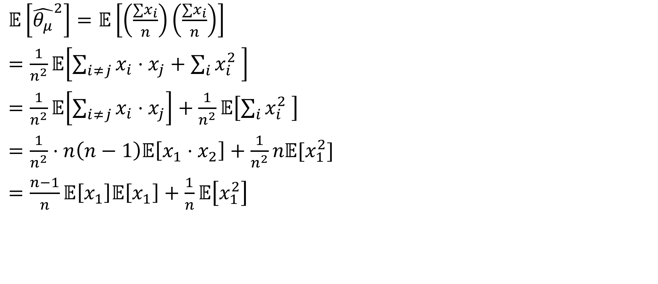
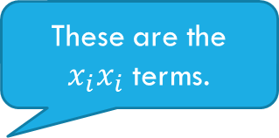
More of That Algebraic Miracle
$𝔼\left[{\hat{θ_{μ}}}^{2}\right]=𝔼\left[\left(\frac{∑x_{i}}{n}\right)\left(\frac{∑x_{i}}{n}\right)\right]$
$=\frac{1}{n^{2}}𝔼\left[\sum_{i≠j}{x_{i}⋅x_{j}}+\sum_{i}{x_{i}^{2} }\right]$
$=\frac{1}{n^{2}}𝔼\left[\sum_{i≠j}{x_{i}⋅x_{j}}\right]+\frac{1}{n^{2}}𝔼\left[\sum_{i}{x_{i}^{2} }\right]$
$=\frac{1}{n^{2}}⋅n\left(n−1\right)𝔼\left[x_{1}⋅x_{2}\right]+\frac{1}{n^{2}}n𝔼[x_{1}^{2}]$
$=\frac{n−1}{n}𝔼\left[x_{1}\right]𝔼\left[x_{1}\right]+\frac{1}{n}𝔼\left[x_{1}^{2}\right]$
These are the $x_{i}x_{i}$ terms.
This is where the $x_{i}x_{i}$ terms end up

Slide 23
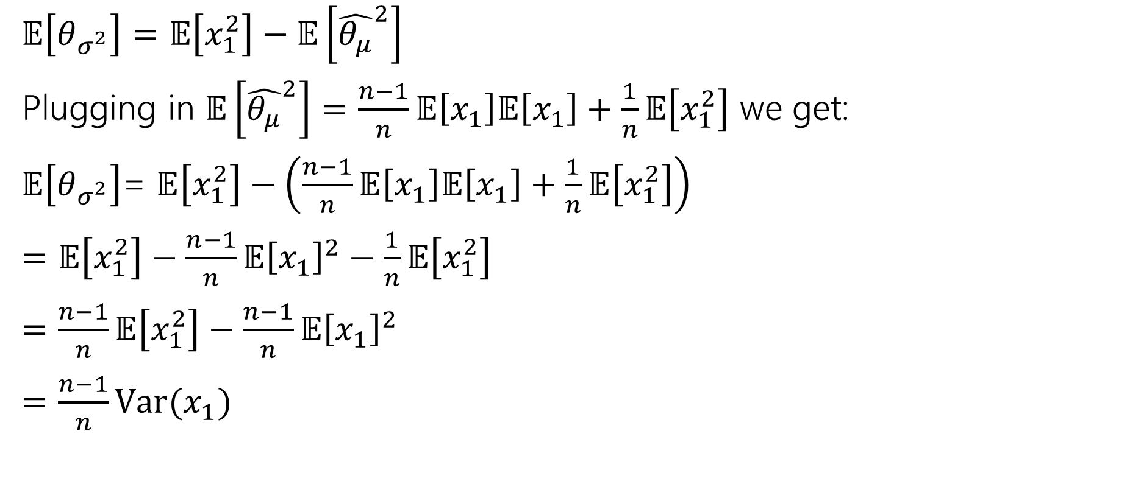
Wrapping Up the Algebraic Miracle
$𝔼\left[θ_{σ^{2}}\right]=𝔼\left[x_{1}^{2}\right]−𝔼\left[{\hat{θ_{μ}}}^{2}\right]$
Plugging in $𝔼\left[{\hat{θ_{μ}}}^{2}\right]=\frac{n−1}{n}𝔼\left[x_{1}\right]𝔼\left[x_{1}\right]+\frac{1}{n}𝔼\left[x_{1}^{2}\right]$ we get:
$𝔼\left[θ_{σ^{2}}\right]$= $𝔼\left[x_{1}^{2}\right]−\left(\frac{n−1}{n}𝔼\left[x_{1}\right]𝔼\left[x_{1}\right]+\frac{1}{n}𝔼\left[x_{1}^{2}\right]\right)$
$=𝔼\left[x_{1}^{2}\right]−\frac{n−1}{n}𝔼{\left[x_{1}\right]}^{2}−\frac{1}{n}𝔼\left[x_{1}^{2}\right]$
$=\frac{n−1}{n}𝔼\left[x_{1}^{2}\right]−\frac{n−1}{n}𝔼{\left[x_{1}\right]}^{2}$
$=\frac{n−1}{n}Var(x_{1})$

Slide 24
Non-optional Takeaways

Slide 25
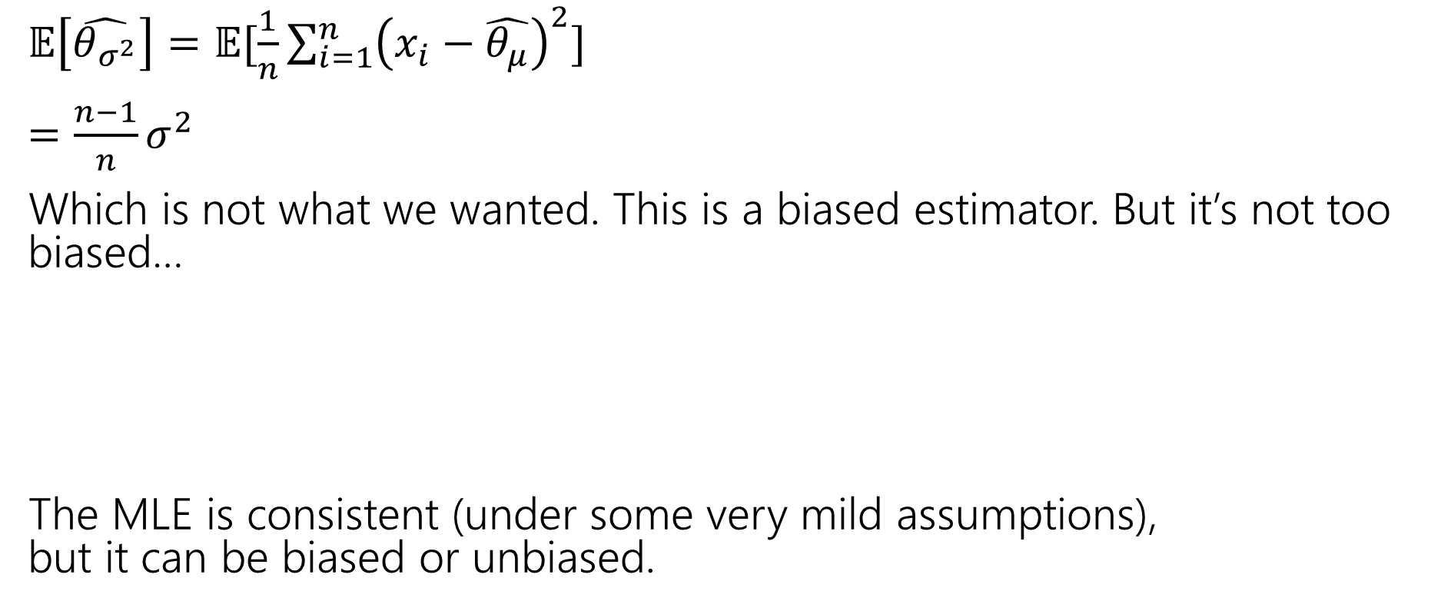

Not Unbiased
$𝔼\left[\hat{θ_{σ^{2}}}\right]=𝔼[\frac{1}{n}\sum_{i=1}^{n}{{\left(x_{i}−\hat{θ_{μ}}\right)}^{2}]}$
$=\frac{n−1}{n}σ^{2}$
Which is not what we wanted. This is a biased estimator. But it’s not too biased…
The MLE is consistent (under some very mild assumptions),
but it can be biased or unbiased.
An estimator $\hat{θ}$is “consistent” if
$$\lim_{n→∞}{𝔼\left[\hat{θ}\right]}=θ$$
Notes:
See, e.g., https://stats.stackexchange.com/questions/323873/assumptions-of-mle

Slide 26
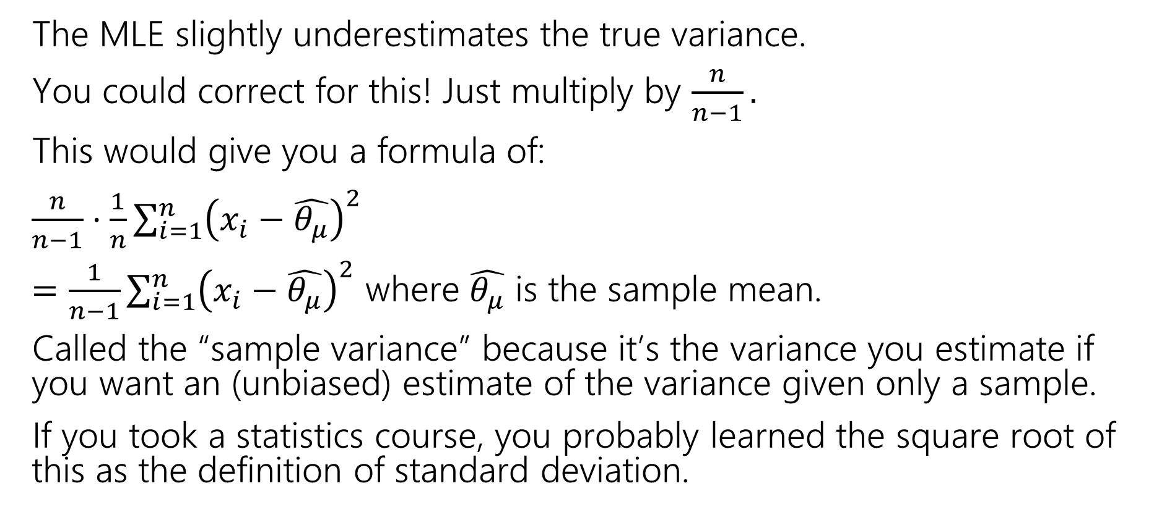
Correction
The MLE slightly underestimates the true variance.
You could correct for this! Just multiply by $\frac{n}{n−1}.$
This would give you a formula of:
$\frac{n}{n−1}⋅\frac{1}{n}\sum_{i=1}^{n}{{\left(x_{i}−\hat{θ_{μ}}\right)}^{2}}$
$=\frac{1}{n−1}\sum_{i=1}^{n}{{\left(x_{i}−\hat{θ_{μ}}\right)}^{2}}$ where $\hat{θ_{μ}}$ is the sample mean.
Called the “sample variance” because it’s the variance you estimate if you want an (unbiased) estimate of the variance given only a sample.
If you took a statistics course, you probably learned the square root of this as the definition of standard deviation.

Slide 27
Fun Facts

Slide 28
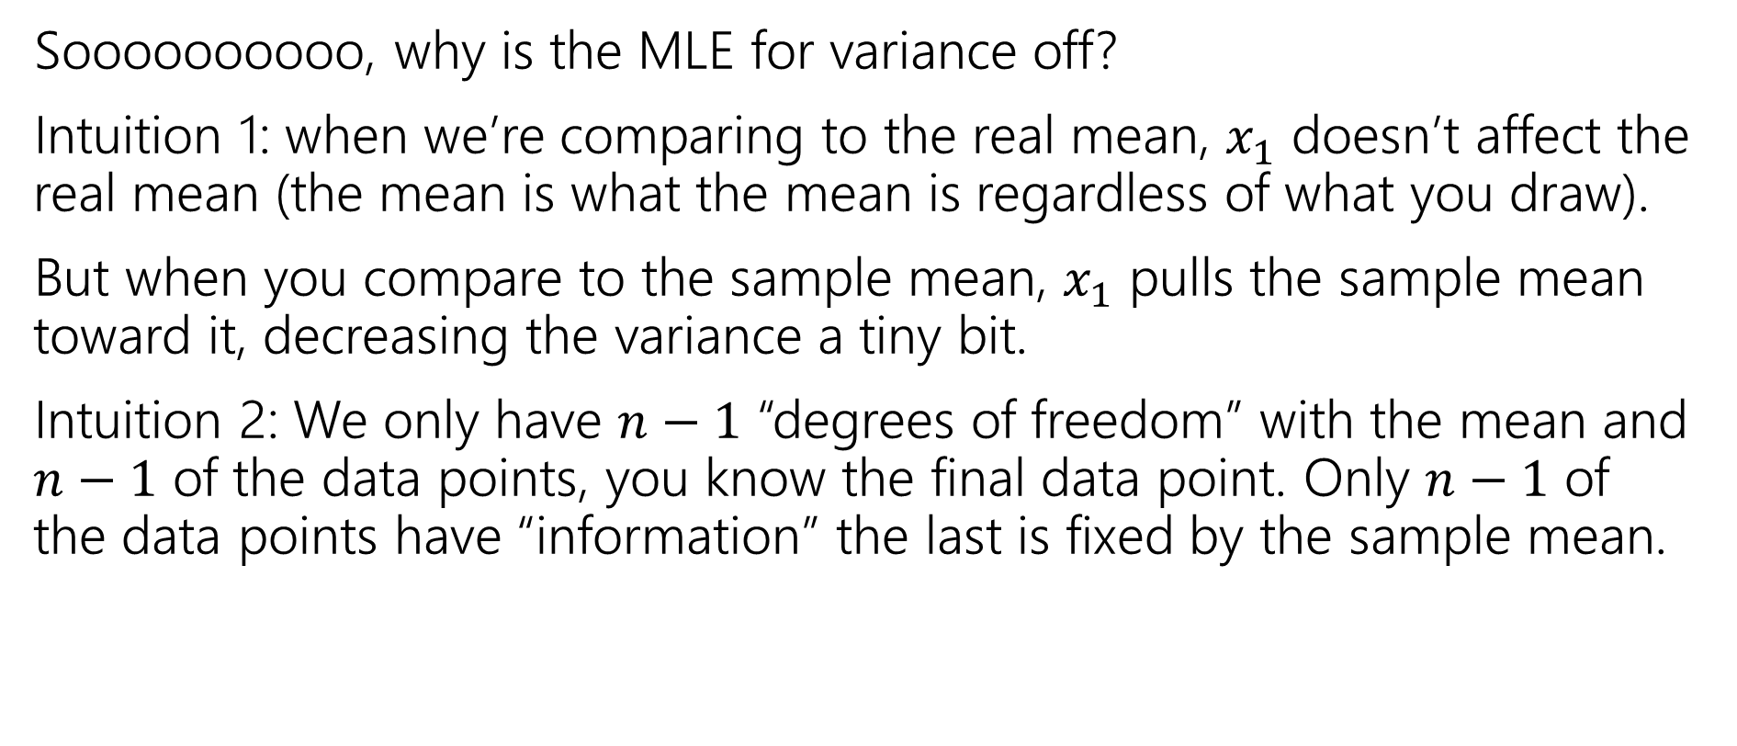

What’s with the $n−1$?
Soooooooooo, why is the MLE for variance off?
Intuition 1: when we’re comparing to the real mean, $x_{1}$ doesn’t affect the real mean (the mean is what the mean is regardless of what you draw).
But when you compare to the sample mean, $x_{1}$ pulls the sample mean toward it, decreasing the variance a tiny bit.
Intuition 2: We only have $n−1$ “degrees of freedom” with the mean and $n−1$ of the data points, you know the final data point. Only $n−1$ of the data points have “information” the last is fixed by the sample mean.

Slide 29
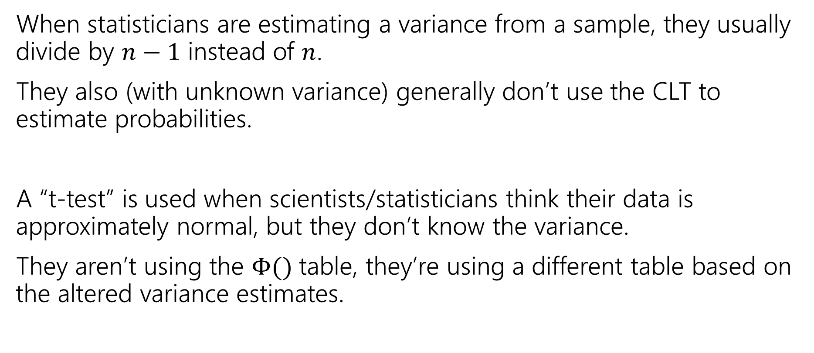
Why does it matter?
When statisticians are estimating a variance from a sample, they usually divide by $n−1$ instead of $n$.
They also (with unknown variance) generally don’t use the CLT to estimate probabilities.
A “t-test” is used when scientists/statisticians think their data is approximately normal, but they don’t know the variance.
They aren’t using the $Φ()$ table, they’re using a different table based on the altered variance estimates.

Slide 30
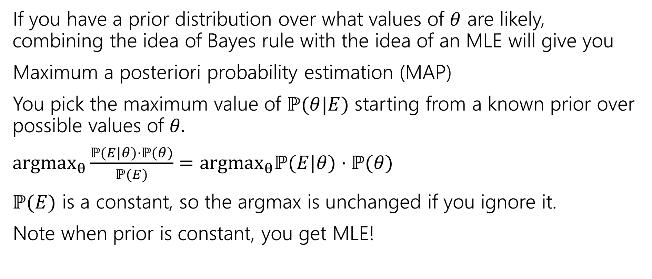
Why use MLEs? Are there other estimators?
If you have a prior distribution over what values of $θ$ are likely, combining the idea of Bayes rule with the idea of an MLE will give you
Maximum a posteriori probability estimation (MAP)
You pick the maximum value of $ℙ(θ|E)$ starting from a known prior over possible values of $θ.$
$argmax_{θ}\frac{ℙ(E|θ)⋅ℙ(θ)}{ℙ(E)}=argmax_{θ}ℙ(E|θ)⋅ℙ(θ)$
$ℙ(E)$ is a constant, so the argmax is unchanged if you ignore it.
Note when prior is constant, you get MLE!

Slide 31
Are our MLE’s accurate?

Slide 32
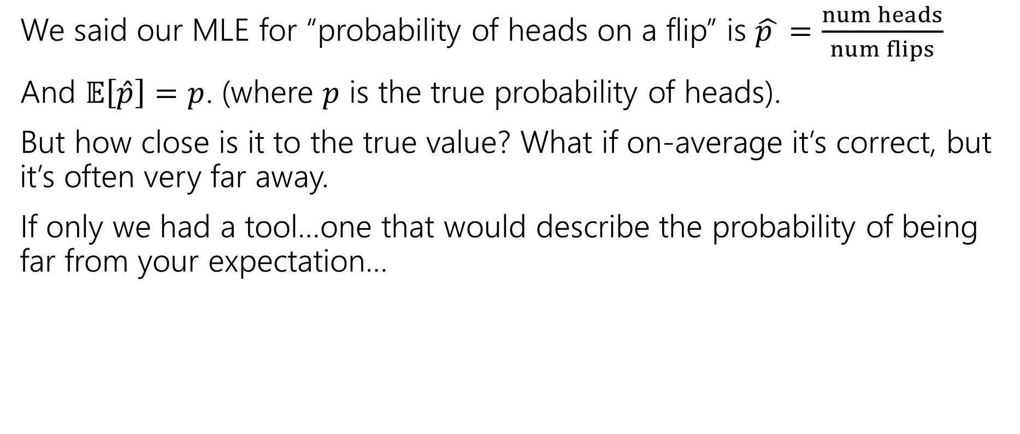
Confidence for MLEs
We said our MLE for “probability of heads on a flip” is $\hat{p }=\frac{num heads}{num flips}$
And $𝔼\left[\hat{p}\right]=p$. (where $p$ is the true probability of heads).
But how close is it to the true value? What if on-average it’s correct, but it’s often very far away.
If only we had a tool…one that would describe the probability of being far from your expectation…

Slide 33
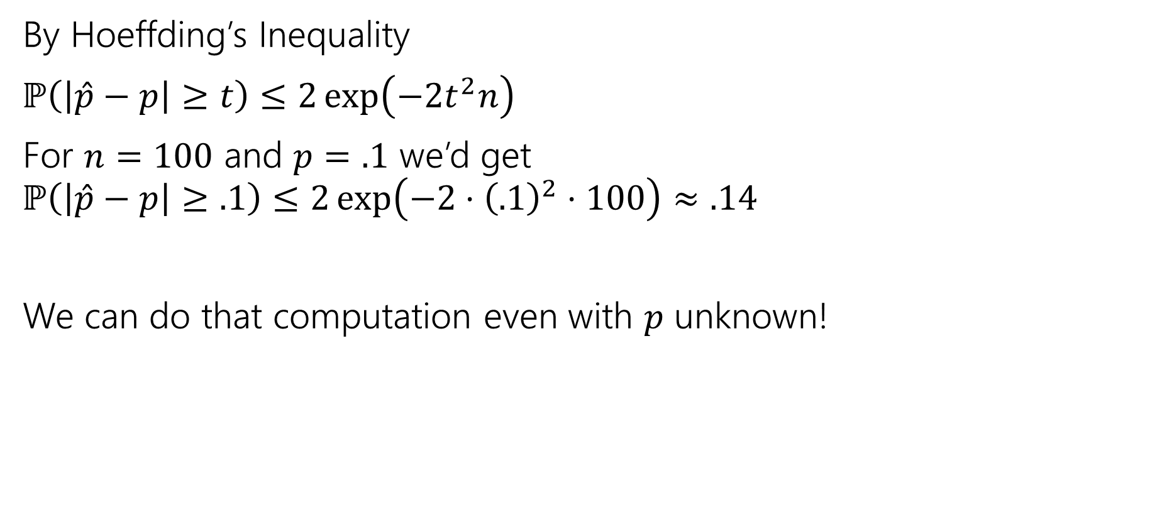
Confidence for MLEs
By Hoeffding’s Inequality
$ℙ\left(\left|\hat{p}−p\right|≥t\right)≤2\exp\left(−2t^{2}n\right)$
For $n=100$ and $p=.1$ we’d get
$ℙ\left(\left|\hat{p}−p\right|≥.1\right)≤2\exp\left(−2⋅{\left(.1\right)}^{2}⋅100\right)≈.14$
We can do that computation even with $p$ unknown!

Slide 34
Optional: one more example

Slide 35
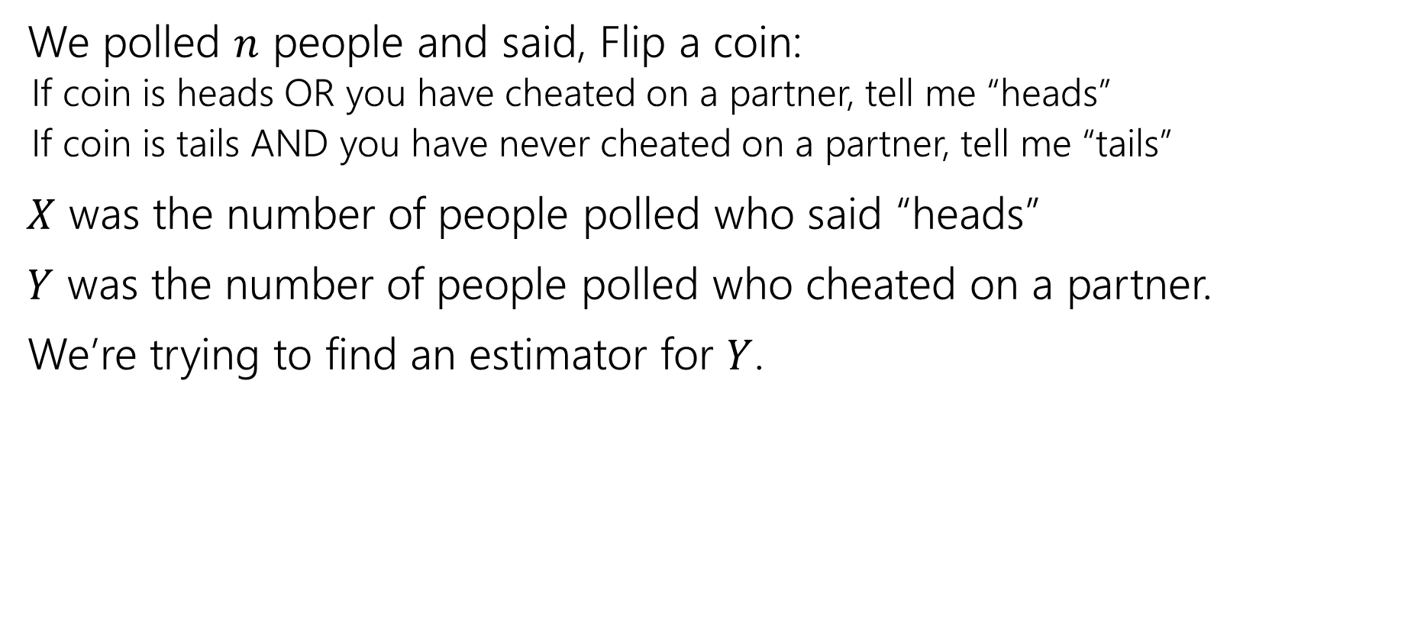

What about $X$ and $Y$ from last Friday?
We polled $n$ people and said, Flip a coin:
  If coin is heads OR you have cheated on a partner, tell me “heads”
  If coin is tails AND you have never cheated on a partner, tell me “tails”
$X$ was the number of people polled who said “heads”
$Y$ was the number of people polled who cheated on a partner.
We’re trying to find an estimator for $Y$.

Slide 36
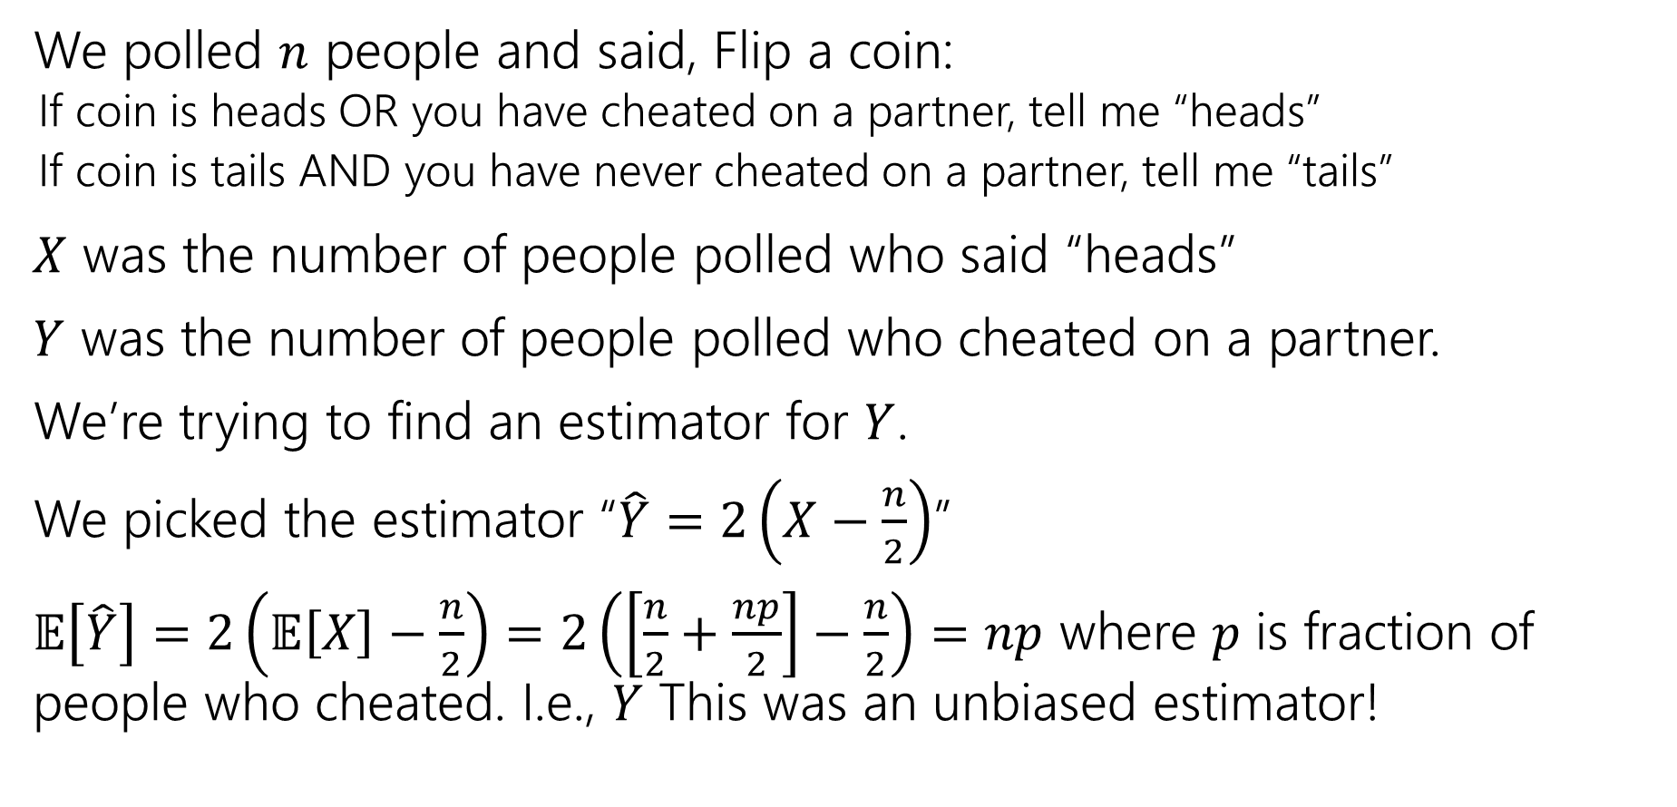
What about $X$ and $Y$ from last Friday?
We polled $n$ people and said, Flip a coin:
  If coin is heads OR you have cheated on a partner, tell me “heads”
  If coin is tails AND you have never cheated on a partner, tell me “tails”
$X$ was the number of people polled who said “heads”
$Y$ was the number of people polled who cheated on a partner.
We’re trying to find an estimator for $Y$.
We picked the estimator “$\hat{Y}=2\left(X−\frac{n}{2}\right)$”
$𝔼\left[\hat{Y}\right]=2\left(𝔼\left[X\right]−\frac{n}{2}\right)=2\left(\left[\frac{n}{2}+\frac{np}{2}\right]−\frac{n}{2}\right)=np$ where $p$ is fraction of people who cheated. I.e., $Y$ This was an unbiased estimator!

Slide 37
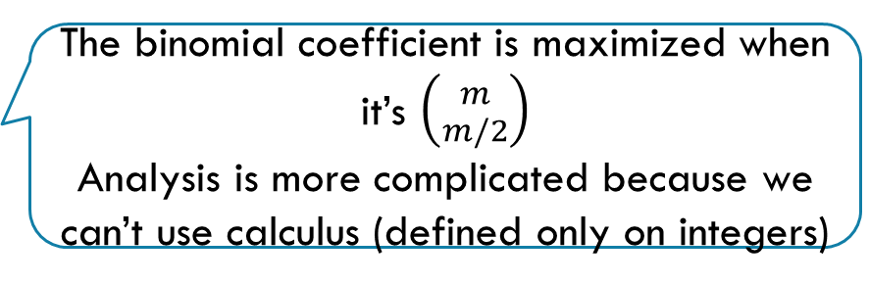
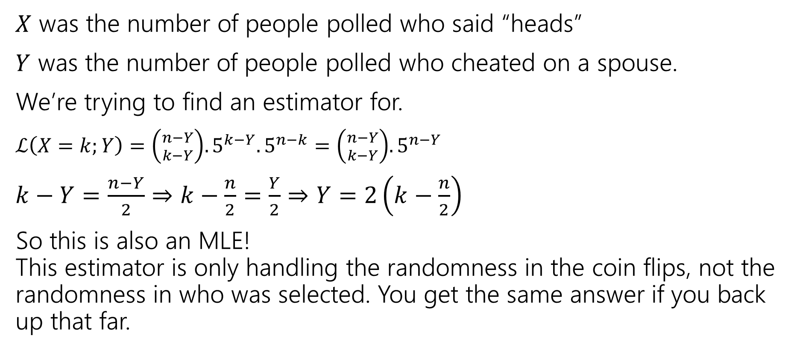
What about $X$ and $Y$ from last Friday?
$X$ was the number of people polled who said “heads”
$Y$ was the number of people polled who cheated on a spouse.
We’re trying to find an estimator for.
$ℒ\left(X=k;Y\right)=\left({n−Y \atop k−Y}\right).5^{k−Y}.5^{n−k}=\left({n−Y \atop k−Y}\right).5^{n−Y}$
$k−Y=\frac{n−Y}{2}⇒k−\frac{n}{2}=\frac{Y}{2}⇒Y=2\left(k−\frac{n}{2}\right)$
So this is also an MLE!
This estimator is only handling the randomness in the coin flips, not the randomness in who was selected. You get the same answer if you back up that far.
The binomial coefficient is maximized when it’s $\left({m \atop m/2}\right)$
Analysis is more complicated because we can’t use calculus (defined only on integers)
Notes:
This is VEEEEEERY hand-wavy; to make this rigorous we have to also deal with Y increasing causing the exponent of .5 to decrease (and therefore the likelihood to go up)

