Slide 1
More Joint Distributions
CSE 312 Winter 25
Lecture 19

Slide 2
Announcements
Ed’s interface for the coding question is broken at the moment.
The underlying code is fine, but it won’t import a library we need.
Gradescope can run the code properly.
Robbie has a ticket with Ed support to get our environment fixed; in the meantime, the coding question will be due with HW7 not HW6 in case you weren’t able to work on it. That’s just the coding question; 1-3 (including the math for distinct elements) still due Wednesday.
Robbie is traveling at the end of this week (at SIGCSE)
TAs will guest lecture on Wednesday/Friday.
Robbie will have access to email but will be slower.

Slide 3
Multiple Random Variables

Slide 4
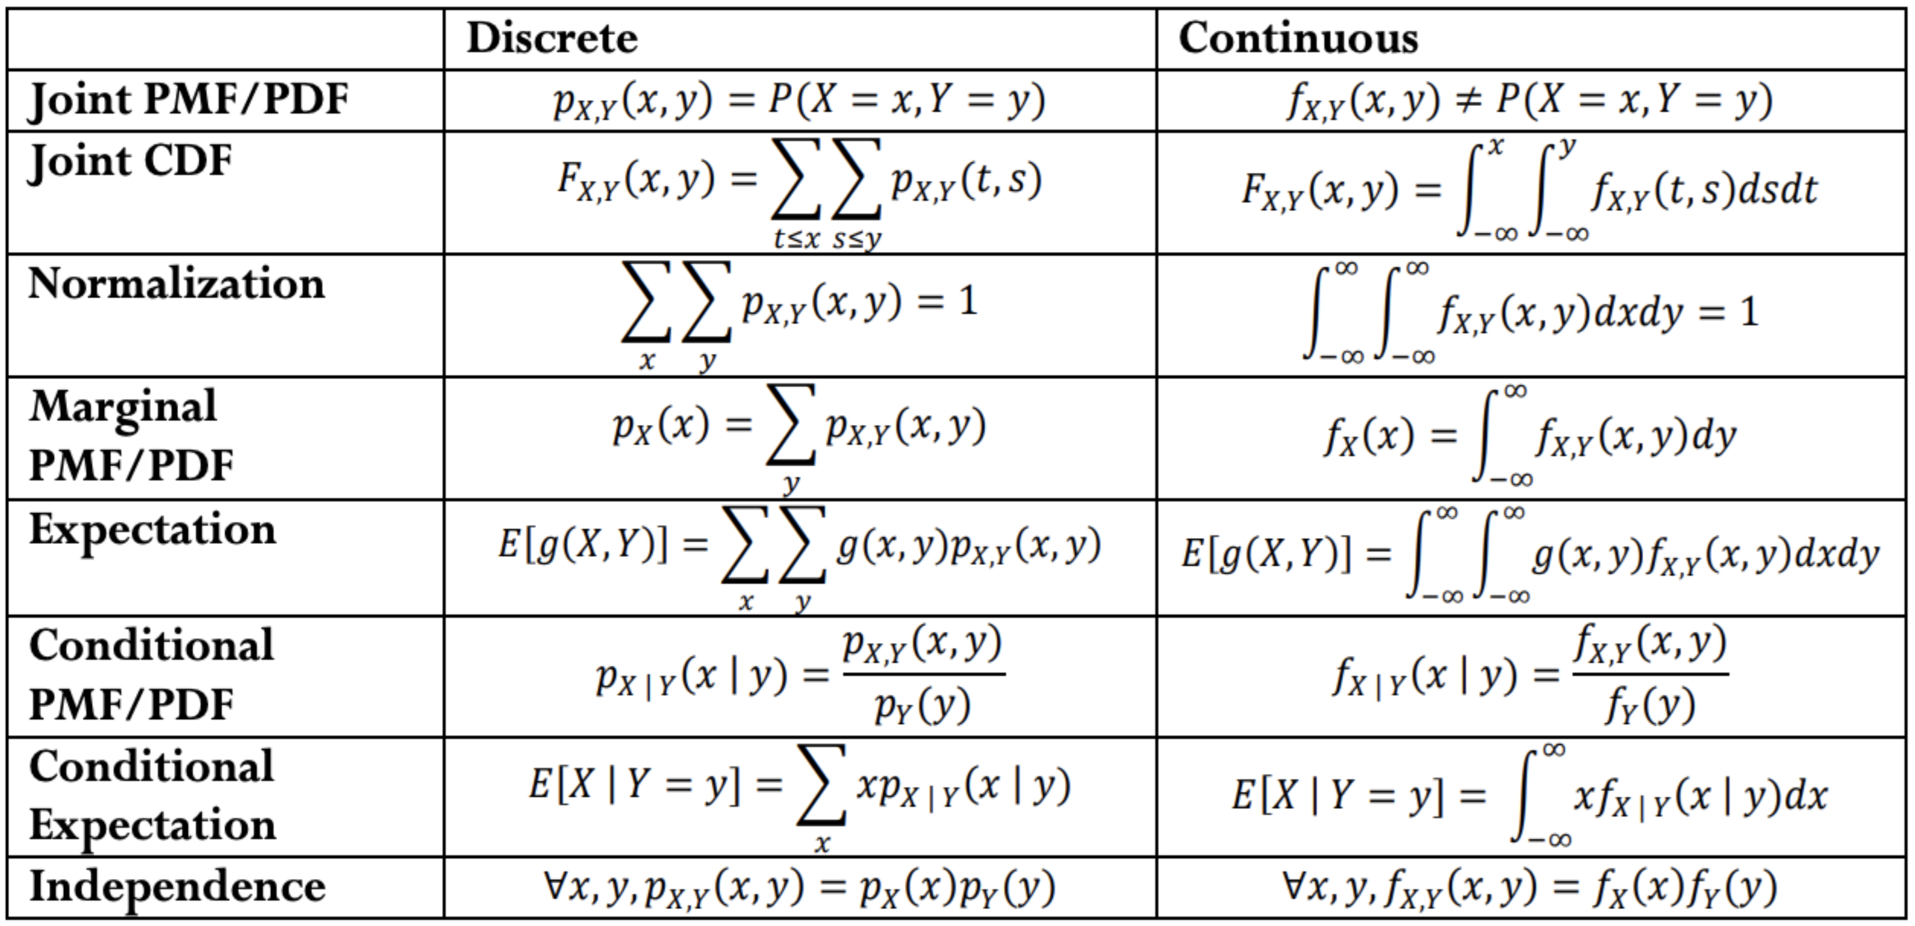
Analogues for continuous
Everything we saw today has a continuous version.
There are “no surprises”– replace pmf with pdf and sums with integrals.

Slide 5
Different dice
Roll two fair dice independently. Let $U$ be the minimum of the two rolls and $V$be the maximum
What is $ℙ(U=2|V=3)$?
$\frac{ℙ\left(U=2∩V=3\right)}{ℙ\left(V=3\right)}=\frac{2/16}{5/16}=\frac{2}{5}$
$p_{U|V}\left(2 | 3\right)=\frac{2}{5}$
$$p_{U,V}$$ | $U$=1 | $U$=2 | $U$=3 | $U$=4
$V$=1 | 1/16 | 0 | 0 | 0
$V$=2 | 2/16 | 1/16 | 0 | 0
$V$=3 | 2/16 | 2/16 | 1/16 | 0
$V$=4 | 2/16 | 2/16 | 2/16 | 1/16

Slide 6
Different dice
Find these values
$p_{V|U}\left(2|1\right)=$
$p_{U|V}\left(1 | 2\right)=$
$p_{U|V}\left(4 | 1\right)=$
$$p_{U,V}$$ | $U$=1 | $U$=2 | $U$=3 | $U$=4
$V$=1 | 1/16 | 0 | 0 | 0
$V$=2 | 2/16 | 1/16 | 0 | 0
$V$=3 | 2/16 | 2/16 | 1/16 | 0
$V$=4 | 2/16 | 2/16 | 2/16 | 1/16

Slide 7
Different dice
Find these values
$p_{V|U}\left(2|1\right)=\frac{p_{V,U}(2,1)}{p_{U}(1)}=\frac{2/16}{7/16}=\frac{2}{7}$
$p_{U|V}\left(1 | 2\right)=\frac{p_{U,V}(1,2)}{p_{V}(2)}=\frac{2/16}{3/16}=\frac{2}{3}$
$p_{U|V}\left(4 | 1\right)=\frac{p_{U,V}(4,1)}{p_{V}(1)}=\frac{0}{1/16}=0$
$$p_{U,V}$$ | $U$=1 | $U$=2 | $U$=3 | $U$=4
$V$=1 | 1/16 | 0 | 0 | 0
$V$=2 | 2/16 | 1/16 | 0 | 0
$V$=3 | 2/16 | 2/16 | 1/16 | 0
$V$=4 | 2/16 | 2/16 | 2/16 | 1/16

Slide 8
What about the continuous versions?
In the continuous case, everything is still a density function, not a mass function.
Joint density
Marginal density
Conditional density
Expectations, conditional expectations integrate $x⋅$(cond)density($x$)
You aren’t getting a probability, you’re getting a density; have to integrate to get a value.

Slide 9
Analogues for continuous
Everything we saw today has a continuous version.
There are “no surprises”– replace pmf with pdf and sums with integrals.

Slide 10
Conditioning on probability 0
We said for discrete spaces, when $ℙ\left(B\right)=0, ℙ(A|B)$ is undefined
How can you condition on something that doesn’t happen?
Also, how can you have $ℙ(B)$ in the denominator?
For continuous spaces, we have to use densities to avoid the problem, but we can avoid the problem with densities!
$f_{X|Y}\left(x | y\right)=\frac{f_{X,Y}(x,y)}{f_{Y}(y)}$
$ℙ(Y=y)$ is $0$, but the density might not be $0$ there so this expression can be defined (and it works!). If density is 0 for $Y=y$, the conditional density is undefined there.

Slide 11
A note on independence
The definition of independence says $X,Y$ independent if and only if
$p_{X,Y}\left(x,y\right)=p_{X}\left(x\right)p_{Y}(y)$ or $f_{X,Y}\left(x,y\right)=f_{X}\left(x\right)f_{Y}(y)$ (as appropriate)
There’s often a nice shortcut. If $X,Y$ are independent then joint support of $X,Y$ (denoted $Ω_{X,Y}$) must be $Ω_{X}×Ω_{Y}$.
Joint support is $\{\left(x,y\right):p_{X,Y}\left(x,y\right)>0\}$.
Often easier to verify dependence when those are different (especially in the continuous case).
But note this is a single implication not an if-and-only-if.
Notes:
$U,V$ from last example can have their dependence verified this way.

Slide 12
Continuous definitions and theorems
Conditional expectation:
$𝔼\left[X | Y=y\right]=\int_{−∞}^{∞}{x⋅f_{X|Y}(x|y)} dx$
LTE:
$𝔼\left[X\right]=\int_{−∞}^{∞}{𝔼[X|Y=y]⋅f_{Y}(y)} dy$
LTP:
$ℙ\left(A\right)=\int_{−∞}^{∞}{ℙ(A|X=x)⋅f_{X}(x)} dx$ $X$ is continuous; integrating over all values for $X$ gives the full space
Notes:
Common use of conditional density is a conditional expectation

Slide 13
Covariance

Slide 14
Covariance
We sometimes want to measure how “intertwined” $X$ and $Y$ are – how much knowing about one of them will affect the other.
If $X$ turns out “big” how likely is it that $Y$ will be “big” how much do they “vary together”
$$Cov\left(X,Y\right)=𝔼\left[\left(X−𝔼\left[X\right]\right)(Y−𝔼\left[Y\right])\right]=𝔼\left[XY\right]−𝔼[X]𝔼[Y]$$
Covariance
Notes:
Covariance can be positive or negative! Positive covariance means (linearly) vary together---X bigger than expectation predicts Y bigger than expectation If covariance is negative than X bigger than expectation predicts Y less than expectation

Slide 15
$$Cov\left(X,Y\right)=𝔼\left[\left(X−𝔼\left[X\right]\right)(Y−𝔼\left[Y\right])\right]=𝔼\left[XY\right]−𝔼[X]𝔼[Y]$$
Covariance
If $X,Y$ go in the same direction
If $X,Y$ go in the opposite directions

Slide 16
Covariance
$Var\left(X+Y\right)=Var\left(X\right)+Var\left(Y\right)+2Cov(X,Y)$
That’s consistent with our previous knowledge for independent variables. (for $X,Y$independent, $𝔼\left[XY\right]=𝔼\left[X\right]𝔼[Y]$).
You and your friend are playing a game, you flip a coin: if heads you pay your friend a dollar, if tails they pay you a dollar. Let $X$ be your profit and $Y$ be your friend’s profit.
What is $Var(X+Y)$?
Before you calculate, make a prediction. What should it be?

Slide 17
Covariance
You and your friend are playing a game, you flip a coin: if heads you pay your friend a dollar, if tails they pay you a dollar. Let $X$ be your profit and $Y$ be your friend’s profit.
What is $Var(X+Y)$? $Cov(X,Y)$?
$Var\left(X\right)=Var\left(Y\right)=𝔼\left[X^{2}\right]−{\left(𝔼\left[X\right]\right)}^{2}=1−0^{2}=1$
$Cov\left(X,Y\right)=𝔼\left[XY\right]−𝔼[X]𝔼[Y]$
$𝔼\left[XY\right]=\frac{1}{2}⋅\left(−1⋅1\right)+\frac{1}{2}\left(1⋅−1\right)=−1$
$Cov\left(X,Y\right)=−1−0⋅0=−1$.
$Var\left(X+Y\right)=1+1+2⋅−1=0$

Slide 18
Covariance, Another example
Let $X$ be a Bernoulli RV with probability $p$ of success.
Let $Y=X$ ($Y$ is $X$, not an iid copy, literally the same experiment)
Let $Z=−X$
Let $W$ be an independent Bernoulli, indentically distributed to$X$
Find
$Cov\left(X,Y\right)$, $Cov\left(X,Z\right), Cov(X,W)$

Slide 19
Covariance, Another example
Let $X$ be a Bernoulli RV with probability $p$ of success.
Let $Y=X$ ($Y$ is $X$, not an iid copy, literally the same experiment)
Let $Z=−X$
Let $W$ be an independent Bernoulli, indentically distributed to$X$
$Cov\left(X,Y\right)=𝔼\left[XY\right]−𝔼\left[X\right]𝔼[Y]$
$=\left(1⋅1⋅p+0⋅0⋅\left[1−p\right]\right)−p⋅p$
$=p−p^{2}=p(1−p)$
Hey, that’s the variance of $X$. This is a pattern: $Cov(X,X)=Var(X)$

Slide 20
Covariance, Another example
Let $X$ be a Bernoulli RV with probability $p$ of success.
Let $Y=X$ ($Y$ is $X$, not an iid copy, literally the same experiment)
Let $Z=−X$
Let $W$ be an independent Bernoulli, indentically distributed to$X$
$Cov\left(X,Z\right)=𝔼\left[XY\right]−𝔼\left[X\right]𝔼[Y]$
$=\left(1⋅−1⋅p+0⋅−0⋅\left[1−p\right]\right)−\left(p⋅\left[−p\right]\right)$
$=−p−\left[−p^{2}\right]=−p(1−p)$
General pattern: $Cov\left(X,−Y\right)=−Cov(X,Y)$
Notes:
Cov(aX,Y)=aCov(X,Y) in general

Slide 21
Covariance, Another example
Let $X$ be a Bernoulli RV with probability $p$ of success.
Let $Y=X$ ($Y$ is $X$, not an iid copy, literally the same experiment)
Let $Z=−X$
Let $W$ be an independent Bernoulli, indentically distributed to$X$
$Cov\left(X,W\right)=𝔼\left[XW\right]−𝔼\left[X\right]𝔼[W]$
$=\left(1⋅1⋅p^{2}+1⋅0⋅p\left[1−p\right]+0⋅1⋅\left[1−p\right]p+0⋅0⋅{\left[1−p\right]}^{2}\right)−\left(p⋅\left[p\right]\right)$
$={(p}^{2})−p^{2}=0$
General pattern: if $X,Y$ independent $Cov(X,Y)=0$
Notes:
Converse is not a general pattern; there are “uncorrelated” random variables which are dependent but have covariance 0.
Covariance only measures “linear” relationship; sometimes higher dimensional relationships are hidden. Taking $X\sim N\left(0,1\right), Y=X^2$ is a standard example, but not worth the effort to compute here.

Slide 22
A Few Notes
Covariance is an un-normalized number.
It measures both how intertwined $X,Y$ are and in some sense how much $X,Y$ vary in the first place (if you multiply both $X,Y$ by $2$, the strength of the relationship intuitively is the same, but covariance increases).
If you want just the strength of the relationship, you probably want the “correlation coefficient”: $\frac{Cov(X,Y)}{\sqrt{Var\left(X\right)Var\left(Y\right)}}$ always between $−1$ and $1$.
Covariance directly measures only “linear” relationships; if $Y$ depends on $X^{2}$, the covariance might not be as high as you expect.
If dealing with real data, look at a plot to see if you should be looking for a linear relationship in the first place.

Slide 23
Covariance
We sometimes want to measure how “intertwined” $X$ and $Y$ are – how much knowing about one of them will affect the other.
If $X$ turns out “big” how likely is it that $Y$ will be “big” how much do they “vary together”
$$Cov\left(X,Y\right)=𝔼\left[\left(X−𝔼\left[X\right]\right)(Y−𝔼\left[Y\right])\right]=𝔼\left[XY\right]−𝔼[X]𝔼[Y]$$
Covariance
Notes:
Covariance can be positive or negative! Positive covariance means

Slide 24
A Continuous-ish Example
Recall from Friday: You will flip $2$ (independent, fair coins). Call the number of heads $X$. Then (independently of the coin flips) draw an exponential random variable $Y$from the distribution $Exp(X+1)$.
Let’s find the PDF of $Y$.
Let $g_{λ}\left(x\right)=λe^{−λx}$, i.e. density for Exp($λ$) (for $x≥0)$
$f_{Y}\left(y\right)=g_{1}\left(y\right)⋅\frac{1}{4}+g_{2}\left(y\right)⋅\frac{1}{2}+g_{3}\left(y\right)⋅\frac{1}{4}$
$f_{Y}\left(y\right)={\frac{1}{4}e}^{−y}+\frac{1}{2}⋅2⋅e^{−2y}+\frac{1}{4}⋅3e^{−3y}$ (for $y≥0)$
Notice this isn’t an exponential random variable!
Notes:
This is an unusual example as it mixes discrete and continuous.

Slide 25
A Continuous-ish Example
Now we can check that expectation…
$𝔼\left[Y\right]=\int_{0}^{∞}{y}\left({\frac{1}{4}e}^{−y}+\frac{1}{2}⋅2⋅e^{−2y}+\frac{1}{4}⋅3e^{−3y}\right)dy$
$=\int_{0}^{∞}{y⋅\frac{1}{4}e^{−y}dy+\int_{0}^{∞}{y}e^{−2y}dy+\int_{0}^{∞}{y}}\frac{1}{4}⋅3e^{−3y}dy$
Integral of $ye^{−y}$ will be $1$, since that’s the expectation of Exp(1)
$=\frac{1}{4}⋅1+\frac{1}{2}\int_{0}^{∞}{2y}e^{−2y}dy+\frac{1}{4}⋅\int_{0}^{∞}{y}3e^{−3y}dy$
Setup for same trick, Exp(2), Exp(3)
$=\frac{1}{4}⋅1+\frac{1}{2}⋅\frac{1}{2}+\frac{1}{4}⋅\frac{1}{3}=\frac{1}{4}+\frac{1}{4}+\frac{1}{12}=\frac{7}{12}$
Notes:
Same as we got with LTE!
Could also get this directly by doing the integrals (requires a bit of integration by parts)

