Slide 1
Central Limit Theorem
CSE 312 Winter 25
Lecture 17

Slide 2
Why Learn Normals?
When we add together independent normal random variables, you get another normal random variable.
The sum of any independent random variables approaches a normal distribution.
Let $X_{1},X_{2},…,X_{n}$ be i.i.d. random variables, with mean $μ$ and variance $σ^{2}$. Let $Y_{n}=\frac{X_{1}+X_{2}+…+X_{n}−nμ}{σ\sqrt{n}}$
As $n→∞$, the CDF of $Y_{n}$ converges to the CDF of $𝒩(0,1)$
Central Limit Theorem

Slide 3
Breaking down the theorem
Let $X_{1},X_{2},…,X_{n}$ be i.i.d. random variables, with mean $μ$ and variance $σ^{2}$. Let $Y_{n}=\frac{X_{1}+X_{2}+…+X_{n}−nμ}{σ\sqrt{n}}$
As $n→∞$, the CDF of $Y_{n}$ converges to the CDF of $𝒩(0,1)$
Central Limit Theorem
Notes:
The X_i are iid. Independence is needed! If X_i are all same RV (i.e. all have the same value, fully dependent) then Y_n is distributed as normalized die roll (i.e. mean 0, variance 1, but still support of size 6)
What is Y_n ? Well, we’re standardizing: subtracting the mean and dividing by the standard deviation.
This is a limit statement as n-> infinity
CDF convergence: your intuition for what it means to a function to converge is good enough here, but take an analysis class if you want to know more Key is Normal! Don’t need a big theorem to say it’s mean 0 variance 1. It’s normality that’s the result of the theorem.

Slide 4
Proof of the CLT?
No.
How is the proof done?
Step 1: Prove that for all positive integers $k, 𝔼\left[{\left(Y_{n}\right)}^{k}\right]→𝔼[Z^{k}]$
Step 2: Prove that if $𝔼\left[{\left(Y_{n}\right)}^{k}\right]=𝔼\left[Z^{k}\right]$ for all $k$ then $F_{Y_{n}}\left(z\right)=F_{Z}(z)$
Notes:
Z is standard normal on this slide
Called the “moments” of the distribution. This is another reason why Variance is a “good” thing, it’s based off moments which are a full description of a RV.

Slide 5
“Proof by example”
The dotted lines show an “empirical pmf” – a pmf estimated by running the experiment a large number of times.
The blue line is the normal rv that the CLT predicts.
Shown are $n=1,2,3,10$

Slide 6
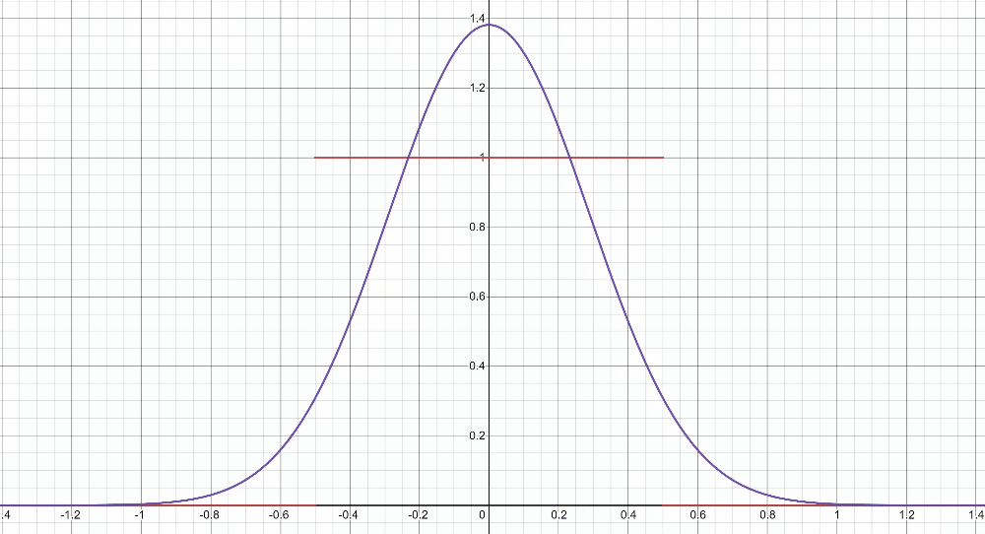
“Proof by example” -- uniform
https://www.desmos.com/calculator/2n2m05a9km

Slide 7
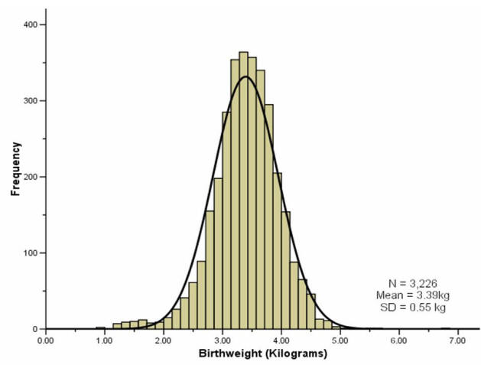
“Proof by real-world”
A lot of real-world bell-curves can be explained as:
1. The random variable comes from a combination of independent factors.
2. The CLT says the distribution will become like a bell curve.
birthweight

Slide 8
Theory vs. Practice
The formal theorem statement is “in the limit”
You might not get exactly a normal distribution for any finite $n$ (e.g. if you sum indicators, your random variable is always discrete and will be discontinuous for every finite $n$.
In practice, the approximations get very accurate very quickly (at least with a few tricks we’ll see soon).
They won’t be exact (unless the $X_{i}$ are normals) but it’s close enough to use even with relatively small $n$.

Slide 9
Using the Central Limit Theorem
Suppose you are managing a factory, that produces widgets. Each widget produced is defective (independently) with probability 5%.
Your factory will produce 1000 (possibly defective) widgets. You want to know what the chances are of having a “very bad day” where “very bad” means producing at most 940 non-defective widgets. (In expectation, you produce 950 non-defective widgets)
What is the probability?

Slide 10
True Answer
Let $X\sim Bin(1000,.95)$
What is $ℙ(X≤940)$?
The cdf is ugly…and that’s a big summation.
$\sum_{k=0}^{940}{\left({1000 \atop k}\right)(.{95)}^{k}⋅(.{05)}^{1000−k}≈}.08673$
What does the CLT give?

Slide 11
CLT setup
Bin(1000,.95) is the sum of a bunch of independent random variables (the indicators/Bernoullis we summed to get the binomial)
So, let’s use the CLT instead
$𝔼\left[X_{i}\right]=p=.95$.
$Var\left(X_{i}\right)=p\left(1−p\right)=.0475$
$Y_{1000}=\frac{\sum_{i=1}^{1000}{X_{i}}−1000⋅.95}{\sqrt{1000⋅.0475}}$ is approximately $𝒩(0,1)$.

Slide 12
With the CLT.
The event we’re interested in is $ℙ(X≤940)$
$ℙ(X≤940$)
$=ℙ\left(\frac{X−1000⋅.95}{\sqrt{1000⋅.0475}}≤\frac{940−1000⋅.95}{\sqrt{1000⋅.0475}}\right)$
$=ℙ(Y_{1000}≤\frac{940−1000⋅.95}{\sqrt{1000⋅.0475}})$
$≈ℙ\left(Y≤\frac{940−1000⋅.95}{\sqrt{1000⋅.0475}}\right)$ by CLT
$=Φ\left(\frac{940−1000⋅.95}{\sqrt{1000⋅.0475}}\right)$
$≈Φ\left(−1.45\right)=1−Φ(1.45)$
$≈1−.92647=.07353$.

Slide 13
It’s an approximation!
The true probability is
$1−\sum_{k=941}^{1000}{\left({1000 \atop k}\right)(.{95)}^{k}⋅(.{05)}^{1000−k}≈}.08673$
The CLT estimate is off by about 1.3 percentage points.
We can get a better estimate if we fix a subtle issue with this approximation.

Slide 14
A problem
What’s the probability that $X=950$? (exactly)
True value, we can get with binomial:
$\left({1000 \atop 950}\right)⋅(.{95)}^{950}⋅(.05)^{50}≈.05779$
What does the CLT say?

Slide 15
A problem
What’s the probability that $X=950$? (exactly)
True value, we can get with binomial:
$\left({1000 \atop 950}\right)⋅(.{95)}^{950}⋅(.05)^{50}≈.05779$
What does the CLT say?
$=ℙ\left(\frac{X−1000⋅.95}{\sqrt{1000}⋅.0475}=\frac{950−1000⋅.95}{\sqrt{1000}⋅.0475}\right)$
$≈ℙ\left(Y=0\right)$
$=0$
Uh oh.

Slide 16
Continuity Correction
The binomial distribution is discrete, but the normal is continuous.
Let’s correct for that (called a “continuity correction”)
Before we switch from the binomial to the normal, ask “what values of a continuous random variable would round to this event?”

Slide 17
Slide from 24AU 312 (Rao/Tessaro)
Assumes discrete RV takes on integer values; if RV has different support, interval is different, but idea is same.

Slide 18
Applying the continuity correction
$ℙ(X=950)$
$=ℙ\left(949.5≤X<950.5\right)$
$=ℙ\left(\frac{949.5−950}{\sqrt{1000⋅.0475}}≤\frac{X−950}{\sqrt{1000⋅.0475}}<\frac{950.5−950}{\sqrt{1000⋅.0475}}\right)$
$≈ℙ\left(\frac{949.5−950}{\sqrt{1000⋅.0475}}≤Y<\frac{950.5−950}{\sqrt{1000⋅.0475}}\right)$ By CLT
$=Φ\left(\frac{950.5−950}{\sqrt{1000⋅.0475}}\right)−Φ\left(\frac{949.5−950}{\sqrt{1000⋅.0475}}\right)$
$≈Φ\left(0.07\right)−Φ\left(−0.07\right)=Φ\left(0.07\right)−(1−Φ(0.07)$)
$≈0.5279−\left(1−0.5279\right)=0.0558$
Continuity correction. This step really is an “exactly equal to” The discrete rv $X$ can’t equal $950.2.$

Slide 19
Still an Approximation
$\left({1000 \atop 950}\right)⋅(.{95)}^{950}⋅(.05)^{50}≈.05779$ is the true value
The CLT approximates: $0.0558$
Very close! But still not perfect.

Slide 20
Let’s fix that other one
Question was “what’s the probability of seeing at most 940 non-defective widgets?”

Slide 21
With the CLT.
The event we’re interested in is $ℙ(X≤940)$
$ℙ(X≤940$)
$=ℙ\left(\frac{X−1000⋅.95}{\sqrt{1000⋅.0475}}≤\frac{940−1000⋅.95}{\sqrt{1000⋅.0475}}\right)$
$≈ℙ\left(Y≤\frac{940−1000⋅.95}{\sqrt{1000⋅.0475}}\right)$ By CLT
$=Φ\left(\frac{940−1000⋅.95}{\sqrt{1000⋅.0475}}\right)$
$≈Φ\left(−1.45\right)=1−Φ(1.45)$
$≈1−.92647=.07353$.
$ℙ(X≤940.5$)
$=ℙ\left(\frac{X−1000⋅.95}{\sqrt{1000⋅.0475}}≤\frac{940.5−1000⋅.95}{\sqrt{1000⋅.0475}}\right)$
$≈ℙ\left(Y≤\frac{940.5−1000⋅.95}{\sqrt{1000⋅.0475}}\right)$By CLT
$=Φ\left(\frac{940.5−1000⋅.95}{\sqrt{1000⋅.0475}}\right)$
$≈Φ\left(−1.38\right)=1−Φ(1.38)$
$≈1−.91621=.08379$.
True answer: $.08673$

Slide 22
Approximating a continuous distribution
You buy lightbulbs that burn out according to an exponential distribution with parameter of $λ=1.8$ lightbulbs per year.
You buy a 10 pack of (independent) light bulbs. What is the probability that your 10-pack lasts at least 5 years?
Let $X_{i}$ be the time it takes for lightbulb $i$ to burn out.
Let $X$ be the total time. Estimate $ℙ(X≥5)$.

Slide 23
Where’s the continuity correction?
There’s no correction to make – it was already continuous!!
$ℙ\left(X≥5\right)$
$=ℙ\left(\frac{X−10/1.8}{\sqrt{10/{1.8}^{2}} }≥\frac{5−10/1.8}{\sqrt{10/{1.8}^{2}}}\right)$
$≈ℙ\left(Y≥\frac{5−10/1.8}{\sqrt{10/{1.8}^{2}}}\right)$ By CLT
$≈ℙ(Y≥−0.32)$
$=1−Φ\left(−0.32\right)=Φ(0.32)$
$≈.62552$
True value (needs a distribution not in our zoo) is $≈0.58741$
Notes:
Sum of n IID exponentials with parameter lambda is a Gamma distribution with paramaters n, 1/lambda https://en.wikipedia.org/wiki/Gamma_distribution

Slide 24
Outline of CLT steps
1. Write event you are interested in, in terms of sum of random variables.
2. Apply continuity correction if RVs are discrete.
3. Standardize RV to have mean $0$ and standard deviation $1$.
4. Replace RV with $𝒩(0,1)$.
5. Write event in terms of $Φ$
6. Look up in table.

Slide 25
Process For Continuity Correction
Let $X$ be the discrete random variable you are approximating with $Y$.
To do a continuity correction, find all real numbers that, when rounded to nearest value in $Ω_{X}$, would be part of the event.
For example, if $X\sim Bin(n,p)$, $Ω_{X}=\{0,1,…,n\}$
To find event $ℙ(X≥6)$, 5.5 rounds to 6, which is $≥6$. 5.4 rounds to 5 not $≥6$. Want $ℙ(X≥5.5)$
To find event $ℙ(X>6)$ 5.5 rounds to 6, which is not >6, 6.1 rounds to 6 which is not > 6, 6.5 rounds to 7; Want $ℙ(X≥6.5)$
To find event $ℙ\left(X=5\right),$ 4.5 rounds to 5, 5.4 rounds to 5, 4.4 rounds to 4. Want $ℙ(4.5≤X<5.5)$

Slide 26
Polling

Slide 27
Polling
Suppose you know that 60% of students support you in your run for student government. If you draw a sample of $30$ students, what is the probability that you don’t get a majority of their votes.
How are you sampling?
Method 1: Get a uniformly random subset of size $30$.
Method 2: Independently draw $30$ people with replacement.
Which do we use?

Slide 28
Polling
Method 1 is what’s accurate to what is actually done…
…but we’re going to use the math from Method 2.
Why? Hypergometric variable formulas are rough, and for increasing population size they’re very close to binomial.
And we’re going to approximate with the CLT anyway, so…the added inaccuracy isn’t a dealbreaker.
If we need other calculations, independence will make any of them easier.

Slide 29
Polling
Let $X_{i}$ be the indicator for “person $i$ in the sample supports you.”
$\overline{X}=\frac{\sum_{i=1}^{n}{X_{i}}}{30}$ is the fraction who support you.
We’re interested in the event $ℙ\left(\overline{X}≤.5\right)$.
What is $𝔼\left[\overline{X}\right]$? What is $Var\left(\overline{X}\right)$?
$𝔼\left[\overline{X}\right]=\frac{1}{30}𝔼\left[{∑X}_{i}\right]=\frac{.6⋅30}{30}=\frac{3}{5}$.
$Var\left(\overline{X}\right)=\frac{1}{{30}^{2}}Var\left(∑X_{i}\right)=\frac{1}{30}⋅.6⋅.4=\frac{1}{125}$.

Slide 30
Using the CLT
$ℙ\left(\overline{X}≤.5\right)$
$=ℙ\left(\frac{\overline{X}−.6}{1/\sqrt{125}}≤\frac{.5−.6}{1/\sqrt{125}}\right)$
$≈ℙ\left(Y≤\frac{.5−.6}{1/\sqrt{125}}\right)$ where $Y\sim 𝒩(0,1)$
$≈ℙ(Y≤−1.12)$
$=Φ\left(−1.12\right)=1−Φ\left(1.12\right)≈1−0.86864=0.13136$

Slide 31
Confidence Intervals
A “confidence interval” tells you the probability (how confident you should be) that your random variable fell in a certain range (interval)
Usually “close to its expected value”
$ℙ\left(\left|X−μ\right|>ε\right)≤δ$
If your RV has expectation equal to the value you’re searching for (like our polling example) you get a probability of being “close enough” to the target value.

Slide 33
Confidence Intervals
Using the CLT, we estimated the probability of “missing low”
There’s a few drawbacks though
1. Using the CLT we get an estimate, not a guarantee---what if the CLT estimate is underestimating the probability of failure?
2. We needed to know the true value to do that computation---if we knew the true value, we wouldn’t run the poll!
Some algebra tricks can handle problem 2, but 1 really asks for a new tool; we’ll see concentration inequalities next week.

Slide 34
CLT Polling Summary

Slide 35
CLT Wrap-up
It’s not ideal that we had an approximation symbol in the middle (that “$≥$” isn’t really a guarantee at this point, it’s an approximation) Observation 1: with our current tools, we wouldn’t get an answer in a reasonable amount of time.
But using a binomial would be even harder.
As $n$ changes, the distribution of a binomial changes. Wolfram alpha isn’t even enough here (unless you have 2+ hours to spare to guess and check values). You need a computer program to get the exact value.
You’re computer scientists! You can write that program. But it takes time.
Observation 2: if you need an absolute guarantee, you won’t get one. The tool you want is a “concentration inequality/tail bound.” We’ll see those next week.

Slide 36
CLT Wrap-up
Use the CLT when:
1. The random variable you’re interested in is the sum of independent random variables.
2. The random variable you’re interested in does not have an easily accessible or easy to use pmf/pdf (or the question you’re asking doesn’t lend itself to easily using the pmf/pdf)
3. You only need an approximate answer, and the sum is of at least a moderate number of random variables.

Slide 37
Application: More Detailed Idealized Polling
This is a *very* detailed example to try to understand confidence intervals better. You may find it helpful to read on your own; we’ll discuss more aspects of computations like these when we get to concentration inequalities in 2 weeks.

Slide 38
Polling
Our end goal is to answer the question “how many people do I need to poll to get an accurate sense of how the population is going to vote?”
That’s a weird question (it’ll require “going backwards” in the algebra) so first we’ll “go forwards” (given the poll size how accurate will we be?) to see what’s happening more clearly.

Slide 39
Polling
Suppose you know that 60% of CSE students support you in your run for SAC. If you draw a sample of $30$ students, what is the probability that you don’t get a majority of their votes.
How are you sampling?
Method 1: Get a uniformly random subset of size $30$.
Method 2: Independently draw $30$ people with replacement.
Which do we use?

Slide 40
Polling
Method 1 is what’s accurate to what is actually done…
…but we’re going to use the math from Method 2.
Why? Hypergometric variable formulas are rough, and for increasing population size they’re very close to binomial.
And we’re going to approximate with the CLT anyway, so…the added inaccuracy isn’t a dealbreaker.
If we need other calculations, independence will make any of them easier.

Slide 41
Polling
Let $X_{i}$ be the indicator for “person $i$ in the sample supports you.”
$\overline{X}=\frac{\sum_{i=1}^{n}{X_{i}}}{30}$ is the fraction who support you.
We’re interested in the event $ℙ\left(\overline{X}≤.5\right)$.
What is $𝔼\left[\overline{X}\right]$? What is $Var\left(\overline{X}\right)$?

Slide 42
Polling
Let $X_{i}$ be the indicator for “person $i$ in the sample supports you.”
$\overline{X}=\frac{\sum_{i=1}^{n}{X_{i}}}{30}$ is the fraction who support you.
We’re interested in the event $ℙ\left(\overline{X}≤.5\right)$.
What is $𝔼\left[\overline{X}\right]$? What is $Var\left(\overline{X}\right)$?
$𝔼\left[\overline{X}\right]=\frac{1}{30}𝔼\left[{∑X}_{i}\right]=\frac{.6⋅30}{30}=\frac{3}{5}$.
$Var\left(\overline{X}\right)=\frac{1}{{30}^{2}}Var\left(∑X_{i}\right)=\frac{1}{30}⋅.6⋅.4=\frac{1}{125}$.

Slide 43
Using the CLT
$ℙ\left(\overline{X}≤.5\right)$
$=ℙ\left(\frac{\overline{X}−.6}{1/\sqrt{125}}≤\frac{.5−.6}{1/\sqrt{125}}\right)$
$≈ℙ\left(Y≤\frac{.5−.6}{1/\sqrt{125}}\right)$ where $Y\sim 𝒩(0,1)$
$≈ℙ(Y≤−1.12)$
$=Φ\left(−1.12\right)=1−Φ\left(1.12\right)≈1−0.86864=0.13136$

Slide 44
Hey! Where’s the continuity correction?
If this were just a question about $n=30,$ we would have used one. But for preparing for the next calculation it made sense to skip it.
What is $\overline{X}$?
It’s the average of a bunch of indicators.
So the support is:
$\frac{0}{n},\frac{1}{n},\frac{2}{n},\frac{3}{n},…,\frac{n−1}{n},\frac{n}{n}$.
Instead of $.5,$we’d use $.5+\frac{1}{2n}$. Which makes the algebra much worse.
And for real polling applications, $n$ is going to be quite big anyway where $\frac{1}{2n}$ is not going to make a substantial difference.

Slide 45
Hey! You didn’t tell us how many students were in CSE!
The accuracy of a poll is dependent on the number of people you sample, not the size of the population.*
Weird right?
This isn’t a trick of the fact that we used the CLT. The same is true if we calculated exactly with a binomial.
*at least for this idealized scenario, where the answer is a simple “yes” or “no” and you can get a uniformly random person. Those things become less likely as populations get bigger.

Slide 46
The Reverse Question
Polls are made by sampling $n$ people from a population. They are then reported with “52% of likely voters would vote in favor of proposal if held today (margin of error +/- 3%)”
You are going to run your own poll. And you want a better “margin of error” – you want 2% how many people do you need to poll?
Let’s think about idealized polling – pretend we’re really getting a uniformly random person.

Slide 47
Margin of Error
Wait…what’s a “margin of error”
The result of the poll is a random variable – it has a distribution.
You’d like to know something about its variance (Did you poll everyone in the entire country? Just 3 people? How much variance is there in the poll?)
A “margin of error” is an intuitive measurement of the variance of the poll. “If I performed this poll repeatedly, 95% of the time, we’re within true +/- the margin of error.”

Slide 48
Our Goal
Set a target – I want my margin of error to be $2\%$. That is, at least $95\%$ of the time, your poll’s estimate of the fraction of people in favor will be within $2$ percentage points of the true value.
So…how many people are you going to need to interview?

Slide 49
Poll Setup
Let $X_{i}$ be the indicator that the $i^{th}$ person you interview supports the proposal.
Your random variable is $\hat{p}$: $∑X_{i}/n$
Let $p$ be the true fraction of people who support the proposal.
What is the
$𝔼\left[\hat{p}\right]=$
$Var\left(\hat{p}\right)=$

Slide 50
Poll Setup
Let $X_{i}$ be the indicator that the $i^{th}$ person you interview supports the proposal.
Your random variable is $\hat{p}$: $∑X_{i}/n$
Let $p$ be the true fraction of people who support the proposal.
What is the
$𝔼\left[\hat{p}\right]=\frac{1}{n}⋅𝔼\left[∑X_{i}\right]=\frac{pn}{n}=p$
$Var\left(\hat{p}\right)=\frac{1}{n^{2}}Var\left(X_{i}\right)=\frac{p\left(1−p\right)}{n}$

Slide 51
Using the CLT
What are we looking for? Well we have a margin of error:
$ℙ\left(p−.02≤\hat{p}≤p+.02\right)≥.95$
That says we’re within the $2\%$ margin of error at least $95\%$of the time.
What is that probability? Well let’s setup to use the CLT. Subtract the expectation and divide by the standard devation.
$ℙ\left(\frac{p−.02−p}{\sqrt{p(1−p)/n}}≤\frac{\hat{p}−p}{\sqrt{p(1−p)/n}}≤\frac{p+.02−p}{\sqrt{p(1−p)/n}}\right)≥.95$

Slide 52
Apply the CLT
$ℙ\left(\frac{p−.02−p}{\sqrt{p(1−p)/n}}≤\frac{\hat{p}−p}{\sqrt{p(1−p)/n}}≤\frac{p+.02−p}{\sqrt{p(1−p)/n}}\right)≥.95$
Is well approximated by $ℙ\left(\frac{−\sqrt{n}⋅.02}{\sqrt{p\left(1−p\right)}}≤Z≤\frac{\sqrt{n}⋅.02}{\sqrt{p\left(1−p\right)}}\right)≥.95$ for $Z\sim 𝒩(0,1)$
So as $n$ changes, the probability changes. So choose the smallest $n$ for which the probability is at least $.95$
WAIT, what’s $\sqrt{p\left(1−p\right)}$? We don’t know $p$. That’s why we’re doing the poll in the first place.

Slide 53
Handling $\sqrt{p\left(1−p\right)}$
Justification 1: If we make a mistake, we want it to be making $n$ bigger. (since we’re trying to say “take $n$ at least this big, and you’ll be safe”).
The bigger the standard deviation, the bigger $n$ will need to be to control it. So assume the biggest possible standard deviation.
Justification 2:
As $\sqrt{p\left(1−p\right)}$ gets bigger, the interval gets smaller (it’s in the denominator), so assuming the biggest value of $\sqrt{p\left(1−p\right)}$ gives us the most restricted interval. So no matter what the true interval is we have a subset of it. And if our probability is at least $.95$ then the true probability is at least $.95$.
What’s the maximum of $\sqrt{p\left(1−p\right)}$?

Slide 54
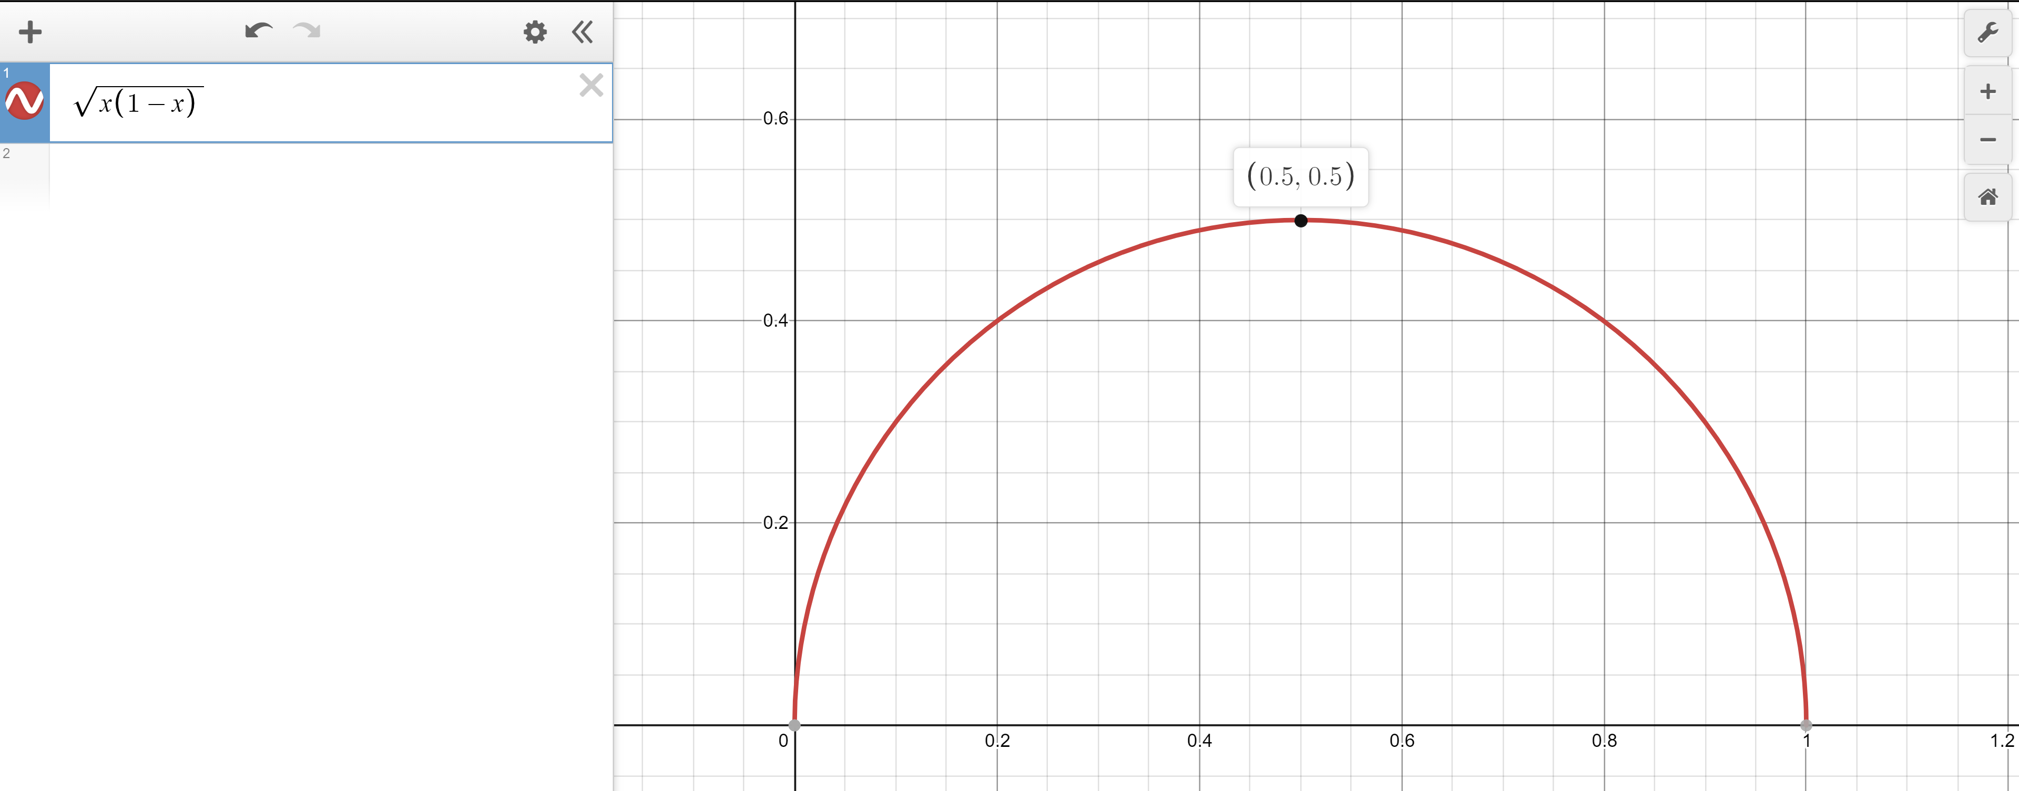
Worst value of $p$
Calculus time!
Set $\frac{d}{dp}\sqrt{p−p^{2}}=0$
$\frac{1}{\sqrt{p−p^{2}}}\left(1−2p\right)=0$
$1−2p=0$ $→p=1/2$
Second derivative test will confirm $p=\frac{1}{2}$ is a maximizer
Or just plot it.
$\sqrt{\frac{1}{2}\left(1−\frac{1}{2}\right)}=\sqrt{1/4}$.

Slide 55
Doing the algebra
$ℙ\left(\frac{p−.02−p}{\sqrt{p(1−p)/n}}≤\frac{\hat{p}−p}{\sqrt{p(1−p)/n}}≤\frac{p+.02−p}{\sqrt{p(1−p)/n}}\right)$
$≈ℙ\left(\frac{−\sqrt{n}⋅.02}{\sqrt{p\left(1−p\right)}}≤Z≤\frac{\sqrt{n}⋅.02}{\sqrt{p\left(1−p\right)}}\right)$ by CLT; $Z\sim 𝒩(0,1)$
$≥ℙ\left(\frac{−\sqrt{n}⋅.02}{\sqrt{1/4}}≤Z≤\frac{\sqrt{n}⋅.02}{\sqrt{1/4}}\right)$
$=ℙ\left(−.04\sqrt{n}≤Z≤.04\sqrt{n}\right)$
$=Φ\left(.04\sqrt{n}\right)−\left(1−Φ\left(.04\sqrt{n}\right)\right)=2Φ\left(.04\sqrt{n}\right)−1$
$2Φ\left(.04\sqrt{n}\right)−1≥.95$ $→$ $Φ\left(.04\sqrt{n}\right)≥\frac{1.95}{2}$

Slide 56
Using the $Φ$-table
$Φ\left(.04\sqrt{n}\right)≥.975$
$Φ$-table says:
$.04\sqrt{n}≥1.96$
$\sqrt{n}≥49$
$n≥2401$. gives $95\%$ confidence interval of +/- $2\%.$
I.e. $95\%$ of the time, our poll gets a value within $2\%$ of the true value.

Slide 57
Breaking down the theorem
Let $X_{1},X_{2},…,X_{n}$ be i.i.d. random variables, with mean $μ$ and variance $σ^{2}$. Let $Y_{n}=\frac{X_{1}+X_{2}+…+X_{n}−nμ}{σ\sqrt{n}}$
As $n→∞$, the CDF of $Y_{n}$ converges to the CDF of $𝒩(0,1)$
Central Limit Theorem
Notes:
The X_i are iid. Independence is needed! If X_i are all same RV (i.e. all have the same value, fully dependent) then Y_n is distributed as normalized die roll (i.e. mean 0, variance 1, but still support of size 6)
What is Y_n ? Well, we’re standardizing: subtracting the mean and dividing by the standard deviation.
This is a limit statement as n-> infinity
CDF convergence: your intuition for what it means to a function to converge is good enough here, but take an analysis class if you want to know more Key is Normal! Don’t need a big theorem to say it’s mean 0 variance 1. It’s normality that’s the result of the theorem.

Slide 58
