Slide 1
Normal RVs
CSE 312 Winter 25
Lecture 16

Slide 2
Announcements
Midterm information posted.
Fill out the conflict form as soon as possible (by Friday) if you need a conflict.
Lecture slots next Wednesday (day of midterm) are just (optional) last-minute Q&A

Slide 3
Continuous Zoo
$$X\sim Unif(a,b)$$
$$X\sim Exp(λ)$$
$$X\sim 𝒩(μ,σ^{2})$$
$$f_{X}\left(k\right)=\frac{1}{b−a}$$
$$𝔼\left[X\right]=\frac{a+b}{2}$$
$$Var\left(X\right)=\frac{{\left(b−a\right)}^{2}}{12}$$
$f_{X}\left(k\right)=λe^{−λk}$ for $k≥0$
$$𝔼\left[X\right]=\frac{1}{λ}$$
$$Var\left(X\right)=\frac{1}{λ^{2}}$$
$$f_{X}\left(k\right)=\frac{1}{σ\sqrt{2π}}exp\left(−\frac{{\left(x−μ\right)}^{2}}{2σ^{2}}\right)$$
$$𝔼\left[X\right]=μ$$
$$Var\left(X\right)=σ^{2}$$
It’s a smaller zoo, but it’s just as much fun!

Slide 4
Exponential
$X\sim Exp(λ)$
Parameter $λ≥0$ is the average number of events in a unit of time.
$f_{X}\left(k\right)=\left\{\begin{aligned}λe^{−λk} if k≥0 \\ 0 otherwise\end{aligned}\right.$
$F_{X}\left(k\right)=\left\{\begin{aligned}1−e^{−λk} if k≥0 \\ 0 otherwise\end{aligned}\right.$
$𝔼\left[X\right]=\frac{1}{λ}$
$Var\left(X\right)=\frac{1}{λ^{2}}$

Slide 5
Are these memoryless?
You arrive to a bus stop at a (uniformly) random time, to a bus that arrives every 10 minutes. How long until the bus arrives? How long conditioned on you’ve already waited 8 minutes?
You put everyone in class into a random order. You’ll iterate through that list. What is the probability of being next? Probability of being next conditioned on not selected yet AND half the class has gone?
You flip a coin (independently) until you see a heads. How many flips do you need? How many additional flips after seeing 4 tails?

Slide 6
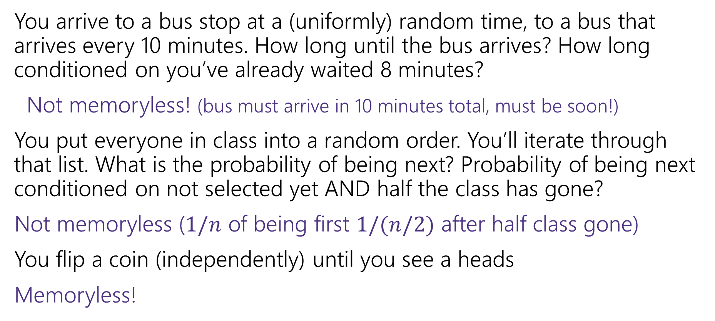
Are these memoryless?
You arrive to a bus stop at a (uniformly) random time, to a bus that arrives every 10 minutes. How long until the bus arrives? How long conditioned on you’ve already waited 8 minutes?
Not memoryless! (bus must arrive in 10 minutes total, must be soon!)
You put everyone in class into a random order. You’ll iterate through that list. What is the probability of being next? Probability of being next conditioned on not selected yet AND half the class has gone?
Not memoryless ($1/n$ of being first $1/(n/2)$ after half class gone)
You flip a coin (independently) until you see a heads
Memoryless!

Slide 7
A continuous memoryless RV?
Poisson random variables come from a memoryless-type process.
Number of earthquakes (people in bakery, days with snow) would be memoryless under assumption that events are independent of each other!
Same experiments, but now ask a different question:
Poisson: how many incidents occur in fixed interval?
Exponential: how long do I have to wait to see the next incident?

Slide 8
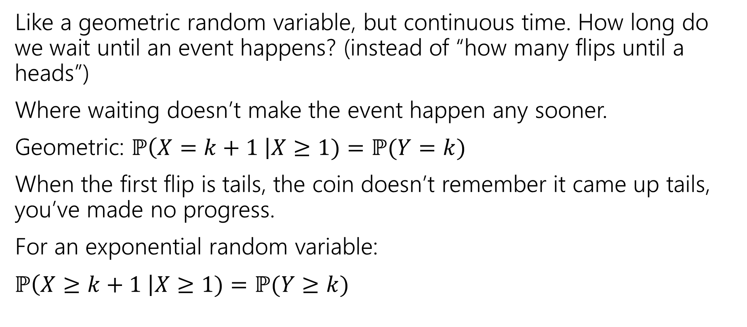
Exponential Random Variable
Like a geometric random variable, but continuous time. How long do we wait until an event happens? (instead of “how many flips until a heads”)
Where waiting doesn’t make the event happen any sooner.
Geometric: $ℙ\left(X=k+1 \right|X≥1)=ℙ(Y=k)$
When the first flip is tails, the coin doesn’t remember it came up tails, you’ve made no progress.
For an exponential random variable:
$ℙ\left(X≥k+1 \right|X≥1)=ℙ(Y≥k)$

Slide 9
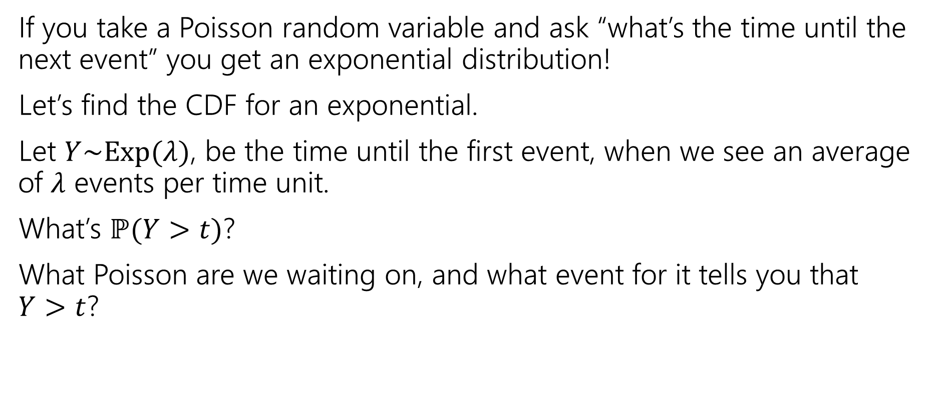
Exponential random variable
If you take a Poisson random variable and ask “what’s the time until the next event” you get an exponential distribution!
Let’s find the CDF for an exponential.
Let $Y\sim Exp(λ)$, be the time until the first event, when we see an average of $λ$ events per time unit.
What’s $ℙ(Y>t)$?
What Poisson are we waiting on, and what event for it tells you that
$Y>t$?

Slide 10
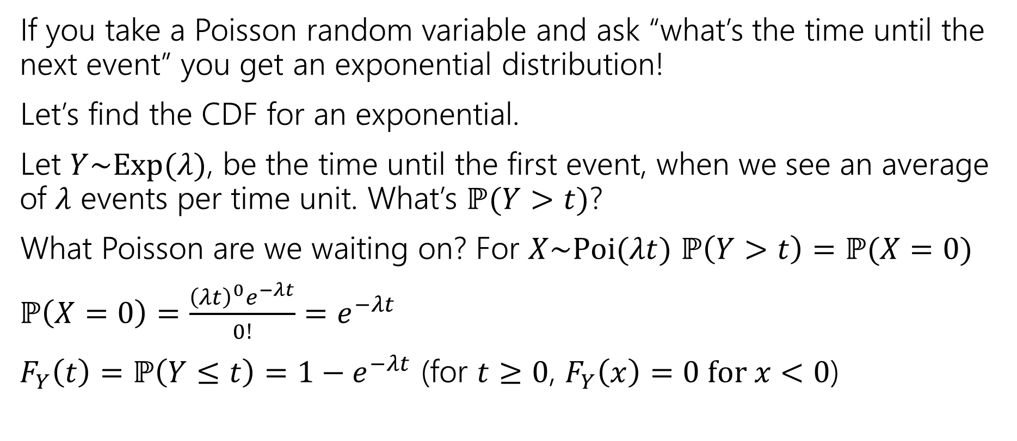
Exponential random variable
If you take a Poisson random variable and ask “what’s the time until the next event” you get an exponential distribution!
Let’s find the CDF for an exponential.
Let $Y\sim Exp(λ)$, be the time until the first event, when we see an average of $λ$ events per time unit. What’s $ℙ(Y>t)$?
What Poisson are we waiting on? For $X\sim Poi(λt)$ $ℙ\left(Y>t\right)=ℙ(X=0)$
$ℙ\left(X=0\right)=\frac{{\left(λt\right)}^{0}e^{−λt}}{0!}=e^{−λt}$
$F_{Y}\left(t\right)=ℙ\left(Y≤t\right)=1−e^{−λt}$ (for $t≥0$, $F_{Y}\left(x\right)=0 for x<0$)

Slide 11
Find the density
We know the CDF, $F_{Y}\left(t\right)=ℙ\left(Y≤t\right)=1−e^{−λt}$
What’s the density?
$f_{Y}\left(t\right)=$

Slide 12
Find the density
We know the CDF, $F_{Y}\left(t\right)=ℙ\left(Y≤t\right)=1−e^{−λt}$
What’s the density?
$f_{Y}\left(t\right)=\frac{d}{dt}\left(1−e^{−λt}\right)=0−\frac{d}{dt}\left(e^{−λt}\right)=λe^{−λt}$.
For $t≥0$ it’s that expression
For $t<0$ it’s just $0.$

Slide 13
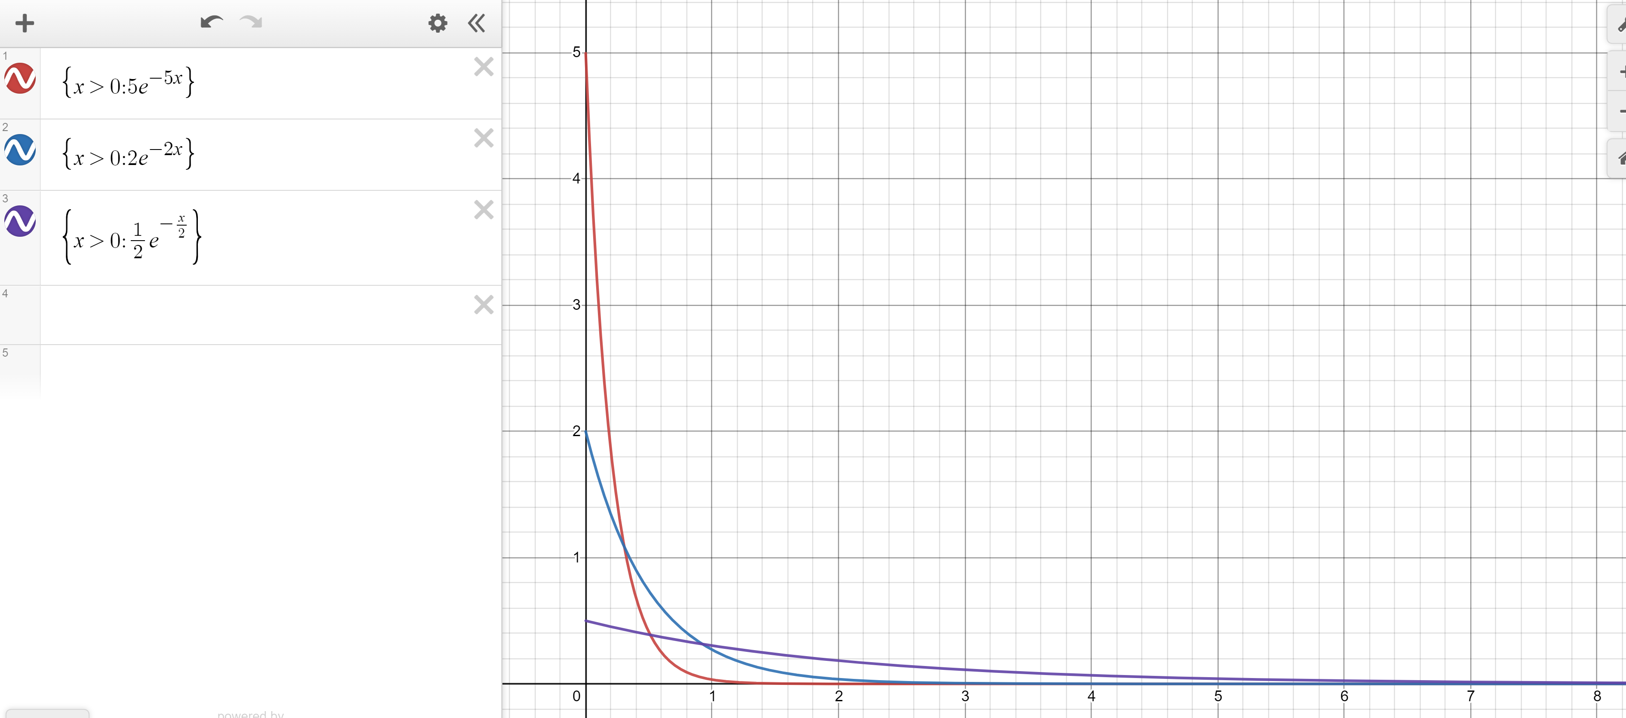
Exponential PDF
Red: $λ=5$
Blue: $λ=2$
Purple: $λ=0.5$

Slide 14
Memorylessness
$ℙ\left(X≥k+1 | X≥1\right)=\frac{ℙ(X≥k+1∩X≥1)}{ℙ(X≥1)}=\frac{ℙ(X≥k+1)}{1−(1−e^{−λ⋅1})}$
$=\frac{e^{−λ(k+1)}}{e^{−λ}}=e^{−λk}$
What about $ℙ(X≥k)$ (without conditioning on the first step)?
${1−(1−e}^{−λk})=e^{−λk}$
It’s the same!!!
More generally, for an exponential rv $X,$ $ℙ\left(X≥s+t | X≥s\right)=ℙ(X≥t)$

Slide 15
Side note
I hid a trick in that algebra,
$ℙ\left(X≥1\right)=1−ℙ\left(X<1\right)=1−ℙ(X≤1)$
The first step is the complementary law.
The second step is using that $\int_{1}^{1}{f_{X}\left(z\right)dz}=0$
In general, for continuous random variables we can switch out $≤$ and $<$without anything changing.
  We can’t make those switches for discrete random variables.

Slide 16
Expectation of an exponential
Don’t worry about the derivation (it’s here if you’re interested; you’re not responsible for the derivation. Just the value.
Let $X\sim Exp(λ)$
$𝔼\left[X\right]=\int_{−∞}^{∞}{{z⋅f}_{X}\left(z\right)dz}$
$=\int_{0}^{∞}{z⋅λe^{−λz}}dz$
Let $u=z; dv=λe^{−λz}dz$ ($v=−e^{−λz}$)
Integrate by parts:$−ze^{−λz}−\int{−e^{−λz}}dz=−ze^{−λz}−\frac{1}{λ}e^{−λz}$
Definite Integral:$−ze^{−λz}−\frac{1}{λ}e^{−λz}{\left.​\right|}_{z=0}^{∞}=(\lim_{z→∞}{−ze^{−λz}−\frac{1}{λ}e^{−λz}) −(0−\frac{1}{λ})}$
By L’Hopital’s Rule $(\lim_{z→∞}{−\frac{z}{e^{λz}}−\frac{1}{λe^{λz}}) −(0−\frac{1}{λ})}=\left(\lim_{z→∞}−\frac{1}{λe^{λz}}\right)+\frac{1}{λ}=\frac{1}{λ}$

Slide 17
Variance of an exponential
If $X\sim Exp\left(λ\right)then Var\left(X\right)=\frac{1}{λ^{2}}$
Similar calculus tricks will get you there.

Slide 18
Exponential
$X\sim Exp(λ)$
Parameter $λ≥0$ is the average number of events in a unit of time.
$f_{X}\left(k\right)=\left\{\begin{aligned}λe^{−λk} if k≥0 \\ 0 otherwise\end{aligned}\right.$
$F_{X}\left(k\right)=\left\{\begin{aligned}1−e^{−λk} if k≥0 \\ 0 otherwise\end{aligned}\right.$
$𝔼\left[X\right]=\frac{1}{λ}$
$Var\left(X\right)=\frac{1}{λ^{2}}$

Slide 19
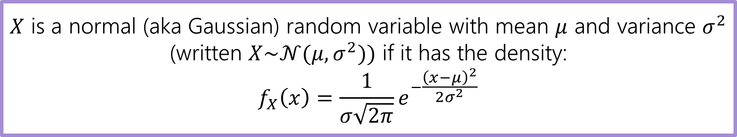
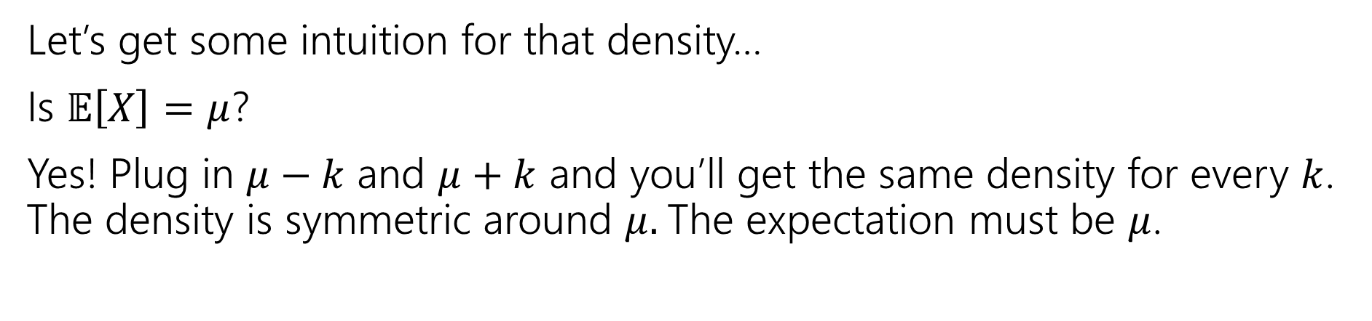
Normal Random Variable
$X$ is a normal (aka Gaussian) random variable with mean $μ$ and variance $σ^{2}$ (written $X\sim 𝒩(μ,σ^{2}))$ if it has the density:
$$f_{X}\left(x\right)=\frac{1}{σ\sqrt{2π}}e^{−\frac{{\left(x−μ\right)}^{2}}{2σ^{2}}}$$
Let’s get some intuition for that density…
Is $𝔼\left[X\right]=μ$?
Yes! Plug in $μ−k$ and $μ+k$ and you’ll get the same density for every $k$. The density is symmetric around $μ.$The expectation must be $μ$.

Slide 20
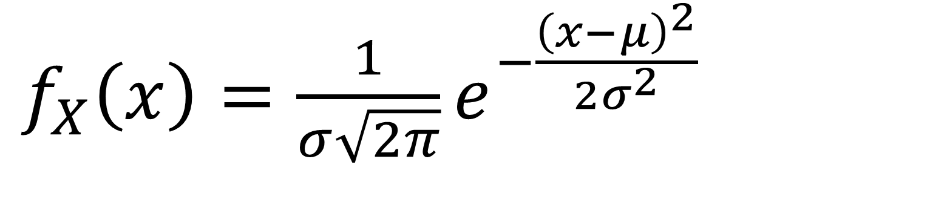
Breaking down the density
$f_{X}\left(x\right)=\frac{1}{σ\sqrt{2π}}e^{−\frac{{\left(x−μ\right)}^{2}}{2σ^{2}}}$
Notes:
Constant 1 / sigma sqrt(2 pi) makes sure when we integrate we get 1
e to the negative power, means we expect exponential decay
x minus mu squared says exponential decay is fast as you move away from the mean, and in either direction
/2 sigma squared controls the rate at which decay occurs (if variance is larger, you decay slower)

Slide 21
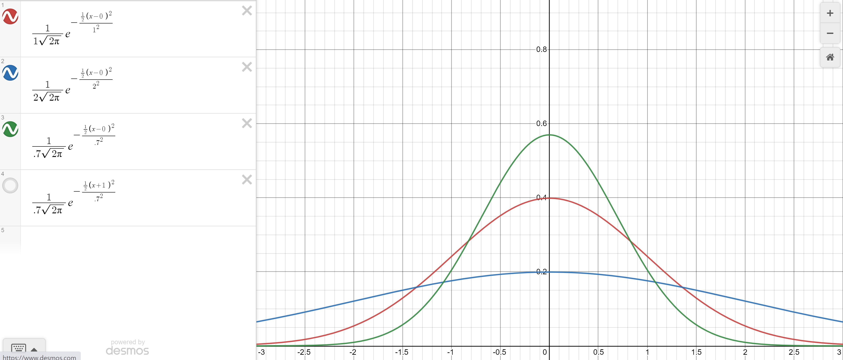

Changing the variance
Green: $σ^{2}=.7$
Red $σ^{2}=1$
Blue: $σ^{2}=2$

Slide 22
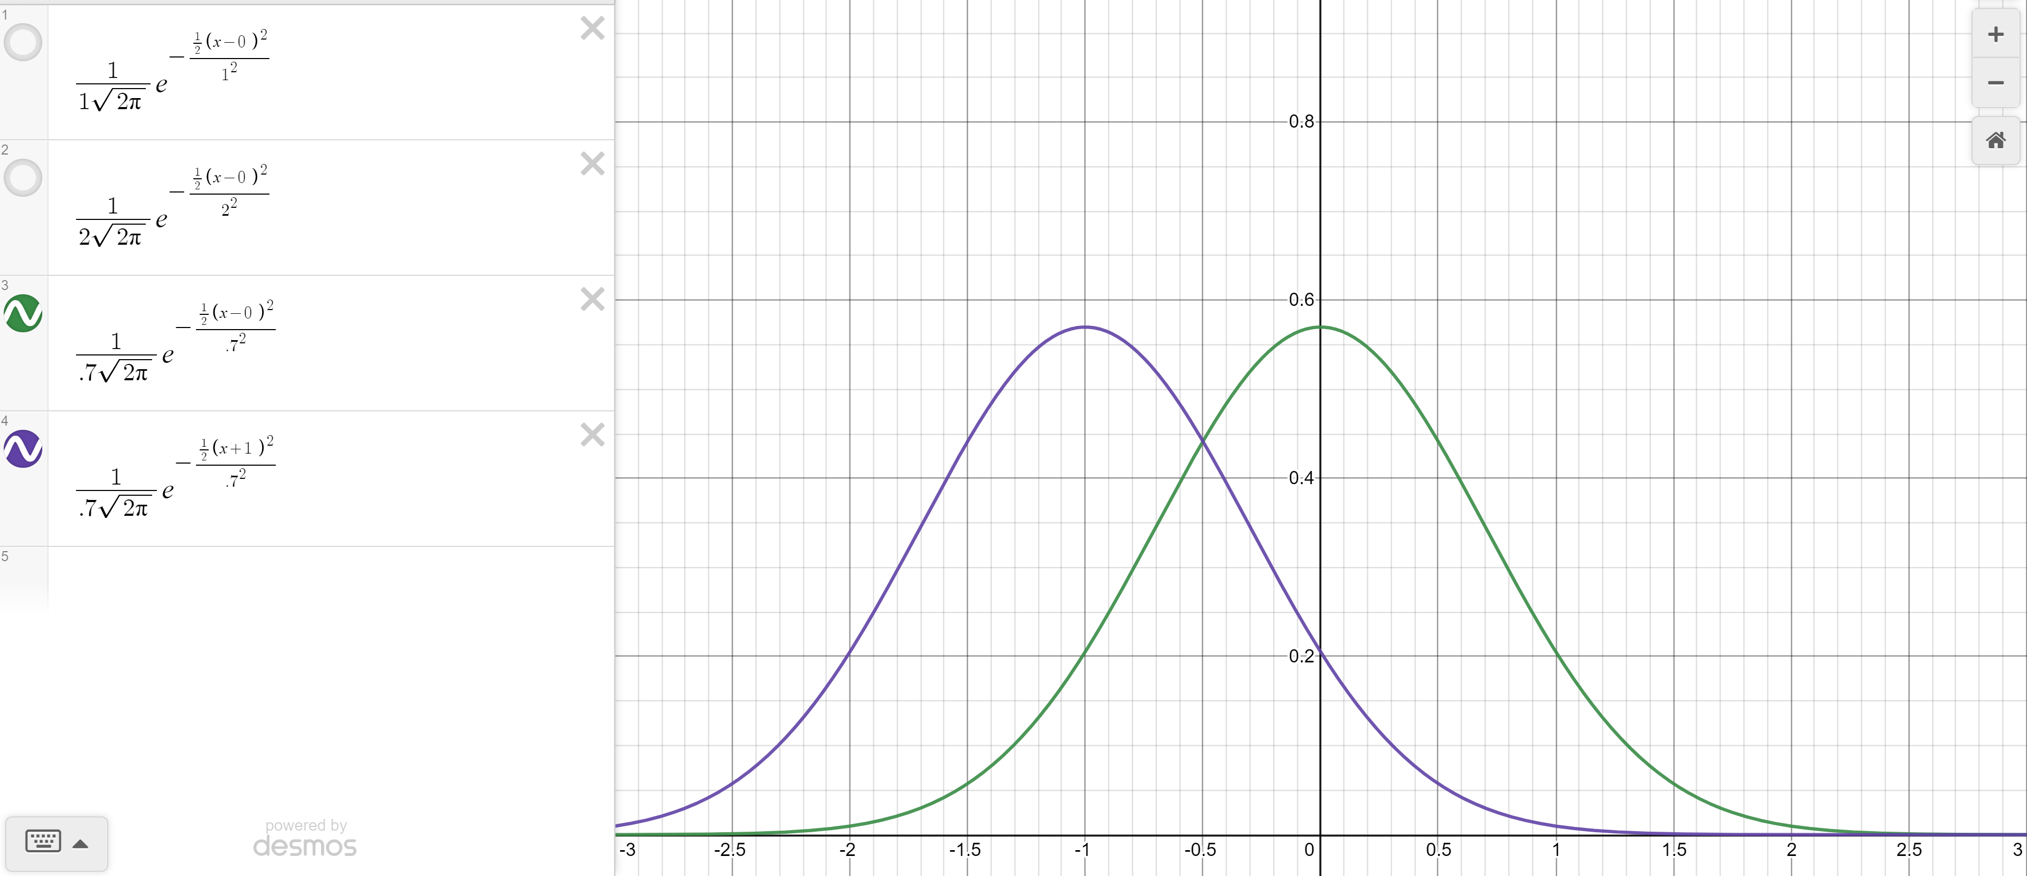

Changing the mean
Green: $σ^{2}=.7, μ=0$
Purple $σ^{2}=.7, μ=−1$

Slide 23
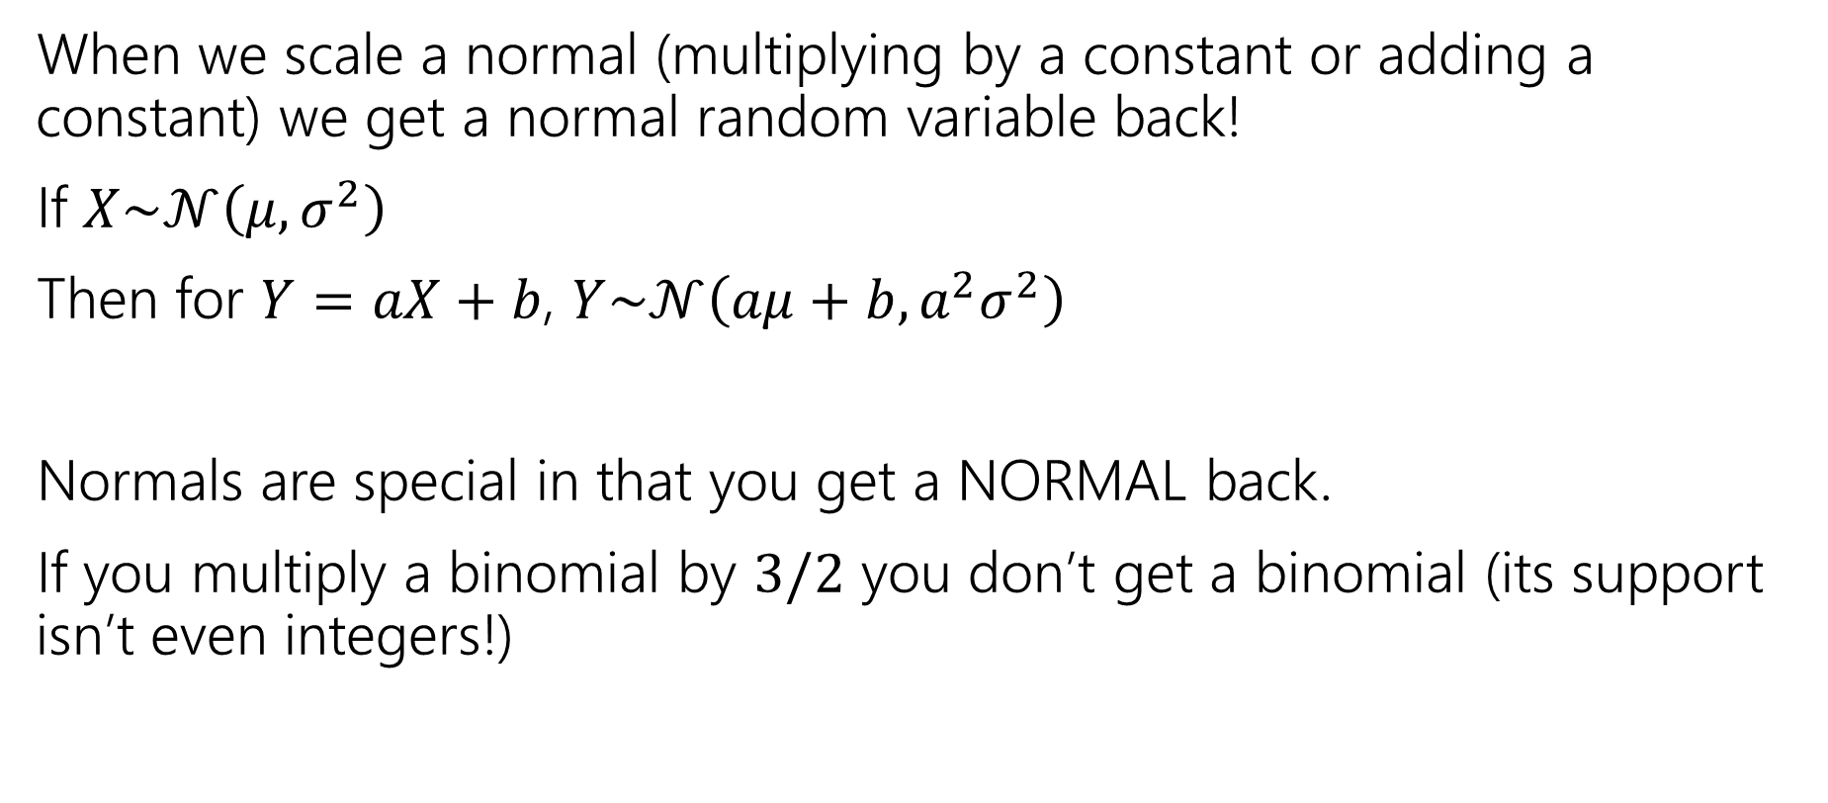
Scaling Normals
When we scale a normal (multiplying by a constant or adding a constant) we get a normal random variable back!
If $X\sim 𝒩\left(μ,σ^{2}\right)$
Then for $Y=aX+b$, $Y\sim 𝒩\left(aμ+b, a^{2}σ^{2}\right)$
Normals are special in that you get a NORMAL back.
If you multiply a binomial by $3/2$ you don’t get a binomial (its support isn’t even integers!)

Slide 24
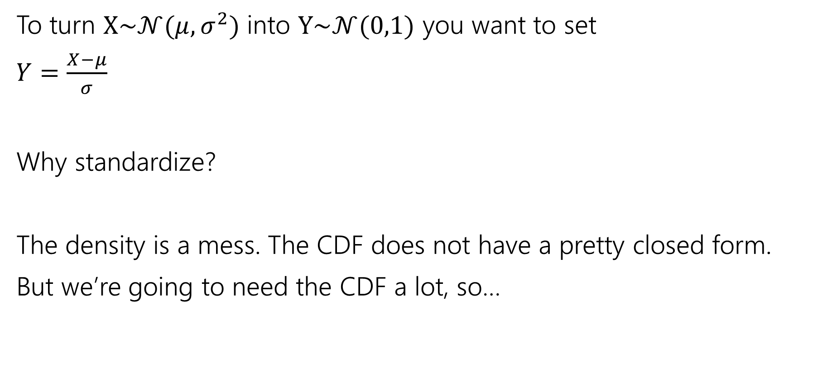
Standardize
To turn $X\sim 𝒩(μ,σ^{2})$ into $Y\sim 𝒩(0,1)$ you want to set
$Y=\frac{X−μ}{σ}$
Why standardize?
The density is a mess. The CDF does not have a pretty closed form.
But we’re going to need the CDF a lot, so…
Notes:
You’ll be tempted to say “normalize” because normal means….normal. But we really want to say “standardize” the “standard” one has mean 0 variance 1.

Slide 25
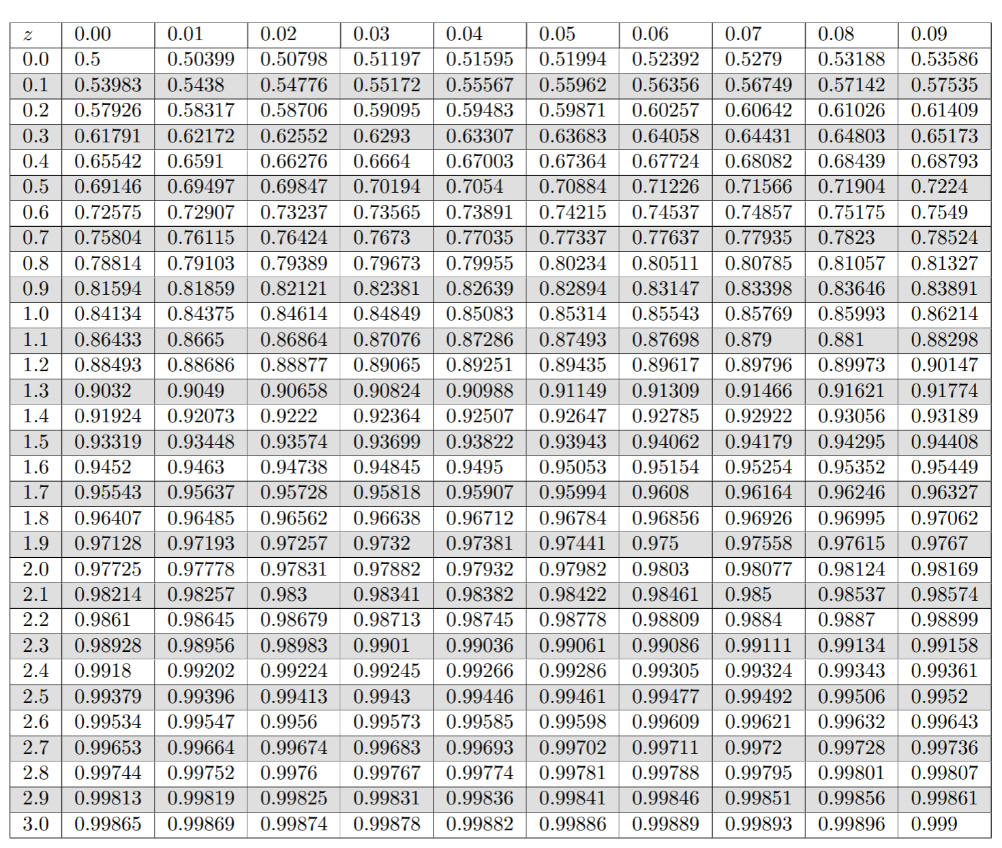
Table of Standard Normal CDF
The way we’ll evaluate the CDF of a normal is to:
1. convert to a standard normal
2. Round the “z-score” to the hundredths place.
3. Look up the value in the table.
It’s 2025, we’re using a table?
The table makes sure we have consistent rounding rules (makes it easier for us to debug with you).
You can’t evaluate this by hand – the “z-score” can give you intuition right away.

Slide 26
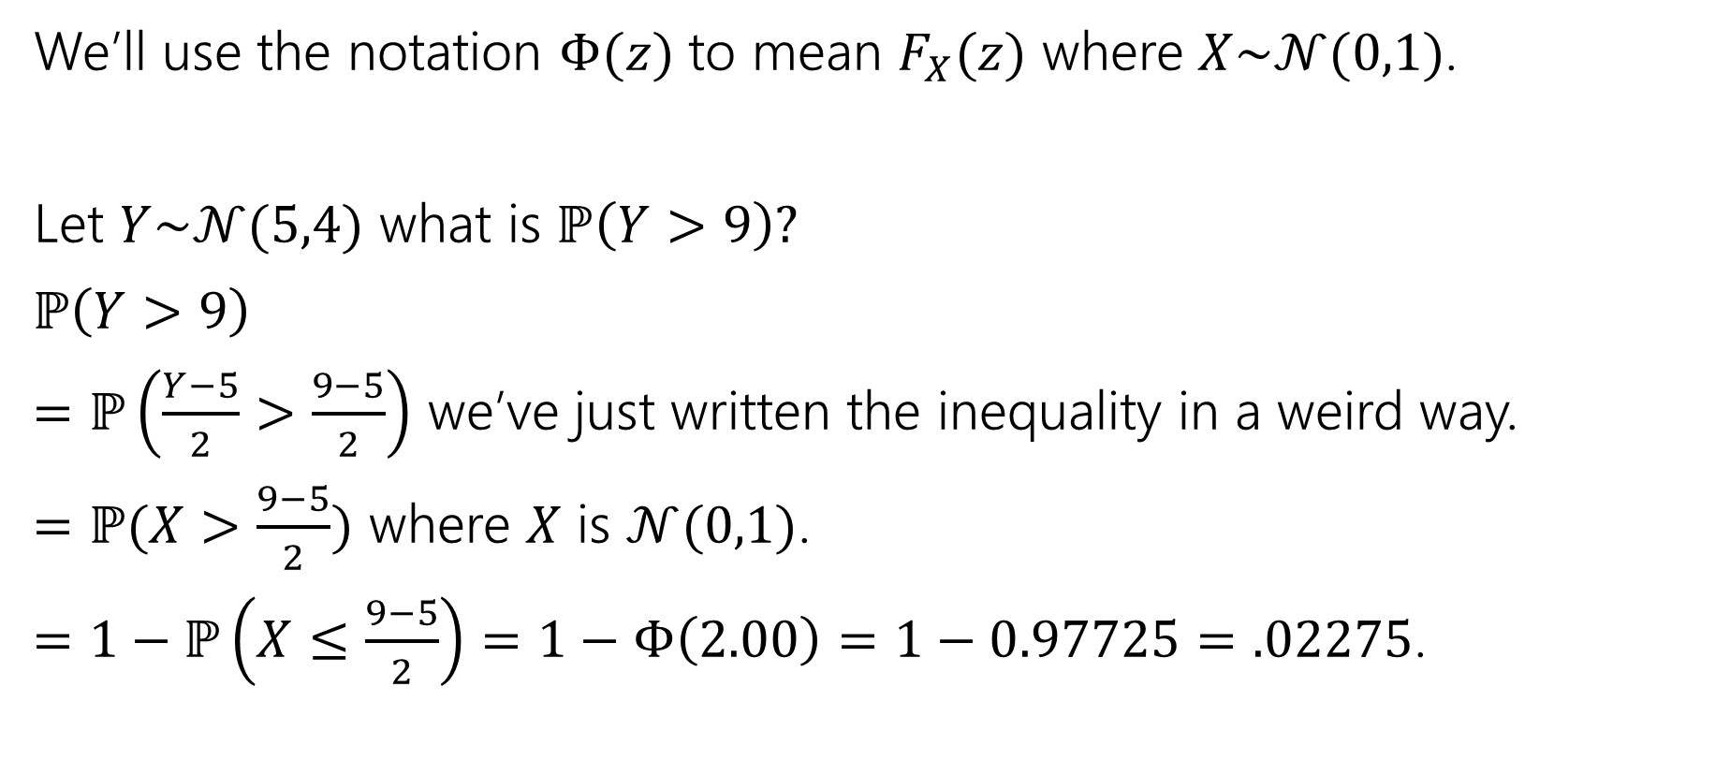
Use the table!
We’ll use the notation $Φ(z)$ to mean $F_{X}(z)$ where $X\sim 𝒩(0,1)$.
Let $Y\sim 𝒩(5,4)$ what is $ℙ\left(Y>9\right)?$
$ℙ\left(Y>9\right)$
$=ℙ\left(\frac{Y−5}{2}>\frac{9−5}{2}\right)$ we’ve just written the inequality in a weird way.
$=ℙ(X>\frac{9−5}{2})$ where $X$ is $𝒩(0,1)$.
$=1−ℙ\left(X≤\frac{9−5}{2}\right)=1−Φ\left(2.00\right)=1−0.97725=.02275$.

Slide 27

Normal (aka Guassian)
$X\sim 𝒩(μ,σ^{2})$
Parameter $μ$ is the expectation; $σ^{2}$ is the variance.
$f_{X}\left(x\right)=\frac{1}{σ\sqrt{2π}}e^{−\frac{{\left(x−μ\right)}^{2}}{2σ^{2}}}$
$F_{X}\left(k\right)$ has no nice closed form. Use the table.
$𝔼\left[X\right]=μ$
$Var\left(X\right)=σ^{2}$

Slide 28

More practice
Let $X\sim 𝒩(3, 2)$.
What is the probability that $1≤X≤4$

Slide 29
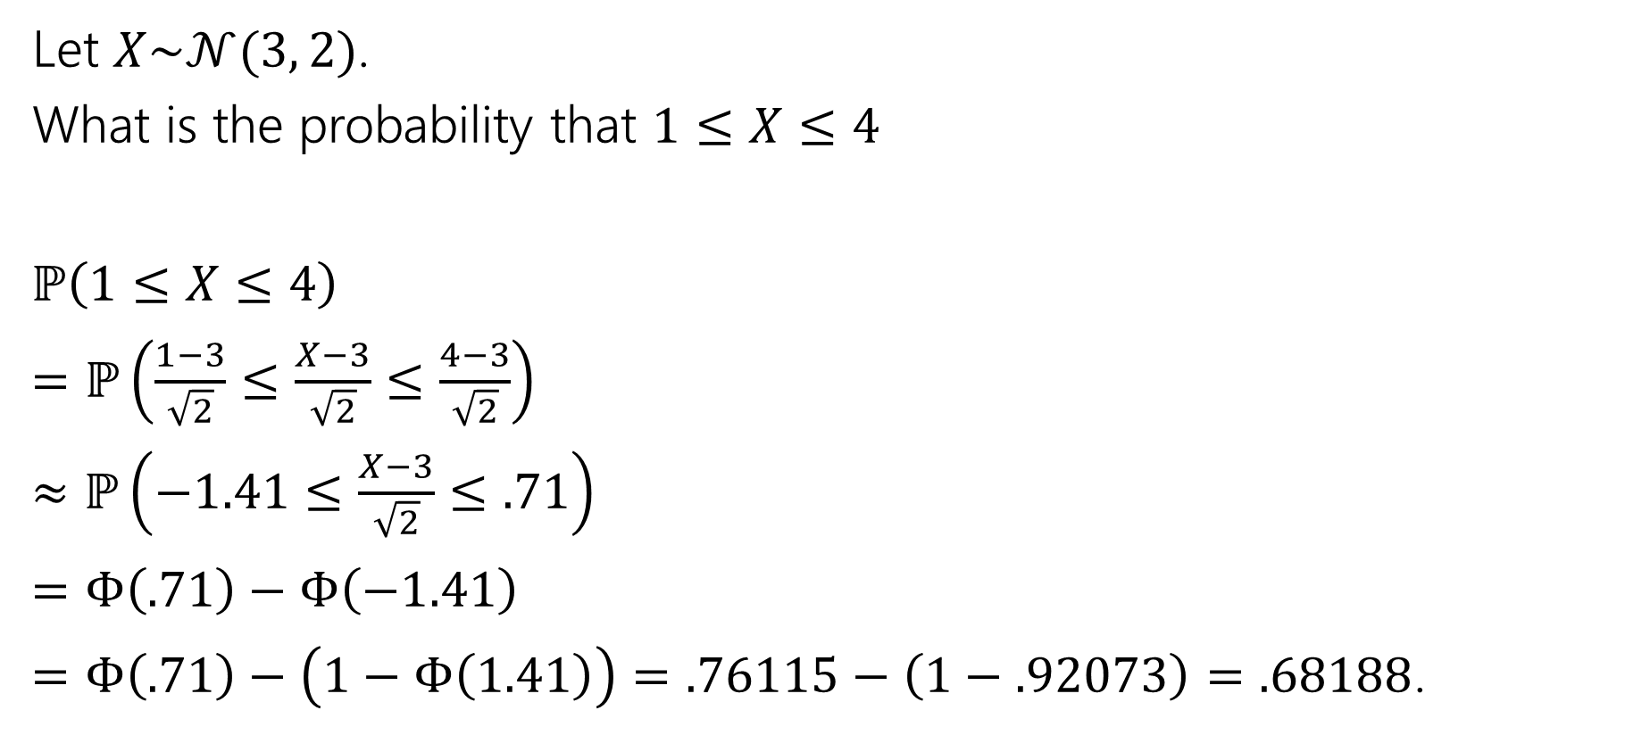
More practice
Let $X\sim 𝒩(3, 2)$.
What is the probability that $1≤X≤4$
$ℙ\left(1≤X≤4\right)$
$=ℙ\left(\frac{1−3}{\sqrt{2}}≤\frac{X−3}{\sqrt{2}}≤\frac{4−3}{\sqrt{2}}\right)$
$≈ℙ\left(−1.41≤\frac{X−3}{\sqrt{2}}≤.71\right)$
$=Φ\left(.71\right)−Φ\left(−1.41\right)$
$=Φ\left(.71\right)−\left(1−Φ\left(1.41\right)\right)=.76115−\left(1−.92073\right)=.68188$.

Slide 30

















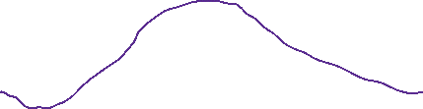
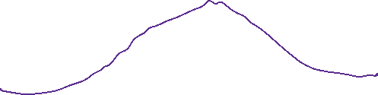



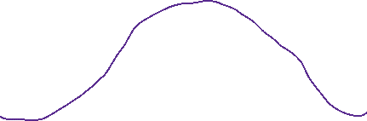








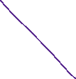























Slide 31
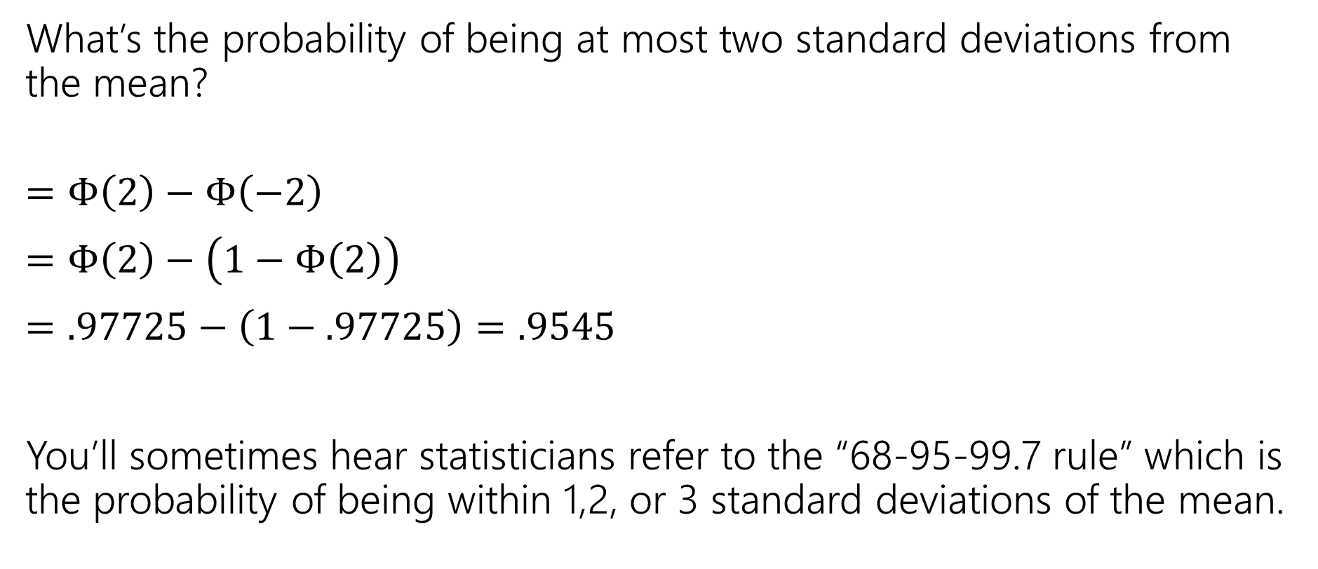
In real life
What’s the probability of being at most two standard deviations from the mean?
$=Φ\left(2\right)−Φ\left(−2\right)$
$=Φ\left(2\right)−\left(1−Φ\left(2\right)\right)$
$=.97725−\left(1−.97725\right)=.9545$
You’ll sometimes hear statisticians refer to the “68-95-99.7 rule” which is the probability of being within 1,2, or 3 standard deviations of the mean.

Slide 32
One last (unrelated) thing

Slide 33
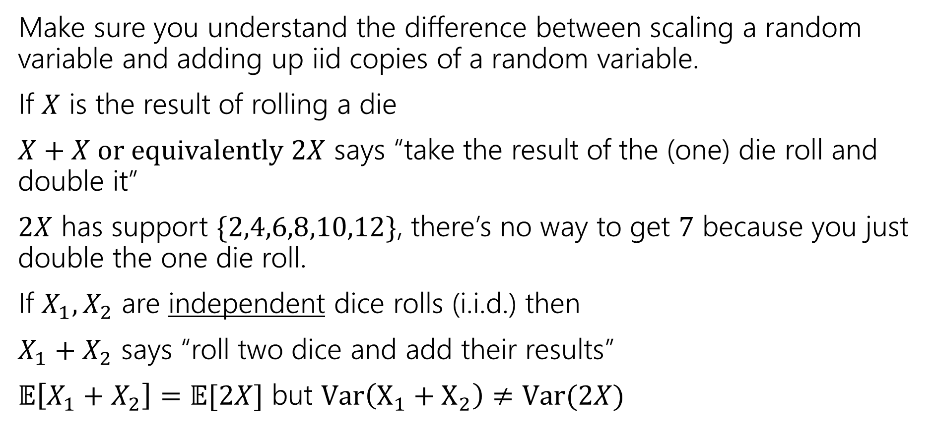
A Side Note
Make sure you understand the difference between scaling a random variable and adding up iid copies of a random variable.
If $X$ is the result of rolling a die
$X+X or equivalently 2X$ says “take the result of the (one) die roll and double it”
$2X$ has support $\{2,4,6,8,10,12\}$, there’s no way to get $7$ because you just double the one die roll.
If $X_{1},X_{2}$ are independent dice rolls (i.i.d.) then
$X_{1}+X_{2}$ says “roll two dice and add their results”
$𝔼\left[X_{1}+X_{2}\right]=𝔼[2X]$ but $Var\left(X_{1}+X_{2}\right)≠Var(2X)$

Slide 34


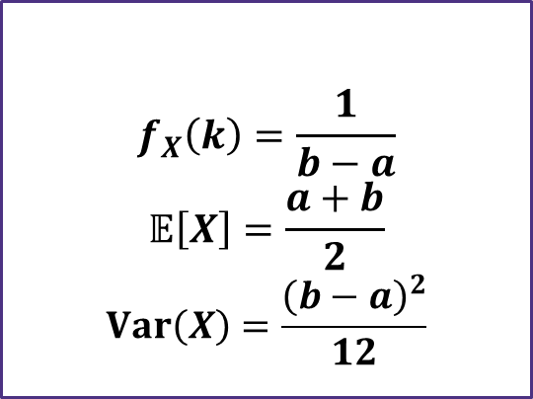
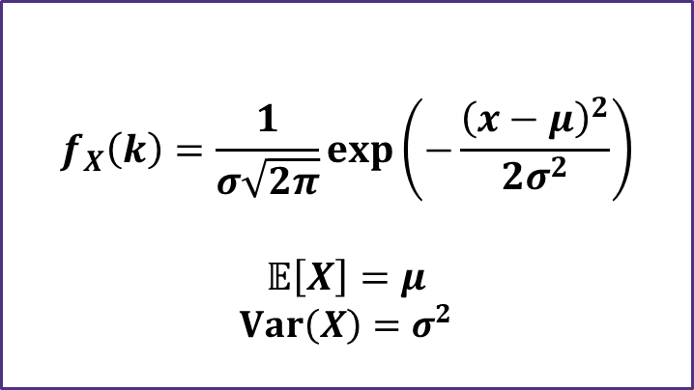

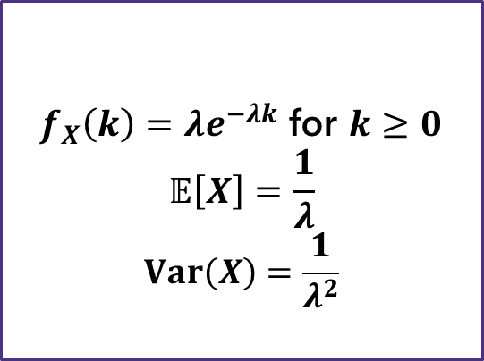
Continuous Zoo
$$X\sim Unif(a,b)$$
$$X\sim Exp(λ)$$
$$X\sim 𝒩(μ,σ^{2})$$
$$f_{X}\left(k\right)=\frac{1}{b−a}$$
$$𝔼\left[X\right]=\frac{a+b}{2}$$
$$Var\left(X\right)=\frac{{\left(b−a\right)}^{2}}{12}$$
$f_{X}\left(k\right)=λe^{−λk}$ for $k≥0$
$$𝔼\left[X\right]=\frac{1}{λ}$$
$$Var\left(X\right)=\frac{1}{λ^{2}}$$
$$f_{X}\left(k\right)=\frac{1}{σ\sqrt{2π}}exp\left(−\frac{{\left(x−μ\right)}^{2}}{2σ^{2}}\right)$$
$$𝔼\left[X\right]=μ$$
$$Var\left(X\right)=σ^{2}$$
It’s a smaller zoo, but it’s just as much fun!

